Slide 1




A TPC for High-Rate Experiments:
Towards an Upgrade of the ALICE TPC
Bernhard Ketzer
Technische Universität München
On behalf of the GEM-TPC Collaboration and the ALICE TPC Collaboration
11 February 2013
Vienna Conference on Instrumentation 2013

Slide 2
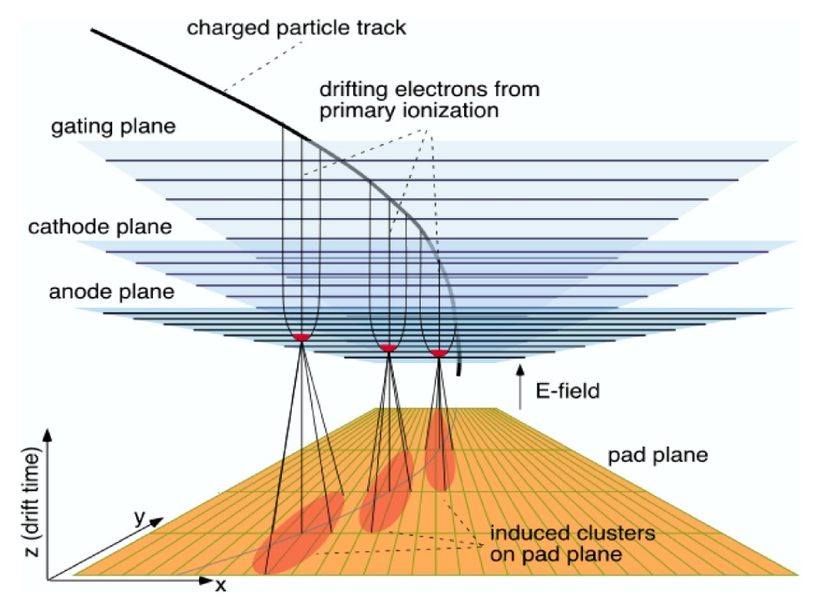
Time Projection Chamber
Time Projection Chamber [D.R. Nygren et al., Phys. Today 31, 46 (1978)]
Combination of MWPC and Drift Chamber: 3-D tracking device
  long drift path (~m) in gas-filled volume  z coordinate
  MWPC + pads perpendicular to drift path  x,y coordinates

Slide 3
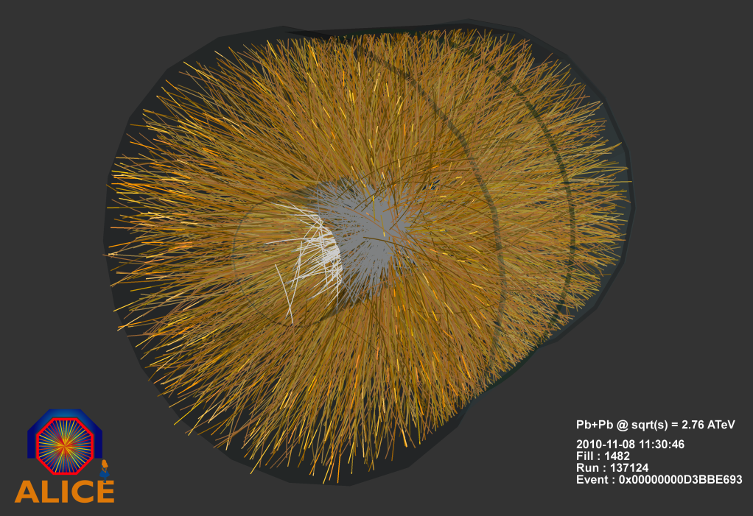
Advantages and Limitations of a TPC
An (almost) ideal tracking detector:
Large acceptance
Large active volume
Low material budget
3D hits  simple pattern recognition
Extremely high particle densities
 heavy ion experiments
Good momentum resolution
Particle identification
Limitations:
Calibration very demanding
Drift distortions due to ion backflow
Gating  low trigger rates
Examples:
STAR (420 cm × 400 cm)
ALICE (500 cm × 500 cm)

Slide 4
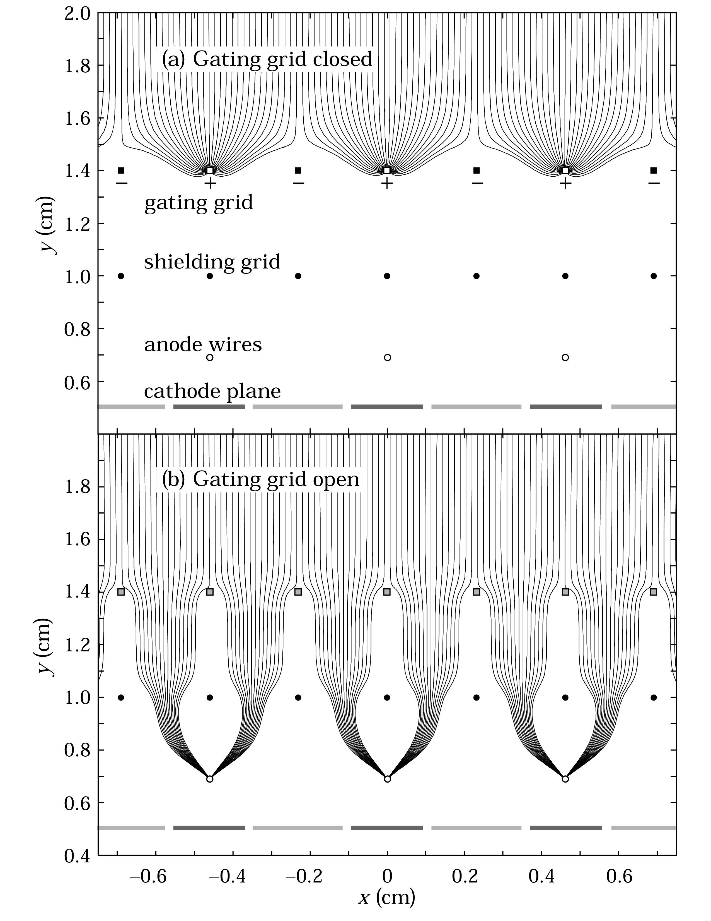
Advantages and Limitations of a TPC
Limitations:
Calibration very demanding
Drift distortions due to ion backflow
Gating  low trigger rates
Examples:
STAR (420 cm × 400 cm)
ALICE (500 cm × 500 cm)

Slide 5
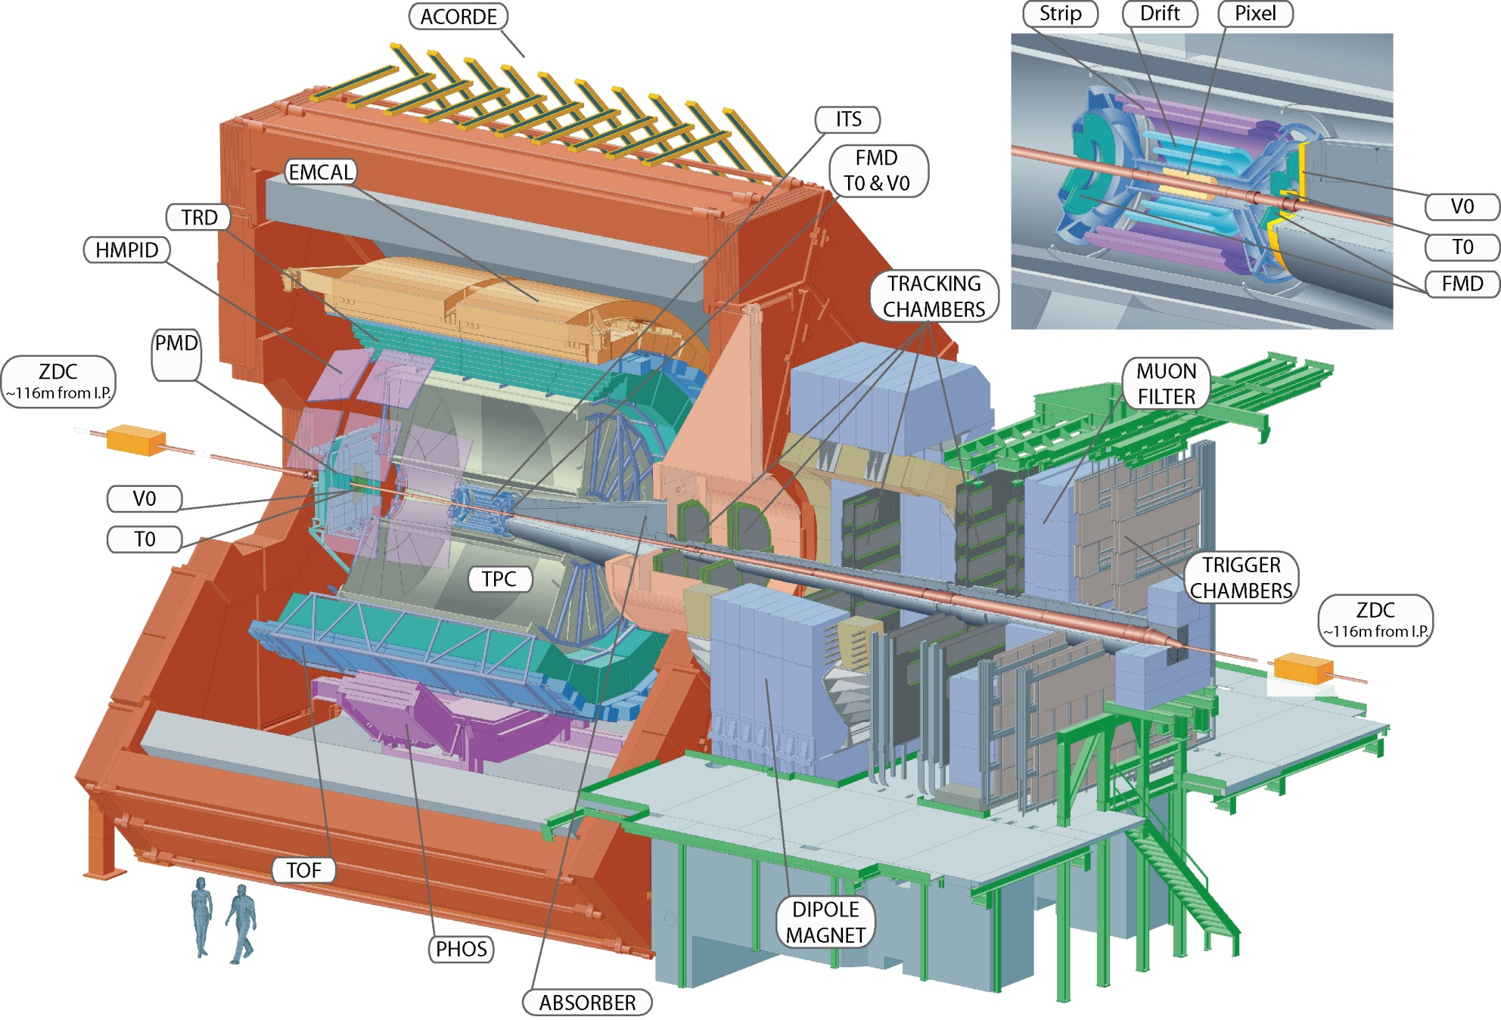

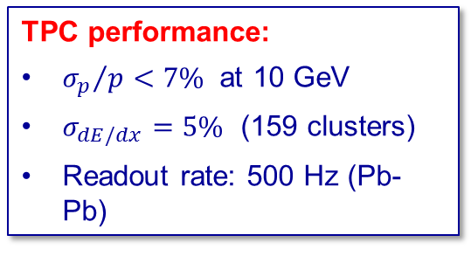
The ALICE Detector
e ALICE Detector
TPC Parameters:
$87<r<247 \text{cm}$
$−250<z<250 \text{cm}$
Ne/CO₂(90/10)
$E_{d}=400 \text{V}\text{/}\text{cm}$
$B=0.5 \text{T}$
18 sectors per readout plane
557568 pads
IROC: $4×7.5 {\text{mm}}^{2}$pads
OROC: $6×10/15 {\text{mm}}^{2}$pads
TPC performance:
${σ_{p}}/{p<7\%}$ at 10 GeV
$σ_{dE/dx}=5\%$ (159 clusters)
Readout rate: 500 Hz (Pb-Pb)

Slide 6
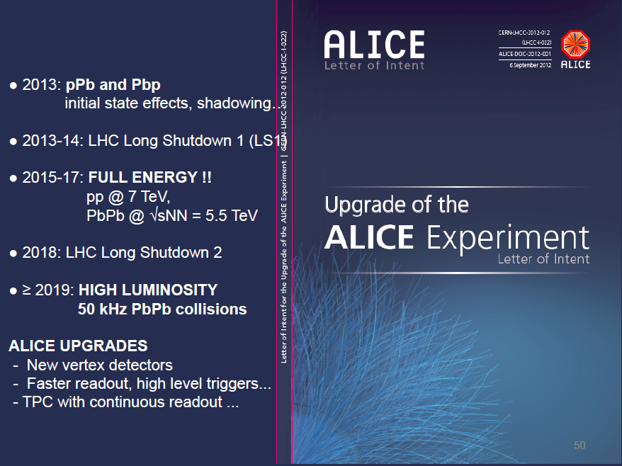
ALICE Upgrade
Talk by Serhiy SENYUKOV on 13 Feb 2013 at 11:30 AM
- Small diameter beam pipe

Slide 7
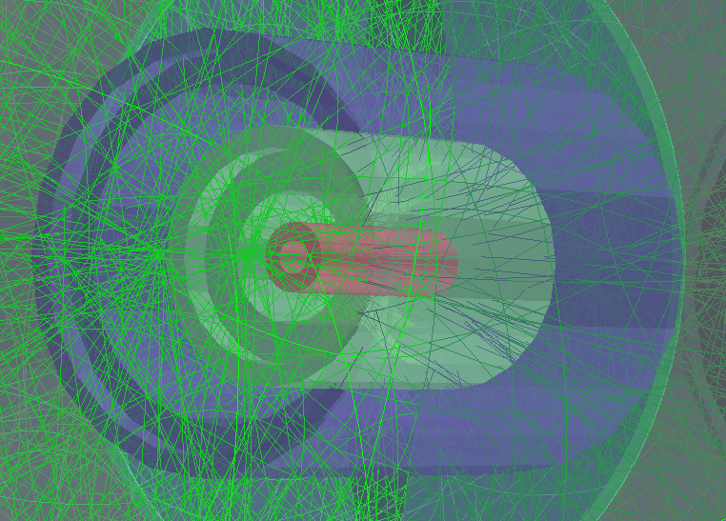
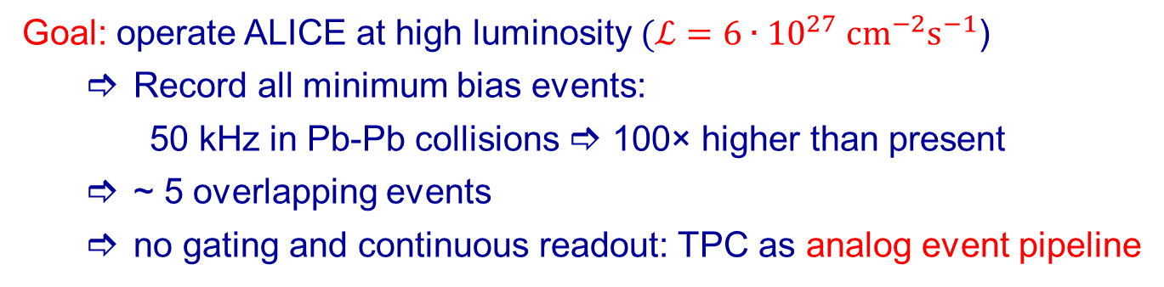
Operation at High Rates
  Goal: operate ALICE at high luminosity $(ℒ=6∙{10}^{27} {cm}^{−2}s^{−1}$)
    Record all minimum bias events:
      50 kHz in Pb-Pb collisions  100× higher than present
  ~ 5 overlapping events
  no gating and continuous readout: TPC as analog event pipeline
Event from
2013 p-Pb
Run
Notes:
Preserve tracking and PID preformance
Enhance secondary vertex capability and tracking at low pT

Slide 8
Outline
Introduction
Ion Backflow and Distortions
Prototype Detectors
  GEM-TPC in FOPI
  ALICE IROC with GEM amplification
Conclusions and Outlook

Slide 9
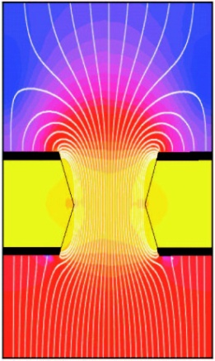
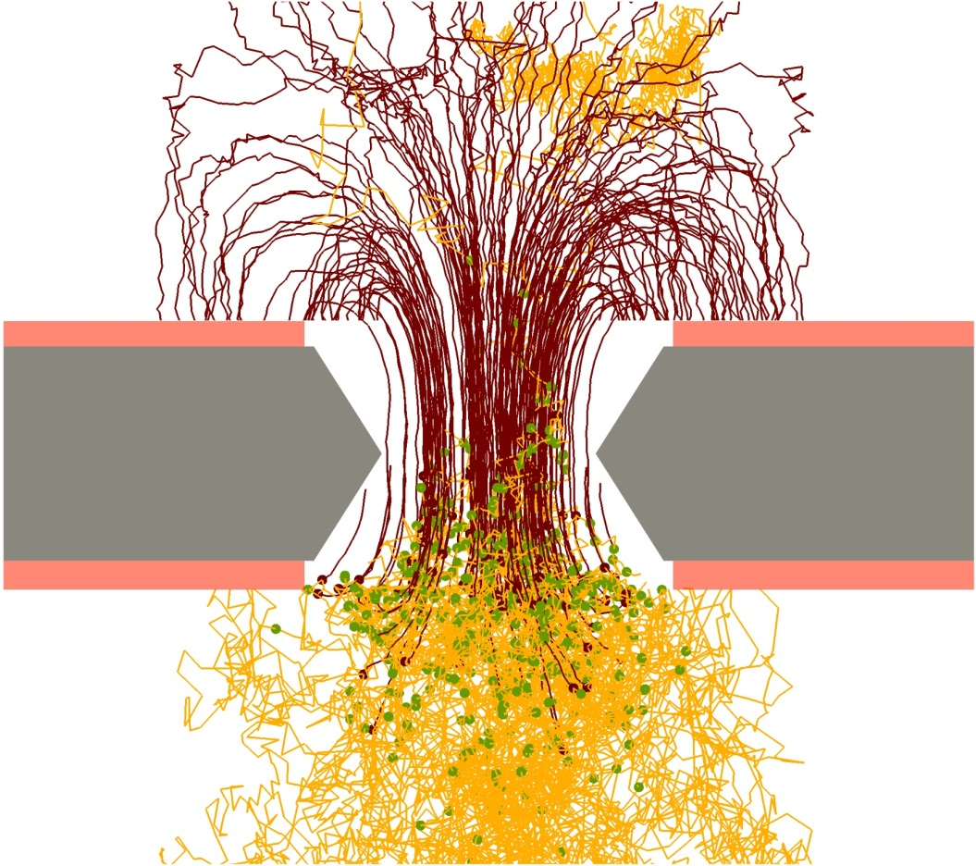
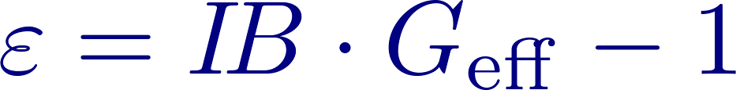



Ion Backflow Suppression in GEM
$$E_{drift}=250 V/cm$$
$$E_{trans}=3.75 kV/cm$$
Low ion density in drift region requires
  low primary ionization
  low gain
  low ion backflow
$$n_{tot}=n_{ion}∙IB{ ∙G}_{eff}$$

Slide 10
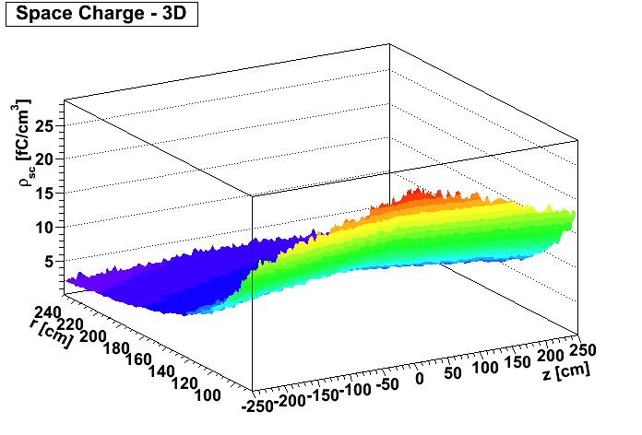
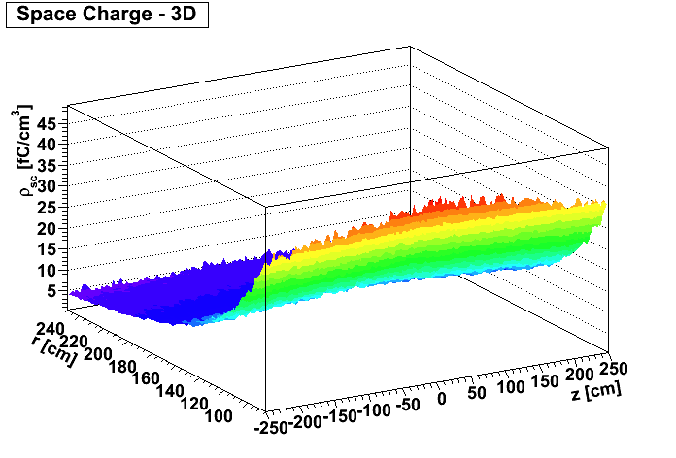
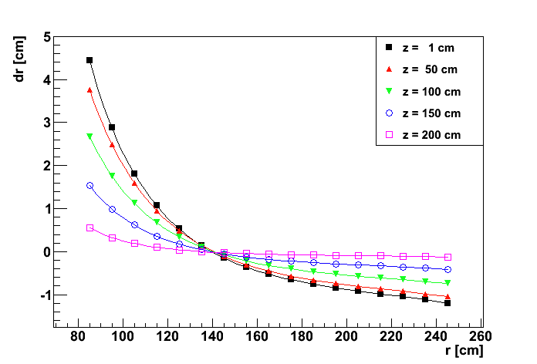

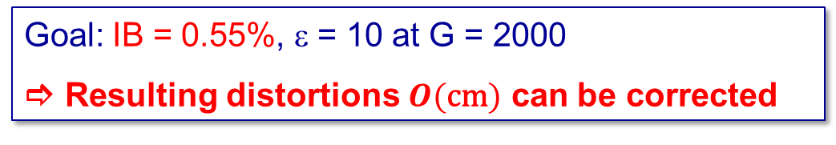
Space Charge Effects
ε = 5
ε = 10
Goal: IB = 0.55%, ε = 10 at G = 2000
 Resulting distortions $O(\text{cm})$ can be corrected
[S. Rossegger, CERN, F. Böhmer, TUM]

Slide 11
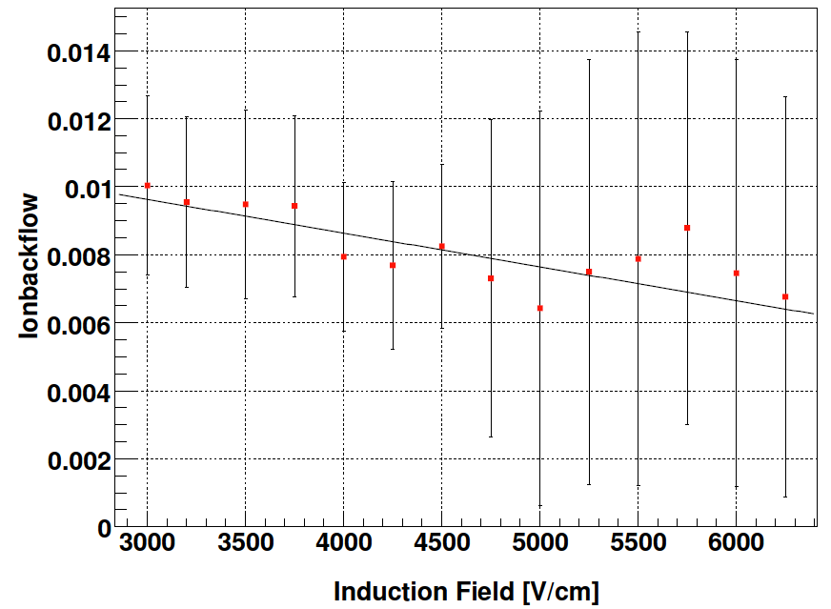
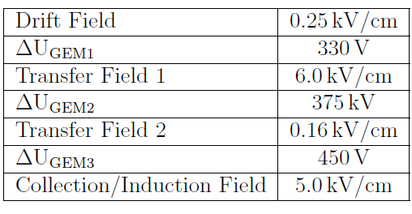
Ion Backflow - Measurements
Ar/CO₂ (70/30)
TUM
Low ion backflow requires
    low drift field
    very asymmetric transfer fields
    highest amplification in 3rd GEM
 Issues concerning:
  diffusion, e⁻ transparency
  energy resolution
  stability
[T. Huber, TUM]

Slide 12
Ion Backflow - Measurements
Ar/CO₂ (70/30)
Ar/CO₂ (70/30)
CERN
TUM
Low ion backflow requires
    low drift field
    very asymmetric transfer fields
    highest amplification in 3rd GEM
Rate dependence
 Space charge effect?
[T. Huber, TUM]
[C. Garabatos, Y. Yamaguchi, CERN]

Slide 13
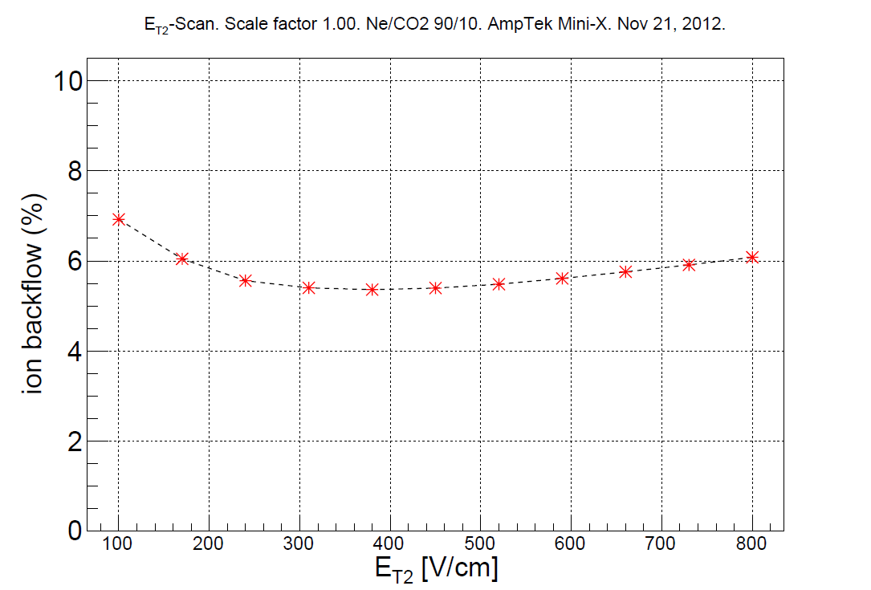
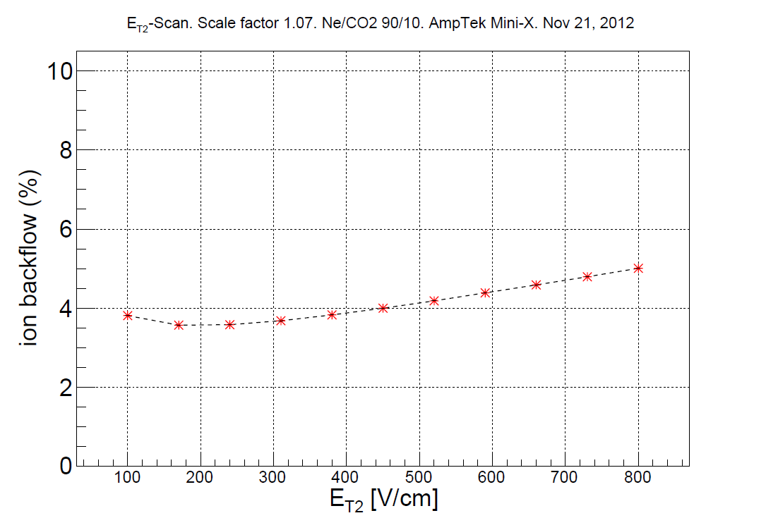
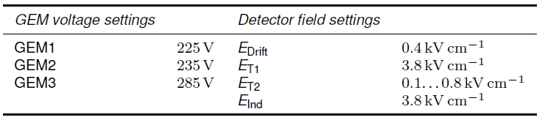
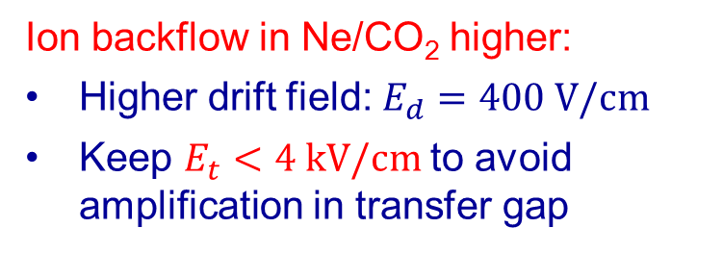
Ion Backflow - Measurements
Ne/CO₂ (90/10)
Ion backflow in Ne/CO₂ higher:
Higher drift field: $E_{d}=400 \text{V}\text{/}\text{cm}$
Keep $E_{t}<4 \text{kV}\text{/}\text{cm}$to avoid amplification in transfer gap
Solutions under study:
Add N₂ to gas
Tolerate small amplification in transfer gap
Add 4th GEM
[A. Hönle, K. Eckstein, TUM]

Slide 14
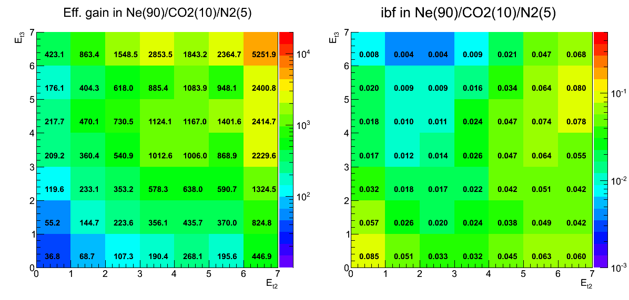
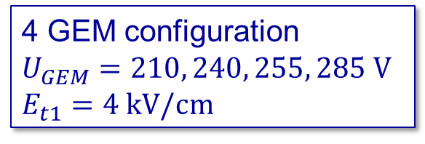
Ion Backflow - Simulations
ANSYS + GARFIELD/MAGBOLTZ: Systematic scan of parameter space
    Gas composition
    Three / four GEMs
4 GEM configuration
$$U_{GEM}=210, 240, 255, 285 \text{V}$$
$$E_{t1}=4 \text{kV}\text{/}\text{cm}$$
[T. Gunji, Univ. Tokyo]

Slide 15
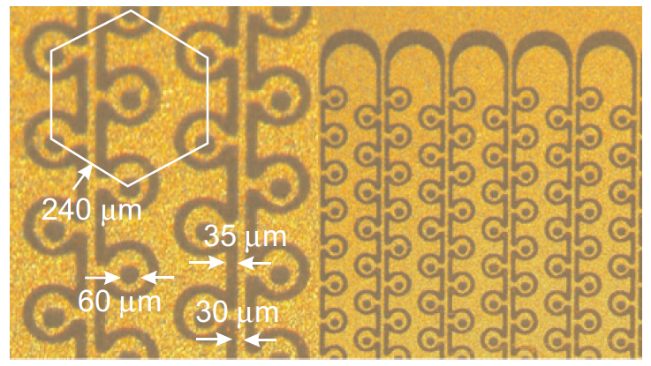
Ion Backflow - Simulations
ANSYS + GARFIELD/MAGBOLTZ: Systematic scan of parameter space
    Gas composition
    Three / four GEMs
    Hole geometry, aspect ratio
  Explore more exotic configurations
    Hole alignment
    Cobra GEM
[A. Lyashenko et al., NIM A 598 (2009) 116]
[F. Sauli et al., NIM A 560 (2006) 269]

Slide 16
Outline
Introduction
Ion Backflow and Distortions
Prototype Detectors
  GEM-TPC in FOPI
  ALICE IROC with GEM amplification
Conclusions and Outlook

Slide 17
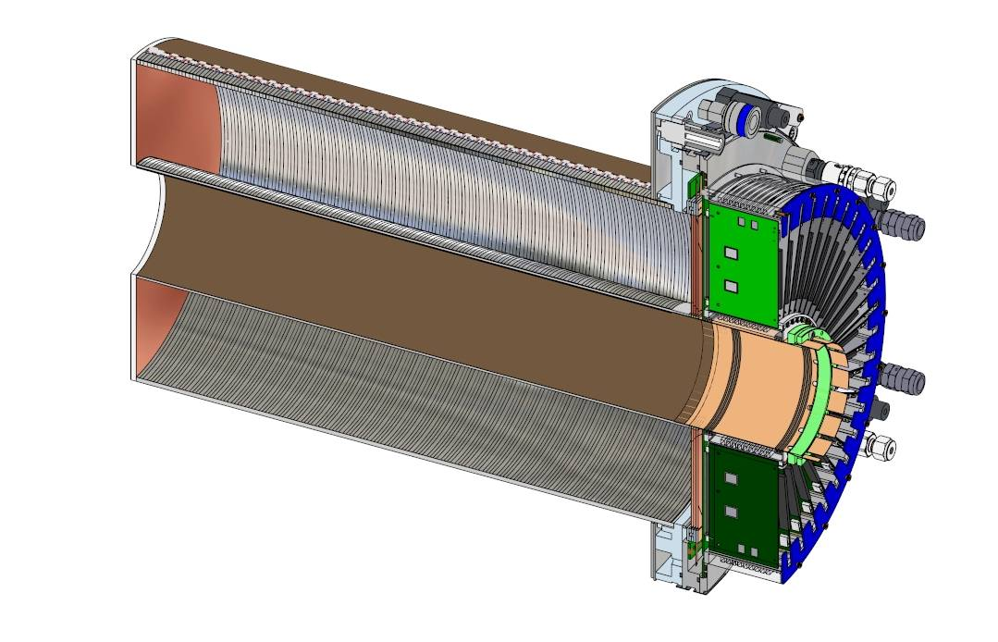



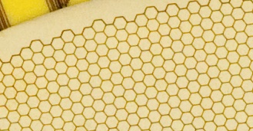
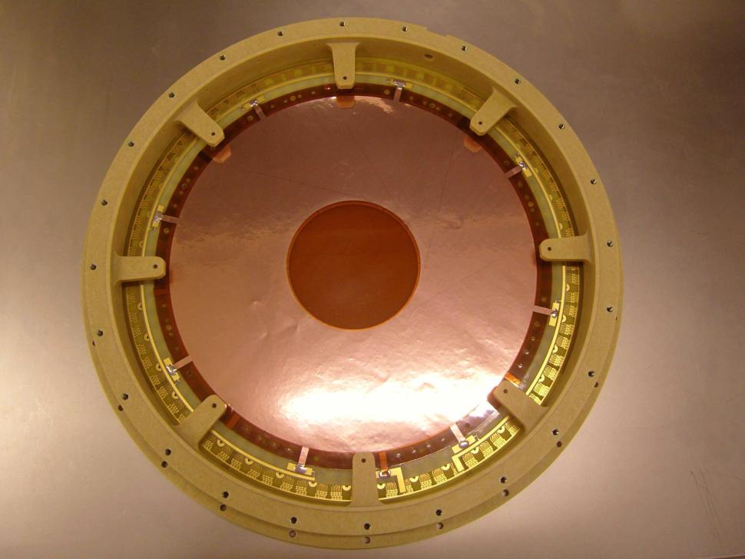
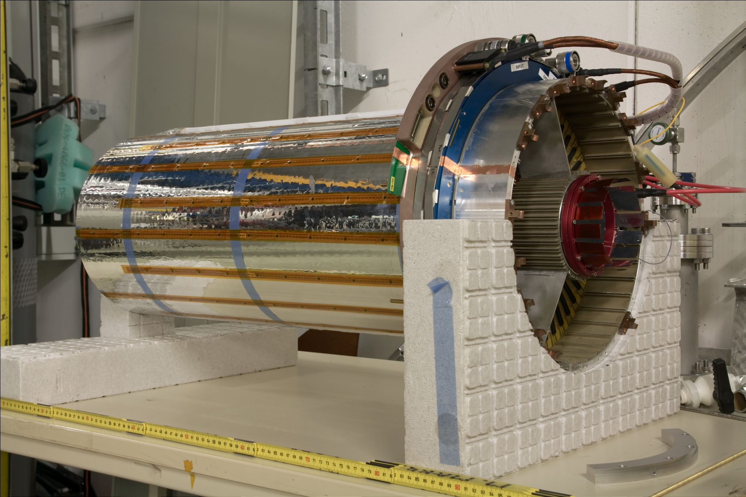
FOPI GEM-TPC
Light-weight field cage
Drift length 725 mm
Ø 105-300 mm
Triple GEM amplification
10254 ch., AFTER ASIC
Gas: Ar (Ne)/CO₂ (90/10)
[L. Fabbietti et al., NIM A 628, 204 (2011),
M. Ball et al., arXiv1207.0013, 2012]

Slide 18
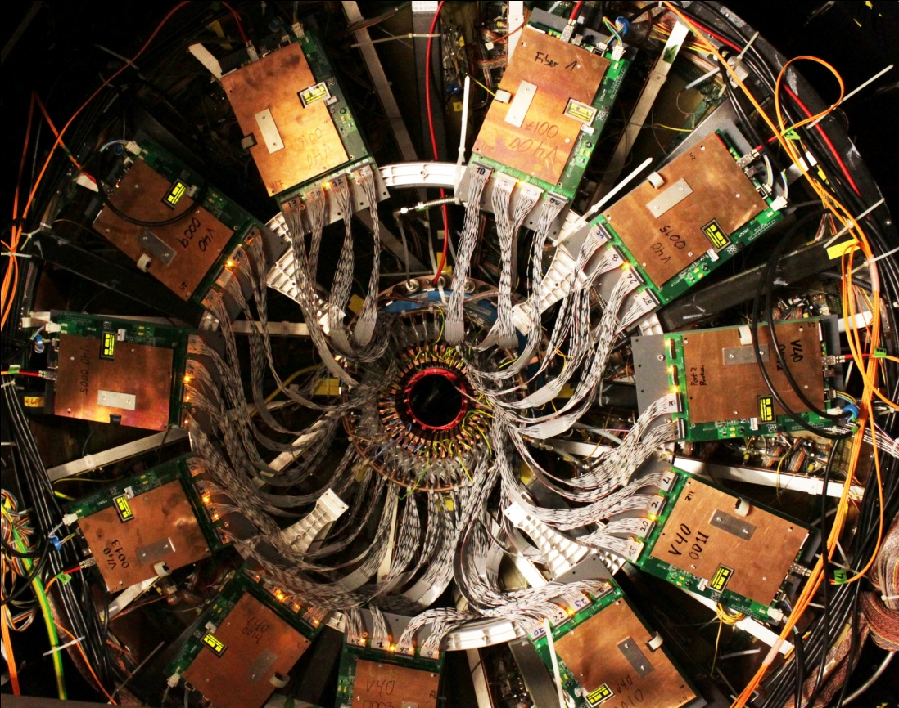
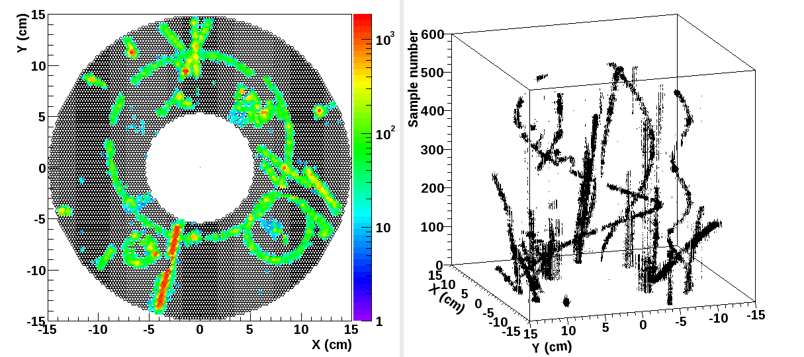
Installation in FOPI
Al target (x/λ_{I} = 2%) at z=0 and -34 cm
  ⁸⁴Kr beam, 1.4 AGeV, 40·10⁴ / 10s
  ¹⁹⁷Au beam, 1.2 AGeV, 40·10³ / 10s
  ²²Ne beam, 1.7 AGeV, 1·10⁶ / 10s
Physics run, π beam, 1.7 GeV/c, C, Cu, Pb targets

Slide 19
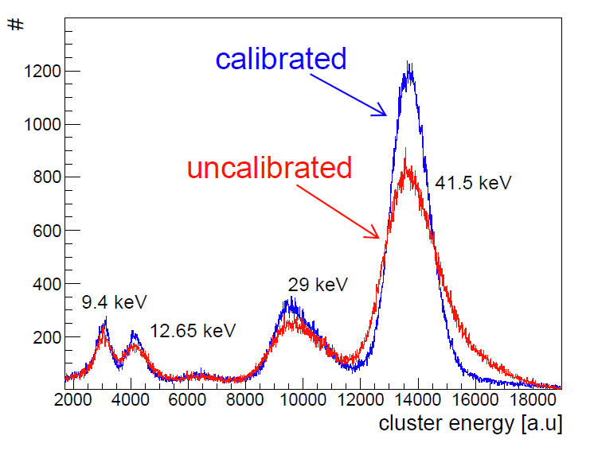


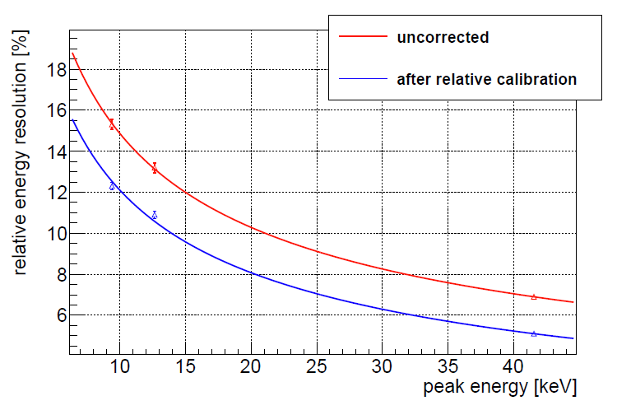
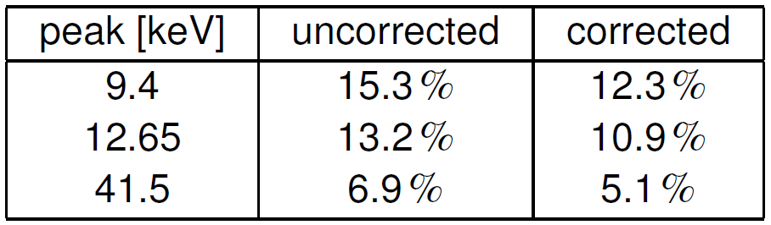
Gain Calibration with ^{83m}Kr
Equalization of gain for each pad
Resolution before correction:
  Main peak 6.9%
After correction:
  Main peak 5.1%
Results similar for Ne/CO₂ (90/10)
[R. Schmitz, D. Kaiser, HISKP Bonn]

Slide 20
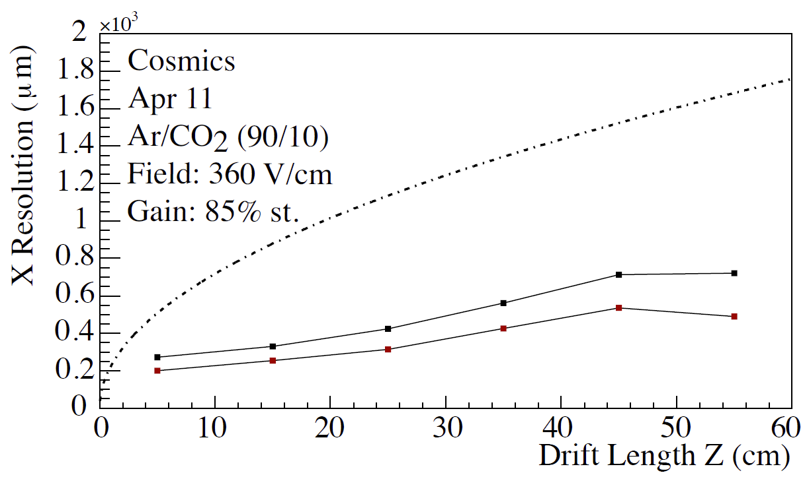
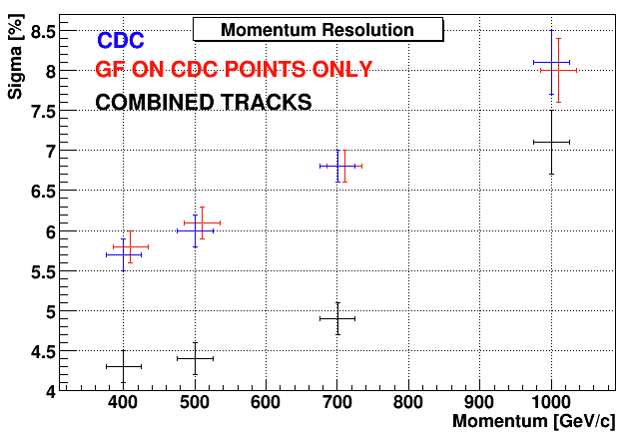
Position and Momentum Resolution
Spatial Resolution vs z
Momentum Resolution
σ = 230 μm
[M. Berger, TUM]
[F. Cusanno, TUM]
Track reconstruction in TPC:
Riemann pattern recognition
[J. Rauch, TUM]
Track fitting: GENFIT
[C. Höppner et al., NIM A 620, 518 (2010)]

Slide 21
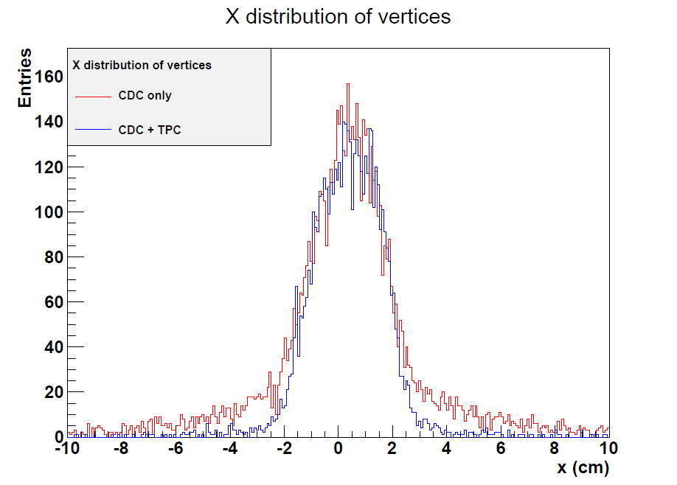
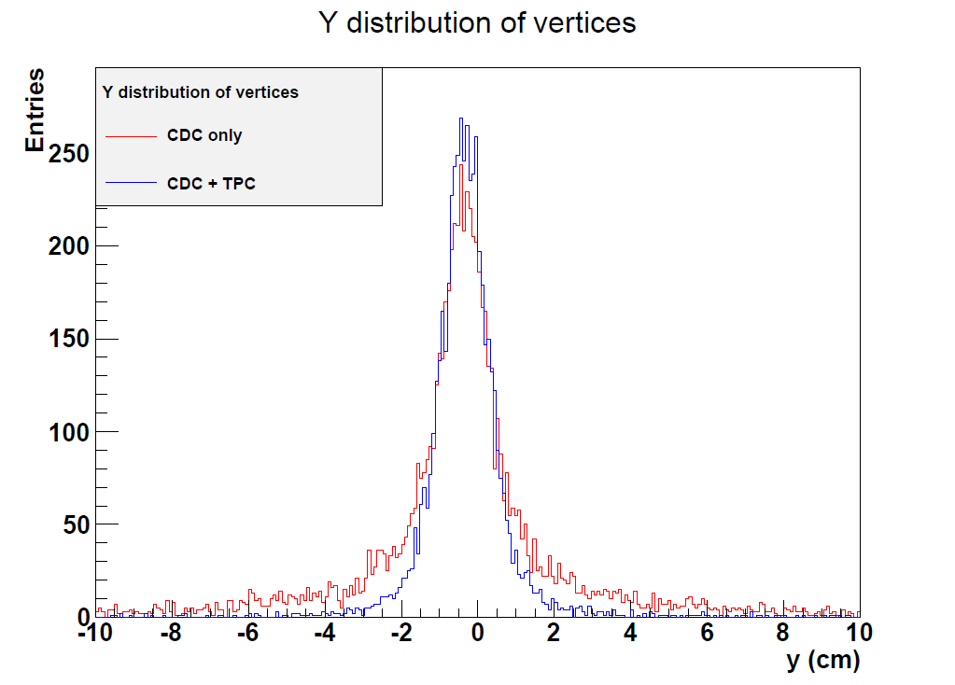
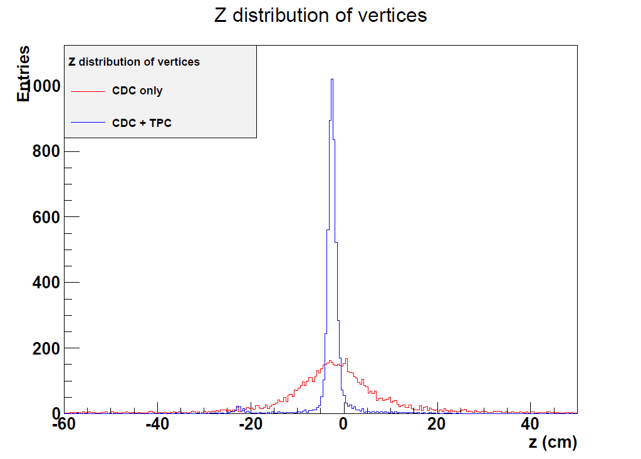
Vertex Resolution
Vertex reconstruction
using GENFIT / RAVE
Considerable improvement in z-direction
[J. Rauch, TUM]

Slide 22
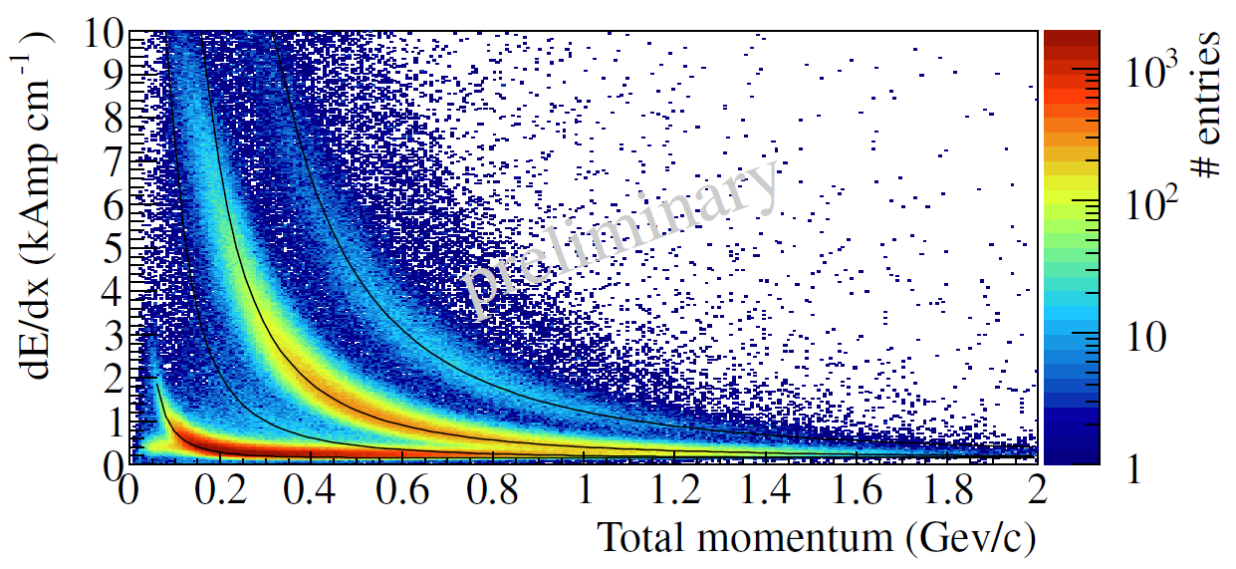
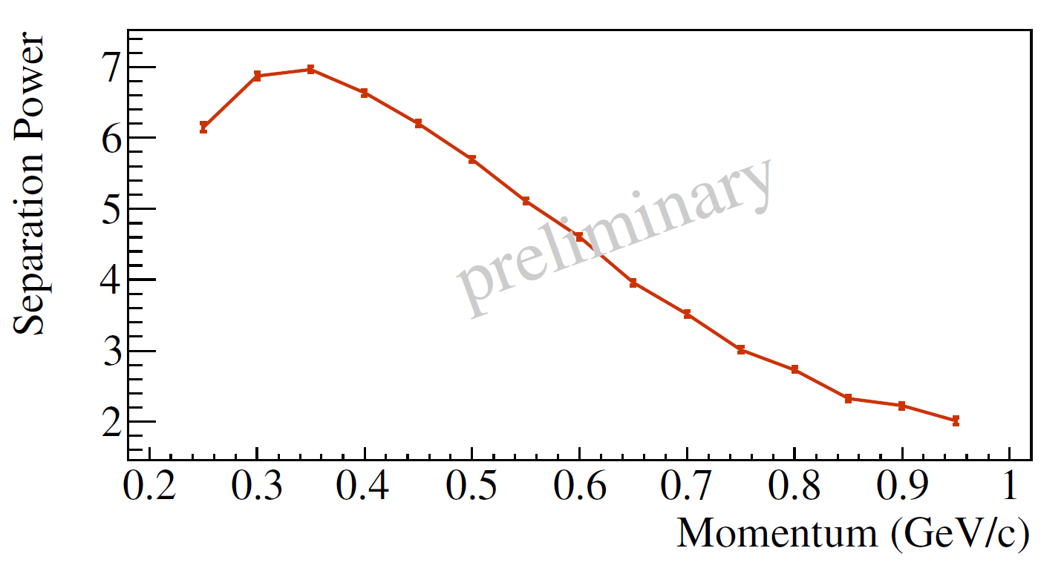
Energy Resolution
Sum up charge in 5 mm steps
Truncated mean: 0-70%
Momentum from TPC + CDC
d
p
K
π
PID using dE/dx:
  Resolution ~ 18%
  No density correction yet
π-p separation
First dE/dx measurement
with GEM-TPC!
[F. Böhmer, M. Ball, TUM]

Slide 23
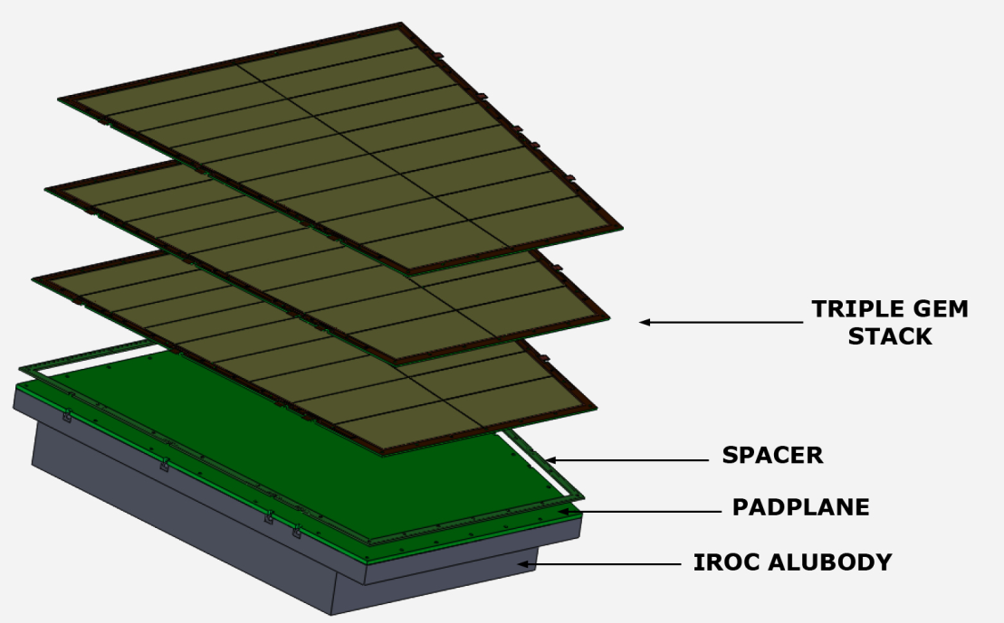
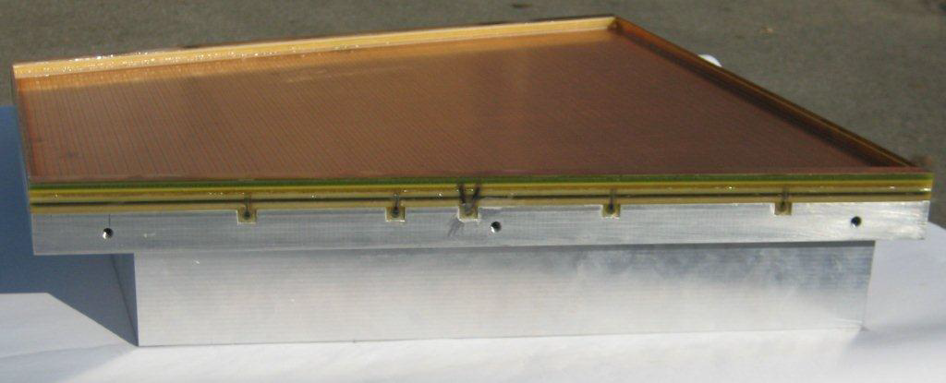
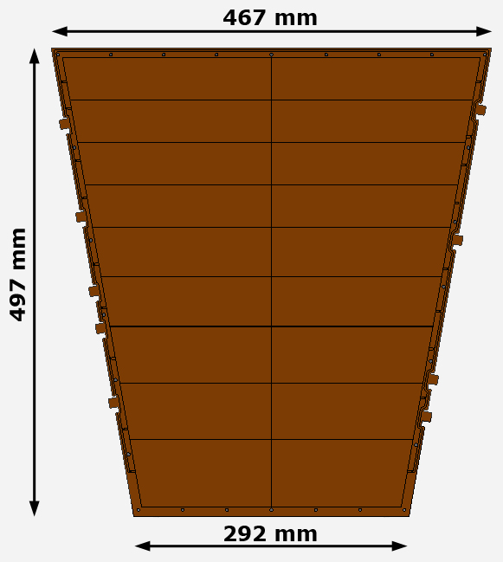
ALICE IROC Prototype
3 large-size GEM foils: single-mask
18 sectors (top side), ~ 100cm² each
bias resistors 10 / 1MΩ
2mm frames glued on bottom side
spacer grid: 400mm thickness
additional frame for induction gap: 4mm
[P. Gasik, M. Berger, TUM]

Slide 24
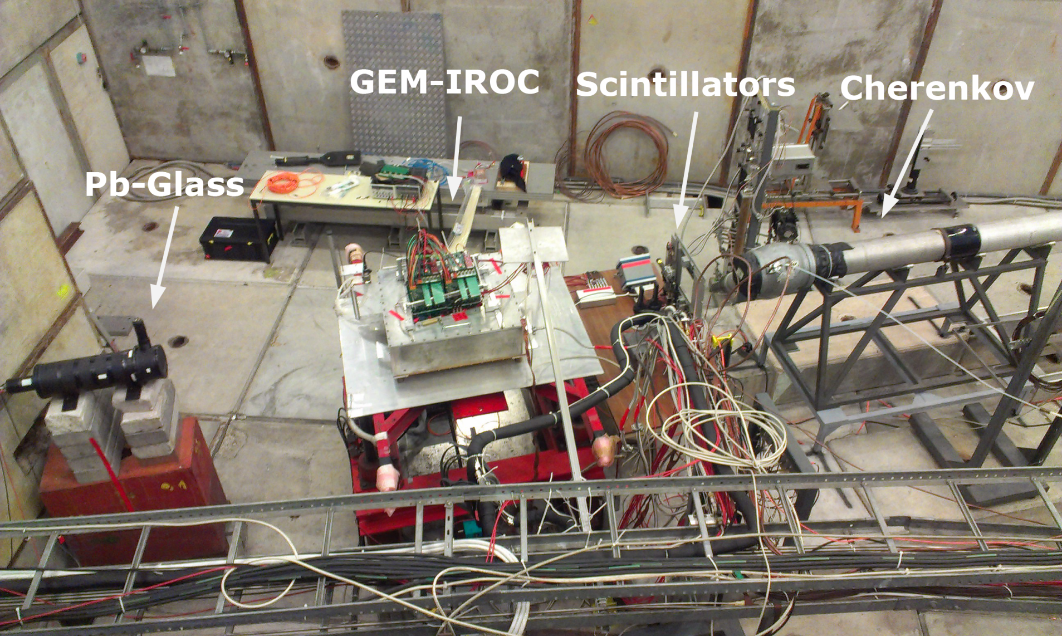
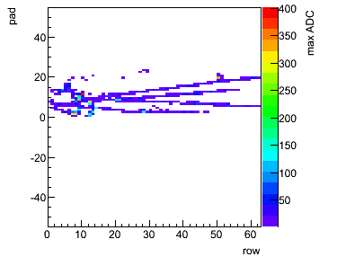
IROC Beam Test at CERN PS
p, π±, e± beam, 1/2/3/6 GeV/c
2000 particles / 0.5s
Cherenkov and Pb glass detectors for PID
Electronics: PCA16 / ALTRO (LCTPC)
Goal: measure separation power for different voltage settings

Slide 25
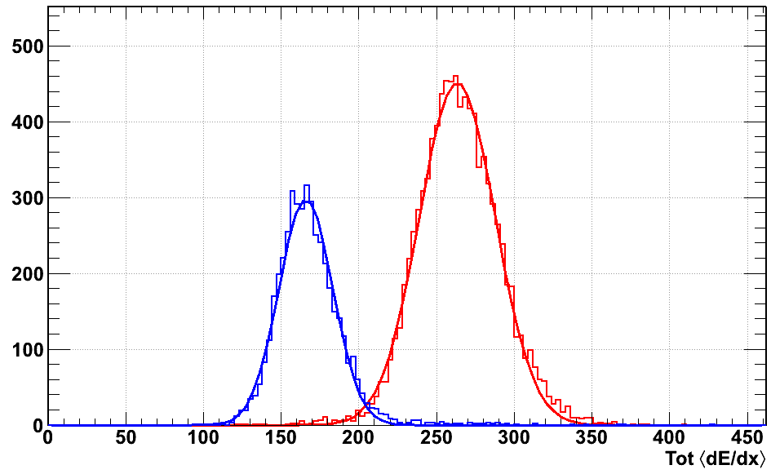
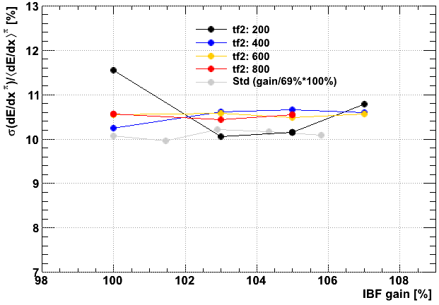
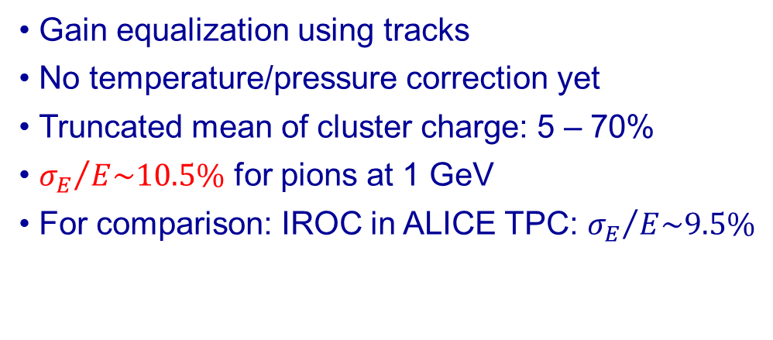
IROC Beam Test at CERN PS
electrons
p=1 GeV/c
G=5000
pions
Gain equalization using tracks
No temperature/pressure correction yet
Truncated mean of cluster charge: 5 – 70%
${σ_{E}}/{E\sim 10.5\%}$ for pions at 1 GeV
For comparison: IROC in ALICE TPC: ${σ_{E}}/{E\sim 9.5\%}$
[J. Wiechula, Tübingen]

Slide 26
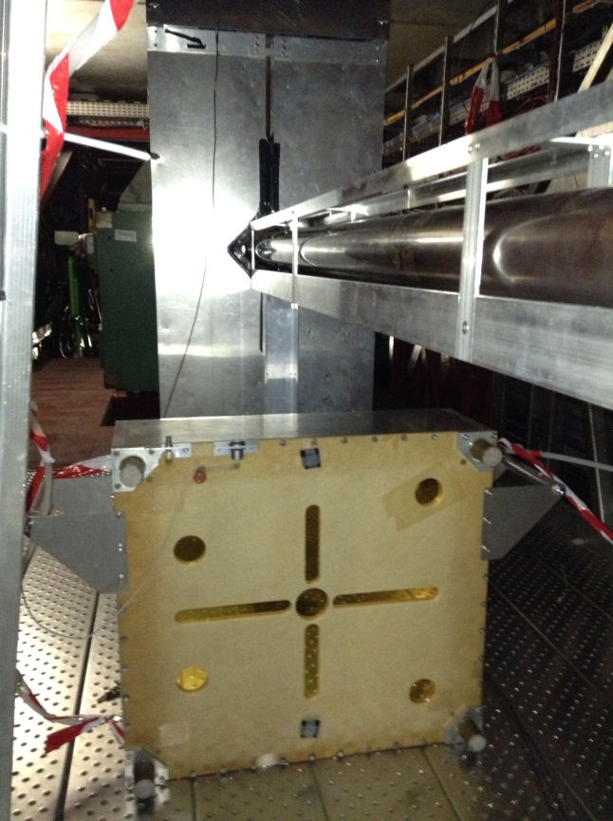


Test in ALICE with p-Pb 2013
Chamber installed underneath LHC beam pipe
Standalone readout: signals, discharges, trips
Run still ongoing

Slide 27
Conclusions
GEM-TPC:
  Opens possibility to use TPC in high-rate environments without gate
  Large GEM-TPC fully operational in FOPI
  Performance: improvement of vertex/momentum resolution, forward
  First dE/dx measurement with GEM-TPC
  Physics analysis ongoing
ALICE TPC:
  Plan to upgrade TPC with GEM endorsed by LHCC
  Prototype IROC equipped with GEMs
  Successful beam test at CERN PS
  Stability test in ALICE cavern during p-Pb run in 2013
  Issues under study:
    ion backflow
    front-end electronics and readout

Slide 28





Experiments with GEM-TPCs
FOPI (GSI)
CB-ELSA (Bonn)
DarkLight (JLAB)
ILC
ALICE (CERN)

Slide 29
Thanks to
GEM-TPC Collaboration
R. Arora, M. Ball, R. Beck, M. Berger, J.-C. Berger-Chen, F.V. Böhmer, P. Bühler, F. Cusanno, S. Dørheim, K. Eckstein, L. Fabbietti, J. Frühauf , J. Hehner , N. Herrmann, A. Hönle, C. Höppner, D. Kaiser, B. Ketzer, M. Kis, V. Kleipa, I. Konorov, J. Kunkel, N. Kurz, M. Lang, Y. Leifels, P. Müllner, R. Münzer, S. Neubert, S. Paul, K. Peters, J. Rauch, H. Risch, C.J. Schmidt, L. Schmitt, S. Schwab, R. Schmitz, D. Soyk, S. Uhl, M. Vandenbroucke, B. Voss, J. D. Walther, J. Weinert, J. Zmeskal
ALICE TPC Upgrade Team
H. Appelshaeuser, M. Ball, E. Bartsch, G. Bencze, M. Berger, P. Braun-Munzinger, J.-C. Berger-Chen, S. Dorheim, K. Eckstein, I. Erdemir, L. Fabbietti, C. Garabatos, P. Gasik, T. Gunji, A. Hoenle, B. Ketzer, G. Hamar, C. Lippmann, M. Ljunggren, S. Masciocchi, T. Morhardt, E. Oliveri, A. Oskarsson, M. Ozdemir, G. Paic, V. Peskov, N. Pitz, L. Ropelewski, K. Teresaki, D. Vranic, J. Wiechula, Y. Yamaguchi

Slide 30


Thank you for your attention!

Slide 31
Spare Slides

Slide 32






Signal-to-Noise Ratio
Ne/CO₂ (90/10)
E_{drift} = 360 V/cm
B = 0.6 T

Slide 33

Spatial Resolution
GEM pad response function smaller than MWPC  pad size adequate?
Resolution diffusion-dominated for z<200 cm
Increasing number of single-pad clusters for shorter drift length,
but partially outside barrel acceptance (|η|<0.9)
[H. Appelshäuser]

Slide 34

Momentum Resolution
[H. Appelshäuser]

Slide 35


Cobra
[A. Lyashenko et al., NIM A 598 (2009) 116–120]
reached
problem of IB completely eliminated!
to be studied: e- transparency, size

Slide 36
FEE Specifications
Aim: Common FE chip for different ALICE subdetectors
Based on S-ALTRO
  Programmable polarities and frontend peaking times,
  DSP: Signal processing etc.
10 bit SAR ADC; power consumption only 1-2 mW per channel
 | TPC
 | Now | Upgrade
Polarity | Pos | Neg
Detector capacitance | 12 – 28 pF | 12 – 28 pF
Peaking time | 160ns | 160ns
Shaping | 4th order | 4th order
Sensitivity (mV/fC) | 12 | 12
Gas gain | ~4000 | 1,000-2,000
Noise (electrons) | 700e–@25pF | <700e-@25pF
Linear Range (V) | 2V | 2V
Linear Range (fC) | 170fC | 170fC
Signal coding | 10 bits | 10 bits
Power consumption (per ch) | ~32mW (PASA+ALTRO) | ≤ 32mW
Channel per chip | 16 | 16 – 32
Chan per readout link | 2,304 – 3,200 | 80 – 400

Slide 37
Readout Architecture
Readout architecture has to support
  Continuous (trigger-less) readout for physics data taking
  Triggered readout (for calibration runs, e.g. pedestal)
Two options under study:
  CERN GBT (radiation hard ASIC, 4.8 Gb/s versatile links)
  DDL3: Custom optical link with radiation-tolerant smartfusion2 FPGA as readout unit close to the Front-End (10 Gb/s)
DCS
Server
FTP
LTU
DCS
Network
Option 1
DCS
Server
Trigger
& Busy
Monitoring
& Control
Front-End
DAQ/HLT
FLP
DAQ/HLT
Network
DAQ/HLT
EPN
GBT: Trigger & Data & Control
Data traffic

Slide 38

Electronics
Performance of present FE electronics satisfactory for final detector
Self-triggering capability  several solutions being developed
+ ASIC for ATLAS muon upgrade (BNL)

