Slide 1
R&D for THE upgrade of the high momentum particle identification detector for ALICE at LHC
A. Di Mauro
(CERN - Geneva, Switzerland)
on behalf of the ALICE/VHMPID collaboration

Slide 2
Outline
Physics motivation for a Very High Momentum PID upgrade
New design specifications and related R&D
Expected performance
Testbeam studies
Summary

Slide 3
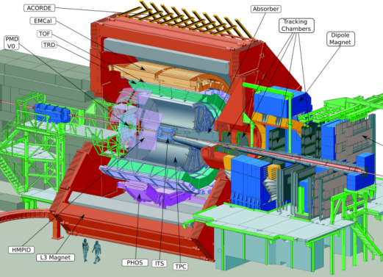
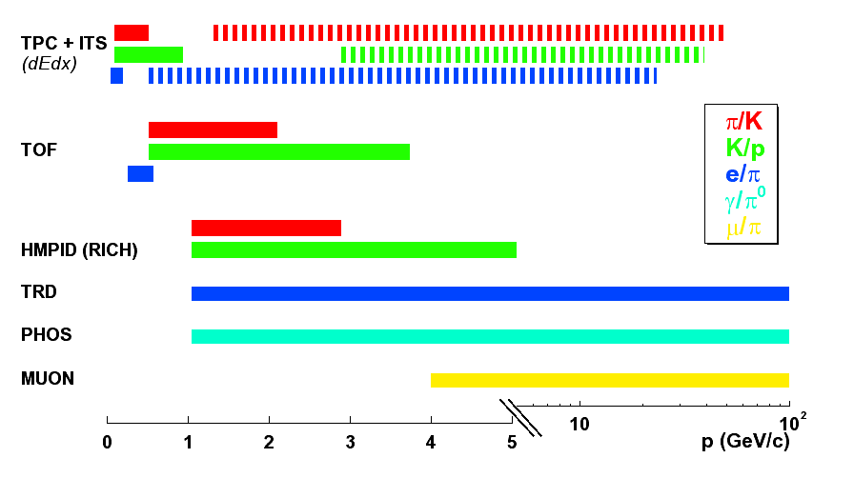
PID in ALICE
ALICE specifically designed to study Quark-Gluon Plasma in “heavy ion collisions” at LHC, pp studies relevant part of the physics program
Excellent PID capabilities by combining different techniques over a large momentum range
ALICE: P.P.R., vol. I”, J.Phys.G30:1517-1763,2004

Slide 4
Physics motivation
The Very High Momentum PID (VHMPID) RICH has been proposed as additional detector to extend charged hadron track-by-track PID capability up to 25 GeV/c and complement the existing measurements based on statistical methods (dE/dx), addressing specifically the study of jets properties
The latest proposal foresees the combined integration of an EMCAL and a RICH in the same acceptance to achieve direct reconstruction of the full jet and its energy, thus significantly improving the track-by-track physics and correlation measurements (jet-hadron, di-hadron)
Such an integrated detector system will provide major contribution in the determination of particle identified fragmentation functions both in pp and in heavy ion physics

Slide 5
Design specifications and R&D issues I.
First VHMPID proposal in 2006, various layouts studied; after first LHC results at the end of 2011, new specifications requiring further R&D:
Charged hadrons (π, K, p) identification in 5 -25 GeV/c and combined integration with EMCAL extension (DCAL) -> Cherenkov radiator
  K identification starting at 5 GeV/c not possible with any gaseous radiator at atmospheric pressure: increase radiator gas pressure to lower Cherenkov threshold
  After discontinuing of production by 3M, poor UV transparency and larger cost of C₄F₁₀ available on the market: new radiator gas C₄F₈O, tested for BTeV RICH in the visible, first use in UV. 2nd option: C₅F₁₂.
  Max detector depth ~70 cm (limited “free” space) pushes for a compact detector
  Focusing RICH with pressurized C₄F₈O gaseous radiator

Slide 6
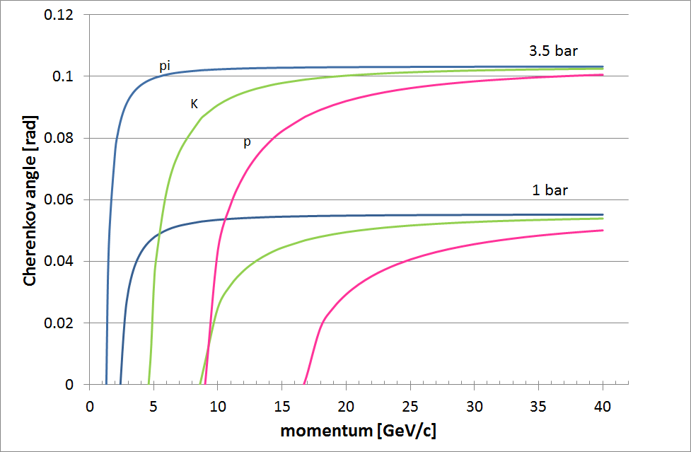
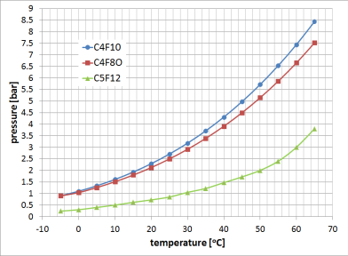
Cherenkov radiator gas pressurization
Refractive index optimization
@ 3.5 bar and L= 50 cm: excellent photon yield and ring radius (5 cm) suitable for pattern recognition
PID range can be extended by lowering P
@ 3.5 bar C₄F₈O needs heating at ~ 40 ºC to prevent condensation
Using C₅F₁₂ : P ~ 2.8 bar, T~ 60 ºC
P [bar] | Refr. ind.@ 175 nm | Momentum threshold [GeV/c] |  |  | N_{ph} cm⁻¹ eV⁻¹ at saturation
 |  | π | K | p
1 | 1.00153 | 2.5 | 9 | 17 | 1.1
1.5 | 1.002295 | 2.1 | 7.3 | 13.5 | 1.7
2 | 1.00306 | 1.8 | 6.4 | 12 | 2.2
2.5 | 1.00383 | 1.6 | 5.6 | 10.7 | 2.9
3 | 1.0046 | 1.5 | 5.1 | 9.8 | 3.4
3.5 | 1.00535 | 1.3 | 4.8 | 9.1 | 3.9
liquid
gas

Slide 7
Design specifications and R&D issues II.
Large acceptance (up to 60 m², ~ 30% of the barrel) and large photosensitive area (up to 8 m²) + B=0.5 T -> photon detector
  ALICE HMPID ( 11 m² of CsI-MWPC) know-how, CsI-based photo-detector is the most cost effective solution
  Modified MWPC with reduced CsI PC pad size and anode-cathode gap: improved spatial resolution + smaller induction spread (5 cm ring radius wrt 12 cm in HMPID)
  CsI-based TGEM photon detector
  Photonis Planacon XP85012Q with bialkali PC to work in the visible
High luminosity ALICE upgrade (pp: up to 2 MHz, Pb-Pb: 50 KHz)
  Front-end and readout electronics
Other topics
  Radiator vessel and mirror system engineering studies
  Radiator gas cleaning and UV transparency measurement systems
  Tracking detector based on CCC (Close-Cathode Chamber)

Slide 8
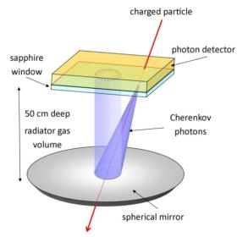
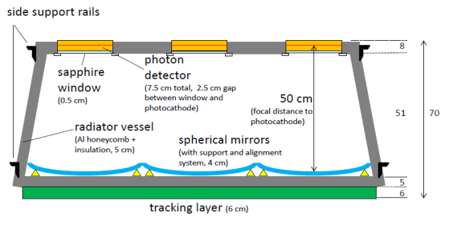
Baseline detector principle scheme
phi cross section
Focusing RICH, C₄F₈O gaseous radiator L~ 50 cm, operated at 1-3.5 bar
Al honeycomb radiator vessel, 4 mm sapphire window with A/R coating
HMPID-like photon detector: MWPC with CsI pad segmented photocathode, operated with CH₄ ; pad size 4x8 mm² , 20 μm anode wires, 0.8 mm gap, 4 mm pitch
50x50 cm² spherical mirror, light C-fiber substrate, Al/MgF₂ coating
CCC tracking layers with strip chambers
FEE with analogue readout for centroid measurement, three options:
  HMPID Gassiplex chip with T/H, modified version from COMPASS RICH (max 500 KHz trigger rate)
  APV25 with continuous sampling at 40 MHz, as used in COMPASS RICH and HADES RICH upgrades
  new common FEE developments for ALICE high-lumi upgrade

Slide 9
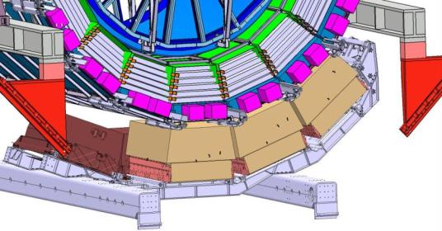
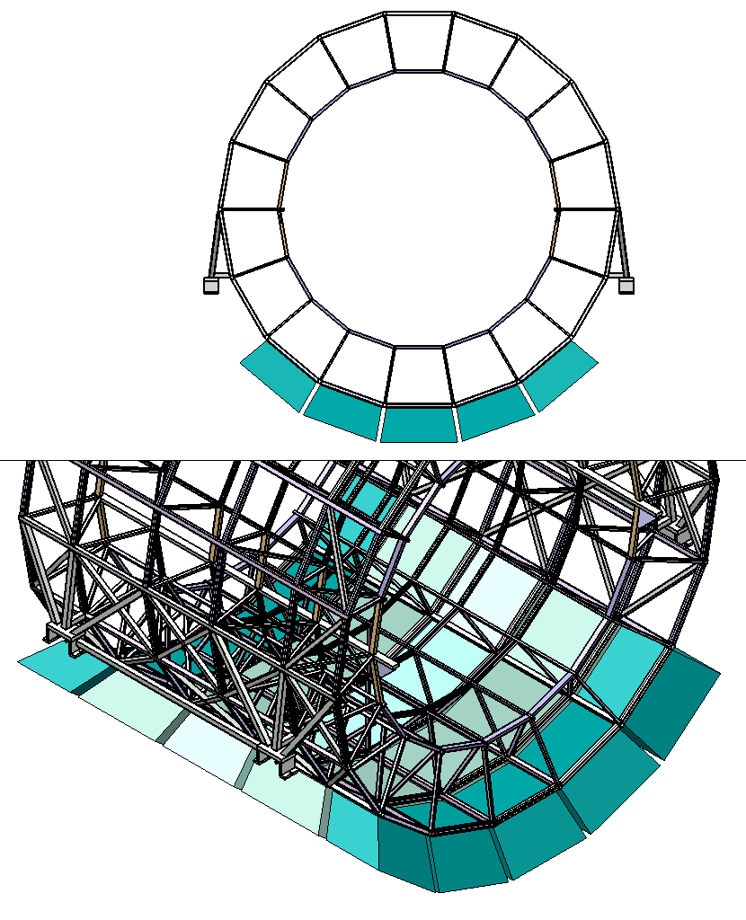
Detector layout and integration in ALICE
VHMPID
DCAL
Module arrangement under study
5 Central modules, size ~ 1.4x1.7x0.7 m³
10 Side modules, size: ~ 2.7x1.7x0.7 m³

Slide 10
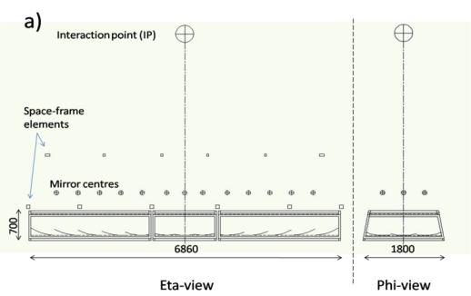
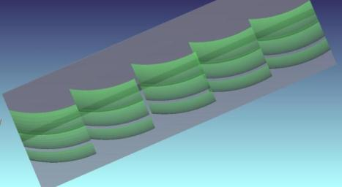
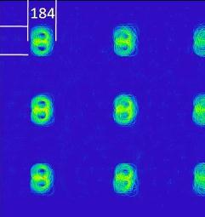
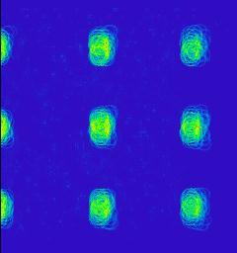
Mirror layout studies with ZEMAX
IP
Focal point for mirror 1
Focal point for mirror 2
CsI photocathode
217
3-D View

Slide 11
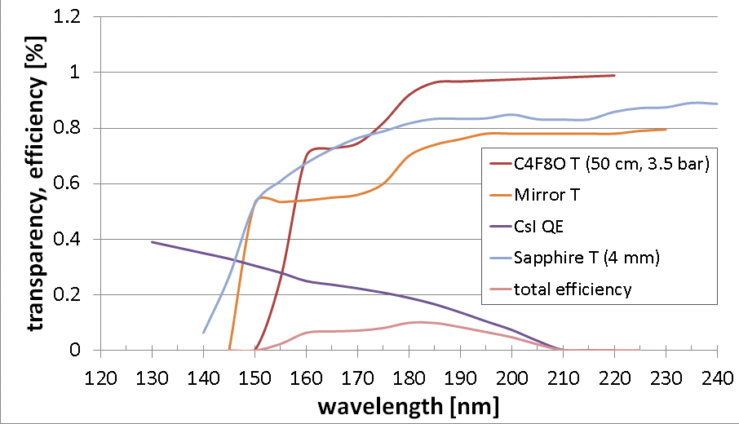
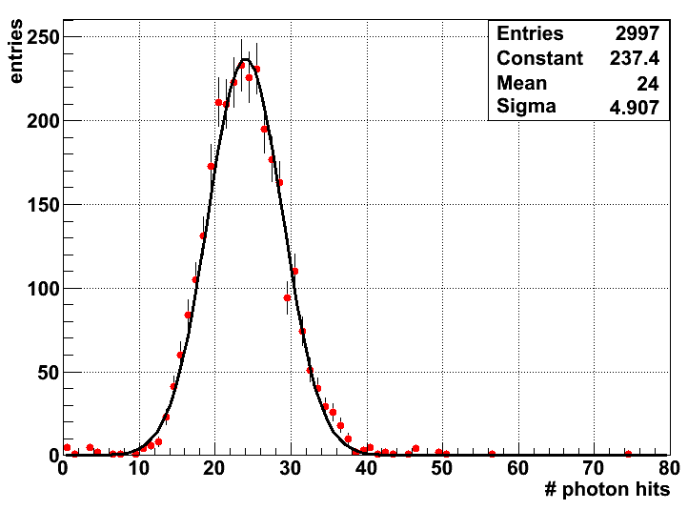
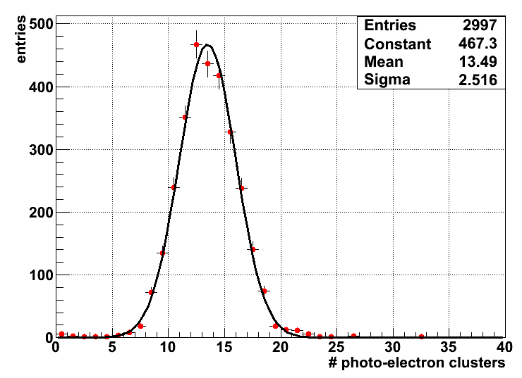
Detector figure of merit N₀
Lab measurements
 | UV | Visible
N₀ [cm⁻¹] | 60 | 130
N_{pe} | 24 | 45
MC simulation: 15 GeV/c π, C₄F₈O @ 3.5 bar
Single photoelectrons overlap within a pad cluster: number of reconstructed photons
N_{rp} < N_{pe} .
N_{pe}
N_{rp}

Slide 12
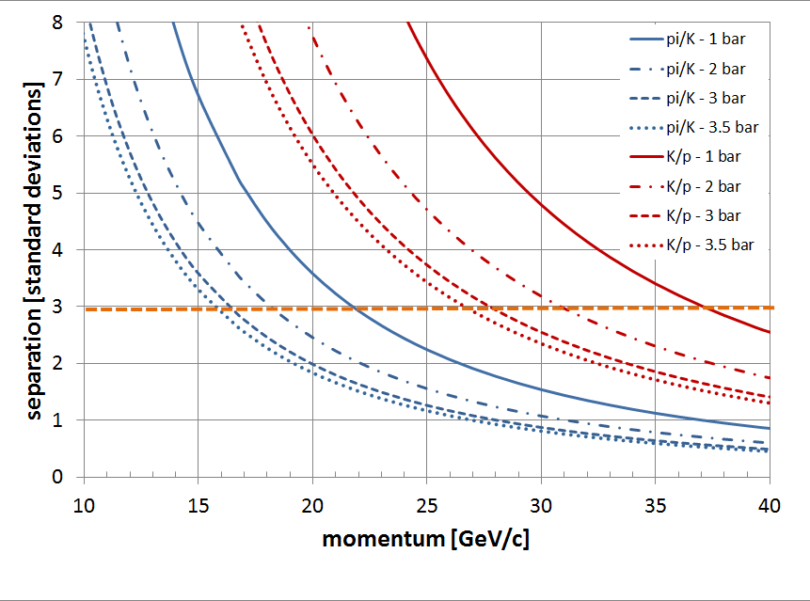
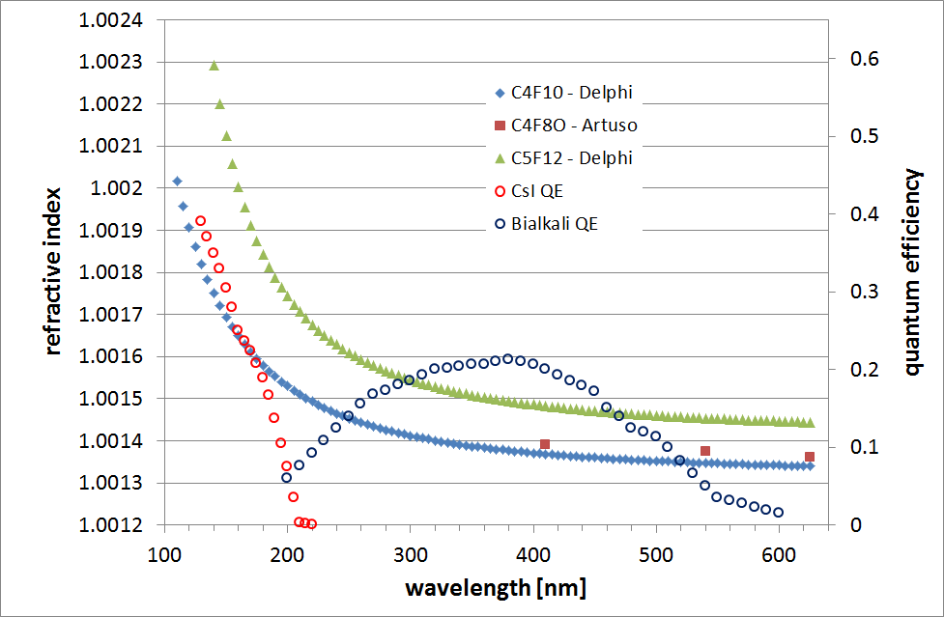
Angular resolution and particle separation
Theoretical estimation
C₄F₈O @ 3.5 bar
 | UV | Visible
σ_{θ} ^{chromatic} | 2.7 mrad | 5.3 mrad (!)
σ_{θ} ^{emission} | 0.5 mrad | 0.5 mrad
σ_{θ} ^{granularity} | 1.7 mrad | 1.7 mrad
σ_{θ} ^{tracking} | 1.6 mrad | 1.6 mrad
σ_{θ} ^{total} | 3.6 mrad | 5.8 mrad
N_{rp} | ~ 13 | ~ 30
σ_{θ} ^{track} | ~ 1 mrad | ~ 1.1 mrad
assuming σ_{θ}^{track} ~ 1.5 mrad
 | Signal (GeV/c) | Absence of signal (GeV/c)
π | 2-16
K | 5-16
p | 10-25 | 5-10
PID ranges
- Lower limit: cut N_{rp} >2
- Upper limit: 3σ separation
12/30

Slide 13
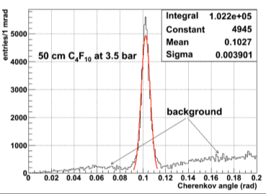
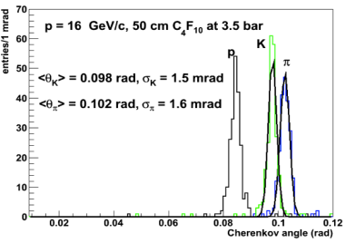
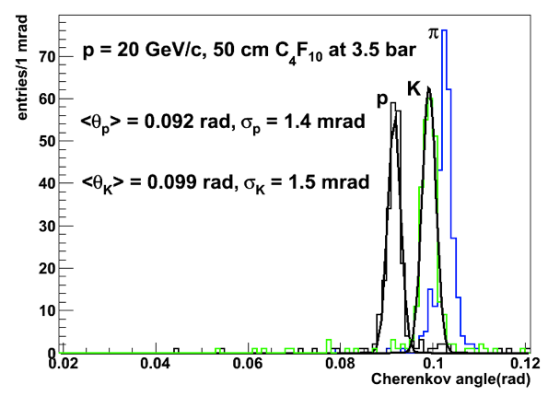
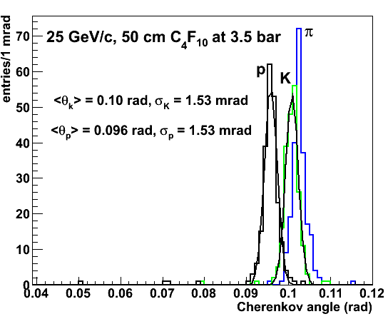
MC studies of PID performance
Events from single particles gun embedded in HIJING generated background (ALIROOT framework)

Slide 14
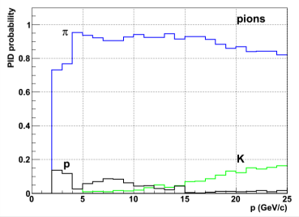
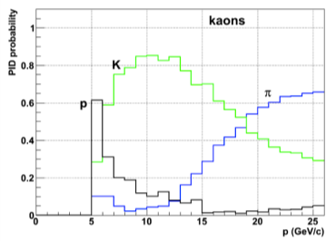
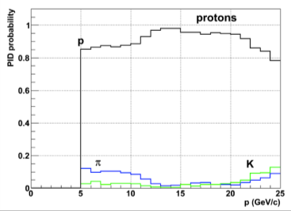
MC studies of PID performance
Events from single particles gun embedded in HIJING generated background (ALIROOT framework)
Probability of identification for π, K, p
PID algorithm based on HMPID pattern recognition (Hough transform)
Further tuning/optimization in progress for VHMPID ring patterns

Slide 15
Testbeam studies at CERN PS/T10
Prototypes using liquid C₆F₁₄ radiator (in proximity focusing, HMPID-like), and C₄F₁₀ or C₄F₈O at atmospheric pressure with mirror focusing
MWPC prototype with adjustable anode-cathode gap (0.8-2 mm), smaller pad
Prototype with C₄F₈O radiator pressurization and heating
CsI-TGEM and -RETGEM as photon-detector in RICH prototype with C₆F₁₄ radiator (see V. Peskov’s talk)

Slide 16
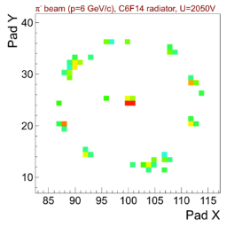
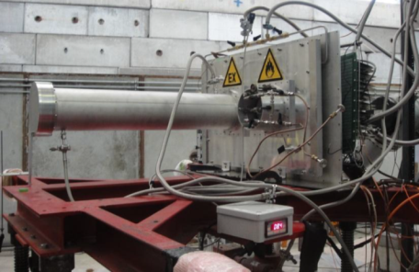
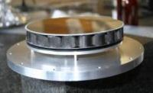
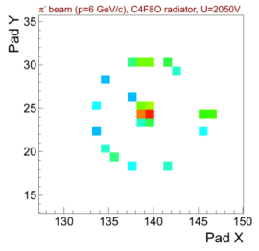
Prototype with two Cherenkov radiators (Nov 2011)
CsI PC, 8x8 mm² pads
Achieved HMPID benchmark performance
Liquid radiator
beam
SiO₂ windows
Gaseous radiator
C₆F₁₄ liquid radiator
MWPC
20 μm anode wires,
2 mm gap, 4 mm pitch
Spherical mirror
Spherical mirror
C₄F₁₀ or C₄F₈O radiator gas at atmospheric pressure
(L = 100 cm)

Slide 17
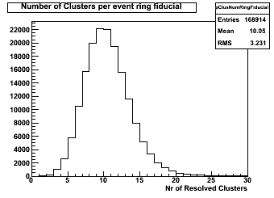
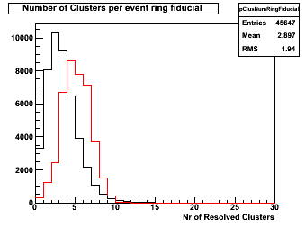
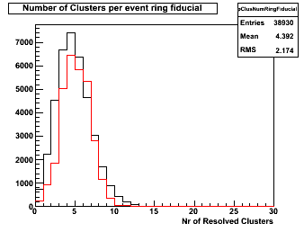
Comparison C₆F₁₄ /C₄F₁₀ /C₄F₈O
C₆F₁₄
<10>
C₄F₁₀
<2.9>
C₄F₈O
<4.4>
Simulation with
full absorption
for λ < 175 nm
Simulation with
full absorption
for λ < 175 nm
C₆F₁₄ thickness : 6 mm, to obtain same photon yield as 100 cm gaseous radiator
First tests with radiator gas, C₄F₁₀ and C₄F₈O used w/o cleaning or filtering

Slide 18
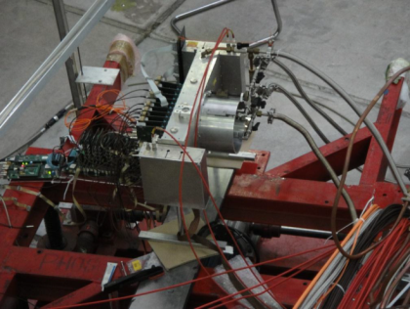
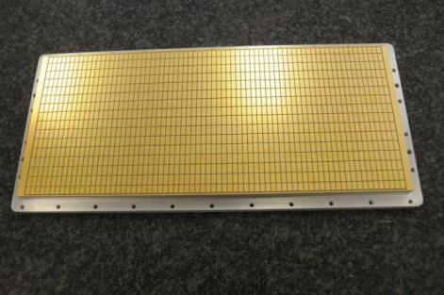
Variable-gap chamber tests (June 2012)
C₆F₁₄ liquid radiator
RICH prototype with variable-gap
MWPC photon-detector
Pad cathode before CsI coating
60x16 pads, 4x8 mm²
Refurbished old prototype (F. Piuz, RD26), anode-pad cathode gap adjustable in 0.8-2 mm (100 μm steps), anode -wire cathode 2 mm, 20 μm anode wires, pitch 4 mm
Basic performance studies using liquid C₆F₁₄ radiator, 3 mm thick: HV scan, gap scan

Slide 19
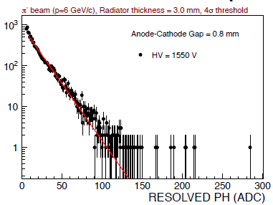
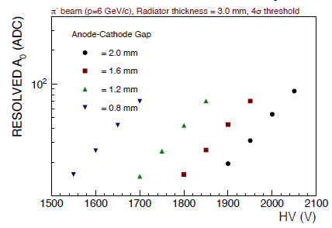
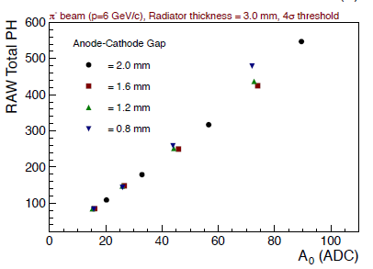
Variable-gap chamber tests (June 2012)
Single e- PH spectrum
Gain vs HV at various gaps
slope-> gain A₀
Equal amount of photons seen @ various gaps

Slide 20
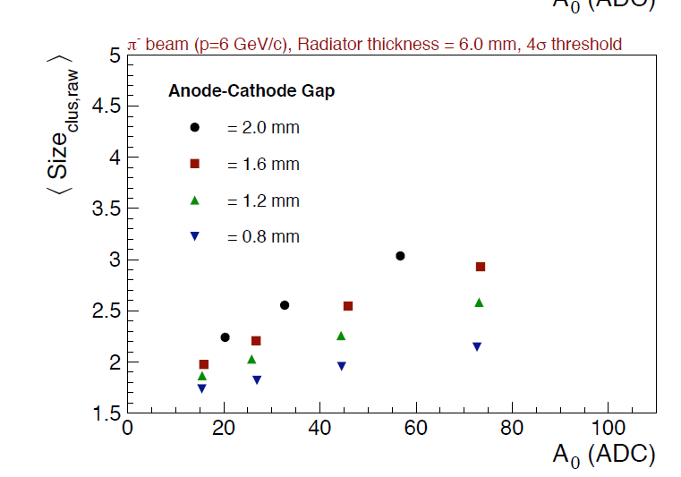
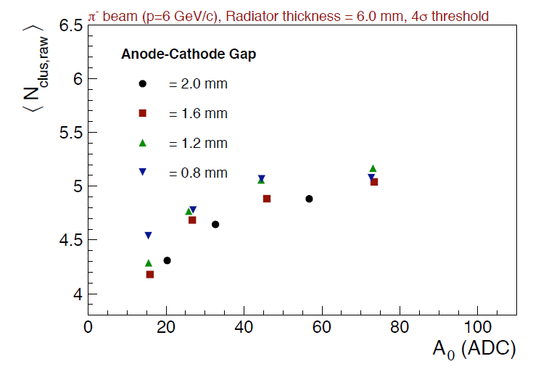
Variable-gap chamber tests (June 2012)
Cluster size proportional to gap
No. of raw clusters increases by reducing the gap

Slide 21
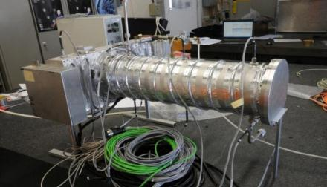
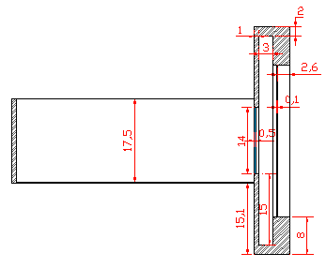
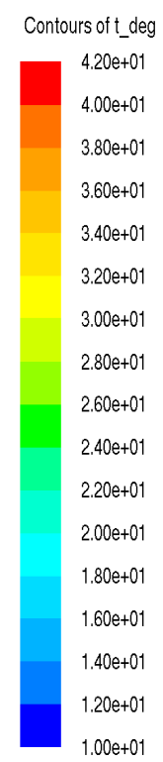
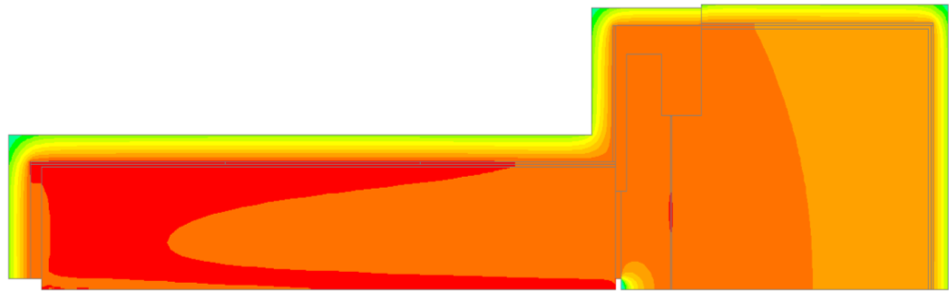
Testbeam with pressurized C₄F₈O radiator (Oct 2012)
Radiator equipped with heating tape and P, T probes
Safety pressure test (@ 5 bar for 5 h)
Heating studies with Fluent 6.0 to optimize insulation and ensure radiator temperature uniformity
OUT
C₄F₈O
radiator
Sapphire window
51
IN

Slide 22
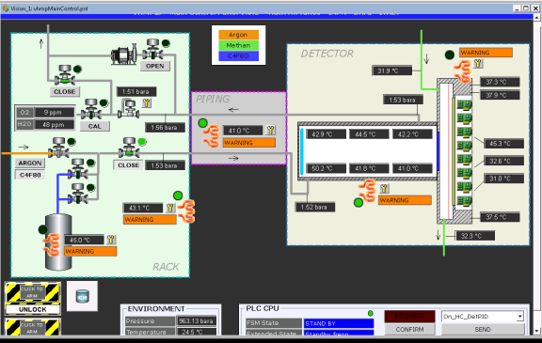
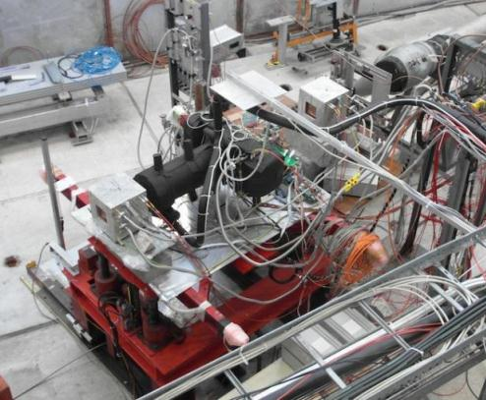
Testbeam with pressurized C₄F₈O radiator (Oct 2012)
P, T monitoring and control panel
Gas system, piping and detector heated and insulated

Slide 23
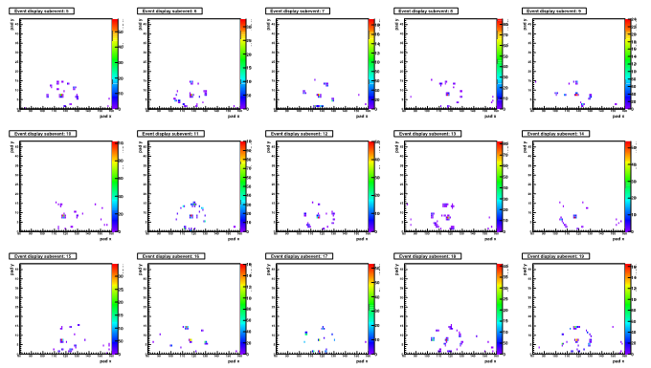
Testbeam with pressurized C₄F₈O radiator (Oct 2012)
The first 15 events for C₄F₈O at 3.5 bara with 6 GeV/c π⁻ beam

Slide 24
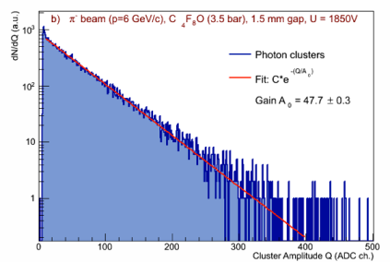
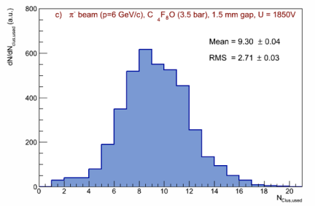
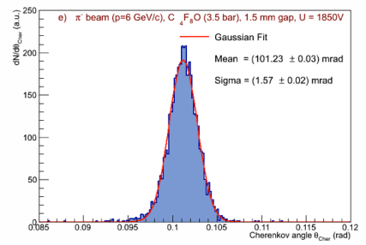
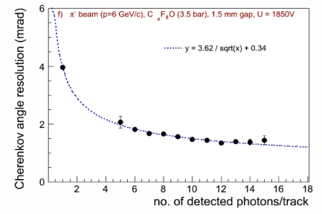
Testbeam with pressurized C₄F₈O radiator (Oct 2012)

Slide 25
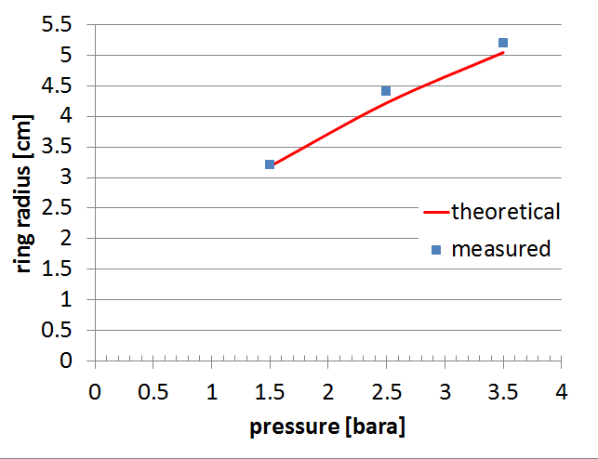

Testbeam with pressurized C₄F₈O radiator (Oct 2012)
C₄F₈O refractive index in UV ~ C₄F₁₀ , simulation are in progress to deduce exact parameterization
Few % K’s contamination: detected and identified

Slide 26




Testbeam of CsI-TGEM photon detector with C₆F₁₄ liquid radiator (2011)
6 TGEM stack layout
Observed detection efficiency ~ 60% of HMPID, Gassiplex not optimized for TGEM
First tests performed with APV25 and in progress
New tests planned with larger TGEM

Slide 27




Photonis Planacon XP85012
Due to delay on electronics production, it could not be tested before the end of testbeam at CERN/PS in 2012
Planned lab tests with LED source
Pro’s | Con’s
Larger photon yield (larger bandwidth in visible), intrinsically faster | Cost (~ 8.8 K$ /piece) and timescale for full production
No issues from radiator gas transparency (purity, O₂ and H₂O contamination), less demanding systems | Chromatic error due to larger bandwidth, (compensated by photon yield, final performance similar to UV)
Can be mounted inside radiator vessel, sapphire windows not needed | Detection efficiency losses due to 80% packing factor
Commercial device, savings on work for photon detector, no CH₄ gas system
LAPPD ALD-MCP (A. Elagin’s talk) could be a further option depending on R&D timescale

Slide 28
Summary and outlook
Intense R&D campaign has been performed in 2011/12 to meet new design requirements
Successful tests of C₄F₈O as Cherenkov radiator in UV, proven preliminary design concepts for pressurization/heating
Baseline solution for photon-detector: CsI-MWPC with thin gap; new prototype with final layout successfully tested in Dec ‘12
Further activities
  continue tests on CsI-TGEM and Planacon, for “faster” detector option
  FEE and readout electronics development
  engineering studies on vessel structure and mirror system
LoI submitted this week to the ALICE Collaboration, final decision in March

Slide 29


Slide 30


Slide 31
BACK-UP SLIDES

Slide 32
Material budget
Detector component | X/X₀
Bottom+top radiator vessel sandwich panel | 7%
Photon detector + tracking layers | 3%
C-fiber mirror substrate | 2%
Radiator gas at 3.5 bar | 4%
Sapphire window | 6%
total | 22%
For comparison:
- ITS + TPC ~ 15% X0
- TRD ~ 26% X0
- TOF ~ 20% X0

Slide 33
Radiator refractive index and QE curves
sapphire cutoff
C₄F₈O cutoff

