Slide 1
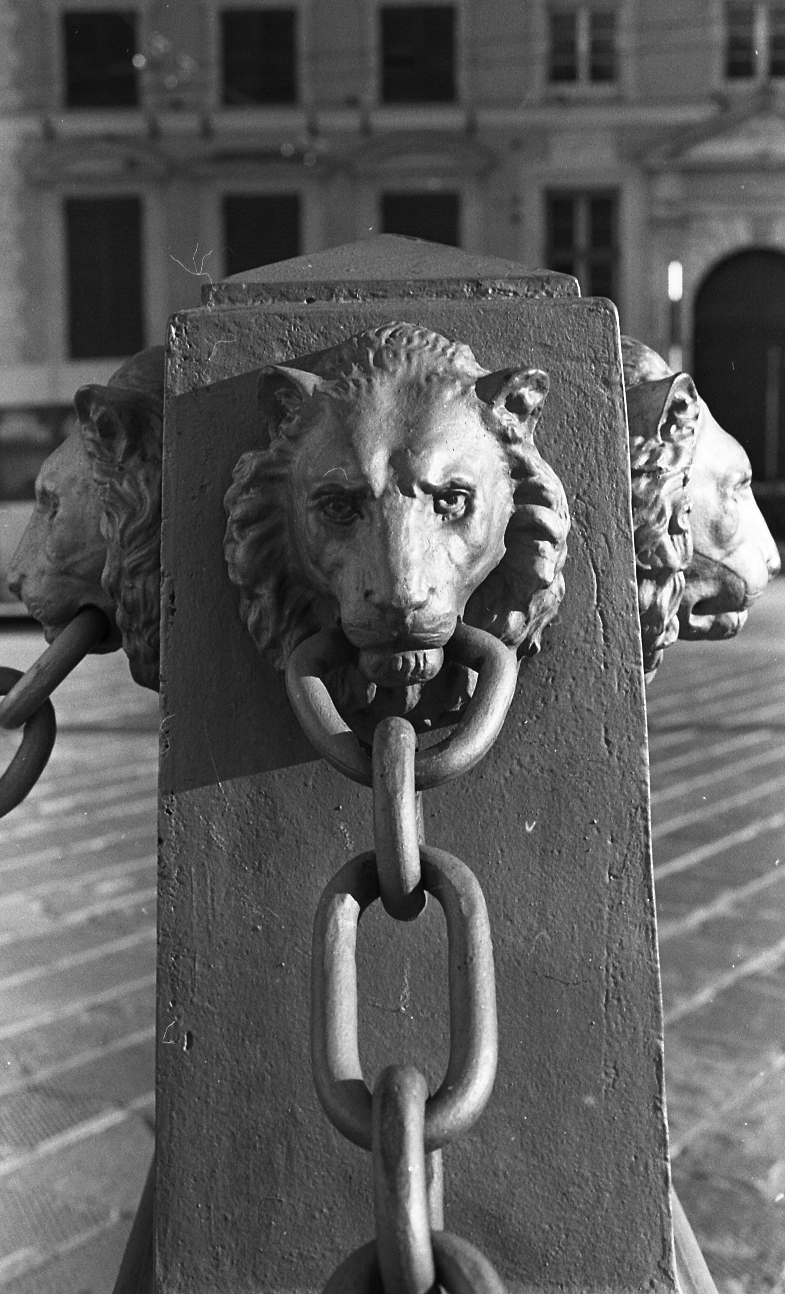




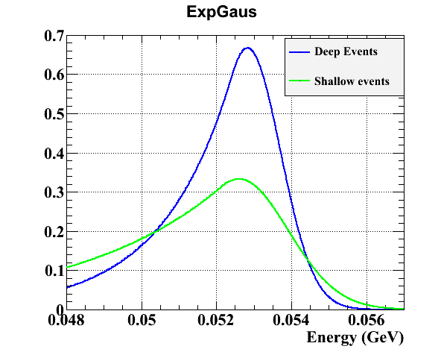
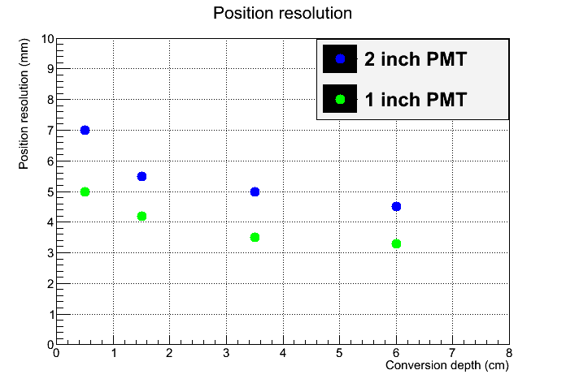
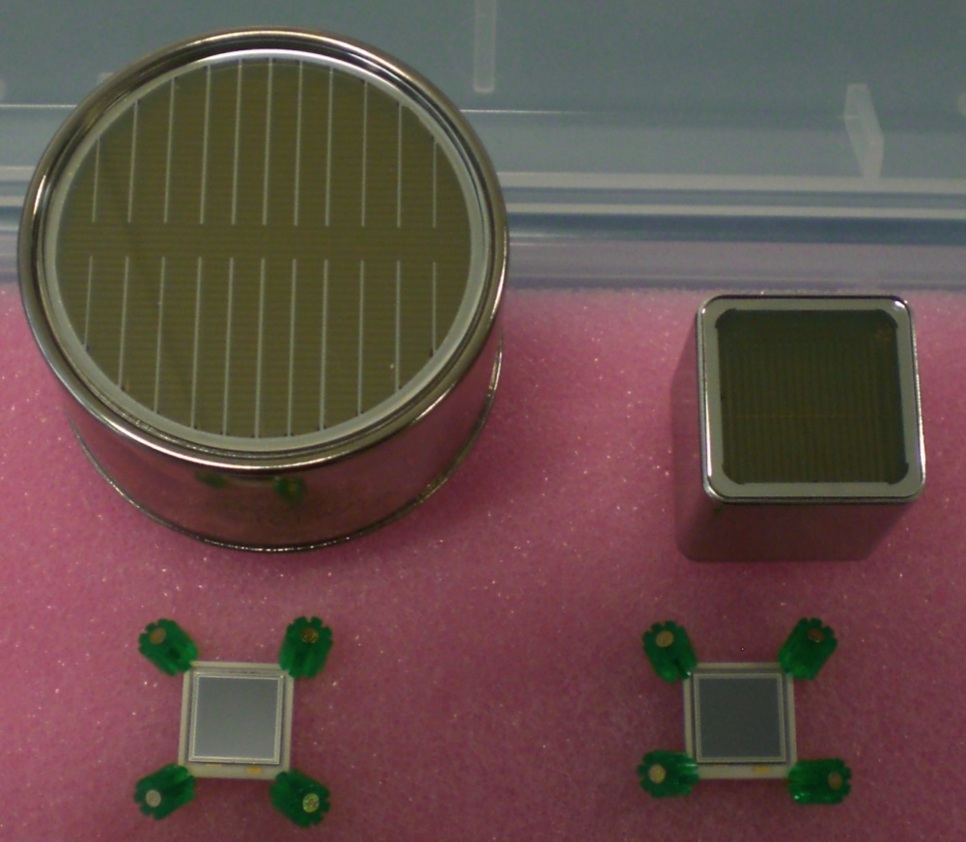

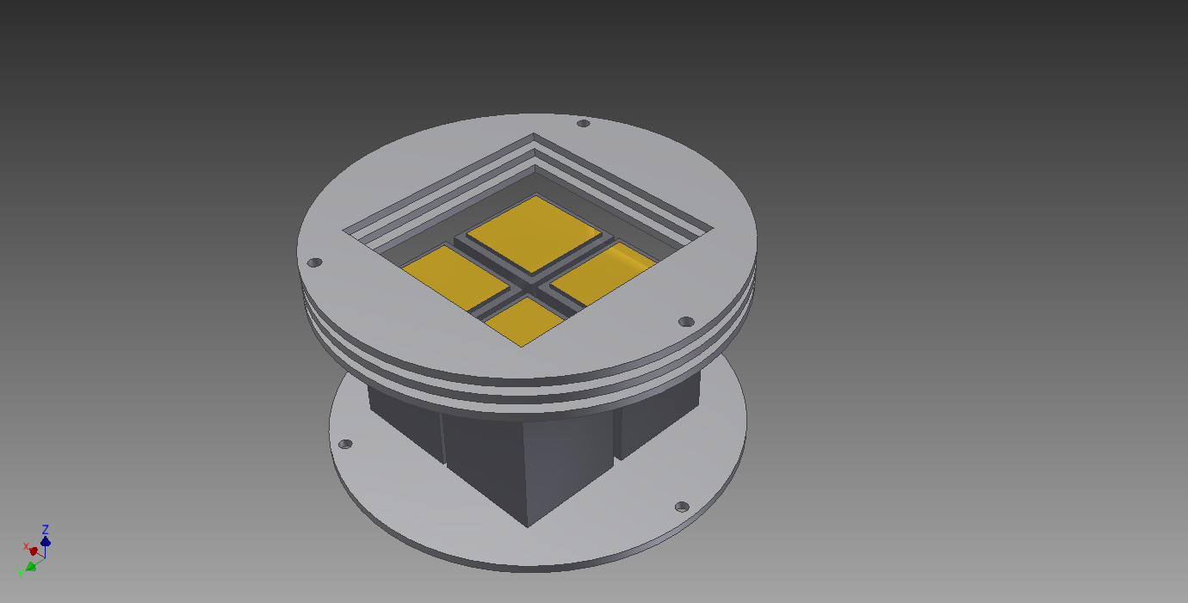
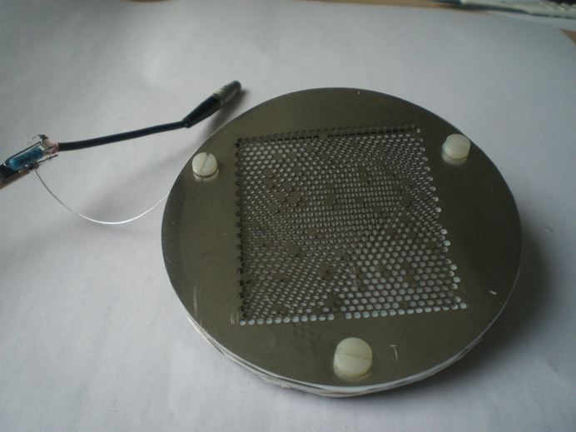
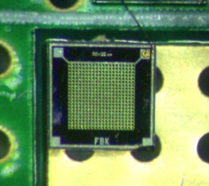
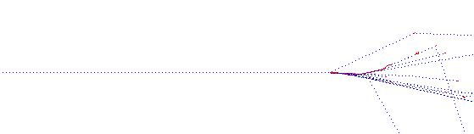
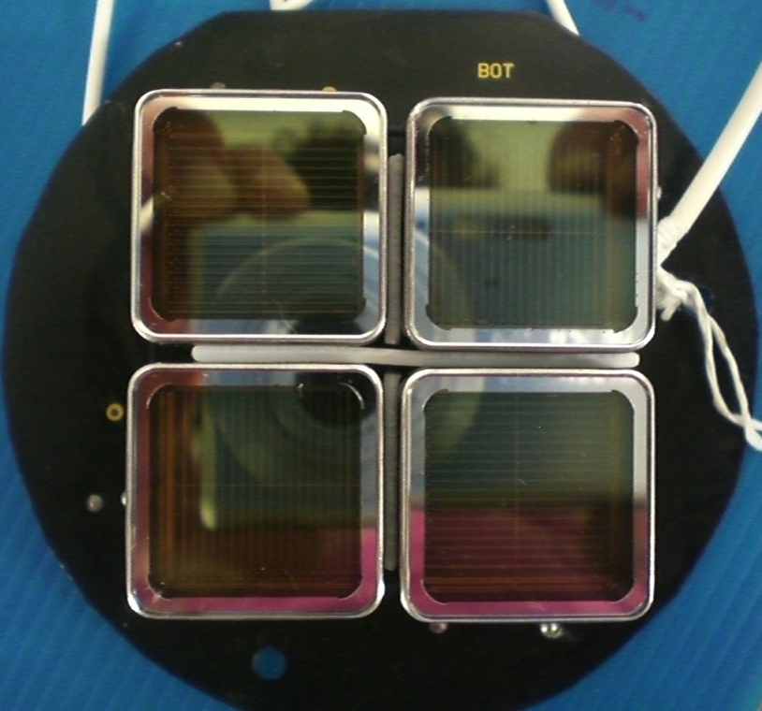
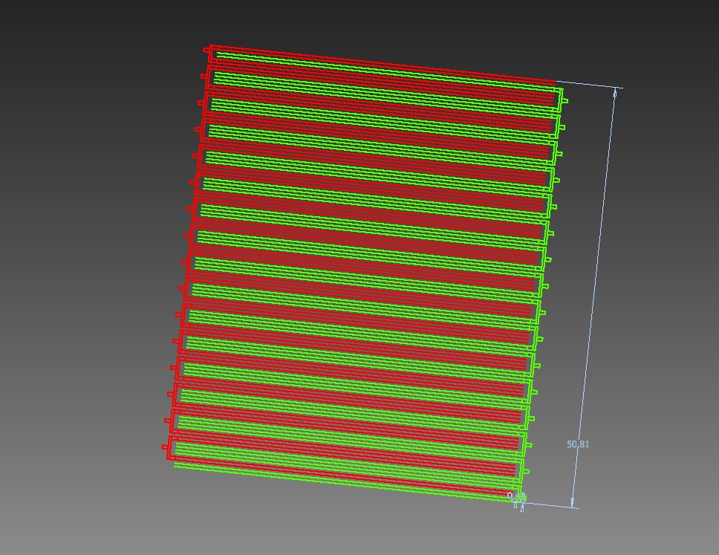
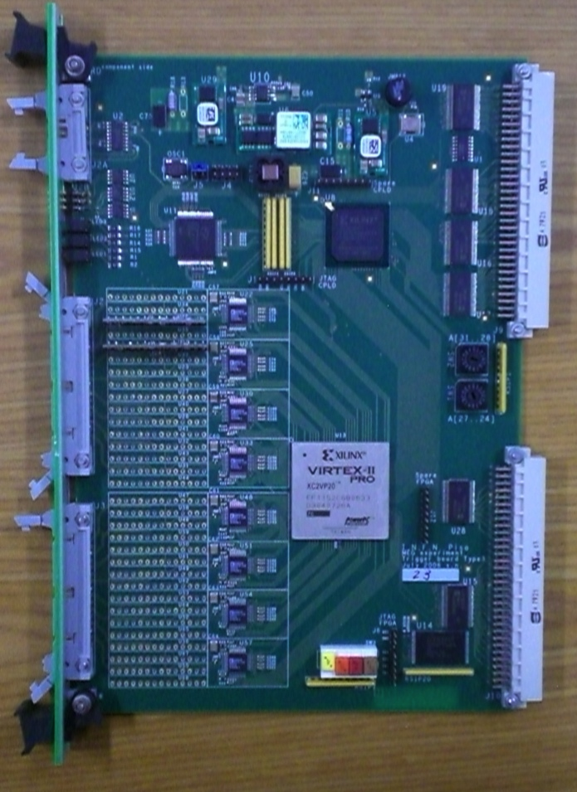
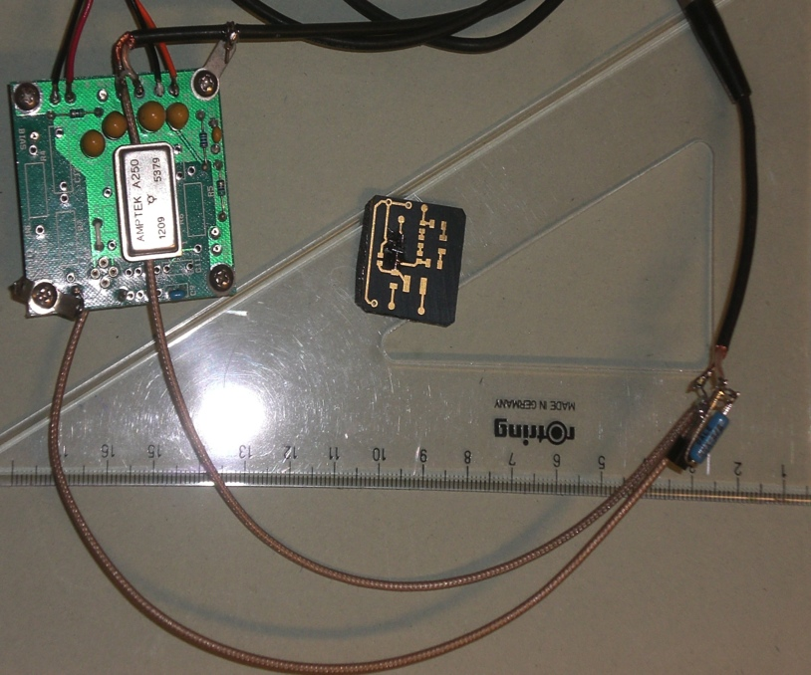
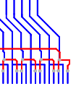
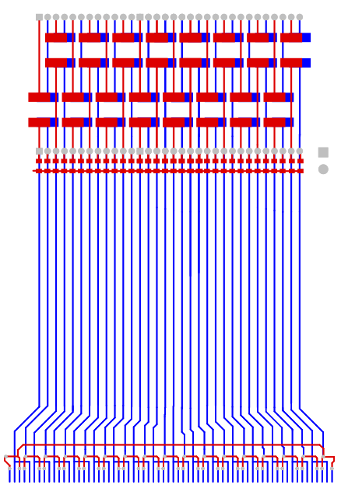
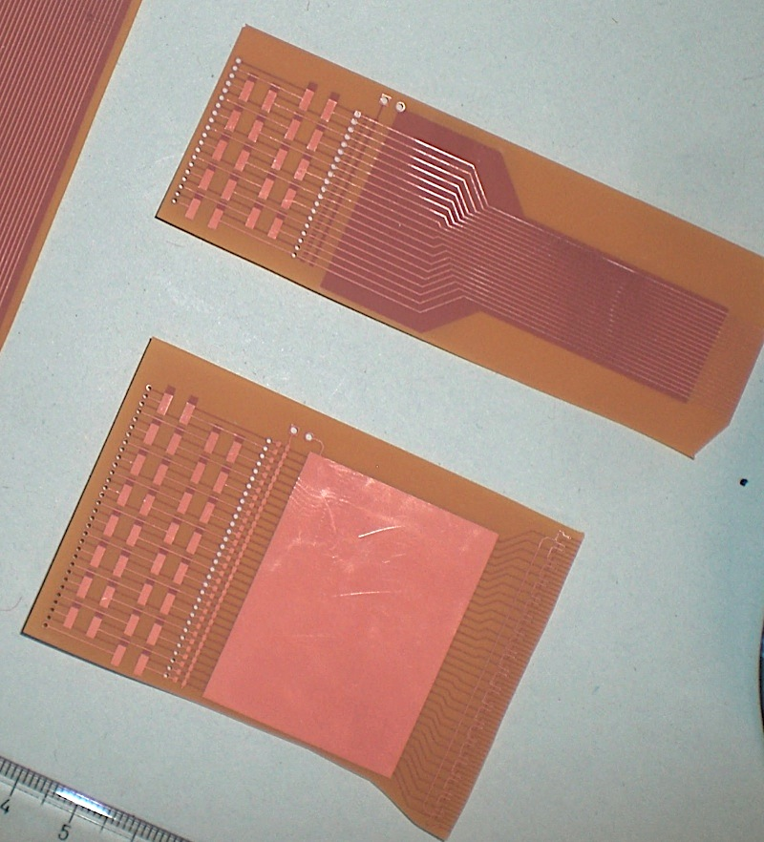
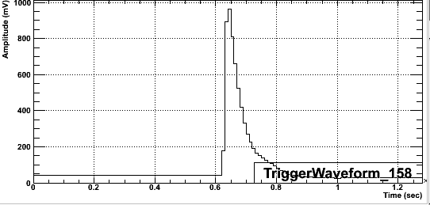
R&D on a Fast LXe TPC with real-time event reconstruction
SUMMARY: We are studying and developing techniques for the detection of rare processes in elementary particle physics by means of Liquid Xenon detectors in the framework of the FOXFIRE project. Particles in noble liquids (and Xenon in particular) release energy resulting in emission of both scintillation light and ionization charge. The usage of this information is being exploited by many research groups investigating Dark Matter, Neutrinoless Double Beta Decay and Lepton Flavor Violation.
Our aim is to extend the application field of these techniques towards high-rate, high-energy (tens of MeV) environments with particular emphasis on real-time event reconstruction and improved imaging capability.
S. Dussoni ⁽¹⁾, A. M. Baldini ⁽¹⁾, C. Cerri ⁽¹⁾, M. Grassi ⁽¹⁾, A. Papa ⁽²⁾, G. Signorelli⁽¹⁾
INFN Sezione di Pisa, Largo B. Pontecorvo 3, 56127 Pisa, Italy
Paul Scherrer Institut (PSI) CH-5232 Villigen, Switzerland
Liquid Xenon Facts
Atomic Number Z 54
Mean Atomic Weight 131.3
Density 3 g/cm³
Boiling point 165 K
Ionization potential 12.13 eV
Light yield 40 000 phe/MeV
Radiation length X₀ 2.87 cm
Electron drift velocity 3-10⁵ cm/s (2 kV/cm)
Energy release in Xe
“High” energy photons interact in LXe producing
– prompt scintillation light
- VUV (178 nm peak)
- measured with light detectors
– ionization
- drift under applied electric field
- sub millimeter 3D position resolution
Our basic idea is stimulated by the fact that in the MEG Liquid Xenon Calorimeter events converted in the first few cm are reconstructed with poorer resolutions (energy, position, and time) with respect to deeper events. Due to the high density of Xenon, these shallow events are a significant fraction of the total (65% of incident photons are converted in the first 3 cm). A solution could be the read out of ionization information but instrumenting the whole volume will result in a detector not suitable for high event rates such those in HEP precision experiment, due to large drift time
(v_{d} = 30 cm/μs @ 2 kV/cm).
The elegant solution is to implement ionization readout only for a thin layer (total of 3÷5 cm divided in two sub-gaps) just behind the entrance window.
Benefits will be:
short dead time, with intrinsic limit due to charge drift <1μs;
Possibility of adequate segmentation of the entrance face with minimum amount of passive material:
  Excellent efficiency;
  “imaging” capability (exploited at online level);
  Capability of sustaining higher rate by having several independent readout channels
An intense R&D activity is ongoing for such a detector, exploring different paths.
Energy resolution in the MEG photon detector:
σ_{Right}=1.6% (Deep events, conversion depth z > 2 cm)
σ_{Right}=2.5% (Shallow events, z < 2 cm)
Photon energy: 52.8 MeV)
Position resolution depends both on photo-detector size and on conversion depth
Same Photodetector candidates are presently under test for the final prototype (real scale):
Hamamatsu R9869 2” presently used in the MEG experiment
Hamamatsu R8520-406 1” square PMT
Hamamatsu large area VUV-APD’s 1 x 1cm² (S8664-1010VUV)
Silicon PhotoMultiplier, AdvanSiD 1 x 1mm², 400 pixel, 50µm, not to scale)
1
50 MeV photons in liquid xenon simulated with GEANT 3.21 entering this side
2
Shallow event (<2cm) need independent knowledge of conversion point to improve position/time/energy information
Electric Field
For charge drift
4
3
Scintillation read out
Front face: fast signal for offline and online event reconstruction (triggering);
Side faces: offline energy and time reconstruction.
E
E
A prototype chamber is
designed and being
assembled:
2x2 array of 1” square PMTs
Thin (few cm) LXe volume
instrumented with field grids
Test with a calorimetric setup:
single channel, only drift field
(no position reconstruction,
Intended for optimization of
working parameters)
Read out with low noise amplifiers for use in Lxe:
  Commercial reference amplifier AMPTEK A250 with FET in Lxe;
  Input stage: SMD High bandwidth FET on Cirlex™ PCB (clean material for LXe);
  Cold amplifier evolved from NA48;
  Other devices are studied.
Drawback: need for a large number of channels for position reconstruciton
Future prospect is to exploit charge multiplication in Liquid phase.
Pros:
Easier signal transport outside the cryostat: no need for low noise feedthrough;
Diminished heat load (few active elements);
Possible to instrument a large number of readout channels at room temperature (goal: direct connection to trigger boards with dedicated receiver)
Cons:
Difficult to achieve (high field strength needed)
Eventual non-linear effects to be assessed (worsening of energy resolution)
Secondary luminescence can arise: possibility of fake events!
We are designing an integrated “liquid Phase Charge Multiplier” implemented with use of semiconductor manufacturing techniques.
Deep event, good energy/time/position resolution
Preamp Input
Field shaping
Charge readout:
TPC instrumented volume z<(15 ÷ 25 x 2) mm
Charge multiplication in Lxe
Needed very high field (>1MV/cm)
Observed with few μm wires: not attractive in a real detector (unpractical handling)
But: the high field values can be easily obtained by micro-machining of silicon-based features
Idea: reproduce a “micro-Gap-Chamber”-like structure
All process can be implemented on SiO substrates (transparent to Lxe emission)
Natively segmented device
Two planes for X and Y sensing
  ~1mm pitch results in sub-mm resolution
  Under study:
  Field configuration for optimal multiplication process:
    Suppression of secondary luminescence
    Proportionality between energy release and output
    Stability
  Readout scheme with interleaved electrodes and smart fan-in design, resulting in half or less channels
Online Event reconstruction
Signals will be sampled by custom VME waveform digitizers derived from the MEG experiment trigger system.
They can provide complete trigger and read-out capabilities with proper design of input stage and firmware. Match to charge/light signals: user selectable input range and buffer dimension:
Configuration of memory depth from 1 to 50 µs;
Choice of sampling frequency between 10 and 100 MHz.
Online reconstruction is allowed by on-board FPGA performing complex selection algorithms for the estimate of event energy, time and position.
Drifting electrons
Output signals
✚
X-Strips
Multiplication region
SiO with metalized contacts
Output signals
sync&clock bus
Y-Strips
Not to scale!
To outer world (supply, output connections, test pulser)
Top: Conceptual drawing of multiplication region. The entire device will be micro-machined on SiO substrates resulting in an integrated detector.
Right: CAD drawing of an array of strips (X or Y arrangement will be obtained by rotating the mask between two subsequent layers).
The combination of the interleaved strips and the interface cabling (see below) permit readout with 4:1 fan-in without loss of spatial information.
differential input x 32
Custom input stage
Xilinx Virtex II PRO FPGA
Example of LXe scintillation signal
Low noise “warm” Preampl
Cirlex™ Input FET PCB
Input FET w/
feedback
E D C B A
A
FADCs
D E C D B C A B A
AC coupling
Read out concept:
drawing of flex cable for x (y) strips; Inset: detail of alternate output fan-in with example of coded-mask to keep position reconstruction;
B) two different strip design made of Cu on Kapton foil
Kapton has been chosen being a suitable material for use in clean environment. Strips are flexible allowing for tailored detector assembly.
GND plane/
Shielding
Bias
Bonding pads
For sense wires
B
Project time profile
2011 Founding granted. Started R&D, material procurement. Laboratory set-up.
2012-start of 2013 R&D on photo detectors, front-end electronics and charge read-out. Definition of detector geometry.
2013 Construction of full-scale prototype (10 litre LXe). Implementation of online reconstruction algorithms.
2014 Prototype ready for test-beam with photons in multi MeV range.
Contacts: Simeone.Dussoni@pi.infn.it
Notes:
Manca:
1 foto finta dell’assemblaggio della camerina “integrante”
2 forma d’onda del preamp
3 schema assemblaggio strip+micromoltiplicatore di carica
4 nomi: io giovanni angela caludio marcoG aleB

