Slide 1
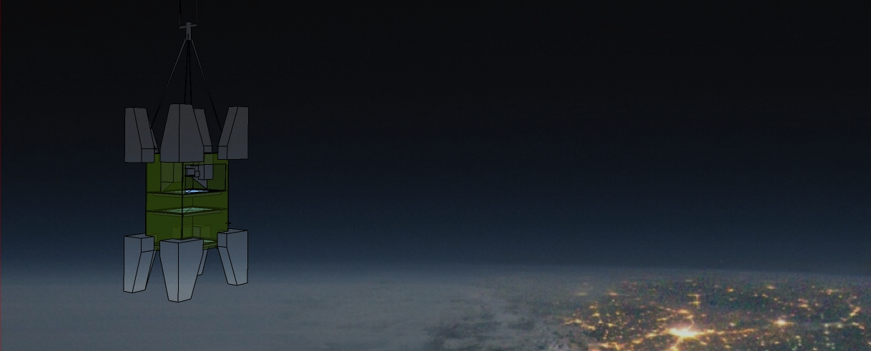

VCI 2013 13th Vienna Conference on Instrumentation
Euso Balloon a pathfinder mission for the JEM-EUSO experiment
Giuseppe Osteria
INFN Naples, Italy
- Reminder on JEM-EUSO mission
EUSO BALLOON
  Main objectives
  Instrument description
  Status and planning
  Simulation
  Conclusion
Notes:
at one glance

Slide 2
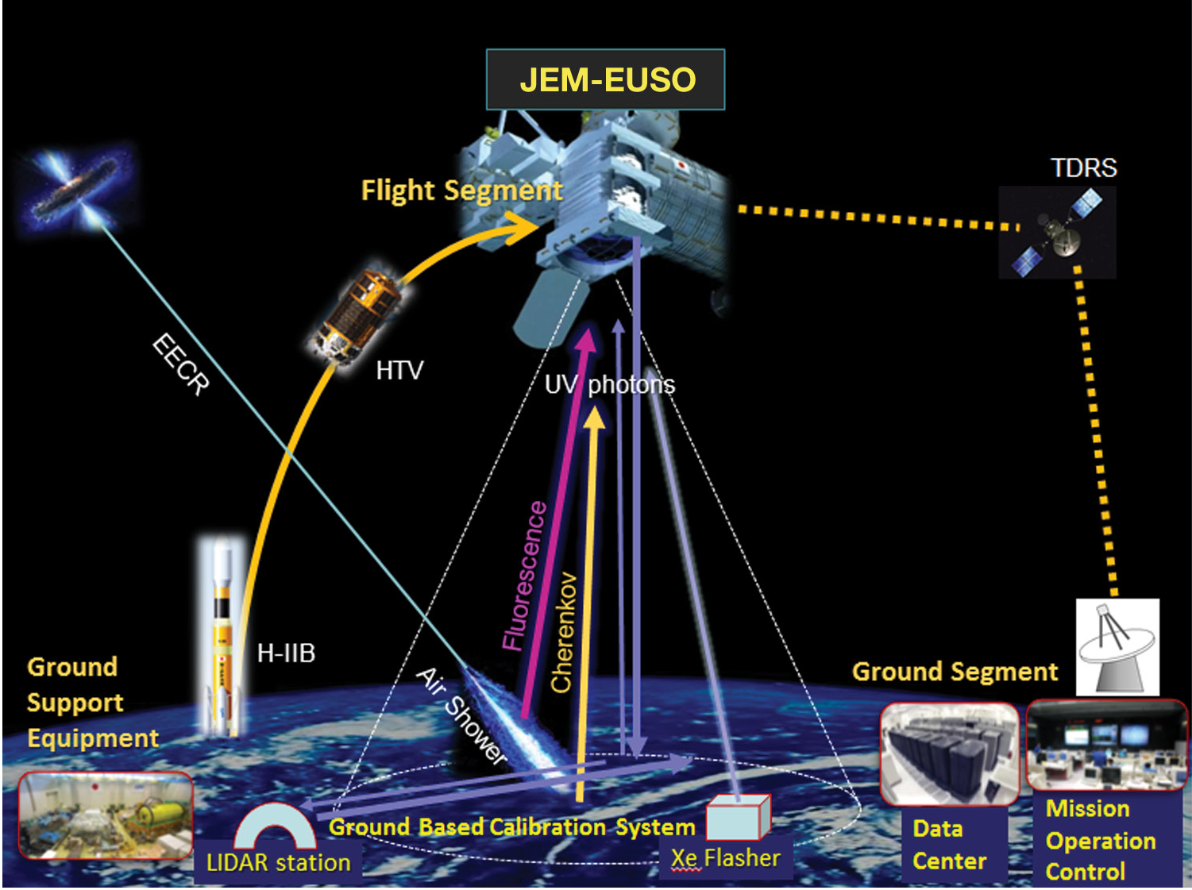
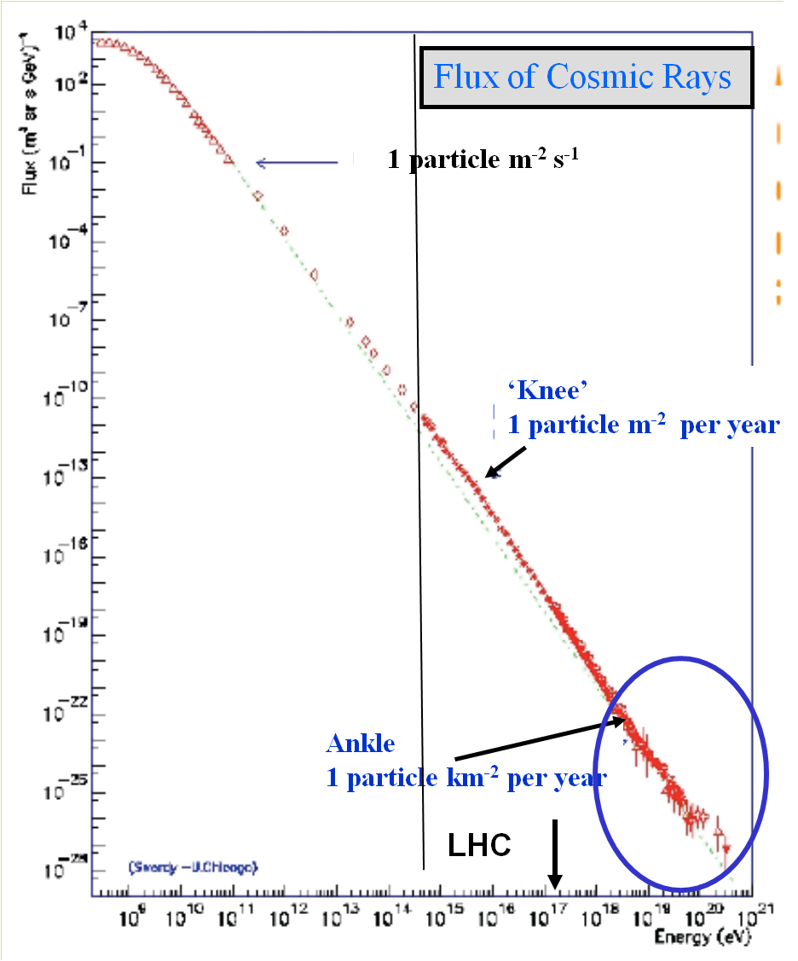
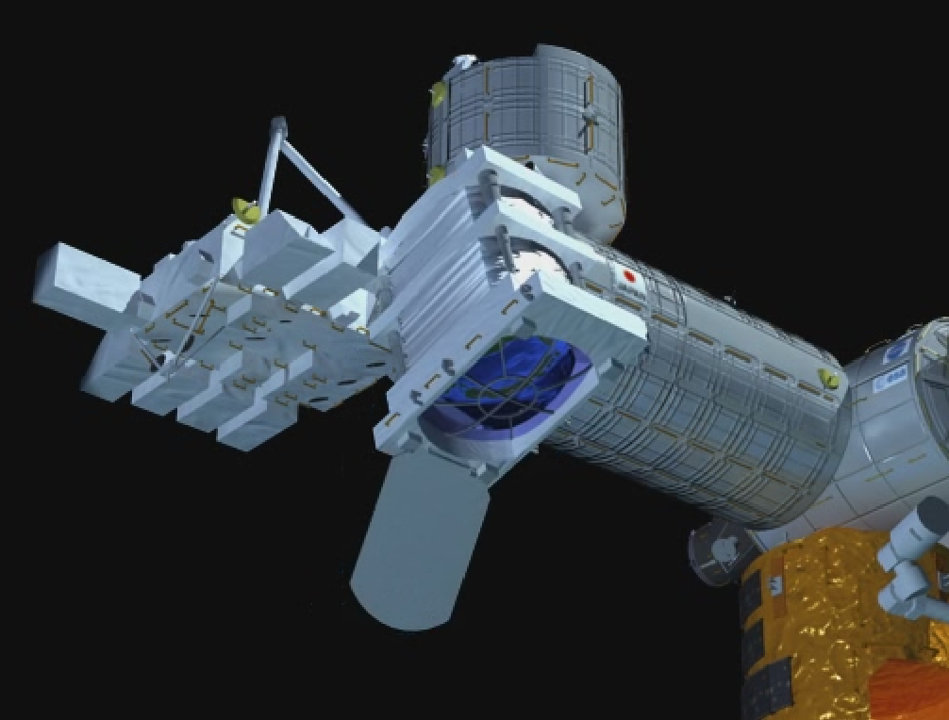
The JEM EUSO mission
The Extreme Universe Space Observatory onboard the International Space Station (ISS) Japanese Experiment Module is a new type of observatory which observes transient luminous phenomena occurring in the earth's atmosphere.
The main objective of JEM-EUSO is to investigate the nature and origin of the Ultra High Energy Cosmic Rays, UHECRs (E > 5×10¹⁹ eV), which constitute the most energetic component of the cosmic radiation.
The instrument is planned to be attached to JEM/EF of ISS during the first half of 2017 for a three years long mission

Slide 3
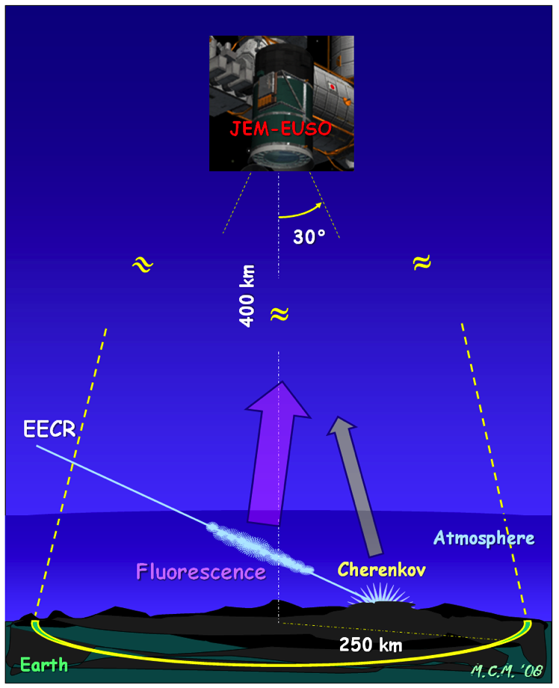
The observation principle of JEM-EUSO
JEM-EUSO telescope observes fluorescence and Cherenkov photons generated by air showers created UHE Cosmic Rays,
duration ~ 50 – 150 μs
Simulation of the light profile observed at the entrance pupil (above) and through the instrument using the ESAF code
The target volume is far greater than possible from the ground
3

Slide 4
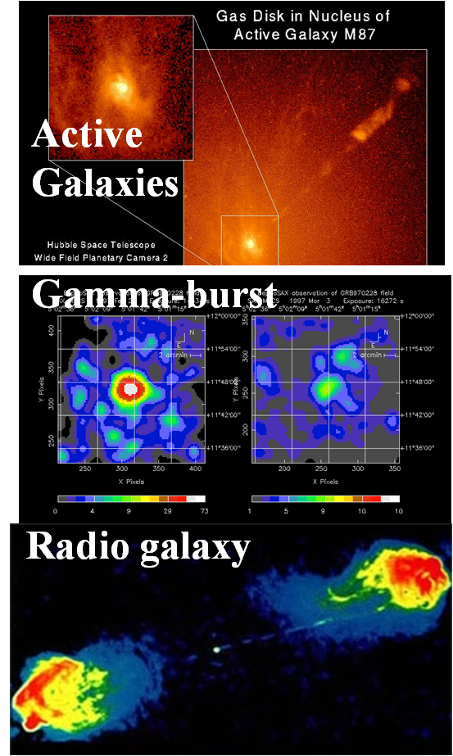
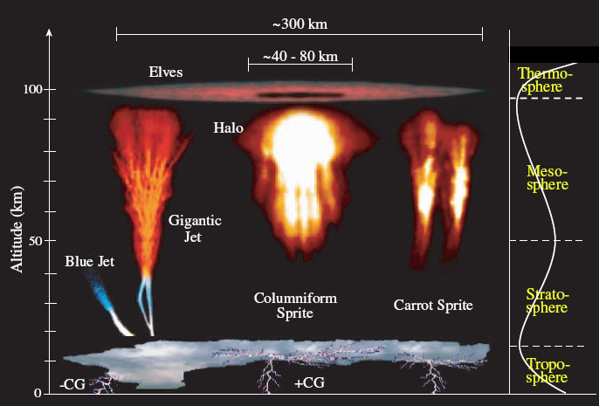
JEM-EUSO Science
Astrophysics and Cosmology:
Main Science Objectives:
  identification of UHE sources
  measurement of the energy spectra of individual sources
  measurement of the trans-GZK spectrum
Exploratory objectives:
  discovery of UHE neutrinos
  discovery of UHE Gamma-rays
  study of the galactic and local extragalactic magnetic field
Atmospheric Science
Nightglow
the transient luminous events (TLE)
meteors and meteoroids

Slide 5
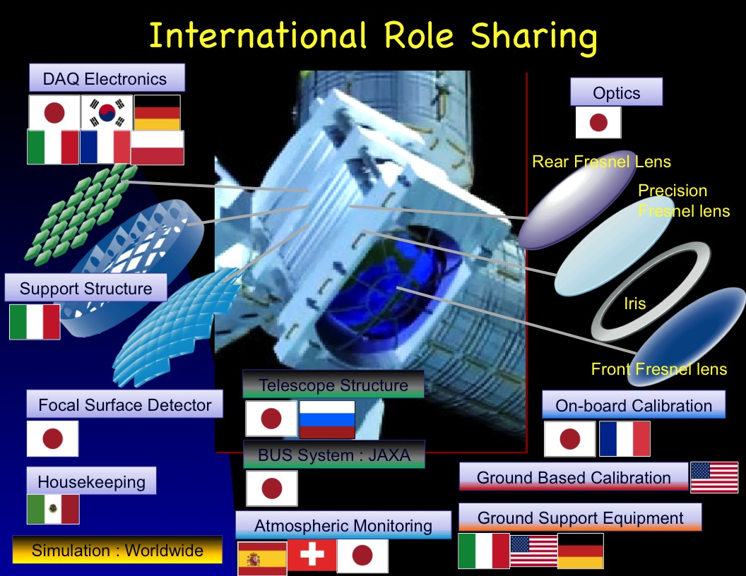













JEM-EUSO Collaboration
Japan, USA, Korea, Mexico, Russia
Europe: Bulgaria, France, Germany, Italy, Poland, Slovakia, Spain, Switzerland
13 Countries, 80 Institutions,
290 researchers
RIKEN: Leading institution
Notes:
The JEM-EUSO collaboration

Slide 6
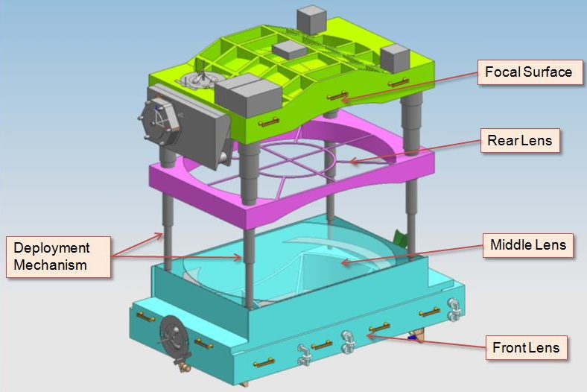
The JEM EUSO instrument
The telescope is an extremely-fast and highly-pixelized ( ̴ 3x10⁵ pixels) digital camera with a large diameter (2.35 m) and a wide-FoV (±30°). It works in near-UV wavelength (330-400 nm) in single-photon counting mode.
The telescope consists basically of four parts:
optics: 3 high transmittance optical Fresnel lenses focusing the arriving UV photons onto the FS
FS detector: ̴ 5000 MAPMTs of 64 pixels;
FS electronics: trigger, data acquisition and controls;
mechanical structure.
An atmosphere monitoring system ( IR camera and Lidar) and a calibration system complete the apparatus.

Slide 7
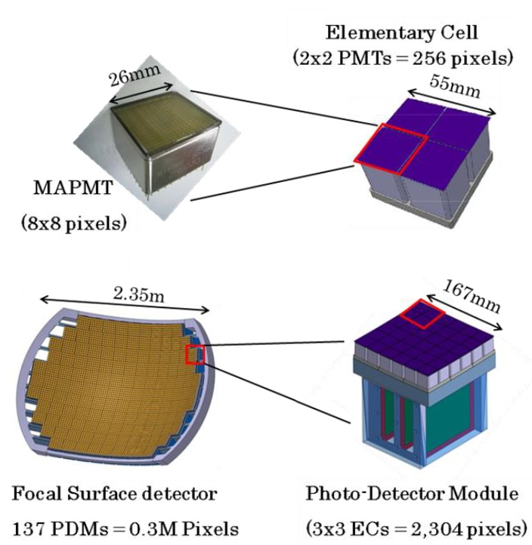
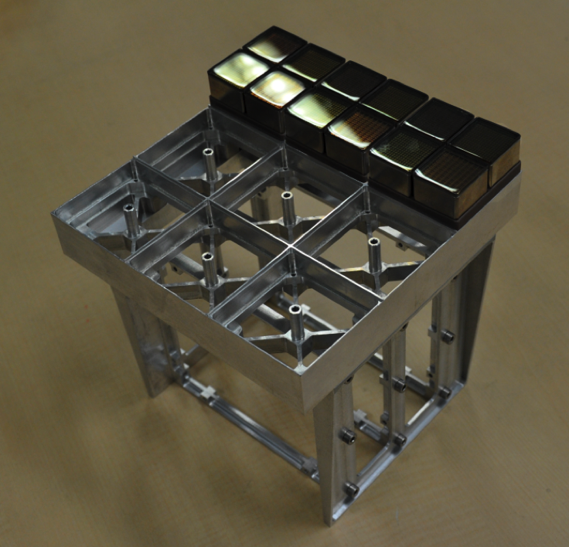
The Focal Surface detector
The FS detector has a curve surface of about 2.35 m, totally covered by MAPMT.
  137 Photo-Detector Modules on the Focal surface
  9 Elementary Cell on a PDM
  4 MAPMT on a Elementary cell
  4932 MAPMT on FS
137 x 9 x 4 = 4932 MAPMT

Slide 8
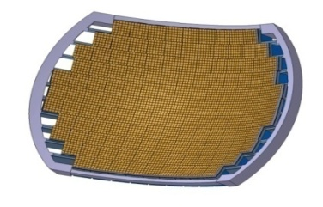
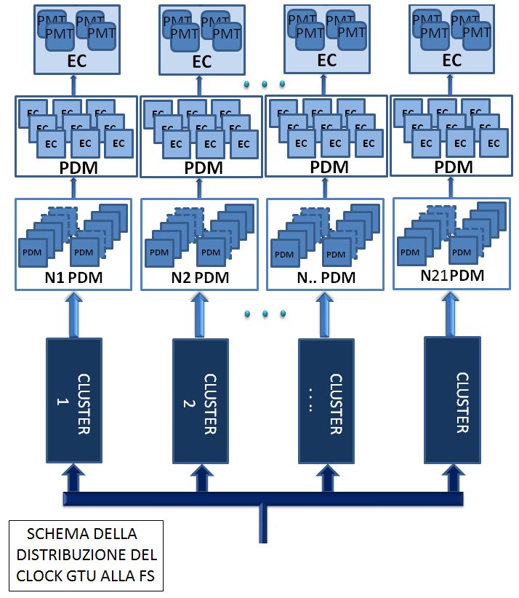
The data acquisition chain
Photons coming from EASs are converted into electric pulses by MAPMTs.
Signals from every MAPMT are discriminated from noise and digitalized by a front-end ASIC.
The ASIC counts the number of photo-electrons produced in a fixed time window for each pixel (Gate Time Unit, 2,5 µs).
The data electronics issues a trigger for EAS event and sends data to the ground for further analysis.
300 Kchannels, 4392 MAPMT
4392 FE ASIC, ̴ 300 FPGA
[300kch] →[ > 10 Gbyte/s (FS)]
21
CPU

Slide 9
Trigger
10 GB/s
Since the total number of pixels is very large, a multi-level trigger scheme has been developed.
The 1st level trigger is implemented in a dedicated PDM board, connected to 36 MAPMTs. The output from each PDM board is transmitted to a CCB.
[300kch] →[ > 10 Gbyte/s (FS)]
Every CCB collects data from 9 PDM and transmits pixels information to the CPU for event passing the 2nd level trigger conditions only.
1st level trigger: PDM Board
hierarchical and highly parallel structure
intrinsically redundant
2nd level: Cluster Control Board
21
Also the clock distribution network has a hierarchical structure
256 Kbps
CPU
CLK-BOARD

Slide 10
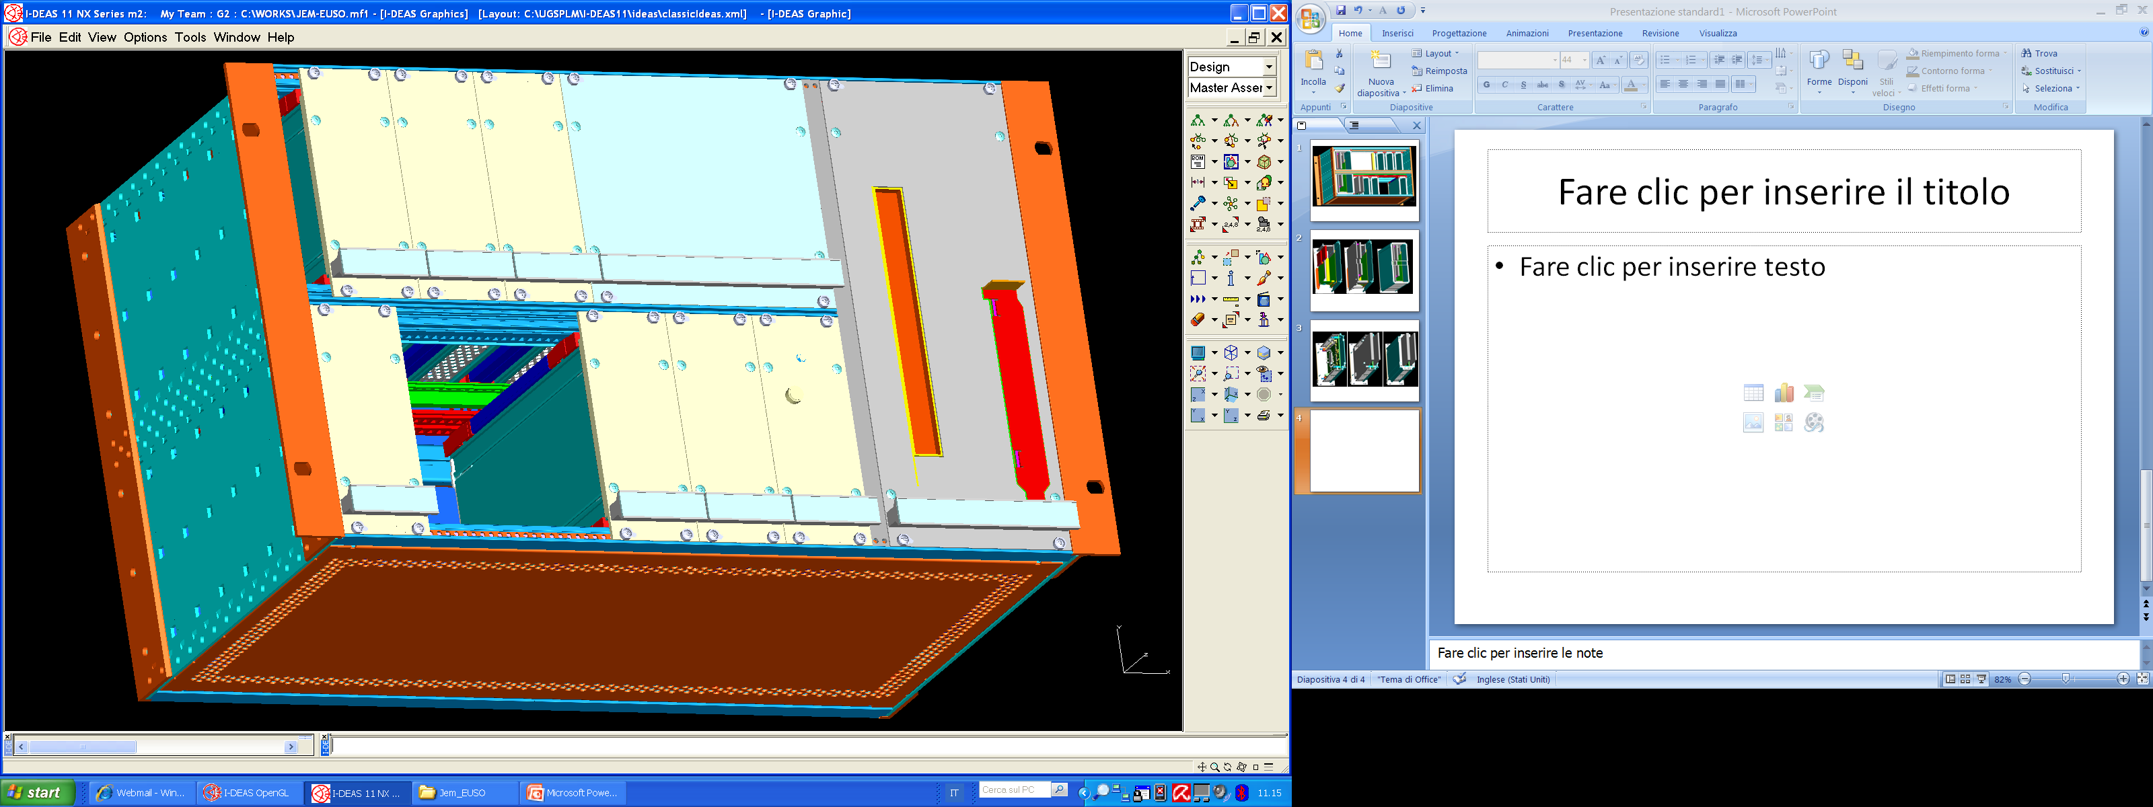
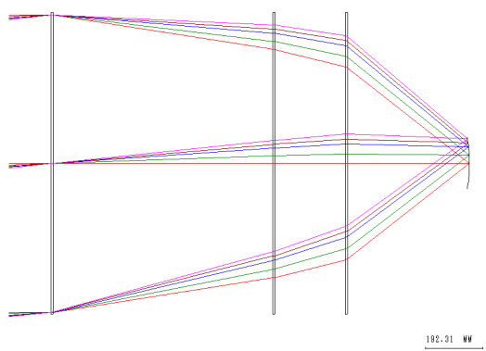
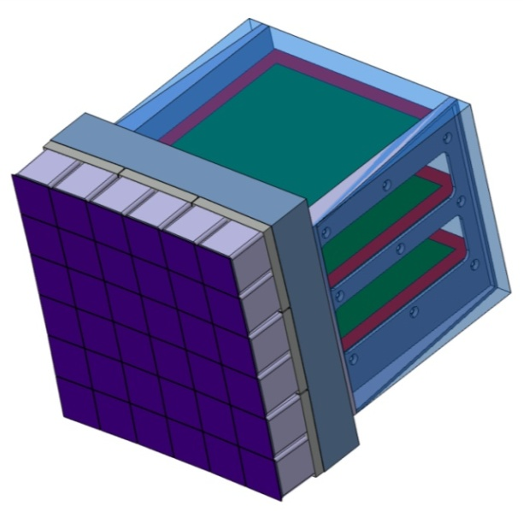
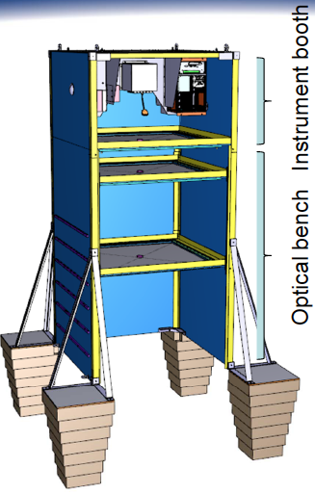
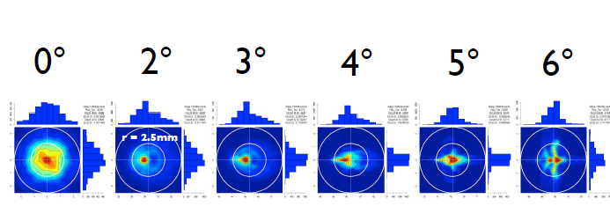
EUSO BALLOON instrument
The EUSO BALLOON instrument consists of:
1 Optical system (3 flat-type lenses)
LVPS
HK
CPU
1 PDM
1 Data Processor
PS
CCB
1 Telescope structure
GPS
CLK
162cm
Data Processor
100cm
PDM
(2304 pixels)
Fresnel lens
diffrattive
Fresnel lens
Telescope structure

Slide 11
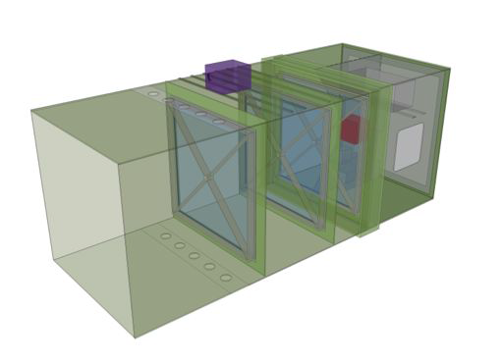
Assembled instrument w/o floaters & crash pads
IR camera
roof-rack
evacuation holes
radiator
PDM
Baffle &
“deceleration cylinder
L3
Fixed/tight
L2
Adjustable (tight)
L1
adjustable

Slide 12
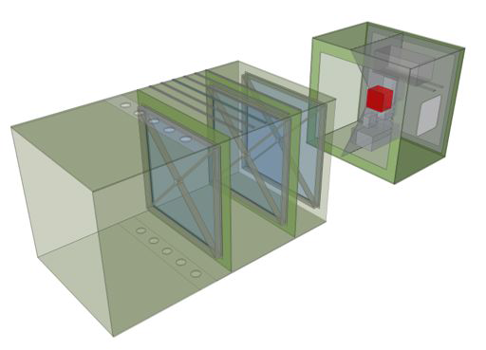
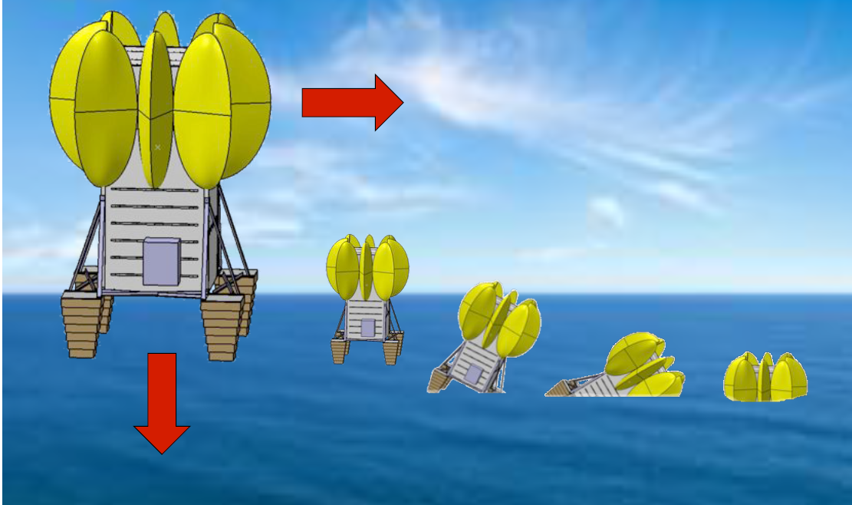
Optical Bench (OB) Instrument Booth (IB)
roof-rack
radiator
evacuation holes
PDM
Watertight
Instrument Booth
Baffle &
“deceleration cylinder
electronics
on conducting
"dry"-shelf
L3
Fixed/tight
L2
Adjustable (tight)
Safe in case of splashdown
L1
adjustable

Slide 13
Objectives for EUSO BALLOON
A-level (technology demonstrator)
Full scale end-to-end test of the JEM-EUSO's key technologies and instrumentation:
- the entire PDM, its ASIC's, the FEE, Trigger, HV power supplies, HV switches
- onboard hard- and software algorithms for triggering and shower-recognition
B-level (cosmic ray acquisition and background study)
- experimental confirmation of the effective background below 40 km
- test and adjust trigger and switching algorithms, observational modes
- testing of the acquisition capability of the IR camera
C-level (precursor mission) :
- 1st detection of air-showers by looking down from the edge of space
- detection of laser induced events from space …
"fringe benefits" of EUSO-BALLOON
- balloon triggers decisive steps in TRL levels in JEM-EUSO subsystems

Slide 14
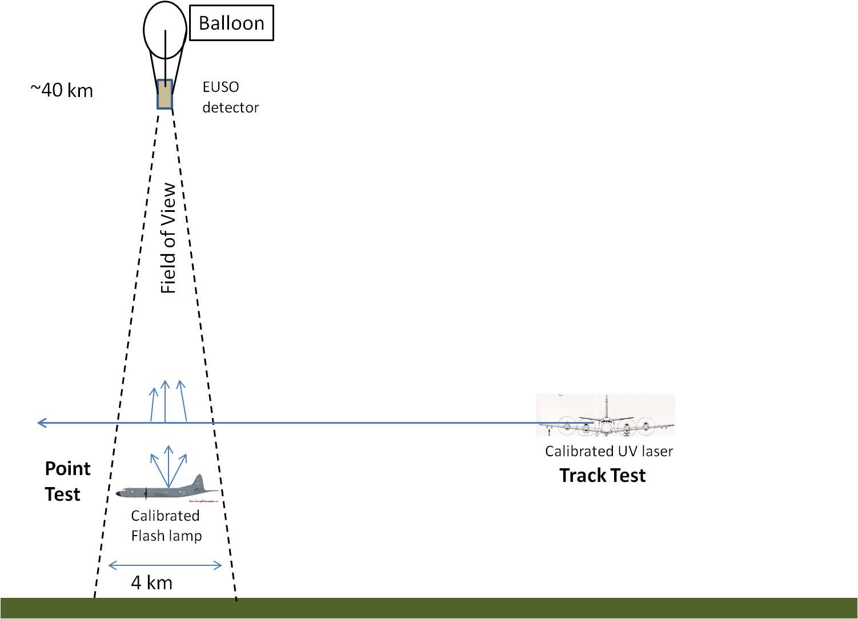
EUSO-Balloon “in flight” calibration
Testing EUSO-Balloon
Fly one aircraft equipped with two types of calibrated pulsed UV light sources.
Point Test: Fly airplane in field of view and fire flash lamp. Light travels directly from lamp to detector
Track Test: Fly airplane outside field of view and shoot a UV pulsed laser across field of view. Light scatters out of the beam to the detector.
(5 mJ Laser ~100 EeV Cosmic Ray)
Fly aircraft at altitudes between 1-5 km.

Slide 15
EUSO-BALLOON vs. JEM-EUSO
 | JEM-EUSO | EUSO-Balloon
Height(km) | 420 | 40
Diameter(m) | 2.5 | 1
FoV/pix(deg) | 0.08 | 0.25
Pixel@ground(km) | 0.580 | 0.175
FoV/PDM(deg) | 3.8 | 12
PDM@ground(km) | 28.2 | 8.4
Signal Ratio | 1 | 17.6
BG Ratio | 1 | 0.9-1.8
S/√N | 1 | 20-10
E_{thr}(eV) | 3x10¹⁹ | 1.5-3x10¹⁸
Number of PDM | 143 | 1
Maximize performance of EUSO-Balloon keeping parameters as close as possible to JEM-EUSO

Slide 16
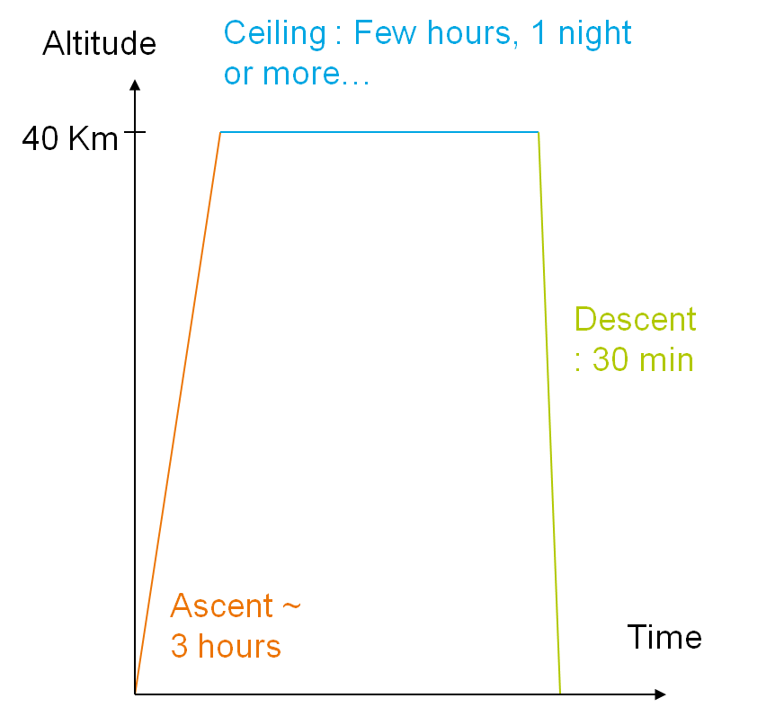
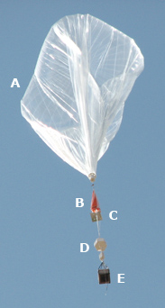
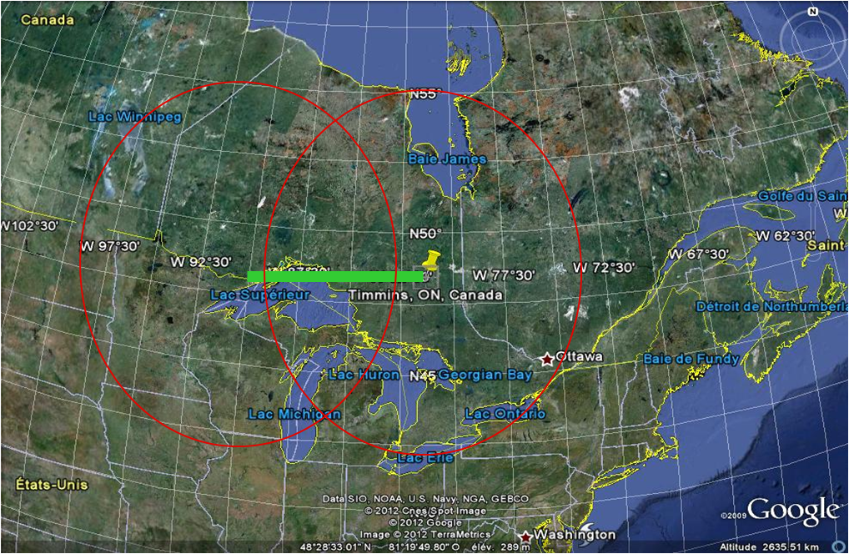
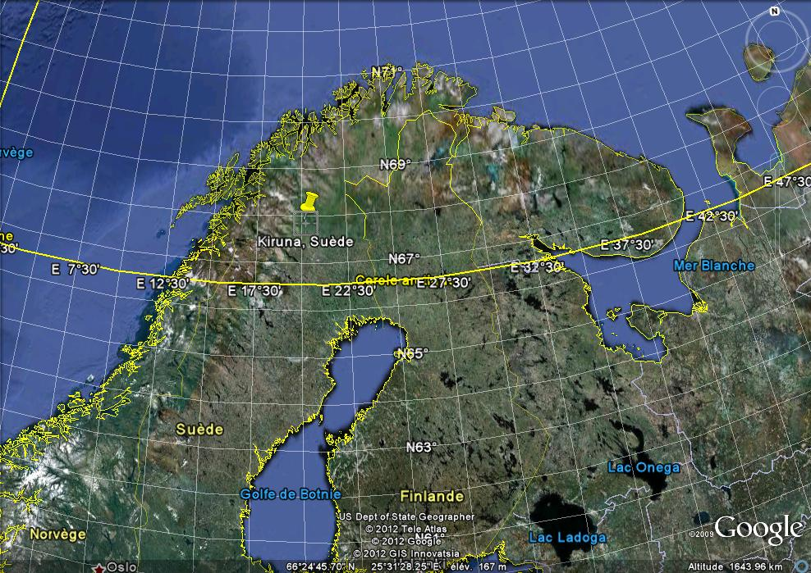
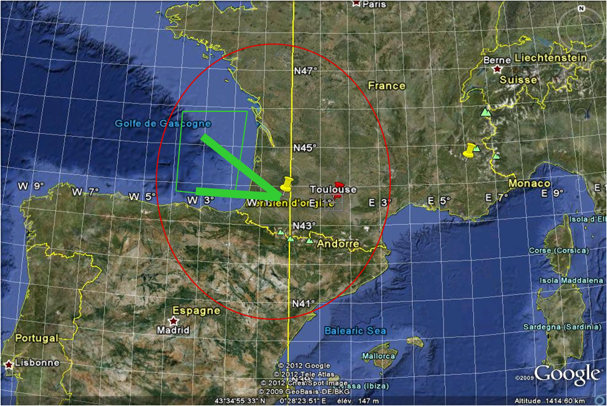
EUSO BALLON mission
Three flights mission (recently approved by CNES)
First flight : 2014 Timmins.
Balloon size for EUSO :
400 000 m³ -> 40 Km altitude
Second flight : 2015 Kiruna?
Third flight : 2016 Aire sur l’Adour?
Environmental constrain:
Low pressure (3 mbar)
Thermal range: -30°C +50°C

Slide 17
EUSO BALLOON subsystems
DP
PDM
GPSR
EC-Front
IR-CAM
EC-DYNODE
LVPS1-DP
CLKB
EXT
MAPMT
EC-HV
CCB
SIREN
SPACEWIRE
/PCI
EC-ANODE
CNES Telemetry
CPU
LVPS2-DP
EC-ASIC
Batteries
DST
PDM-B
Bat Controller
LVPS-PDM
HVPS-2
PWP
HK
Sensors
LVPS-HK
HVPS-1
Motors
EC-Back
TLS

Slide 18
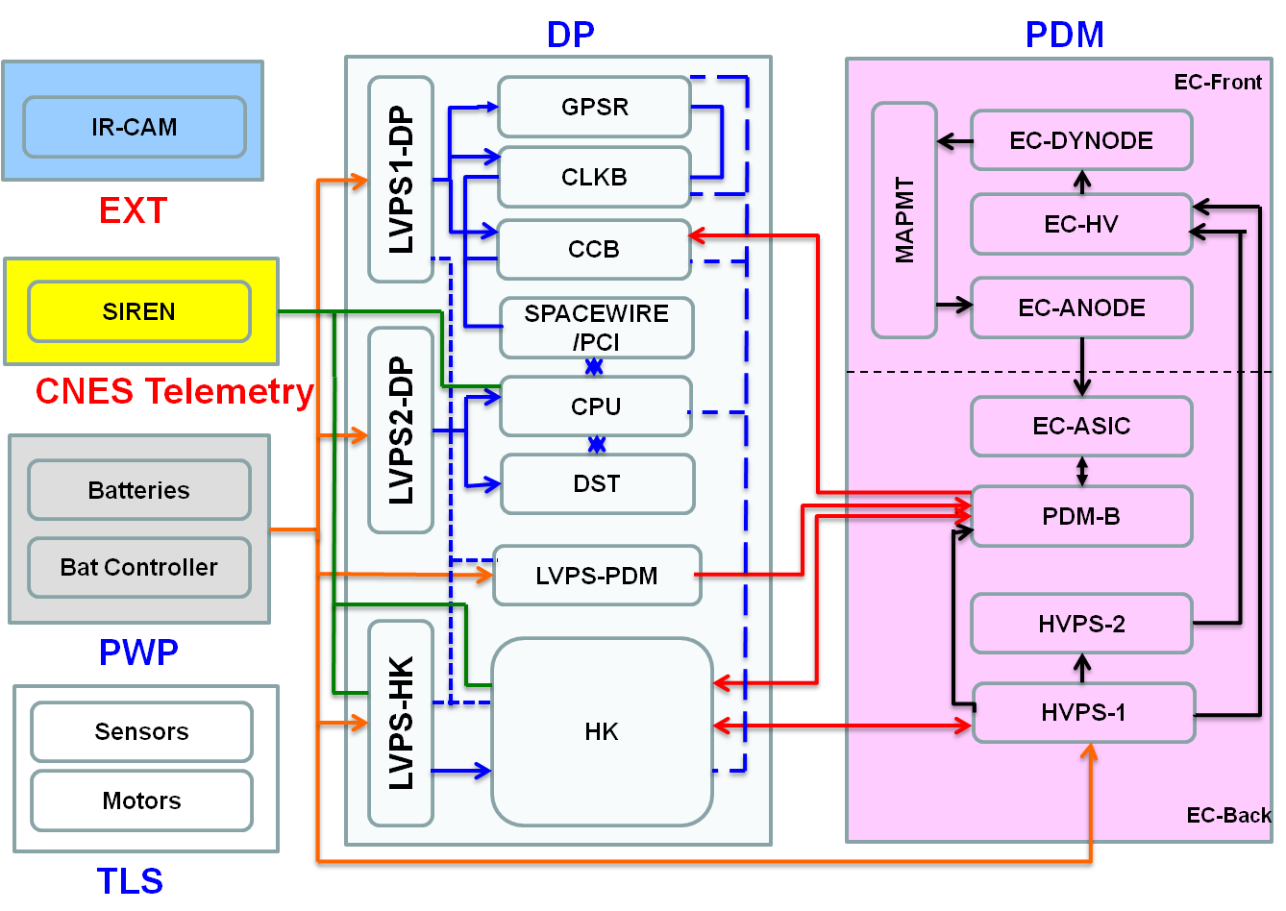
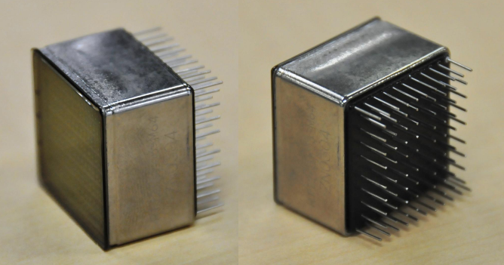
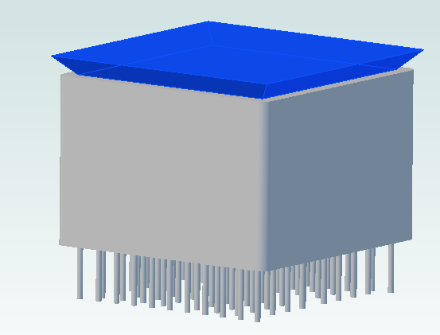
Global view of the PDM
The PDM consists in an assembly of several components:
  1 mechanical structure
  9 Elementary Cell (EC) front units
    Multi-Anode Photomultipliers (MAPMTs): 36 in total
    Front end electronic
  6 ASIC boards (EC_ASIC)
  2 High Voltage Power Supplies (HVPS)
  1 PDM board (also called FPGA board)
It has to detect the UV photons coming from the optic
Its size is given by the mechanical structure: 167 x 167 x 160 mm
Its weight will be around 3.6 kg
Its power budget will be 20 W
VCI 2013
Euso Balloon a pathfinder mission for the JEM-EUSO experiment

Slide 19
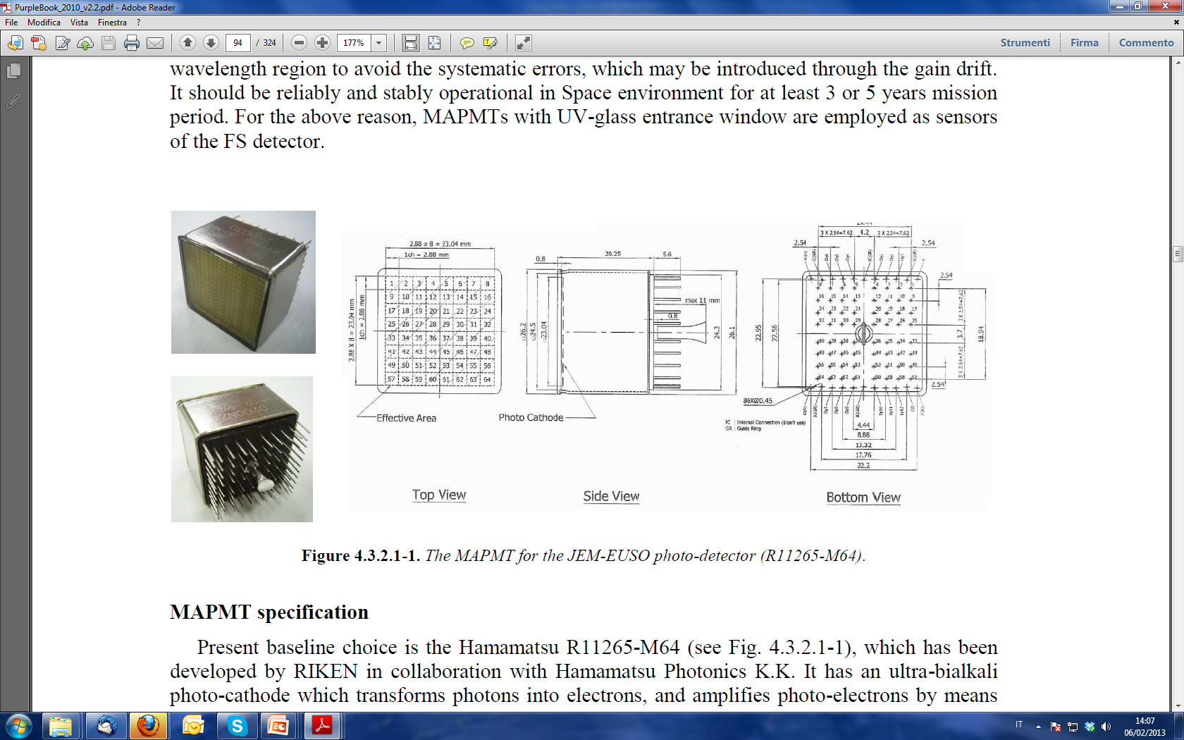
The MAPMT
The main specifications of R11265-03-M64 are as follows:
  pixels side 2.88 mm
  maximum sensitive area 23.04 mm × 23.04 mm.
  physical dimension of the MAPMT 26.2 mm × 26.2 mm (length is 20.25 mm).
  weigth 27.3 g.
  photo-cathode ultra-bialkali
  window material/thikness UV glass/ 0.8 mm
  quantum efficiency higher than 35% (maximum 40%) for wavelengths from 330 nm to 400 nm.
  dynode structure metal channel with 12 stages,
  gain 10⁶ at 0.9 kV with a tapered voltage divider.
  anode pulse rise-time I 1.5 ns.
  transit time spread about 0.3 ns.
  cross talk about 1%.
  gain non-uniformity (anodes) 1:3.
  gain non-uniformity (MAPMT) within 1:2.
  anode dark curr. (30 min. storage) 1 nA.

Slide 20
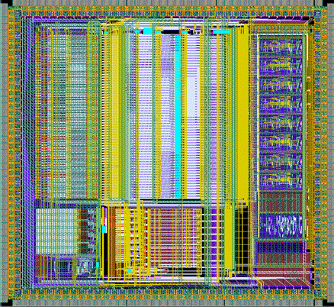
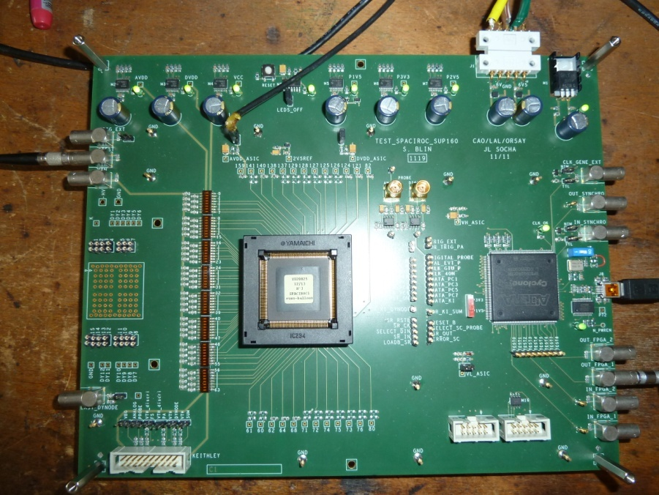
SPACIROC ASIC
64 channels ASIC in AMS 0.35 µm SiGe technology designed by Omega group at LAL
Requirements:
  Readout of MAPMT (charge or current input)
  Gain adjustment (preamplifier)
  Photo-electron counting (Fast Shaper + discriminator)
  Estimation of the charge (Q to T converter)
  Radiation hardness
  Low consumption (<1 mW/ch)
All achieved with the first version of the ASIC

Slide 21
Data Processor functional requirements
The Data Processor sub system has to:
Control of the front-end electronics (configuring)
Perform Second level trigger filtering
Tag the events with arrival time (UTC) and payload position (GPS)
Manage the Mass Memory for data storage
Measure live and dead time of the instrument
Provide signals for time synchronization of the event
Perform housekeeping monitor
Handle interface to tele-commands and to telemetry system
Budgets:
  Mass < 20 kg
  Power < 50 W
  Data acquisition: 2304 channels → 330 kbytes/event

Slide 22
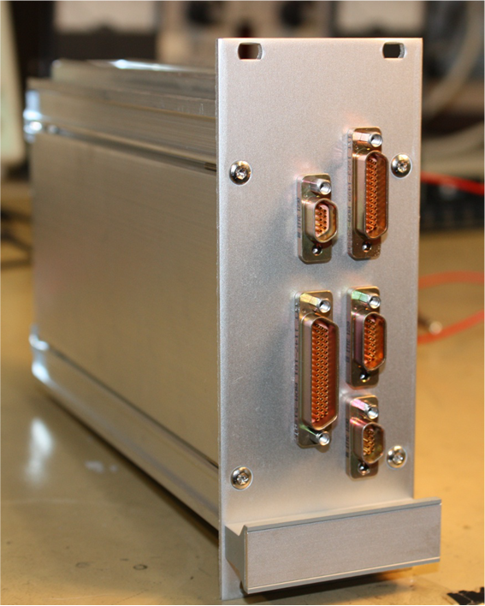
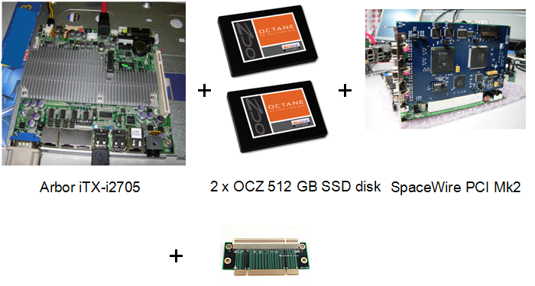
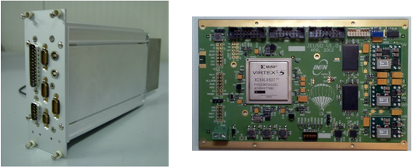
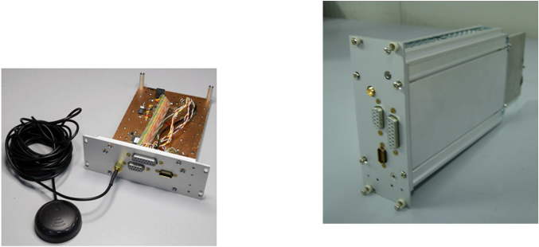
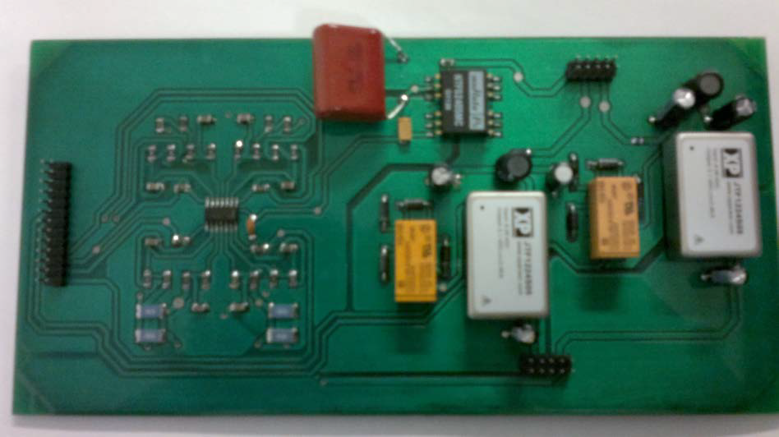
Description of the DP and its components
The DP functionality is obtained by connecting different specialized items, which form a complex system.
The main subassembly items are:
Control Cluster Board (CCB)
Main processing unit (CPU)
Data Storage (DST)
Housekeeping system (HK)
Clock Board (CLKB)
GPS receiver (GPSR)
Data Processor Power Supplies (DP-LVPS1-2-3)
PDM Power Supply (PDM-LVPS)

Slide 23
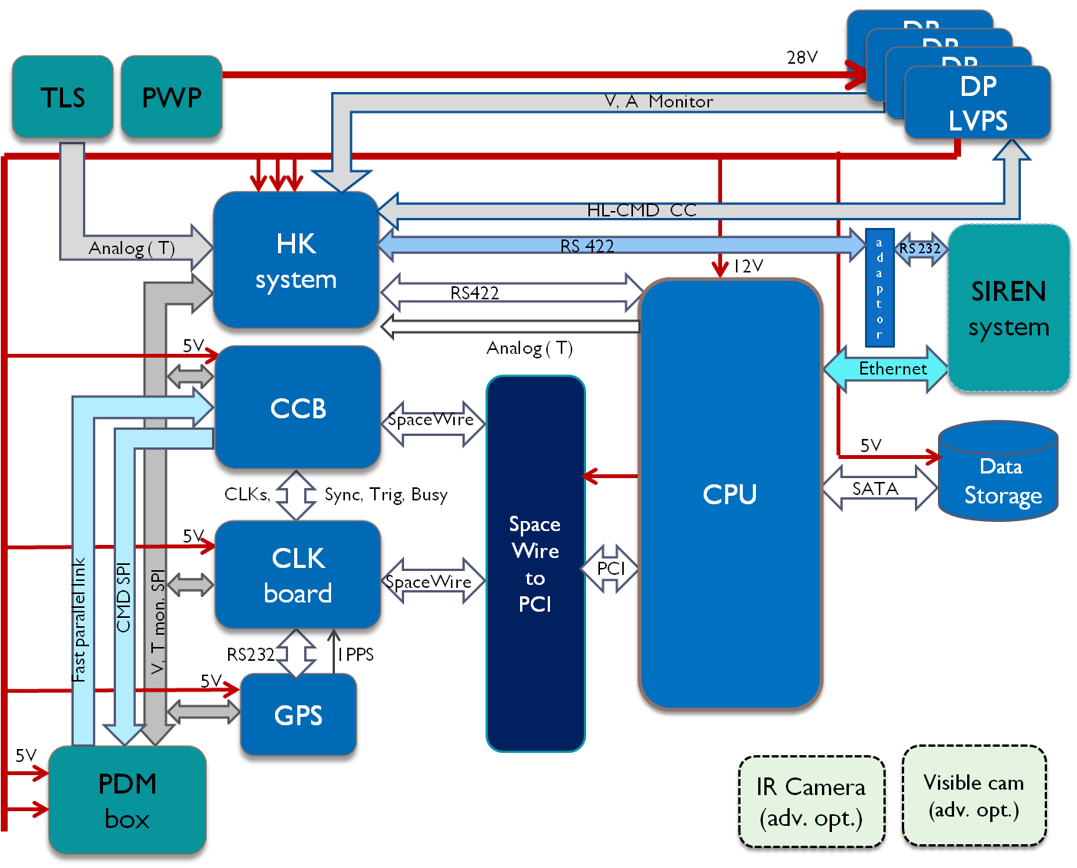
Data Processor block diagram
(telemetry)

Slide 24
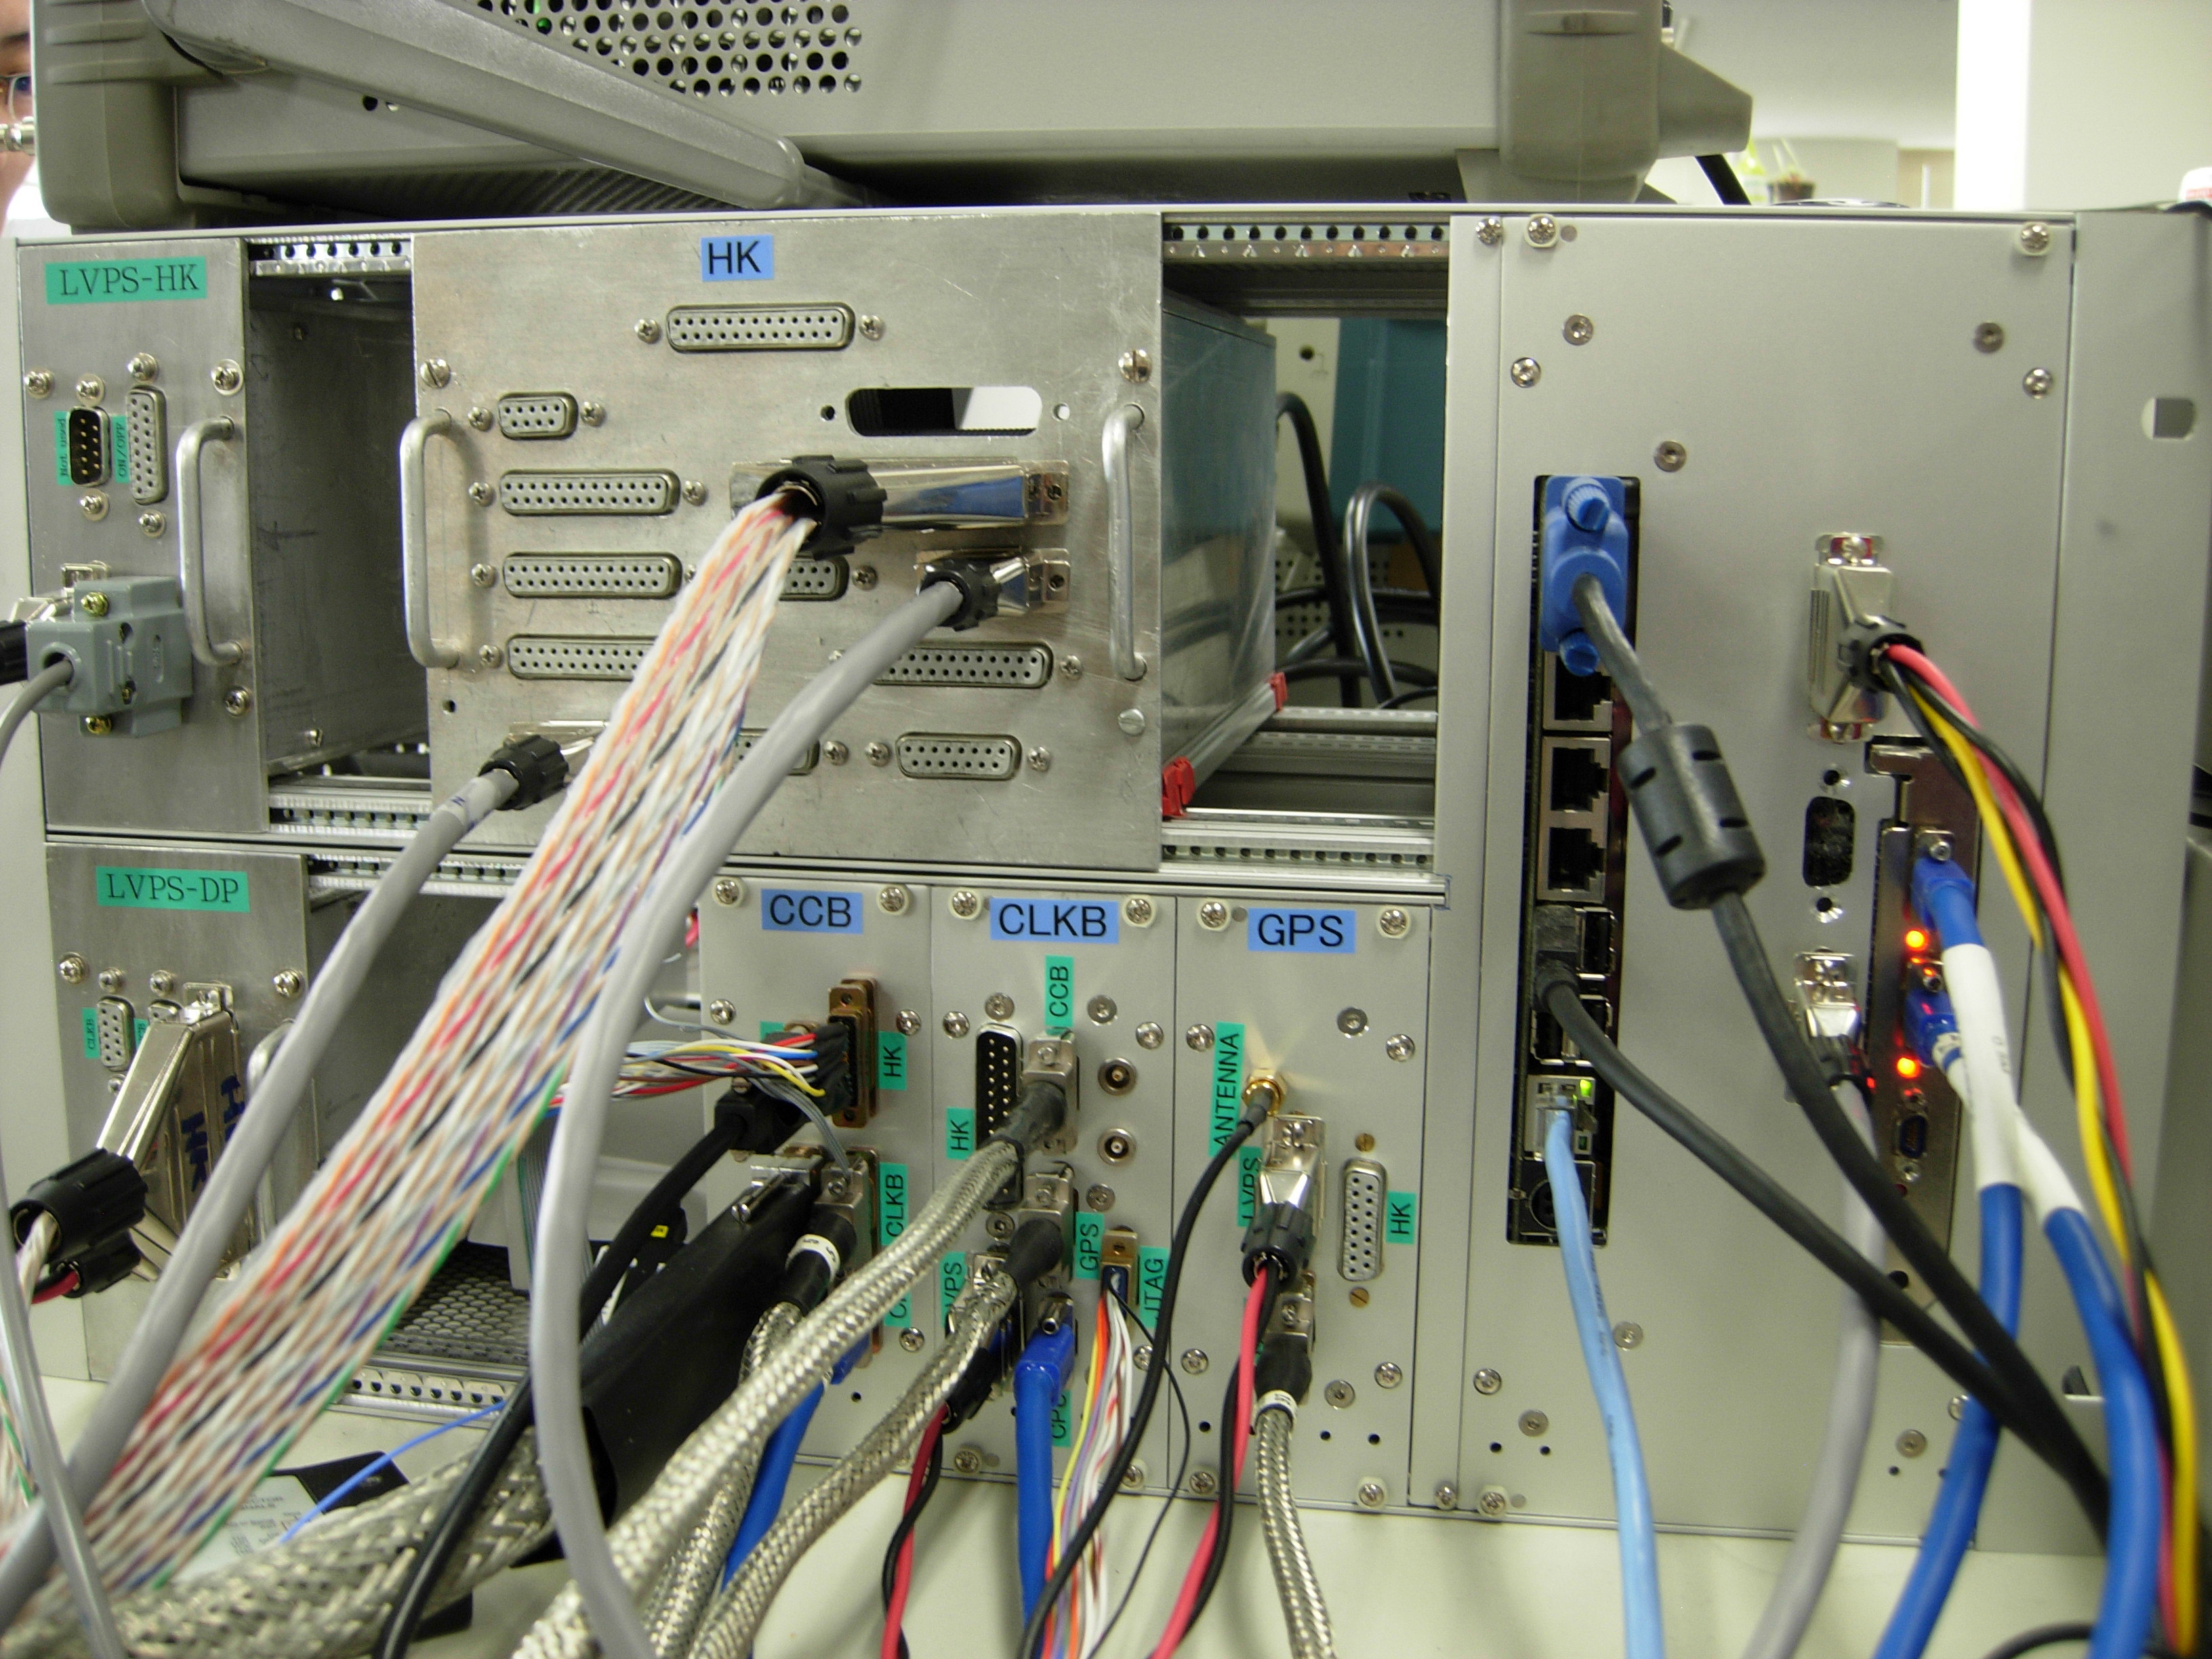
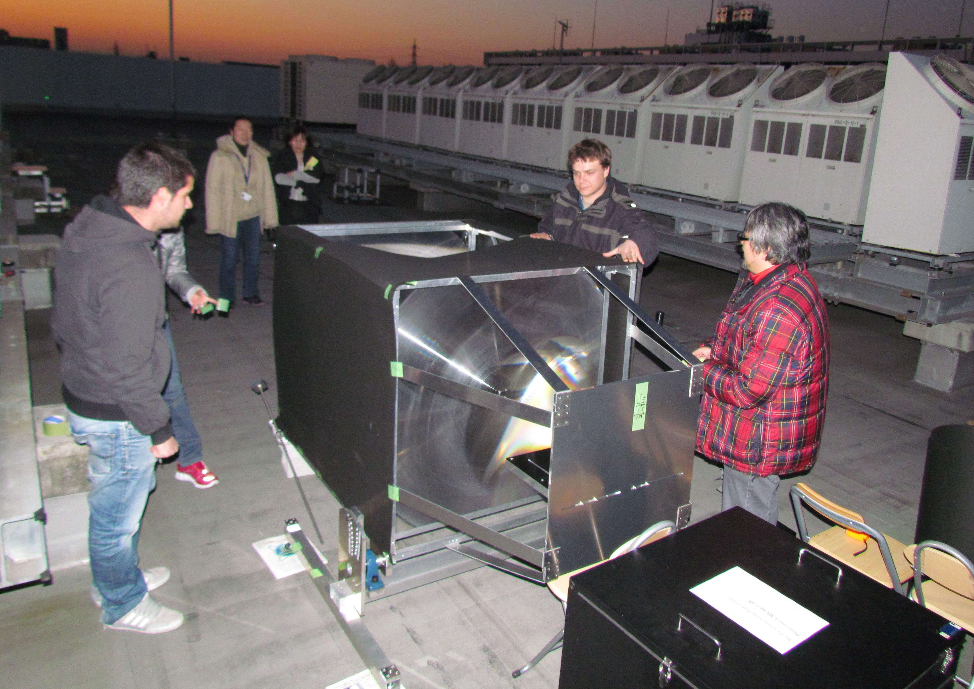
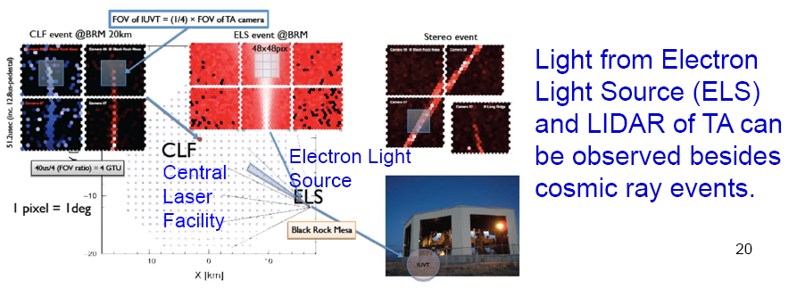
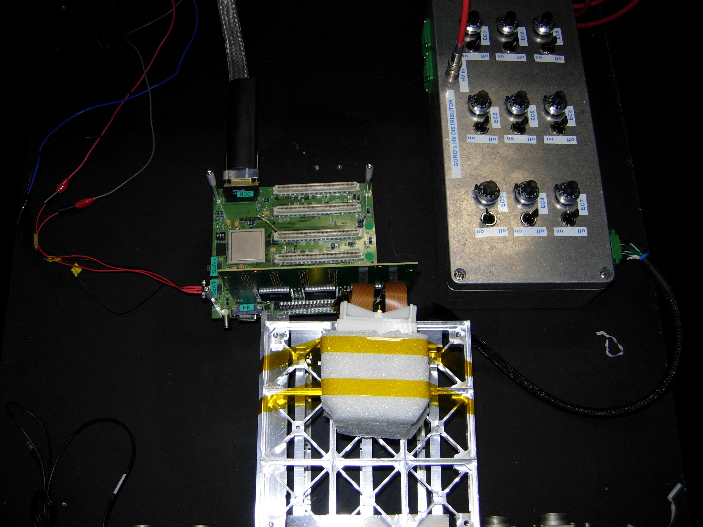
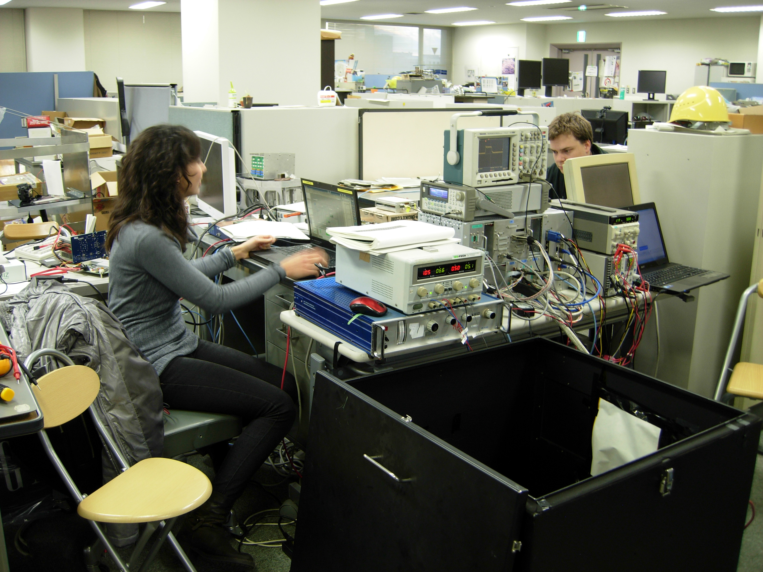
Status
A full prototype of the instrument has been realized and integrated at Riken.
The prototype will be installed in the Telescope Array site in Utah

Slide 25
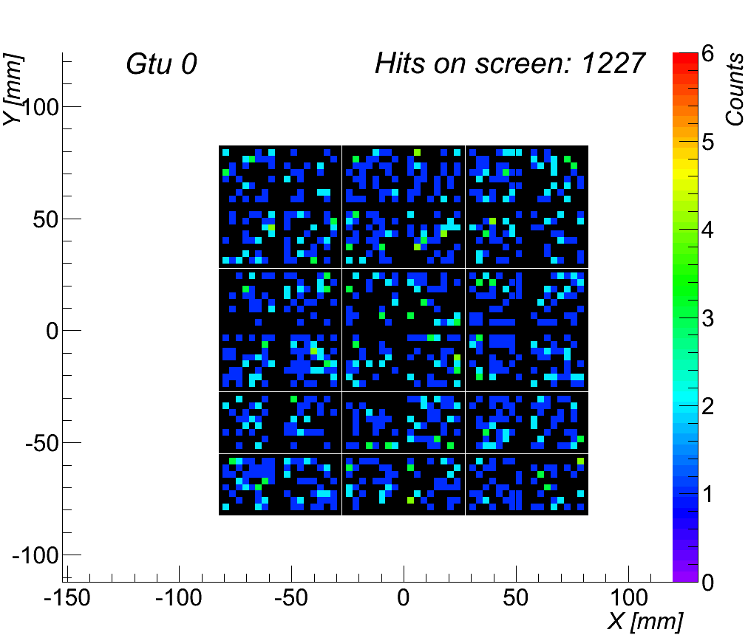
Simulation
An example of background observation
250 photons / m² ns sr
Uniform distribution
Simulated at electronics level
The EUSO Simulation and Anlaysis Framework has been used for the simulation

Slide 26
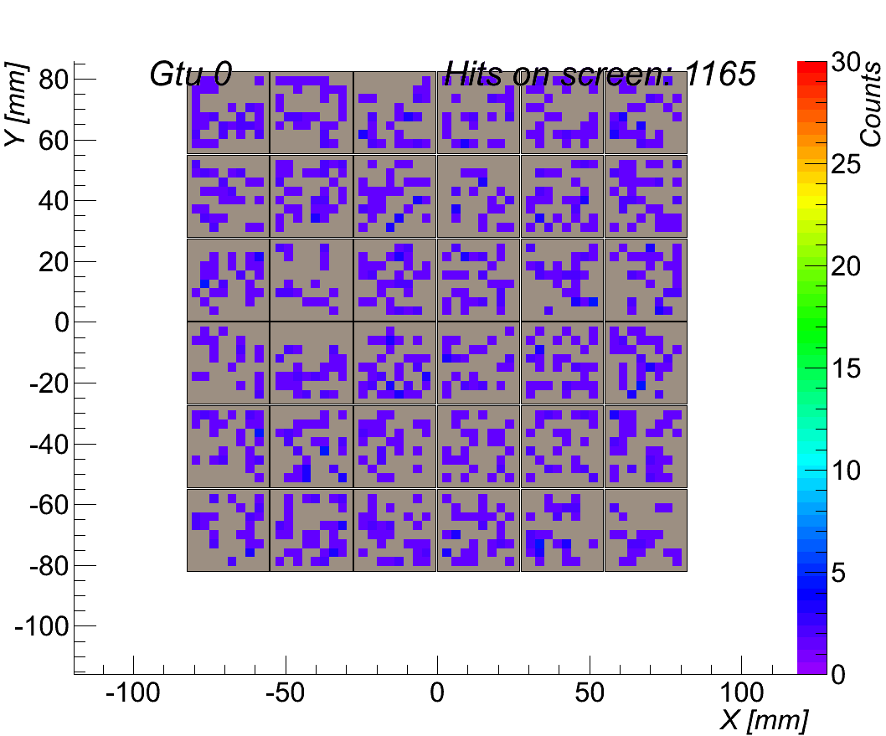
Example Signal Track
Proton
1e19 eV
Theta= 20°
Phi= 135°
26

Slide 27
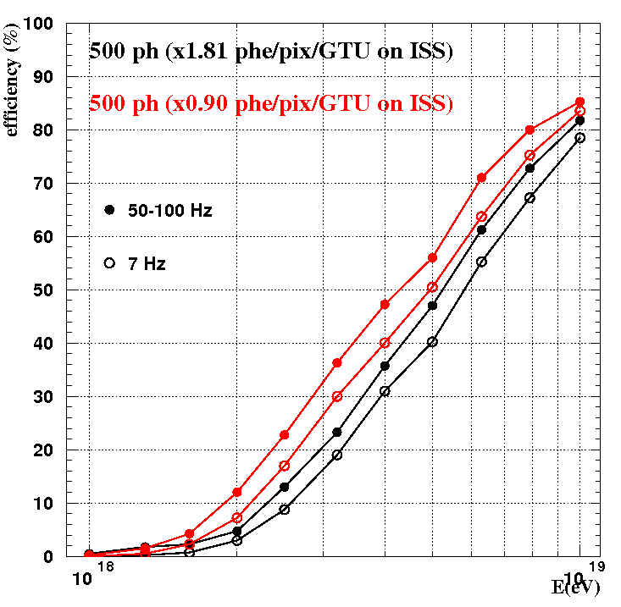
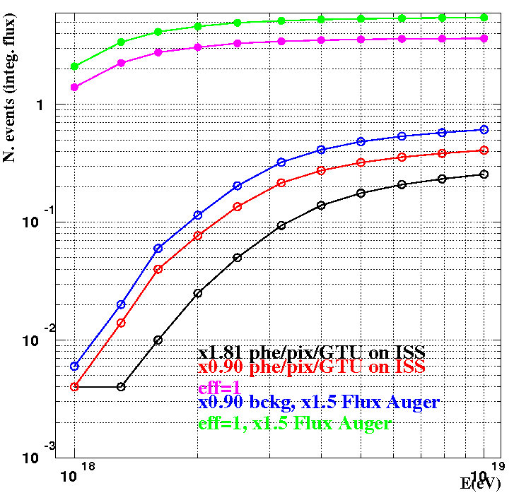
Trigger Efficiency
EUSO-B. & <B>=1.4 phe/pix/GTU
EUSO-B. & <B> =2.8 phe/pix/GTU
7 Hz/PDM
● 80 Hz fake trig.
o 7 Hz fake trig.
Trigger efficiency (%)
Integrated N. Events [10¹⁸,E]eV in 10h
Efficiency=1 & 1.5 x Aug. flux
Efficiency=1 & Auger flux
EB & A.fl. & <B>=1.4 phe
EB & 1.5xA.fl. & <B>=1.4 phe
EB & A.fl. & <B> =2.8 phe
Energy(eV)
Energy(eV)
LEFT PLOT: Trigger efficiency curve for events with impact point inside FoV.
RIGHT PLOT: Black, red and blue curves give preliminary results on the performance from a 10 h duration flight for different assumptions of background and cosmic ray flux.

Slide 28
Conclusions
EUSO-Balloon will IMAGE the UV sky background (star light, airglow, TLEs, artificial lights) in the bandwidth used by the JEMEUSO mission.
All key components and the relative sub-assembly items will be tested according to the configuration foreseen for the JEM-EUSO mission: in particular the trigger scheme and its capability to cope with the variable sky conditions.
Simulation studies have been performed to understand the structure of the expected signal and the effective energy threshold of EUSO-Balloon and its possibility to detect Extensive Air Showers. Results confirm the capability of the instrument of detecting primary cosmic rays of energy E>10¹⁸ eV.
Due to the low cosmic ray flux the detection of a couple of events will require few days exposure time → therefore the detection of the first air shower from the edge of the space will most probably require more than one flight.
Everything is on schedule for the first flight from Timmins (spring 2014)
28

Slide 29
Thanks

