Slide 1

Solid State and bio-physics at ISOLDE
Karl Johnston
ISOLDE/CERN
karl.johnston@cern.ch
FPRIB2012, Kolkata

Slide 2
Outline
Overview of the community
Introduction to techniques used in nuclear solid state physics
Techniques used at ISOLDE
Focus on some recent results in solid state and biophysics.

Slide 3
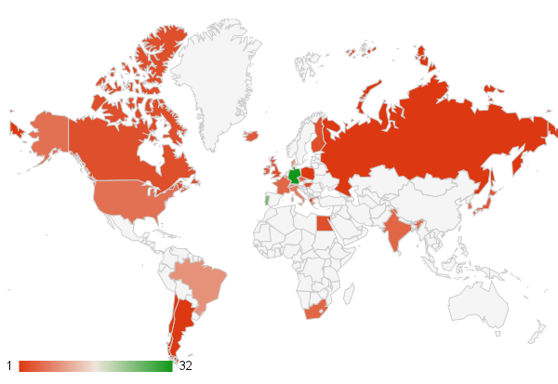
SSP @ ISOLDE: Diverse community
Solid State physics: Semiconductors, Metals
Materials scientists: High Tc Superconductors, Multiferroic materials
Biophysics: structural properties & role of heavy metals in proteins, DNA.
Running experiments/letters of intent | 24
Participating countries | 26
Scientists | 160
SSP collaborations

Slide 4
Radioactive isotopes for solid state physics? Why & How??
Nothing is more easy to detect with high sensitivity than nuclear radiation, i.e. very low concentrations of radioactive impurity atoms in a material can be detected.
The radioactive isotopes (“probes”) act as “spies” transmitting information with atomic resolution via their decay.
Crucially: what information do you get?????
Adds extra dimension to “normal spectroscopies” e.g. optical / electrical characterisation of semiconductors
Provides extremely local probe which is applied to variety of systems
A facility providing a large variety of radioactive isotope (if possible, isotopically clean)
You need
You have to introduce the isotopes into the semiconductor
by ion implantation
by diffusion
during crystal growth
by nuclear reaction with one of the constituents of the solid

Slide 5
Techniques used at ISOLDE
Nuclear probes
Interactions
Methods
Radioactive
Nuclei
➔ γ, α, β
Hyperfine
Interaction
Mößbauer effect
γγ angular correlation
Nuclear Magnetic resonance
Nuclear orientation
Radioactive
decay
DLTS
Photoluminescence
Tracer Diffusion
Muons
➔ ß⁺
Coulomb
Interaction
Solid state physics
Applications in use at ISOLDE
Nuclear
Physics
Emission Channeling
Ion Channeling
Backscattering
Elastic Recoil
Resonant Scattering
Neutron Scattering
Ions
Scattering,
Diffraction
Neutrons
Nuclear
Reaction
Nuclear Reaction Analysis
Positrons
ß⁺-e⁻
Interaction
Positron Annihilation
Positron Angular Distribution
Positron Energy Distribution

Slide 6
Techniques & facilities available
Hyperfine Interactions:
PAC (See Prof Das’ talk)
  9 γ-γ machines on-site
  4 detectors; 6 detectors: analogue and digital.
  Online UHV beamline for surface physics
Mossbauer Effect: 3 online chambers available.
β-NMR including novel system developed for biophysics.
Lattice location using emission channelling: 3 offiline and 1 online setup
Radiotracer diffusion: online and offline systems
Semiconductor spectroscopy: full PL and DLTS characterisation labs
Dedicated suite of offline labs for sample preparation, treatment and measurement.

Slide 7
Experimental techniques used with radioactive isotopes at ISOLDE

Slide 8
Nuclear SSP Elements produced at ISOLDE
low energies & high multipolarities → highly converted cascades → e-g PAC
e-g
RED → g-g PAC BLUE g-e PAC
e-e

Slide 9
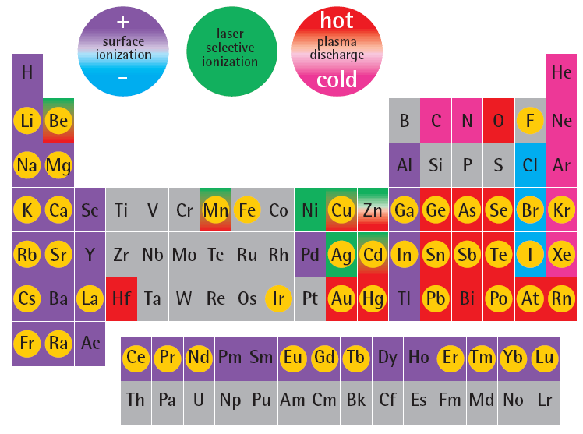
ISOLDE table of elements
Cr
Co
Ni
Isotopes of this element
used for solid state physics
or life science
Pt

Slide 10
Magnetic semiconductors studied using Mossbauer spectroscopy
Development of 57Mn beam in late 1990s (with laser ionisation) brought about a new era in Mossbauer experiments at ISOLDE.
Very clean, intense beam of ⁵⁷Mn (>3e8 ions sec⁻¹)
Allows collection of single Mossbauer spectrum in ~ 3 mins.
Able to collect many hundreds over course of a 3 day run.
Allows low concentrations of probe atoms to be used (~10⁻⁴At%)

Slide 11
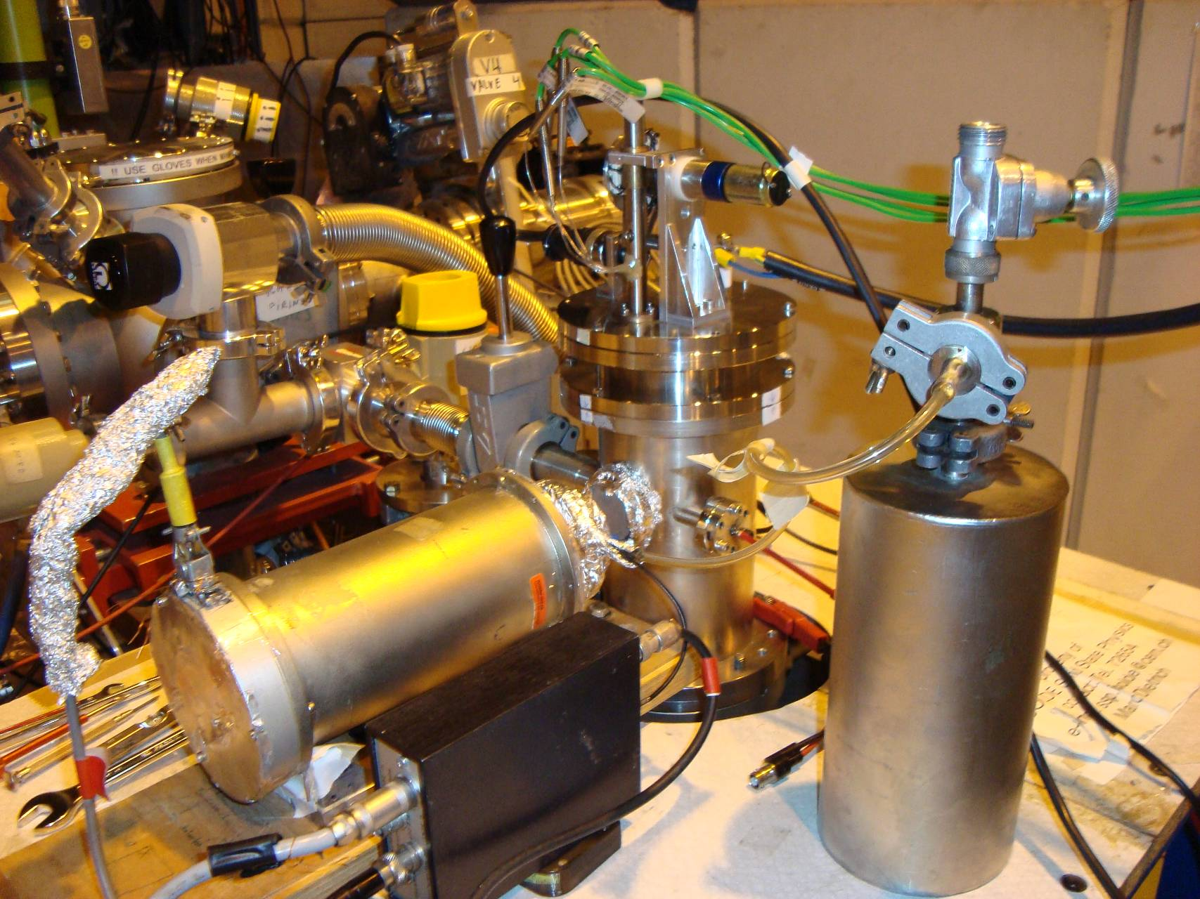
Experimental setup
Incoming 40-60 keV ⁵⁷Mn⁺ beam
Intensity: ~2×10⁸ ⁵⁷Mn⁺/cm²
Implantation
chamber
Sample
Mössbauer drive with
resonance detector
On-line measurements
High statistical spectrum

Slide 12
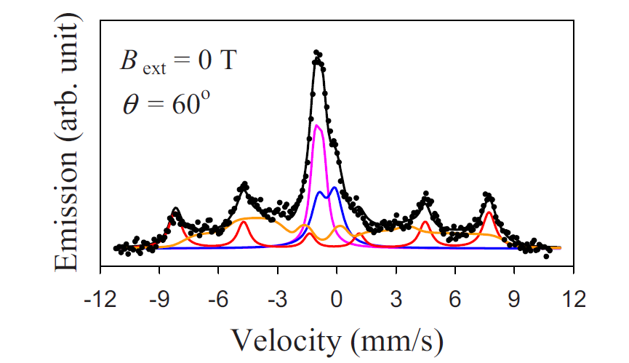
ZnO: a ferromagnetic semiconductor?
Not quite.
Further reults in an external magnetic field show that the spectrum shown to be a slowly relaxing paramagnetic system .
Gunnlaugsson et al (APL 97 142501 2010)
Observation of 6 fold spectrum: characteristic of magnetic structure (at room temperature!!!).
Time to celebrate?

Slide 13
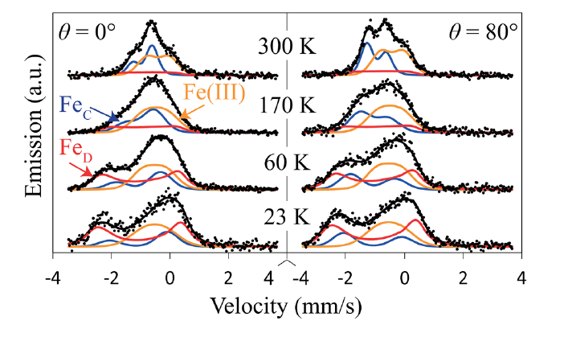
More on ZnO
After high-dose implantations, precipitates of Fe-III are formed. These form clusters yielding misleading information about the nature of magnetism in ZnO (as reported by many groups over the last number of years).
Gunnlaugsson et al (APL 100 042109 2012)

Slide 14
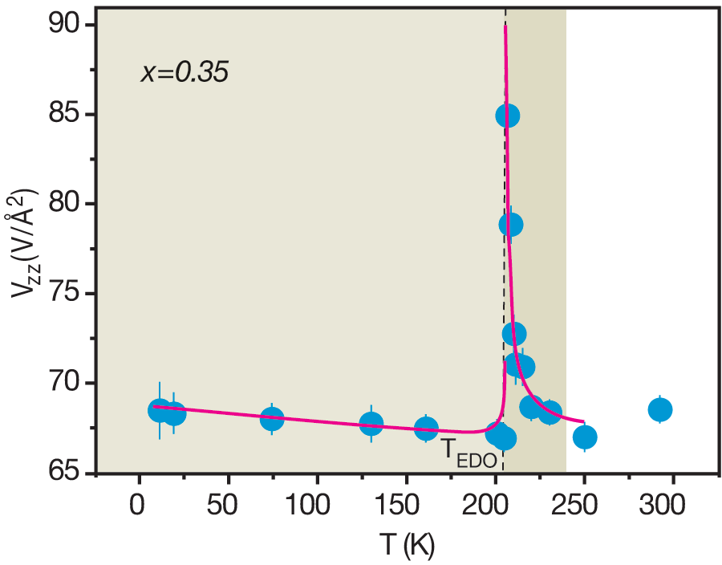
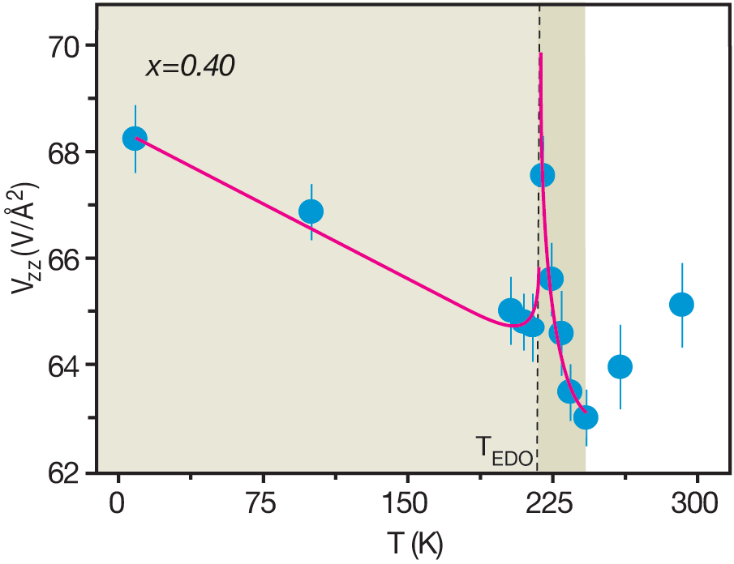
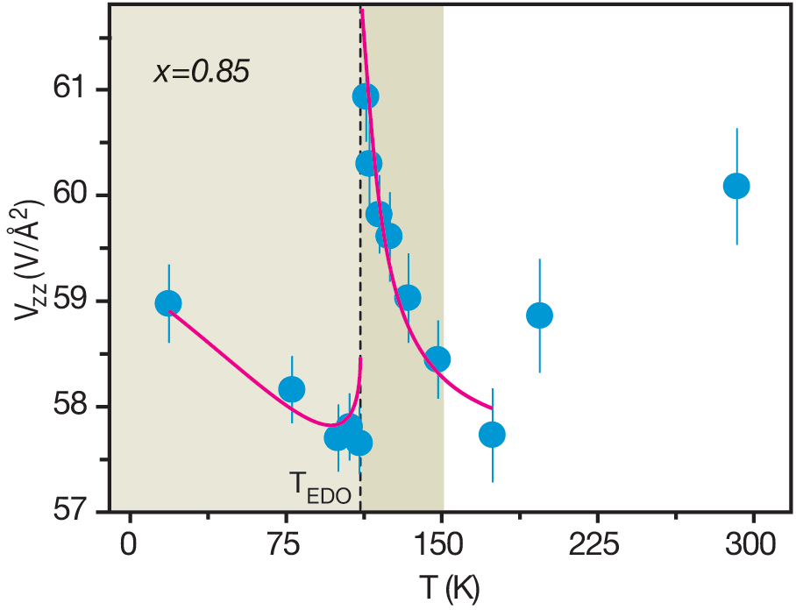
PAC results: Local Probe Studies / Pr_{1-x}Ca_{x}MnO₃ system
Results: Electric susceptibility / spontaneous polarization below T_{C}
x=0.35 ->T_{EDO}=206 K, x=0.4 ->T_{EDO}=218 K,
x=0.85 -> T_{EDO}=112 K
Described as first-order dielectric phase transition below T_{co}
A.M.L. Lopes et al., Phys. Rev. Lett. 100, 155702 (2008)

Slide 15
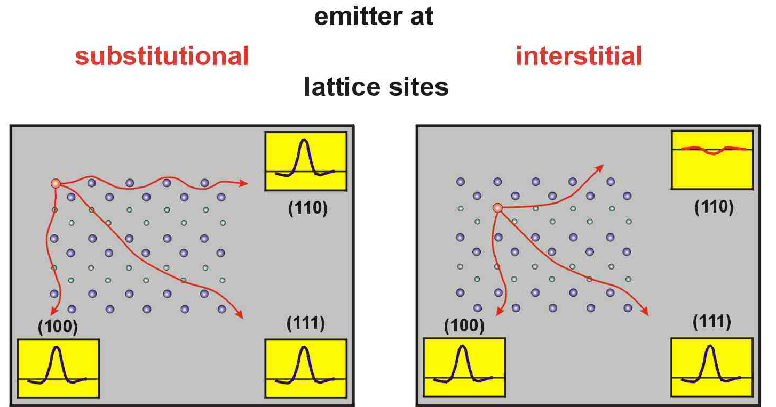
Emission channelling: locating impurity atoms in the lattice
Channelling of charged particle in crystal, channels along high symmetry directions.

Slide 16
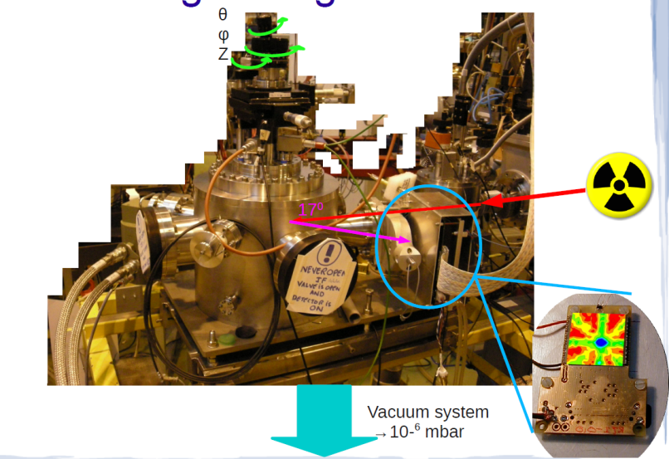
Emission channelling: locating impurity atoms in the lattice
Since 2009, online system available, able to measure isotopes with half-lives of ~1min.
Position sensitive detectors produced at CERN (Medipix project).

Slide 17
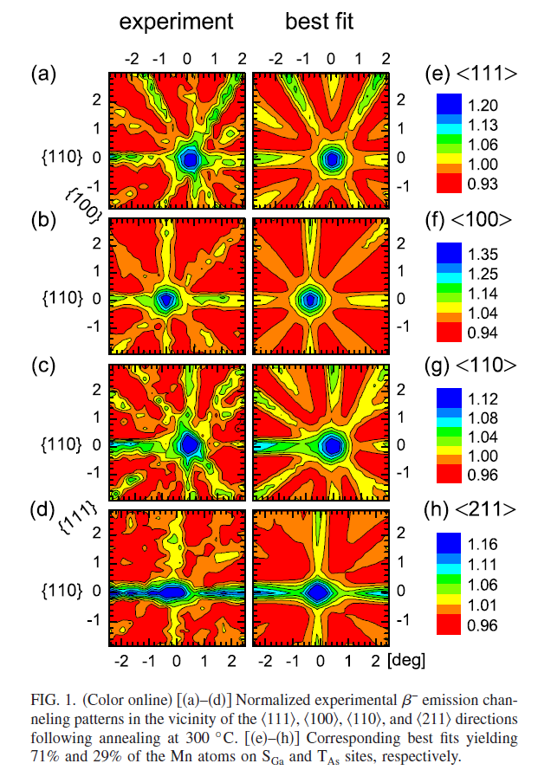
Spintronics: Location of Mn in Ga_{1-x}Mn_{x}As
GaAs: a dilute magnetic semiconductor, not yet at room temperature.
Emission channelling results showed that Mn is surprisingly stable at interstitial sites in GaAs (400C).
Results that have consequences for “defect engineering” of this material.
Pereira et al APL 98 201905 (2011)

Slide 18
PL Characterisation of Semiconductors
One of the principal techniques in semiconductor research.
High Spectral resolution
Non-destructive
No need for contacts
Very sensitive (can probe ppb)
Relatively flexible and straightforward
Can be extended to include external perturbations.
Not quantitative
Low concentrations may be more optically efficient
Lack of chemical information (except for some rare cases where isotope shifts are observed)

Slide 19
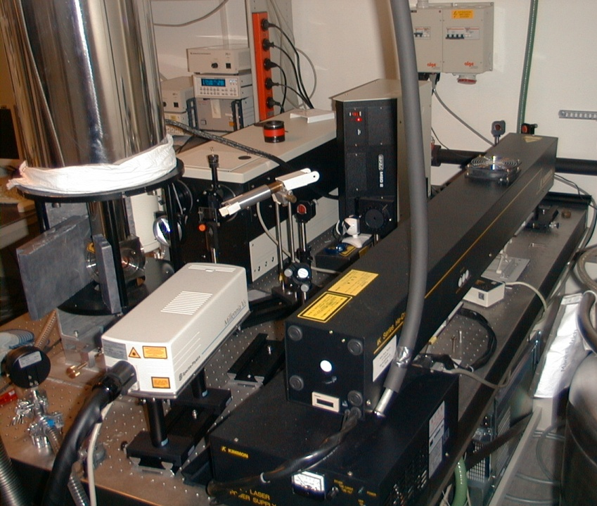
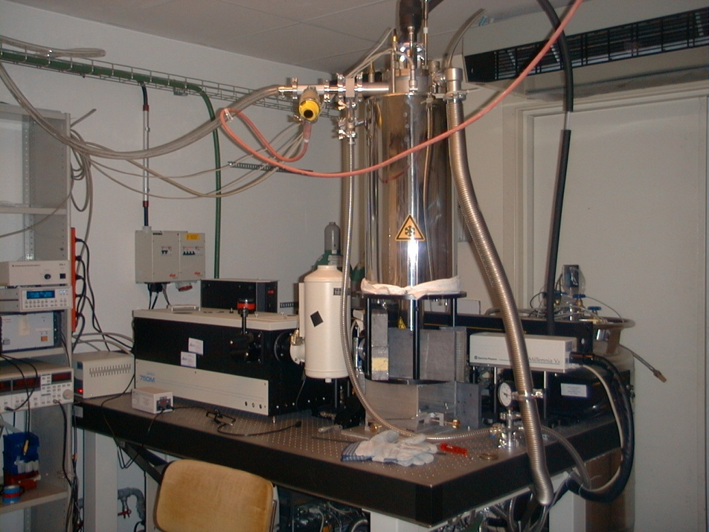
PL + L-DLTS apparatus at ISOLDE
LASER
HeCd (3,8 eV)
Nd:YAG (2,3 nm)
Diode (1,9 nm)
Cryostat
He-Bathcryostat (1,5 – 300 K)
Closed cycle
Monochromator
Focus: 0,75 m
Gratings: 150 – 1800 l/mm
Detectors
CCD-camera (1,1 - 6,2 eV)
Ge-Diode (0,7 - 1,5 eV)

Slide 20
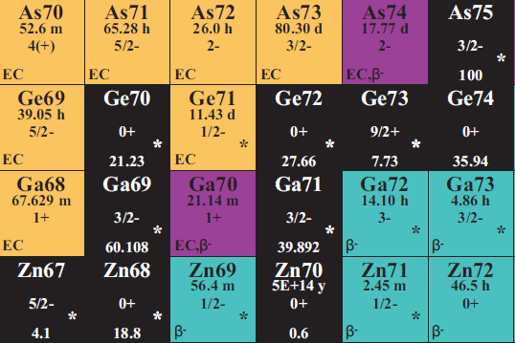
Fundamental properties of donors in ZnO
(2)
(1)
(3)
(1)

Slide 21
Time
I₈
DD₂
I₁
I₈ feature decays as Ga decays; So does the weak I₁ line; DD₂ grows as Ge is produced.
First chemical identification of Ga and Ge in ZnO, (PRB 73, 165212 (2006)) and PRB 83 125205 (2011))

Slide 22
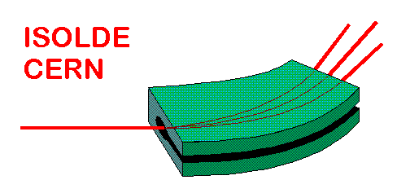
Diffusion: experimental procedure
¹¹¹Ag Implantation
550 … 900 K
CdTe
Ø = 6 mm
d = 800 µm
thermal
treatment
¹¹¹Ag
CdTe
CdTe:¹¹¹Ag
T_{diff} = 570 K
t_{diff} = 30 min
1...30 µm

Slide 23
Diffusion: Ag in CdTe
T_{diff} = 825 K
t_{diff} = 60 min
Shapes of diffusion profiles strongly depend
on external vapor pressure
H. Wolf, F. Wagner, Th. Wichert, and ISOLDE Collaboration, Phys. Rev. Lett. 94, 125901, 2005

Slide 24
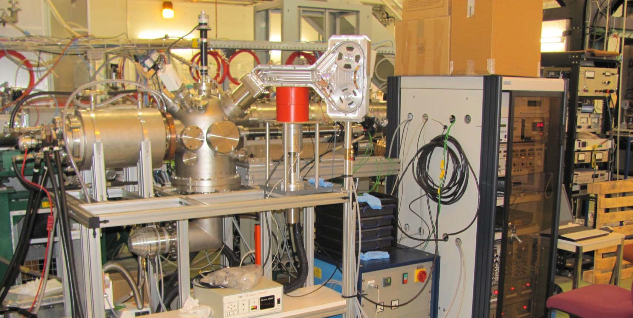
Online Diffusion
Implantation
Diffusion annealing up to 1800 °C
Sample sectioning by ion sputtering
Catching the sputtered ions by a tape system
In situ activity measurement
Remote control

Slide 25
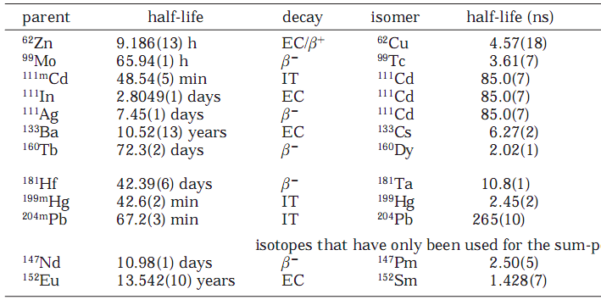
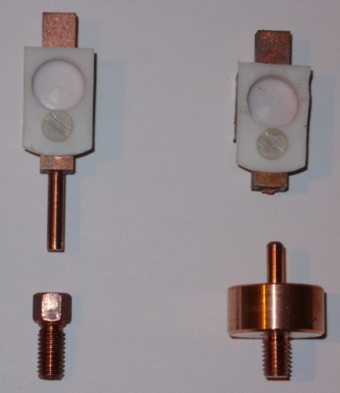
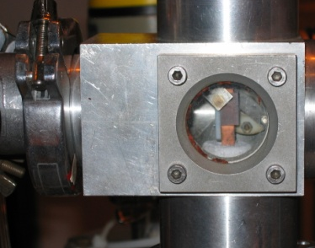
Biophysics at ISOLDE: Radioisotopes for Probing Biomolecular Functionality in Living Matter
PAC isotopes used for biophysics at ISOLDE:
Hemmingsen et al. Chem. Rev., 2004, 104: 4027
No implantations: collect ativity in ice → chemistry

Slide 26
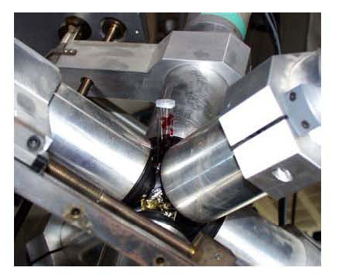
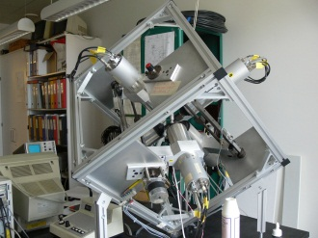
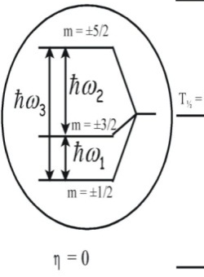
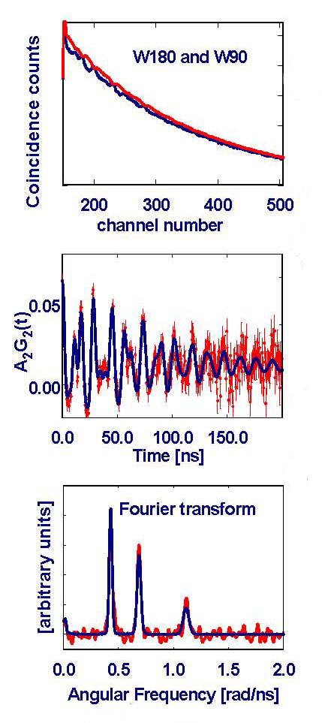
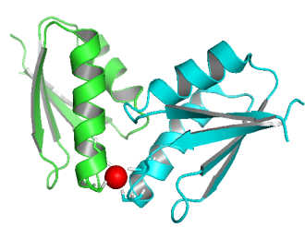
In practice….
6·180º spectra and 24·90º spectra
Least χ² analysis
ω_{Q} and η
BASIL model
QM calculations
Fourier transform
compare experiment to model

Slide 27
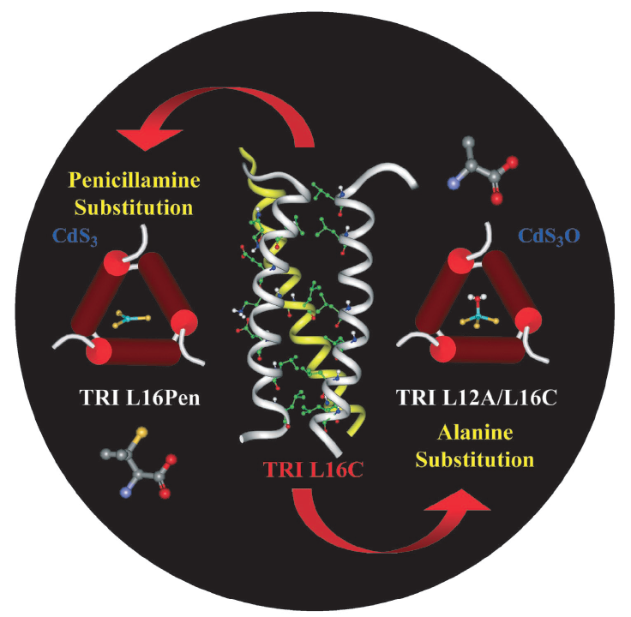
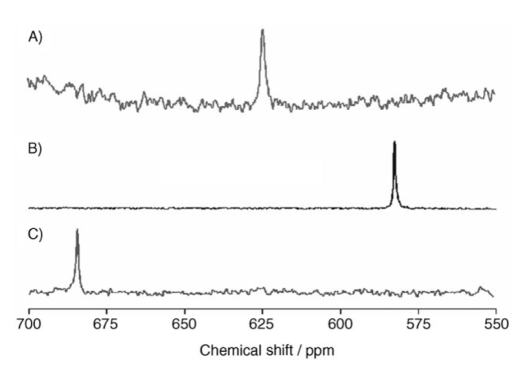
A
Metal Ion Binding Site Structure:
Fast inter-conversion between species
B
^{111m}Cd-PAC
C A B
C
A
B
¹¹³Cd-NMR
C
Matzapetakis et al. J. Am. Chem. Soc. 2002, 124: 8042; Lee et al.
Angew. Chem., 2006, 45: 2864; Peacock et al. Proc. Nat. Acad. Sci. 2008, 105: 16566

Slide 28
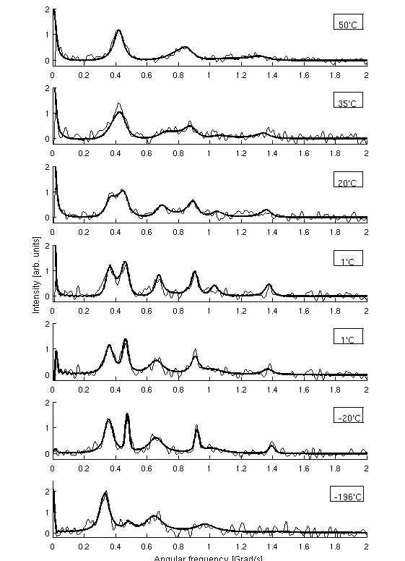
De novo designed heavy metal
Ion binding proteins: ns dynamics
^{111m}Cd-PAC
50 ºC
35 ºC
20 ºC
1 ºC
1 ºC
-20 ºC
-196 ºC
Temp [ºC] | τ₁ [ns] | τ₋₁ [ns]
1 | 52 | 48
20 | 42 | 36
35 | 28 | 20
50 | 19 | 12
Stachura et al. Manuscript in preparation

Slide 29
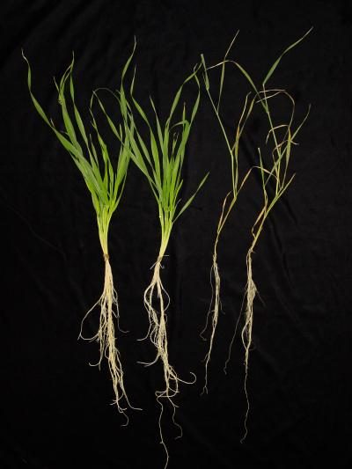
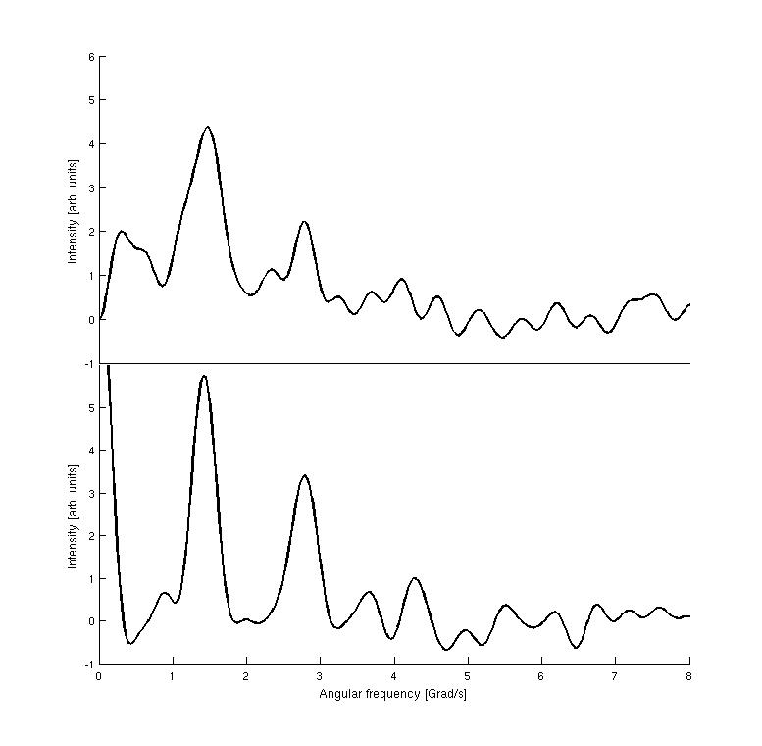
In vivo experiments
Hg(II) binding to barley
Whole barley plant
Homogenised barley leaves
5-7 days-old plants
Plant inserted into test tube.
Fast uptake of Hg(II) (<1h)
Bound to large molecules, similarities to HgS₂ compounds
Adolph et al. Chem. Eur. J., 2009, 15, 7350 – 7358
Notes:
29

Slide 30
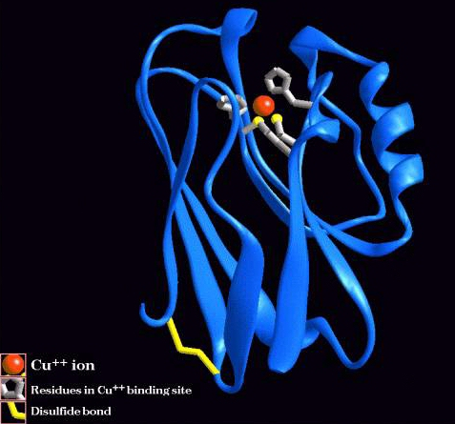
Beta-NMR applied to biophysics
Beta-NMR
Cu, Zn, Mg, Mn, Fe, Ni
Measurement of electric field gradient
  Cu(I) is “invisible” in most (except X-ray and nuclear) spectroscopic techniques because it is a closed shell ion
  Cu(I)/Cu(II) are essential in many redox processes and electron transport in biology

Slide 31
Advantages and Limitations of PAC Spectroscopy for biophysics
Advantages:
Characterisation of structure
and dynamics at the PAC
probe site (including rotational
correlation times)‏
High sensitivity to structural
changes
Small amount of PAC probe needed
(in principle about 1 pmol)‏
Different physical states
(crystals, surfaces, solutions, in vivo...)‏
Mechanically stable, allowing for
stirring, flow, ...
Limitations:
Suitable PAC isotopes do not exist for
all elements
PAC isotope must bind strongly to
the molecule of interest
Spectral parameters do not uniquely
determine structure
After effects can cause problems (in
particular for EC). (¹¹¹In)‏
Production of PAC-isotopes
Hemmingsen et al. Chem. Rev., 2004, 104: 4027; Hemmingsen and Butz, in "Application of Physical
Methods to Inorganic and Bioinorganic Chemistry" 2007, Ed. R.A. Scott, Wiley
Notes:
31

Slide 32








Funding and Acknowledgements
Manfred Deicher, Herbert Wolf, University of Saarlandes, Germany
Guilherme Correia, Uli Wahl ITN, Lisbon, Portugal
Ligia Amorim, KU, Leuven, Belgium
Martin Henry, Dublin City university, Ireland
Haraldur Gunnlaugsson, University of Arhus, Denmark
Torben Molholt, University of Iceland, Iceland
Monika Stachura, University of Copenhagen, Denmark
Krish Bharuth-Ram, iThemba Labs, South Africa

Slide 33

Summary
Solid state physics/biophysics: a very active experimental programme at ISOLDE
Radioactive measurements complement work at home laboratories
Unique information – be it chemical or local – which is only achievable using radioactive implantations/probes.
Synergy between groups e.g. extension of biophysics methods for studying graphene and fullerenes (Prof Das).
Ability to profit from the huge range of beams available at ISOLDE (especially now with online and offline setups).
Many new developments under preparation e.g. β-NMR for biophysics
Much more info at:
Cern.ch/ssp or follow us on

Slide 34
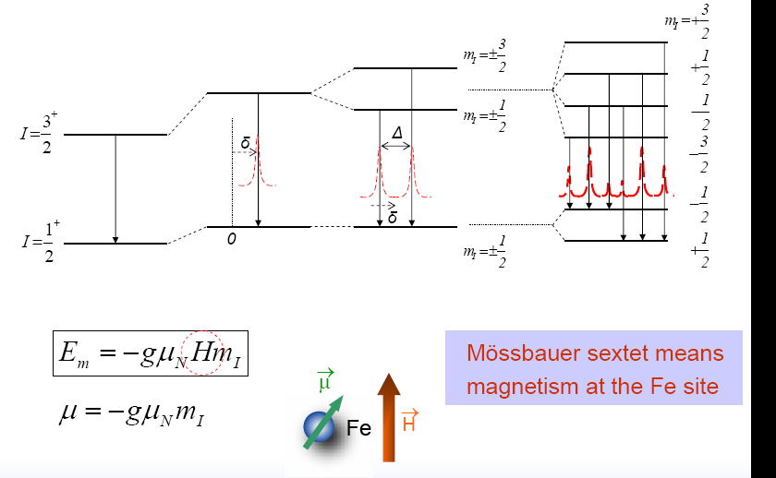
Splitting of features
Mossbauer sextet indicates magnetism at the Fe site

