Slide 1



Nuclear Surface Unveiled by Knockout Reactions.
Arun K Jain
Nuclear Physics Division, B.A.R.C., Mumbai.

Slide 2
N-N Interaction has a complicated nature ( provided to it by the strong
coupling finite mass mesons), it has strong short range repulsion (almost a hard core of ~ 0.5 to 0.6 fm) and a finite short range, but a comparatively longer range, ~2 fm strong attraction.
r
This longer range residual
interaction leads to clustering
V_{NN}
For structure most of the N-N interaction leads to
the mean field of finite range Woods Saxon type.
r_{NA}
V_{NA}
Clustering due to long range residual interaction

Slide 3
Knockout Reaction Kinematics
p₁
p₀
θ₁
θ₂
p_{B}
p₂

Slide 4
a’
Knockout
Reaction
A(a, a’b)B
a
Incident
momentum k₁
b

Slide 5
If b were free then
k₃ = - k₃ = 0
E₁=E’₁+E’₂
If the particle is bound by a few MeV, then
E₀=E’₁+E’₂+Q
as the Q is (- ve )
E’₁ and E’₂ are < E₁ and E₂ respectively.
Hence k’₁ and k’₂ are < k₁ and k₂ respectively.
and θ₁ and θ₂ of k’₁ and k’₂ will be
slightly < that of free scattering.

Slide 6
Zero Range Knockout

Slide 7
Zero Range Knockout

Slide 8
Zero Range Knockout

Slide 9
Zero Range Knockout

Slide 10
Zero Range Knockout

Slide 11
Zero Range Knockout

Slide 12
Zero Range Knockout

Slide 13
Zero Range Knockout

Slide 14
Zero Range Knockout

Slide 15
Zero Range Knockout

Slide 16
Zero Range Knockout

Slide 17
Zero Range Knockout

Slide 18
Zero Range Knockout

Slide 19
Zero Range Knockout

Slide 20
Zero Range Knockout

Slide 21
Zero Range Knockout

Slide 22
Zero Range Knockout

Slide 23
Zero Range Knockout

Slide 24
Zero Range Knockout

Slide 25
Zero Range Knockout

Slide 26
Zero Range Knockout

Slide 27
Zero Range Knockout

Slide 28
Zero Range Knockout

Slide 29
Zero Range Knockout

Slide 30
Zero Range Knockout

Slide 31
Zero Range Knockout

Slide 32
Zero Range Knockout

Slide 33
Zero Range Knockout

Slide 34
Zero Range Knockout

Slide 35
Zero Range Knockout

Slide 36
Zero Range Knockout

Slide 37
Zero Range Knockout

Slide 38
Zero Range Knockout

Slide 39
Zero Range Knockout

Slide 40
Zero Range Knockout

Slide 41
Zero Range Knockout

Slide 42
Zero Range Knockout

Slide 43
Zero Range Knockout

Slide 44
Zero Range Knockout

Slide 45
Zero Range Knockout

Slide 46
Zero Range Knockout

Slide 47
Zero Range Knockout

Slide 48
Zero Range Knockout

Slide 49
Zero Range Knockout

Slide 50
Zero Range Knockout

Slide 51
Zero Range Knockout

Slide 52
Zero Range Knockout

Slide 53
Zero Range Knockout

Slide 54

Zero Range Knockout

Slide 55
Zero Range Knockout

Slide 56
Zero Range Knockout

Slide 57
Zero Range Knockout

Slide 58
Zero Range Knockout

Slide 59
Zero Range Knockout

Slide 60
Zero Range Knockout

Slide 61
Zero Range Knockout

Slide 62
Zero Range Knockout

Slide 63
Zero Range Knockout

Slide 64
Zero Range Knockout

Slide 65
Zero Range Knockout

Slide 66
Zero Range Knockout

Slide 67
Zero Range Knockout

Slide 68
Zero Range Knockout

Slide 69
Zero Range Knockout

Slide 70
Zero Range Knockout

Slide 71
Zero Range Knockout

Slide 72
Zero Range Knockout

Slide 73
Zero Range Knockout

Slide 74
Zero Range Knockout

Slide 75
Zero Range Knockout

Slide 76
Zero Range Knockout

Slide 77
Zero Range Knockout

Slide 78
Zero Range Knockout

Slide 79
Zero Range Knockout

Slide 80
Zero Range Knockout

Slide 81
Zero Range Knockout

Slide 82
Zero Range Knockout

Slide 83
Zero Range Knockout

Slide 84
Zero Range Knockout

Slide 85
Zero Range Knockout

Slide 86
Zero Range Knockout

Slide 87
Zero Range Knockout

Slide 88
Zero Range Knockout

Slide 89
Zero Range Knockout

Slide 90
Zero Range Knockout

Slide 91
From Transfer Reactions one obtains reasonable
relative spectroscopic factors.
For Knockout Reactions one uses quasi free scattering approx.
or Distorted Wave Impulse Approximation (DWIA ).
(α,2α) , knockout reaction cross section
= product of kinematic factor,
α-α Cross section and
Distorted wave form factor,
(~Fourier transform of Wfn).
S_{LJ} is the cluster spectroscopic factor for specific L and J.
The transition amplitude may be written as :
Here ε = B/A.

Slide 92
Ground State spectroscopic factors S_{α} for ¹⁶O(α, 2α)¹²C
Eα | S_{o+} | σ_{PW} / σ_{DW}
Theory | 0.23 | -
850 MeV | < 1.8 | 5.4
90 MeV | 15 | ~1500
52.5 MeV | 150 | ~3200
Ground State spectroscopic factors S_{α} for ¹²C(α, 2α)⁸Be
at 139 MeV and 200 MeV
 | MeV | 200 MeV | Ratio
 | 17 | 0.48 | 35
Theory | 0.55 | 0.55

Slide 93
Discrepancy between Proton and Alpha inducted
Cluster Knockout Reactions
Here Spectroscopic Factor Sα is seen to be almost
~2-orders of magnitude too large
Reaction | θ₁-θ₂ | P3 (MeV/c) | Spectroscopic factor (Sα)
¹⁶O(p,pd)¹⁴N | 40.1⁰-40.0⁰ | ~41 | 0.43
¹⁶O(p,pt)¹³N | 40.1⁰-40.0⁰ | ~51 | 3.4
¹⁶O(α,αd)¹⁴N | 9.0⁰-43.99⁰ | ~4 | 55
¹⁶O(α,αt)¹³N | 25.81⁰-43.99⁰ | ~13 | 53
¹⁶O(α,αt)¹³C | 25.81⁰-43.99⁰ | ~2 | 55

Slide 94
Finite Range Knockout

Slide 95
Knockout using Short Finite Range Repulsion

Slide 96
Knockout using Short Finite Range Repulsion

Slide 97
Knockout using Short Finite Range Repulsion

Slide 98
Knockout using Short Finite Range Repulsion

Slide 99
Knockout using Short Finite Range Repulsion

Slide 100
Knockout using Short Finite Range Repulsion

Slide 101
Knockout using Short Finite Range Repulsion

Slide 102
Knockout using Short Finite Range Repulsion

Slide 103
Knockout using Short Finite Range Repulsion

Slide 104
Knockout using Short Finite Range Repulsion

Slide 105
Knockout using Short Finite Range Repulsion

Slide 106
Knockout using Short Finite Range Repulsion

Slide 107
Knockout using Short Finite Range Repulsion

Slide 108
Knockout using Short Finite Range Repulsion

Slide 109
Knockout using Short Finite Range Repulsion

Slide 110
Knockout using Short Finite Range Repulsion

Slide 111
Knockout using Short Finite Range Repulsion

Slide 112
Knockout using Short Finite Range Repulsion

Slide 113
Knockout using Short Finite Range Repulsion

Slide 114
Knockout using Short Finite Range Repulsion

Slide 115
Knockout using Short Finite Range Repulsion

Slide 116
Knockout using Short Finite Range Repulsion

Slide 117
Knockout using Short Finite Range Repulsion

Slide 118
Knockout using Short Finite Range Repulsion

Slide 119
Knockout using Short Finite Range Repulsion

Slide 120
Knockout using Short Finite Range Repulsion

Slide 121
Knockout using Short Finite Range Repulsion

Slide 122
Knockout using Short Finite Range Repulsion

Slide 123
Knockout using Short Finite Range Repulsion

Slide 124
Knockout using Short Finite Range Repulsion

Slide 125
Knockout using Short Finite Range Repulsion

Slide 126
Knockout using Short Finite Range Repulsion

Slide 127
Knockout using Short Finite Range Repulsion

Slide 128
Knockout using Short Finite Range Repulsion

Slide 129
Knockout using Short Finite Range Repulsion

Slide 130
Knockout using Short Finite Range Repulsion

Slide 131
Knockout using Short Finite Range Repulsion

Slide 132
Knockout using Short Finite Range Repulsion

Slide 133
Knockout using Short Finite Range Repulsion

Slide 134
Knockout using Short Finite Range Repulsion

Slide 135
Knockout using Short Finite Range Repulsion

Slide 136
Knockout using Short Finite Range Repulsion

Slide 137
Knockout using Short Finite Range Repulsion

Slide 138
Knockout using Short Finite Range Repulsion

Slide 139
Knockout using Short Finite Range Repulsion

Slide 140
Knockout using Short Finite Range Repulsion

Slide 141
Knockout using Short Finite Range Repulsion

Slide 142
Knockout using Short Finite Range Repulsion

Slide 143
Knockout using Short Finite Range Repulsion

Slide 144
Knockout using Short Finite Range Repulsion

Slide 145
Knockout using Short Finite Range Repulsion

Slide 146
Knockout using Short Finite Range Repulsion

Slide 147
Knockout using Short Finite Range Repulsion

Slide 148
Knockout using Short Finite Range Repulsion

Slide 149
Knockout using Short Finite Range Repulsion

Slide 150
Knockout using Short Finite Range Repulsion

Slide 151
Knockout using Short Finite Range Repulsion

Slide 152
Knockout using Short Finite Range Repulsion

Slide 153
Knockout using Short Finite Range Repulsion

Slide 154
Knockout using Short Finite Range Repulsion

Slide 155
Knockout using Short Finite Range Repulsion

Slide 156
Knockout using Short Finite Range Repulsion

Slide 157
Knockout using Short Finite Range Repulsion

Slide 158
Knockout using Short Finite Range Repulsion

Slide 159
Knockout using Short Finite Range Repulsion

Slide 160
Knockout using Short Finite Range Repulsion

Slide 161
Knockout using Short Finite Range Repulsion

Slide 162
Knockout using Short Finite Range Repulsion

Slide 163
Knockout using Short Finite Range Repulsion

Slide 164
Knockout using Short Finite Range Repulsion

Slide 165
Knockout using Short Finite Range Repulsion

Slide 166
Knockout using Short Finite Range Repulsion

Slide 167
Knockout using Short Finite Range Repulsion

Slide 168
Zero Range Approximation for the knockout vertex is hidden in the conventional language of the factorization approximation of the knockout vertex matrix element.
Actually the transition matrix element and the double differential cross section are written as,
Which includes the finite range effects, which we have worked for the first time.

Slide 169
t- matrix effective Interaction

Slide 170
t-matrix:-
The Moller wave operator is such that it transforms the plane wave states, into scattering states, is defined in terms of radial scattering solutions u_{l}(kr) as:
Arun K Jain & Bhushan N. Joshi, Prog. Theor. Phys. 120 (2008) 1193

Slide 171
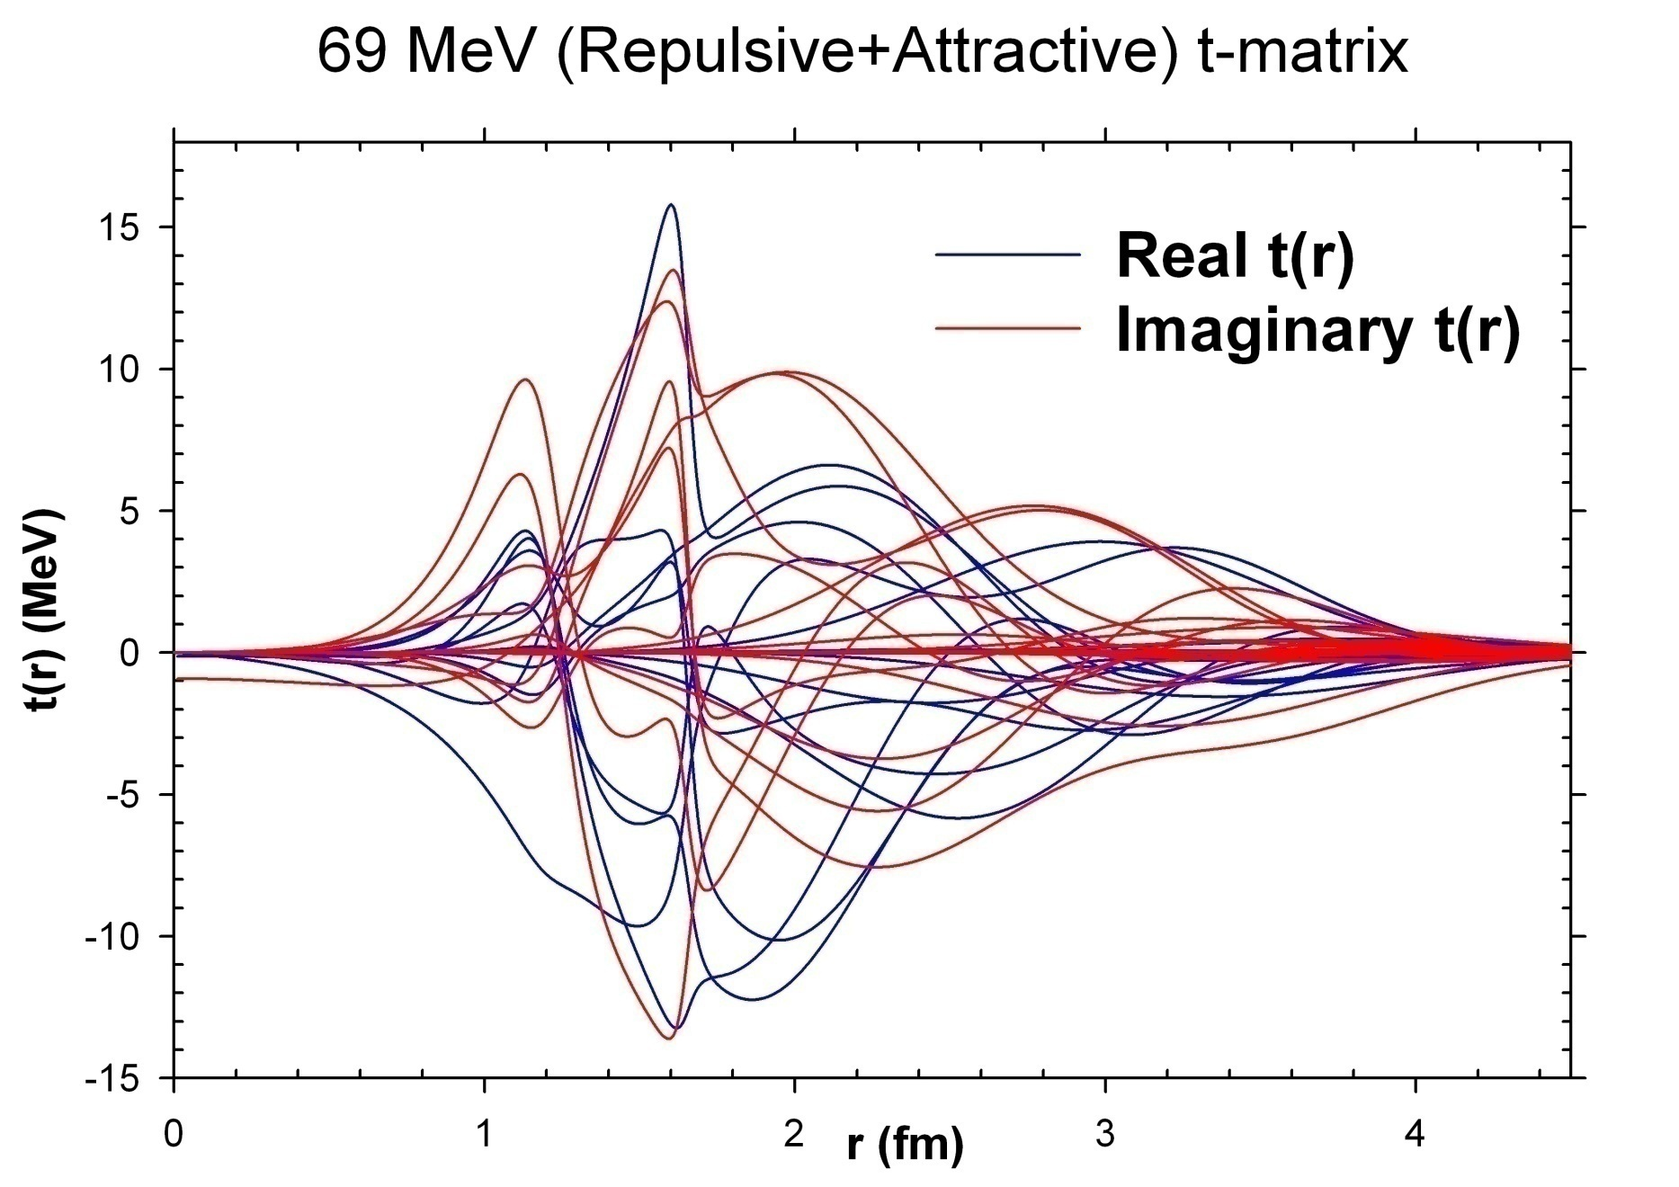
Repulsive core + Attractive α-α t-matrix, tψ=VФ
Arun K Jain & Bhushan N. Joshi, Prog. Theor. Phys. 120 (2008) 1193

Slide 172
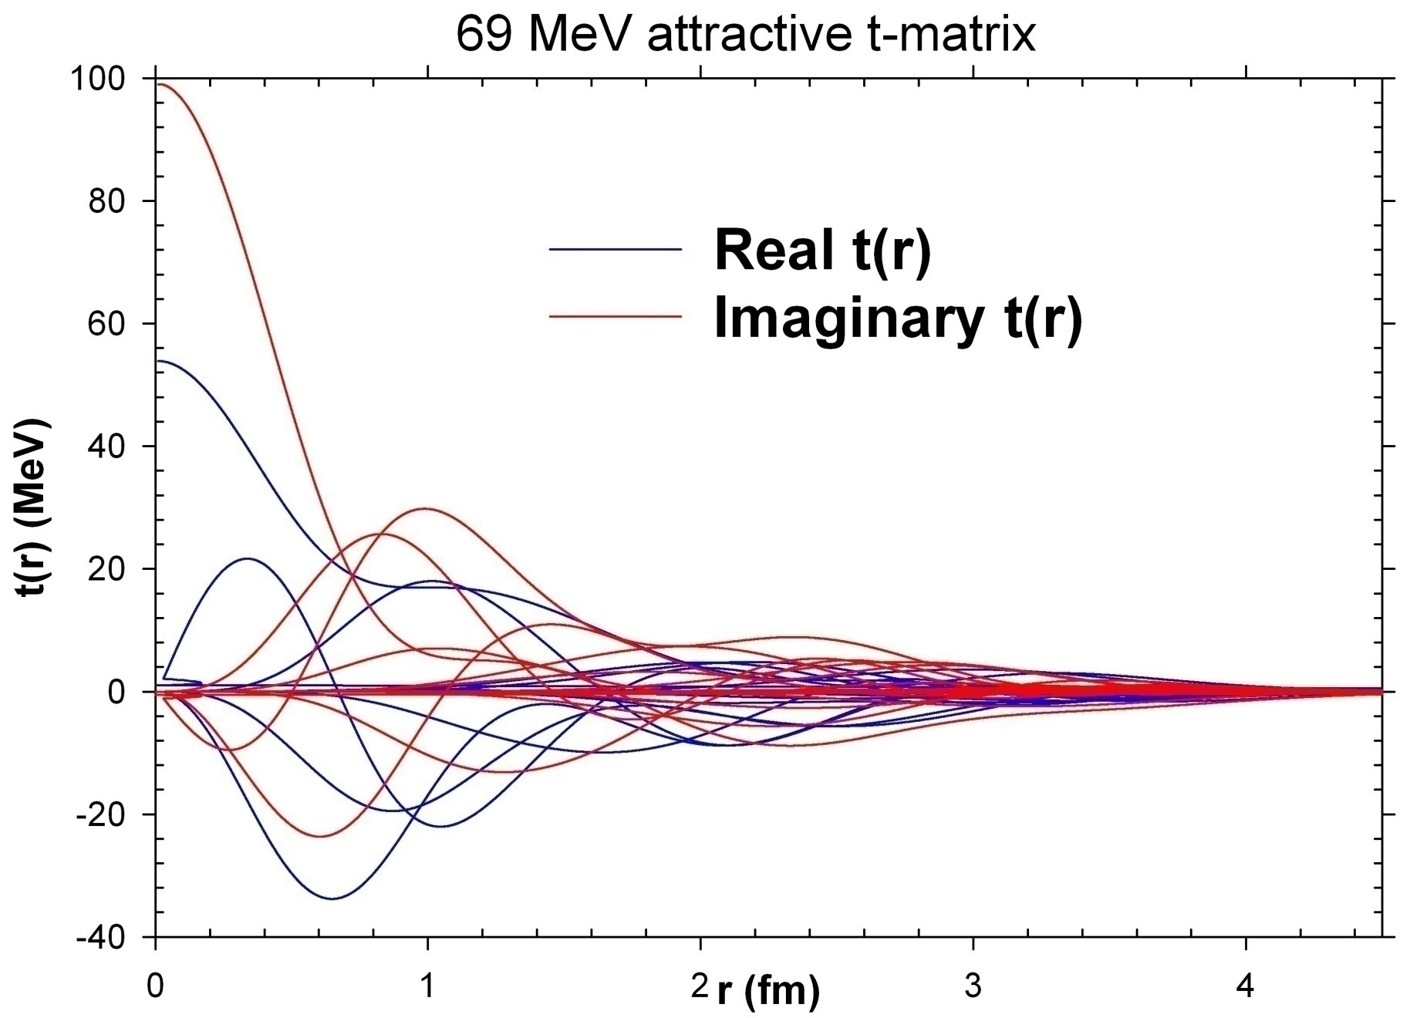
Attractive α-α t-matrix, tψ=VФ
Arun K Jain & Bhushan N. Joshi, Prog. Theor. Phys. 120 (2008) 1193

Slide 173
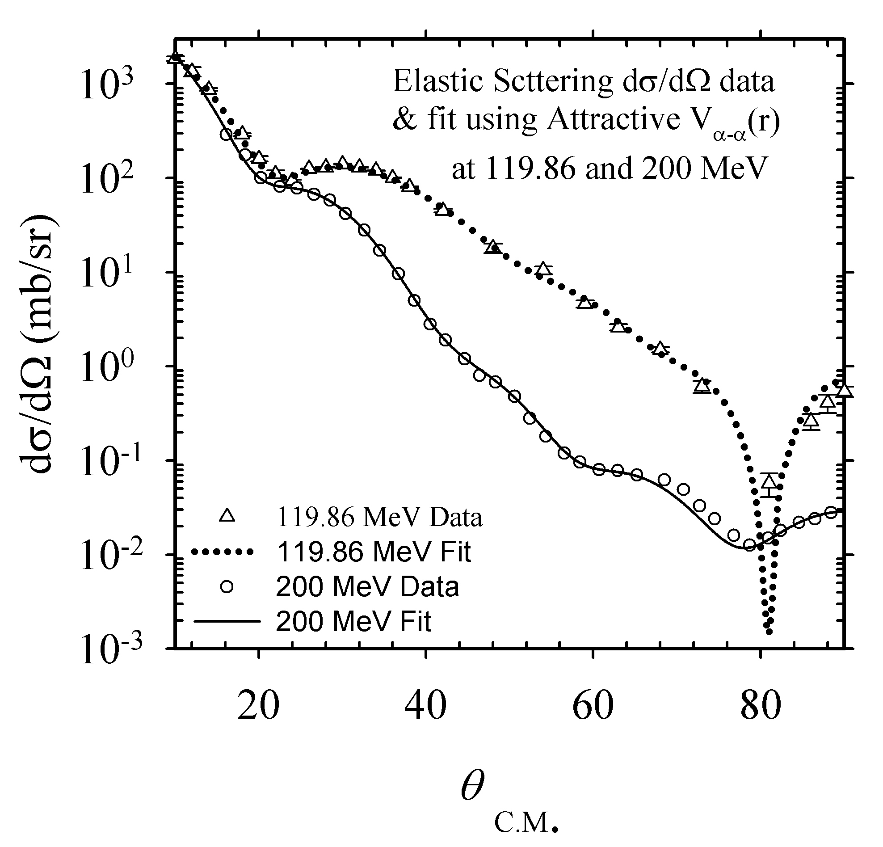
dσ/dΩ from Attractive α-α potential
Arun K Jain & Bhushan N. Joshi, Prog. Theor. Phys. 120 (2008) 1193

Slide 174
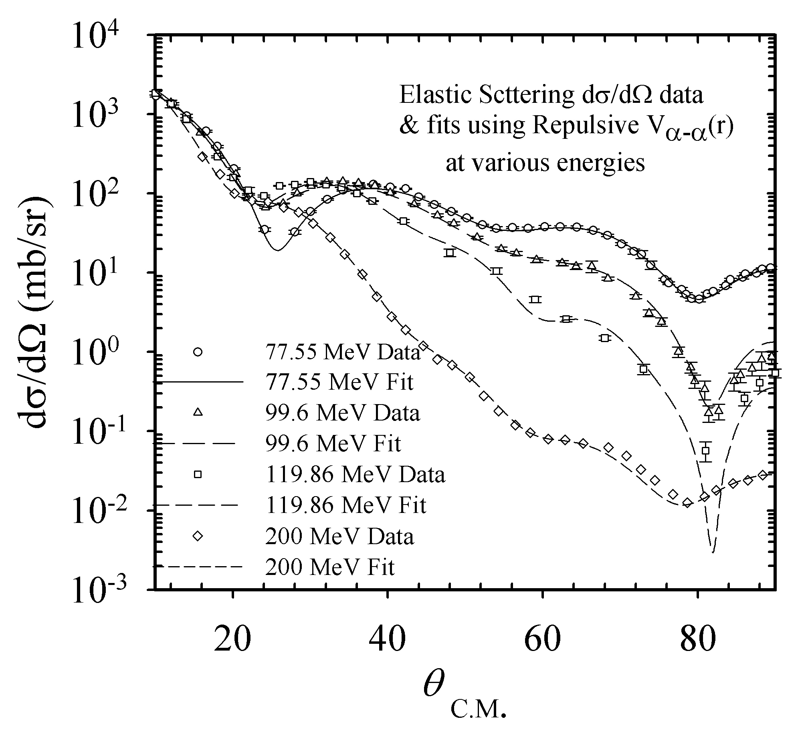
dσ/dΩ from Attractive + Repulsive Core α-α Potential
Arun K Jain & Bhushan N. Joshi, Prog. Theor. Phys. 120 (2008) 1193

Slide 175
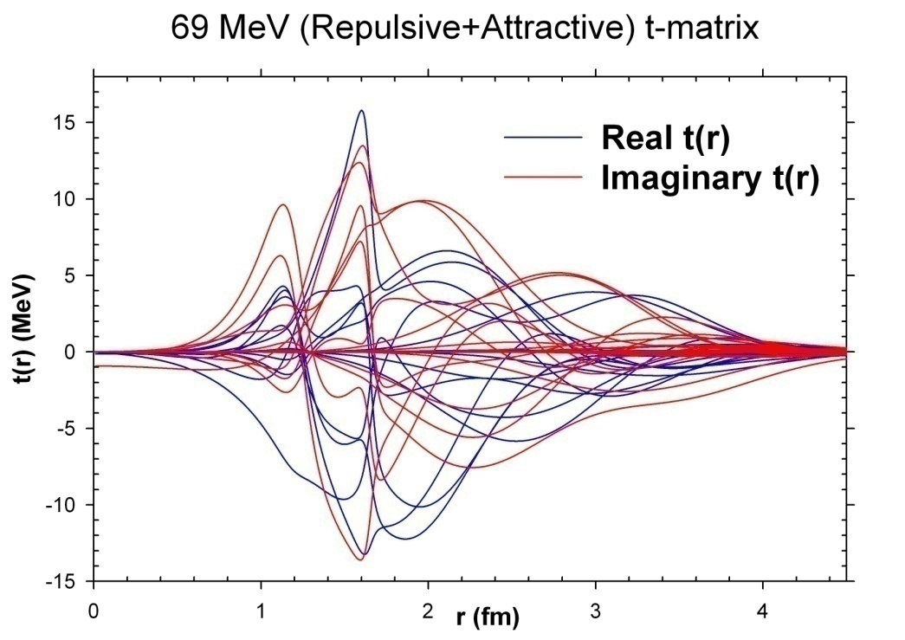
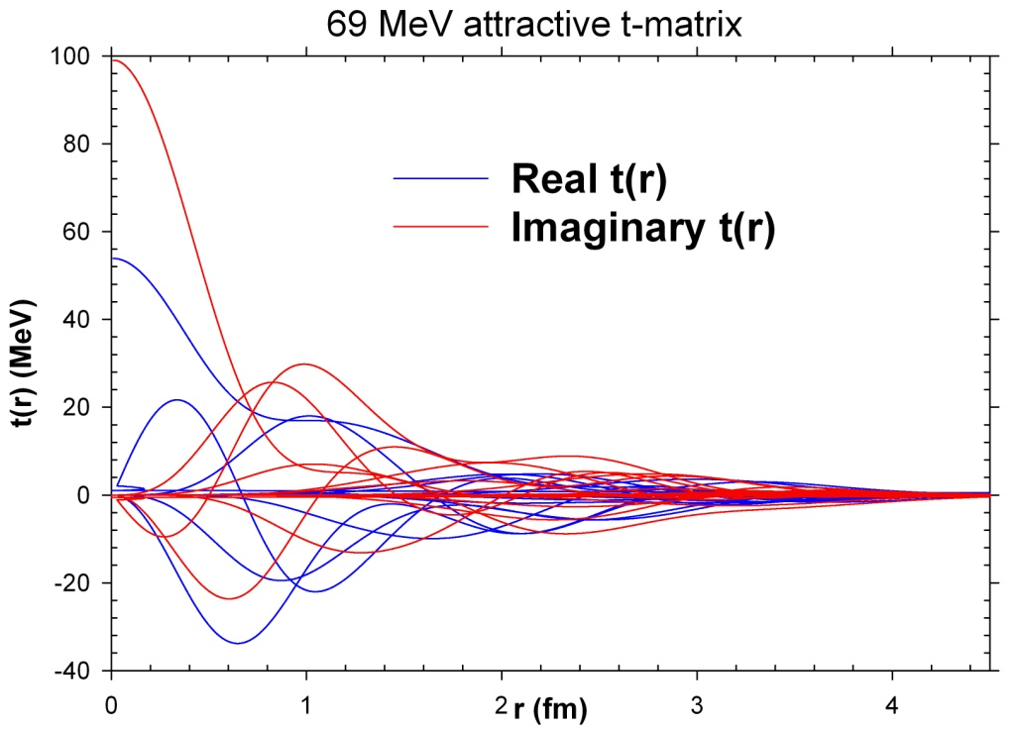
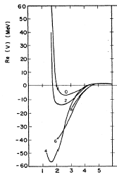
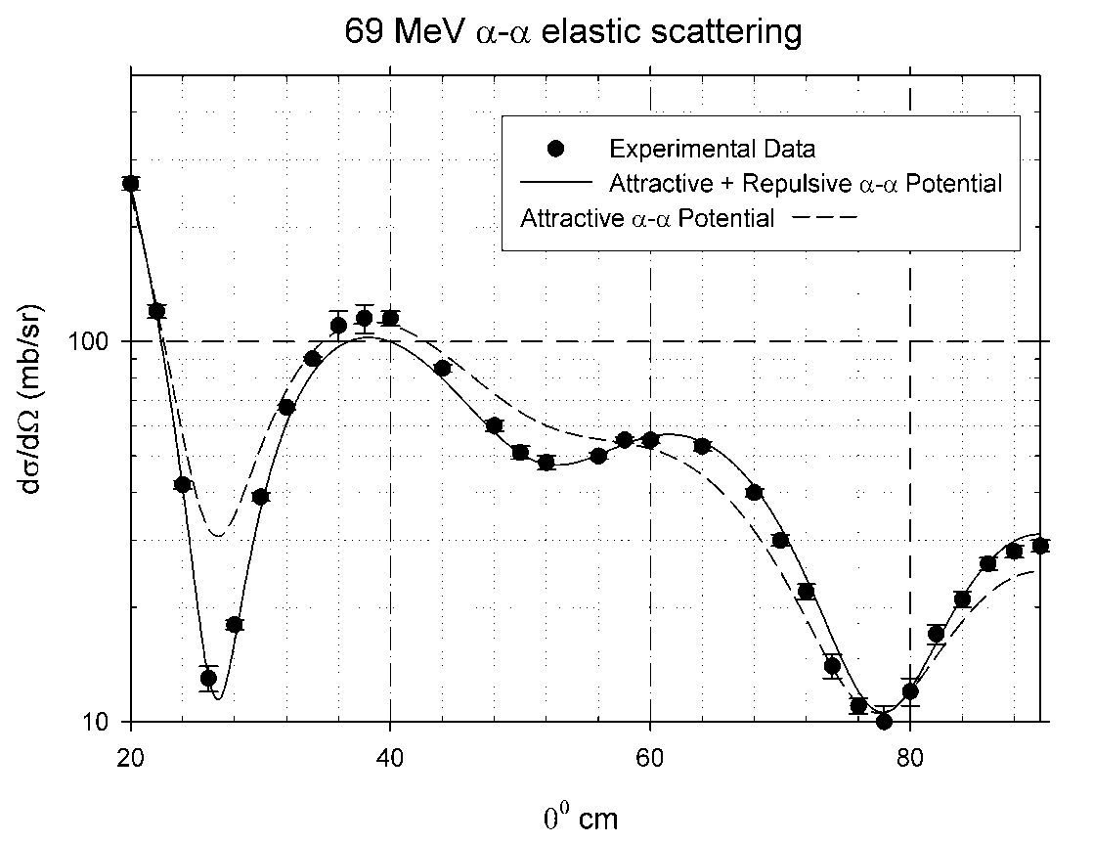
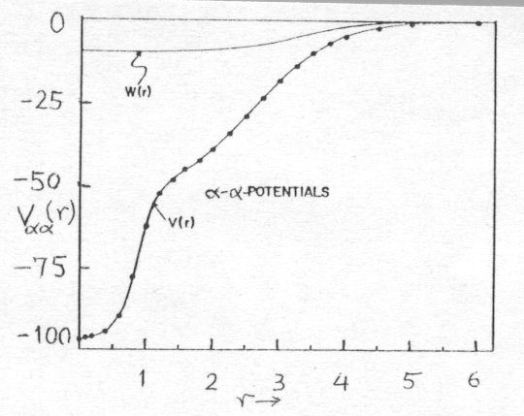

Slide 176
FR DWIA A2A CODE
χ₀ ℓ (r, θ, ϕ, R, Θ, Φ )
60 90, 64, 64, 22, 22, 22
χ₁ ℓ m (r, θ, ϕ, R, Θ, Φ )
60, 121 90, 64, 64, 22, 22, 22
χ₂ ℓ m (R, Θ, Φ)
60, 121 22, 22, 22
(R) (R, Θ, Φ)
22, 22, 22
t_{ℓ} (r) ℓ (r, θ, ϕ)
60 90, 64, 64
D_{ℓ m} (β) ℓ m
60, 121
64∗64∗90∗22∗22∗22= 3.9∗10⁹ Multiplications
60*60*121*60*121*60*60*121= 1.38*10¹⁵ Sums

Slide 177
(α, 2α) results

Slide 178
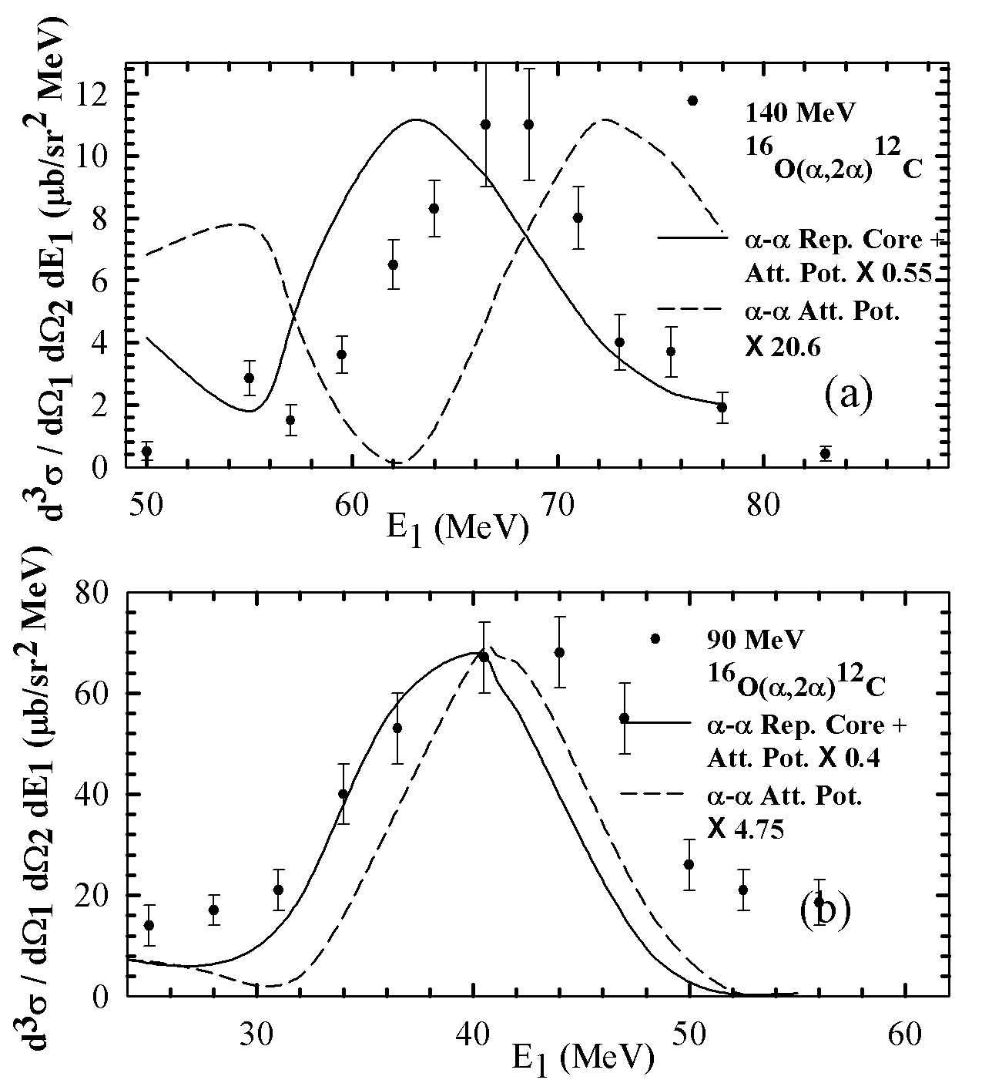
Arun Jain & Bhushan Joshi
P R L, 103 (2009)132503
140 MeV ¹⁶O(α, 2α)¹²C
Repulsive α-α potential explains the spectroscopic factor
90 MeV ¹⁶O(α, 2α)¹²C
Repulsive α-α potential explains the spectroscopic factor

Slide 179
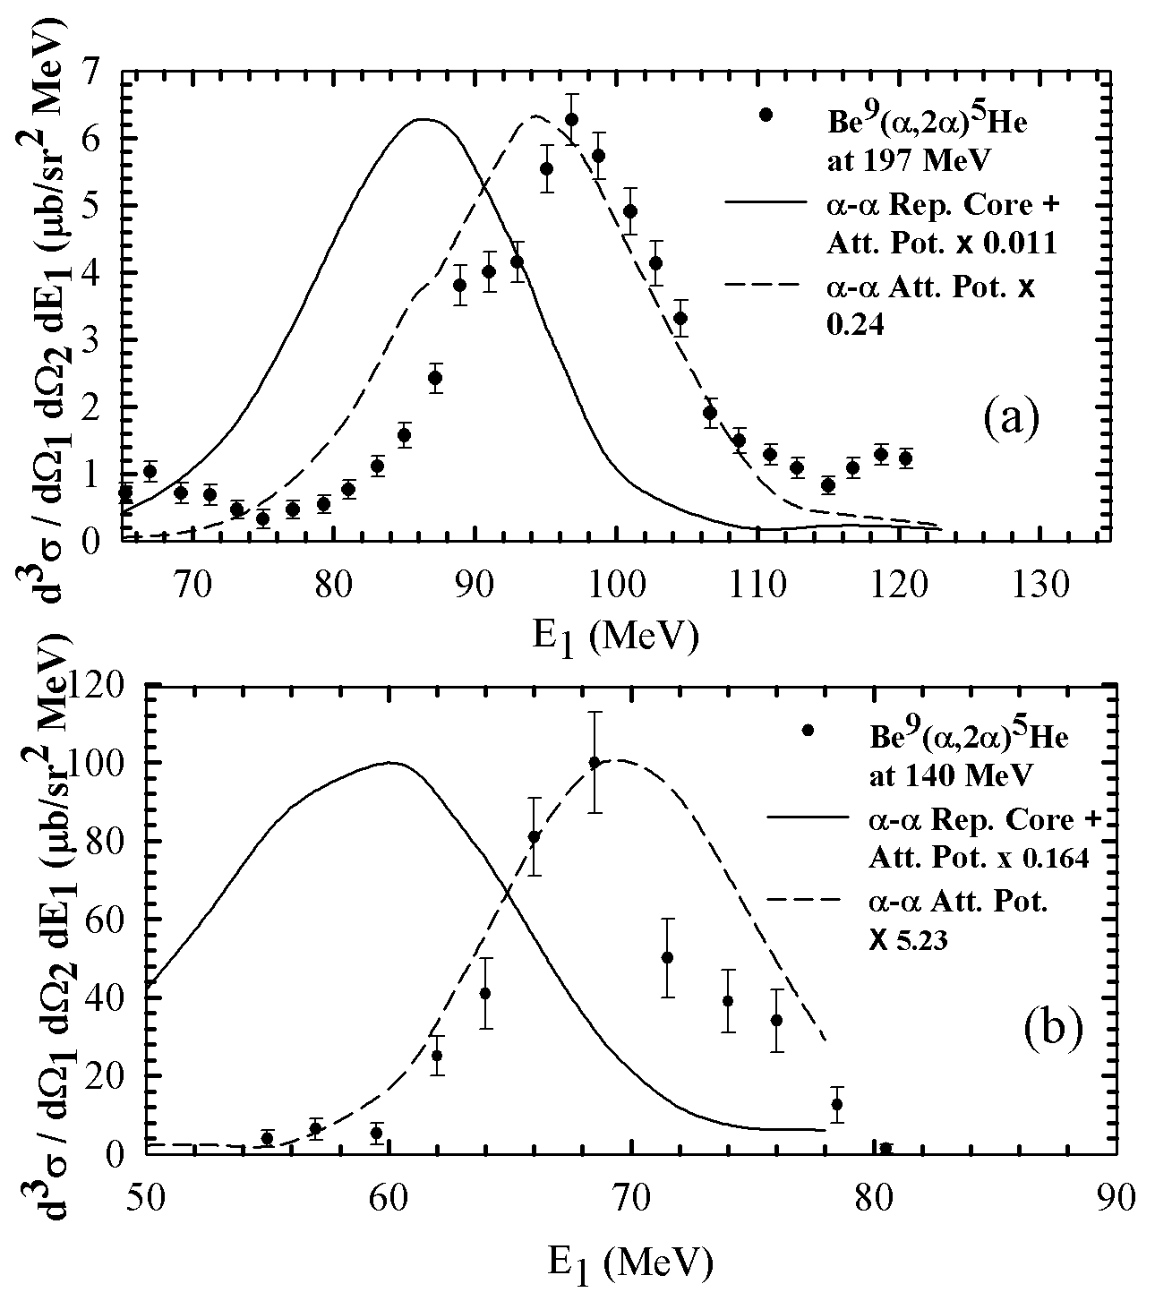
Arun Jain & Bhushan Joshi
P R L, 103 (2009)132503
197 MeV ⁹Be(α, 2α)⁵He
Attractive α-α potential
explains the spectroscopic factor
90 MeV ⁹Be(α, 2α)⁵He
Repulsive α-α potential explains the spectroscopic factor

Slide 180
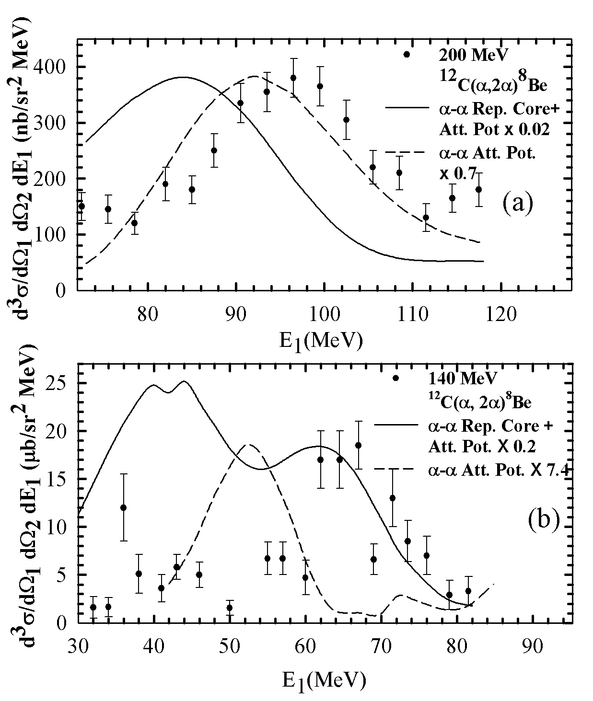
Arun Jain & Bhushan Joshi
P R L, 103 (2009)132503
200 MeV ¹²C(α, 2α)⁸Be
Attractive α-α potential explains the spectroscopic factor
140 MeV ¹²C(α, 2α)⁸Be
Repulsive α-α potential explains the spectroscopic factor

Slide 181
Comparison of (α, 2α) Spectroscopic factors from FR-DWIA calculations on ⁹Be, ¹²C, ¹⁶O nuclei at various energies
Reaction | Eα |  | Sα
 | (MeV) | (R+A) | (A) | Theory
⁹Be(α,2α)⁵He | 197 | 0.011 | 0.24 | 0.57
 | 140 | 0.164 | 5.23
¹²C(α,2α)⁸Be | 200 | 0.02 | 0.7 | 0.55, 0.29
 | 140 | 0.2 | 7.4
¹⁶O(α,2α)¹²C | 140 | 0.55 | 20.6 | 0.23, 0.3
 | 90 | 0.4 | 4.75
Arun Jain & Bhushan Joshi, P R L, 103 (2009) 132503

Slide 182
Understanding:-
In the shell model picture the two α’s can not physically overlap
unless their nucleonic wave functions satisfy Pauli Principle.
Which means that their shell model single particle orbitals are to
be occupied by the second set of 2-neutrons and 2-protons with
their single particle 1s -1p energy gap. Which can be seen in the
excitation of α -particle at ~20 MeV.
4-particles of the other alpha to be promoted to this level require
an excitation of ~80 MeV.
In the α - α lab system it will be ~160 MeV.
Thus the two α’s repel each other below this lab energy.
Thus we have achieved an explanation of most of the puzzling
features of the Direct Nuclear Reactions.

Slide 183
Explanation of α-α potential
in RGM - Shell Model picture
α-α Attractive Potential
α-α Repulsive Core + Attractive Potential
1P_{3/2}
E_{αα/4}
1S_{1/2}
R_{αα}=0
E_{αα/4}
1S_{1/2}
=Proton
=Neuron
R_{αα}

Slide 184
Heavy Cluster Knockout

Slide 185
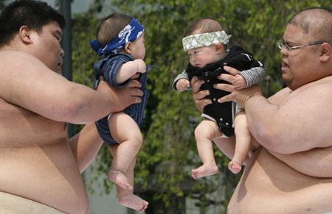
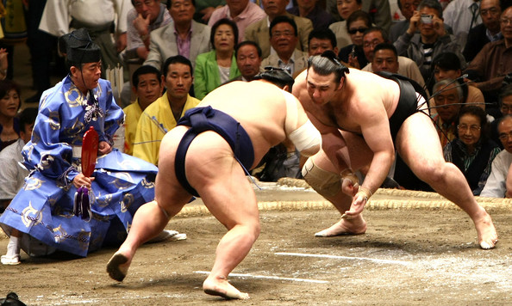
(α, 2α)
(C, 2C)

Slide 186
Comparison of
¹⁶O (α,2α) ¹²C and ¹⁶O (¹²C, 2¹²C) ⁴He
C
α
C
α
α
C
α
C
O
O
α
α
C
C
¹⁶O(C,2C)α was performed at Mumbai LINAC-Pelletron at E_{C}=119 MeV

Slide 187
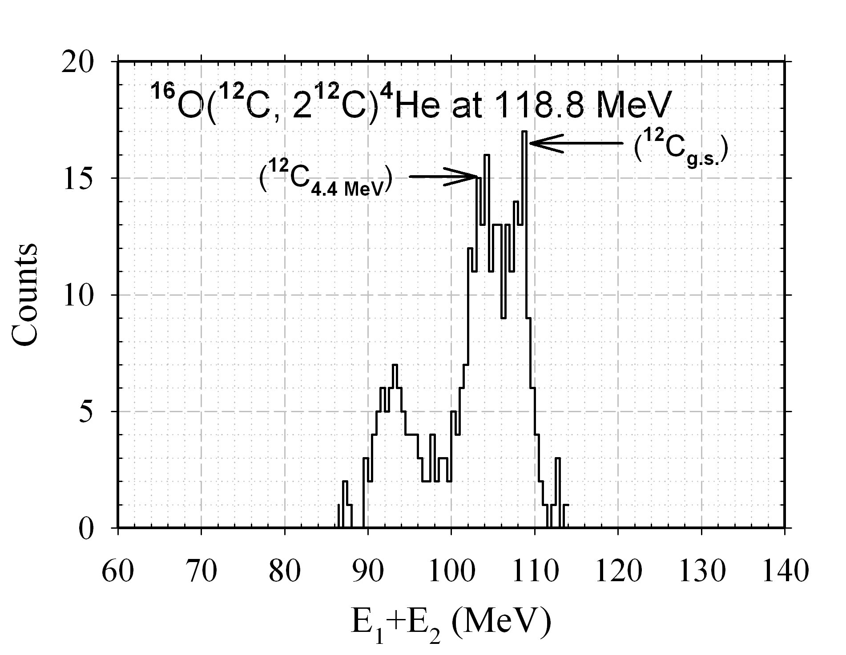
Summed energy spectrum for the ¹⁶O(¹²C, 2¹²C)⁴He Reaction
Bhushan Joshi et al, P R L 106 (2011) 022501

Slide 188
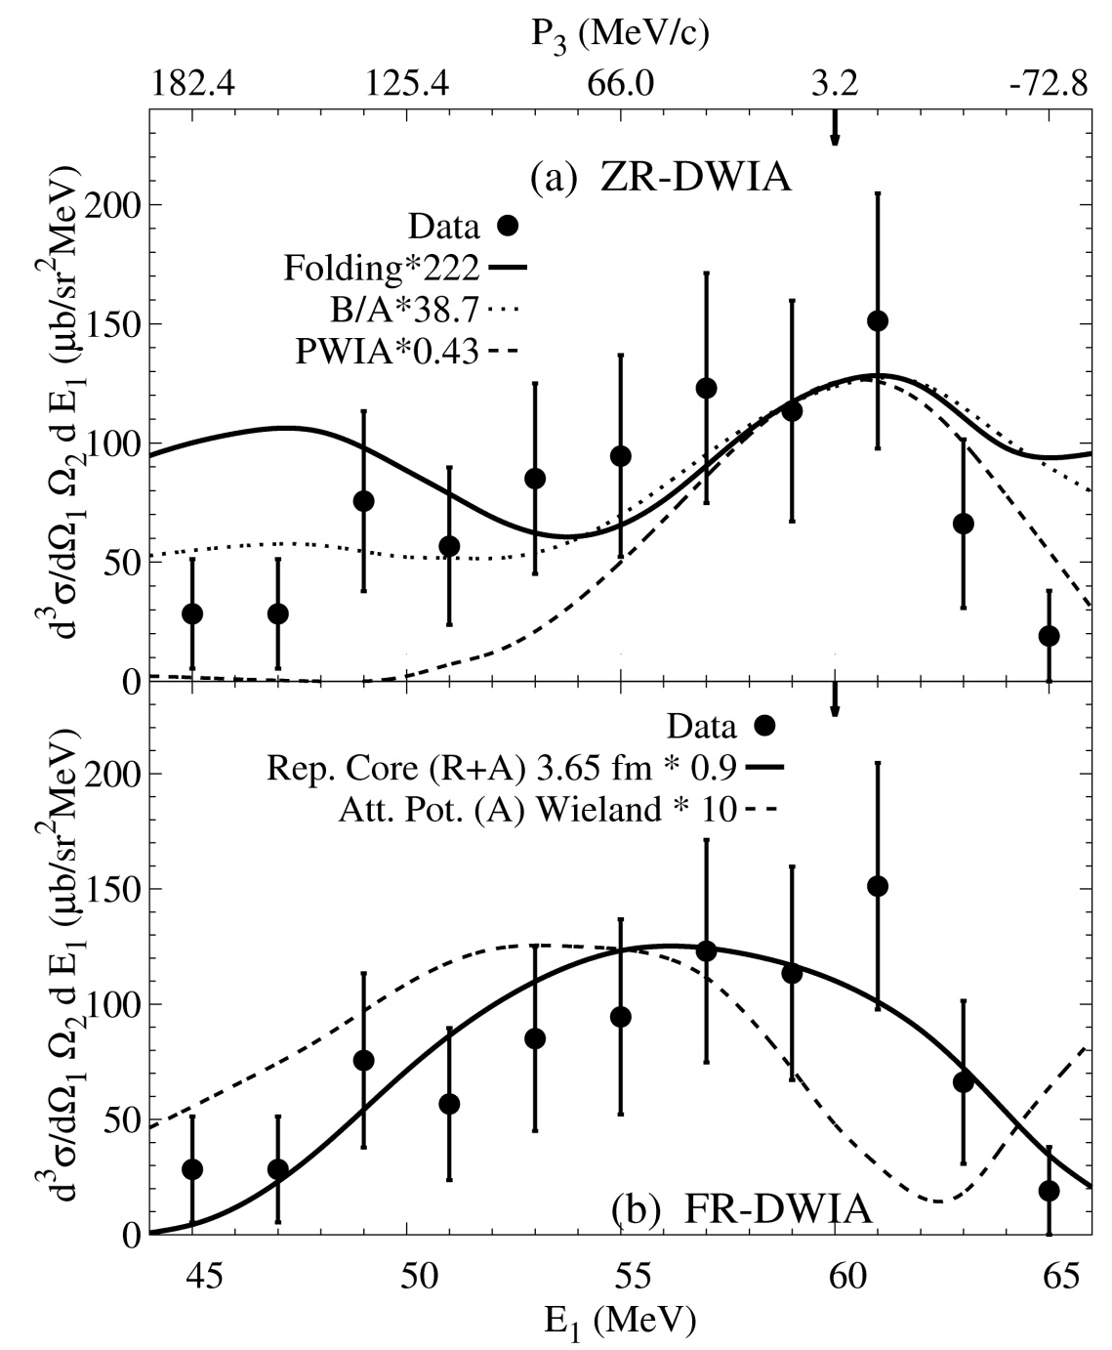
Comparison of Theory and Experiment: energy sharing distribution for 119 MeV ¹⁶O(C, 2C)⁴He Reaction:-
Bhushan Joshi,
Arun Jain, Y. K. Gupta,
D. C. Biswas, A. Saxena
B. V. John, L. S. Danu,
R. P. Vind and
R. K. Choudhury
P R L 106 (2011)
022501
ZR-DWIA
FR-DWIA

Slide 189
Comparison of the (α, 2α) and (C, 2C) reactions on ¹⁶O
Proje- ctile Energy (MeV) | Reaction | Exptl. X-Section μb/sr² MeV | ZR-DWIA X-Section μb/sr² MeV | S_{α} ZR-DWIA | FR-DWIA X-Section μb/sr² MeV |  | S_{α} FR-DWIA |  | Theory
 |  |  |  |  | A | R+A | A | R+A
140 | ¹⁶O(α,2α)¹²C | 10.5 | 0.96 | 11 | 0.51 | 19.1 | 20.6 | 0.55 | 0.23
119 | ¹⁶O(C,2C)α | 125±50 | 0.56 | 222 | 12.5 | 138 | 10 | 0.9 | 0.23
Comparison of S_{α} (ZR-DWIA) indicates an enhancement of
20 times more in (C, 2C) case as compared to (α, 2α) case
A comparison of S_{α} (ZR-DWIA) with theory indicates an enhancement of 965 times in the (C, 2C) case

Slide 190
Notes:
190

Slide 191
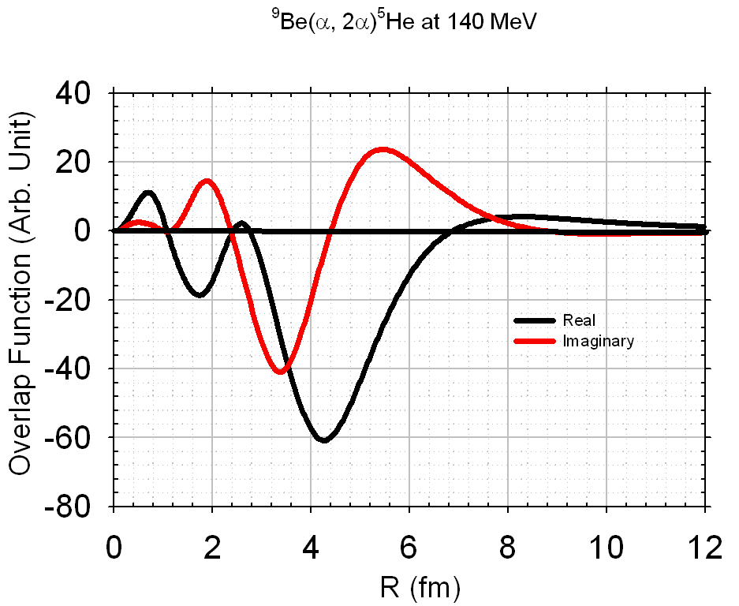

Slide 192
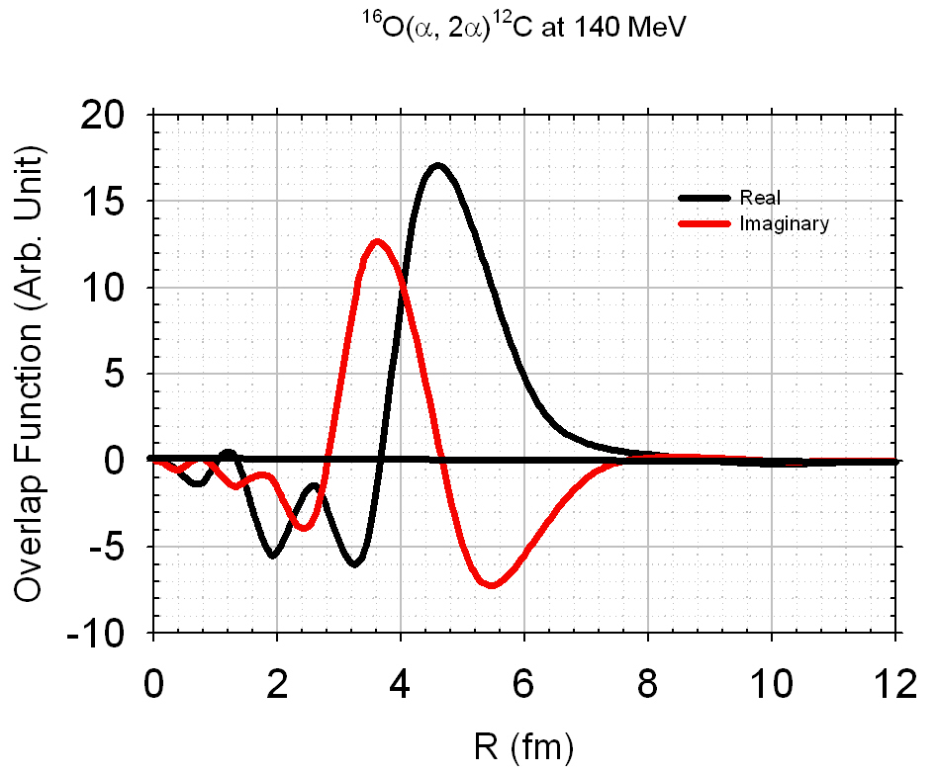

Slide 193
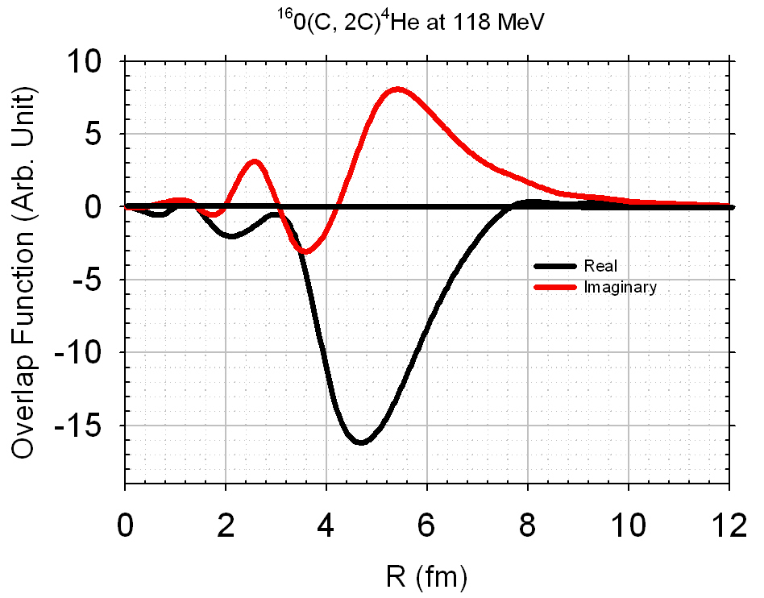

Slide 196
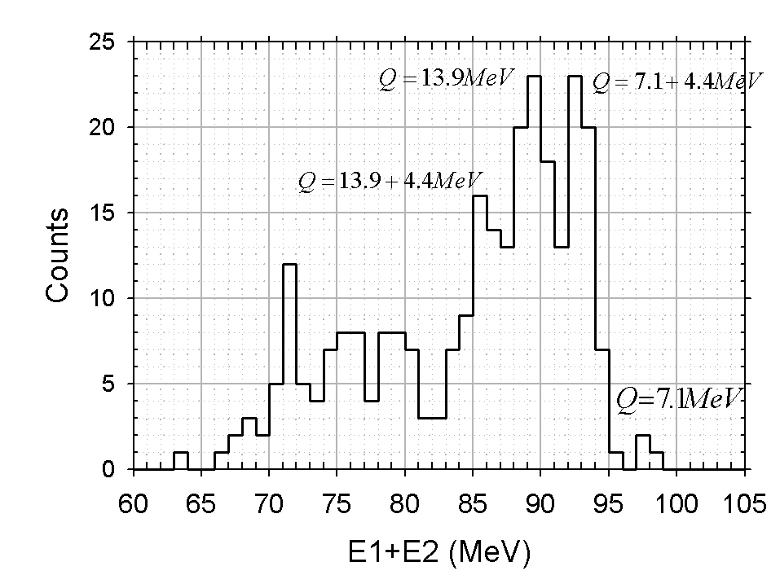
Summed Energy Spectrum of ²⁴Mg(¹²C, 2¹²C)¹²C at 104 MeV. Q=13.9 MeV at coplanar symmetric angle of 40.5⁰

Slide 197
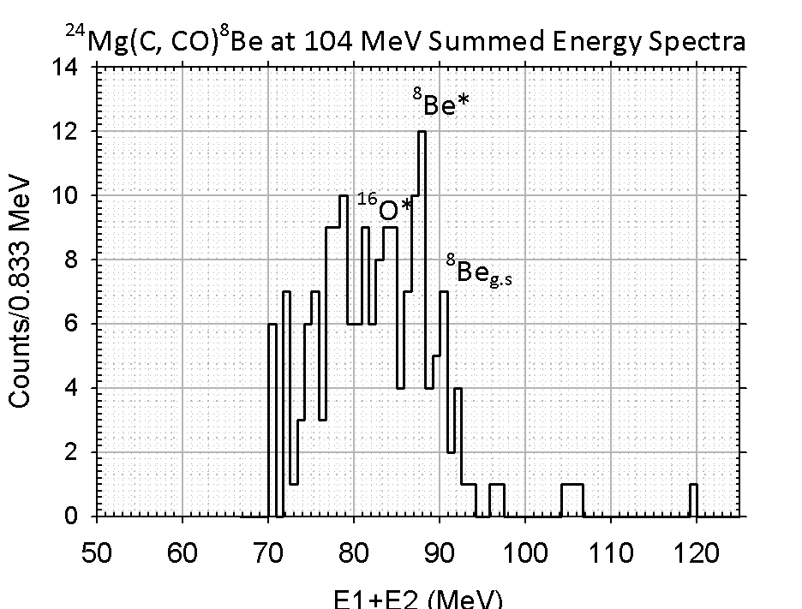

Slide 198
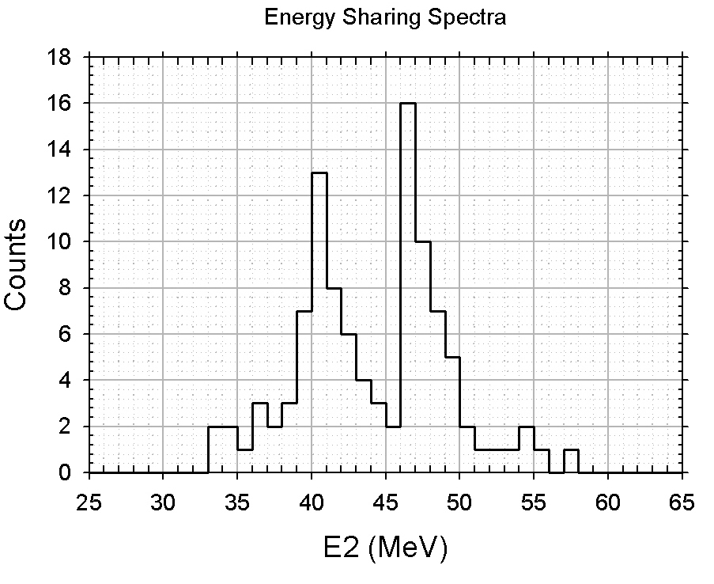
Energy sharing spectra of ²⁴Mg(¹²C, 2¹²C)¹²C at 104 MeV with Q=13.9 MeV
at coplanar symmetric angle of 40.5⁰

Slide 199
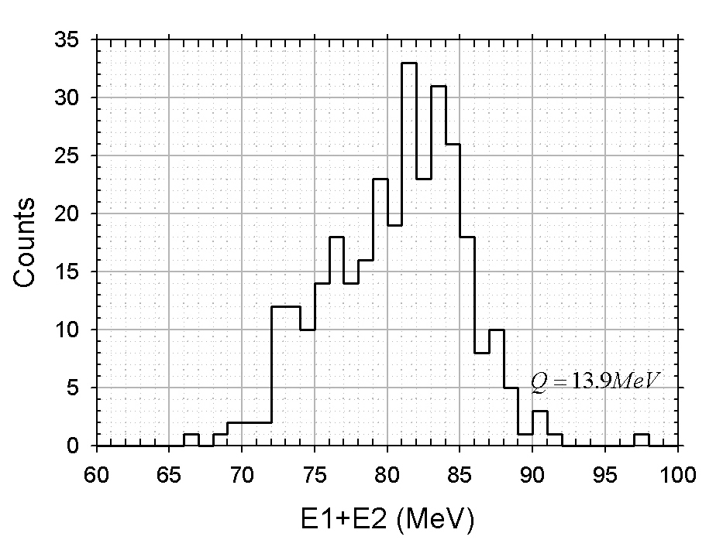
Summed Energy Spectrum of ²⁴Mg(¹²C, 2¹²C)¹²C at 104 MeV. Q=13.9 MeV at coplanar symmetric angle of 36.7⁰

Slide 200
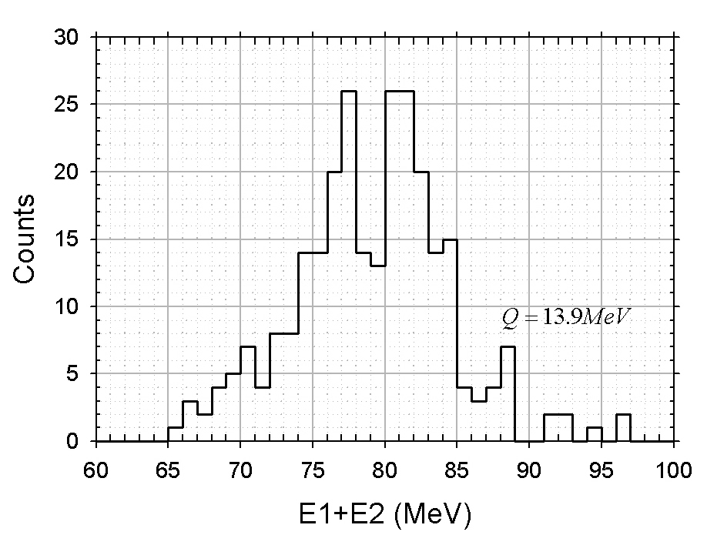
Summed Energy Spectrum of ²⁴Mg(¹²C, 2¹²C)¹²C at 104 MeV. Q=13.9 MeV at coplanar symmetric angle of 33.9⁰

Slide 201
Finite Range with distortions explain elastic as well as knockout data.
One can do heavy cluster knockout similar to (C,2C) reaction to study the short distance behaviour of the heavy clusters vertex (Repulsive core radius).
The repulsion arises from the antisymmetrization of
the many fermions system.
Distortions due to the residual nucleus can be used as an observer (not just a spectator) of the knockout vertex.
Knockout reactions are very sensitive to the interaction at the knockout vertex. Which has never been imagined by earlier workers.
Heavy cluster knockout is possible to analyze because of our Finite Range Formalism and program.

Slide 202
Shrinkage of Deuteron in ⁶Li

Slide 203
Surface Clustering in Light Nuclei
R
r
θ

Slide 204
Surface Clustering in Light Nuclei
R
r
θ

Slide 205
Surface Clustering in Light Nuclei
R
r
θ

Slide 206
Surface Clustering in Light Nuclei
R
r
θ

Slide 207
Surface Clustering in Light Nuclei
R
r
θ

Slide 208
Surface Clustering in Light Nuclei
R
r
θ

Slide 209
Surface Clustering in Light Nuclei
R
r
θ

Slide 210
Surface Clustering in Light Nuclei
R
r
θ

Slide 211
Surface Clustering in Light Nuclei
R
r
θ

Slide 212
Surface Clustering in Light Nuclei
r
R
θ

Slide 213
Surface Clustering in Light Nuclei
R=0
θ

Slide 214
Surface Clustering in Light Nuclei
r
R
θ

Slide 215
Surface Clustering in Light Nuclei
r
R
θ

Slide 216
Surface Clustering in Light Nuclei
r
R
θ

Slide 217
Surface Clustering in Light Nuclei
r
R
θ

Slide 218
Surface Clustering in Light Nuclei
r
R
θ

Slide 219
Surface Clustering in Light Nuclei
r
R
θ

Slide 220
Surface Clustering in Light Nuclei
r
R
θ

Slide 221
K_{α}= 0
K_{α}= 30 MeV/c
Arb Unit
4
3
2
1
0 20 40 60 80 20 40 60 80
θ⁰_{CM} Degree
Shift of the Angular distribution of Li⁶(d, tp)He⁴ reaction to larger angles for k _{α}= 30 MeV/c exhibiting shrinkage of d - cluster in ⁶Li as it approaches α - cluster

Slide 222
Plane wave overlap function for Li⁶(d, tp)He⁴ Reaction ~28 MeV
PRL. 32 (1974) 173
Sin (k_{α}R)/(k_{α}R) x R² ψ_{dα}(R) (Arb. Units)
3
2
1
K_{α}= 0
K_{α}= 30 MeV/c
0 5 10 15 20
R(fm)

Slide 223
As seen in the previous figure, when the Deuteron cluster goes farther away from the α cluster (when Kα= 0 MeV/c) the transition amplitude has relatively more contribution from larger R_{d-α}.
Otherwise, corresponding to K_{α}= -30MeV/c the ⁶Li(d, t p)⁴He is expected to display more contribution from the distorted deuteron and if the n-p residual interaction in Deuteron cluster is long range type then we will see shrinkage.
It is clear from next slide; as compared to the free d(d, t)p distribution (free Deuteron cluster), the c.m. t-p angular distribution of the ⁶Li(d, t p)⁴He reaction shifts outwards. Which means that the relative momentum between the n – p of the deuteron cluster in ⁶Li increased.

Slide 224
from Halo to !!!
Hollow

Slide 225

Halo to Hollow !!
¹¹Li
⁴He + ⁷H
⁴He
⁴He
R=1-2 fm
R=0
⁴He
R=4-6 fm

Slide 226



Slide 227




Slide 228
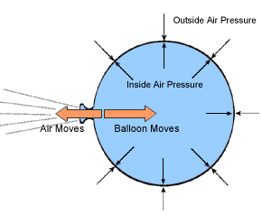
Otherwise
Deflation of a balloon when the surface tension is larger that the pressure inside the balloon.
It nicely represent the decay of a cluster to a compact shape when the long range N-N residual interaction is strong.

Slide 229
Core Knockout Reaction of a Halo Nuclues:-
⁴He(¹¹Li, 2α)⁷H at E₀~ 300 MeV

Slide 230
Core Knockout Reaction of a Halo Nuclues :-
⁴He(⁶He, 2⁴He)2n

Slide 231
Core Knockout Reaction of a Halo Nuclues :-
⁹Be(¹¹Li, ⁹Li ⁹Be)2n

Slide 232
Conclusions:-
1. In case of (α, 2α) knockout reactions there is a transition from 160 MeV to 200 MeV, where the α-α interaction changes from repulsive to attractive potential.
2 One can by explain the sudden change in reaction cross sections considering the strong interaction vertex.
One can do heavy cluster knockout similar to (C,2C) reaction to study the short distance behaviour of the heavy clusters vertex (Repulsive core radius).
4 Preliminary data analysis and understanding of the ²⁴Mg(¹²C, 2¹²C)¹²C Reactions at 104 MeV suggest that ²⁴Mg(g.s) can not be described in terms of two Carbon-12 (g.s) clusters.
5 Data also indicated that ¹⁶O knockout from ²⁴Mg is very significant leading to ²⁴Mg as ¹⁶O+⁸Be
This also can be used to study the very weakly bound nuclei such as ¹¹Li, ⁸He, ⁶He etc by core knockout reaction etc.
This way one can probably arrive at “HOLLOW” nuclei.

Slide 235
In the present project we would like to study the heavy ion knockout on ²⁸Si and ³²S using ²⁴Mg and ²⁸Si Beams respectively at the Mumbai LINAC in order to compare these reactions with the corresponding (α,2α) reactions.
²⁸Si(²⁴Mg ,2 ²⁴Mg )⁴He vs ²⁸Si(α , 2 α.) ²⁴Mg
³²S(²⁸Si ,2 ²⁸Si )⁴He vs ³²S(α , 2 α.) ²⁸Si.
.
This way we will be able to observe the influence of bigger and bigger knockout vertices on the knockout reactions.

