Slide 1

Radioactive Ion Beam and Chemical Perspectives
Bichitra Ganguly
Saha Institute of Nuclear Physics
Applied Nuclear Physics Division
1/AF Bidhannagar, KOLKATA
INDIA , 700064
Email : bichitra.ganguly@saha.ac.in
SOLDE Collaboration , CERN

Slide 2
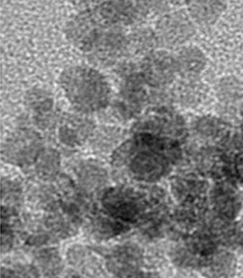
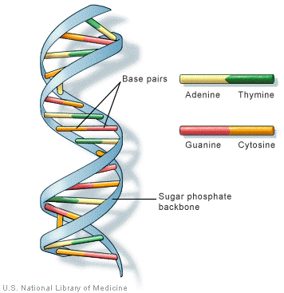
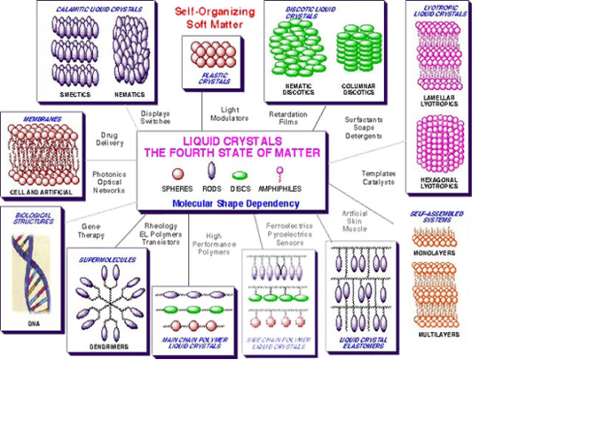
● Radioactive ion beam studies in chemistry opens up a new horizon with unlimited scope to alter the chemical functionality of materials/molecular substances since the consequences of such interaction remains unknown.
● Detection of the reactive species after the exposure to the radioactive
ion beam would therefore open up a wonderland in chemical domain.
Here some important domains of work that are focused :
nano size particles
biological molecules
lyotropic liquid crystals

Slide 3
Semiconductor ZnO nano particle
A_{c}⁺
(acceptor potential)
Stable state (A_{C}⁰)
Conduction band
e⁻
Nanoparticles are surface active, unusual properties.
Optical pumping of electrons from valence band to conduction band (semiconductor).
electrons at conduction band is excited at a high reduction potential. If an Ac+ present may take up the e⁻ charge, photo induced charge transfer reactions are important in biology, device fabrication
hν
e⁻
Valence band
Zinc Oxide nanoparticles grown chemically under the influence of a biotemplate, which is Folic acid, for : size control, monodispersity

Slide 4
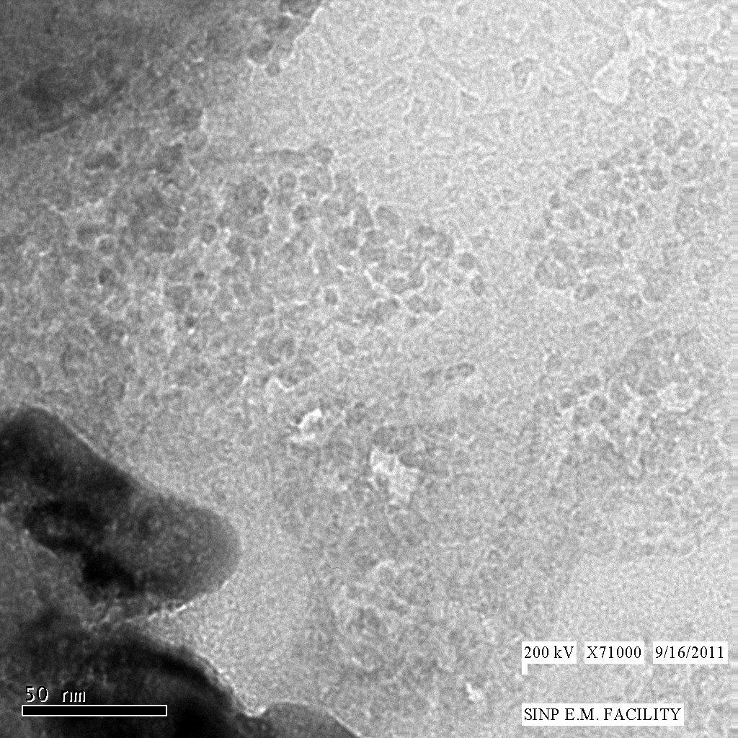
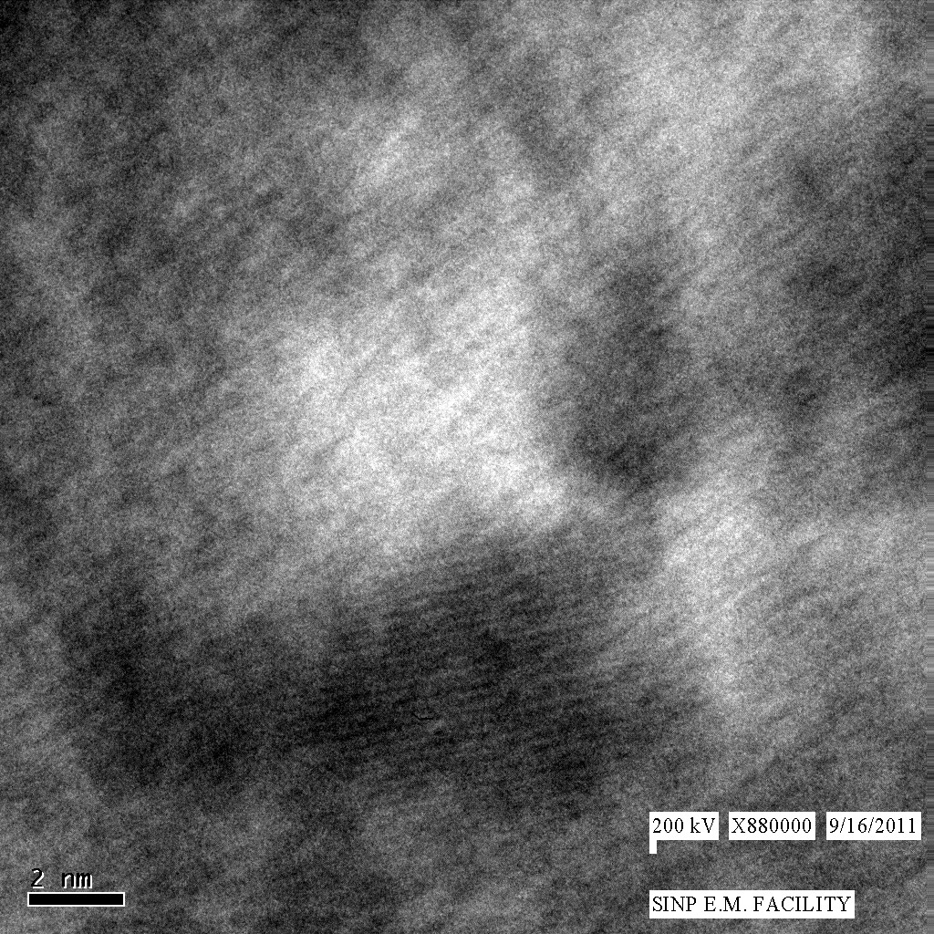
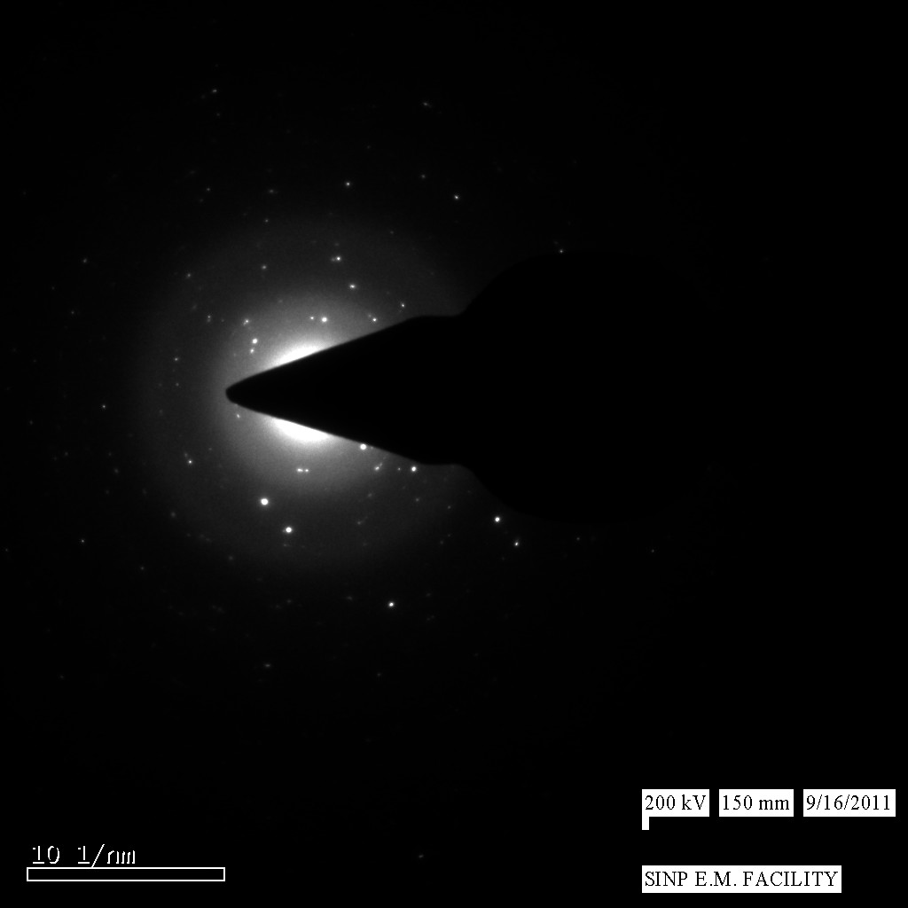
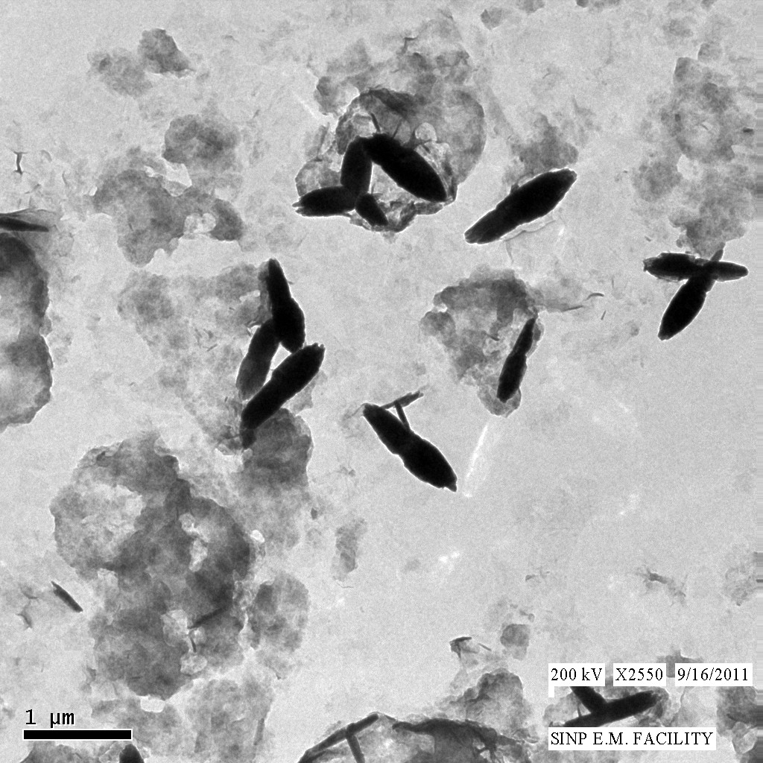
Biotemplate: FOLIC ACID
It regulates the growth of nanoparticles through its charged layer surface properties, prevents Ostwald ripening.
Why we choose Folic acid:
- Folic acid is a member of the Vitamin B family.
It is necessary for the healthy function of a variety of bodily processes.
Folic acid is itself not biologically active, but it is biologically important.
Folic acid ensconced ZnO
TEM

Slide 5
Grain Size calculation
The grain sizes of the powdered samples have been calculated from the Scherrer formula :
D_{hkl} = Kλ/β cosθ
The particle size of synthesized ZnO is ~ 41±2 nm.
Particle size decreases (~ 20±1 nm) with increase of folic acid concentration.
In case of 1% folic acid solution, a sharp decrease of grain size (~ 18±1 nm) is observed.
It may be the transition zone.
Avg. grain size | n | Surface /volume | No. of molecules in the surface
40 nm | 4x10²⁴ | 0.1 | 4x10²³
20 nm | 2x10²⁴ | 0.3 | 6x10²³
Agglomeration no. n = 4/3 (π r³ρ) (N_{A}/M)
Density of ZnO = 5.606 gm/cm³
Molecular weight = 81.389 gm/mole

Slide 6
Ultraviolate-Visible (UV-Vis) Spectroscopy : Semiconductor Bandgap properties
⇨ The band gap of pure ZnO is ~ 3.3 eV, which is in agreement with the band gap of ZnO prepared by other techniques [Appl. Phys. Lett. 65 (1994) 1373]
Overall decreasing nature of band gap has been found (from 3.30 eV to 3.22 eV).
There is so many defect states between the valence band and the conduction band.
Band gap energy (1% FA solution) = 3.21 eV
Band gap energy (1.3% FA solution) = 3.17 eV
⇓
There is a transition zone in the band gap properties.

Slide 7
⇨For the as-grown ZnO, there is a broad emission in UV-Visible region.
⇨ At 392 nm ⇒ UV emission spectra ⇒ attributed to near band edge emission of ZnO.
⇨ With the increase of folic acid concentration (upto 1.3%), UV and visible band are separately distinguished.
⇨ With the increase of folic acid conc., the UV emission peak shifts from 392 nm to 382 nm (1.3% conc. of folic acid ). It shows a clear evidence of charge transfer reaction.
⇨ At 440 nm ⇒ blue emission spectra ⇒ surface defect in ZnO, mainly Zn vacancy.
⇨ At 550 nm ⇒ green emission spectra ⇒ excitation from valence band to intra-gap sates.
In all samples, green light emission is most prominent.
A signature of red emission has been observed in case of 1.3% folic acid concentration.
⇨ Above 1.3% conc. of folic acid, only visible emission spectra is prominent.

Slide 8
USE OF RADIO ACTIVE ION BEAM IN THE ZnO SYSTEM
Irradiation with radio active ion beam of ⁶⁷Cu^{( n+)}z=29, ⁶⁸Ga^{(n+)}z=31, ^{111m}Cd^{(n +)} z=48 with (Energy range: 10 KV to about 60KV) and appreciable current and fluence needed on the prepared samples.
Diffusion of the doped ions (at different oxidation states) : studies can be performed on line (if possible).
c) Depending up on doped ionic state and their concentration , spectroscopic properties,
UV-Vis range and PL Studies will be required.
d) Perturbed Angular Correlation (PAC) studies, with Cd^{111m} is required.
e) X-ray diffraction data and microscopic studies (SEM/TEM ) often needed to examine the irradiation effects for morphological characterization.
f) Positron annihilation spectroscopic studies, at least Doppler broadening of the 511 keV line shape can be done (because it is simpler , with ⁶⁸Ga) and life time analysis can be done either indirectly .or at a later stage.

Slide 9
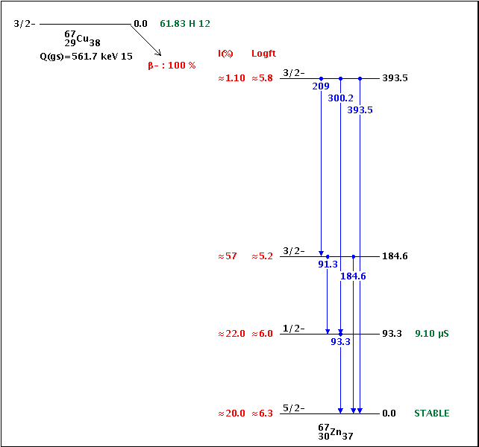

Decay scheme of ⁶⁷ Cu₂₉ T1/2= 61.83h, β⁻
Decay scheme of ¹¹¹Cd ₄₈, IT T_{1/2}=48.54m
Decay scheme
⁶⁸Ga₃₁, T_{1/2}=67.71 m
EC₂
^{2.3386} ^{(MeV)}
EC₃
^{1.8832} ^{(MeV)}
EC₅ β₁⁺
^{1.0774} ^{(MeV)}
EC₆ β₂⁺
⁶⁸₃₀Zn (stable)

Slide 10
Results envisaged :
● Doped ions will bring about a change in crystal structure, create structural defects,
induce phase transitions. radiation effects.
● Doped material effectively will be a new system with unstable valency state of the
radioactive ions, may propagate further changes
● Distortion in the lattice due to variation of the ionic radii :
r_{Zn+2}=0.074nm < r_{cd+2} =0.097nm, there can be lowering of the band gap,
important from solar cell point of view (emitting in the visible region)
Application :
● ZnO is an important nontoxic LED material useful in medicine and biotechnology. The radioactive ion doped and modified material will emerge in a new way in
medicine and biology.
● ⁶⁸Ga is a short lived positron emitter, can be used in connection to PET diagnostics.
● Cu and Ga ions are physiologically active elements, can be useful in nuclear
medicine in various ways.

Slide 11
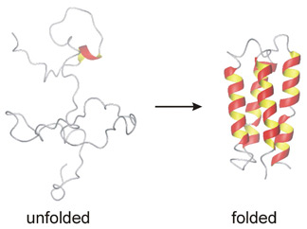
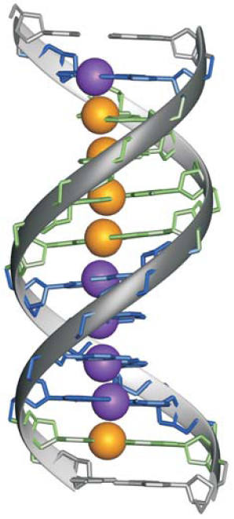
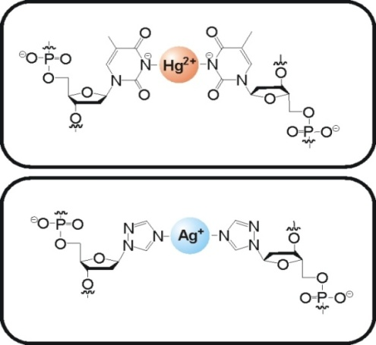
Biological macro molecules
Protein aggregates, nucleic acid etc. are some of the important biological macro molecules which could host metal ions when doped in regulated quantities. It could have wide implication in their functionalities. An energy dependent doping of metal ions as micro nutrients in biological systems could be meaningfully utilized towards their medicinal usage.
  binding sites in biomolecules
Metal ion binding to proteins may lead to a special functional form, eg.
Azurin – an example of a
Cu(I)/Cu(II) dependent electron
transporting protein
Metal-mediated base pairs represent a powerful tool for the site-specific functionalization of nucleic acids with metal ions. Nature Chemistry 2, p 229–234(2010)

Slide 12
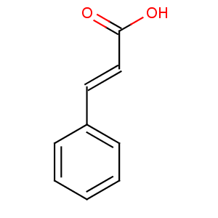

Lyotropic liquid crystals
lattice constants range from several nanometers to tens of nanometers, perfect template candidate for designing novel materials by doping with radioactive ion beam,
different energy scale and low current conditions
study the properties of the structural modifications.
# CINN exerts its antiproliferative effcts by inhibition of protein isoprenylation:
- the protein ‘cysteine’ has a terminal ‘thiol (-SH) group’ at its residue.
non polar tail
Cinnamic
acid
CINN dimer
polar head
~ 1nm
#if CINN gets the (-SH) moiety it stacks up subsequently
- this results in differentiation/blocking the pathway for cell division - thus tumour growth is prevented !
# forms a crystalline layered structure also in solid state - PAS can be helpful to elucidate structural aspects
# bulk PAS studies (LT, DB) revealed a heterogeneous layer structure for CINN crystalline grains [6]
# we try to probe the stacking feature (supra-structure) of CINN deposited on different substrates

Slide 13
summary
Modification of substrates and their detection/ structural identification
Nano size semi conductor particle
Bio macro molecules
Lyotropic liquid crystals
Thank you
& Looking forward to collaboration

