Slide 1


The HIE-ISOLDE Project
Yacine Kadi on behalf of HIE-ISOLDE project team
FPRIB 2012 , 16-18 April2012

Slide 2

Outline
Scope of HIE-ISOLDE
Upgrade of ISOLDE Facility: HIE-ISOLDE
R&D Activities
Outlook for 2012

Slide 3
Scope
The High Intensity and Energy (HIE) ISOLDE project builds on the success of the REX-ISOLDE post-accelerator and will focus on the upgrade of the REX facility but also aims to improve the target and front-end part of ISOLDE to fully profit from upgrades of the existing CERN proton injectors (LINAC4 and PSB Upgrade):
    Higher energy for the post-accelerated radioactive beam
    More beams (Intensity wise and different species)
    Better beams (High purity beams, low emittances, more flexibility in the beam parameters)

Slide 4
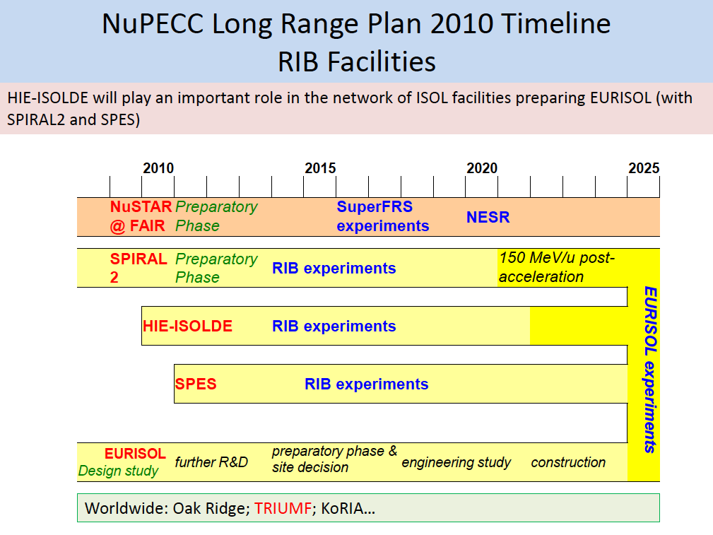

Slide 5
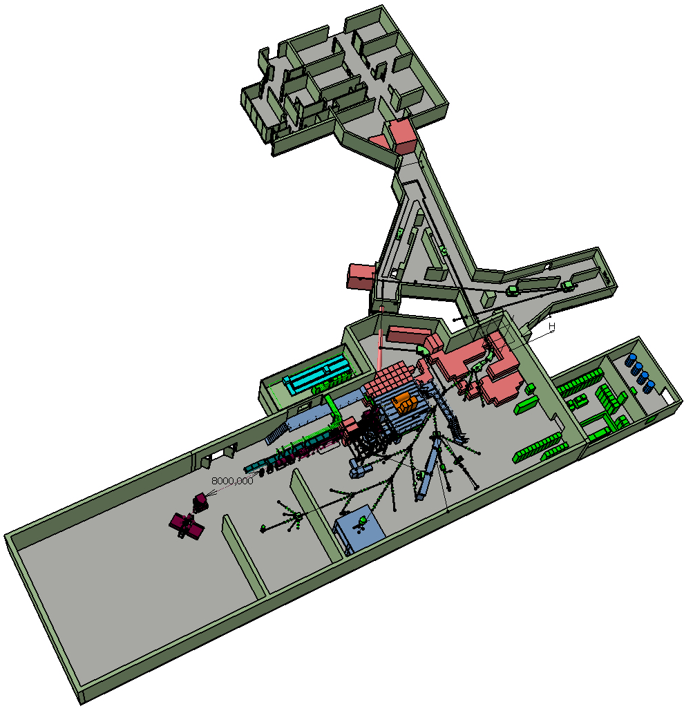
Scope of HIE-ISOLDE
Energy Upgrade:
The HIE-ISOLDE project concentrates on the construction of the SC LINAC and associated infrastructure in order to upgrade the energy of the post-accelerated radioactive ion beams to 5.5 MeV/u in 2014 and 10 MeV/u by 2015/2016
Intensity Upgrade:
The design study for the intensity upgrade, also part of HIE-ISOLDE, starts in 2012, and addresses the technical feasibility and cost estimate for operating the facility at 10 kW once LINAC4 and PS Booster are online. The 30 kW option (SPL beam) will be studied at a later stage

Slide 6
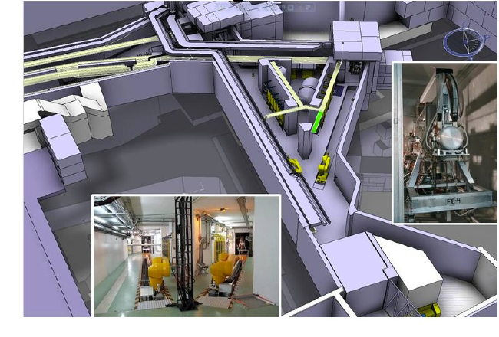
Target Zone

Slide 7
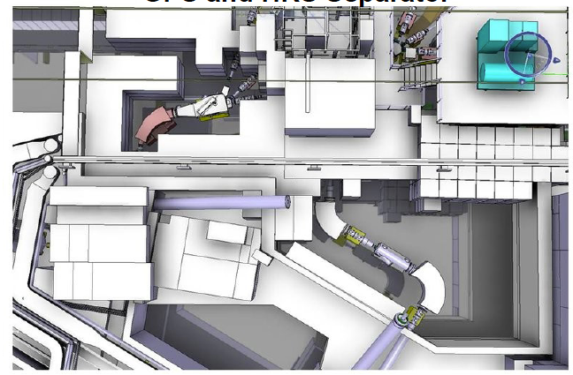
GPS and HRS Separators

Slide 8
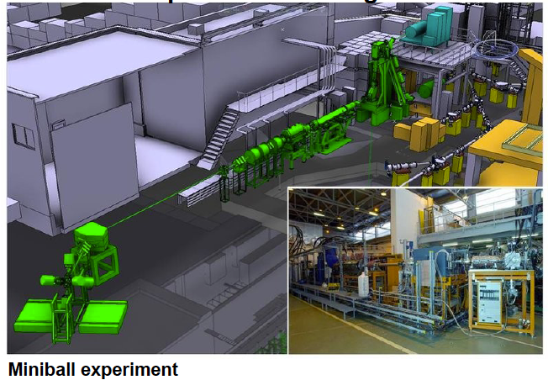
REX Post-Accelerator Linac

Slide 9
Energy Upgrade: Modular SC Linac
1.2 MeV/u
3
MeV/u
5.5 MeV/u
8
MeV/u
10 MeV/u

Slide 10
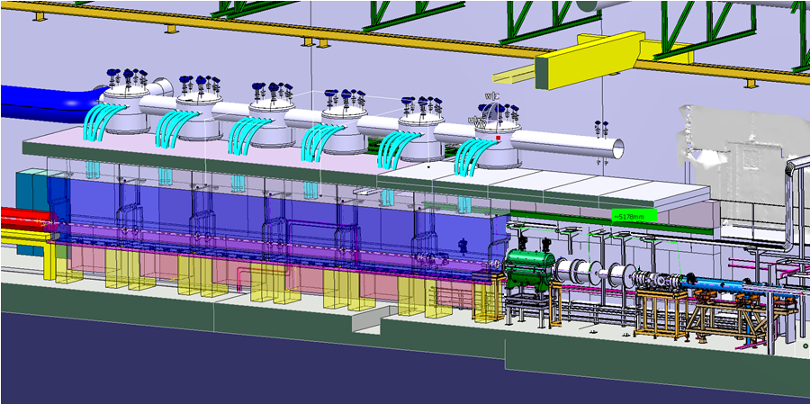
Hie-Isolde SC Linac
Hie-Isolde SC Linac:
5.5MeV/u by late autumn of 2014
First 10MeV/u by March 2016
Bunched beam by 2017 ?

Slide 11
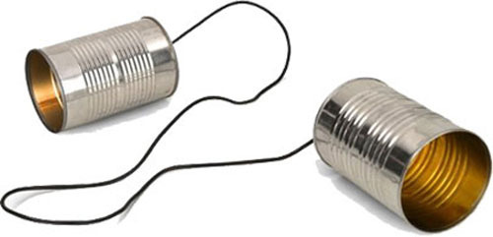
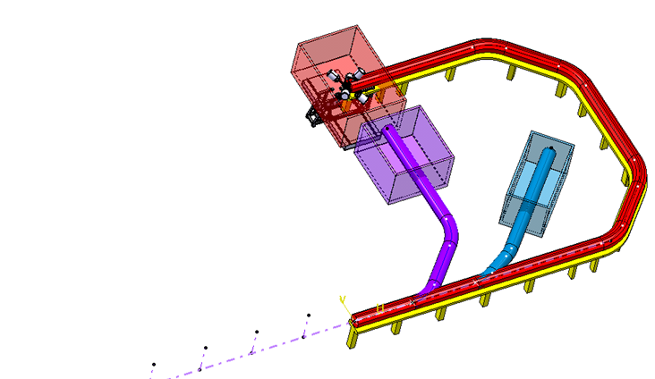
Beam Transfer Line

Slide 12
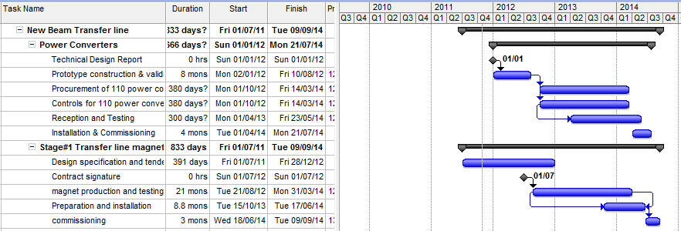
Beam Transfer Line
LS1
CM1&2
EN/HDO : YACINE KADI, TE/EPC: DAVID NISBET, TE/MSC: JEREMY BAUCHE, TE/ABT: BRENNAN GODDARD, BE/OP: DIDIER VOULOT

Slide 13
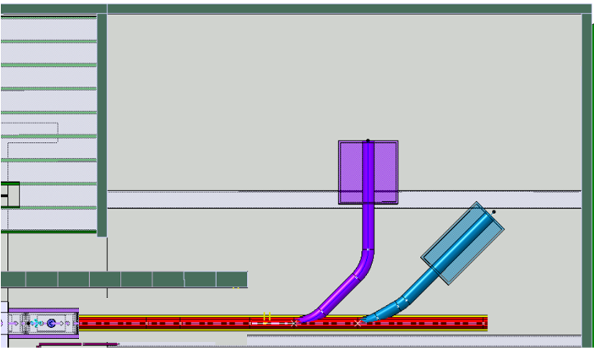

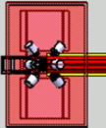


Beam Transfer Line Stage 1
Miniball
Exp.
station
Actar / Helios
Miniball
Beam diagnostics
Straight line with 2 branches – Oct 2013 - Sept 2014
Miniball move: Oct 2013 – April 2014

Slide 14
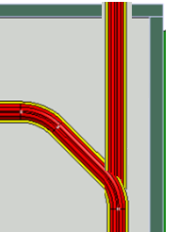
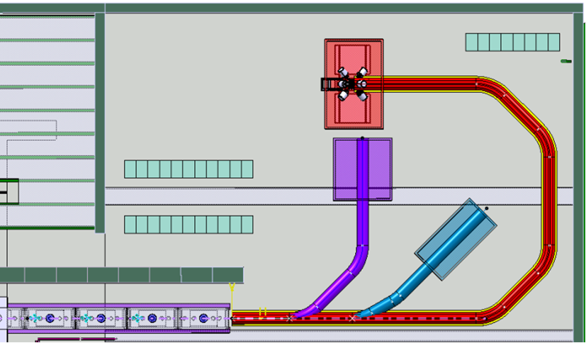

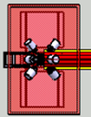
Stage 3
Beam Transfer Line Stage 2
Spectrometer
Miniball
TSR
Miniball
Exp. station
Actar / Helios
The bend
Stage 3:
TSR and beyond..
2nd Miniball move and Spectrometer installation

Slide 15
Hie-Isolde Planning
A simplified presentation of the different stages:
2011
2012
2013
2014
2015
2016
Q1
Q2
Q3
Q4
Q1
Q2
Q3
Q4
Q1
Q2
Q3
Q4
Q1
Q2
Q3
Q4
Q1
Q2
Q3
Q4
Q1
Q2
Q3
Q4
Beam Transfer Line
Civil
Cryo
Main services
Ventilation
Demi water
CM 1&2
Electrical syst.s
CM 3&4
CM 5&6
5.5MeV/u
10MeV/u
Timeline:
What is the impact on operations?
sd
sd
LS1
CM1&2
sd
sd
Dec 2012 - Apr 2014
shutdown
Cryo Mod 1 & 2 install
(Isolde normal operations)
(REX perturbations)
Isolde & REX Ops

Slide 16
Outline
Scope of HIE-ISOLDE
Upgrade of ISOLDE Facility: HIE-ISOLDE
R&D Activities
Outlook for 2012

Slide 17
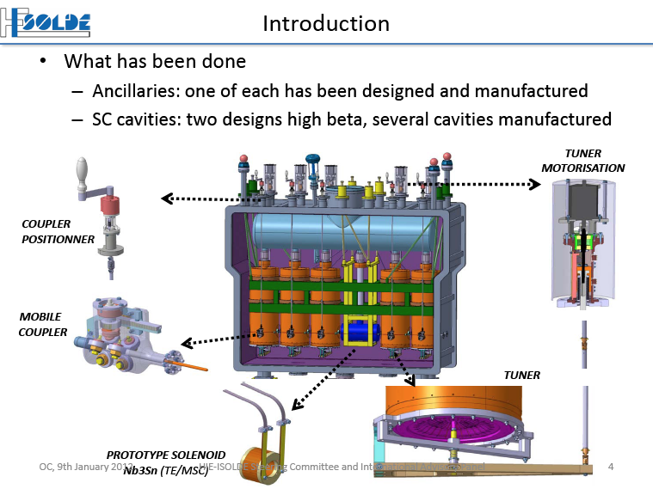
R&D activities (2008 – 2010)

Slide 18
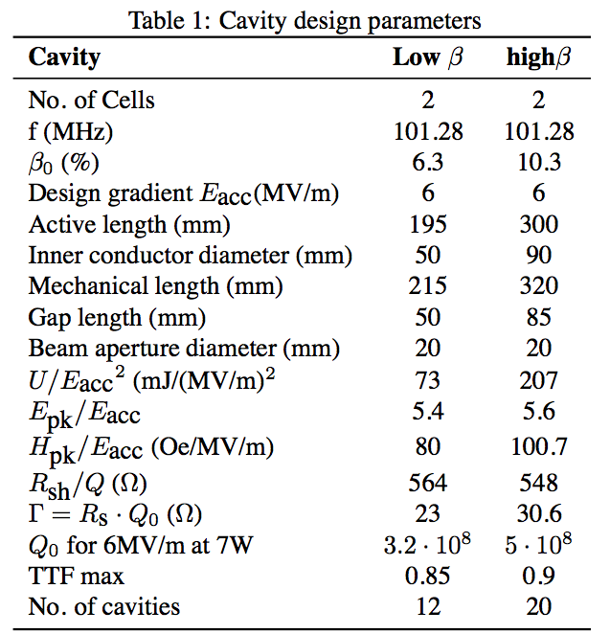
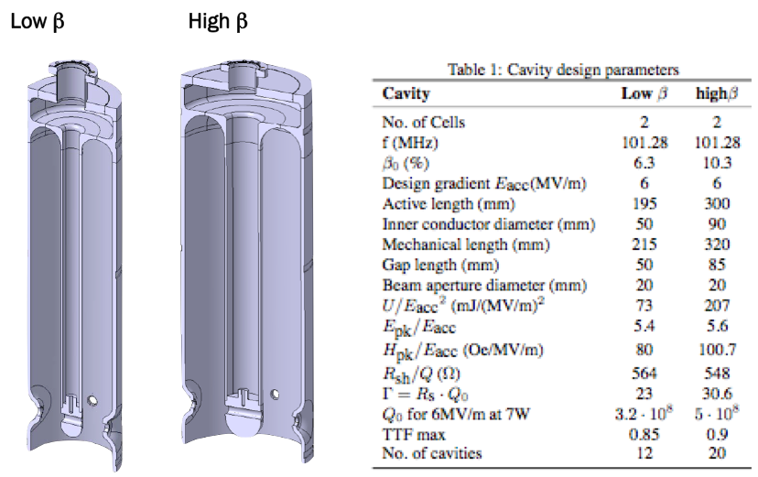
QWR cavities (Nb sputtered)

Slide 19
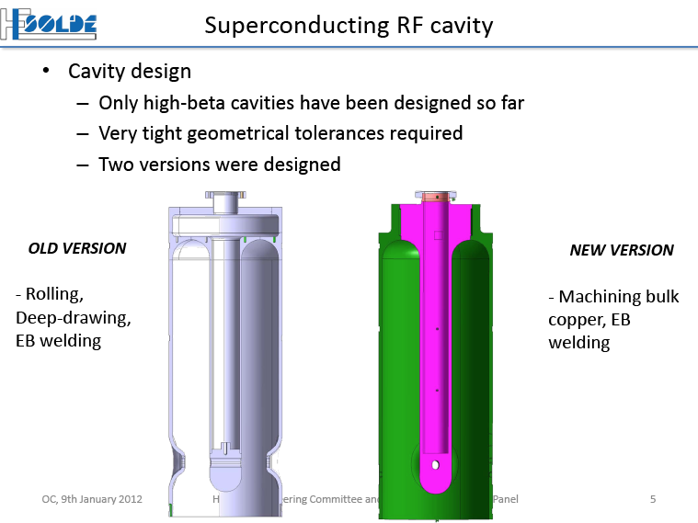

Slide 20
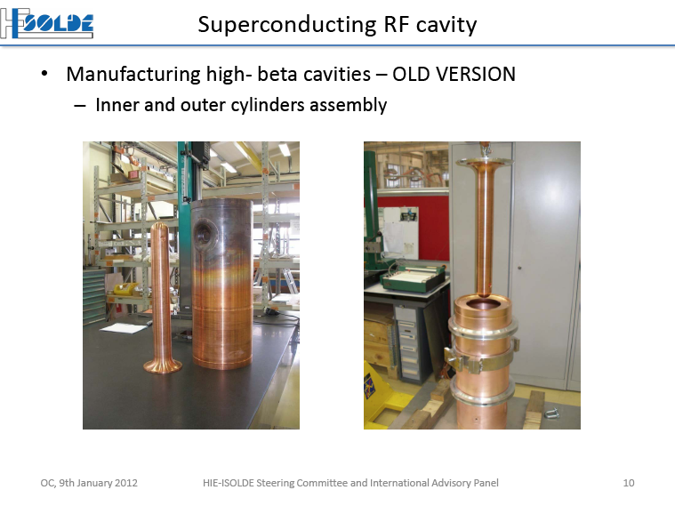

Slide 21
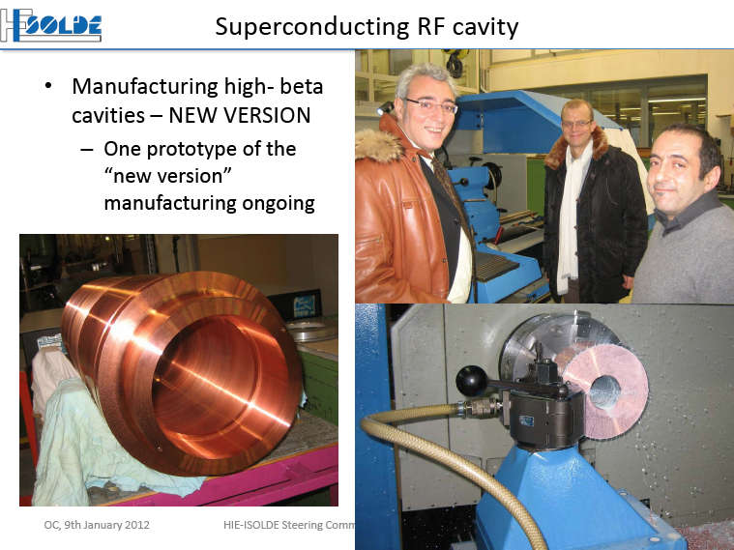

Slide 22
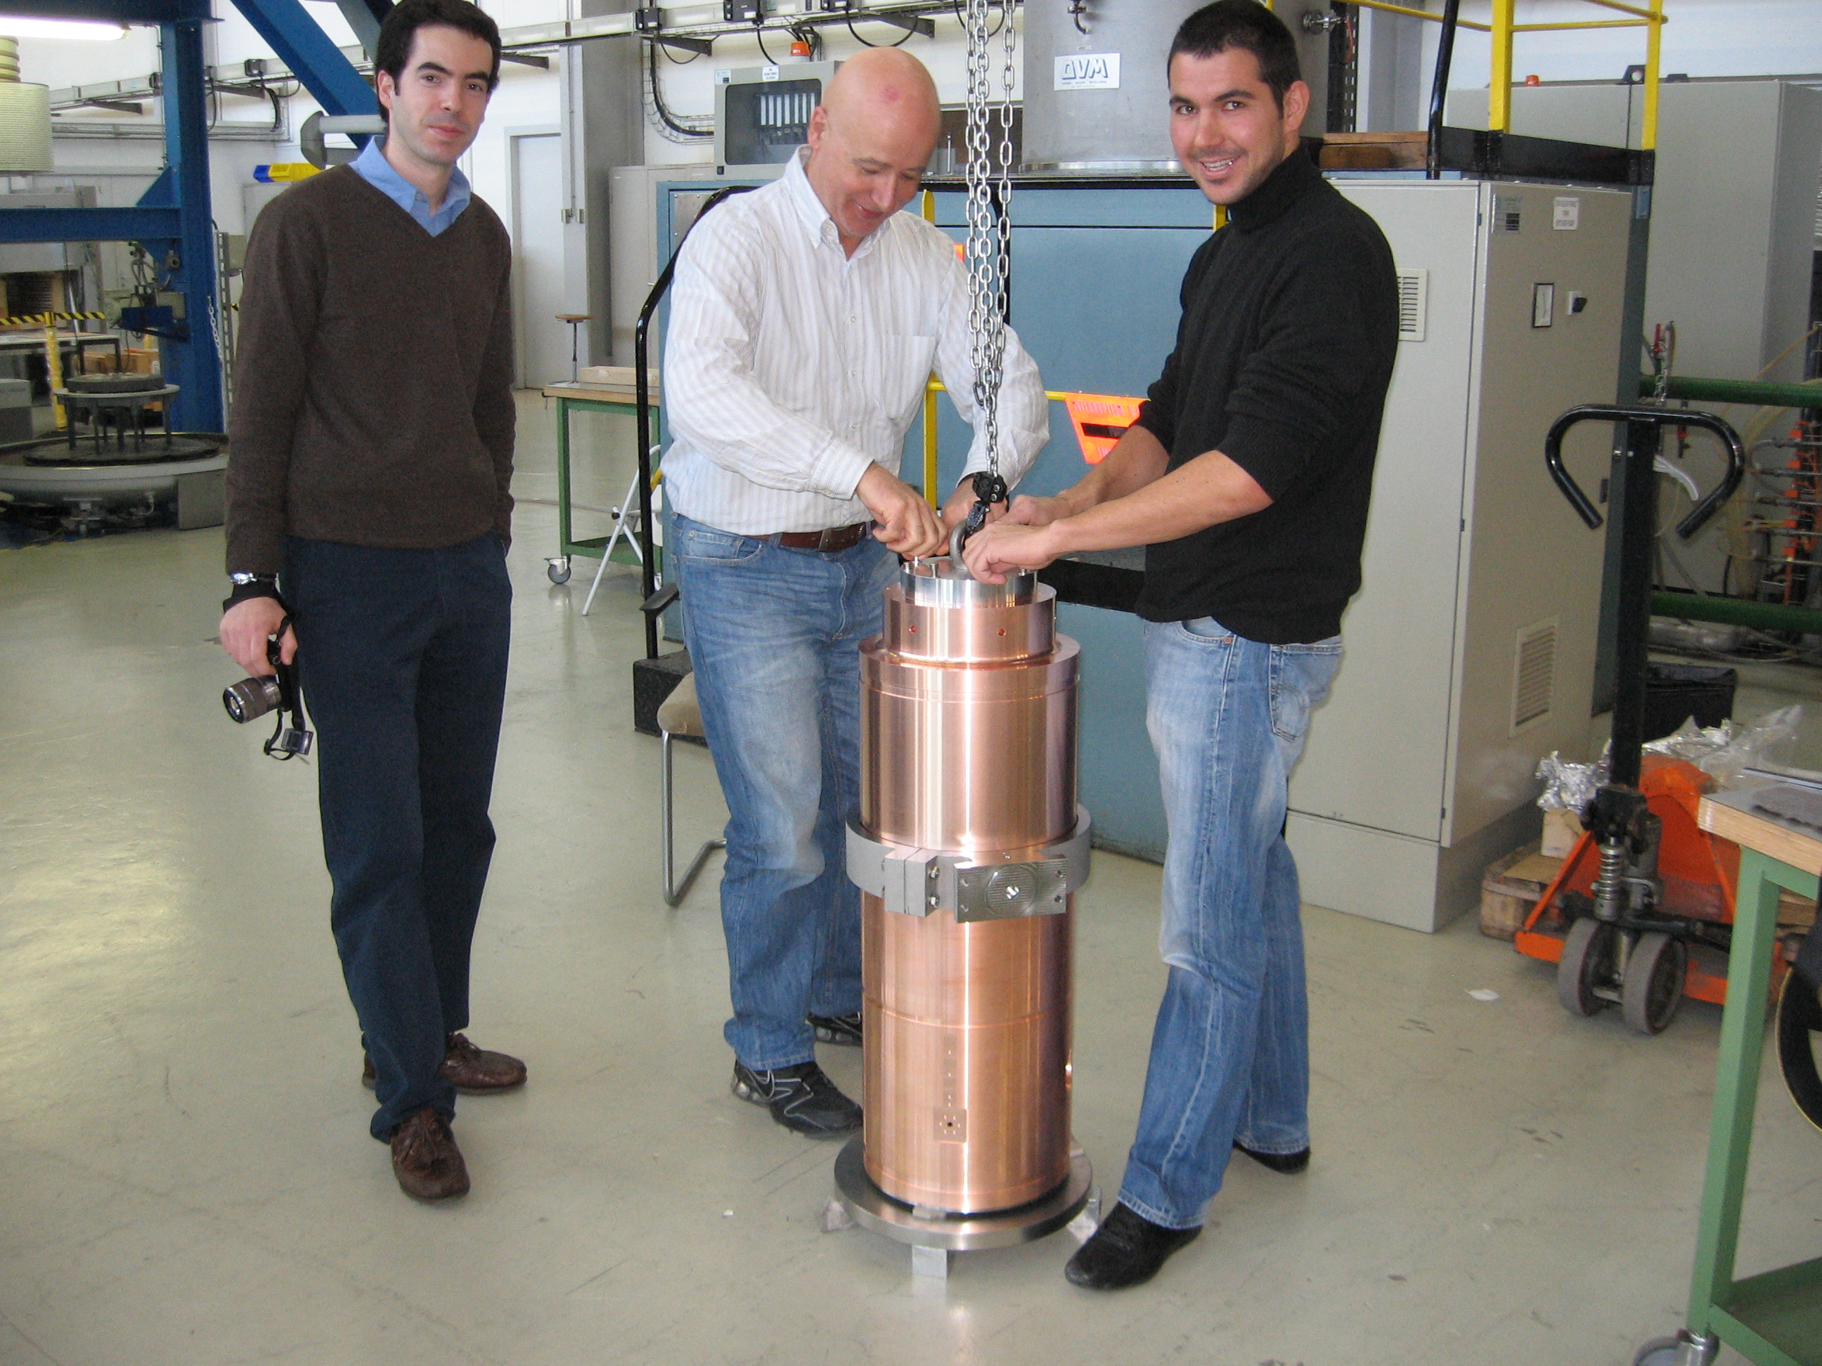
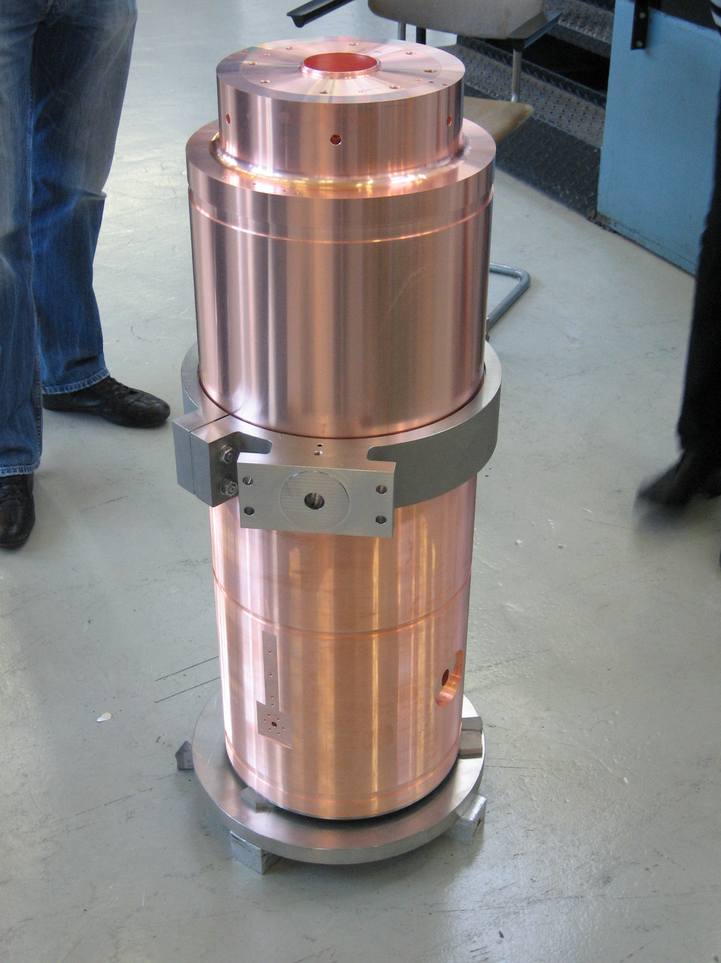

Slide 23
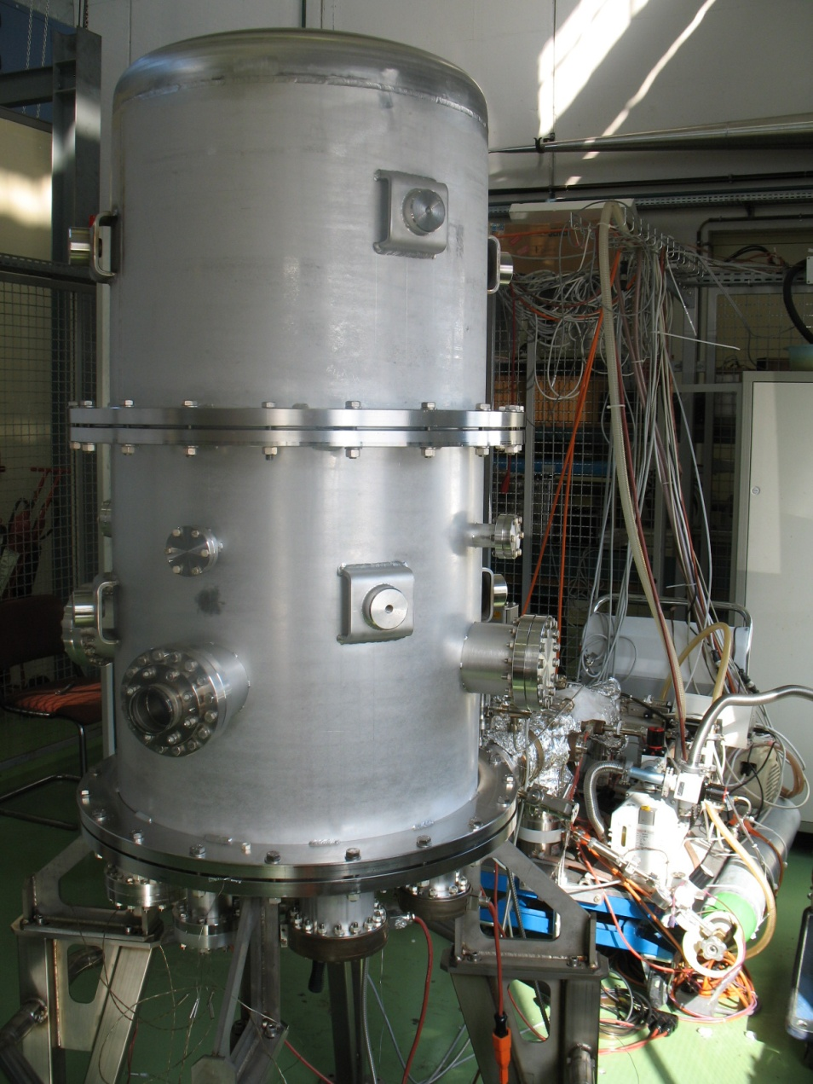
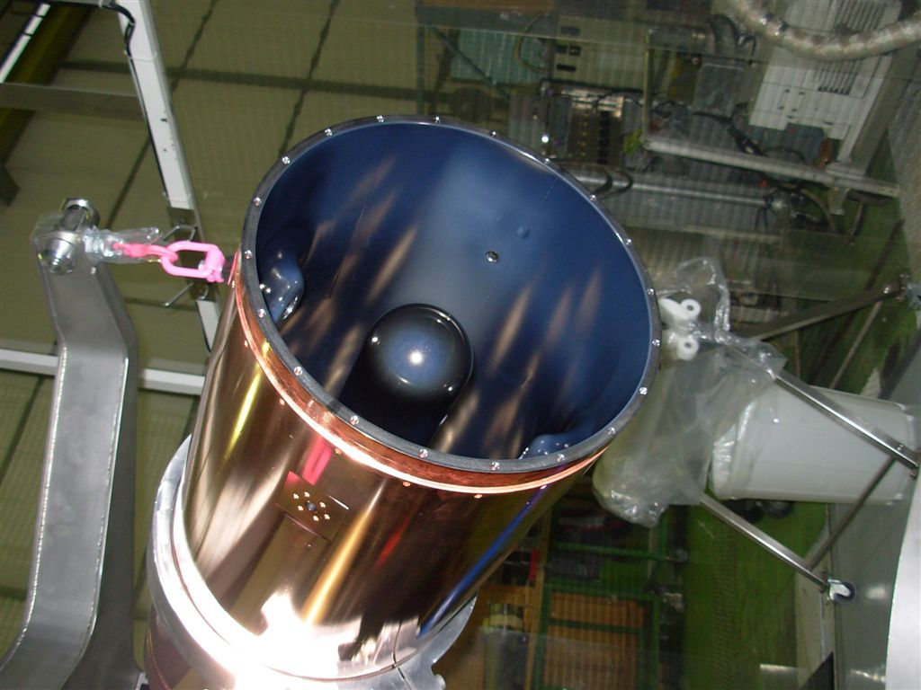
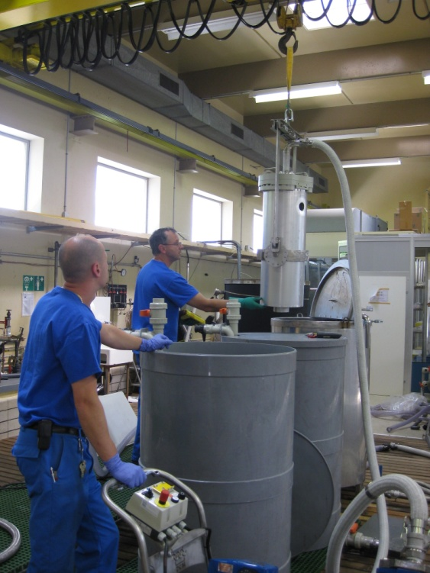
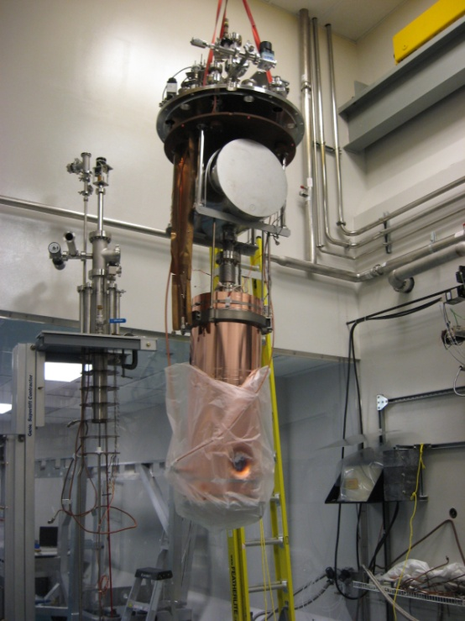
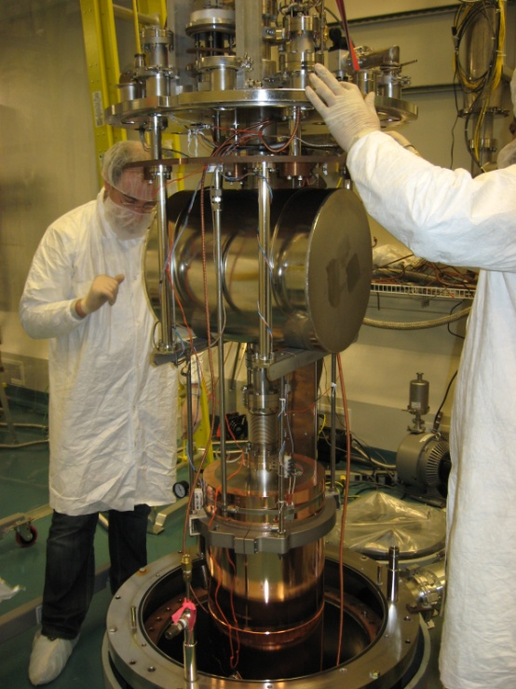
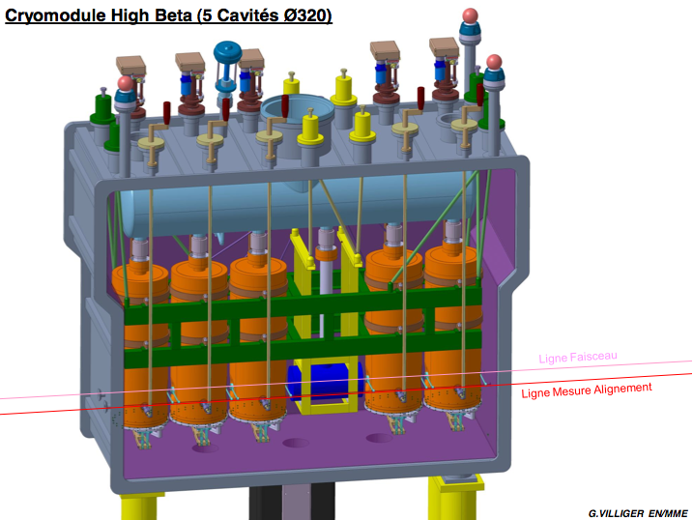
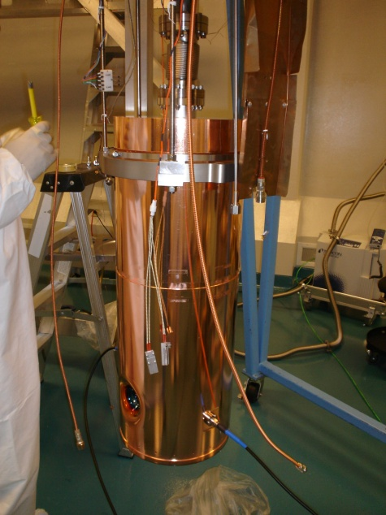
Key Technologies
Notes:
Thursday March 25:Installation of the cavity in the TRIUMF cryostat completed, all electrical connections were checked and low level RF measurements were done. We inserted the cavity in the cryostat for pumping and pre-cooling (the heat screen was filled with LN2) Thursday March 25:Installation of the cavity in the TRIUMF cryostat completed, all electrical connections were checked and low level RF measurements were done. We inserted the cavity in the cryostat for pumping and pre-cooling (the heat screen was filled with LN2)

Slide 24
RF Measurements @ 4.5K (2011)

Slide 25
RF Measurements (2012)
~ 35 W @ 6 MV/m
~ 70 W @ 6 MV/m

Slide 26
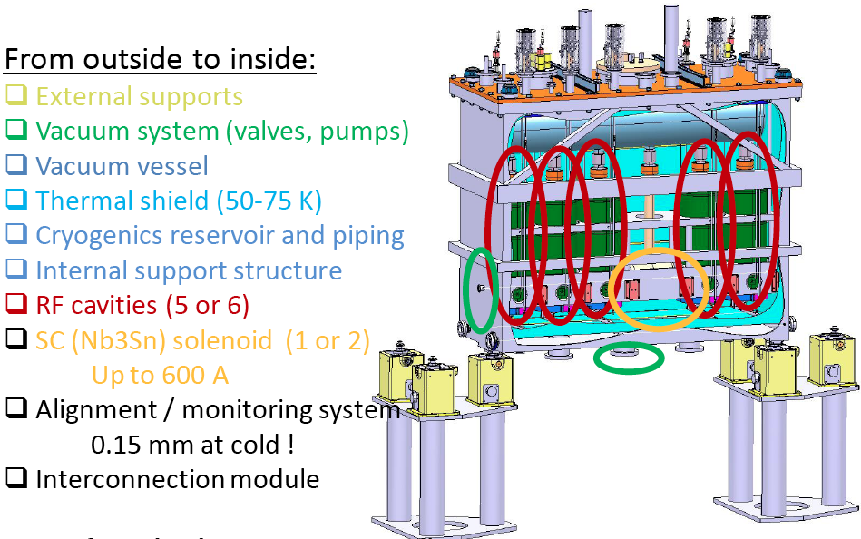
The HIE-ISOLDE Cryomodule

Slide 27
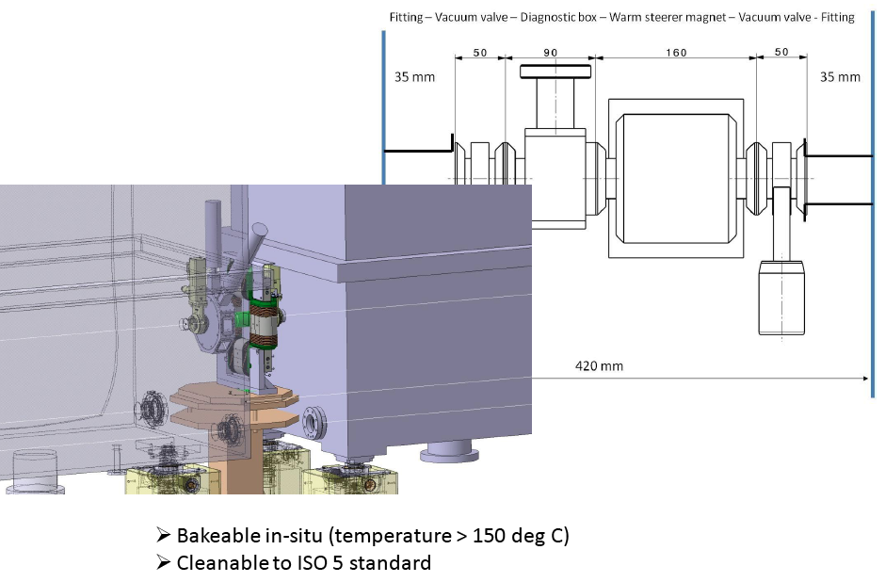
The Interconnection Module

Slide 28
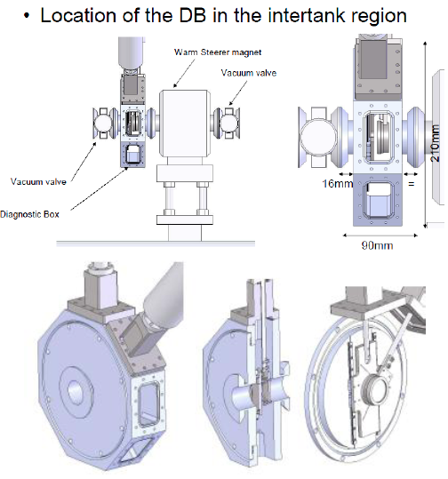
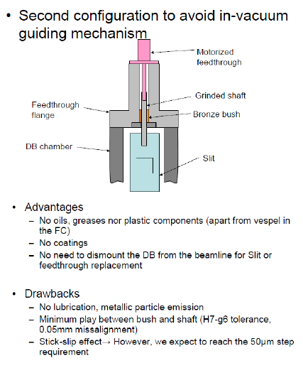
Diagnostic Box Design

Slide 29
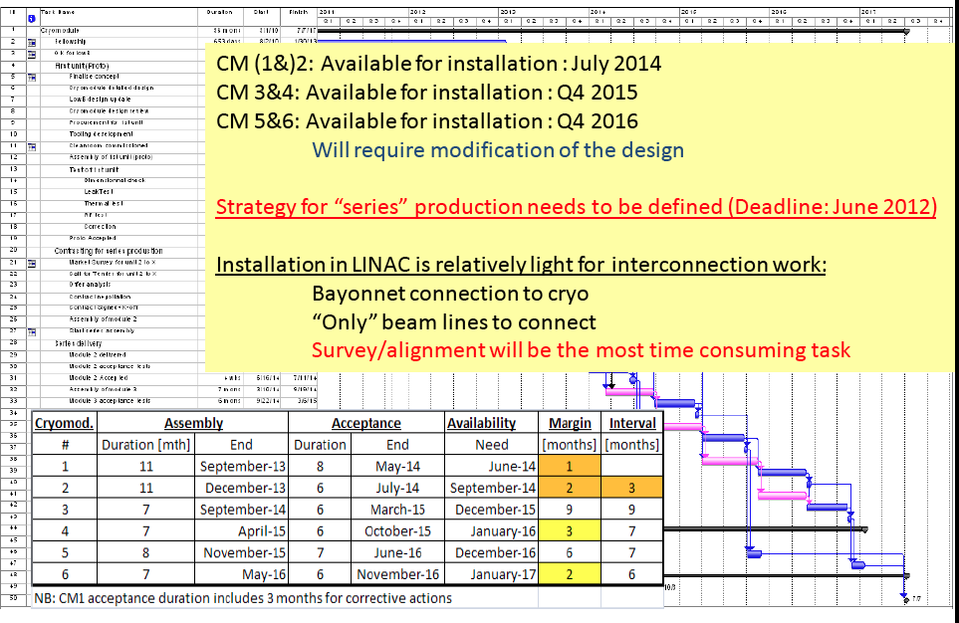
Planning for the 6 cryomodules

Slide 30
Outlook for 2012
Completion of Civil Engineering Works by Q3 2012
Installation of Main Services (EL, CV, Transport)
Launch procurement of Cryogenic Plant (FC Sep. 2012)
Launch procurement of first batch of 5 (+ 15 ?) high-beta cavities by Q1 2012.
Review Cryomodule Design (26-27 Apr. 2012) and launch procurement of CM1 by Q2 2012.
Review HEBT Layout (25 Apr. 2012) and launch procurement
Validate LLRF system and tuner plate design

Slide 31
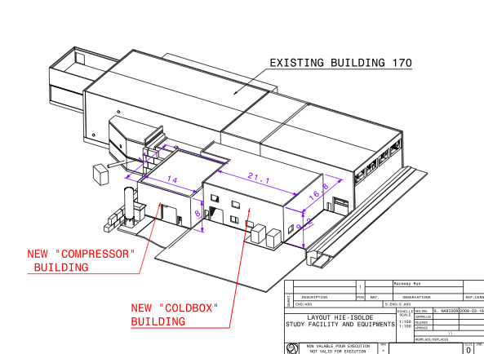

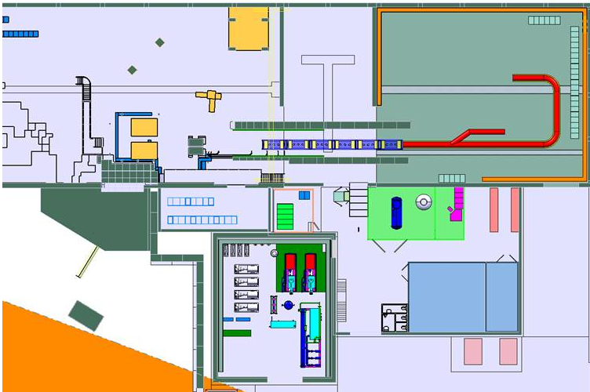
Thank you
HIE-ISOLDE web site -> http://hie-isolde.web.cern.ch/hie-isolde/
CATHI-ITN web site -> https://espace.cern.ch/Marie-Curie-CATHI/default.aspx

