Slide 1


Introduction to ISOLDE
Yorick Blumenfeld
Spokesperson and Physics Group Leader

Slide 2
OUTLINE
Introduction
The ISOLDE facility
Physics and Instrumentation at HIE-ISOLDE
The Organization of ISOLDE
ISOLDE and HIE-ISOLDE in the European Roadmap

Slide 3
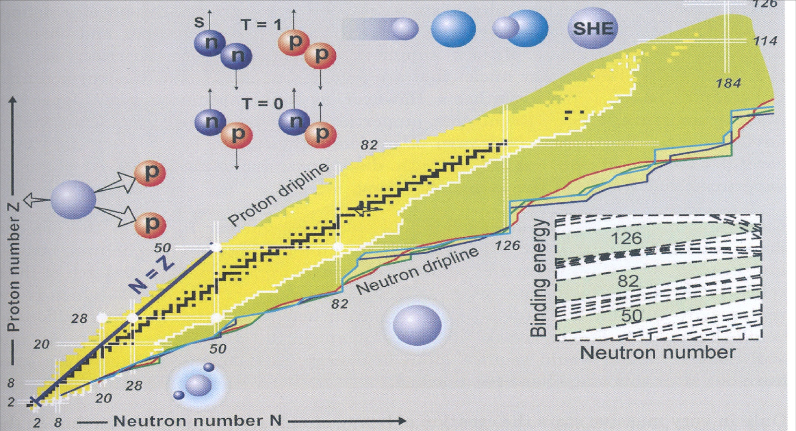
The Nuclear Chart and Challenges
Notes:
Un résumé de la présentation. Noyaux stables, connus et inconnus. Les driplines. La structure en couches avec les nombres magiques traditionnels. Exemples de phénomènes associés avec les noyaux exotiques : radioactivité 2-protons, noyaux à halos et systèmes quantiques faiblement liés, appariement neutron-proton à la ligne N=Z, les noyaux super-lourds.

Slide 4
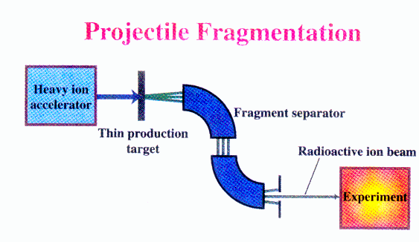
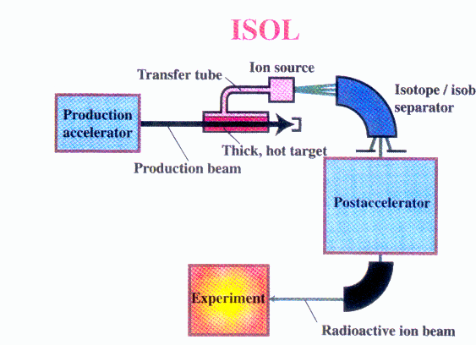
Radioactive beam production: Two complementary methods
In Flight
FAIR, FRIB
High energy, large variety of species,
HIE-ISOLDE; SPIRAL2
Variable energy, high intensity , good beam qualities

Slide 5
A Few Facts
ISOLDE is the CERN radioactive beam facility
In operation since 40 years
The largest selection of isotopes of any ISOL facility worldwide
Provides low energy or post-accelerated beams
Run by an international collaboration
Open to users from around the world

Slide 6
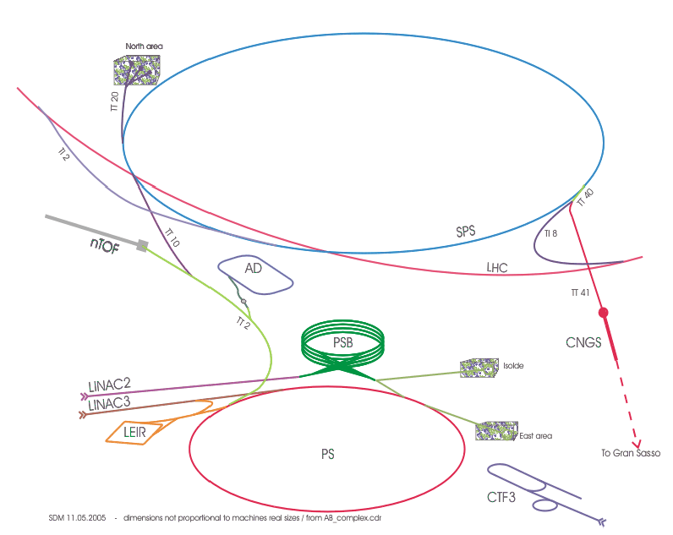
Accelerators at CERN

Slide 7
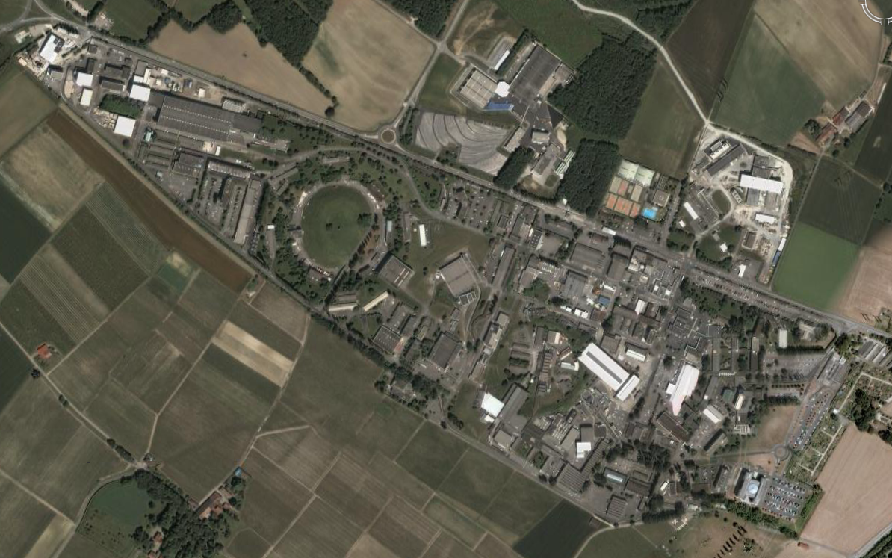
ISOLDE
PSB
PS
LINAC2

Slide 8
ISOL: Isotope Separation
On-Line

Slide 9
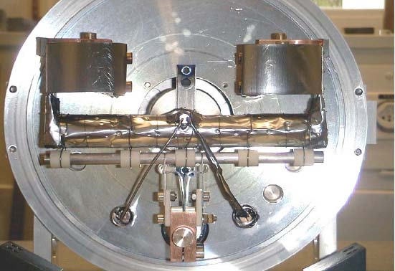
Targets
Target
Target
p+
p+
p+
p+
p+
p+
Converter
Converter Target
Standard

Slide 10
Production of exotic ions
spallation
+
2
0
1
F
r
1 GeV p
fragmentation
+
+
2
3
8
U
1
1
L
i
X
fission
n
+
+
p
1
4
3
C
s
Y

Slide 11
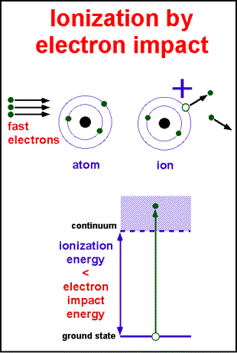
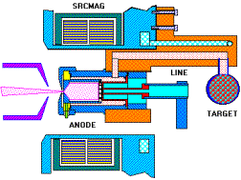
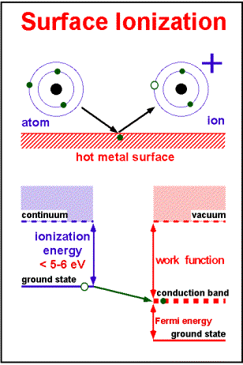
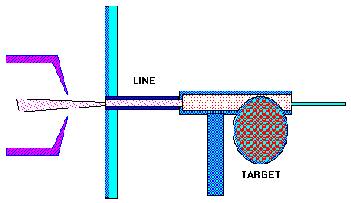
Surface & plasma ionization

Slide 12
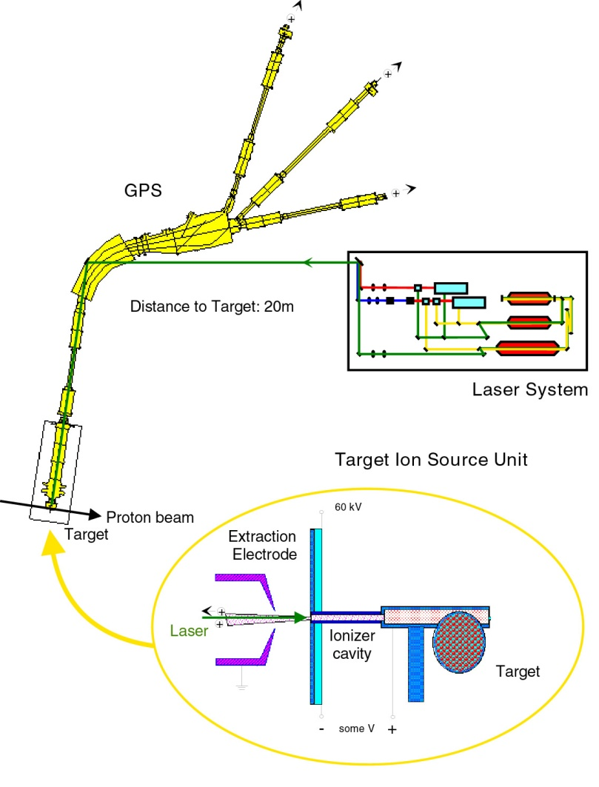
Ion source
Laser ionization

Slide 13
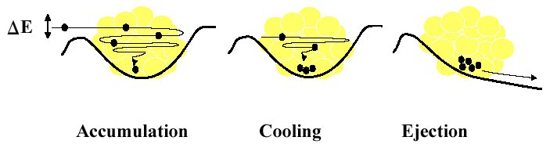
REX-Isolde
* charge breeding
* 1+ ions to n+
REXEBIS
Optional stripper
MASS SEPARATOR
ISOLDE
9-GAP RESONATOR
@ 202.56 MHz
7-GAP RESONATORS
@ 101.28 MHz
IH
RFQ
ISOLDE beam
Primary
target
High energy
driver beam
protons
Rebuncher
60 keV
3.0 MeV/u
2.2 MeV/u
1.2 MeV/u
0.3 MeV/u
REXTRAP
Experiments
* longitudinal accumulation and bunching
* transverse phase space cooling
* 6 cavities
* 100 and 200 MHz, ~100 kW
* 300 keV/u to 3 MeV/u
D. Voulot

Slide 14
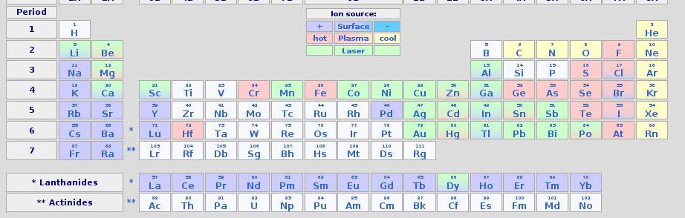
Beam consolidation/development at ISOLDE
Beam evolution in the past 4 years
Beam development: Thierry Stora
Notes:
14

Slide 15
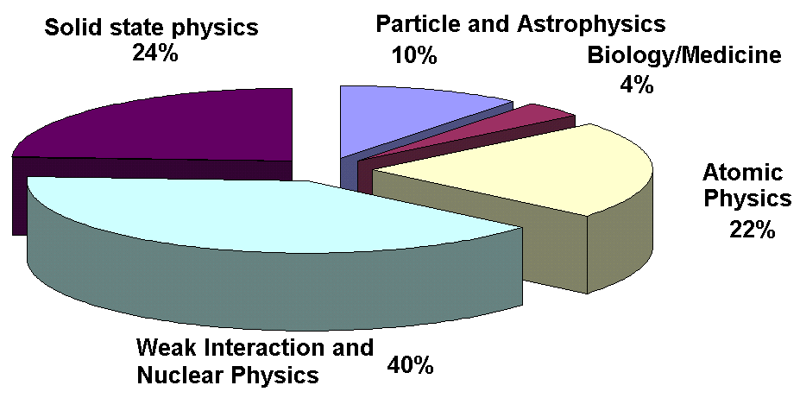
Research with Radioactive Ion Beams
Applied Physics
Implanted Radioactive Probes, Tailored Isotopes for Diagnosis and Therapy
Condensed matter physics and Life sciences
Nuclear Physics
Nuclear Decay Spectroscopy and Reactions
Structure of Nuclei
Exotic Decay Modes
Fundamental Physics
Direct Mass Measurements, Dedicated Decay Studies - WI
CKM unitarity tests, search for
β-ν correlations, right-handed currents
Atomic Methods
Laser Spectroscopy and Direct Mass Measurements
Radii, Moments, Nuclear Binding Energies
Nuclear Astrophysics
Dedicated Nuclear Decay/Reaction Studies
Element Synthesis,
Solar Processes
f(N,Z)

Slide 16
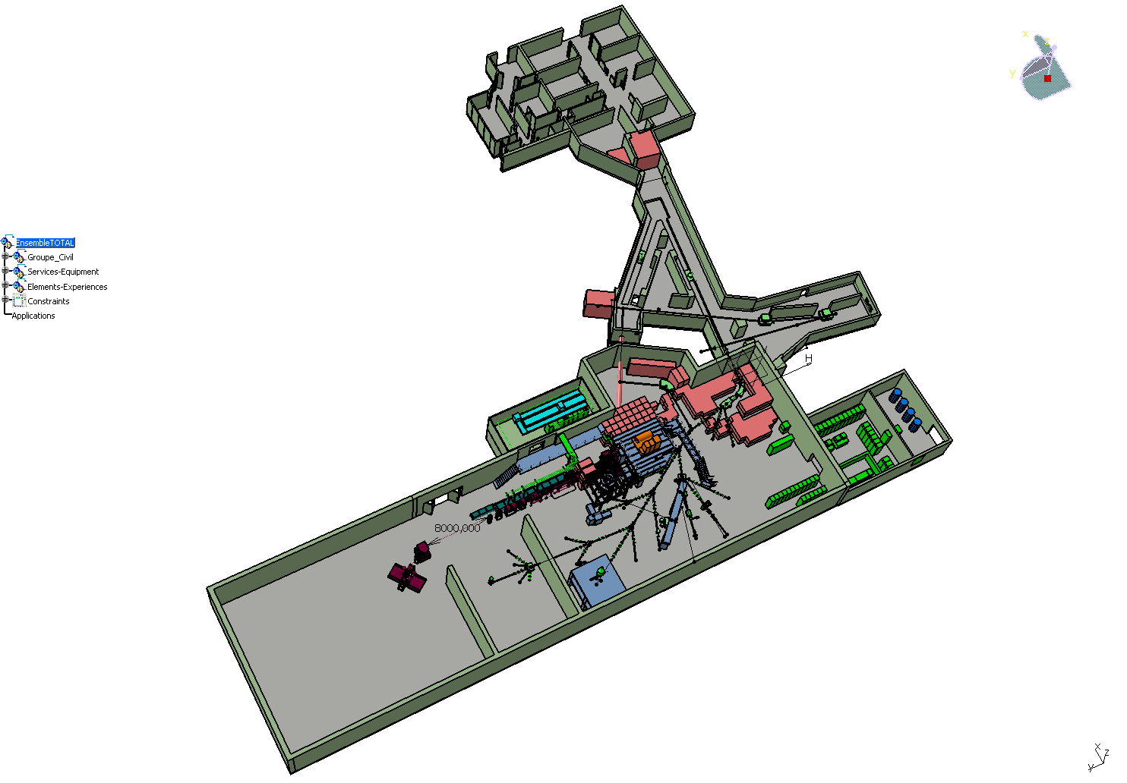
ISOLDE Layout
Target stations
HRS & GPS
WITCH
PS-Booster
1.4 GeV protons
3×10¹³ ppp
Mass-sep.
HRS
ISCOOL
RILIS
REX-ISOLDE
Travelling setups
NICOLE
MINIBALL and T-REX
Travelling setups
COLLAPS
CRIS
ISOLTRAP

Slide 17
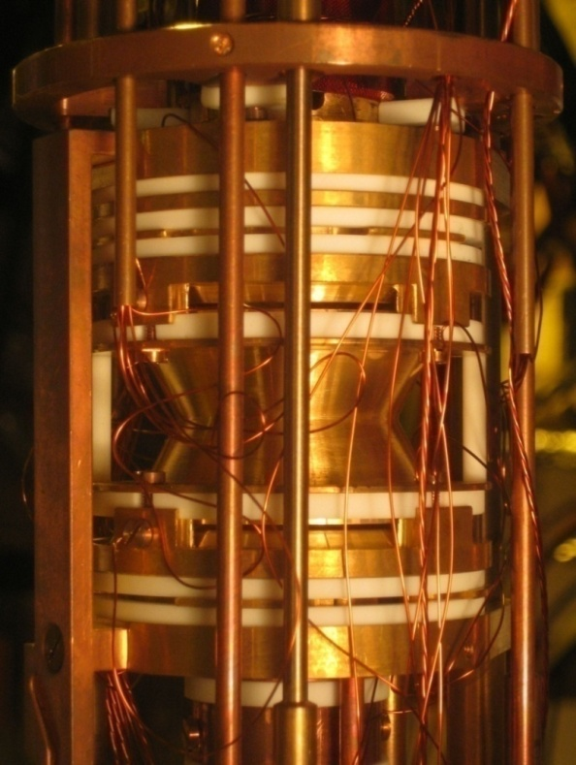
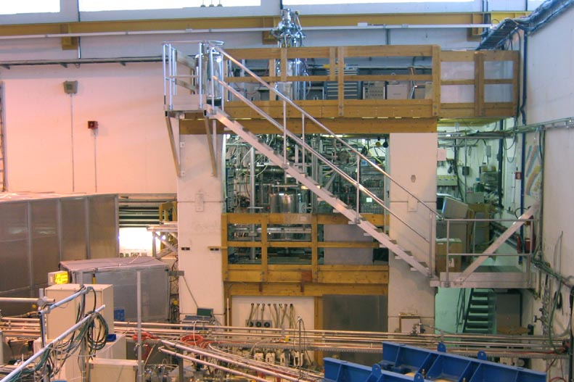
Ion traps at ISOLTRAP
precision
trap
preparation
trap
precision trap
buncher

Slide 18
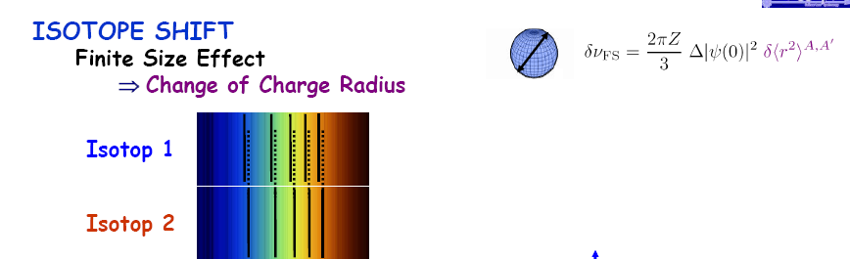
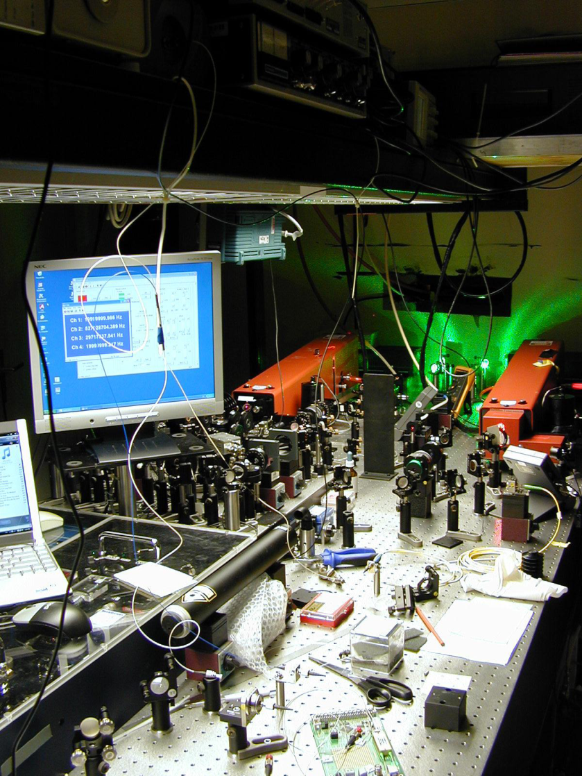
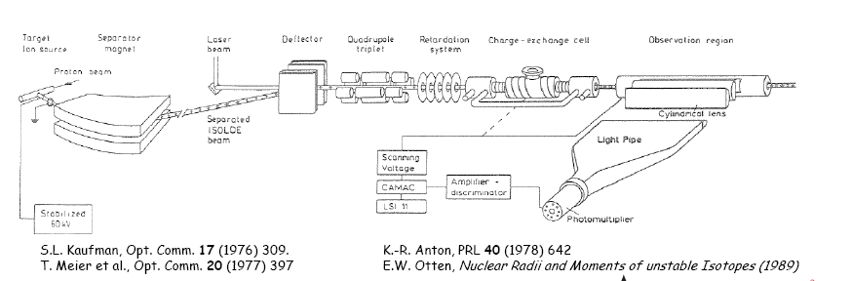
Isotope shifts and charge radii

Slide 19
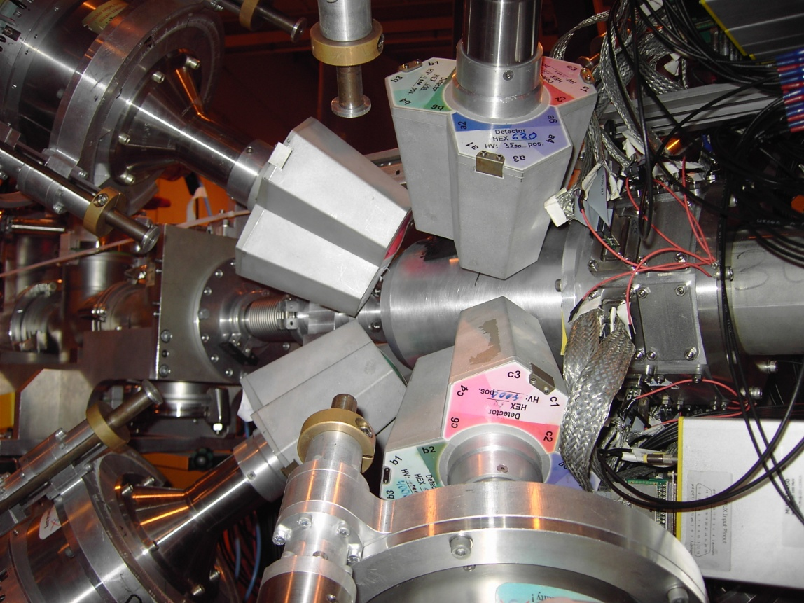
Experimental set-up: T-REX &MINIBALL
MINIBALL
24 HPGe
6-fold segmented
ε ≈ 3% @ 1.3 MeV
beam
beam
… shown is GEANT4
Implementation of set-up

Slide 20

Scope of HIE-ISOLDE
HIE-ISOLDE aims at increasing the energy of these RIB up to 10A MeV and their intensity by a factor 10
Energy Upgrade:
The HIE-ISOLDE project concentrates on the construction of the SC LINAC and associated infrastructure in order to upgrade the energy of the post-accelerated radioactive ion beams to 5.5 MeV/u in 2014 and 10 MeV/u by 2016
Intensity Upgrade:
The design study for the intensity upgrade, also part of HIE-ISOLDE, starts in 2011, and addresses the technical feasibility and cost estimate for operating the facility at 10 kW once LINAC4 and PS Booster are online.

Slide 21
Hie-Isolde Planning
A simplified presentation of the different stages:
2011
2012
2013
2014
2015
2016
Q1
Q2
Q3
Q4
Q1
Q2
Q3
Q4
Q1
Q2
Q3
Q4
Q1
Q2
Q3
Q4
Q1
Q2
Q3
Q4
Q1
Q2
Q3
Q4
Beam Transfer Line
Civil
Cryo
Main services
Ventilation
Demi water
CM 1&2
Electrical syst.s
CM 3&4
CM 5&6
5.5MeV/u
10MeV/u
Timeline:
What is the impact on operations?
sd
sd
LS1
CM1&2
sd
sd
Dec 2012 - Apr 2014
shutdown
Cryo Mod 1 & 2 install
(Isolde normal operations)
(REX perturbations)
Isolde & REX Ops

Slide 22
Call for Letters of Intent
(deadline May 21 2010)
34 Letters submitted
284 Participants from 76 Laboratories in 22 Countries
30 LOIs make use of the Energy and Intensity increases; 4 of the intensity upgrade only
Major mechanisms are Coulex (13) and transfer(16);
elastic scattering(3); fission(2)
(3) letters concern masses and moments; (4) astrophysics and (5) major new instrumentation
Major subjects: Nuclear shapes ; Shell evolution; Halo properties; Nuclear astrophysics

Slide 23
Radioactive isotopes requested in HIE-ISOLDE Letters of Intent
protons
post-accelerated
30-60 keV
neutrons

Slide 24
Instrumentation Envisaged
Miniball + T-Rex (upgrade planned) : COULEX + Transfer
Multipurpose reaction chamber
Helios type device: transfer
ACTAR: resonant scattering + transfer. Test experiment with MAYA should be scheduled in 2012.
TSR storage ring
Magnetic spectrometer ?

Slide 25
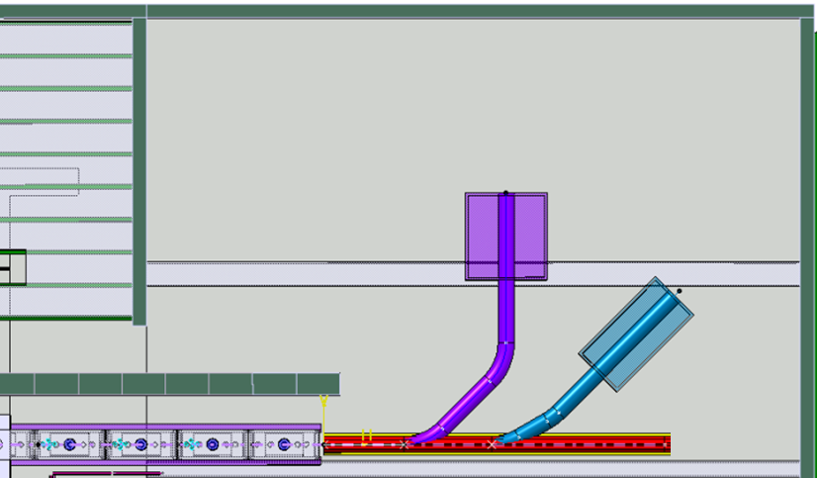

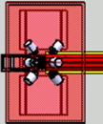


Beam Transfer Line
Miniball
Exp.
station
Actar / Helios
Miniball
Beam diagnostics
Stage 1:
Straight line with 2 branches – Oct 2013 - Sept 2014
Miniball move: Oct 2013 – April 2014
Courtesy Erwin Siesling

Slide 26
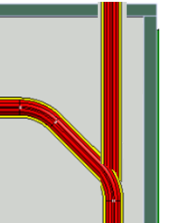
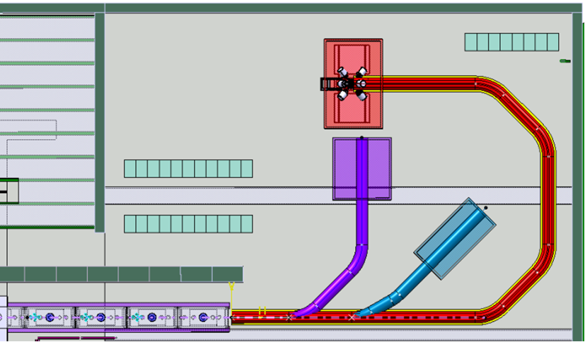

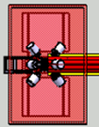
SC Linac & Beam Transfer Lines
Spectrometer
Miniball
TSR
Miniball
Exp. station
Actar / Helios

Slide 27
Physics cases discussed in the TSR@ISOLDE TDR
Half-life measurements of ⁷Be in different
atomic charge states
Capture reactions for astrophysical p-process
Nuclear astrophysics through transfer reactions
Nuclear structure through transfer reactions
Long-lived isomeric states
Atomic effects on nuclear half-lives
Di-electronic recombination on exotic nuclei
Atomic physics experiments
Neutrino physics
10.Laser spectroscopy experiments in the storage ring

Slide 28
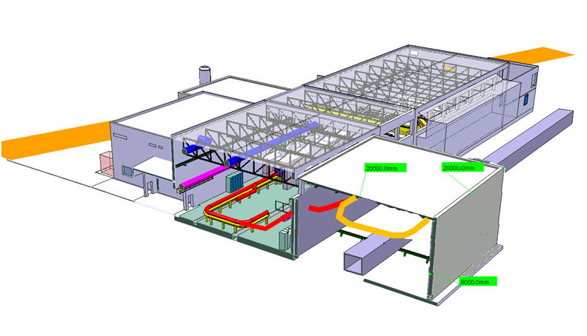
Jura (west) side
23.3m
24.6m
3m
Proposed layout to fit the TSR at the west side:
- Installation above the CERN infrastructure-tunnel (not negotiable to move the tunnel: houses essential CERN signals and infrastructure)
- Tilted beamline coming up from the machine
28

Slide 29
The ISOLDE Collaboration
ISOLDE is run by a collaboration comprising 13 countries and CERN.
Each country pays a annual fee of 60 KEuros. This budget is used to support experiments, buy common equipment and consumables, pay some personnel (visitors, secretary….) and contribute to upgrades (HIE-ISOLDE…)
Each county has a representative on the Isolde Collaboration Committee which meets three times a year. The chair is currently Prof. MJG Borge (Spain)

Slide 30
How to do an experiment @ ISOLDE
Start with a good idea!
If it is a new concept or line of research submit an LOI to the INTC (Isolde N-Tof Committee; chair Peter Butler) which meets 3 times/year
The INTC endorses the LOI and can recommend a few shifts for tests
Then submit a proposal to the INTC and present it.
The INTC takes advice from its technical committee and 2 referees.
The INTC recommends a number of shifts to the research board.
Request scheduling to the physics coordinator, Magda Kowalska
Come and do the experiment
Present results at the annual ISOLDE workshop (this year Dec. 17-19)
Publish
Go to top

Slide 31
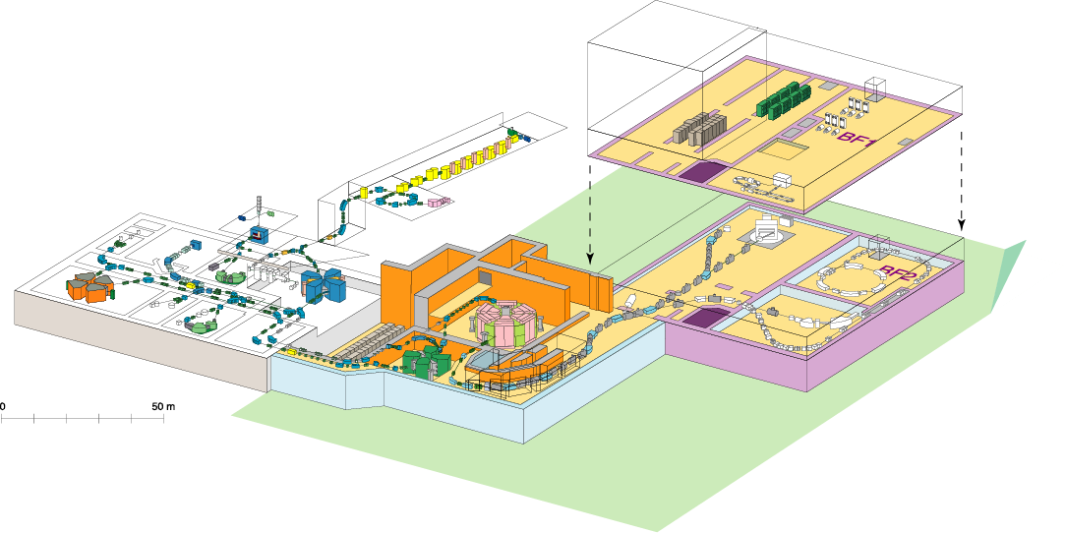
RIKEN RI Beam Factory (RIBF)
Experiment facility
To be funded
Old facility
Accelerator
RIPS
GARIS
SHE (eg. Z=113)
~100 MeV/nucleon
~5 MeV/nucleon
RILAC
SCRIT
AVF
ZeroDegree
SAMURAI
fRC
RRC
SRC
SLOWRI
IRC
RI-ring
BigRIPS
SHARAQ
CRIB (CNS)
350-400 MeV/nucleon
New facility
  Intense (80 kW max.) H.I. beams (up to U) of 345AMeV at SRC
  Fast RI beams by projectile fragmentation and U-fission at BigRIPS
  Operation since 2007

Slide 32
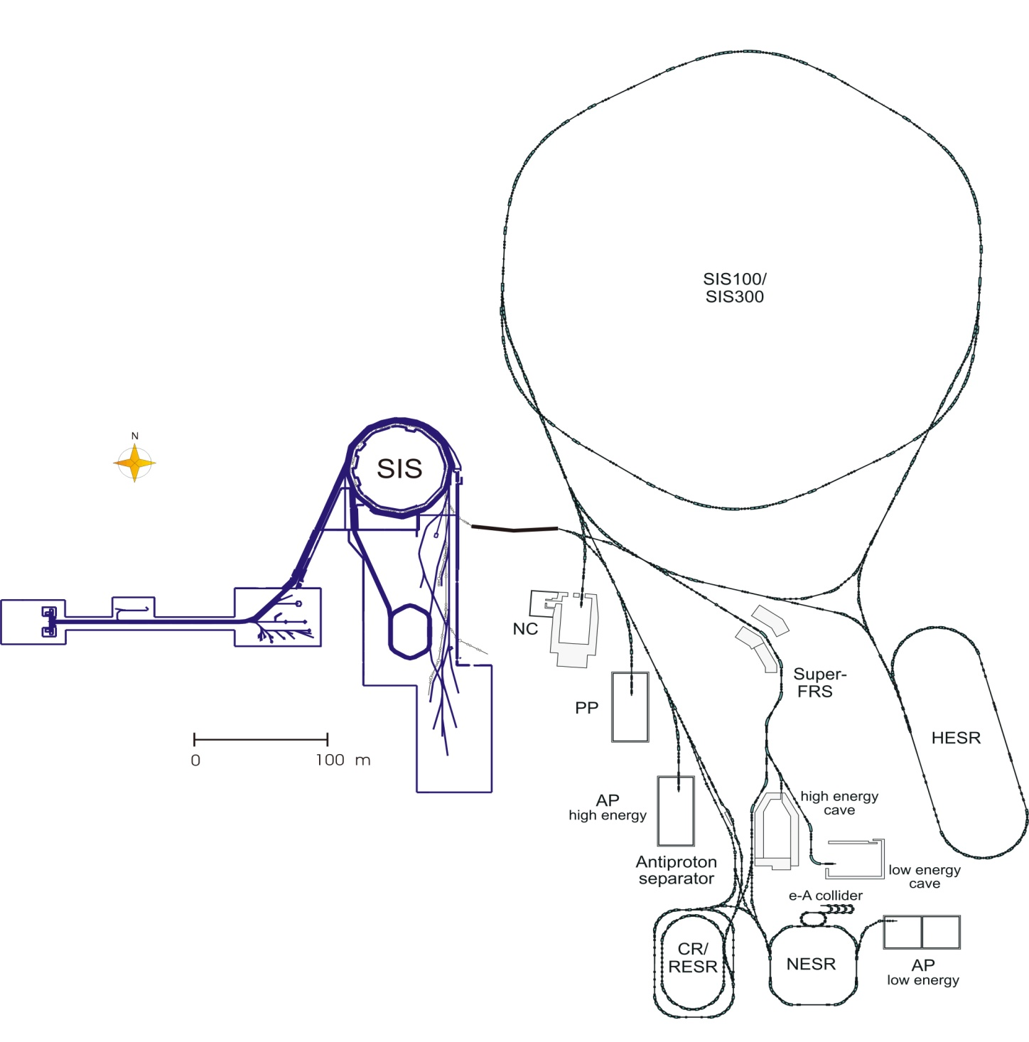
Next Generation Facility: FAIR at GSI
Primary Beams
Secondary Beams
10¹²/s; 1.5-2 GeV/u; ²³⁸U²⁸⁺
Factor 100-1000
over present in intensity
2(4)x10¹³/s 30 GeV protons
10¹⁰/s ²³⁸U⁷³⁺ up to 25 (- 35) GeV/u
Broad range of
radioactive beams up to
1.5 - 2 GeV/u;
up to factor 10 000 in
intensity over present
Antiprotons 3 - 30 GeV
Storage and Cooler Rings
Radioactive beams
e – A collider
10¹¹ antiprotons
stored and cooled
at 0.8 - 14.5 GeV
Key Technical Features
Cooled beams
Rapidly cycling superconducting magnets

Slide 33

H-
HWRs
176MHz
1 GeV/q
H-, H+,
³He++
n-generator
UC_{x} target
RFQ
176 MHz
3-spoke ISCL
325 MHz
Elliptical ISCL
704 MHz
Elliptical ISCL
704 MHz
4-MW
target
station
100
keV
β = 0.09, β = 0.15
β = 0.03
β = 0.047
β = 0.65
β = 0.78
1+ ion
source
1.5 MeV/u
60 MeV/q
140 MeV/q
H+, D+,
³He++
>200 MeV/q
D+, A/q=2
Ion
sources
A possible schematic layout
for a EURISOL facility
One of several
100-kW direct
target stations
Secondary
fragmentation
target
Low-resolution
mass-selector
Spoke
ISCL
264 MHz
8 HWRs
ISCL
176 MHz
3 QWRs
ISCL
88 MHz
QWR
ISCL
88 MHz
Bunching
RFQ
Charge
selector
RFQs
High-resolution
mass-selector
Charge
breeder
β = 0.385
β = 0.27
β = 0.14
β = 0.065
20-150 MeV/u
(for ¹³²Sn)
9.3- 62.5 MeV/u
2.1-19.9 MeV/u
To high-energy
experimental areas
To low-energy areas
To medium-energy experimental areas

Slide 34
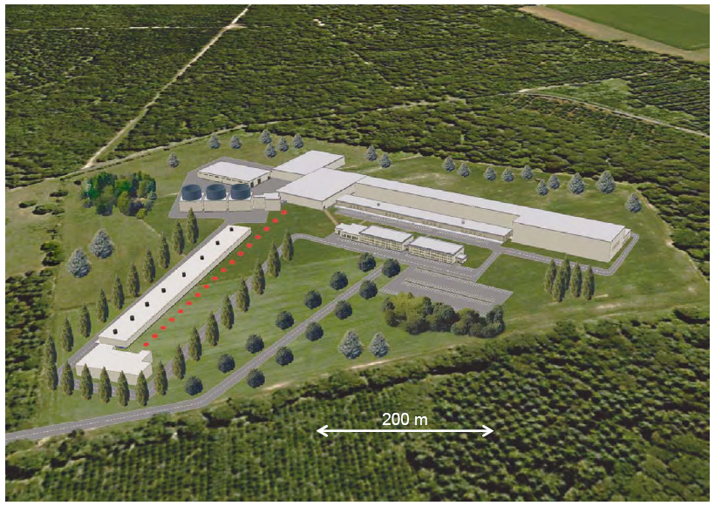
What is EURISOL?

Slide 35
NuPECC Long Range Plan 2010 Timeline
RIB Facilities
 |  | 2010 |  |  |  |  | 2015 |  |  |  |  | 2020 |  |  |  |  | 2025
 | NuSTAR@ FAIR |  | Preparatory Phase |  |  |  |  | SuperFRS experiments |  |  |  | NESR
 | SPIRAL2 |  | Preparatory Phase |  |  | RIB experiments |  |  |  |  |  |  | 150 MeV/u post-acceleration |  |  |  | EURISOL experiments
 |  | HIE-ISOLDE |  |  |  | RIB experiments |  |  |  |  |  |  |  | CERN injector upgrade
 |  |  | SPES |  |  |  | RIB experiments
EURISOL Design study |  |  | further R&D |  |  | preparatory phase & site decision |  |  |  | engineering study |  |  |  | construction

Slide 36
WE LOOK FORWARD TO SEEING YOU AT ISOLDE

