Slide 1
An overview of Radioactive Ion Beam facility at
VECC
Shashi Srivastava*
VECC, Kolkata
* On behalf of the VECC RIB group

Slide 2
RIB : the beginning of a new era in Nuclear Physics, Nuclear Astrophysics, Material Science, Biology, etc.
Nucleo-synthesis in normal stars and in explosive stellar events (we are but stellar dusts)
Stellar evolution
Nuclear structure: Study of exotic nuclei;
Production and study of Super Heavy Elements
Material properties using various radioactive beams as dopants
Atomic physics, Biology; radioisotope production
State of the art Accelerator technology
Human Resource Development
New / unanticipated findings

Slide 3
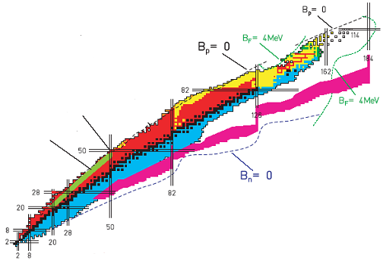
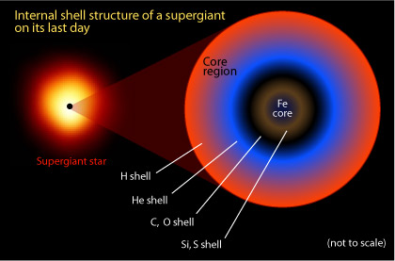
RIB physics summary
(Huge increase in the no. of accelerated beams)
126
SHE
184
p-drip line
Test of Standard Model
N=Z nuclei;
Super-allowed β-decay
Proton number
rp-process
Atomic Physics, Radio-isotopes
Material science, Biology
with RI Beams
n-drip line
r-process path
Origin of elements,
Stellar Nucleo-synthesis
New Magic Numbers
Shell Quenching
Neutron number

Slide 4
Production of RIB: Two Complimentary ways
Intensity (RIB) = Intensity (primary beam) x production cross-section x no. of target atoms x efficiency factor
ISOL method
light ion
beam
Primary
Accelerator
Ion
source
Separator
Post
Accelerator
Low energy
RIB
(<20 MeV/A)
Thick-target
CN/Spallation/fragmentation
of target nuclei
High beam
purity, quality
Projectile Fragmentation method
heavy ion
beam
High energy
RIB
(100-2000 MeV/A)
Primary
Accelerator
Separator
Thin-target
Lower beam
purity, quality
Fragmentation
of beam nuclei

Slide 5
Challenges
Int. (rib) should be adequate for various experiments (1 – 10⁹ pps)
Int. (rib) = Int. (primary Beam) x cross-section x No. of target atoms/cm² x efficiency factors (diffusion, ionization, separation, acceleration)
High intensity primary beam (ADSS; accelerator-energy interface)
Development of thick targets that can sustain high beam power (ADSS)
Efficient ionization, separation & post-acceleration of RIB
Both PFS & ISOL type facility to cover all ranges of half-life
State of the art detector systems (traps, arrays, ISOL, PFS, storage rings) & New ideas and detector arrays to improve S/N ratio

Slide 6
Towards our aim.. What have we achieved so far?
Accelerated stable isotope beams to 415 keV/u
Developed 1st RFQ in the country (29 keV/u). Second RFQ commissioned in 2008 (100 keV/u). Fully indigenous development.
Developed 1st IH-Linac in the country. Linac-1 & 2 & 3 are already commissioned. Stable ion beams accelerated to 415 keV/u at the end of Linac-3.
Linac 4 ready to be commissioned. Linac 5-6 being ordered. To be installed in new annex building by 2013
Target R&D , on-line experiments ongoing.
Experiments using cyclotron beam for acceleration of Radioactive Ion Beams are underway. ^{42,43}K, ¹⁴O, & ⁴¹Ar beams are already produced
Superconducting Electron Linac development started, in collaboration with TRIUMF Canada.
Ion-beams from the facility have been used for material science experiments.
Fragment Separator based experiment & PFS design (collaboration with RIKEN)
K130 Cyclotron
e-accelerator
50 MeV, 2 mA
p/α, 20/60 MeV, 10 μA
Target/1⁺ IS
RIB
ECR Charge-breeder
Isotope Separator
Isotope Separator
1.7 keV/u
1.7m RFQ
3.4m RFQ
29 keV/u
100 keV/u
LINAC 1 & 2
289 keV/u
We are here
LINAC 3
415 keV/u
LINACs 4-5
SC LINAC
1.0 MeV/u
2.0 MeV/u

Slide 7
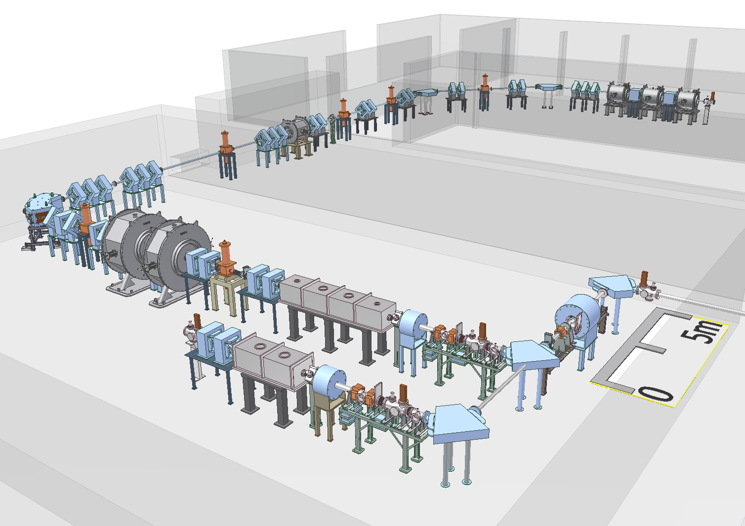
Schematic layout of RIB beam-line at VECC
New annex building
Under construction
Linac3 is placed here for the time-being
415 keV/u
2011
LINAC4-6
LINAC3
1.3 MeV/u RIB
289 keV/u
2011-13
2010
100 keV/u
2008
RFQ2
1⁺ RIB
Target-IS
LINAC2
n⁺ RIB
ECR
LINAC1
K130 Cyclotron beam
29 keV/u
2005
1.7 keV/u
RFQ1
HR cave-1
K130 vault

Slide 8
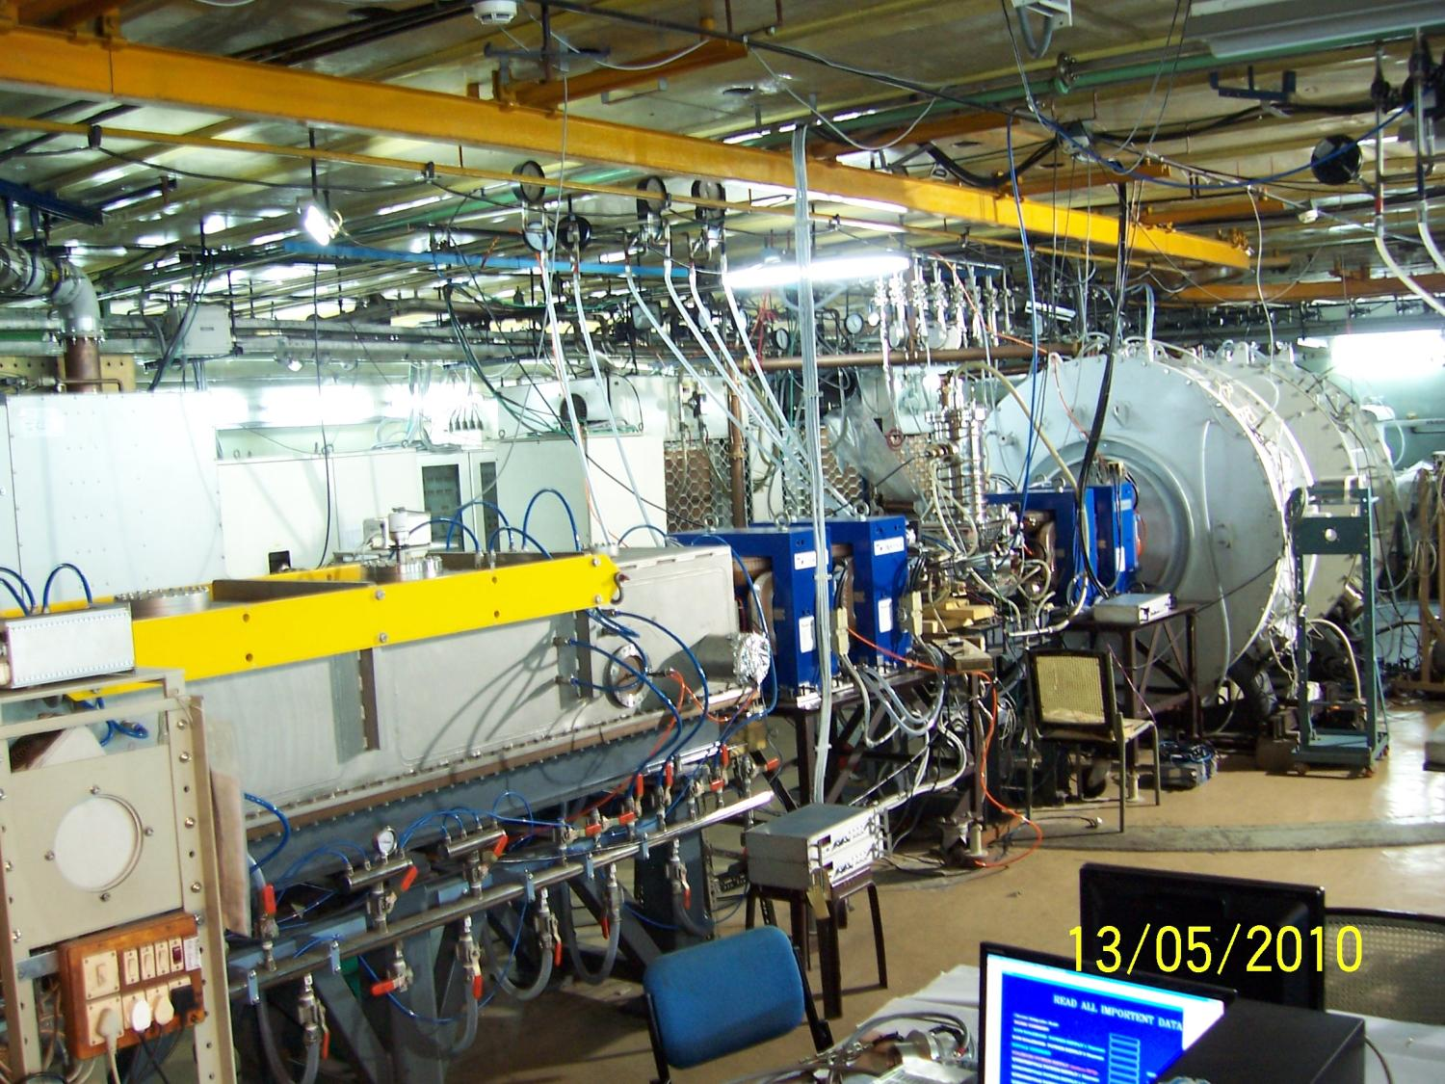
RIB project site
LINAC-1
LINAC-2
Rebuncher
RFQ
A photograph of RIB facility project site showing RFQ, MEBT line and first two Linac cavities

Slide 9
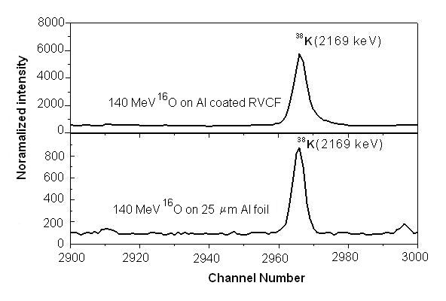
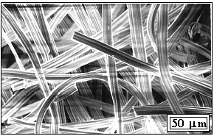
Production of RIB: R&D on Thick target
Targets should be porous : Efficient & Fast release of radioactive atoms
Targets should withstand beam irradiation for days together
Target material coated on base matrix of RVC : Reticulated Vitreous Carbon
Target release experiments with
Oxygen beam from K130 cyclotron
SEM of RVC Foam
RVC Foam with Al₂O₃
10 times Yield enhancement in Aluminum coated RVCF (top) as compared to Al foil (bottom) : effect of increase in surface to volume ratio is clearly seen
RVC Fibres with Al₂O₃
Ceramics International, 34 (2008) 81
Nucl. Instrum. & Meth. A539 (2005)54

Slide 10
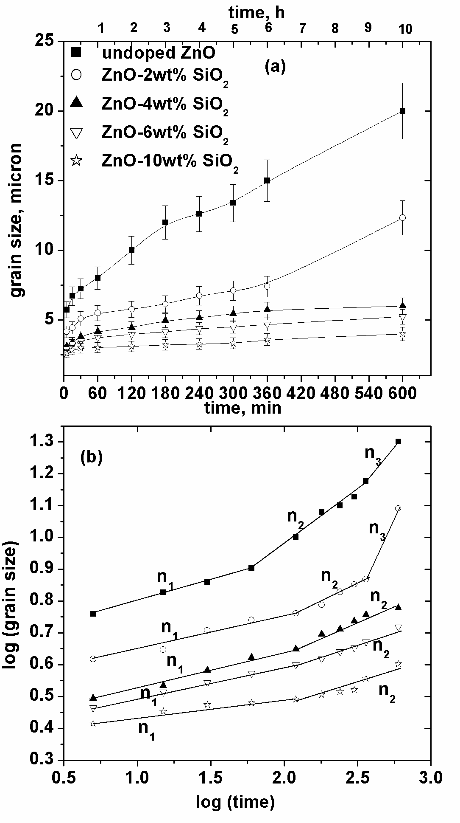
Grain growth studies in ZnO – R&D on high power targets
Ceramic International 34 (2008) 81; Ceramic International 37 (2011) 2679
RIB intensity critically depends on radioactive isotope yield from the target.
Radioactive atoms should efficiently and quickly diffuse out of the target. Target should withstand high primary beam intensity without getting damaged.
Sintering & grain growth in target due to beam heating hinders release of radioactive atoms and leads to localized heating which amplifies grain growth. Studies show that grain size of ≥ few microns reduces release efficiency.
Our studies at VECC on ZnO have shown that grain growth can be controlled to< 20 micron grain size if one chooses nano-crystalline target compound. Grain growth can be further controlled to < 5 micron by Silica doping of 4 wt %.
x300
(top) Grain growth for un-doped and Silica doped ZnO sintered at 1300 °C for 10 hours (bottom) Kinetics of grain growth changes due to silica doping
SEM image of nano-crystalline ZnO sintered at 1300 °C for 10 hrs. Grain size increase is ~ 20 micron size.

Slide 11
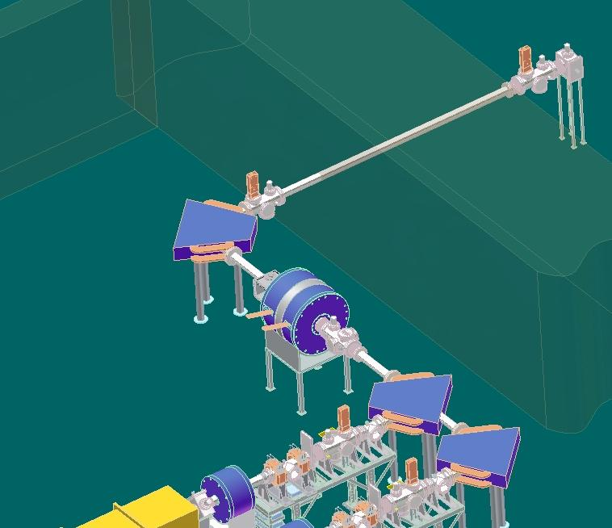

Ionization: Target-ion-source (1+) and 2 ion-source Charge Breeder (n+)
NIM A547 (2005)
Cyclotron beam
Shielding wall
1+ separator
Target chamber & 1+ ion-source
Cyclotron beam
n+ ECR
RF
Transfer tube
ECR plasma
n+ separator
Target
Beam
dump
RFQ post-accelerator
1⁺ RIB

Slide 12
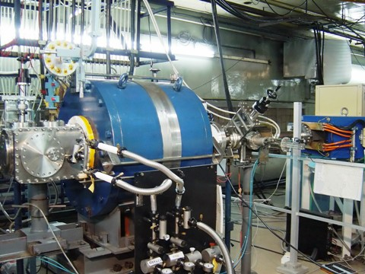
Electron Cyclotron Resonance ion source
6.4 GHz on-line ECR ion-source
Typical spectrum from ECR ion source

Slide 13
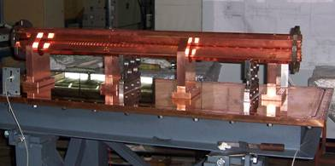
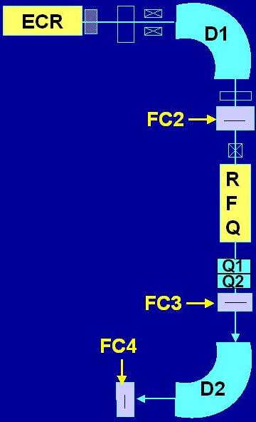
Acceleration: 1.7 m RFQ commissioned in Sept. 2005 India’s first RFQ
Rev Sci Instrum. 78 (2007) 043303 ; Rev. Sci. Instrum. 80, (2009) 103303
2.3m
1.8m
2.0m
1.7 m RFQ during installation
Transmission efficiency measurement scheme
1.85m
Measured Parameters | Value
Frequency Q- value RF power for ¹⁶O⁴⁺ (V_{vane}=11.45 kV) RF power for ¹⁶O³⁺ (V_{vane}=15.27 kV) RF power for ¹⁶O¹⁺ (V_{vane}=45.9 kV) Typical transmission at RFQ exit (FC3/FC2) Typical transmission of analyzed beam (FC4/FC2) * Duty factor 20% # Electron suppressed FC | 33.7 MHz 5200 670 W 1.2 kW *10.8 kW #85 % #80 %
2.2m
1.7m
RFQ constructed with complete indigenous technology
Machining of Vane, post & other components at Central Mechanical Engineering Research Institute (CMERI), Durgapur (200 km from Calcutta)
RF transmitters made by SAMEER, Mumbai ; RIKEN’s (Japan) help in physics design

Slide 14
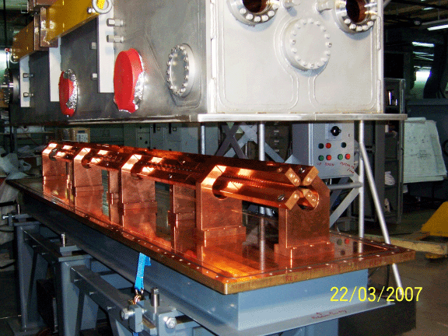
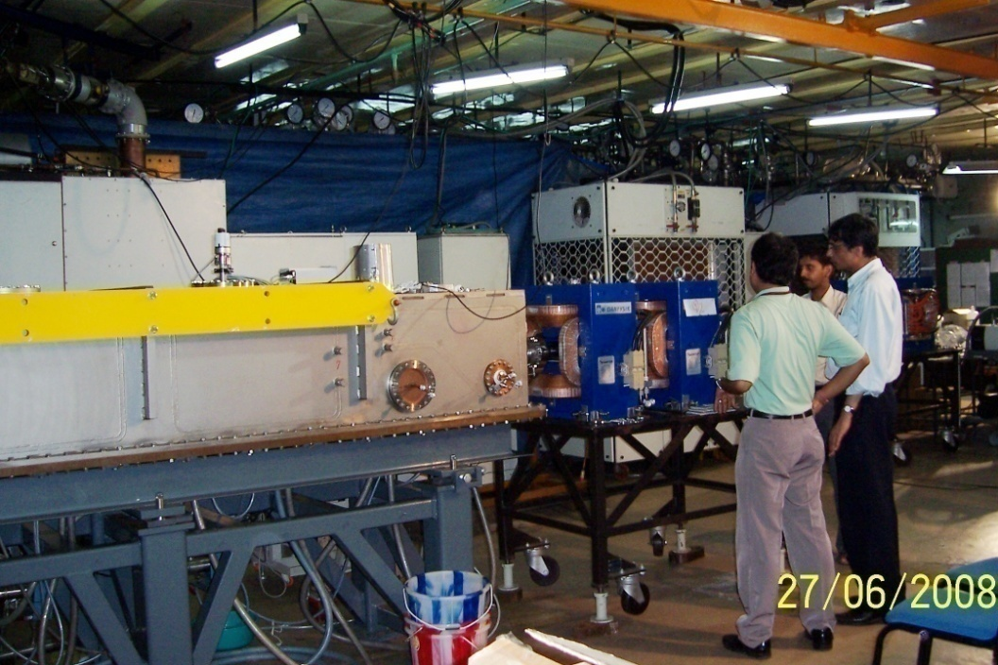
3.4m RFQ: commissioned in July 2008
q/A=1/14 ; input = 1.75 keV/u;
output = 100 keV/u, 3.4m long,
vane length ~ 3.12m, resonating at 37.83 MHz
RFQ made at CMERI Durgapur, Cavity,
Cu plating at GSI, Darmsadt via Danfysik
Measured transmission efficiency at
RFQ exit for O⁵⁺ ~ 90 %
Rev Sci Instrum. 81 (2010) 023301
FC current versus pick-up voltage measured at QQ focus downstream of RFQ
FC3 current (arb units)
Normalized vane voltage V/V₀
3.4m RFQ
RIB project site
3.4m RFQ during installation

Slide 15
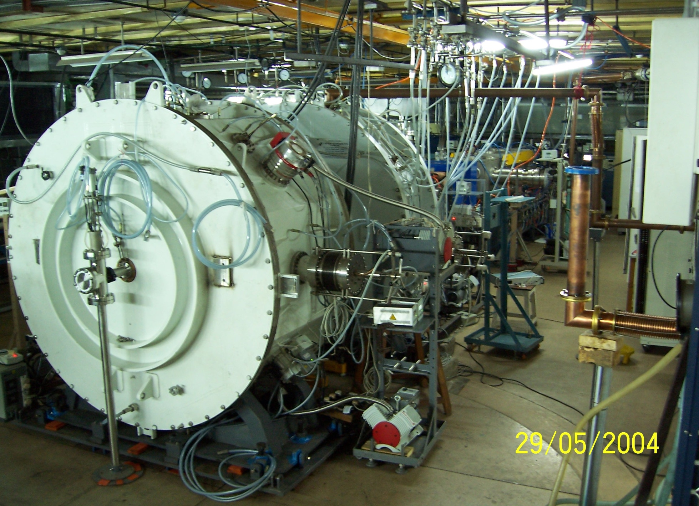
Linac Modules
3.4m RFQ
Linac-2
Linac-1
13/02/10
15

Slide 16
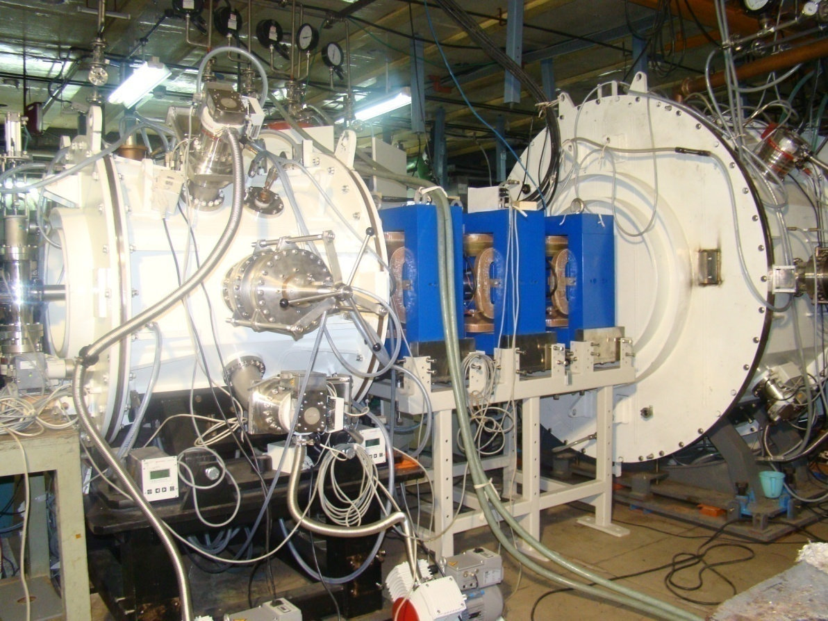
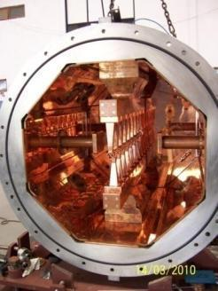
LINAC-3 Commissioned in March 2011
414 keV/u (5.8 MeV), 400 nA ¹⁴N⁴⁺ beam accelerated through LINAC-3
Linac-3 with front cover open
Linac-2
Linac-3
Parameter | Unit | Linac-2 | Linac-3
Frequency | MHz | 37.8 | 75.6
q/A | >= | 1/14 | 1/14
E(in) | KeV/u | 186.2 | 289.1
E(out) | KeV/u | 289.1 | 413.9
Peak Vol. | kV | ±107.8 | ±75.8
Length | m | 0.871 | 0.913
Inner Dia | m | 1.72 | 0.8
Accln. Grad. | MV/m | 1.79 | 1.99
Power (Calc) | kW | 9.84 | 11.5
A photograph of Linac-3 installed downstream of Linac-2 for beam test;
Eventually will be moved to adjacent cave

Slide 17
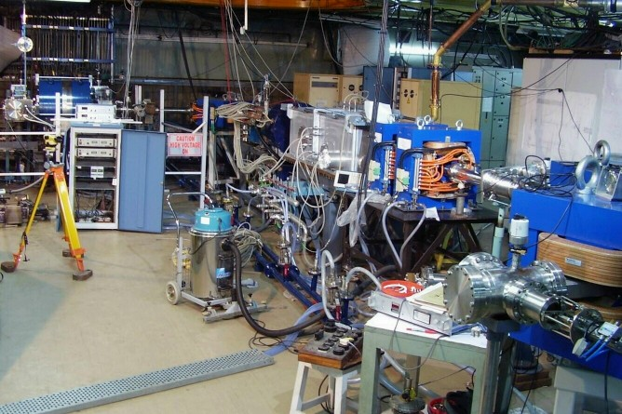
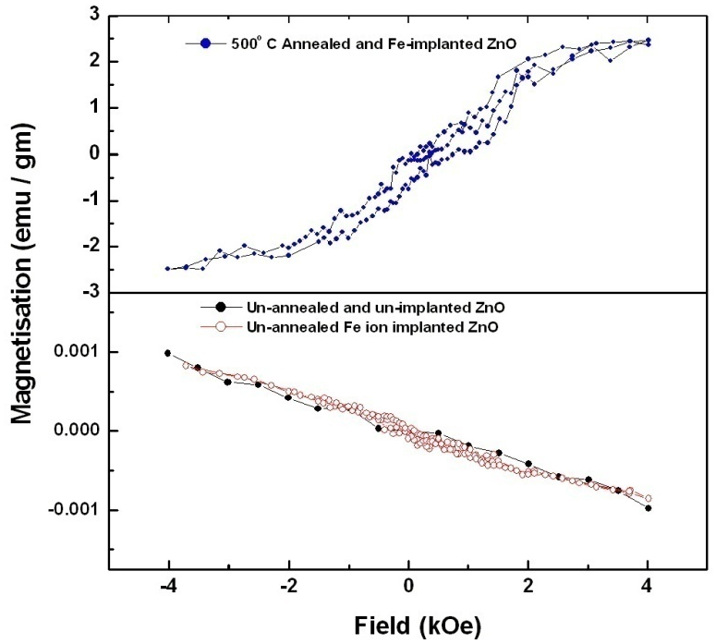
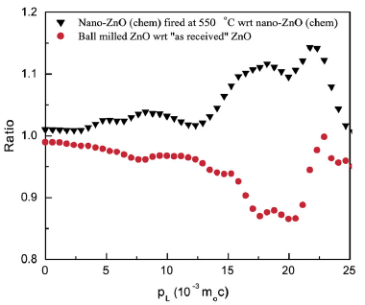
Study on room temp. ferromagnetism in ZnO; effect of Fe Ion-implantation
Nucl. Instrum. & Meth. B267 (2009) 1783 ; Phys. Lett. A371 (2007) 482
Ion implantation of Fe beam accelerated in RFQ
Spintronics : ZnO - potential candidate ; prediction that it may show ferromagnetic ordering at room temperature
Positron annihilation studies at VECC show clearly that defects govern room temperature ferromagnetic properties of nano-crystalline ZnO.
Enhanced positron annihilation with core electrons of Zn observed in 500 °C annealed ZnO ; strong correlation between defects and ferromagnetism seen experimentally
Two orders enhancement in saturation magnetic moment seen in Fe ion-implanted ZnO (500 °C annealed). For this study 10¹⁶ ⁵⁶Fe⁶⁺ ions of 1.63 MeV were implanted in 0.75 micron ZnO sample.
ECR
1.7m RFQ
Dipole2
Sample
Experimental setup
x300
(left ) Enhanced saturation magnetic moment in 500 °C annealed Iron implanted ZnO, compared with un-implanted annealed ZnO (top)
Ratio of electron-positron momentum distribution for various samples. Enhancement in higher momentum region indicates preferred annihi-lation with Zinc 3d core electrons

Slide 18
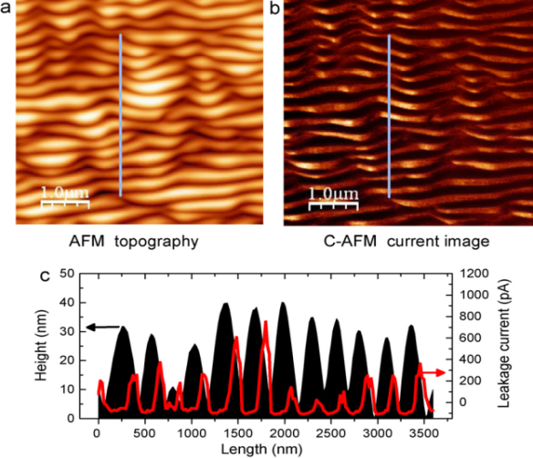
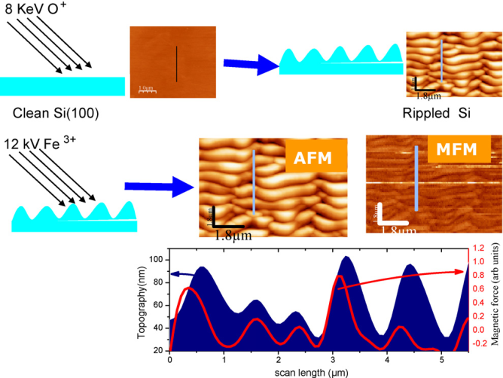
Surface science studies using ion-beams from the facility
Appl. Surf. Sci. 257, 6775 (2011), Appl. Surf. Sci. (2011) doi:10.1016/j.apsusc.2011.07.038; Nucl. Instr. & Meth. xx, xxx (2012)
S. Bhattacharjee, et.al., AIP Conf. Proc.1349,611 (2011); J. Phys. Cond. Matt. 22, 175005 (2010).
Ion beam induced nano-pattern formation and coulomb sputtering studies on Silicon oxide, Zinc Oxide, Carbon films etc. using oxygen, carbon, argon, nitrogen ion beams from the facility.
Periodic semiconducting insulating stripes formation by keV oxygen ion bombardment
Effect of projectile’s chemical reactivity on nano-patterning. Oxygen and nitrogen show enhanced effect on nano-patterning.
Periodic magnetic non magnetic stripe formation by ion implantation

Slide 19
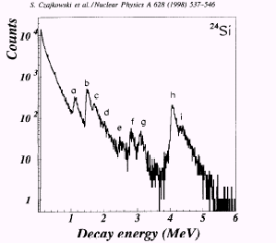
A novel detector & technique for delayed proton measurement
Phys. Rev. C 63, 024307 (2001) ; Phys. Rev. C 80, 044302 (2009) ; Eur. Phys. J. A 42, 375-378 (2009)
T
Q
Primary beam
A/Z
VECC group established a new technique for beta delayed-proton spectroscopy of proton-rich exotic nuclei.
VECC made detector was used at RIKEN projectile-fragment separator facility to study decay of 140 msec ²⁴Si.
RIKEN is now using this technique for studying other proton-rich nuclei. The studies have lead to two PhD thesis – one from VECC & another from RIKEN.
D1
Q
Slit
Al degrader
First focus
Q
F1
D2
A^{2.5}/Z^{1.5}
Secondarybeam
Q
Second focus
F2
Slit
Q
Delayed proton spectra of ²⁴Si (T_{1/2} 140ms)
Final focus
F3
VECC-RIKEN Expt.
GANIL spectrum
earlier study
VECC Detector
Fragments
Set of Al absorbers
Si(Li) range
1mm Al absorber
T2
T1
10 torr
P10 gas
ΔE
2.6 μm
New technique for delayed proton measurement at RIKEN RIPS facility: Dramatic improvement in quality of delayed proton spectra
E_{p}
Al foil
Si(Li) last
19

Slide 20
Transport and production of RIB- a new approach
Target chamber
Radioactive recoils
beam
α, p
Transport
capillary
He/Ar+ cyclohexane
Gas-jet Multiple-Target station
targets
Vault
ECR ion-source
HR Cave-2
≈
25m
Radioactive atoms + He/Ar
10⁻⁴ mbar
10⁻² mbar
10⁻⁶ mbar
Gas-jet
n⁺ RIB
He/Ar
TMP
Radioactive atoms
TMP
Roots
pump
1st collection chamber
ECR plasma

Slide 21

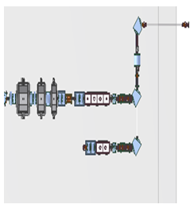
Successful production of RIB – first test experiments
Aim:
To transport radioactive atoms to RIB site using Gas-jet Transport system√
Production of low energy RIB and measurement of yield at FC2 (before RFQ2) √
Acceleration of RIB to 100 keV/u
Target/ion-source will be later installed here
Test experiment location of Target chamber
Cyclotron beam has been recently transported to this location
Beam-line getting ready
LINAC3
LINAC2
LINAC1
ECR
RFQ2
RFQ1
K130 cyclotron
Vault
RIB site

Slide 22
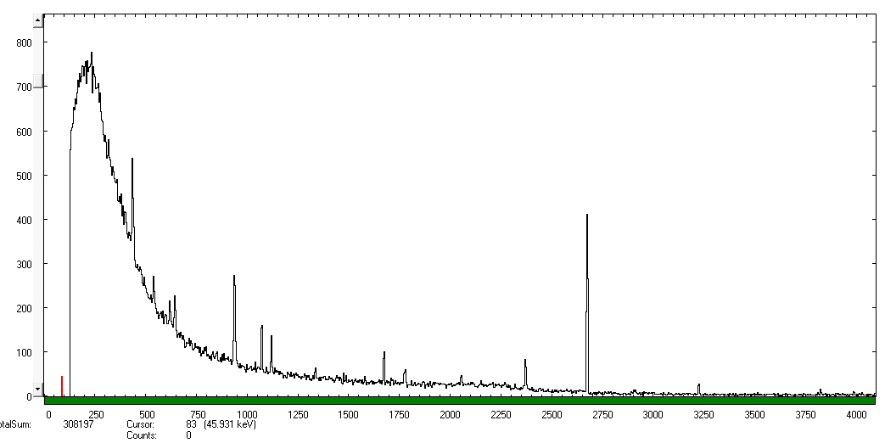
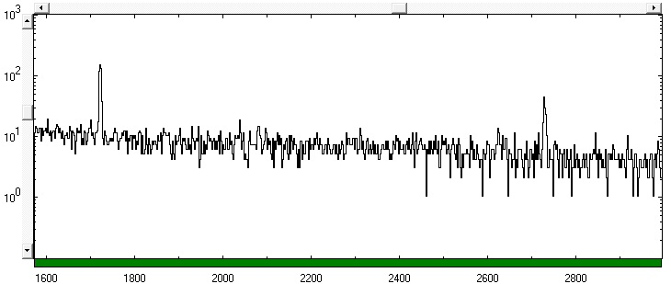
Measured RIB decay-spectra before RFQ2
Radioactive atoms from target chamber placed in cyclotron vault
⁴¹Argon (109 min.)
HR cave RIB site
Detector @ entry
Jan 12, 2012
Gamma-ray spectrum at FC2 (before RFQ)
ECR
L3
L2
L1
1.46 MeV 40K (backg.)
Det @ FC1
1.29 MeV
⁴¹Ar (109 min)
1.3 x 10 ³ pps
RFQ2
Detector @FC2
¹⁴Oxygen (71 sec.)
1.46 MeV ⁴⁰K (backg.)
2.31 MeV
¹⁴O (71 s)
4.4 x 10 ³ pps
RIB | Prod. route | T1/2 | pps @ FC2
¹⁴O | ¹⁴N(p,n) | 71 s | 4.4 x 10³
⁴²K | ⁴⁰Ar(α,pn) | 12.36 hr | 2.7 x 10³
⁴¹Ar | ⁴⁰Ar(α,2pn) | 109 min | 1.3 x 10³
Gamma-ray spectrum at FC2 (before RFQ)
March 6,2012

Slide 23
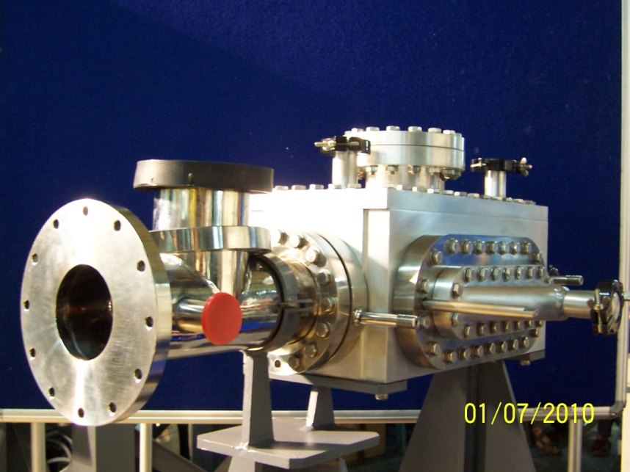
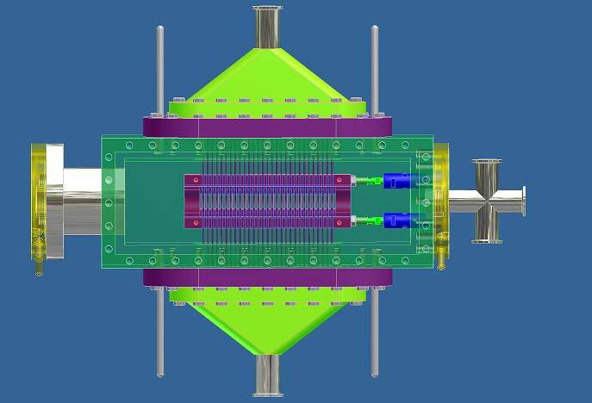
RI beams to be developed
RIB | T_{1/2} | Reaction | Target
¹⁴O | 71 sec | ¹⁴N(p,n) | N₂
⁴¹Ar | 109 min | ⁴⁰Ar(α,2pn) | Ar
^{42, 43}K | 12.4 hrs, 22 hrs | ⁴⁰Ar(α,pxn) | Ar
¹¹¹In | 2.8 days | ¹⁰⁹Ag(α,2n) | Ag
¹⁹Ne | 17 sec | ¹⁶O(α,n) | HfO₂,Al₂O₃
⁶⁶Ga | 9.4 hours | ⁶³Cu(α,n); ⁶⁴Zn(α,pn) | Cu foils, Zinc Oxide
⁶⁸Ga | 68 min | ⁶⁵Cu(α,n) | Cu foils
Multiple target
Radioactive atoms
Multiple target chamber
Window
Window
Cyclotron
Beam
1 atm He
Faraday
cup
Transport capillaries
Radioactive atoms
He-jet multiple target system

Slide 24
Publications from RIB project group*
(*in international journals)
(Since the year 2000)
Accelerator development
Nuclear Physics & Material Science Experiments
Ceramics International, ( 2011) 2679. Target
Nucl. Instrum. & Meth. A 631 (2011) 1 MEBT
Pramana 75 (2010) 485. MEBT
Rev. Sci. Instrum. 81, 023301 (2010); RFQ2
Rev. Sci. Instrum. 80, (2009) 103303. RFQ2
Ceramics International, 34 (2008) 81. Target
Nucl. Instrum. & Meth. B261(2007)1018. RIB facility status
Rev Sci Instrum. 78 (2007) 043303. RFQ1
Nucl. Instrum. & Meth. A562 (2006)41. Beam-line
Nucl. Instrum. & Meth. A560 (2006)182. Linac
Nucl. Instrum. & Meth. A547 (2005)270. Charge breeder
Nucl. Instrum. & Meth. A539 (2005)54. Target
Nucl. Instrum. & Meth. A535 (2004)599. RFQ1
Nucl. Instrum. & Method A 533 (2004) 37. RFQ1
Pramana 59 (2002) 923. RIB facility
Pramana 59 (2002) 957. RFQ1
Nucl. Instrum. & Meth. A 447 (2000) 345. charge breeder
Nucl. Instr. & Meth. xx, xxx (2012)
Materials Science Forum, 699 (2012) 1-38
J of Phys. Cond. Matt. 23 (2011) 155801
Appl. Surf. Sci. 257 (2011) 6775
Solid State Communications, 150, (2010) 2266.
J. Phys.: Condens. Matter 22 (2010) 175005
Nuclear Instru. & Method B267 (2009) 1783.
Phys. Rev. C 80, 044302 (2009)
Eur. Phys. J. A 42, 375-378 (2009)
J. of Phys: Cond. Matt. 21 (2009) 445902
Appl. Phys. Lett. 93, (2008) 103102.
Materials Characterization 60 (2009) 1014.
J. of Phys. D 41 (2008) 135006.
Appl. Phys. Letts. 93 (2008) 103102
J of Phys. C 20 (2008) 45217
J of Phys. D 41 (2008) 135006.
Phys. Lett. A371 (2007) 482.
J of Phys. C 19, (2007) 236218.
J of Phys. C 19, (2007) 236210.
J. of Mat. Sc. 40 (2005) 5265.
Physica C, Vol416, (2004) 25.
Nanotechnology 15 (2004) 1792.
Physica C 416 (2004) 25.
Phys. Rev. C 63 (2001) 024307.
4 Ph. D theses during 2004-2007 ; 2 PhD thesis submitted recently ; 2 M.Tech Thesis

Slide 25
Superconducting Electron Linac (VECC-TRIUMF Collaboration)
50 MeV, 2 mA; 100 kW CW, 1.3 GHz, 2 deg K
For production of neutron rich nuclei through photo-fission of Uranium
Also a strong neutron source of intensity 10¹⁴ per sec
e-
γ
e-linac
Target
Fission products separator
RIB
50 MeV, 100 kW
Tantalum
converter
²³⁸U
target
γ - induced fission (photo-fission); GDR peak at ~13.5 MeV
peak photo-fission cross-section for ²³⁸U/²³⁵U= 168/400 mbarn

Slide 26
50 MeV Superconducting Electron Linac - Schematic
Injector
Accelerator
300 keV to 10 MeV
10 MeV to 50 MeV
20kW
20kW
20kW
20kW
20kW
Buncher
Gun
ICM
ACM1
ACM2
300 keV
Diag.
Diag.
Beam dump
Beam dump
VECC-TRIUMF MOU phase-1
10MeV, 2 mA
50MeV, 2 mA
Phase-1 : 2009 – 2013
Phase-2 : 2013 – 2018

Slide 27

The ultimate goal : ANURIB facility
A National Facility for Unstable and Rare Isotope Beams
e-
n
Neutron beam-line for nuclear astrophysics
Phase-1
ActinideTarget
e-
γ
12th Plan
2012-17
SC electron LINAC
50 MeV, 100 kW
1⁺
Ion Source
1+ RIB
e+e-
Ta
Radioactive Atoms
e+
ECR Ion Source
Stable isotope
injection
High freq., high current ECR Ion Source
Positron beam-line
n+ RIB
Spectroscopy of r-process, n-rich exotic nuclei
Separator
Material Science with stable & RIBs
1.5 keV/u
1.5 keV/u
RFQ
0.1 MeV/u
LINAC
Nuclear Astrophysics
1.0 MeV/u
LINAC booster
Nuclear structure, Elastic/ Inelastic scattering, Coulomb barrier physics, Super Heavy Elements
RIB
7 MeV/u
Stripper
PFS
Stable Isotope Beam
Storage Ring
RIB
Phase-2
100 MeV/u
Studies on drip line & near drip line nuclei
SC Ring Cyclotron
2017-onwards

Slide 28
12th plan Project: ANURIB phase-1
e-
n
Neutron beam-line for nuclear astrophysics
Phase-1
ActinideTarget
e-
γ
12th Plan
2012-17
SC electron LINAC
50 MeV, 100 kW
1⁺
Ion Source
1+ RIB
e + e-
Ta
Radioactive Atoms
e+
ECR Ion Source
Stable isotope
injection
High freq., high current ECR Ion Source
Pulsed Positron beam-line
n+ RIB
Spectroscopy of r-process, n-rich exotic nuclei
Separator
Material Science with stable & RIBs
1.5 keV/u
1.5 keV/u
Financial outlay of ANURIB phase-1
No. | Major Activity | Expenditure (Rs. Crore)
1. | Target Modules, Remote handling, High Power Beam Dumps | 27.00
2. | ECR ion-sources, LEBT line, Acc. R&D, Isotope Separator facility & other expt. facility | 38.00
3. | Electron Linac Accelerator Cryo-Module (ACM) for acceleration from 30 to 50 MeV; R&D on High current injector (comprising of ECR, RFQ, & Linac delivering beam energy up to 2.5 MeV) & Misc | 25.00
4. | Building (phase-1) and Services : electrical power, air-conditioning, LCW plant, Cryogenic & other infrastructure services | 75.00
 | Total (Rs. in Crore) | 165.00

Slide 29
12th plan ANURIB phase-1 activities
Physics & Engineering Design of entire ANURIB facility (both phases)
2. Construction of high power actinide target modules, Accelerator Cryo-Module (ACM) for electron-linac, ECR ion-source, low energy beam-line (Isotope Separator),
3. Experimental facility for 1.5 keV/u beams – nuclear spectroscopy of r-process nucleo-synthesis nuclei, laser spectroscopy, ion-beam based material science
4. Design of phase-1 building & AERB clearance
5. R&D on high current injector, prototype development
6. Construction of Phase-1 building that will house the following:
Electron linac (ii) Target stations (iii) ECR ion-source (iv) Isotope separator (v) Neutron facility cave (vi) Misc. expt. cave (vii) positron cave
7. Identification & development of vendors
8. Collaborations : national & international; Workshop/Symposium on ANURIB

Slide 30
Thank You!

Slide 31
Intensity of RIB for various experiments (ISOL method)
I_{RIB} = I_{primary} ∗ N_{t}∗ σ ∗ η
Physics Topics
Reaction &
Techniques
Beams
Desired Intensities
particles/s
Energy Range
MeV/u
1. Rapid proton
capture (rp-process)
Transfer, elastic, inelastic,
radioactive capture,
Coulomb dissociation
¹⁴O, ¹⁵O,
²⁶Si, ³⁴Ar, ⁵⁶Ni
10⁸ - 10¹¹
10⁵ - 10¹¹
0.15 - 15
2. Studies of N = Z nuclei, symmetry study
Transfer, fusion,
decay studies
⁵⁶Ni, ⁶²Ga, ⁶⁴Ge, ⁶⁸Ge, ⁶⁷As, ⁷²Kr
10⁴ – 10⁹
0.1 - 15
3. Decay studies of
¹⁰⁰Sn
decay
¹⁰⁰Sn
1 - 10
low
4. Proton drip-line
Studies
decay, fusion, transfer
⁵⁶Ni, ^{62,66}Ge, ⁷²Kr,
10⁶ – 10⁹
5
5. Slow neutron
capture s-process
capture
^{134,135}Cs, ¹⁵⁵Eu,
10⁸ - 10¹¹
0.1
6. Symmetry studies
with Francium
decays, traps
^{A}Fr
10¹¹
low
7. Heavy element studies
fusion, decay
⁵⁰⁻⁵²Ca, ⁷²Ni,
⁸⁴Ge, ⁹⁶Kr,
10⁴ – 10⁷
10⁶ – 10⁸
5 – 8

Slide 32
Intensity of RIB for various experiments cont..
8. Fission limits
fusion, fission
¹⁴⁰⁻¹⁴⁴Xe, ¹⁴²⁻¹⁴⁶Cs, ¹⁴²I, ¹⁴⁵⁻¹⁴⁸Xe, ¹⁴⁷⁻¹⁵⁰Cs
10⁷ - 10¹¹
10⁴ – 10⁷
5
9. Rapid neutron
capture (r-process)
capture decay
mass measurement
¹³⁰Cd, ¹³²Sn, ¹⁴²I,
10⁴ – 10⁹
0.1 – 5
10. Nuclei with large
Neutron excess
Fusion, transfer,
deep inelastic
¹⁴⁰⁻¹⁴⁴Xe, ¹⁴²⁻¹⁴⁶Cs,
¹⁴²I, ¹⁴⁵⁻¹⁴⁸Xe, ¹⁴⁷⁻¹⁵⁰Cs,
10⁷ – 10¹¹
10² – 10⁷
5 - 15
11. Single-particle
States, effective
Nucleon-nucleon
interactions.
direct reactions,
nucleon transfer
¹³²Sn, ¹³³Sb
10⁸ – 10⁹
5 - 15
12. Shell structure,
Weakening of gaps,
Spin-orbit potential
mass measurement,
Coulomb excitation,
fusion, nucleon transfer,
deep inelastic
^{A}Kr, ^{A}Sn, ^{A}Xe,
10² – 10⁹
0.1 - 10

Slide 33


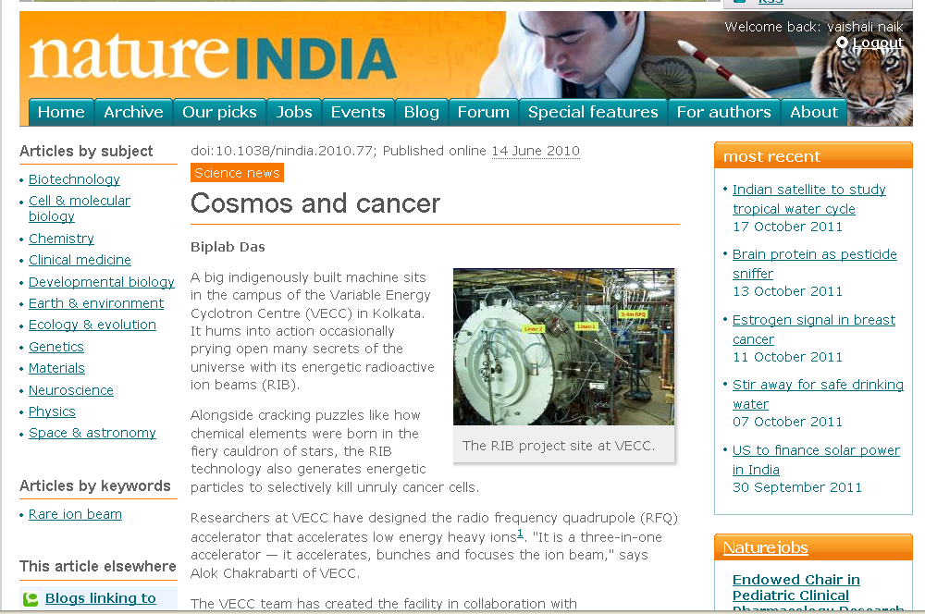
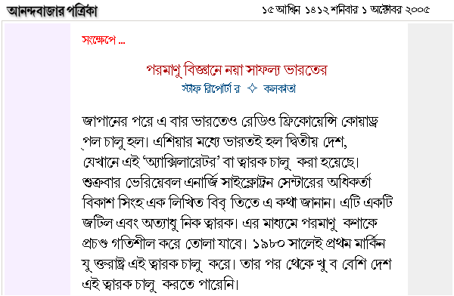
RFQ : India joins the select club

Slide 34
Major components of total ANURIB project and Tentative Cost projection
No. | Major Activity | Expenditure (Rs. Crore)
1. | Super Conducting Electron Linac, acceleration from 30 to 50 MeV, high Power Actinide Target Module, Remote handling, Waste Management, High Power Beam Dumps | 60.00
2. | Production and Acceleration of RIB to 6 - 7 MeV/A | 140.00
3. | Super Conducting Ring Cyclotron for 100 MeV/A acceleration | 140.00
4. | Experimental facilities for nuclear physics, nuclear astrophysics, material science, & PF Separator, ion storage ring, | 180.00
5. | Building comprising of Accelerator Complex and Services - electrical power, air-conditioning, LCW plant, Cryogenic plant & other infrastructure services | 350.00
 | Total : Rs. in crore (million US Dollar) | 870.00 (174)
Phasing of Expenditure (Rs. Crore)
2012-13 | 2013-14 | 2014-15 | 2015-16 | 2016-17 | Total 12th Plan | Spill over 13th & 14th Plan
2.00 | 5.00 | 8.00 | 75.00 | 75.00 | 165.00 | 600.00 (13th plan) 105.00 (14th plan)

Slide 35
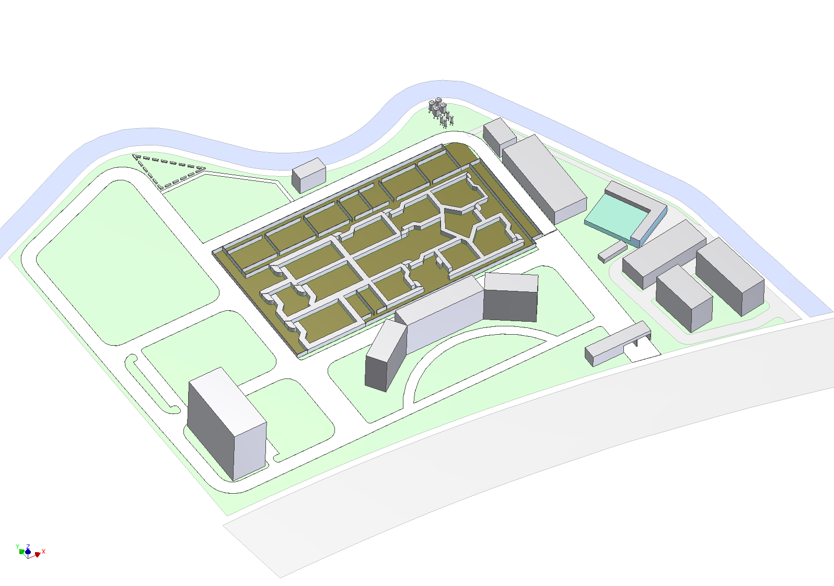
VECC Rajarhat site layout (tentative)
VECC New Campus
Cryogenic building
ANURIB Accelerator Complex
canal
Multipurpose R & D building
Electrical sub-station
Water storage & pump
IUC-DAEF
Main Building
Main gate
~300m
From salt lake
SINP
264m
To Airport
Kolkata Tata Memorial Hospital

Slide 36
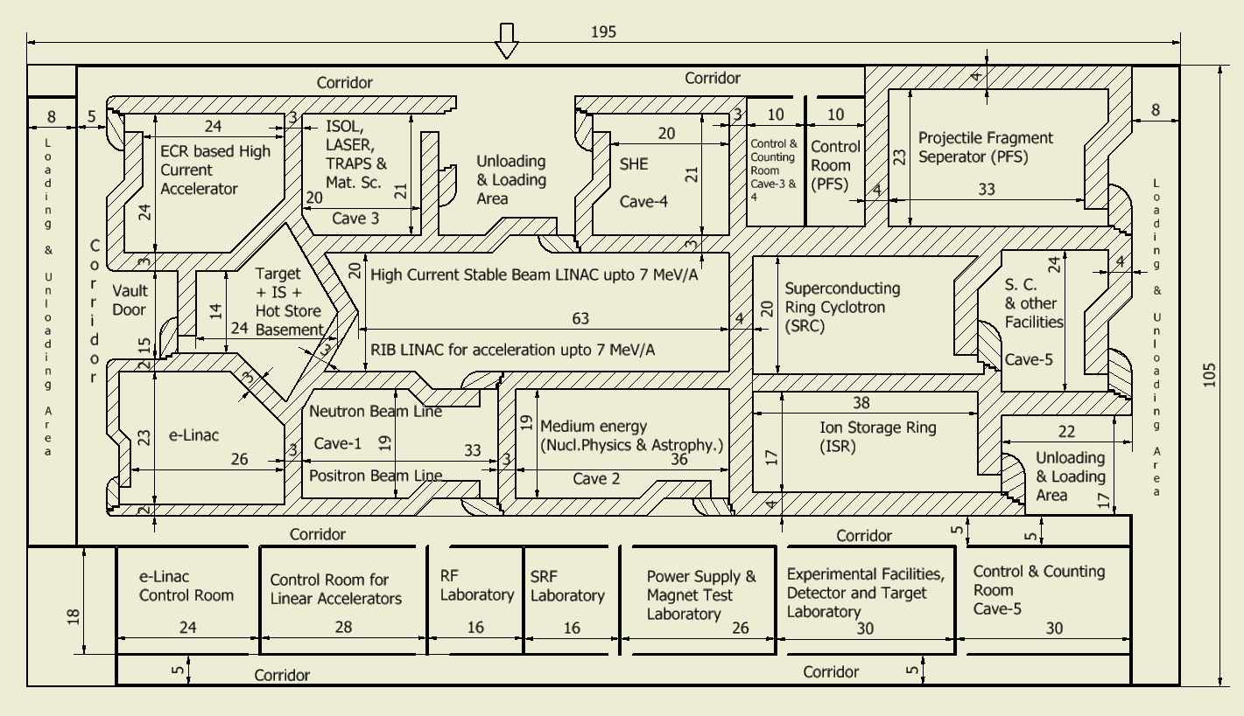
Floor layout of ANURIB Accelerator Complex (tentative)
105m
195 m

Slide 37
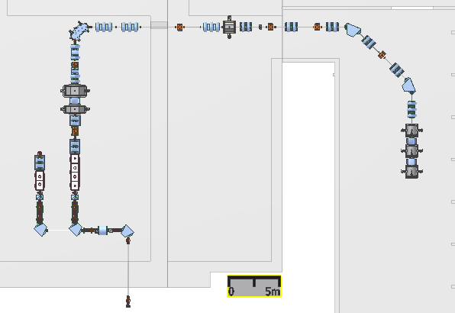
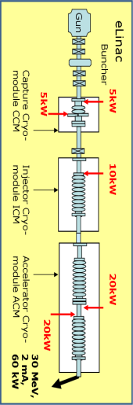
Location for Electron Linac in HR Cave 1
RIB
HR cave-2
RIB annex
Linac-3
4m
6m
Linac-2
wall
Linac-1
HR cave-1
4K LHe & 77K LN lines
Linac4–6
12m
19m
RFQ-1
RFQ-2
ECR
Experimental facility
Target/1+ ion-source
9.8m
K130 vault
Cyclotron beam

Slide 38
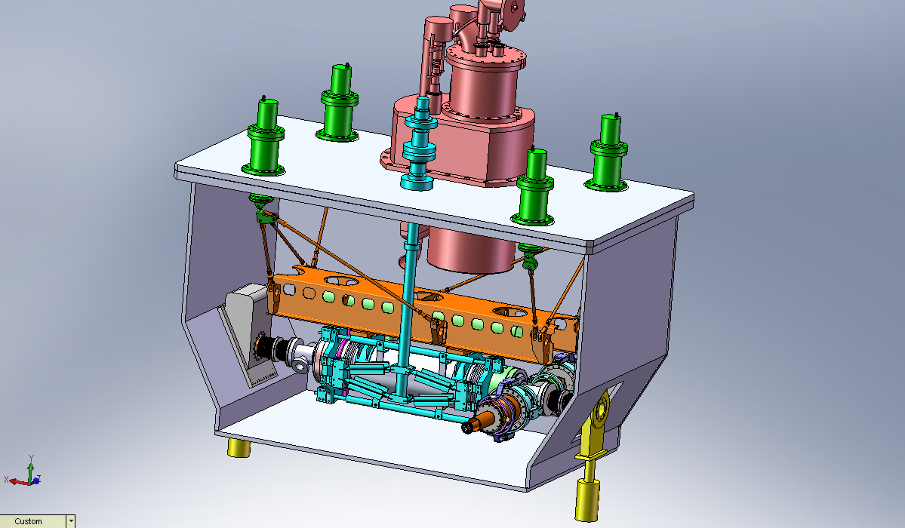
Est. heat load 10 MV/m ICM
Static + Dynamic
15 W @ 2K
+ 6 W @ 4.2K
+ 275 W @ 77K
2K operation important
RF surface resistance 20 nΩ (2K) but 800 nΩ at 4K.
4K operation will need 10 times higher Cryo-plant capacity.
Injector Cryo- Module details
Cryo-Insert
Support & Alignment Post
Tuner drive
Vacuum Chamber
Support Strut
4K GHe return
Cold to warm transition
JT& Control valves
Scissor Tuner (Cold Part)
4K LHe supply
9 cell module & LHe jacket
Coupler
Manas Mondal, Tim Emmens
Isolation Valve
Mounting flange
Status of 10 MeV Injector & ICM
Beam dynamics design of e-Linac completed
Mechanical engineering design of ICM and ACM completed
Cryogenic-line design underway
Heat exchanger
4K reservoir
Radiation baffle plate

Slide 39
Hydrostatic burning stages leading to ⁵⁶Fe
H burning
He burning
C burning
Ne burning
O burning
Si burning
4p ⇒ ⁴He+2e⁺+2ν +26.7 MeV
α+α ⇒ ⁸Be
⁸Be+α ⇒ ¹²C+γ+7.2 MeV
¹²C+¹²C ⇒ ²³Na+p+2.23 MeV
⇒ ²⁰Ne+α+4.6MeV
¹²C(p,γ)¹³N(e⁺ν)¹³C(α,n)¹⁶O
²⁰Ne+γ ⇒ ¹⁶O+α ; ²⁰Ne+α ⇒ ²⁴Mg+γ
¹⁶O+¹⁶O ⇒ ³¹P+p ⇒ ²⁸Si+α ⇒ ³¹S+n
²⁸Si+α ⇒ ³²S+α +α …+α ⇒ ⁵⁶Fe
²⁸Si+γ ⇒ α+Mg
(main source of α )

Slide 40
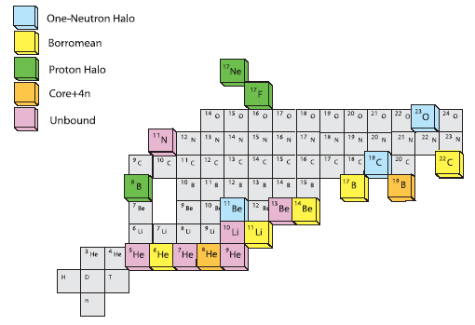
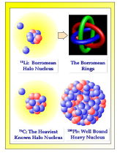
Halo Nuclei – nuclei with unusually large matter distribution
¹¹Li Borromean
Halo nucleus
Borromean
Rings
Halo universality?
Halo in excited states?
¹⁹C Heaviest known Halo nucleus
²⁰⁸Pb well bound heavy nucleus

Slide 41
Halo in excited states
Excited states close to particle threshold in stable or near stable nuclei may exhibit halo structure
¹²C (n, γ) ¹³C ; ¹⁶O (γ, n) ¹⁷O
Reaction rate (expt.) ≈ 100 x Reaction rate (1/v)
⇒ Reduction of neutrons in the Helium- burning stage of a star
⇒ significant effect on s process (n, γ) nucleo-synthesis rates

Slide 42
Beta-decay of Fully/highly stripped ions &
Cosmo-chronology
¹⁶³Dy⁶⁶⁺ (Z=66) → ¹⁶³Ho⁶⁶⁺
(Half-life = 47 days when fully stripped; stable if neutral)
¹⁸⁷Re⁷⁵⁺ (Z=75) → ¹⁸⁷Os⁷⁵⁺
(Half-life = 33 yrs when fully stripped; 4x10¹⁰ yrs if neutral)
correction in galactic age determination

Slide 43
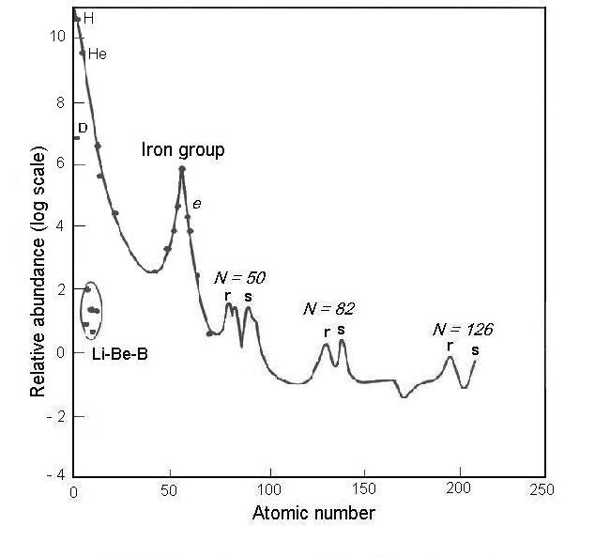
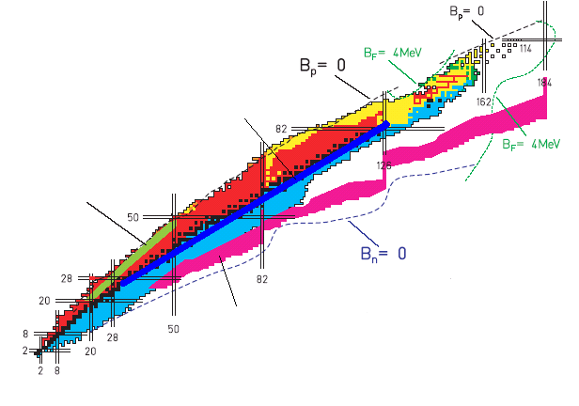
Element synthesis & Exotic Nuclei
(we are but stellar dust)
fusion stops at ⁵⁶Fe ; S-process : up to ²⁰⁹Bi
Beyond Bi, only r-process
Solar Abundance
s – process
Relative abundance (log scale)
rp – process
r– process
Mass number

Slide 44
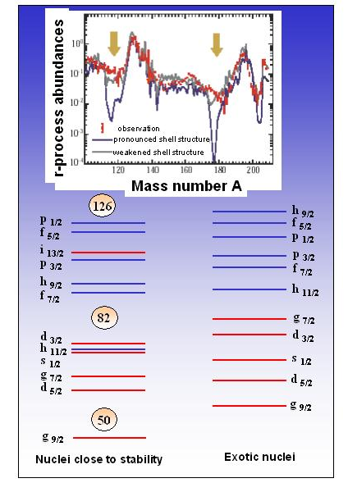
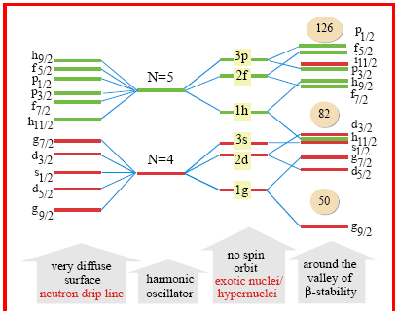
Weakening of shells away from beta-stability
N=50 N=82
Moving towards neutron-drip line
Calculations with weakened shell structure show a reduced discrepancy between measured and calculated r-process abundances at N=50 and N=82 shell closures

Slide 45
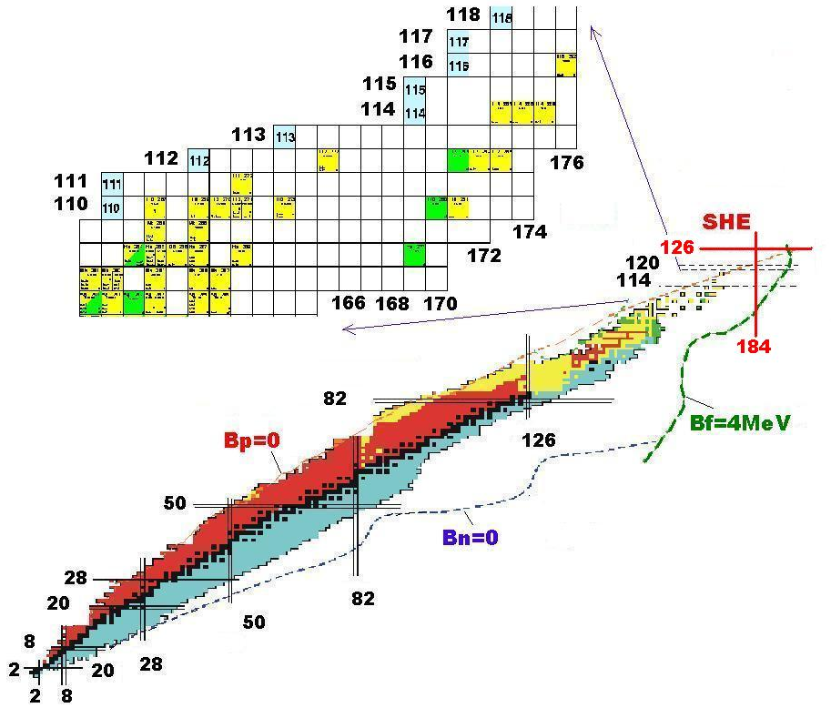
Synthesis of Super Heavy Elements (SHE)
prediction
shell closure at N= 184 Z=114/118/120/126 (depending on the model)
with stable beams it is not possible to reach these closed shells

