Slide 1

Chemistry at the lead bismuth loop
for EURISOL prototype
Susanta Lahiri¹, Moumita Maiti¹, T. Stora²
¹Saha Institute of Nuclear Physics, Kolkata, India
²CERN, CH-1211 Geneve 23, Switzerland

Slide 2
Liquid lead-bismuth eutectic : prototype converter target in
proposed EURISOL project.
Composition: 44.5% lead and 55.5% bismuth
Melting temperature 123.5 °C
Boiling temperature 1670 °C.
It has good heat transfer properties.

Slide 3
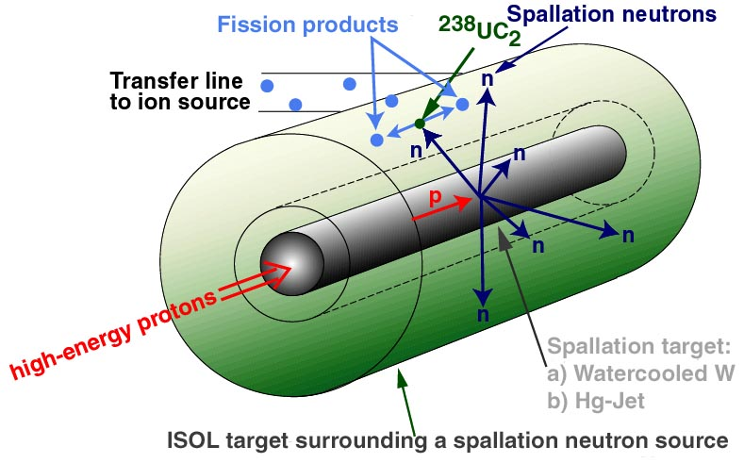
The EURISOL Project
(The ultimate ISOL facility)

Slide 4
Source : EURISOL facility
Large volume of liquid Hg or Pb-Bi target will be used as converter target as well as coolant
Large number and huge amount of radionuclides will be produced in the converter targets: Hg/Pb-Bi when bombarded by a few GeV high current proton beam
Continuous source of radionulcides
This multi-MW converter target of the proposed “next generation” European Isotope Separation On-Line (EURISOL) facility may be able to serve as a potential alternative source of several pronounced radionuclides

Slide 5
Identification of these radionuclides are important
    They can be enormous source of useful radionuclides in all branches of sciences especially for clinical applications.
Why large facilities became so important?
1
Limitations of low energy medical accelerators
Reduced reactor facilities/shutdown of reactors
How to identify?
The high shielding from high Z targets is the main constrain for identification of these radionuclides.

Slide 6
Quantification of each radionuclide is important
    To make exact inventory of each radionuclide is important for commercial purpose.
    The successful commercial application may even be helpful to share the cost of such facilities for basic sciences.
How to Quantify?
2
Constrains:
  High shielding by high Z target
  Irregular geometry
  Large number of radionuclides with overlapping peaks.

Slide 7
Our proposal is to build Radionuclide Bank from proton irradiated Pb-Bi targets
PROBLEM + SOLUTION
RADIOCHEMICAL SEPARATION
We would like to develop chemical separation technique for each radionuclides with high radiochemical and radio-isotopical purity --- therefore fulfilling the primary requirement for clinical radionuclides
3

Slide 8
Techniques
Identification & quantification of radionuclides
γ-spectrometry by HPGe detectors
ICP-OES and ICP-MS
Chemical separation
Radioanalytical techniques
(i) LLX
(ii) Ion-exchange chromatography
(iii) Adsorption
(iv) Amalgamation …… etc.
Thermochromatography

Slide 9
Work report available in this direction
Identification of radionuclides of proton irradiated Hg target
Report of Neuhausen et al. from PSI
Large number of radionuclides were identified
Isolation of radionuclides from liquid Hg target

Slide 10
Results we found
Radioisotope present | Radioisotopes to be confirmed | Radioisotopes to be confirmed
As-72 (26.0 h ) | As-74 (17.77 d) | Pr-142 (19.12 h)
Co-56 (77.27 d) | Au-194 (38.02 h) | Pt-188 (10.2 d)
Co-58 (70.86 d) | Au-199 (3.139 d) | Pt-195m (4.01 d)
Co-60 (1925.28 d) | Ba-128 (2.43 d) | Rb-84 (33.1 d)
Cr-51 (27.7025 d) | Ba-135m (28.7 h) | Rb-86 (18.642 d)
Eu-145 (5.93 d) | Be-7 (53.22 d) | Re-183 (70.0 d)
Eu-146 (4.61 d) | Ca-47 (4.536 d) | Re-186 (3.7186 d)
Eu-147 (24.1 d) | Co-57 (271.74 d) | Re-189 (24.3 h)
Eu-150m (12.8 h) | Cs-129 (32.06 h) | Rh-101 (3.3 y)
Fe-59 (44.495 d) | Er-172 (49.3 h) | Rh-101m (4.34 d)
Gd-146 (48.27 d) | Eu-148 (54.5 d) | Rh-105 (35.36 h)
Gd-153 (240.4 d) | Eu-149 (93.1 d) | Ru-103 (39.26 d)
Hf-175 (70 d) | Hf-172 (1.87 y) | Ru-97 (2.791 d)
Hg-203 (46.595 d) | Hg-195m (41.6 h) | Sc-44m (58.61 h)
Ir-188 (41.5 h) | I-123 (13.232 h) | Sc-47 (3.3492 d)
Lu-172 (6.7 d) | I-133 (20.8 h) | Sc-48 (43.67 h)
Mo-99 (2.7489 d) | In-111 (2.8047 d) | Se-75 (119.779 d)
Os-185 (93.6 d) | Ir-192 (73.827 d) | Sm-153 (46.284 h)
Rb-83 (86.2 d) | Ir-194 (19.28 h) | Sn-113 (115.09 d)
Re-188 (17.003 h) | Lu-173 (1.37 y) | Tb-153 (2.34 d)
Sc-46 (83.79 d) | Mg-28 (20.915 h) | Tb-155 (5.32 d)
Ta-183 (5.1 d) | Mn-54 (312.12 d) | Tc-95 (20.0 h)
Tc-99m (6.0058 h) | Na-22 (2.6027 y) | Te-121m (154 d)
V-48 (15.9735 d) | Nb-92m (10.15 d) | Tm-167 (9.25 d)
Y-88 (106.616 d) | Nb-95 (34.991 d) | Y-87m (13.37 h)
Yb-169 (32.018 d) | Ni-57 (35.6 h) | Zn-69m (13.76 h)
Zr-95 (64.032 d) | Pd-100 (3.63 d) | Zr-86 (16.5 h)
 | Pm-143 (265 d) | Zr-97 (16.744 h)

Slide 11
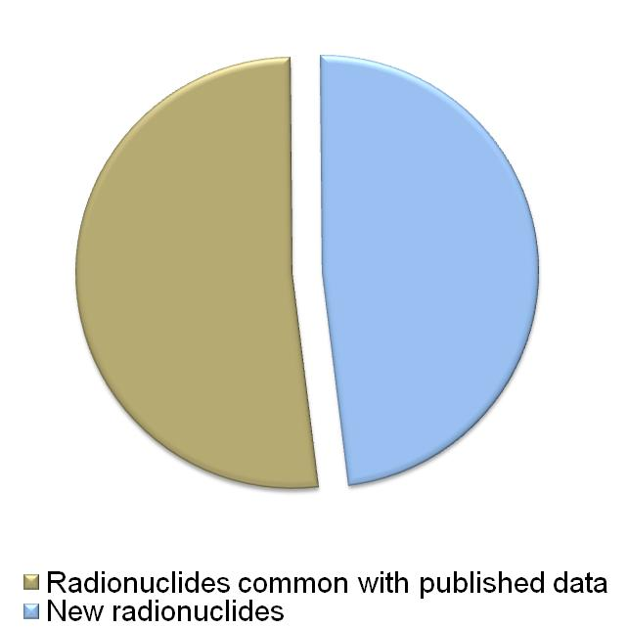
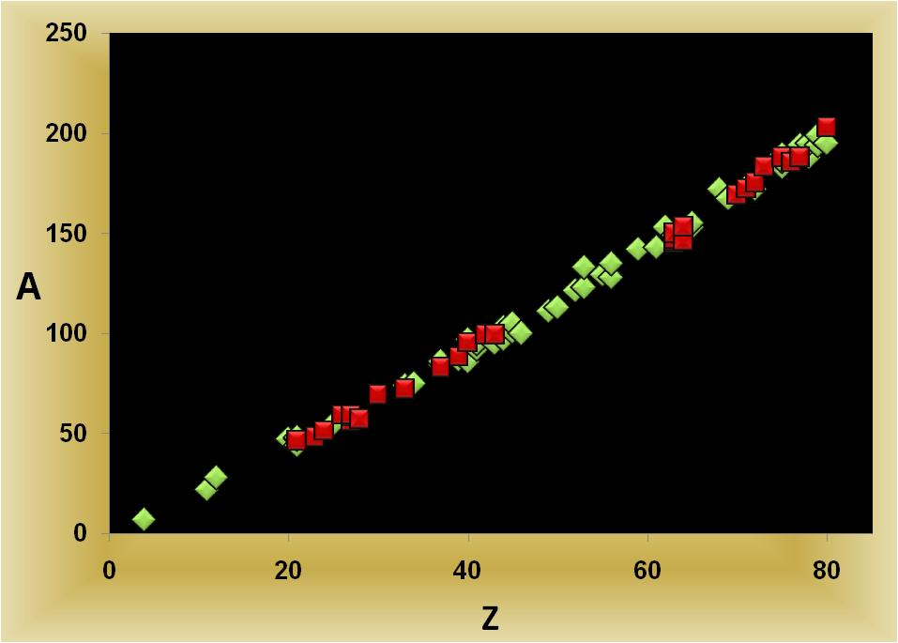
Identified probable radionuclides by our group

Slide 12
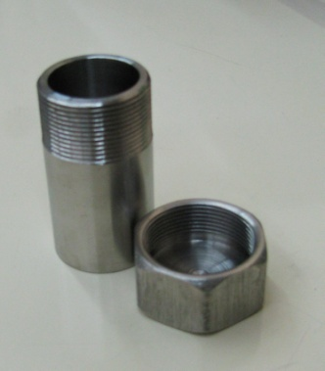
Behavior of ⁹⁹Mo-^{99m}Tc activity in bulk Hg environment
Liquid Hg in capped stainless steel vial
⁹⁹Mo-^{99m}Tc activity injected in liquid Hg and homogeneous mixed in Hg by sonication
Radiochemical extraction of ⁹⁹Mo-^{99m}Tc activity from bulk Hg by liquid-liquid extraction using
  Dil. HNO₃ (pH =1)
  Dil HCl (pH = 2)
  Hot (~65°C) and Cold (~26°C) water

Slide 13
Findings……
Mercury shows high self-shielding of ~90%
A major part of the ⁹⁹Mo-^{99m}Tc (~80%) goes to Hg
Rest amount is almost evenly distributed between the
surface of the steel capsule and in the tiny amount of
aqueous solution, which carried the total activity to
the mercury.
As per expectation, bulk mercury partially dissolved
in dil HNO₃ removing the clarity of the transparent
HNO₃ phase during distillation of ⁹⁹Mo-^{99m}Tc activity
from bulk mercury.
Extracting phase | Dil HCl (pH = 2) | Cold (~26°C) water | Hot (~65°C) water
Extraction of activity | ~20% | ~50% | ~20%

Slide 14
Other important properties to be investigated:
Long term proton irradiation will introduce enough activity in the LBE assembly, which needs to be separated at a regular frequency in order to recycle the target matrix.
Emphasis will be given to build a data bank of various thermodynamic parameters like adsorption enthalpy, sublimation enthalpy for these radionuclides on Pb-Bi surface.
The study will be extended to the migration behavior of these radionuclides in various solid materials like stainless steel, glass, graphite, etc.

Slide 15
Thank you….

