Slide 1


Opening CERN to non-European States
(aka as ‘geographical enlargement’)
Rüdiger Voss
CERN International Relations Office
FPRIB, SINP Kolkata| April 16-18, 2012

Slide 2
The rationale
Follow, at the institutional level, the ‘vote with the feet’ of the global particle physics community and their unprecedented move to CERN triggered by the LHC
Anticipate the fact that the next big project in particle physics can only be realized as a global project, with
  Global scientific participation
  Global funding
  Global governance

Slide 3
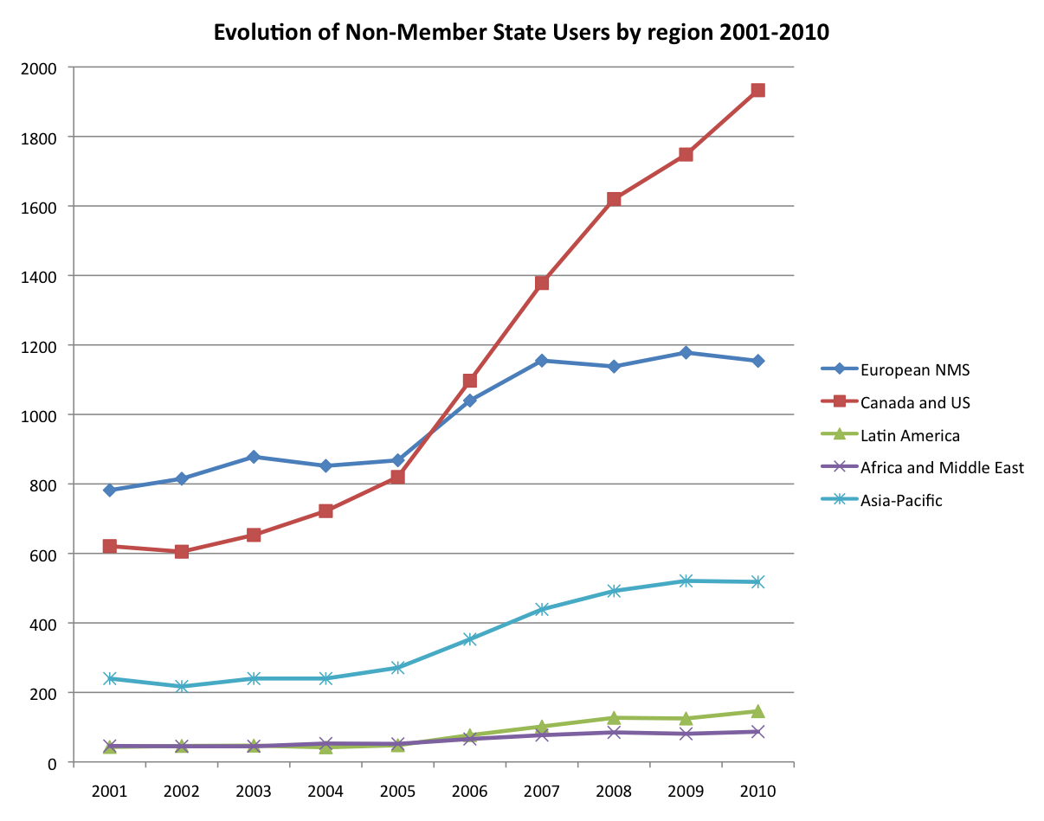
Non-Member State Users

Slide 4
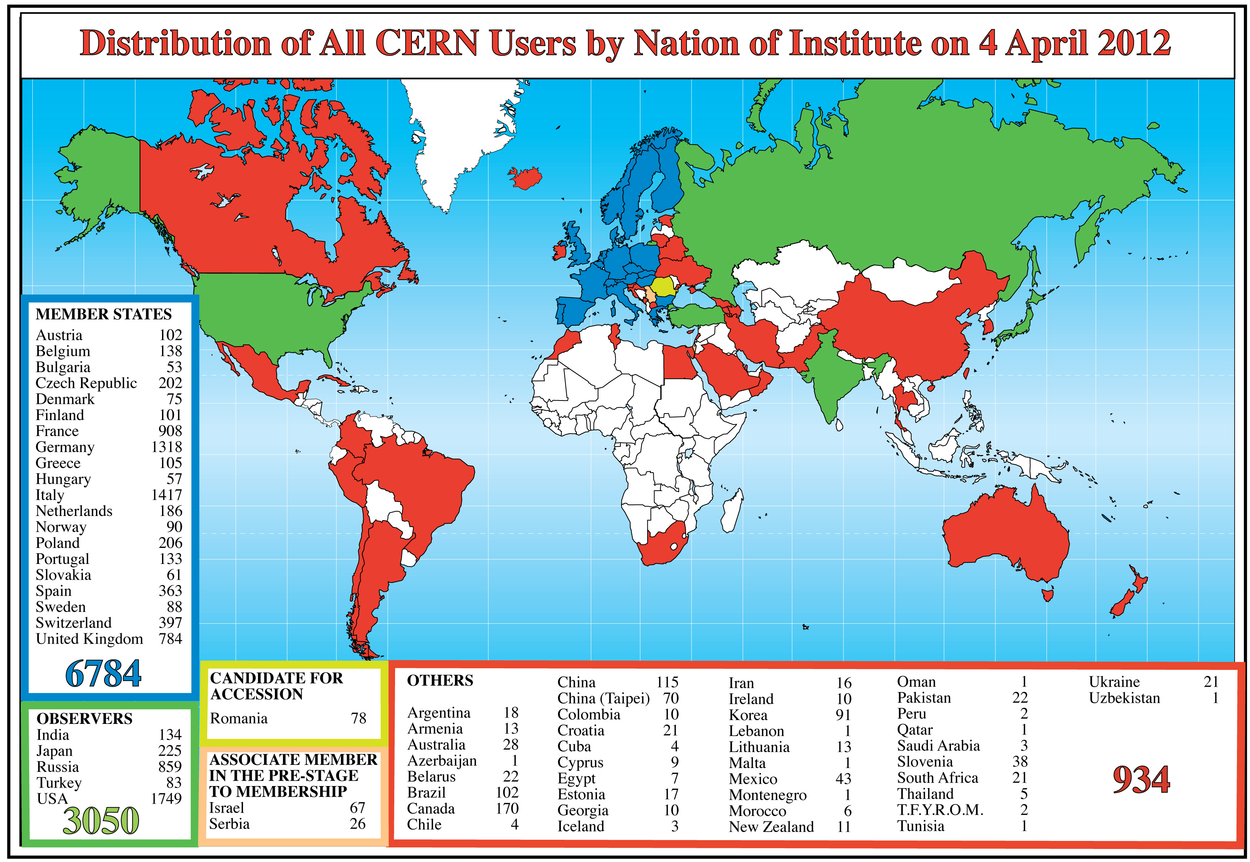
CERN Users by Institute

Slide 5
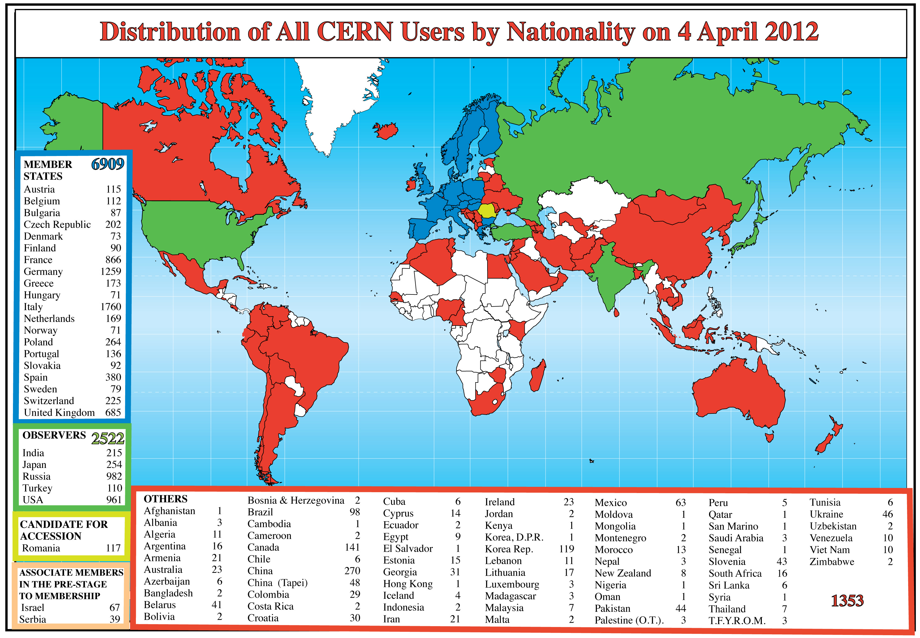
CERN Users by passport nationality

Slide 6
Non-European participation in CERN
Observer Status
  ‘Honorary’ status with right to attend (open) CERN Council Sessions – no other significant obligations and benefits
  Mostly awarded to countries who made important in-kind contributions to LHC construction (India!)
International Co-operation Agreements (ICAs)
  Mostly umbrella agreements to provide formal framework
  Actual collaboration implemented through Protocols/Addenda (accelerators) and MoUs (experiments)
  ICA with India (DAE) concluded in 1991

Slide 7
Where do we stand?
From a European perspective, the unprecedented Non-Member State participation in the LHC has brought about substantial scientific, technical and political benefits
Helped to establish CERN firmly as world’s leading center at the high energy frontier, in the perception of governments, funding agencies, and of the taxpayer

Slide 8
Where do we go from here?
The LHC has convincingly demonstrated the potential of global collaboration in science, and is widely perceived as a paradigm of successful global collaboration on megascience projects
To take this collaboration to the next-higher level, and to fully exploit its potential to the benefit of all partners, CERN invites an enhanced institutional participation of its major non-European partners, in the framework of CERN’s new membership policy (aka ‘Geographical Enlargement’)

Slide 9
A bit of history
For > 50 years, the CERN Council has repeatedly interpreted the 1953 Convention as restricting membership to European states
In response to the strong global participation in the LHC – and in anticipation of the post-LHC era – the Council in 2010 approved the most significant shift in CERN’s membership policy thus far, opening CERN fully to non-European states (CERN/2918/Rev.)

Slide 10
Dimensions of enlargement
Full Membership open to non-European states
Associate Membership – in two flavours:
  Pre-stage to full membership: compulsory transition period on the way to full membership (2–5 years)
  Regular (‘steady state’) Associate Membership
Instrument of International Co-operation Agreements (ICAs) to be maintained
  ≈ 45 ICAs currently in force
Observer status to be phased out for states
  India presently one of 5+2 observers
  New states will not be admitted
  To be maintained for International Organizations (presently UNESCO, EU)

Slide 11
Associate Membership
A simplified view of the ‘steady state’ scheme:
Obligations
  Annual contribution to CERN budget corresponding to ≥ 10% of ‘theoretical’ full Membership contribution (minimum 1 MCHF/year)
Benefits
  Representation in CERN Council (no voting rights)
  Access to employment and education programmes (excluding tenured positions)
  Access to industrial contracts

Slide 12
Criteria for Associate Membership
A solid basis in experimental and theoretical elementary particle physics, adequately funded to support research at home and work at CERN
A sufficiently developed industry able to tender for CERN contracts with reasonable chance of success
The will of the national authorities to support basic research, and their awareness of the implications of participation in a common endeavour in the field of particle physics

Slide 13
The case of India
The Atomic Energy Commission chaired by Dr. S. Banerjee approved Associate Membership in CERN on April 9, 2012
Next steps:
  Formal application to CERN Council
  Evaluation by Council-mandated Task Force
  Approval of admission by the Council (by consensus)
  Signature & ratification of accession agreement
Expected financial contribution in 2013:
MCHF 8.8 (49 Crore Rupees)

Slide 14
Looking beyond the borders
Israel, Cyprus, Serbia, Turkey and Slovenia applied for (full) membership in 2008-2009
  Will have to go through Pre-stage Associate Membership
  Negotiations completed with Israel (Associate Member (AM) since October 2011) and Serbia (January 2012)
  Expect others to join as AMs 2012-2013
Ukraine applied for regular AM in January 2012
Brazil signed Declaration of Intent
In discussion with several other countries
  Russia, US, Canada, …
  The Canadian community, through the 2010 IPP submission to NSERC and in later roadmaps, has issued a strong recommendation for Canada to join CERN as AM

Slide 15
Conclusion
Beyond existing R&D collaboration, Associate Membership brings about substantial, additional benefits in a win-win-scenario for all partners:
  Staff employment and participation in the Fellows, Associates and Student programmes;
  The possibility to submit own research proposals
  Participation in all training and education programmes
  Industrial participation in selected areas of R&D, and in CERN procurement through industrial orders and service contracts
  Participation in CERN’s governing bodies
CERN will be happy to welcome India amongst its members!

