Slide 1



Multi-nucleon transfer: a probe to investigate the reaction mechanism around Coulomb barrier
Samit K Mandal
Department of Physics & Astrophysics
University of Delhi
Future Plan with Radioactive ion beam’ (FPRIB2012) at Saha Institute of Nuclear Physics from 16 -18, April, 2012

Slide 2
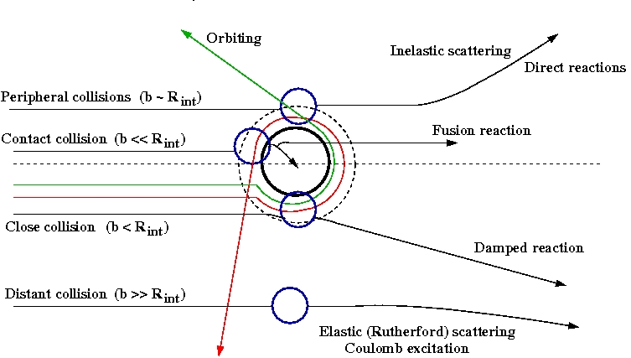
Nuclear Reaction

Slide 3
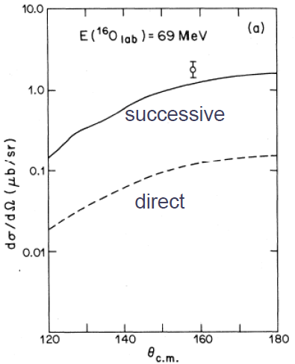
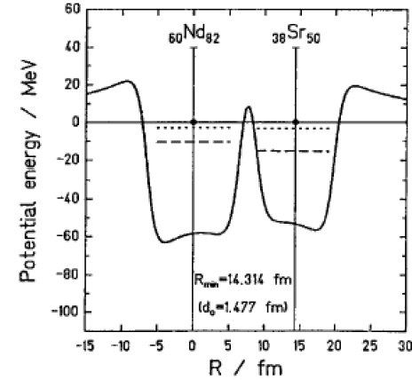
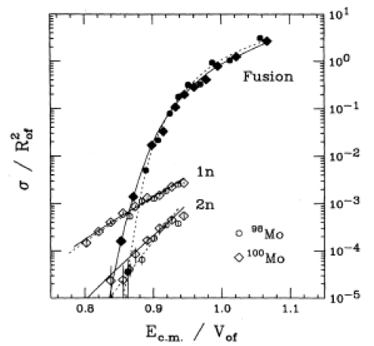
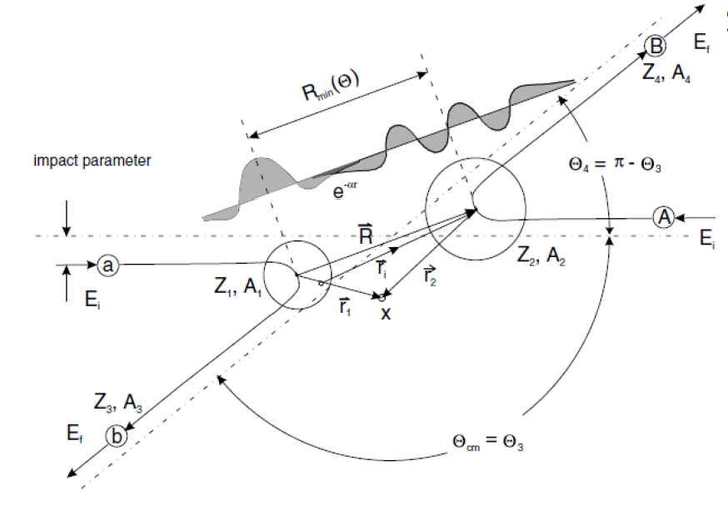
Multinucleon transfer reaction
Transfer & Fusion in an overlapping zone
Single & multi step process
Tunneling effect

Slide 4
Recent Interest:
Multi-neutron transfer will give access to very neutron-rich nuclei.
Spectroscopic tool for nuclei far off stability. Because of long range and the non-locality of the form factors
→ coupled reaction channels method is mandatory.
The role of the pairing interaction in states with low binding energy
→ information on the pairing interaction at low densities.
The effect of the continuum and the role of coupling to collective low-lying vibrations of the core in weakly bound systems need to be clarify.
In two-nucleon stripping
→stable targets & projectile with low binding energy of the nucleon pairs in exotic nuclei
→ favour population of pairing states in the final nucleus close to the particle → matching condition
→These states are expected to have different and new collective properties. Some information on the predicted giant pairing vibrations .

Slide 5
Near Barrier Transfer Less no. of open channels
Narrow Q-value distribution
Theoretical Advantage
Low kinetic energy
Angular Distribution are backward peak
Small cross section
Difficulty in identification of final reaction products
Experimental Challenge

Slide 6
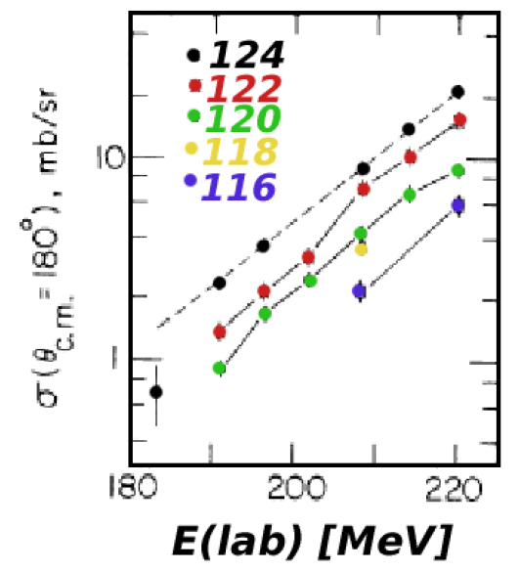
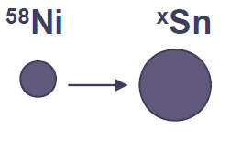
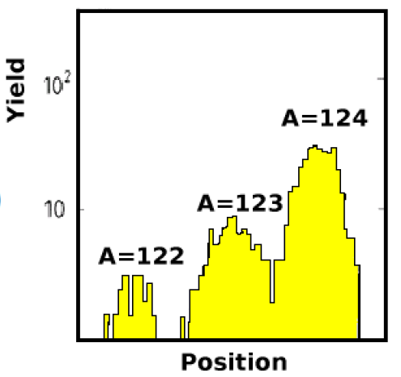
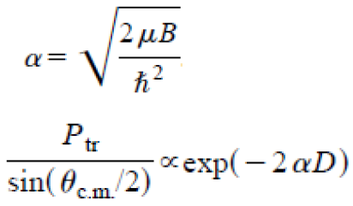
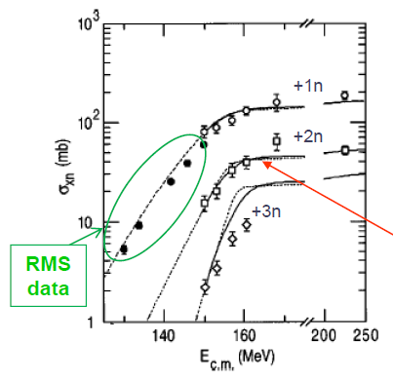
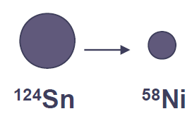
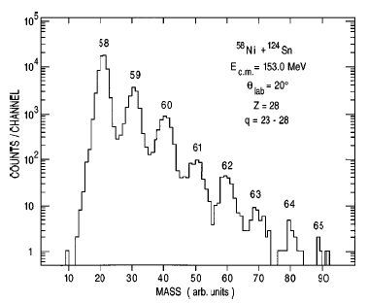

Successive & Pair transfer

Slide 7
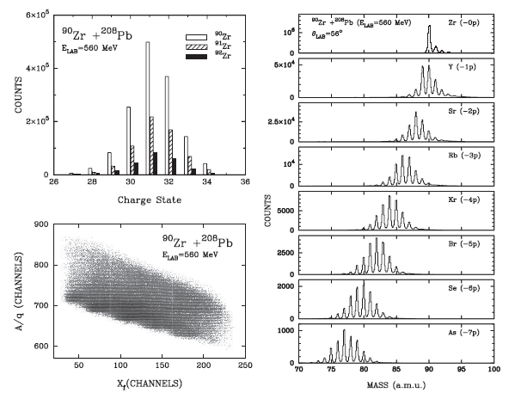
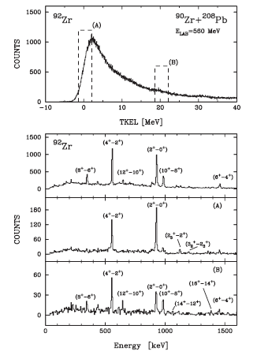
L. Corradi et al. J. Phys G 36 (2009) 113101

Slide 8
Few-nucleons transfer reaction mechanism
System : ²⁸Si + ⁹⁰⁻⁹⁶Zr
    Effect of pairing correlation on multinucleon transfer reaction (Cooper-pair transfer)
    Transfer mechanism ( sequential, cluster, transfer)
Isotope | Ex(2⁺) (MeV) | B(E2) (e²b²) | Ex(3⁻) (MeV) | B(E3) (e²b³)
⁹⁰Zr | 2.1862 | 0.061 | 2.7479 | 0.098
⁹²Zr | 0.9345 | 0.083 | 2.3397 | -----
⁹⁴Zr | 0.9187 | 0.066 | 2.0576 | 0.09
⁹⁶Zr | 1.7505 | 0.055 | 1.8972 | 0.202
²⁸Si + ^{90,92,94,96}Zr
Systems | +1n | +2n | +3n | +4n | +5n | +6n | -1p | -2p | +α
²⁸Si + ⁹⁰Zr | -3.50 | -2.20 | -7.96 | -8.38 | -16.62 | -18.81 | -6.43 | -7.24 | 0.28
²⁸Si + ⁹²Zr | -0.16 | 3.25 | -2.13 | -2.24 | -10.11 | -12.19 | -5.54 | -5.32 | 3.99
²⁸Si + ⁹⁴Zr | 0.25 | 4.13 | 2.08 | 4.09 | -3.40 | -5.18 | -4.78 | -3.75 | 3.20
²⁸Si + ⁹⁶Zr | 0.62 | 4.76 | 3.13 | 5.60 | 1.45 | 1.79 | -4.13 | -2.61 | 1.95

Slide 9
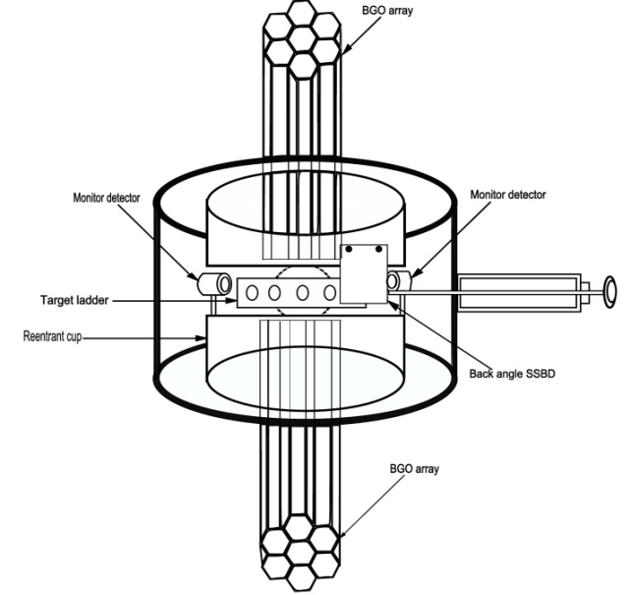

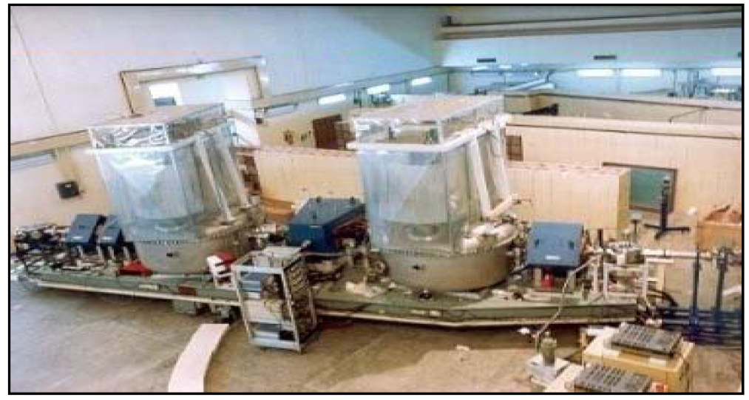
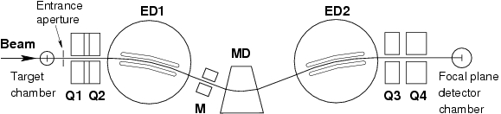
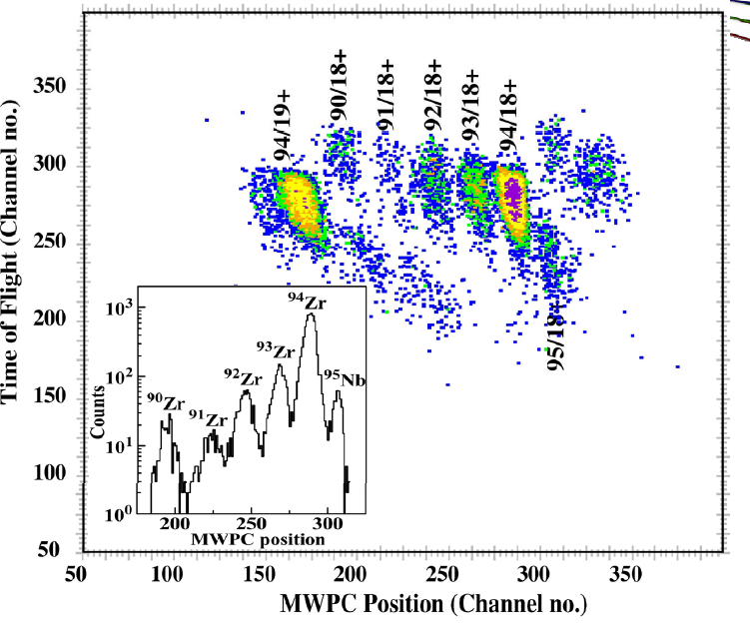
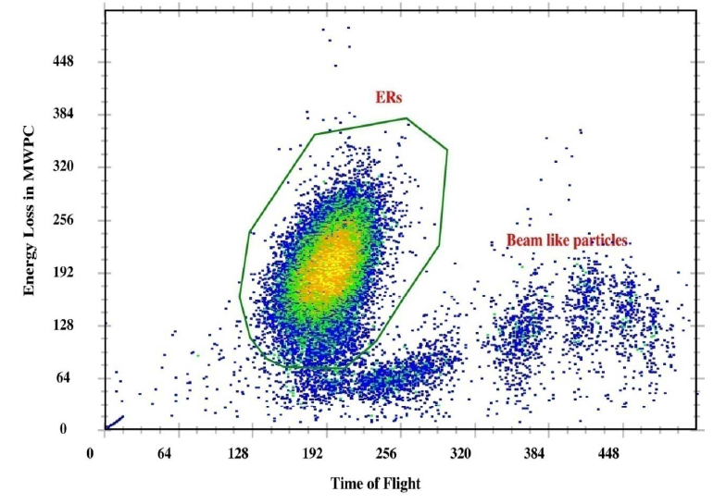
HIRA
Transfer
Fusion
Sunil Kalkal et al. Phys. Rev. C81 (2010)044610
Sunil Kalkal et al. Phys. Rev. C83 (2011)054607

Slide 10
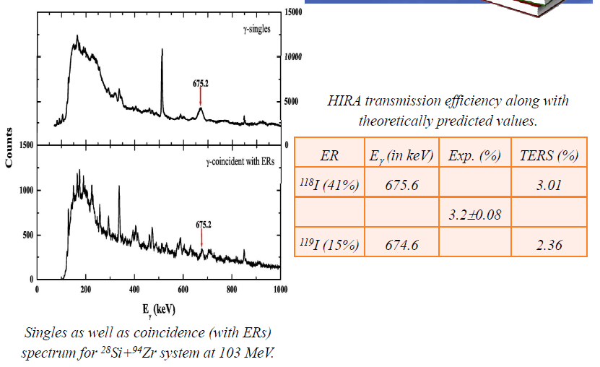
Efficiency of HERA

Slide 11
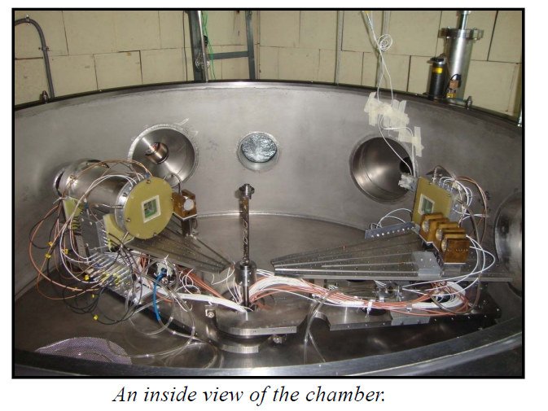
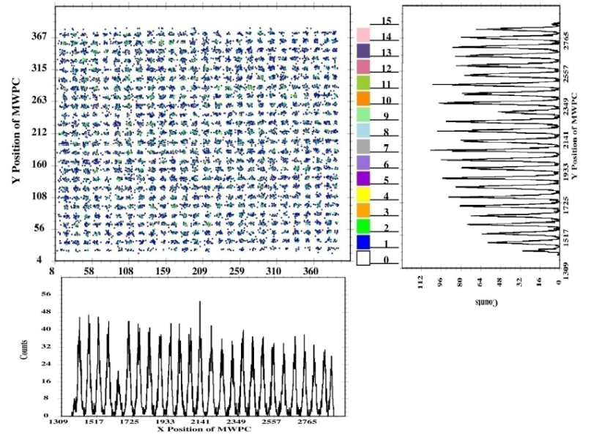
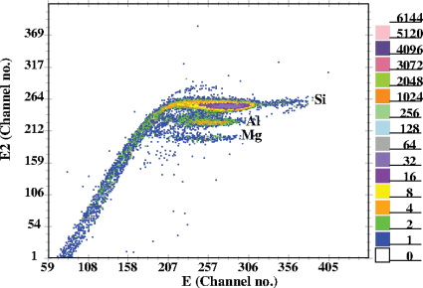
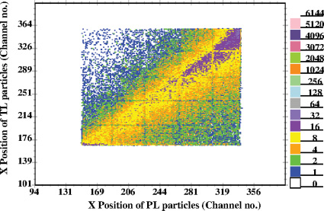
GPSC
Sunil Kalkal et al. Phys. Rev. C85 (2012) 034606

Slide 12
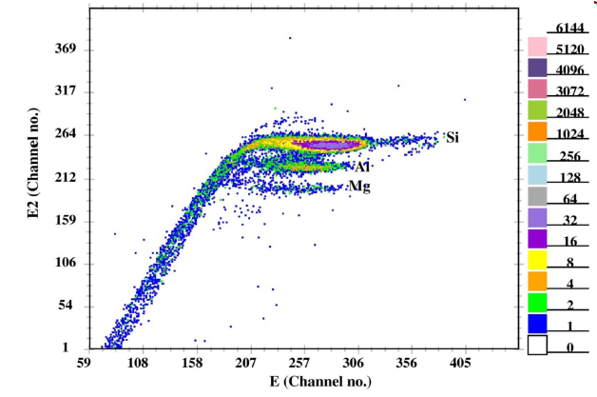
²⁸Si + ⁹⁴Zr system at 120 MeV

Slide 13
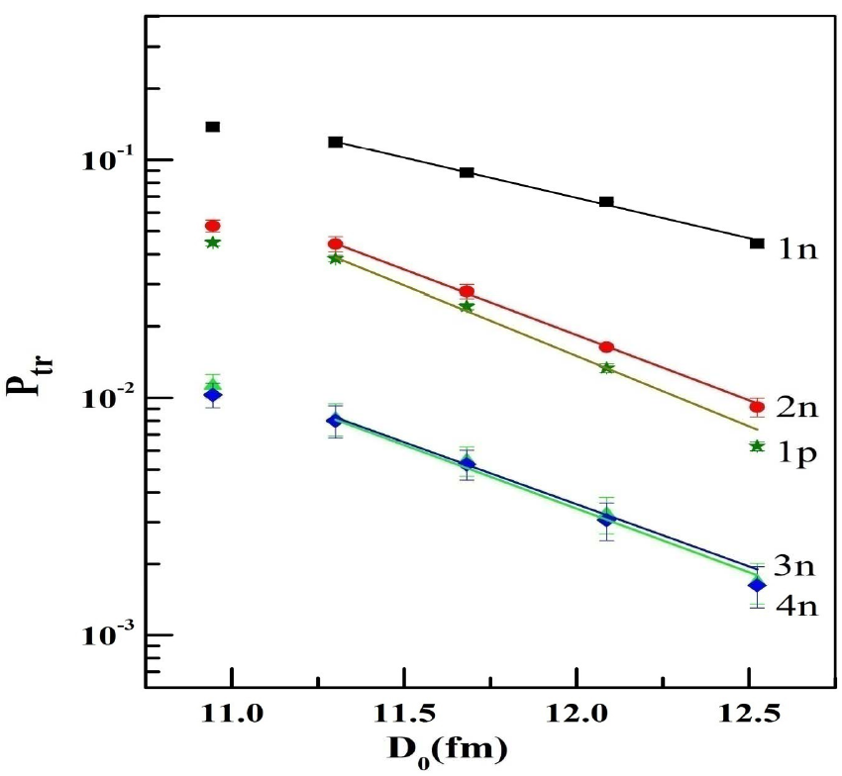

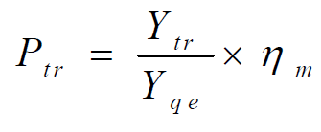
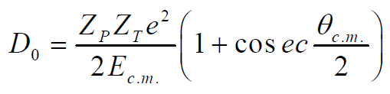
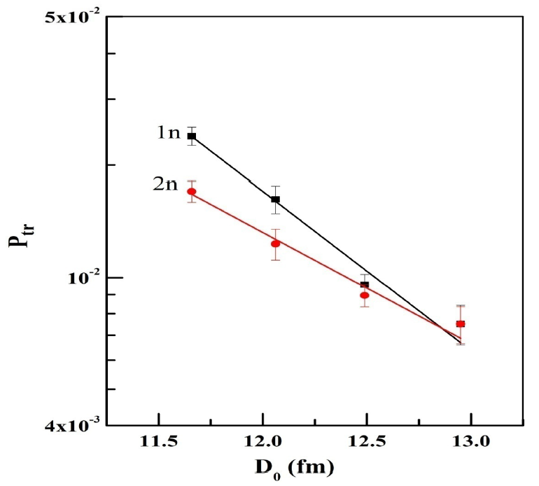

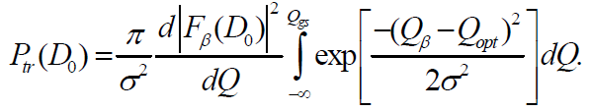


Transfer Probability
Sunil Kalkal et al. Phys. Rev. C83 (2011)054607

Slide 14
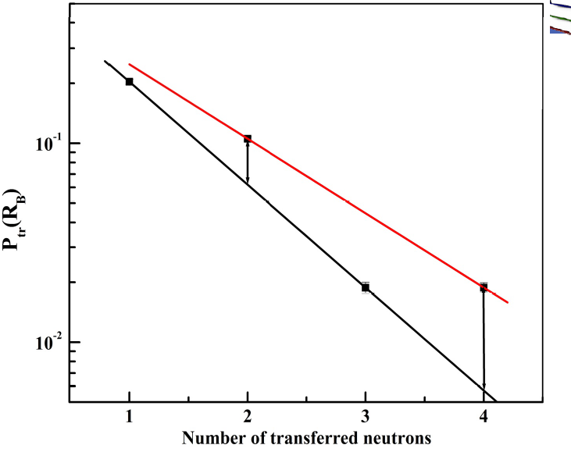
Odd - Even Effect !!

Slide 15
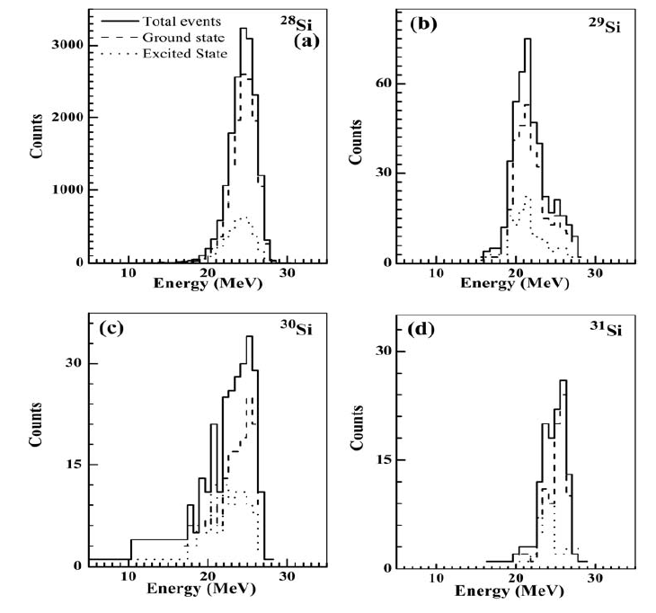

Sunil Kalkal et al.

Slide 16
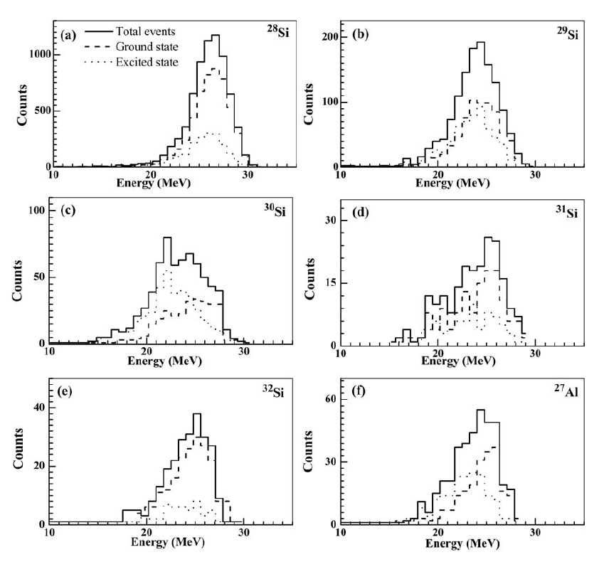

Sunil Kalkal et al.

Slide 17
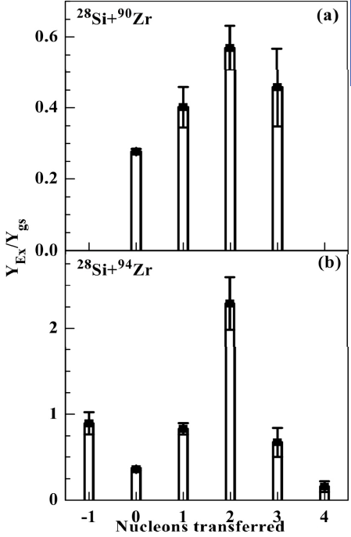
Ratio of Excited state to the Ground State Transfer evens
Sunil Kalkal et al.

Slide 18
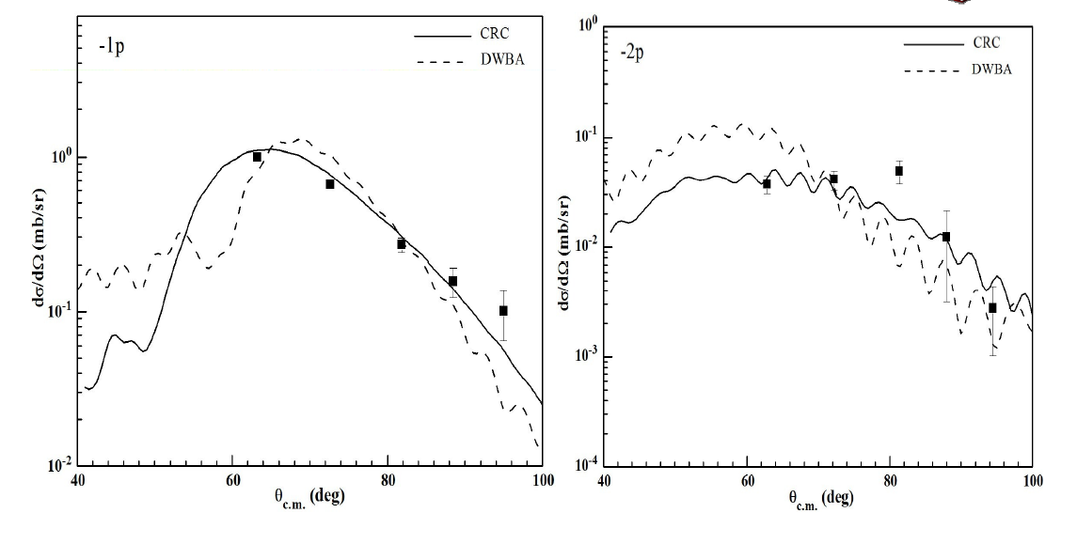
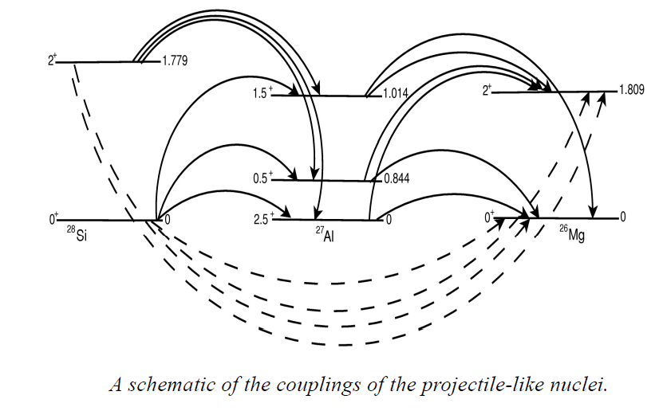
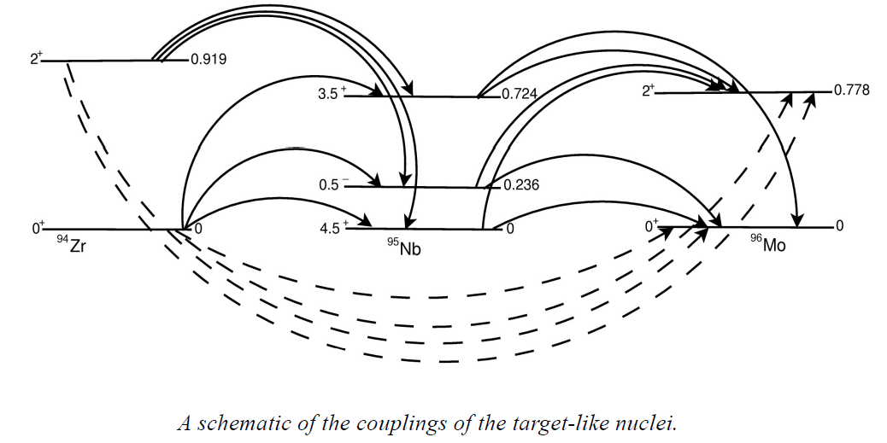
Coupling Scheme for CRC Calculations

Slide 19
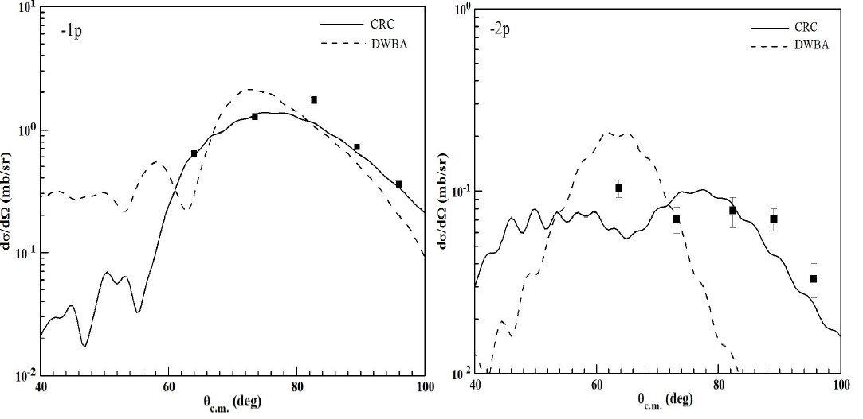
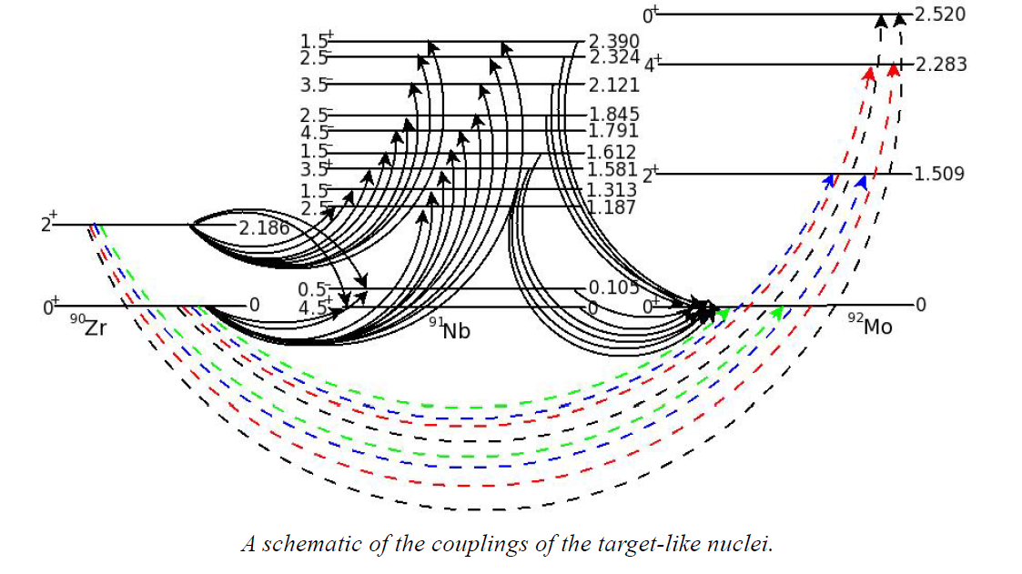
Coupling Scheme for CRC Calculations
Sunil Kalkal et al. Phys. Rev. C85 (2012) 034606

Slide 20
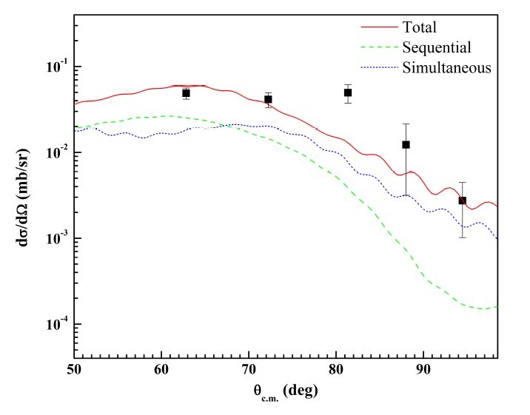

FRESCO Calculations
2-proton stripping
Sunil Kalkal et al. Phys. Rev. C85 (2012) 034606

Slide 21
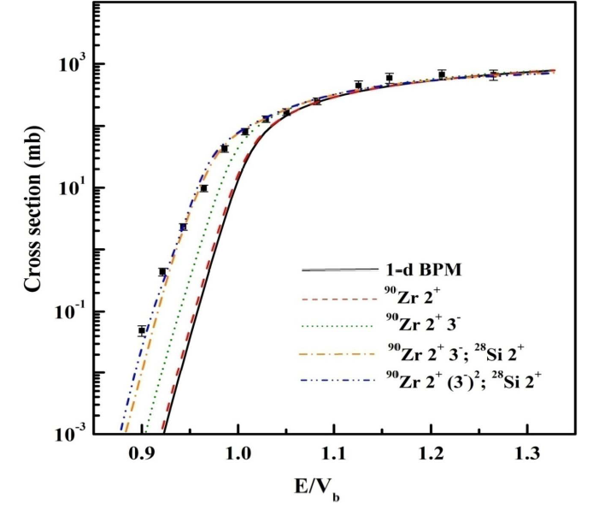

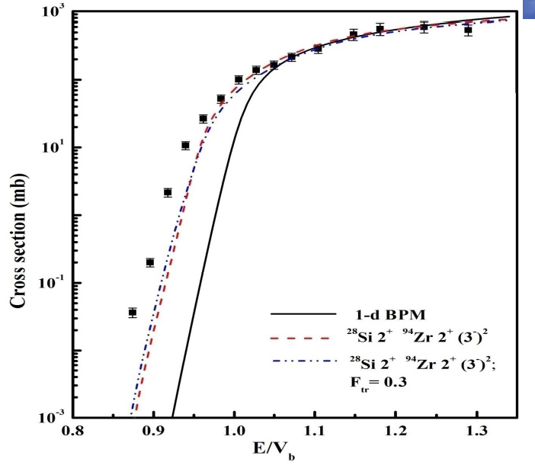
FUSION EXCITATION FUNCTIONS
Sunil Kalkal et al. Phys. Rev. C81 (2010)044610

Slide 22
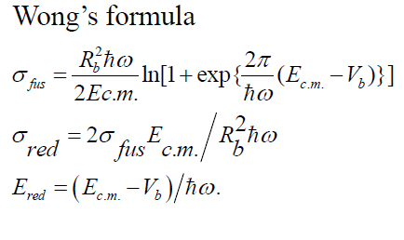
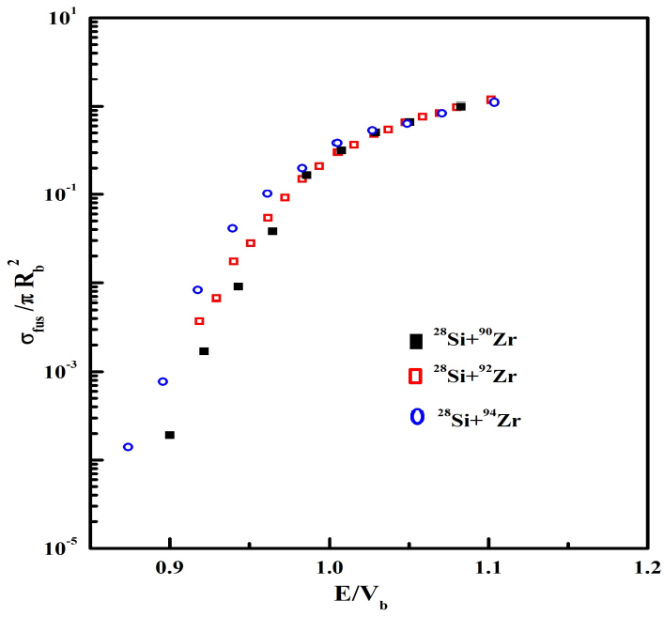
FUSION EXCITATION FUNCTIONS
Sunil Kalkal et al. Phys. Rev. C81 (2010)044610
J.O. Newton et al Phys. Rev. C64 (2007) 064608

Slide 23
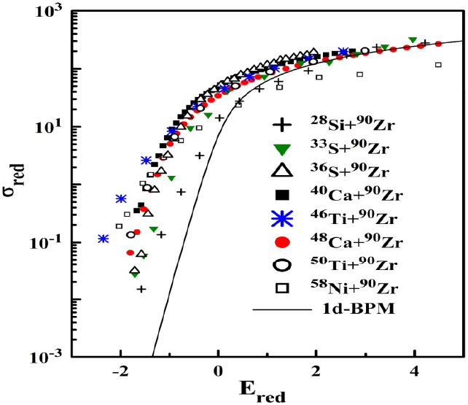
Sunil Kalkal et al. Phys. Rev. C81 (2010)044610

Slide 24
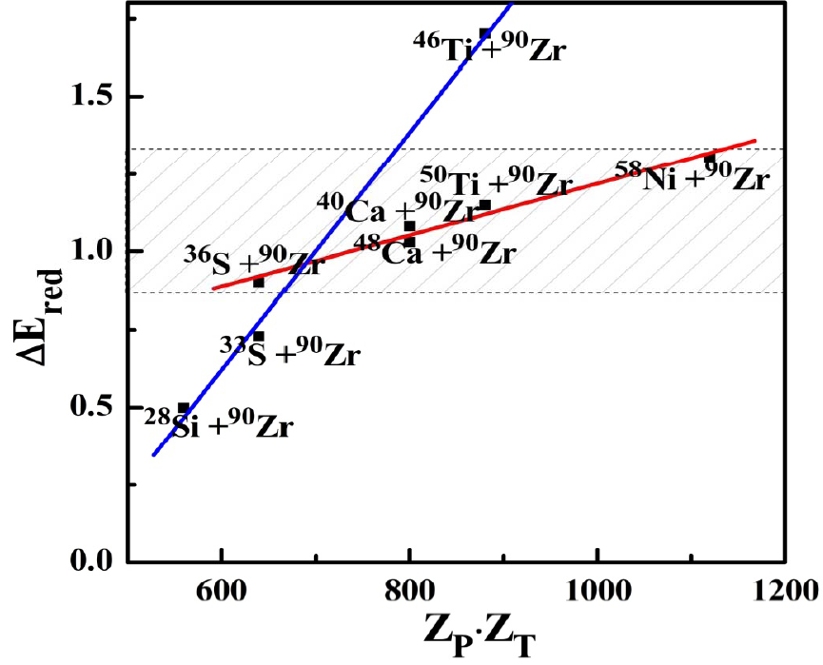
ΔE_{red} : difference in the value of E_{red} correspond to the cross section (~ 0.1mb) for various system
Multi Nucleon coupling effect on fusion channel: (Zagrebev model )
Sunil Kalkal et al. Phys. Rev. C81 (2010)044610

Slide 25
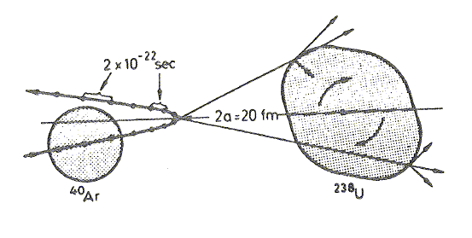
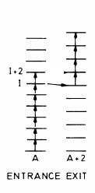
Diabolic pair transfer at higher angular momentum states
Pair transfer as a function of spin
Spectroscopic quantities
Intrinsic quantities
pair transfer amplitude
Parameters
Nuclear Josephson Effects:
Enhanced transfer of nucleon pairs between two superfluid heavy nuclei in a cold reaction correspond to a super-current.
⁴⁰Ar
²³⁸U
Notes:
Maximum pair transfer is expected in such cases where both partners can be in a superfluid state and the superfluid flow of pair will lead to an increased flow of nucleons.

Slide 26
Nuclear Josephson Effects:
Enhanced transfer of nucleon pairs between two superfluid heavy nuclei in a cold reaction correspond to a super-current.
alternating current JE:
Strong coupling situation
Flux oscillation in particular mass partition
Characteristic dependences on incident energy or reaction angle
Transfer probability values larger than 0.5
direct super current JE:
Weak coupling situation
Enhanced transfer of several nucleon pairs
Transfer probability values less than 0.5
G.Eckert et al. Z.Phys. A343 (1992), 276
I.Peter,W.von Oertzen et al., Eur.Phys. J.A16(2003),509
Notes:
The direct enhanced super current (dc) JEs or the occurence of alternating current (ac) can be favoured or hindered with the choice of different Q-value and mass partitions. The quenching of the pairing field at high angular momenta is due to the Coriolis force, acts in opposite directions on the two nucleons of each time reversal pair. This implies a weakening of the pair correlation with increasing angular momentum which lead to a reduced probability of two nucleon transfer effects. Maximum pairing enhancement is expected in such cases where both partners can be in a superfluid state and the superfluid flow of pair will lead to an increased flow of nucleons which will enhance reactions with a large change in mass asymmetry.

Slide 27
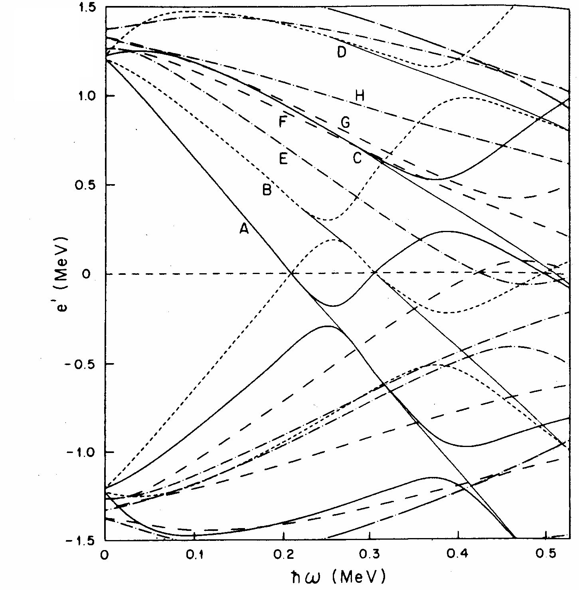
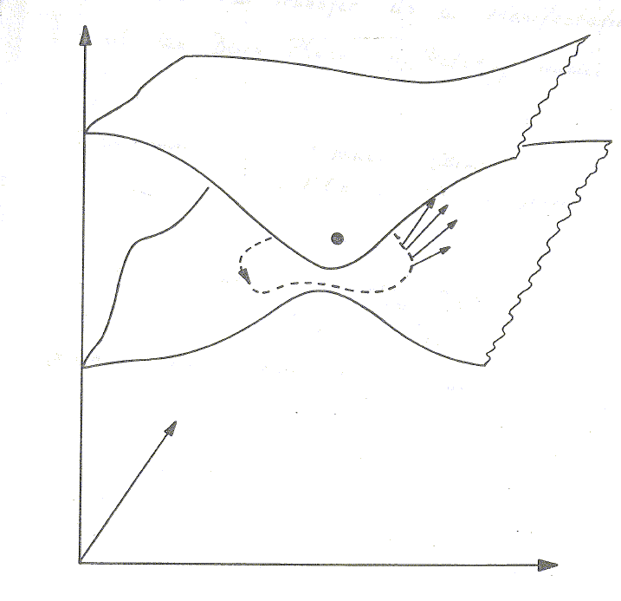
Berry's Phase, Diabolic Pair Transfer
Berry's phase is a simple mathematical fact. Berry considers a Hamiltonian, which depends on external parameters
Examples: (a) Nilsson Model R=β
(b) Cranked Shell Model R=(λ,Δ,ω)
E_{n}(λ,ω)
E₂(λ,ω)
Φ ₀
V
C
Φ ₁
E₁(λ,ω)
ω
Φ ₁=e^{iγ} Φ₀
Φ₁= -Φ₀
λ
A diabolical point, where two energy surfaces touch and a closed path on the lower surface encircling this point
chemical potential λ, angular velocity ω, pairing gap Δ
Notes:
Change the parameters adiabatically slowly on a path C in R-space. The wavefunction stays always on the energy surface. γ(C) depends on the geometrical properties of the line bundle. For real matrices is C in the x-y plane and e^{iγ}=-1

Slide 28



Berry's Phase and the Backbending Effect
Two different paths around a diabolic point
The oscillating behavior of the pair transfer matrix element has a close analogy to the oscillating behavior of the electric current in Superconducting Quantum Interference Devices as a function of the magnetic field, the DC-Josephson effect
<A+2,J/(a⁺a⁺)_{l=0}/A,J>
J(ђ)
Notes:
Change the parameters adiabatically slowly on a path C in R-space. The wavefunction stays always on the energy surface. γ(C) depends on the geometrical properties of the line bundle. For real matrices is C in the x-y plane and e^{iγ}=-1

Slide 29

Berry's Phase in Nuclear Physics
  open problem for experimentalist
Pair transfer matrix
Full horizontal arrow indicates pair transfer matrix elements with positive sign and dashed arrows indicate those with negative sign . K quantum number for j=13/2 is shown.

Slide 30
Possible Systems:
^{172,174}Yb on ²⁰⁶Pb
^{174,176}Hf on ²⁰⁶Pb
The Hf and Yb-chain : The interaction strength in the level crossing between the ground state band and the s-band characterized by the minimal distance between the yrast band and the first excited band ΔE_{min.} Connected lines correspond to minimal distances for the angular momenta I= 10-16ħ. Full dot symbols indicate the even mass Yb-isotopes. The position of the deformed single-particle energies of the v i_{13/2} levels for the nucleus ¹⁶⁶Yb and ¹⁷⁰Hf are given on the abscissa.
Y. Sun et al, Z. Phys. A339 (1991) 51

Slide 31

2n-transfer probability as a function of spin
yrast-states
yrare-states
¹⁷⁴Hf(²⁰⁶Pb,²⁰⁸Pb)¹⁷²Hf
The calculation show the diabolic effect for ²⁰⁶Pb on ¹⁷⁴Hf. This calculation assumes ¹⁷⁴Hf transfers to ¹⁷²Hf. The symbol o’s are non diabolic case and Δ’s are diabolic cases.
L F Canto et al PRC 47,2836(1993).
Notes:
2n transfer probability as a function of spin for transfer to (a) yrast and (b) yrare. The calculation show the diabolic effect for 206Pb on 174Hf.
This calculation assumes 174Hf transfers to 172Hf. The symbol o’s are non diabolic case and Δ’s are diabolic cases.

Slide 32
Diabolic pair transfer at higher angular momentum states by using heavy-ion induced reaction
Berry Phase in Nuclear Physics
Nuclear Josephson Effects
^{174,176}Hf
^{172,174}Yb
Y. Sun et al, Z. Phys. A339 (1991) 51

Slide 33

Multi-nucleon transfer: Production of Super-Heavy
²³⁸U + ²⁴⁶Cm
@780 MeV
²³⁸U
Protron Number
²⁴⁶Cm
²⁴⁶Cm
Protron Number
¹³⁶Xe
¹³⁶Xe + ²⁴⁶Cm @500 MeV
Neutron Number

Slide 34
Summary
Strong correlation between the transfer and fusion reactions.
Sequential transfer of nucleons is an important mechanism of transfer in multi nucleon transfer reactions at above barrier energies.
Indication of cold pair transfer at sub-barrier energies.
Odd-even staggering is observed in multi neutron transfer case for ²⁸Si+^{90,94}Zr systems.
The ratio of excited to ground state transfer is much more in ²⁸Si+⁹⁴Zr as compared to ²⁸Si+⁹⁰Zr.

Slide 35
Collaboration (Transfer + Fusion)
Sunil Kalkal, Ritika Grag, Savi Goyal, Mansi Saxena, Davinder Siwal, Shashi Verma, Suresh Kumar & R. Singh
University of Delhi, New Delhi
Inter University Accelerator Centre, New Delhi
N. Madhavan, Akhil Jhingan, S. Nath, J. Gehlot, P. Sugathan, K. S. Golda, S. Muralithar & Gayatri Mohanto
Calicut University, Kerala
E. Prasad
Panjab University, Chandigarh
Rohit Sandal & Bivash Behera
UGC-DAE Consortium for Scientific Research, Kolkata
A. K. Sinha
Saha Institute of Nuclear Physics, Kolkata
U. D. Pramanik
GSI, Darmstadt
G. Eleonora & H. J. Wollersheim

Slide 36

Thanks
THANKS

