Slide 1

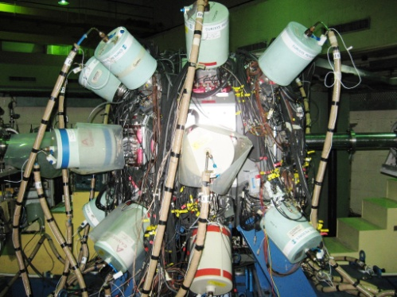
Exploring nuclear structure of neutron deficient heavy nuclei at the CERN-ISOLDE facility
Satyajit Saha
Applied Nuclear Physics Division
SAHA INSTITUTE OF NUCLEAR PHYSICS
17 April 2012

Slide 2
Outline
MOTIVATION
DIFFICULTIES AND CHALLENGES INVOLVED
RESULTS FROM RECENT INDIAN NATIONAL GAMMA ARRAY
(INGA) EXPERIMENT ON HEAVY NUCLEI
FUTURE PLAN INVOLVING CERN-ISOLDE FACILITY
17 April 2012

Slide 3
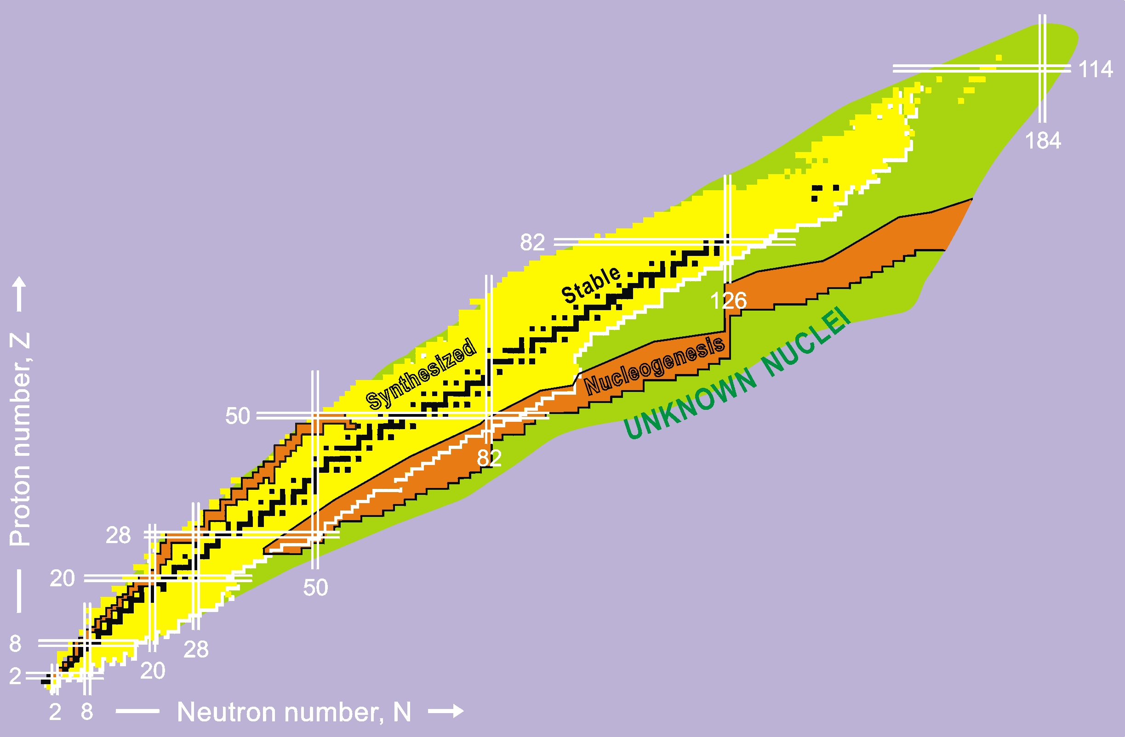
Region of interest:
²⁰²⁻²¹⁶Fr
²⁰²⁻²¹⁴At
²⁰⁰⁻²¹⁶Rn
²⁰⁰⁻²¹²Po
TRANS-LEAD NUCLEI

Slide 4
Why explore trans-lead nuclei?
Poor knowledge of nuclear structure in this domain
    Investigate by experiment
    Look for single particle behaviour and co-operative phenomena
    Shell model calculation of nuclear structure
    RMF PHF
    Collective behaviour
    Small deformation → perhaps only M1 band ? At Fr Ra
    (β₂ ≤ 0.1)
    Large deformation →
    Rotational bands
    Octupole correlation in nuclei
        ΔL=3, ΔJ=3 orbitals co-exist near the Fermi surface
        (proton: i13/2, f7/2 neutron: j15/2, g9/2)
        (proton: h11/2, d5/2 neutron: i13/2, f7/2)
        Both protons and neutrons satisfy the condition
        Have similar single particle energy values

Slide 5
Octupole correlation in trans-lead nuclei (Z=88, N ~ 134): Benchmark example
p(i13/2,f7/2) n(j15/2, g9/2)
J F Cocks et al, PRL78 (1997) 2920 (Jyvaskyla group)
17 April 2012

Slide 6
Exploring nuclear structure of Trans-lead nuclei: difficulties
Prone to fission
Need good knowledge of fission barrier to predict production rate.
→ Important for prediction of the end point of the r-process
nucleosynthesis [I. V. Panov et al, A & A 513, A61 (2010)]
        heavy n-rich element production.
        superheavy elements.
Fission barrier modifies due to shell effect near the shell closure.
LDM FRLDM FT-HFB TF (Myers & Swiatecki) ETFSI
Two-centre shell model (TCSM) for PES calculation
Bottom line: Need to know fission barrier better to predict ER production
rate by heavy ion fusion. (Statistical model)
Summary:
Expect increase in ER production cross-section for trans-Lead heavy
elements.
Super heavy element production.
17 April 2012

Slide 7
Why explore trans-lead nuclei?
Abundance of isomers:
  How isomers are generated in nuclei?
  Smaller level spacing
  Change of single particle configuration
  Relatively higher multipolarity Spin Trap Isomer
  Shape isomer / fission isomer
  Advantages of having isomers:
    Corroborates the nuclear models through experiment.
    Facilitates observation and detection of excited states below
    the isomers
      Detect isomers at the focal plane of RFD.
    Energy storage mechanism in nuclei.
  Disadvantages of having isomers:
In-beam prompt spectroscopic investigation incomplete.
Interest in nuclear structure of proton-rich Fr (Z=87) isotopes:
Candidate for PNC search for anapole moment in 208-210Fr
(odd or odd-odd nuclei of alkali metals).

Slide 8
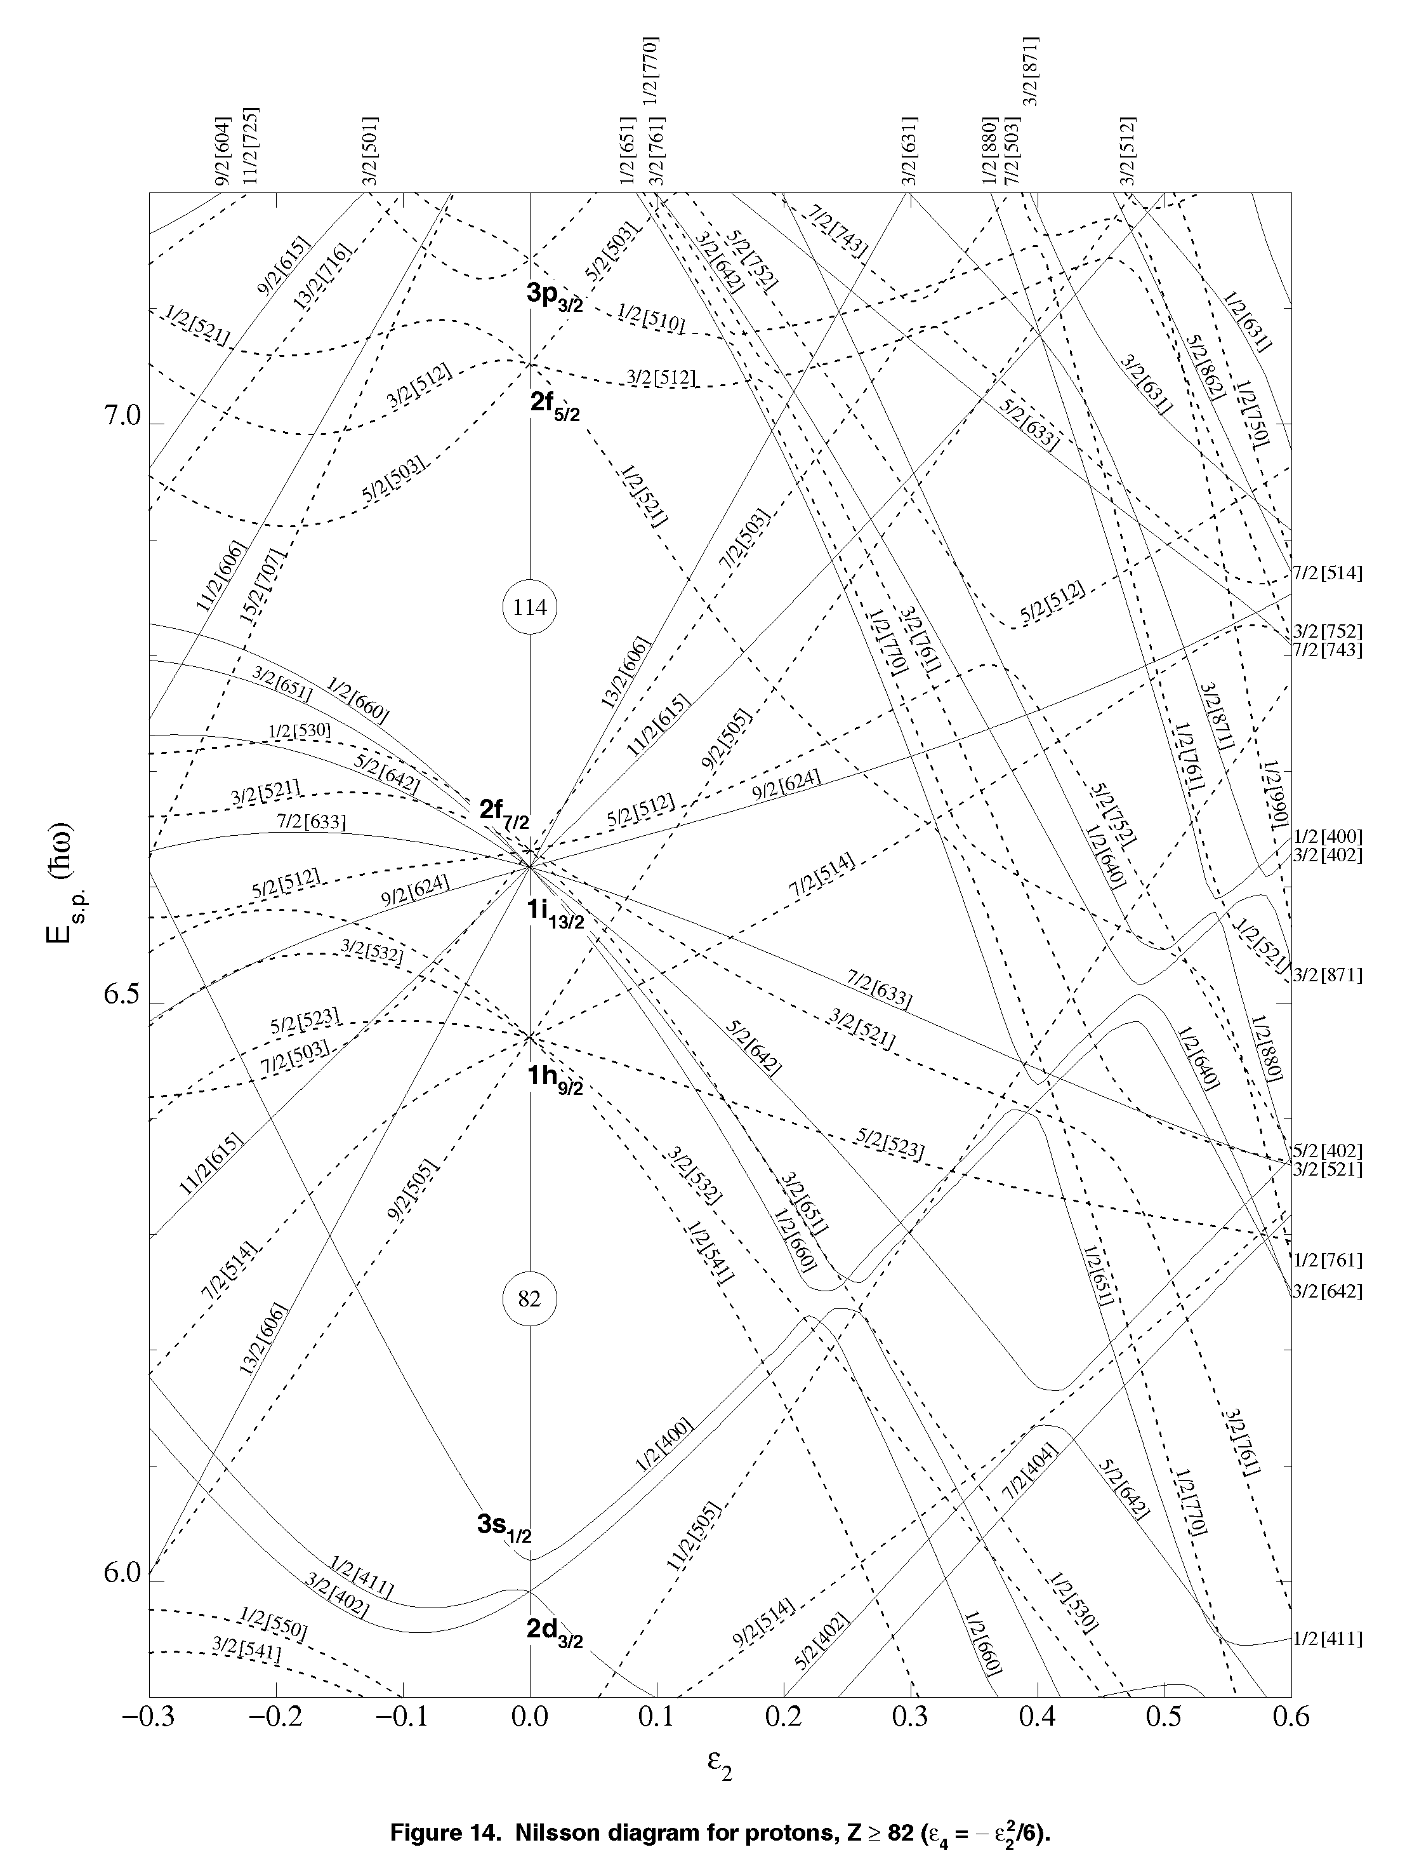
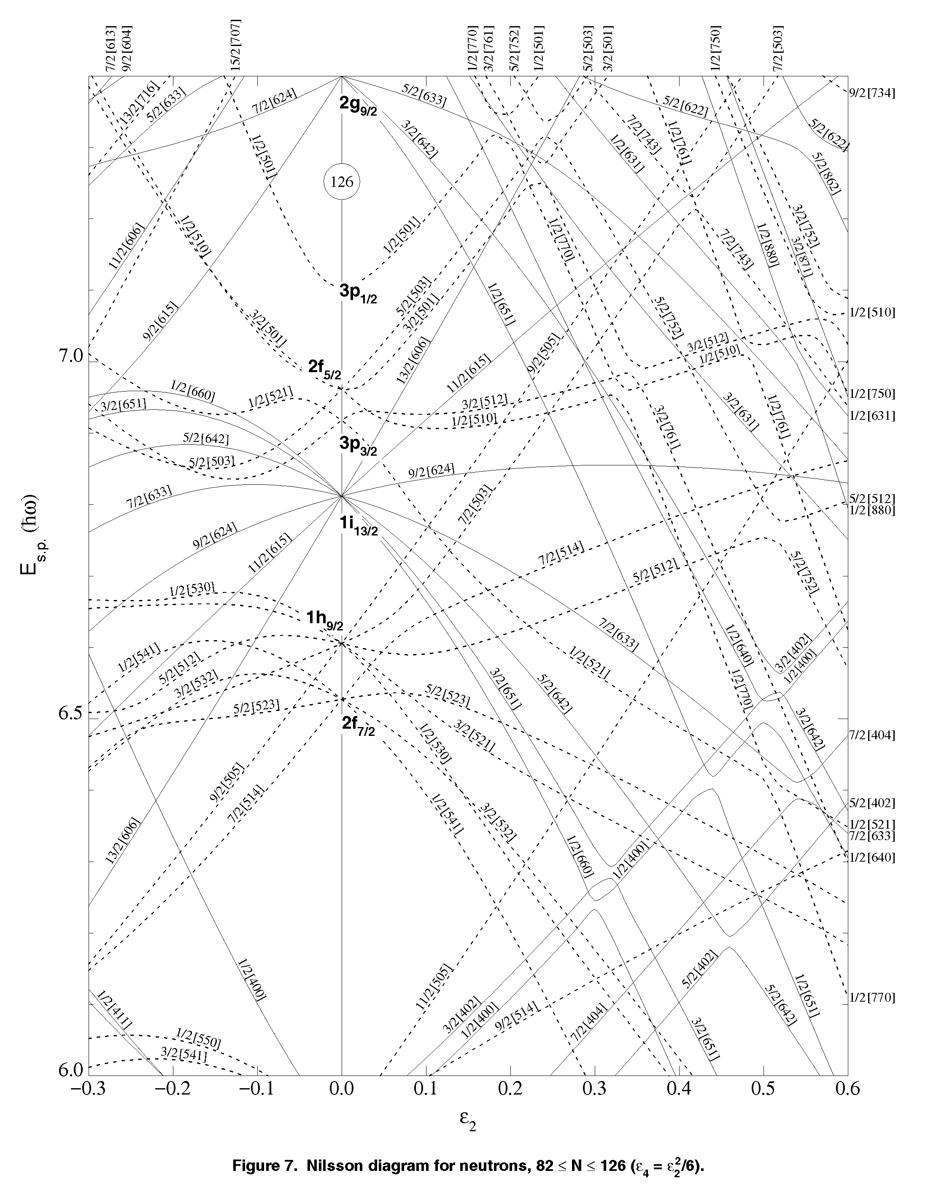
Nilsson Diagrams
Possible participating configurations for trans-lead region
NILSSON DIAGRAM
Neutrons
Protons

Slide 9
Difficulties & Challenges Involved
Two major production mechanisms:
Evaporation Residues(ER) produced at high excitation energy and
angular momenta (CN reactions around CB)
Difficulties:
  Very low ER cross-section (20-30% at 100 MeV for Z~84-88)
  Huge fission back ground
Tools and techniques to get around:
  Recoil identification or very good reaction channel selectivity (RFD).
  Use the power of high resolution and high efficiency gamma detector array.
  X-ray gating and / or validation by x-rays.
  Use BGO sum-multiplicity filter.

Slide 10
Projectile fragmentation reactions (~ 1GeV/A for ²³⁸U / ²⁰⁸Pb)
Difficulties:
  Wide range of A, Z of fragments produced (n-rich to n-deficient).
  Large Doppler effect (v/c ~ 15% as compared to 2-4% for ERs).
  Relatively lower yield (w.r.t ER) for each nucleus.
Tools and techniques to get around:
  Fragment identification and measure energy / velocity.
  Very efficient method of Doppler correction / adequate segmentation.
  Only long lived isomers (~ 100s of ns and above) can be studied.
  Secondary beam excitation (possibly Coulex?) for populating excited
  states bypassing isomers.

Slide 11
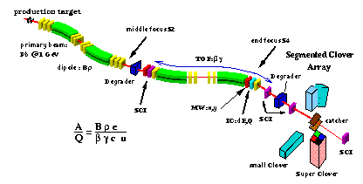
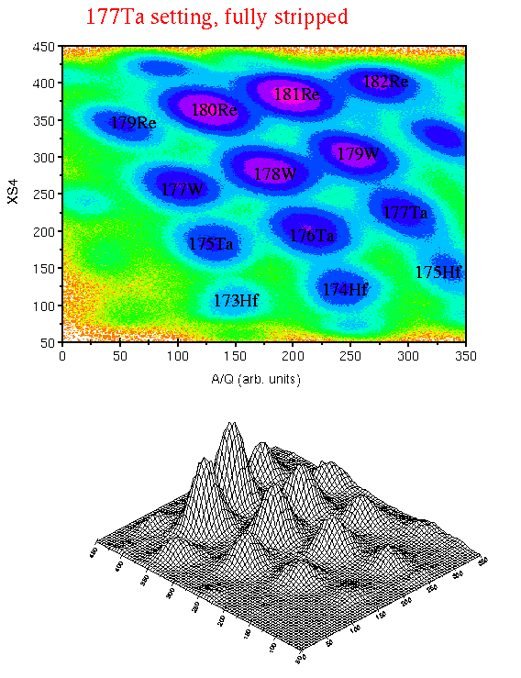
Production target
In-Flight Technique Using Projectile Fragmentation
Central focus, S2
Final focus, S4
Primary beam
U / Pb @ ~1 GeV/u
dipole, Bρ
degrader
degrader
scint
MW=x,y
catcher
scint
ΔE(Z²)
scint
(veto)
FRS@GSI to identify nuclei.
Transport some in isomeric states (TOF~ x00ns).
Stop and correlate isomeric decays with nuclei identified.

Slide 12
High spin and isomer decays: ²⁰⁸Fr / ²¹⁰Fr
Ph D student : DEBASMITA KANJILAL
Collaborators: SINP / TIFR / IUAC / VECC / Visva-Bharati

Slide 13
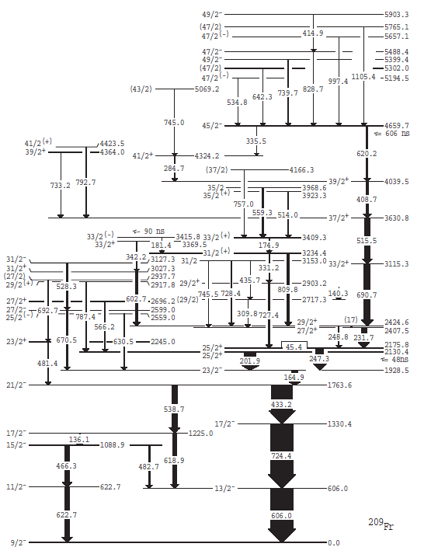
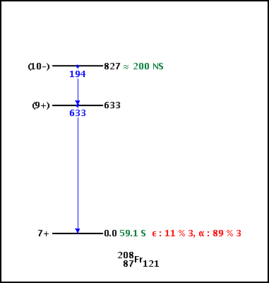
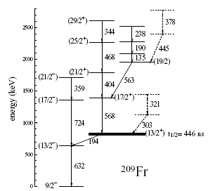
Motivation
4.
PRC 79, 054313 (2009, May)
²⁰⁹Fr
¹⁹⁷Au(¹⁶O, 5n) @ 95 MeV
Pulsed beam of 1 ns width and 1716 ns and 19 μs separation from ANU, 14UD Pelletron accelerator
CAESAR array of 6 Compton suppressed HPGe (± 97º, ± 148º, ± 48º) , 3 larger volume Compton suppressed Ge detectors and 2 LEPS
1.
AIP Conf. Proc. 831 (2006)
PRC 73, 024307 (2006)
2.
¹⁹⁷Au(^{16, 17, 18}O, 5n) @ 82-99 MeV
Pulsed beam of 1 ns width and 1716 ns and 19 μs separation from ANU, 14UD Pelletron accelerator
CAESAR array of 6 Compton suppressed HPGe (± 97º, ± 148º, ± 48º) , 3 larger volume Compton suppressed Ge detectors and 2 LEPS
p(1h_{9/2)} n(1i_{13/2}⁻¹)
Zs Podolyak et al, AIP Conf. Proc. 831 (2006)
⁹Be(²³⁸U, X) Proj Fragmentation
900 MeV/u
FRS at GSI + Ionization Chamber
6 Clovers at focal plane
3.
Eur. Phys J. A 40, 127 (2009, March)
[p(1h_{9/2)} n(2f_{5/2}⁻¹)] 2⁺
¹⁷⁶Yb(³⁵Cl, 4n) @ 173, 179, 185 MeV
YRAST Ball of 6 clovers at target
position
SASSYER recoil separator
Solar cell array & 3 clovers at focal
plane
563.3
569.4
742.2
723.8
194.1
432(11) ns
²¹⁰Fr
632.2
²⁰⁸Fr

Slide 14
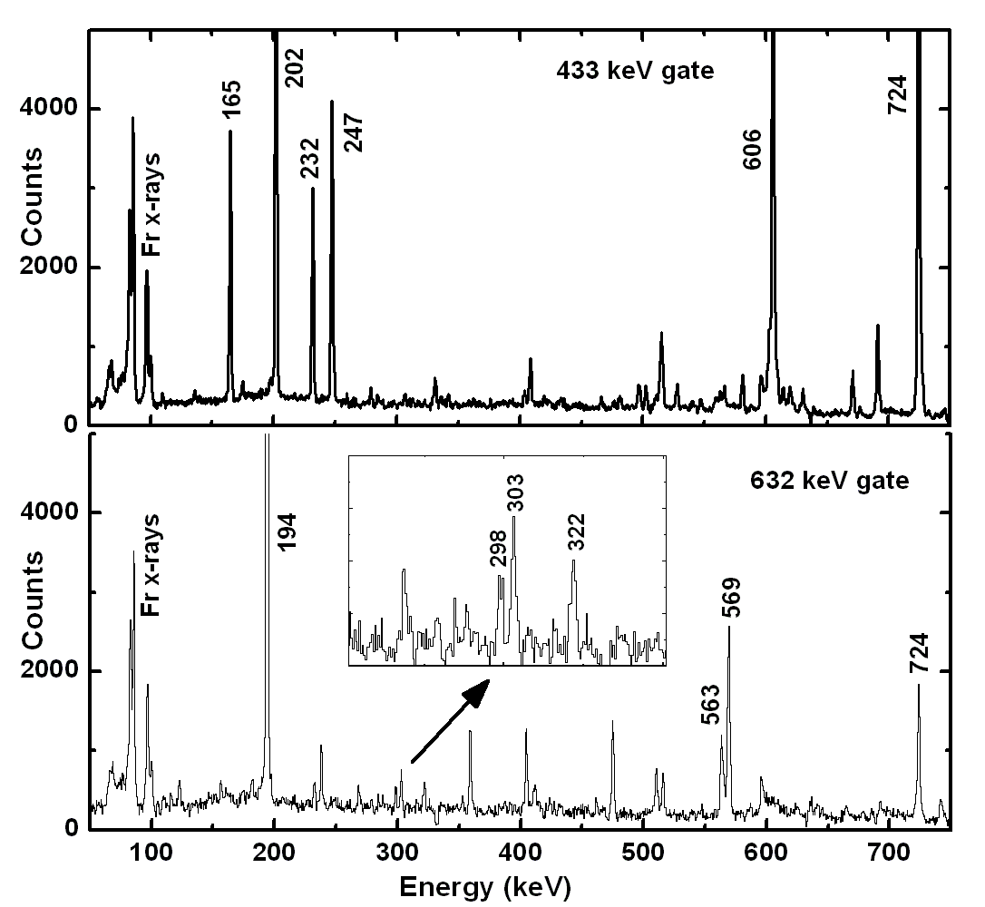
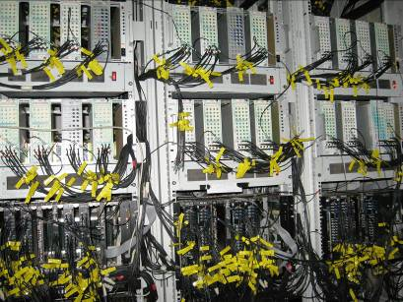

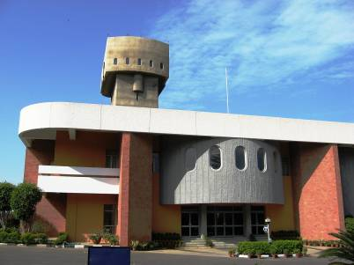
Our Experiment at INGA
Beam :- ¹⁶O
Target :- ¹⁹⁷Au (99.95% purity)
Target thickness :- 3.5 mg / cm²
Beam Energy :- 88, 94, 100 MeV
Clover position :- 4 at 148º, 4 at 123º, 6 at 90º & 4 at 57º
Events (100 MeV) : 2fold : 315×10⁶ 3fold: 48×10⁶
4fold : 7.3×10⁶ 5fold : 8.7×10⁵ 6fold : 10⁴
DAQ :- CANDLE
INDIAN NATIONAL GAMMA ARRAY (INGA)
IUAC, NEW DELHI

Slide 15
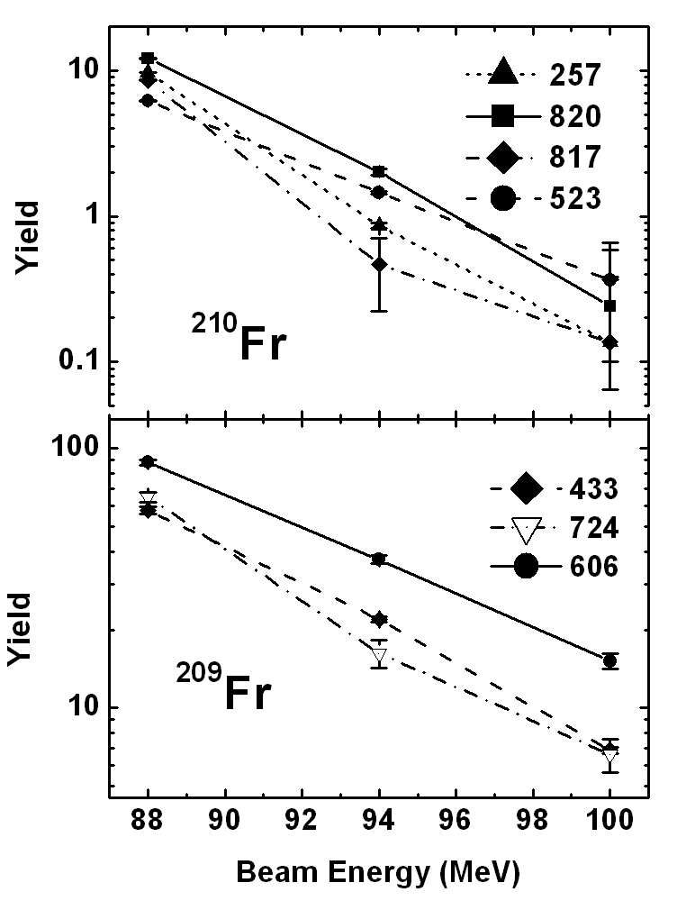
Excitation Function Measurement
PACE4

Slide 16
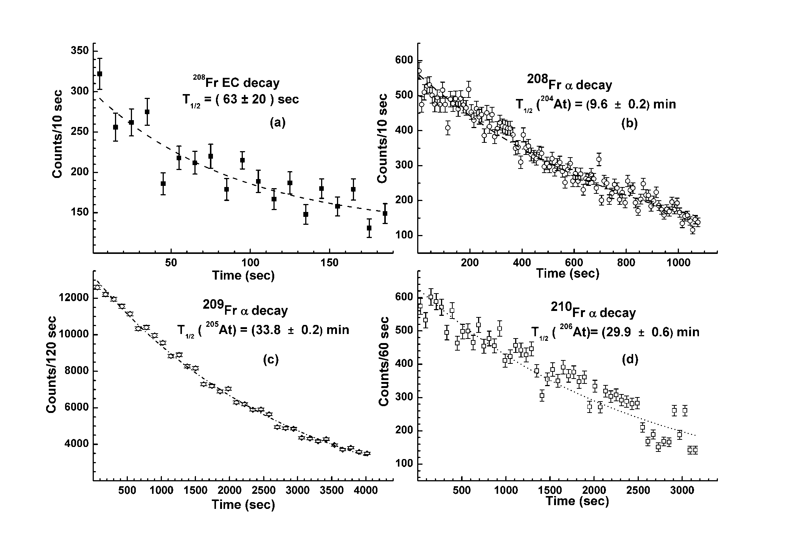
Yields and decay half lives Results from the offline decay run
Yield ratio: σ(208Fr) / σ(209Fr)
Beam Energy | 88 MeV | 94 MeV | 100 MeV
Decay Run | 0 | 0.15(1) | 0.62(1)
Exc. Func. | 0.024(7) | 0.14(1) | 0.45(4)
D. Kanjilal et al, DAE Symp. 53, 265 (2008)

Slide 17
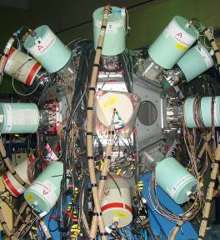
Time Difference Analysis: Isomer decay study
ΔT →[γ γ ΔT]
Gated ΔT
ΔT covered ± 400 ns TDC range
Useful range of ~ 500 ns
D. Kanjilal et al, Nucl Phys A 842 (2010) 1

Slide 18
Half life measurements of some known isomers produced in this expt
²⁰⁴Po
²⁰⁸Rn
Start - 335
Stop - [779+325]
Start - [588+609]
Stop - 426
ER | Level (keV) | E_{γ} (keV) | ML | T_{1/2} (ns) (this expt) | T_{1/2} (ns) (earlier)
²⁰⁸Fr | 826 | 194.1 | E1 | 233 (18) | 432 (11) ~200
²⁰⁸Fr | 1209 | 382.9 | E2 | 33 (7)
²⁰⁸Rn | 1828 | 88.7 | E2 | 590 (144) | 509 (14)
²⁰⁶At | 807 | 121.6 | E1 | 377 (44) | 410 (80) 813 (21)
²⁰⁴Po | 1639 | 12.1 | E2 | 161 (4) | 158 (2)
²⁰⁶At
Start - MASTER
Stop - 686

Slide 19
---- New transitions
D. Kanjilal et al, arXiv: 0911.2968 (Nov 2009)
Nucl. Phys A 842 (2010) 1

Slide 20
High spin states in ²¹⁰Fr
D. Kanjilal et al, Phys Rev C 2011

Slide 21
DCO Plots
DSAM
Level Systematics
Level systematics of ²⁰⁶⁻²¹²Fr

Slide 22
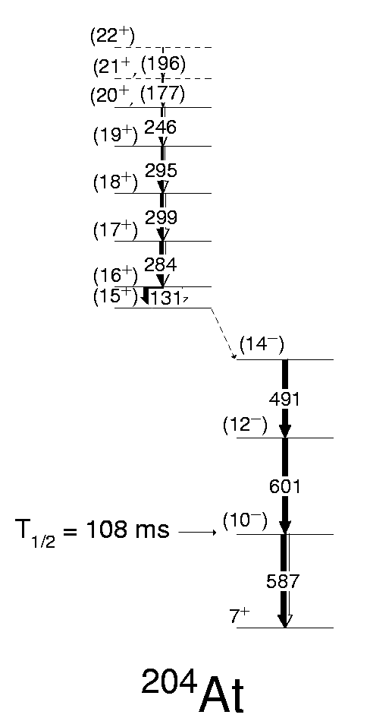
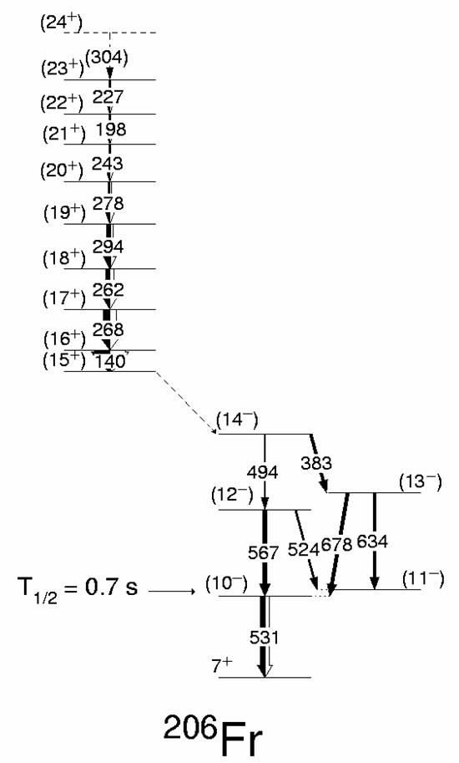
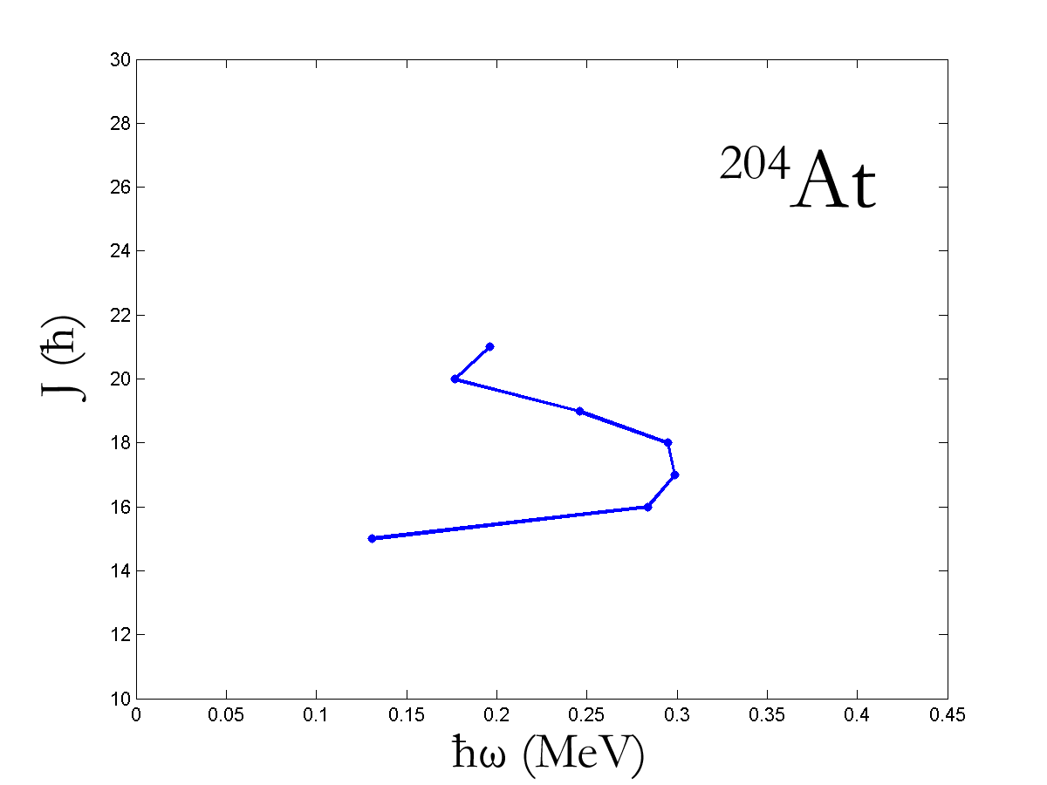
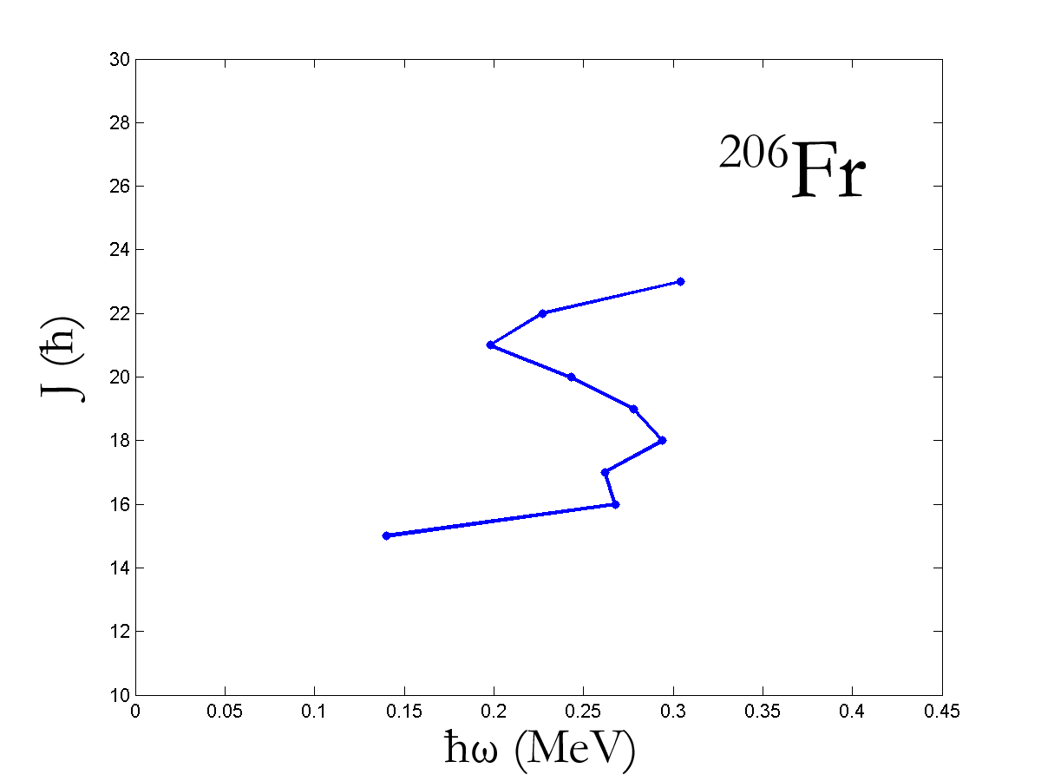
Shears Bands in ²⁰⁴At and ²⁰⁶Fr
Backbending also observed in ^{197,199}Pb and ²⁰⁵Rn
Hartley et al, PRC 78, 054319 (2008)

Slide 23
What can be done at CERN-ISOLDE along this line of research ?
Alpha / beta decay rate study of the proton-rich nuclei (Ra, Fr, Rn, At, Po)
Look for isomers; measure Isomer decay rates for nuclei near Z=82 N=126 → correlate with single particle strength, occurrence of spin traps, level energy difference
Coulomb excitation across the isomeric level, spectroscopy to explore nuclear structure
HIE-ISOLDE beam at 5.5 MeV/u MINIBALL + Tagging detectors + CE spectrometer
Use multiple Coulomb excitation to populate moderate spin states coupled by dipoles and quadrupoles → Revisit energy levels of the single particle states and look for change in magic numbers
Interplay of the single particle and the collective degrees of freedom through spectroscopic investigation (energy levels, spin-parities, life time) near Z=82 and N=126.
Precision mass and isomeric shift measurements on the chain of nuclei (Fr, At) using ISOLTRAP.
Search for long lived low lying isomers
Production of heavier nuclei through asymmetric fusion and transfer reactions at HIE-ISOLDE (after energy upgrade) and subsequent spectroscopic investigation using MINIBALL + Residue tagging detectors
DSSD detectors with forward angle coverage for ER tagging

Slide 24

Summary
Gamma spectroscopy of trans-lead nuclei done at the recent INGA campaign has lead to building up of near-complete level schemes in proton-rich Francium isotopes. Unknown level scheme in ²¹⁰Fr could be built up with INGA experiment based on little or no information.
Residue tagging or channel selection for exclusive spectroscopy will be the way to go for the next phase to look for exotic collective behavior in trans-lead nuclei.
Need detailed theoretical calculations on nuclear structure of the high spin states in these nuclei.
Explore the evolution of nuclear structure along the north-west of the valley of stability above Z=82 and N=126 using the unique HIE-ISOLDE facility.
Thank You

