Slide 1

Top Physics Results at CMS
Luca Scodellaro
Instituto de Fisica de Cantabria - CSIC
On behalf of the CMS Collaboration
2012 LHC Days in Split
October 1st-6th, 2012
Split (Croatia)

Slide 2

Motivations
Unique role in standard model of elementary particles:
• Very large mass, Yukawa coupling to Higgs close to unity
• Special role in electroweak symmetry breaking?
• Sensitive to physics beyond the standard model?
Precise measurements of top quark properties allow to test the standard model:
• Top couplings, charge, width, decay branching ratios
Important background to many physics signals
Ideal event final states to test many reconstruction tools:
• Jet energy scale, b-tagging, missing transverse energy

Slide 3
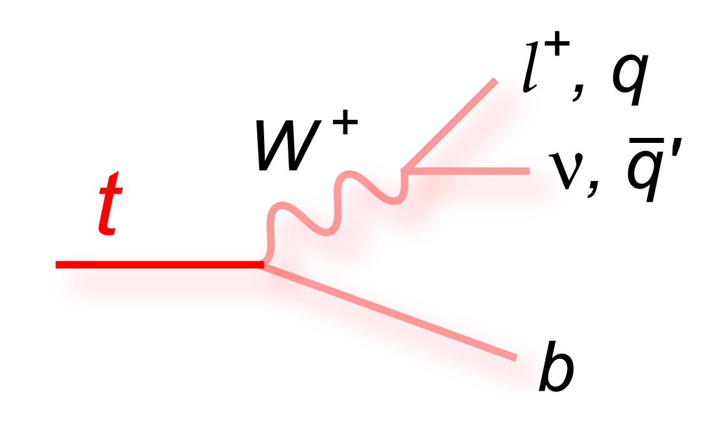
Top Physics at CMS
Production properties: • Spin correlation • Top polarization • Charge asymmetry
Top properties: • top mass • top-antitop Δm • top charge • BR(t→Wb) • W polarization • Boson radiation
Top pair production: • Inclusive cross sections • Differential cross sections • Missing E_{T}, jet multiplicity • tt+X measurements • Alpha strong
_
New physics in top sector: • Exotic top decays • tt and tW resonances • Heavy particles decaying to top
Single top production: • t-channel production • tW associated production
_
Complete review of CMS results on top physics at: • https://twiki.cern.ch/twiki/bin/view/CMSPublic/PhysicsResultsTOP

Slide 4
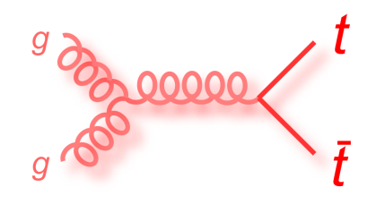
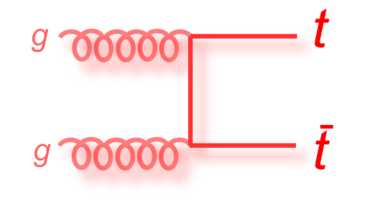
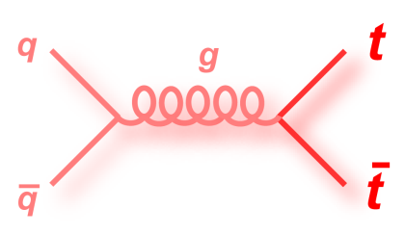
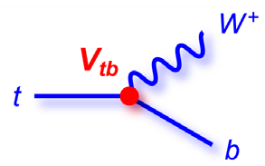
Top Quark Production and Decay
Pair production dominant in pp collisions at LHC:
• Gluon fusion: ~80% • Quark annihilation: ~20%
Decay mainly to Wb via electroweak interaction:
• BR(t->Wb) ~ 100% in SM
Observed final states classified according to W bosons’ decays:
+
_
_
_
_
_
b
e⁻,µ⁻
b
e⁻,µ⁻
b
q’
b
τ⁻
_
_
_
_
_
_
_
t
W⁺
ν
t
W⁺
ν
t
W⁺
q
t
W⁺
ν
_
_
t
W ⁻
e⁺,µ⁺
t
W ⁻
q’
t
W ⁻
q’
t
W ⁻
q’
b
ν
b
q
b
q
b
q
Dilepton (~5%)
Lepton+jets (~30)
All hadronic (~46%)
Tau+jets (~15%)

Slide 5
tt Event Reconstruction
_
_
Most analyses need a full reconstruction of the tt event: • top mass and charge, angular distributions, production asymmetries
Kinematic fit used to select/weight parton-jet assignments
Dilepton events underconstrained due to the presence of two undetected neutrinos: • Use expectation from theory to assign a probability to the solutions (kinematic distributions of the neutrinos, matrix elements)
Allow momenta to fluctuate
according to their resolution
Constrain on
W masses
Same mass for top and antitop

Slide 6
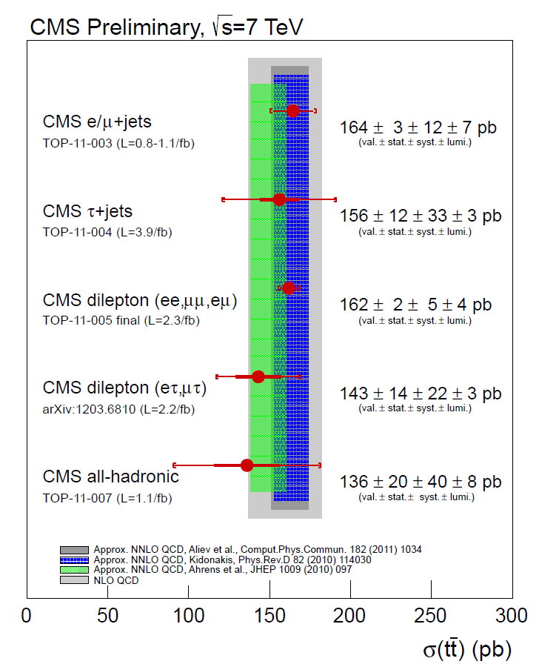
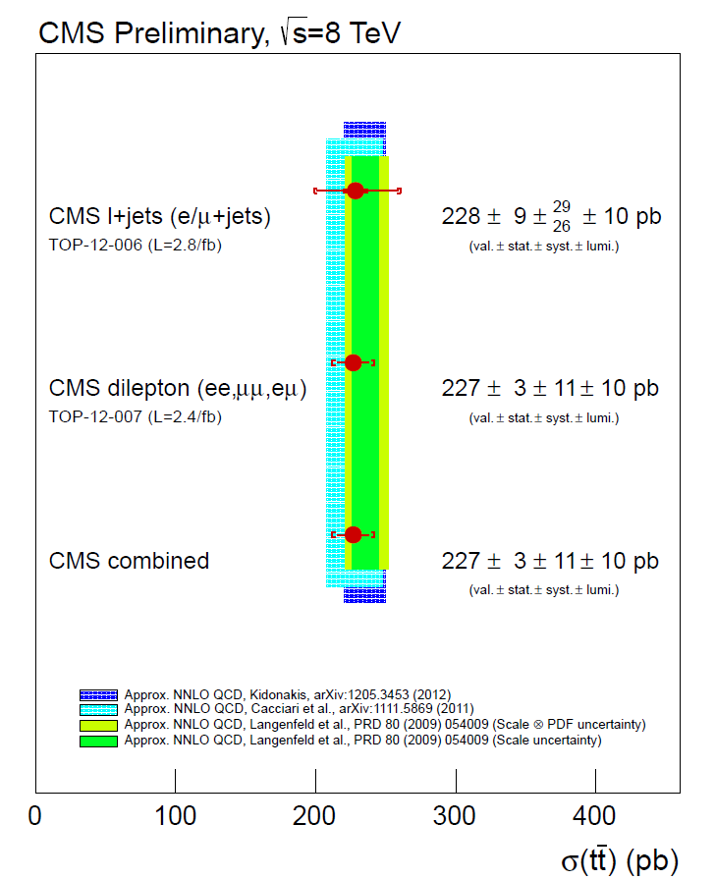
tt Cross Sections
_
Measurements at 7 TeV: • Dominated by the very precise dilepton channel (updated result)
Exp. precision challenging the approx. NNLO QCD calculations
Measurements at 8 TeV: • Preliminary results in dilepton and lepton+jets channels

Slide 7
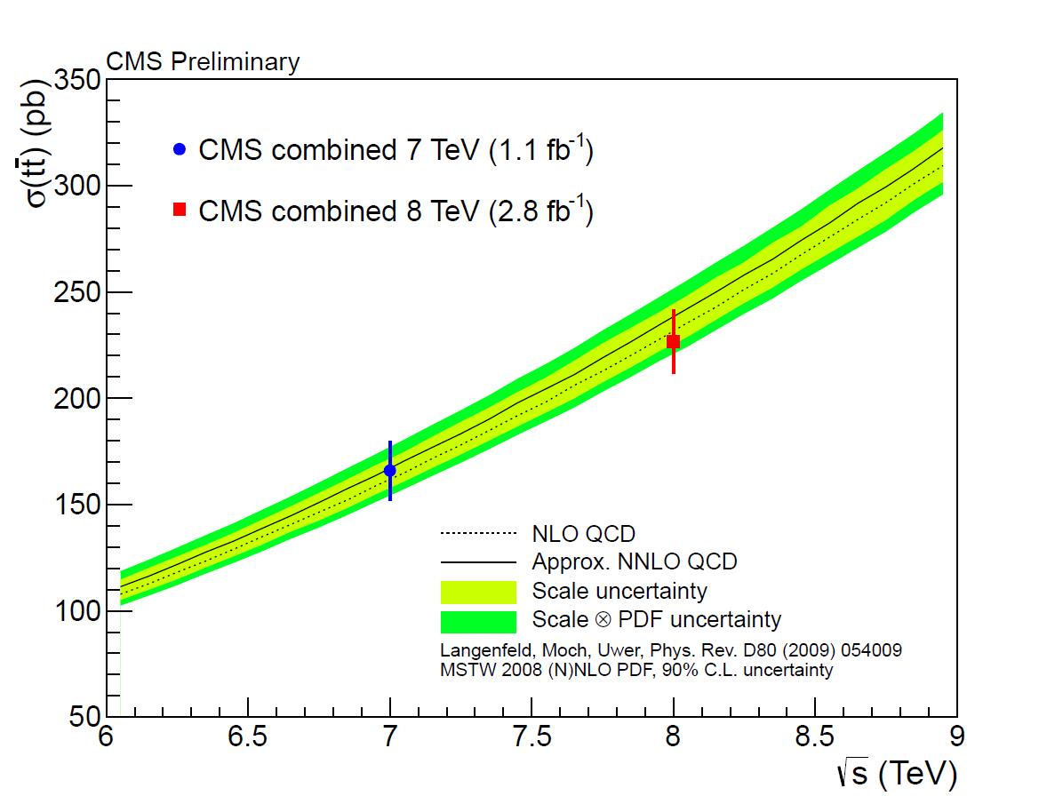
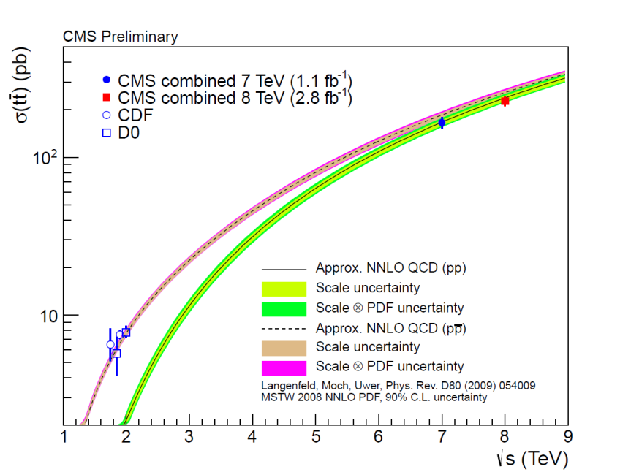
tt Cross Sections
_
Cross section increase with energy agrees with predictions
Ratio R = σ(8TeV)/σ(7TeV):
R = 1.41 ± 0.10
• Experimental uncertainties taken as uncorrelated (pessimistic scenario) • Theoretical uncertainties assumed to be 100% correlated

Slide 8
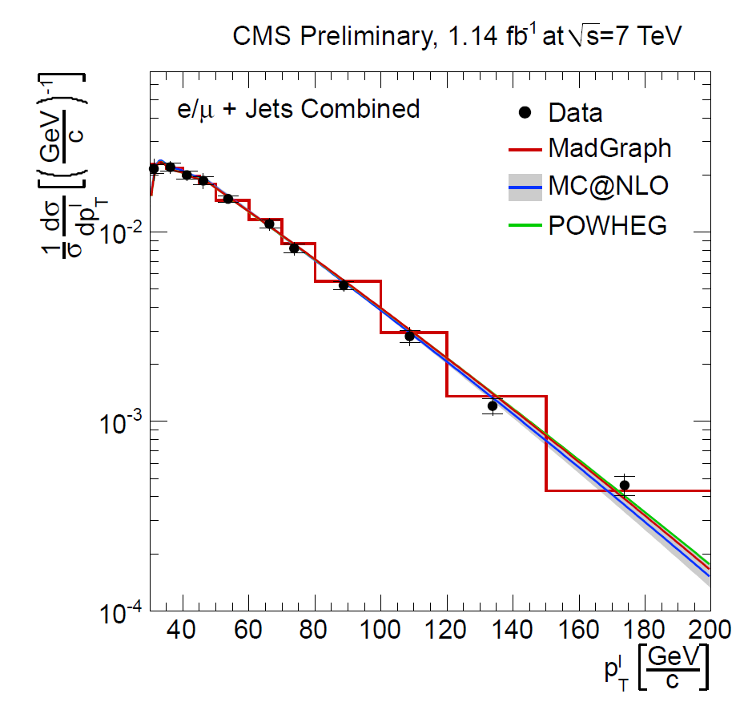
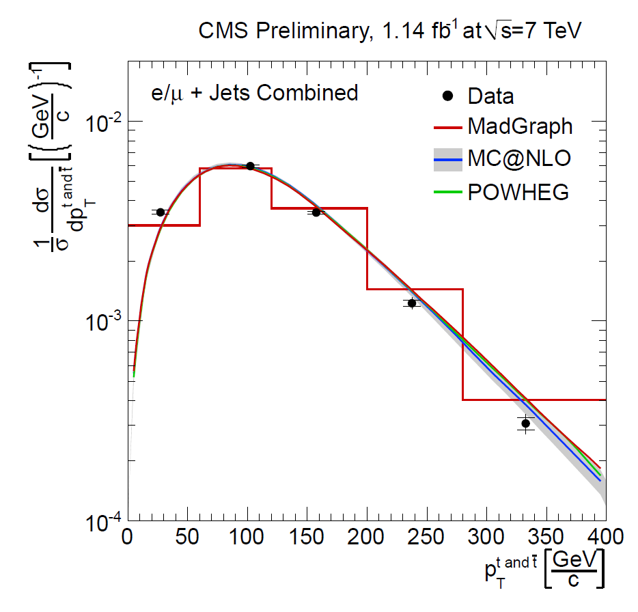
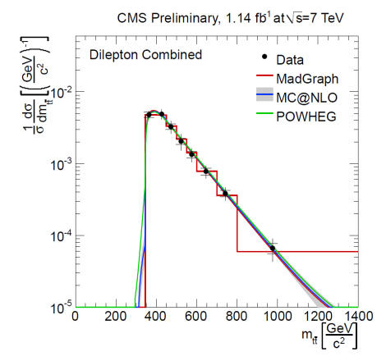
Differential tt Cross Sections
_
TOP-11-013
Inclusive cross section precision matching theoretical uncertainty
Differential cross sections test different QCD calculation schemes: • Unfolding distributions to parton level • Shape measurement: lot of systematic uncertainties cancel out in the normalization
Lepton+jets: lepton P_{T}
Dilepton: top P_{T}
_
Dilepton: tt mass

Slide 9
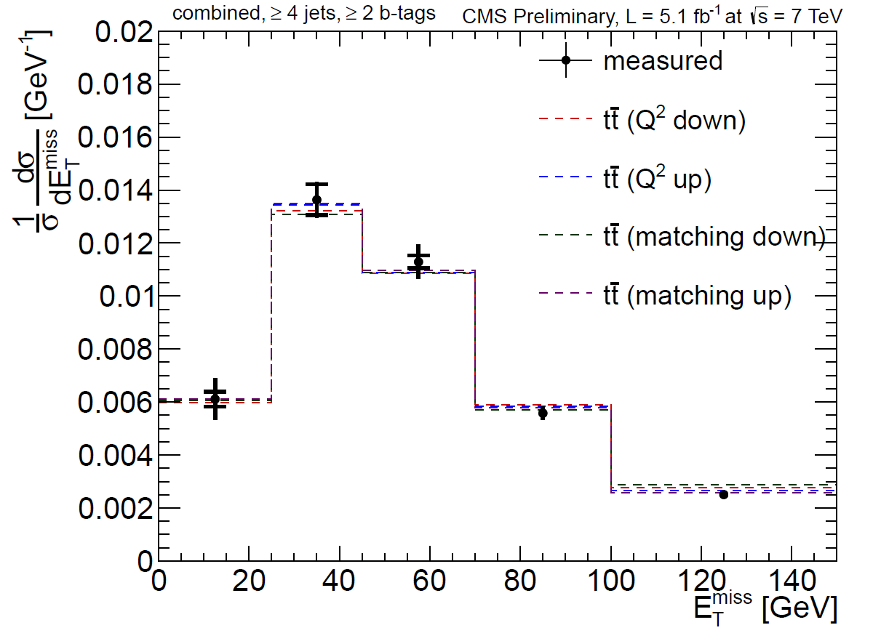
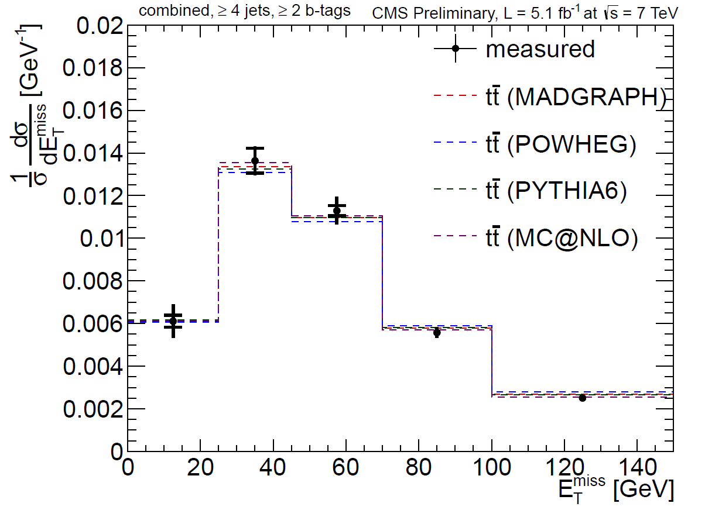
Missing E_{T} in tt Events
_
TOP-12-019
Test of the current models of top quark pair production • ttbar is a major background to many processes involving MET • Also sensitive to BSM production of MET with ttbar pairs
Selecting tt events in lepton+jets final states • Fit to lepton pseudorapidity in bin of missing E_{T}
_

Slide 10
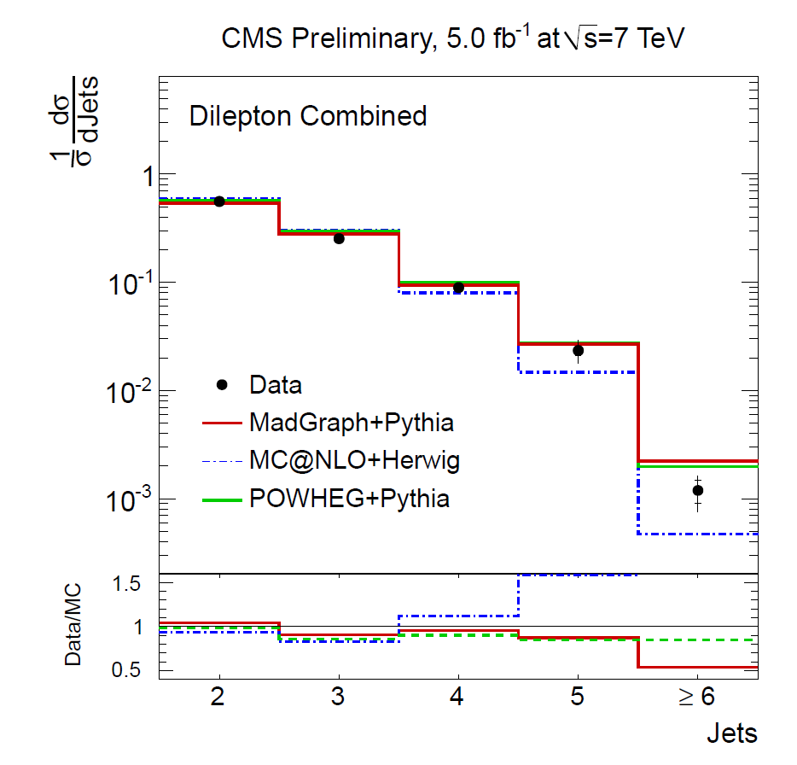
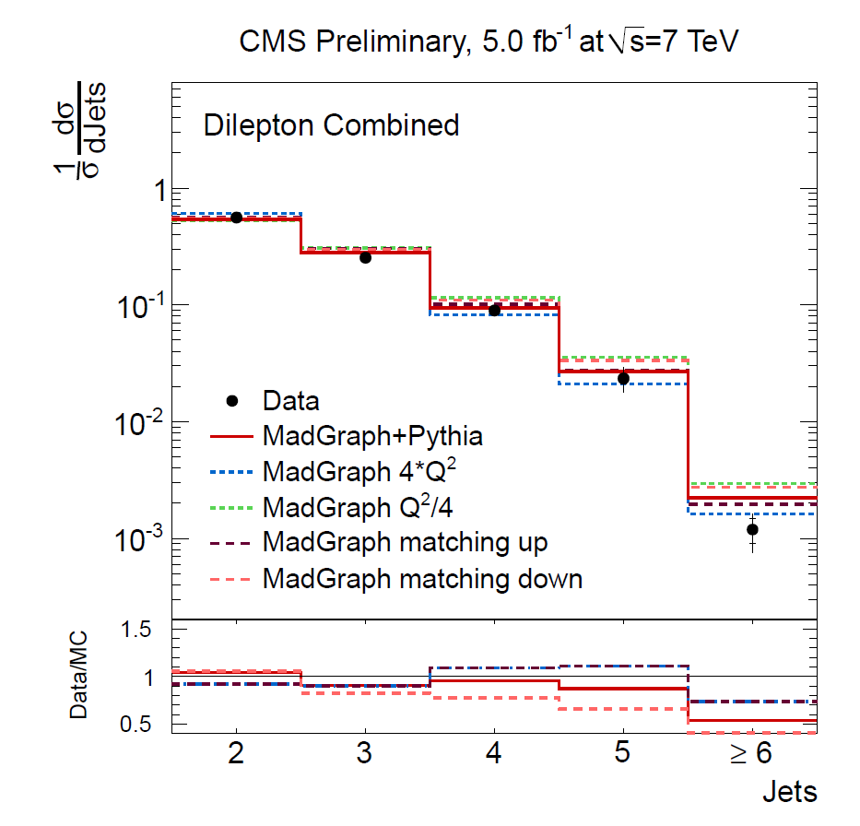
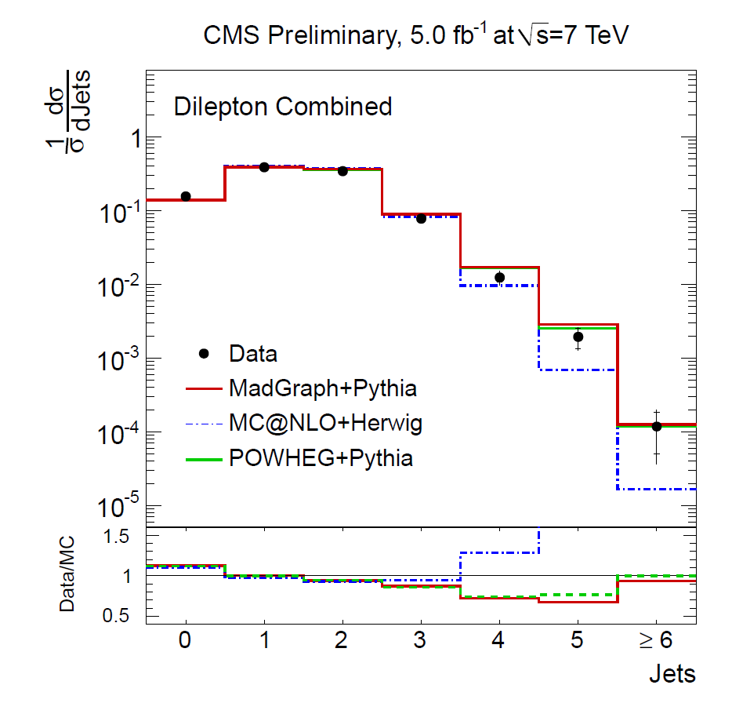
Jet Multiplicity in tt Events
_
TOP-12-023
Differential cross sections for dilepton final state events • Test of perturbative QCD calculations at higher order
Probing higher order effects of different generators using different parameters and shower models
P_{T}^{jet}>30GeV
P_{T}^{jet}>30GeV
P_{T}^{jet}>60GeV

Slide 11
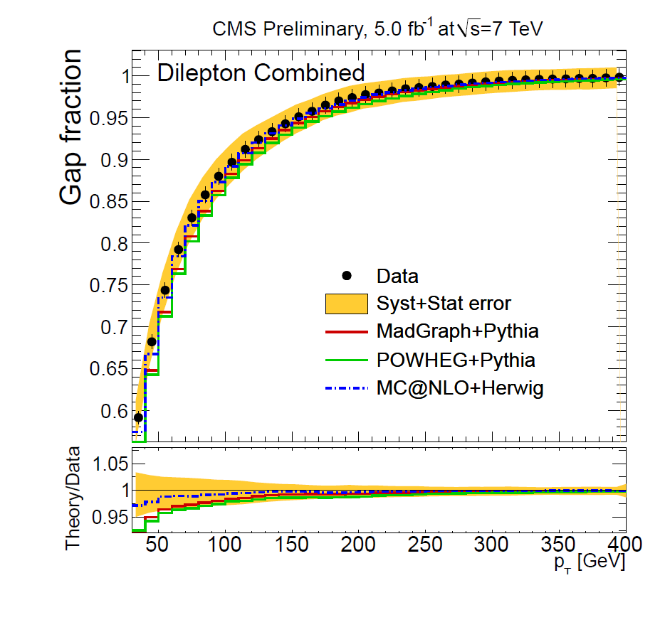
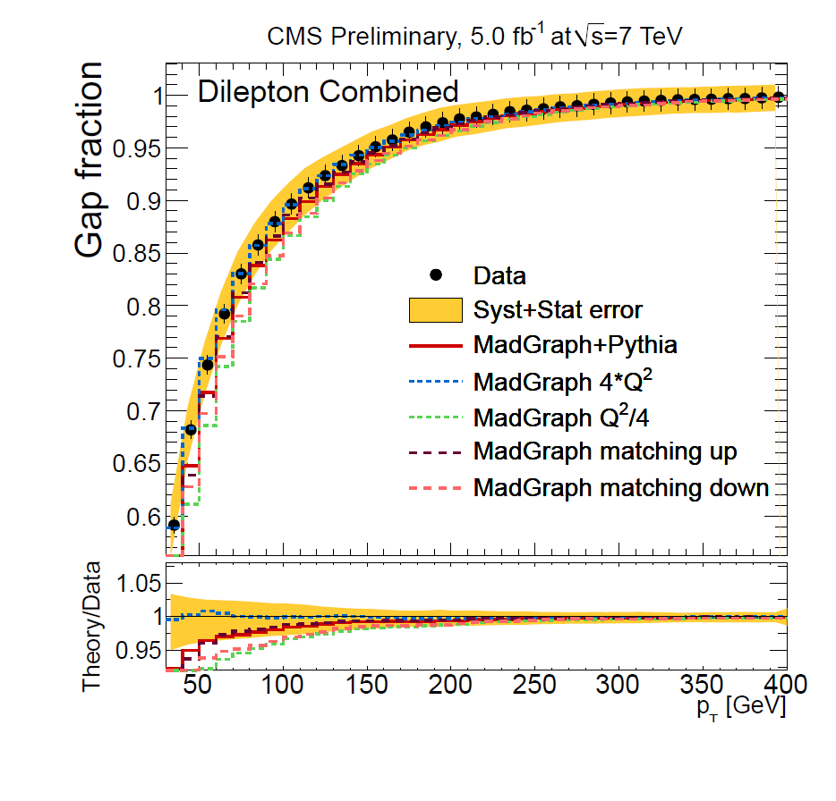
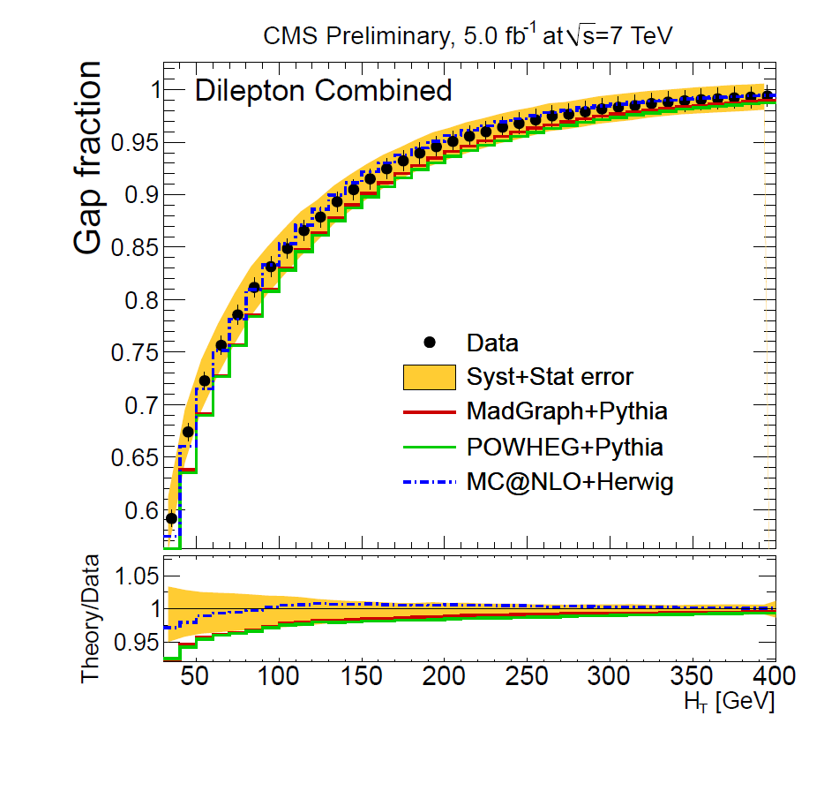
tt+Jets Events
_
TOP-12-023
Gap fraction: fraction of events no containing additional jets
Measured as a function of a threshold on: • Transverse momentum of the leading additional jet • Scalar sum of the transverse momentum of the additional jets

Slide 12
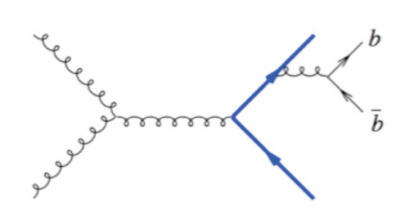
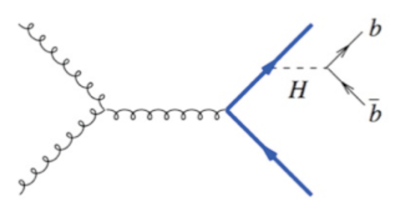
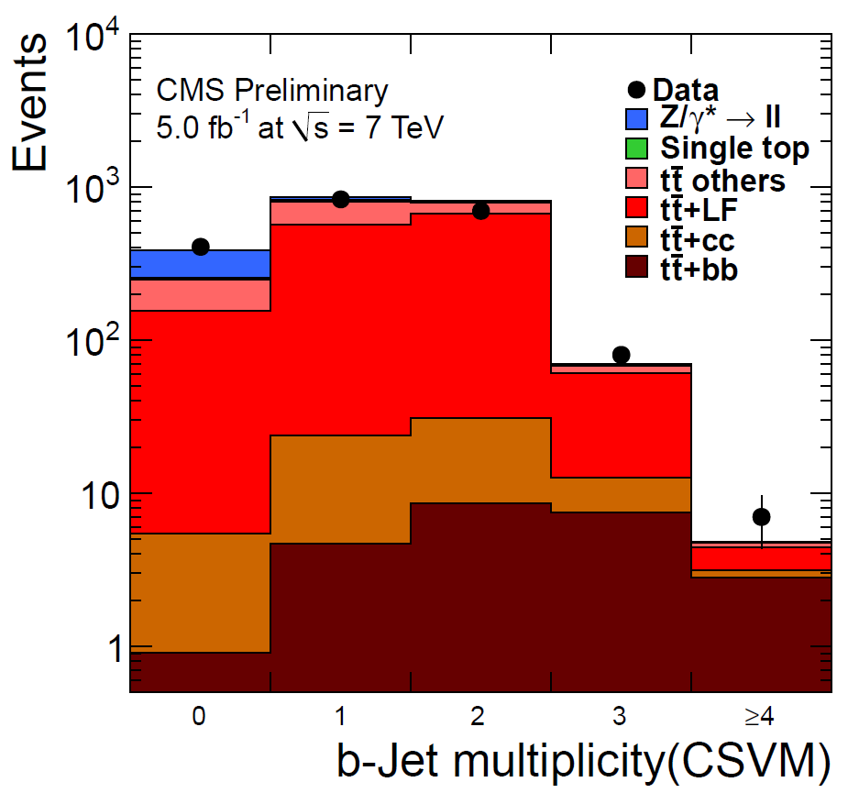
ttbb Production
_
_
TOP-12-024
_
_
Irreducible background for ttH → ttbb searches • Crucial for testing the Yukawa coupling of the new found boson
Measuring the ratio σ(ttbb)/σ(ttjj): • Lot of systematic uncertainties cancel
Fit to the observed b-tag multiplicity in events with two leptons and four jets: • σ(ttbb)/σ(ttjj) = 3.6±1.1(stat.)±0.9(syst.)% • NLO QCD: 4.7% (before detector effects)
_
_
_
_
_
_
Signal
region

Slide 13
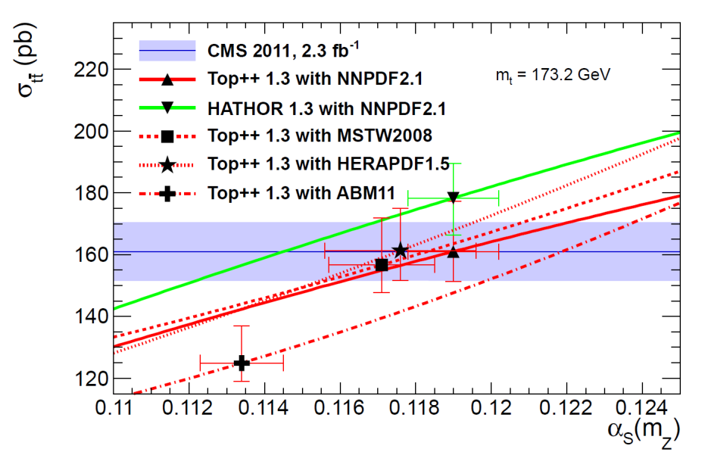
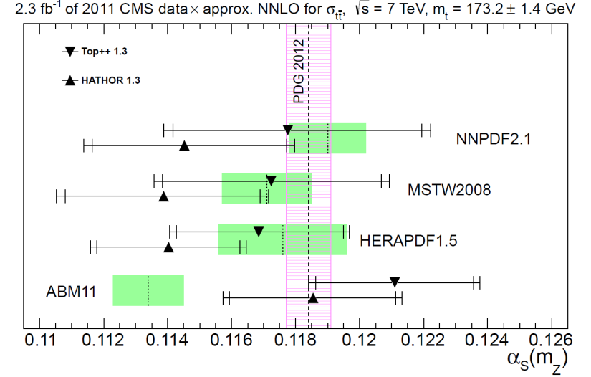
α_{s} from tt Cross Section
_
TOP-12-022
_
High precision of tt cross section measurement allows to determine strong coupling constant α_{s}(M_{Z})
Cross section dependence on α_{s} and m_{t} determined with Top++ and HATHOR and for different PDFs
Likelihood function maximization for fixed top mass value (m_{t} = 173.2 GeV):
L(α_{s}) = ∫f_{exp}(σ_{tt}ﺍα_{s})f_{th}(σ_{tt}ﺍα_{s})dσ_{tt}
_
_
_
Experimental
term (gaussian)
Convolution of PDF
(gaussian) and ren./fact.
scales (rectangular) terms
Add uncertainty varying m_{t} by ±1.4 GeV

Slide 14
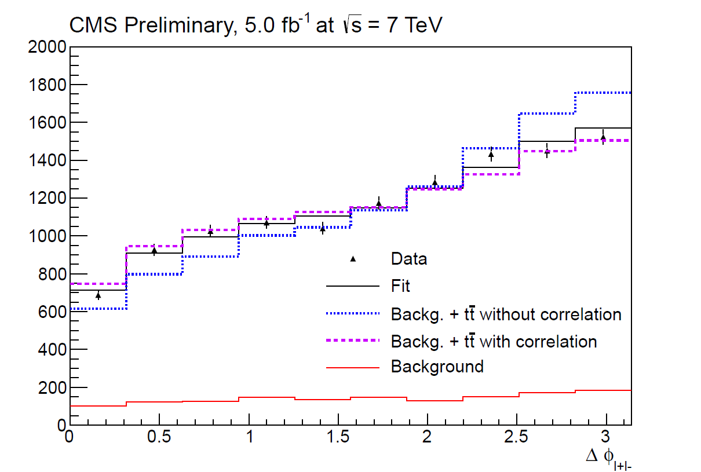
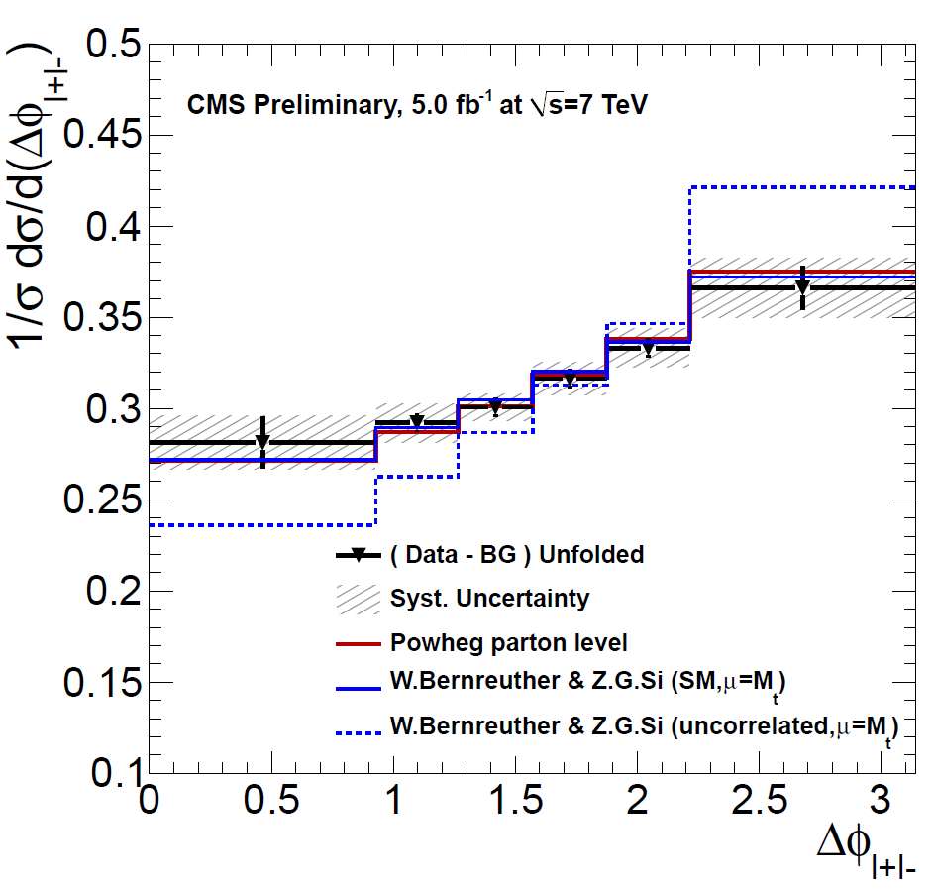
Spin Correlation
TOP-12-004
Test of top pair production processes and perturbative QCD
N_{like} - N_{unlike}
N(↑↑) + N(↓↓) - N(↑↓) - N(↓↑)
A_{hel.} = =
N_{like} + N_{unlike}
N(↑↑) + N(↓↓) - N(↑↓) - N(↓↑)
Fitting lepton azimuthal difference in dilepton final states:
meas.
A_{hel.} = 0.24 ± 0.02 (stat.) ± 0.08 (syst.) (A _{hel.} = 0.31, ±~1%)
th.
Template fit
Unfolded Δφ

Slide 15
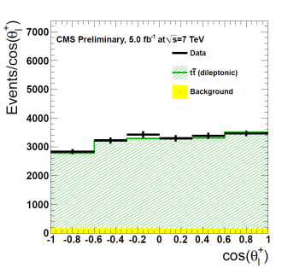
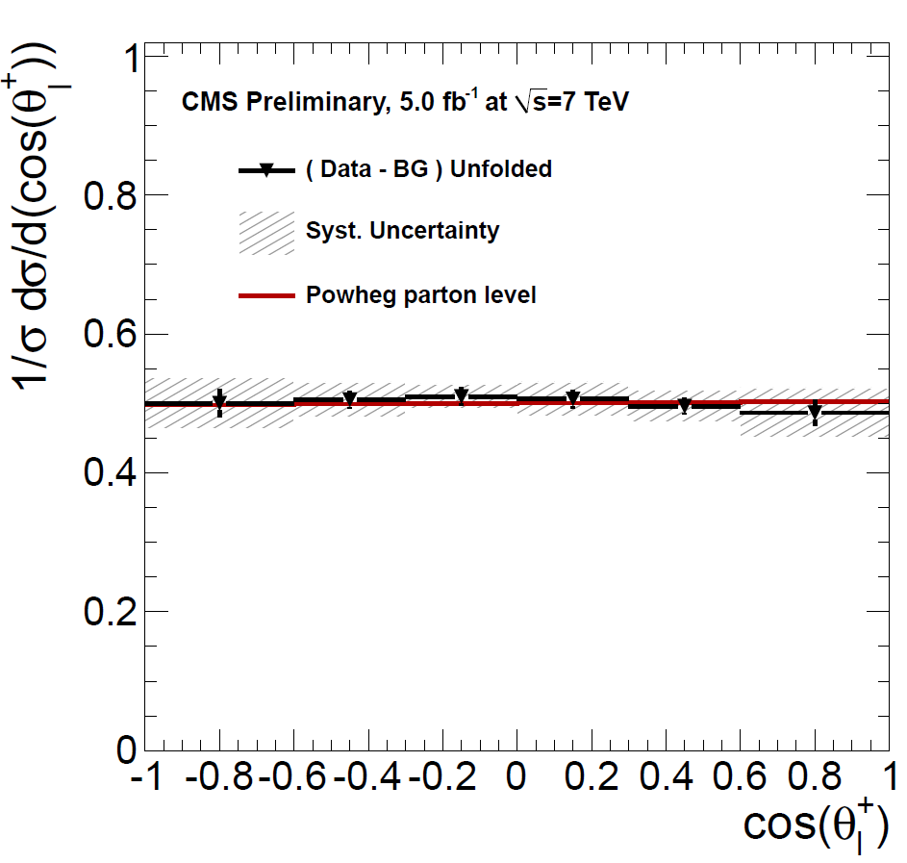
Top Polarization
TOP-12-016
Top polarization P_{n} reflected by kinematic distributions of its decay products: • Angle θ_{n,l} between lepton direction in top rest frame and top direction n in tt CM frame
Fitting the unfolded θ_{l,n} distributions observed in dilepton final states
Measured P_{n} consistent with parton-level prediction from simulations:
P_{n} = -0.009 ± 0.029 (stat.) ± 0.041 (syst.)
^
^
_
^
^
1 dГ 1
= (1 + 2k_{l}P_{n}cosθ_{l,n})
Г dcosθ_{l,n} 2
^
^
^
^
^

Slide 16
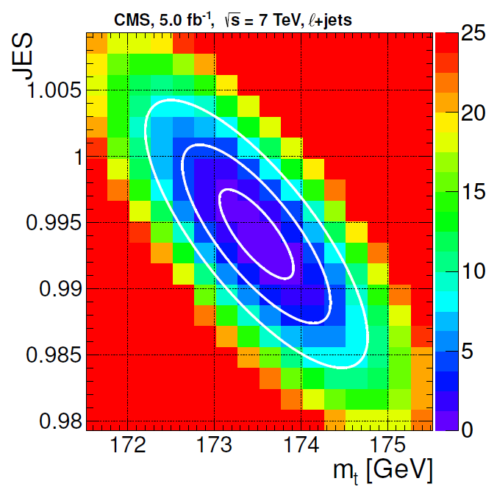
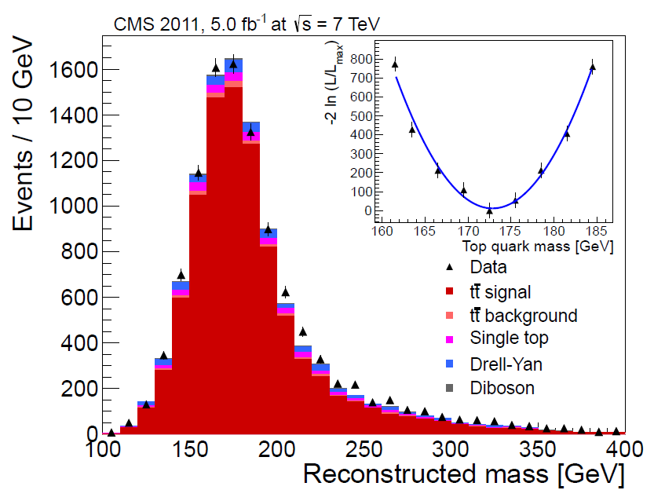
Top Mass Measurement
Updated results in the lepton+jets and dilepton channels
Lepton+jets channel (5fb⁻¹): • 2D ideogram method with in situ JES calib. • Most precise single top mass measurement
m_{t} = 173.5 ± 0.4 (stat.+JES) ± 1.0 (syst.) GeV
TOP-11-015
Dilepton channel (5fb⁻¹): • Neutrino momenta computed analytically • Solutions weighted by LO matrix element
m_{t} = 172.5 ± 0.4 (stat.) ± 1.5 (syst.) GeV
TOP-11-016

Slide 17
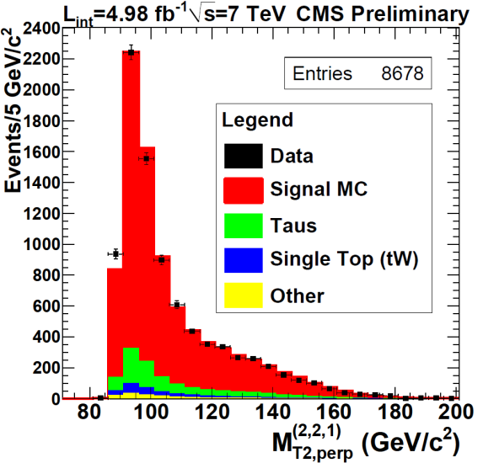
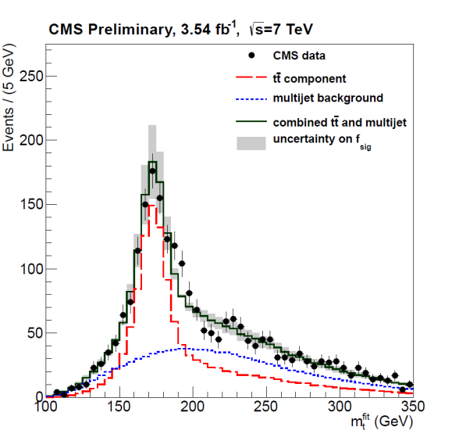
Top Mass Measurement
Results exploiting new techniques or decay channels
Dilepton channel (5fb⁻¹): • Kinematic endpoint method • Technique developed in BSM searches
m_{t} = 173.9 ± 0.9 (stat.) _{-1.8} (syst.) GeV
TOP-11-027
+1.2
All hadronic channel (3.5fb⁻¹): • Similar approach as in lepton+jets channel • Result with no in situ JES calibration
m_{t} = 173.5 ± 0.7 (stat.) ± 1.3 (syst.) GeV
TOP-11-017

Slide 18
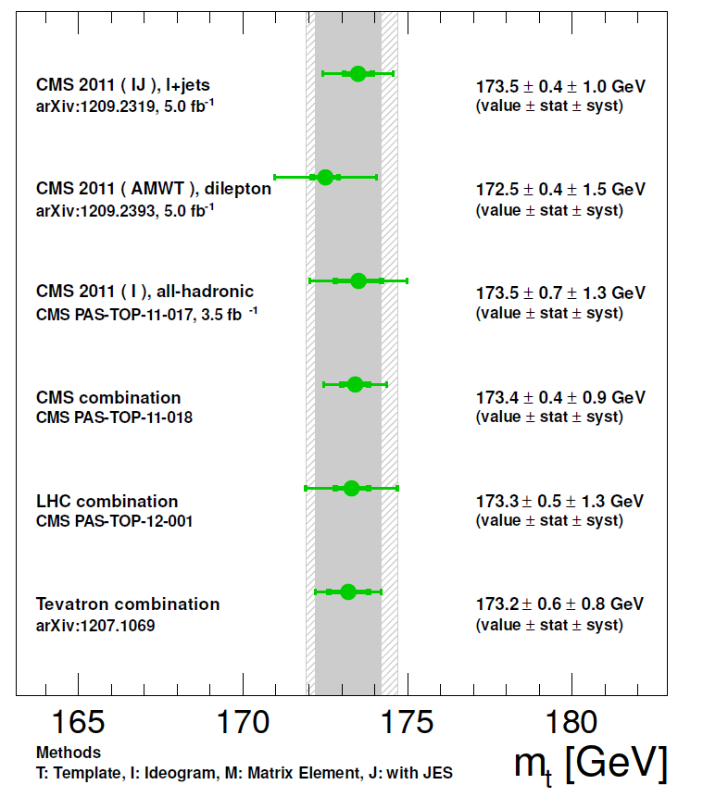
Top Mass Measurement
CMS top mass measurement reached the precision obtained at the Tevatron
Many ideas to reduce systematics: • JES calibrations in situ, b-specific JES • ISR/FSR from tt+jets cross sections • Constrain theoretical models on data (Color recon., underlying event, PDFs) • With large statistics, use well understood regions of phase-space • Combine alternative methods with complementary systematics
_

Slide 19
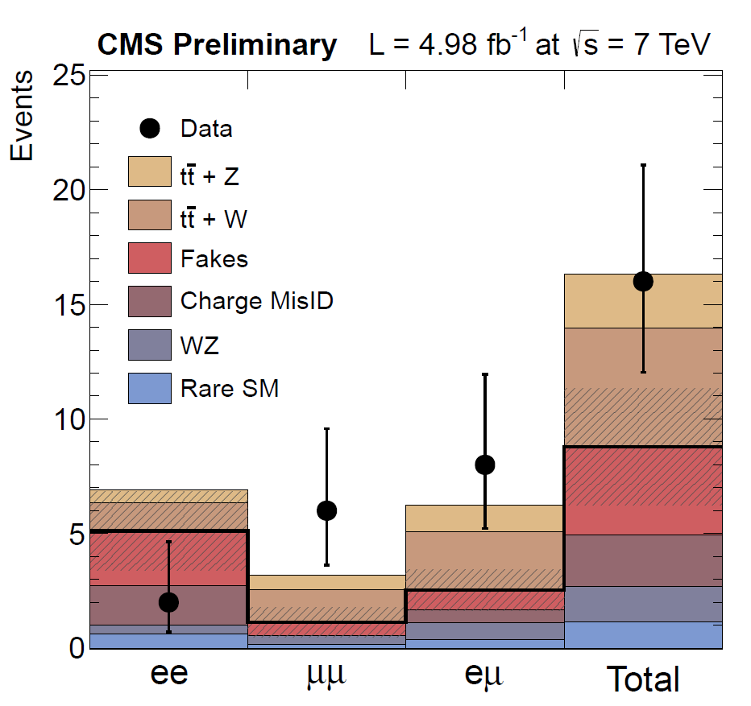
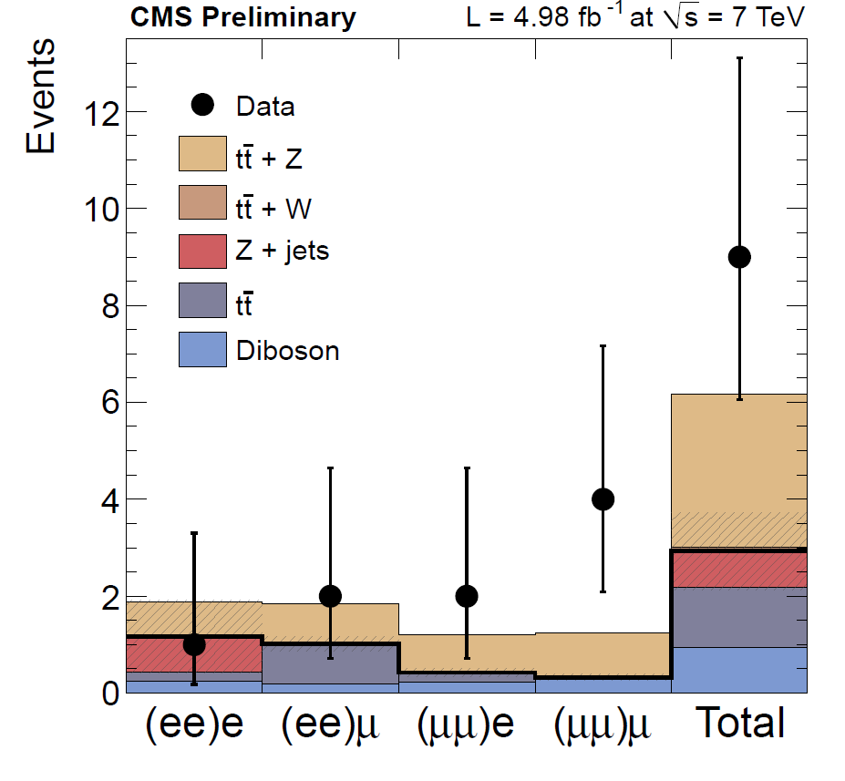
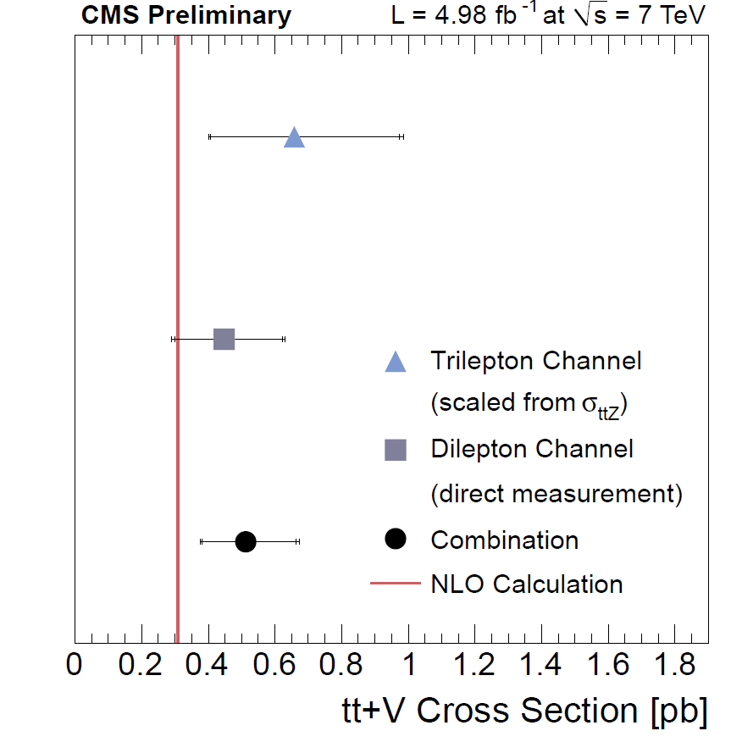
tt+V (V=W/Z) Production
_
TOP-12-014
Top coupling to weak vector bosons not yet directly measured
Two independent analyses in lepton+jets tt final states: • Trilepton search: designed to select only tt+Z events • Same sign dilepton search: sensitive to both tt+Z/W production
Measured cross sections compatible with NLO calculations
_
_
_
Trilepton
SS dilepton

Slide 20
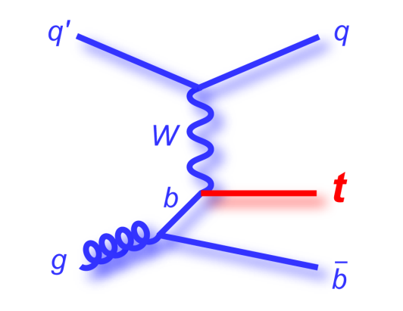
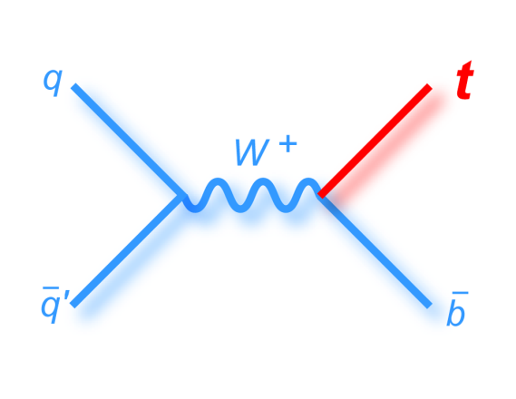
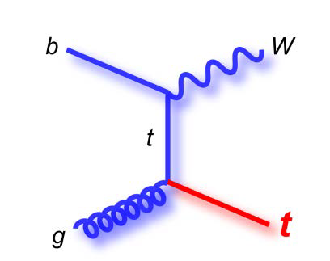
Single Top Production
Test of top EWK coupling, measurement of |V_{tb}|
Probe for PDFs for b-quarks
Sensitive to new physics: • Anomalous W_{tb} couplings, W’ or H⁺, FCNC production, 4th generation
t-channel
s-channel
Wt-channel
Kidonakis, approx. NNLO, arXiv:1205.3453v1 (2012)
pp energy | σ(t-channel) | σ(s-channel) | σ(Wt-channel)
7 TeV | 65.9 _{-1.8} pb | 4.6 ± 0.2 pb | 15.6 _{-0.6} pb
8 TeV | 87.2 _{-2.4} pb | 5.6 ± 0.2 pb | 22.2 ± 0.8 pb
+2.6
+0.5
+3.4

Slide 21
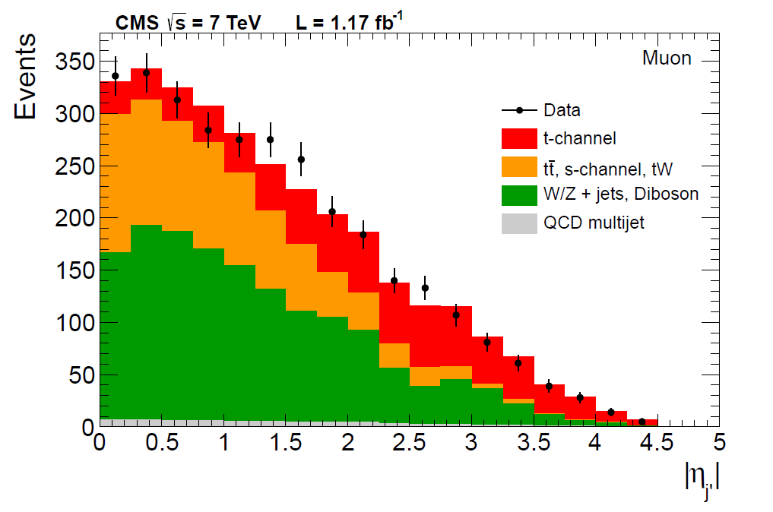
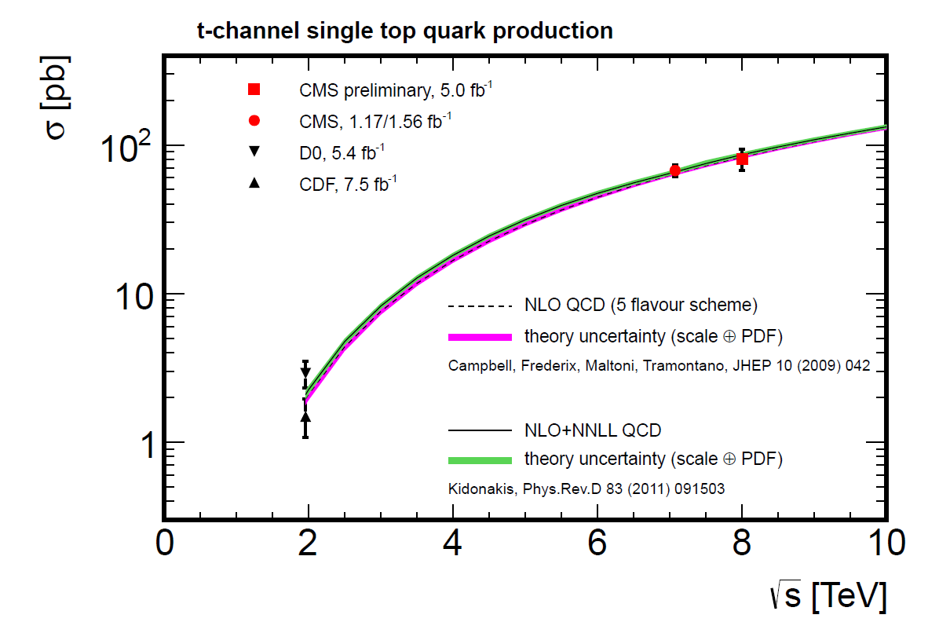
Single Top in the t-Channel
TOP-11-021
Cross section measurement at 7 TeV:
• Two approaches in lepton+jets events:
- Top mass and light jet recoil (|η’|)
- Multivariate discriminators
• Combined results:
- σ = 67±4(stat.)±3(syst.)±4(th.)±2(lum.)pb
- V_{tb} = 1.02 ± 0.05 (exp.) ± 0.02 (th.)
- 0.92<V_{tb}<1 @95% CL
TOP-12-011
Cross section measurement at 8 TeV:
• Only |η’| analysis in μ+jets events:
- σ = 80 ± 6 (stat.) ± 11 (syst.) ± 4 (lum.)pb
- R(8TeV/7TeV) = 1.14±0.12(stat.)±0.14(syst.)
- V_{tb} = 0.96 ± 0.08 (exp.) ± 0.02 (th.)
- 0.81<V_{tb}<1 @95% CL

Slide 22
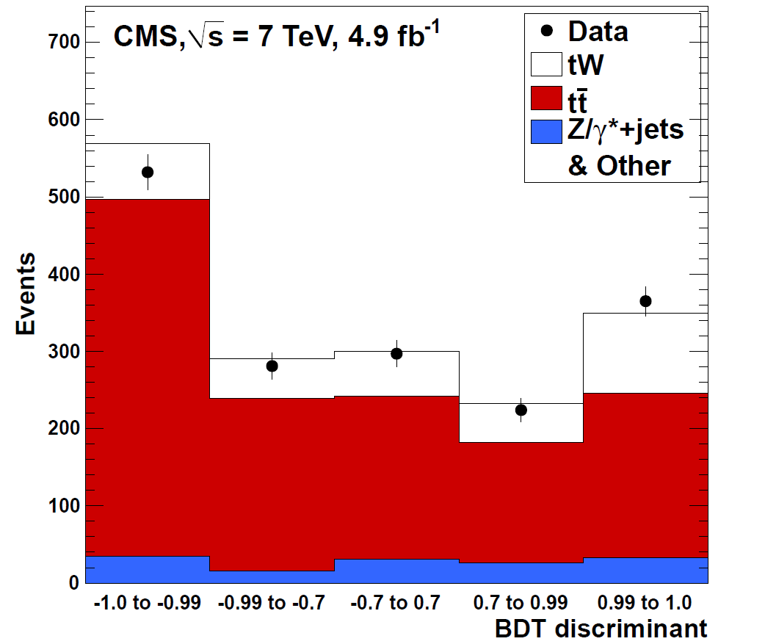
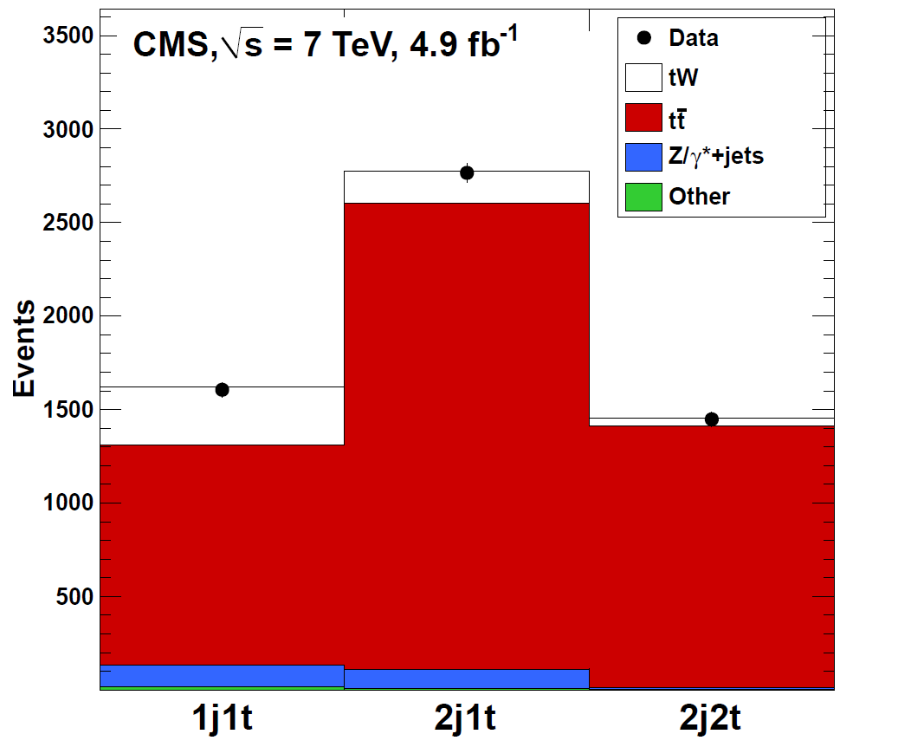
tW Associated Production
TOP-11-022
Search for tW associated production in 7 TeV pp collision • Decay channel tW→(bW)W→(blυ)(lυ)
Binned likelihood fit to BDT output in signal and control regions • Excess observed: σ = 16 ₋₄ pb (4σ significance) • V_{tb} = 1.01_{-0.13} (exp.) _{-0.04} (th.) (0.79<V_{tb}<1 @90% CL)
+5
+0.16
+0.03
Signal
region
Control region

Slide 23
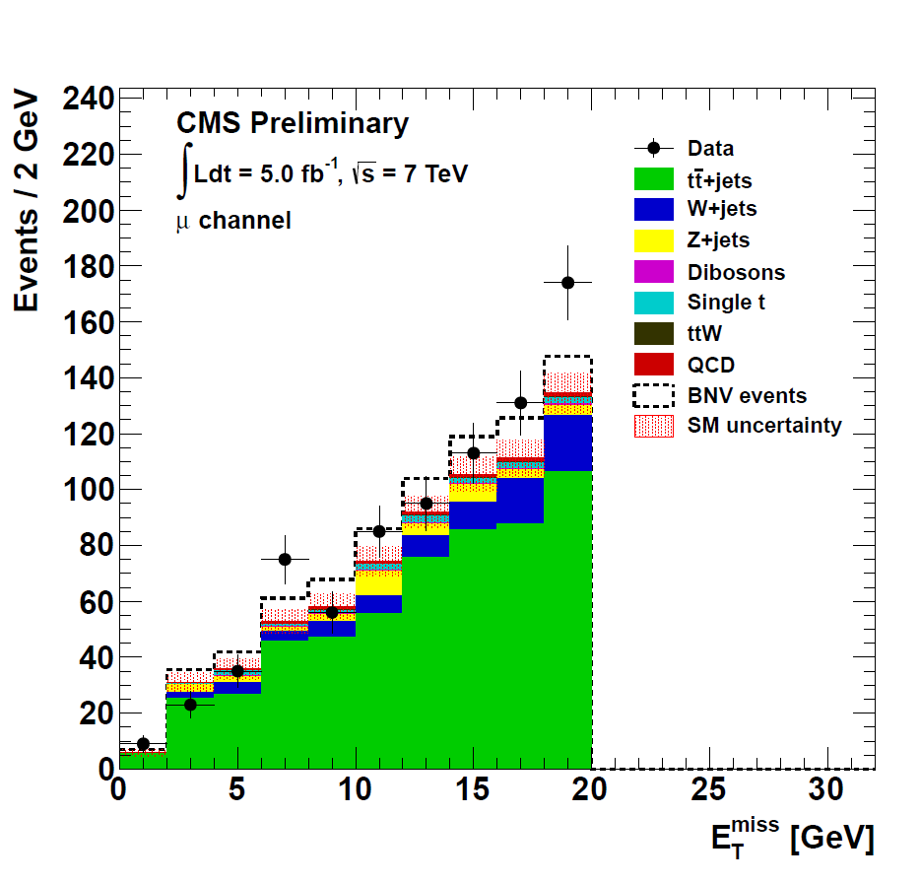
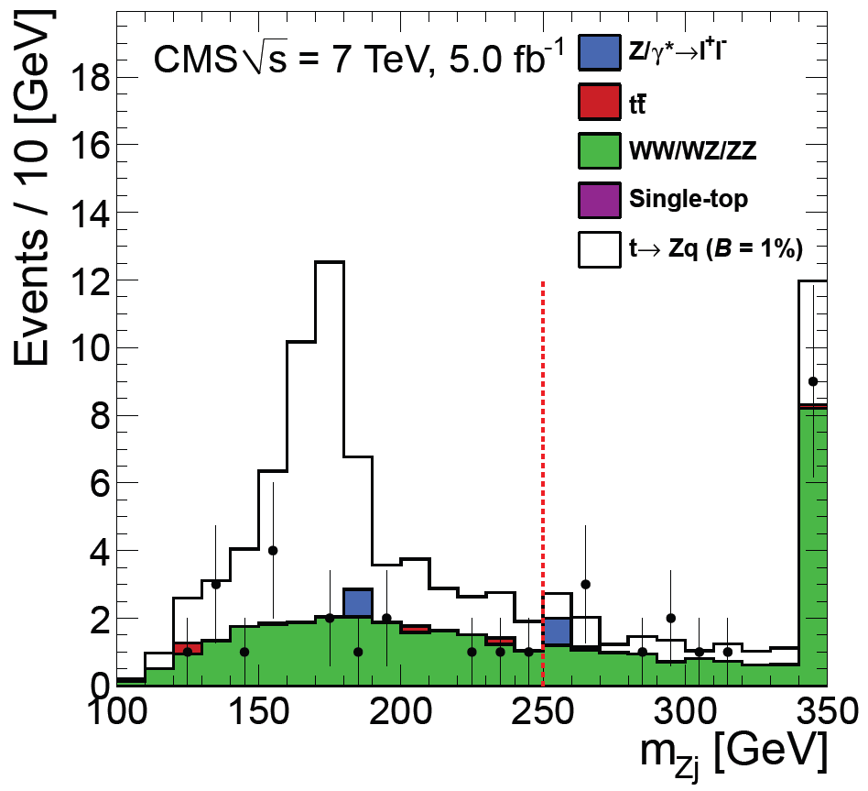
New Physics in Top Quark Decays
TOP-11-028
B2G-12-002
Search for FCNC top decays into a Z boson, t→Zq: • tt→(Wb)(Zq)→(blυ)(qll): three leptons in the final states • BR(t→Zq)<0.24% @95% CL
Search for baryon number violating top decays: • tt (Wb)(bql)→(bqq)(bql): one charged lepton, no neutrinos • BR(t→bql)<0.67% @95% CL
_
_
BR(t→bql)=0.3%

Slide 24
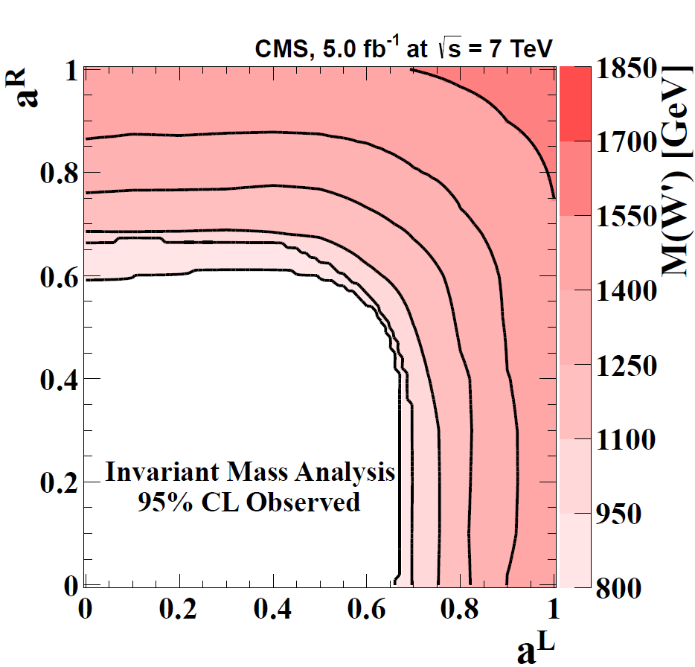
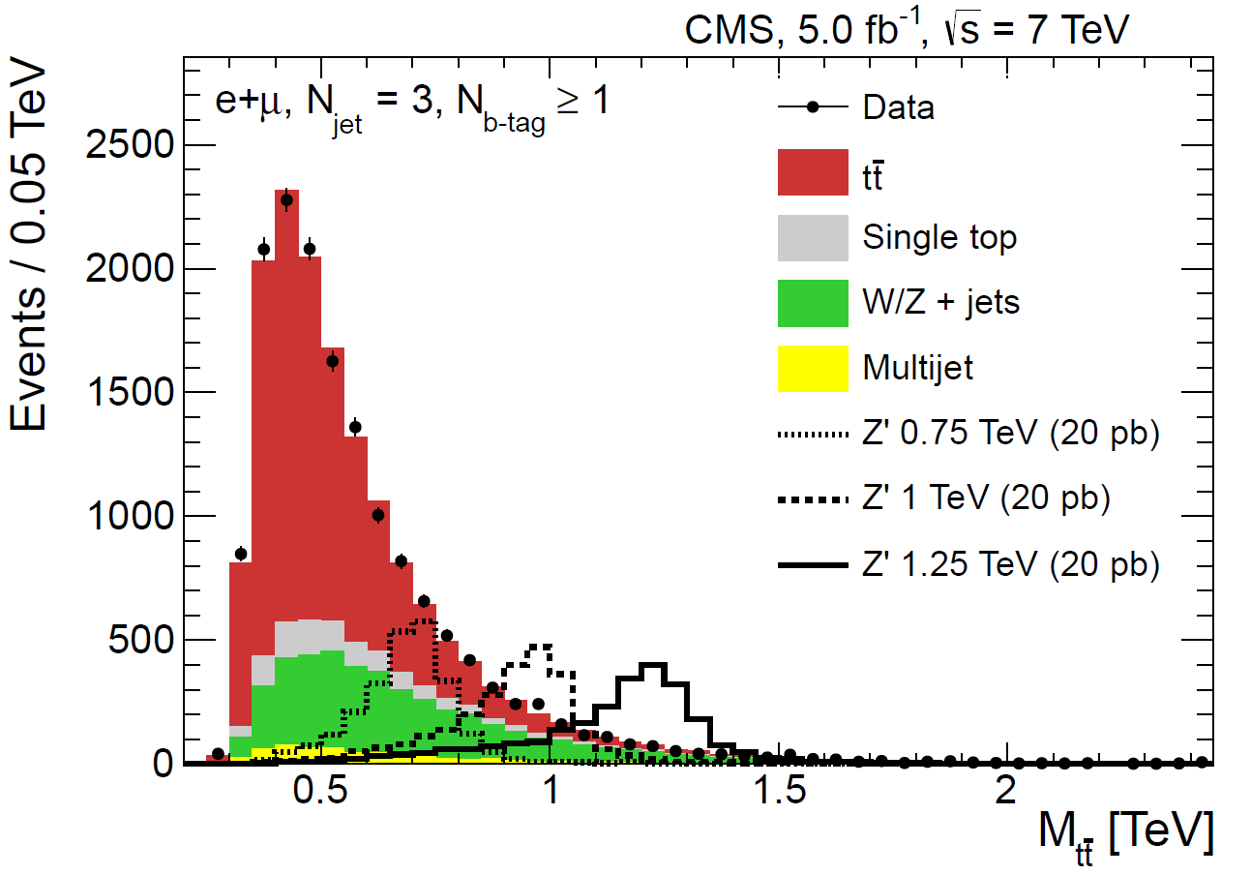
New Physics in Top Production
TOP-12-017
EXO-12-001
_
Search for tt resonances: • M_{tt} in lepton+jets events • Lower limits (95% CL):
W’ boson decaying to tb: • W’→tb→Wbb→lυbb • Assuming SM couplings:
_
- Topcolor Z’: M_{Z’}>1.49 TeV
- KK excited g: M_{g*}>1.82 TeV
- Right-handed W’:M_{W’}>1.85 TeV
- M_{W’} contours in (a^{L},a^{R}) plane

Slide 25
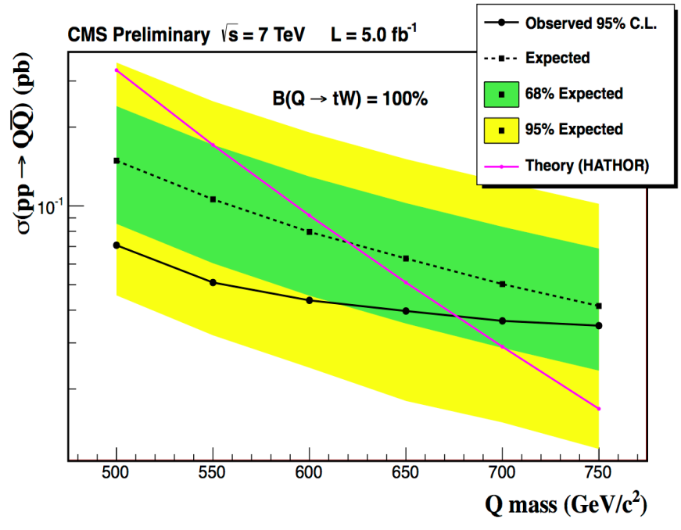
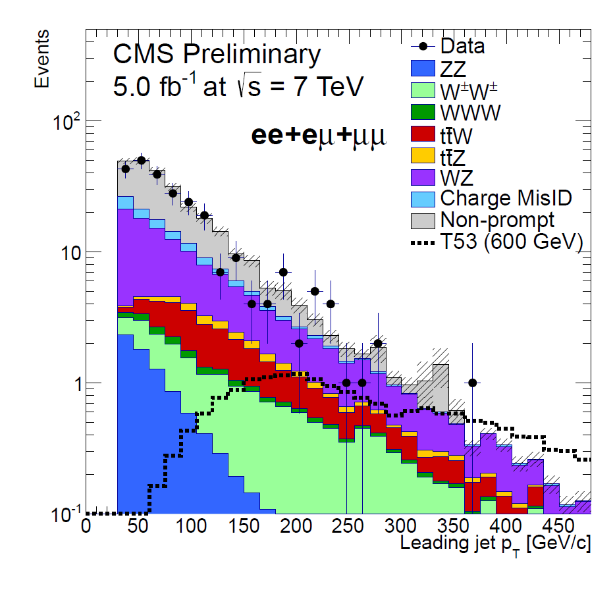
New Physics in Top Production
B2G-12-004
B2G-12-003
Heavy quark decaying to tV: • QQ→ttVV→lυ+≥4jets • No excess over SM observed:
Heavy top quark partner, Q=5/3: • Same sign dilepton + ≥4 jets from T_{5/3}T_{5/3}→(tW)(tW)→(blυlυ)(bqqqq):
_
- M(Q→tW)>675 GeV @95% CL
- M(Q→tZ)>625 GeV @95% CL
- M(T_{5/3})>645 GeV @95% CL

Slide 26
Conclusions
CMS is investigating top production and properties in pp collisions at center-of-mass energies of 7 and 8 TeV
High precision measurements on inclusive and differential cross section challenge theoretical models, and can be used to validate their predictions and constrain their parameters
Measurements of many top properties test the validity of the standard model
Direct searches for new phenomena constrain the scenarios for beyond standard model physics
Expect new results with improved precision and reach from 2012 data

Slide 27

Back Up Material

Slide 28



Charge Asymmetry
TOP-11-030
_
Charge asymmetry in tt pair production: • Sensitive to BSM top production • In pp collisions, antitop expected to be produced more centrally
CMS measurements compatible with SM predictions:
A_{c}^{y} = (N_{P}-N_{N})/(N_{P}+N_{N}), N_{P} = N(|y_{t}|-|y_{t}|>0), N_{N} = N(|y_{t}|-|y_{t}|<0)
A_{c}^{y} = 0.004 ± 0.010 (stat.) ± 0.012 (syst.), A_{c}^{th} = 0.0115 ± 0.0006
_
_

Slide 29



Top Mass from Cross Section
TOP-11-008
Exploit strong dependence of top pair cross section on top mass • Using cross section measurement from dilepton channel (1.14 fb⁻¹)
Well defined renormalization scheme: • Test of the mass scheme as applied in the MC simulations

Slide 30

Top-Antitop Mass Difference
TOP-11-019
If CPT is conserved, particle and antiparticle must have same mass
• The top quark is the only one with which we can test this directly
CMS: reconstruct t (t) mass in had. decay in l⁻(l⁺)+jets events:
∆m_{t} = -0.44± 0.46 (stat.) ± 0.27 (syst.) GeV

Slide 31


Top Quark Charge
TOP-11-031
Constraints on top charge: • Top charge reconstructed from the charge of the decay products:
- W: same charge of muon from W±→µ±υ decay
- b: flavor from charge of muon in semileptonic decay
q=+2/3 vs q_{t}=-4/3 hypotheses: • Good agreement with SM

Slide 32


W Boson Polarization
TOP-11-020
W boson polarization tests V-A coupling in top decays:
+1/2
0
-1/2
+1
W
+1/2
b
+1/2
W
Suppressed in SM
t
t
t
W
b
W
b
+1/2
+1
-1/2
W₀ longitudinal: F₀ = 0.7
W₋ left-handed: F₋ = 0.3
W₊ right-handed: F₊ ≈ 0.0
CMS measured the W helicity fractions in the l+jets channel:
• F₀ = 0.57±0.07±0.05
• F₋ = 0.39±0.04±0.03
• F₊ = 0.04±0.04±0.04

Slide 33


Top Quark Decay
TOP-11-029
Measurement of decay ratio R=BR(t→Wb)/BR(t→Wq): • Fit to b-tag multiplicity in tt dilepton decays • R=0.98±0.04, R>0.85 @95% CL
_

