Slide 1
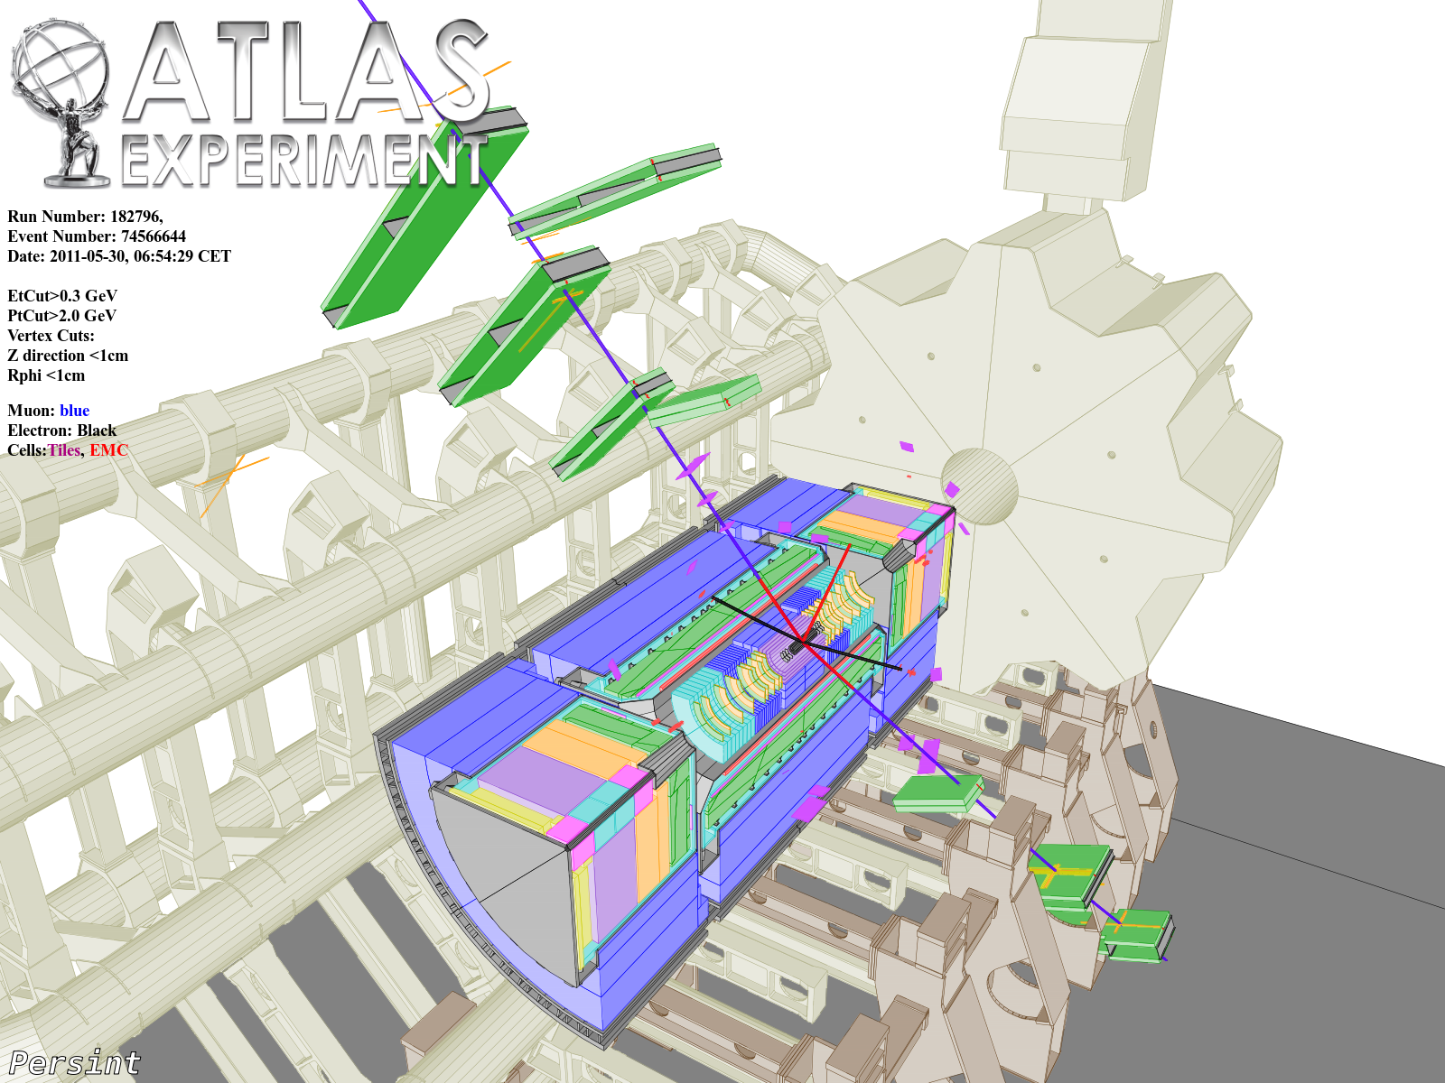
Observation of a narrow resonance in the search for the SM
Higgs decays to γγ, 4leptons, and WW with ATLAS
Stathes Paganis (The University of Sheffield)
On behalf of the ATLAS Collaboration
LHC Days in Split, Conference 1-Oct-2012

Slide 2
Introduction/Outline
On the 4th of July 2012, ATLAS and CMS experiments announced the observation of a new narrow resonance at a mass of ~125-126 GeV. Studies of the properties of this particle are now in full force with the aim to establish if the particle is the long sought Higgs boson of the Higgs mechanism responsible for the EW gauge symmetry breaking.
Here we present the latest results from ATLAS with a focus in γγ, ZZ→4l and WW→lνl’ν final states, for an integrated luminosity of ~10.7 fb⁻¹.
H→γγ
H→ZZ→4 leptons (e,μ)
H→WW→lνl’ν
Coupling Measurements → covered later by Sven Kreiss
Phys. Lett. B 716 (2012) 1-29

Slide 3

The ATLAS Detector

Slide 5
γγ event selection summary
Uncertainty | Description
Fiducial cuts | E_{T,γ1} > 40 GeV, E_{T,γ2} > 30 GeV, |η|<2.37, excluding 1.37<|η|<1.52
Photon ID | EM shower-shape based. NeuralNet-based for 2011
Photon Isolation | Summed E_{T} in a calo cone ΔR<0.4 around photon excluding the photon cluster, not to exceed 4GeV.
Categories | 10 categories based on photon η, P_{T,t}, converted, unconverted, dijet.
Photons: converted, unconverted.
Photon energy: from LAr EM cluster energy
Photon position: η from calorimeter and the primary vertex, φ from calorimeter
Dijet category improves sensitivity to VBF.
Search performed in the 110-150 GeV γγ mass range.

Slide 6
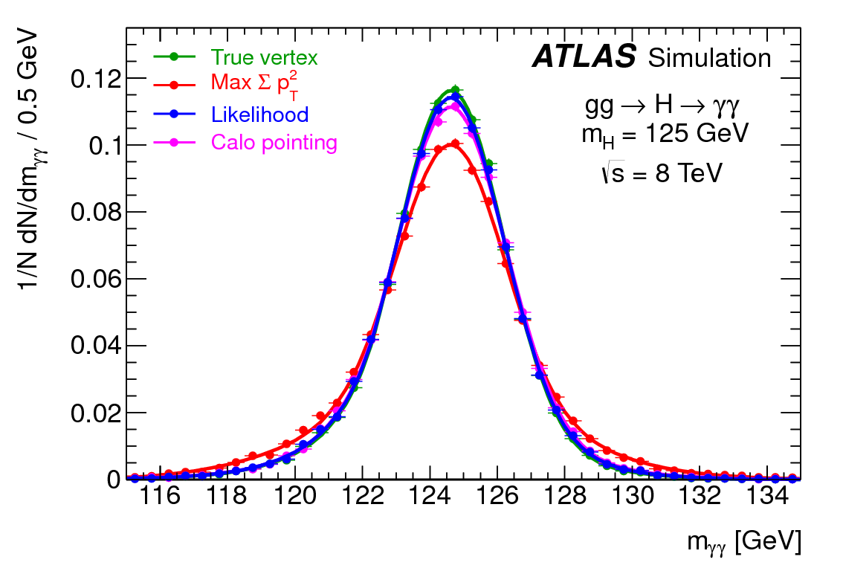
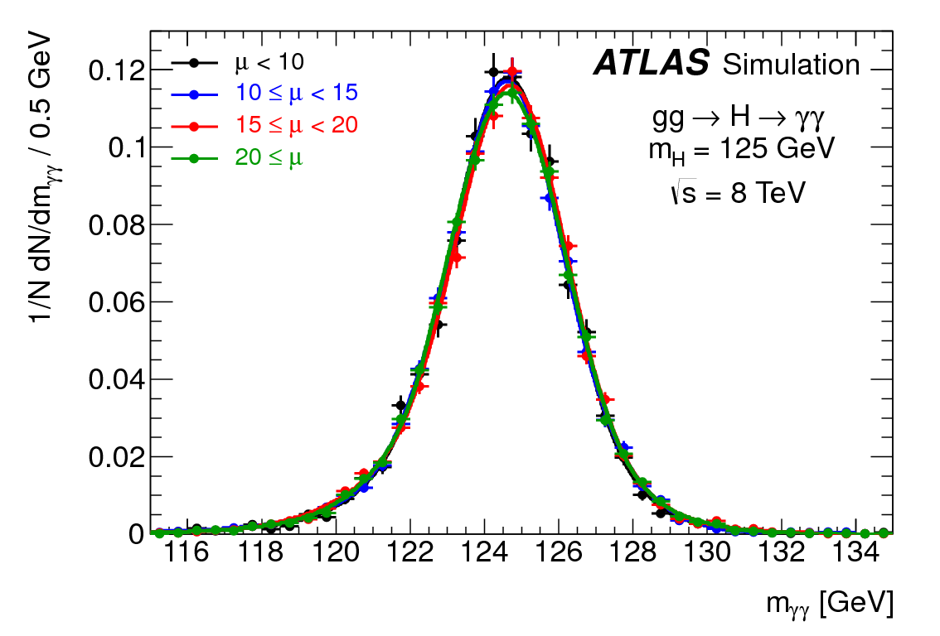
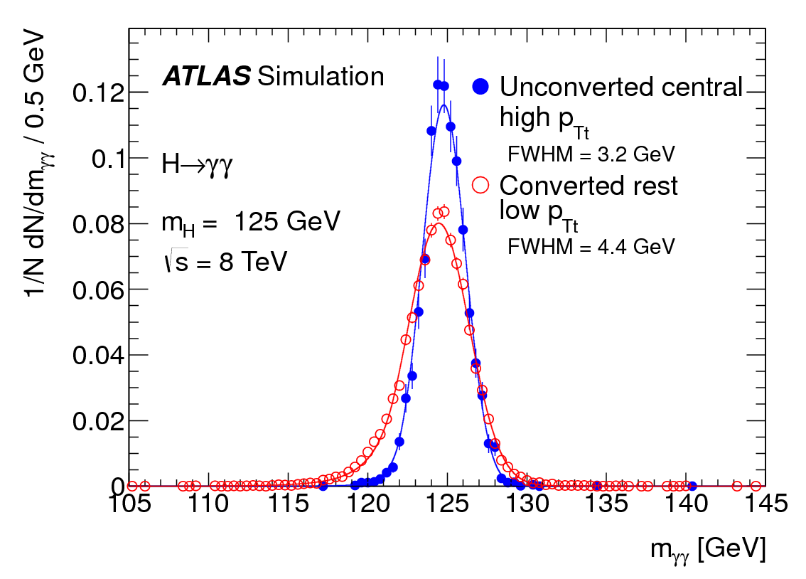
γγ signal mass resolution
Higgs Mass Resolution:
for different methods of longitudinal vertex position reconstruction. Calorimetric pointing and likelihood lead to improved resolution.
Not affected by increased levels of pileup.
Varies from category to category.

Slide 7
Systematic Uncertainties
Uncertainty | Description
Signal yield uncertainty from γ ID efficiency | ±8% , ±11% (7TeV, 8TeV)
Pile-up modelling | ±4%
Theory uncertainties in Higgs kinematics (affecting event migration between categories) | ±9%
Signal resolution uncertainty | ±14%
Trigger | ±1%
Photon isolation | ±0.4% , ±0.5% (7TeV, 8TeV)
Luminosity | ±1.8% , ±3.6% (7TeV, 8TeV)
Uncertainties in the expected fractions of events per category (includes migrations) due to material effects, jet energy scale, pile-up effects, PDFs and jet vertex fraction, have been included.

Slide 8
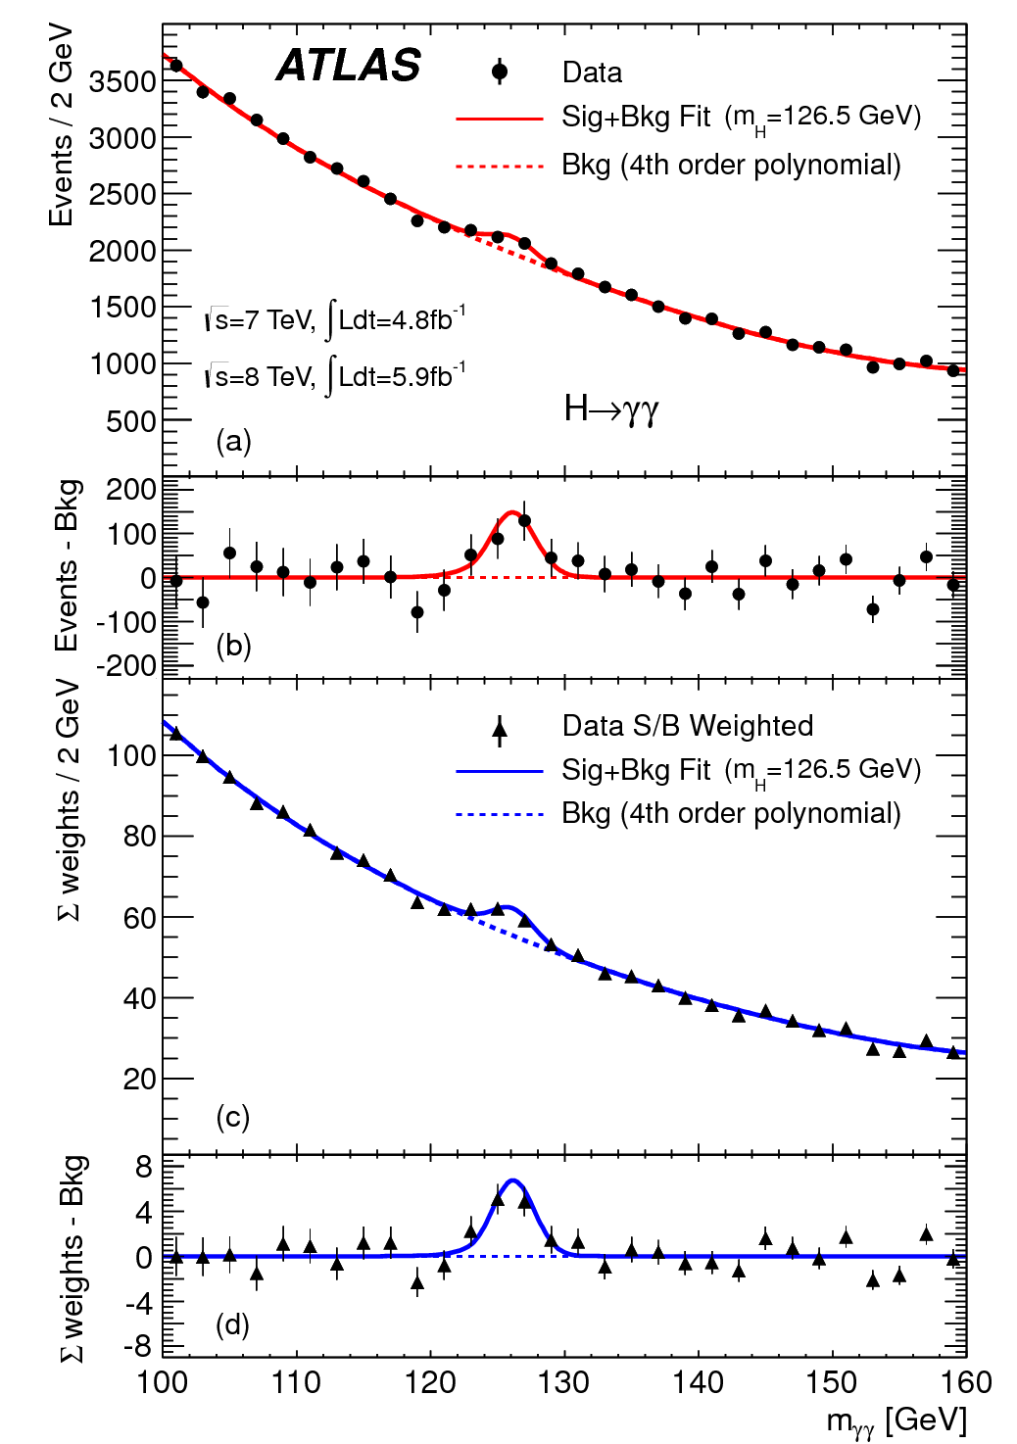
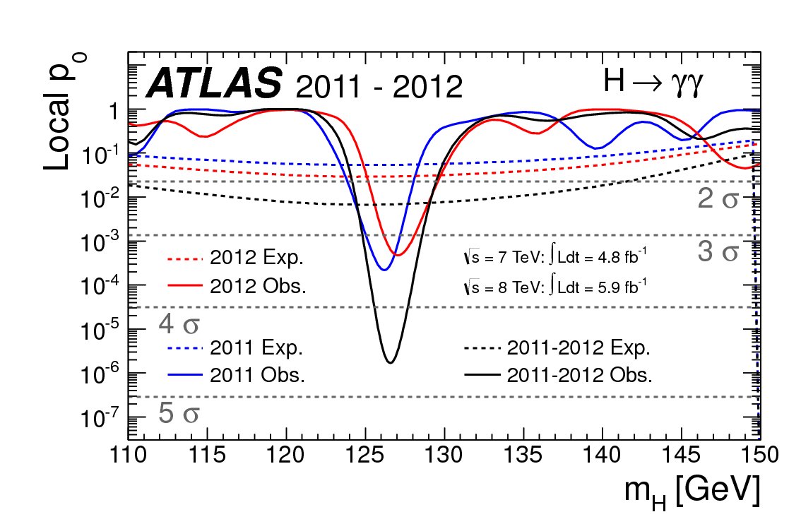
γγ invariant mass and local Significance
Combination of all categories leads to a 4.5σ significance.

Slide 9
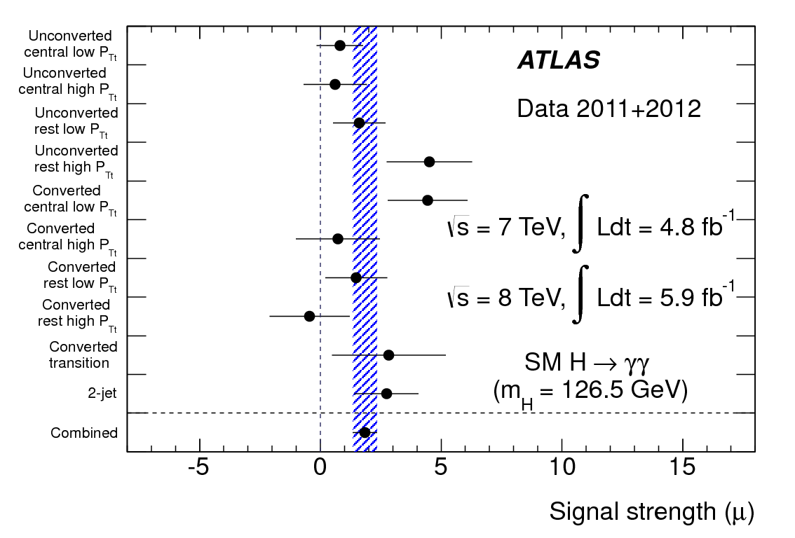
γγ signal strength per category (at 126.5 GeV)
(blue band corresponds to the error of the combined result)

Slide 11
4-lepton event selection summary
Selection | Description
Final states | e⁺e⁻e⁺e⁻, μ⁺μ⁻μ⁺μ⁻, μ⁺μ⁻e⁺e⁻, e⁺e⁻μ⁺μ⁻
Fiducial cuts | All leptons p_{T,μ} > 6 GeV, p_{T,e} > 7 GeV, Leading p_{T} > 20 GeV Subleading p_{T} > 15 GeV Third p_{T} > 10 GeV |η_{μ}| < 2.7, |η_{e}| < 2.47
Lepton Isolation | Track sum ET and Calo sum ET inside a ΔR<0.2 cone around the Z leptons.
e (μ) Impact Parameter | d0/σ_{d0} < 6.5 (3.5)
Leading dilepton (12) | Same flavour opposite charge with M closest to 91.18 GeV. Pairs must satisfy m₁₂>50 GeV, m₃₄>17.5 GeV.
Leading Z mass cut | 50 < m₁₂ < 106 GeV
Subleading Z mass cut | M_{min}(m_{4l}) < m₃₄ < 115 GeV (M_{min} is a minimum mass cut that depends on the 4-lepton mass)

Slide 12
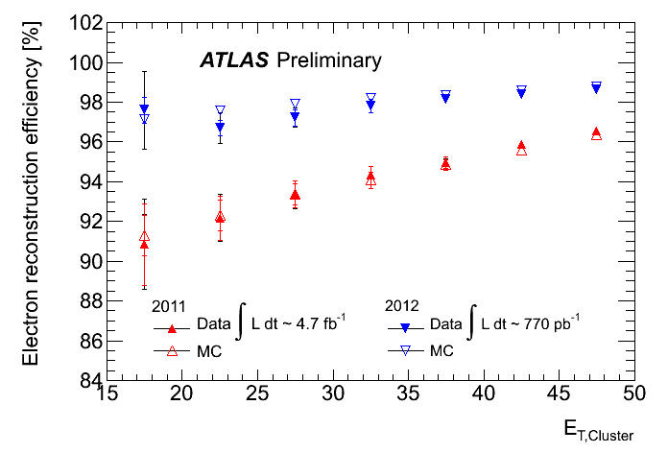
Lepton Reconstruction
Electron reconstruction/identification improved in 2012: New pattern finding/track fitting, Improved track-cluster matching, to recover electrons undergoing hard bremsstrahlung , GSF.
Muon reconstruction: use ID tracks matched with partial or complete track segments in the muon spectrometer, and ID tracks+energy deposits in the calo (|η|<0.1 pt>15GeV). Standalone muons (2.5<|η|<2.7).

Slide 13
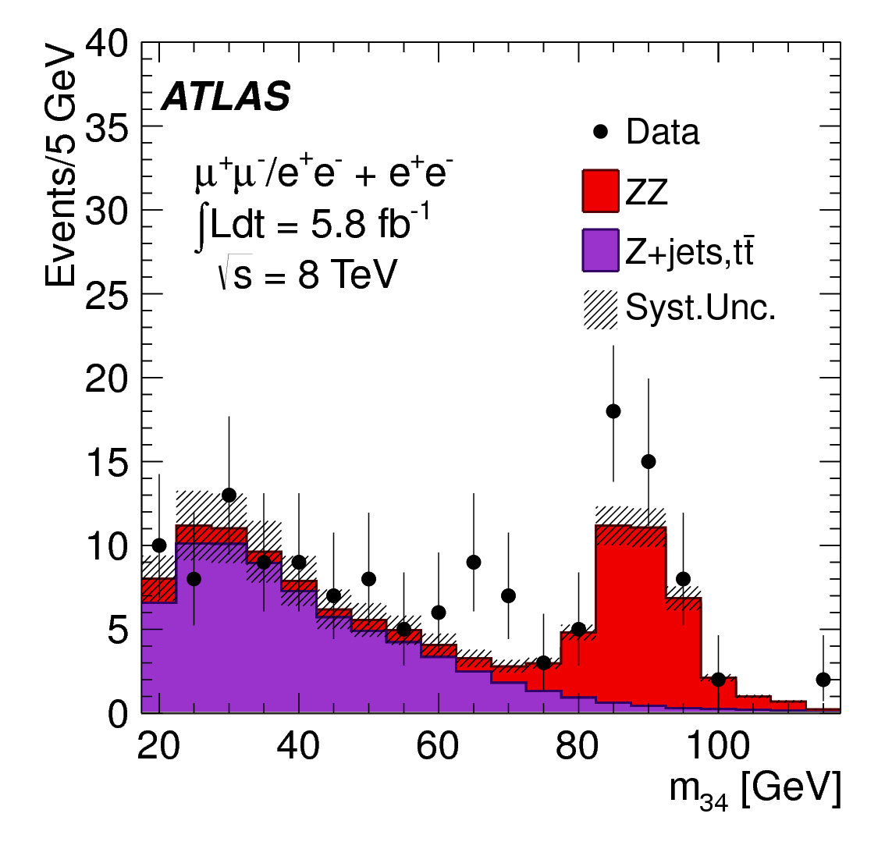
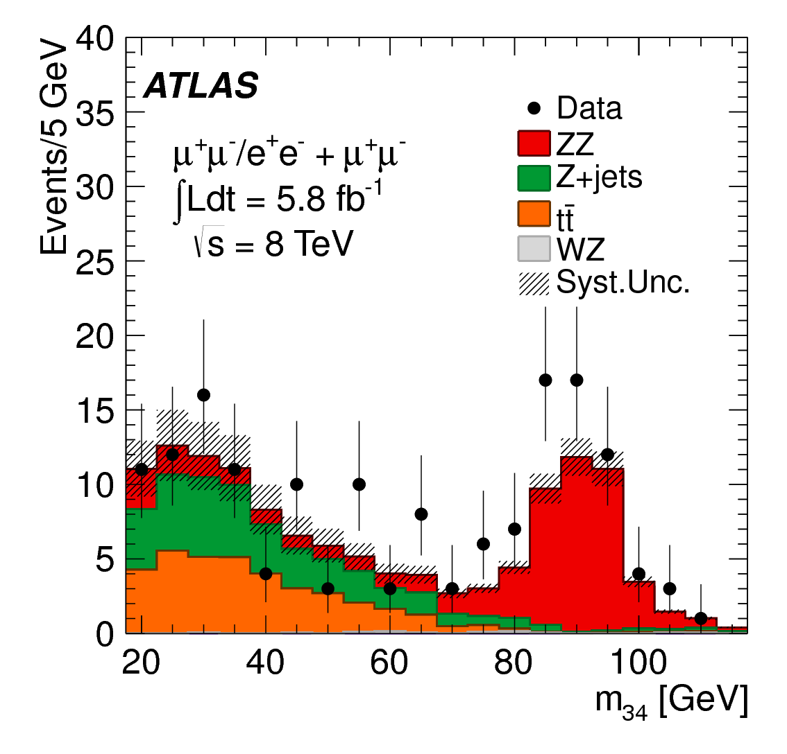
Background measurements from data
A number of methods was used to determine the various backgrounds using data. A subset of the analysis cuts is applied to define a control region.
One example is to use the invariant mass of the subleading dilepton M34 to control the Z+jets and ttbar backgrounds. For these leptons the isolation and impact parameter cuts are not applied. All other analysis cuts are applied.

Slide 14
Systematic Uncertainties
Uncertainty | Description
μ acceptance uncertainty due to reco and ID efficiency uncertainties | from ±0.7% (±0.5%,±0.5%) for 4μ (2e2μ,2μ2e) at 600GeV to ±0.9% (±0.8%,±0.5%) for 4μ (2e2μ,2μ2e) at 115GeV
e acceptance uncertainty due to reco and ID efficiency uncertainties | from ±2.6% (±1.7%,±1.8%) for 4e (2e2μ,2μ2e) at 600GeV to ±8.0% (±2.3%,±7.6%) for 4e (2e2μ,2μ2e) at 115GeV
ZZ* bkg uncertainty (QDC scale) | ±5%
ZZ* bkg uncertainty (α_{s} + PDF) | ±4% (±8%) for processes initiated by quarks (gluons)
Z+jets and ttbar backgrounds | estimated from control regions
ZZ normalization comes from MC.
Dependence of ZZ* uncertainties on m_{4l} has been taken into account

Slide 15
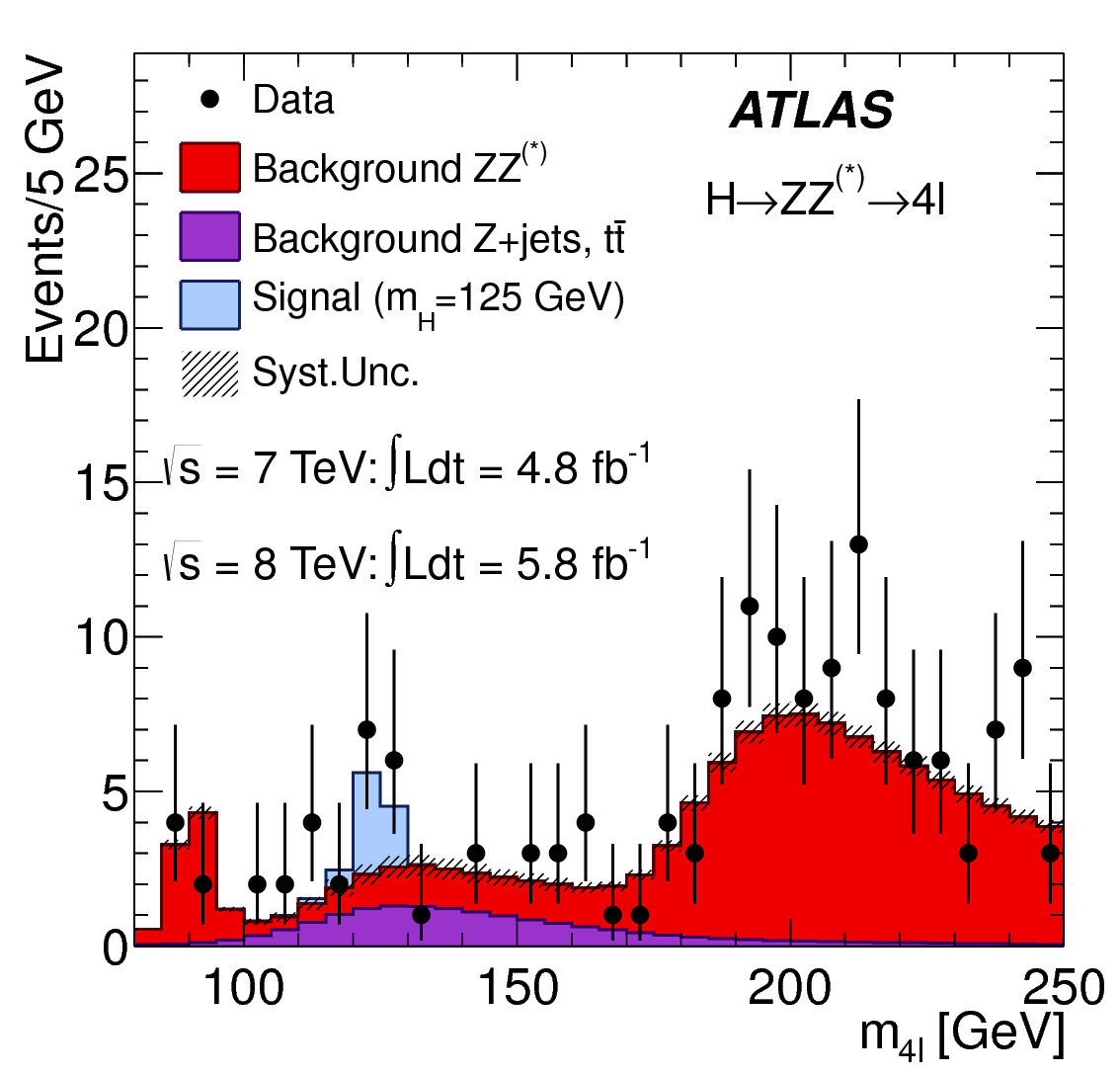
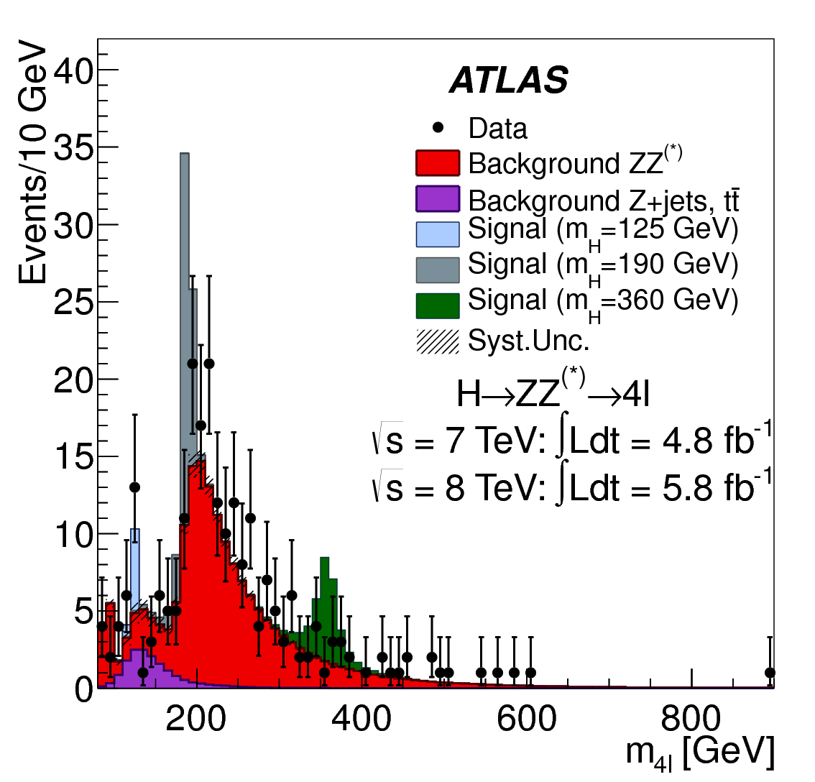
4-lepton invariant mass
Observed excess in 120-130 GeV

Slide 16
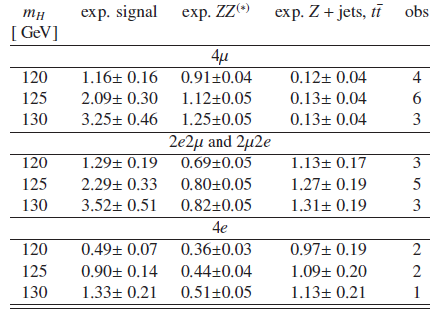
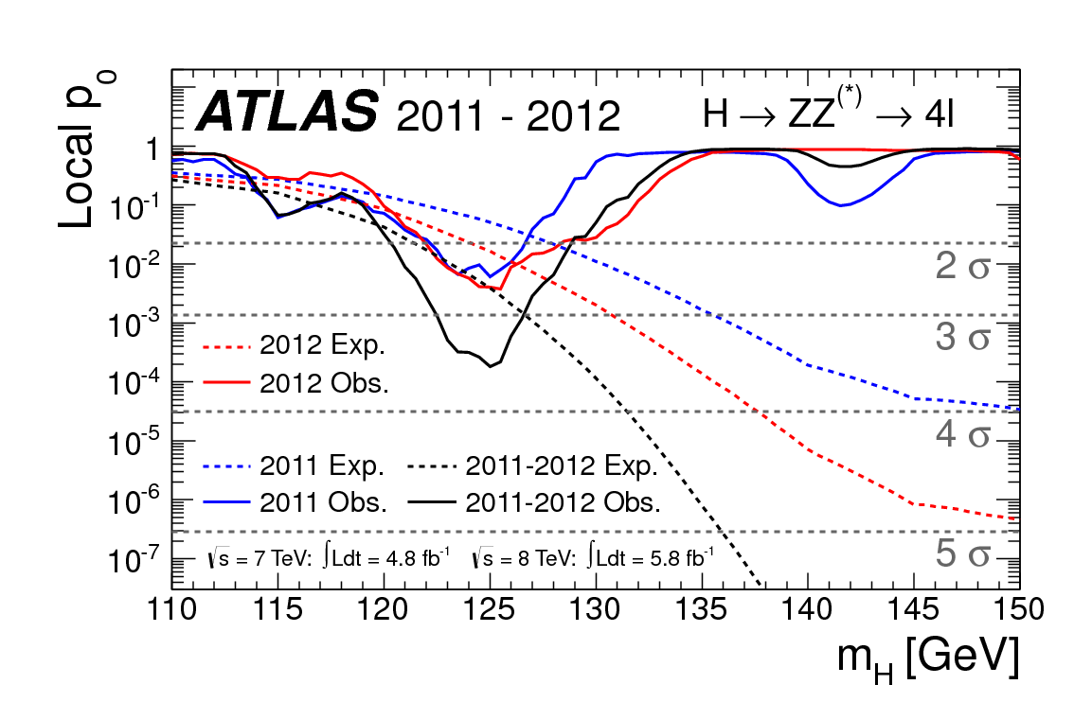
4-lepton expected and observed events: 120-130GeV
Maximum local significance of 3.6σ observed at 125 GeV.
No other significant excess is observed in m_{H}.

Slide 17
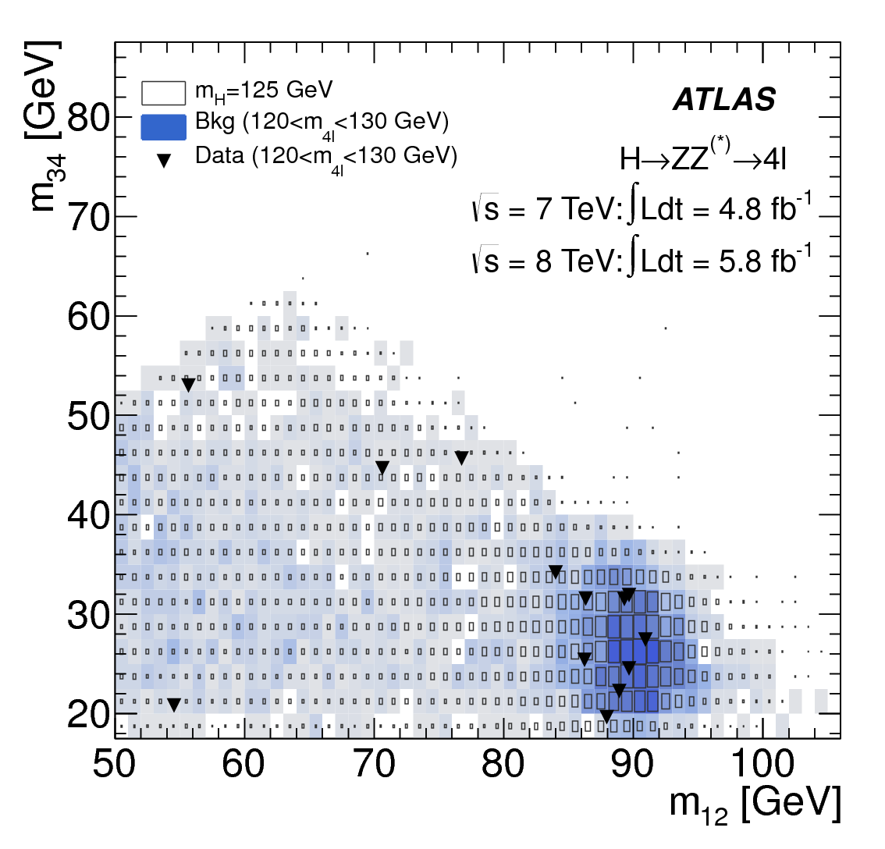
m₃₄ vs m₁₂ for 120<m_{4l}<130 GeV
Distribution of the m₃₄ versus the m₁₂ invariant mass for the selected candidates in the m_{4l} range 120 to 130 GeV. The expected distributions for a SM Higgs with m_{H} = 125 GeV and for the total background are shown. The sizes and intensity of the boxes indicate the relative density.

Slide 18
Focus in 2012 data: eμ,μe final states

Slide 19
WW event selection summary
Fiducial cuts | p_{T,l1} > 25 GeV, p_{T,l2} > 15 GeV, |η_{μ}|<2.5, |η_{e}|<2.47, excluding 1.37<|η_{e}|<1.52
Lepton Isolation | Track sum ET and Calo sum ET inside a ΔR<0.3 cone around the Z leptons.
Dilepton Invariant mass
Dilepton PT (0-jet channel)
Missing ET (relative) | ET,rel>25 GeV
Categories | H + 0 jets, H + 1 jet, H + 2 jets
For 2012 (8TeV) only the eμ final state is used (5.8 fb⁻¹)
Transverse mass is the discriminant used in the search:

Slide 20
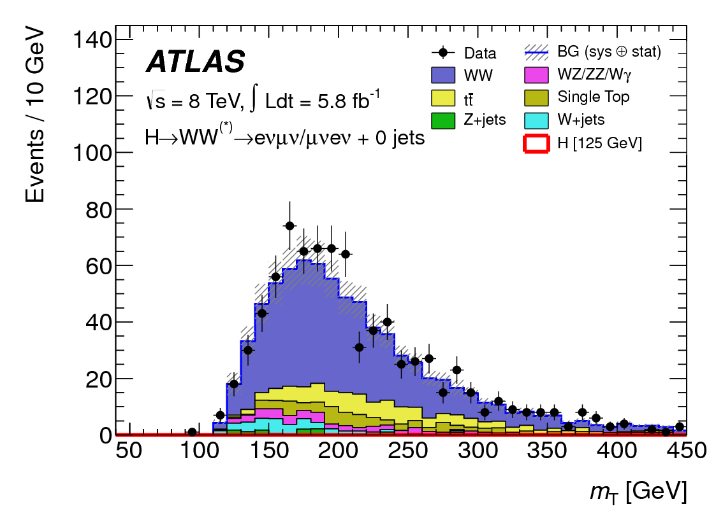
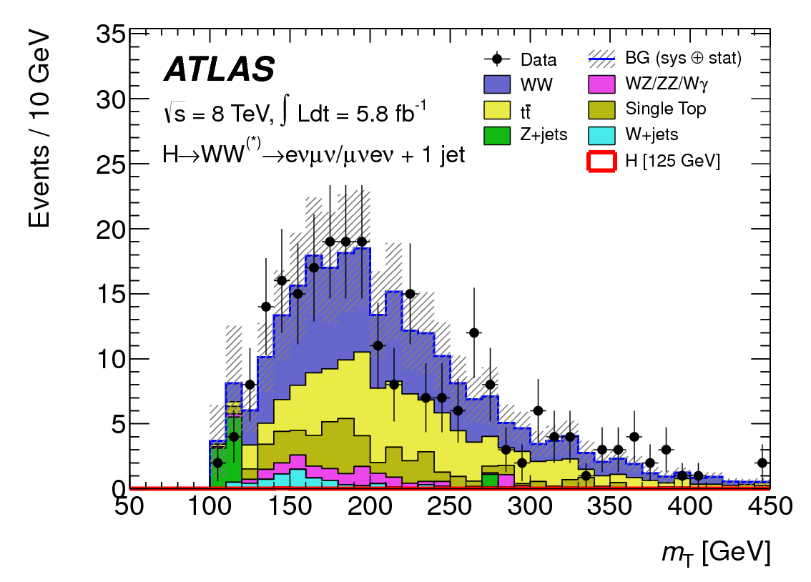
Background measurements from data
Example control regions
for WW + 0 jets (mostly WW)
and WW + 1 jet (large ttbar + single top fraction).

Slide 21
Systematic Uncertainties
Uncertainty | Description
Theoretical uncertainties associated to the signal | ±17% (0-jets), ±36% (1-jet)
Jet energy scale (max effect on signal) | ±7% in W+0jet
Jet energy scale (max effect on bkg) | ±4% in W+1jet
Jet energy resolution (max effect on signal) | ±4% in W+1jet
Jet energy resolution (max effect on bkg) | ±2% in W+1jet
Pile-up to JES (max effect on signal) | ±4% in W+1jet
Pile-up to JES (max effect on bkg) | ±2% in W+1jet
Missing ET effect in total yield | ±3% (±3%) signal (bkg)
b-jet tagging efficiency | ±10% in W+1jet
W+jet prediction effect in the total bkg | ±5%

Slide 22
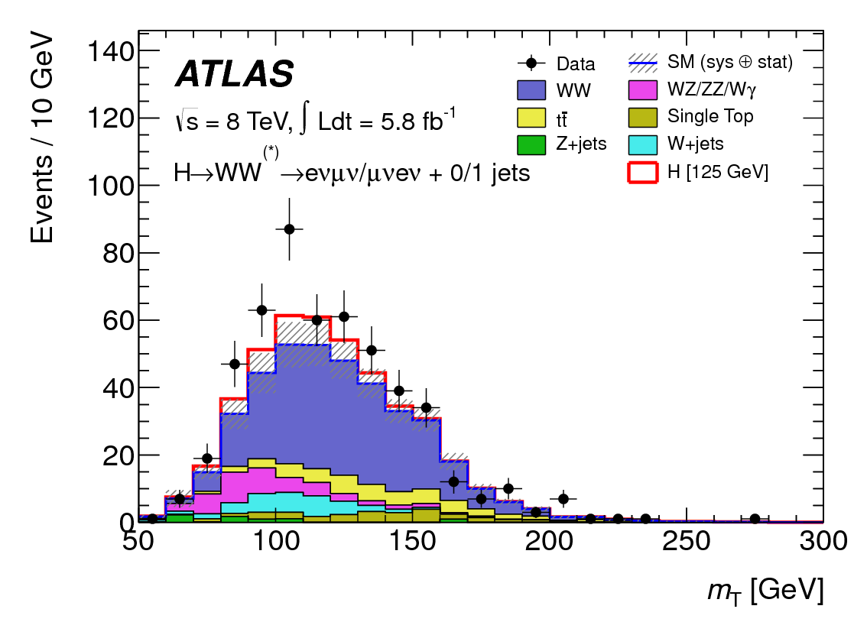
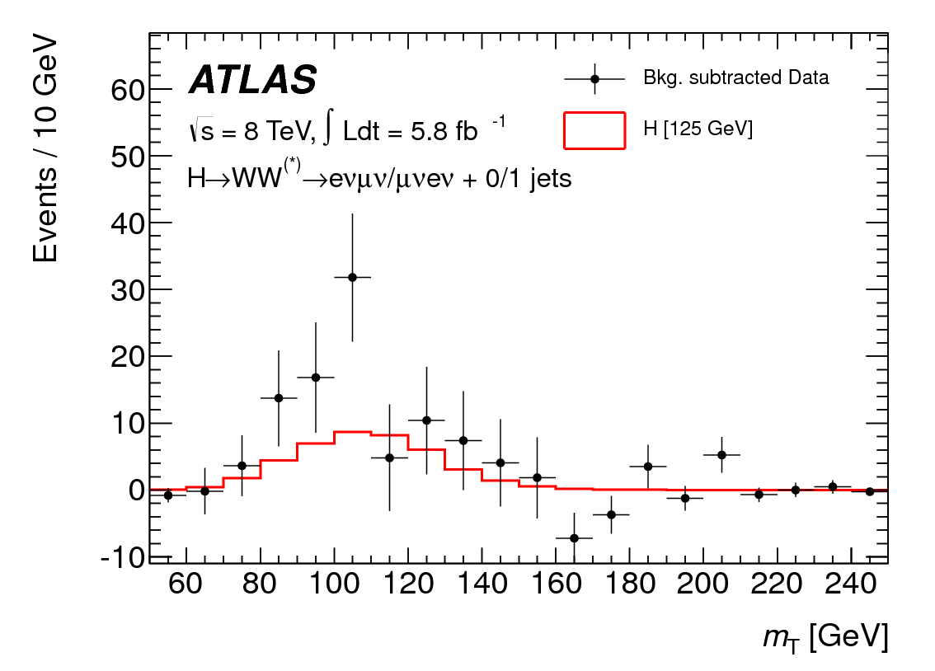
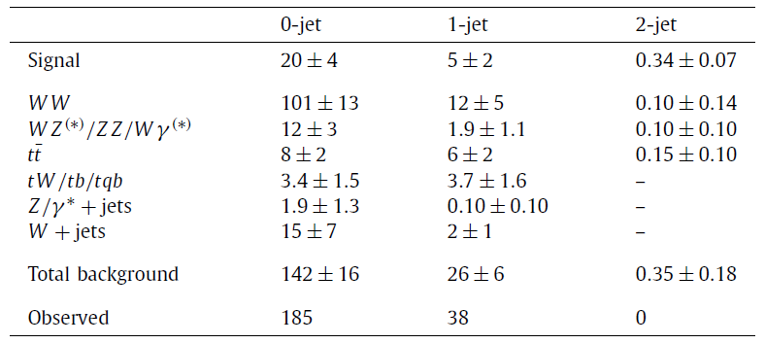
WW Observed and expected events
Bkg systematics not included
0.75m_{H} <m_{T} <m_{H} for m_{H} =125 GeV.

Slide 23
Combination
More on Sven Kreiss’ talk

Slide 24
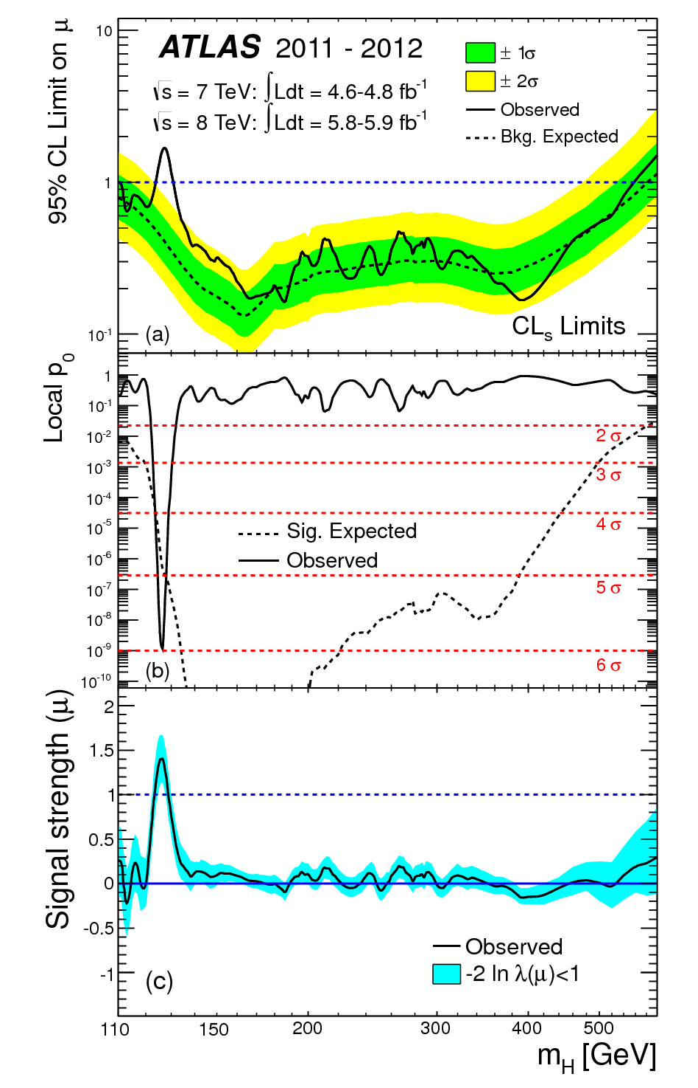
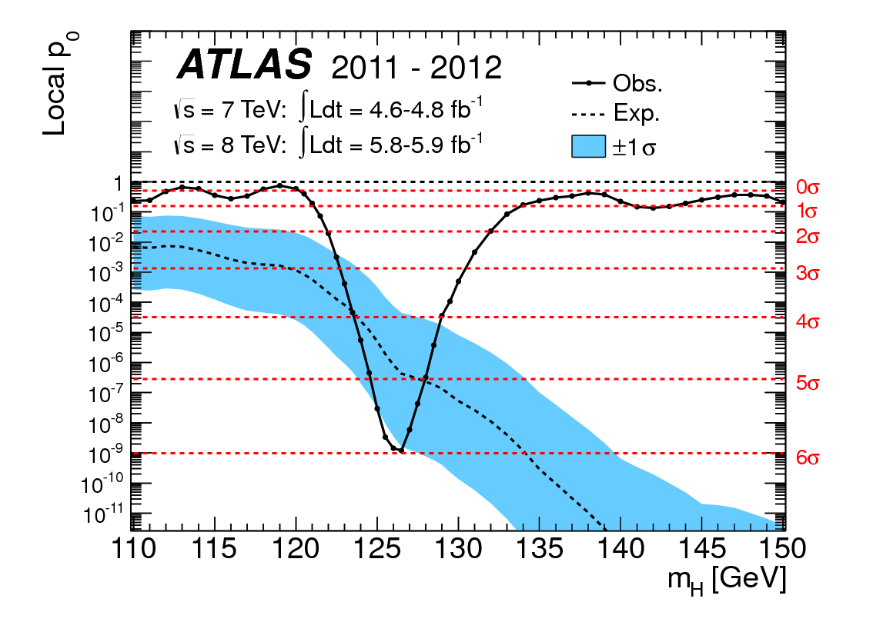
Exclusion Region and Combined Significance
Combination of all channels (including 2011 ττ, bb, etc) leads to a 5.9σ significance.

Slide 25
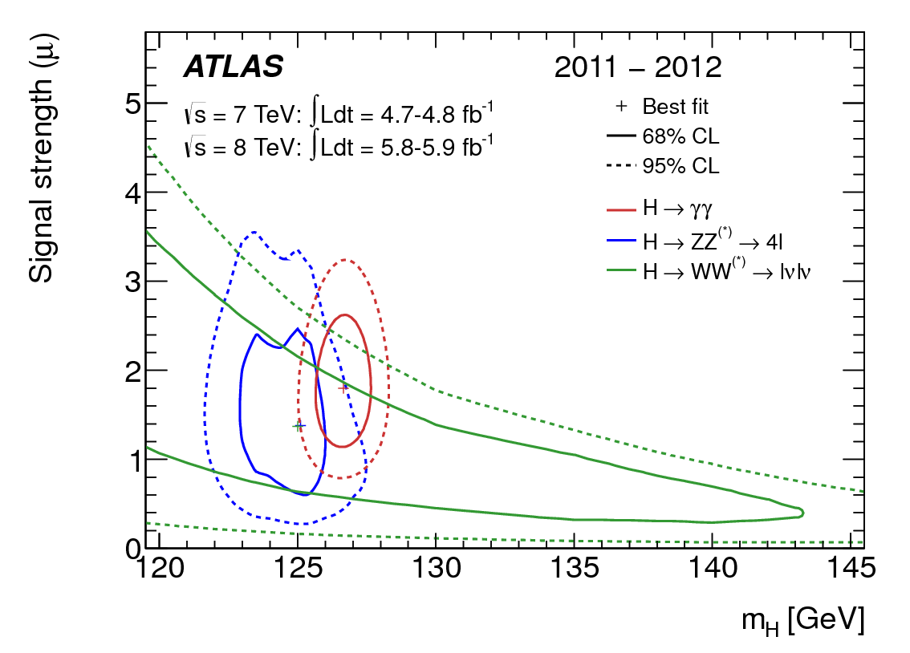
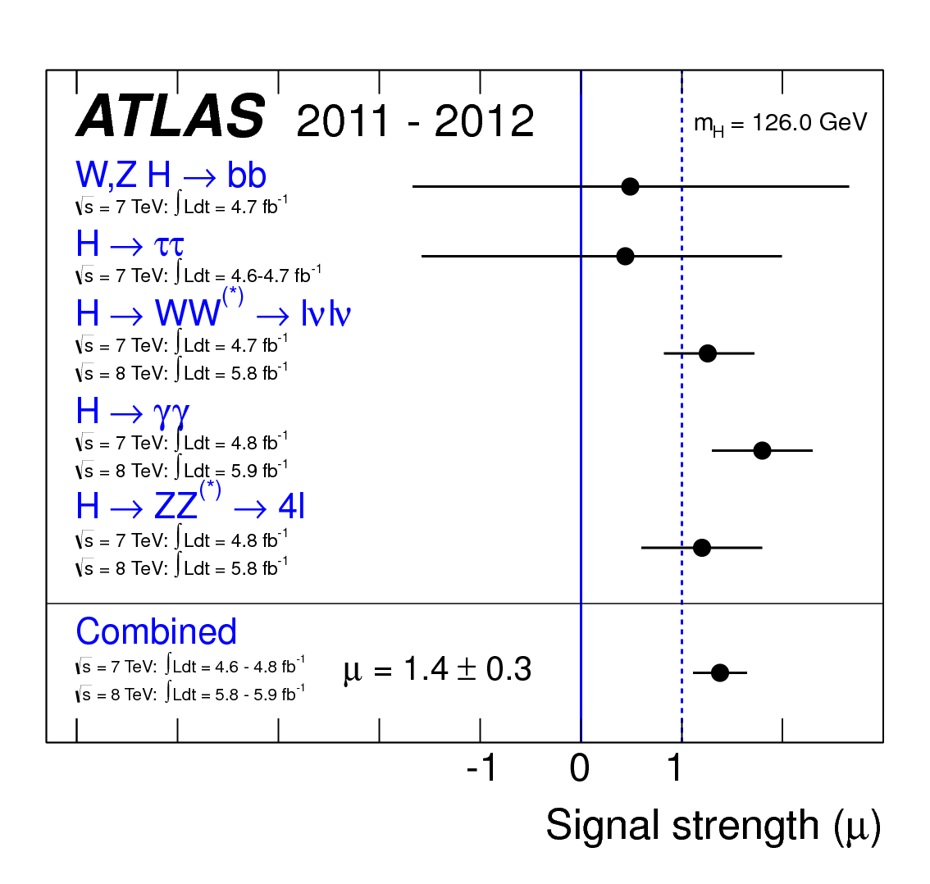
Mass and Signal strength μ wrt Standard Model
Extracted mass:126 ± 0.4(stat) ± 0.4(syst) GeV
(using only 4-lepton and γγ channels)
Combined Signal Strength:1.4 ± 0.3

Slide 26
Conclusions
ATLAS has performed a search for the SM Higgs boson with an integrated luminosity of ~10.7 fb⁻¹.
A 5.9σ excess of events is observed in the region 121-131 GeV. The excess is dominated by the high mass resolution channels H→γγ and H->ZZ→4l in addition to H→WW→lνl’ν.
The SM Higgs boson is excluded at the 95% or higher CL in 111-559 GeV apart from the narrow range 121-131 GeV where a clear excess is observed.
The measured invariant mass of the new particle is:
126 ± 0.4(stat) ± 0.4(syst) GeV

Slide 28
Additional Slides

Slide 29
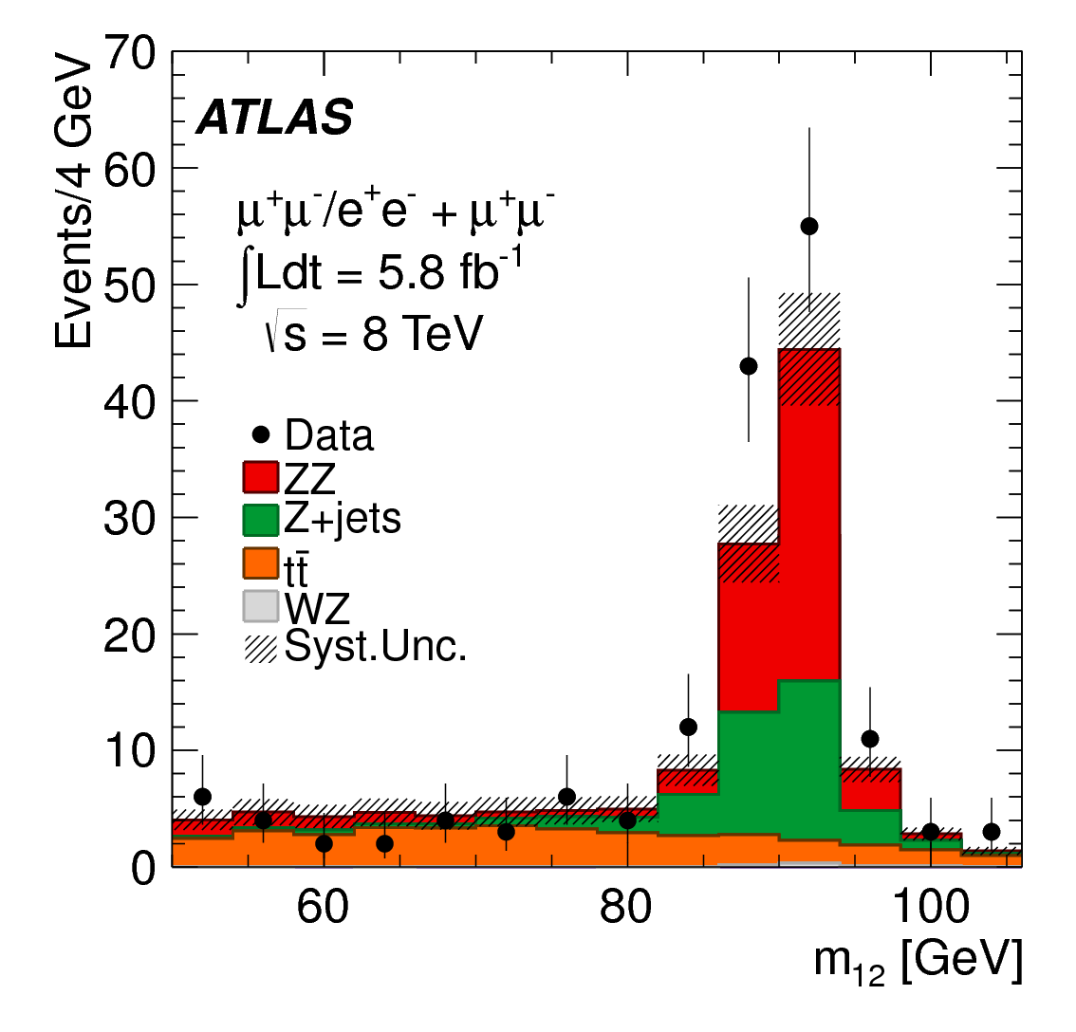
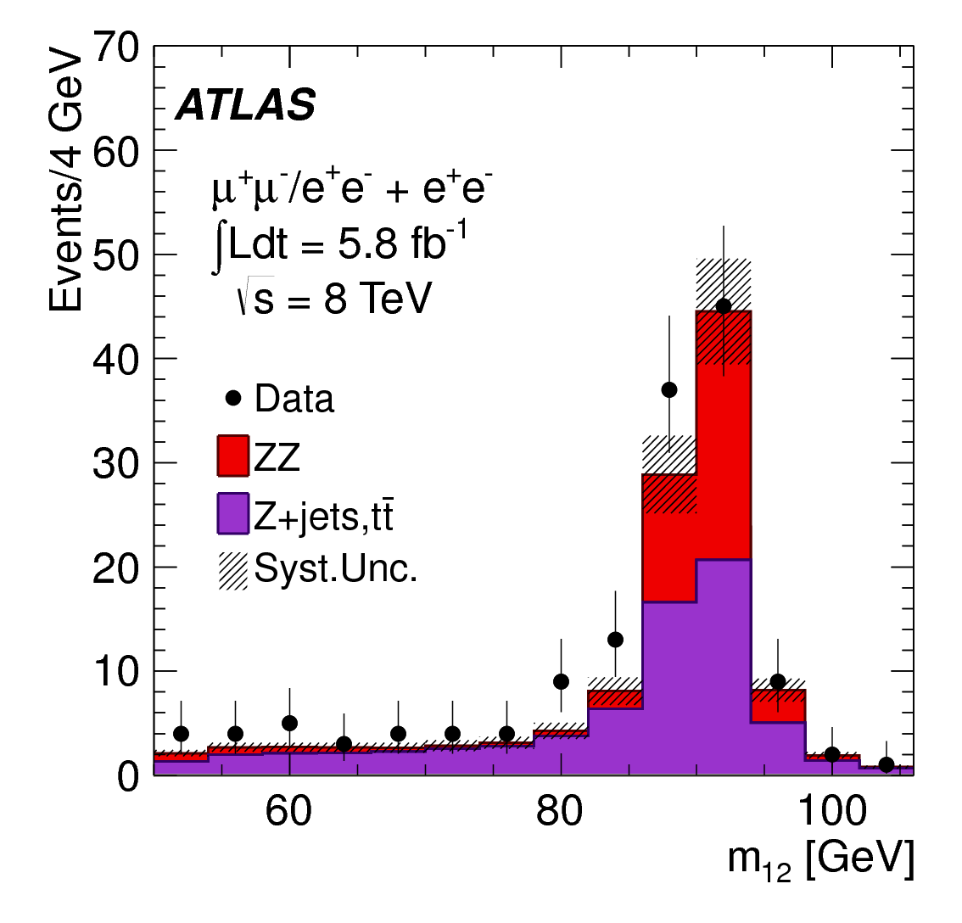
Z+ee and Z+μμ 4lepton control regions

Slide 30
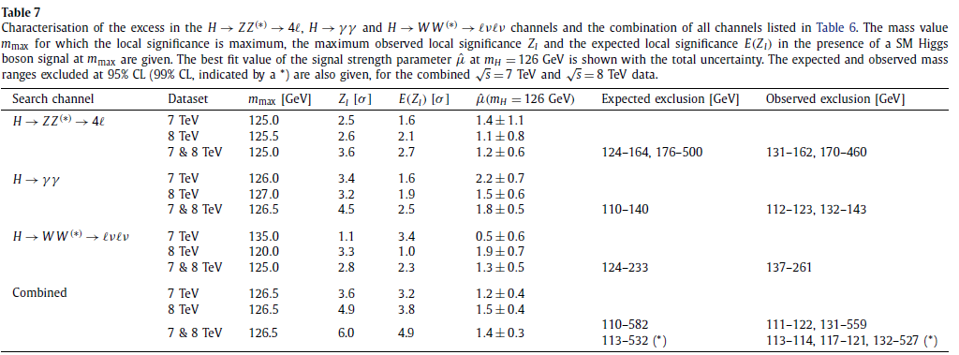
Summary of characterization of excess

Slide 31
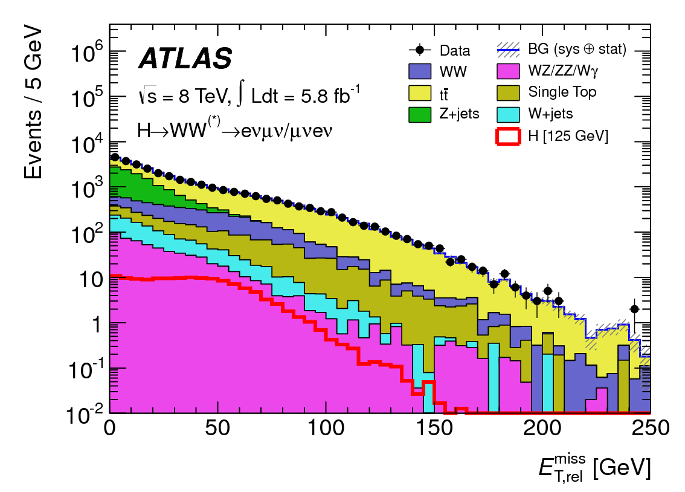
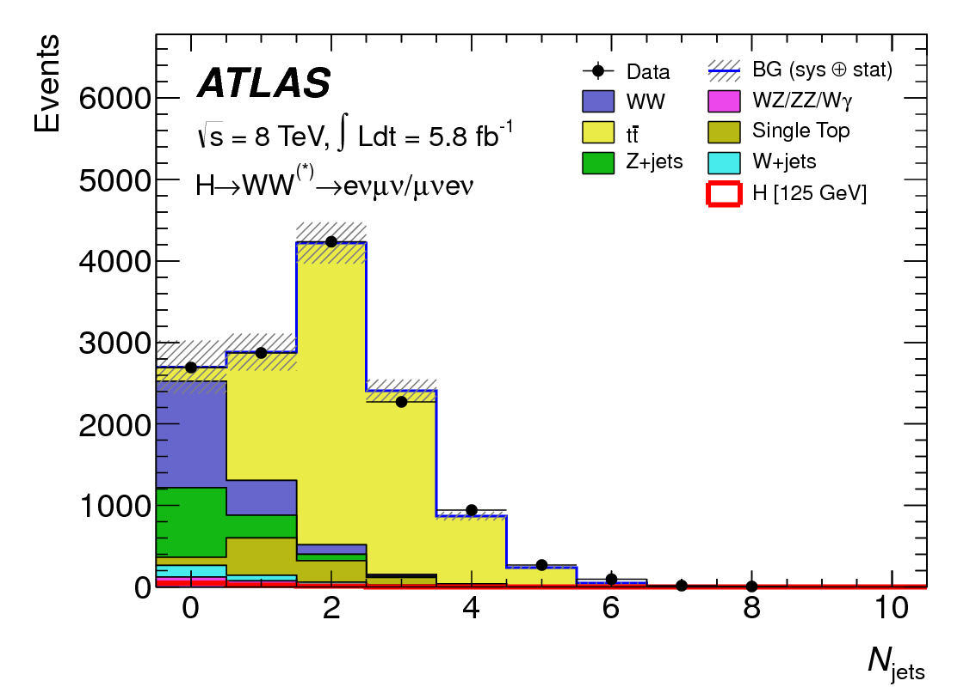
H→WW, missing Et and Jet multiplicity

Slide 32
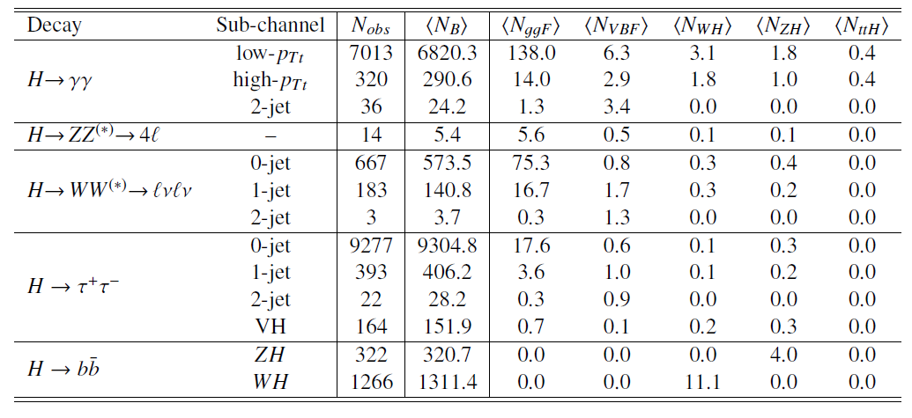
Numbers of observed and expected SM signal events
Number of selected events, bkg and expected SM signal contribution for a 126GeV Higgs boson from various production modes satisfying all selection requirements.
These numbers refer to mass windows that contain about 90% of the signal. Categories that do not provide significant discrimination for the production mode are merged.

Slide 33
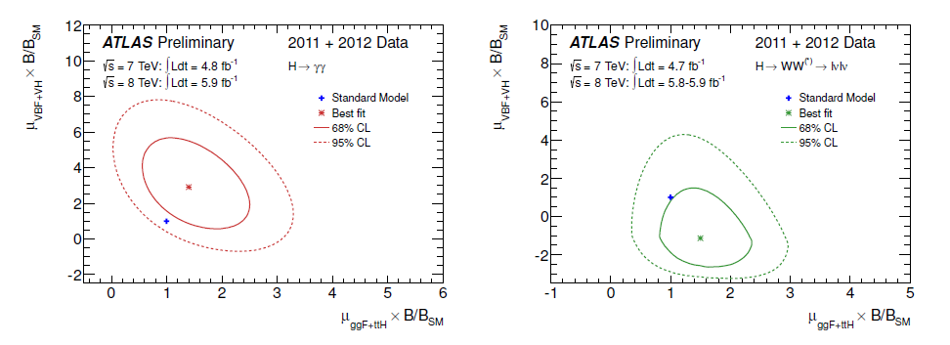
Likelihood contours for H→γγ and H→WW→lνlν
VBF+VH vs ggF+ttH

