Slide 1
AD/ELENA (B193)
Experimental hall conditions

Slide 2
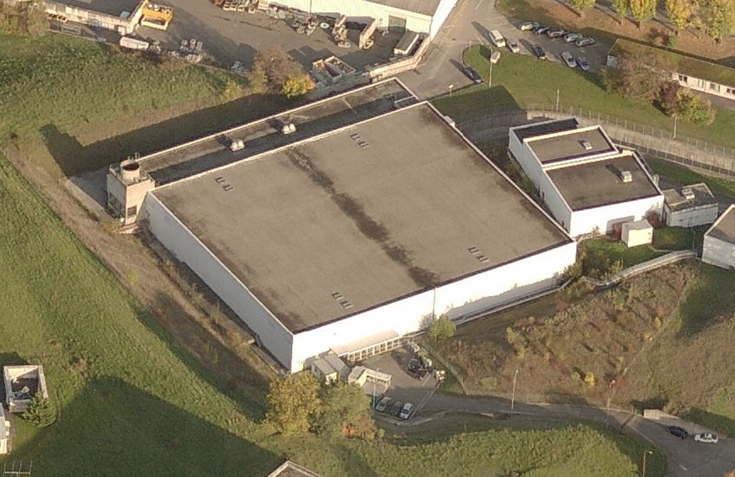
Bdg 193…
Hall AD
Bâtiment 193

Slide 3
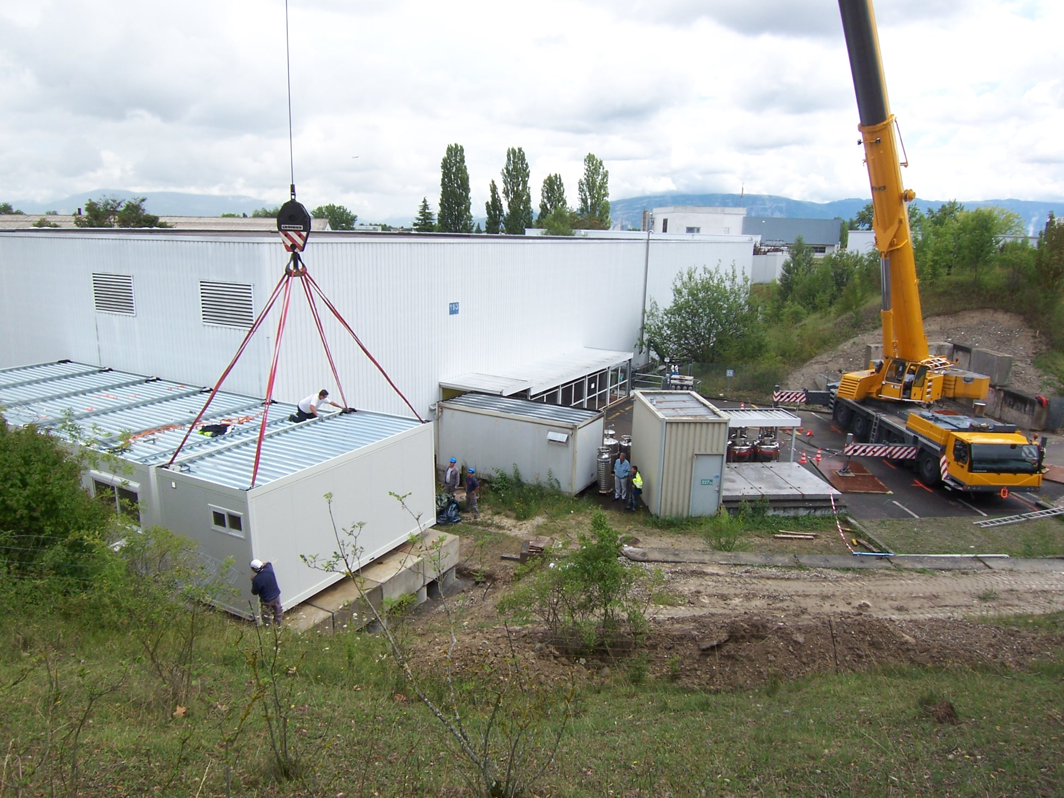
New control rooms being added…
Stage 1 of new control rooms installed,
Stage 2 planned for summer 2012

Slide 4
New control rooms, stage 2 and 3
Stage 2:
ATRAP CR
CAFET
MEETING ROOM
STAIRS
WC
ACE CR
AEGIS CR
TR
WC
Stage 3:
Existing
Stage 3 is not completely defined yet but may include CR’s for ASACUSA, ALPHA,
plus ELENA related experiments, including Gbar
No rack in CR, all racks in AD hall
No work place in AD hall. All work places in CR !

Slide 5
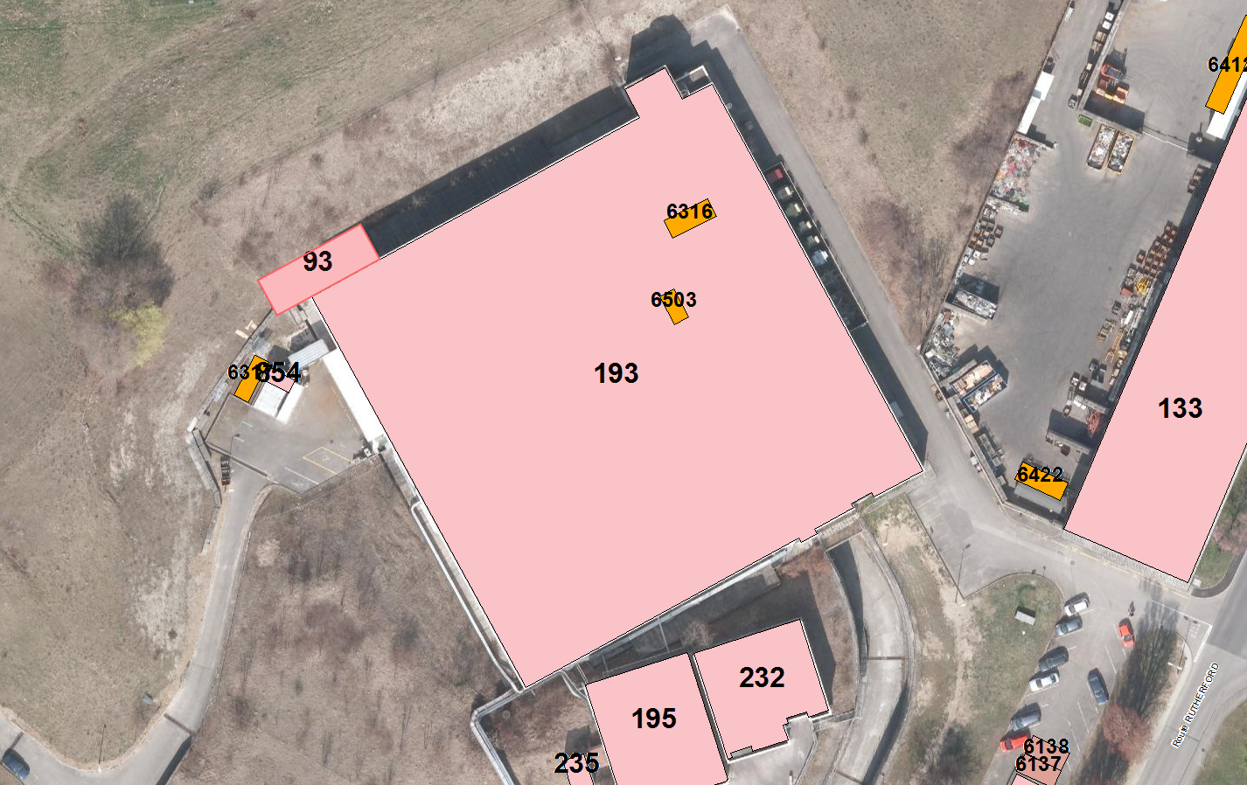
CR is remotely located !
Control room (bdg 93)
~70 m
GBar

Slide 6
Need for an extension of AD hall
Four main goals for an extension of AD hall:
Relocate the existing workshop
Provide short term storage space for experiments
Accomodate for ELENA ring and experimental areas
Host the magnetic horns test bench

Slide 7
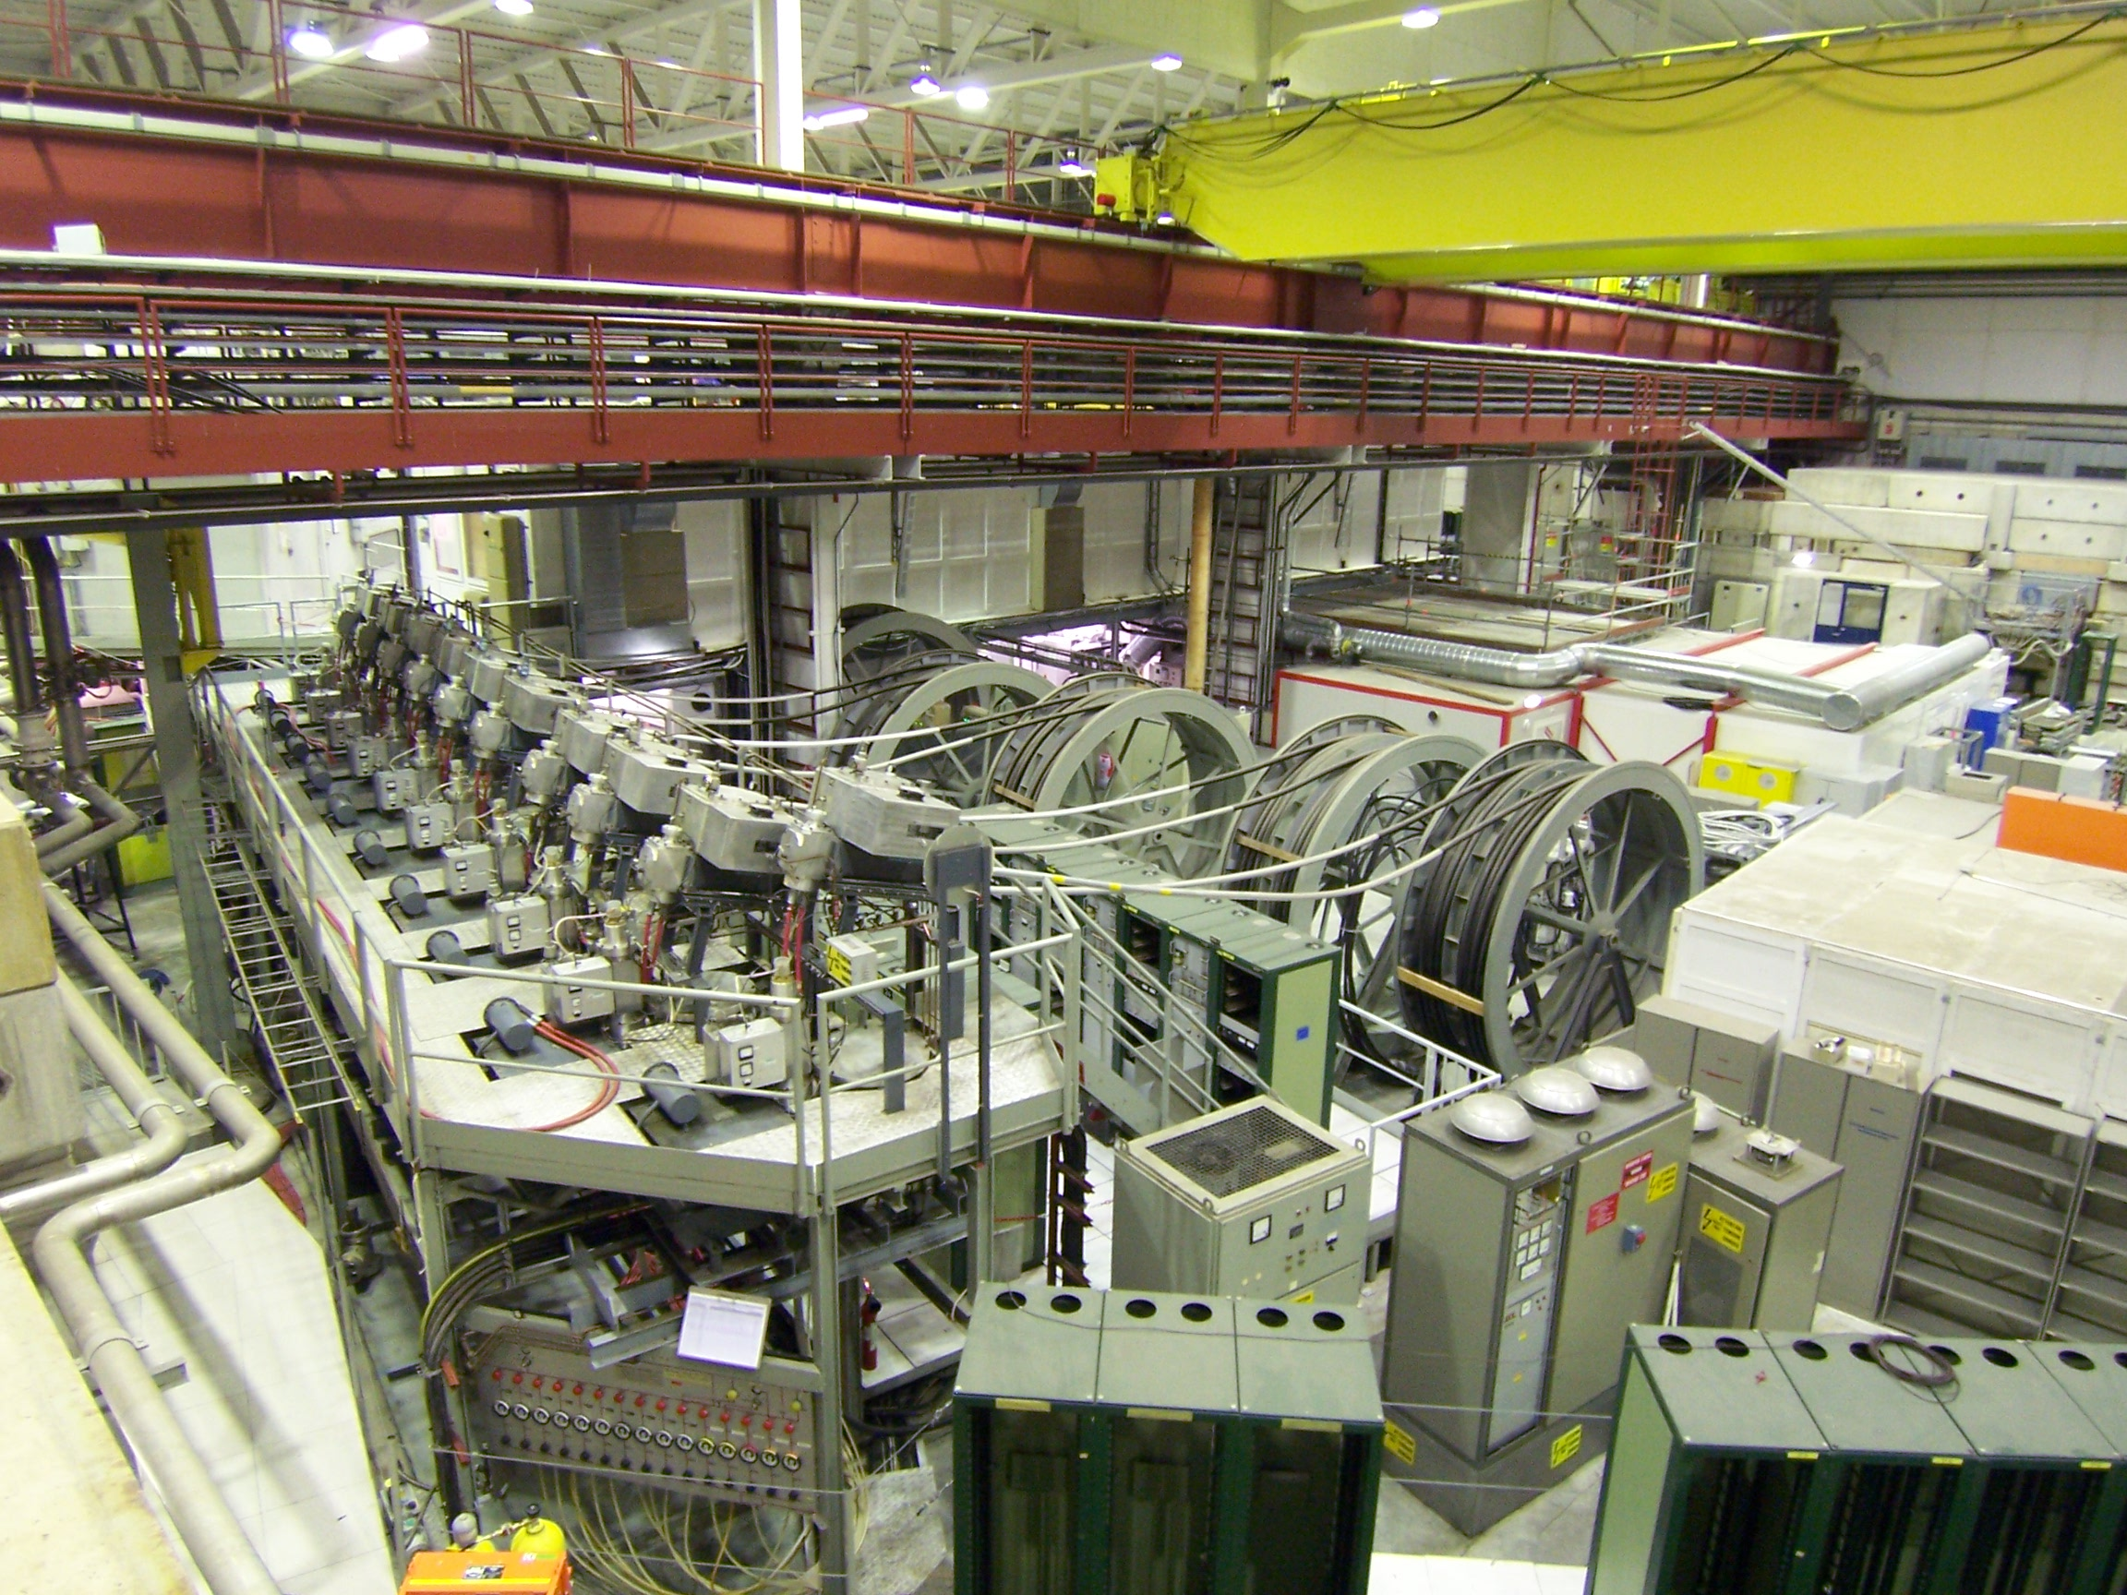
Accomodate for ELENA
ELENA ring will sit here:
Need to remove quite a bit of stuff

Slide 8
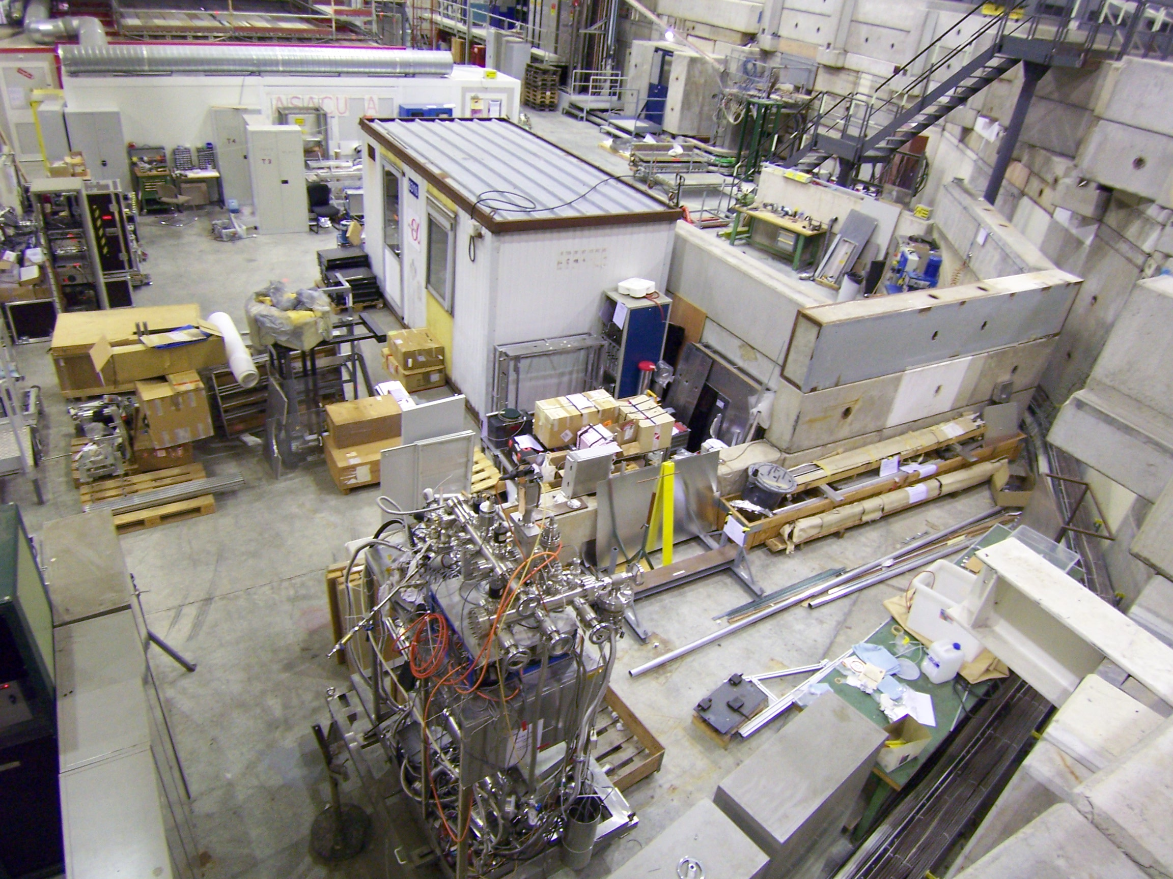
Accomodate for experimental areas
ELENA experiment (Gbar)
may sit here

Slide 9
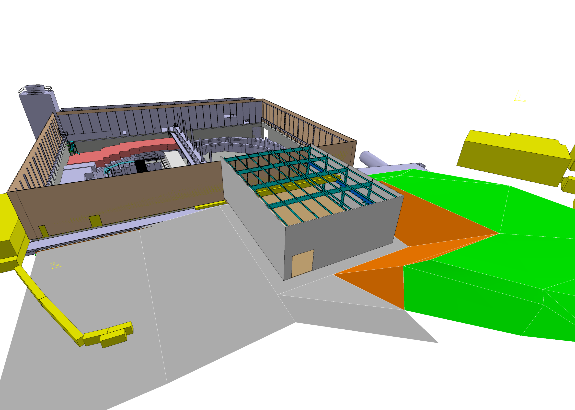
Solution : New building proposal
570 m2 AD hall extension
Sketch: A. Kosmicki

Slide 10
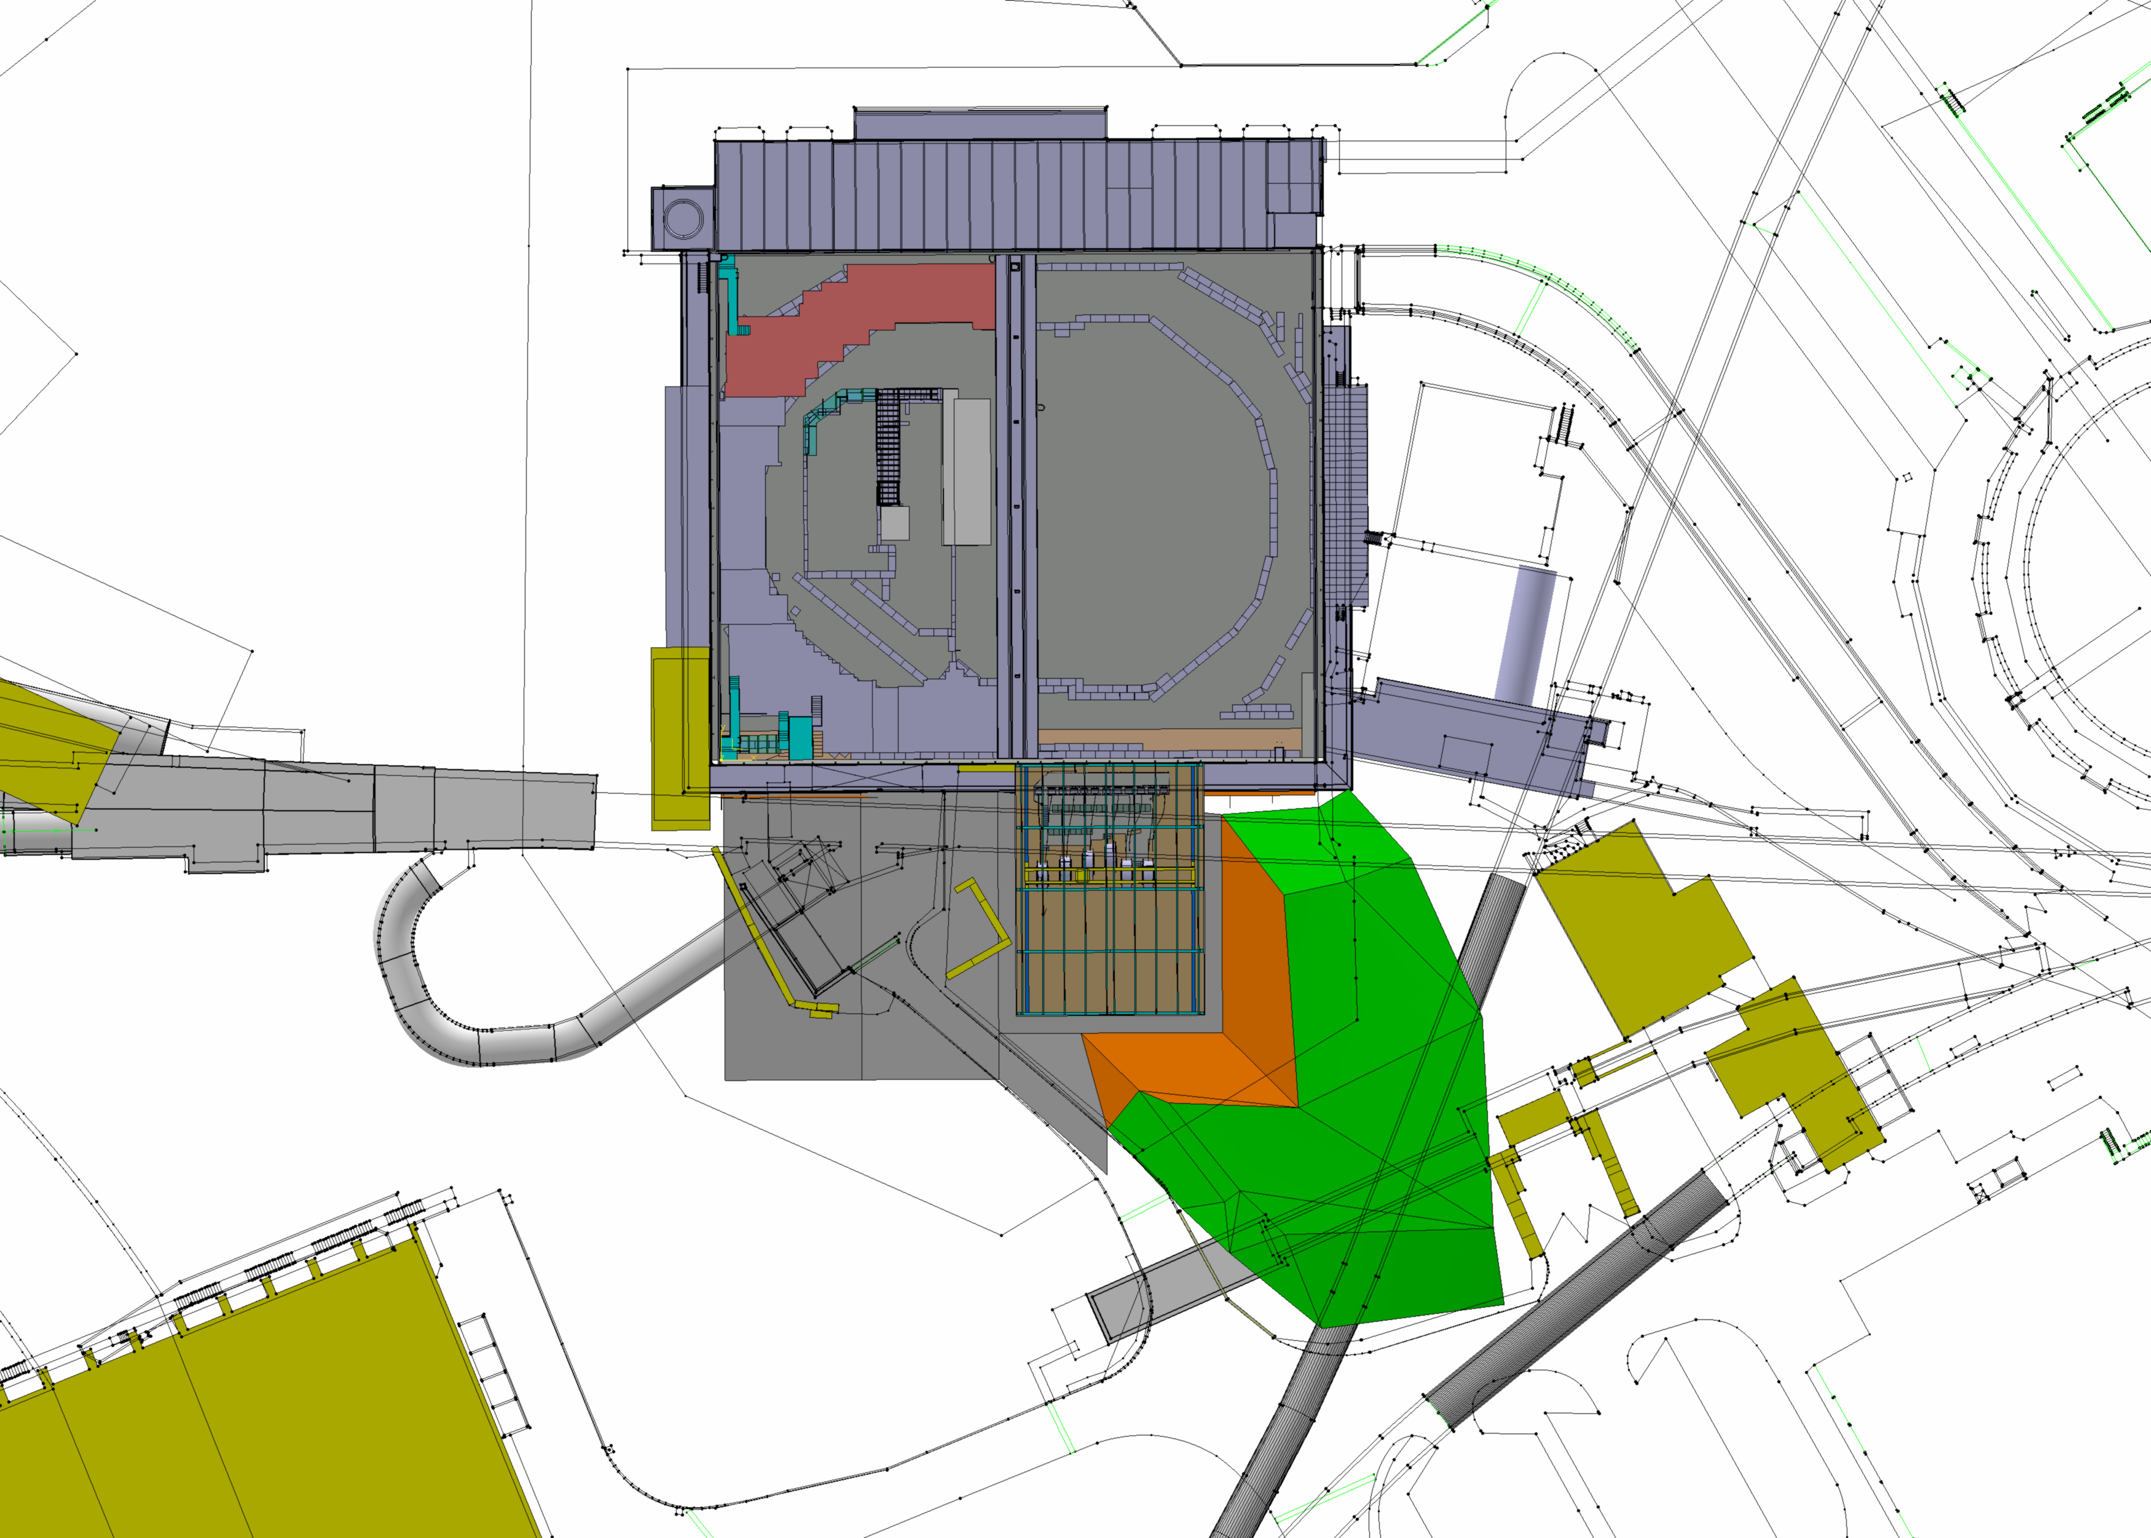
Booster
193
TT2
TTL2
Extension
TT7
181
Sketch: A. Kosmicki

Slide 11
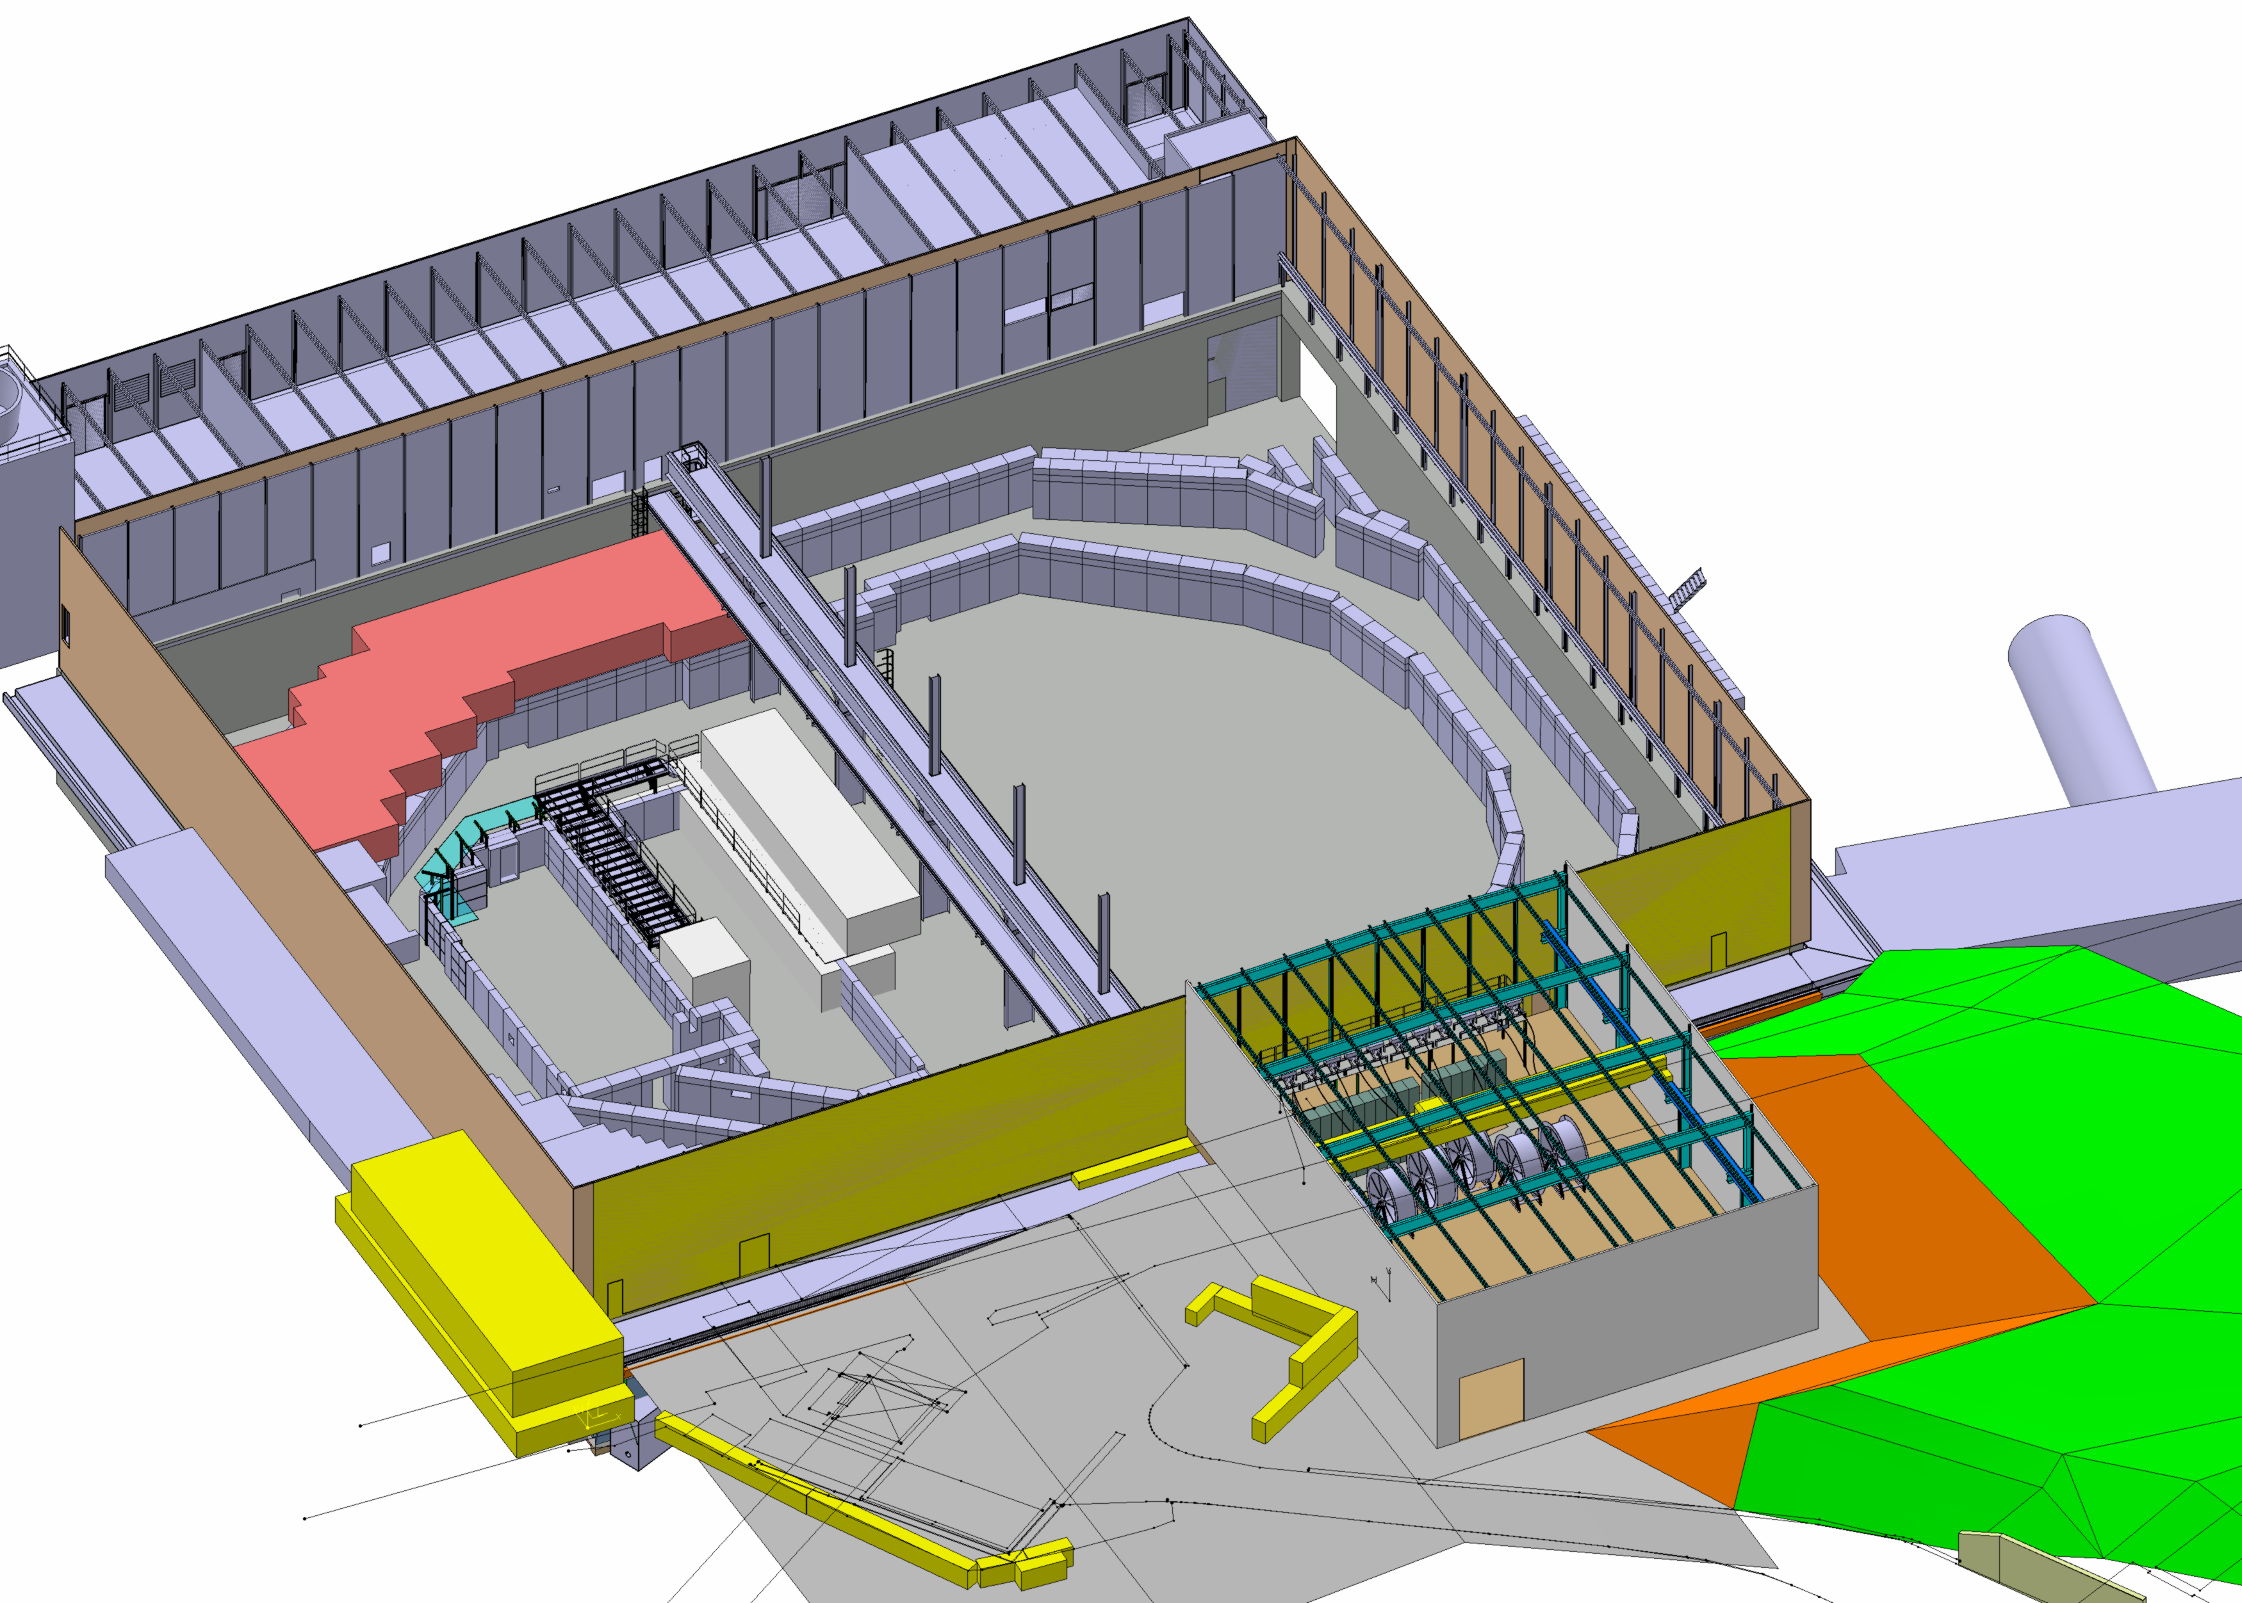
193
Butte à excaver
Blocs à évacuer
Extension
Accès
Sketch: A. Kosmicki

Slide 12
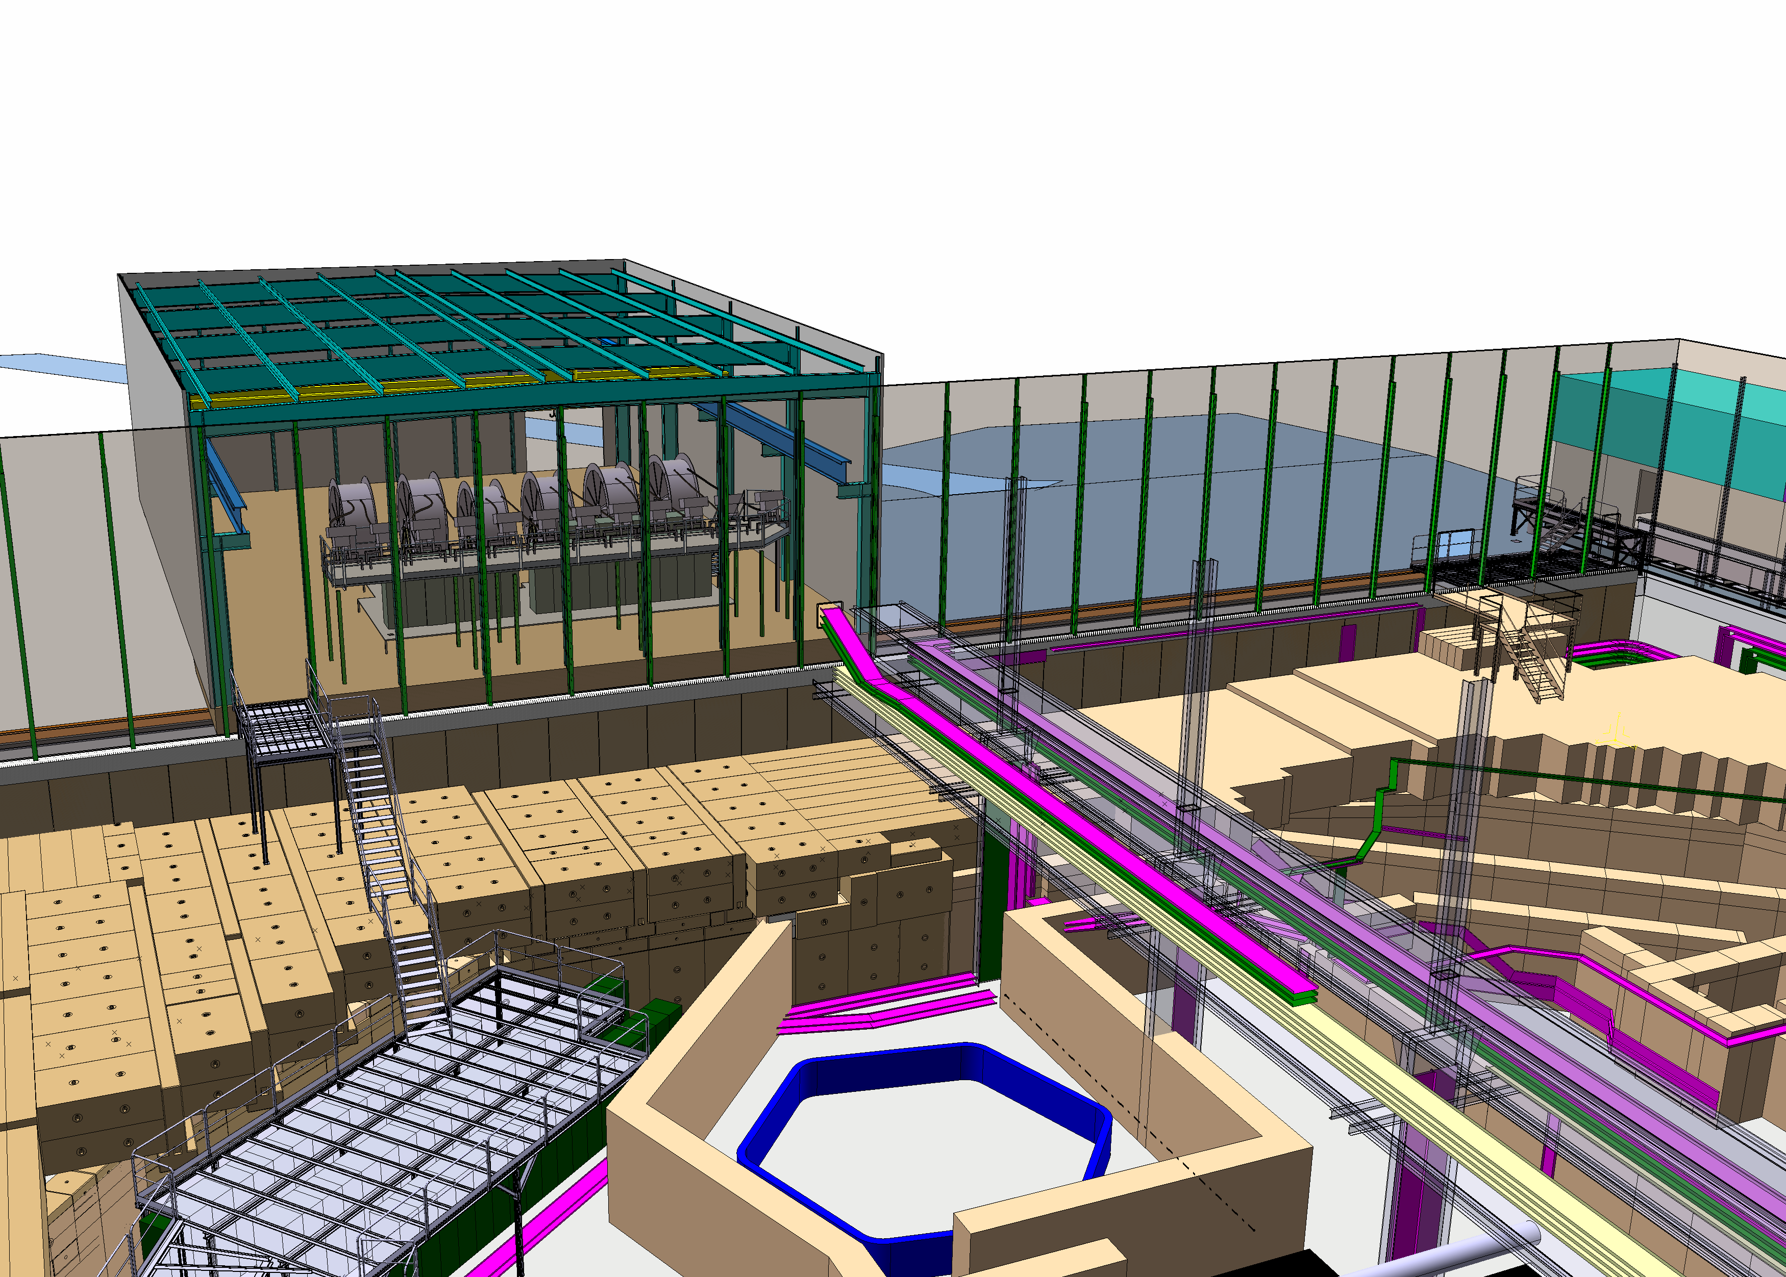
New building details
Complete CE project by A. Kosmicki and L. Lopez on EDMS# 1176220
Sketch: A. Kosmicki

Slide 13
New building details
Surface needed:
Storage: 180 m2
Kickers: 200 m2
Workshop: 50 m2
Horn test bench: 70 m2
CV installation: 10 m2
Circulation: 60 m2
Total: 570 m2

Slide 14
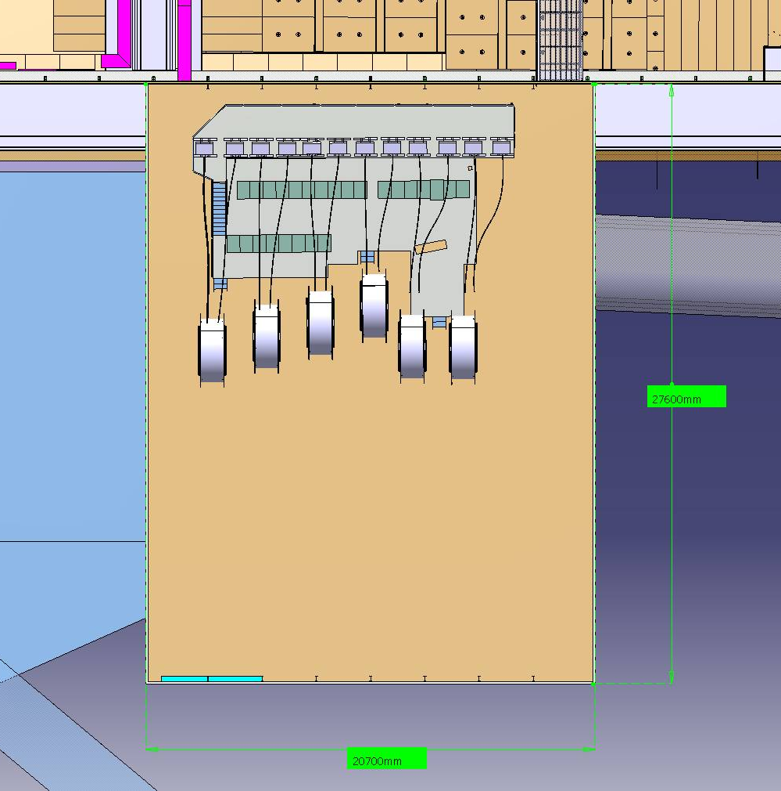
Kickers 12.7 x 14.7 m2
Storage (7x2 m2)
Storage (14x2 m2)
Storage (7x4 m2)
Storage
(5 x 9 m2)
Workshop
(5 x 10 m2)
Offloading area
(8x2.3 m2)
Storage (7x4 m2)
Magnetic horns test bench
(10 x 7 m2)
Test bench
7 x 10 m2

Slide 15
What AD hall will look like after ELENA’s installation

Slide 16
Rough proposal of Gbar area
To be adapted with extraction line
and with Gbar needs

Slide 17
Work conditions in AD environment
To access and work in AD hall:
Valid CERN access card
Safety training level 1 and 2.
Radiation + electrical training mandatory
Dosimeter (medical certificate)
Specific AD area access right (when operational)
No particular EPI, except during heavy handling operations
Visits are possible and regulated

Slide 18
General rules for AD experiments
40 cm shielding around exp area. Access controled. No access inside shielded zone during run
Linac case to be treated with great care
CRs are located in bdg 93, racks are in 193
Radiations (eg. generated by Linac): shielding to be put in place to reach <3μSv/h at working/circulation places
Visit circuit nearby: < 0.5 μSv/h

Slide 19
Specific constraints with GBar
Electronics cooling: max 10 kW released in air, how much with water ?
Use of gases (N₂, Ar, Ne, SF₆, O₃), no cryogens: Distribution ? Extraction ? Need of ODH detection ?
Test stands ? Assembly area ? Clean room ?
Number of racks that can be accomodated is limited (about 25)
Position of laser hut is tricky (location/stability)…

Slide 20
Conclusions 2
ELENA project is on its way
Space reserved for at least 1 new experiment and corresponding control room, pending approval of AD hall extension building
Waiting for official approval to launch serious integration work for Gbar in AD/ELENA environment

