Slide 1
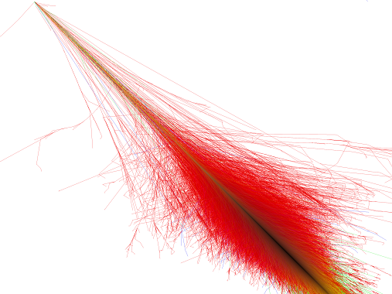


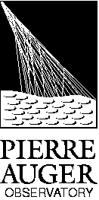

Light Studies and exotics events at
Pierre Auger Observatory
Jornadas do LIP 2012
Auger LIP Group
João Pedro Espadanal
22-04-2012

Slide 2
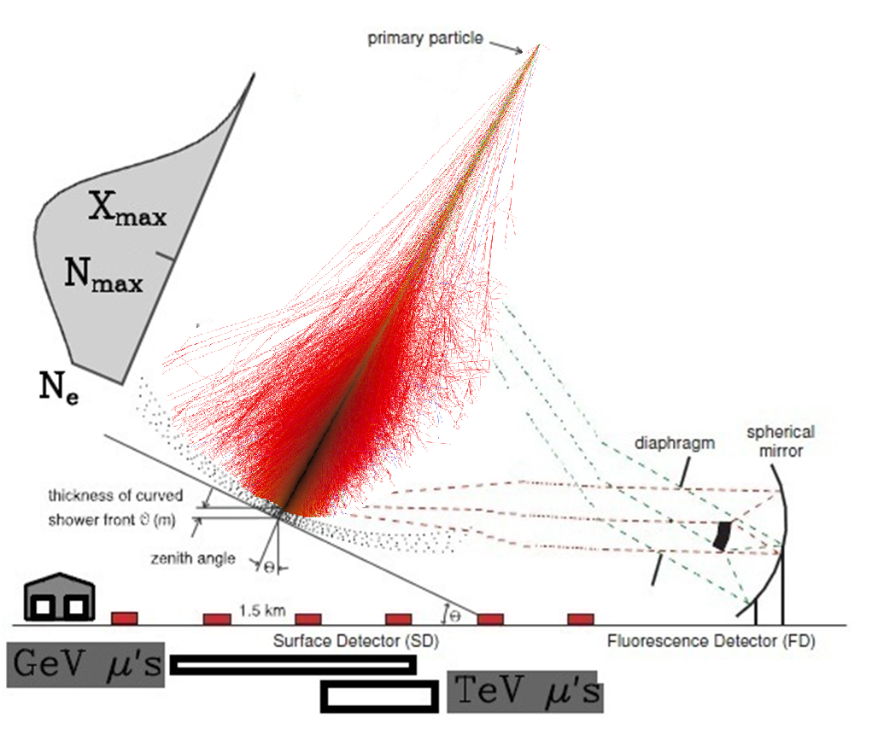
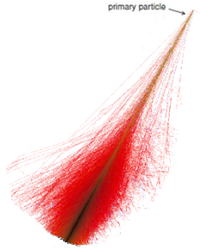
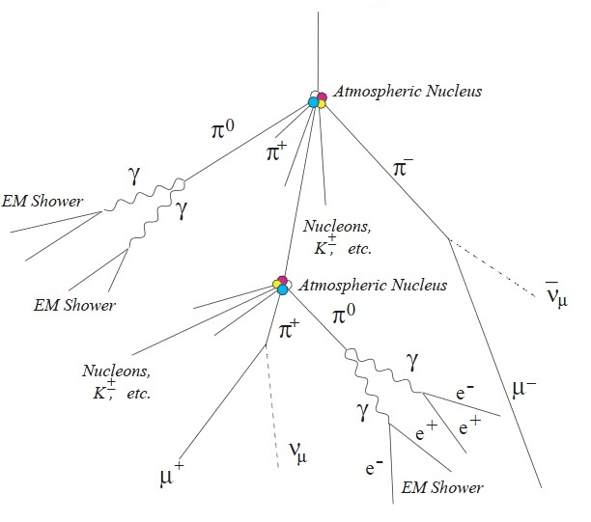
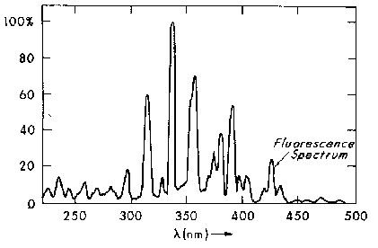
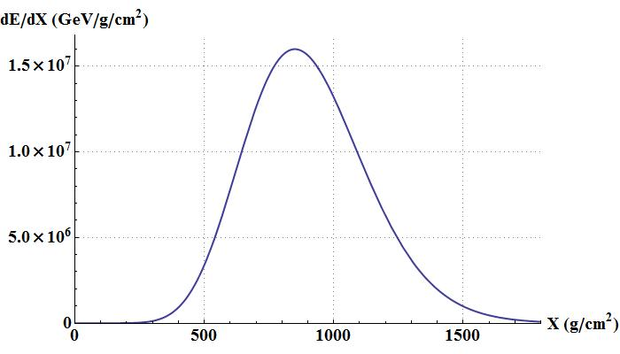


How to detect the light emission of a shower?
1. Light In Auger
What is an Extensive Air Shower (EAS)?
Through the emitted light
Cosmic Ray
(p, Fe, ɣ ... )
1. Cherenkov Light
2.Fluorescence Light in Nitrogen
Hadronic component
The hadronic interactions produce
p n π⁰ + π⁺ + π ⁻
+ К Λ η Ω Σ …
Cherenkov
Light
Fluorescence Light
Electromagnetic Component
Produced mainly by
π⁰ → ɣ ɣ
Muonic Component
Deposited Energy
Produced mainly by
But we also have light scattering in the atmosphere that distort the shower image
Rayleight Scattering
Mie Scattering
Cosmic Ray Primary Energy
Quasi calorimetric energy measurement

Slide 3
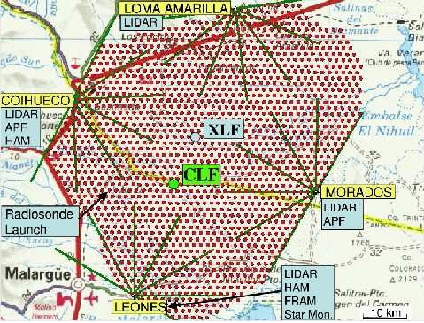
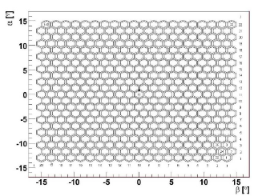
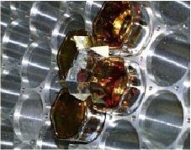
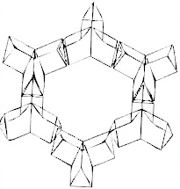
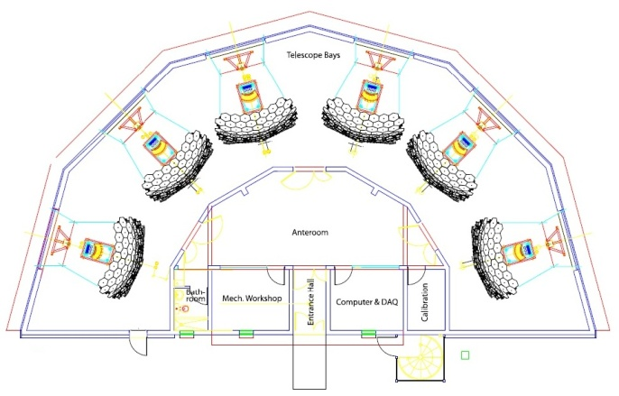
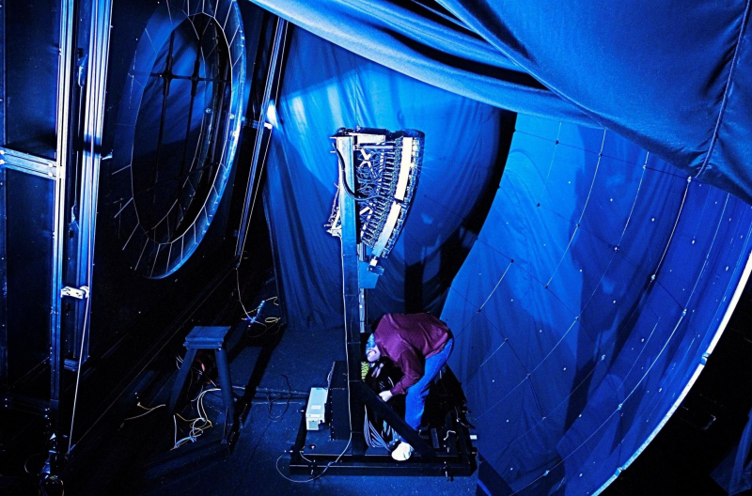
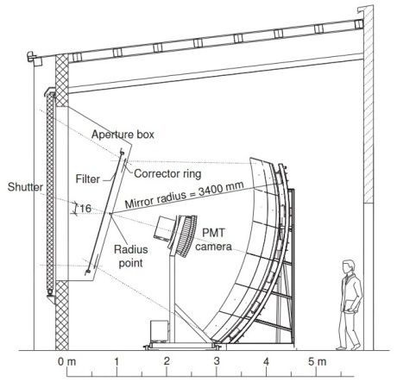
Fluorescence Detectors
1. Light In Auger
PMT Pixels
Fluorescence Detector (FD)
4 stations with 6 telescopes
Each telescope with each with 30º x 28.6º field of view
Camara with 440 PMT pixels (20 x 22)
Several calibrating systems
  Laser system, LIDAR stations, Aerosol monitors, clouds and stars monitoring
~10% duty cycle
FD Camera representation
FD building design
FD Telescope design

Slide 4
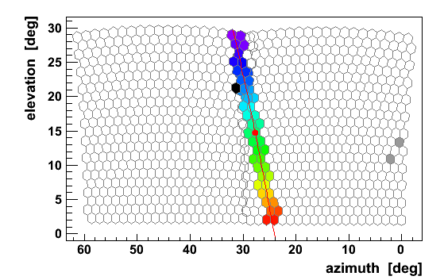
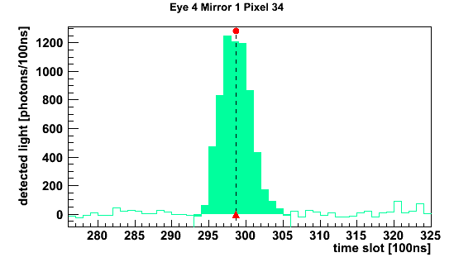
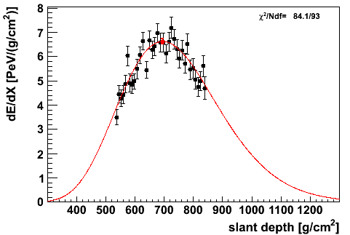
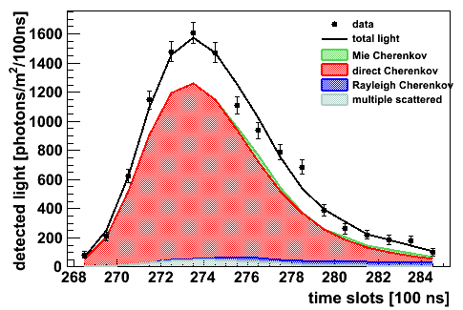
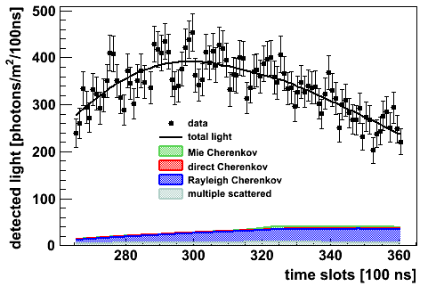
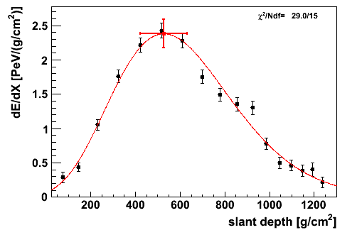
Light Detected
1. Light In Auger
One typical event:
Time signal in one pixel
Fluorescence rich event
Cherenkov rich event

Slide 5


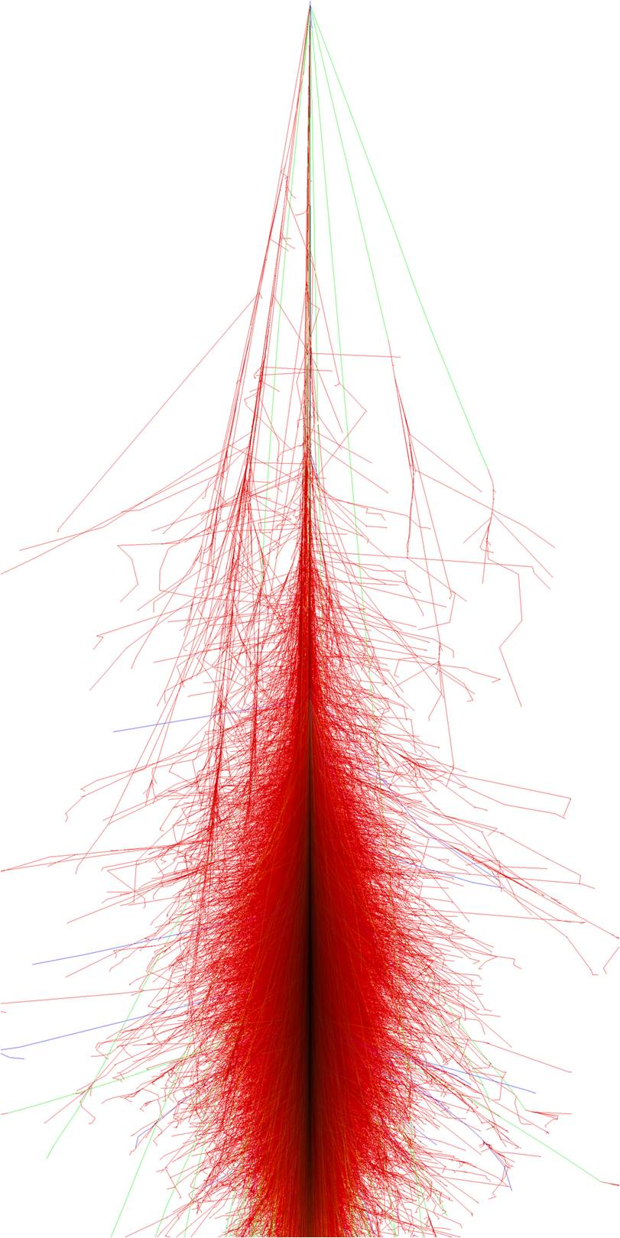
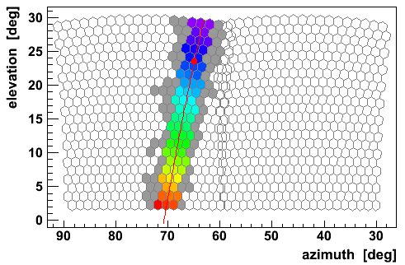
Shower in 3 Dimensions
1. Light In Auger
Shower in 3D space
Shower Image width
Shower intrinsic width
Atmosphere
Detector
Shower intrinsic width
Detector effects
Atmospheric effects
SDId 3599086
Energy = 1.58x10¹⁹
Distance _{to eye}= 3.87 km

Slide 6

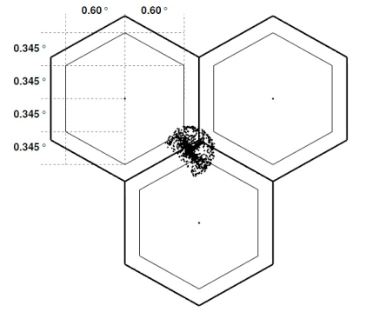
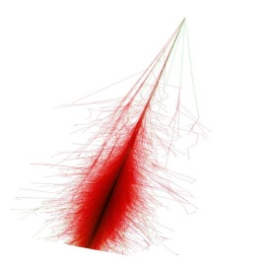
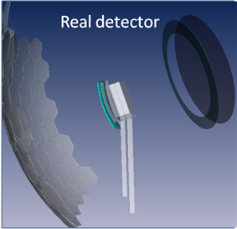
Shower in 3 Dimensions
1. Light In Auger
Shower in 3D space
Shower Image width
Shower intrinsic width
Atmosphere
Detector
Shower intrinsic width
Detector effects
Atmospheric effects
Rayleigh Scattering of Fluorescence Light
Mie and Rayleigh Cherenkov Scattering, Multi-Scattering
Spread of the light
Less light at the telescopes
Light aberration
Internal reflections
Reflections and detections efficiencies
Multi Scattering
Geant4 simulation
Multi Scattering

Slide 7
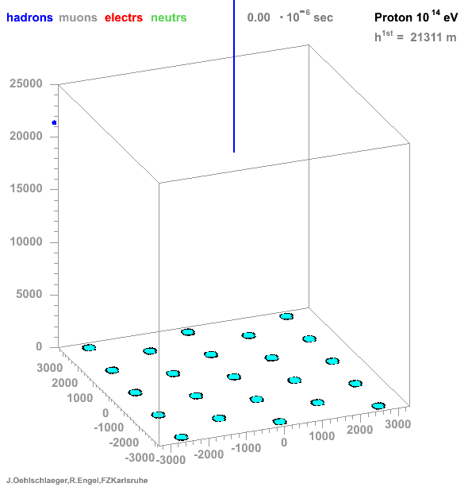
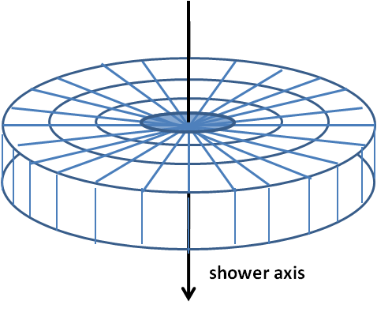
3D Shower Simulation
2. 3D Simulation
We generate the air showers
The energy deposited is projected into a line
Shower in 3D space
Shower intrinsic width
Detector effects
Atmospheric effects
Is Better
to have
We are working in a shower simulation
Within the intrinsic shower
To study interesting lateral information we need to have a 3D simulation, instead of having the information projected into a line
( at the generator level)

Slide 8

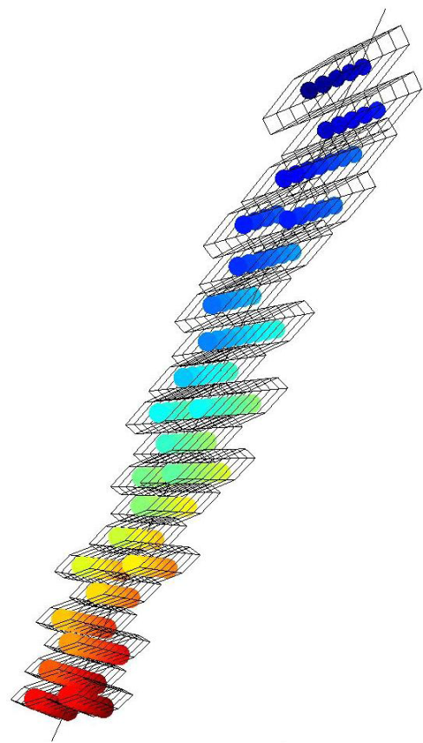
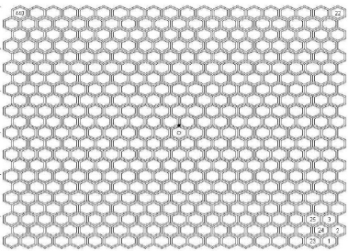
3D Simulation: Offline Framework Intervention
2. 3D Simulation
Offline Framework Intervention
  Produce photons: Fluorescence Cherenkov
  Propagate to detector using
  geometrical information :
  Attenuate and scatter photons
More two dimensions for analysis
Propagation
time
And new dimension due to the timing in the pixels
Lateral width
Fluorescence emission already validated
Cherenkov emission being implemented and validated
Emission
time
Cherenkov
Time

Slide 9
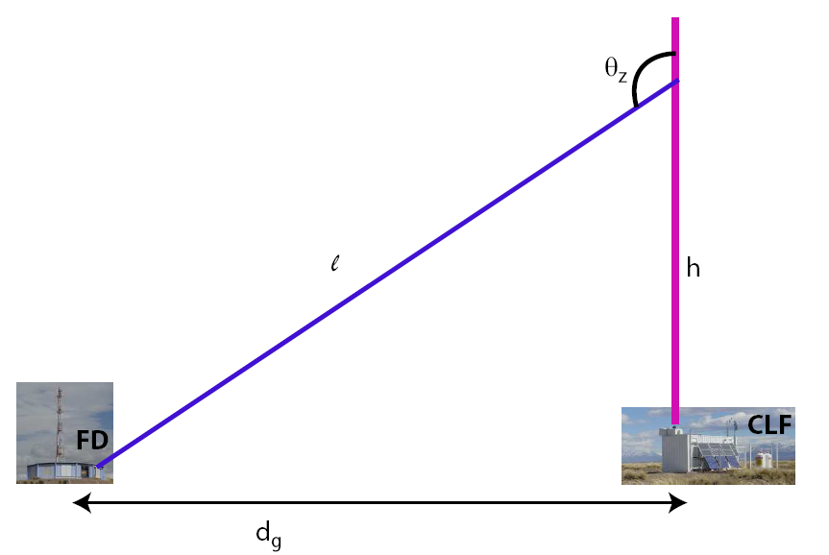
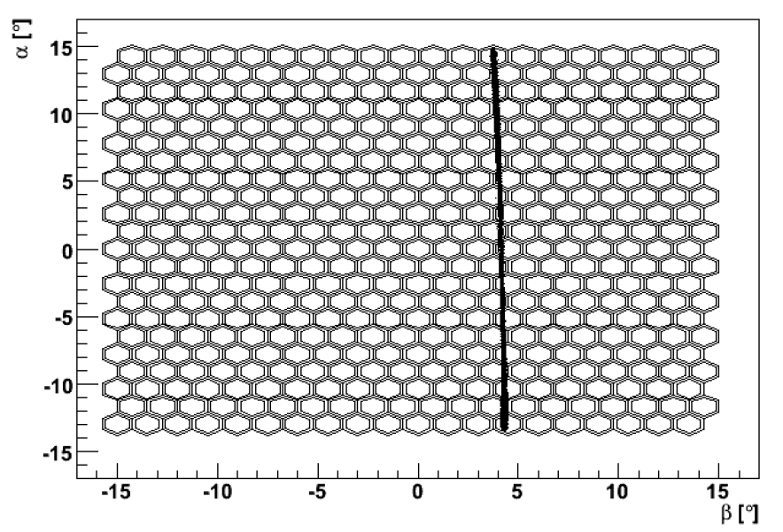

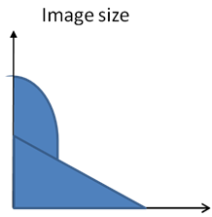
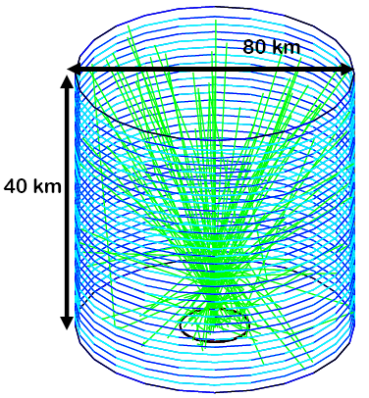
CLF and Roving Laser
3. Roving Laser And CLF
The best way of study the detector and atmosphere effects is using laser
  Laser
  We know the laser shape and energy
  (so we can analyze the distortions)
Roving Laser
Shower in 3D space
Shower intrinsic width
Multi Scattering
Detector effects
Atmospheric effects
How to study the distortion of the detector + atmosphere?
  Pulse Laser Facility
  Image on the camera
Geant4 simulation for Telescopes and laser in order to understand the effects
Direct Light
Multi Scattering
  Distance in the camera to the laser pulse center

Slide 10
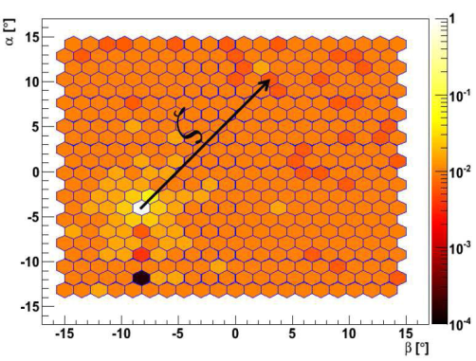
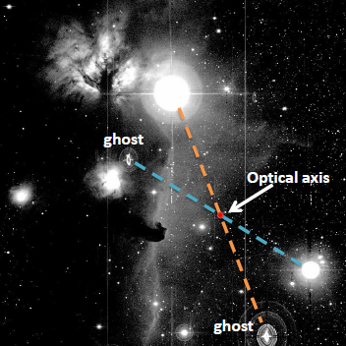
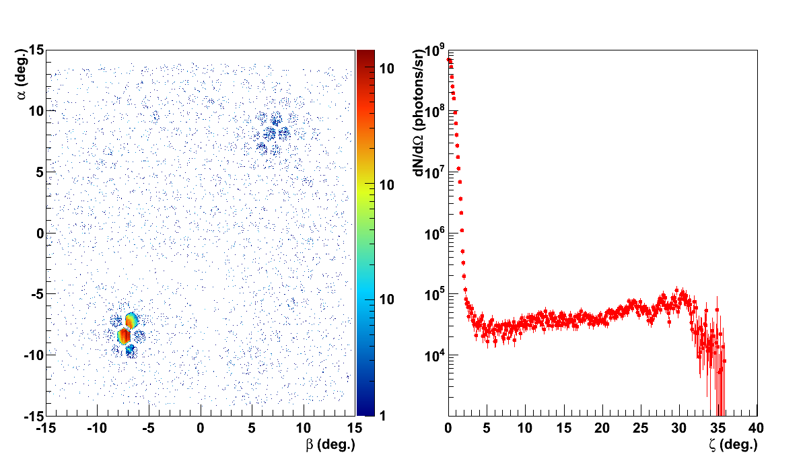
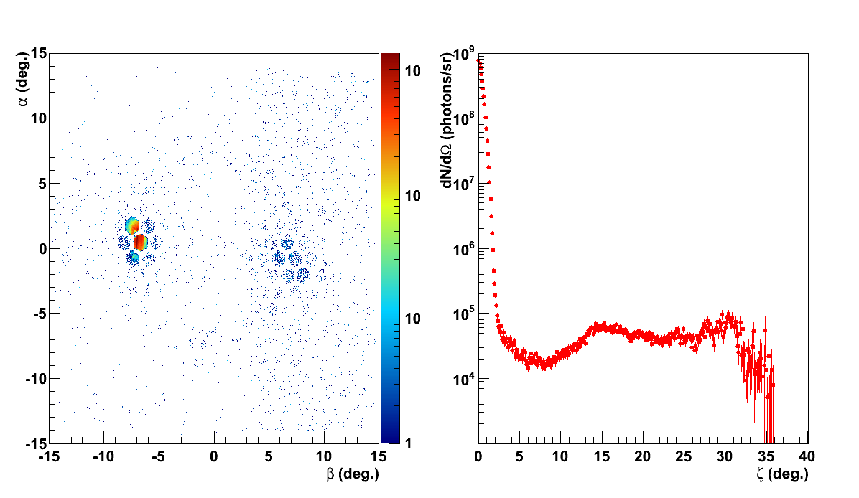
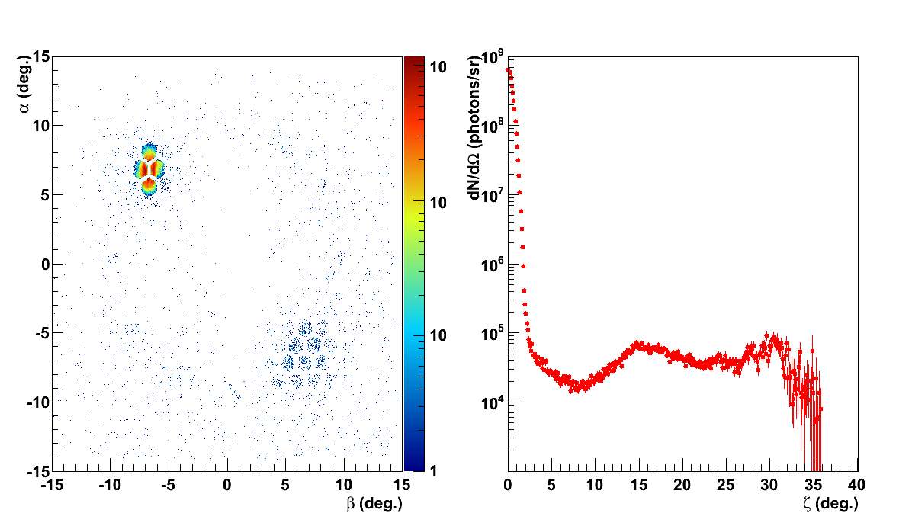
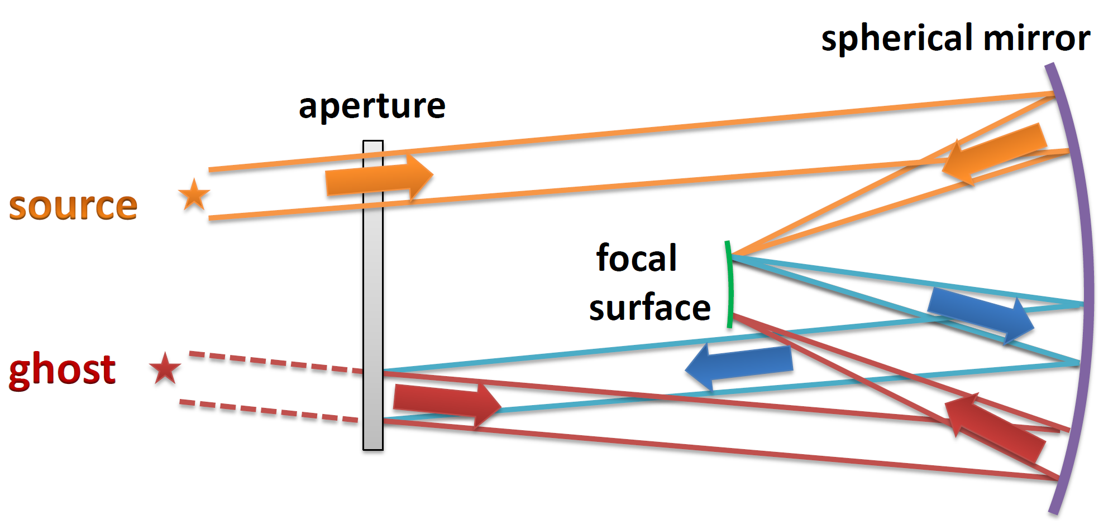
CLF and Roving Laser
3. Roving Laser And CLF
The Horsehead Nebula
Internal reflections of in the detector
With roving laser
From Burrell Schmidt telescope at Kitt Peak

Slide 11

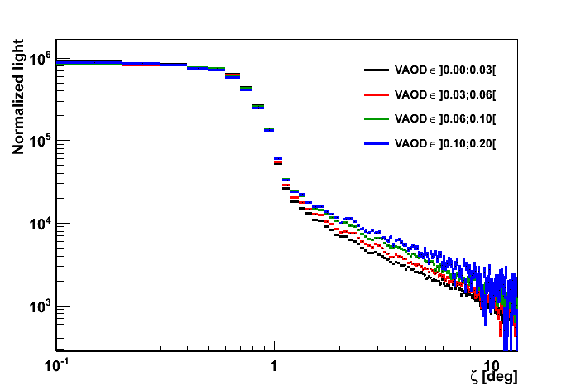
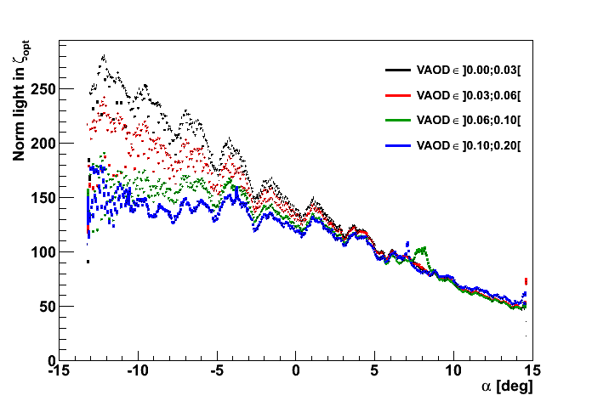
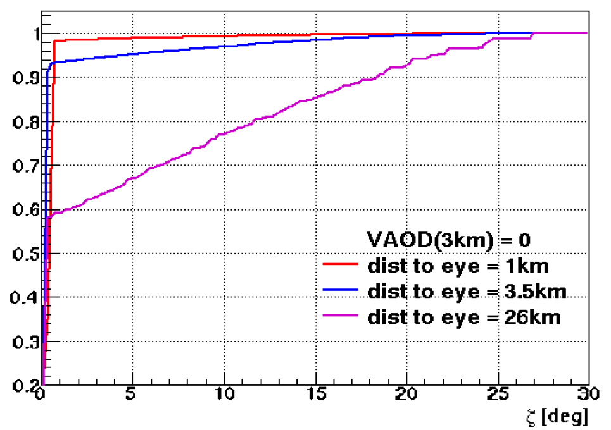
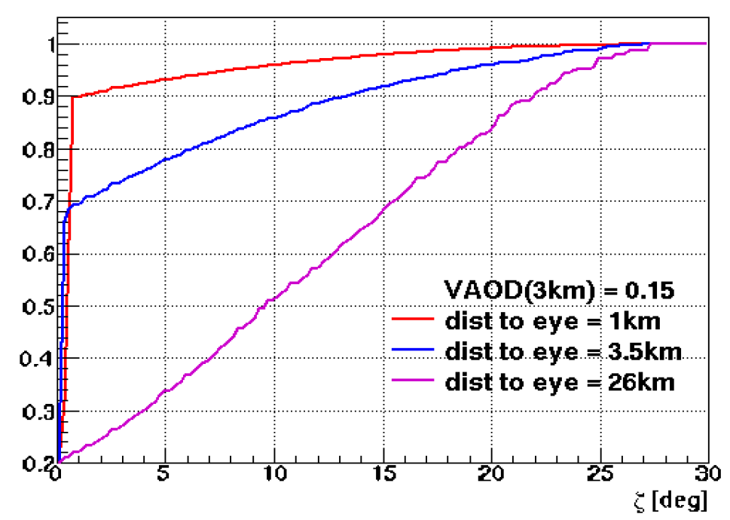
CLF and Roving Laser
3. Roving Laser And CLF
CLF Data -> Far away from telescopes (atmosphere effects)
  VAOD
  Proportional to the amount of aerosols
  Equivalent to height
  Top atm
  Which cause more multi scattering by Mie

Slide 12
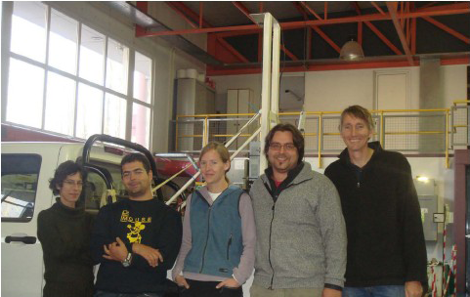
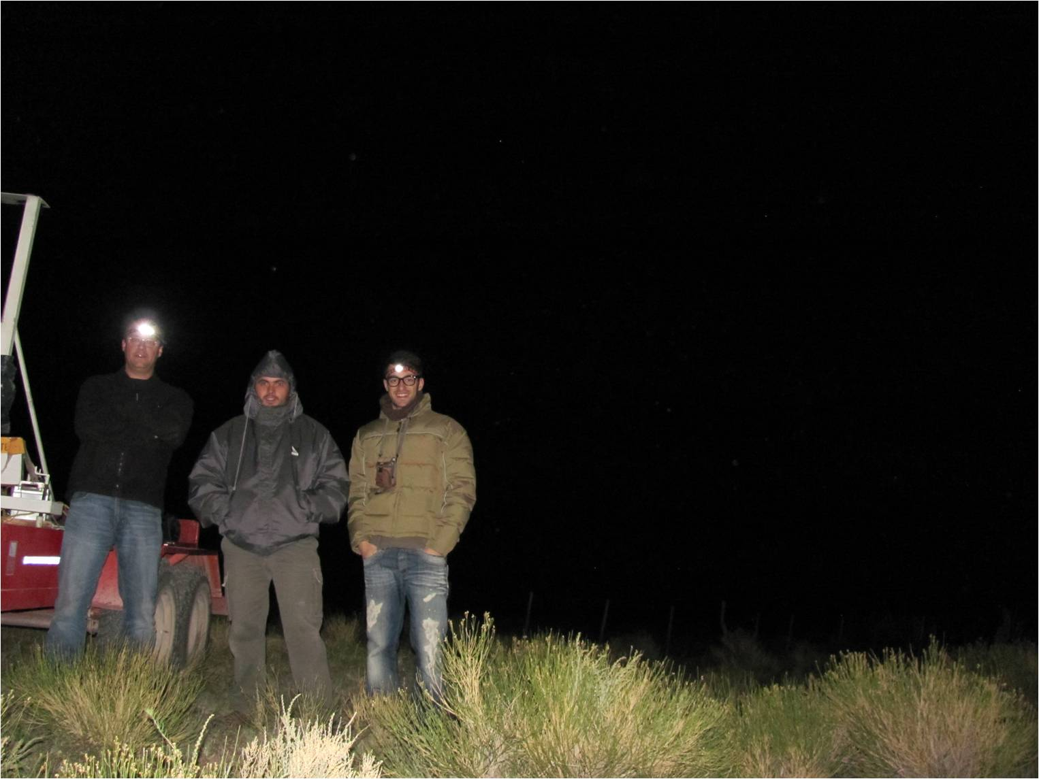
Roving Laser Campaign - Photos
3. Roving Laser And CLF
Campaign July 2010
Campaign April 2011

Slide 13
Outlook
Detailed understanding of the detector behavior and atmospheric effects
Shower physics studies with new spatial dimensions
After understanding the atmosphere and detector, we can disentangle strange and exotics events

Slide 14
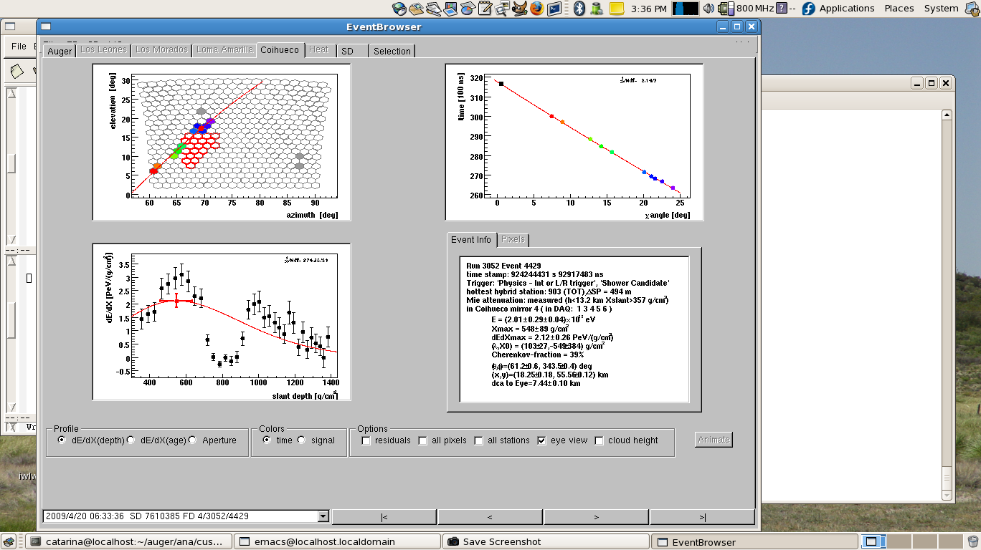
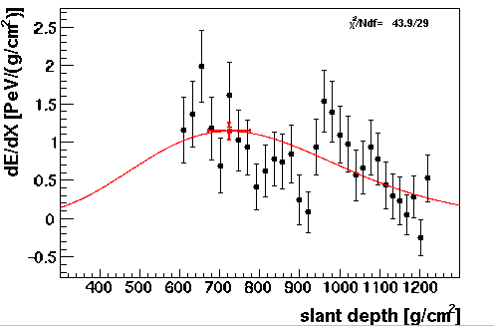
Exotics Events
4. Exotics Events
Example:
Double Bangs
Cloudy day
Bad pixels
14

Slide 15
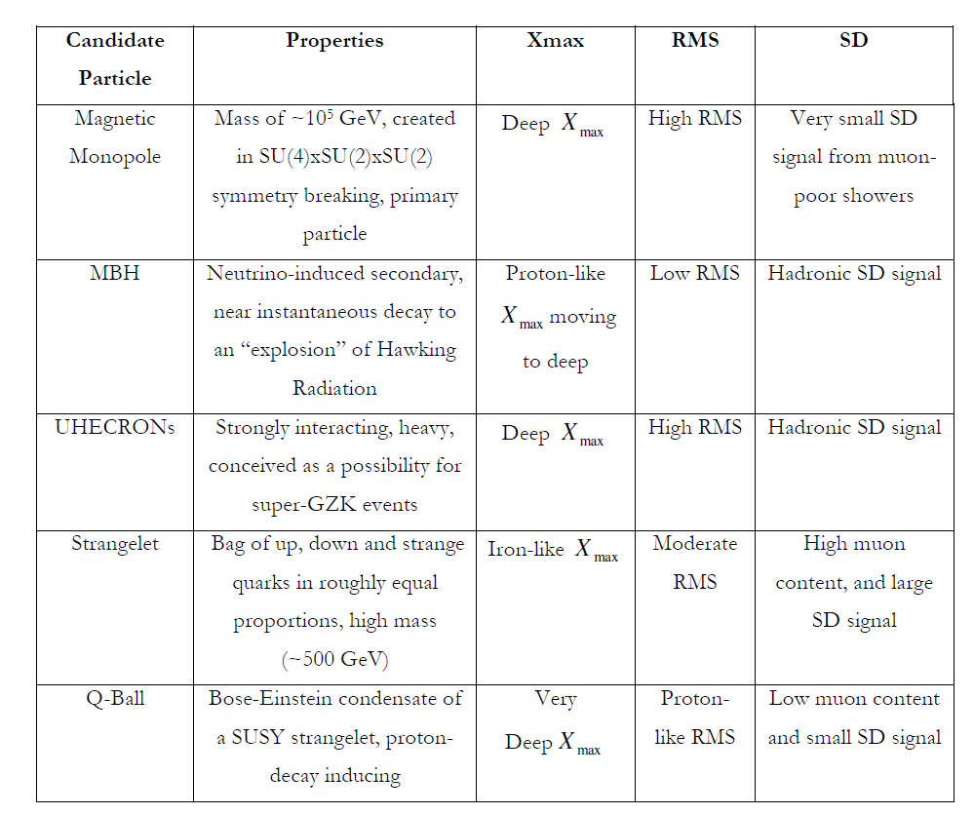
Exotics Events
4. Exotics Events
Low flux
Limited detector capabilities
But a unique energy window!
New physics
at primary or in shower development
Neutrino channel: low background
Looking for distinctive signatures

Slide 16
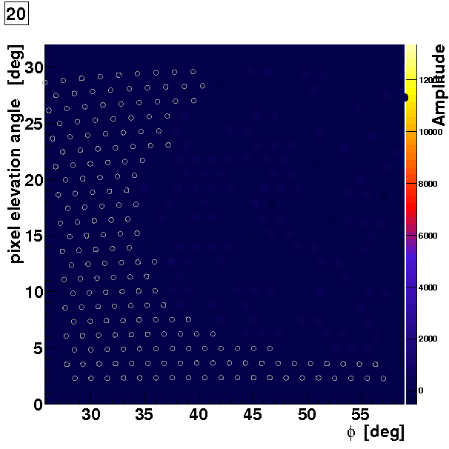
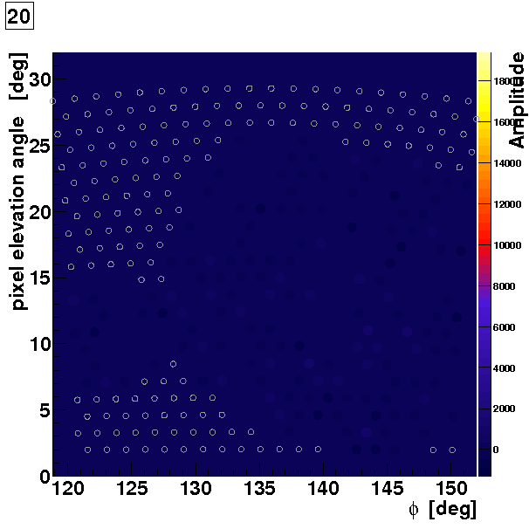





Auger@ Lisbon Group
But we found Elves!!!
Thank You

Slide 17
Back up slides

Slide 18
New approach: 3D Simulation
4. 3D Simulation
In Corsika:
The energy deposited and other relevant variables are saved for each sky bin
Physical Geometry
Shower has azimuthal symmetry
Bins with smaller volume in denser shower region (small r)
Cylindrical geometry (r, φ, z):
r : 50 x 20m
φ : 24 x 15 deg 24 x 50 x 300 = 6 x 10 ⁵ bins
z : 500 x 100 m
(max size: 1000m x 360 deg x 50000 m)

Slide 19

New approach: 3D Simulation
4. 3D Simulation
primary
Cylindrical geometry (r, φ, z):
r : 50 x 20m
φ : 24 x 15 deg 24 x 50 x 300 = 6 x 10 ⁵ bins
z : 500 x 100 m
(max size: 1000m x 360 deg x 50000 m)
eye

Slide 20



Sky Bins Information
4. 3D Simulation
For fluorescence:
Energy Deposited in each SkyBin
Isotropic Emission

Slide 21







Sky Bins Information
4. 3D Simulation
For Cherenkov:
Electron Length distribution
Electrons angle distribution

Slide 22

Sky Bins Information
4. 3D Simulation
For Cherenkov:
Electron Length distribution
Electrons angle distribution

Slide 23
3D Simulation: Offline Framework Intervention
4. 3D Simulation Method
Offline Framework Intervention
Offline Framework simulates and reconstructs the events after Monte Carlo generation:
  Simulate the event
  Simulate the detector
  Add backgrounds and simulate efficiencies
  Reconstruct the event
Change and create a few modules, in order to be able to simulate in the framework
  Produce photons: Fluorescence emission
  Cherenkov emission
  Propagate to detector using
  geometrical information :
    solid angle
    emission angle
    distance to telescope
  Attenuate and scatter photons
    Cherenkov scattered
    Multiple-scattering
Propagation
time
Emission
time
Cherenkov

Slide 24



Validation of 3D Simulation
4. 3D Simulation
Geometry reconstruction

Slide 25





Validation of 3D Simulation
4. 3D Simulation
Xmax reconstruction
(dE/dX)max
Xmax
g/cm² of crossed atmosphere
Energy reconstruction

Slide 26




Reconstruction

Slide 27



Slide 28
Atmosphere

Slide 29


Slide 30
Challenging Effects
1. Light In Auger
Challenging Effects
Shower width
Rayleigh Scattering of Fluorescence Light
Mie and Rayleigh Cherenkov Scattering
Multi-Scattering
Smearing of the light
Less light at the telescopes
Detector effects
Atmospheric effects
Light aberration
Internal reflections
Reflections and detections efficiencies
Multi Scattering
Geant4 simulation
Multi Scattering

Slide 31

CLF and Roving Laser
3. Roving Laser And CLF
  VAOD
  Proportional to the amount of aerosols
  Which cause more multi scattering by Mie

Slide 32

Ruben Conceição

Slide 33
AUGER

Slide 34





Cosmic Rays spectrum and propagation
3. Recent results and challenges
Energy Spectrum
Strong evidences for the GZK effect
Cosmic Ray Propagation
Assuming magnetic field 1µG
Proton with ~10¹⁹eV corresponds to a Larmor radius of ~10kpc
*The Pierre Auger Collaboration, Phys. Lett. B685:239-246,2010
* Cronin, J. W. 2005, Nuclear Physics B (Proc. Suppl.), 138, 2005

Slide 35




Cosmic Rays directions
3. Recent results and challenges
Anisotropy
High Energy Centaurus A
(NGC 5128) excess
Analysing the 57 more energetic events (>10¹⁹ eV), we have anisotropy, but more statistic is needed for better conclusions
*The Pierre Auger Collaboration, arXiv:1009.1855v2 [astro-ph.HE]

Slide 36


Xmax results
3. Recent results and challenges
Xmax remind
(dE/dX)max
Cosmic Ray
Interaction
Leading particle
X₀
Cosmic Ray
Interaction
Leading particle
Xmax
g/cm² of crossed atmosphere
X₀
RMS Xmax

Slide 37





3. Xmax results
3. Recent results and challenges
Xmax evolution with energy
Xmax goes from iron to proton, and then seems to returns to heavier nuclei again (at ultra high energies)
Are cosmic rays really becoming heavier?
Astrophysical Challenges
Or problems with model predictions
Are there new interactions?
?
Recent results
data until March 2010
*The Pierre Auger Collaboration, Phys. Rev. Lett. 104, 2010.

Slide 38




Muon Number
3. Recent results and challenges
Larger Muon number
More muons than possible
Standard physics can not reproduce it
May be new kinds of interactions
  Non-perturbative QCD
  is not understood
  Problems in the hadronization
Energy reconstruction?

Slide 39





Hadronic Models
3. Recent results and challenges
Cross section
Multiplicity
Non-perturbative QCD regime
so we can not make analytic calculations
Models are inconsistent between each other and with the data
Cosmic rays composition still an open question
Challenges for new Data
Challenge for news models
GeV
Inelasticity
The models can not describe the Air showers consistently

