Slide 1
J/ψ and ϒ polarizations
Pietro Faccioli, LIP 22/4/2012
New methods and concepts developed at LIP to study polarizations of quarkonia and vector states
Ongoing J/ψ and ϒ polarization analyses in CMS

Slide 2
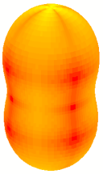
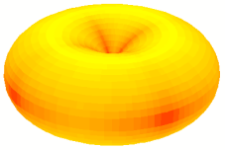
Towards better polarization measurements
P. Faccioli, C. Lourenço, J. Seixas, H. Wöhri,
Phys. Rev. Lett. 102, 151802 (2009),
Eur. Phys. J. C 69, 657 (2010)
λ_{θ} = +1
λ_{θ} = –1
J_{z} = ± 1
J_{z} = 0
“transverse”
“longitudinal”
Proposed solutions to
eliminate physical ambiguities of current measurements
remove artificial kinematic dependencies
improve the comparison between experiments and with theory
avoid analysis mistakes (one-dimensional efficiency corrections and template methods)
Example: effect of choosing a non-optimal frame: Drell-Yan-like polarization
“lucky” choice
“unlucky” choice
λ_{θ} = +0.65
ALICE μ⁺μ⁻ / LHCb
ATLAS / CMS D0 ALICE e⁺e⁻ CDF
λ_{θ} = −0.10

Slide 3
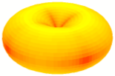

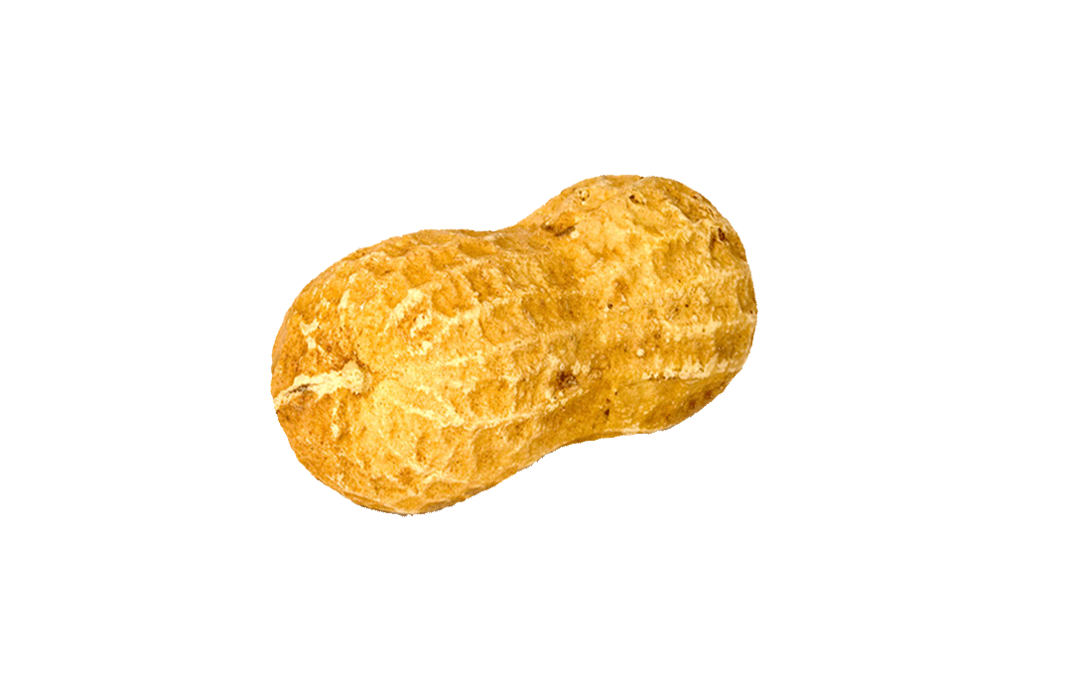
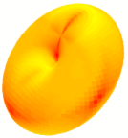
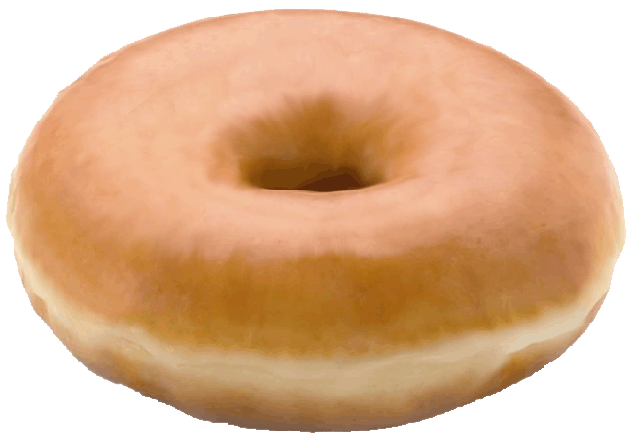
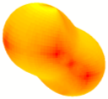
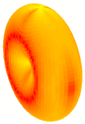
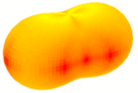
New, frame-independent definition of polarization
P. F., C.L., J.S., H.W., Phys. Rev. D 81, 111502(R) (2010)
The shape of the distribution is obviously frame-invariant (= invariant by rotation)
→ it can be characterized by two different frame-independent parameters:
z
λ_{θ} = –1
λ_{φ} = 0
λ_{θ} = +1
λ_{φ} = 0
λ_{θ} = –1/3
λ_{φ} = –1/3
λ_{θ} = +1/5
λ_{φ} = +1/5
λ_{θ} = +1
λ_{φ} = –1
λ_{θ} = –1/3
λ_{φ} = +1/3
- enable systematic checks
- facilitate experiment-theory comparisons

Slide 4
Physical meaning: Drell-Yan, Z and W polarizations
always fully transverse polarization
but with respect to a subprocess-dependent quantization axis
V = γ*, Z, W
_
Due to helicity conservation at the q-q-V (q-q*-V) vertex,
J_{z} = ± 1 along the q-q (q-q*) scattering direction z
z
_
q
z = relative dir. of incoming q and qbar
(Collins-Soper)
V
_
~
q
λ = +1
q
V
q
V
z = dir. of one incoming quark
(Gottfried-Jackson)
~
q*
q*
λ = +1
_
~
any frame
q
g
λ = +1
QCD
corrections
q
V
z = dir. of outgoing q
(cms-helicity)
q*
g
q
~
λ = +1
Note:
Lam-Tung relation (LO pQCD)

Slide 5
A generalization of the Lam-Tung relation
P. F., C.L., J.S., Phys. Rev. Lett. 105, 061601 (2010)
The Lam-Tung relation is not a miraculous pQCD result!
It simply a quantum-mechanical constraint stemming from
1) rotational invariance
2) specific properties of fundamental couplings (vector boson – quark – quark vertices)
→ Lam-Tung. New interpretation: only vector-boson-quark-quark couplings in planar processes → automatically verified in DY at QED & LO QCD levels and in several higher-order QCD contributions
→ vector-boson-quark-quark couplings in
non-planar processes (higher-order contributions)
→ contribution of different/new couplings or processes
(e.g.: Z from Higgs, W from top, triple ZZγ coupling,
higher-twist effects in DY production, etc…)

Slide 6
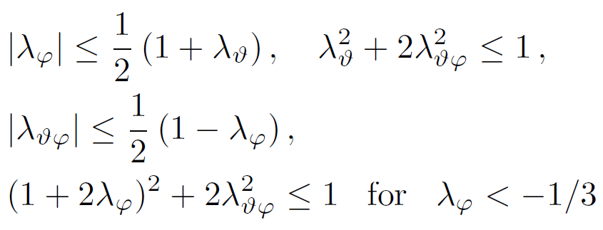
Positivity constraints for dilepton distributions
P. F., C.L., J.S., Phys. Rev. D 83, 056008 (2011)
General and frame-independent constraints on the anisotropy parameters of vector particle decays
λ_{φ}
J_{y} |V⟩ = 0
J_{x} |V⟩ = ±|V⟩
~
λ = +1
J_{z} |V⟩ = 0
J_{z} |V⟩ = ±|V⟩
~
J_{y} |V⟩ = ±|V⟩
λ = –1
J_{x} |V⟩ = 0
λ_{θ}
λ_{θφ}
λ_{θφ}
physical
domain
λ_{θ}
λ_{φ}

Slide 7
Rotation-invariant parity asymmetry
P. F., C.L., J.S., H.W., Phys. Rev. D 82, 096002 (2010)
How to maximize of the observable parity asymmetry in di-fermion decays of γ*-Z and W
→ new, frame-independent definition of the “forward-backward” asymmetry
Robust method to measure χ_{c} and χ_{b} polarizations
P. F., C.L., J.S., H.W., Phys. Rev. D 83, 096001 (2011)
In the electromagnetic decay chain χ → ψ/ϒ γ → ℓ⁺ℓ ⁻ γ, the reconstruction of the photon angular distribution is experimentally very difficult at the LHC.
We have shown that χ polarizations can be measured from the dilepton distributions alone without any loss of information
J/ψ polarization as a signal of sequential suppression?
P. F., J.S., Phys. Rev. D 85, 074005 (2012)
It may be impossible to test quarkonium sequential suppression directly:
measuring the varying χ_{c} yield (reconstructing χ_{c} radiative decays) in PbPb collisions is prohibitively difficult due to the huge number of photons.
However, χ_{c} suppression will be signalled by a change of prompt-J/ψ polarization from pp to central Pb-Pb collisions (a “simple” dilepton measurement).
Feasible with 20k J/ψ’s in PbPb collisions

Slide 8
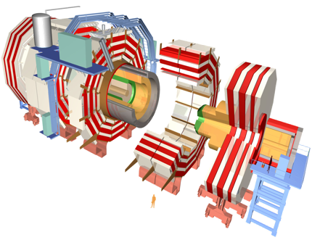
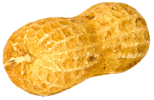
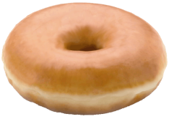
Quarkonium polarization in CMS
With CERN and HEPHY-Vienna
Using 2011 CMS data:
  ongoing: ϒ(1S), ϒ(2S) and ϒ(3S) polarizations
  (no non-prompt contribution,
  easier efficiency description)
  next: J/ψ and ψ(2S) polarizations
Analysis method
  Background modelled from sidebands. Novel per-event background-subtraction method based on likelihood-ratio (made in LIP)
  Non-standard “fitting” technique: using Metropolis-Hastings importance-sampling algorithm to build the posterior probabilities of the polarization parameters (made in LIP)
  No MC acceptance maps or templates needed. Using single-lepton efficiencies, provided by data-driven T&P studies
  The only MC ingredient is the lepton-lepton efficiency correlation, found to be very small for the ϒ analysis
  Simultaneous determination of lambda parameters in three polarization frames and frame-independent parameters
(not to scale)

Slide 9
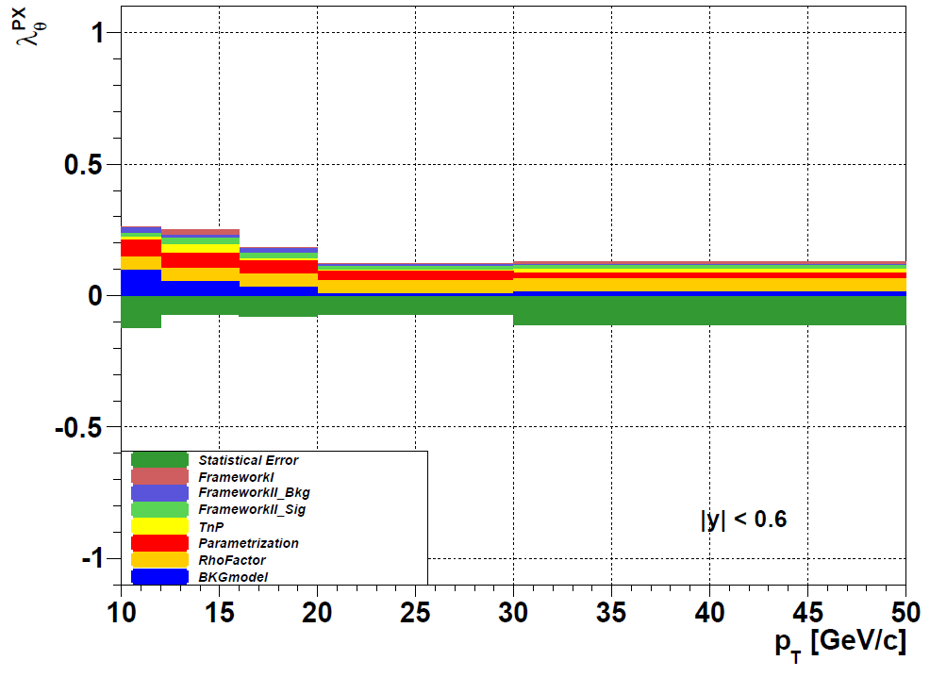
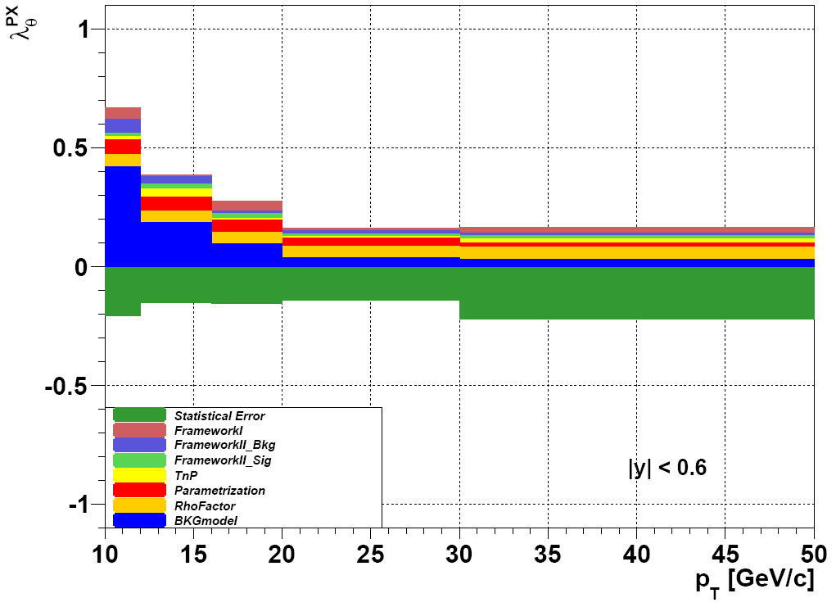
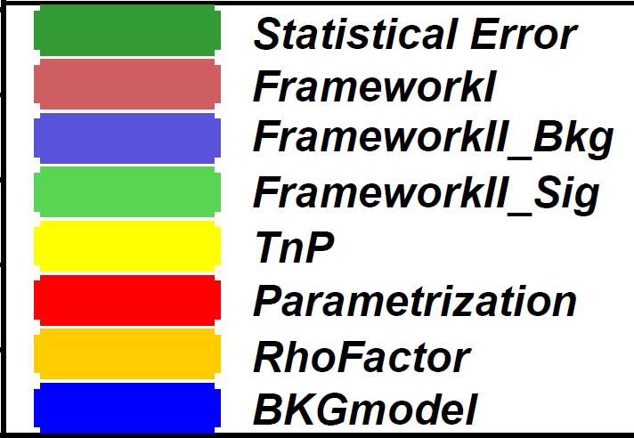
Expected uncertainties
Example: polar anisotropy in the PX frame
Uncertainties due to “fitting” and BKG-subtraction framework determined with many MC pseudo-experiments,
injecting transverse or longitudinal signal polarization and several extreme background polarization hypotheses (suggested by data distributions in the mass sidebands)
∆λ_{θ}
^{PX}
ϒ(1S)
ϒ(3S)
(figures by Valentin Knünz)
Largest systematics: efficiency determination, background model

