Slide 1
NEXT International Collaboration
Coimbra-LIP research team
C.A.N.Conde
Teresa T. Dias
Filomena P. Santos
Filipa Borges
João Barata
Alexandre Trindade
Alexandre Garcia

Slide 2
Purpose
Search for neutrinoless double beta decay (ββ0ν):
  Tests Majorana nature of neutrino
  Helps determine absolute neutrino mass
  If observed, lepton number NOT conserved

Slide 3
How to look for neutrino-less decay
Measure the spectrum of the electrons

Slide 4
Where to look for neutrino-less decay
In a number of even-even nuclei, β-decay is energetically forbidden, while double-beta decay is energetically allowed
(A,Z) →(A,Z+2)
(A,Z) → (A,Z+2) + e⁻₁ + ν₁ + e⁻₂ + ν₂ ββ2γ
(A,Z) → (A,Z+2) + e⁻₁ + e⁻₂ ββ0γ
Candidates are
⁴⁸Ca, ⁷⁶Ge, ⁸²Se, ⁹⁶Zr, ¹⁰⁰Mo, ¹¹⁶Cd, ¹²⁸Te, ¹³⁶Xe,¹⁵⁰Nd

Slide 5
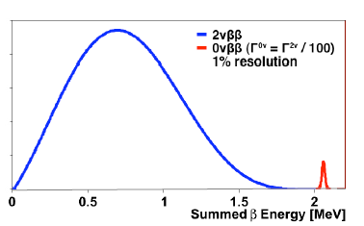
Experimental considerations
Extremely slow decay rates
Large (> 100kg) and very efficient source mass
    detector active medium as source?
Best possible energy resolution
    separate both peaks
Extremely low backgrounds in the 0γββ peak region
    must have:
        Ultra clean radiopure materials
        Hability to discriminate signal from background

Slide 6
Ideal detector
Source serves as detector (enough active material)
Elemental enriched source
Large Q-value eliminates most potential backgrounds
Slow ββ2ν rate would help control irreducible background
Eliminate background:
    Direct identification of the decay to (except ββ2ν)
    Event reconstruction/ spatial resolution and timing to eliminate background
Some isotope might work better than others (are better understood)

Slide 7
Why use Xe for ββ0ν search
Only inert gas with a ββ0ν candidate (isotope 136)
Long ββ2ν lifetime ~10²²-10²³ y (not seen yet)
No need to grow crystals
Can be re-purified in place (recirculation)
No long lived Xe isotopes
Noble gas:
    easier to purify
    no chemistry involved
¹³⁶Xe enrichment easy (natural 8.9%)

Slide 8
LXe or HPXe?
With high-pressure xenon (HPXe)
A measurement of ionization alone
is sufficient to obtain
good energy resolution…

Slide 9
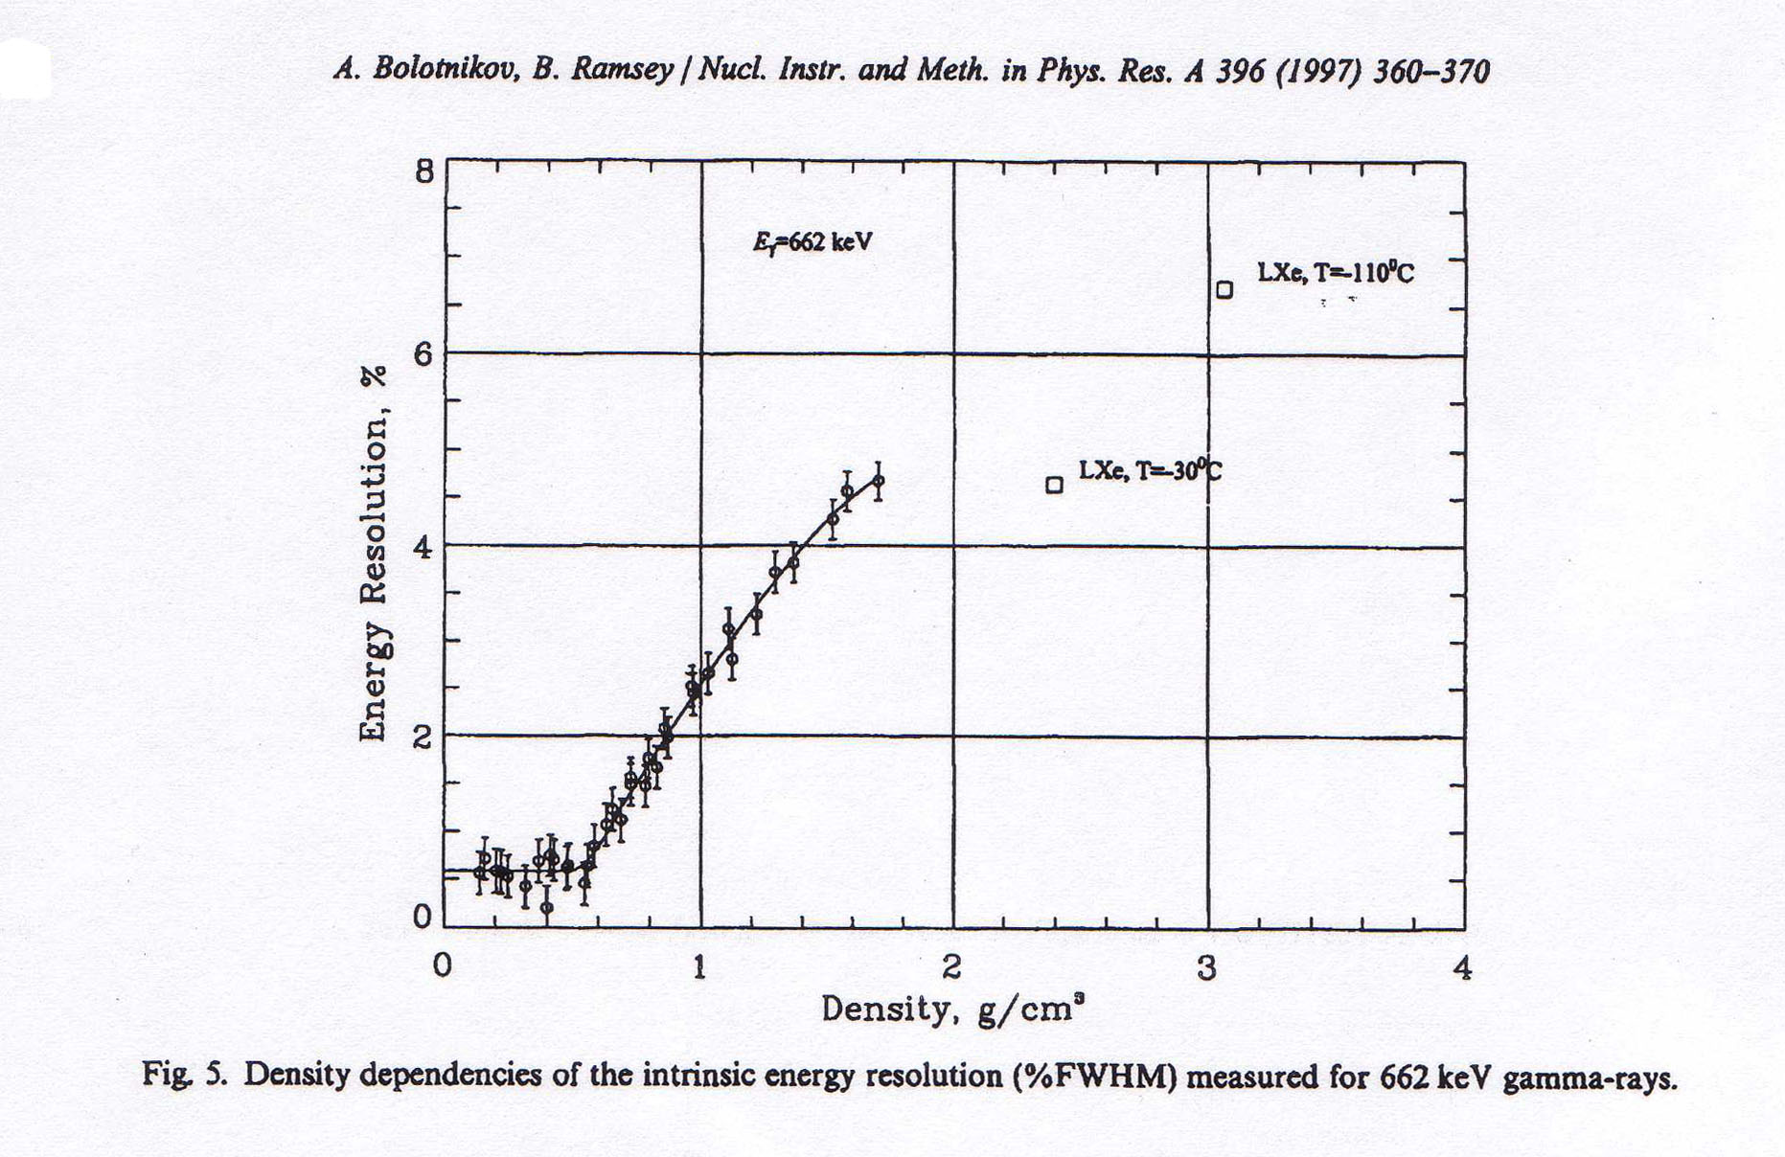
Xenon: Strong dependence of energy resolution on density!
Ionization signal only
For ρ >0.55 g/cm³, energy resolution deteriorates rapidly

Slide 10
Detector Concept
Use enriched High Pressure Xenon
  Guarantees the large source mass
TPC to provide image of the decay particles
Design to also get an energy measurement as close to the intrinsic resolution as possible
In fact it all comes down to energy resolution and background rejection!!

Slide 11
ΔE/E ~ 1-2 10⁻³ FWHM
ΔE/E ~ 35 10⁻³ FWHM

Slide 12
Electro-Luminescence (EL)
(Gas Proportional Scintillation)
  Electrons drift in low electric field region
  Electrons then enter a high electric field region
  Electrons gain energy, excite xenon, lose energy
  Xenon generates UV
  Electron starts over, gaining energy again
  Linear growth of signal with voltage
  Photon generation up to ~1000/e, but no ionization
  Early history irrelevant, ⇒ fluctuations are small
  Maybe… G ~ F?
  (G is a measure of the precision with which a single electron from an ionizing track can be counted).

Slide 13
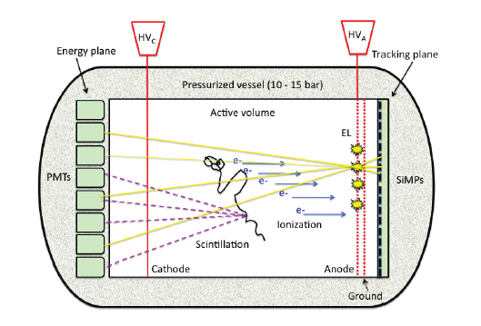
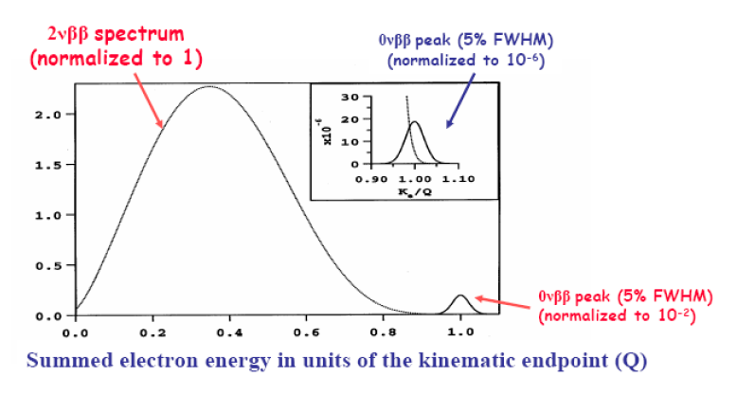
NEXT TPC scheme
Neutrinoless double beta decay spectrum

Slide 14
However…
So, the use of pure gaseous xenon with EL technique guarantees a very good intrinsic energy resolution,
BUT electron drift velocity in Xe is low and diffusion coefficients are high, blurring the identification of the ionization track hindering the necessary background rejection.
The use of xenon doped with a molecular additive has been a suggested solution to increase electron drift velocity and decrease diffusion coefficients.

Slide 15
Coimbra-Lip Team GOALS
Find molecular additives to be mixed to xenon to
without compromising detector energy resolution
HOW
of GPSC elecroluminescence (EL) yield & energy resolution
ADDITIVE Candidates
N₂, CH₄, CF₄, TMA.
increase electron drift velocity
decrease electron diffusion coefficients
Monte Carlo simulation
experimental measurements

Slide 16
Monte Carlo simulation results: EL Yield
R_{int}² ∝ (1/n ) (F + Q)
F = σ_{n} ²/n
{
Q = J / H
J = σ_{H} ²/H
EL yield H (UV photons per electron), produced under applied reduced electric fields E/N,
when one electron drifts across a D=0.5 cm long EL region in Xe or in the Xe-CH₄ and Xe-CF₄ mixtures with the indicated η_{CH4} and η_{CF4} molecular concentrations [p = 7600 Torr, T=293 K].

Slide 17
Monte Carlo simulation results: EL Fluctuations
Fluctuations parameter Q=J /H of the EL yield H , where J=σ_{H} ²/H is the relative variance of H.
The bar F_{Xe} marks the Xe Fano factor.
Fraction ζ of electrons that become attached to CH₄ or CF₄ molecules in the EL region.
R_{int}² ∝ (1/n ) (F + Q)

Slide 18
Conclusions from EL simulation results:
CH₄ may be a good candidate below ~ 1% concentrations
CF₄ apparently is not, even at much lower concentrations (<0.01%).
However, R_{int} (R_{int} ² ∝ (1/n ) (F + Q) ) is also determined by other factors, namely n (recombination), the Fano factor, etc
And not all candidates have enough and credible data to implement a reliable simulation scheme so…

Slide 19
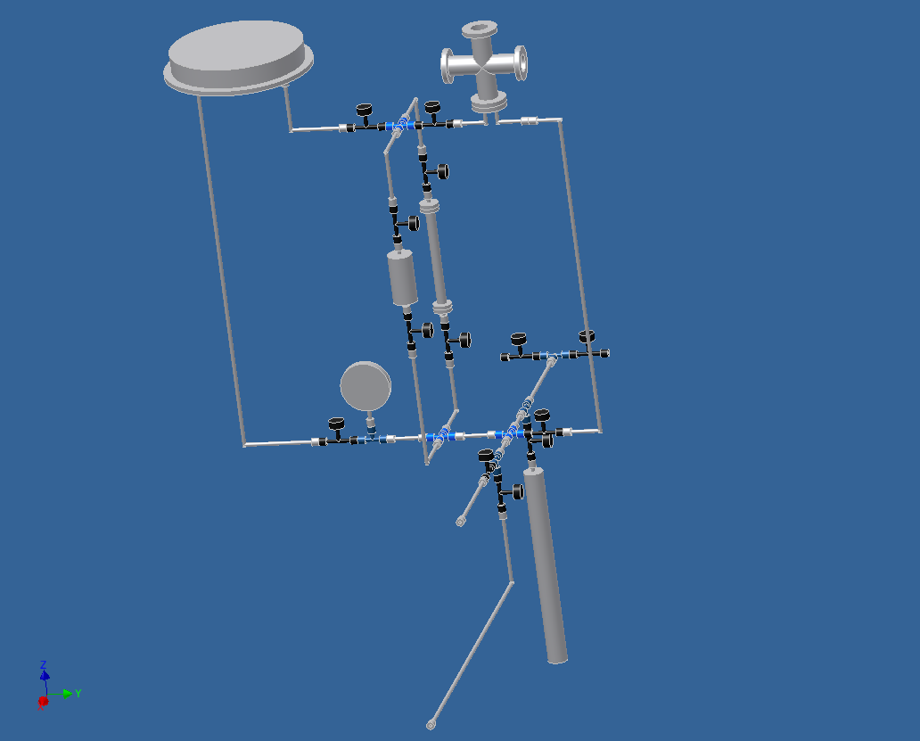

Slide 21
TPC: ββ Signal & Backgrounds
-HV plane
Readout plane A
Readout plane B
Fiducial volume surface
.
*
electrons
ions
Signal: ββ event
Backgrounds

Slide 22
Fluctuations in Electroluminescence (EL)
EL is a linear gain process
G for EL contains three terms:
    Fluctuations in n_{uv} (UV photons per e):
    Fluctuations in n_{pe} (detected photons/e):
    Fluctuations in photo-detector single PE response:
    σ² = 1/(n_{uv}) + (1 + σ²_{pmt})/ n_{pe})
    For G = F = 0.15 ⇒ n_{pe} ≥ 10
    The more photo-electrons, the better!
  Equivalent noise: much less than 1 electron rms!

Slide 23
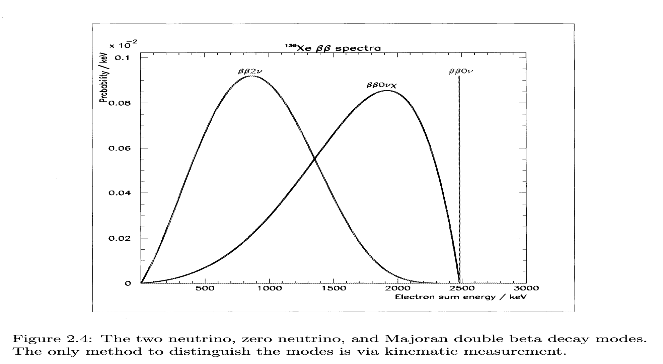
Double Beta Decay Spectra
Notes:
mention that a number of other exotic particles can also contribute to BB decay.

Slide 24
How to look for neutrino-less decay
Measure the spectrum of the electrons

Slide 25
What’s needed…
Long lifetimes (>10²⁵ years) require:
  Large Mass of relevant isotope (>100 kg)
  Small or No background:
    Clean materials
    Underground, away from cosmic rays
    Background rejection methods:
      Energy resolution
      Event topology
      Particle identification
      Identification of daughter nucleus
  Years of data-taking

Slide 26
Double beta decay
Only
2-v decays
Only
0-v decays
Rate
No backgrounds above Q-value
0
Energy
Q-value
The ideal result is a spectrum of all ββ events, with a 0-ν signal present as a narrow peak, well-separated from 2-ν

Slide 27
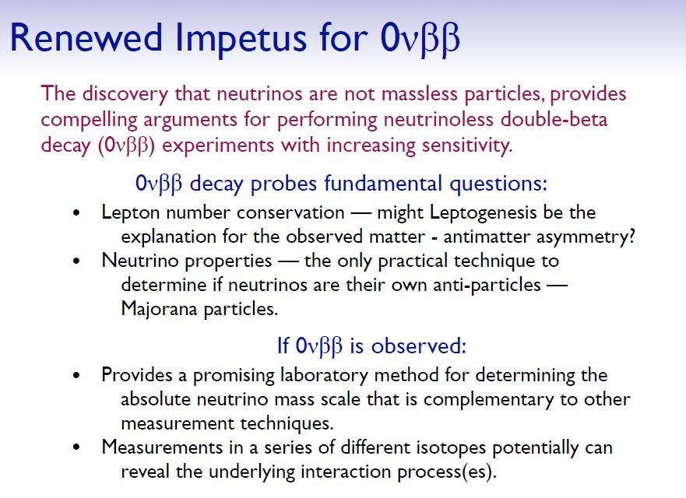

Slide 28
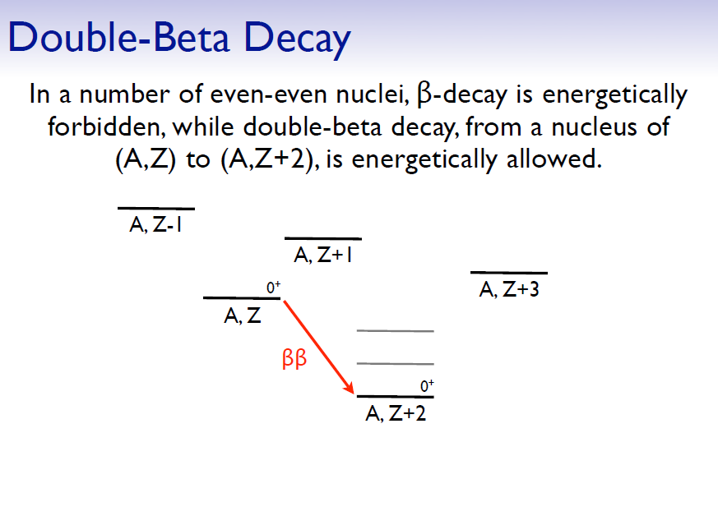

Slide 29
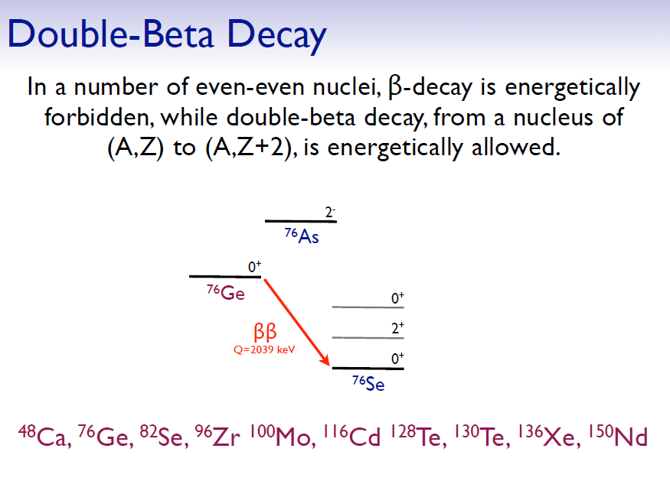

Slide 30
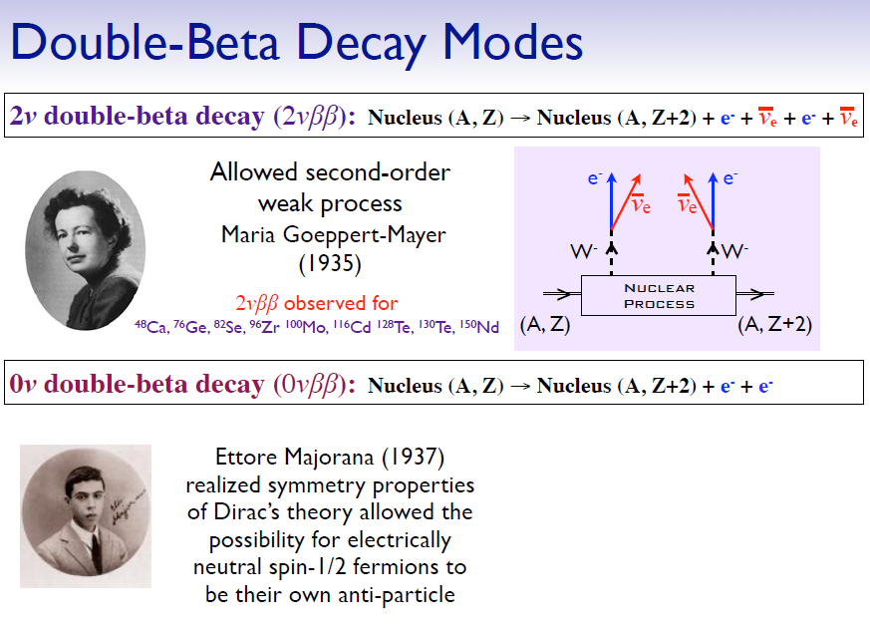
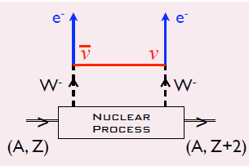

Slide 31
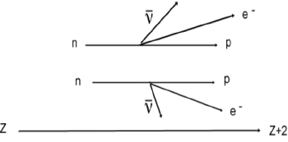
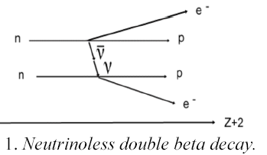
Two Types of Double Beta Decay
2ν ββ
A known standard model process and an important calibration tool
If this process is observed:
Neutrino mass ≠ 0
Neutrino = Anti-neutrino!
Lepton number is not conserved!
0ν ββ
Z
Neutrino effective mass
Neutrinoless double beta decay lifetime

Slide 32
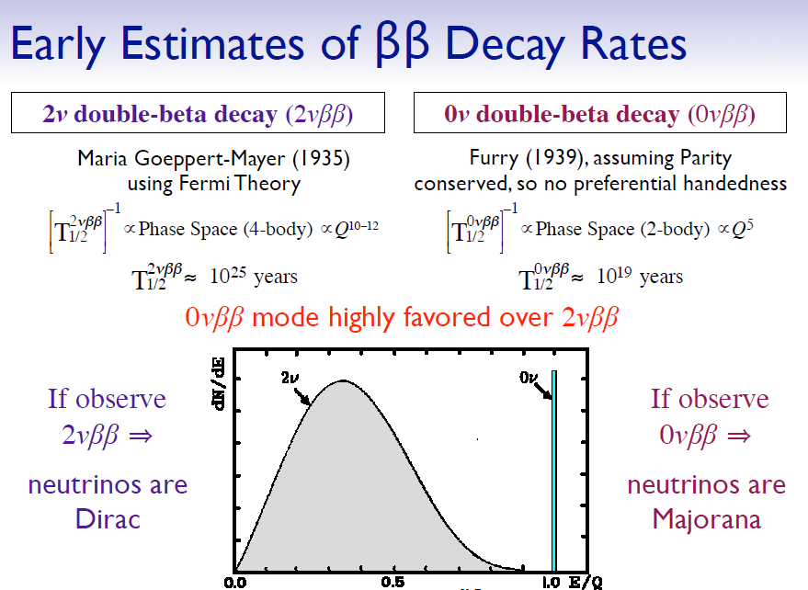

Slide 33
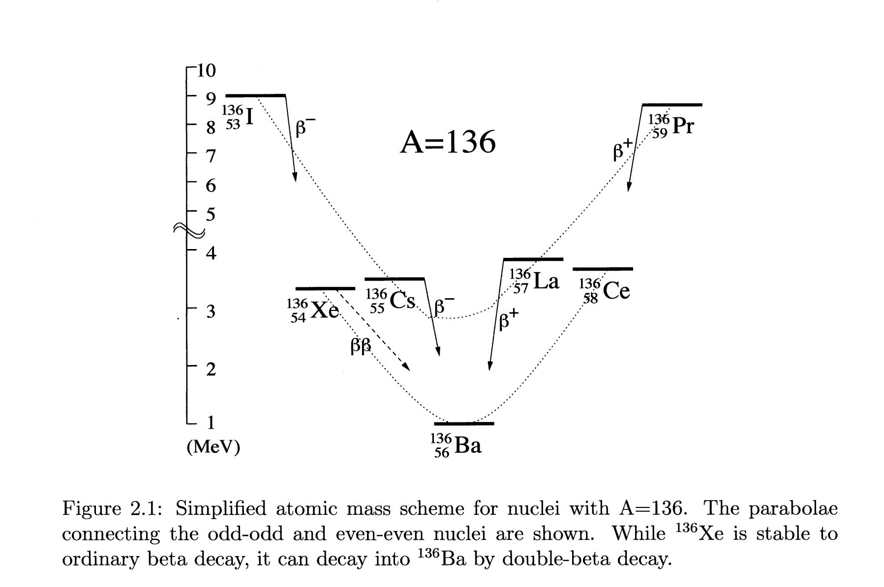
Rare nuclear transition between same mass nuclei
  Energetically allowed for even-even nuclei
(Z,A) → (Z+2,A) + e⁻₁ + ν₁ + e⁻₂ + ν₂
(Z,A) → (Z+2,A) + e⁻₁ + e⁻₂
(Z,A) → (Z+2,A) + e⁻₁ + e⁻₂ + χ

Slide 34
What is this factor “G”?
In in practice:
G is a measure of the precision with which a single electron (from an ionizing track) can be counted.

