Slide 1
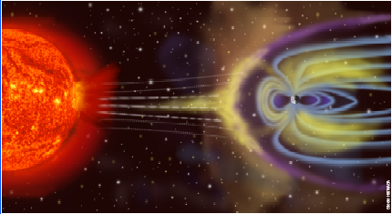

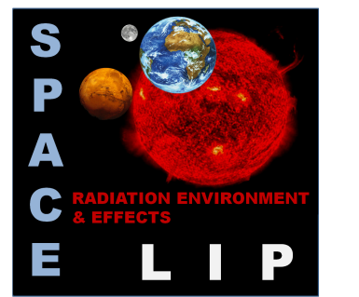
AmBIENTE de radiação no espaço
Patrícia Gonçalves

Slide 2
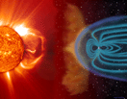
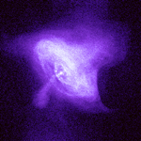
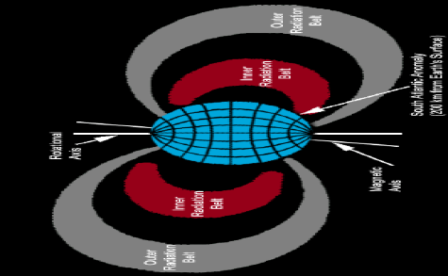
Three sources of radiation
Solar Events (SEP)
protons and electrons
high flux
low energy
sporadic
very dangerous
Galactic Cosmic Rays
Protons and ions
low flux
very energetic
penetrating
Planetary Radiation Belts
protons and electrons
high radiation dose
Supernova in Crab nebula seen in X-ray by the Chandra mission

Slide 3

Magnetospheric Storms
See movie in: http://www.youtube.com/watch?v=BDZj1CmsJ64&feature=related

Slide 4
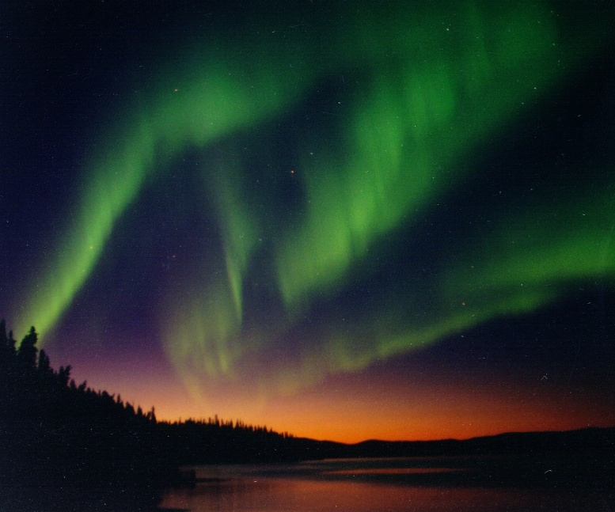
Aurora
Charged particles captured in the radiation belts excite N2 and O2 molecules that emit visible light while returning to the fundamental state.

Slide 5
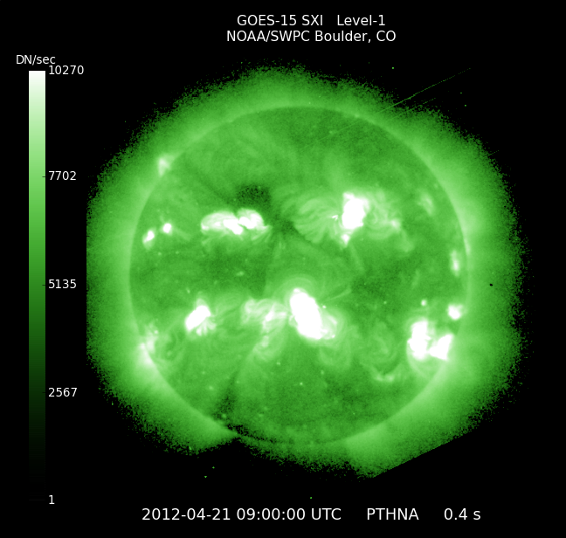
Today´s Space Weather
http://www.swpc.noaa.gov/today.html
3-day Solar-Geophysical Forecast
issued Apr 20 22:00 UTC
Solar Activity Forecast:
Solar activity is expected to be low through the period (21 - 23 April) with a chance for an isolated M-class flare.
Geophysical Activity Forecast:
Geomagnetic field activity is expected to be at quiet levels during the first half of day 1 (21 April). Activity is forecast to increase to unsettled levels with a chance for active levels beginning around 21/1500Z and continuing into day 3 (23 April) due to expected glancing blows from the partial-halo CMEs observed on 18 and 19 April. There will also be a slight chance for minor storm levels on day 1.

Slide 6
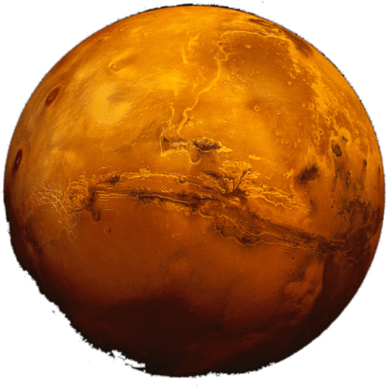
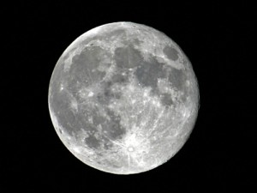
What we do
Model the radiation environment in space
and
study and measure the effects of radiation
in EEE components and for human space flight
An Example:
Radiation Environment Models
Model of the radiation environment on Mars, Phobos and Deimos, including local treatment of surface topography and composition,
atmospheric composition & density
(with diurnal + annual variations) and
local magnetic fields.

Slide 7
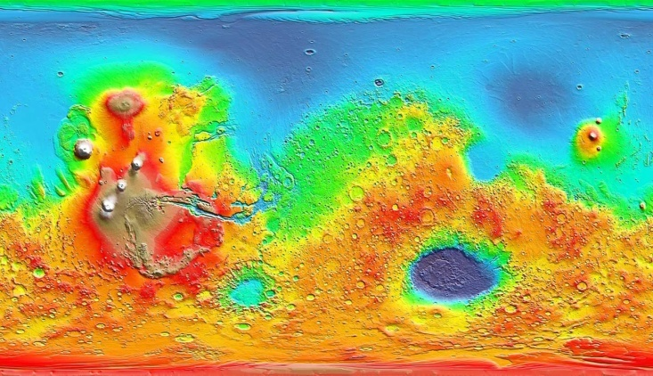
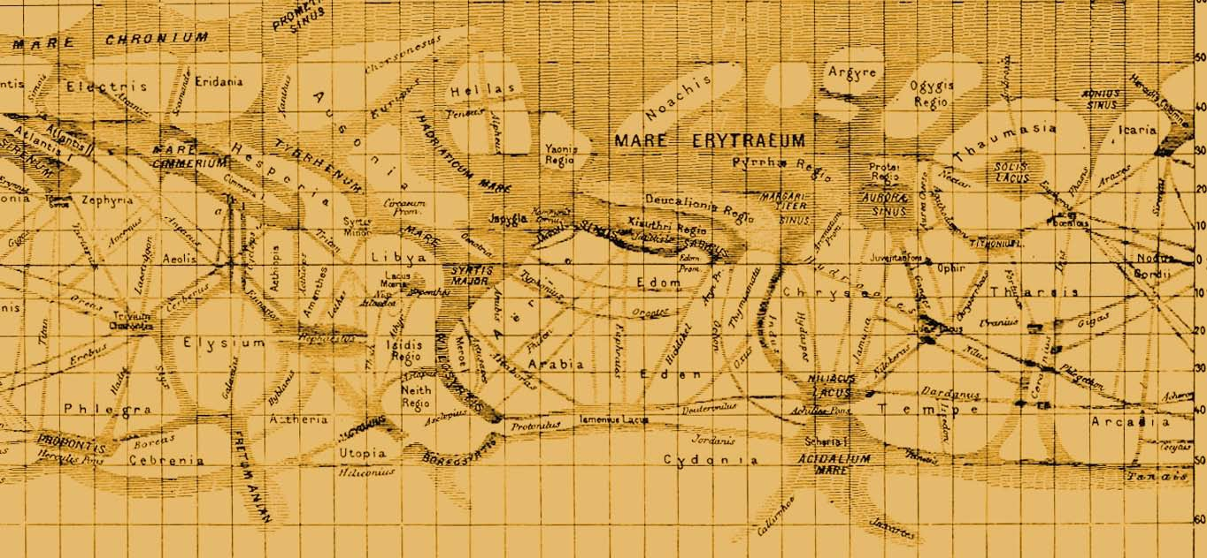
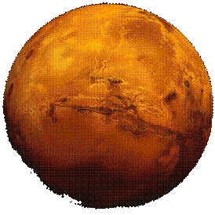
Detailed Martian Radiation Environment Model developed by LIP
Inputs
As a function of 5º x 5º in lat-long, season (12 SL intervals) & (day/night)
Atmosphere composition: EMCD (European Mars Climate Database) or MarsGRAM (NASA)
Topography from Mars Laser Altimeter aboard Mars Global Surveyor.
Soil Composition from analysis of data collected with the Gamma Ray Spectrometer aboard Mars Odyssey, including water content and CO₂ ice.
Magnetic Field Models, from PLANETOCOSMICS
GCR spectra ( α solar cycle ): ISO 15390 model (Nymmik)
SEP ( worst 5 minutes / total fluence): from models & data.

Slide 8
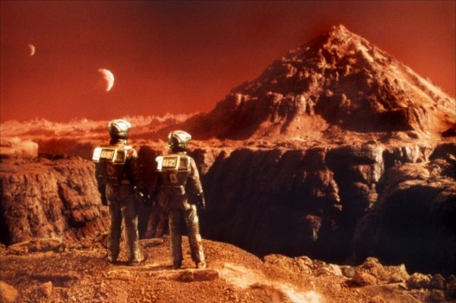
...it is possible !
Predictions of the Models:
It is possible to remain in Martian surface for some time with no serious risk for astronauts!
For longer permanences shelters are required...

Slide 9
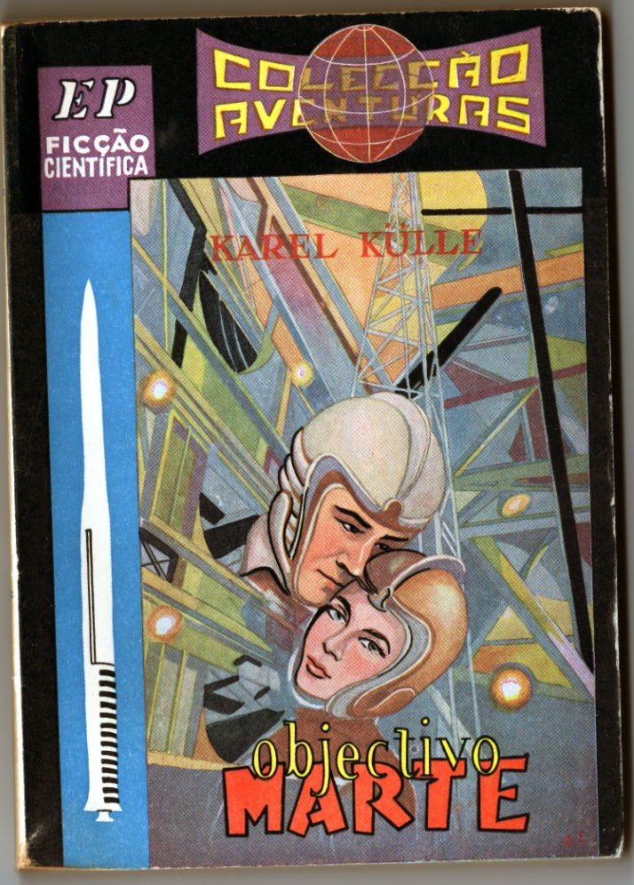
The interplanetary travel
The most dangerous phase in a trip to Mars , from the point of view of the radiation hazard, is the interplanetary travel !
The biggest danger is the possibility of a SEP reaching the mission..
Mitigation Strategies are under development:
Shelters inside water compartments or other
Faster propulsion system
SEP Forecasting tools and alarms

Slide 10
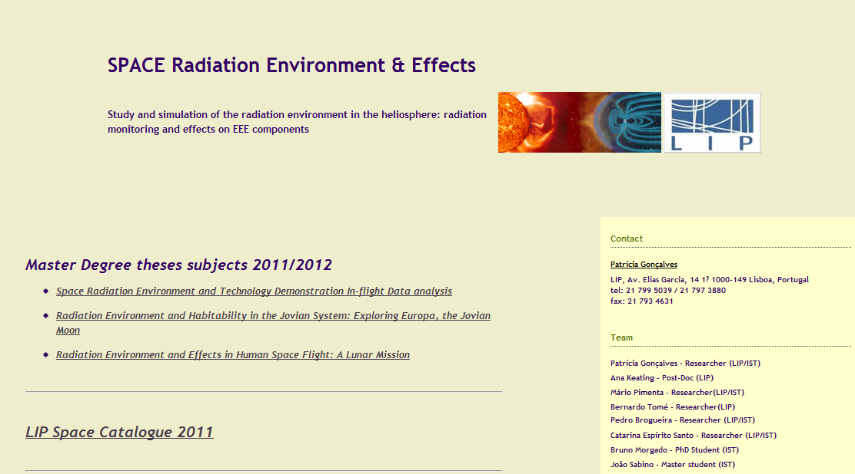
More in
http://www.lip.pt/~space

