Slide 1
Report on U.S. Outreach Activities
April 2012
M. Bardeen
100 years of Cosmic Rays: Educational Opportunities
at the APS April Meeting
M. Bardeen, IPPOG, April 2012.

Slide 2
Statistics
14 talks
27 “authors”
1.5 sessions
180 minutes
8 detectors
5 targeted audiences
~40 attendees
275.5 Index of Participation
2 teachers
2 community college students
5 educators
18 physicists
M. Bardeen, IPPOG, April 2012.

Slide 3
Ideas to Share
School Outreach
Middle School Exercise
High School Cosmic Ray Observatory
High School REU Program
ACME: Bringing Students to Detectors
Community College Detector Project
Mile Deep Detector
College Student Test Stand
M. Bardeen, IPPOG, April 2012.

Slide 4
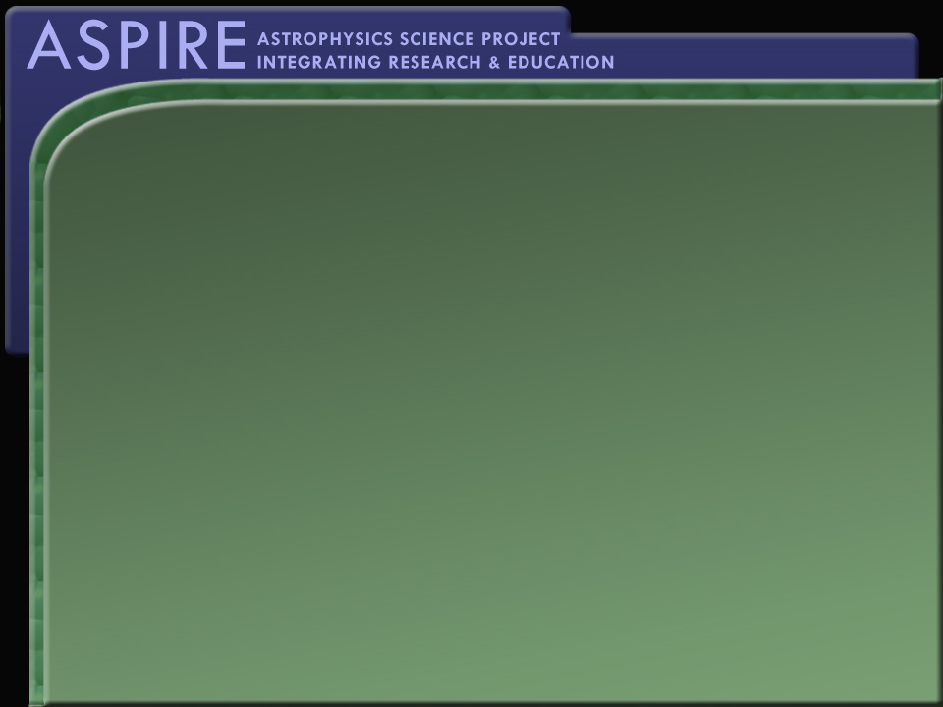
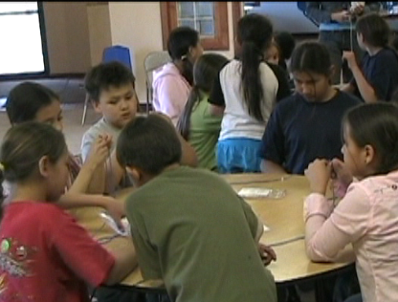
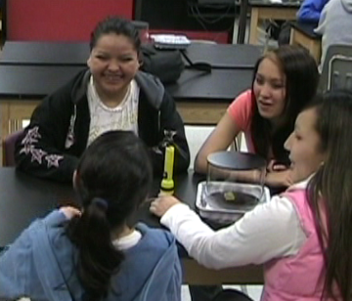
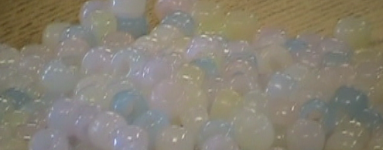
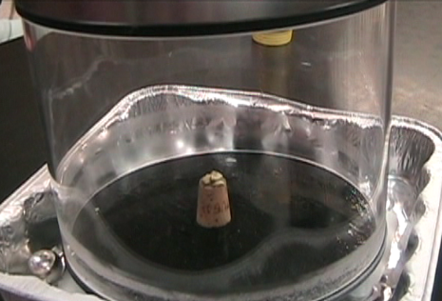
Outreach to Rural Schools

Slide 5

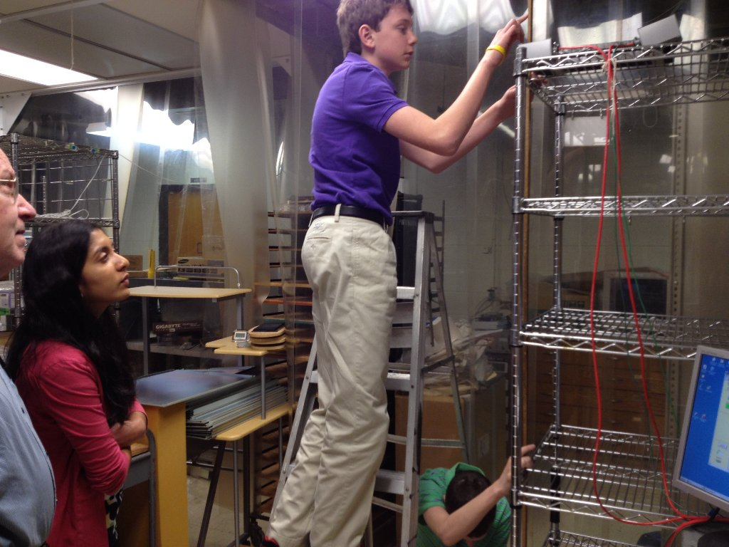
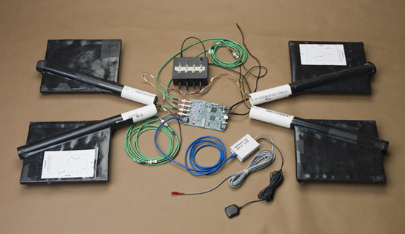
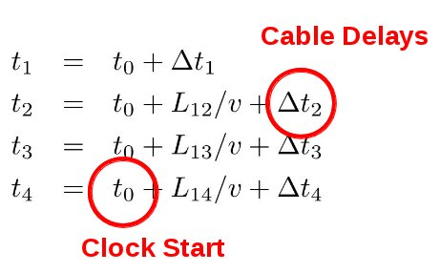
Eighth Grade Internship with QuarkNet
A local middle school's internship program places 8th graders into the work place. Students request certain professions or fields . . . like nuclear or particle physics, in our case.
Our involvement started in 2009 and has continued each year since.
We host 3-4 students and have them from 8:30 a.m. to 11:30 a.m.
The challenge is having the students for only three hours, one morning:
We use the QuarkNet hardware configured for four-fold coincidences and count the time for signals from pairs of counters separated by a known distance.
Students handle the hardware, moving counters around, run the data acquisition computer, take data as spreadsheets and then analyze the timing differences. After “breaking the ice,” students are excited and enthusiastic.
Students must re-arrange two counters to cancel the systematic timing offset in the acquisition chain; this gives a result for the speed of the muons and hence close to the speed of light with errors of 3%.
Google Docs proved very useful for disseminating data as spreadsheets.

Slide 6

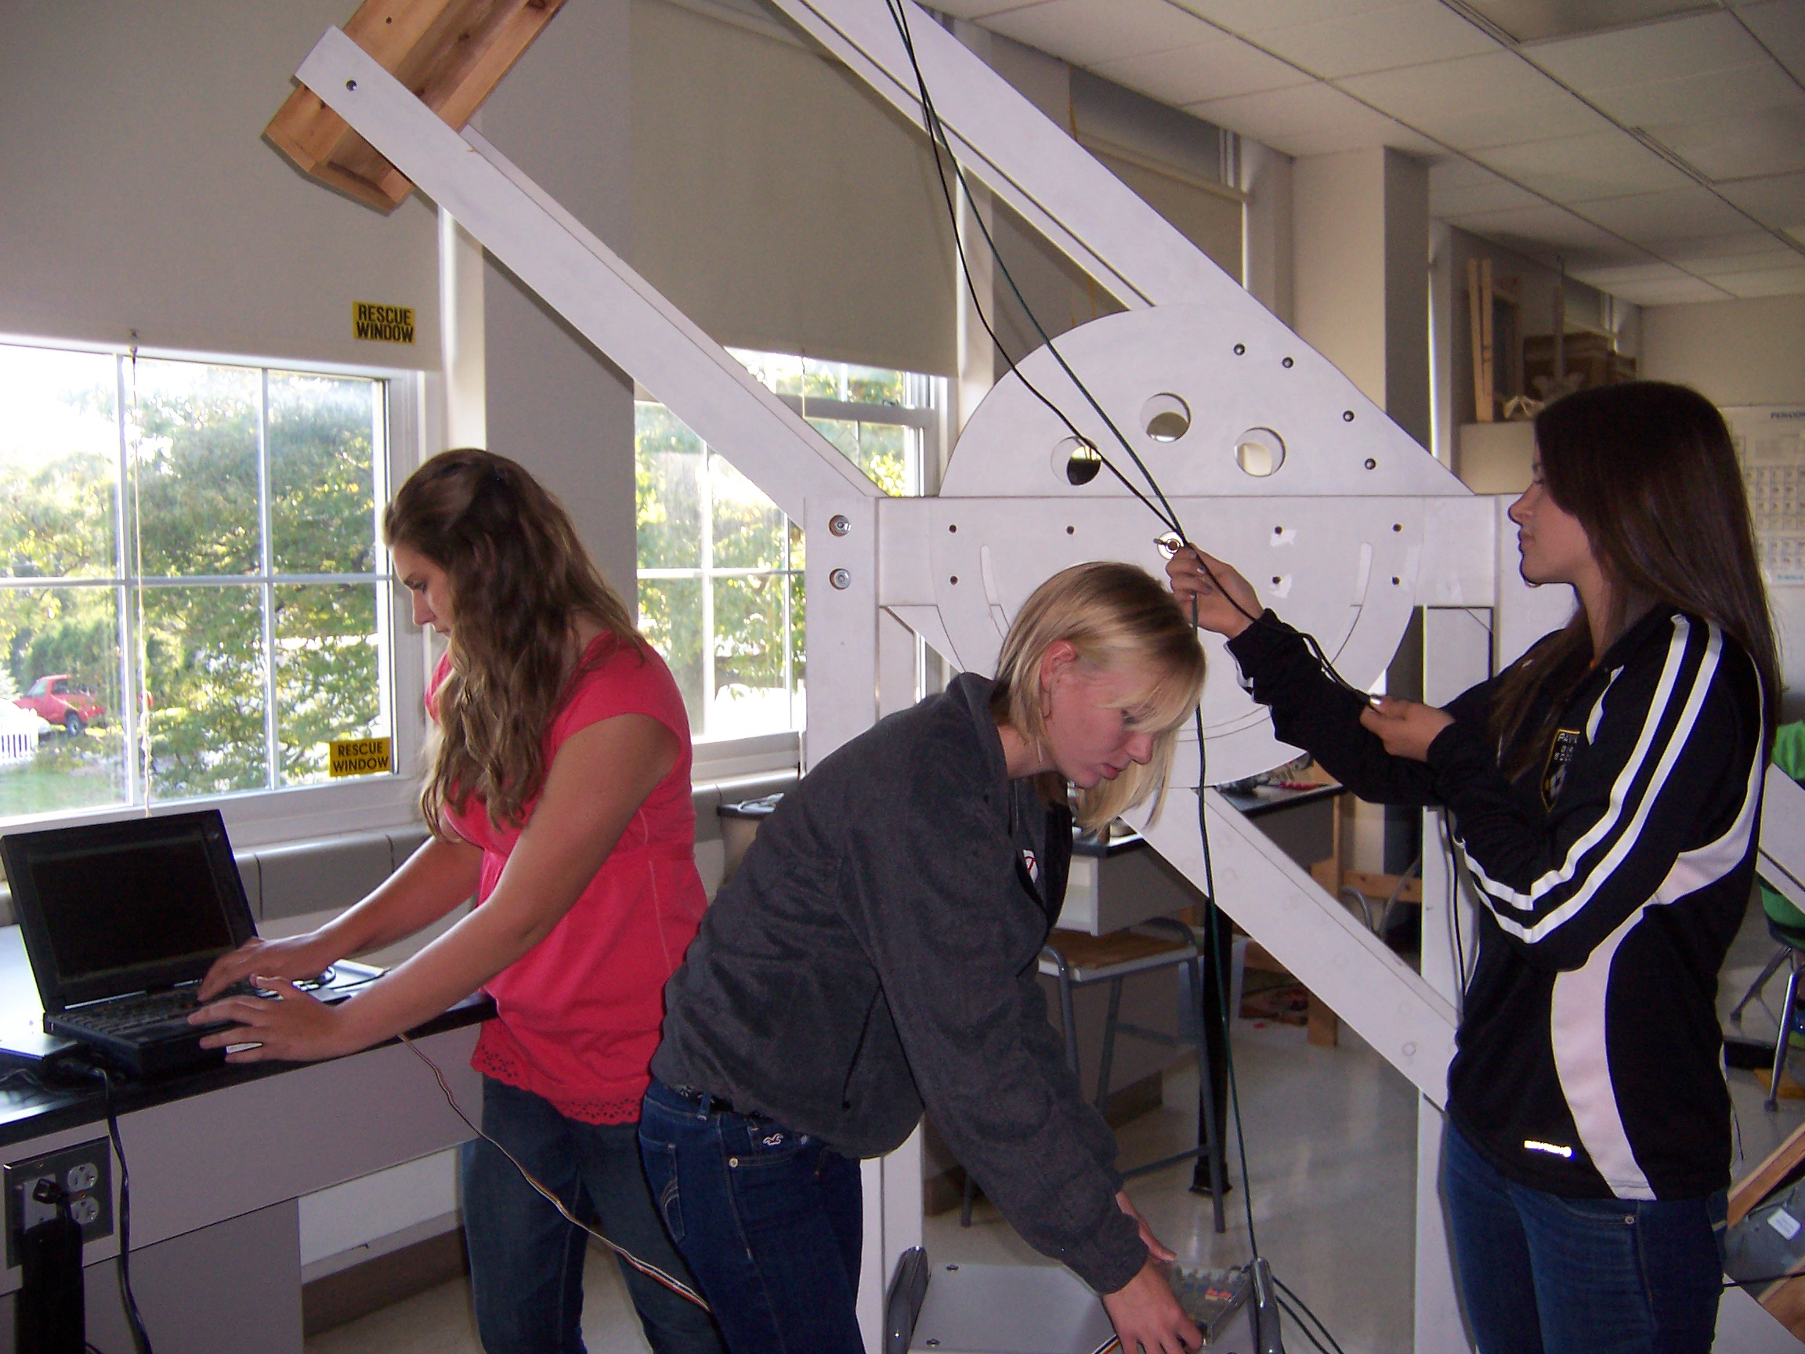
Pavilion Middle/High School
“Cosmic Ray Observatory”

Slide 7
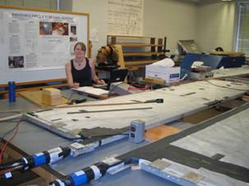
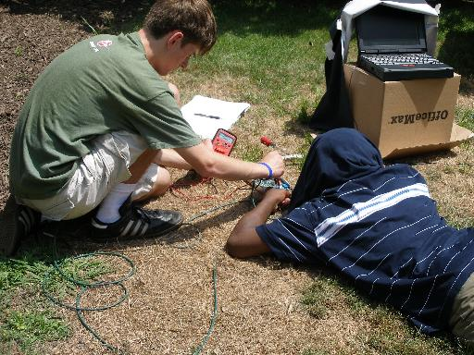
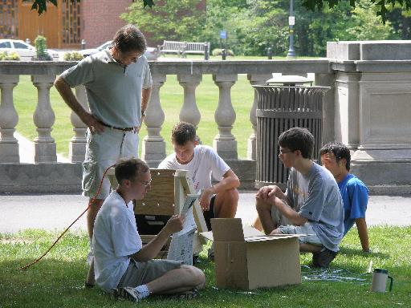
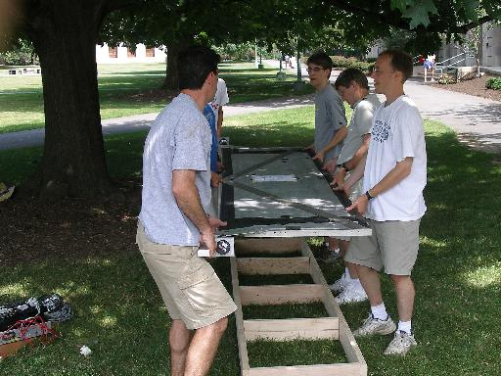
When and Where continued
Summers of '04–'08: REHS @ U of R
6–8 high school students for 6 weeks
Refurbish, test & experiment w/~2.3 m² muon detectors from NuTeV experiment.
Canandaigua Academy
Notes:
7

Slide 8
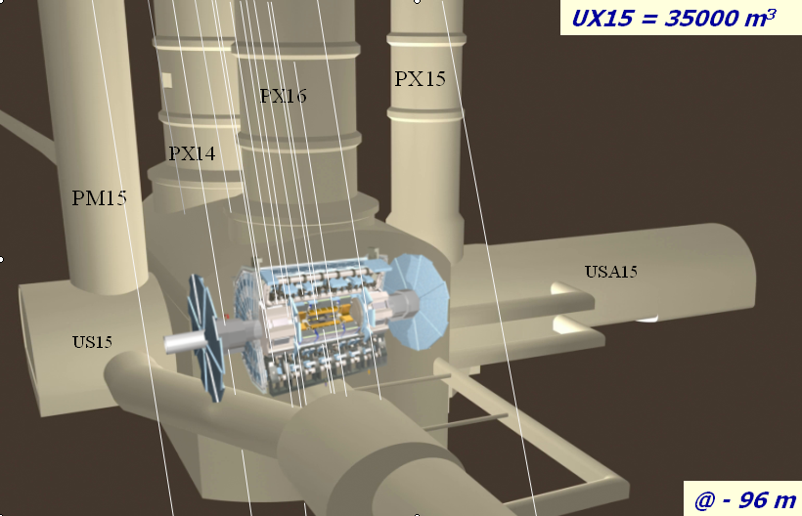
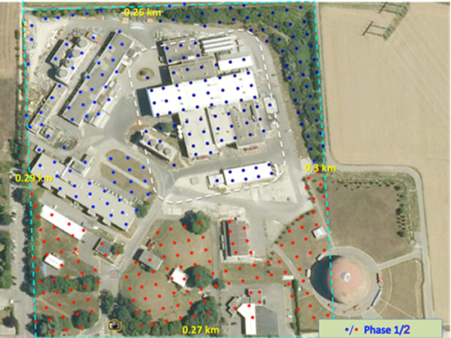
ACME - The ATLAS Cosmic Muon &
Exotics Detector
ATLAS would measure CR muons directly using unprecedented areas of precision m-tracking + calorimetry ~80 m underground.
  ATLAS—used to measure the muon content of the shower—will be combined with a surface array via the ATLAS trigger.
  The surface array is used to measure the energy of the shower.
ACME will provide precise information on cosmic rays with primary energies around 10¹⁵ ÷ 10¹⁷ eV.

Slide 9
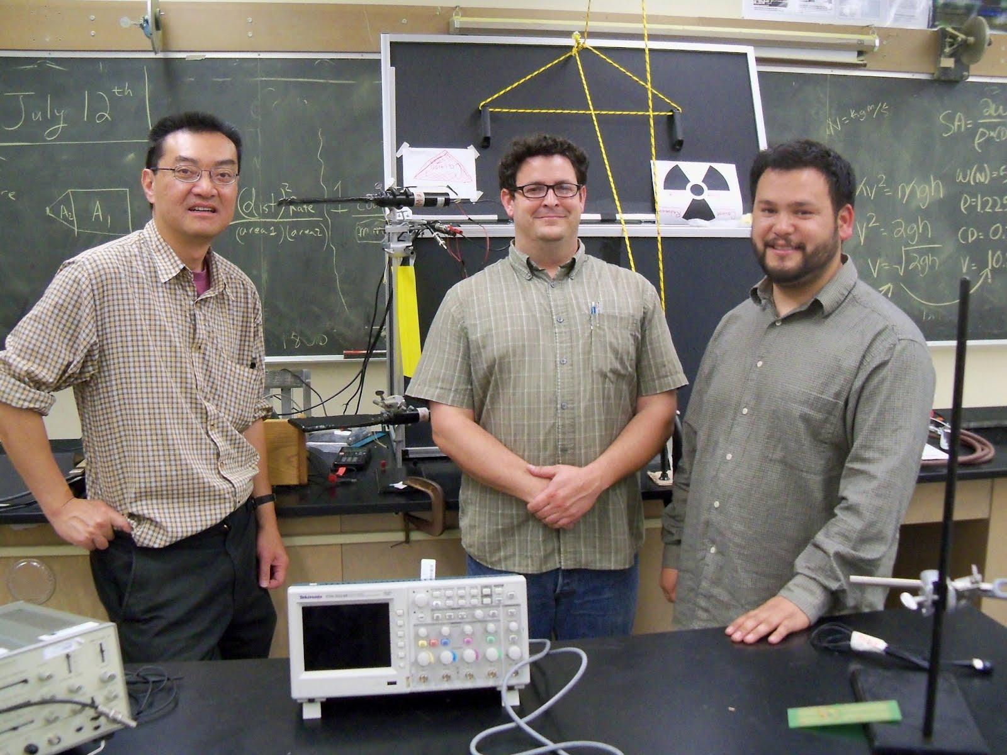
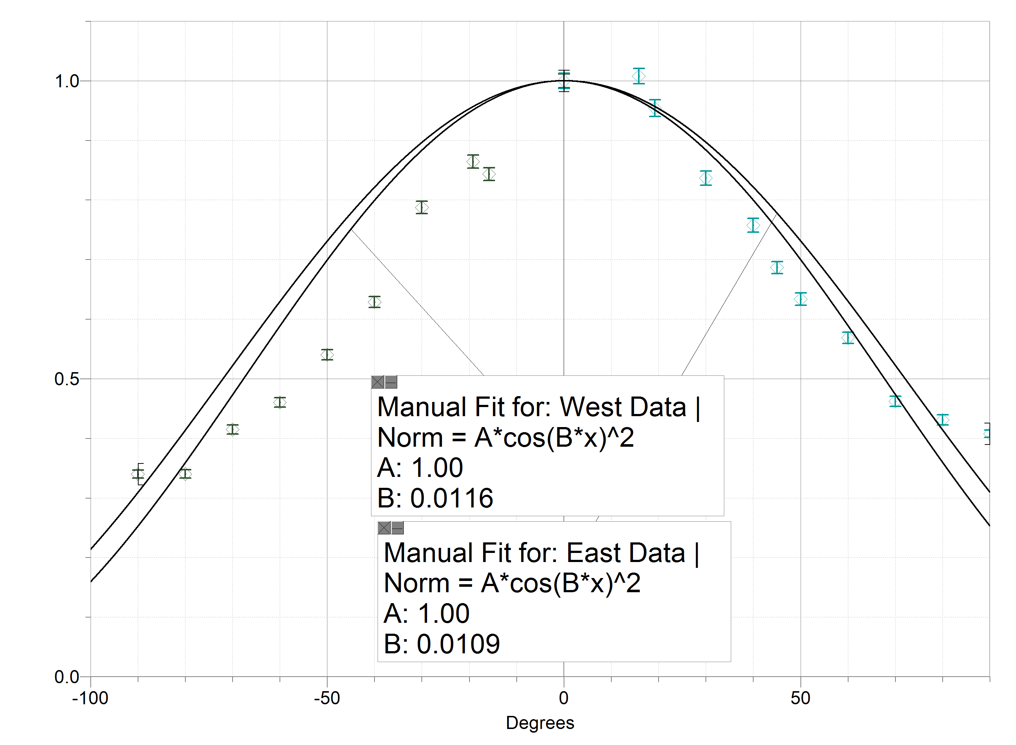
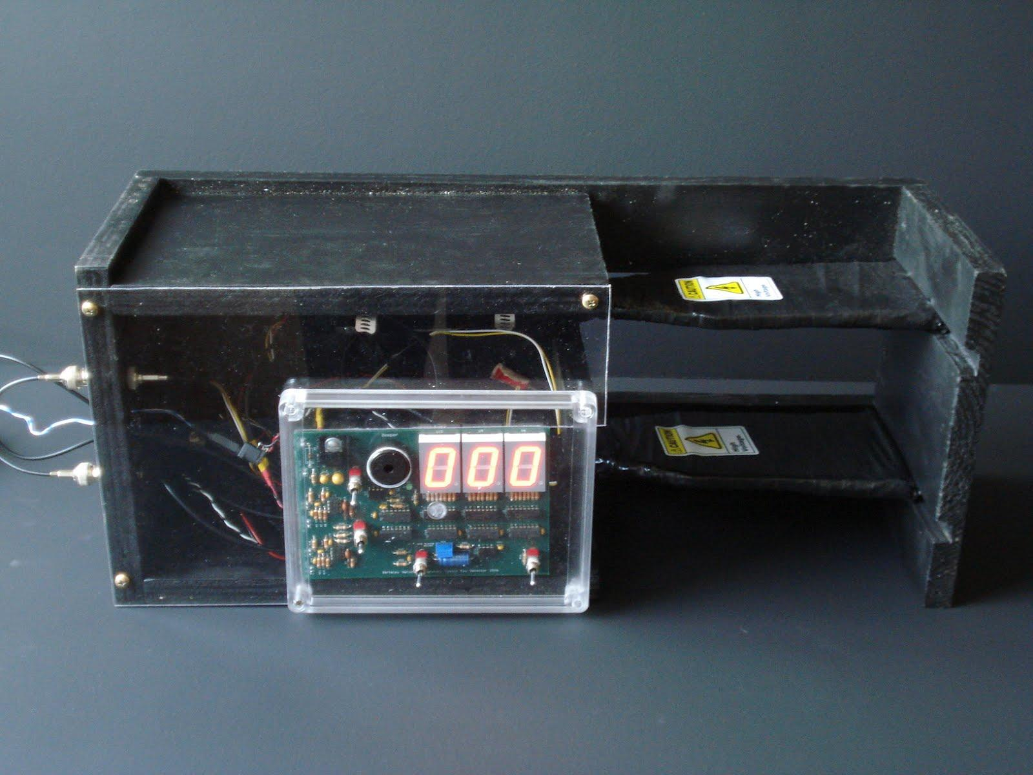
Hartnell College Cosmic Ray Detector
Eight-week internship at two-year college
Constructed a working cosmic ray detector (NIM tested)
Successful and ongoing flux measurements
Upgrades pending
Berkeley Lab Detector

Slide 10
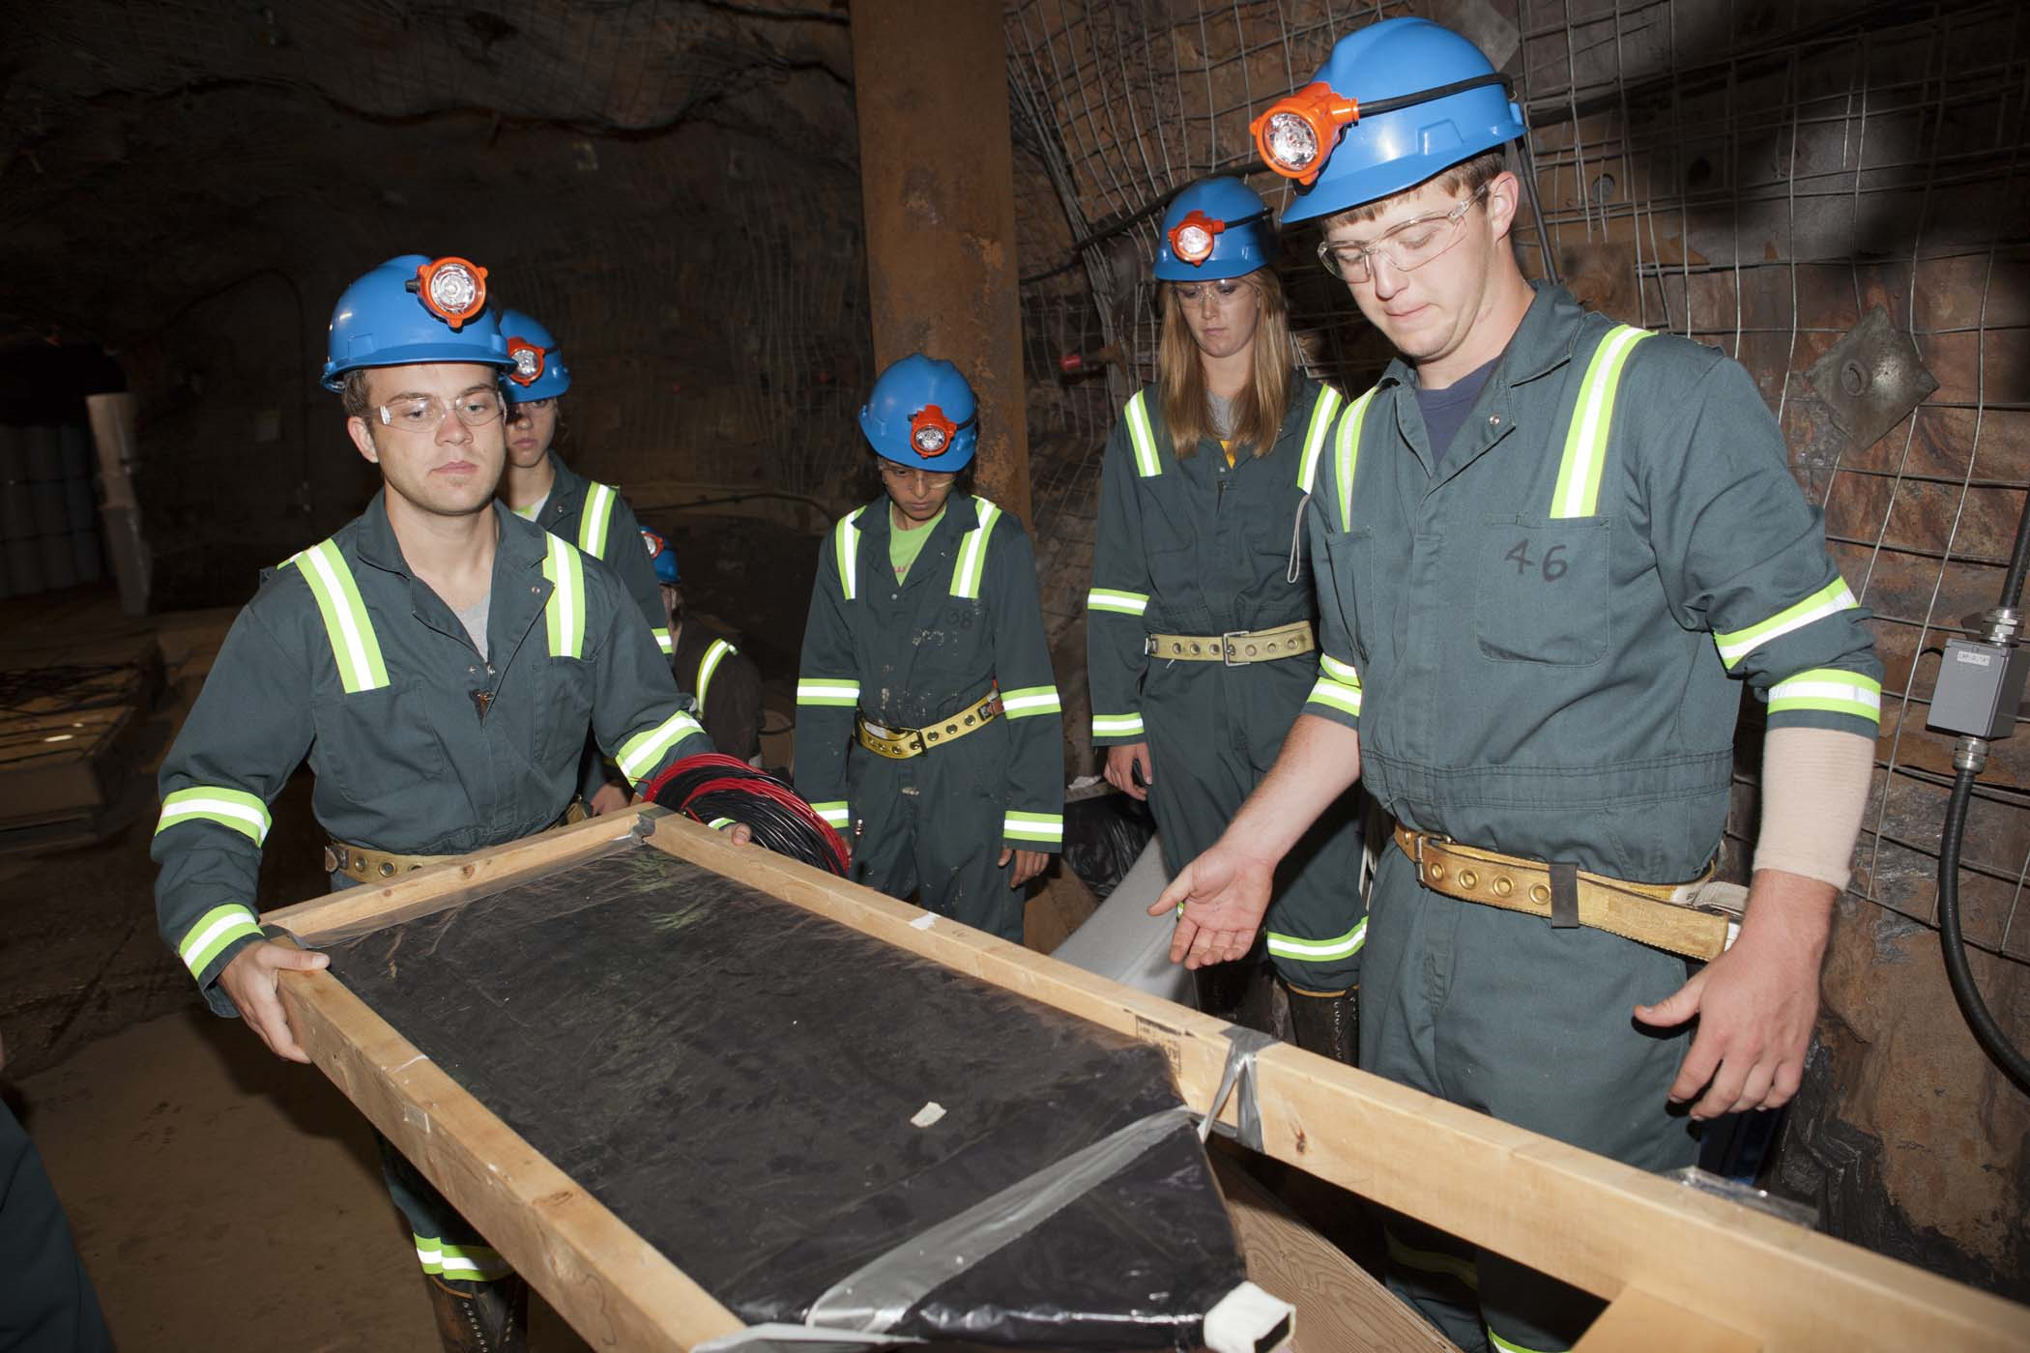
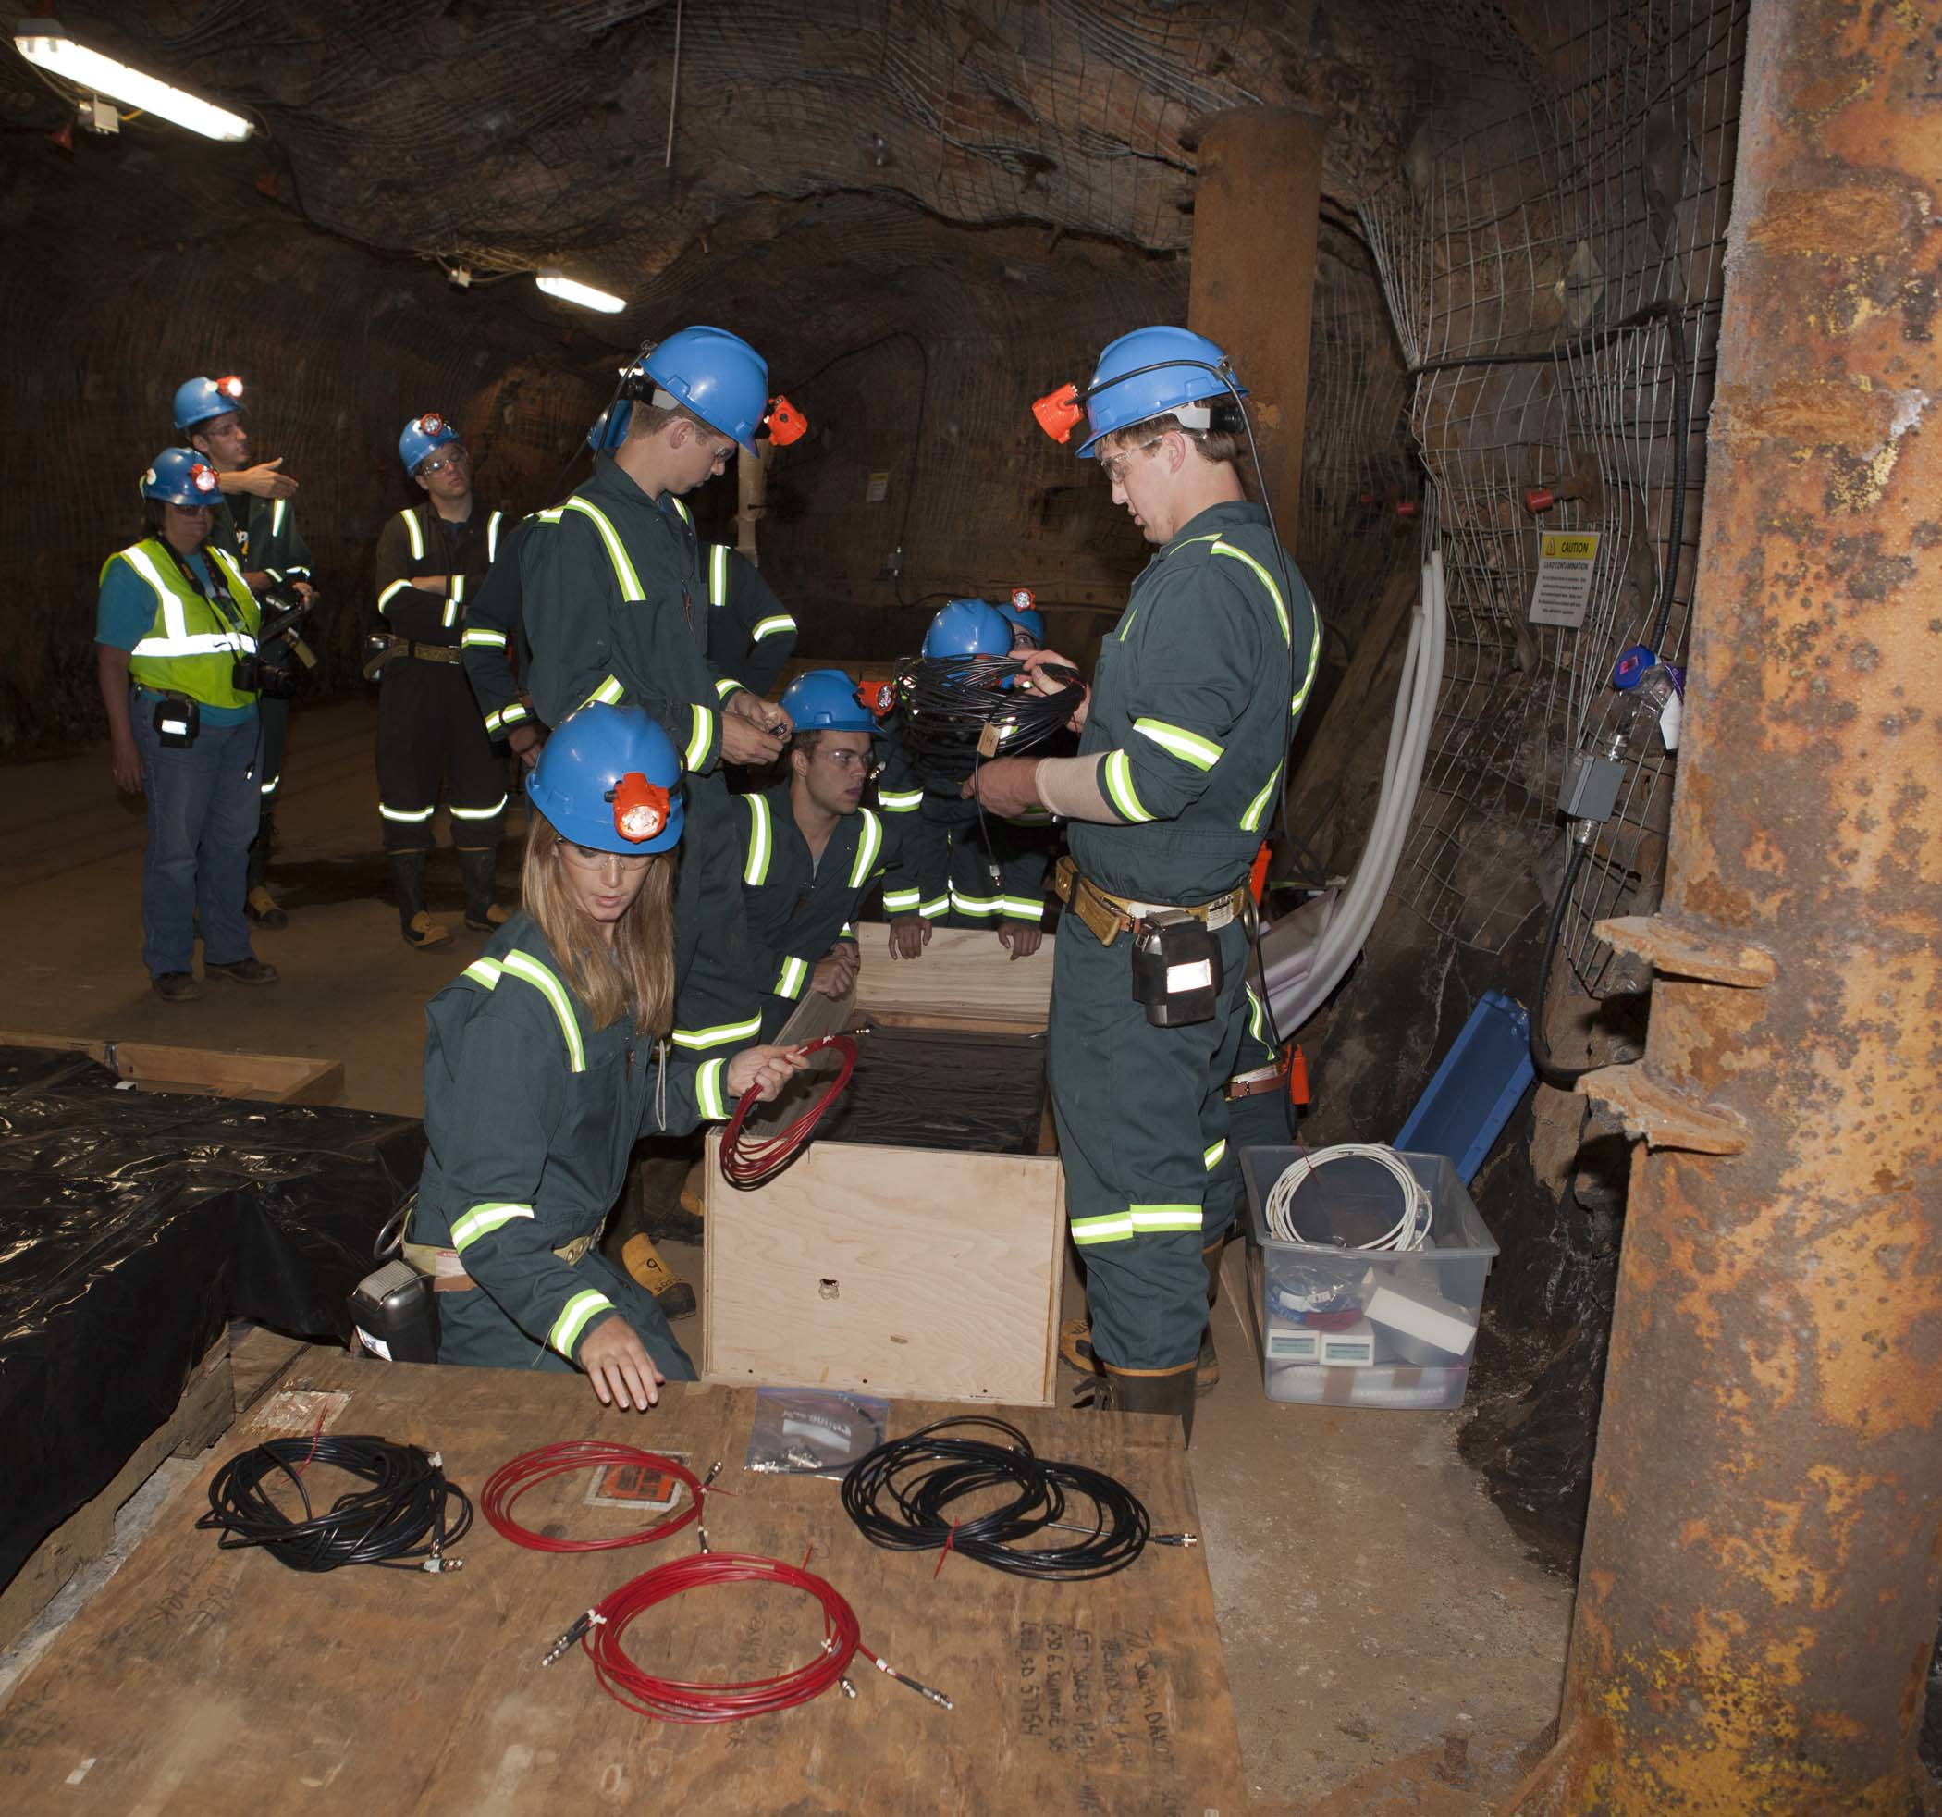
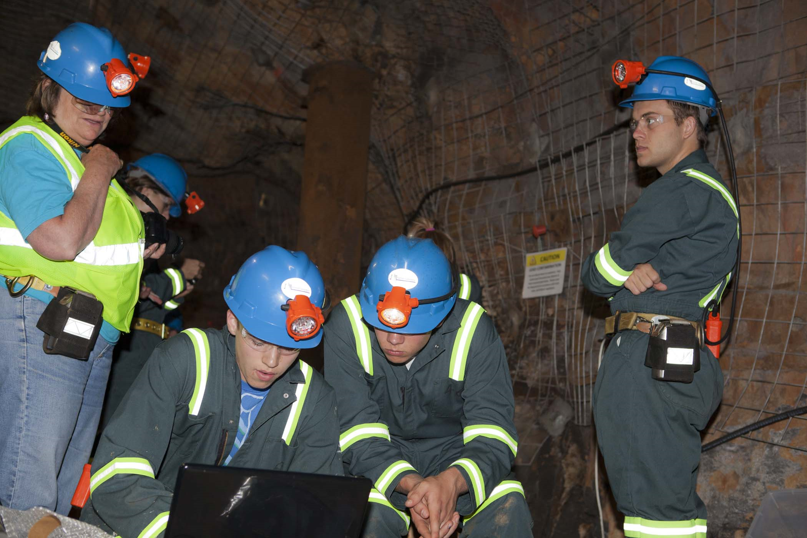

The Mile Deep Muon Detector (MD²)
Cosmic Rays in Context
At the surface in Lead, SD (one mile high)
  ≈ one muon/sec/cm² from cosmic rays
  ≈ 60 billion solar neutrinos/sec/cm²
  Ratio = 10¹⁰:1
Under a mile of rock:
  Muons are attenuated by ≈10⁶.
  Neutrinos aren’t attenuated.
  Ratio = 10¹⁶:1
An Undergraduate Summer Project
Davis-Bahcall Scholars installed the Mile Deep Muon Detector at the 4850L of the Homestake Mine in Summer 2011.
  Preliminary results: 3 muons/day
Even though the counting rate is very low, installing a muon detector underground is a useful educational tool.
The Mile Deep Muon Detector is making the first measurements of muons at the 4850L at Homestake—a publishable scientific result!
For more info: pnorris@sanfordlab.org

Slide 11
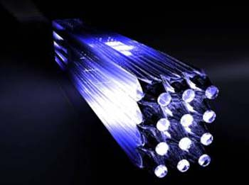
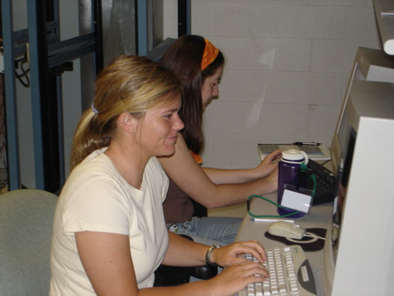
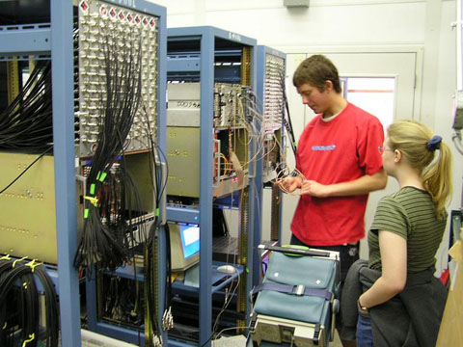
Westmont College Students
Work on the MoNA Collaboration
Analyzing data to discriminate between one & two neutron events
Unwrapped Bars
Working on electronics

Slide 12
April 16-20: International Muon Week
Pilot for International CosmicDay during the week of 24 September
http://www.learnaboutenergy.org/CosmicMap/CosmicMap.html
M. Bardeen, IPPOG, April 2012

