Slide 1
CMS Outreach
Update for IPPOG #3
Achintya Rao
on behalf of the CMS Communications Group

Slide 2
Visits to CMS
~250 visits between mid-December and end of February
Mean of 6 people per visit
Journalists, VIPs, students, teachers

Slide 3
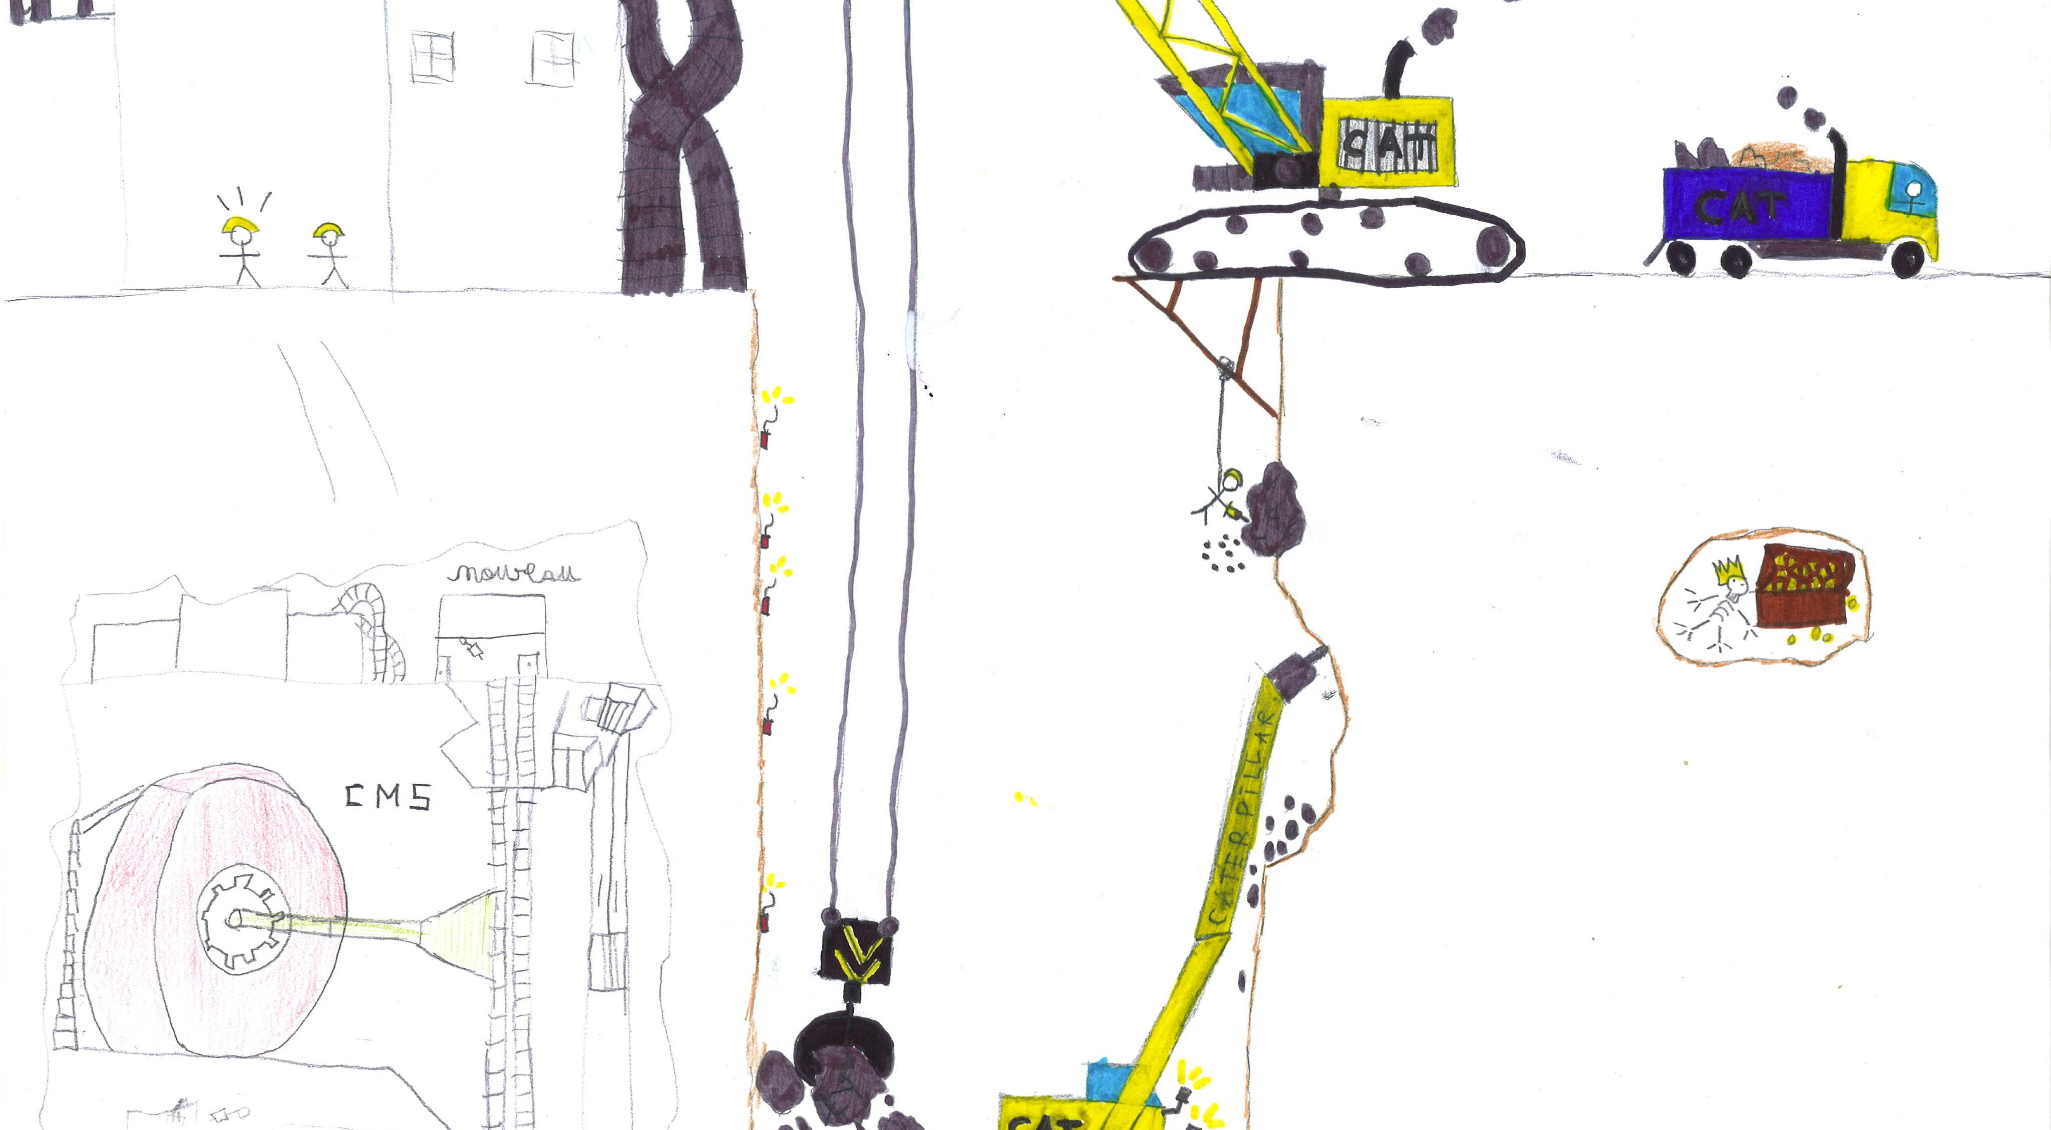
Drawing from students who visited

Slide 4
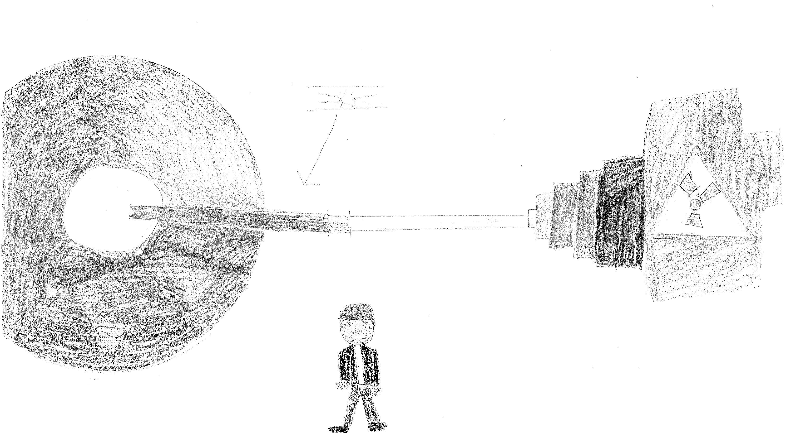
Drawing from students who visited

Slide 5
“Science Hack Day” and CMS data
sciencehackday.com
“A Hack Day is a 48-hour-all-night event that brings together designers, developers, scientists and other geeks in the same physical space for a brief but intense period of collaboration, hacking, and building 'cool stuff'.”
CMS has agreed to release 300k+ events to the public for use in outreach and education
The events have been released in an open, human-readable, and self-documenting format
The format is easily parsed and C++, python (and ruby) APIs have been provided
Hack days are completely self-organized and self-run, with no involvement from the experiment (beyond a minimal amount of guidance from Tom McCauley on the format and APIs).
Article by participant: http://cern.ch/go/fCq9

Slide 6
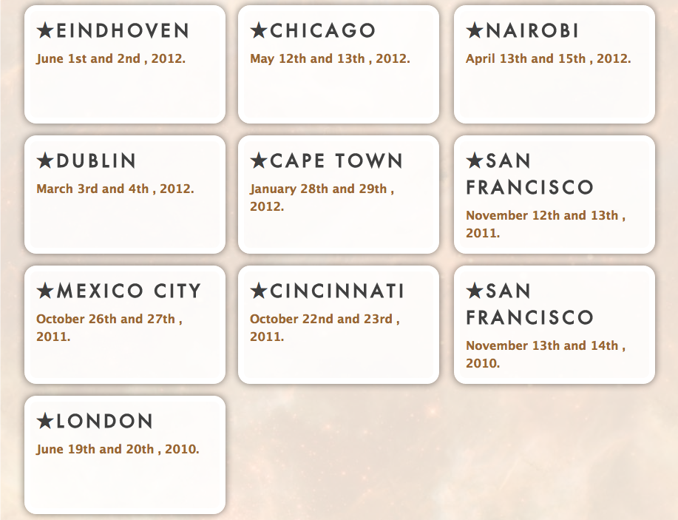
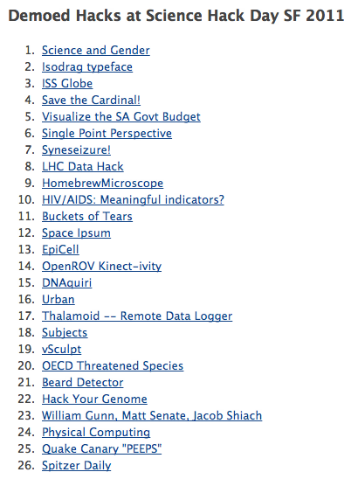

Slide 7
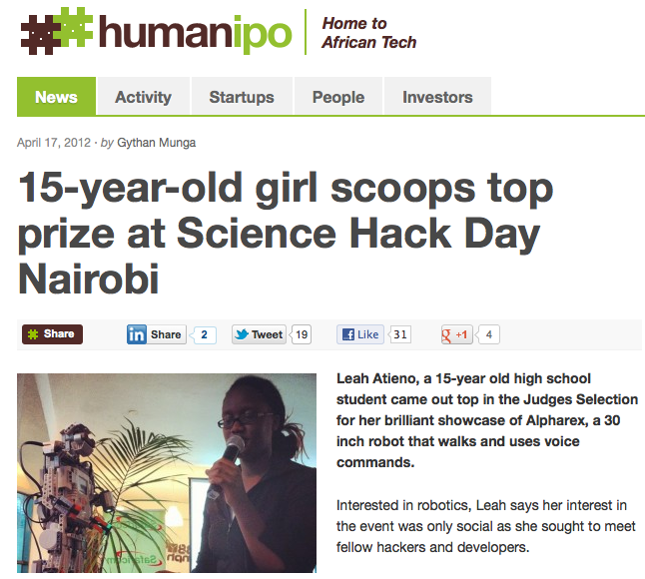
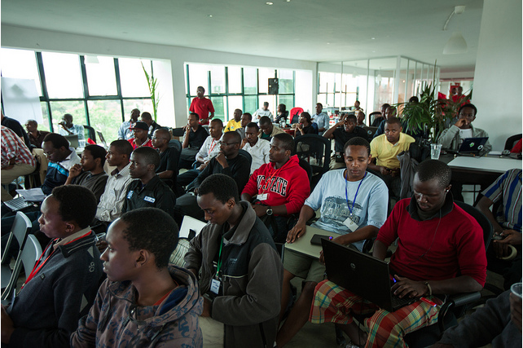

Animation: http://youtu.be/ag7w0vgZj5g
Article: http://www.humanipo.com/blog/210/15-year-old-girl-scoops-top-prize-at-Science-Hack-Day-Nairobi
Photographs: http://www.flickr.com/photos/mbiddulph/sets/72157629442124858/detail/
CMS news: http://cms.web.cern.ch/news/cms-public-data-activity-scoops-prize-nairobi

Slide 8
Google+ Hangouts
Multi-user video chats
Up to 10 simultaneous participants
Can be limited to specific users or can be opened to the public
Hangouts-On-Air: Allows Hangout to be broadcast and recorded
Requirements:
  Hardware – webcam, mic+speakers (also from smartphones)
  Software – browser, Google Talk plugin
  Can share screens, chat, edit documents, watch YouTube videos at the same time etc.

Slide 9
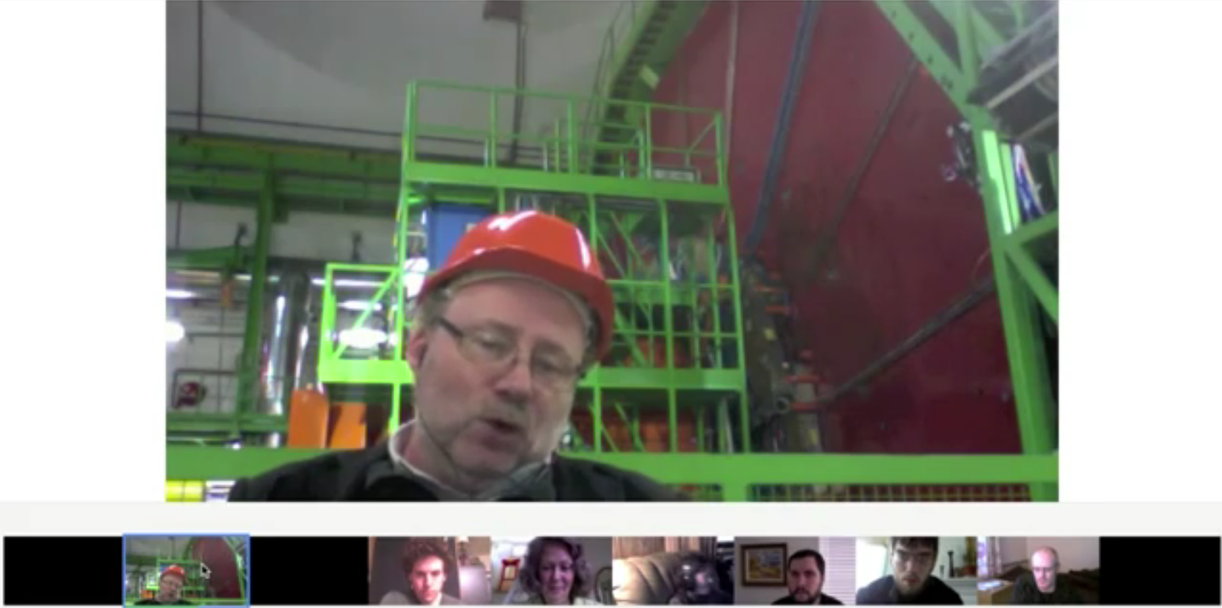
Google+ Hangout
http://www.youtube.com/watch?v=7murS1AnNOI

Slide 10
Google+ Hangout: CMS #1
Announcement: https://plus.google.com/104252363924132346643/posts/VdKGnsg98mE
10th February, 2012Regular Hangout –– Not broadcast
Host: Albert De Roeck
Done in two stages:
  Students from around the world joined from their class – Greece, Bulgaria, Spain, USA, Estonia
  Members of the public, selected based on the questions they asked, enthusiasm and interests
Highlights video got 1500+ views in three days: https://plus.google.com/104252363924132346643/posts/R8RX8W37HYk

Slide 11
Google+ Hangout: CMS #2
Announcement: https://plus.google.com/104252363924132346643/posts/ZnMTwipn2MC
15th February, 2012
Hangout-On-Air –– Hangout launched by Google+
Hosts: Joe Incandela (UXC) and Sue Ann Koay (CR)
Also done in two stages:
  Participants included college students from the US, students from Ghana, high-school students from Romania, Google Science Fair finalist from the US, a mother and her two bright children from South Africa, physics/science enthusiasts from around the world
Videos can be found at: http://cern.ch/go/nh8v | http://cern.ch/go/rc8P

Slide 12

Google+ Hangout: CMS+ATLAS+CERN

Slide 13
Google+ Hangout: CMS+ATLAS+CERN
Announcement: https://plus.google.com/104252363924132346643/posts/gJe2hbvrJ95
4th April, 2012
Hangout-On-Air –– Hangout launched by CMS physicist in Fermilab
Hosts: Dave Barney (CMS Control Room), Steve Goldfarb and Denis Damazio (ATLAS Control Room), Mirko Pojer (CERN Control Centre)
One school from Brazil and three members of the public
Videos can be found at: http://cern.ch/go/GHc7 | http://cern.ch/go/6kpS

Slide 14
Google+ Hangout: Comments
Thank-you for this extraordinary opportunity. My students say they learned a lot and were excited to interact with an actual physicist in the CERN cavern. We appreciate Albert taking time to "hangout" with us. It was a great experience that I'm sure they'll remember. – Jeremy Wegner, teacher from US school
Thank you very much for the wonderful hangout event. Our special thanks to Dr. Joe Incandela and Dr. Sue Ann Koay. My students loved this event! – Ioana Stoica, teacher from Romania
I am on such a high. What a fantastic experience. Thank you for the invite. It was really cool getting to chat with the scientists at CERN. – Matt Morris, Google Science Fair finalist
Mind boggling at so many levels is probably descriptive. People connecting from all over the place. Awesome. Not just world wide but in this case also in the z axis with one of the participants underground – Franc Schiphorst, Netherlands

Slide 15
Google+ Hangout: Comments
Last night, my boys were able to participate in a hangout with the CMS experiment, since they are fascinated by physics and hence asked to join the hangout from the experimental cavern. It was just so exciting, especially since we are based in Africa, to "be there" virtually. Thanks, CMS Experiment and Google+ for making science accessible to us all, everywhere, young or old, enthusiast or expert, hailing from a multiplicity of countries but all connected by a common love of learning. – Kathryn Kure, who joined from South Africa with sons aged 7 and 8.
Thank you very much for hosting this event! It felt like we were there with you! Please do such hangouts more often, as they are very enlightening! – Vladimir Lankevich, who joined with fellow University of Rochester undergrads
Thumbs up for G+ for the hangouts. CERN sometimes seems a little bit inaccessible to the general public. This seems like a step in the right direction for them. – Dessislava Jeleva, viewer

Slide 16
Thank you!
Any questions?

