Slide 1

(New) ALICE Outreach Initiatives
Visits
Masterclasses
Dans la peau d’un chercheur
….
Brainstorming meeting - form “outreach group”
Identify priorities
“Working groups” to follow up various ideas

Slide 2
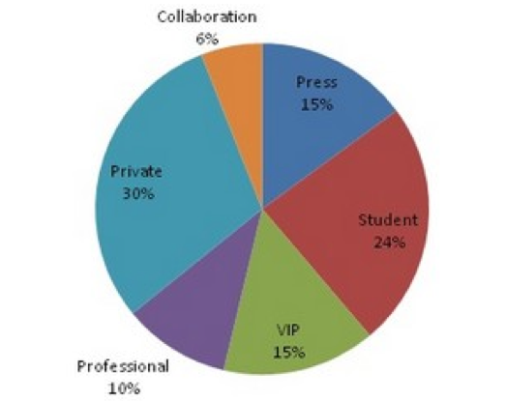
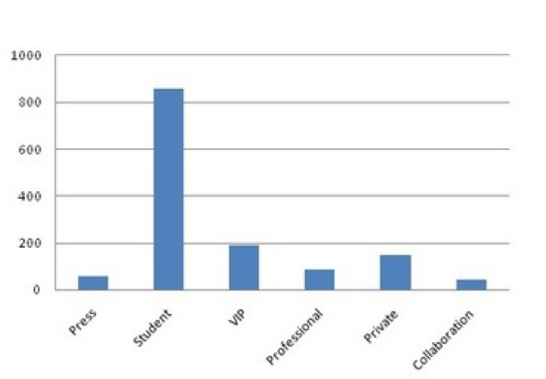
Visits winter stop 2011-2012
> 130 visits ~1500 visitors
Visit of Science Museum London in preparation of LHC exhibition in 2013
Reviewing ALICE winter visits http://alicematters.web.cern.ch/2012visits

Slide 3
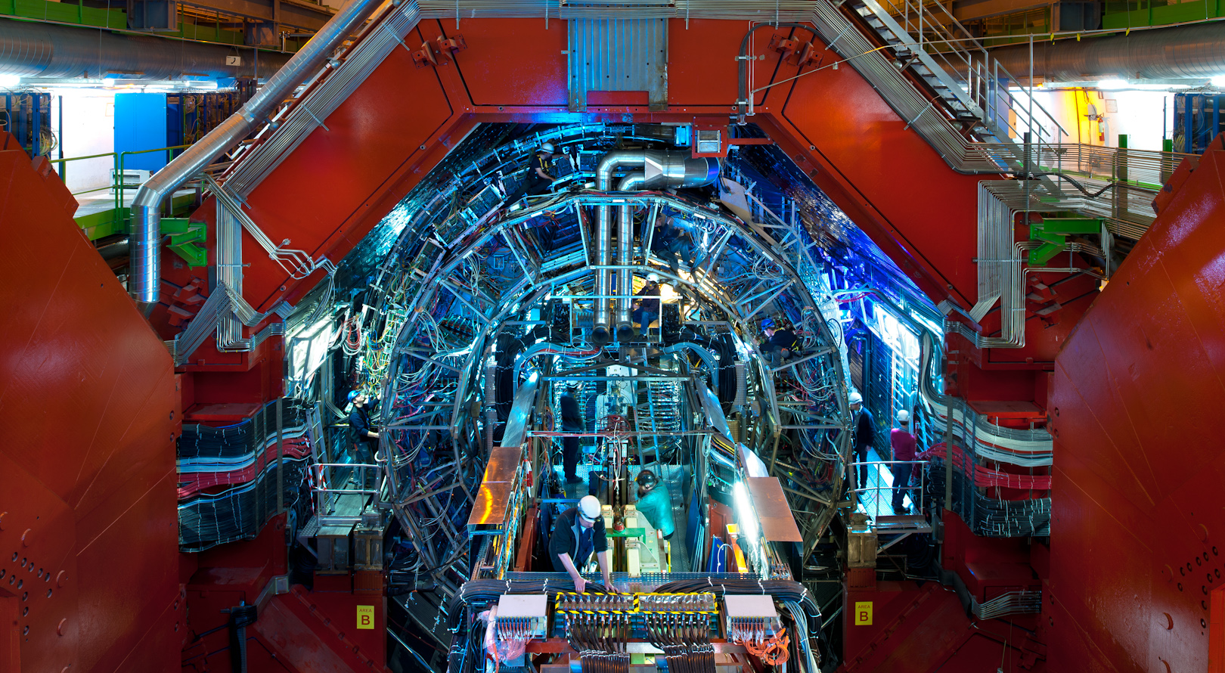
New series of ALICE photographs by Antonio Saba (February 2012)
http://cdsweb.cern.ch/record/1436208 http://cdsweb.cern.ch/record/1436155 http://cdsweb.cern.ch/record/1436153

Slide 4
CERN ALICE masterclass - 22 March 2012
29 pupils + 2 teachers (1ère scientifique Lycée International de Ferney)
Morning lectures
François Arleo Giacinto de Cataldo
Visit ACR + Exhibition
Nicola Arbor Giacinto de Cataldo Despina Hatzifotiadou
Instructors for measurement
François Arleo Giacinto de Cataldo Nicolas Arbor Yiota Foka Frank Cliff
Giacomo Volpe Emilia Leogrande Mihai Niculescu Despina Hatzifotiadou
Organisation (CERN communications)
Sandrine Saison-Marsollier Letitia Pedroso
Techinal support (CERN training centre)
Eric Bonnefoy

Slide 5
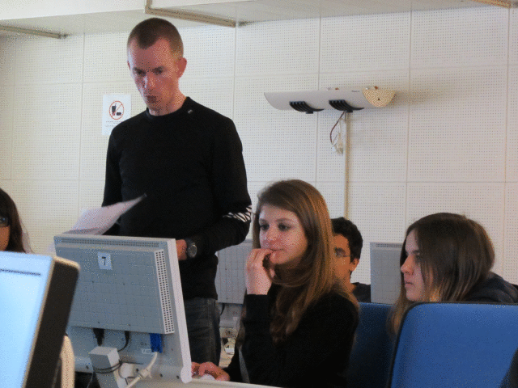
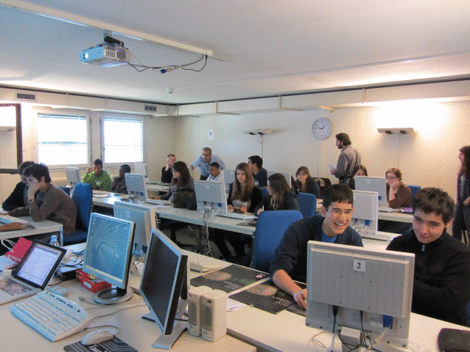
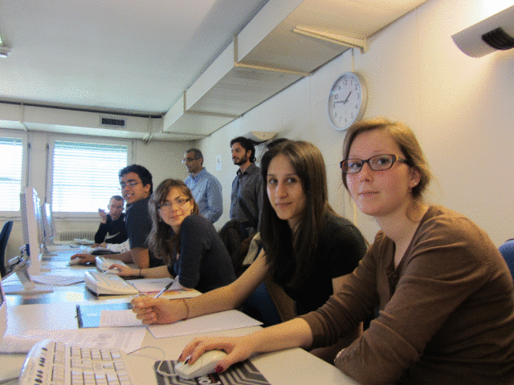
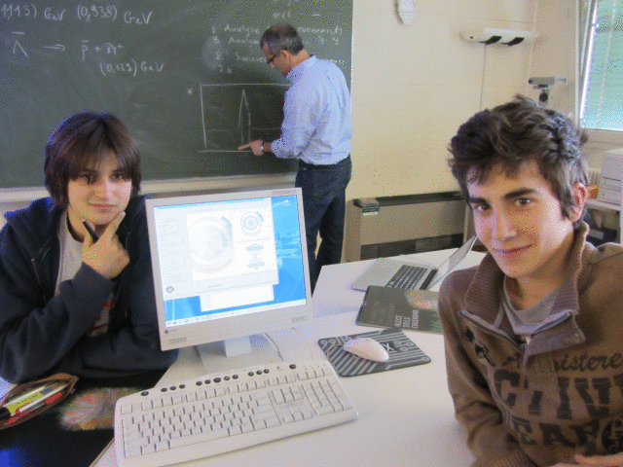
http://cdsweb.cern.ch/record/1438735 CERN 22.3.2012

Slide 6
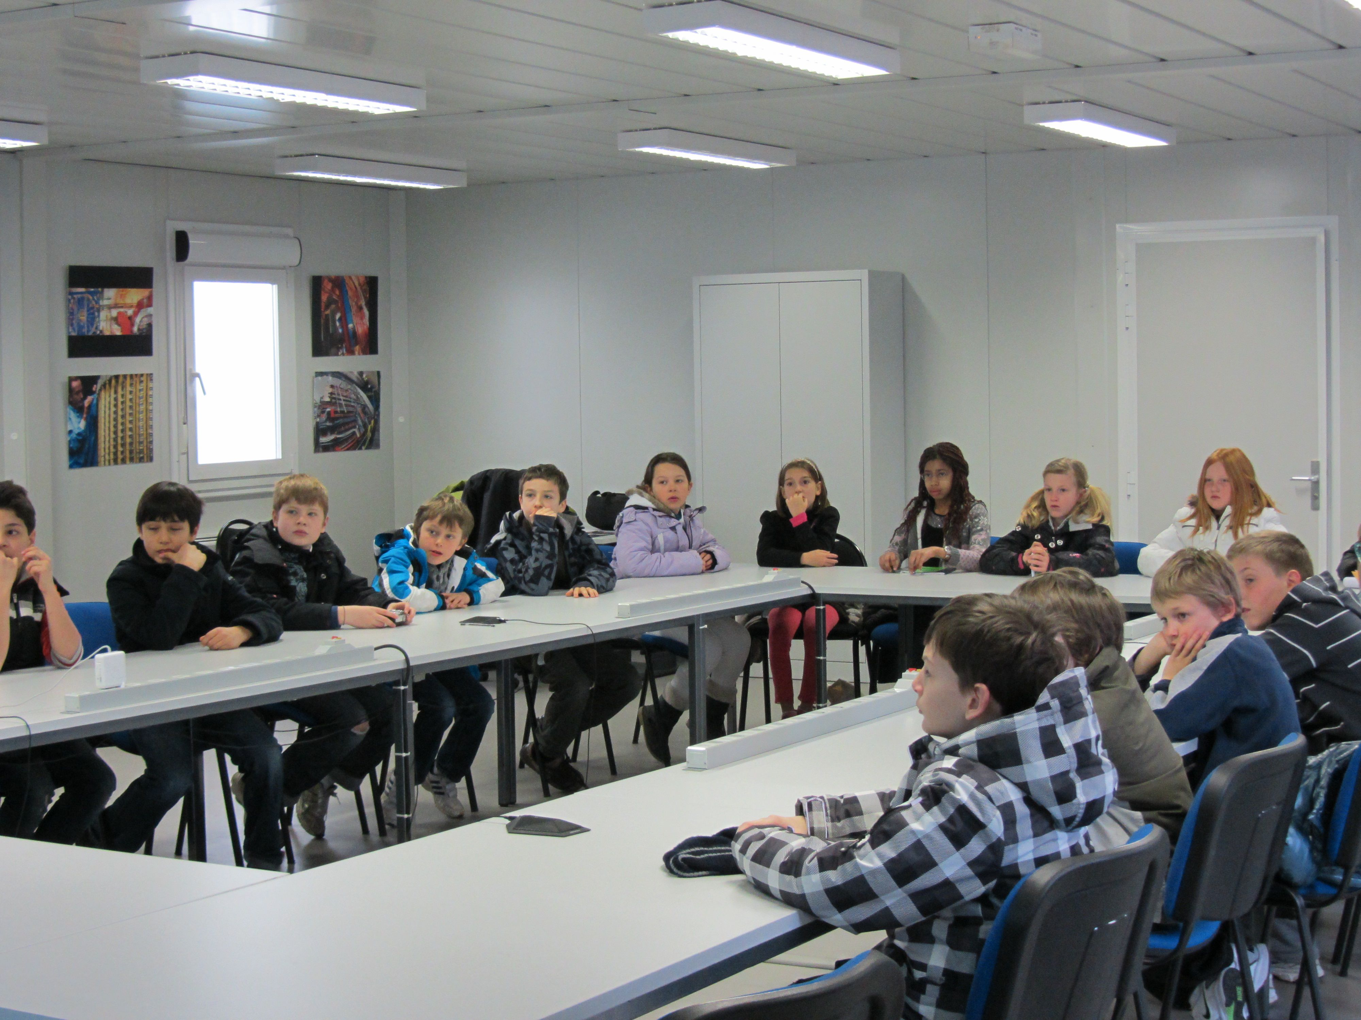
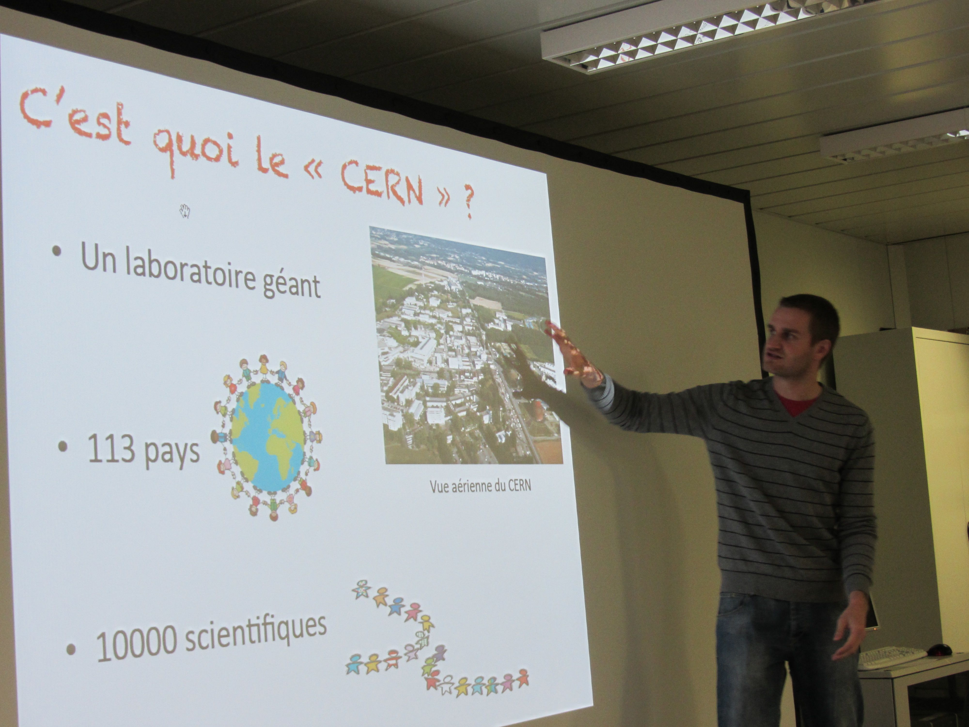
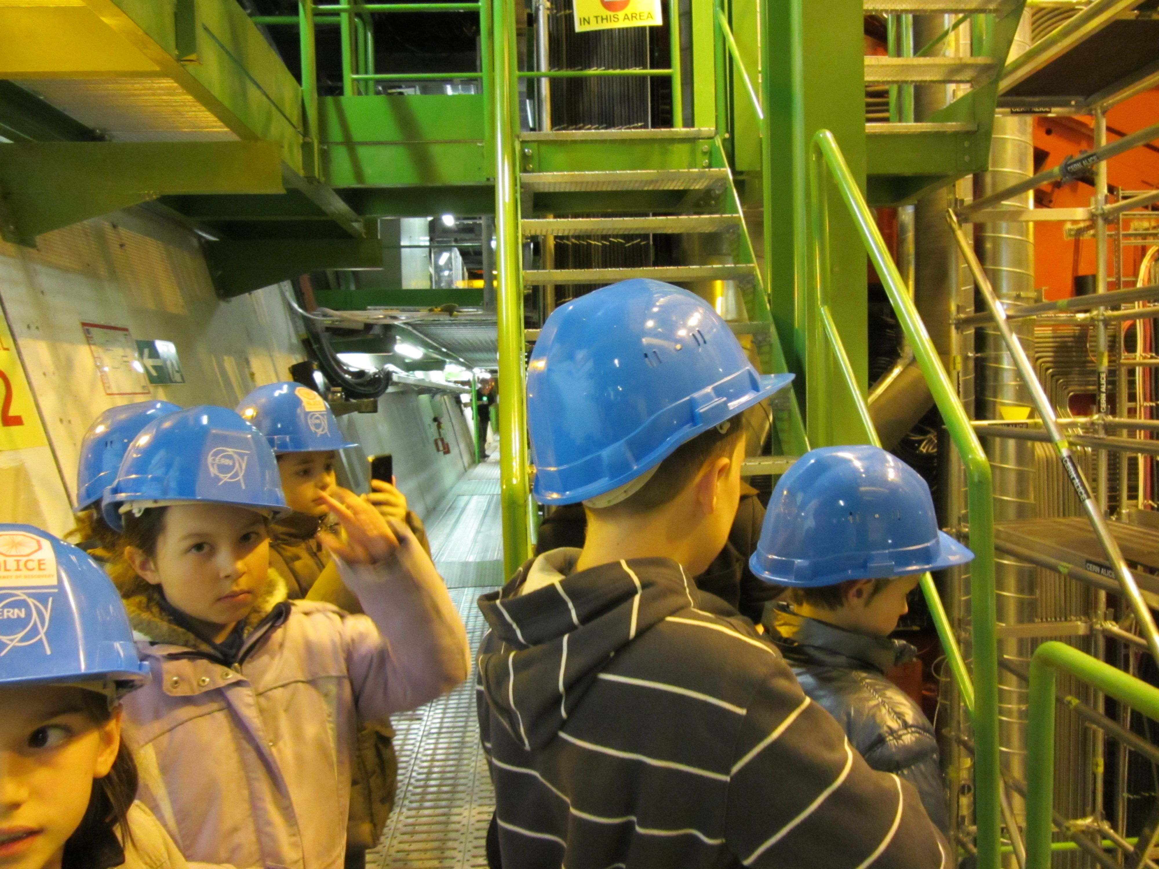
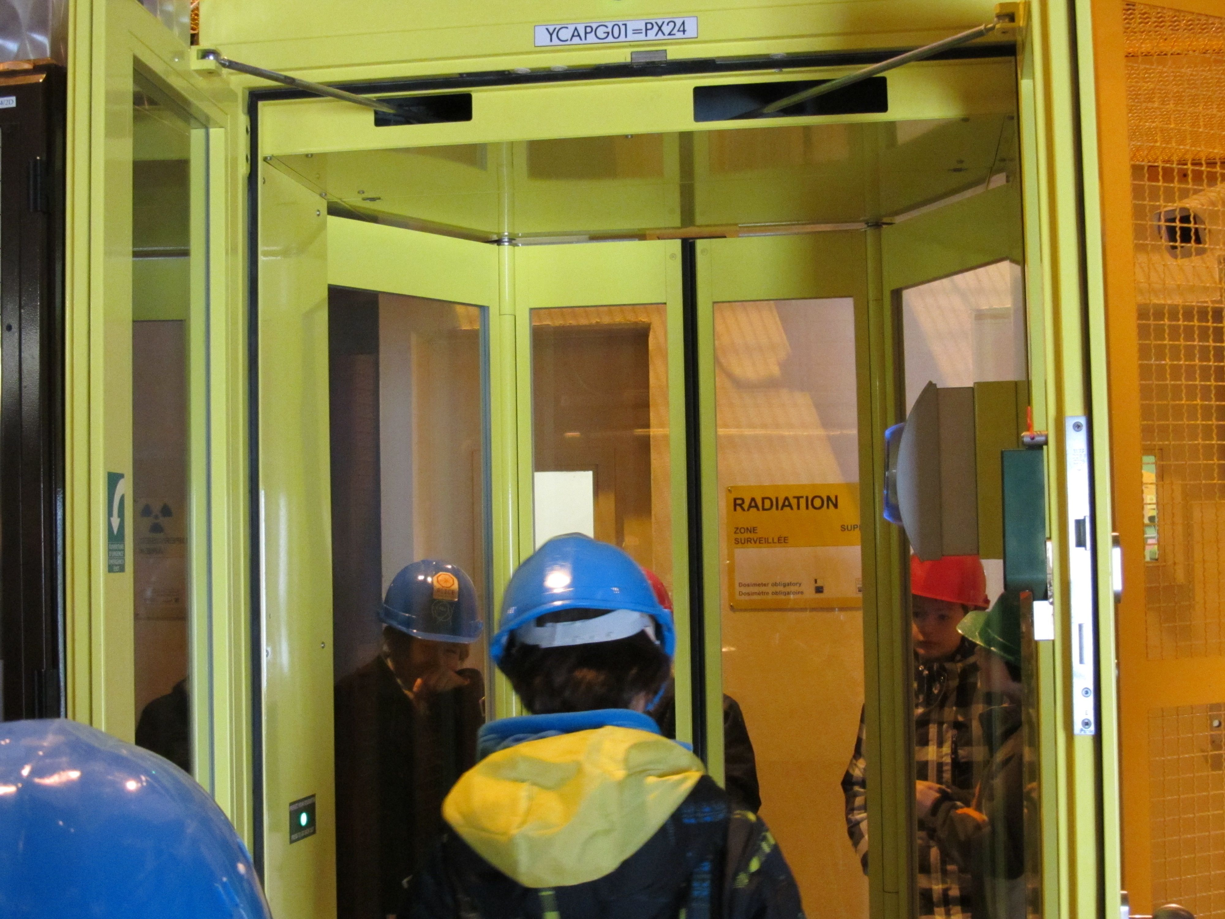
Dans la peau d’un chercheur – Ecole des Grands Chênes, Prevessin – 8 March 2012

Slide 7
Animations : Quark Gluon Plasma (creation – evolution)
Collaboration with Agnes Mocsy, from Pratt Institute
Short term : organise contest for animation students
small cash prize + highlighting their video on ALICE web pages, US LHC blog,…
Involve US ALICE physicists in explaining the QGP physics to animation students
Organise visits to BNL where they can see the real thing
Longer term : organise another competition
prize for the winner(s) will be a trip to CERN, where they can make another video
Look for funding for the above / identify US ALICE physicists
Give animation students a class project and filter them from there
There is interest, enthusiasm and more ideas (interactive ebooks..)

Slide 8
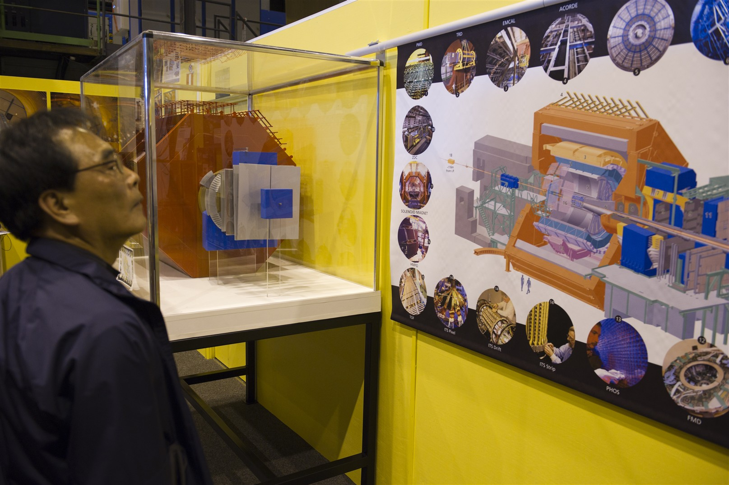
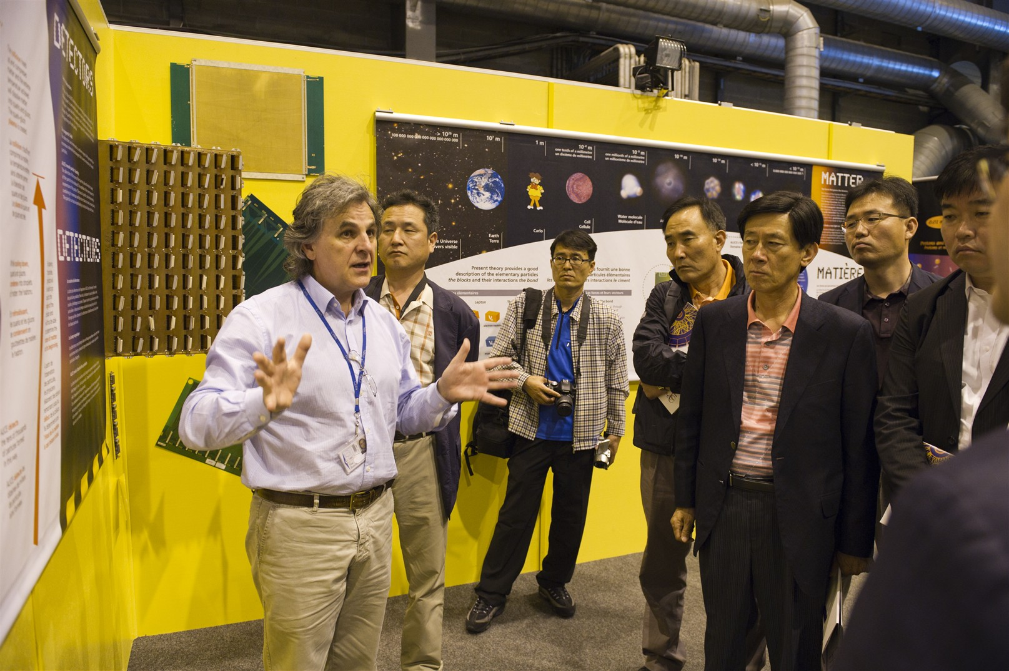
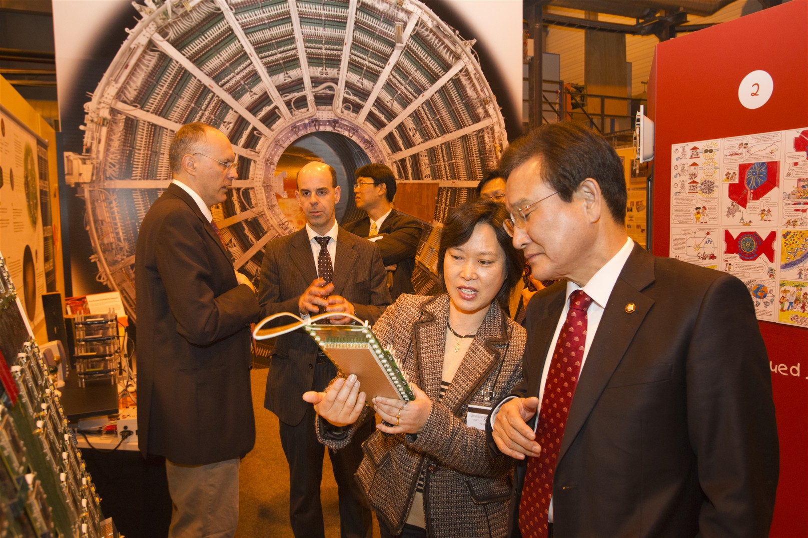
ALICE Exhibition at point 2
“Guides’ manual” will be produced to help guides
Will evaluate exhibition contents/information

Slide 9
Redesign ALICE public web pages
Survey and discussions
Update contents; content management system
Detector posters
Update with
real performance results
physics results
(to replace simulation/test beam results)

Slide 10
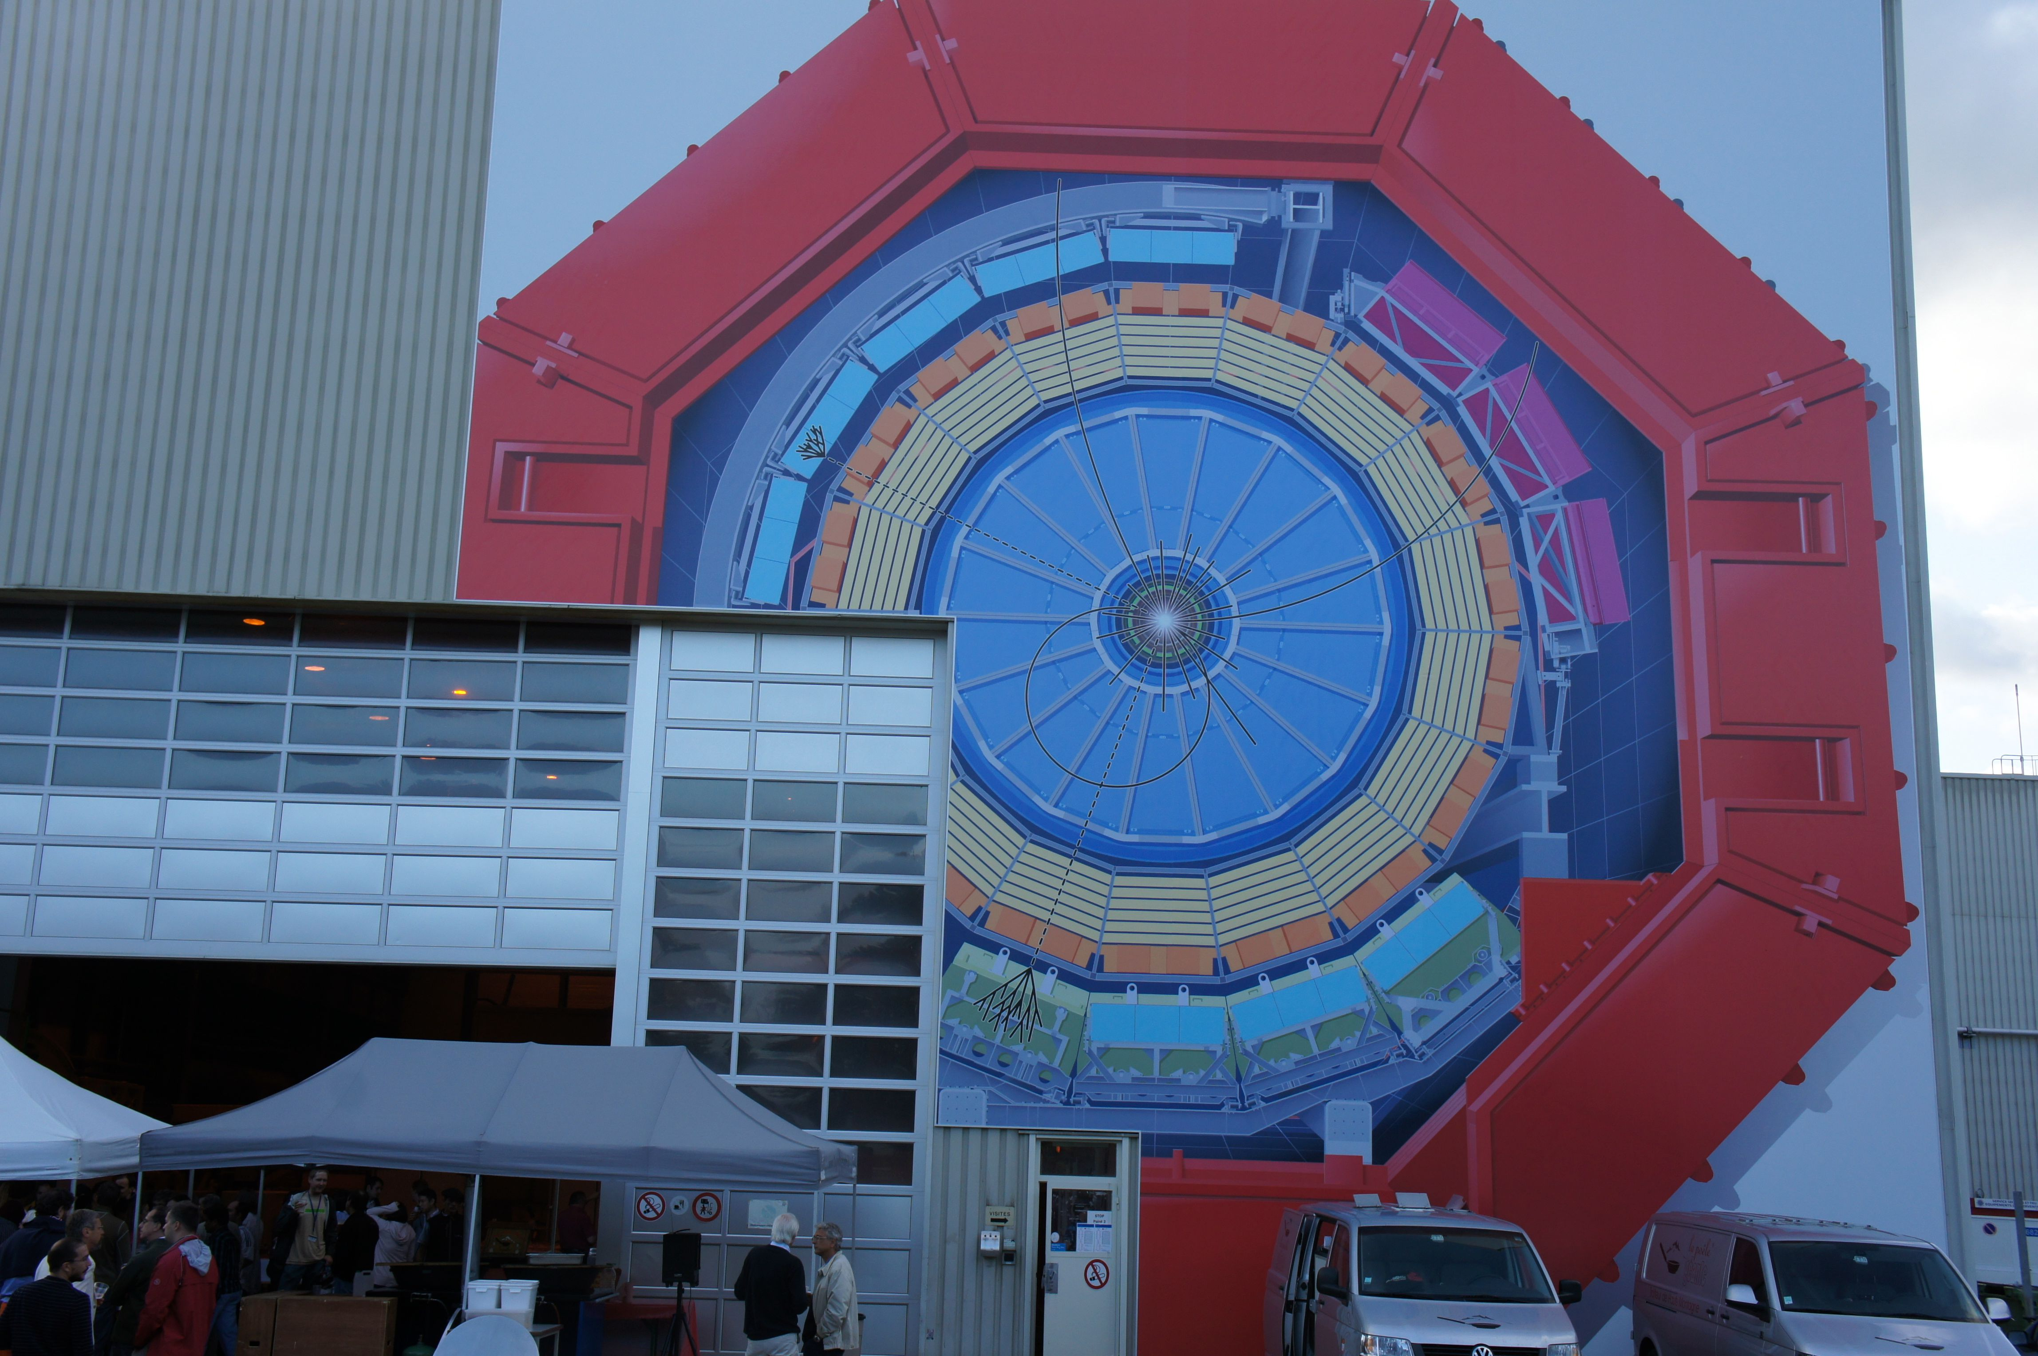

Slide 11
