Slide 1
“MEMBERS” & “ABOUT US”
Web Pages

Slide 2
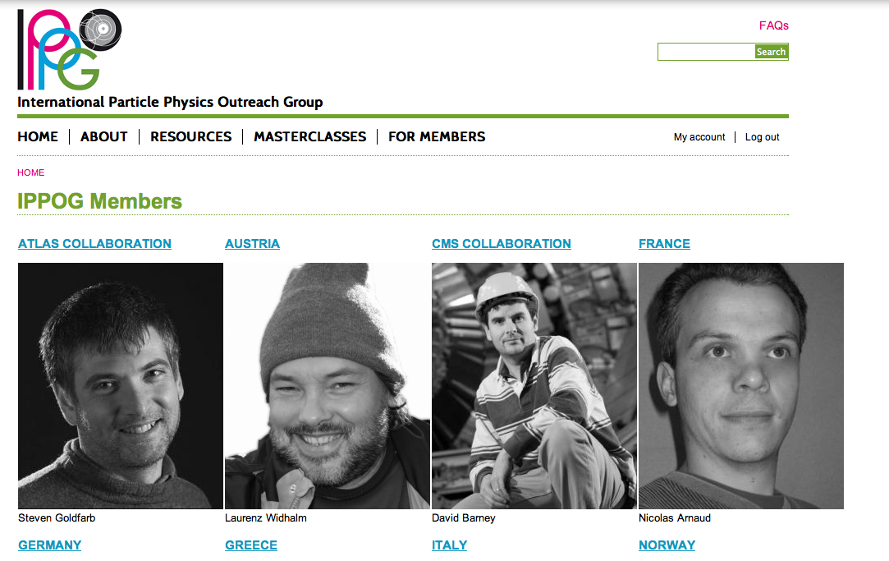

Slide 3
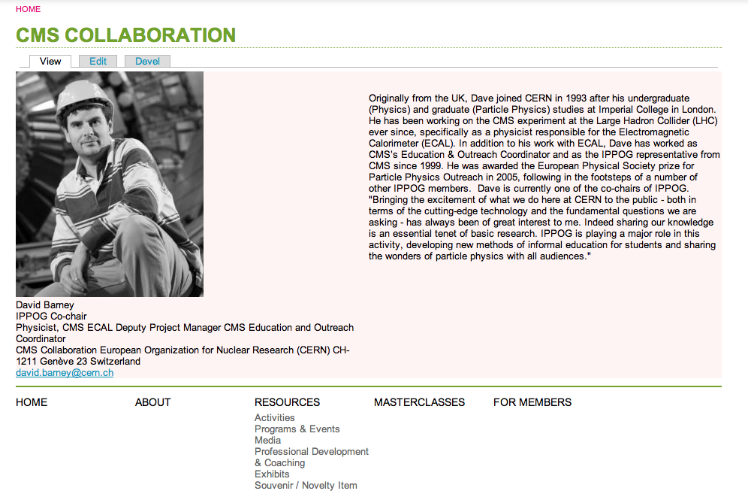

Slide 4
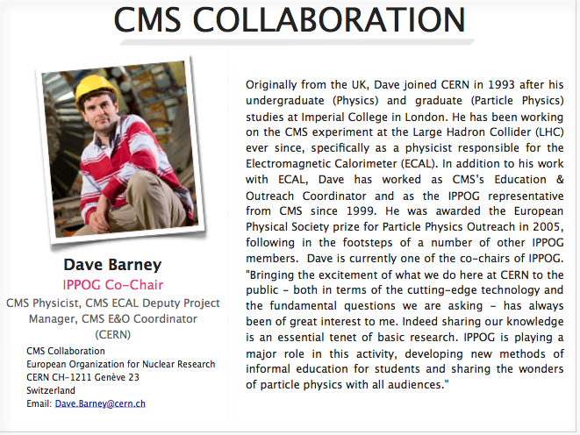

Slide 5
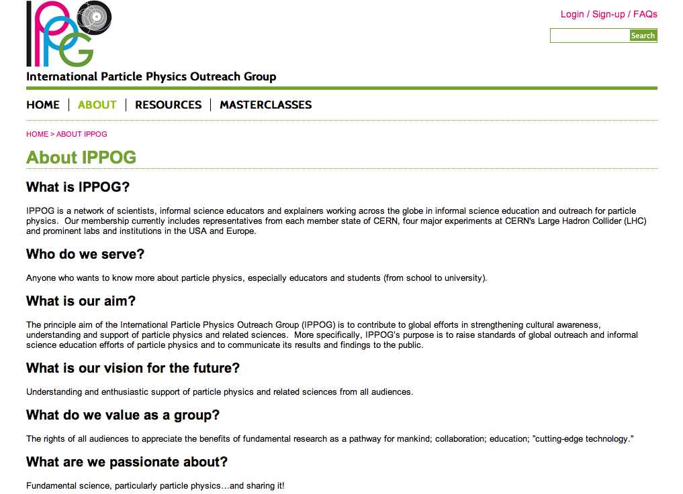

Slide 6


