Slide 1
Explaining the Standard Model Mass Mechanism to the Public aka the Brout-Englert-Higgs-Hagen-Guralnik-Kibble Field and the Higgs Boson
Michael Kobel
Fakultät Mathematik und Naturwissenschaften, Fachrichtung Physik
IPPOG Innsbruck, 20.4.2012

Slide 2
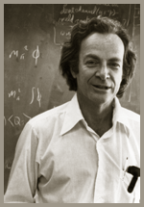
Do you want to be famous?
Do you want to be a king?
Do you want more than the nobel prize?
- Then solve the mass Problem –
R.P. Feynman

Slide 3
What and how to explain?
What is mandatory, what is optional?
  Difference between Field and Boson
  Mass creation mechanism by the BEHHGK-Field
  Production of Higgs Bosons
  Experimental Discovery Techniques of Higgs Bosons
  Connection to Symmetries
  …
How to explain in words
  Be simple but physically correct
How to explain in pictures
  Mechanical analogues:
    which ones work best?
    Which ones are most correct?
How to explain in animations
  Visualization of Field and Boson and their relation

Slide 4
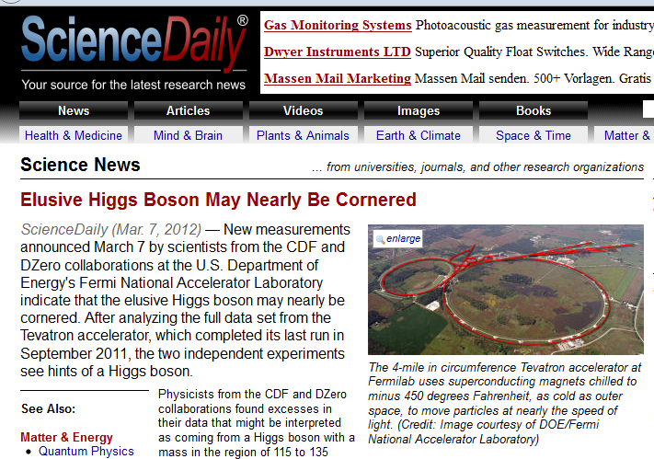
Wrong wording
www.sciencedaily.com/releases/2012/03/120307083629.htm
"Without something like the Higgs boson giving fundamental particles mass, the whole world around us would be very different from what we see today," said Giovanni Punzi, CDF co-spokesperson and physicist at the National Institute of Nuclear Physics, or INFN, in Pisa, Italy.

Slide 5
NO:
It‘s the Higgs FIELD which gives mass.
  Even with just the Higgs field in its ground state,
  without any single Higgs Boson in the universe,
  particles would have mass
AND:
  The higgs field is *not* made of Higgs Bosons
  (see later)

Slide 6
CERN backgrounders
http://press.web.cern.ch/press/background/B01-Higgs_en.html
  According to theory, the Higgs mechanism works as a medium that exists everywhere in space. Particles gain mass by interacting with this medium. Peter Higgs pointed out that the mechanism required the existence of an unseen particle, which we now call the Higgs boson.
O.K! ☺
  The Higgs boson is the fundamental component of the Higgs medium, much as the photon is the fundamental component of light.
NO! ☹

Slide 7

Don Lincoln
http://www.youtube.com/watch?v=ktEpSvzPROc
„the Higgs Field ist made of Higgs Bosons“
In german: http://www.forschungs-blog.de/was-ist-eigentlich-das-gottesteilchen-higgs-boson/
  Das Higgs-Feld besteht aus Higgs-Bosonen. Auch hier trägt das Bild des Wassers zum Verständnis bei. Wenn man ins Wasser eintaucht, bemerkt man: ist es überall, es hat keine Löcher oder Unterbrechungen. Es ist ein durchgehendes Medium. Und Wasser besteht aus unzählbar vielen, einzelnen H2O-Molekülen. Dieser Aufbau ist grob mit dem Higgs-Feld vergleichbar, das aus unzählbar vielen, einzelnen Higgs-Bosonen besteht.

Slide 8
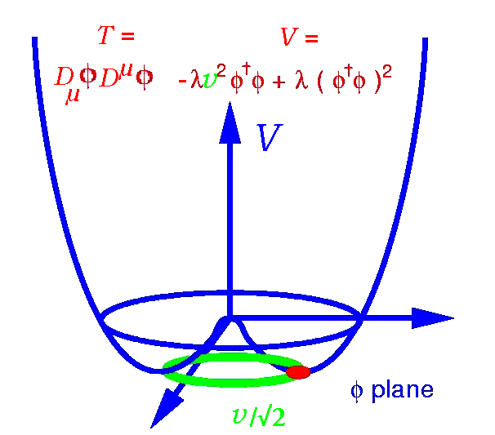
Der BEHHGK-Mechanismus
Minimal Model:
  1 komplex SU(2) Doublett φ
  Quartic Potential
  Ground State not bei
2 komplex Fields φ⁰ und φ⁺
Ground State
2 free parameters:
  v (Vakuum Expectation Value)
  λ (Steepness of Potential)
Broken symmetry
  Rotation symmetry for Potential
  in φ –plane
  spontaneous broken:
  ground state not symmetric
φ⁰
φ⁺

Slide 9
Consequences
  Creation of Fermion Masses
    Each Fermionen couples with its own coupling y_{f} to background medium
    Origin of y_{f} completely unclear!
  excitation of BEGHHGK-Field = Higgs.Bosons with Mass
    ~ √ steepness of potential
    λ unknown, so Higgs-Mass not predictable
  kinetic term of Higgs field
  ~
    Creates automatically die Z-h und W-h interactions
    W and Z-Boson-Massterms
m_{f} = √½ y_{f} v
m_{h} = √(2λ) v

Slide 10
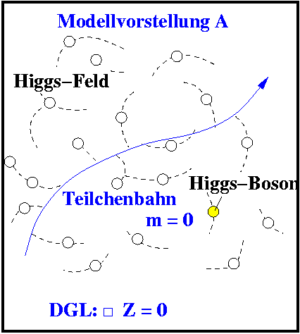
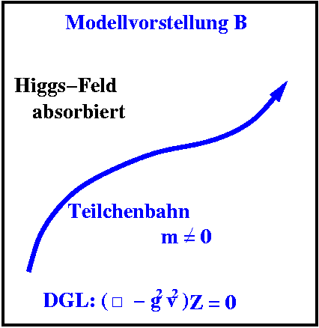
Two equivalent viewpoints
Massless particles move in field == Massive particles move in
field with non-zero v vacuum ground state;
and thus appear massive Mass is
  Higgs Boson is excitation Higgs Boson is a particle
  of the Higgs field: which can be created from
  Φ = (v + h(x)) the vacuum like other partilces

Slide 11
Two equivalent viewpoints
1) View from (0,0): there is a BEHHGK-medium:
  the Higgs Boson is its excitation
  If you visualize a medium, it has to stay there if You produce h-Bosons
2) View from (v/√2, 0): redefine the medium into the vaccum:
  Higgs Bosons are created from the vaccum.
  Better not visualize the medium at all
BUT independent of viewpoint:
The Higgs medium (field) v is never made out of Higgs Bosons h
Mixing viewpoints will lead to wrong conclusions,
( like adding forces in two different reference frames
e.g. centripetal force and centrifugal force )
→ video animations should use either (1) xor (2)
  (2) does not allow to visualize the BEHHGK-medium

Slide 12
Background text from from US-LHC communications group
https://cms-docdb.cern.ch/cgi-bin/EPPOGDocDB/ShowDocument?docid=273
  Some particles interact with the Higgs field more than others, which is why the particles in the Standard Model all have different masses. For light particles such as electrons and neutrinos, traveling through the Higgs field is like running down the street. Heavier particles, such as the electron’s larger cousins, muon and tau, experience more resistance, as though they were running in a swimming pool full of water. For the top quark, which is by far the heaviest particle in the Standard Model, traveling through the Higgs field might feel like wading through a vat of molasses.
  O.k. ☺ …
  The Higgs field is a leading candidate for explaining why this is the case. At a certain temperature, the electroweak force separates into the electromagnetic and weak nuclear forces. This triggers the conversion of parts of the Higgs field into particles. The particles that interact with the weak field become massive, and the particles that interact with the electromagnetic field remain massless. The leftover particles are known as Higgs bosons.
  ??? ☹

Slide 13
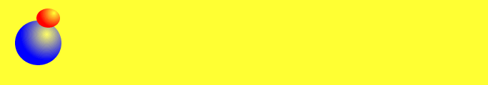
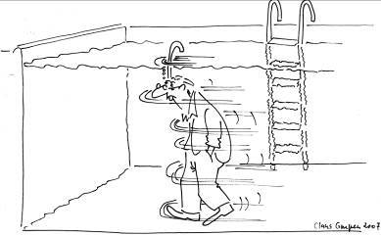


Analogies
Leeres Vakuum
  Alle Teilchen sind masselos
  bewegen sich mit Lichtgechwindigkeit.
Higgshintergundfeld
  Teilchen werden durch WW mit dem
  Higgs-Hintergrund-Feld verlangsamt.
  Teilchen erhalten effektiv eine Masse.
  Wert hängt von der Stärke der WW
  mit dem Hintergrundfeld ab.
Higgs-Teilchen
  quantenmechanische Anregung
  des Higgsfeldes
  notwendige Konsequenz des Konzepts !
  Higgs-Feld nur über diese Higgs-Teilchen nachweisbar
  (wie Luft um uns über Wind, oder Wasser um Taucher über Strömung)

Slide 14
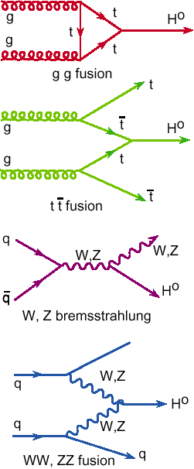
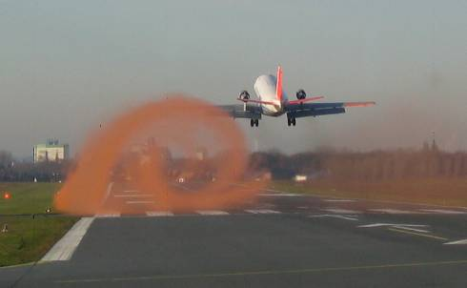
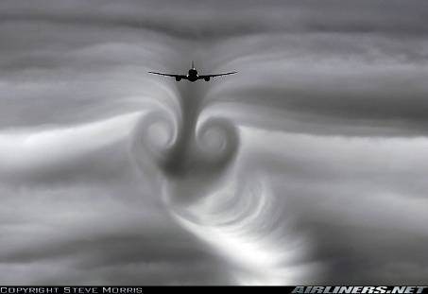
Higgs field and Higgs bosons
Discover Higgs field by Higgs Boson production
  Higgs Boson ~ excitation of Higgs field
  (Rather like a vortex ~ excitation of air)
  Need to move massive
  particles with high E
  through medium
  to create excitations
Copyright: DLR, Köln

Slide 15
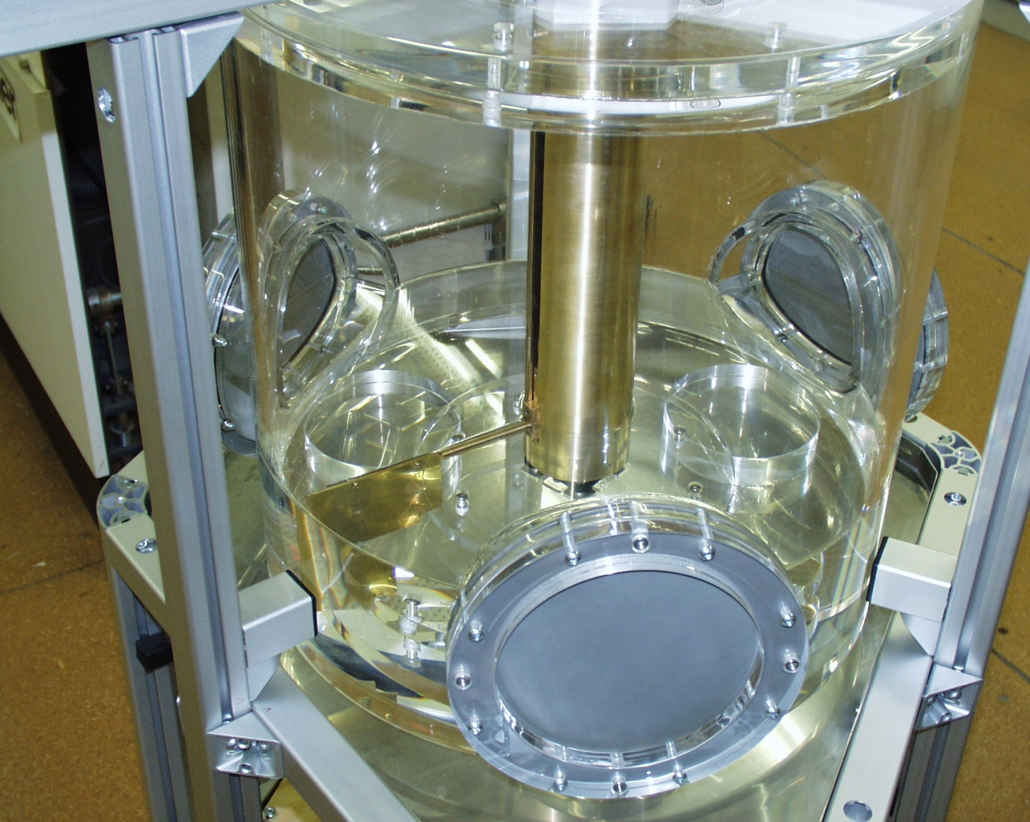
The Higgs Mechanism
(TU Dresden, Würzburg Univ)
Particle
(metal paddle)
moves in
Vacuum
(Air)
or
Higgs field
(Silicone Oil)
with variable
Mass
(inclination angle)
and can create
Higgs Bosons
(bull’s-eye bulge)
YOU CAN FEEL IT!
Handle
Vacuum
“Create” Higgs-Field
Mass Higgs-Field
Particle
Higgs-
Boson

Slide 16
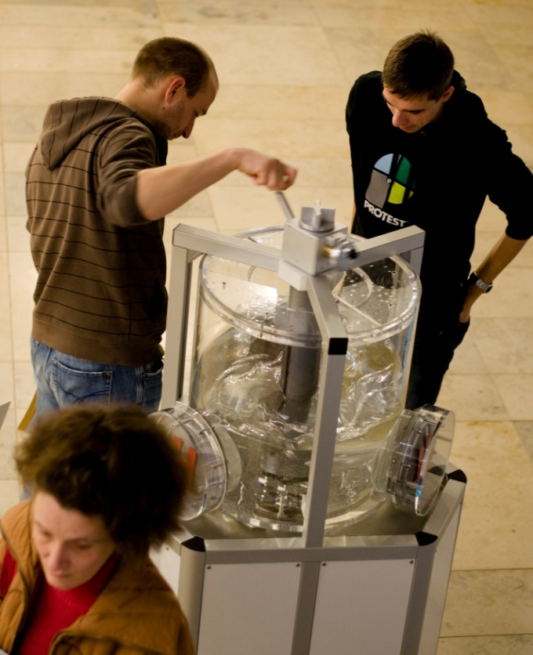
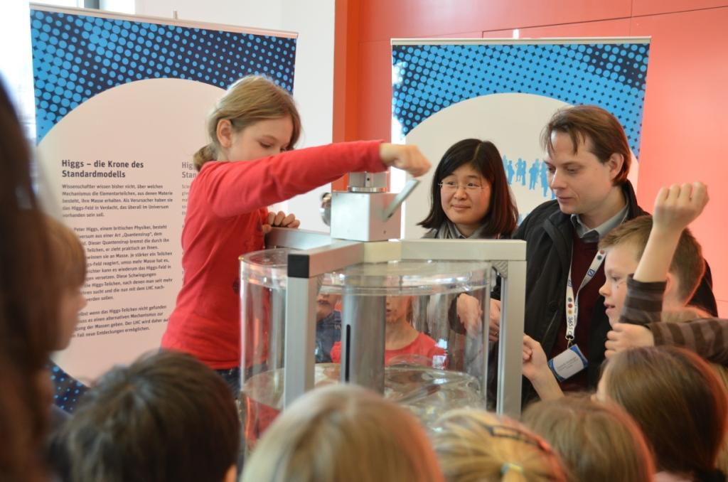
Tag der Weltmaschine, 23.11.2011, Dresden

Slide 17
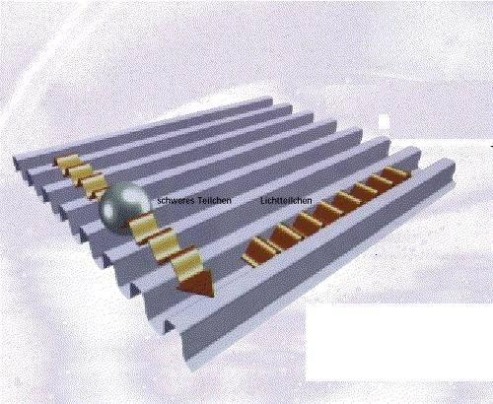
The origin of mass (Poster, DESY)
Each particle moves in ist own (abstract) direction
Depending on this direction the Higgs field causes more or less mass
Details are much more complicated

Slide 18
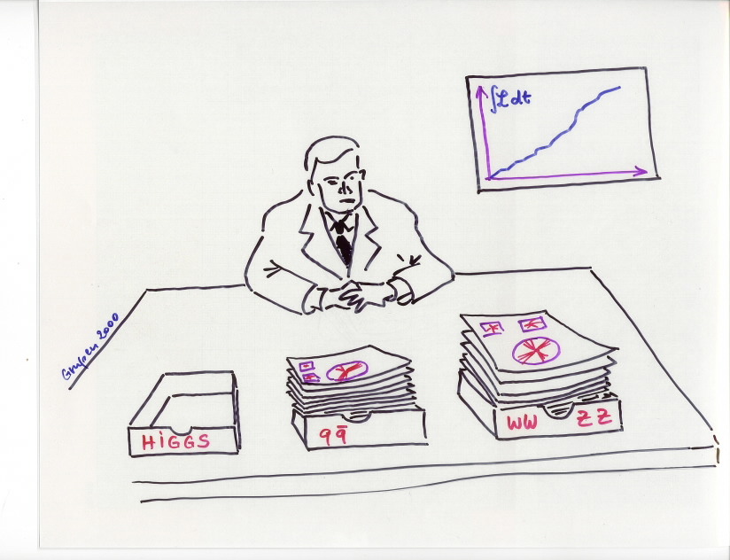
keep on searching!

