Slide 1

IPPOG Database
Status Update
20 April, 2012

Slide 2
Process of Website Development
Consultant paid by Pathway Project
(EU Funds)
Temporary help from Ivan Kuchin (CERN Education Group)
Present situation –
  Lisa now learning Drupal (beginner!) and trying to do as much development as possible
  Existing support at CERN minimal
  Need support from IPPOG members, and…
  Especially if Lisa leaves soon...we need a plan
Remember…Eventually will move this database to CDS = will then have more features available
Notes:
Home Page, Resources Page, view of Item Page

Slide 3
Feedback Received
12 individuals responded
People like it!!
  So far easy to find things
  Looks good, fun, interesting, appealing, clean layout
Several suggestions made on basic page formatting, search functions, categorization
Have already made changes to
  Help text
  FAQ list growing

Slide 4
Questionnaire On-line
LEARNING TOPICS
MISCELLANEOUS SUGGESTIONS
  (Questionnaire Soon available)
Notes:
Too many ideas to discuss now in the group. Better to let people decide on-line.

Slide 5
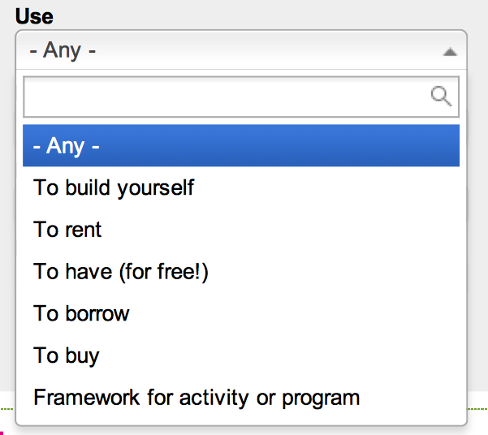
Lisa’s Burning Questions-1
Categorization – “USE”
Notes:
Use seems to be an awkward term. As the spelling “Use” has two meanings.
Need a way for people to categorize items to make it easy for database users to see what they do with the item, what it is used for.
Ideas???

Slide 6
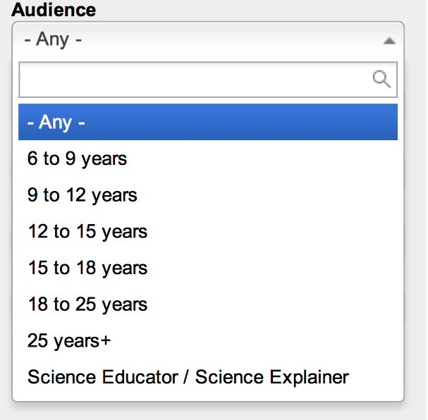
Lisa’s Burning Questions-2
Categorization – “Audience”
Notes:
We need a way to sort items according to what audiences it is good for.
Is this age breakdown the best way?
Suggestions received:
Age breakdown suggestion, 18+ for older group
Don’t have any age breakdown
Add another audience sub-set of teachers, laypersons, etc.

Slide 7
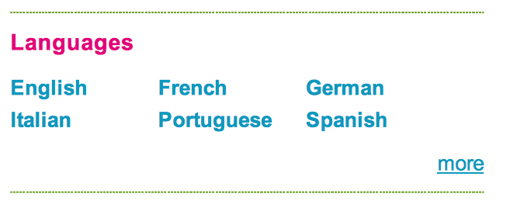
Lisa’s Burning Questions-3
Search Box – “Language”
Notes:
When clicking on a language, it gives us EVERYTHING in that language. We cannot filter by item type or other filters until we migrate to CDS.
Was suggested to get rid of this search box all together for now if it is not super useful
And Replace with Instead, maybe we could implement it as a language selector (as some webpages have to switch between local and English versions), showing flags representing the languages. This would a) do the job of showing that we are multi-lingual and b) make more sense, as you can, if you want, restrict your searches to certain languages.

Slide 8
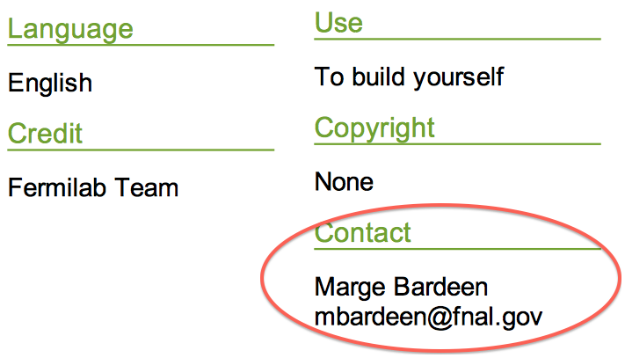
Lisa’s Burning Questions-4
“Contact Person” field
Notes:
Spamnot…or crypted email-addresses, and the link to the email address actually calls a scripts that decrypts the mail address and opens the mail client.
Remember, This must be updated in each entry if this changes.
Or, create a form within the document creation form to a “contact person” form. If the person’s details are already registered, an auto-fill function could suggest names to the submitter. That way the person’s details would be stored in only one place and have to be changed only once, not in every document.

Slide 9
Lisa’s Burning Questions-5
Publication procedures
“Thank you for your submission! Your item is now being reviewed by the IPPOG site administrator and will be published shortly. Should you have any questions, please contact ippog.outreach@cern.ch“
Items now reviewed only for “completeness”, not for “quality”. Quality is left to self-filtering (rating items, comments)
Any comments?
User saves & asks to publish new item for first time = receives “submission” message
Database Administrator receives message - new item to be reviewed
New item reviewed by Administrator and publishes when complete.
When item published – user automatically receives message that their item “x” has been published (and receives link to published item)
Once published, users may edit and re-publish item without administrator’s approval

Slide 10
Lisa’s Burning Questions-6
Database Content = Videos
Any comments?
Want to be able to stream videos from Vimeo/YouTube, etc.
Need IT help with this (Drupal Module’s exist)
Once in CDS, streaming, converting files, etc. easy
BUT- submission process tricky once in CDS
Concern- many teachers may not be able to use streaming function due to internet restrictions @ work

Slide 11
Important Issues
This is a live website/tool
  Has to be filled regularly and maintained- we must all be committed to adding content, keeping content up-to-date
Need for Tech Support for Development & Maintenance
    E.g. adds pages, fix bugs
Review Process for new items
  Now = administrator just making sure new item “complete”
  Quality control – self filtering?
The NAME? “IPPOG Global Resource Collection for Particle Physics” – Phew…that’s long.

Slide 12
BONUS SLIDES
These are changes to be made to the database interface based on feedback from users…

Slide 13
Changes to be made
WELCOME
Shorten welcome text (left column)/or mouse-over pop up only
SEARCH
Add “search by” in search box
Provide less filters, add “advanced search”
Search results 0= show "help the database to grow, do you have something for us on this topic?"
Reset button to clear search filters
Better visual separation of items on search query results
Numbers of results per item type (later with CDS)

Slide 14
Changes to be made
ITEM DISPLAY
Show same item display in “preview” as in published version
Show corresponding learning topics for item in published version
integrate “quiet save” function (to avoid loosing work when entering new item)
Notes:
When preview and press back, loose everything. Can we have a “quiet save” function here so we don’t loose work?

Slide 15
Changes to be made
USERS “DASHBOARD”
Provide users with one easy place to view
List of all their items pending review
All of their published items
LEARNING TOPICS
Provide option for users to submit suggestion for new learning topic
A few suggestions for re-wording, additions, deletions = on line questionnaire (coming soon)
Notes:
When preview and press back, loose everything. Can we have a “quiet save” function here so we don’t loose work?

