Slide 1
(mini) Masterclasses
The IPPOG International Masterclasses work excellently!
Let’s build on this concept to go further…..but with the same overall aims:
  Show the scientific process
  Be a physicist for a few hours (or less!)
Dave, Konrad, Nicolas, Despina, Lucas, Tom, Ken, Uta, Jiri, Ivan

Slide 2
(mini) Masterclasses
What?
  Shorter (half-day – or even less) than traditional IPPOG masterclasses
Why?
  Reach more people
  Throughout the year
  Different audiences
  Different locations
  Get more physicists involved
  …….
Audiences?
  14-16 year olds
  16-18 year olds
  University students – e.g. undergraduate physicists
  General public
  Teachers
Locations?
  @schools
  @universities
  @CERN
  @museums

Slide 3
(mini) Masterclasses
Format?
  Based around a real measurement
  Introduction (not too detailed) + measurement + de-briefing
  ……..
Challenges
  Short time!
  Infrastructure in schools
    Hardware (PCs, WiFi)
    Software installation
    Several solutions to all of this
What is the ideal measurement? ALL OF THEM
  W-path (structure of the proton)
  Z-mass calculation
  Heavy ions
IPPOG involvement?
  With experiments
  “toolkit” of materials for physicists to do their own MCs
Experience so far
  UK (“Roadshow”)
  Germany
  CMS
  ???

Slide 4
(mini) Masterclasses
Other comments for Masterclasses@schools
  Local press should be informed for school visits
  Burden of organization lies with the schools and not us
  Can enhance reputation etc. of school teachers
  Need to document these activities
    Who does what, where, when
    Share experience via social media!
Who are the “Masters”
  PhD students upwards
  The Masters are equally “salespersons” and “informal educators”
  Do we have enough manpower & funding for this?

Slide 5
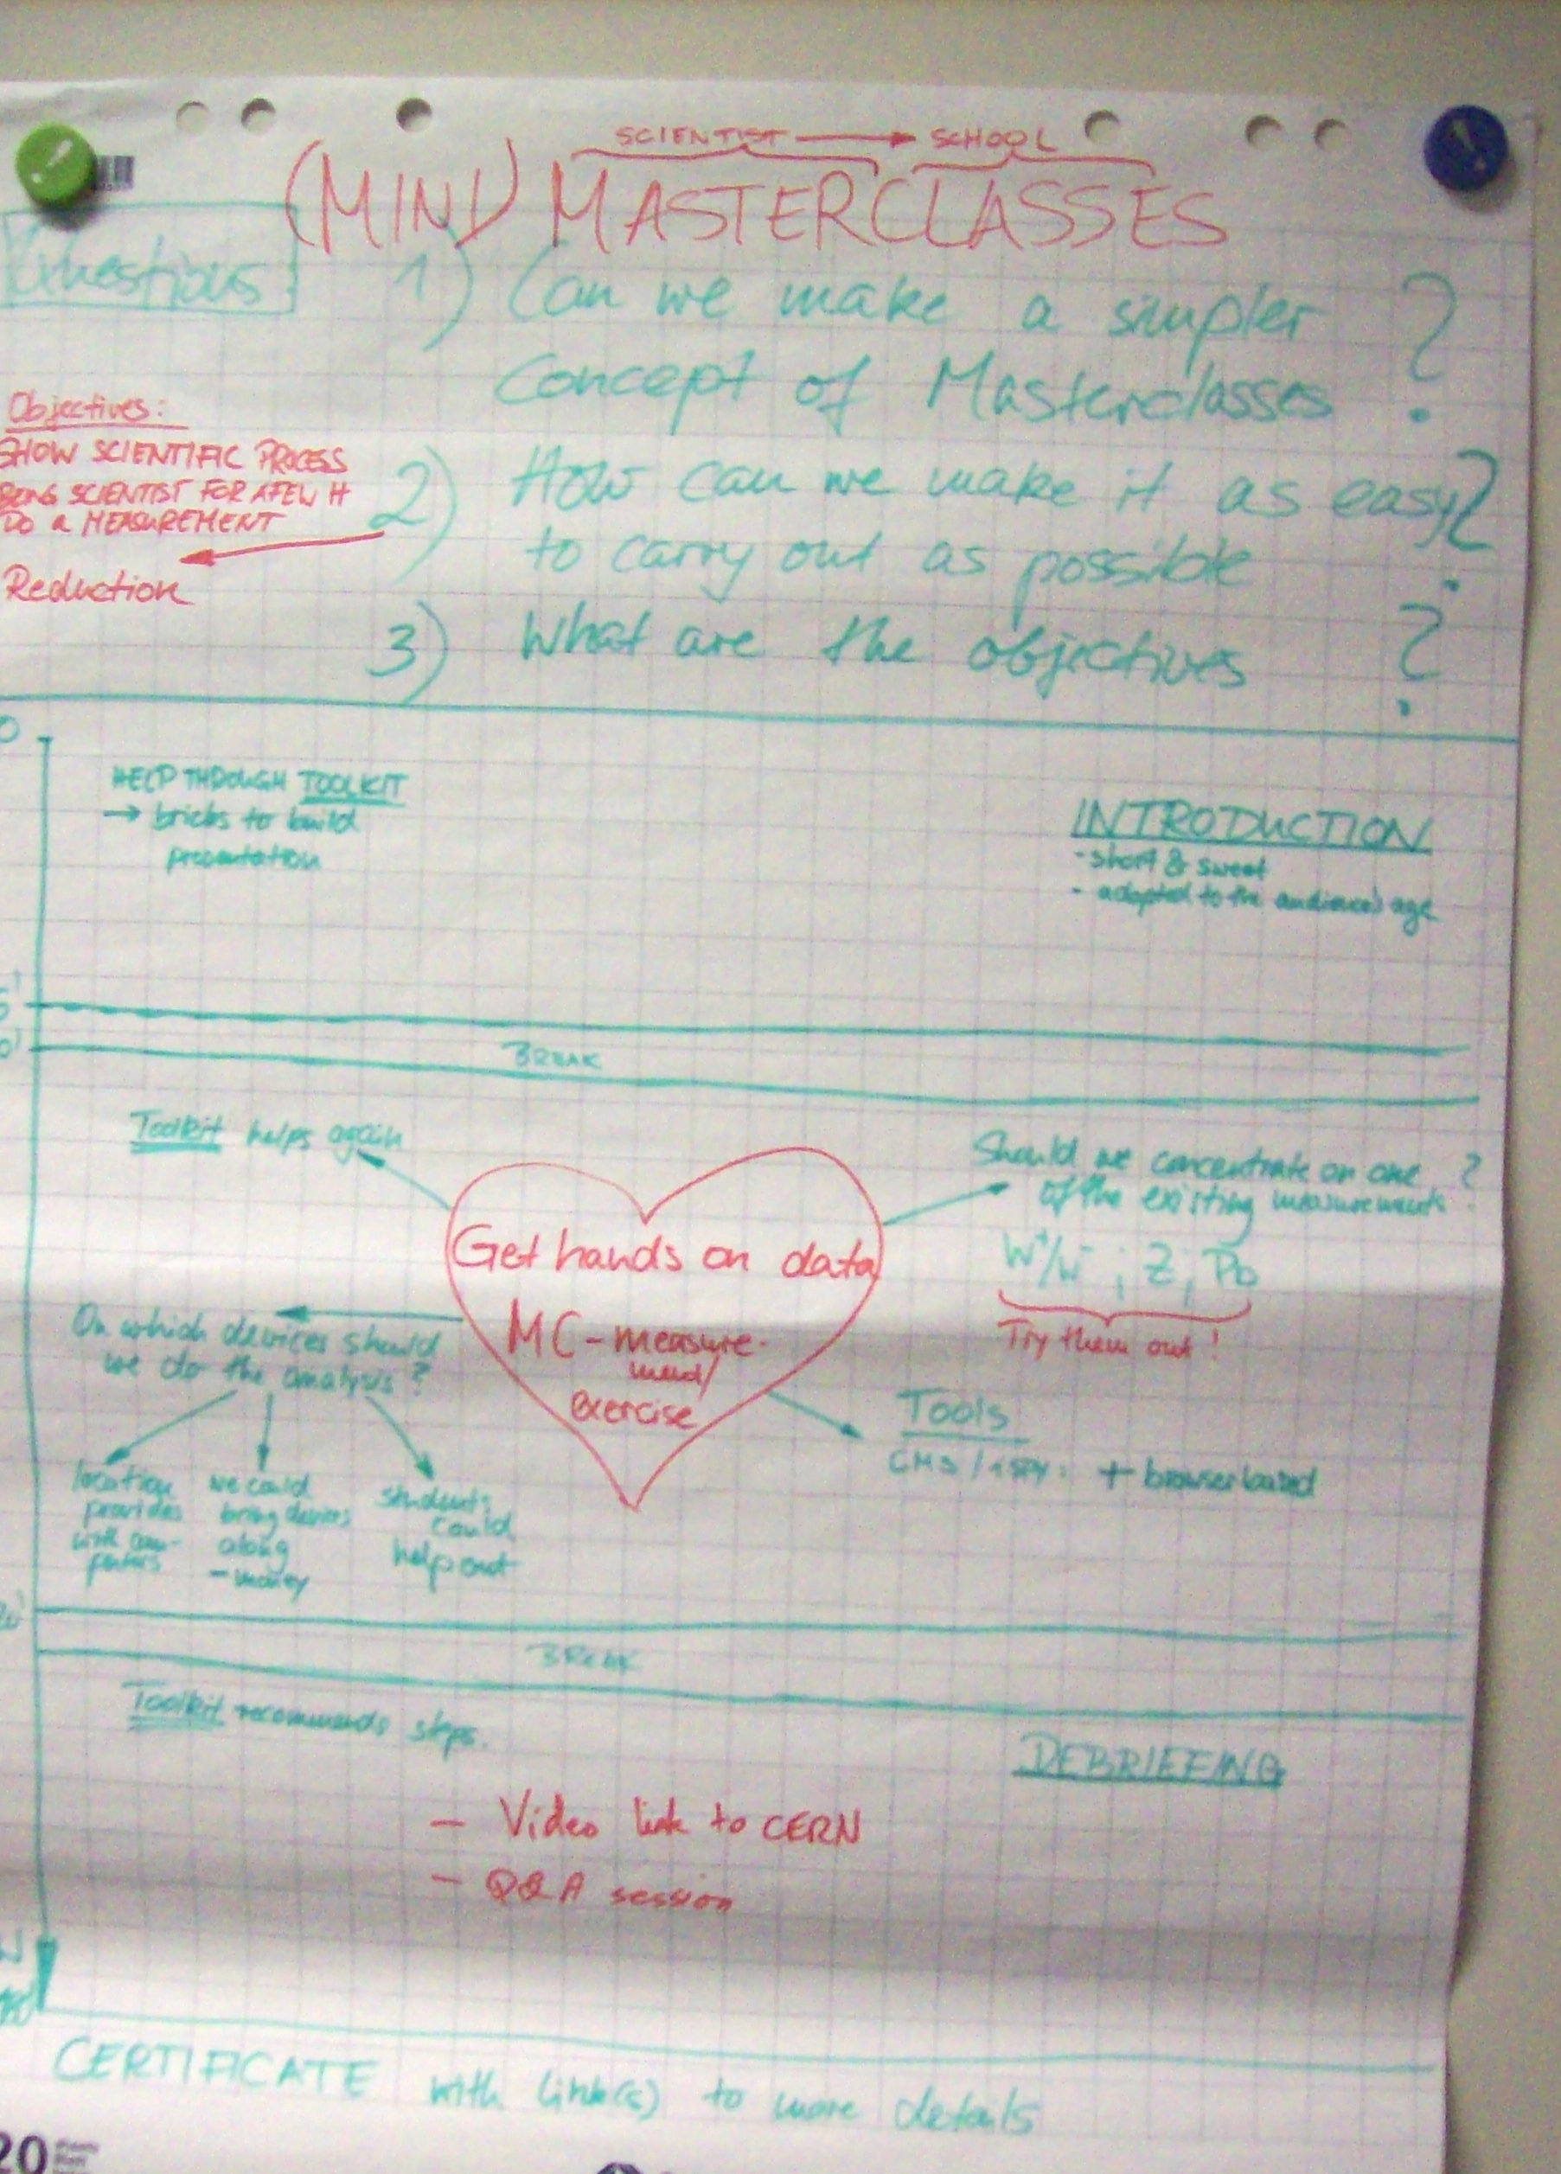
Timeline for 3-hour Masterclass at Schools

Slide 6
Nomenclature
International Masterclasses
  Organized by IPPOG
  Institutes in multiple countries host high school kids
  Video conference hosted by CERN
National Masterclasses
  Organized by individual country
  Institute hosts high school kids
Local of Mini Masterclass
  Organized by country or institute
  Single or multiple physicists go to a school

Slide 7
Experience of CMS “mini Masterclasses”: two high schools in the UK
What worked
  One physicist going to a school
    Low cost for school
    Relatively low cost for institute (CMS in this case)
  Masterclass in 3 hours!
    ~1 hour introduction
    ~1 hour measurement
    ~1 hour debriefing/chat
  Web-based event display & spreadsheet
  Teachers did the measurement!
  Measurement of W⁺/W⁻ ratio generally gives good results!
  No time for students to become bored!
What could be improved
  More contact with schools beforehand to determine level of the students more accurately
  Go through a few events all together on the screen
  Handouts desired
    Cheat-sheet for measurement
    Ideas for further studies
    Information about coming to CERN for visits and, in particular, to study!

