Slide 1
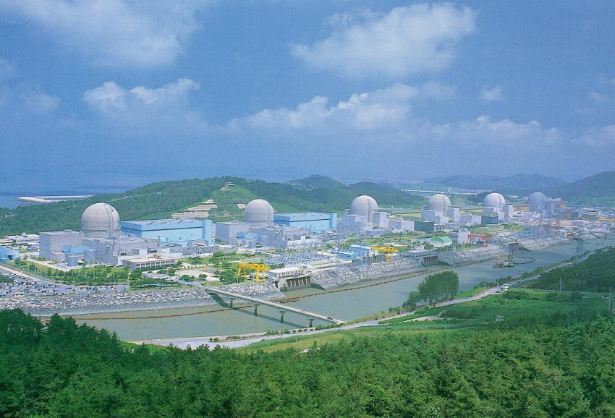
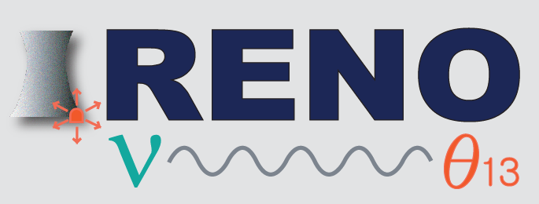

Observation of Reactor Antineutrino Disappearance at RENO
Soo-Bong Kim for the RENO Collaboration
KNRC, Seoul National University
(presented at CERN on May 7, 2012)

Slide 2
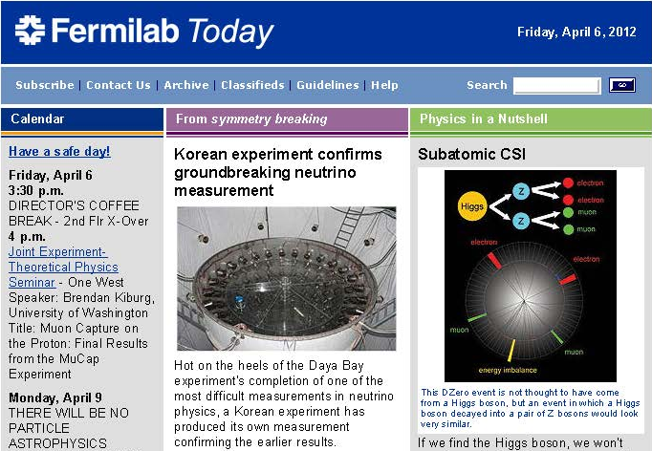
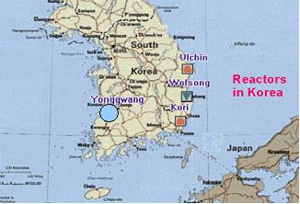
Outline
Introduction
Experimental setup & detector
Data-taking & data set
Calibration
Event selection
Efficiency & Background
Reactor antineutrino prediction
Systematic uncertainties
Results
Summary
YongGwang (靈光) :

Slide 3
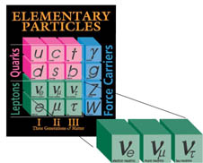
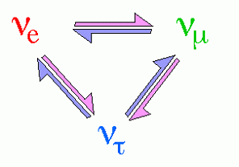
Neutrino Oscillation
PMNS Neutrino Mixing Angles and CP Violation
ν₁
θ₁₂
ν₂
Reactor Antineutrino Oscillation
θ₁₃
(?)
θ₂₃
ν₃

Slide 4
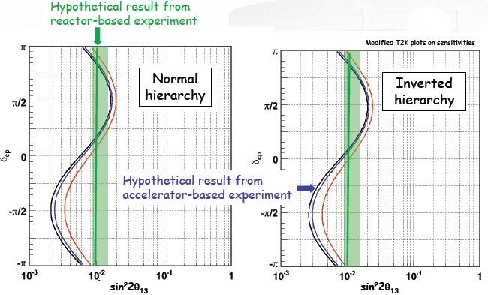
θ₁₃ from Reactor and Accelerator Experiments
* Reactor
- Clean measurement of θ₁₃ with no matter effects
* Accelerator
- mass hierarchy + CP violation + matter effects
Complementarity :
Combining results from accelerator and reactor based experiments could offer the first glimpse of δ_{CP.}

Slide 5
Efforts for Finding θ₁₃
Chooz (2003) & Palo Verde (2000): No signal
sin²(2θ₁₃) < 0.12 at 90% C.L.
Daya Bay (Mar. 8. 2012)
5.2 σ observation
T2K : 2.5 σ excess (2011)
sin²(2θ₁₃) = 0.092 ± 0.016(stat.)±0.005(syst.)
0.03 < sin²(2θ₁₃) < 0.28 at 90% C.L. for N.H.
0.04 < sin²(2θ₁₃) < 0.34 at 90% C.L. for I.H.
MINOS : 1.7 σ excess (2011)
RENO (Apr. 2. 2012)
0 < sin²(2θ₁₃) < 0.12 at 90% C.L. for N.H.
0.04 < sin²(2θ₁₃) < 0.19 at 90% C.L. for I.H.
4.9 σ observation
sin²(2θ₁₃) = 0.113 ± 0.013(stat.)±0.019(syst.)
Double Chooz : 1.7 σ measurement (2011)
sin²(2θ₁₃) = 0.086 ± 0.041(stat.) ± 0.030(syst.)

Slide 6
To be published in PRL
Submitted on Apr. 2, and resubmitted on Apr. 6 after revision
Accepted on Apr. 23 for publication
Expected to appear on May 11 (Daya Bay PRL : April 27)
To be included in a new edition
of Particle Data this year

Slide 7
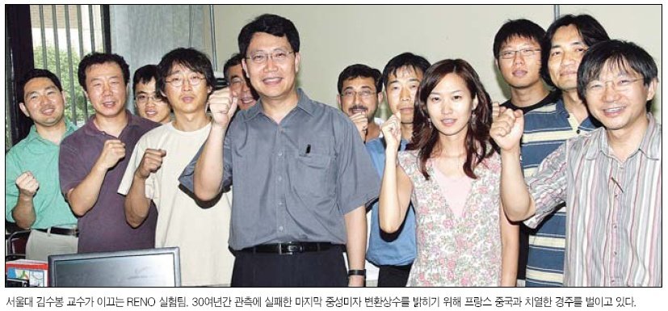
RENO Collaboration
(12 institutions and 40 physicists)
Chonbuk National University
Chonnam National University
Chung-Ang University
Dongshin University
Gyeongsang National University
Kyungpook National University
Pusan National University
Sejong University
Seokyeong University
Seoul National University
Seoyeong University
Sungkyunkwan University
Total cost : $10M
Start of project : 2006
The first experiment running with both near & far detectors from Aug. 2011

Slide 8
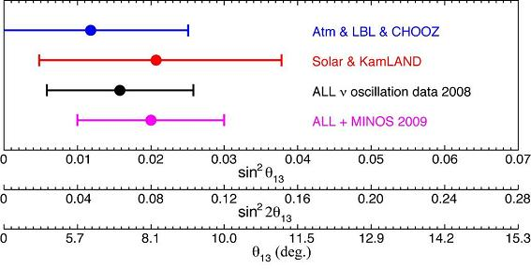
RENO Expected Sensivity
CHOOZ : R_{osc} = 1.01 ± 2.8% (stat) ± 2.7% (syst)
sin²(2θ₁₃) < 0.17 (90% C.L.)
RENO : statistical error : 2.8% → 0.3%
systematic error : 2.7% → <0.5%
sin²(2θ₁₃) > 0.02 (for 90% C.L.)
sin²(2θ₁₃) > 0.035 (for 3σ discovery potential)
10 times better sensitivity
Larger statistics
- More powerful reactors (multi-core)
- Larger detection volume
- Longer exposure
RENO
G. Fogli et al. (2009)
Chooz
Smaller experimental errors
- Identical multi detectors
Lower background
- Improved detector design
- Increased overburden

Slide 9
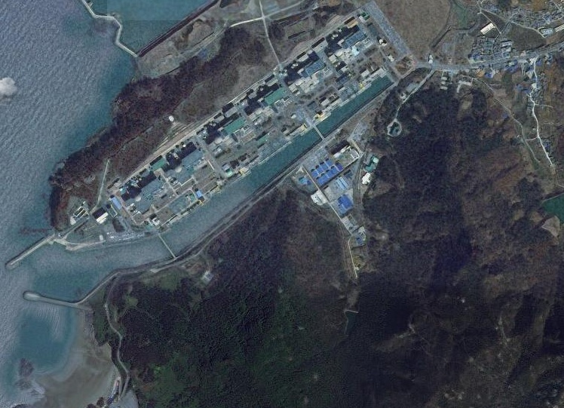

RENO Experimental Setup
Near Detector
290m
1380m
Far Detector

Slide 10
Contribution of Reactor to Neutrino Flux
at Near & Far Detectors
Reactor # | Far ( % ) | Near (% )
1 | 13.73 | 6.78
2 | 15.74 | 14.93
3 | 18.09 | 34.19
4 | 18.56 | 27.01
5 | 17.80 | 11.50
6 | 16.08 | 5.58
Accurate measurement of baseline distances to a precision of 10 cm using GPS and total station
Accurate determination of reduction in the reactor neutrino fluxes after a baseline distance, much better than 0.1%

Slide 11
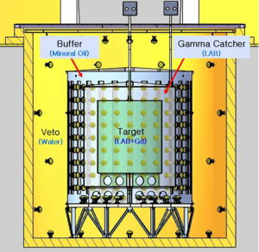
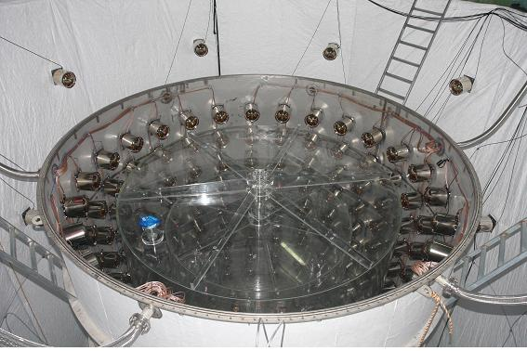
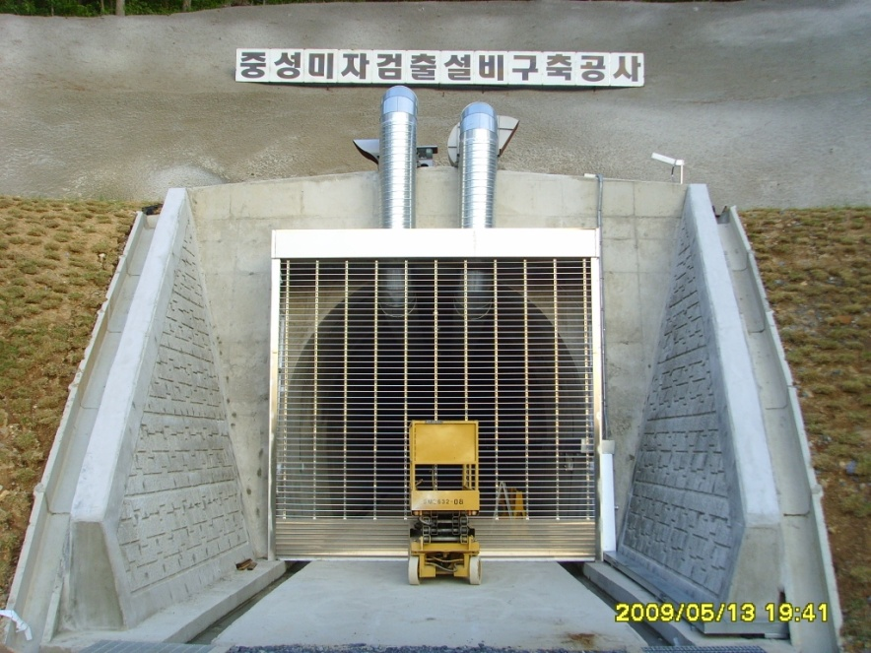
RENO Detector
354 ID +67 OD 10” PMTs
Target : 16.5 ton Gd-LS, R=1.4m, H=3.2m
Gamma Catcher : 30 ton LS, R=2.0m, H=4.4m
Buffer : 65 ton mineral oil, R=2.7m, H=5.8m
Veto : 350 ton water, R=4.2m, H=8.8m

Slide 12
Summary of Detector Construction
2006. 03 : Start of the RENO project
2008. 06 ~ 2009. 03 : Civil construction including tunnel excavation
2008. 12 ~ 2009. 11 : Detector structure & buffer steel tanks
completed
2010. 06 : Acrylic containers installed
2010. 06 ~ 2010. 12 : PMT test & installation
2011. 01 : Detector closing/ Electronics hut & control room built
2011. 02 : Installation of DAQ electronics and HV & cabling
2011. 03 ~ 06 : Dry run & DAQ debugging
2011. 05 ~ 07 : Liquid scintillator production & filling
2011. 07 : Detector operation & commissioning
2011. 08 : Start data-taking

Slide 13
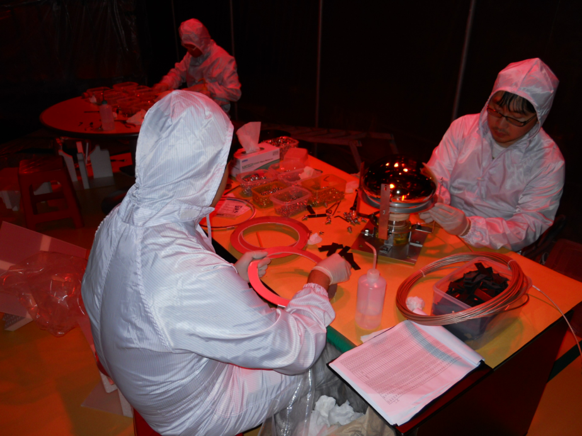
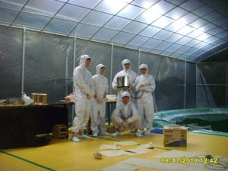
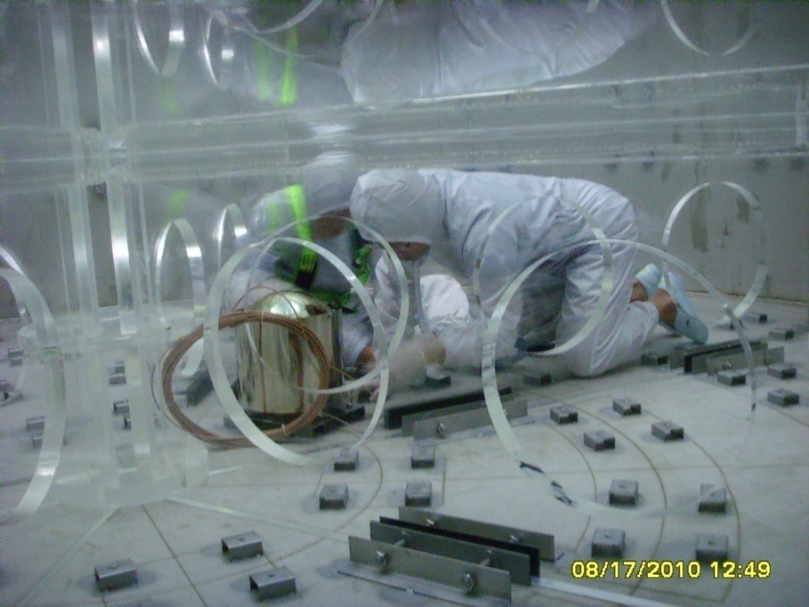
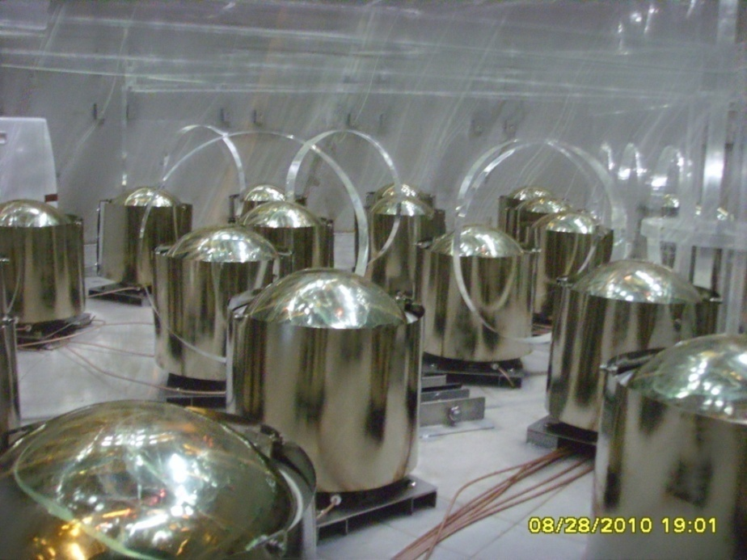
PMT Mounting (2010. 8~10)

Slide 14
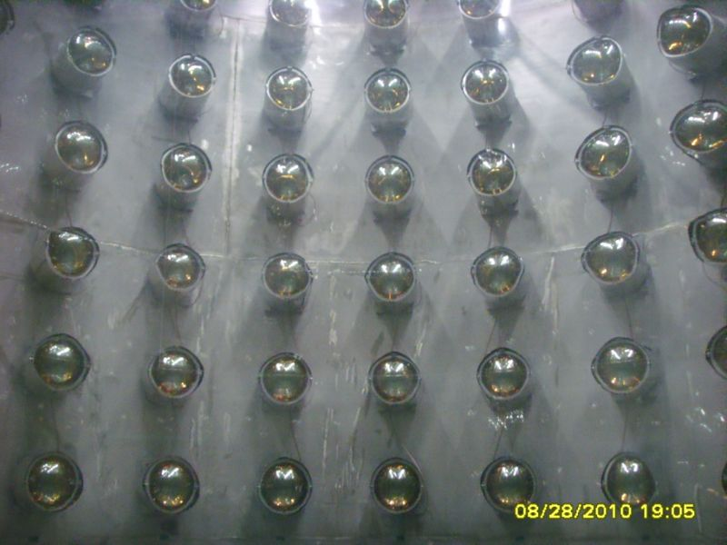
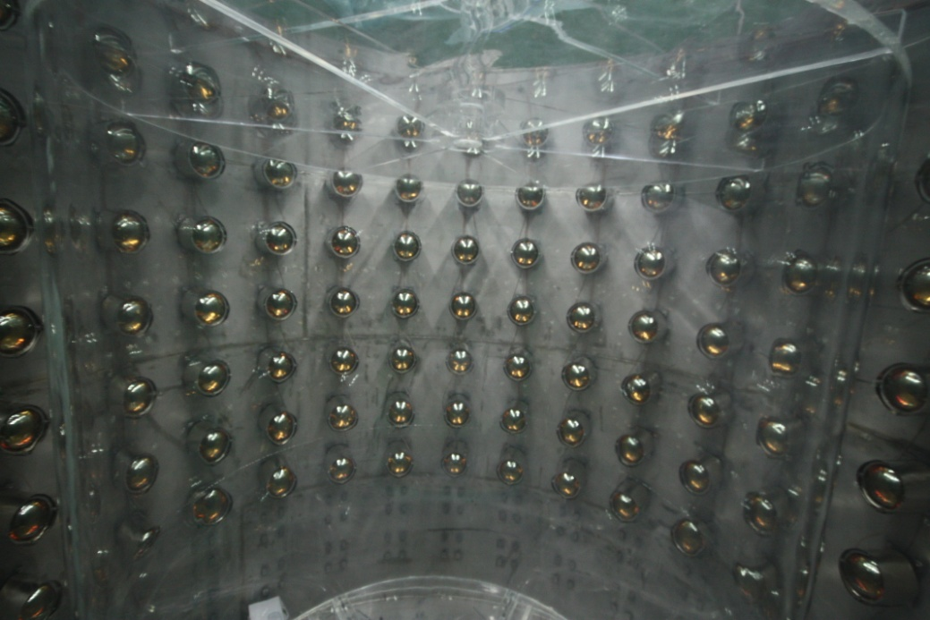
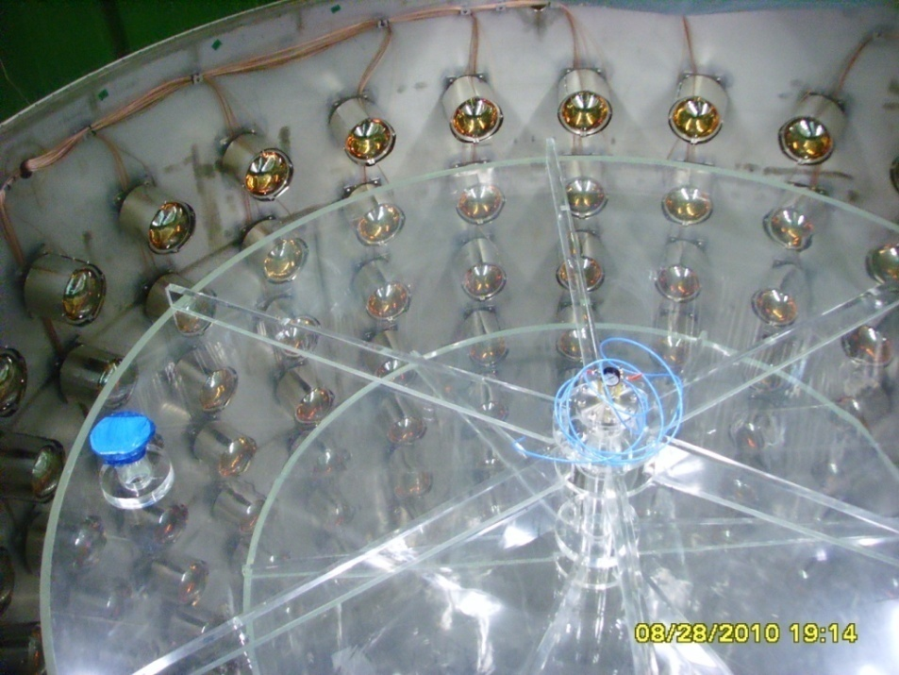
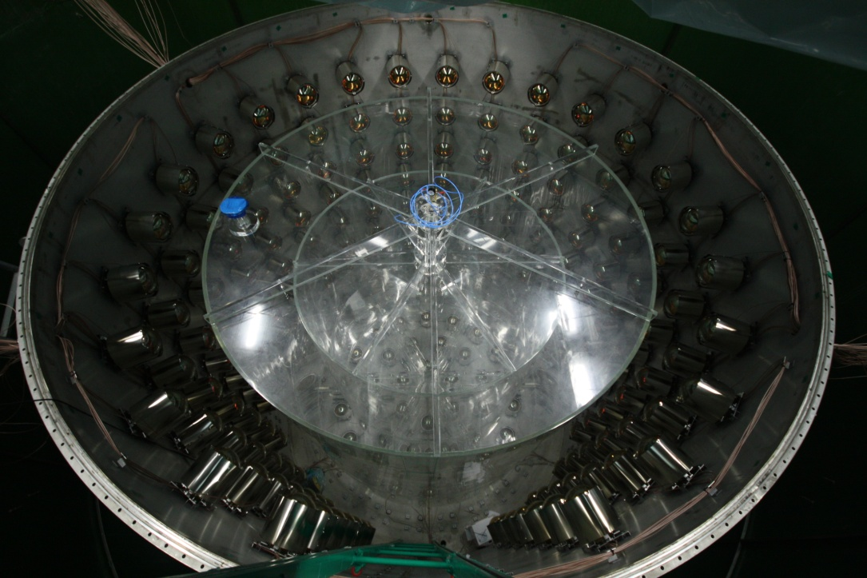
PMT Mounting (2010. 8~10)

Slide 15
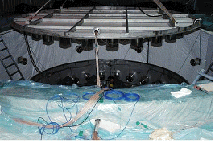
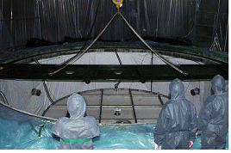
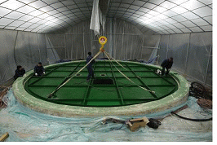
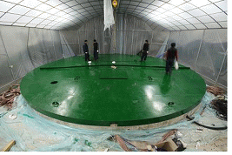
Detector Closing (2011. 1)
Near : Jan. 21, 2011
Far : Jan. 24, 2011

Slide 16
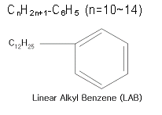

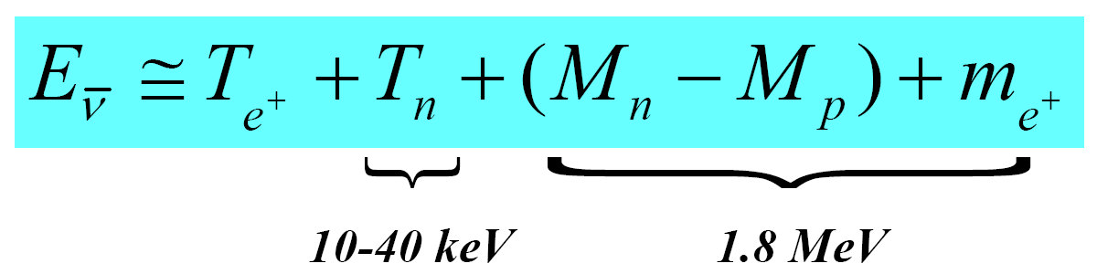
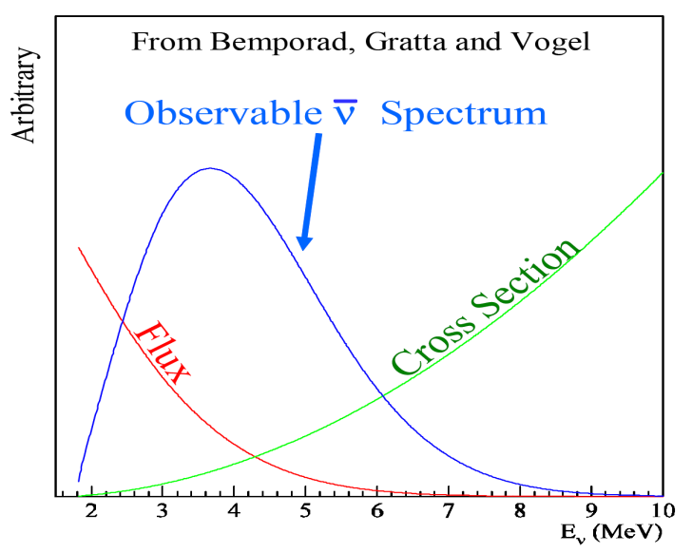
Detection of Reactor Antineutrinos
(prompt signal)
~180 μs
(delayed signal)
+ p → D + γ (2.2 MeV)
~28 μs
(0.1% Gd)
+ Gd → Gd + γ‘s (8 MeV)
Neutrino energy measurement

Slide 17
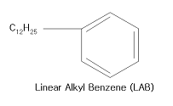
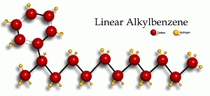
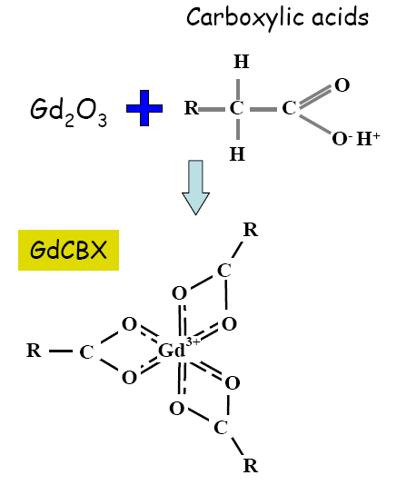
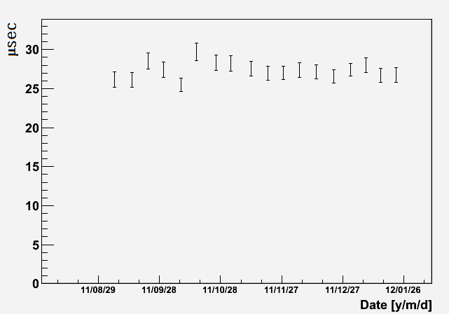
C_{n}H_{2n+1}-C₆H₅ (n=10~14)
Gd Loaded Liquid Scintillator
Recipe of Liquid Scintillator
Aromatic Solvent & Flour | WLS | Gd-compound
LAB | PPO + Bis-MSB | 0.1% Gd+(TMHA)³ (trimethylhexanoic acid)
* Stable light yield over the time period : ~250 pe/MeV
* Measured cosmic induced neutron’s Gd capture time

Slide 18
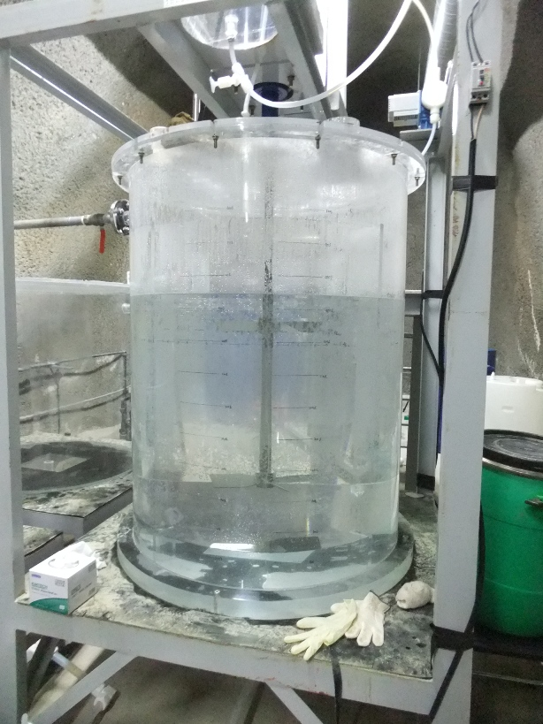
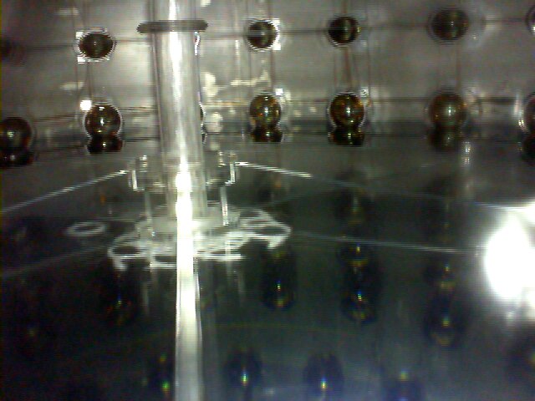
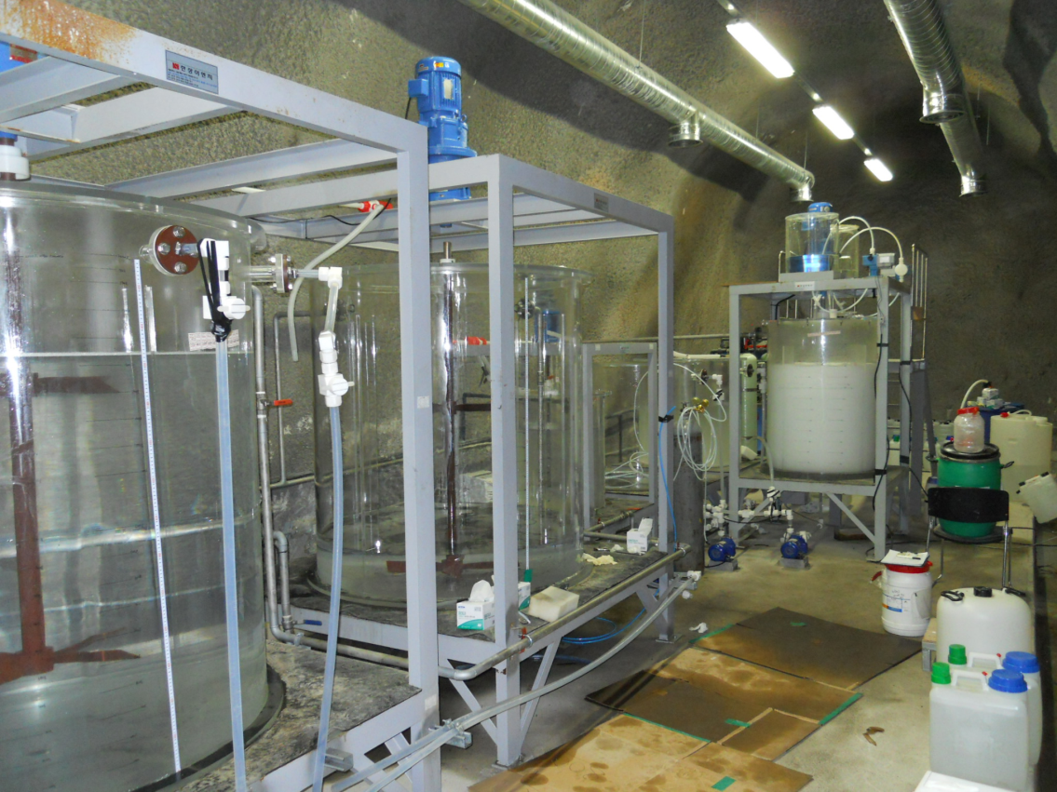
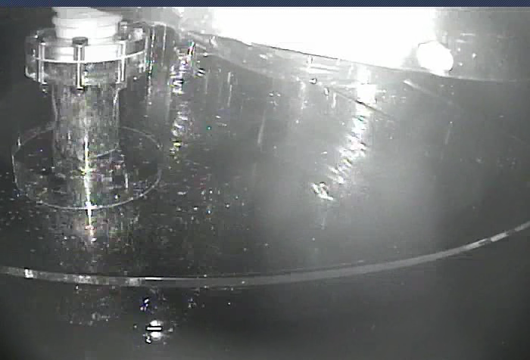
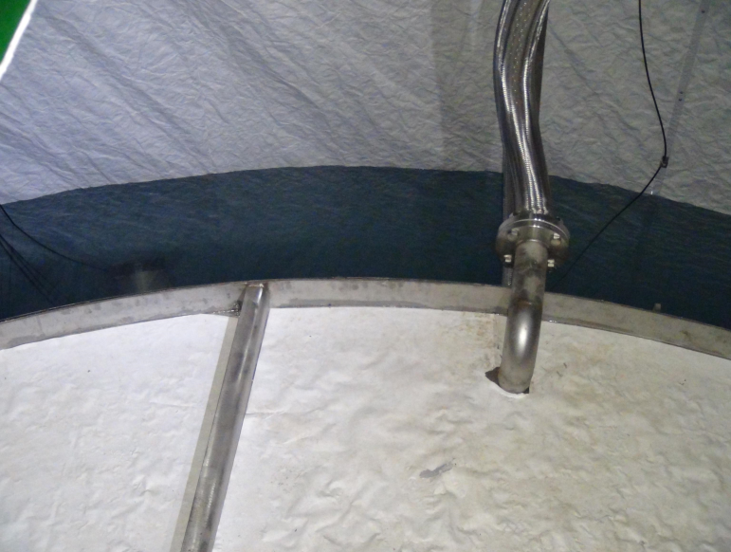
Liquid(Gd-LS/LS/MO/Water) Production & Filling
(May-July 2011)
Gd-LS filling for Target
Gd Loaded Liquid Scintillator
LS filling for Gamma Catcher
Water filling for Veto
Gd Loaded Liquid Scintillator

Slide 19
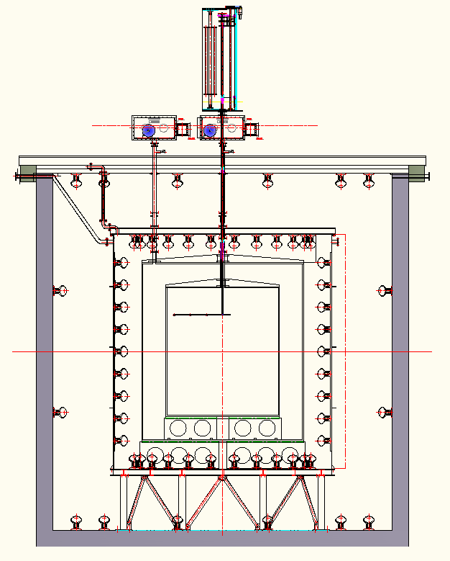
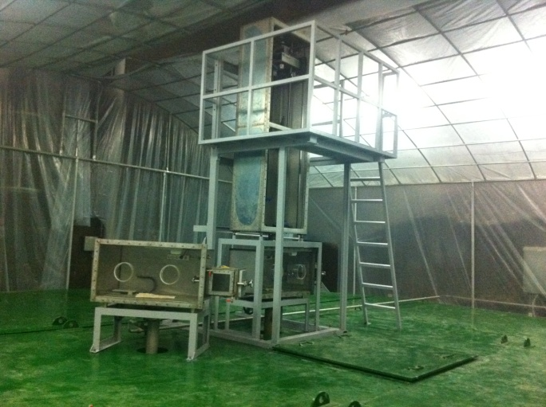
1D/3D Calibration System
Calibration system to deploy radioactive sources in 1D & 3D directions
Radioactive sources : ¹³⁷Cs, ⁶⁸Ge, ⁶⁰Co, ²⁵²Cf
Laser injectors

Slide 20
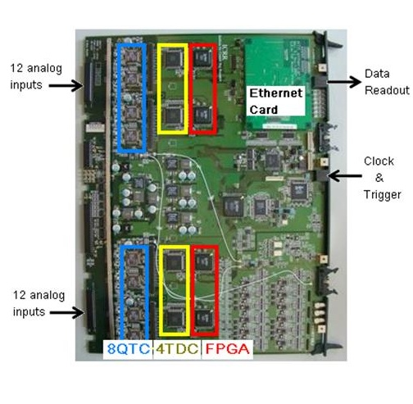
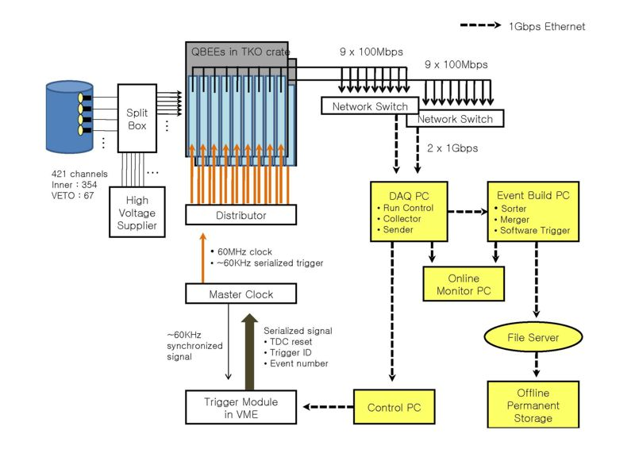
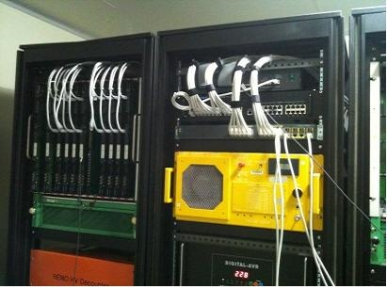
Data Acquisition System
24 channel PMT input to ADC/TDC
0.1pC, 0.52nsec resolution
~2500pC/ch large dynamic range
No dead time (w/o hardware trigger)
Fast data transfer via Ethernet R/W

Slide 21
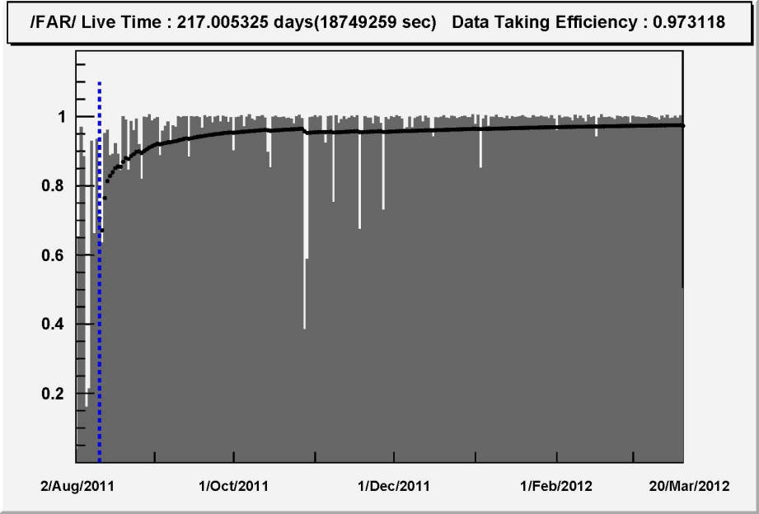
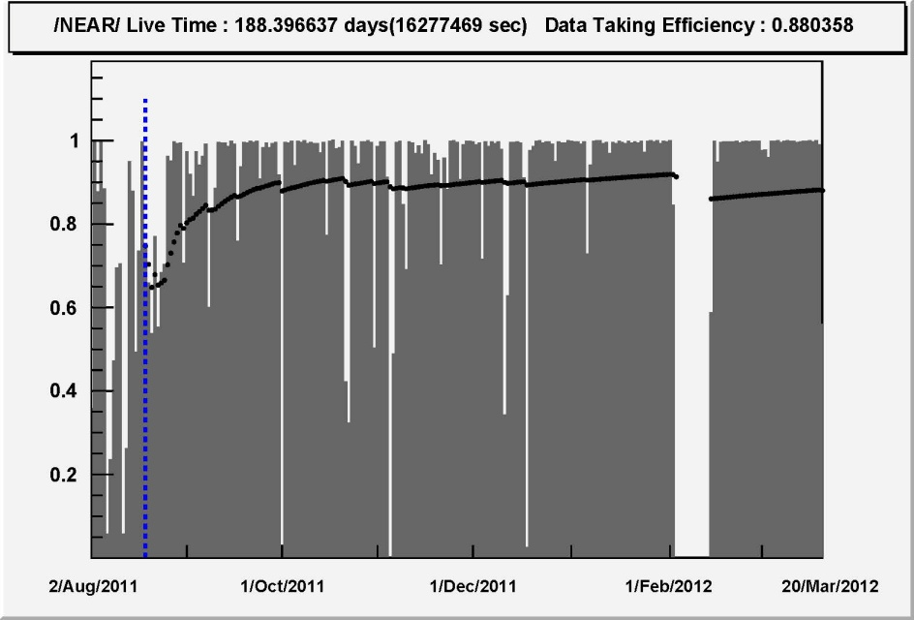
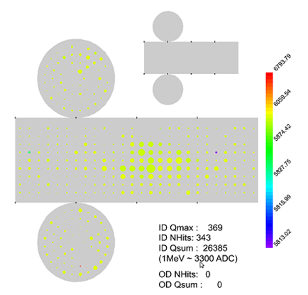
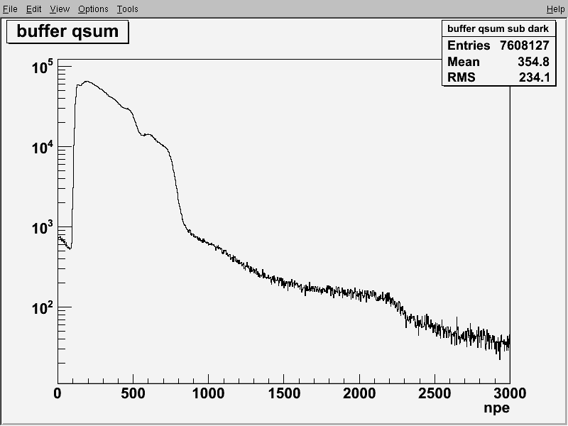
Data-Taking & Data Set
Data taking began on Aug. 1, 2011 with both near and far detectors.
Data-taking efficiency
Data-taking efficiency > 90%.
Trigger rate at the threshold energy of 0.5~0.6 MeV : 80 Hz
Data-taking period : 228 days Aug. 11, 2011 ~ Mar. 25, 2012
Event rate before reduction
²⁰⁸Tl
A candidate for a neutron capture by Gd
⁴⁰K
n capture by Gd
2 MeV
6 MeV
10 MeV

Slide 22
RENO’s Status & Plan
RENO was the first reactor neutrino experiments to search for θ₁₃ with both near & far detectors running, from the early August 2011.
RENO started to see a signal of reactor neutrino disappearance from the late 2011.
According to reported schedules of the other experiments, RENO was thought to present a result first soon. We planned to publish our first results in April without a hurry and to present them in the Neutrino 2012.
But …..

Slide 23
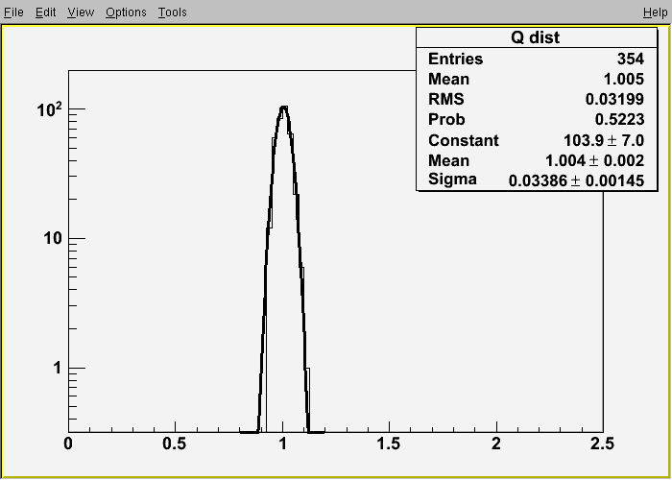
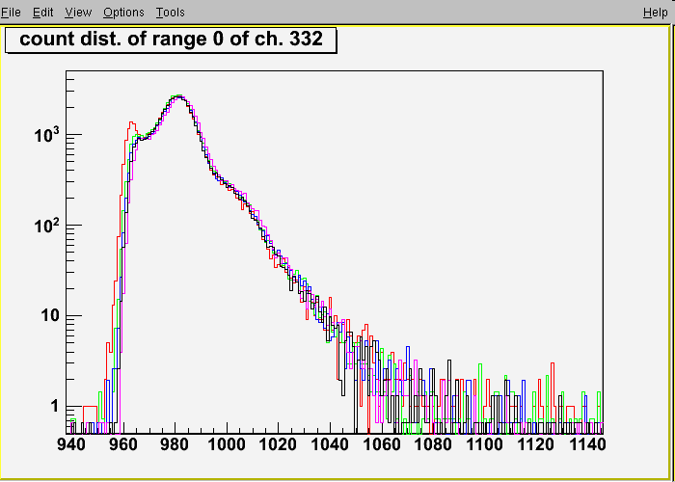
PMT Threshold & Gain Matching
PMT gain : set 1.0x10⁷ using a Cs source at center
Gain variation among PMTs : 3% for both detectors.
discri. thr.
-0.4mV
-0.5mV
-0.6mV
-0.7mV
-1.0mV
Gain (10 ⁷)
PMT threshold : determined by a single photoelectron response using a Cs source at the center
Charge(counts)

Slide 24
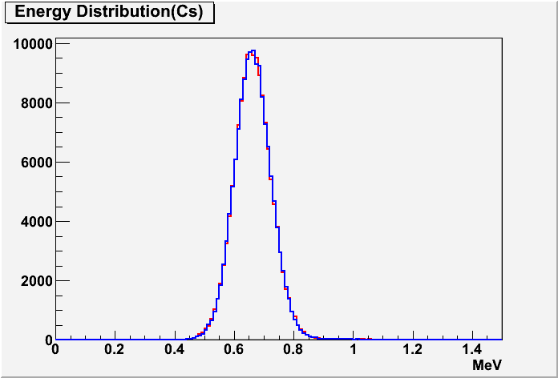
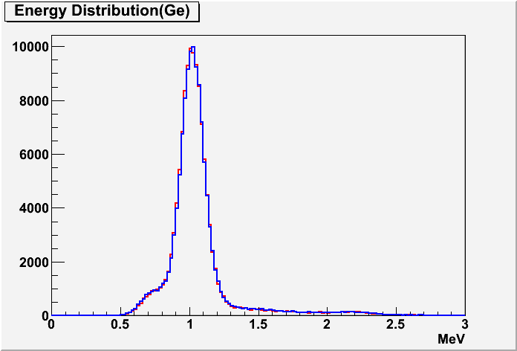


Energy Calibration
Cs 137
Near Detector
Far Detector
Ge 68
(662 keV)
(1,022 keV)
Co 60
Cf 252
(2,506 keV)
(2.2/7.8 MeV)

Slide 25


Energy Scale Calibration
Near Detector
Far Detector
Cf
Cf
Co
Co
Cf
Cf
Ge
Ge
Cs
Cs
~ 250 pe/MeV (sources at center)
Identical energy response (< 0.1%) of ND & FD
Slight non-linearity observed

Slide 26


Detector Stability & Identity
Cosmic muon induced neutron’s capture by H
Near Detector
Far Detector
Capture Time
IBD candidate’s delayed signals (capture on Gd)
Delayed Energy
Near Detector
Far Detector

Slide 27


IBD Event Signature and Backgrounds
IBD Event Signature
Prompt signal (e⁺) : 1 MeV 2γ’s + e⁺ kinetic energy (E = 1~10 MeV)
Delayed signal (n) : 8 MeV γ’s from neutron’s capture by Gd
~28 μs (0.1% Gd) in LS
Prompt Energy
Delayed Energy
Backgrounds
Random coincidence between prompt and delayed signals (uncorrelated)
⁹Li/⁸He β-n followers produced by cosmic muon spallation
Fast neutrons produced by muons, from surrounding rocks and inside detector (n scattering : prompt, n capture : delayed)

Slide 28
IBD Event Selection
Reject flashers and external gamma rays : Q_{max}/Q_{tot} < 0.03
Muon veto cuts : reject events after the following muons
(1) 1 ms after an ID muon with E > 70 MeV, or with 20 < E < 70 MeV and OD NHIT > 50
(2) 10 ms after an ID muon with E > 1.5 GeV
Coincidence between prompt and delayed signals in 100 μs
- E_{prompt} : 0.7 ~ 12.0 MeV, E_{delayed} : 6.0 ~ 12.0 MeV
- coincidence : 2 μs < Δt_{e+n} < 100 μs
Multiplicity cut : reject pairs if there is a trigger in the preceding 100 ms window

Slide 29
Random Coincidence Backgrounds
Calculation of accidental coincidence
ΔT = 100 μs time window
Near detector :
R_{prompt} = 8.8 Hz, N_{delay} = 4884/day →
Far detector :
R_{prompt} = 10.6 Hz, N_{delay} = 643/day →

Slide 30


⁹Li/⁸He β-n Backgrounds
Find prompt-delay pairs after muons, and obtain their time interval distribution with respect to the preceding muon.
⁹Li time interval distribution
⁹Li energy spectrum
Time interval (ms)
Energy (MeV)
Near detector :
Far detector :

Slide 31




⁹Li/⁸He β-n Backgrounds
⁹Li production at near detector
⁹Li production at far detector

Slide 32


Fast Neutron Backgrounds
Obtain a flat spectrum of fast neutron’s scattering with proton, above that of the prompt signal.
Near detector
Far detector
Near detector :
Far detector :

Slide 33



Spectra & Capture Time of Delayed Signals
Near Detector
τ = 27.8 ± 0.2 μsec
Observed spectra of IBD delayed signals
Near Detector
Far Detector
Far Detector
τ = 27.6 ± 0.4 μsec

Slide 34

Summary of Final Data Sample

Slide 35


Measured Spectra of IBD Prompt Signal
Near Detector
154088 (BG: 2.7%)
Far Detector
17102 (BG: 5.5%)

Slide 36


Expected Reactor Antineutrino Fluxes
Reactor neutrino flux
- P_{th} : Reactor thermal power provided by the YG nuclear power plant
- f_{i} : Fission fraction of each isotope determined by reactor core simulation of Westinghouse ANC
- φ_{i}(E_{ν}) : Neutrino spectrum of each fission isotope
[* P. Huber, Phys. Rev. C84, 024617 (2011)
T. Mueller et al., Phys. Rev. C83, 054615 (2011)]
- E_{i} : Energy released per fission
[* V. Kopeikin et al., Phys. Atom. Nucl. 67, 1982 (2004)]

Slide 37

Observed Daily Averaged IBD Rate

Slide 38

Reduction of Systematic Uncertainties
Detector related :
- “Identical” near and far detectors
- Careful calibration
Reactor related :
- Relative measurements with near and far detectors
Neutrino events
1/r²
Number of protons
Detection efficiency
Yield of sin²(2θ₁₃)
Maury Goodman’s neutrino newsletter (5/5/2012):
F. Darwin said “In Science the credit goes to the man who convinces the world, not to the man to whom the idea first occurred.”
But he wishes to give credit to Russians who first proposed a two detector neutrino reactor disappearance experiment : L. Mikaelyan & V. Sinev.

Slide 39


Efficiency & Systematic Uncertainties

Slide 40

Reactor Antineutrino Disappearance
A clear deficit in rate (8.0% reduction)
Consistent with neutrino oscillation in the spectral distortion

Slide 41
χ² Fit with Pulls

Slide 42

Definitive Measurement of θ₁₃
4.9σ significant signal
Near detector: 1.2% reduction
Far detector: 8.0% reduction

Slide 43

χ² Distributions for Uncertainties

Slide 44
Future Plan for Precision Measurement of θ₁₃
RENO
(4.9 σ)
Daya Bay
(5.2 σ)
Contributions of the systematic errors :
- Background uncertainties : 0.0165
(far : 5.5%×17.7% = 0.97%, near : 2.7%×27.3% = 0.74%)
- Reactor uncertainty (0.9%) : 0.0100
- Detection efficiency uncertainty (0.2%) : 0.0103
- Absolute normalization uncertainty (2.5%) : 0.0104
Remove the backgrounds !
Spectral shape analysis

Slide 45
Summary
RENO was the first experiment to take data with both near and far detectors, from August 1, 2011.
RENO observed a clear disappearance of reactor antineutrinos.
RENO measured the last, smallest mixing angle θ₁₃ unambiguously that was the most elusive puzzle of neutrino oscillations
Surprisingly large !!!
→ A plenty of tasks ahead for neutrino physicists

Slide 46
Prospective Future
A surprisingly large value of θ₁₃ :
(Save a lot of dollars for the future neutrino experiments which may need reconsideration of their designs!!)
→ (1) Provides a complete picture of neutrino oscillations
(2) Open a bright window of understanding why there is much more matter than antimatter in the Universe today
A prospective future for neutrino physics due to a large value of θ₁₃ !!!
Our measurement will strongly promote the next round of neutrino experiments to find the CP phase.
Complimentary measurements between accelerator experiments and reactor experiments will provide significant information on the CP phase.

Slide 47

RENO-50
RENO-50
L~50km experiment may be a
natural extension of current
Reactor-θ₁₃ Experiments
* θ₁₃ detectors can be used as near detector
* Small background from other reactors.

Slide 48
RENO-50
■ 5000 tons ultra-low-radioactivity Liquid Scintillation Detector
RENO-50
500 10” OD PMTs
Water
RENO
LAB (5 kton)
3000 10” PMTs
8.8 m
5.8 m
25 m
20 m
5.4 m
8.4 m
20 m
25 m

Slide 49
Physics with RENO-50
Precise measurement of θ₁₂
in a year ← current accuracy : 5.4%
Determination of mass hierarchy Δm²₁₃
Neutrino burst from a Supernova in our Galaxy :
~1500 events (@8 kpc)
Geo-neutrinos : ~ 300 geo-neutrinos for 5 years
Solar neutrinos : with ultra low radioacitivity
Reactor physics : non-proliferation
Detection of T2K beam : ~120 events/year
Test of non-standard physics : sterile/mass varying neutrinos

