Slide 1
EuCARD-2
Enhanced European Coordinated Accelerator Research & Development
A new FP7 Integrating Activity for 2013/2017
Maurizio Vretenar, CERN

Slide 2
Background
EuCARD (and CARE before it) had an enormous impact in structuring and promoting the European R&D on particle accelerators; but the work needs to continue while EuCARD will be completed in March 2013.
The accelerator community, under the coordination of ESGARD (European Steering Group on Accelerator R&D), has underlined the importance of continuing a joint R&D effort and has acknowledged the added value from European projects.
However, the boundary conditions have changed: we need to adapt to new guidelines coming from the EU and to new priorities coming from our field and to coordinate with other accelerator projects.
A new Integrating Activity project covering the period 2013/2017 has been defined and its proposal submitted to EU in November 2011.
Notes:
Bad news and good news; accelerators are important and growing, R&D is critical but dispersed, foster collaboration and join efforts through EU programs – example of HIPPI

Slide 3
EuCARD-2 facts
Preparation of the new project has been initiated by ESGARD in 2011, coming to a first definition of the new project in spring 2011.
Last “details” defined at end of summer 2011: final structure, name of the project, name of the coordinator (…).
Proposal finalized in autumn and submitted to the EU on 24 November 2011: 41 participants for a total budget of 28.3 M€ with a requested EU contribution of 10 M€.
Evaluation by the EU reviewers communicated on 8 March 2012: score of 14/15 (which is very good!).
Project “favourably evaluated” by the EU Commission services on 30 March, but placed in stand-by, waiting for the approval of the 2013 EU budget expected to take place around June (with increased allocations for RI).
As soon as the EU budget is approved, EuCARD-2 is expected to be invited to negotiations with the EU, with a likely reduction in the EU contribution of the order of 20% (i.e. from 10 to 8 M€).
If all goes well, the goal is to start of the project in 2013, ideally at the end of EuCARD or with a minimum overlap.
Notes:
Time for preparation, race against the clock; last version submitted 10 minutes before the deadline. Contribution slightly more then 1/3, average of 700k per institute – budget foresees increase for IAs - could/should

Slide 4
Guidelines from EU
Large push to increase the share of Networking Activities within the IA → reduction of the JRA funding, compensated by an increased focus.
Accent on innovation and outreach to industry → introduction of new Networks (on innovative technologies, applications and technology transfer).
Transnational Access remains an essential ingredient of IA’s (like in EuCARD).
Some preference for high-risk, high pay-off activities.
Coordination with other accelerator projects, in particular TIARA-PP.
Notes:
Project different from EuCARD

Slide 5
Priorities from accelerator community
In the JRA’s, continuation of the main and critical EuCARD studies (magnets, acceleration, collimation), but opening to new programmes (very-high field magnets, new acceleration concepts, thin films, etc.).
In the NA’s, continuation of the successful Network on extreme beams and integrate the new activity on low emittance rings.
Support at a more significant level of novel technologies: Plasma Wakefield Acceleration, ultrafast events processing.
Support of new themes in the field of innovation and outreach to industry: energy efficiency and accelerator applications.
No need to integrate neutrino activities (specific project).
Similar number of partners, with identical core and new members.
Funding of CERN only for management and coordination; CERN waives back funding for JRA activities.

Slide 6
Structuring the project
General coordination entrusted by ESGARD to CERN: structures, experience, etc.
J.P. Koutchouk will retire before the end of EuCARD-2: selection of a new coordinator, with a specific background in accelerator applications, contacts with industry and project management → M. Vretenar (expert in linear accelerators, coordinator of the linac JRA in CARE, project leader for Linac4 at CERN).
New programme but need to underline the continuity with EuCARD and to acknowledge the effort done by EuCARD in communication and in structuring the community: EuCARD-2.

Slide 7
Priorities and motivations
Accelerators based activities are rapidly growing, in full transition from basic science to applied science, medicine and industry.
In the period 2013/17: a) existing accelerators pushed to extreme performance (eg. LHC); b) new accelerators enter final design and/or construction phase (XFEL, FAIR, ESS, SuperB, MYRRHA, etc.); c) strategic decisions will be taken for the future (CLIC, ILC, HE-LHC, LHeC, Neutrinos).
Individual projects have their own support structure (internal, international or EU-based) but general accelerator R&D tends to be second priority for large laboratories and is often left to small institutes and laboratories that do not have the critical mass for breakthrough achievements.
EuCARD2 (and EuCARD) aim at joining the experience and infrastructure of the major labs with the intellectual potential and creativity of smaller universities and institutions on few research topics of excellence.
The objective is to propose and develop ideas and technologies a) for the evolution of the present accelerator infrastructure; b) to support the final design and construction of the coming generation of facilities; and c) to impact on the choices to be made on the future generation of accelerators.
Notes:
We have exciting years ahead … all in 3 lines – ambition of EC2 is to be a partner in the definition of the next large EU research accelerator – ambition of EC2 is being the “trait-d’union” bw. small institutes and large labs

Slide 8
The partners
41 partners from 15 European countries, including Russia.
Types of institutes:

Slide 9
The proposal – 6 Networks

Slide 10
The proposal – 2 TAs and 4 JRAs
Theme coordinators: 9 CERN, 8 non-CERN (STFC 2, PSI HUD INFN UOXF CEA GSI 1)
Females: 3/17 (=18%)

Slide 11
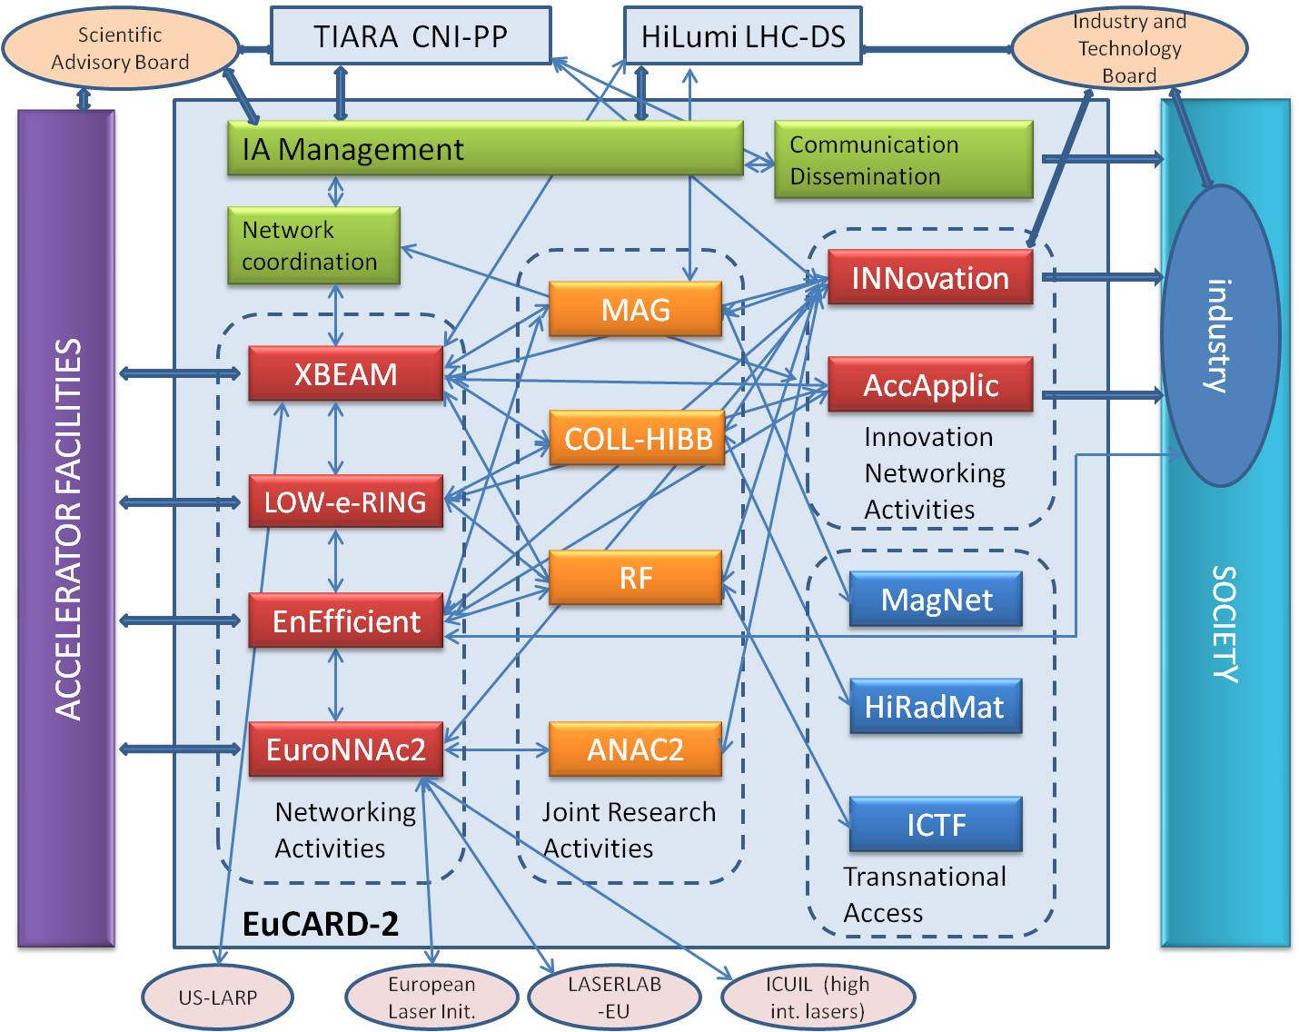
Internal and external links

Slide 12
Management structure
Governing Board
One representative from each beneficiary
Project Coordinator (ex-officio)
Deputy Project Coordinator (ex-officio)
Advisory Board
Steering Committee
Management Team
Project Coordinator
Deputy Project Coordinator
Administrative Manager
WP2-NA Leader
WP3-NA Leader
WP8-TA Leader
WP10-JRA Leader
WP11-JRA Leader
WP4-NA Leader
WP5-NA Leader
WP9-TA Leader
WP12-JRA Leader
WP13-JRA Leader
WP6-NA Leader
WP7-NA Leader

Slide 13
Two “scientific” Networks
Extreme Beams (XBEAM): colliders and accelerator frontiers, for high-intensity high-luminosity, including FFAGs and superconducting hadron and electron linacs – interest for HL-LHC, ESS, FAIR, SuperB, HE-LHC, LHeC, etc.).
Low emittance rings (LOWeRINGS): New synergy between synchrotron light sources, storage rings, damping rings and lepton colliders facilities. Kick off workshops took place under ICFA.

Slide 14
Three “technological” Networks
Energy Efficiency: Interest from several laboratories on optimized energy management for a sustainable accelerator science. This NA wants to be very hands-on and focus on fundamental and precise themes: energy recovery from cooling, efficient klystrons, energy storage, virtual power plant, low-power transport channels.
Accelerator Applications: Aims at reviewing and analysing present applications, propose how to adapt existing accelerator technology to industry, health care, energy, security.
Catalysing Innovation, technology transfer Network based on the existing CERN and STFC structures. Proactive approach, scouting for technologies ready for industry engagement and collaboration. Organise “EuCARD-2 meets industry” events.

Slide 15
One “future” network
Novel Accelerators (EuroNNAC2): federating the European effort in plasma-based accelerators to prepare a roadmap for an efficient use in full-scale accelerators (from acceleration to accelerators...).

Slide 16
Three Transnational Access
Ion Cooling Test Facility (ICTF) of STFC in the UK, tests with high-quality low-energy beams (Phase I in EuCARD)
HiRadMat facility at CERN, performance of materials bombarded with intense proton beams (already in EuCARD, but the real start will be in EuCARD-2)
MagNet test stand at CERN, superconducting cable and magnet test station at CERN freed after the completion of the LHC.

Slide 17
Four JRAs
Future Magnets: development of an HTS magnet that can become the full-bore high-field insert to allow a dipole magnet reaching 20T for the needs of a HE-LHC at 2x16.5 TeV. Preliminary step production of the first HTS 10 kA cable for accelerator magnets (high-quality low-loss).
Collimators for high-brightness beams: steady increase in LHC luminosity leads to accelerate the next phase of collimators (beyond EuCARD), validating the new materials of EuCARD and developing the design for the next generation of collimators.
Radio Frequency Technologies: includes a) thin film deposition technologies for superconducting cavities, b) wakefield extraction and monitoring and cavity testing for high-gradient CLIC structures, c) HOM analysis for XFEL-type cavities, d) new RF photocathodes, based on Pb and on and on Diamond Amplifier cathode.
Novel Acceleration Techniques: laser plasma acceleration, ultra-fast accelerator science and long plasmas. Develop laser-driven and proton-driven plasma-wakefield acceleration, including femtosecond arrival time control.

Slide 18
The budget
EU contribution = 35.4% of project cost
Matching funds = 64.6% of project cost
Scaling: 35.4% EU contribution , 37.5% indirect costs not claimed, 27.1% direct contribution from the labs

Slide 19
Distribution of EU contribution
Project support includes TA’s , common pots for NA’s, common purchase of equipment

Slide 20
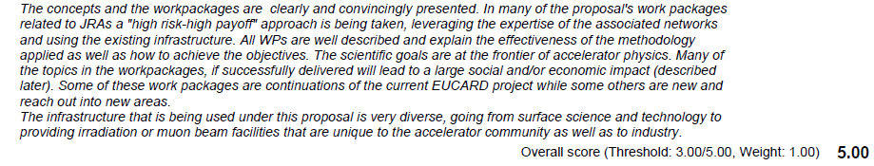
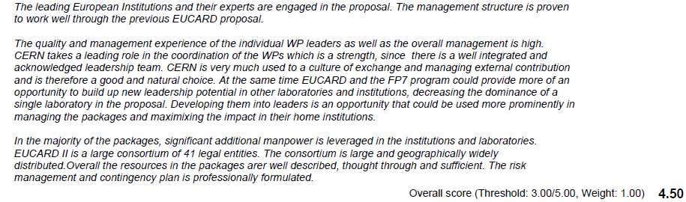
Project evaluation - 1
* high risk-high pay off in JRAs
* socioeconomical impact
* diversity
efficient management proven by EuCARD
leading role of CERN a strength but more opportunities to be given to build leadership potential in other labs

Slide 21
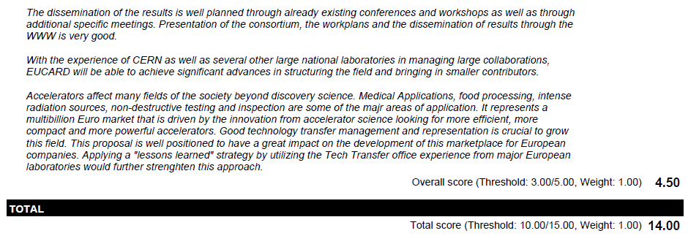
Project evaluation - 2
Positive dissemination
Structuring the field and bringing in small contributors
Development of the accelerator marketplace for EU companies
Learn from previous experience (…) of Tech Transf offices

Slide 22
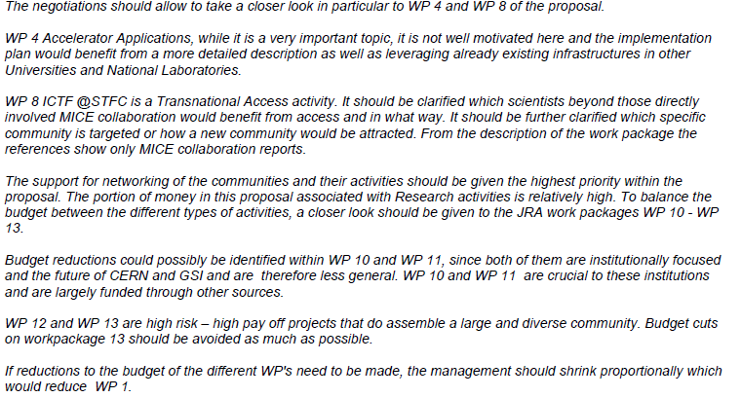
Recommendations
1. Acc. applications needs more focusing and more integration with existing programmes
2. ICTF at STCF should enlarge its scope and programme beyond the MICE community
3. More support to NA’s at the expense of JRA’s,
4. Reduction s to WP10 and WP11, centered at CERN
5. Support of WP12 (RF) and in particular WP13 (PWFA)
6. Reduce management (WP1) in proportion with overall EU budget
CERN officially reacted to this statement (letter 29.3): WP10 and 11 are well ahead of the targeted institutional R&D of both CERN and GSI, involve many participants and CERN has waived all direct funding.

Slide 23
What’s next ?
wait for the approval of the EU budget and the formal invitation to negociations with the EU (expected in June/July);
redefine the project with a reduced EU contribution and accordingly to the guidelines of the reviewers and of the commission;
get the final approval of Annex 1.
if all goes well, start the project in 2013, immediately after EuCARD or with a minimum overlap.

Slide 24


See you in EuCARD-2

