Slide 1
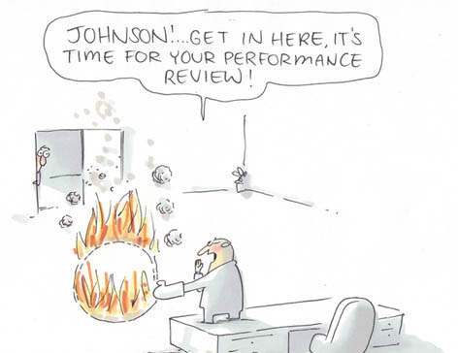
Performance Appraisal and Management at CERN
HR Induction
June 2012
Notes:
This presentation concerns mainly Staff Members, as it deals with the processes and procedures at CERN for the appraisal and management of staff performance/careers. However, some aspects also valid for Fellows and is extremely important aspect of career at CERN, so is good information to have even if does not directly affect each of you. (yet)

Slide 2
Probation Period Milestones
Induction day I
Induction interview
Mid probation review
End of probation review
Induction day II
Meeting staff member / HRA
11 months
5 months
6 weeks
Definition, monitoring and evaluation of work objectives
Reference : Administrative Circular 2 and 26
Notes:
HRA gives advice for performance management for staff members
Induction interview – interview during first 6 weeks. Interview also with HRA during first 6 weeks for introduction.
Mid-probation – 5 months
End-probation – 11 months

Slide 3

Induction Interview
Define work objectives for the first 12 months
Discussion on development needs
Chance for feedback / dialogue
Mandatory for Staff; Strongly recommended for Fellows
Notes:
Interview takes place with supervisor during first 6 weeks; usually HRA will also be in contact for a first meeting.
Definition of work objectives, which can be modified as necessary according to service’s needs/changing priorities etc.
Chance to have feedback on what is expected during the first few months and what development may be needed (e.g. technical training, on-the-job learning etc.). Usually at the time of selection, the supervisor has identified the needs for development to adjust to the post requirements.

Slide 4
Mid / End Probation Review
Monitor and evaluate results of work objectives, progress etc.
Chance for feedback / dialogue
Check / finetune development needs
Performance appraisal over 6 months / over the year (what has been achieved and how it has been achieved)
End of probation period review
Confirmation of appointment
Extension of probation period
End of contract
Notes:
Mid-probation – monitor and evaluate results of work objectives, progress achieved, possible modifications to objectives
End-probation – evaluation of objectives achieved over the whole first year, appraisal of performance (?), can lead to 3 scenarii…
Chance to have feedback on work done and to check on right track, as well as check development needs (fine-tuning of what was set/decided at Induction Interview).
Evaluation of global performance, which acts as basis for advancement/promotion discussions by (departmental) management.
Also important to give opportunity to improve poor performance / address weak points if necessary.

Slide 5

Annual Performance Review
Merit Appraisal: annual appraisal of performance. Includes periodic evaluation of functions and/or expertise.
and
Recognition Scheme: takes the form of career evolution and/or financial award
MARS
Notes:
The performance review process at CERN is an annual exercise, which starts with an interview between the staff member and supervisor.

Slide 6

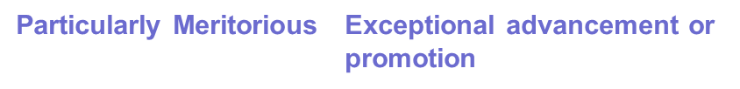
The MARS Exercise
Jan-Mar | Annual MARS Interview | PAST: -review results of work objectives -discuss competencies used -feedback -exchange of views |  | FUTURE: -set work objectives -set development objectives
Feb-Apr | MARS appraisal (MARS form) | Electronic form (EDH) which represents an official record of what was discussed at the interview
Apr-Jun | Performance qualification and advancement and promotion decisions | Department Head rates performance of staff members:
Notes:
The interview is to address the previous year’s work:
assess performance against agreed targets,
Discuss the main competencies that were used to achieve the results
feedback – information to staff on performance and progress (check on right track) and
exchange of views b/t staff and supervisor – e.g. what resources/development needed, what went well/could have gone better etc.
Also to discuss future:
-set work objectives for following year and give direction
-set development objectives (any type of learning activities that will help develop in the functions, take on more responsibilities, different projects, etc.)
Form completed by staff member and supervisor to represent what was discussed at interview. Supervisor and GL write evaluation of performance. Staff member sees form and can make comments if so wishes. Form is official document and forms part of personal file. May be used in other HR processes including career and contract reviews.
Discussions take place in dept. DH decides on performance qualification. Based on this, advancement/promotions are proposed.

Slide 7
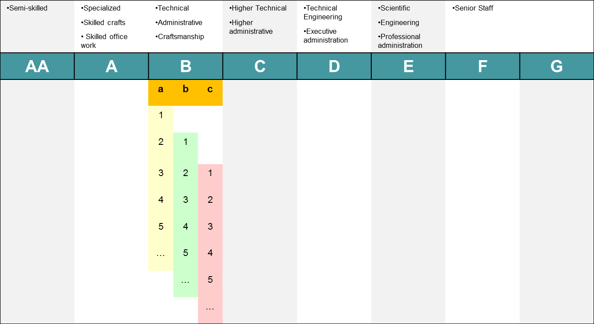
Career Evolution
Advancement
Advancement
ANNUAL procedure
Based on
Performance
Non-meritorious
Meritorious
Particularly meritorious
Promotion
Proposed in case of change of
Functions
Level of Expertise
Level of Responsibilities
Promotion
Notes:
Remind them of the career structure for STAFF. They have all been recruited in one CP and a band depending on the CP the job was open in and their level of experience relevant to the job.
As in any other company we have budgetary constraints in terms of monetary recognition and a distribution guidelines of people falling in one or the other categories of advancement.

Slide 8

Where can I find out more?
MARS FAQ – Admin e-guide
MARS Coordinators
HRAs

Slide 9
