Slide 1


Beam-beam studies in the LHC and new projects
ICFA mini-workshop on
"Beam-Beam Effects in Hadron Colliders”
March 18th to 22nd, 2013
T. Pieloni for the
LHC and HL-LHC Beam-Beam Teams

Slide 2
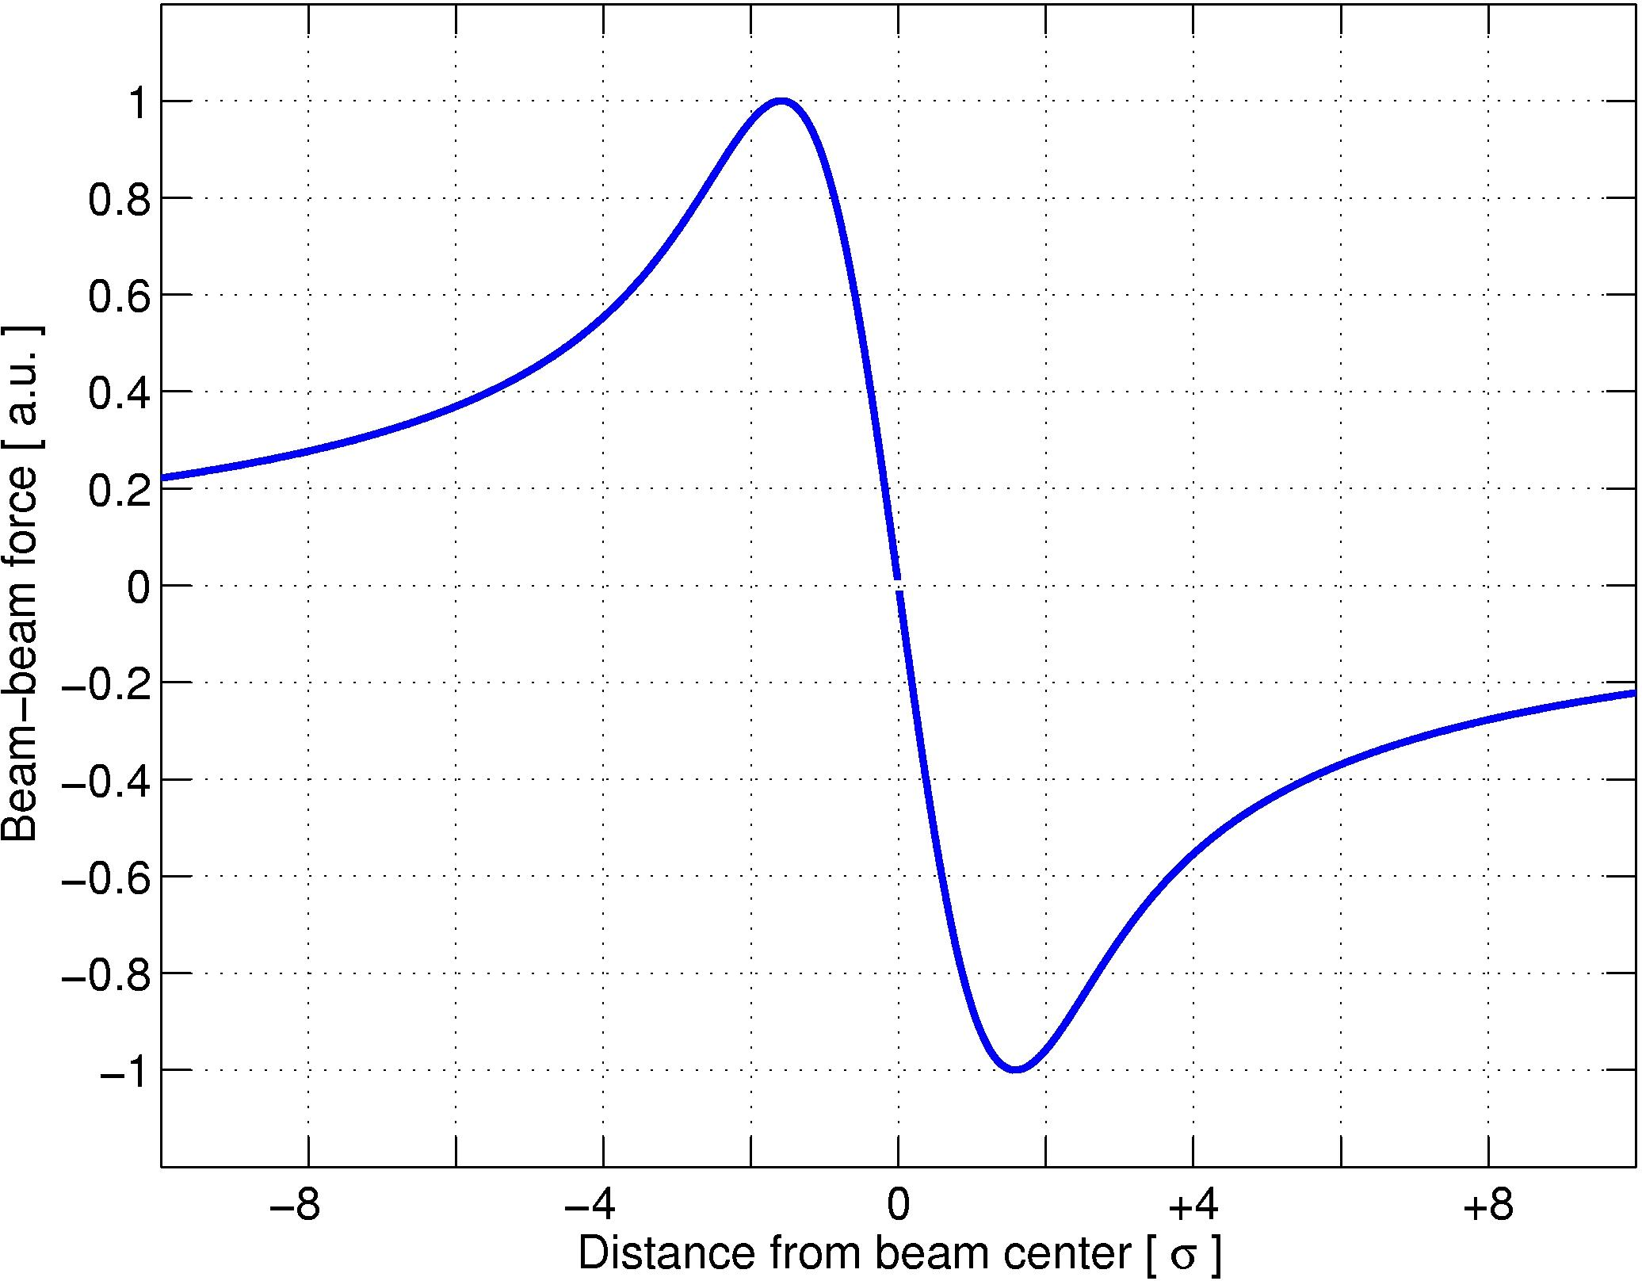
BB effects and luminosity
Pushing for luminosity means stronger beam-beam effects
Beam-beam force
Head-on
Long-range
Different Effects Head-on and Long-range…
Two main questions:
What happens to a single particle?
What happens to the whole beam?

Slide 3
Layout
Experience from other colliders (p-p, e-e, e-p)
LHC BB experiences foreseen and un-foreseen
Beam-beam studies for LHC after LS1
HL-LHC beam-beam studies
Beam-beam compensations (e-lens, wire compensation)
Summary

Slide 4
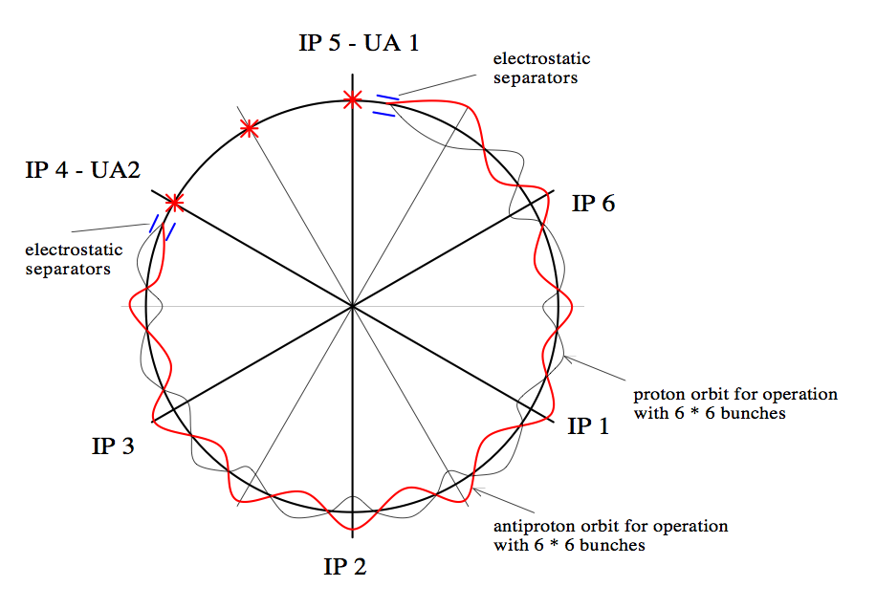
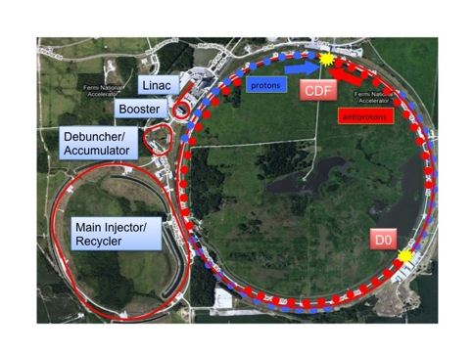
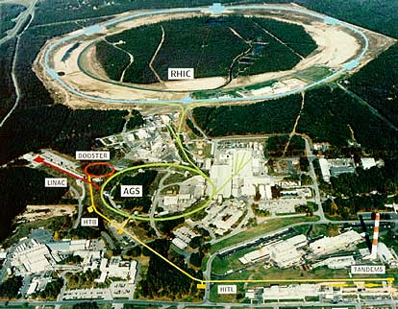
Experience and observations from hadron colliders
SPS collider: 6 bunches
3 HO and 9 LR
RHIC: 110 bunches
2 BBIs Head-on
Tevatron: 36 bunches
2 BBIs Head-on and 72 Long-range
K. Cornelis, ”Experience with beam-beam effects in the SPS collider
V. Shiltsev, “Beam-beam observations in the Tevatron”
V. Shiltsev, “Experience with long range beam-beam effects in the Tevatron”
Y. Luo, “Beam-beam observations in RHIC”

Slide 5

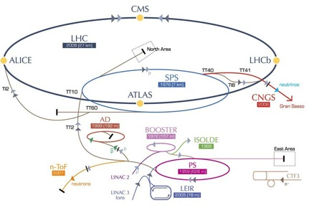
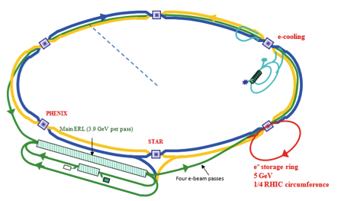
Experience and observations from HERA e/p
ERL LHeC:
HERA: 180 p/bch 182e/bch
2 Head-on collisions
LHeC: Nominal LHC with p-p collisions and 1 Head-on collision e-p
eRHIC: 180 p/bch 180 e/bch
1 Head-on collision
M. Vogt, ”Beam-beam Effects in HERA”
D. Schulte, ”Beam-beam effects in the LHeC”
Y. Hao,” Beam-beam study of the ERL based e-RHIC”

Slide 6
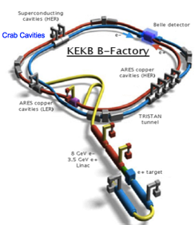
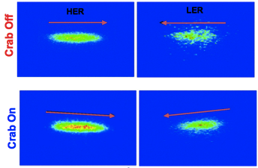
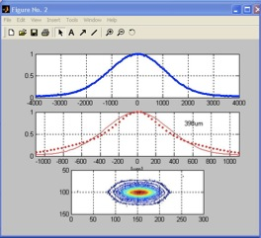
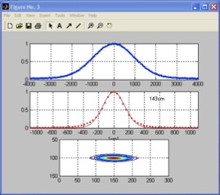
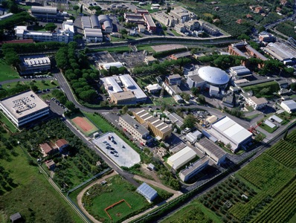
Lepton colliders experiences relevant for LHC
Crab Cavity Experience from KEKB
CRAB OFF
CRAB ON
LPA and crabbed waist
The Φ-Factory complex
LNF
DAFNE-light
DAFNE
BTF
LINAC
-Y. Kunakoshi, ”Operational experience with crab cavities at KEK”
- M. Zobov, “Experience with Large Piwinski Angle and Crabbed Waist”

Slide 7
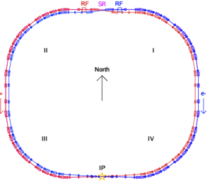
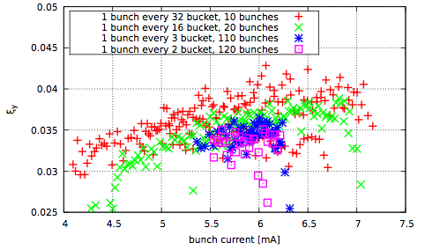
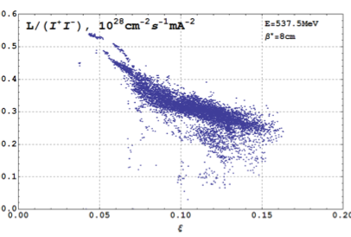
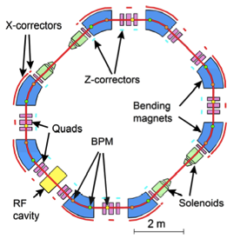
Lepton colliders experiences
BEPCII: 1 head-on collision e⁺-e⁻
Max ξ_{bb} = 0.04 few bunches
-Y. Zhang, ” Beam-beam effects in BEPC-II”
-D. Shwartz, ” Recent beam-beam effects at VEPP-2000 and VEPP-4 ”
VEPP2000: 2 head-on collision e⁺-e⁻
Max ξ_{bb} = 0.13

Slide 8
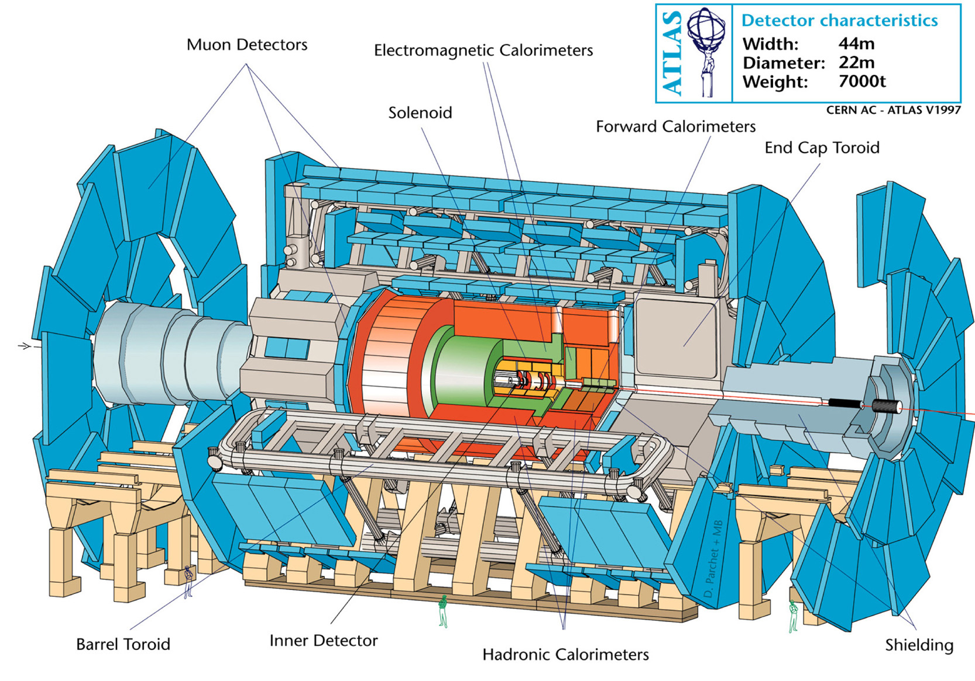
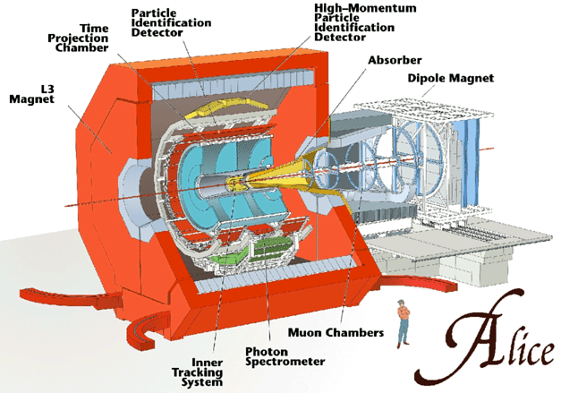
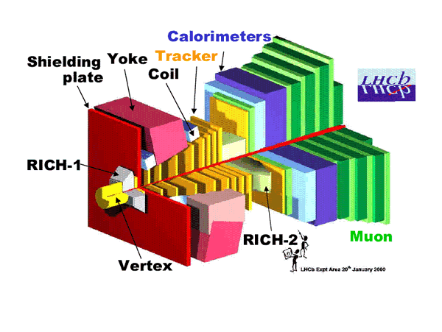
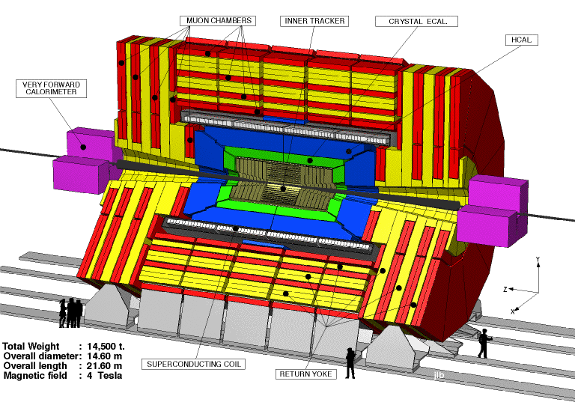
LHC collider and BB effects
pp collisions
High number of bunches (2808/beam) in train structures
Crossing angle operation
Pronounced Pacman effects (LR 40-120)
4 Experiments (3/4 Head-on collisions)
ξ_{HO} = 0.0036 per Interaction Point
Head-On
Long Range
72 bunches
….
 | SppS | Tevatron | RHIC | LHC
Number Bunches | 6 | 36 | 109 | 2808
LR interactions | 9 | 70 | 0 | 120/40
Head-on interactions | 3 | 2 | 2 | 4
Pacman bunches complexity | * | ** | * | ***

Slide 9
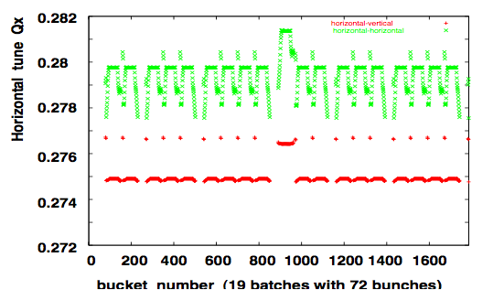
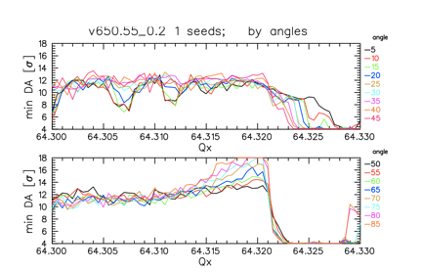
Nominal LHC BB strategy I
ATLAS and CMS alternating crossing: passive compensation of PACMAN effects worked well mitigating Q, Q’ Long Range effects visible in lifetime
LHCb and ALICE Long-range should be kept in the shadow (larger Long-Rang separations), no passive compensation possible
Working point (64.31, 59.32) showed to host well the BB tune spreads for nominal from DA studies
IP 2 and IP8 b* = 11 m

Slide 10
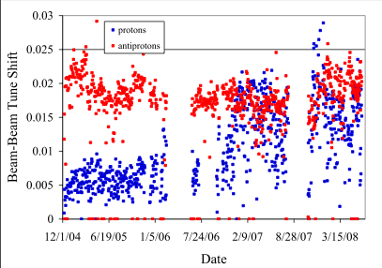
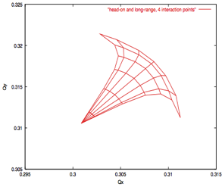
Nominal LHC BB strategy II
Consolidated ξ_{bb} based on Tevatron and SppS experience maximum 0.015 total tune shift, 0.01 allocated to beam-beam effects head-on and long-range
This gives ξ_{HO} = 0.0033/IP (with bunch intensities 1.15e11 and transverse emittances 3.75 μm)
Nominal LHC 25 ns symmetric filling schemes guarantees all bunches Landau damping from at least 1 HO collision
Bunch to bunch fluctuation in emittances should be kept within 10%
Tevatron beam-beam total tune shift
LHC nominal bunch footprint HO+LR beam-beam
LHC has been anything but Nominal….:O)

Slide 11
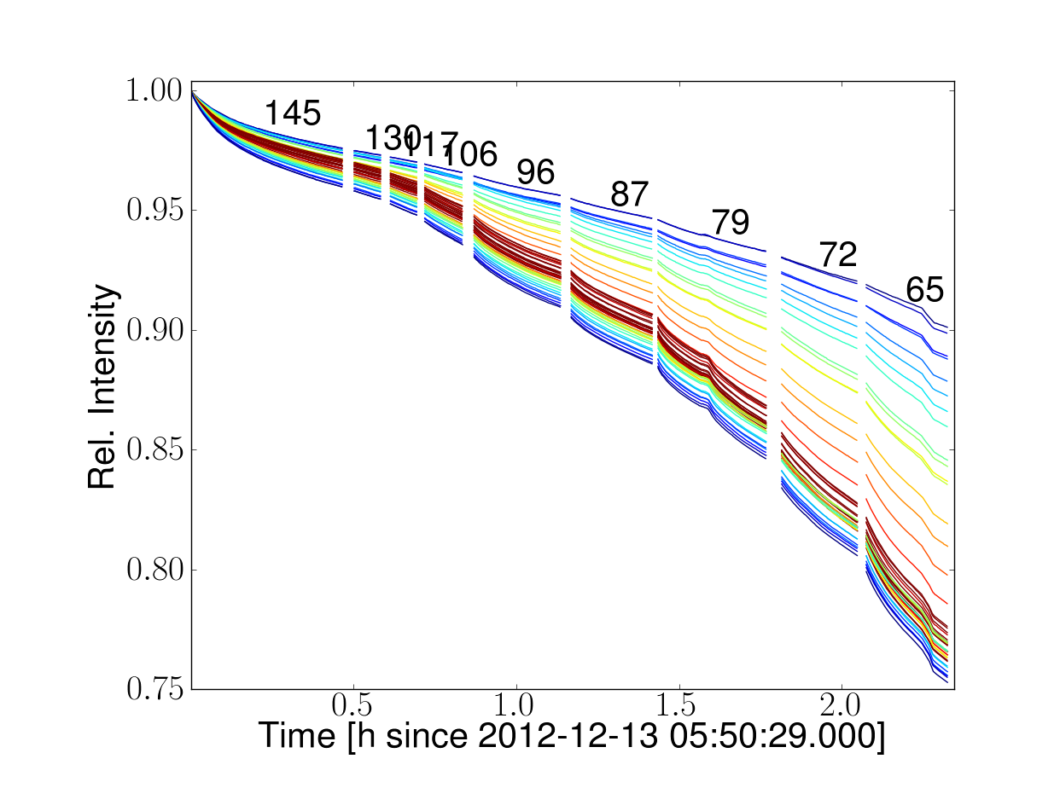
LHC foreseen and un-foreseen:
Long-range effects follows DA studies
Coherent beam-beam modes observed in MDs
Long-range effects for 50ns, 25 ns: scaling laws to predict onset of losses due to DA
q_{H}
q_{V}
q_{H}
q_{V}
ΔQ=0.03
LR experiment with 25 ns
Coherent beam-beam modes during high pile-up MD 2011

Slide 12
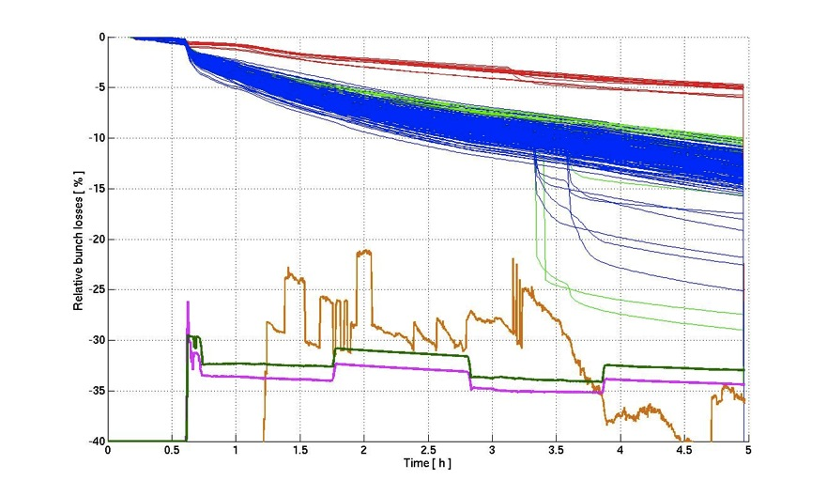
LHC foreseen and un-foreseen:
Large ξ = 0.017/IP , ξ = 0.03 for 2 IPs
Leveling with transverse offset (50 ns requires it!)
IP8
IP1&5
IP1&5&8
Leveling test for ATLAS and CMS
ATLAS
CMS
LHCB

Slide 13
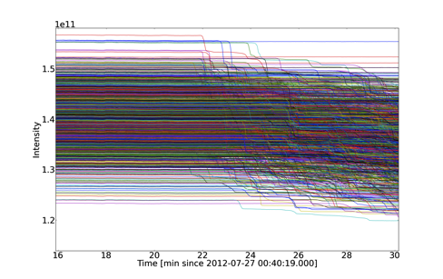
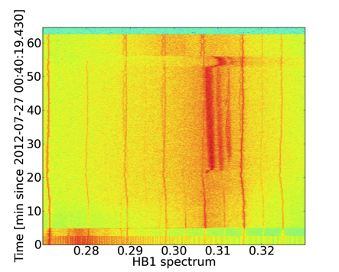
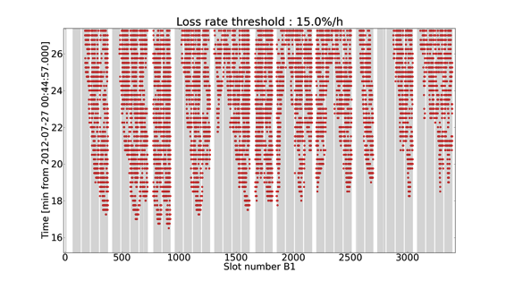
LHC foreseen and un-foreseen:
2012 Instabilities, beam-beam is an important ingredient maybe not the driving one (impedance?)
  Lack of Landau damping IP8 bunches
  Stability at different stages of beam process
  Need for multi-effect models (Impedance+BB+ transverse damper+…)

Slide 14

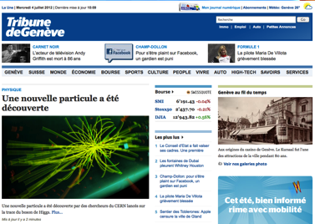
LHC Studies for after LS1
2012 has been very exciting year
Good surprises
Bad surprises
What have we learned?
Study beam-beam effects as in normal operation
Long-range effects should be mitigated where possible
Collide for stability: collide and squeeze and possibly level luminosity
What we should address?
Development of simulation tools for multiple effects, to reproduce LHC observations , and flexible for different operational scenarios
Need observables to benchmark models
Need to define/study possible operational scenarios for cases (25 ns, 50 ns, emittances)
Leveling strategies and BB effects, need careful thinking 4 experiments

Slide 15
Studies for after LS1
What we should address?
Development of simulation tools for multiple effects, to reproduce LHC observations, and flexible for different operational scenarios
Need observables to benchmark models
Need to define/study possible operational scenarios (25 ns, 50 ns, emittances)
Leveling strategies and BB effects, needs careful thinking 4 experiments
Simulation and Theory I - II
M. Vogt, ”Analytical and numerical tools for beam-beam studies”
S. Paret&J. Qiang, ”Poisson solvers for self-consistent multi-particle simulations”
A. Valishev,”Modelling beam-beam in the Tevatron”
A. Burov, ”Beam-beam, impedance and damper”
X. Buffat, “Stability diagrams of colliding beams”
C. Montag,”Beam-beam effects in space charge dominated ion beam”
Strong-Strong and coherent beam-beam effects
S. White, “Beam-beam and impedance”
X. Buffat, “Coherent beam-beam modes in the LHC”
P. A. Goergen,”BTF measurements with beam-beam interactions”
Operatonal aspects
R. Giachino, “Diagnostics needs for beam-beam studies and optimization
W. Kozanecki, “Luminosity measurements and optimization – consequences for bb effects

Slide 16
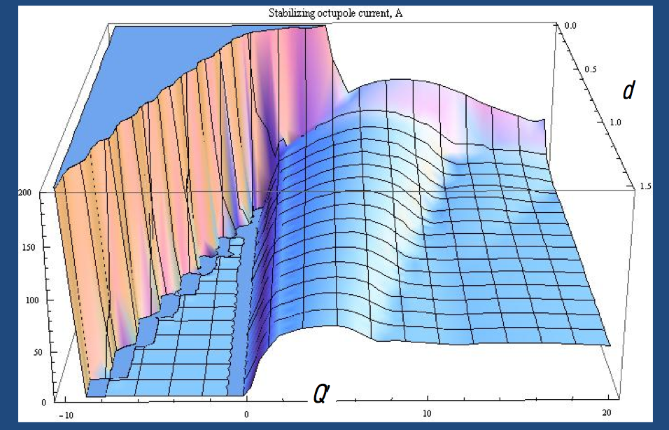
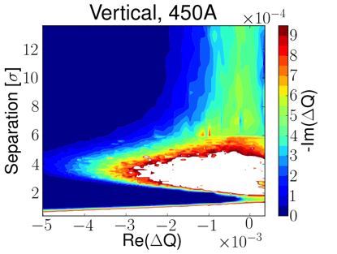
Studies for after LS1
Stability diagrams from tracking
A. Burov NHT Model
Beam-beam and Impedance
How does beam-beam changes/plays with other effects?
Many new models including
beam-beam, impedance, transverse damper for multi bunch beams have been developed during 2012
Instability observed when
π-mode crosses mode -1

Slide 17
Studies for after LS1
What we should address?
Development of simulation tools for multiple effects, to reproduce LHC observations
Need for observables to benchmark models
Need to define/study possible operational scenarios for cases (25 ns, 50 ns, parameters)
Leveling strategies and BB effects, needs careful thinking 4 experiments all independent
Operational aspects of beam-beam effects I - II
R. Jacobsson, “Needs and requirements from the physics experiments”
T. Pieloni&B. Muratori, “Luminosity leveling techniques: implications for beam-beam interactions”
D. Jacquet,”Implementation and experience with luminosity leveling with offset beams”
R. Giachino,”Diagnostics needs for beam-beam studies and optimization”
W. Kozanecki, “Luminosity measurements and optimization-consequences for beam-beam effects
X. Buffat, “Consequences of missing collisions – beam stability and Landau damping”

Slide 18
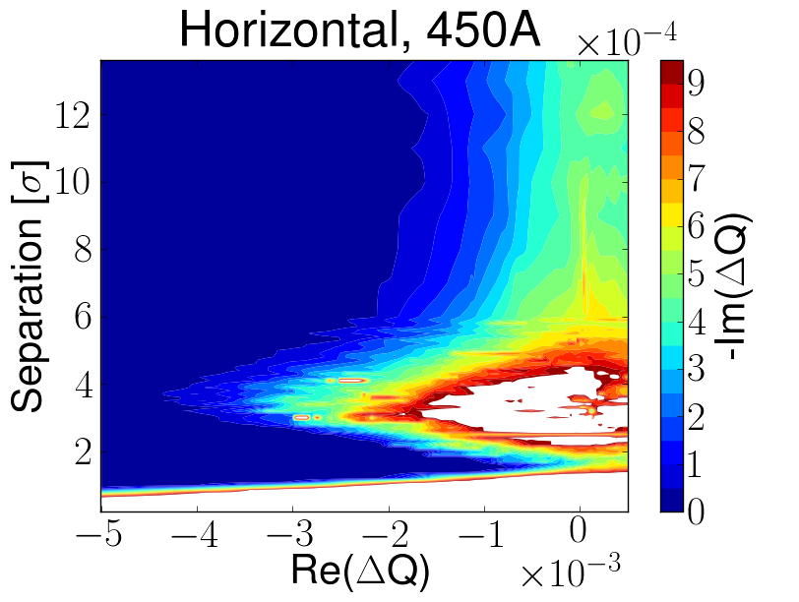
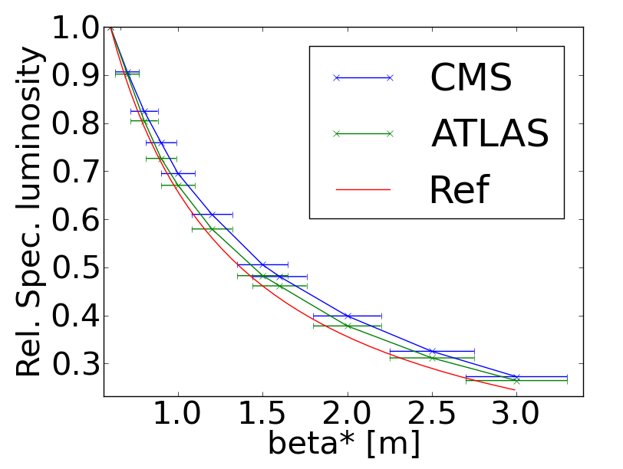
Studies for after LS1
Instabilities cured by: Collide&squeeze
High pile-up reduced by larger β* then squeeze
Time

Slide 19
HL-LHC Project: main parameters and BB view
‘Stretched’ Baseline Parameters following 2nd HL-LHC-LIU:
Parameter | nominal | 25ns | 50ns
N | 1.15E+11 | 2.2E+11 | 3.5E+11
n_{b} | 2808 | 2808 | 1404
beam current [A] | 0.58 | 1.12 | 0.89
x-ing angle [μrad] | 300 | 590 | 590
beam separation [σ] | 9.9 | 12.5 | 11.4
β* [m] | 0.55 | 0.15 | 0.15
ε_{n} [μm] | 3.75 | 2.5 | 3.0
ε_{L} [eVs] | 2.51 | 2.51 | 2.51
energy spread | 1.20E-04 | 1.20E-04 | 1.20E-04
bunch length [m] | 7.50E-02 | 7.50E-02 | 7.50E-02
IBS horizontal [h] | 80 -> 106 | 18.5 | 17.2
IBS longitudinal [h] | 61 -> 60 | 20.4 | 16.1
Piwinski parameter | 0.68 | 3.12 | 2.85
geom. reduction* | 0.83 | 0.305 | 0.331
beam-beam / IP | 3.10E-03 | 3.3E-03 | 4.7E-03
Peak Luminosity | 1 10³⁴ | 7.4 10³⁴ | 8.5 10³⁴
Virtual Luminosity | 1.2 10³⁴ | 24 10³⁴ | 26 10³⁴
Large ξ_{bb}
DA studies with Working Point optimization & Orbit effects
Large crossing angle requires compensation of geometrical factor by CRAB-CAVITIES
High pile-up needs robust strategy for leveling
Events/crossing | 19 /28 | 207/140 | 476/140
O. Bruning

Slide 20
HL-LHC
Geometric reduction factor of 70%
Crab cavities noise on colliding beams to define tolerances
Operational Experience of crab cavities with proton beams
Impact of crab cavities and crab noise on DA
New working points (1/2 integer tunes)? New ideas?
Studies for Future Projects
A. Valishev, ”Beam-beam studies for the HL-LHC”
S. Paret, “ Simulation of beam-beam induced emittance growth in the HL-LHC with crab cavities
K. Ohmi, “Beam-beam predictions for SuperKEKB and Large Crossing Angles”
A. Burov, “Circular Modes”
  Single Particle effects
K. Ohmi, “Beam-beam effects under the influence of external noise”
G. Stancari, “Measurements of the effect of collisions on transverse beam halo diffusion in the Tevatron and in the LHC”
  Experience in Lepton Colliders
Y. Kunakoshi, “ Operational experience with crab cavities at KEK”

Slide 21
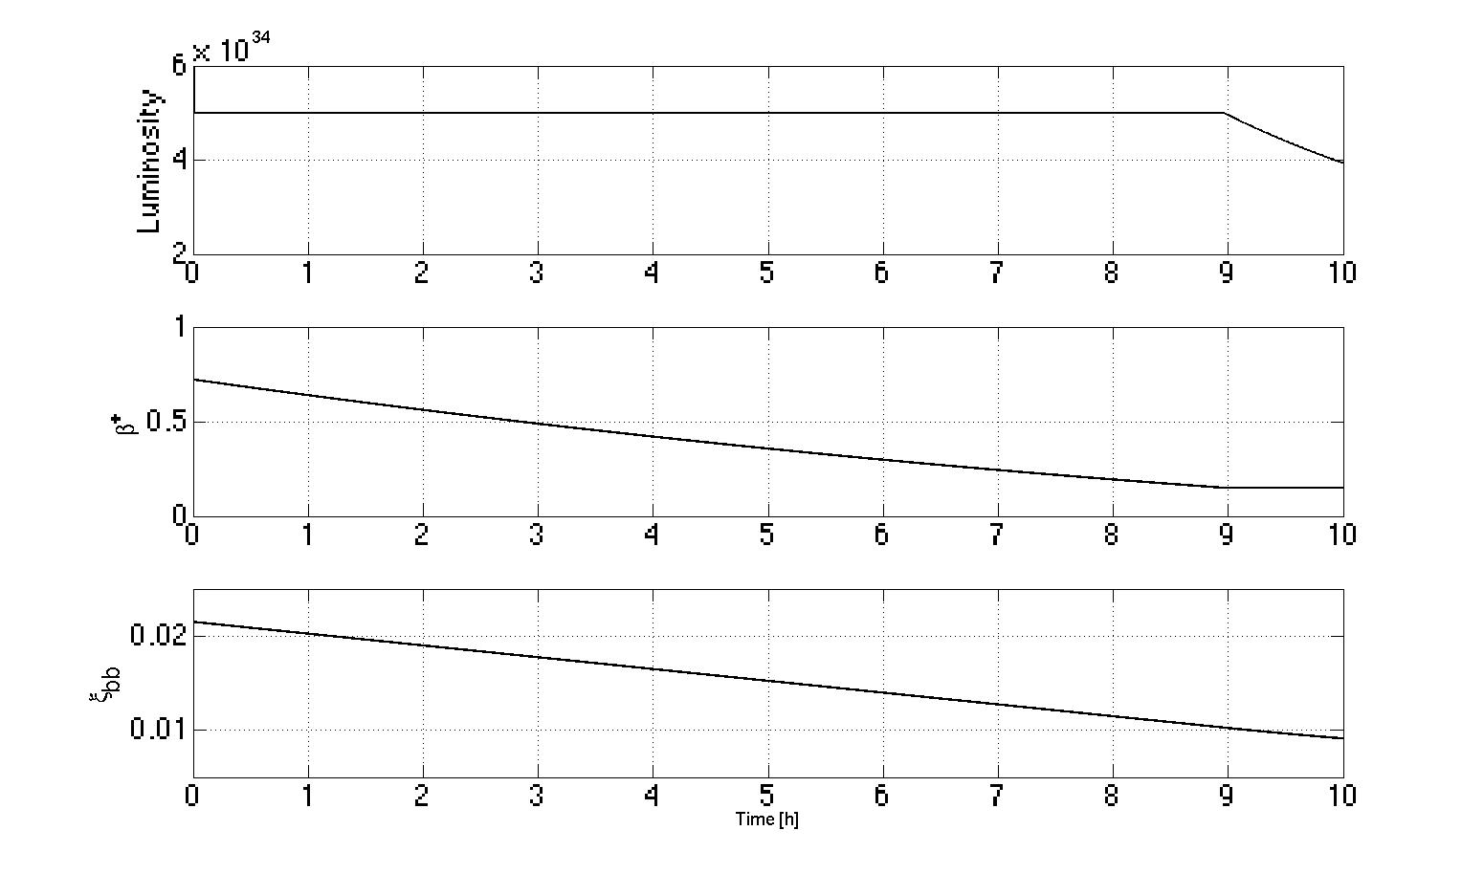
HL-LHC leveling and ξ
Leveling desiderata from the experiments to define strategy
Crab crossing compensation gives large ξ (specially 50 ns), will noise of cavities deteriorate it?
β* Leveling fundamental for stability. Need operational experience in the LHC!
HL-LHC leveling case 25 ns
β* 70cm→15 cm
ξ_{max} 0.02/2IP
R. Jacobson, “Needs and requirements from the physics experiments”
T. Pieloni&B. Muratori, “Luminosity leveling techniques: implications for beam-beam interactions”

Slide 22
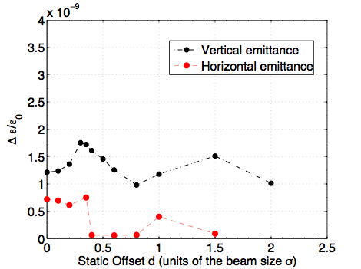
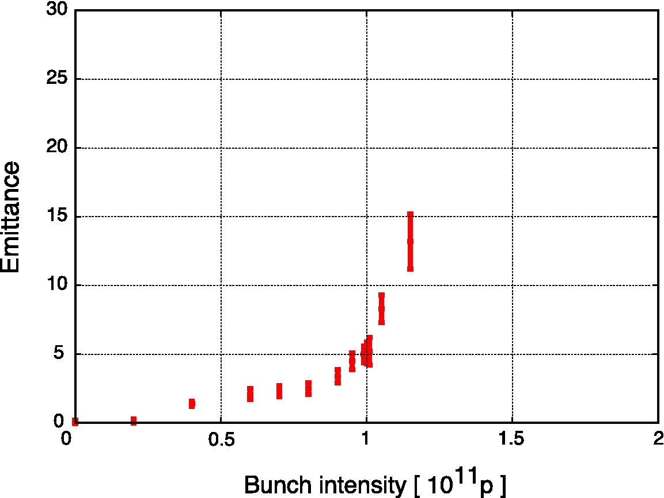
HL-LHC transverse offsets and emittance growth
  Slow Emittance growth
Leveling with transverse offset still option for HL-LHC
Long range interactions will give orbit effects at the IPs. How large the effect?
Emittance growth is induced by small offsets at collision and has intensity threshold! Is HL-LHC safe?
2012 LHC test not conclusive
Δσ / σ ₀ (per turn)
Δσ / σ ₀
  LHC nominal

Slide 23
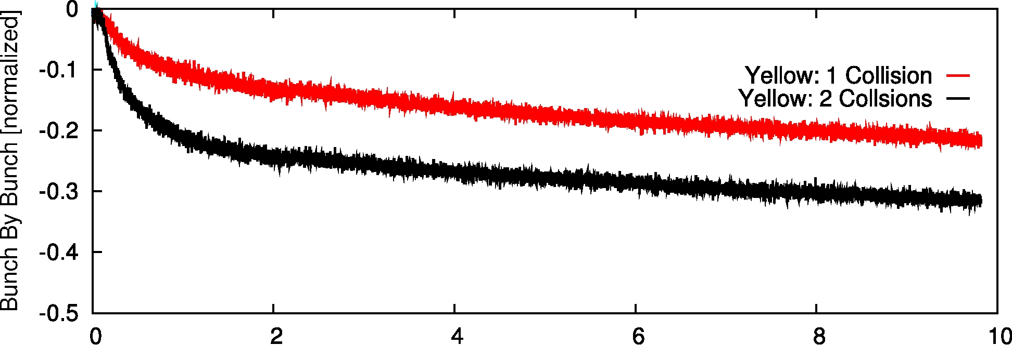
Beam-beam compensation
Head-on compensation by use of an electron beam
RHIC yellow beam intensity evolution during store
Can head-on be partially compensated by an electron beam (RHIC)?
What can we learn from Tevatron experience?
Studies for Future Projects
W. Fischer,”Status of head-on compensation in RHIC”
G. Stancari, “Beam-beam compensation studies in the Tevatron”
Y. Luo, “Six-dimensional weal-strong simulations of head-on compensation in RHIC”
S. White, ”Coherent beam-beam effects in experiments and implications for head-on compensation”

Slide 24
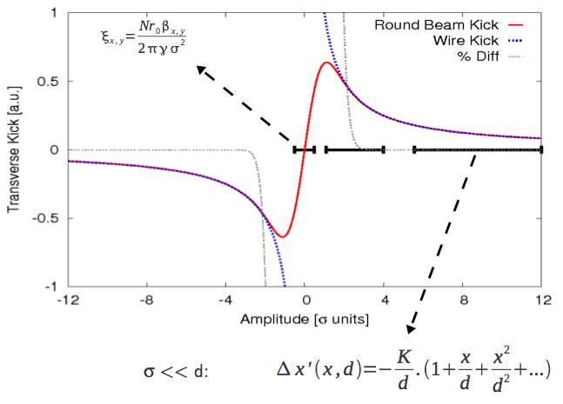
Long range Beam-beam compensation
Long-range compensation by use of a wire
Can we reduce crossing angle for HL-LHC by partially compensating long-range effects?
Which are the difficulties of a beam test?
What is operational experience from RHIC?
Studies for Future Projects
R. Calaga, “ Long-range experiments in RHIC”
T. L. Rijoff,”Simulation of long range compensation in the LHC with a wire”
F. Zimmermann, “10 years of wire excitation experiments in the CERN SPS”

Slide 25
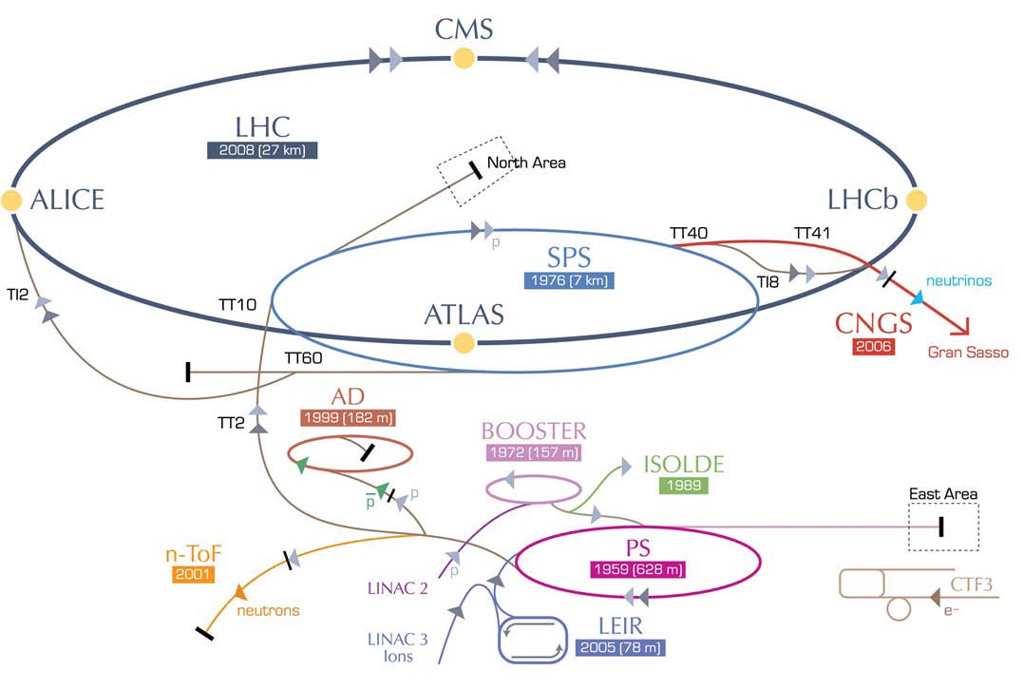
…and in the future HE-LHC?....
HE-LHC
20-T dipole magnets
SPS+
higher energy
transfer lines
2-GeV Booster
Linac4
F. Zimmermann
…no talks at this workshop hopefully at the next BB workshop…!

Slide 26
Summary:
The LHC Beam-beam strategy has not yet been tested, we are not at nominal
2011/2012 experience has shown foreseen and un-foreseen beam-beam effects (leveling needs, large ξ_{bb,} instabilities, Long-range scaling laws)
LHC after LS1 needs new scenarios and beam-beam studies to prepare for:
  Cure the 2012 instabilities by collide&squeeze
  Leveling strategies among the experiments desiderata (b*, offset, how?, when?)
  Study multi effects in the LHC to reproduce observables (BB, impedance, transverse damper)
  Need to push for bunch by bunch and special diagnostics (BTF?)
HL-LHC opens new exciting issues:
  Full and complete study of general noise on colliding beams, need experimental studies in LHC
  DA study for optimizing working point and parameters with and without crab cavities
  Study effect of crab cavities noise on colliding beams
  Leveling strategy fundamental
  Effect of small offsets on emittance growth studies
HE-LHC…no talks at this workshop maybe at the next one….other projects?

Slide 27
Thank you !

