Slide 1
Beam-beam Observations in RHIC
Y. Luo, W. Fischer
Brookhaven National Laboratory, USA
ICFA Mini-workshop on Beam-Beam Effects
in Hadron Colliders, March 18-22, 2013, CERN

Slide 2
Content
Introduction
Observations: General
Explanations & Modeling
Observations: Limits
Summary
In this talk we focus on observations on luminosity, beam intensity, emittance, and bunch length. Observations on coherent beam-beam and long-range beam-beam will be reported separately.

Slide 3
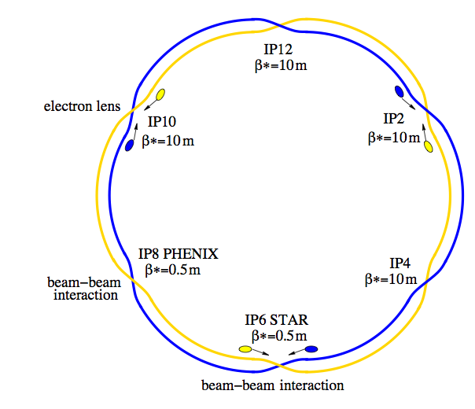
Introduction
RHIC consists of two super-conducting rings which insect at 6 locations along its 3.8 Km circumference.
Two beams collide head-on at IP6 and IP8. They are vertically separated at other non-collisional IPs.
RHIC collides heavy ions and polarized protons. The total maximum beam-beam parameters is 0.003 for Au-Au collision, and 0.018 for p-p collision. In this presentation, we only focus on BB issues in p-p runs.
RHIC layout

Slide 4
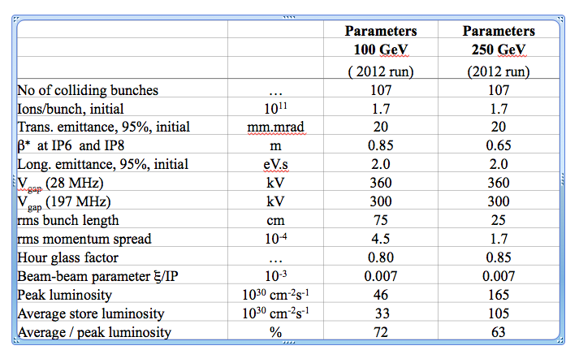
Beam parameters in the RHIC p-p runs
255 GeV
45

Slide 5
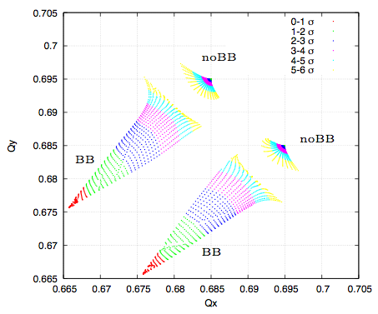
Tune Space
Working point in p-p is determined by the beam lifetime with BB and the polarization preservation on ramp and at store.
Current nominal working point (28.695, 29.685) is constrained between 2/3 and 7/10. 2/3 is strong 3rd order betatron resonance. 7/10 is 10th order betatron resonance but also a spin depolarization resonance.
Figure of merit in double-spin experiments is LP⁴, where L and P are luminosity and polarization.
Np=2.0e11, emit = 15 Pi mm.mrad

Slide 6
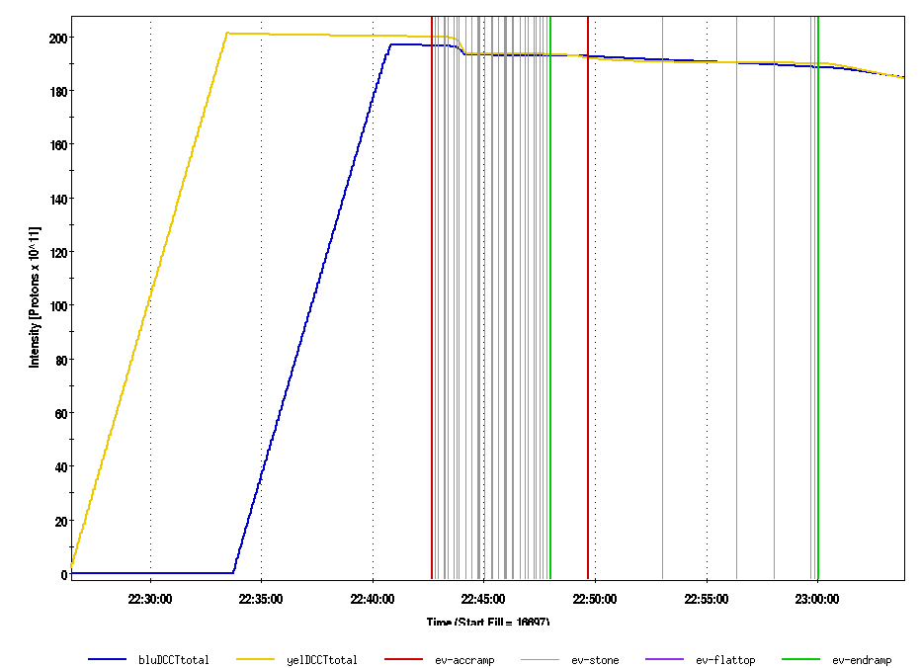
RHIC Fill Cycle
collide
energy
ramp
rotator
ramp
Physics
store
Injection
Re-bucketing
Fill 16697, 2012 run
To mitigate the emittance blowup and bunch lengthening on the ramp, we adopt 9 MHz RF cavities at injection and on the ramp. Between energy and rotator ramps we re-bucket bunches to 28 MHz RF cavities.
197 MHz cavity voltages are added at top energy to achieve a shorter bunch length to increase luminosity. However 197 MHz RF cavities increase beam’s momentum spread.

Slide 7
Observations: General
In this section, we present the general observations with beam-beam interaction:
luminosity lifetime
intensity lifetime
bunch lengthening
transverse emittance growth
And some statistics will be shown.

Slide 8


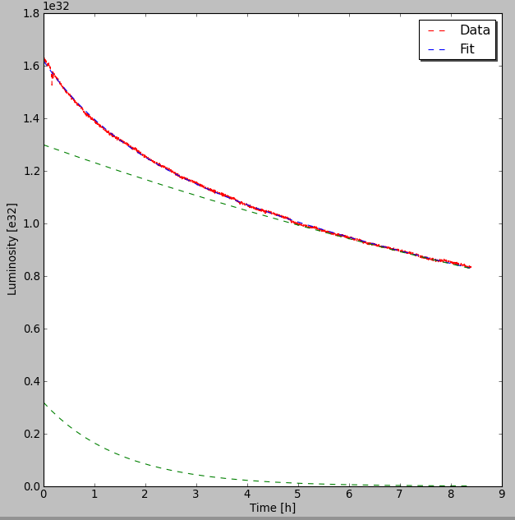
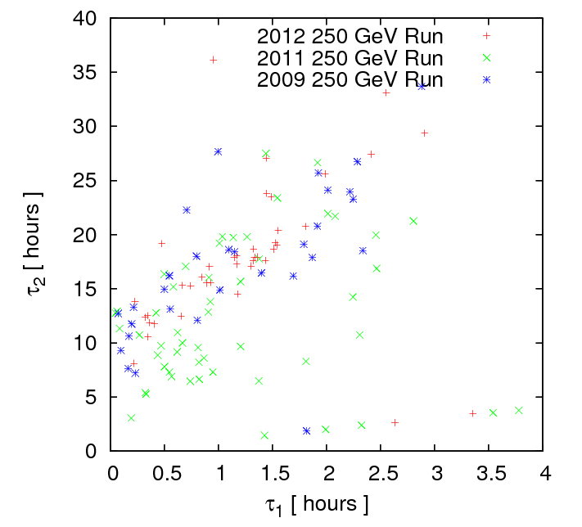
Luminosity Lifetime
Luminosity is determined by:
Empirically, luminosity in RHIC p-p run can be fitted with double exponentials:
(τ1, τ2) =(1.5hr, 18.5hr)
Fill 16697, 2012 run
Fills in 250 GeV runs

Slide 9

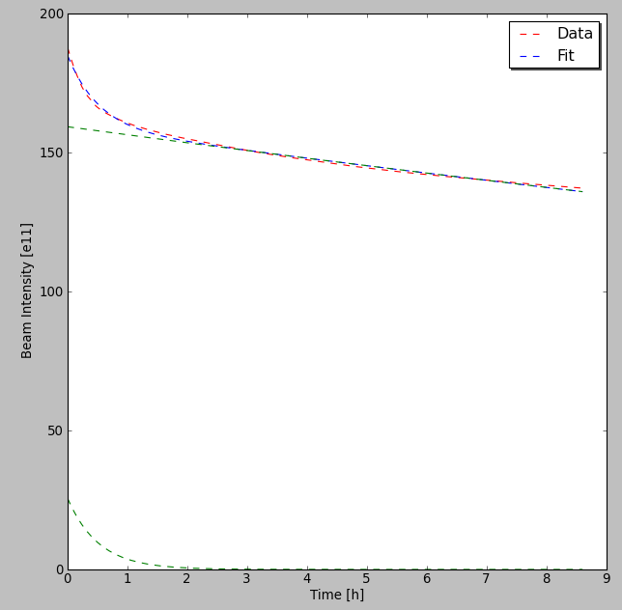
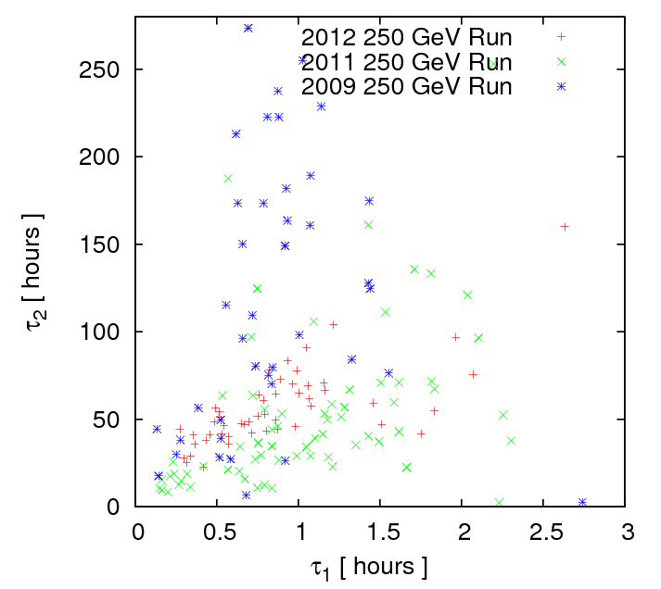
Beam intensity
With collision at store, we observed a fast beam loss in the first 1-2 hours, followed by a slow loss in the rest store.
The total beam intensity and single bunch intensity in the store also can be empirically fitted to double exponentials:
Blue ring, Fill 16697, 2012 run
Blue ring, fills in 250 GeV runs
(τ1, τ2) =(0.5hr, 54hr)

Slide 10
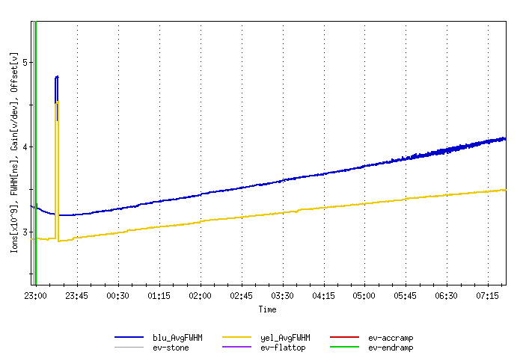
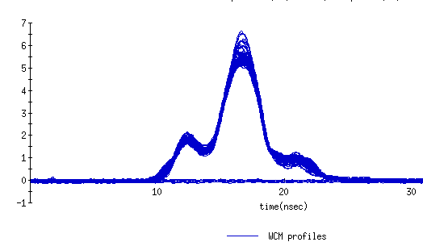
Bunch length
Bunch intensity and longitudinal profile are measured with wall current monitor (WCM). In RHIC control system, we use averaged FWHM of all bunches.
We observed that bunch length is reduced shortly after collision, then it slowly linearly increases in the rest of store. The shorten bunch length in the beginning is related to the fast beam intensity loss.
Fill 16697, 2012 run
FWHM

Slide 11
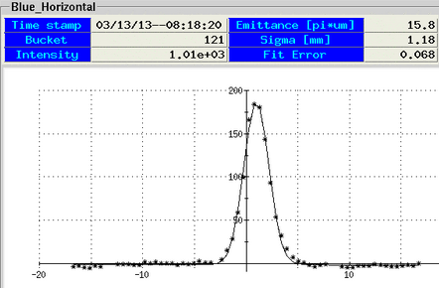
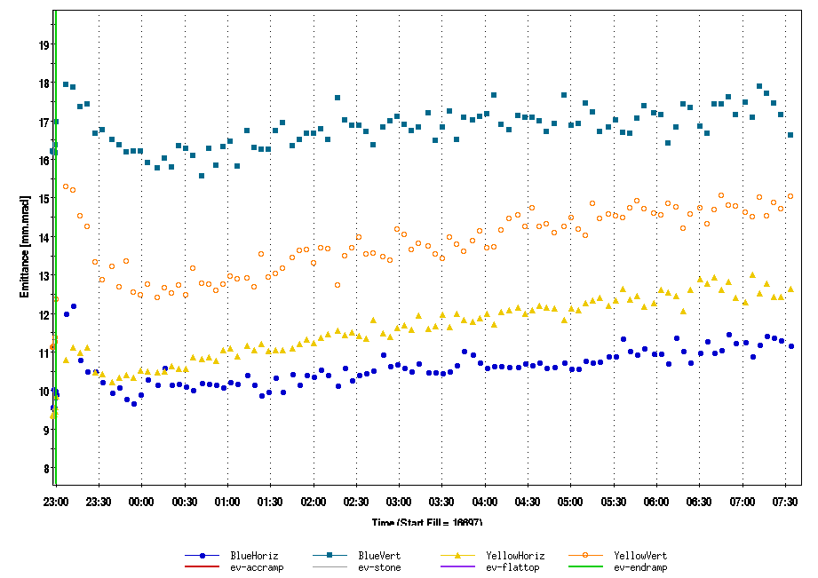
Transverse emittance
Transverse emittances are measured with ion profile monitor (IPM) and derived from luminosity measurement. IPMs requires knowledge of beta function, and need periodic calibration of micro-channel plate channel sensitivity due to aging.
Emittances are reduced shortly after collision, then they slowly increase in the rest of store. The reduced emittances in the beginning of store are also related to the fast beam loss.
Single Gaussian fitting
Fill 16697, 2012 run
IPM channel No.

Slide 12
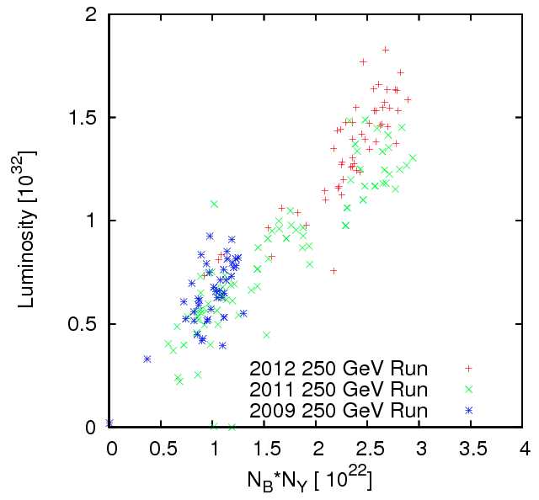
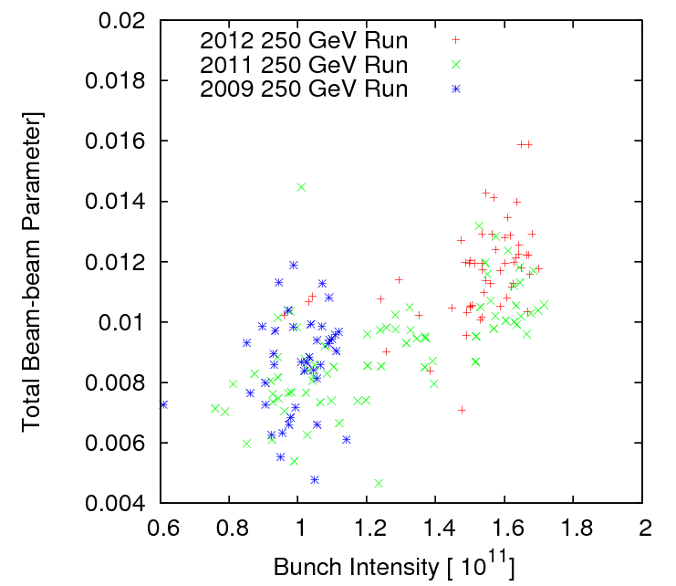
Luminosity & beam-beam parameter
The above plots show luminosity and beam-beam parameter at 10 minutes after beams were brought into collision.
Available tune space between 2/3 and 7/10 is about 0.03. There is still some room to push beam-beam parameter and increase luminosity.

Slide 13
Explanations & Modeling
In this section we will present
1) Mechanism of particle loss
- which particles lost
- how they get lost
Calculate IBS contributions to
- emittance growth
- bunch lengthening
and compare them to observations

Slide 14
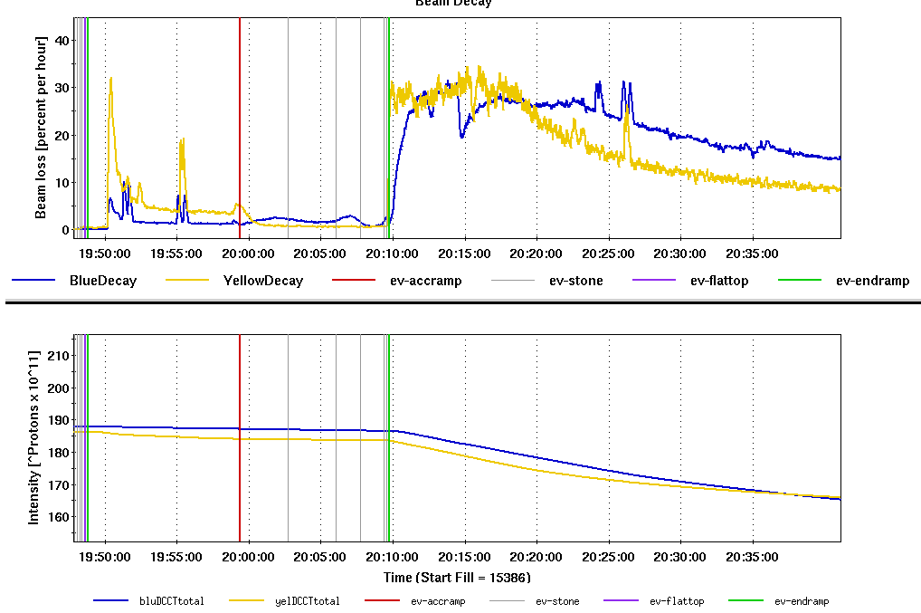
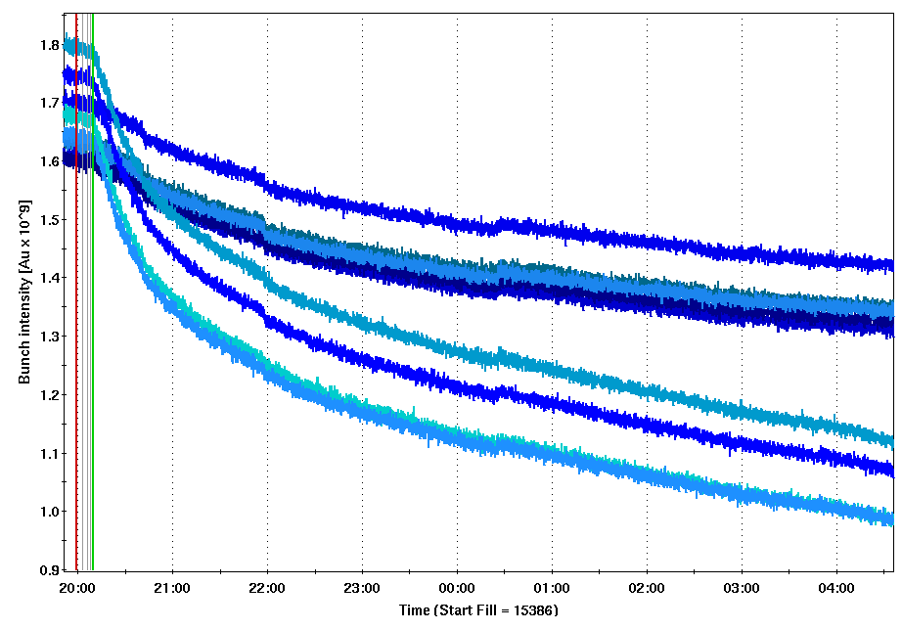
Beam-beam determined beam decay
No collision
With collision
(τ1, τ2) =(1.5hr, 100hr)
1 collision
Beam decay
Fill 15386
Beam intensity
2 collisions
(τ1, τ2) =(0.8hr, 30hr)
Top beam energy
Beam decays without and with collision: the left plot. Beam lifetime got worse immediately after beams were brought into collision.
Bunch decays with 1 and 2 collisions: the right plot. 1-collision bunches had better intensity lifetime as 2-collision bunches.
We conclude : beam-beam is the dominated factor for beam loss at store.

Slide 15
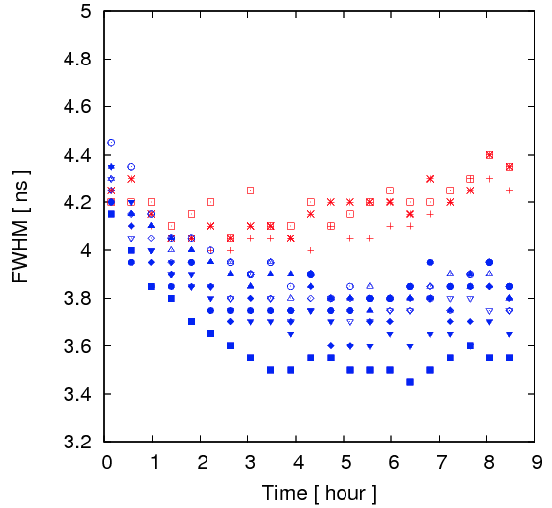
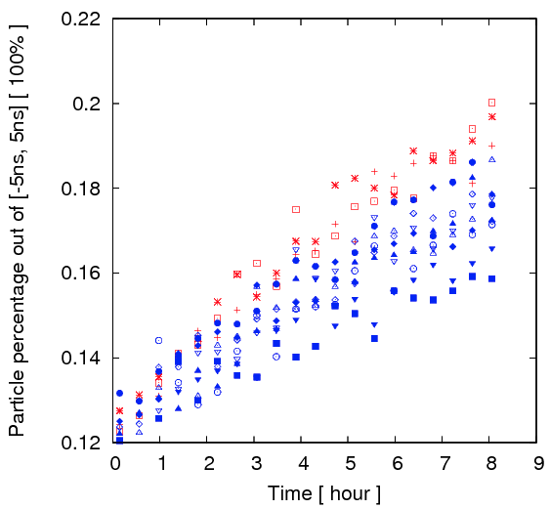
Longitudinal profiles in the store
With WCM, we can calculate each bunch’s particle distribution and particle migration in the longitudinal plane.
1-collision bunches
1-collision bunches
2-collision bunches
2-collision bunches
Blue ring, Fill 15386, 2011 run
1-collision bunches have larger bunch width and larger particle population in the bunch tail than 2-collision bunches.
We conclude : particle with larger δp/p are less stable with beam-beam.

Slide 16
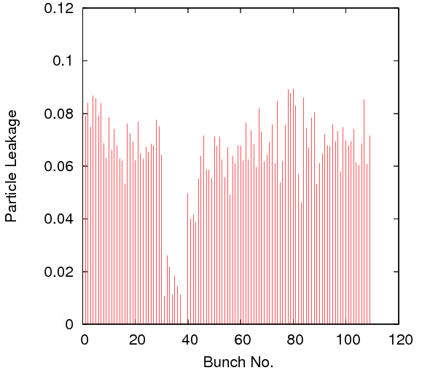
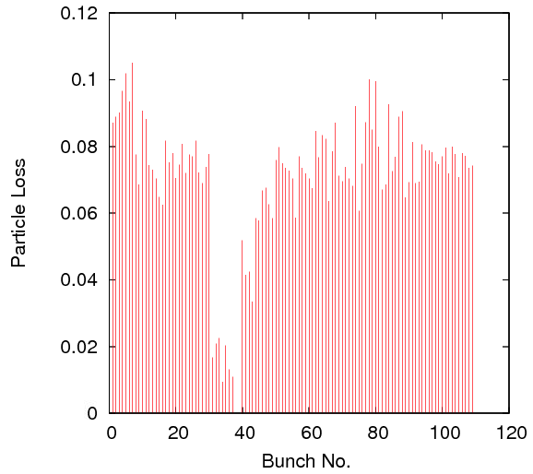
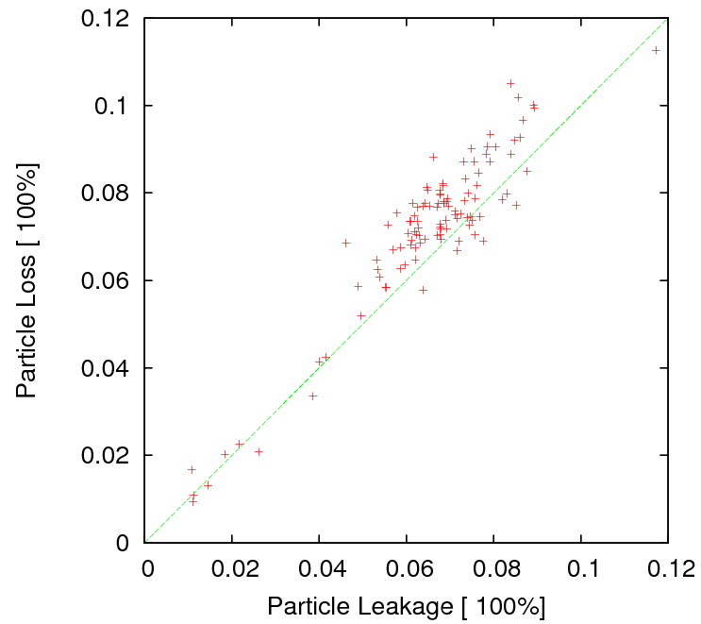
Particle leakage vs. particle loss
Particle leakage pattern ( out of [-5ns,5ns] )
Particle loss pattern
Intensity loss proportional to particle leakage in the longitudinal plane.
However, there was no de-bunching beam from WCM.
Considering particles in the bunch tail having large off-momentum deviation, we conclude: particles lost in transverse plane due to limited off-momentum DA.
Beam-beam reduces off-momentum DA.
Blue ring, Fill 15386,
first 1 hour in the store

Slide 17
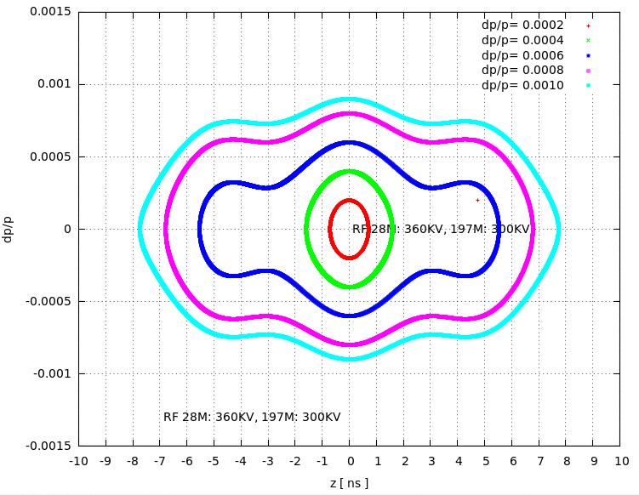
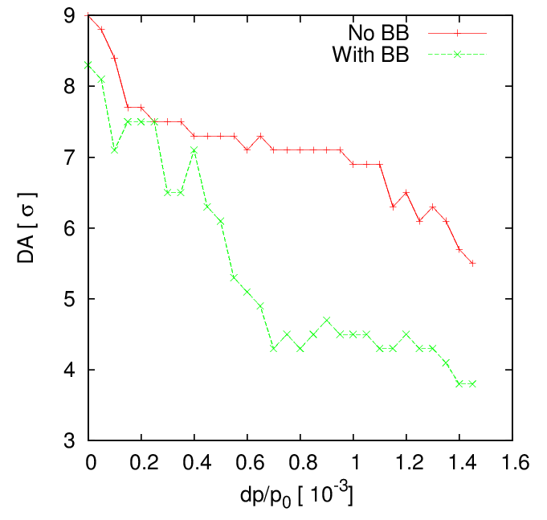
Off-momentum dynamic apertures
Yellow ring, 2012 run
With 197MHz RF the maximum dp/p0 for the center bucket [-2.5ns, 2.5ns] reaches 5e-4. And for the tail particles out of [-6ns, 6ns] ( full width ), dp/p0 is bigger than 6e-4.
Off-momentum DA calculation shows 1) off-momentum DA drops with BB than without BB; 2) for particles with dp/p0 > 6e-4, DA < 5 sigmas and they may get lost.
We believe that the early fast particle loss is caused by large dp/p0 particles left from re-bucketing and adding 197MHz RF voltage and it takes 1.5-2 hours to clean them up.

Slide 18
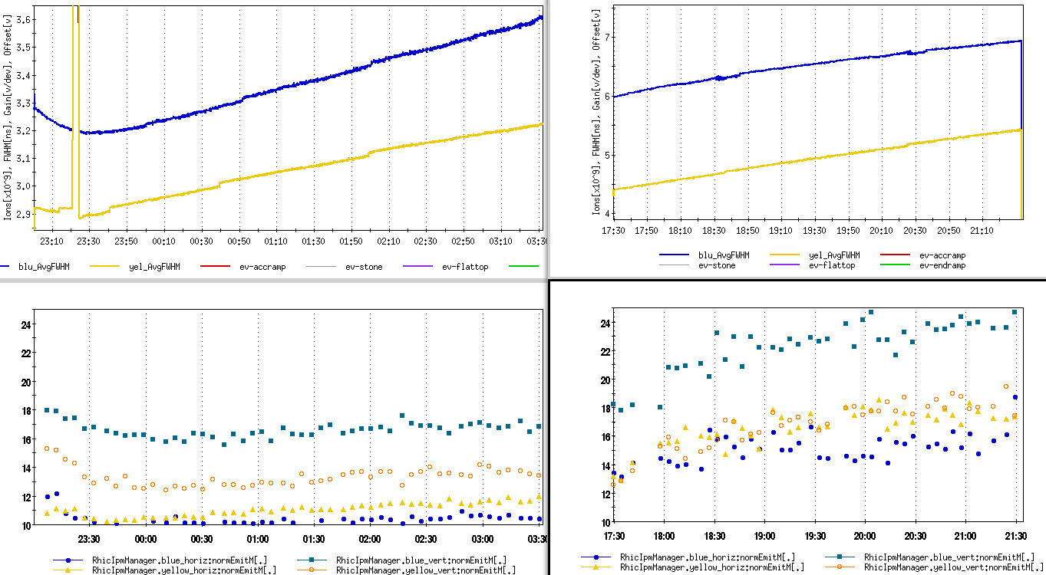
Emittance and bunch length w/o BB
Without beam-beam and 197 MHz RF voltages:
Beam loss rate was below 1%/h during entire store.
No emittance and bunch length reductions at the beginning of store.
Emittance growth bigger than without beam-beam.
Therefore, the beam-beam effects limited transverse emittance growth at store through reduced transverse dynamic aperture.
Fill 16697
Fill 16715
4 hour
4 hour
Re-bucketed, BB
Not re-bucketed, no BB

Slide 19
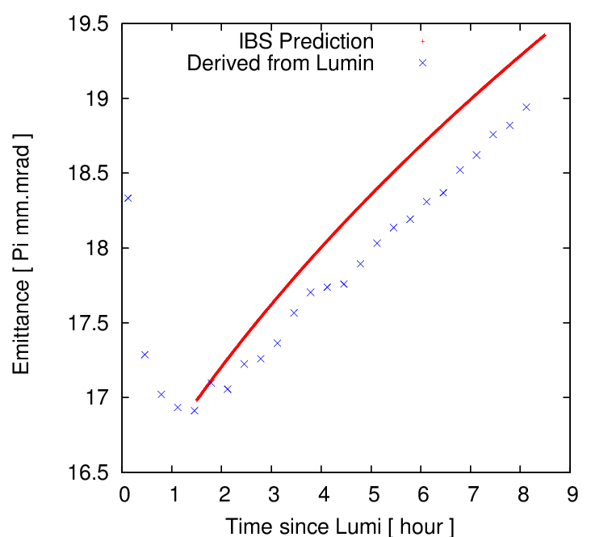
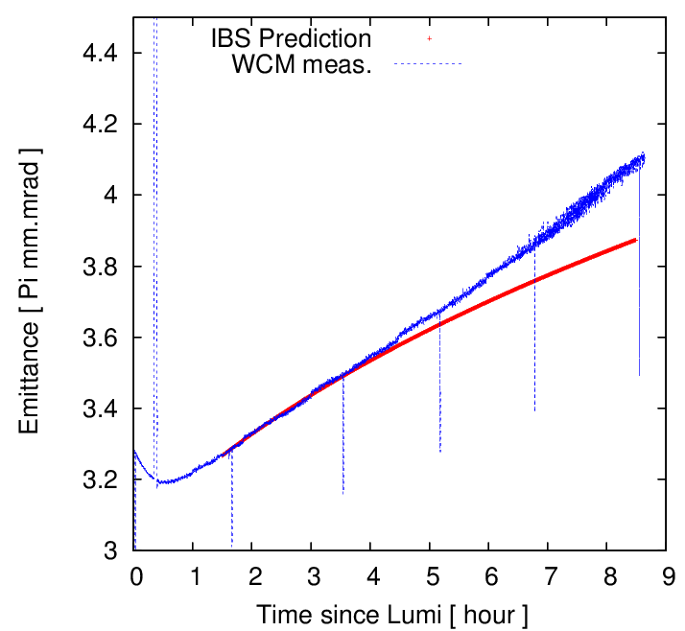
Intra-beam Scattering (IBS) effects
We estimate the emittance and bunch length growth from IBS after 1.5 h.
For example: initial inputs based on Blue ring, Fill 16697. Use real bunch intensity to calculate IBS effects. Assume 90% particles in center Gaussian distribution.
Emittance and bunch length growth are largely consistent with IBS.
Emittance
Bunch length

Slide 20
Observations: Limits
In this section, we focus on operational limits we met in the previous RHIC p-p runs due to particular reasons:
3Qx and 3Qy resonances
chromatic effects with low β*
10 Hz orbit oscillation

Slide 21
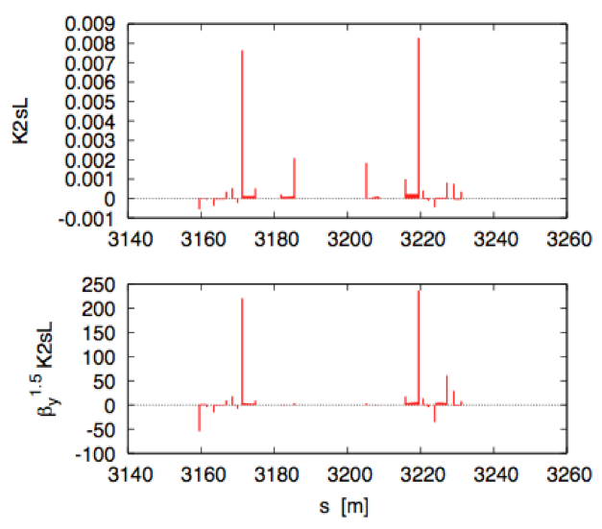
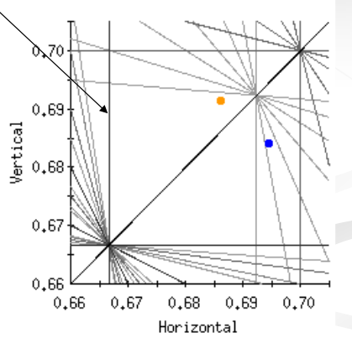
3Qx and 3Qy resonances
We had used mirrored working points of two rings on both side of diagonal in tune space (to suppress coherent modes). However, after 2006 run we have to place working points of two rings below diagonal to avoid 3Qx resonance to obtain better store beam lifetime.
In the 2012 100 GeV run, we observed 3Qy caused beam loss when the bunch intensity is higher than 1.7e11.
The main source of 3Qx,y resonances are located in IR6 and IR8. A lot of efforts have been put in to correct 3Qx,y RTDs. Currently they are corrected with IR bump method
using local IR sextupoles.
3Qx
3Qy
Sources of 3Qy resonance

Slide 22
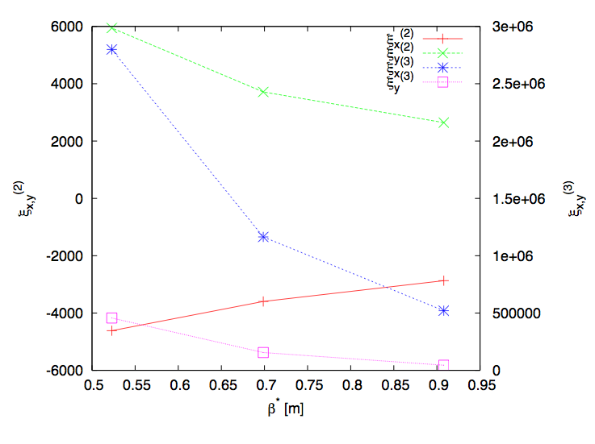
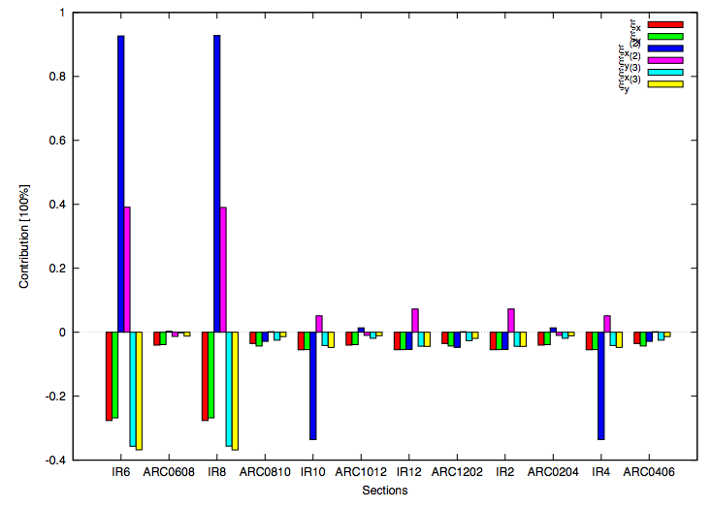
Chromatic effects with low beta*
Low beta* lattices reduce dynamic aperture due to IR nonlinear field errors and nonlinear chromatic effects.
100 GeV run: in 2009 we used beta*=0.7m, we observed a poor beam lifetime. In 2012 we increased beta* to 0.85m which gave 16 hour beam lifetime.
250 GeV run: we achieved beta*=0.65m. Potential to go lower.
The main sources of Q’’ are from triplets in IR6 and IR8. Phase advance adjustment between them may help. And we found lower integer tunes have smaller chromatic effects.
We are interested in and working on LHC’s ATS design for RHIC.
Chromaticities vs. beta*
Each section’s contributions to Q’’ and Q’’’

Slide 23
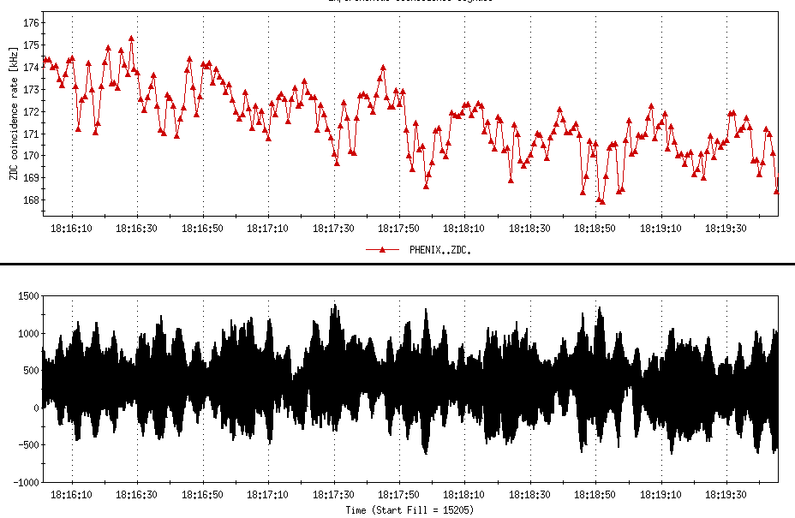
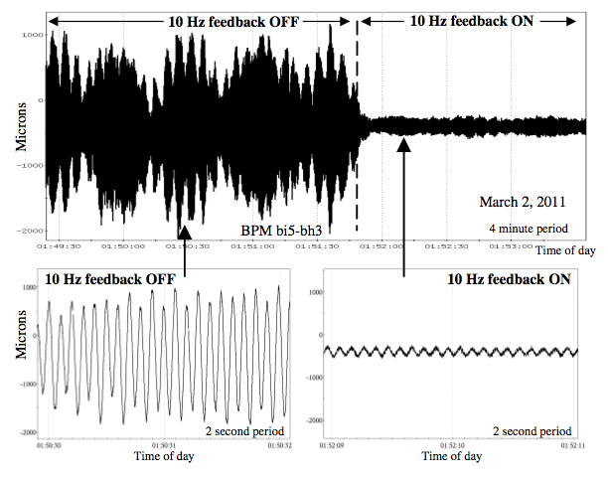
10 Hz orbit oscillation
Horizontal 10 Hz orbit in RHIC due to mechanical eigenfrequencies of triples, driven by cryo flow.
In 2008 we tested a near-integer working point (0.96, 0.95) which was abandoned due to 10Hz orbit oscillation.
A 10 Hz feedback was developed and the peak-to-peak amplitude of 10 Hz orbit oscillation was reduced from 3000 μm to 250 μm in triplets, and luminosity lifetime was improved some.
We plan to revisit the near-integer tunes in the beam experiments.
10 Hz shows in experiment rate
BPM data with 10 feedback off and on

Slide 24
Summary
Beam-beam effects on beam lifetime, emittance and bunch length growth in RHIC have been reported and explained.
The main reason of particle loss in the store is the limited transverse dynamic aperture. Beam-beam interaction, 3Qx,y resonances, and nonlinear chromaticities reduce the dynamic aperture.
To further increase luminosity, we plan to further increase bunch intensity, reduce beta*. We are implementing nonlinear chromaticity and 3Qx,y resonance corrections. We are also improving the longitudinal emittance from injectors and sources and on the energy ramp.

