Slide 1



Beam-beam Effects
with high pile-up test
in the LHC
Georges Trad
on the behalf of the beam-beam team
ICFA Mini-Workshop on Beam-Beam Effects
in Hadron Colliders
(BB2013)

Slide 2
OUTLINE
Overview
LHC commissioning > exploring the beam-beam parameters
High Pile-up tests at the LHC
SPS Q20, new scenarios for brightness
Summary
G.Trad – BB2013 March 19, 2013

Slide 3
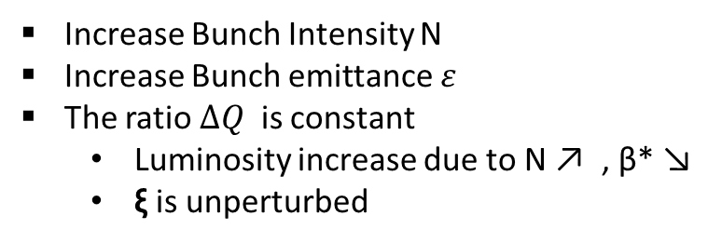
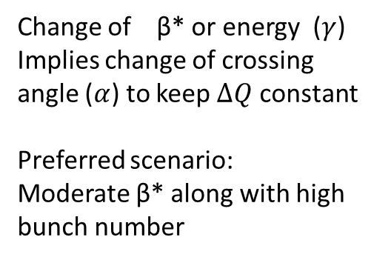


Overview
Beam- beam limit at the LHC
Tolerance
Since the beginning it was unclear whether the beam-beam limitation for the LHC
will come from Head On or Long Range Collisions
HO
LR
vs.
Identifying the limit is crucial for the luminosity optimization scenario :
$$∆Q∝\frac{N}{ε}$$
$$∆Q∝\frac{N.ε}{α^{2}.β^{∗}.γ}$$
Increase Bunch Intensity N
Increase Bunch emittance $ε$
The ratio $∆Q$ is constant
  Luminosity increase due to N ↗ , β* ↘
  ξ is unperturbed
See W. Herr Talk # 31 : Long range beam-beam effects and experience in the LHC
Change of β* or energy ($γ$)
Implies change of crossing angle ($α$) to keep $∆Q$ constant
Preferred scenario:
Moderate β* along with high bunch number
G.Trad – BB2013 March 19, 2013

Slide 4
Overview
From the Design Report of the LHC, the nominal HO tune shift :
ξ =0.0037
Caution:
The nominal HO tune shift
SPS experience
Possible contribution from lattice non linearity
Significant LR contributions
was derived from:
acheive the target of 10³⁴ luminosity
with a coherent set of «safe» parameters
(N:1.15 10¹¹ ppb , ε :3.75 μm)
in order to:
Very Conservative , not an upper limit!!!
G.Trad – BB2013 March 19, 2013

Slide 5
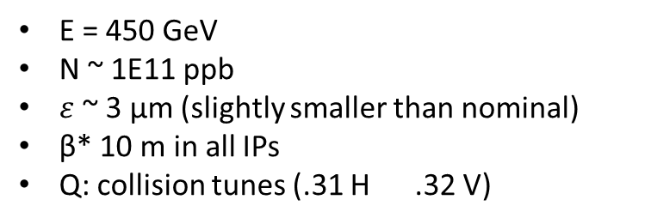
Start of the Quest…
Fill 1068-1069 (May 2010)
GOALS:
check the feasibilty of colliding high intensity bunches (HO)
test whether such bunches can collide with static offset in IP2 (Low PileUP Test)
E = 450 GeV
N ~ 1E11 ppb
$ε$~ 3 μm (slightly smaller than nominal)
β* 10 m in all IPs
Q: collision tunes (.31 H .32 V)
Setup:
little problems with HO bb interactions
small contribution from lattice non linearities which was expected to be important at 450 GeV
no effects during transverse offset scan on lifetime and emittance
Results:
Conclusion:
ξ ~ 0.004 per crossing achieved exceeding the nominal.
intensity was pushed further to nominal eralier than expected for the luminosity runs.
G.Trad – BB2013 March 19, 2013

Slide 6
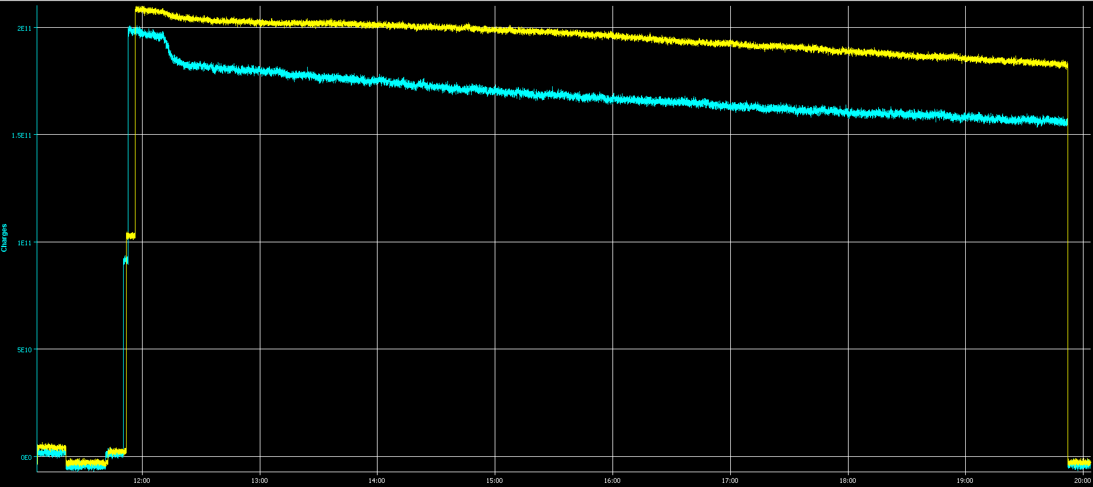

Overview
2E11
Beam 2
Beam 1
1.5E11
$∆Q$_{h} =+0.005 to bring lifetime to 25h
NOMINAL beam beam paramater is achieved !!!
 | Beam 1 |  | Beam 2
(μm) | H | V | H | V
Injection | 2.2 | 2.4 | 3.3 | 3.7
 | Beam 1 |  | Beam 2
(μm) | H | V | H | V
After LumiScan | 2.4 | 2.7 | 3.6 | 4.3
 | Beam 1 |  | Beam 2
(μm) | H | V | H | V
End Coll. | 2.9 | 3.2 | 4.9 | 7.4
G.Trad – BB2013 March 19, 2013
←↑

Slide 7
The Quest continues…
Fill 1765-1766 (May 2011)
GOALS:
check the feasibilty of colliding high intensity bunches (HO)
with a beam beam linear parameter greater than nominal
E = 450 GeV
β* 11 m in all Ips
Nominal crossing angles andSpectrometers off in IP2 / IP8
Q: collision tunes (.31 H .32 V)
ADT on at injection and off afterwards
Setup:
1.6*10^11 emitt 1.2 microns at injection→ blowup (mainly vertical) end up with average almost 2.2 microns
ξ : 0.009/IP , total 0.018 (collide only IP1,5)
Small tune scan, no lifetime effect, emittance blowup beam 2
3 Tests:
1 bunch /beam
2 bunches x beam
4 collisions x bunch
G.Trad – BB2013 March 19, 2013

Slide 8
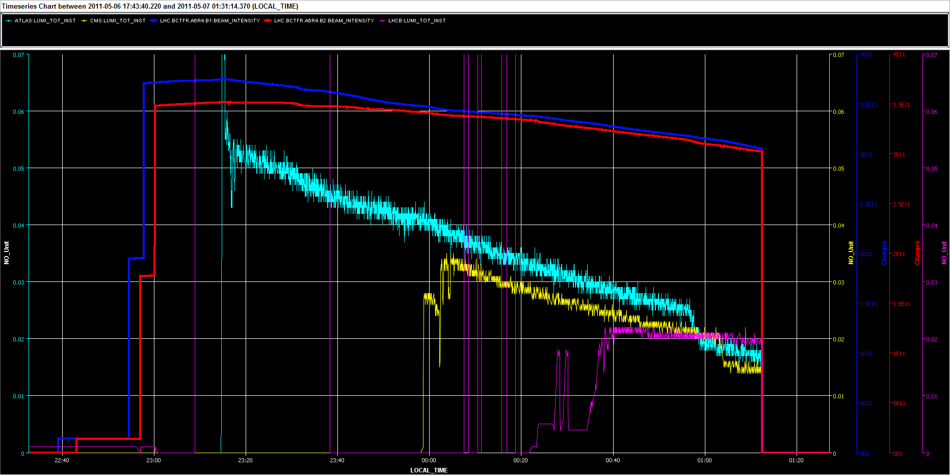
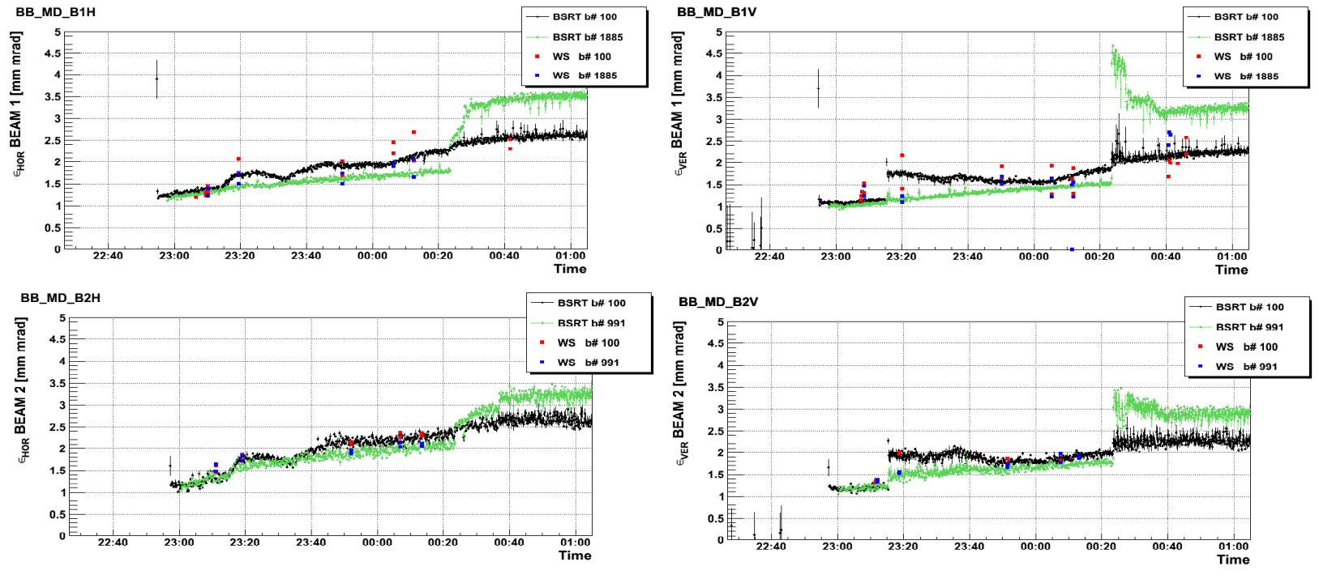
The Quest continues…
Fill 1765-1766 (May 2011)
Collision scheme
IP 1/5 : b100 - b100
IP 2 : b100 - b991
IP 8 : b1885- b991
Test 2:
Beam 1 : bunch 100
bunch 1885
Beam 2 : bunch 100
bunch 991
G.Trad – BB2013 March 19, 2013

Slide 9
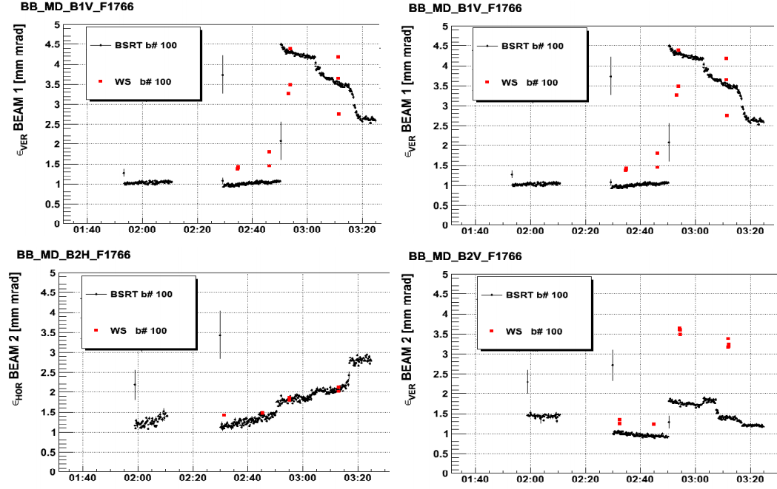
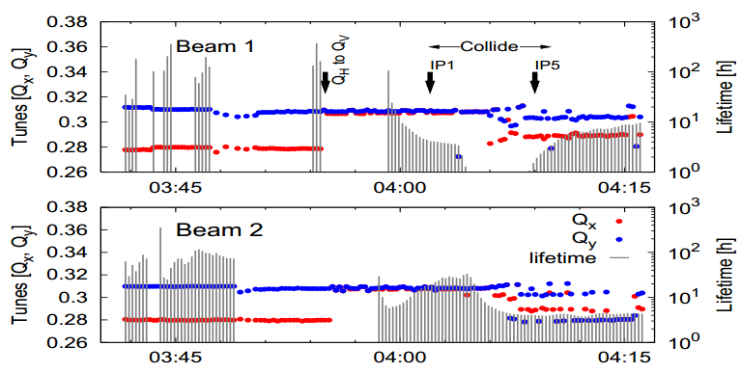
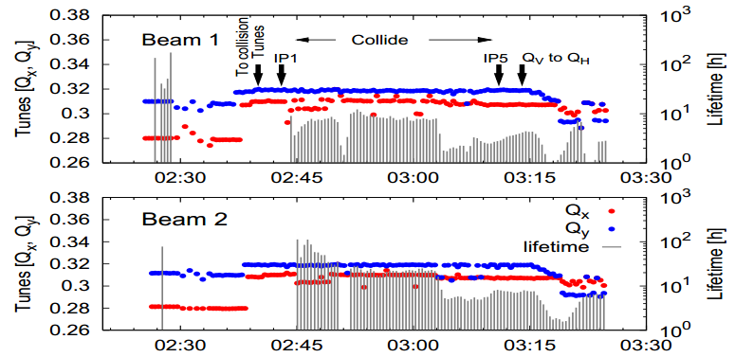
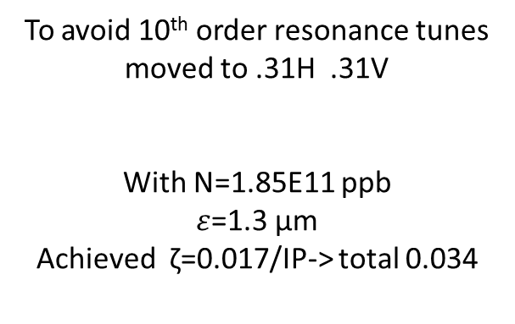
The Quest continues…
Fill 1765-1766 (May 2011)
Machine Protection
Test 3:
Part A
Part B
We wanted : symmetric filling scheme with 4 collisions per bunch
To avoid 10th order resonance tunes moved to .31H .31V
With N=1.85E11 ppb
$ε$=1.3 μm
Achieved ζ=0.017/IP-> total 0.034
G.Trad – BB2013 March 19, 2013

Slide 10
High Pile-up tests
To check whether the bright beams sent from the injectors can be digested by the experiments, 2 high pile up test were scheduled in october 2011.
Parasitically, to these tests the beam parameters evolution were monitored in order to study the high HO tune shift regime and eventual limitations.
  Fill 2201 (10 October 2011)
      Filling scheme
      Emittances and Intensity Measurements.
      Beam Losses Analysis.
      Comparison with the simulations.
  Fill 2252 (25 October 2011)
      Filling Scheme.
      Beam Losses Observation.
      Beams Separation and its effects on intensity and emittances.
G.Trad – BB2013 March 19, 2013

Slide 11
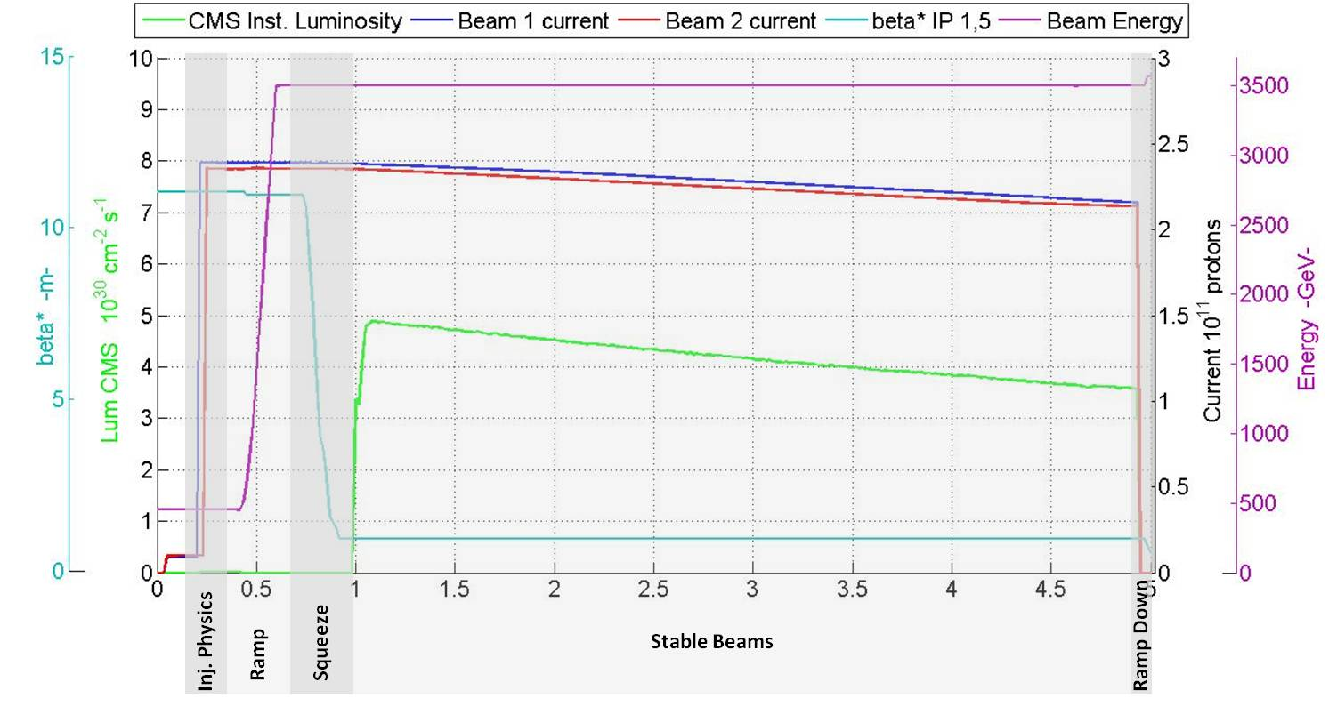
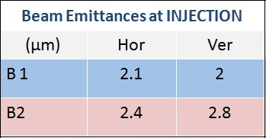
FILL 2201
Filling - Beam Losses - Simulation
Xi ~ 0.025
G.Trad – BB2013 March 19, 2013

Slide 12
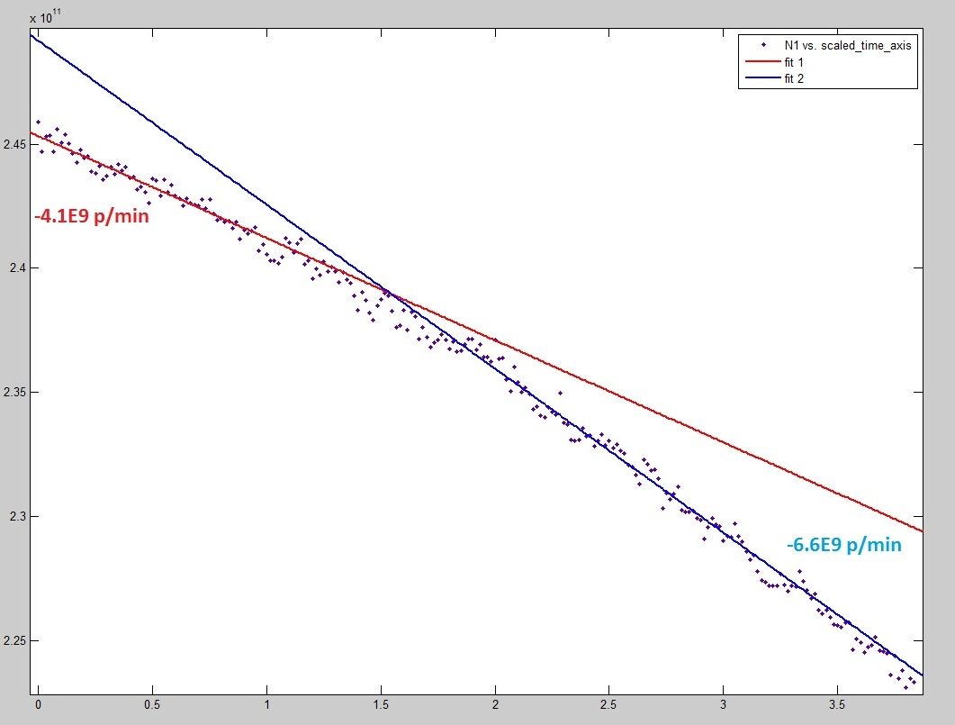
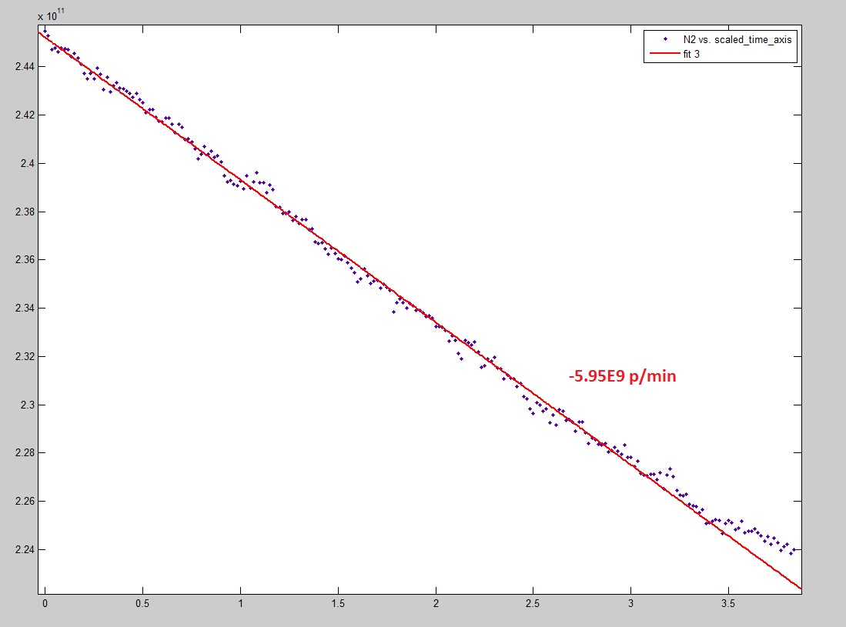
FILL 2201
Filling - Beam Losses - Simulation
BEAM 1
BEAM 2
Burn-off/Total losses
≈40%
BETTER LIFETIME AFTER TUNE SCAN??
Burn-off/Total losses
≈75%
Burn-off/Total losses
≈43%
Burn-off/Total losses
≈75%
G.Trad – BB2013 March 19, 2013
←↑

Slide 13
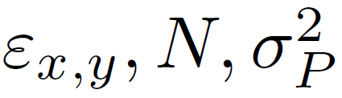
FILL 2201
Filling - Beam Losses - Simulation
Tevatron Luminosity Model
G.Trad – BB2013 March 19, 2013
←↑

Slide 14
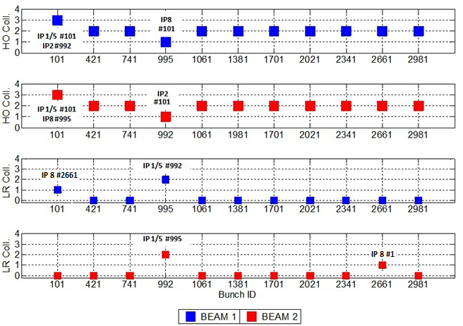
FILL 2252
Filling - Losses Observation - Separation Steps - Emitt. Observation
Separation
Phase
1
2
3
N ≈ 2.3*10^11 pbb
ε ≈ 2.5 μm
G.Trad – BB2013 March 19, 2013

Slide 15
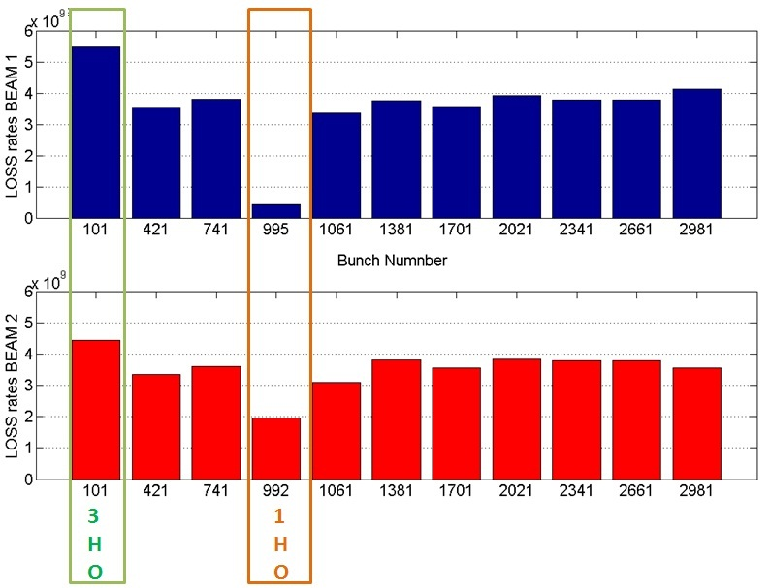
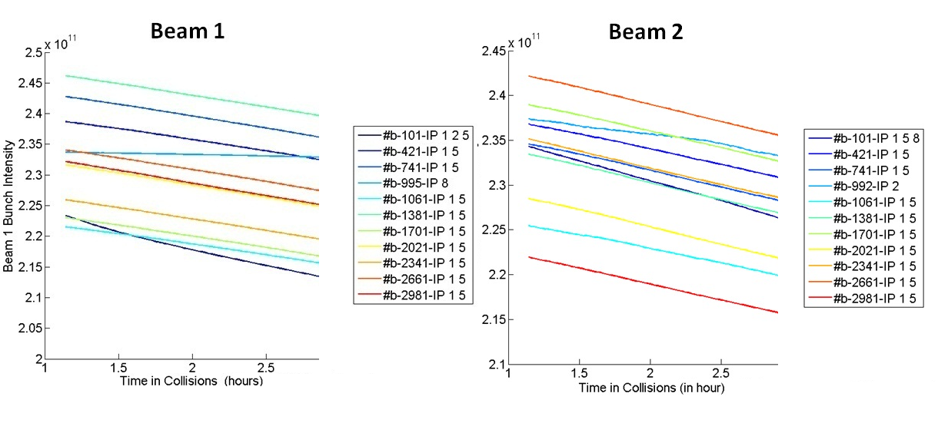
FILL 2252
Filling - Losses Observation - Separation Steps - Emitt. Observation
BEAM 1
BEAM 2
G.Trad – BB2013 March 19, 2013

Slide 16
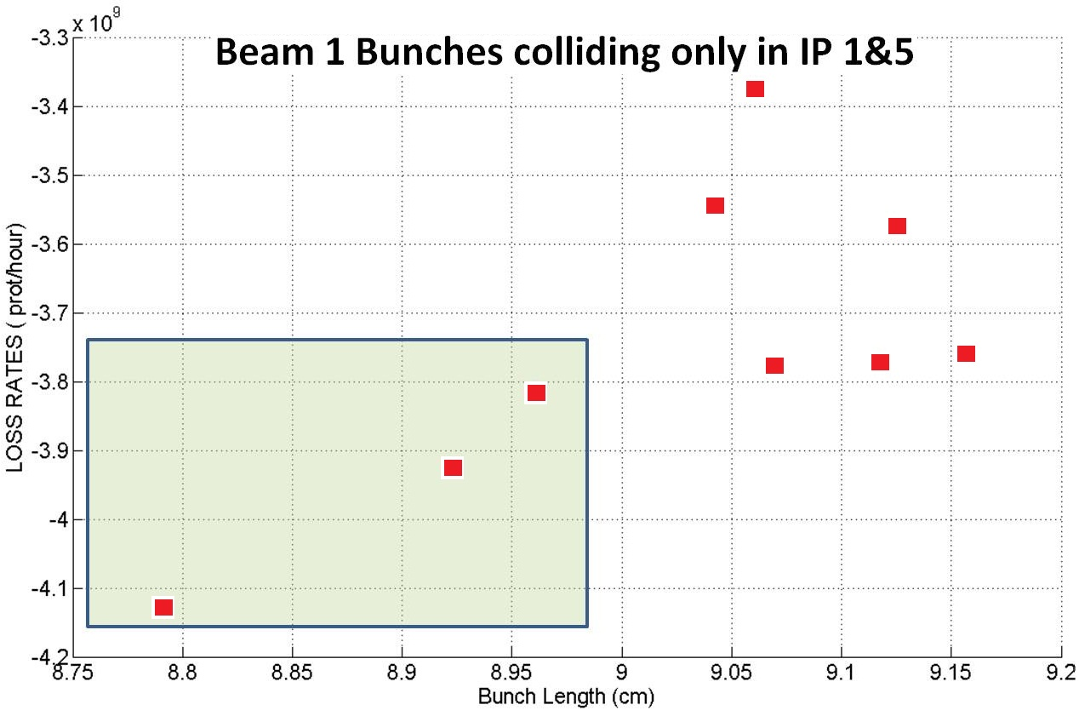
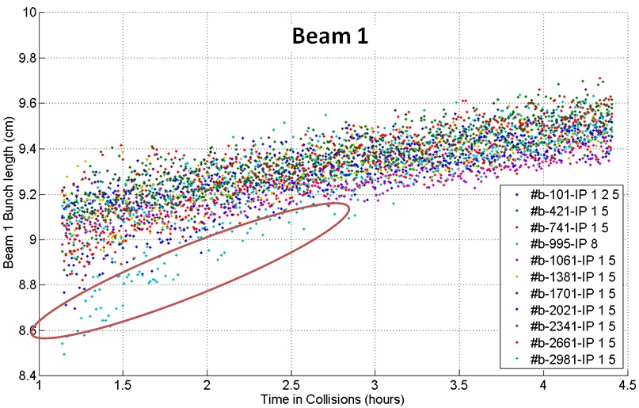
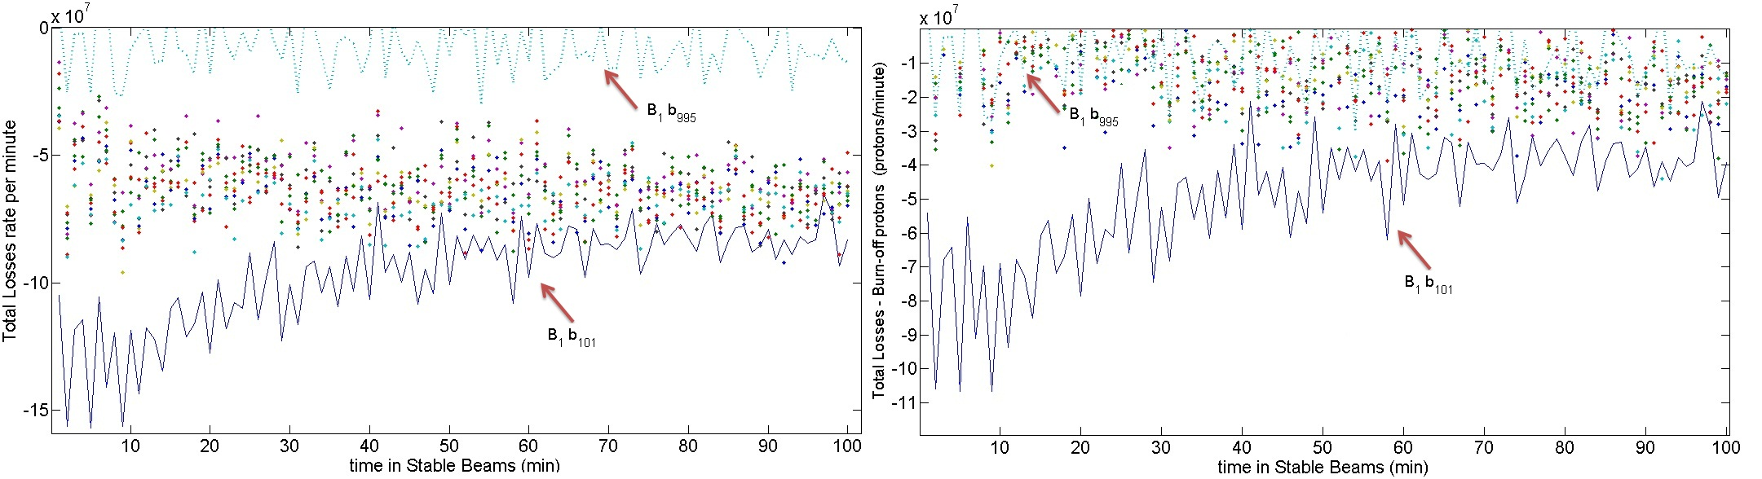
FILL 2252
Filling - Losses Observation - Separation Steps - Emitt. Observation
3 HO Collisions
2 HO Collisions (beam 1)
G.Trad – BB2013 March 19, 2013

Slide 17
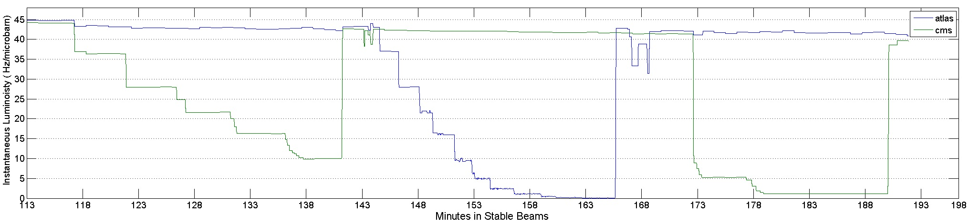
FILL 2252
Filling - Losses Observation - Separation Steps - Emitt. Observation
G.Trad – BB2013 March 19, 2013
←↑

Slide 18
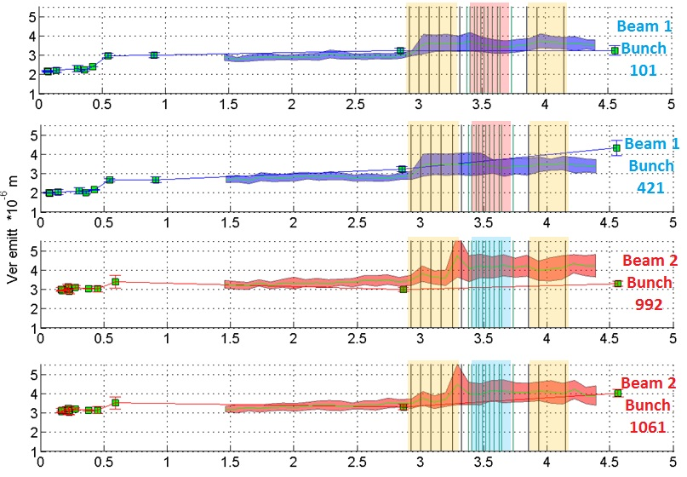
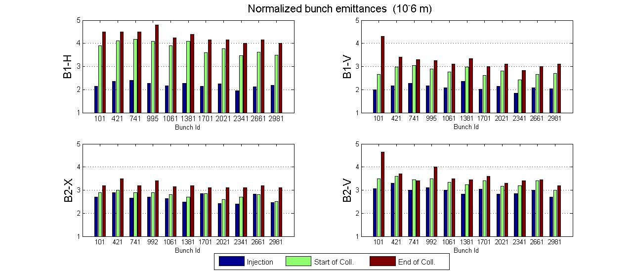
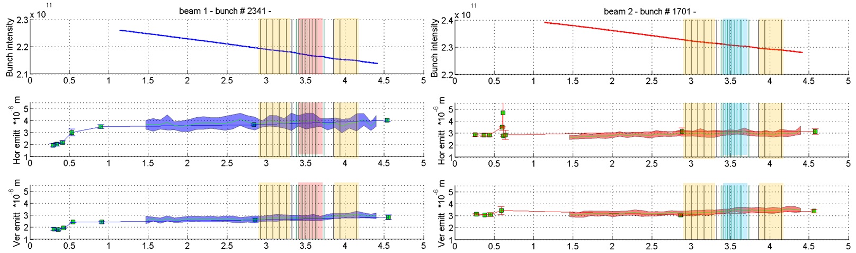
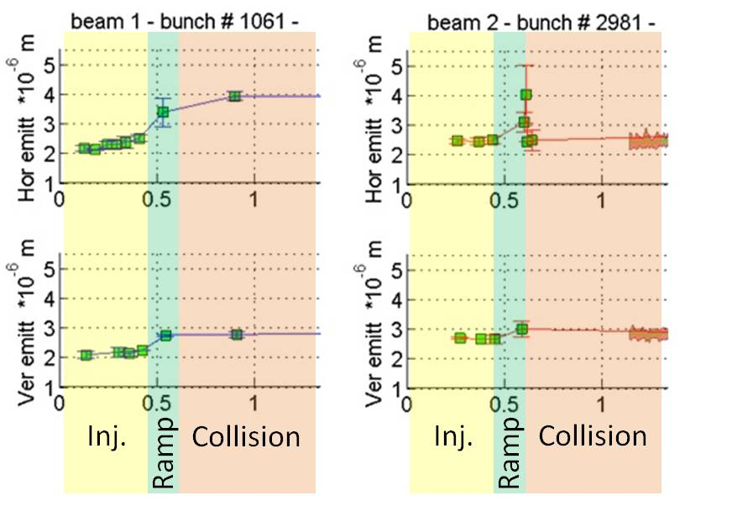
FILL 2252
Filling - Losses Observation - Separation Steps - Emitt. Observation
G.Trad – BB2013 March 19, 2013

Slide 19
Brighter Injectors
Mid 2012 SPS passing to the Q20 optics…
Even brighter beams can be delivered to the LHC!
High pile up to be repeated with a goal of:
µ=100
Again, PARASITICALLY, beam parameters were monitored to study the HO b-b factor and its effects on these bright beams.
Fill 2822-2823-2824-2825 (July 2012)
2822 -> 1 bunch 3e11 ppb 2 um emittance
reached stable beams with deteriorated beams. Pile-up 45
2823 -> same configuration + increase chromaticity by 3 units
decided to dump before reached stable beams since the beams were
unstable again
2824 -> After discovering the problem, 2bunches 3e11ppb
stayed 10 min in SB . Pile-up 58
B1 not cured yet, B2 reached collisions with 2.2 um emittance
2825 -> Longitudinal Blow-up issue solved, still instability observed during the
squeeze causing losses and blow-up.
Pile-up 70 reached in IP1
Longitudinal Blow-up
NOT WORKING
G.Trad – BB2013 March 19, 2013

Slide 20
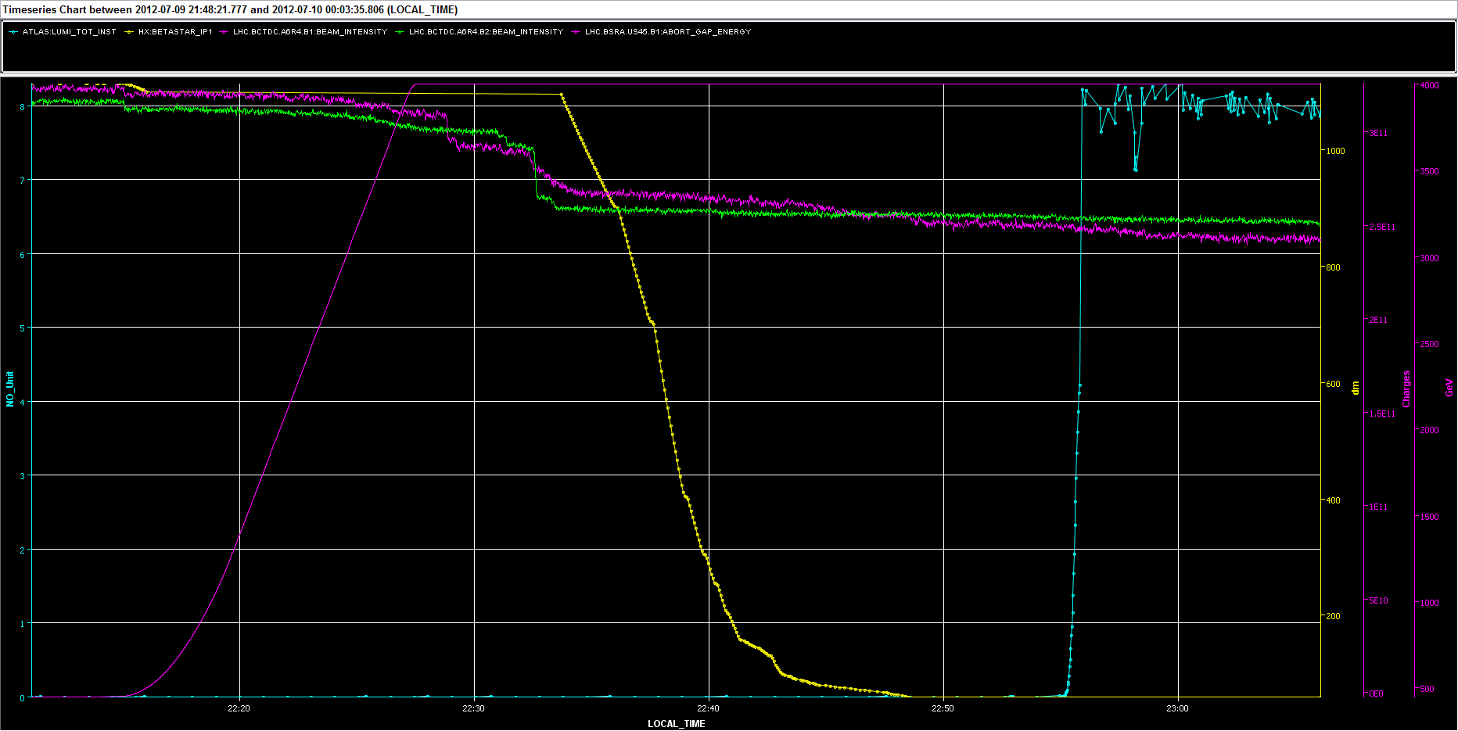
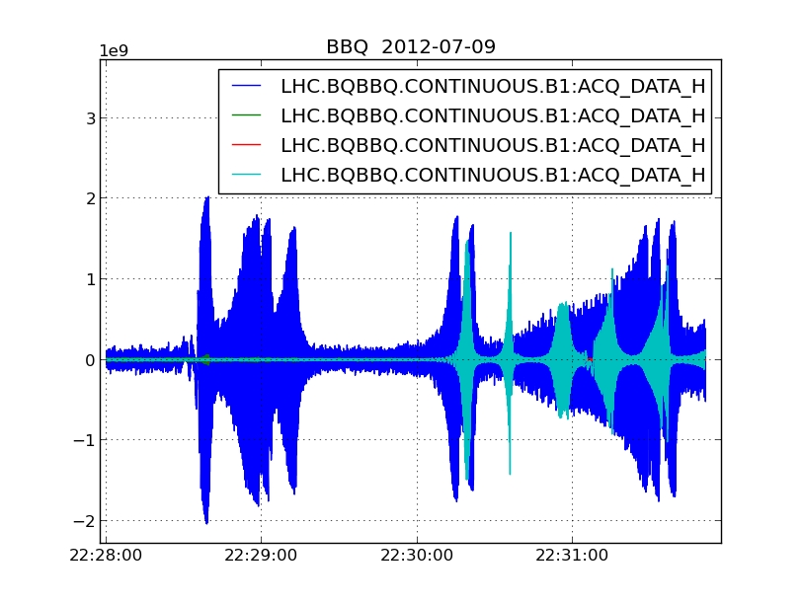
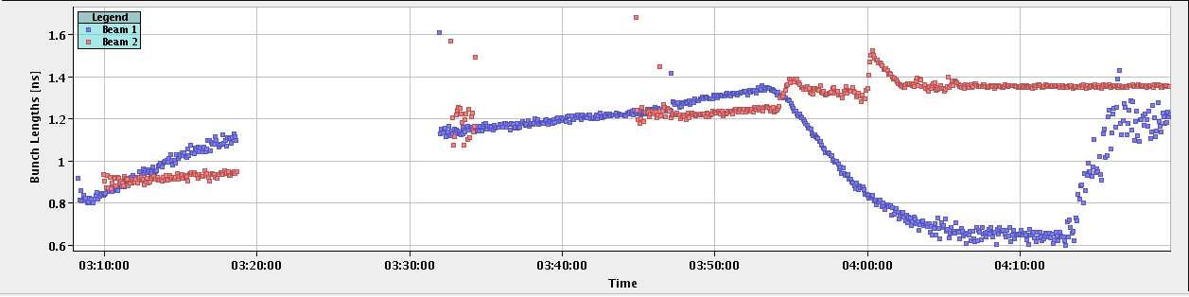
Int B2
Lumi
Int B1
ENERGY
Beta*
G.Trad – BB2013 March 19, 2013

Slide 21
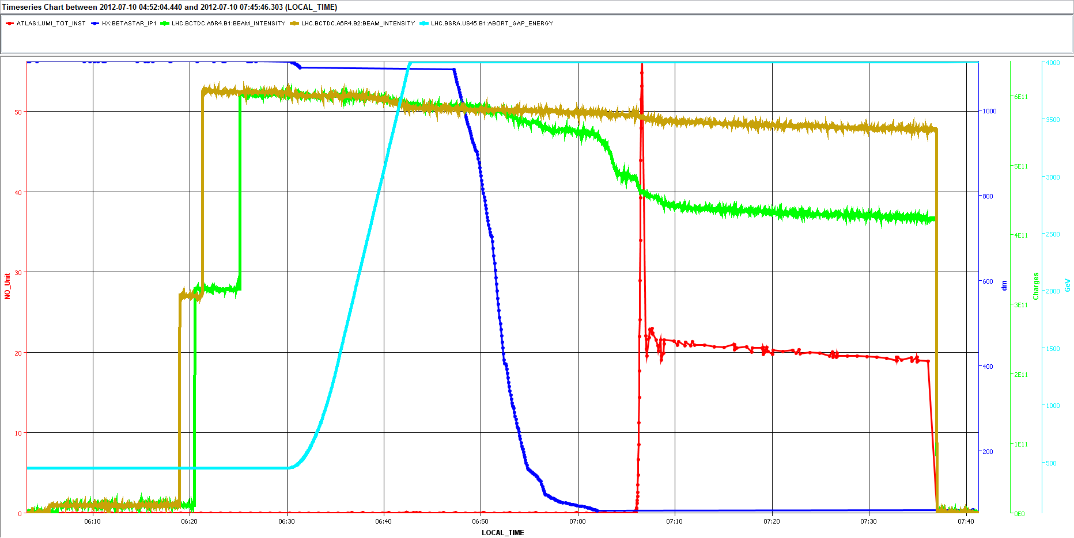
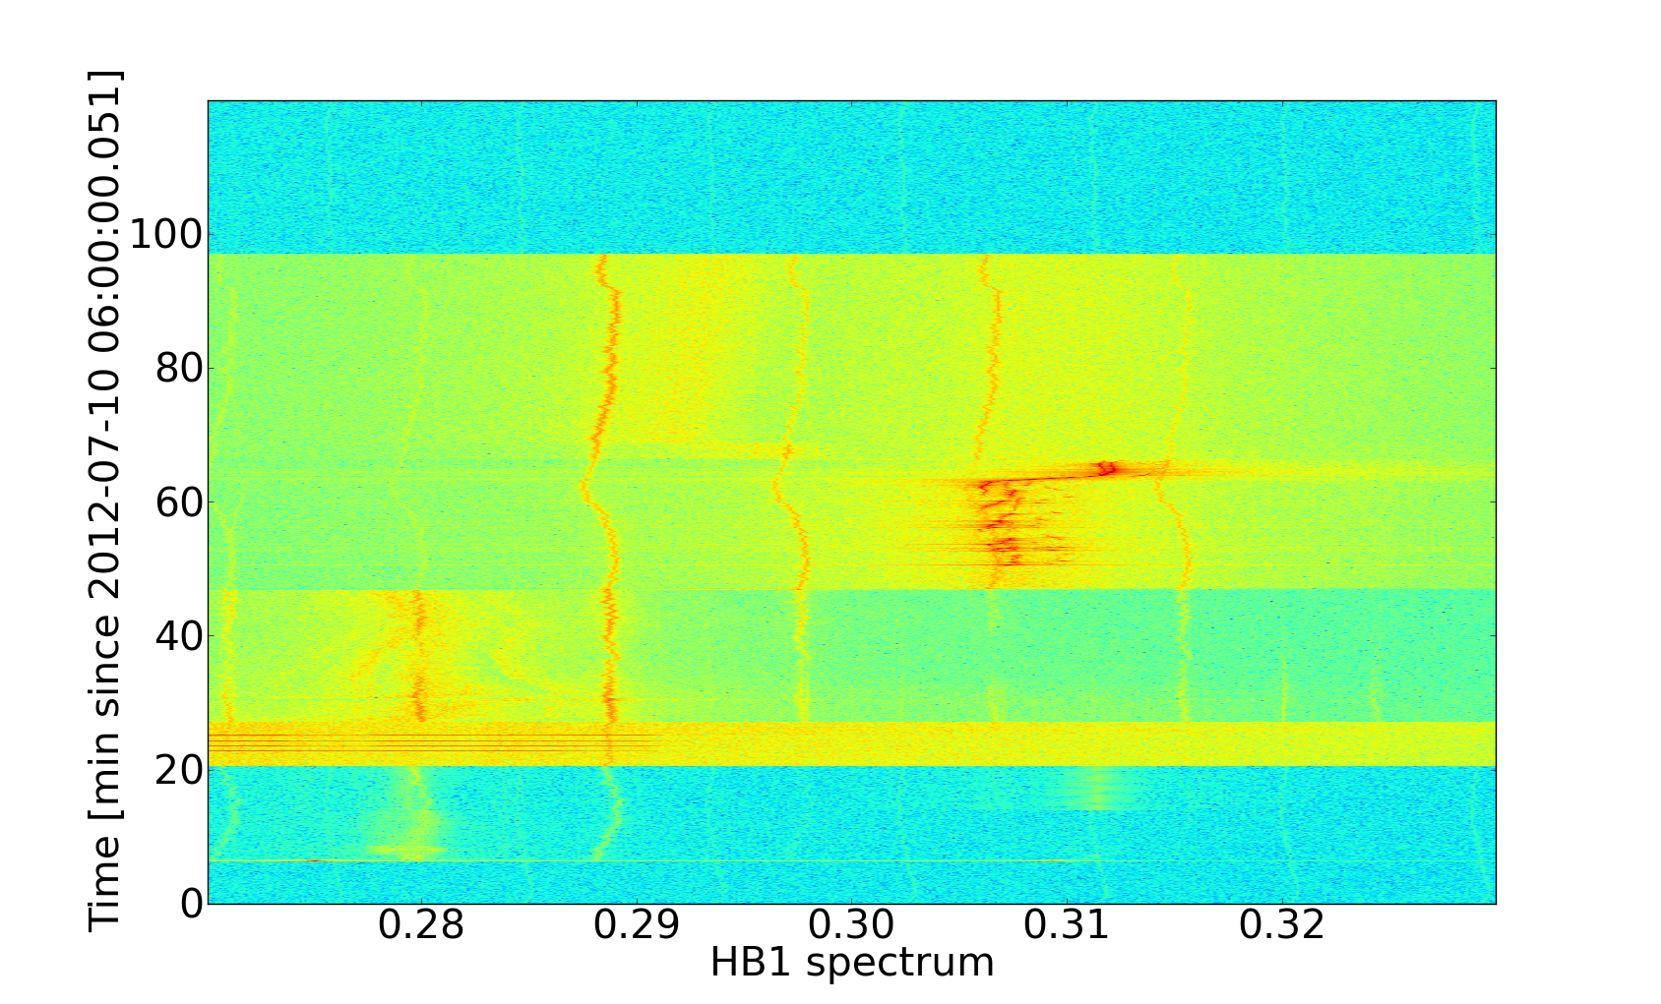
Instability during the squeeze for Beam 1
G.Trad – BB2013 March 19, 2013

Slide 22
SUMMARY
Commisioning
Nominal and beyond beam-beam tune shift was achieved without any
particular problems
High Pile-up 1
  Observed emittance growth at injection energy and more through the ramp.
  Vertical emittance growth observed twice in the vertical plane in beam 1 still under investigations for fill 1, since for fill 2 it corresponds to the separation of the beams.
  Missing losses contribution to the Luminosity evolution model ( not only beam-beam losses ?)
  Long Range effects in fill 2252 or just losses from tune resonances?
High Pile-up 2
Systematic studies (parallel separation, leveling and noise excitation) still to be done.
The instabilities that showed up were independently present from the HO tune shift
Under the present conditions we do not consider the HO bb interaction as a limit for the LHC performance
G.Trad – BB2013 March 19, 2013
Notes:
The obtained bb parameters several times > design value…
Possible mecchanisms that may reduce this brightness of the beams collidable with no HO issues :
Longitudinal or transverse noise
Tune modulation and large Q’
Ripple on power converters
Under the present conditions we do not consider the HO bb interaction as a limit for the LHC performance

Slide 23
Thank you
for your attention
G.Trad – BB2013 March 19, 2013

Slide 24
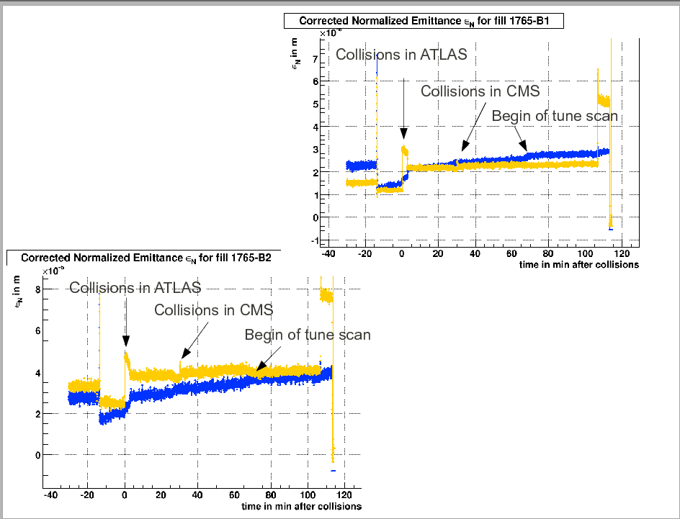
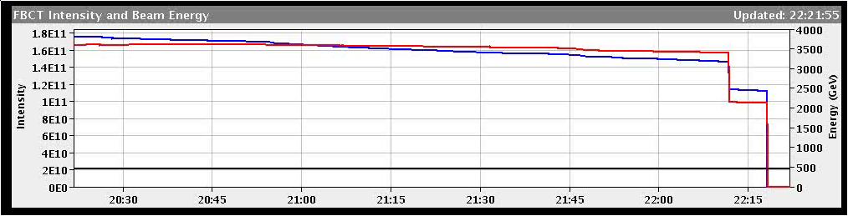
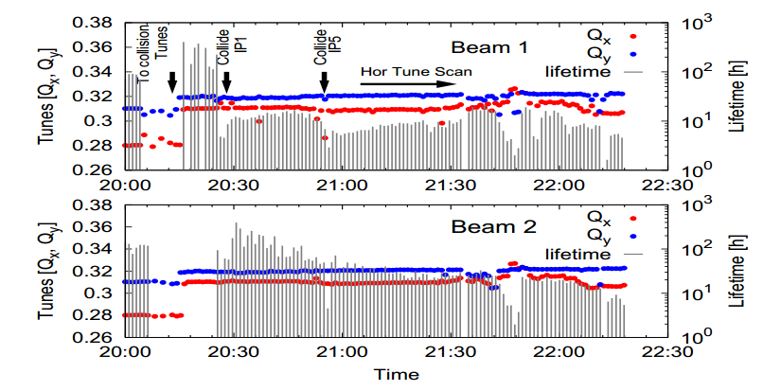
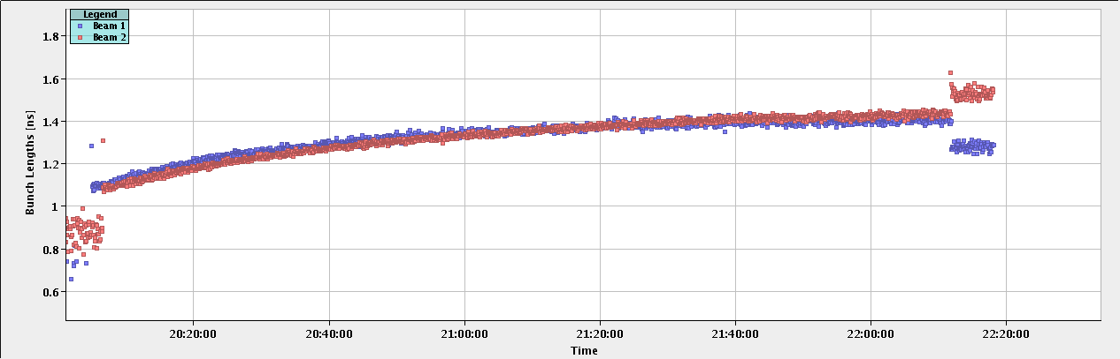
BACKUP SLIDES
Fill 1765-1766 (May 2011)
Test 1:
G.Trad – BB2013 March 19, 2013
←↑

Slide 25
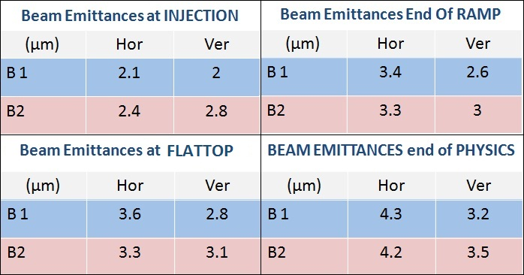
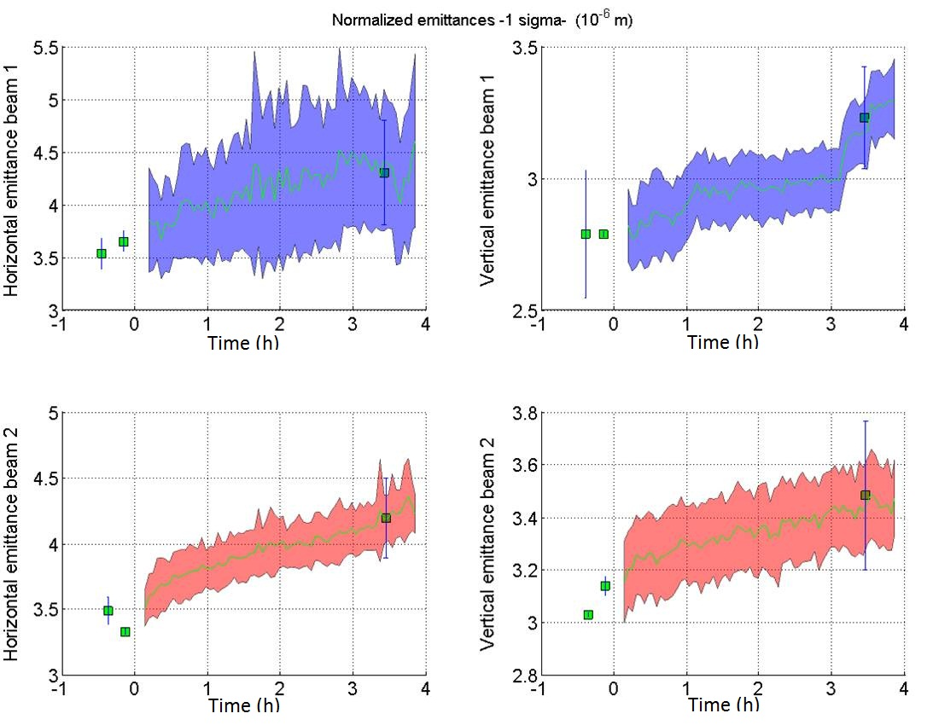
FILL 2201
Filling - Emitt. Int. Meas. - Computed Lumi - Beam Losses - Simulation
Growth @ Inj :
B1 ~ 12%
B2 ~ 8%
Growth @ Ramp:
B1H ~ 44%
B1V ~ 30%
B2H ~ 30%
B2V ~ 7 %
G.Trad – LSWG December 8, 2011
←↑

Slide 26
Backup Slides
Parametric Ordinary Differential Equations (ODEs) in :
Rms Momentum Spread
Beam Emittance
Beam Intensity
• the emittance growth and the particle loss due to scattering on the residual gas;
• the particle loss and the emittance growth due to scattering in IPs;
• the transverse and longitudinal emittance growth due to intrabeam scattering;
• the bunch lengthening due to RF noise;
• The emittance growth predicted from the Transverse Feedback Systems (ADT) noise
• synchrotron radiation damping.
G.Trad – BB2013 March 19, 2013
←↑

Slide 27
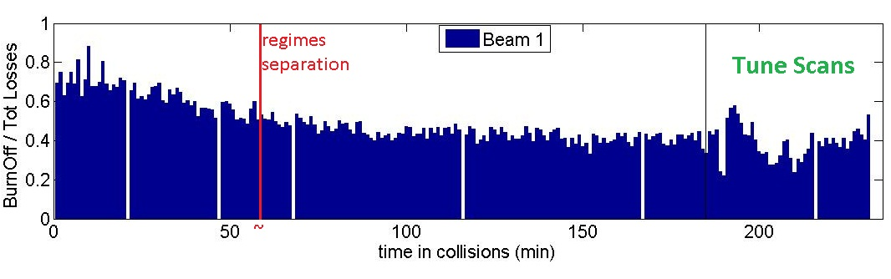
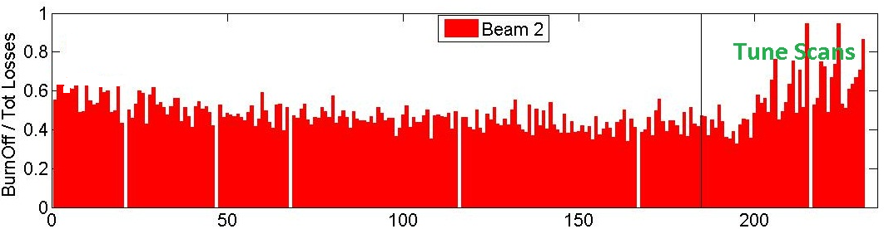
Backup Slides
BEAM 1
BEAM 2
G.Trad – BB2013 March 19, 2013

Slide 28
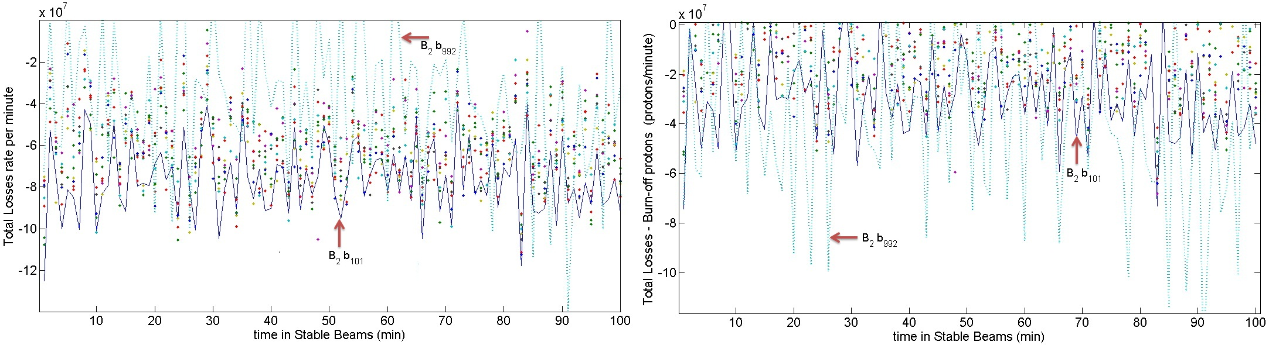
Backup Slides
G.Trad – BB2013 March 19, 2013

Slide 29
Backup Slides
b101 - b101 (HO in IP1 IP5)
b101 - b992 (HO in IP2)
b995 - b101 (HO in IP8)
b995 - b992 (LR in IP 1 IP5)
G.Trad – BB2013 March 19, 2013

Slide 30
Backup Slides
-1.952 E9 p/h
Colliding in : IP 2 with #101
G.Trad – BB2013 March 19, 2013
←↑

