Slide 1

Status of NLO calculations and Tools for BSM Processes Related to Top Final States
Anna Kulesza
LPCC workshop, CERN, 17.07.2012

Slide 2
What This Talk is (Not) About
Processes related to top-final states:
    scalar top (and bottom) pair-production in MSSM
    closely related: squark and gluino-pair production processes
Only production processes, decay processes not discussed
Main focus on the total inclusive cross sections (exclusion limits)
Only NLO and higher order corrections
    LO (+PS) not discussed: PYTHIA, HERWIG, Sherpa, MadGraph, Whizard, CompHEP/CalcHEP, …
Apologies if some work is not mentioned

Slide 3
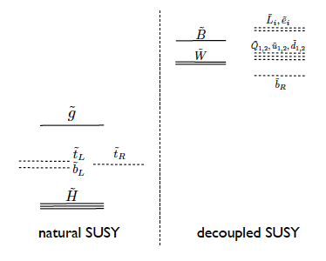
Motivation for Stops
Naturalness needs light stops
Large top Yukawa coupling → lightest squark = stop
  running from universal scalar masses down to EW scale
  large off-diagonal terms in the stop mass mixing matrix → large mass splitting
[from Papucci, Ruderman, Weiler, arXiv:1110.6926]

Slide 4
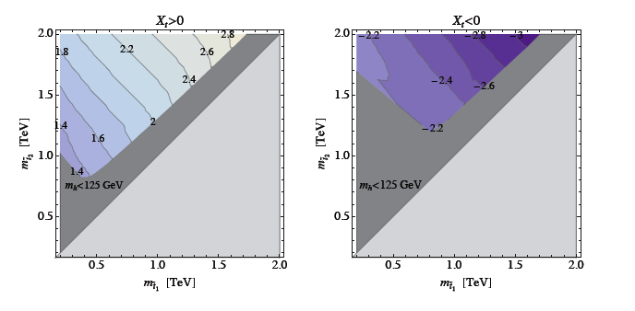
Motivation for Stops
Naturalness needs light stops
Large top Yukawa coupling → lightest squark = stop
  running from universal scalar masses down to EW scale
  large off-diagonal terms in the stop mass mixing matrix → large mass splitting
[from Papucci, Ruderman, Weiler, arXiv:1110.6926]
Higgs mass value m_{h}=125 GeV consistent with relatively light stops and large mixing parameter in the stop sector
Weaker bounds from searches than on the first two generations squarks
[from Draper et al. arXiv:1112.3068]

Slide 5
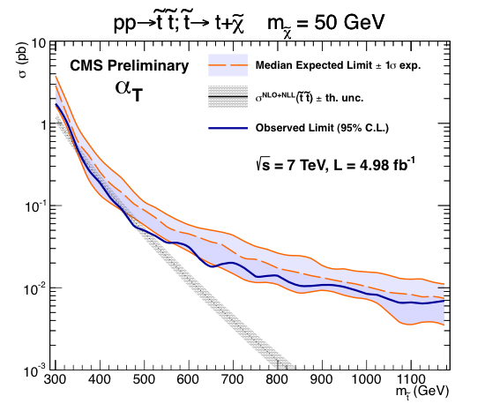
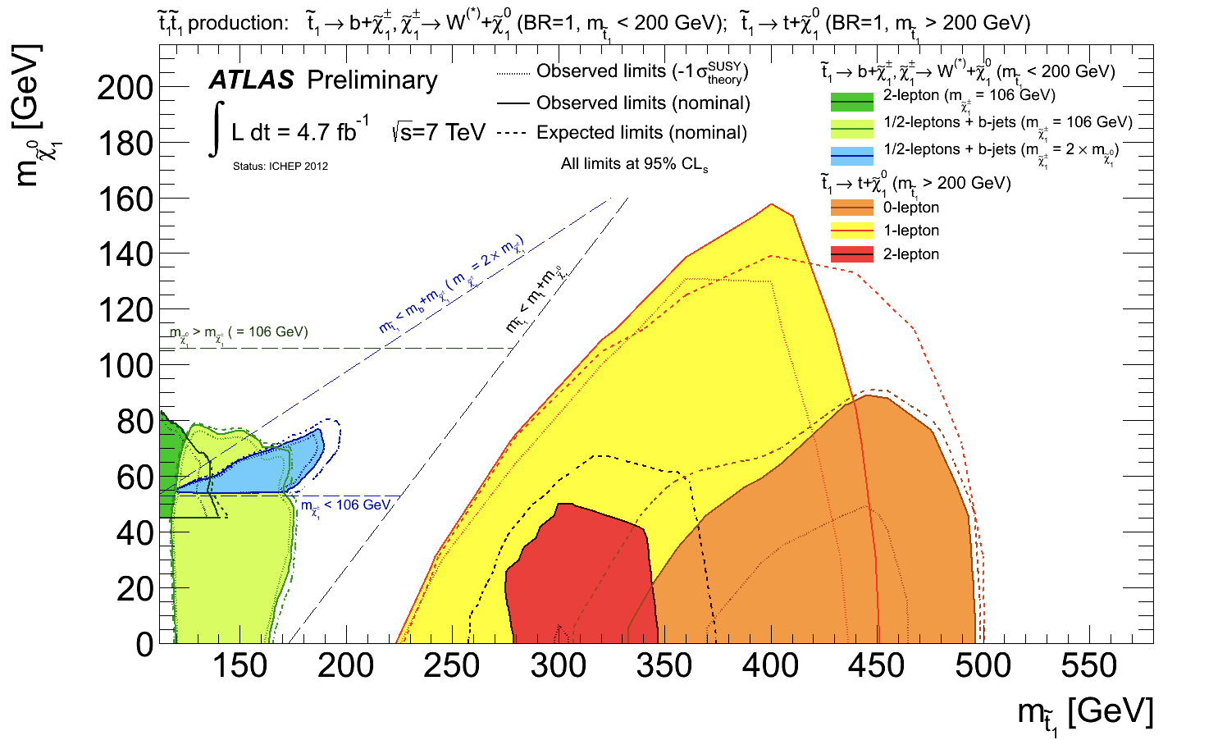
LHC Searches

Slide 6
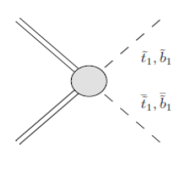
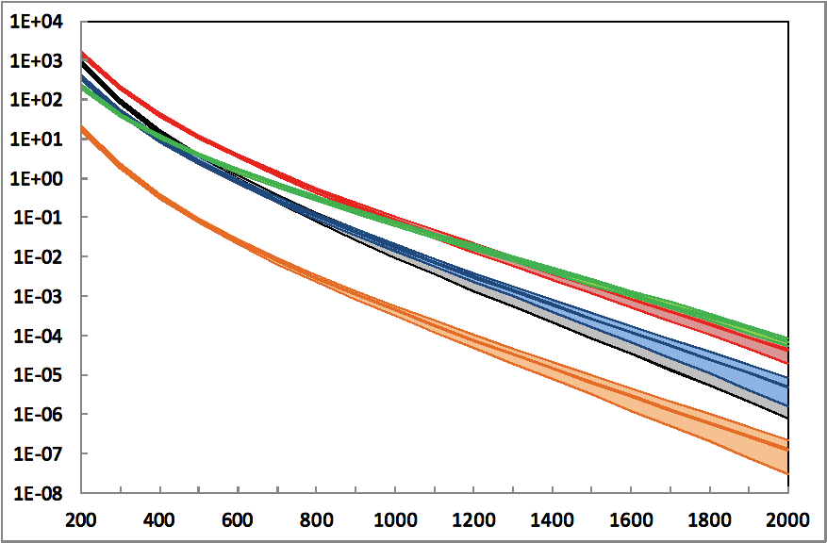
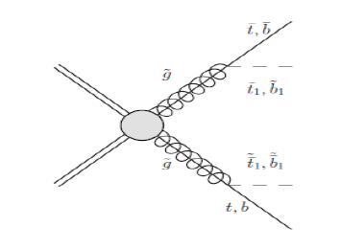
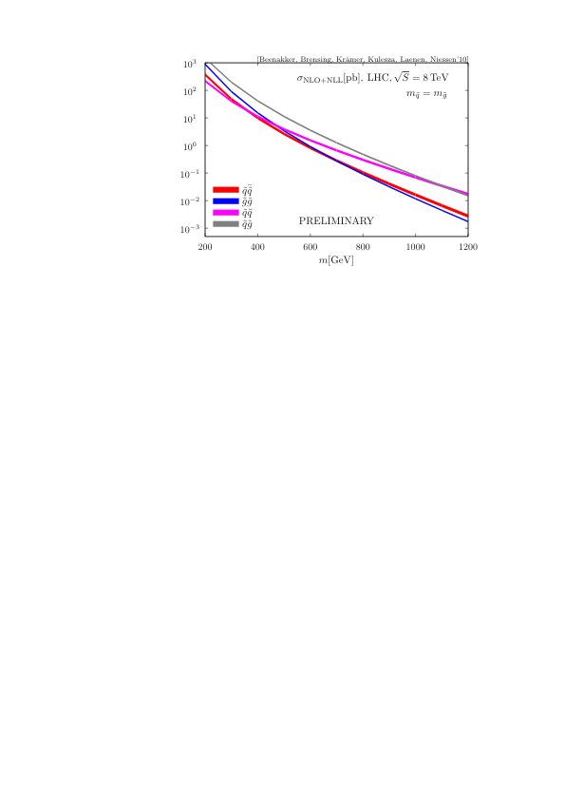
Stops at the LHC
Direct production
Gluino-mediated production

Slide 7



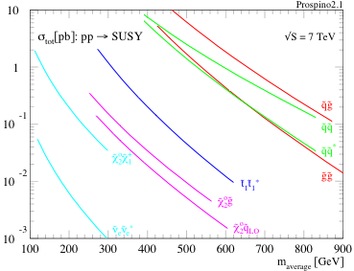
NLO with Prospino
NLO SUSY-QCD corrections to
Public tool (most recent):
…
e.g.
→ known at O(α_{s}³ )
PROSPINO2.1:
[Beenakker, Höpker, Spira, Zerwas'96]
[Beenakker, Krämer, Plehn, Spira, Zerwas’97]
http://www.thphys.uni-heidelberg.de/~plehn/index.php?show=prospino&visible=tools
In addition to purely coloured SUSY includes also pure EW (sleptons, neutralinos/charginos) pair-production and associated production of neutralinos/charginos with coloured particles

Slide 8
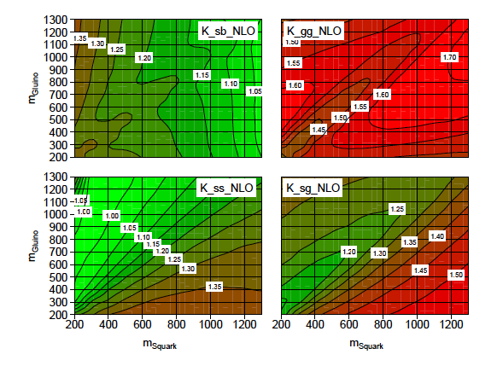
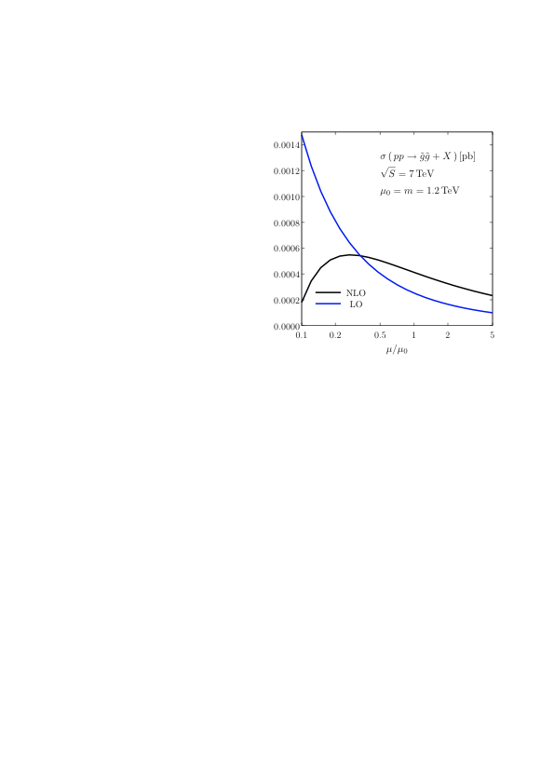
NLO for Gluino-Pair Production
LHC @ 7 TeV
More than 20 % scale variation error
(plot courtesy of S. Brensing)

Slide 9
NLO for Gluino-Pair Production
LHC @ 7 TeV
More than 20 % scale variation error
(plot courtesy of S. Brensing)
SUSY QCD cross sections: limited parameter dependence
→ squark and gluino pair-production: squark mass, gluino mass
→ stop (sbottom) pair production: stop (sbottom) mass, gluino mass, light-flavour squark mass, stop mixing angle

Slide 10
NLO for Gluino-Pair Production
LHC @ 7 TeV
More than 20 % scale variation error
(plot courtesy of S. Brensing)
SUSY QCD cross sections: limited parameter dependence
→ squark and gluino pair-production: squark mass, gluino mass
→ stop (sbottom) pair production: stop (sbottom) mass, gluino mass, light-flavour squark mass, stop mixing angle ← very weak dependence, only enters at NLO

Slide 11
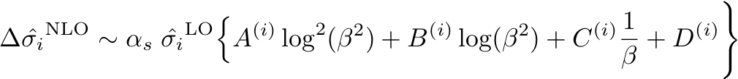
Higher Orders At Threshold
In analogy to top-pair production
General structure of the NLO correction in the threshold limit
Soft/collinear gluon emission
Coulomb gluons
At higher orders:
Both types of corrections can be resummed to all orders

Slide 12
Resummation
→ Resummation of soft gluon corrections (Mellin moment space N ,taken wrt. 4m²/S)
[AK, Motyka ’08-’09][Beenakker, Brensing, AK, Laenen,Niessen’09-’11]
@N(N)LL+NLO
log(β²)↔log(N)≡L
→ Resummation of Coulomb corrections
→ LO Coulomb corrections (α_{s}/β)^{n} resummed for and
→ Subleading Coulomb corrections and bound state effects analysed in NRQCD @NLO for and [Hagiwara, Yokoya’09] [Kauth, Kühn, Marquard, Steinhauser’10-11] [Kauth, Kress, Kühn’11]
[Kulesza, Motyka’09]
→ Resummation of soft and Coulomb corrections together (in momentum space, using SCET) → see Jan Piclum’s talk
[Beneke, Schwinn, Falgari ’09-’10] [Falgari, Schwinn, Wever’12]
@NLL+NLO

Slide 13
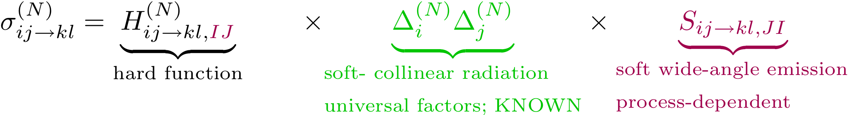

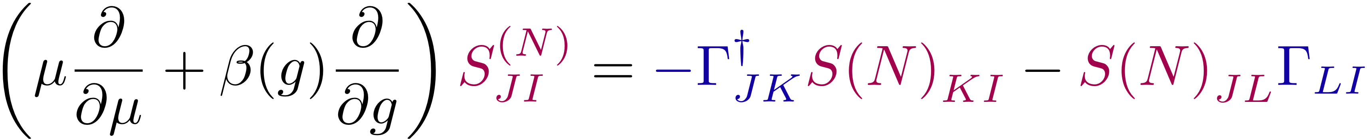
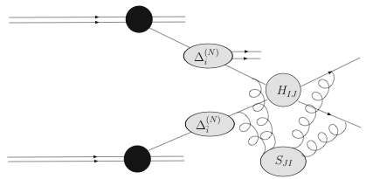
Threshold Resummation For Squark And Gluino Production
2→2 process with nontrivial colour flow
matrices in colour space
from solving the renormalization group equation

Slide 14

Resummation for 2→2 Processes with colour and mass in the final state
Threshold limit: NLL resummed partonic cross section [Kidonakis, Sterman'96-97][Bonciani, Catani, Mangano, Nason'98]
Condition: choice of orthogonal basis in colour space for which Γ_{IJ} is diagonal
Soft, wide-angle emission, process dependent
N-moments of LO
Soft-collinear radiation from incoming partons, universal, known
Soft anomalous dimension matrix
NLL: 1-loop soft anomalous dimensions for all colour structures present in squark and gluino production [AK, Motyka’08] [Beenakker, Brensing, AK, Laenen,Niessen’09]

Slide 15
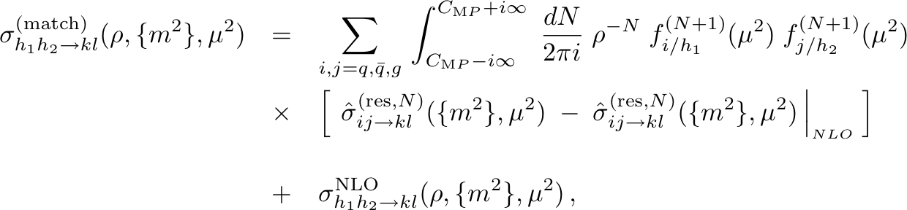
Resummation-improved NLL+NLO total cross section
NLL resummed expression has to be matched with the full NLO result
Inverse Mellin transform evaluated using a contour in the complex N space according to 'Minimal Prescription’ [Catani, Mangano, Nason Trentadue'96]
NLO cross sections evaluated with PROSPINO

Slide 16
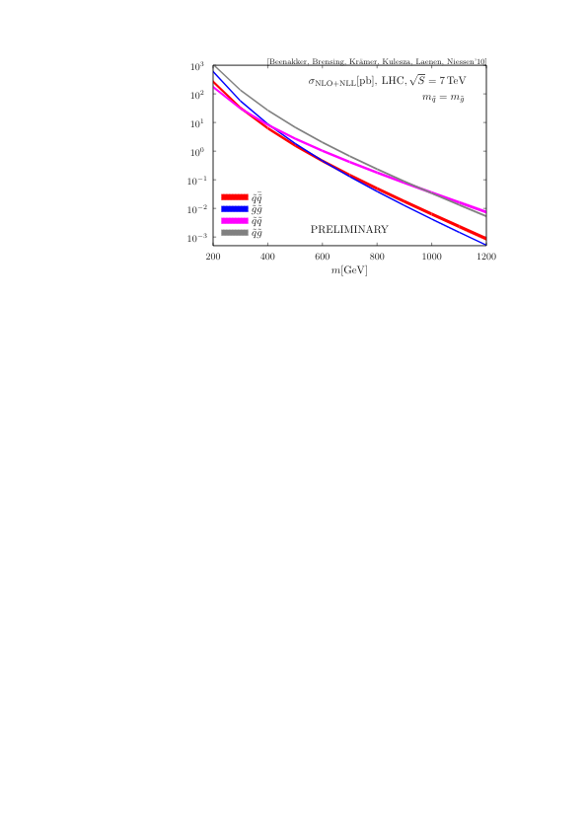
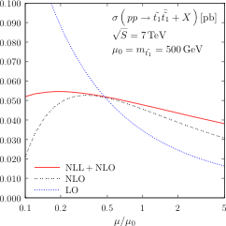
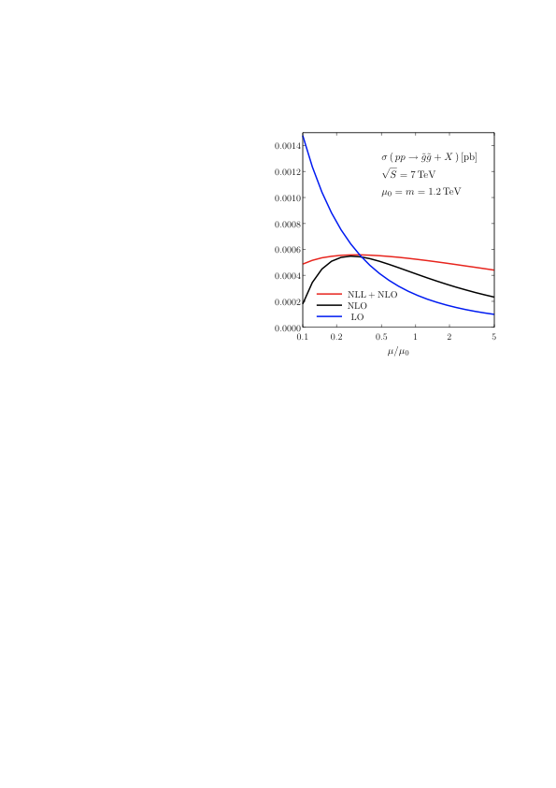
Scale variation
Stop-pair production
Gluino-pair production
MSTW 2008
MSTW 2008
Significant reduction of the scale dependence for NLL+NLO compared to NLO

Slide 17
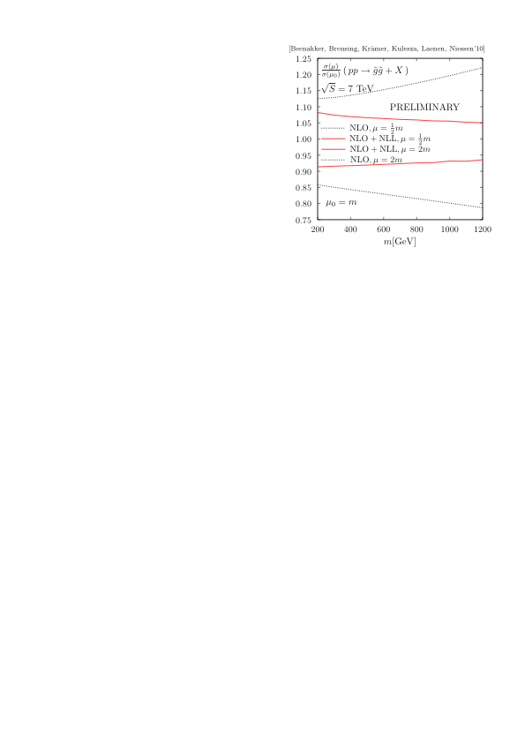
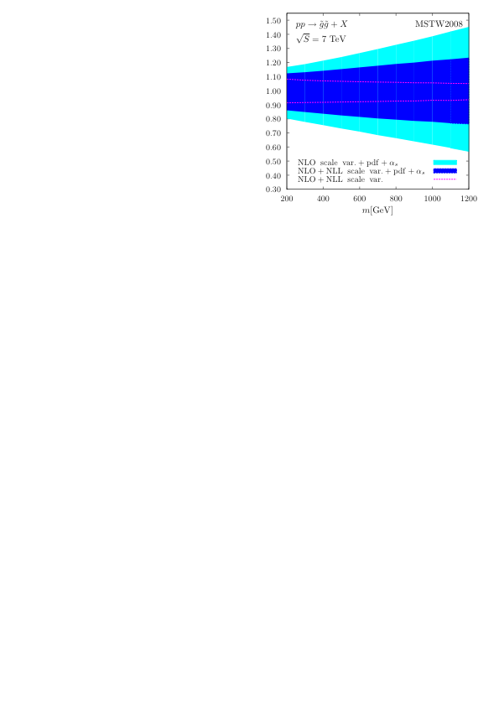
Theory Error
[W. Beenakker, S. Brensing, M. Krämer, AK, E. Laenen, L.Motyka and I. Niessen’11]
Gluino-pair production
Scale variation error
Full theory error
Significant reduction of the FULL theory error due to reducing the scale variation

Slide 18
Public Code: NLL-Fast
NLL-fast = public tool to perform calculations of NLL+NLO for:
  squark and gluino pair-production
  stop-antistop (sbottom-antisbottom) production
  gluino pair-production in the decoupling limit of large squark masses and vice versa
For a given squark mass and a gluino mass the code returns:
  LO and NLO central values (from PROSPINO)
  NLL+NLO central value
  upper and lower scale variation error on NLL+NLO
  upper and lower pdf uncertainty
  upper and lower α_{s} uncertainty
  K_{NLO} and K_{NLL} factors
Interpolation subroutine with grid files for squark and gluino masses in the range of 200-2000 (2500) GeV for 7 (8) TeV, stop masses masses in the range of 100-1000 (2000) GeV for 7 (8) TeV

Slide 19
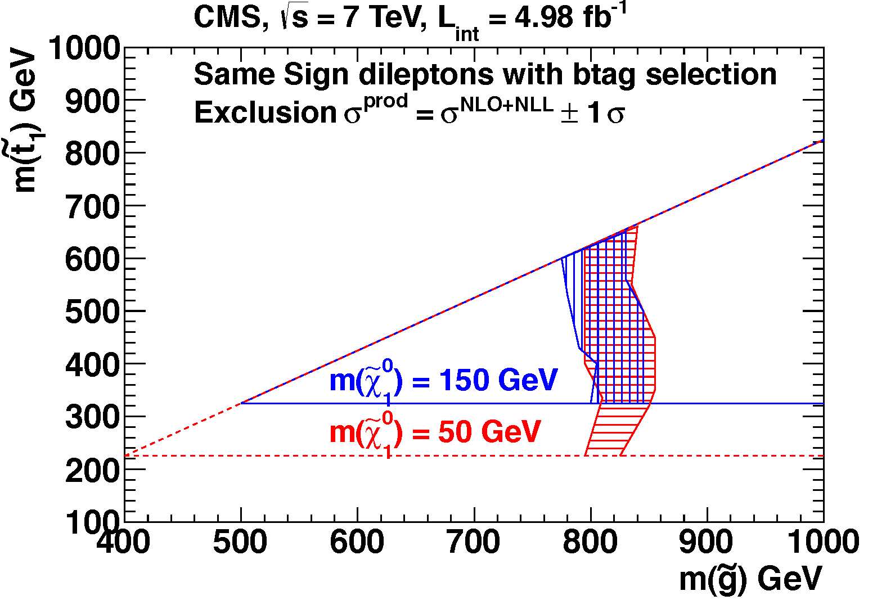
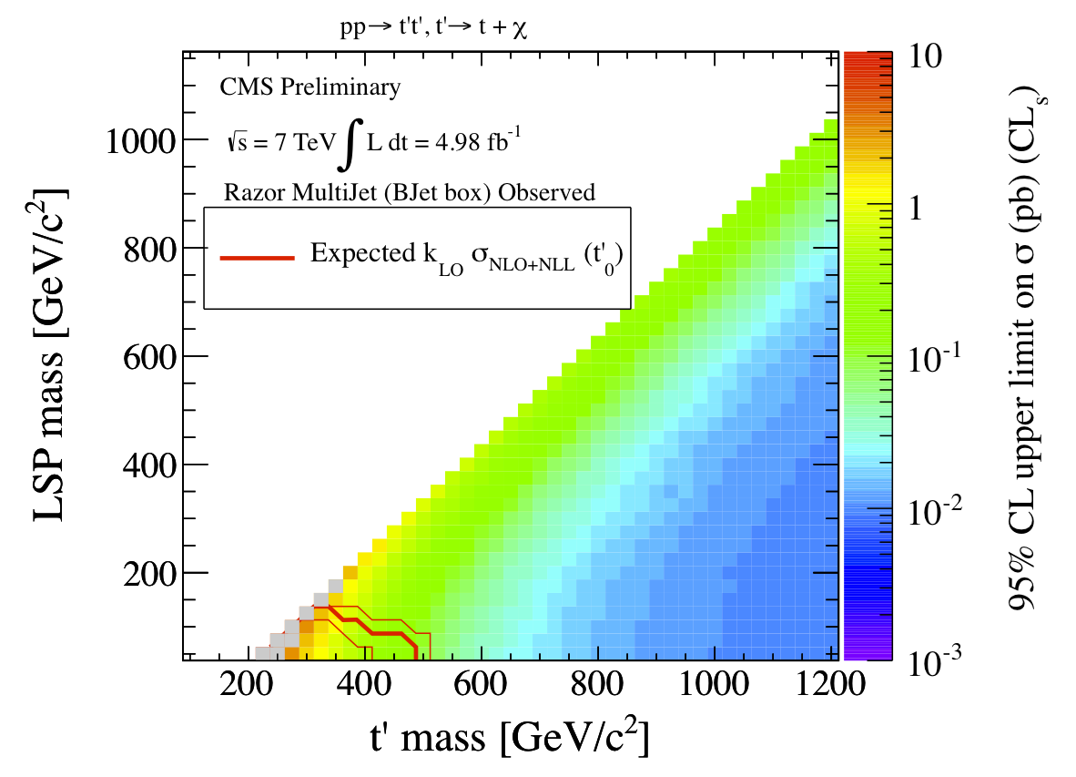
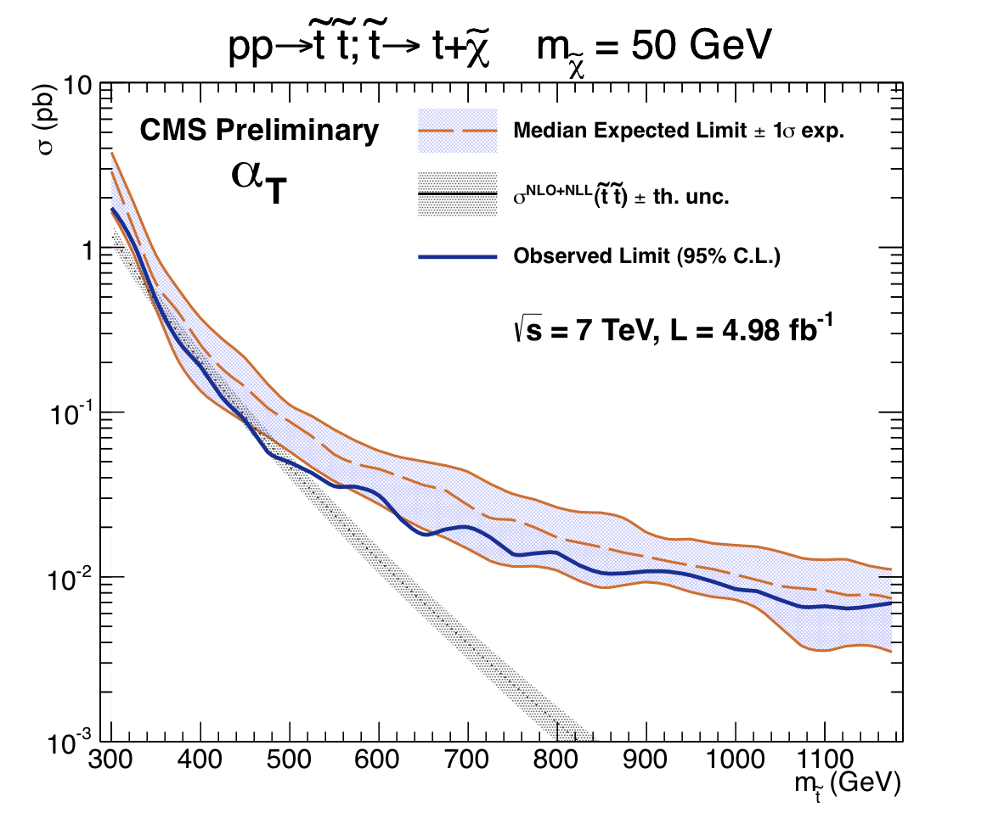
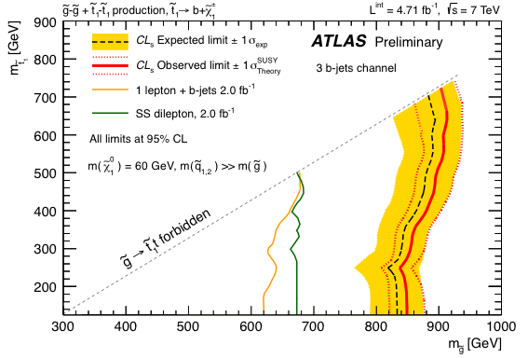
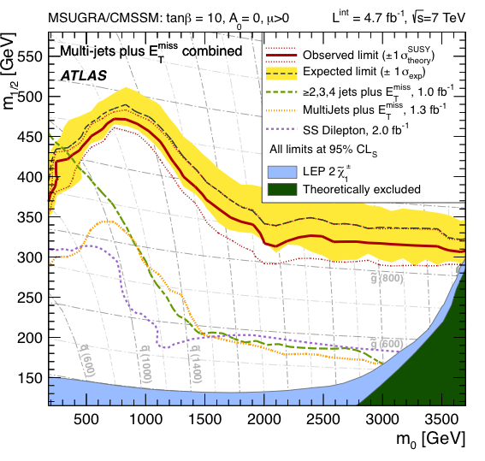
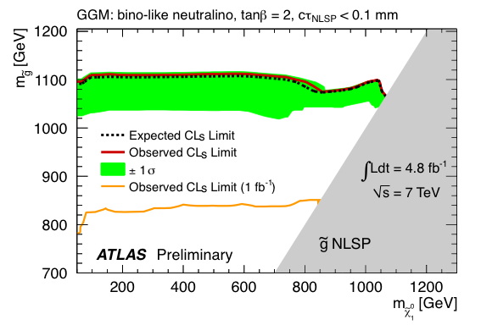
NLL-Fast in Action
Available at
http://web.physik.rwth-aachen.de/service/wiki/bin/view/Main/BSMCrossSectionWorkingGroup
( → LPCC working group on BSM cross sections and branching ratios)
Starting from Moriond this year, NLL-fast used in the analysis of experimental data by both ATLAS and CMS
Usage documented in [Krämer, AK, van der Leeuw, Mangano, Padhi, Plehn, Portell, arXiv:1206.2892] = a reference for the experimental collaborations on the evaluation of cross section and associated uncertainties

Slide 20
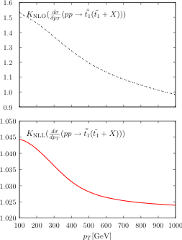
NLO+NLL: p_{t} Distributions For Stops
[Beenakker, Brensing, Krämer, AK, Laenen, Niessen’10]
K-factors for transverse momentum distributions are not constant and depend on p_{T}!

Slide 21

NLO+NLL: p_{t} Distributions For Stops
[Beenakker, Brensing, Krämer, AK, Laenen, Niessen’10]
Transverse momentum distributions contain large logarithms in the threshold limit
Same structure of the threshold resummed cross section in the Mellin moment space (moments taken wrt. ) , soft anomalous dimension a function of p_{T .}
K-factors for transverse momentum distributions are not constant and depend on p_{T}!

Slide 22
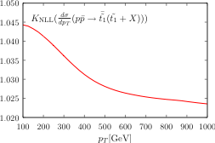
NLO+NLL: p_{t} Distributions For Stops
[Beenakker, Brensing, Krämer, AK, Laenen, Niessen’10]
Transverse momentum distributions contain large logarithms in the threshold limit
Same structure of the threshold resummed cross section in the Mellin moment space (moments taken wrt. ) , soft anomalous dimension a function of p_{T .}

Slide 23
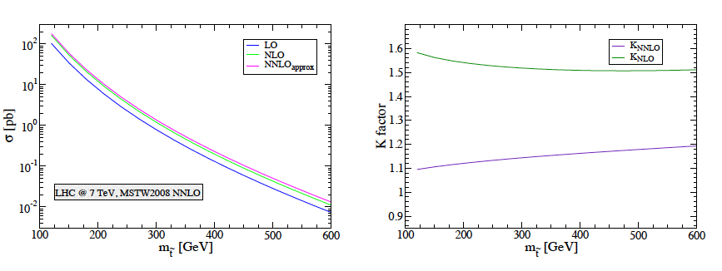
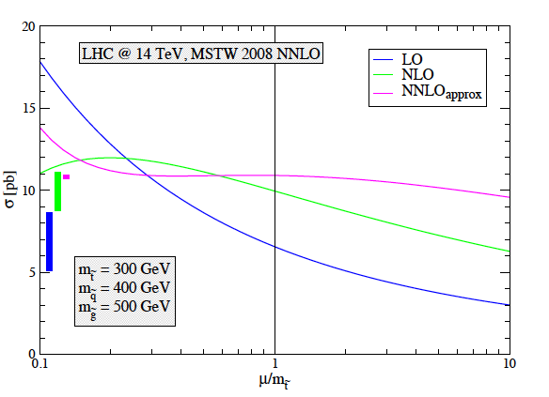
NNLO approximation
Expansion of the NNLL exponent, supplemented by NNLO scale dependent terms, proportional to log(μ²/m²) and two-loop Coulomb corrections
Same methodology as for top-antitop [Moch, Uwer’08], applied to squark-antisquark [Langenfeld, Moch’09] and stop-antistop [Langenfeld’11]
Stop-antistop:

Slide 24
Towards NNLL
Exponentials at NNLL accuracy
    Three-loop cusp anomalous dimension [Moch,Vermaseren,Vogt’04]
    Two-loop soft anomalous dimensions [Contopanagos, Laenen,Sterman’96][Catani, de Florian, Grazzini’01][Beneke, Falgari, Schwinn’09][Czakon, Mitov, Sterman’09] [Ferroglia, Neubert, Pecjak, Yang’09]
Matching coefficients
Matching coefficients
Soft wide-angle emission
N-moments of LO
Soft-collinear radiation from incoming partons

Slide 25

Matching Coefficients for NNLL
Soft-Coulomb factorization [Bonciani, Catani, Mangano, Nason’98][Beneke, Falgari, Schwinn’09-10]
Form of the NLO Coulomb corrections known:
Hard-matching coefficients C⁽¹⁾_{ij,I}: Analytical results ✔
    NLO correction in the threshold limit expanded up to O(β) with Coulomb corrections subtracted
    Mellin transform, logarithms of N subtracted → remaining N- independent terms give C⁽¹⁾_{ij,I}

Slide 26
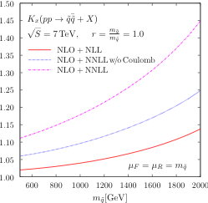
Squark-Antisquark production at NNLL
[Beenakker, Brensing, Krämer, AK, Laenen, Niessen’11]
NNLL +NLO: → up to 30% increase of the total cross section wrt NLO for squarks with mass of 1.5 TeV

Slide 27
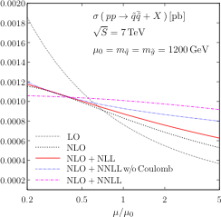
Squark-Antisquark production at NNLL
[Beenakker, Brensing, Krämer, AK, Laenen, Niessen’11]
NNLL +NLO: → up to 30% increase of the total cross section wrt NLO for squarks with mass of 1.5 TeV
→ significant reduction of the scale dependence

Slide 28
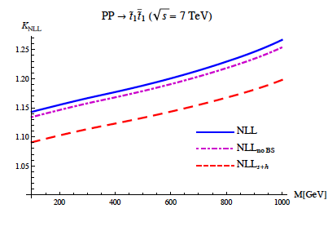
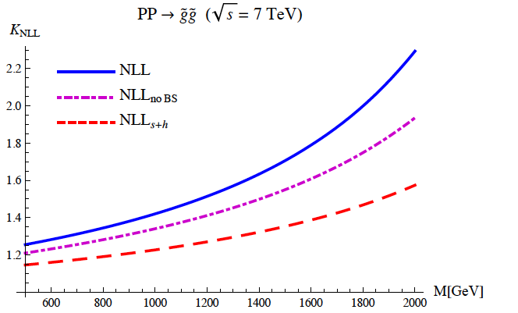
Soft and Coulomb resummation I
SCET-based resummation formalism for coloured heavy particle pair-production developed in [Beneke, Falgari, Schwinn ’09-’10], applied at NNLL to top-antitop production → see Jan Piclum’s talk
Applied at NLL to squark-antisquark [Beneke, Falgari,Schwinn ’10], and recently to all processes of squark and gluino pair-production, including stops [Falgari, Schwinn, Wever ’12]
Coulomb (+bound states) corrections important

Slide 29
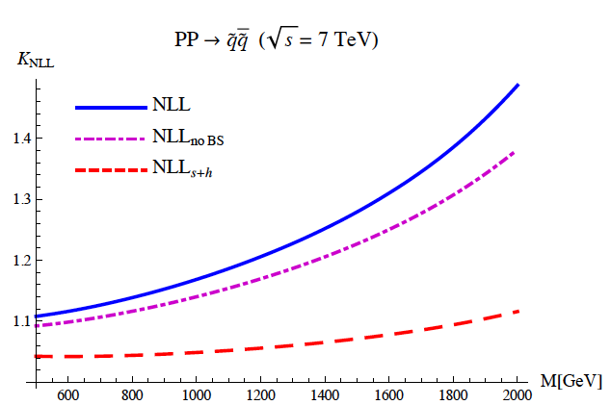
Soft and Coulomb resummation II
Comparison of the “soft” part of the result with NLL in Mellin space (NLL-fast): agree within theory uncertainties but further studies needed
Comparison of the full result with NNLL in Mellin space for squark-antisquark shows a very good agreement → importance of the Coulomb-soft interference
  need to perform a comprehensive comparison of various approaches → possible future activity of the LPCC BSM cross section working group
Public code: http://omnibus.uni-freiburg.de/~cs1010/susy.html
  Also uses grid files and an interpolation function

Slide 30



EW corrections
EW corrections → O(α_{s}² α) [Hollik, Kollar, Trenkel'07][Hollik, Mirabella'08] [Hollik, Mirabella, Trenkel'08] [Beccaria et al.'08] [Mirabella'09] [Germer, Hollik, Mirabella, Trenkel’10] ] [Germer, Hollik, Mirabella’11]
Corrections to O(α_{s}²) processes
e.g.
Tree-level EW effects O(α_{s} α) and O(α²)
QCD-EW interference and photon-induced contributions, tree-level EW [Bornhauser et al.'07][Alan, Cankocak, Demir'07] [Hollik, Kollar, Trenkel'07][Hollik, Mirabella'08] [Hollik, Mirabella, Trenkel'08] [Bozzi, Fuks, Klasen'05] [Germer, Hollik, Mirabella, Trenkel’10] [Germer, Hollik, Mirabella’11]
etc.
→ Available for all processes of squark and gluino pair-production, including stop and sbottoms

Slide 31
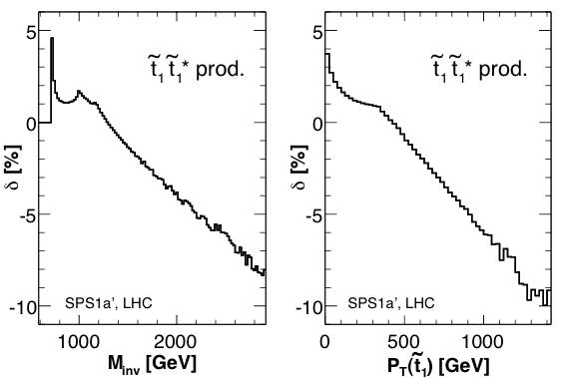
EW effects at the LHC
. [Hollik,Kollar, Trenkel'07][Hollik, Mirabella'08][Hollik, Mirabella, Trenkel'08] [Beccaria et al.'08] [Mirabella'09][Germer et al.’10-11]
EW contributions can provide corrections of the order of 10-20 % for sufficiently high invariant masses and transverse momenta
Up to tens of percent effects reported in total cross section for a given chirality
For total inclusive cross sections, the EW contributions O(α² + α_{s}α + α_{s}²α) vary in size from ~1% for squark-gluino and stop-antistop to 5% for squark-squark (SPS1a’)

Slide 32
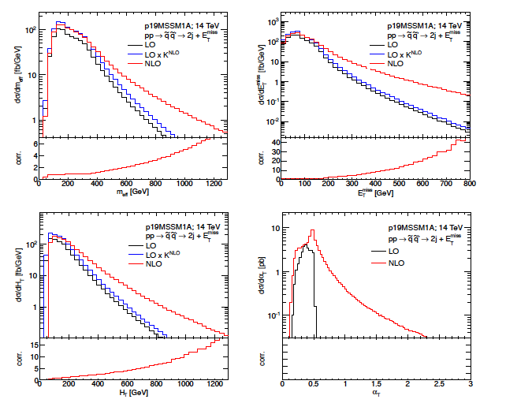
SUSY Pair-Production, Other Developments
Automated NLO: MadGOLEM, applied to squark-neutralino [Binoth, Goncalves Netto, Lopez-Val, Mawatari,Plehn, Wigmore’12]
Production + decay @ NLO: pp → squark+squark → 2j +Etmiss [Hollik, Lindert, Pagani’12]
Resummation for pure EW pair-production: sleptons [Bozzi, Fuks, Klasen’04-’07], gauginos: [Debove, Fuks, Klasen’07-’09] [Fuks, Klasen, Lamprea, Rothering’12]

Slide 33
Not only SUSY pair-Production
4th generation heavy T-quark at NLO+NNLL [Cacciari, Czakon, Mangano, Mitov, Nason’11]
Single heavy T-quark at NLO [Berger, Cao’10]
Single stop at NLO (RPV) [Plehn’00]
NLL+LO resummation for heavy colour-octet scalars: single and pair-production (incl. Coulomb) [Idilbi, Kim,Mehen’09-’10]
Sgluons at NLO [Goncalves Netto, Lopez-Val, Mawatari,Plehn, Wigmore’12]
Top quark pair-production mediated by massive colour octet vector bosons [Zhu, Li, Shao, Wang, Yuan’12]
…

Slide 34
Conclusions and Outlook
Total cross sections for pair-production processes of squark and gluino, including stop and sbottom, are known at NLO+NLL (soft and soft+Coulomb); tools are available
Above NLO+NLL SUSY-QCD :
  NNLL for squark-antisquark
  NNLO approx. for squark-antisquark and stop-antistop
NLO EW also calculated for all processes
A selection of results for differential distributions at NLO and NLO+NLL exist, efforts are underway
Recent shift from NLO to NLO+NLL in the experimental analysis → NLL-fast
Goals:
    NNLL for squark and gluino production in time for the final SUSY analysis of 8 TeV data
    comparison of various apparoaches (Mellin space, SCET , …)
    inclusion of NNPDFs, separate scale variation, ..

Slide 35
BACKUP

Slide 36
Stops
Scalar SUSY-partners of left- and right-handed fermions mix: weak interaction eigenstates mix into mass eigenstates
The off-diagonal terms in the mixing matrix are proportional to fermion mass, m_{f}
Stop likely to be the lightest squark
Strongest mixing in the 3rd generation, in particular in the stop sector
a
a
aa
a

Slide 37
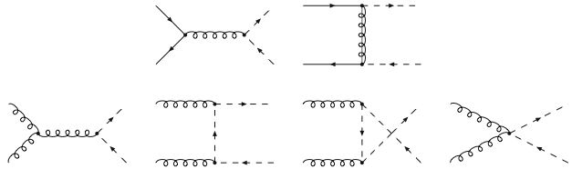
Stops
Scalar SUSY-partners of left- and right-handed fermions mix: weak interaction eigenstates mix into mass eigenstates
The off-diagonal terms in the mixing matrix are proportional to fermion mass, m_{f}
Stop likely to be the lightest squark
At leading order
Strongest mixing in the 3rd generation, in particular in the stop sector
Stop-antistop
a
a
aa
a

Slide 38
Stops
Scalar SUSY-partners of left- and right-handed fermions mix: weak interaction eigenstates mix into mass eigenstates
The off-diagonal terms in the mixing matrix are proportional to fermion mass, m_{f}
Stop likely to be the lightest squark
At leading order
Strongest mixing in the 3rd generation, in particular in the stop sector
Squark-antisquark
a
a
aa
a

Slide 39
Stops
Scalar SUSY-partners of left- and right-handed fermions mix: weak interaction eigenstates mix into mass eigenstates
The off-diagonal terms in the mixing matrix are proportional to fermion mass, m_{f}
Stop likely to be the lightest squark
At leading order
Strongest mixing in the 3rd generation, in particular in the stop sector
Stop-antistop
    Only diagonal i.e.
    pairs produced
    LO cross section depends only on the stop mass
    Note: for sbottom-pair production LO contribution negligible
a
a
aa
a

Slide 40
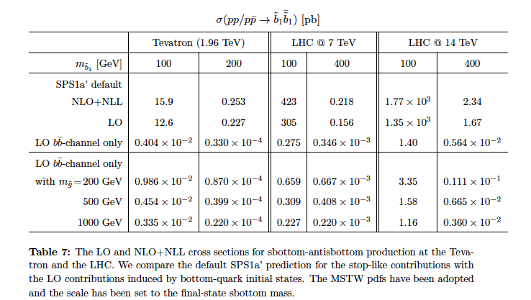
LO BBbar

Slide 41
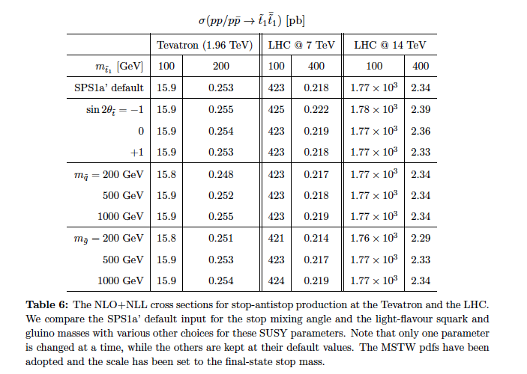
Parameter Dependence

Slide 42
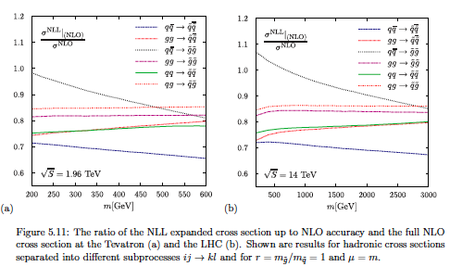
NLL expanded vs. NLO
[from S.Brensing’s PhD thesis]

Slide 43
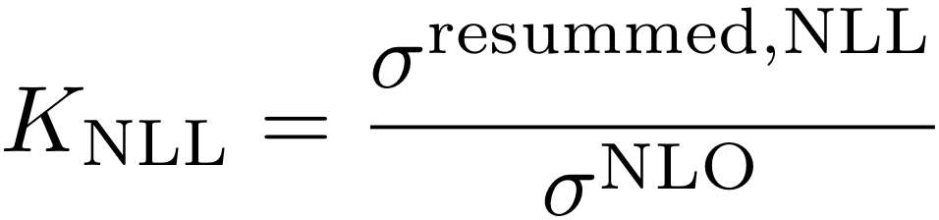
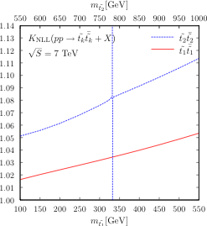
Stop Resummation
Status: NLO SUSY-QCD
NNLO dominant contributions [Langenfeld’10]
[Beenakker, Krämer, Plehn, Spira, Zerwas’97]
Here: NLL+NLO
[Beenakker, Brensing, Krämer, A.K., Laenen, Niessen’10]
Reduction of the scale dependence for NLO+NLL predictions, compared with NLO

Slide 44
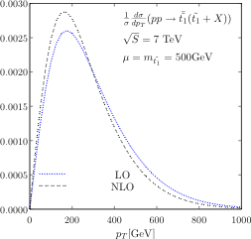
Stop p_{T} distribution
[Beenakker, Höpker, Spira, Zerwas’97]
[Beenakker, Brensing, Krämer, A.K., Laenen, Niessen’10]
K-factors for transverse momentum distributions are not constant and depend on p_{T}!

Slide 45
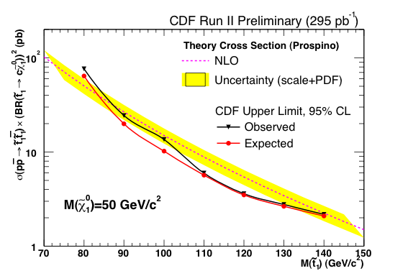
Stop production at NLO
[Beenakker, Krämer, Plehn, Spira, Zerwas’97]
At NLO also only the diagonal pairs are produced, mixed pairs only at O(α_{s}⁴)
Very weak dependence of the NLO results on SUSY parameter other than stop mass
NLO calculations used by the Tevatron collaboration to establish mass limits
Stop masses in the range 115-200 GeV, depending on the measurement channel and details of the SUSY model, excluded by Tevatron collaborations

Slide 46
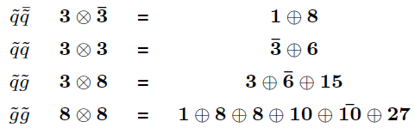
Soft anomalous dimensions
Need 1-loop anomalous dimension matrices in order to resum up to NLL
  massless 2→n QCD processes [Kidonakis, Oderda, Sterman'98] [Bonciani et al.'03][Mert Aybat, Dixon, Sterman'06]
  massive case: heavy quark pair-production [Kidonakis, Sterman'96][Bonciani et al.'98]
Calculation of 1-loop soft anomalous dimension matrices Γ_{ij} for 2→2 processes with nontrivial colour structure and massive particles in the final state
same colour structure as in top-antitop production ✓

Slide 47
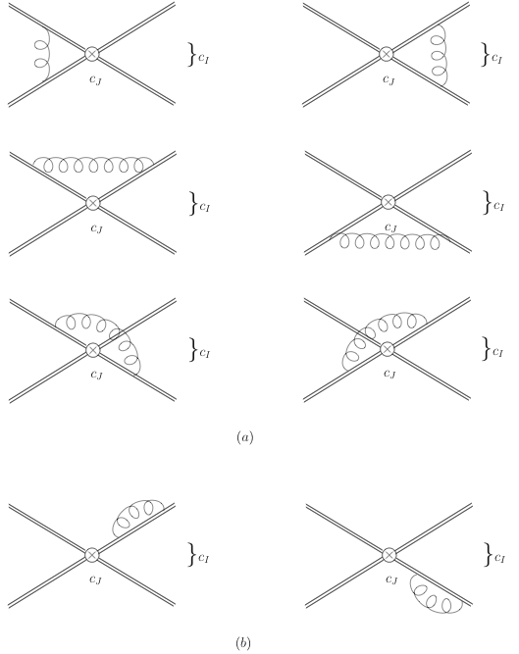

Soft anomalous dimensions
Need 1-loop anomalous dimension matrices in order to resum up to NLL
  massless 2→n QCD processes [Kidonakis, Oderda, Sterman'98] [Bonciani et al.'03][Mert Aybat, Dixon, Sterman'06]
  massive case: heavy quark pair-production [Kidonakis, Sterman'96][Bonciani et al.'98]
Calculation of 1-loop soft anomalous dimension matrices Γ_{ij} for 2→2 processes with nontrivial colour structure and massive particles in the final state
One-loop integrals in the eikonal approximation
  equal masses [Kidonakis, Sterman'96]
  unequal masses ( ) [Beenakker, Brensing, Krämer, AK, Laenen, Niessen'09]
Combination with colour structures ➔Γ_{ij} for , , ,

