Slide 1





ESS Target Options
ESS Target Division
Pb/Bi loop target for EURISOL
May 10th 2012, CERN

Slide 2
Outline
ESS general project status
Target concept selection
ESS TSDU project
Baseline tungsten target
Comparative LBE target

Slide 3
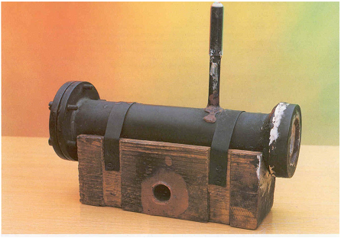
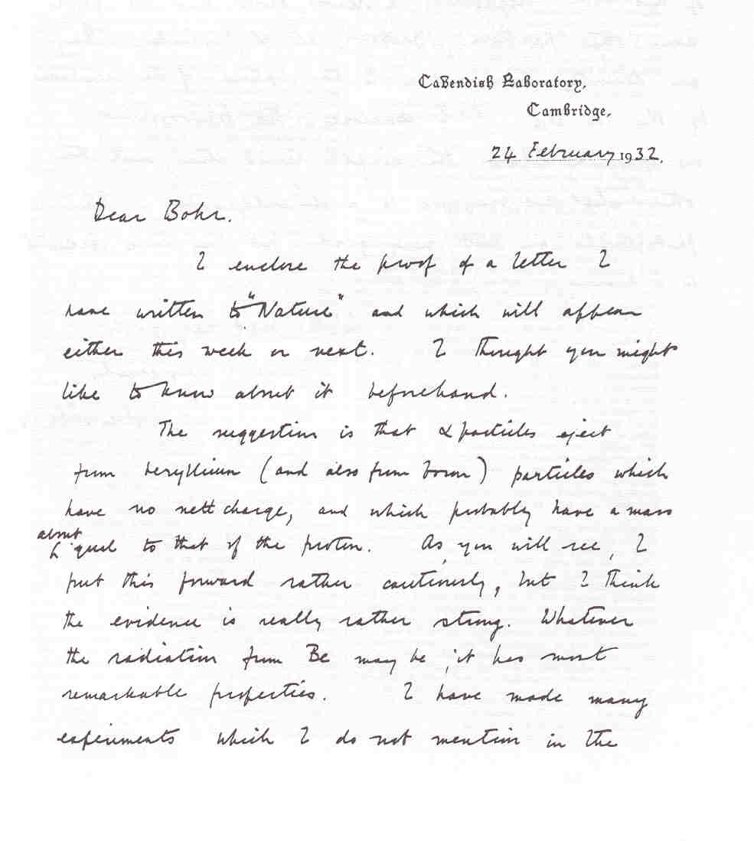
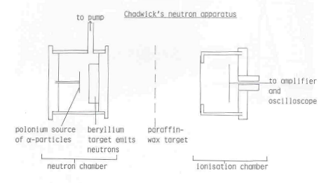

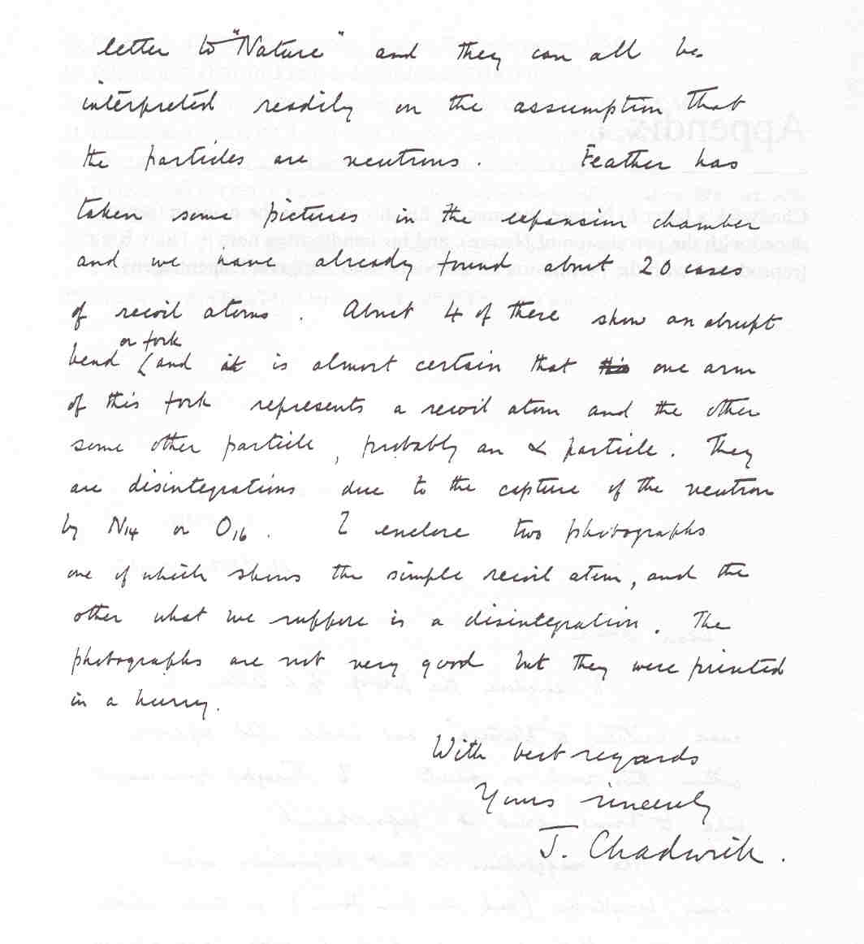
Discovery of neutrons
neutrons
p
α

Slide 4
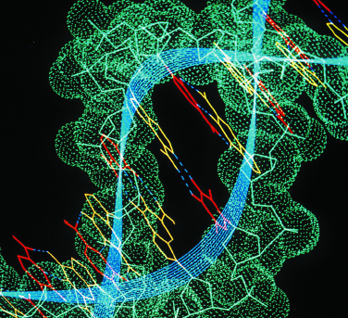
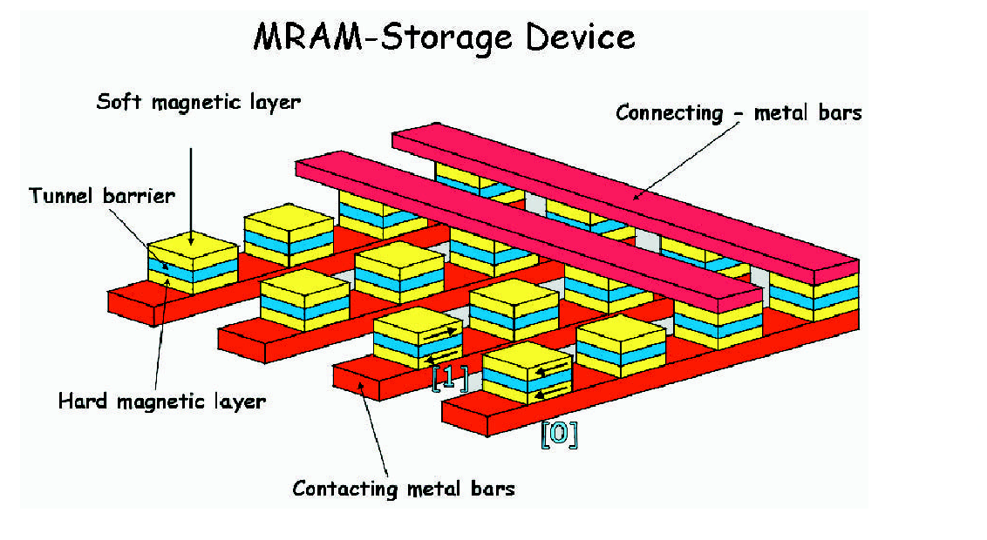
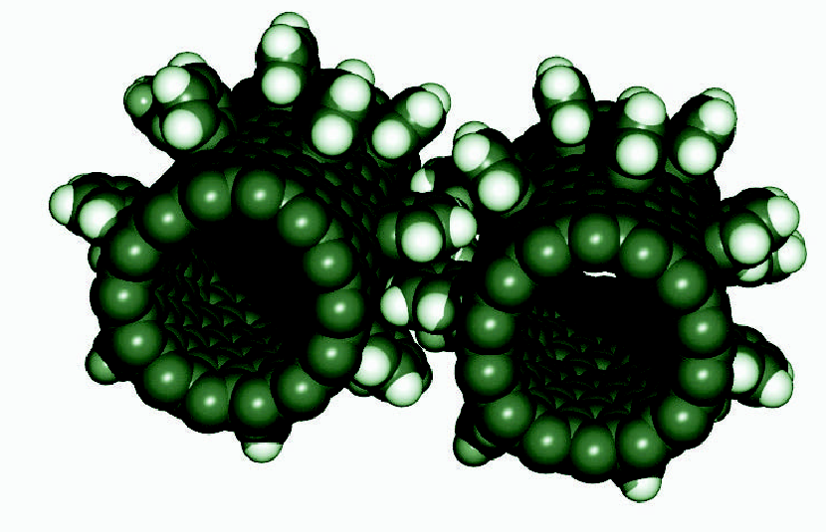
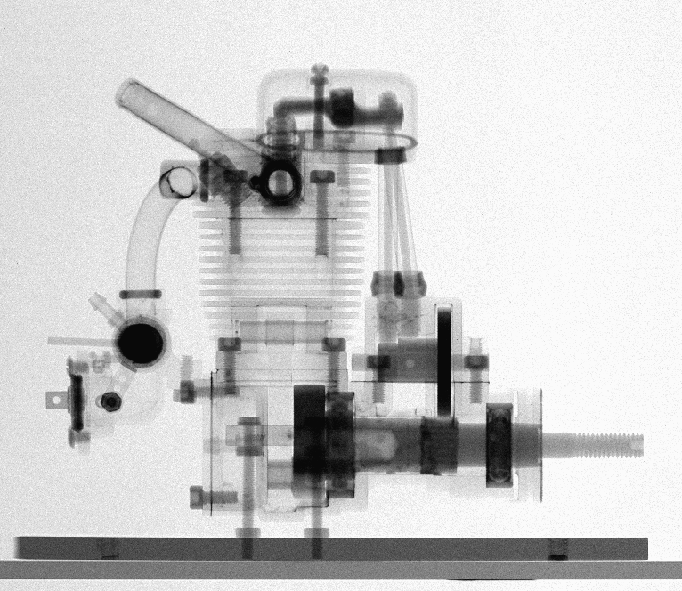
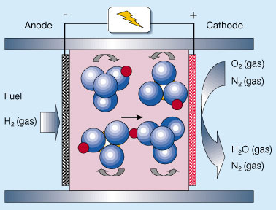

Neutrons 80 yrs ON
Materials science Bio-technology Nano science
Energy Technology Hardware for IT Engineering science
Neutrons can provide unique information on almost all materials.
Information on both structure and dynamics simultaneously. ”Where are the atoms and how do they behave?”
5000 users in Europe today.
- Science with neutrons is limited by the performance of today’s neutron sources. ESS performance will open new frontiers.

Slide 5
Motivation for ESS
Many research reactors in Europe are aging and will be closed before 2020:
  Up to 90% of the use is with cold neutrons
There is an urgent need for a new high flux cold neutron source in Europe:
  The vast majority of users will profit from a pulsed structure
  A large fraction of the users are fully satisfied by a long pulse source (approx 2 ms, 20 Hz)
  Existing short pulse sources (ISIS, JPARC and SNS) can supply the present and imminent future need of short pulse users
  Construction must start now for use in 2018-2019

Slide 6
Motivation for ESS (2)
Evolution of the performance of neutron sources
ESS
10²⁰
ISIS
SNS
10¹⁵
MTR
NRU
HFIR
ILL
J-PARC
NRX
HFBR
ZINP-P/
IPNS
FRM-II
X-10
WNR
KENS
SINQ
Effective thermal neutron flux n/cm²-s
ZINP-P
10¹⁰
CP-2
CP-1
10⁵
Berkeley 37-inch cyclotron
350 mCi
Ra-Be source
Steady State Sources
Pulsed Sources
1
Chadwick
1930
1940
1950
1960
1970
1980
1990
2000
2010
2020
(Updated from Neutron Scattering, K. Skold and D. L. Price, eds., Academic Press, 1986)

Slide 7
Motivation for long pulse
ESS
SNS

Slide 8
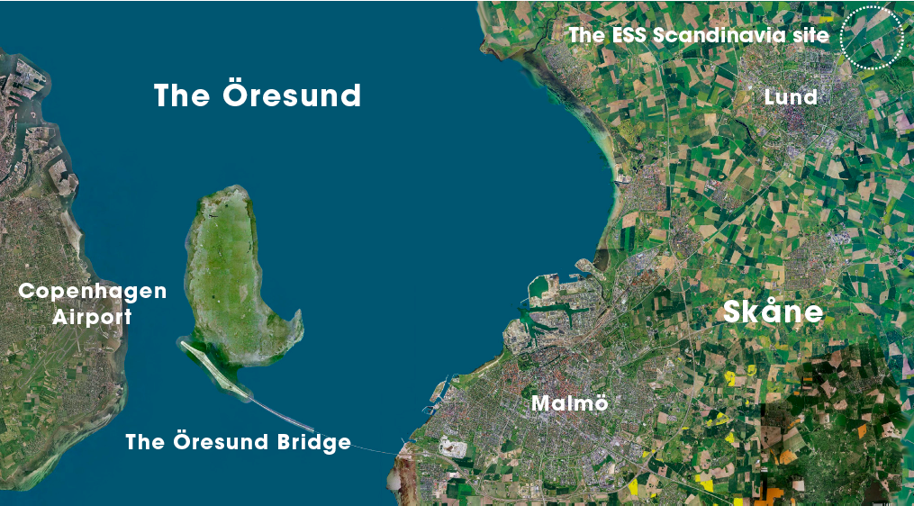
Lund: host site for ESS
Neutrons and SR at the same site
  MAX-IV and ESS
A World-leading cluster of science facilities
  XFEL, ESS, PETRA and MAX-IV
Excellent Communications
  33 minutes to airport
  125 direct destinations
  A cross-roads for 10 European countries
Intellectual capital
  10,000 scientists - 140,000 students
  3rd biopole in Europe
  Lund University 3rd largest attractor of EU R&D funds
  IDEON - MEDICON Village

Slide 9





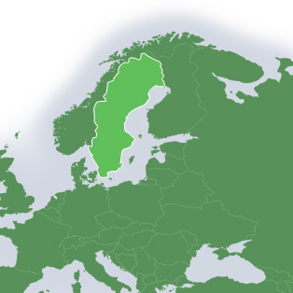













ESS partner countries
Sweden, Denmark and Norway
50% of construction costs
17 Partners
today

Slide 10
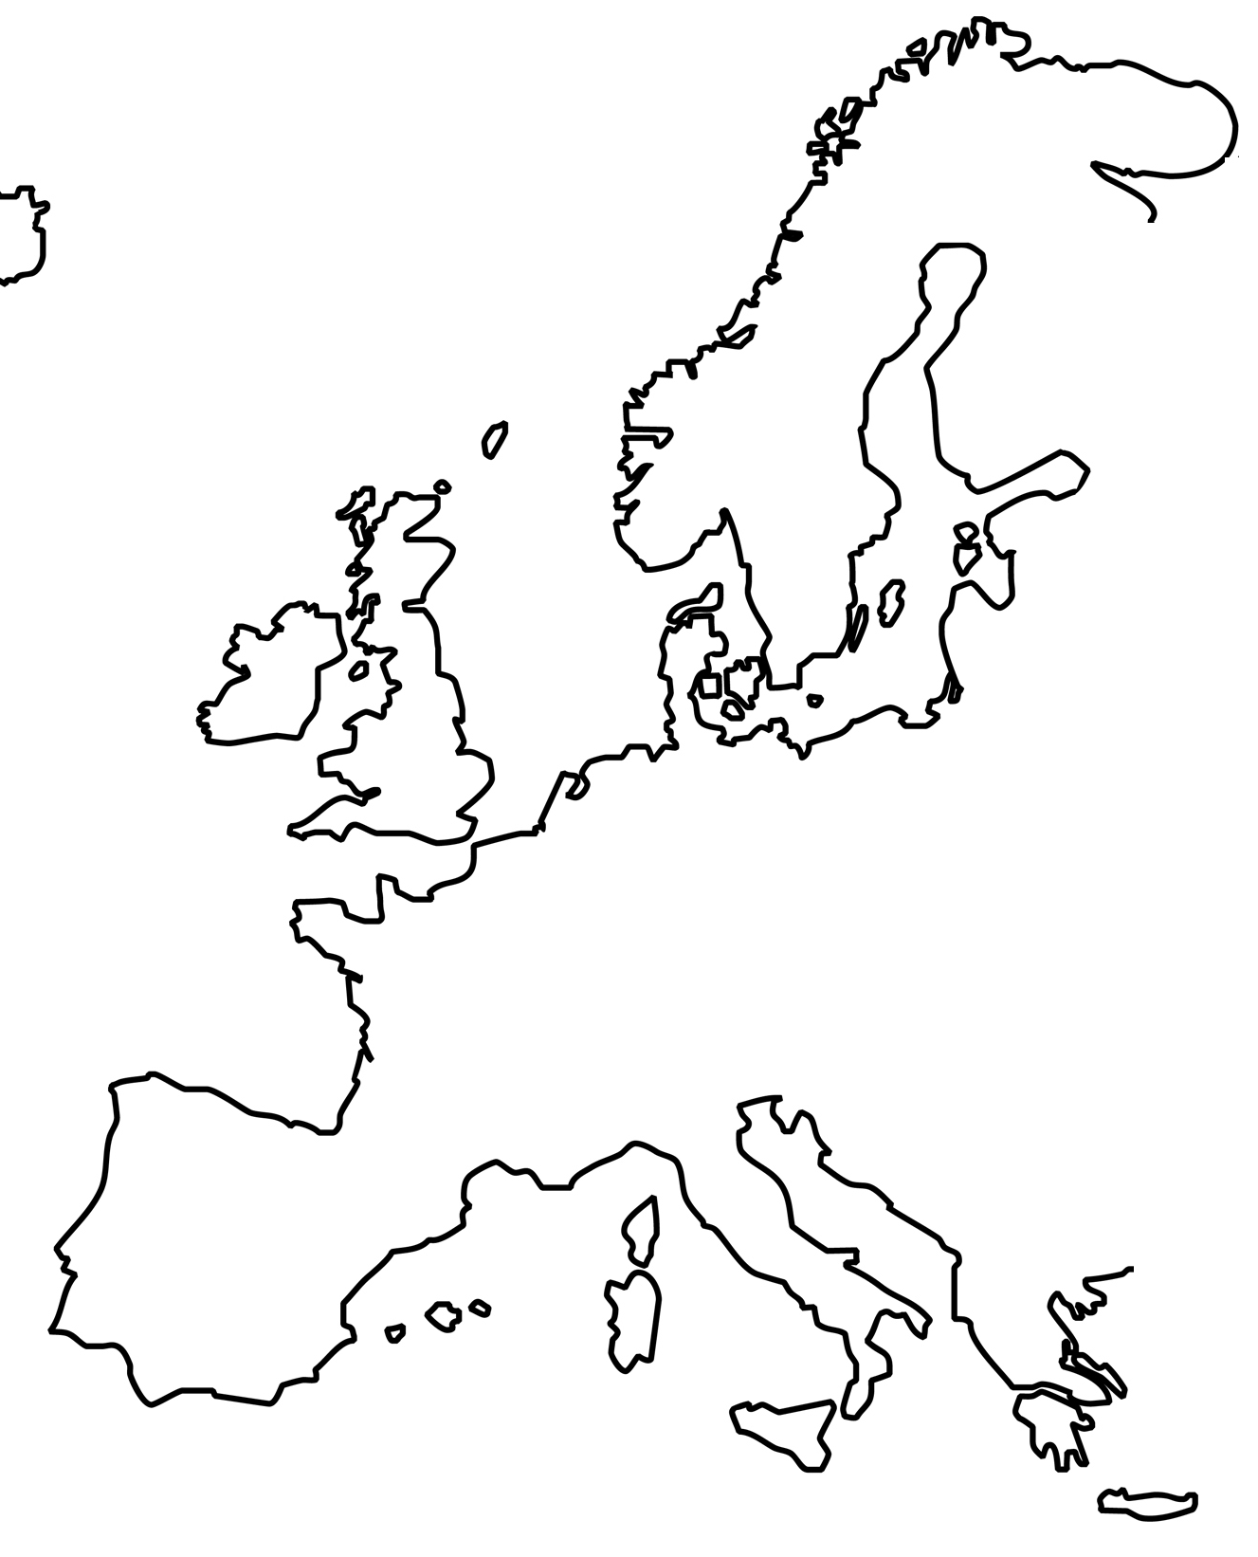
ESS partner institutes
  Collaboration partners for work-packages and in-kind contributions:
  Instruments and use:
  Networks involving ILL, RAL,
  FRMII, HMI, FZJ, CTH, UU, LU
  LLB, …
  Target: PSI, FZJ, KTH, CERN,
  IDOM, KIT, CEA …
  Accelerator: CEA/IN2P3, INFN,
  UU, Århus U, TEKNIKER, CERN,
  ….
  Systems Integration, Project
  management, Safety, Data
  handling, Construction :
  ESS central team
Map of possible
partner labs.
Under construction!

Slide 11
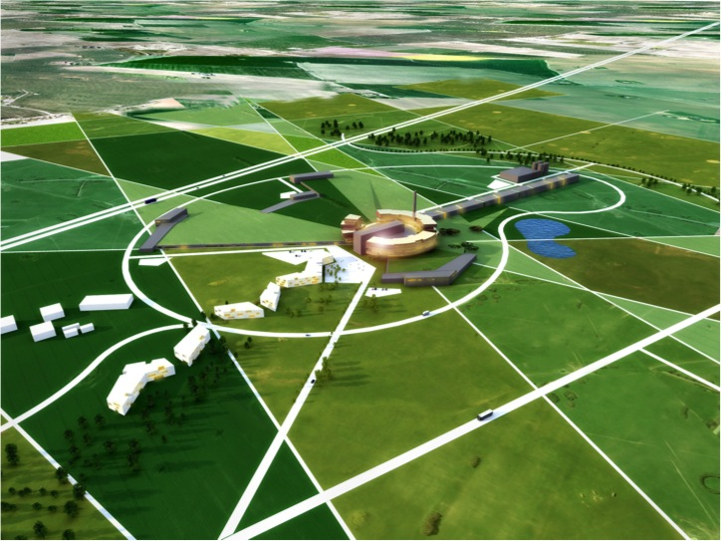
ESS baseline parameters
Proton beam
2.5 GeV proton linac
2 mA average beam current
2.86 ms pulse length
14 Hz rep. frequency
Target options:
Baseline: Solid Tungsten (or W alloy)
Comparative: Molten LBE

Slide 12
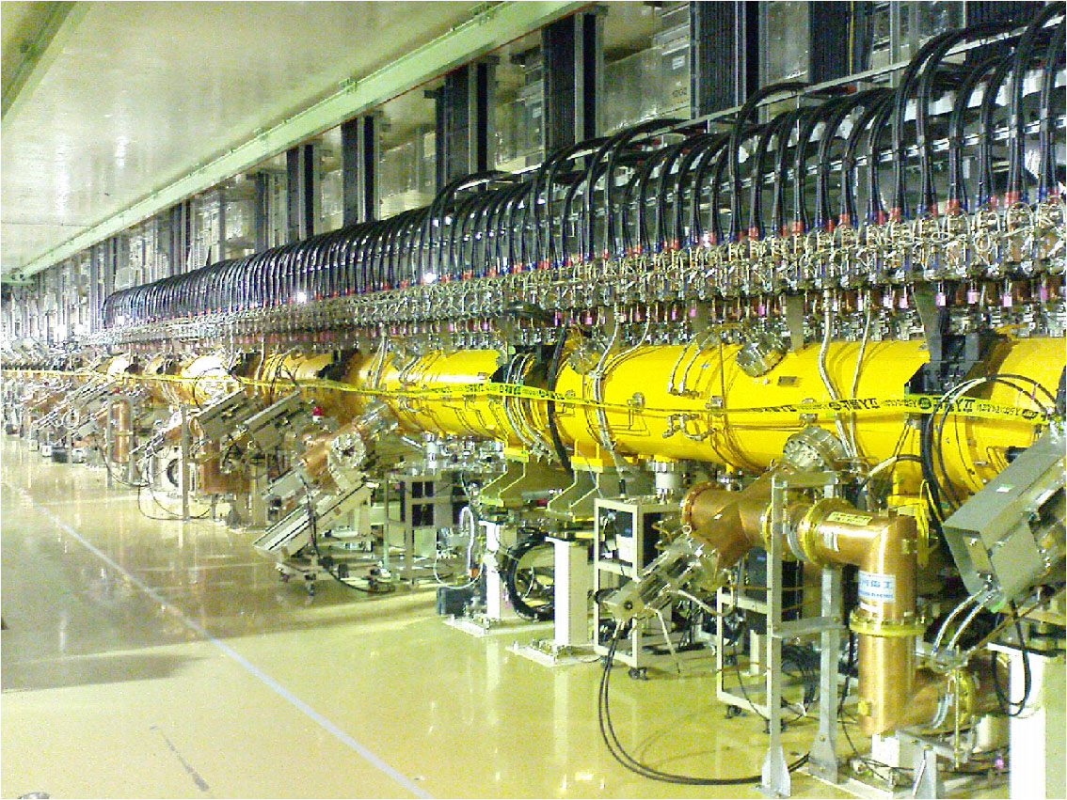
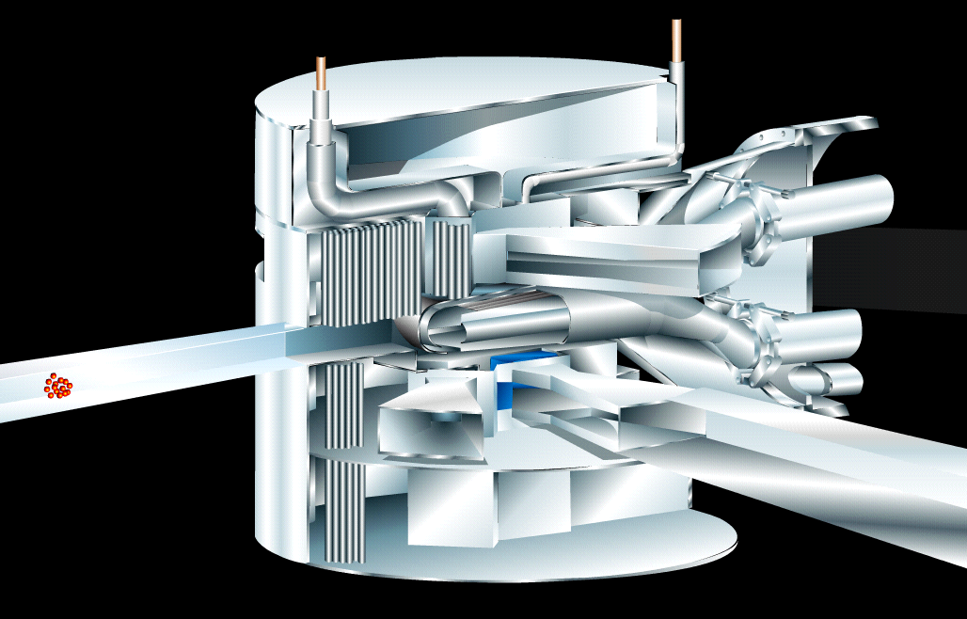
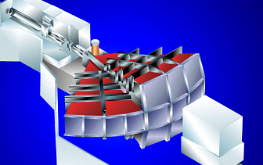
ESS main elements
Proton linac (~400 M€)
- Cavities, cryomodules
- High power RF
- Cryogenics, vaccuum, cooling
- Shielding
Target station (~200 M€)
- Nuclear tech/safety systems
- Hot cell / remote handling
- Cooling & Cryogenics
- Shielding – Steel & Concrete
Instruments (~250 M€)
- Shielding
- Detectors
- Neutron guides, choppers
- Electronics
- …
Conventional facilities (~400 M€)
- Buildings – labs & offices
- Cooling, heating, electric
systems (energy)
- Computers & Controls

Slide 13
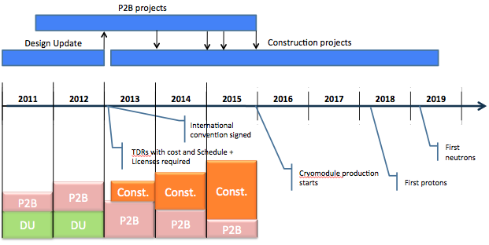
ESS Project Timeline

Slide 14
Accelerator - progress
Accelerator Design Update is launched – kick off meeting in Lund 24/3
WP1 Management - ESS AB work funded & started
WP2 Accelerator Science - ESS AB work funded & started
WP3 Infrastructure - TEKNIKER – contract signed, but made void
since funding was not yet received
WP4 & WP5 Elliptical & Spokes - CEA, CNRS contracts signed, work started
WP6 Front end - INFN – contract agreed, awaiting signature and
funding in weeks, work started
WP7 HEBT & Magnets - Aarhus University – contracts signed and
funding is there, work started
WP8 RF - Uppsala University – Contract agreed – only about 1 M€ missing for complete funding
Important to secure funding so contracts can be signed, not to loose coherence.

Slide 15
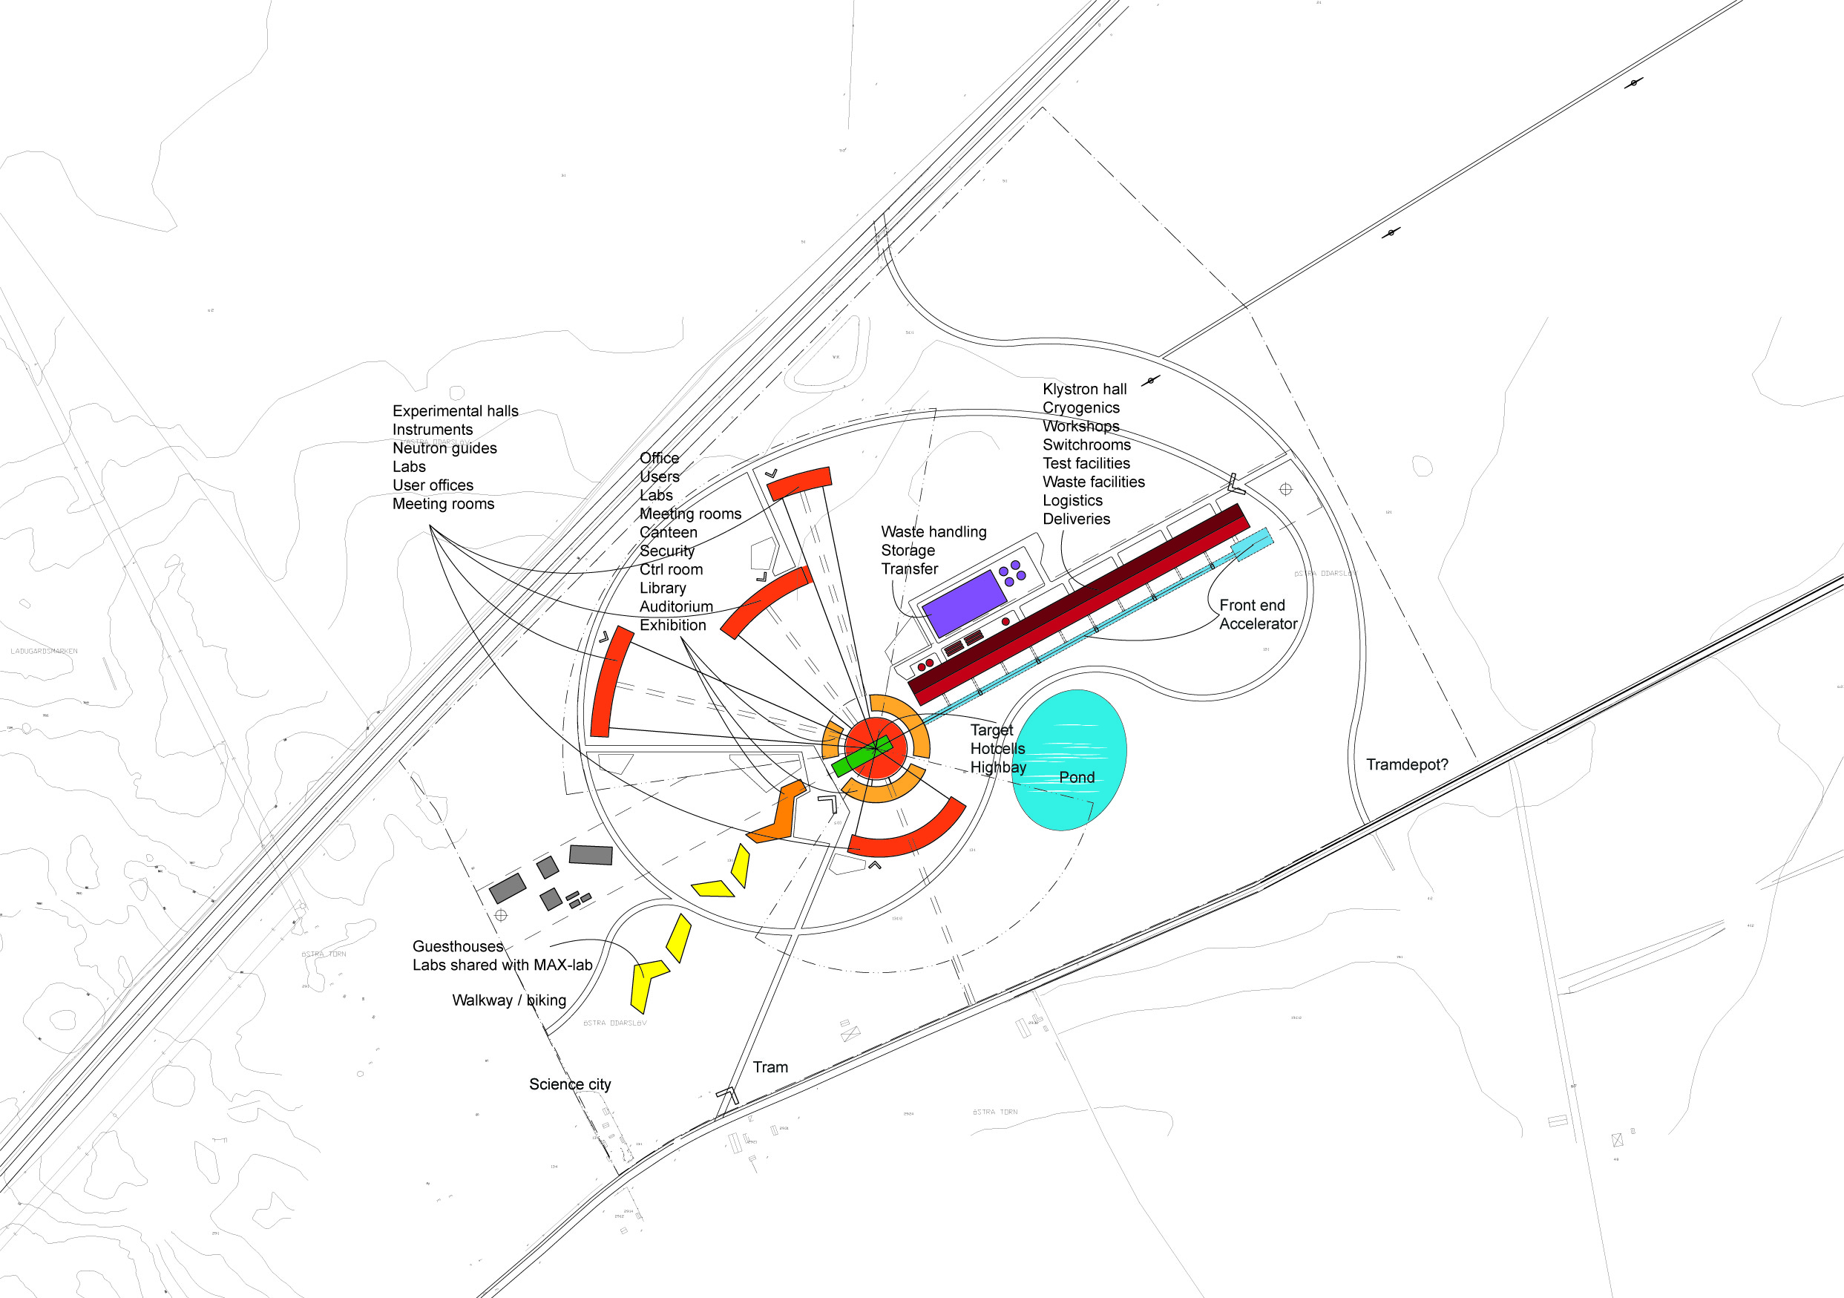
Conventional facilities - progress
Project plan, organisation, contract forms
Refined site layout
with zones
for buildings
and activity types
Takes elaborated
requests from
science directorate
into account

Slide 16
Licensing - progress
General Safety Objectives
PSAR – work is ongoing, focusing on Target Design Concepts
EIA – work is ongoing
Safety Advisory Committee set up
  Required by authorities
  Foreign and domestic experts. Some cross membership with TAC.
The required licenses are foreseen to be available by early 2013, with a slight reservation for the time needed by the Environmental Court. Risks are mitigated by Swedish government permissibility right.

Slide 17
Staff numbers – pre-construction phase

Slide 18
Target concept – decision process
Target Station Concept Selection Completed end 2010 as a European collaboration
Target baseline and fallback internal decision May 16, 2011 ESS Lund ( CCB & EPG)
Workshop to discuss decision Lund May 31st, 2011
Collaboration on Target
Review by Technical Advisory Committee July 11-12
TAC
Endorsement by Steering Committee October 2011
STC

Slide 19
Target Station Design Update Project
The TSDU project aims at integrating most recent worldwide knowledge, experience and state-of-the-art technology into an updated target design for ESS. Its main goals are:
  Providing information needed for the environmental licensing of the ESS Target Station on two design options.
  Producing a Technical Design Report for the ESS Target Station by end 2012.

Slide 20
TSDU Work Packages
  WP1: Project Management, Coordination of Global Design Effort and overall system integration
  WP2: Target Performance Modelling and Optimisation
  WP3: Material Properties
  WP4: The RoTHeTa Concept – Replaceable systems
  WP5: The RoTHeTa Concept – Permanent systems
  WP6: Liquid Metal Target
  WP7: Premoderator, Moderator and Reflector Engineering Design
  WP8: Shielded Target Monolith System and Beam Extraction
  WP9: Infrastructure Services and Utilities
  WP10: Hot cell, Handling of used Targets, Moderators, Reflectors outside Target Shielding Monolith – Beam dumps
  WP11: Waste Disposal, Emissions, Dismantling and Decommissioning
  WP12: Control Systems for Target Station

Slide 21
Some Recent ESS Documentation
 | Date issued/due | Completed? | LBE?
Evaluation of ESS safety relevant concerns assuming two basic target concepts for the target station | September 2011 | Yes | Yes
Target Station Design Update Baseline | December 2011 | Yes | No
Project specification for the ESS Target Station Design Update Project | February 2012 | Yes | Yes
TAC4 documentation | February 2012 | Yes | No
ESS Conceptual Design Report | February 2012 | Yes | Yes
ESS Technical Design Report | December 2012 | No | Yes

Slide 22
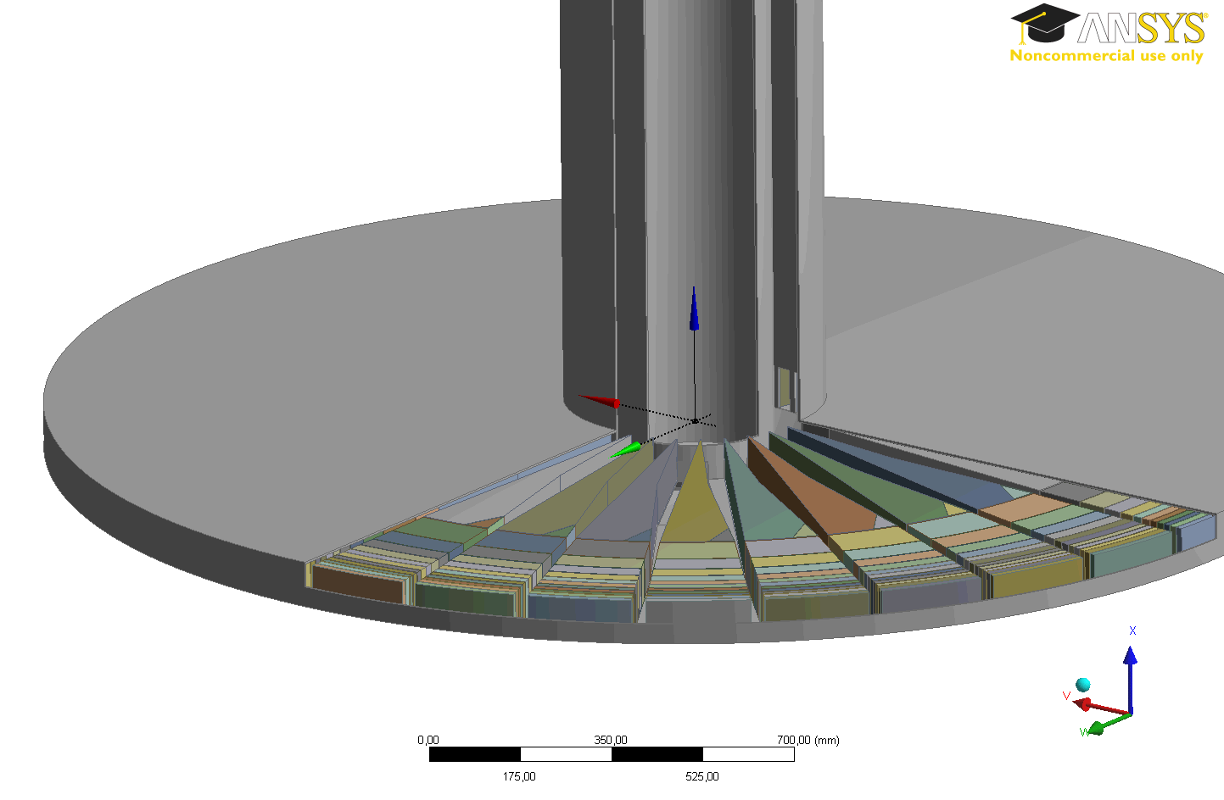
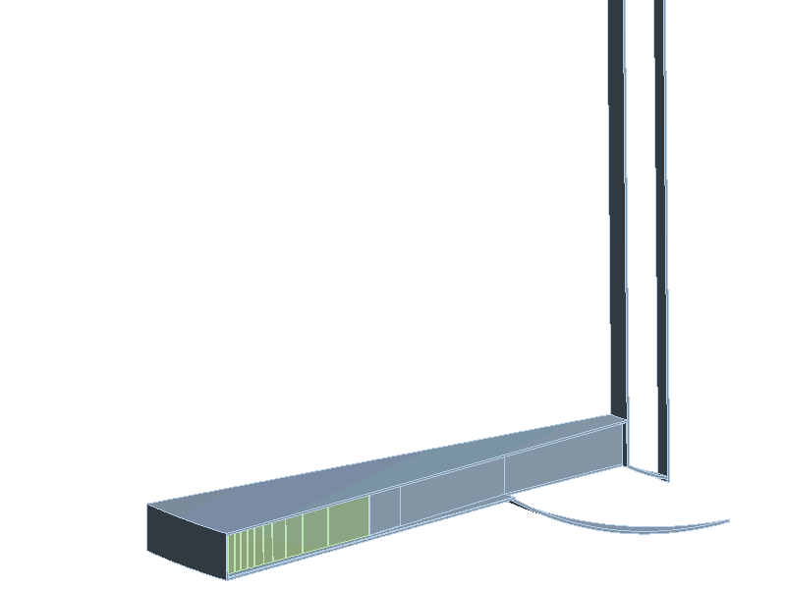
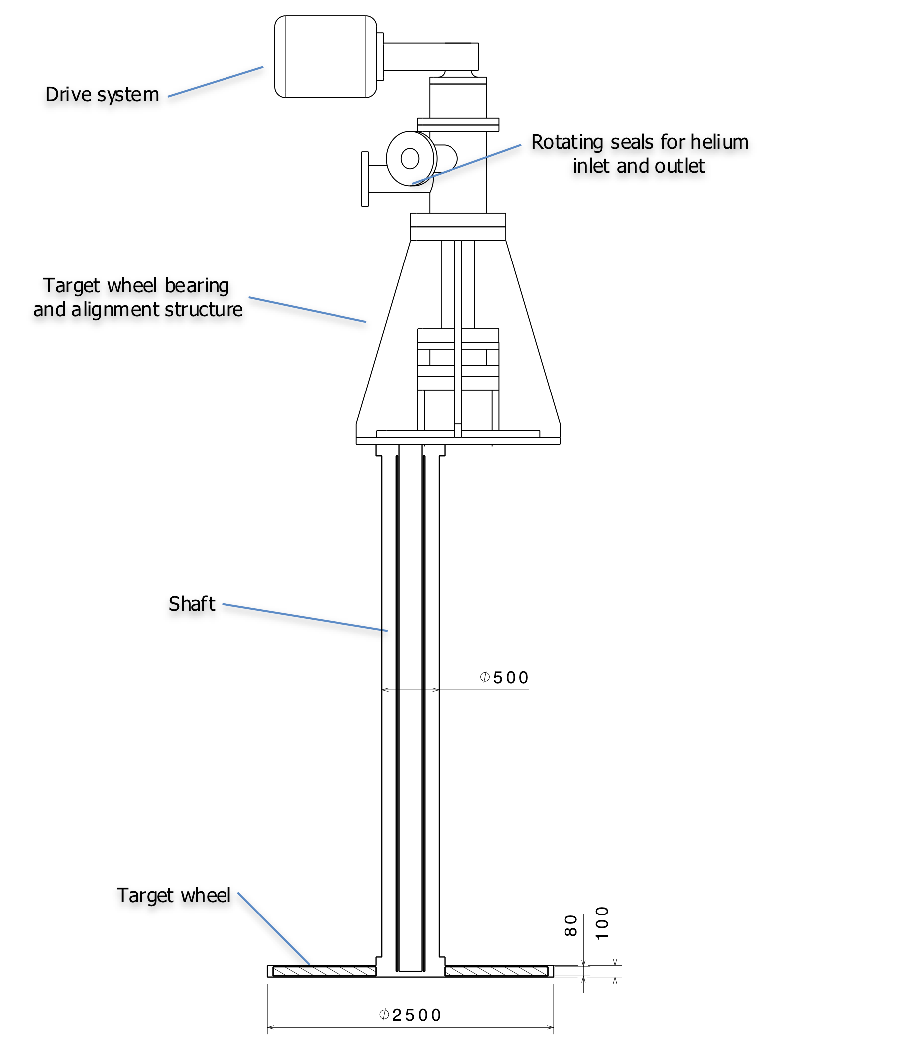
The RoTHeTa Concept
  ø2.5m
  33 sectors
  Tungsten vertical plates with cooling channels in between

Slide 23
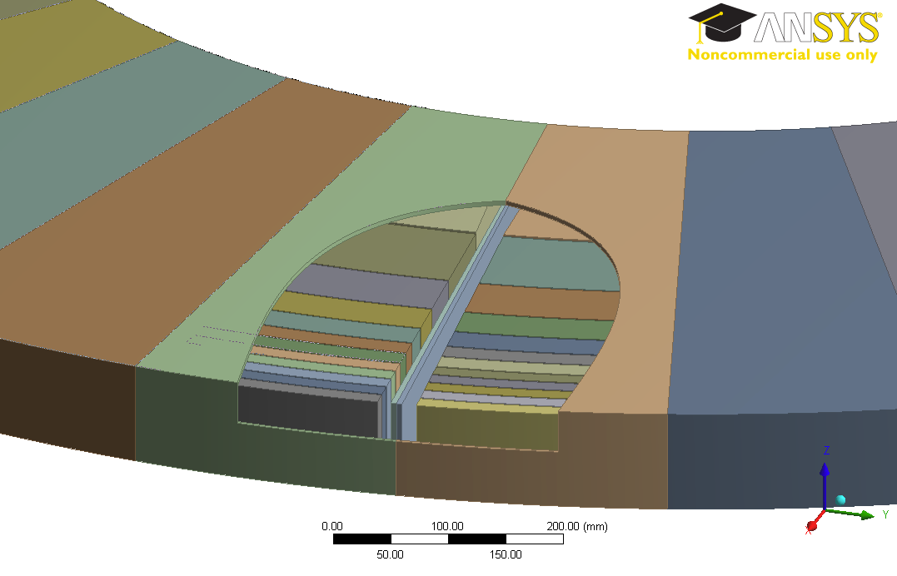
RoTHeTa Wheel Velocity
33 slices in total
Beam repetition rate is 14Hz
Angular velocity should be 0.42Hz, 25.45rpm
Each section sees on average 1/33 of the beam.

Slide 24
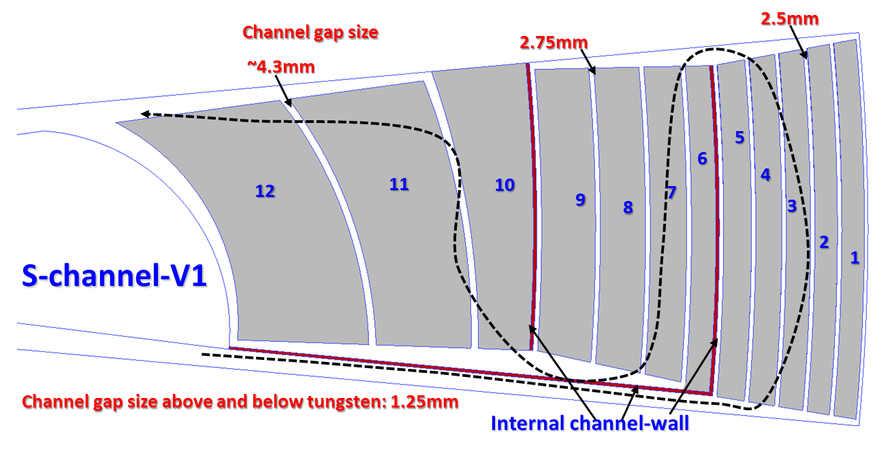
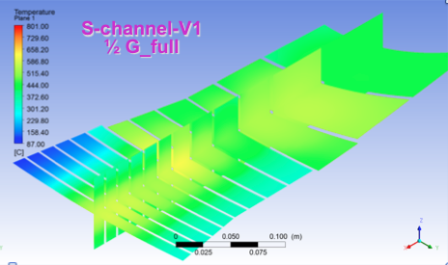
RoTHeTa Flow Pattern
S-channel: Lower W max. temperature

Slide 25
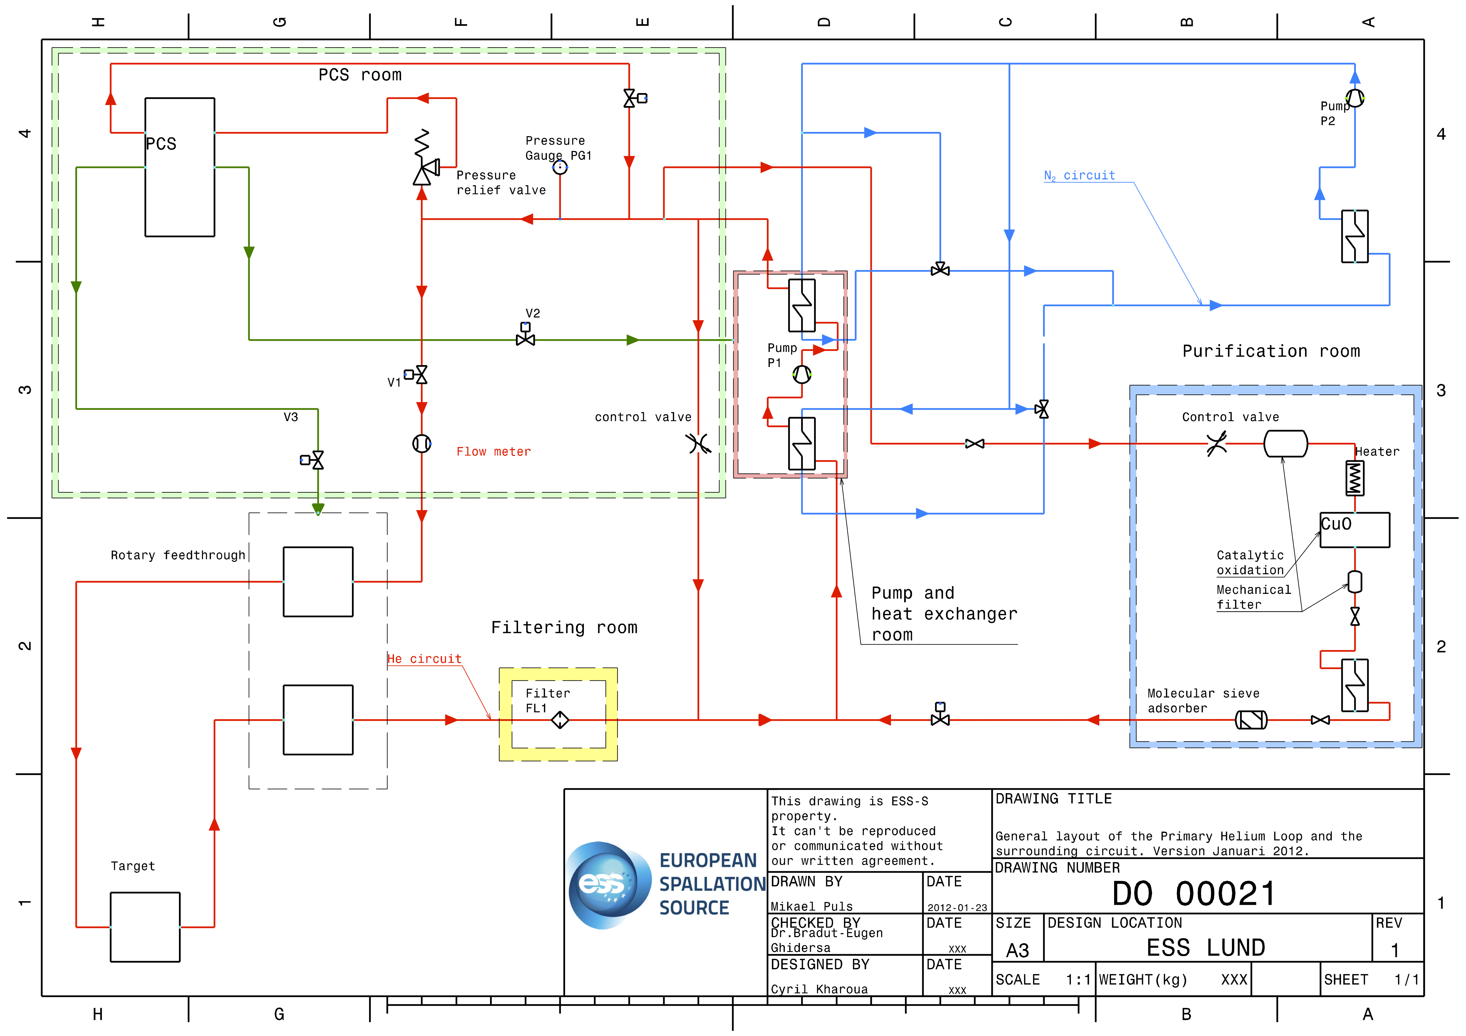
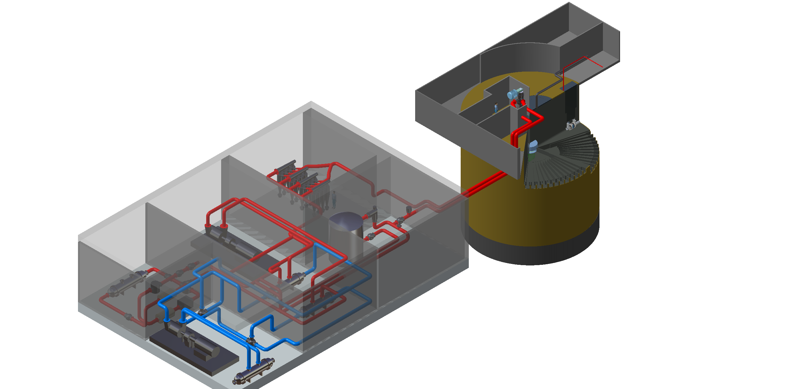
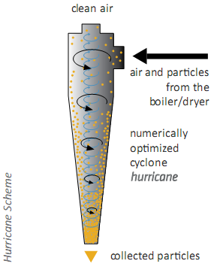
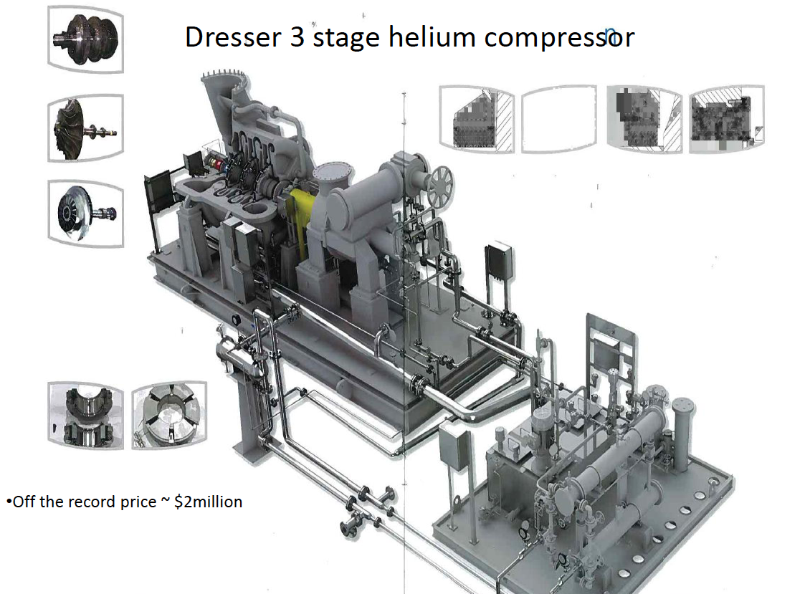
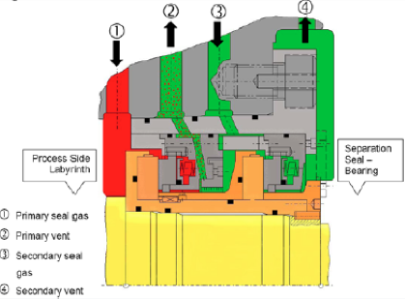
RoTHeTa Helium Loop

Slide 26
RoTHeTa Helium Loop Parameters

Slide 27
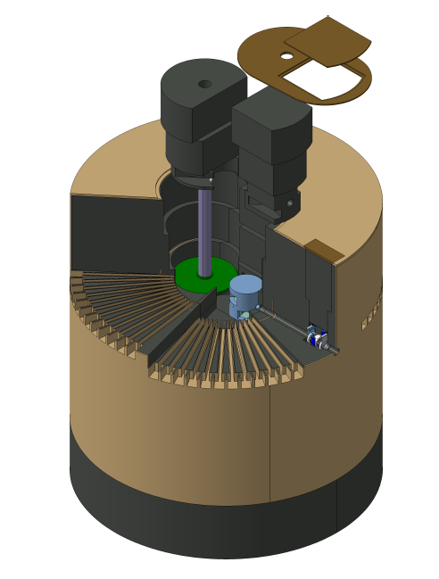
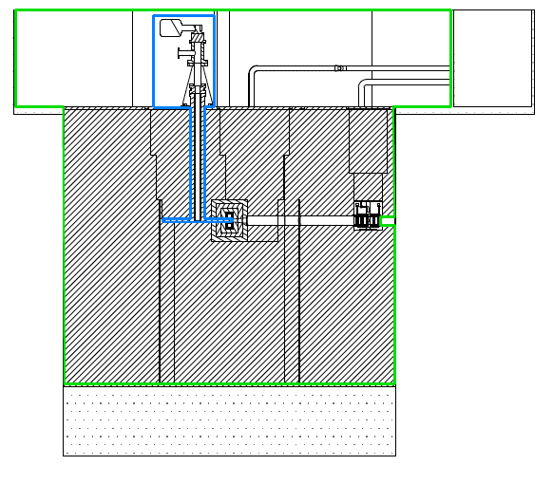
Target Station For a Rotating Target

Slide 28
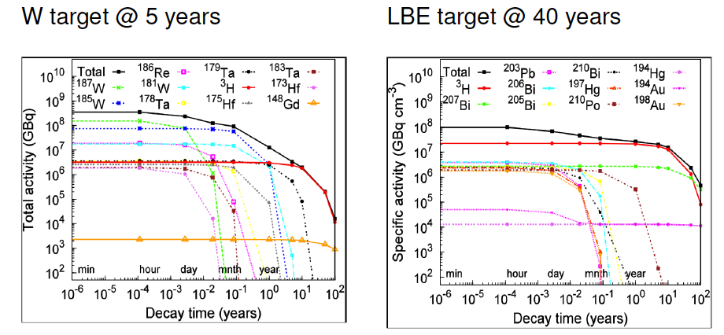
Total activity: W vs LBE
D. Ene

Slide 29
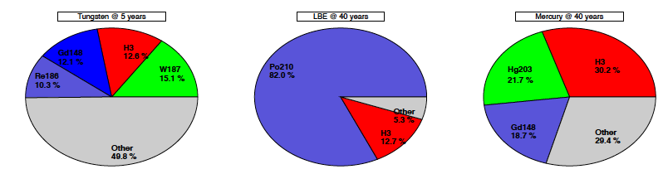
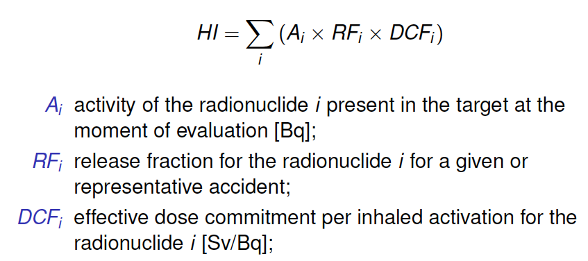
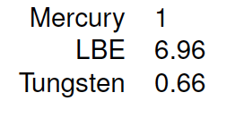
Hazard index for different options
Most active isotopes at shutdown
D. Ene

Slide 30
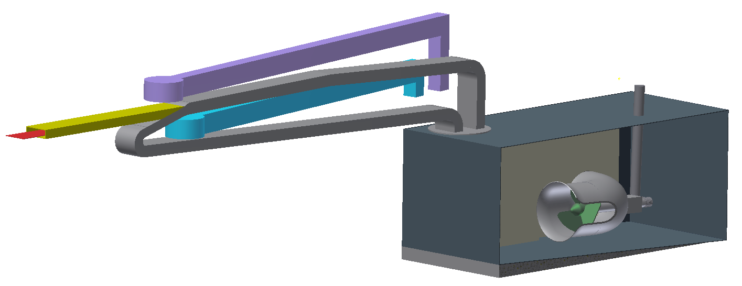
LBE META:LIC Layout
heat exchanger module
target module
pool
pump module
A. Class

Slide 31
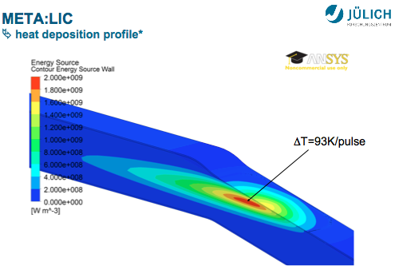
Pressure pulse issue
J. Wolters

Slide 32
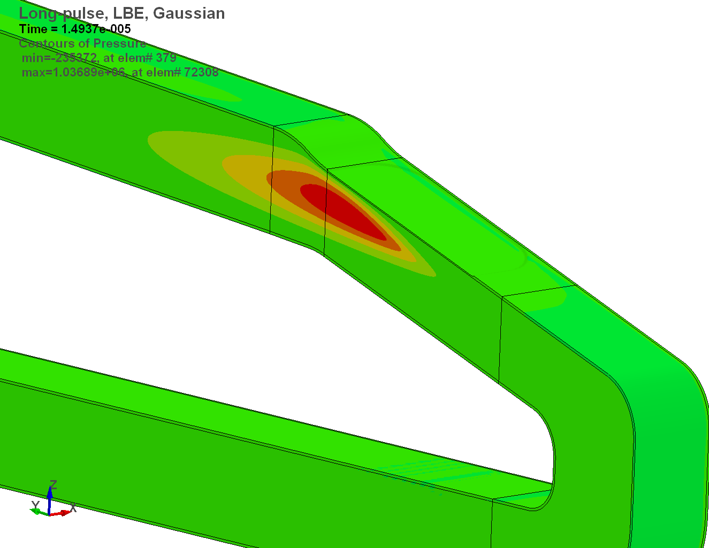
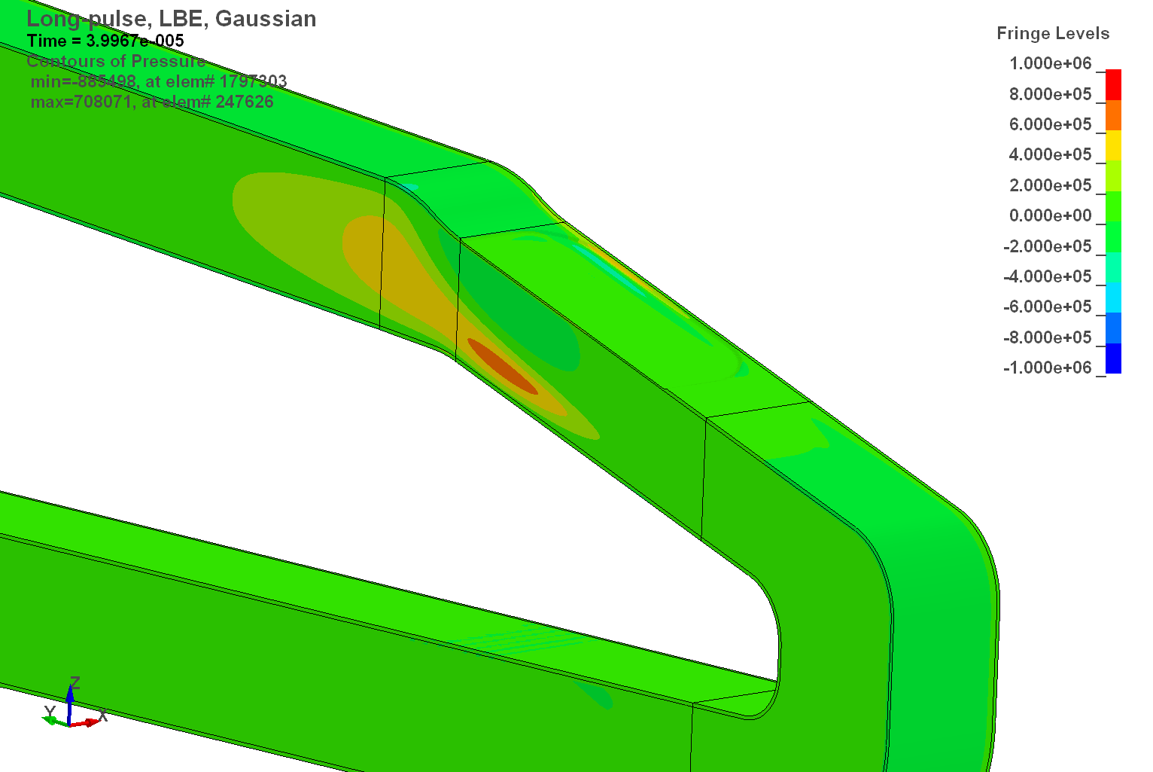
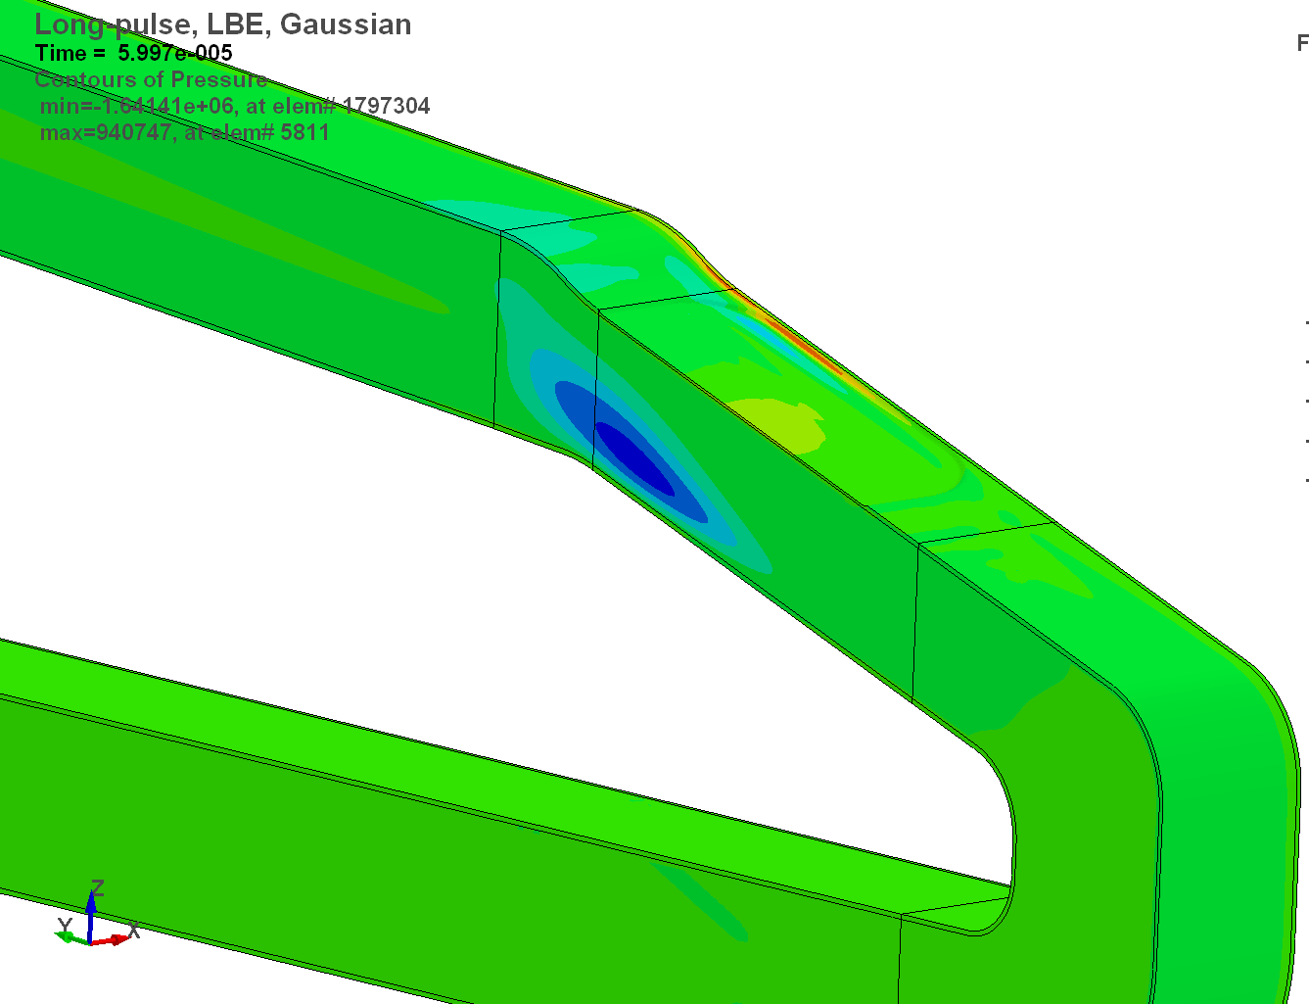
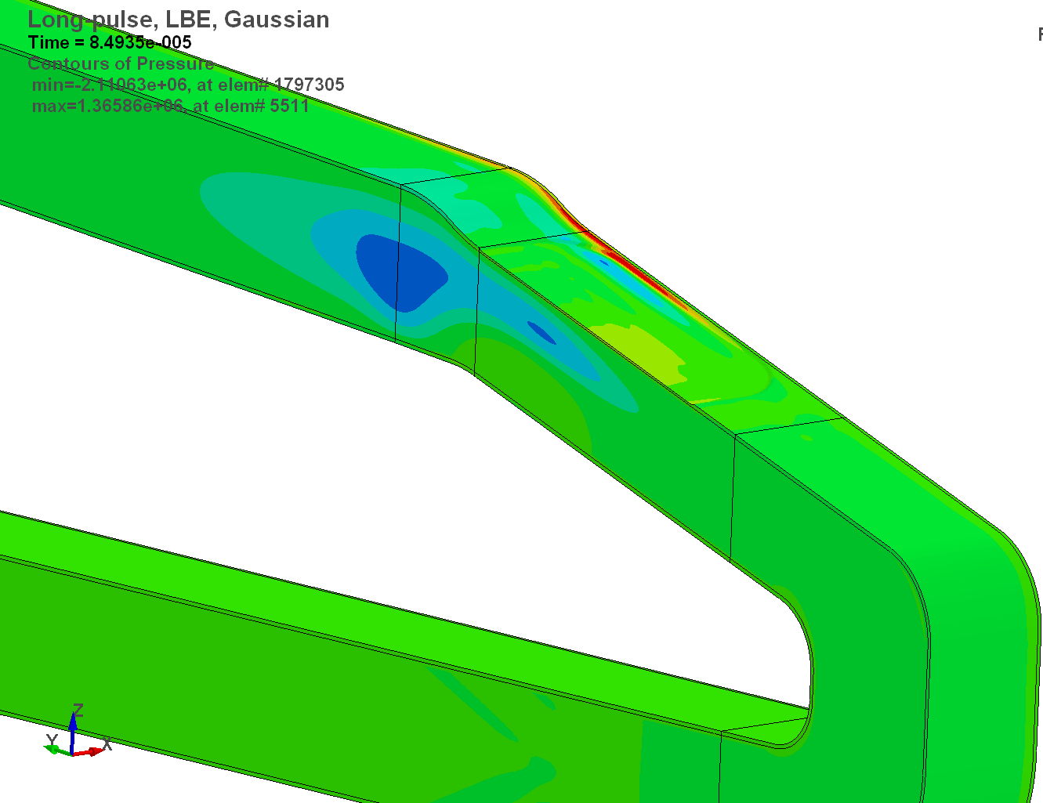
Pressure pulse problem
Pressure [MPa]
t = 15 µs
t = 40 µs
t = 60 µs
t = 85 µs
J. Wolters

Slide 33
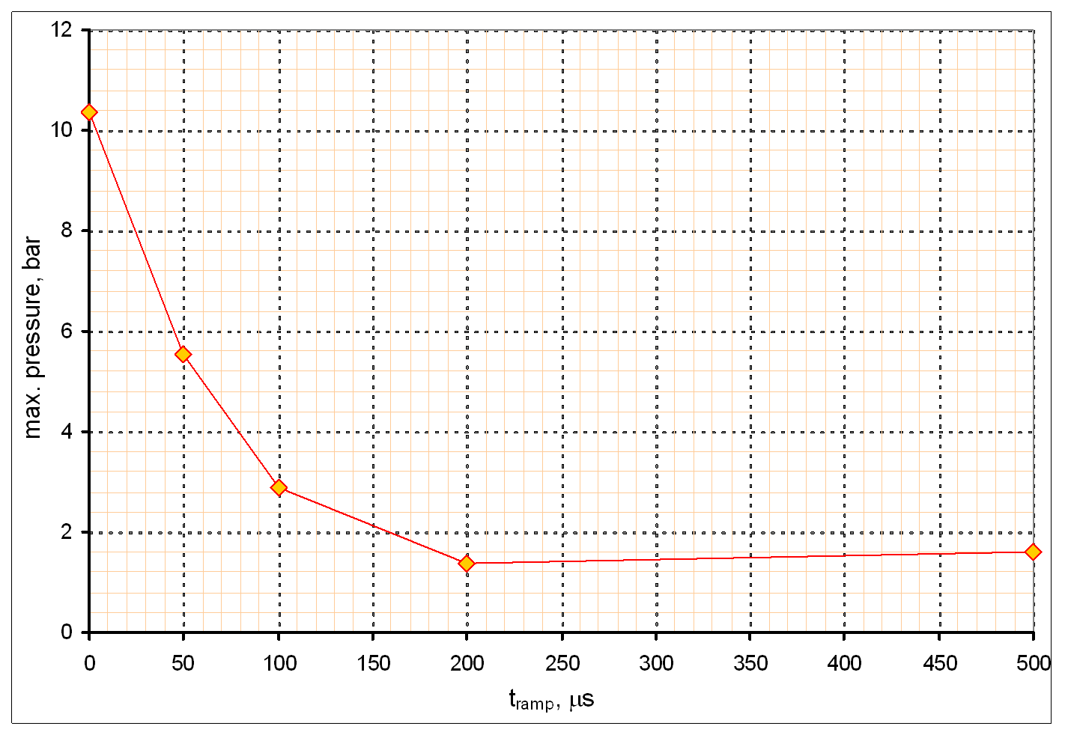
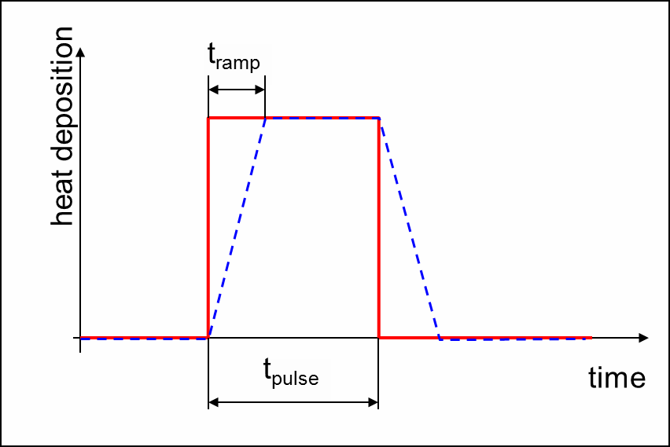
Effect of pulse ramp
J. Wolters

Slide 34
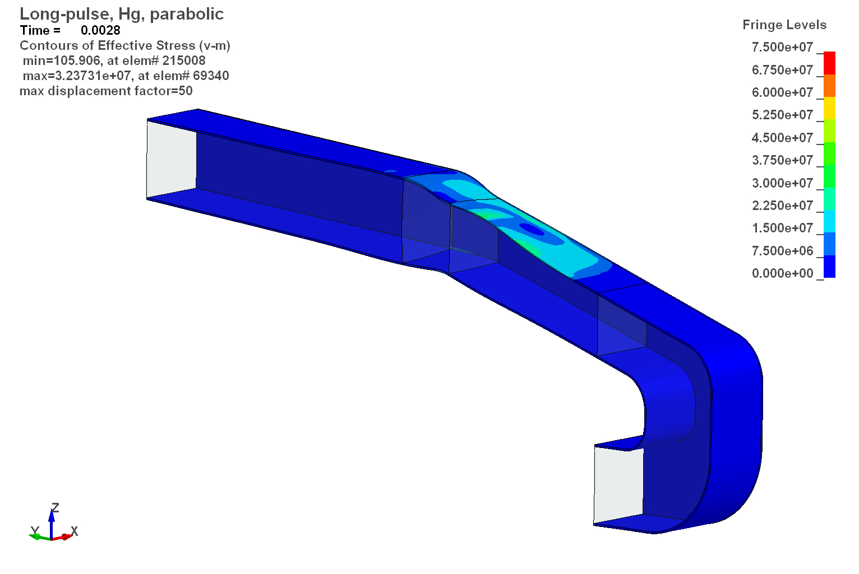

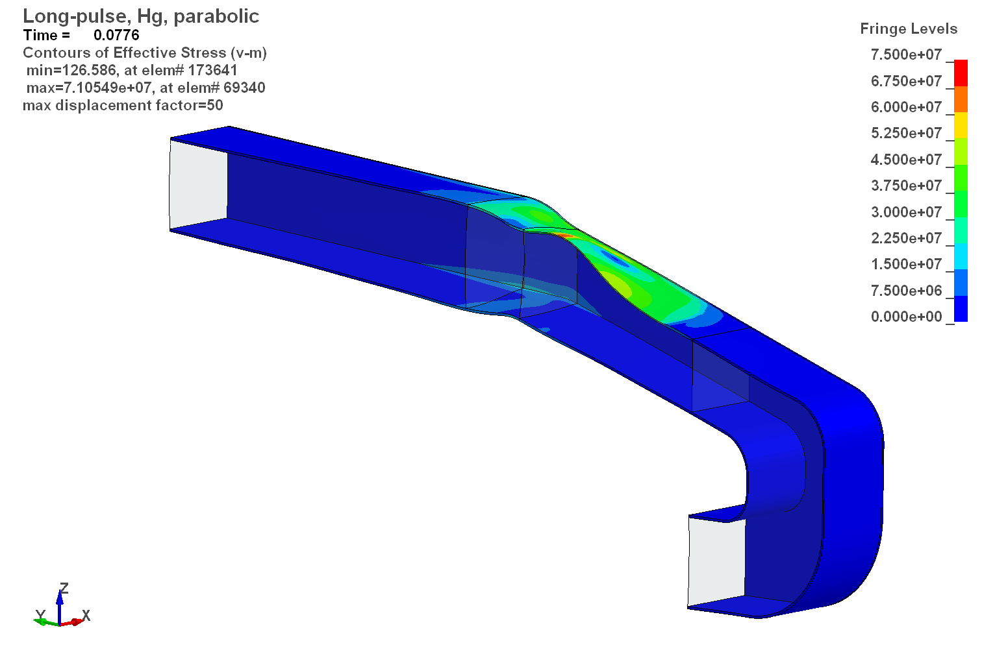
Time dependent stresses in container
after first pulse
prior to second pulse
To avoid accumulation of stresses for transient events like a beam trip, an additional spillway can be used. Dimensioning and demonstration of the effectiveness is one of the next tasks.
after second pulse
J. Wolters

Slide 35
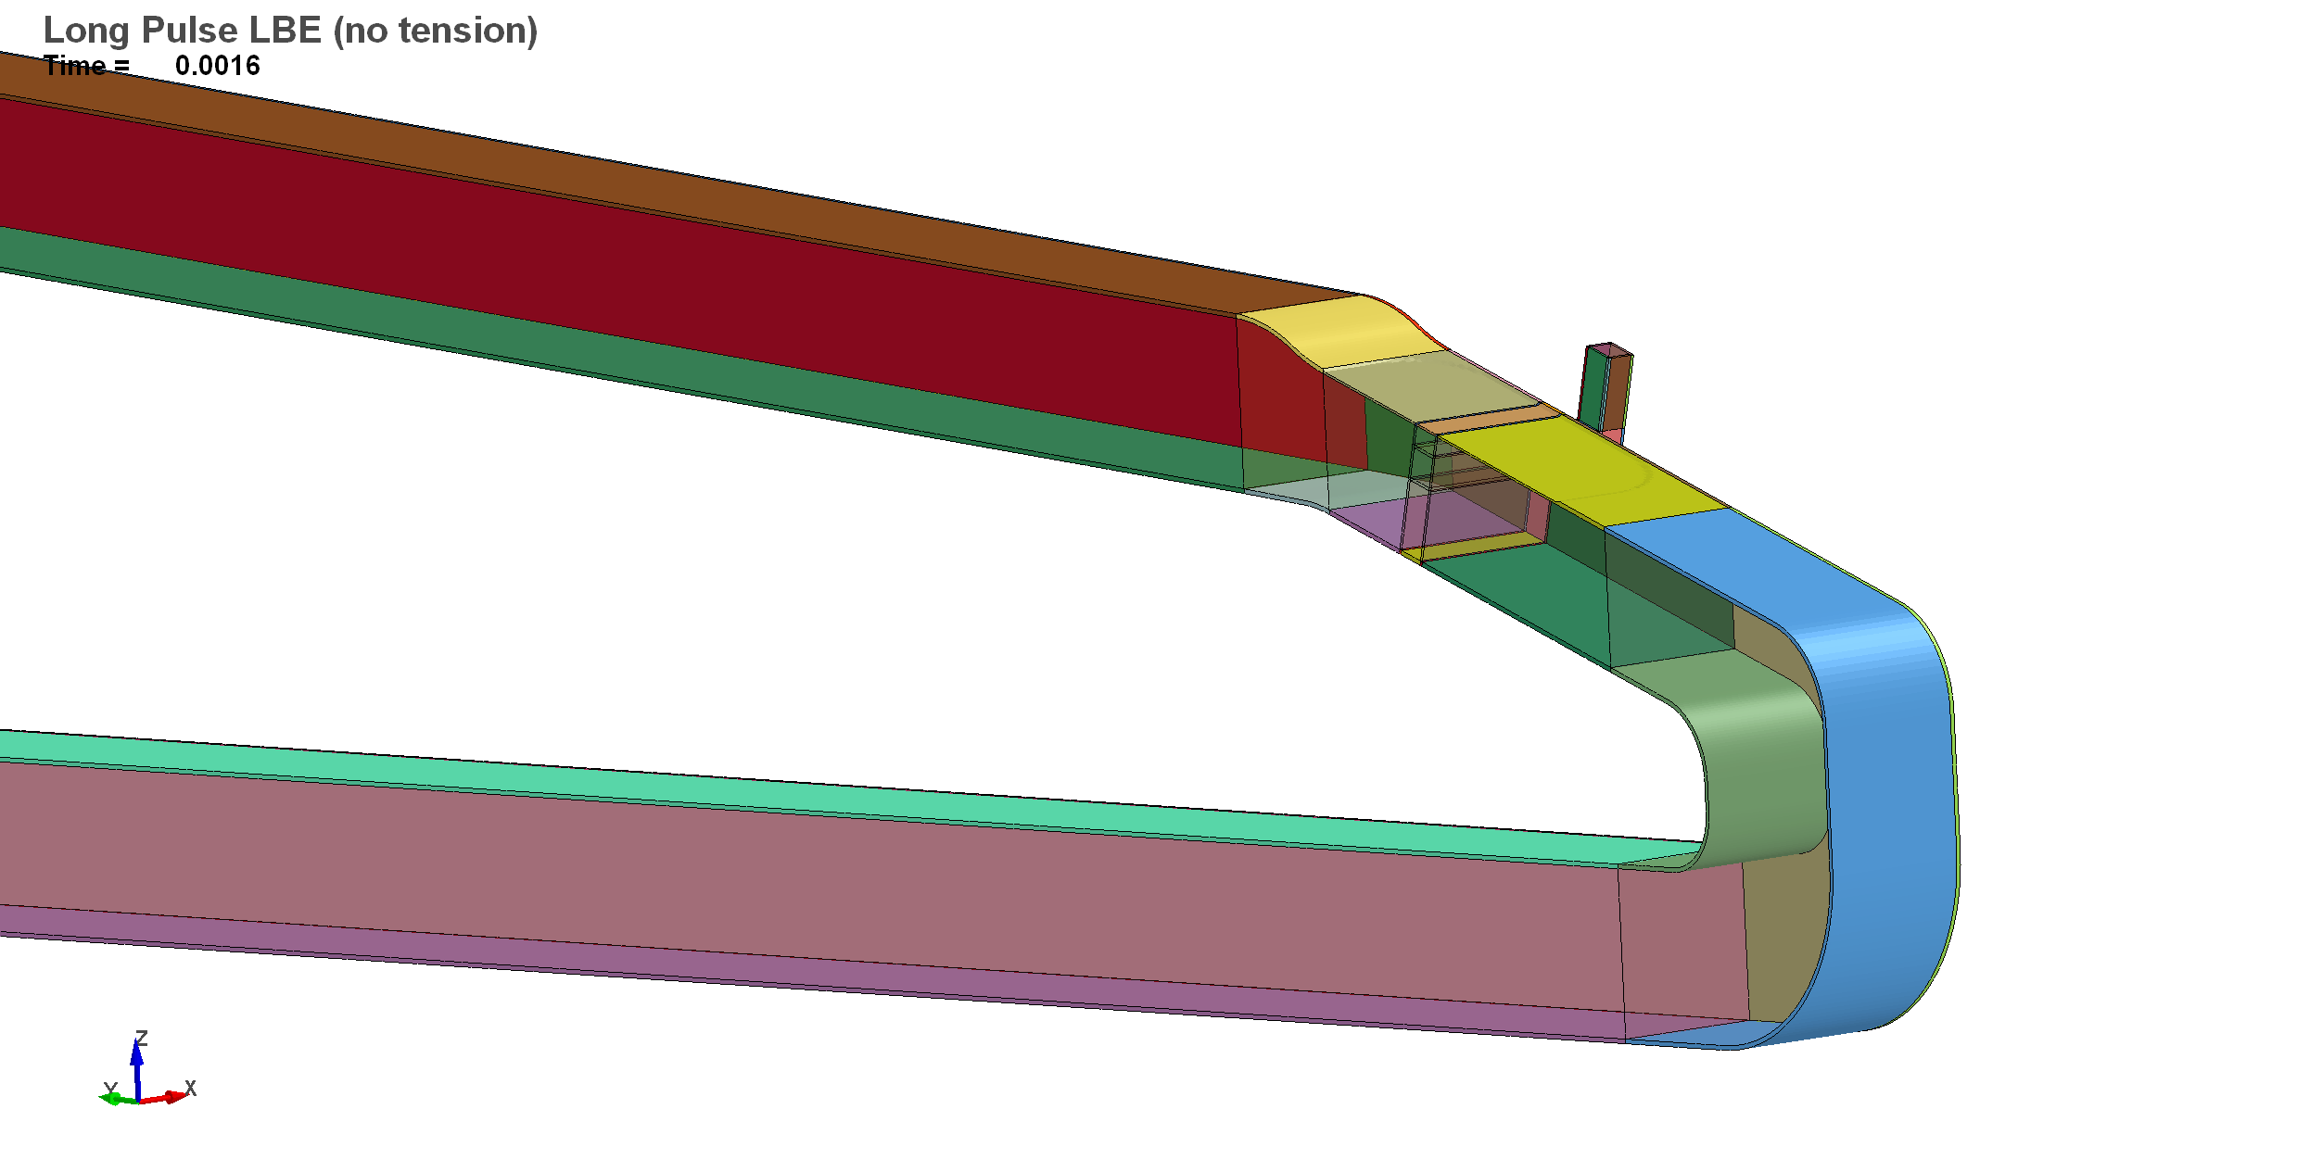
Bypass to diffuse stresses
additional spillway
(bypass)
J. Wolters

Slide 36
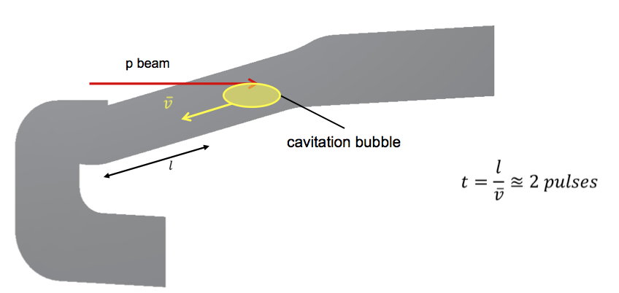
Dealing with beam trips I/II
Water hammer beam trip on → off
time for the cavitation bubble to be neutralized at the free surfaces: approx. 2 pulses
A. Class

Slide 37
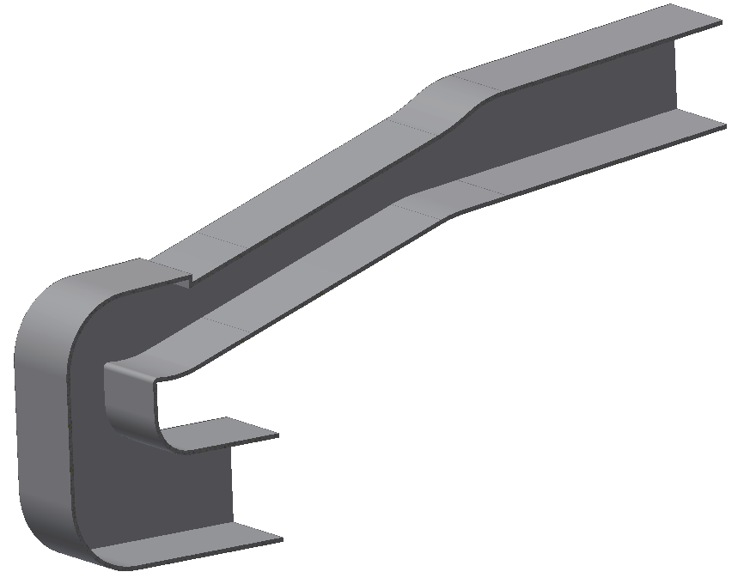
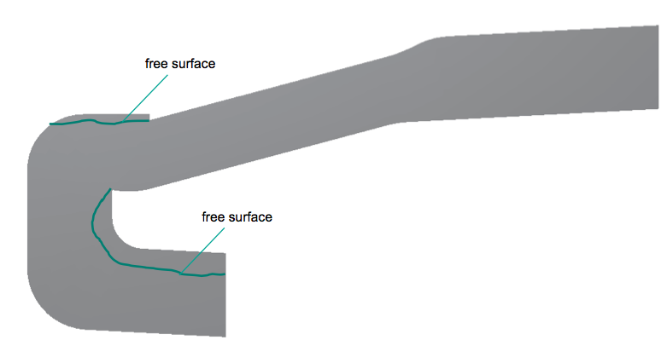
Dealing with beam trips II/II
Modified design to account for LBE expansion:
  expansion volume
  2 internal free surfaces
„expansion volume“
„spoiler for forced detachment“
A. Class

Slide 38
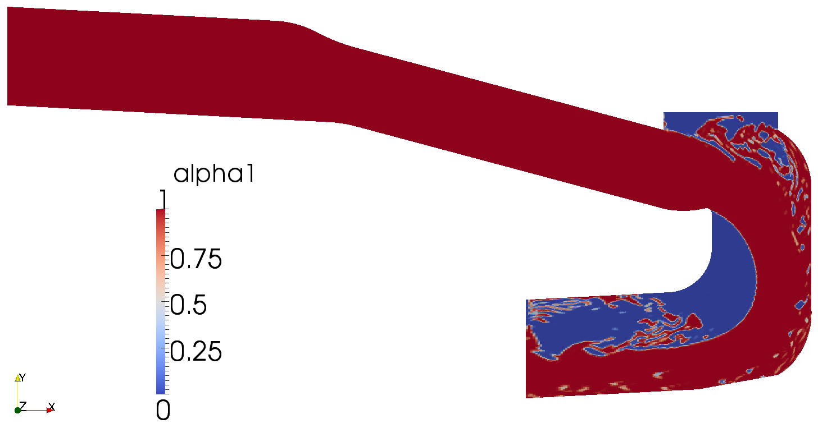
Free surfaces
Internal free surfaces at t = 1.75 s
A. Class

Slide 39

Velocity distribution
Velocities at t = 1.76 s
Velocity distribution at t= 1. 76s
A. Class

Slide 40

Pressure distribution
Pressures at t = 1.76 s
A. Class

Slide 41


META:LIC Test Stand at IPUL
1-Module of Target body;
2-PbBi loop (diameter 108 x 4.0; SS316L);
3-Channel of EMP;
4-Valve;
5-Venturi tube;
6-Electromagnetic Q-meter
Operating parameters:
Temperature, ⁰C up to 400;
Flowrate, L/S up to 11;
Pressure, bars 4
Expansion tank, supply vessel, heaters etc. are not showed
E. Platacis

Slide 42


Instrumentation
Differential pressure across circular to rectangluar transition
temperature ahead & after pump
Temperature >3 ahead of the test section
CIFT inflow channel?
bulk velocity
  EHM
  Venturi

Slide 43
LBE ESS TDR Contributions
Introduction (C. Fazio)
Design requirements and configuration selection (A. Class, U. Fischer)
Neutronic design (U. Fischer)
Engineering design (A. Class with input from FZJ J. Wolters)
Instrumentation of liquid metal flow (S. Eckert, F. Stefani and K. Thomsen PSI)
Trolley design and interface to monolith (J. Fetzer, A. Class)
Needed ancillary systems (K. Thomsen – include here experience from MEGAPIE)
Target module validation (E. Platacis, A. Class with input from all involved partners in the experiment)
Corrosion and erosion properties of structural steels in contact with liquid metal coolant (A. Weisenburger)
Potential needs for licensing, dismantling and final disposal (K. Thomsen PSI taken from the MEGAPIE experience – calculation of spallation products is done by Dana (ESS))

Slide 44
Thank you for your attention!

