Slide 1

Chemistry at the lead bismuth loop for EURISOL prototype
Susanta Lahiri
Saha Institute of Nuclear Physics
Kolkata, India

Slide 2
Towards building a Radionuclide Bank from proton irradiated Pb-Bi targets
Our proposal given on 2009 December ISOLDE meeting therefore is still relevant
The 1-2 GeV proton induced spallation reaction on the Pb-Bi eutectic converter target will produce large variety of radionuclides along with strong flux of fast neutrons.
We would like to develop methods for separate confinement of each radionuclides with high radiochemical and radioisotopical purity.

Slide 3
Why?
The radionuclids will have potential applications
in medical science as well as in the industry
Diagnostic : ^{99m}Tc,¹¹¹In,¹²³I, ²⁰¹Tl, etc.
Therapeutic : ¹⁵³Sm, ¹⁸⁸Re, ¹⁸⁶Re, ¹⁶⁶Ho, ⁹⁰Y,^{117m}Sn,⁸⁹Sr,¹⁴⁹Tb etc.
Industrial : ¹⁹²Ir,⁵⁵Fe,¹⁰⁹Cd,³⁵S,⁶³Ni,⁸⁵Kr,²⁰⁴Tl etc.
Radionuclides having demand in basic science
Separation of radionuclides will help to recycle the
converter target

Slide 4
Why large facilities became so important
Reduced reactor facilities/shutdown of reactors
Limitations of low energy medical accelerators
Example from ¹⁴⁹Tb
¹⁴⁹Tb is among the few promising α-emitters, which are presently projected for human clinical use.
Half life : 4.118 h
Decay modes: EC (82.3%) and α (17.7 %)
α-particle energy: 3.97 MeV

Slide 5
Production routes
Light charged particle (p, α, ³He) induced reactions
¹⁵²Gd(p, 4n)¹⁴⁹Tb
¹⁵²Gd(α, 7n)¹⁴⁹Dy(EC)¹⁴⁹Tb,
¹⁵²Gd(³He, 6n) ¹⁴⁹Dy(EC)¹⁴⁹Tb
proton induced spallation on heavy targets, like Ta, W etc.
heavy ion induced reactions
¹⁴¹Pr(¹²C, 4n)¹⁴⁹Tb
¹⁴¹Pr(¹⁴N, p5n)¹⁴⁹Tb
¹⁴⁴Sm(⁹Be, 4n)¹⁴⁹Dy (EC) ¹⁴⁹Tb ^{142/143}Nd(¹²C, 5/6n)¹⁴⁹Dy(EC)¹⁴⁹Tb
Notes:
light charged particle (p, α, ³He) induced reactions
proton induced spallation reaction on heavy targets and
heavy ion induced reactions

Slide 6
Existing reports…
¹²C+¹⁴¹Pr (1963)

Slide 7
Theory…
PACE-II
In order to understand discrepancies in the production of ¹⁴⁹Tb from the natural praseodymium target we made an attempt to measure production cross sections in the same reaction.

Slide 8
Our measurement…

Slide 9
Comparison…

Slide 10
Production of ¹⁴⁹Tb was not satisfactory
Possible reasons
^{149m}Tb shows high shielding towards the production of
¹⁴⁹Tb
The high initial angular momentum of the compound
nucleus formed in ¹²C+¹⁴¹Pr reaction likely populates
the high spin (11/2-) isomer (^{149m}Tb) which directly
decays to ¹⁴⁹Gd.
¹⁴⁹Tb (spin 1/2+) is produced only from the decay of low
spin states of the compound nucleus.

Slide 11
Why low cross section?
 |  |  | 7/2- 0
 |  |  | ¹⁴⁹Dy (4.23 min)
 |  | 11/2- 35.8 | ^{149m}Tb (4.16 min)
 | 99.978%  | 1/2+ 0 | 0.022% α
 |  | ¹⁴⁹Tb (4.1 h)
 | 83.3%  |  | 16.7% α
 | 7/2-
 | ¹⁴⁹Gd (9.28 d)

Slide 12
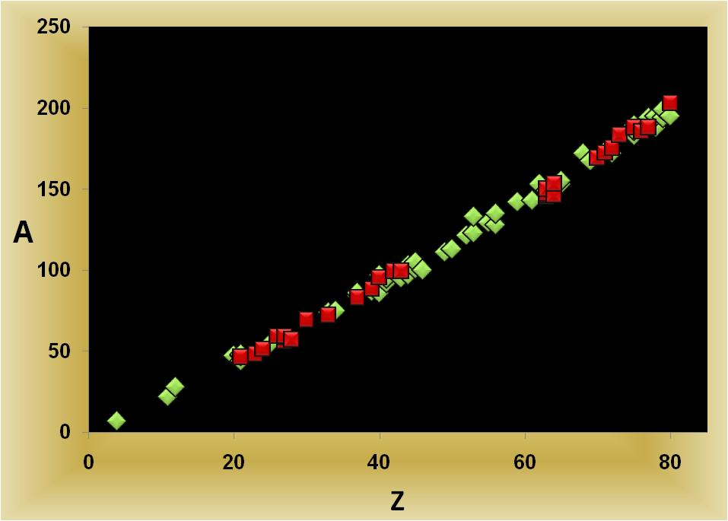
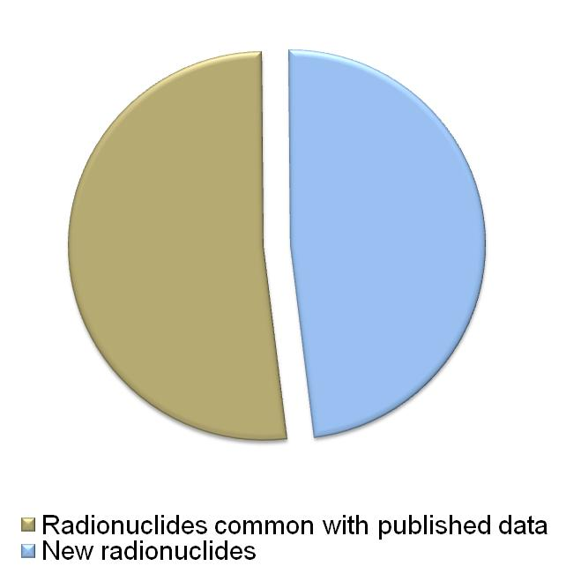
Our aim
Identification of radionuclides
Quantification of each radionuclide
Development of chemical separation techniques
Identified probable radionuclides by our group

Slide 13
Results we found
Radioisotope present | Radioisotopes to be confirmed | Radioisotopes to be confirmed
As-72 (26.0 h ) | As-74 (17.77 d) | Pr-142 (19.12 h)
Co-56 (77.27 d) | Au-194 (38.02 h) | Pt-188 (10.2 d)
Co-58 (70.86 d) | Au-199 (3.139 d) | Pt-195m (4.01 d)
Co-60 (1925.28 d) | Ba-128 (2.43 d) | Rb-84 (33.1 d)
Cr-51 (27.7025 d) | Ba-135m (28.7 h) | Rb-86 (18.642 d)
Eu-145 (5.93 d) | Be-7 (53.22 d) | Re-183 (70.0 d)
Eu-146 (4.61 d) | Ca-47 (4.536 d) | Re-186 (3.7186 d)
Eu-147 (24.1 d) | Co-57 (271.74 d) | Re-189 (24.3 h)
Eu-150m (12.8 h) | Cs-129 (32.06 h) | Rh-101 (3.3 y)
Fe-59 (44.495 d) | Er-172 (49.3 h) | Rh-101m (4.34 d)
Gd-146 (48.27 d) | Eu-148 (54.5 d) | Rh-105 (35.36 h)
Gd-153 (240.4 d) | Eu-149 (93.1 d) | Ru-103 (39.26 d)
Hf-175 (70 d) | Hf-172 (1.87 y) | Ru-97 (2.791 d)
Hg-203 (46.595 d) | Hg-195m (41.6 h) | Sc-44m (58.61 h)
Ir-188 (41.5 h) | I-123 (13.232 h) | Sc-47 (3.3492 d)
Lu-172 (6.7 d) | I-133 (20.8 h) | Sc-48 (43.67 h)
Mo-99 (2.7489 d) | In-111 (2.8047 d) | Se-75 (119.779 d)
Os-185 (93.6 d) | Ir-192 (73.827 d) | Sm-153 (46.284 h)
Rb-83 (86.2 d) | Ir-194 (19.28 h) | Sn-113 (115.09 d)
Re-188 (17.003 h) | Lu-173 (1.37 y) | Tb-153 (2.34 d)
Sc-46 (83.79 d) | Mg-28 (20.915 h) | Tb-155 (5.32 d)
Ta-183 (5.1 d) | Mn-54 (312.12 d) | Tc-95 (20.0 h)
Tc-99m (6.0058 h) | Na-22 (2.6027 y) | Te-121m (154 d)
V-48 (15.9735 d) | Nb-92m (10.15 d) | Tm-167 (9.25 d)
Y-88 (106.616 d) | Nb-95 (34.991 d) | Y-87m (13.37 h)
Yb-169 (32.018 d) | Ni-57 (35.6 h) | Zn-69m (13.76 h)
Zr-95 (64.032 d) | Pd-100 (3.63 d) | Zr-86 (16.5 h)
 | Pm-143 (265 d) | Zr-97 (16.744 h)

Slide 14
Work plan
1
C1 Irradiation and Production of radionuclides
C2/S1 Identification of γ-emitting radionuclides
S2 Chemical separation
S3 Development of sequential separation technique
of clinical radionuclides (T_{1/2} > 7d)
2
C3/S4 Identification of α-emitting radionuclides
C4/E 1 Development of chemical separation technique
for short lived (≤ 1 d) radionuclides
3
S5 Separation and detection of long-lived (T_{1/2} ~100 yr-few Myr) radionuclides
Constrains ?
Safety clearance….
Transport
Finance

Slide 15
Outlook…
It becomes important to study production of ¹⁴⁹Tb by spallation in targets like LBE.

Slide 16
Aim of the project
Identification
Quantification
Separation
To develop methods for separate confinement of each radionuclides with high radiochemical and radioisotopical purity. Special attention to be paid for the quantitative decontamination of bulk Hg.

Slide 17
Identification
Problems
Presence of large numbers of radionuclides in the sample
Highly complex and convoluted γ-spectra
Presence of large numbers of parent-daughter pair,
especially where (Parent) T_{1/2} < (Daughter) T_{1/2}
Large number of radionuclides are produced from the container (and from the trace elements present in the container)
α and β emitting radionuclides are shielded by Hg or Pb-Bi target
Isobaric interferences for detection of stable elements.

Slide 18
Approach
A large number of time resolved γ-spectra is necessary to correctly identify all radionuclides produced (at least over a time span of 1 year or more)
An advanced software is required to deconvolute γ peaks.
Series of chemical separation is required to separate the radionuclides in a lexicon way so that each separated fraction contains less number of radionuclides
Chemical separation is must to identify α-emitting radionuclides
For stable elements both ICP-OES and ICP-MS measurements will be done. ICP-OES will give information on the elements and ICPMS can give information on mass. However, sensitivity of these two techniques vary by two order of magnitudes.

Slide 19
Quantification
Problems
High shielding by Pb-Bi target
The distribution of radionuclides in both surface and bulk material make the quantification more complicated
Convoluted peaks
α and β emitting radionuclides are shielded by Hg or Pb-Bi target
Approach
  Chemical separation of each radionuclide
  Comparison with standard calibrated source
  Calculation of chemical yield (separation efficiency) for each radionuclides.
  Simulation studies
  For stable elements (or long-lived radionuclides) ICPMS data will be compared with the standard

Slide 20
Separation
Problems
Scale of separation: Huge amount of Hg is present while the products are present in trace quantity.
Traditional difficulties of separation of chemically similar elemental pair
(For example, Zr-Hf, Mo-W, lanthanides, etc).
Approach
      (A) Chemical techniques
  Liquid liquid extraction (LLX)
  Aqueous biphasic extraction
  Ion exchange and other chromatographic techniques
  Precipitation etc.
    (B) Physicochemical techniques
  Adsorption of radionuclides on hot and cold metal surfaces
  Thermochromatography
  Effort should be given to develop greener technologies, i.e., not to generate additional hazards

Slide 21
Work plan
Time scale : 5 years
1
Identification of γ-emitting radionuclides (T_{1/2}≥ 1 d)
Chemical separation
Development of sequential separation technique of clinical radionuclides
Study on the distribution of reaction products
Identification of α-emitting radionuclides
Development of chemical separation technique
for short lived (≤ 1 d) radionuclides
Place: CERN/Near the source of irradiation
2
3
Separation and detection of long-lived (T_{1/2} ~100 y-few My) radionuclides which has high demand in basic science

Slide 22

Work report available in this direction…
EURISOL-DS/Task2 Report of Neuhausen et al. from PSI
Large number of radionuclides were identified
Isolation of some radionuclides from liquid Hg target

Slide 23
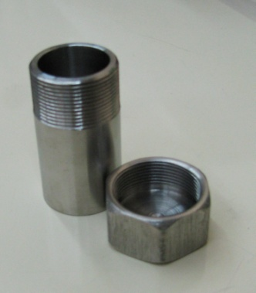
Simulation experiment in our lab
Liquid Hg in capped stainless steel vial
⁹⁹Mo-^{99m}Tc activity injected in liquid Hg and homogeneous mixed in Hg by sonication
Radiochemical extraction of ⁹⁹Mo-^{99m}Tc activity from bulk Hg by liquid-liquid extraction using
  Dil HCl (pH = 2)
  Hot (~65°C) and Cold (~26°C) water

Slide 24
Findings……
Mercury shows high shielding of ~90%
A major part of the ⁹⁹Mo-^{99m}Tc (~80%) goes to Hg
Rest amount is almost evenly distributed between the
surface of the steel capsule and in the tiny amount of
aqueous solution, which carried the total activity to
the mercury.
Extracting phase | Dil HCl (pH = 2) | Cold (~26°C) water | Hot (~65°C) water
Extraction of activity | ~20% | ~50% | ~20%

Slide 25
Facilities in SINP……
HPGe detectors
NaI(Tl) detector
Compton suppression system
α-spectrometer
Approved radioanalytical laboratory
ICP-OES
ICP-MS
HPLC
GC
Laser ablation

Slide 26
Future scope
Once the separation protocol of the radionuclide bank is established, application of radionuclides in various fields will be easy to many research groups.

Slide 27

On behalf of Radiochemistry group of SINP
Thank you….

