Slide 1
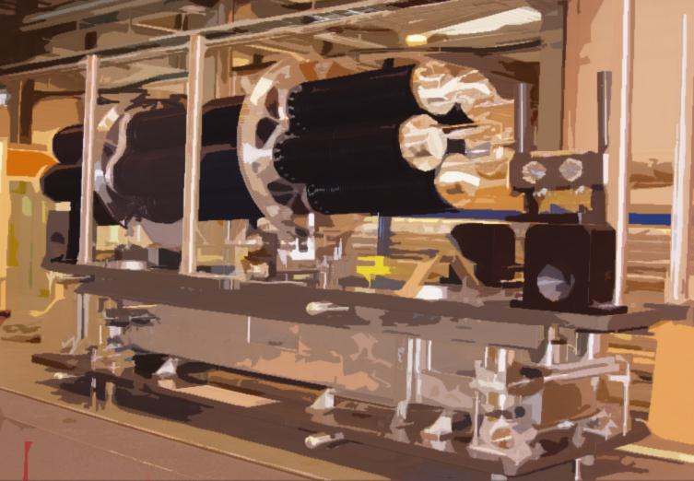
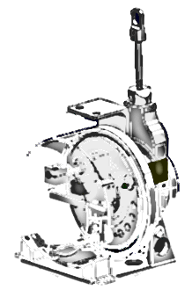
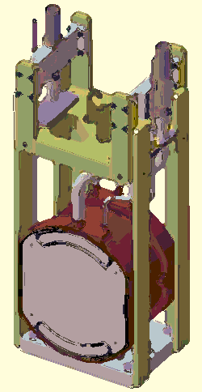

CERN targetry activities
A non-exhaustive review

Slide 2
Outline
CNGS
  Development, Design tools, Manufacturing, Installation, Operation
nTof
  Target history, Design tools, New cooling and moderator circuits, Operation
ISOLDE
  Target concepts and strengths, Installation & Operation, Storage
  Static molten Pb/Bi bath
Molten metal target activities
  MERIT free Hg jet target
  Offline molten Pb loop

Slide 3
CNGS
Development
Design tools
Manufacturing
Installation
Operation
Thanks to R. Losito, D. Grenier

Slide 4
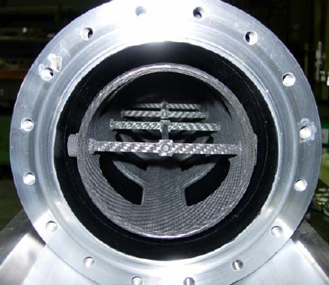
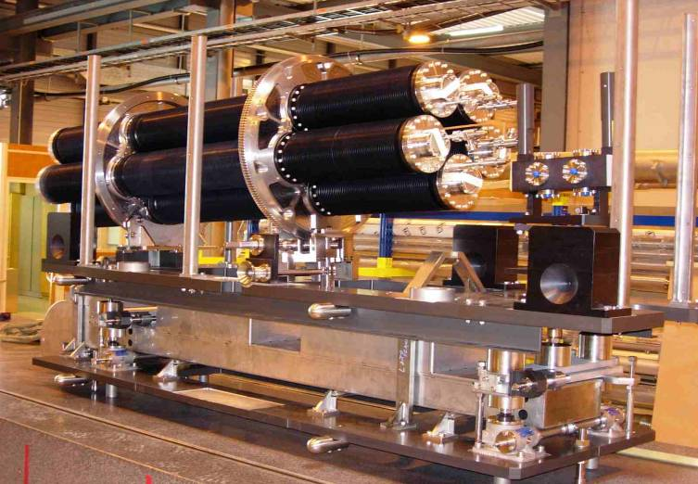
CNGS
Design development
  Target rod: C (2020PT), SC24
  & CC Aerolor A035
  Vacuum / 0.5bar He
  4.3kW avg / 750kW peak
  Dedicated Target WG
  Collaborations with
  several institutes
  Development 2001-2006

Slide 5
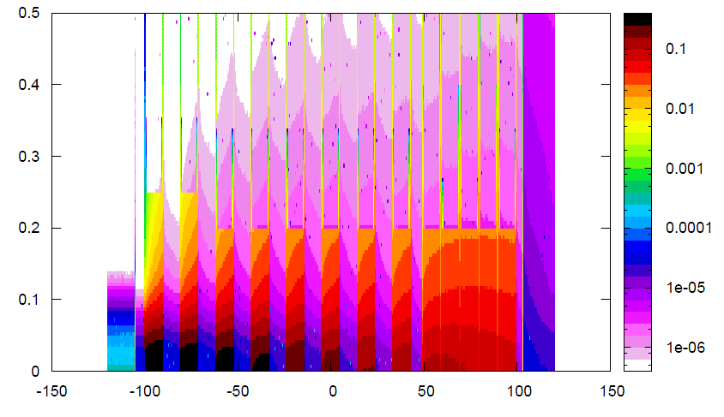
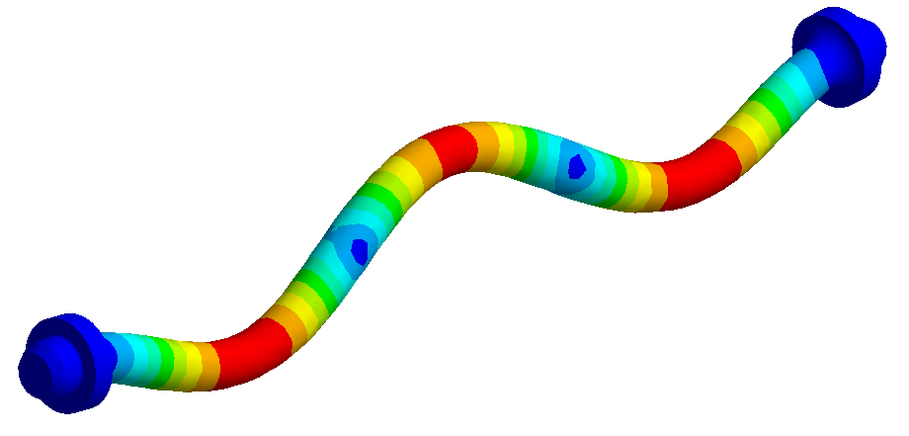
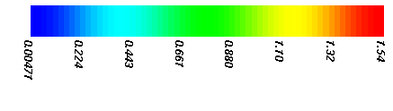
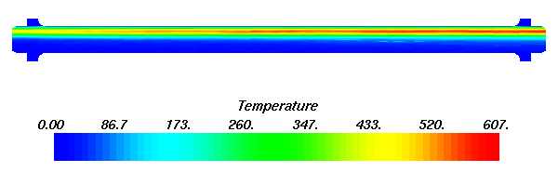
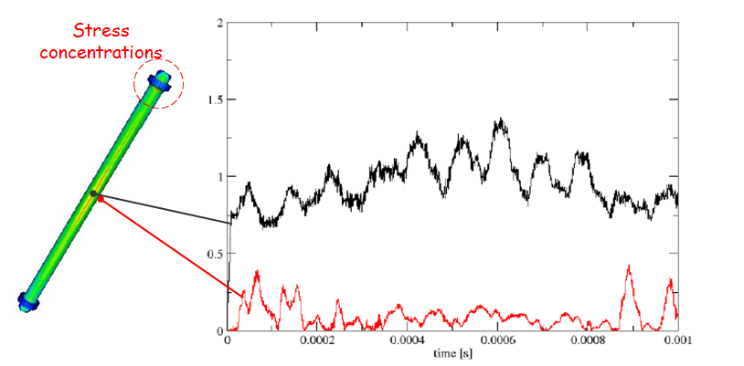
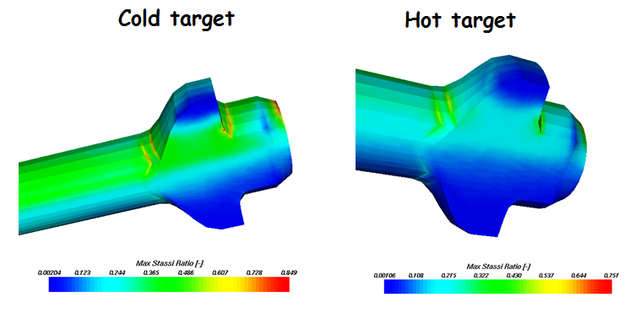
CNGS
Design tools
  Monte-Carlo analysis (FLUKA)
  Modal and dynamic analyses (Spectral Element Method and explicit FEM)
  Thermo-structural analyses
  (implicit FEM)

Slide 6
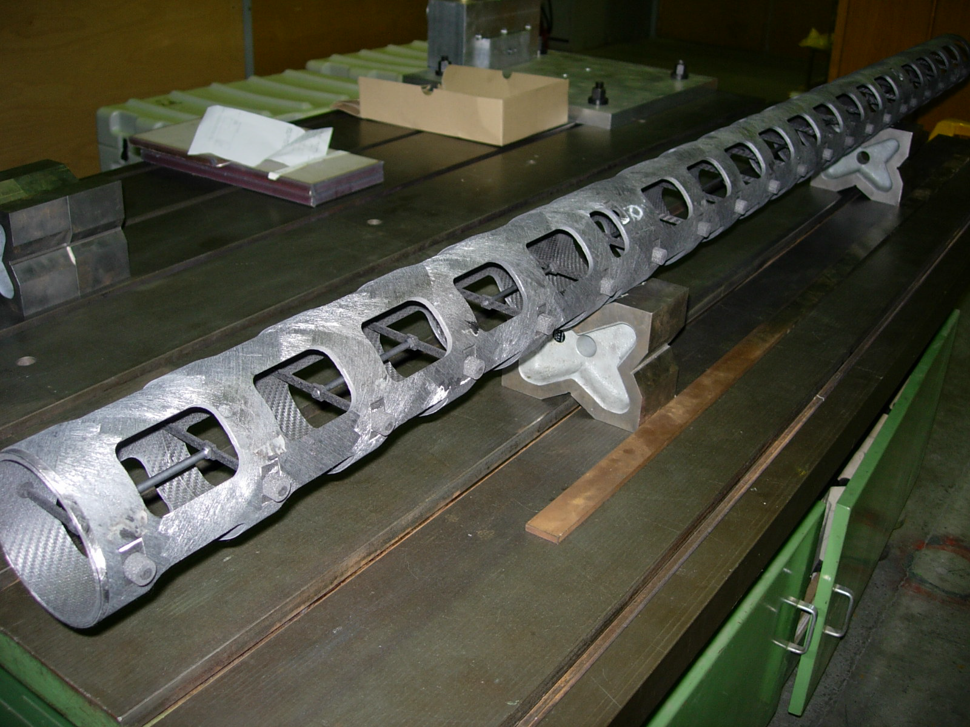
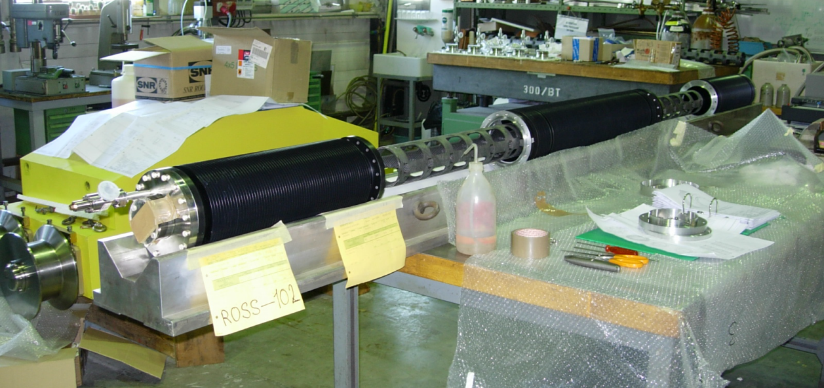
CNGS
In-house manufacturing and assembly

Slide 7
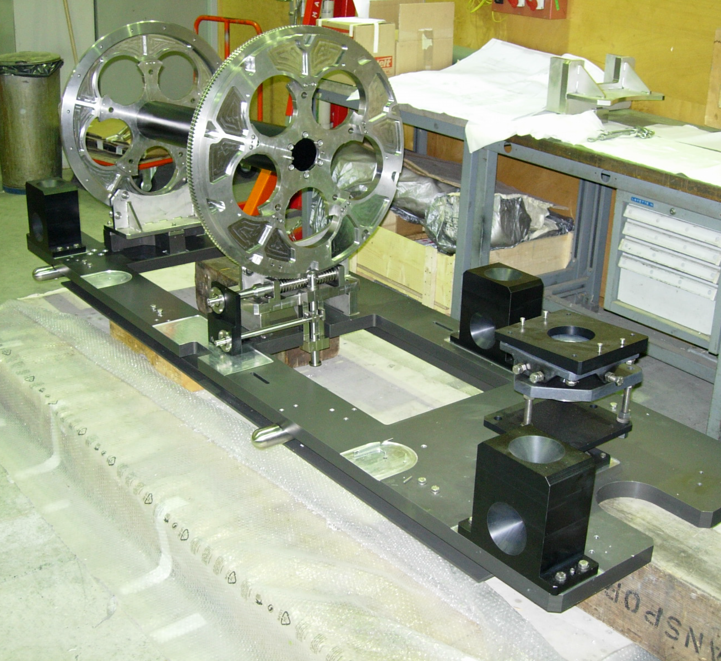
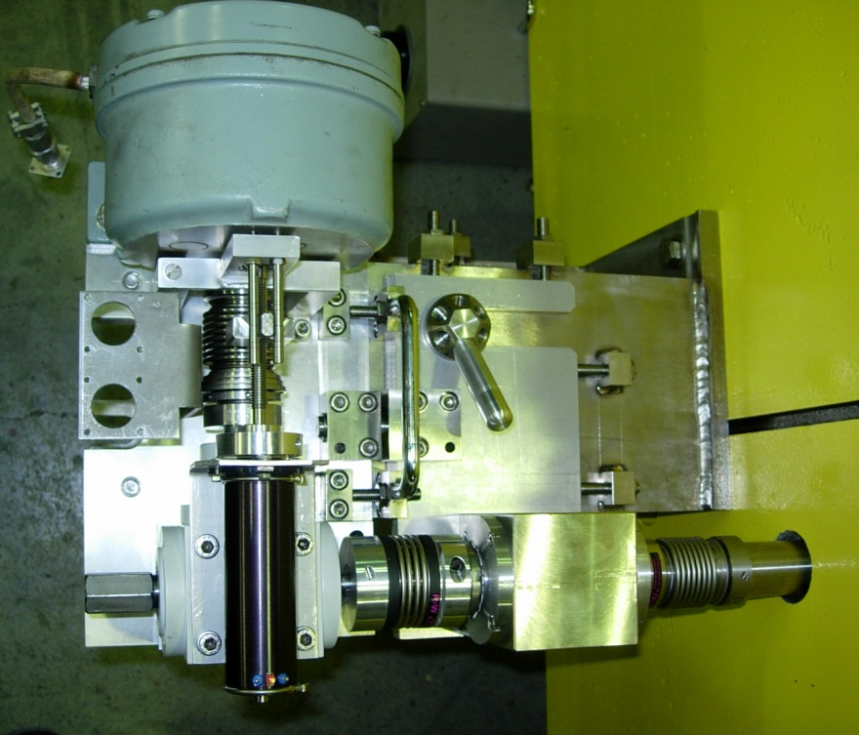
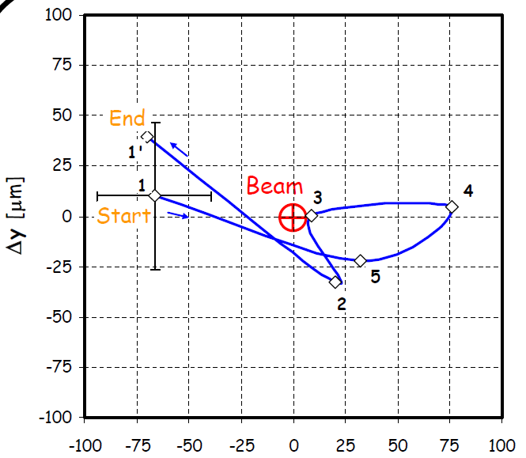
CNGS
Alignment
Motorization and Rotation precision

Slide 8
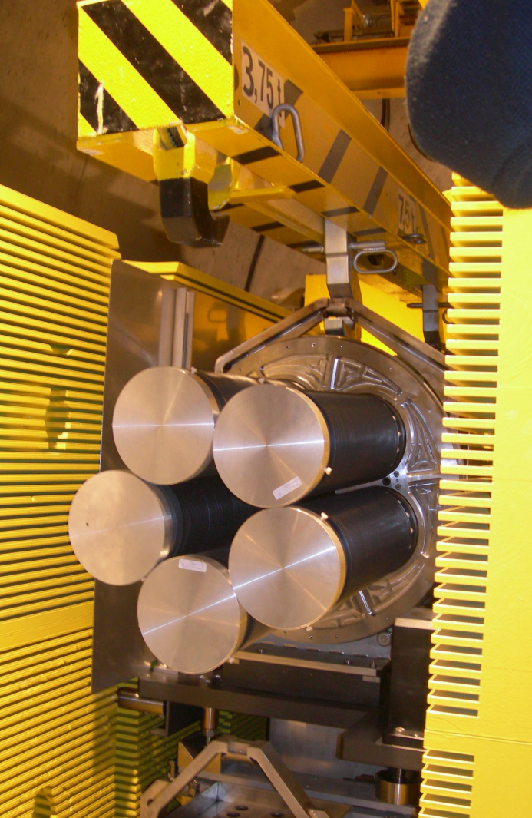
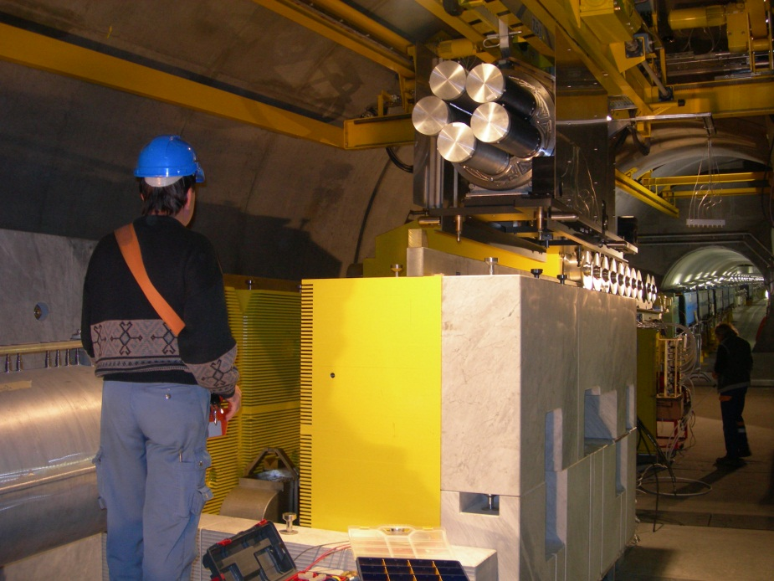
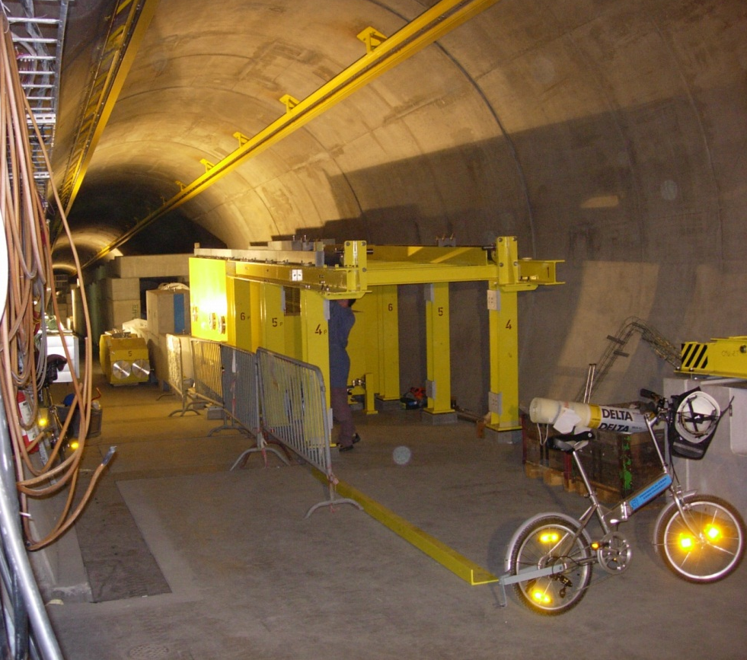
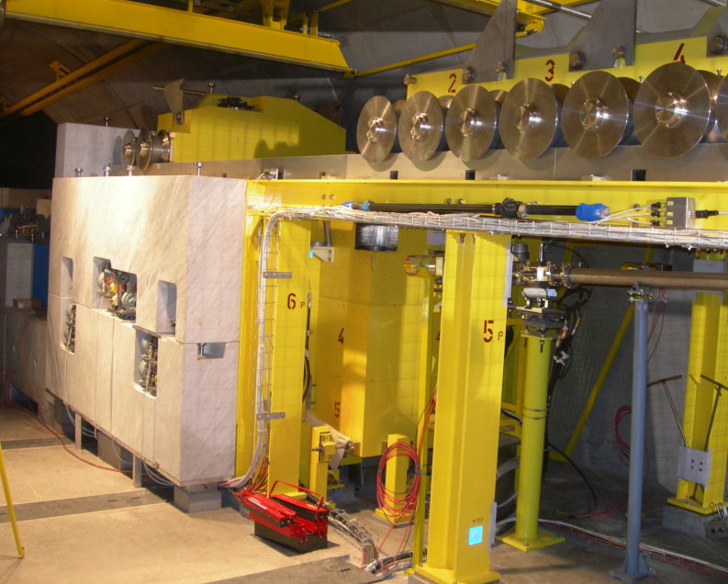
CNGS
Installation in TT40

Slide 9
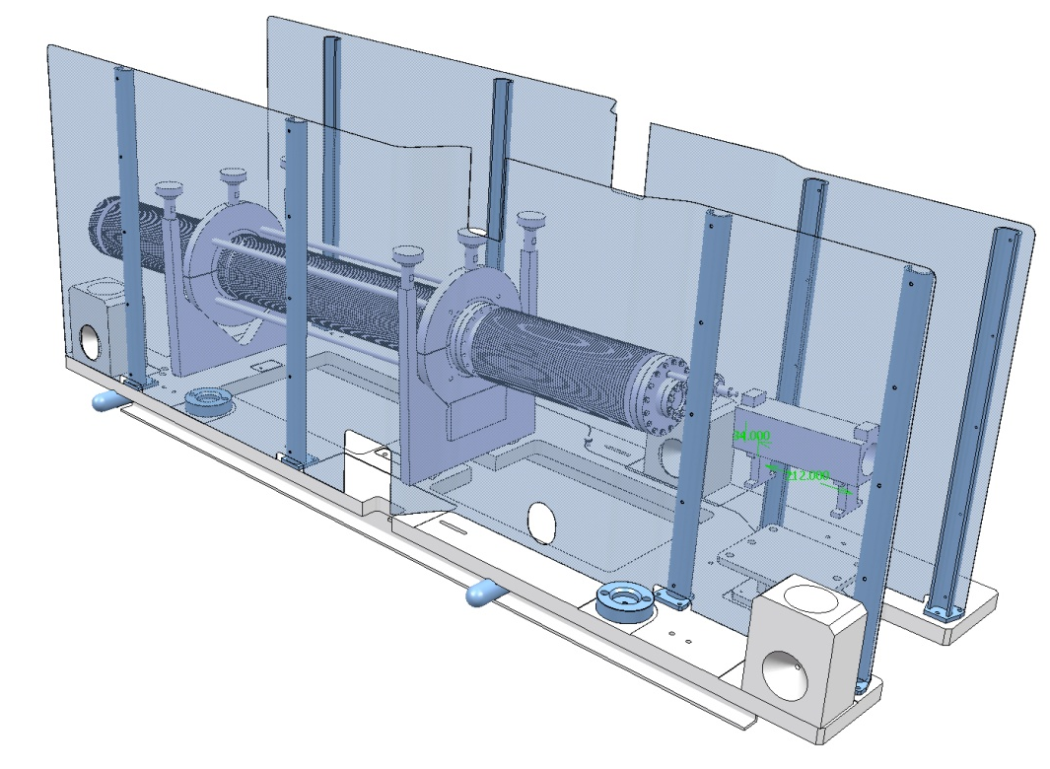
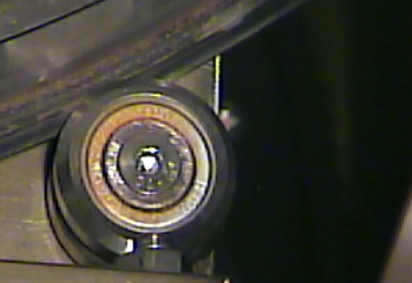
CNGS
Operation
  1st run 2007 – today
  Issues in rotating the target (ball bearing corrosion @ 450 MGray)
  Estimated production of H inside the target inert atmosphere
  Spare target modification ongoing to substitute the target in case of problems

Slide 10
nTof
Target history
Design tools
New cooling and moderator circuits
Operation
Thanks to M. Calviani

Slide 11
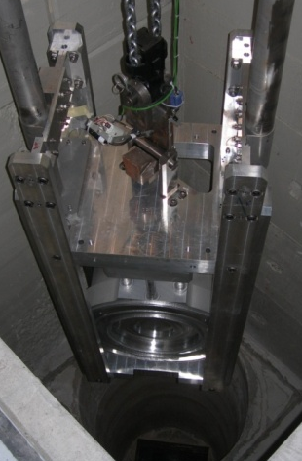
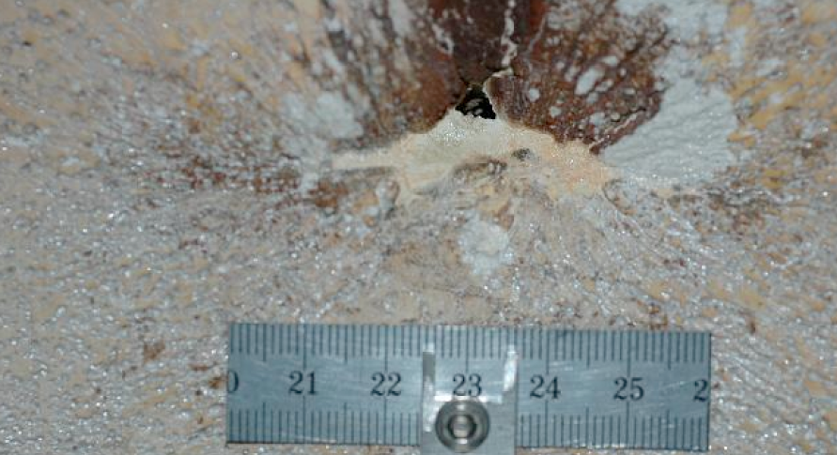
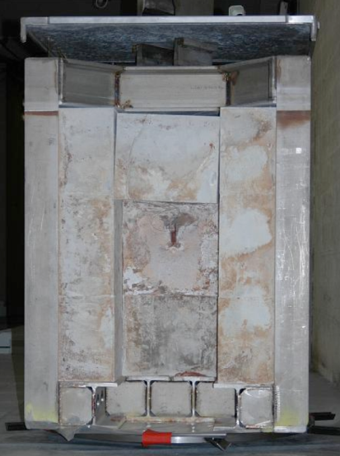
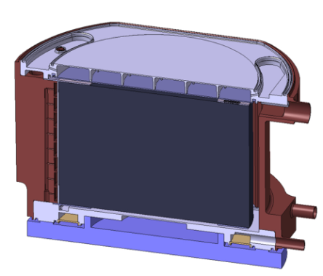
nTof
Target history
  1st run 2000-2004
  Inspection 2007/08
  Update and restart (2nd run) in 2008
  Power: 6.5kW avg / 22kW max avg

Slide 12
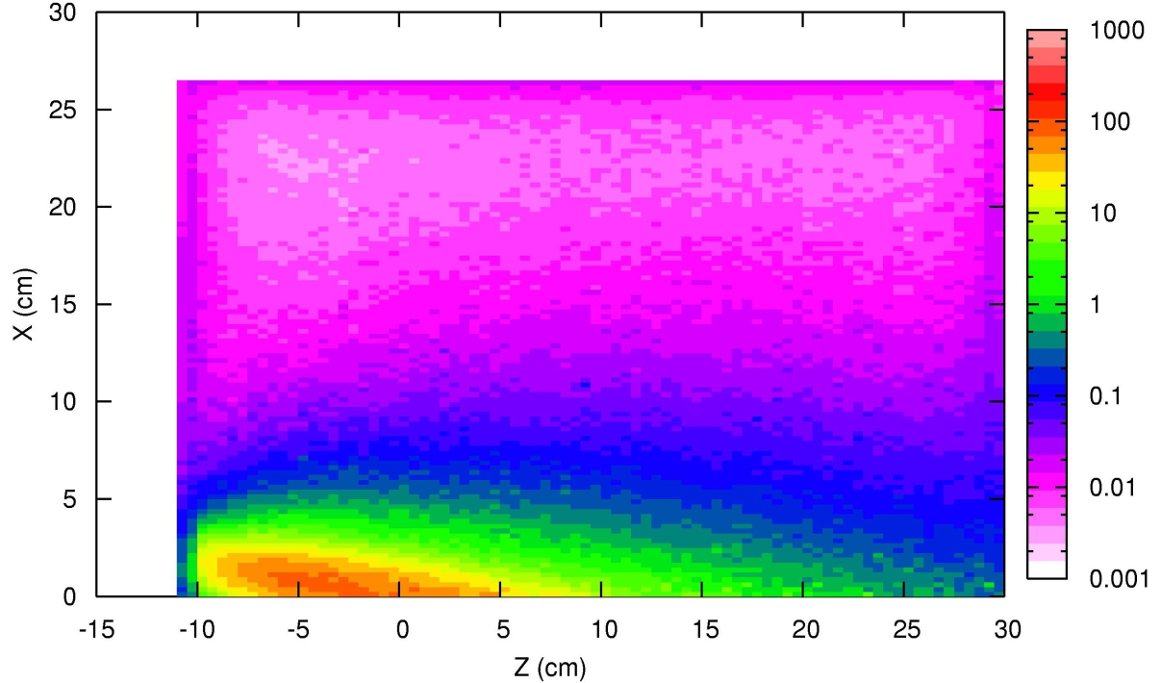
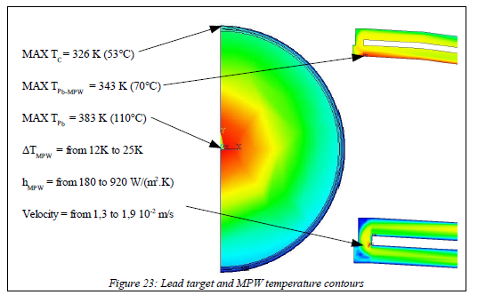
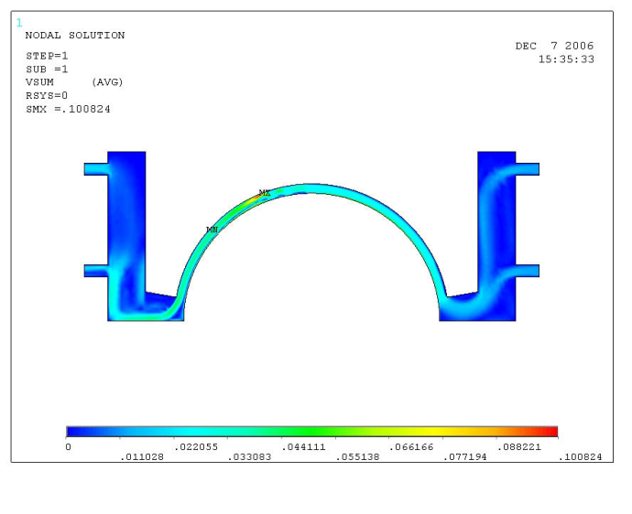
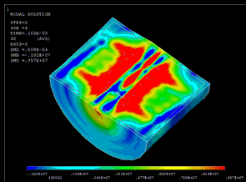
nTof
Design tools:
  External collaboration
  Monte Carlo (Fluka) analyses
  CFD analysis of cooling circuit
  Elastic wave propagation in Pb core (Explicit FEM)

Slide 13
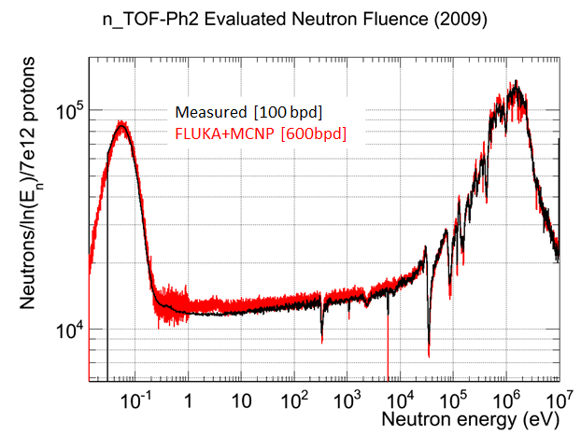
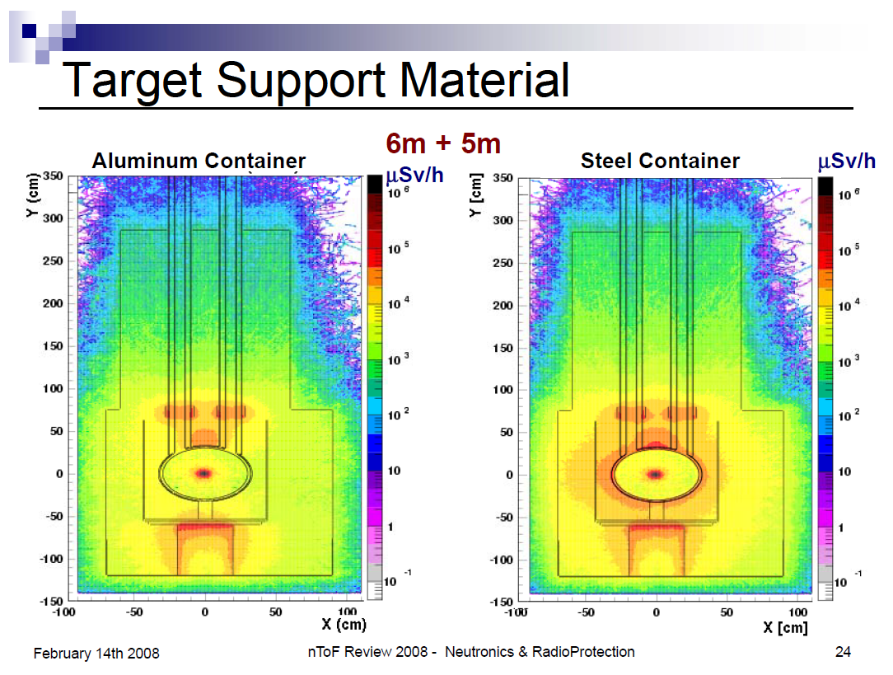
nTof
Design tools:
  Neutron fluence (FLUKA)
  RP studies (FLUKA)
Non-borated water
http://pceet075.cern.ch/Meetings/TB2006/index.html
https://edms.cern.ch/cedar/plsql/project.info?cookie=10315092&proj_id=1064549944&p_tab=TAB3

Slide 14
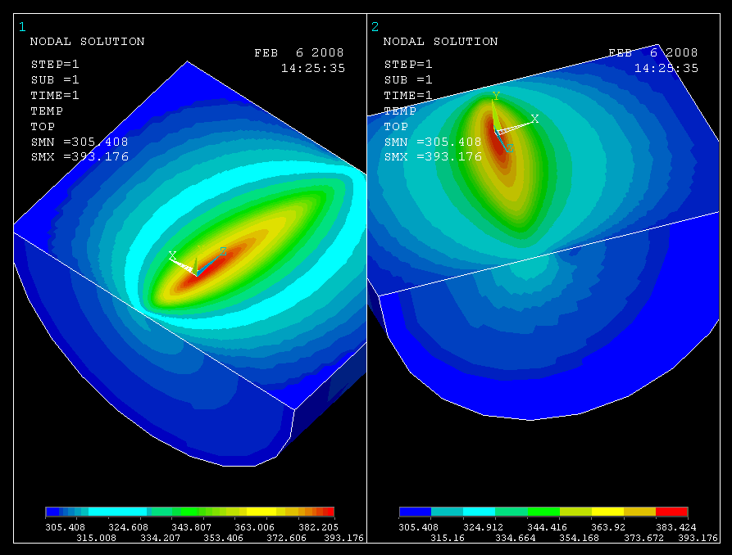
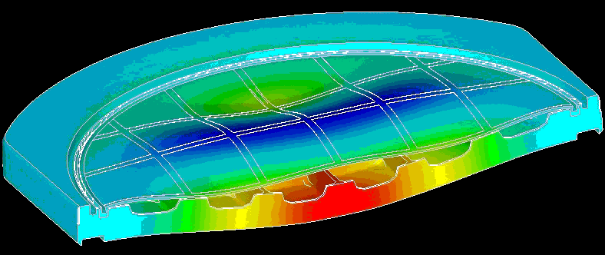
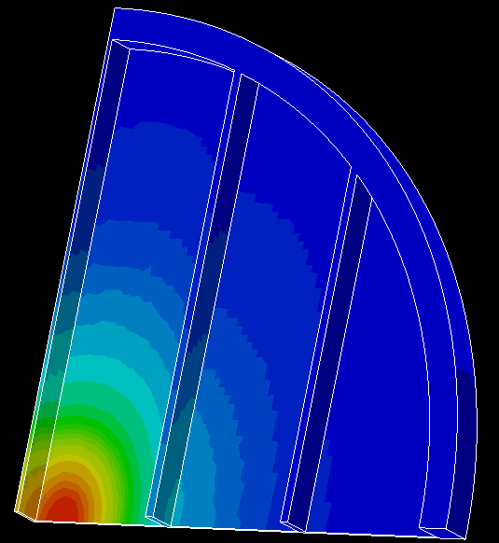
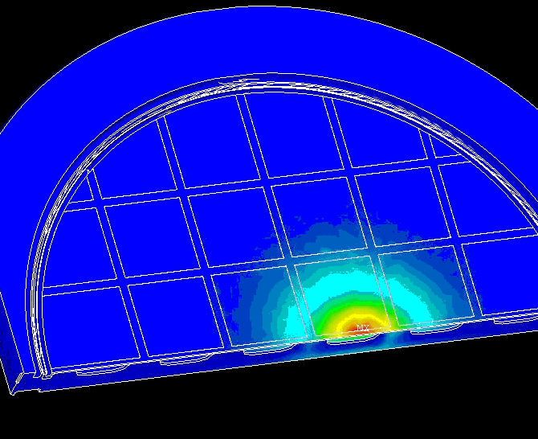
nTof
Design tools:
  Beam window modal analysis and fatigue life assessment (FEM)
  CFD analysis of the moderator circuit

Slide 15
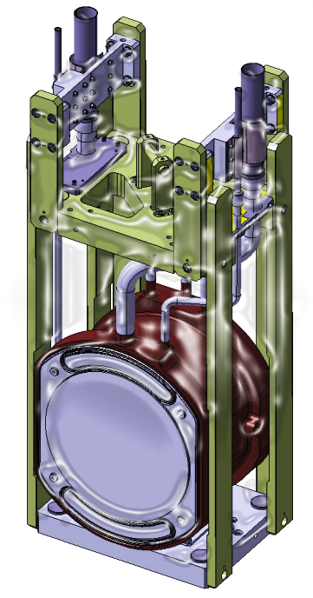
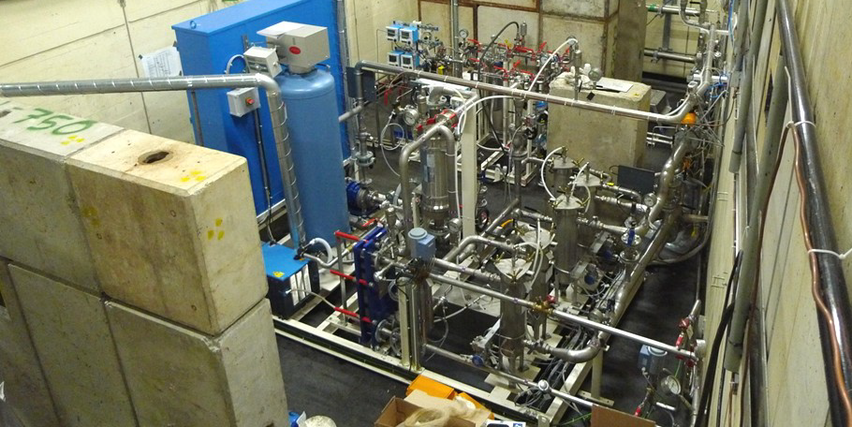
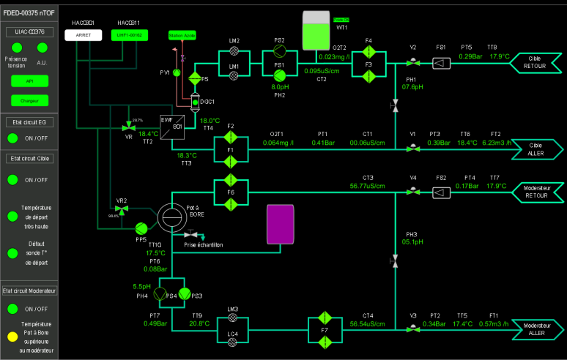
nTof
  New cooling circuit:
  Water flow ~5-6 m3/h (0.5 m3/h at proton face)
New (separated) moderator circuit:
  B-water, reduction of in-beam γ-rays & thermal fluence
Moderator circuit
Cooling circuit
https://ntofdaq.cern.ch/Cooling.php

Slide 16
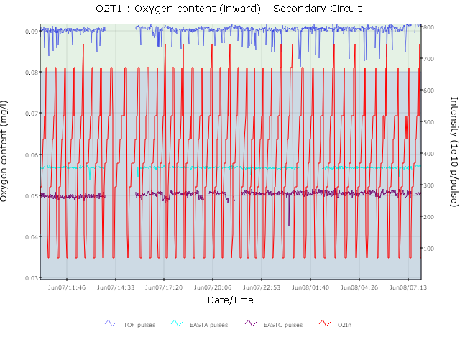
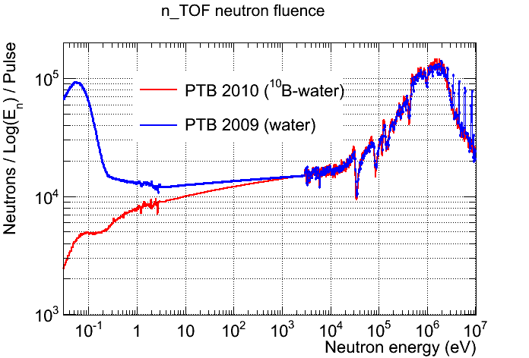
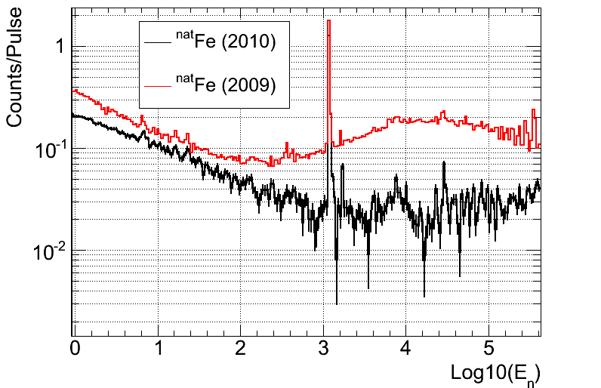
nTof
Operation
  Monitoring O₂ content, pH and conductivity (both circuits)
  Degassing device via N₂ flush in cooling circuit
  Moderator circuit with saturated ¹⁰B-water (~90 litres) at 20 °C
  ~constant boron concentration
https://ntofdaq.cern.ch/Cooling.php
https://edms.cern.ch/document/1105710/6
~x10
x18

Slide 17
ISOLDE
Target concepts and strengths
Solid target
Installation & operation
Storage
Static molten Pb/Bi bath
Thanks to T. Stora

Slide 18
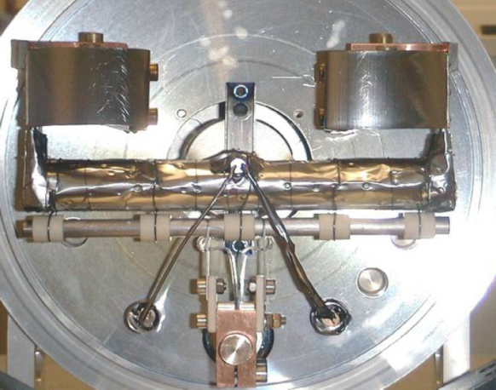
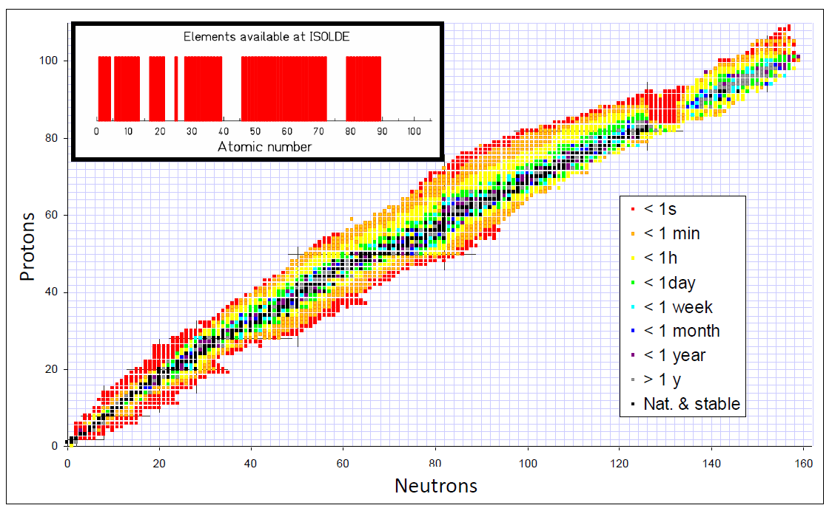
ISOLDE
Established Solid target concept
  UCx but also CeO, SiC, Sn, Pb, Ta, Ti, MgO
  Also used Al₂O₃ , Y₂O_{3 ,} hBN, ZrO2 , …
  Power: 3kW avg/10 GW peak
Strengths
  Remote handling and monitoring
  Well Defined beam-time schedule
  Target unit tracking system
  In-house target unit production
  and assembly (few weeks)
  PIE (@ PSI) and ALARA

Slide 19
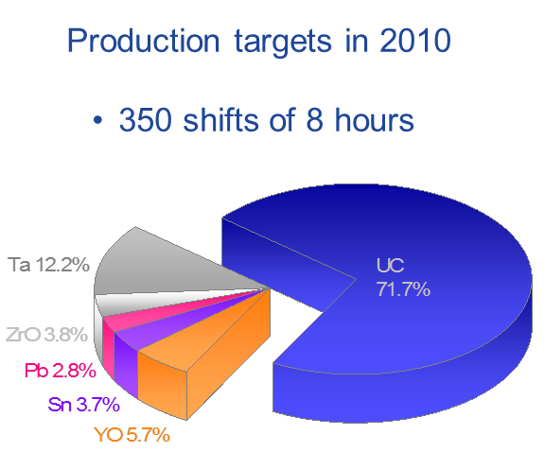
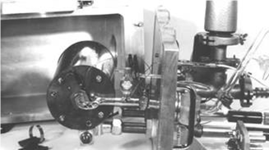
ISOLDE
Proven solid target design
  Concept in use since the late 60’s
1967

Slide 20
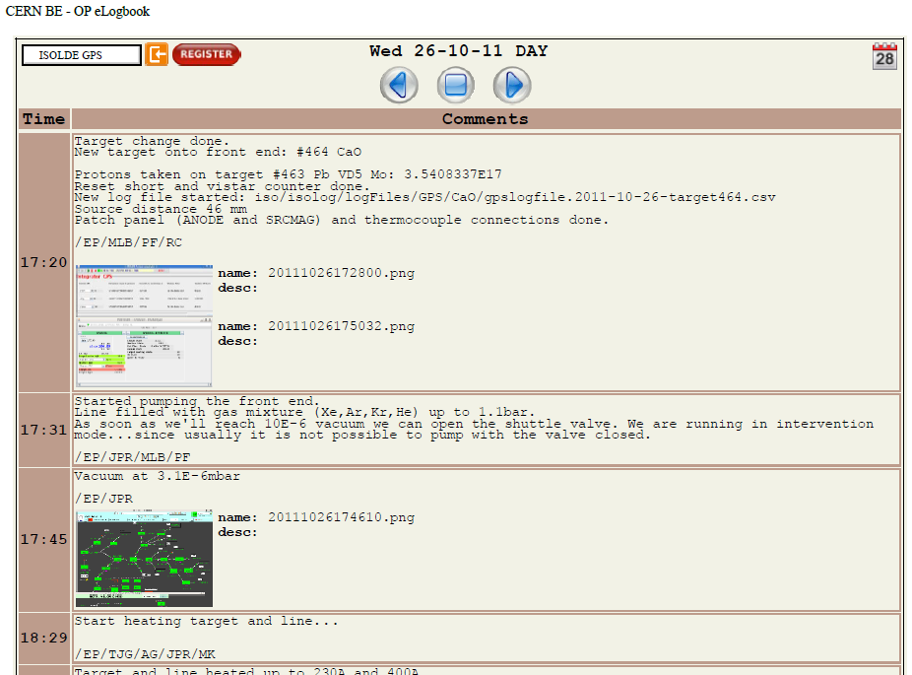
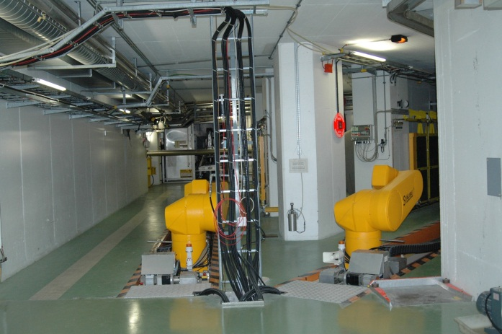
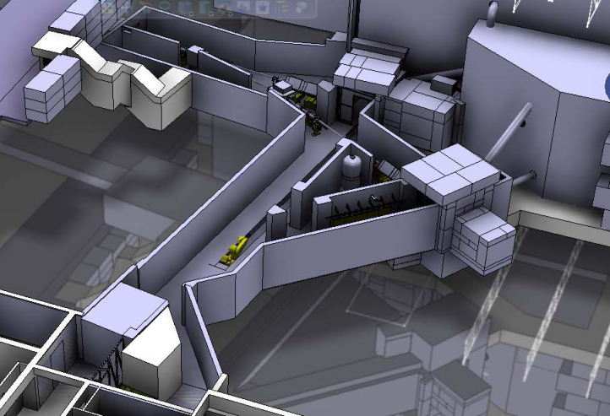
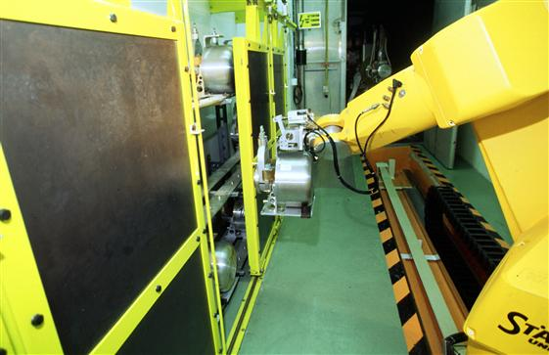
ISOLDE
Operation
  Transfer to target station : trained operators
  Operation for 3 days- 4 weeks on target station
  Recuperation and short-term storage in primary area
https://ab-dep-op-elogbook.web.cern.ch/ab-dep-op-elogbook/elogbook/eLogbook.php?shiftId=1039819

Slide 21

ISOLDE
Storage
  Recuperation and short-term storage in primary area
  Intermediate storage at CERN (DIMR/ALARA procedure )
  Dismantling/shipping to PSI
https://edms.cern.ch/file/857363/1/ISL-T-ES-003-00-10.pdf

Slide 22

ISOLDE
Proven design of the static Pb/Bi molten bath
  High purity Pb(44.5%) / Bi(55.5%) eutectic alloy, used in 2004/05
  Molten Pb used for 1 week/year
Notes:
Correlation between the thermal shock and release of radioisotopes

Slide 23





ISOLDE
Proven design of the static Pb/Bi molten bath
  Thermal shock enhance the release of radioisotopes
  Thermal shock weaken the target container (pitting corrosion on window)
Exemple_movie
Notes:
Correlation between the thermal shock and release of radioisotopes

Slide 24
Molten metal target activities
MERIT free Hg jet target
Offline molten Pb loop
Thanks to T. Stora, E. Noah

Slide 25



Molten metal target activities
MERIT free Hg jet target
  International collaboration
  2001/02 small-scale validating experiments
  2007 experiment with full-scale target in TT2A gallery (nTof)
  14 and 24 GeV. 1cm-dia, 20m/s Hg jet
  Proof of principle of Hg jet in 0-15T solenoid field

Slide 26





Molten metal target activities
Offline molten Pb loop
  600 °C pressurized Pb droplets trough diffusion chamber (DC)
  Tests at IPUL during EURISOL Design Study by E. Noah (CERN-ISOLDE)
  Proof of principle for the feasibility of film/droplets and operation of the loop

Slide 27
Thank You
C. Maglioni, CERN EN-STI-TCD

Slide 28





Spare slides
NA
  4 targets (T2,T4,T6,T10) built in the 70s & running since then – consolidation in LS1
  Forced air cooled 2mm-thickness Be plates
  Forced air cooled 2mm-dia Be rods
AD
  Same configuration as from the 80’s
  8-100W avg power on target
T2, T4, T6
  https://edms.cern.ch/document/1146356/
T10
AD pbar production target

