Slide 1
CLIC DR Beam Transfer Optics
R. Apsimon
CERN – TE/ABT
In collaboration with
F. Antoniou, B. Balhan, M. Barnes, J. Borburgh,
Y. Papaphilippou, J. Uythoven
9th April 2012

Slide 2
DR beam parameters
Parameter [Unit] | Value (2GHz) | Value (1GHz)
Energy [GeV] | 2.86
Circumference [m] | 427.5 → 438.1
Number of trains | 1 | 2
Bunches per train | 312 | 156
Bunch spacing [ns] | 0.5 | 1
Bunch population [10⁹] | 4.07
Basic cell type | TME
Number of dipoles | 100
Dipole field [T] | 1.0
Transverse tunes (h/v) | 48.38/10.39 → 48.61/10.31
Synchrotron tune | 0.0065 | 0.0057
Natural chromaticity (h/v) | -115/-85 → -98/-59
Norm. H/V Emittance (including IBS) [nm.rad] | 472/4.8 | 456/4.8
Damping times (h/v/l) [ms] | 2.0/2.0/1.0
Mom. compaction factor [10⁻⁴] | 1.3
Energy loss per turn [MeV] | 3.98
Harmonic Number | 2851 | 1425
RF Frequency [GHz] | 2 | 1
RF Voltage [MV] | 4.5 | 5.1
RF acceptance [%] | 1.0 | 2.4
RMS energy spread (including IBS) [%] | 0.1
RMS bunch length (including IBS) [mm] | 1.6 | 1.8
Number of wigglers | 52
Wiggler peak field [T] | 2.5
Wiggler length [m] | 2
Wiggler period [cm] | 5
These are the beam parameters for the damping ring before designing the injection/extraction systems.
Aim to minimise changes to these parameters when designing the inj/ext systems.

Slide 3
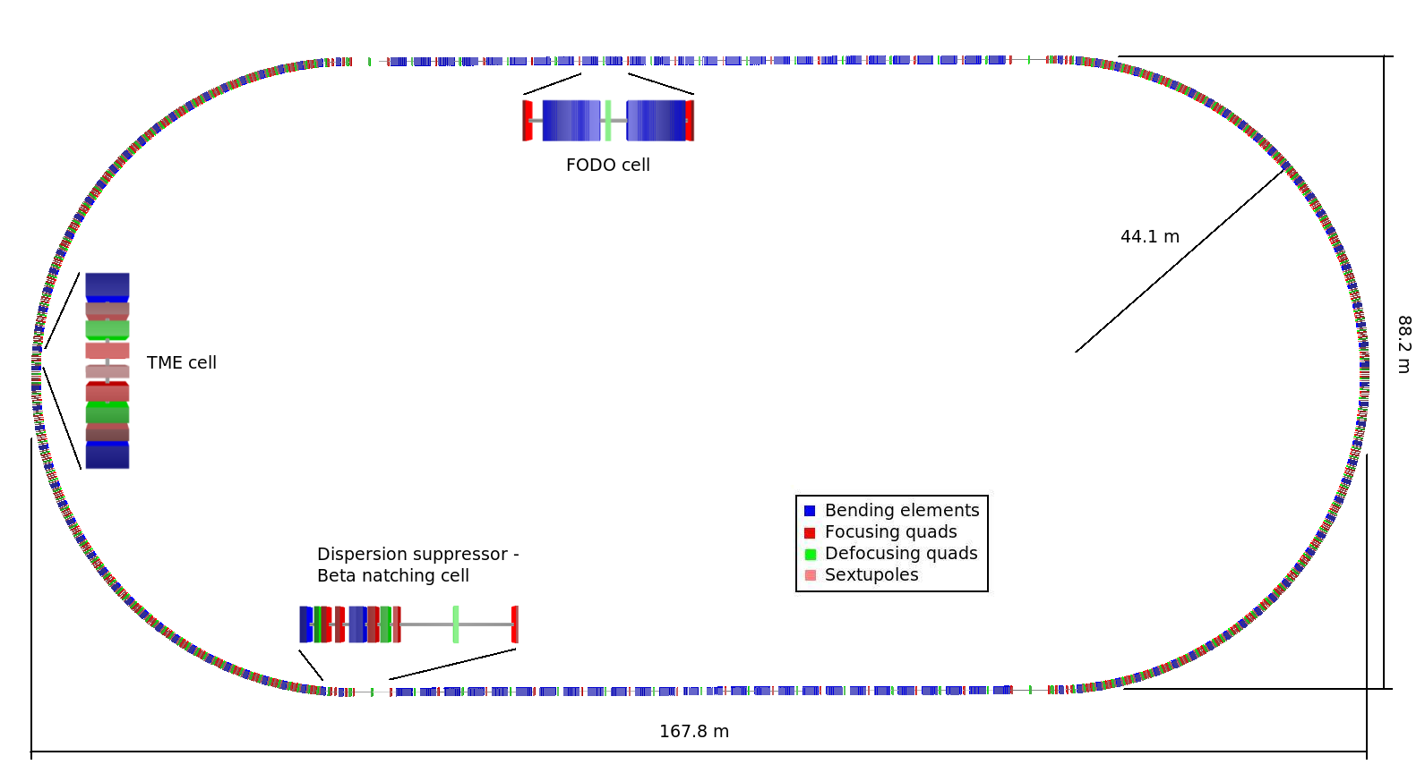
DR layout
Injection
Extraction
Racetrack shape with
  96 TME arc cells (4 half cells for dispersion suppression and matching)
  26 Damping wiggler FODO cells in the long straight sections (LSS)
  Space reserved upstream the LSS for injection/extraction elements and RF cavities

Slide 4
Constraints for injection/extraction
Beam and Machine Parameters
Parameter | Symbol | At injection | At extraction
normalised H emittance (m.rad) |  | 5.40×10⁻⁵ | 4.56×10⁻⁷
normalised V emittance (m.rad) |  | 5.40×10⁻⁵ | 4.80×10⁻⁹
geometric H emittance (m.rad) | ε_{H} | 9.65×10⁻⁹ | 8.15×10⁻¹¹
geometric V emittance (m.rad) | ε_{V} | 9.65×10⁻⁹ | 8.57×10⁻¹³
Beam energy (GeV) |  | 2.86
γ |  | 5598
Energy spread | δp/p | 0.001
β max X (m) | β_{max,H} | 52.5
β max Y (m) | β_{max,V} | 28.5
Parameter | Symbol | Value
# sigma | N_{σ} | 5
β beat factor | k_{b} | 1.1
Mechanical tolerance (mm) | δ_{M} | 1
H orbit tolerance (mm) | δ_{CO} | 2
V orbit tolerance (mm) | δ_{CO} | 2
Beam aperture (mm) |  | 20
Quad external radius (mm) |  | 276
Beam envelope
D is the local dispersion and β is the local beta function

Slide 5
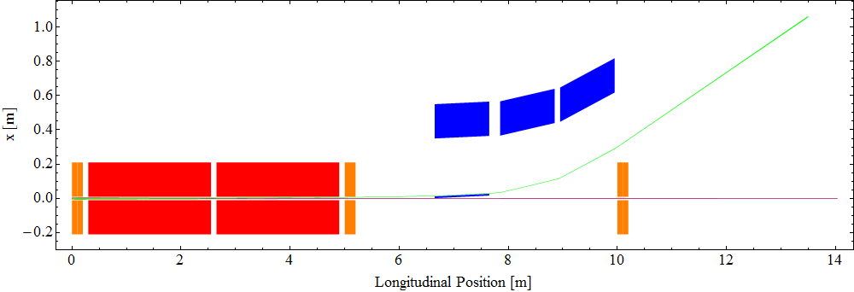
Extraction system (H-plane)
Zoom in on next slide
Orange: Quadrupoles
Red: Kickers
Blue: Septum magnets

Slide 6
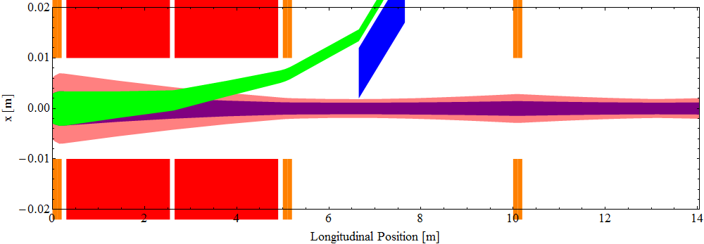
Extraction system (H-plane)
Orange: Quadrupoles Pink: Beam envelope at injection
Red: Kickers Purple: Beam envelope at extraction
Blue: Septum magnets Green: Beam envelope of extracted beam

Slide 7
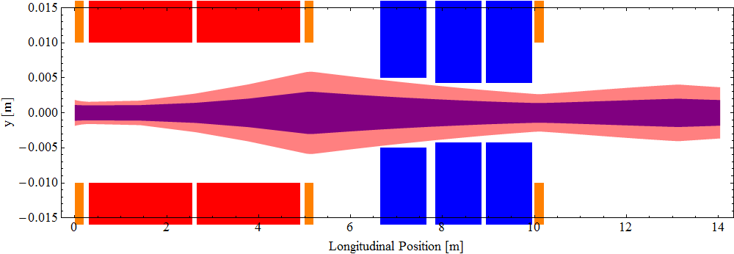
Extraction system (V-plane) stored channel
Orange: Quadrupoles Pink: Beam envelope at injection
Red: Kickers Purple: Beam envelope at extraction
Blue: Septum magnets

Slide 8
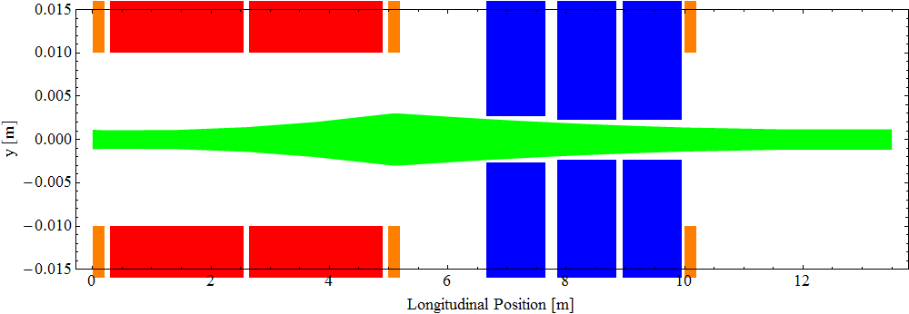
Extraction system (V-plane) extraction channel
Orange: Quadrupoles
Red: Kickers
Blue: Septum magnets Green: Beam envelope of extracted beam
Vertical aperture for extraction channel smaller than for stored channel.
Large emittance for injected beam requires large aperture to pass through.
Smaller emittance at extraction allows for smaller aperture in extraction channel.
Required to minimise magnet current.

Slide 9
Matching parameters
Cell length increased 4.7m→10.0m
Matching cell quad strengths reduced
Matching produces achievable quad strengths
  K-values shown in table
Injection/extraction cell parameters
Parameter | Regular DR lattice | Modified DR lattice
Cell length (m) | 4.7 | 10.00
F-quad strength (T/m) | 7.764275555 | 7.470612831
D-quad strength (T/m) | -3.728607027 | -1.729539285

Slide 10
Kicker and septum parameters
Kicker parameters
(Red values are the ones that have changed since the CLIC CDR)
Septum parameters
(Red values are the ones that have changed since the CLIC CDR)
Parameter | CLIC CDR | New
Number of kickers | 1 | 2
Beam Energy (GeV) | 2.86 | 2.86
Total deflection angle(mrad) | 1.5 | 2.68
Aperture (mm) | 20 | 20
Field rise & fall times (ns) | 1000 | 1000
Pulse flat top duration (ns) | ≈ 160 | ≈ 160
Flat top reproducibility | ± 10⁻⁴ | ± 10⁻⁴
Injection stability | ± 2×10⁻³ | ± 2×10⁻³
Extraction stability | ±- 2×10⁻⁴ | ± 2×10⁻⁴
Injection field homogeneity (%) | ± 0. 1 | ± 0.1
Extraction field homogeneity (%) | ± 0.01 | ± 0.01
Repetition rate (Hz) | 50 | 50
Total length (m) | ≈ 2.45 | 2.25
Effective stripline length (m) | ≈1.7 | ≈1.58
Vacuum (mbar) | 10⁻¹⁰ | 10⁻¹⁰
Pulse voltage per stripline (kV) | ± 12.5 | ± 12.18
Stripline pulse current (50Ω load) (A) | ± 250 | ± 244
Parameter | CDR thin | CDR thick | New thin | New thick
Number of magnets | 1 | 1 | 1 | 2
Beam energy (GeV) | 2.86 | 2.86 | 2.86 | 2.86
Deflection Angle (mrad) | 20 | 180 | 20 | 96.2
Vertical acceptance (mm) | 5 | 5 | 5.4 | 4.6
Apparent septum thickness (mm) | 5 | 20 | 10 | 25
Length (m) | 1.0 | 2.0 | 1.0 | 1.0
Injection stability | ± 2×10⁻⁴ | ± 2×10⁻⁵ | ± 2×10⁻⁴ | ± 2×10⁻⁵
Extraction stability | ± 2×10⁻⁵ | ± 2×10⁻⁶ | ± 2×10⁻⁵ | ± 2×10⁻⁶
Pulsed mode | DC | DC | DC | DC
Available length (m) | ≈ 1.5 | ≈ 2.5 | 1.0 | 1.0
Vacuum (mbar) | 10⁻¹⁰ | 10⁻¹⁰ | 10⁻¹⁰ | 10⁻¹⁰
Gap field (T) | 0.19 | 0.86 | 0.19 | 0.92
Coil current (kA) | 0.8 | 3.4 | 0.82 | 3.36
Septum design constraints
Gap field ≤ 1T
Current design uses 1 thin septum (S1) and 2 thick septa (S2). Large deflection in thick septum, so might reduce length and use 3 thick septa; this will reduce the horizontal aperture.
Kicker design constraints
Pulse voltage = 12.5 kV ± 1kV
Aperture = 20mm
Current design uses 2 kickers, although may use 1 kicker of length 4.5m; easier to build.

Slide 11
Septum stray field considerations
Neglecting stray fields from septum magnets
  DR has perfect 2-fold rotational symmetry
  Inj and ext cells + corresponding matching cells identical
  Injection system same as extraction, but order of elements reversed
Stray fields break lattice symmetry
Question: How much stray field can we tolerate?

Slide 12
Compensating for stray field
Neglect dipole term
  Can be compensated with correctors
Quadrupole terms
  Match quads in inj/ext cells and 4 matching cells.
Sextupole terms
  Match sextupole strengths to correct chromaticity.
Higher order terms not corrected

Slide 13
Field simulations for septum magnets
Early simulation results for the septum stray fields.
  Currently 2D modelling using FLUX2D (Cedrat)
  Check whether stray field requirements are feasible.

Slide 14
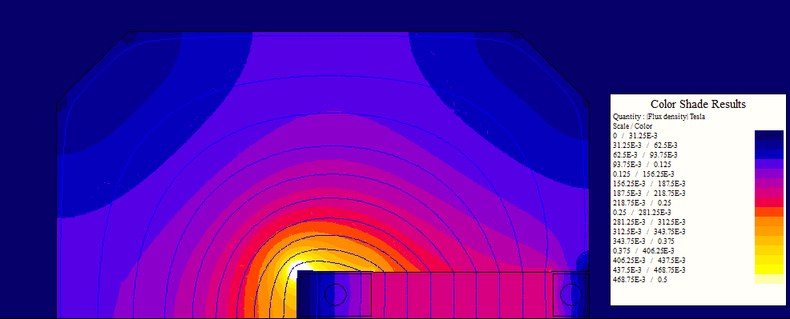
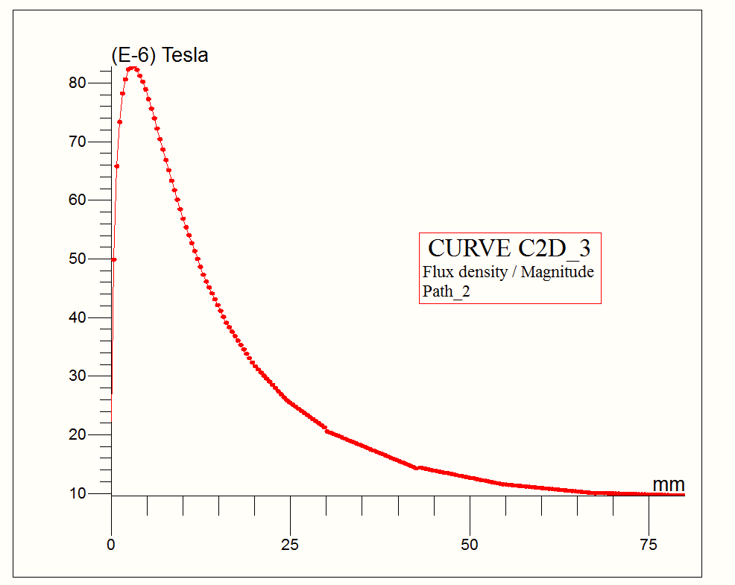
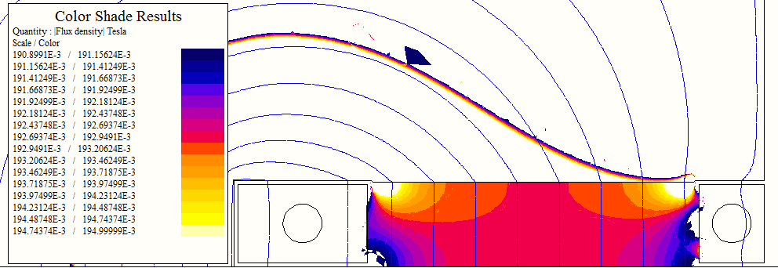
Early modelling of thin septum
Field distribution for thin septum.
Gap field is 0.02T
Magnitude of the stray field on the mid plane from the outer septum edge (0mm) to 75mm.
The peak stray field is 82μT which is approximately 0.04% of the gap field; well below the required 0.5% for the thin septum.
Field homogeneity for thin septum.

Slide 15
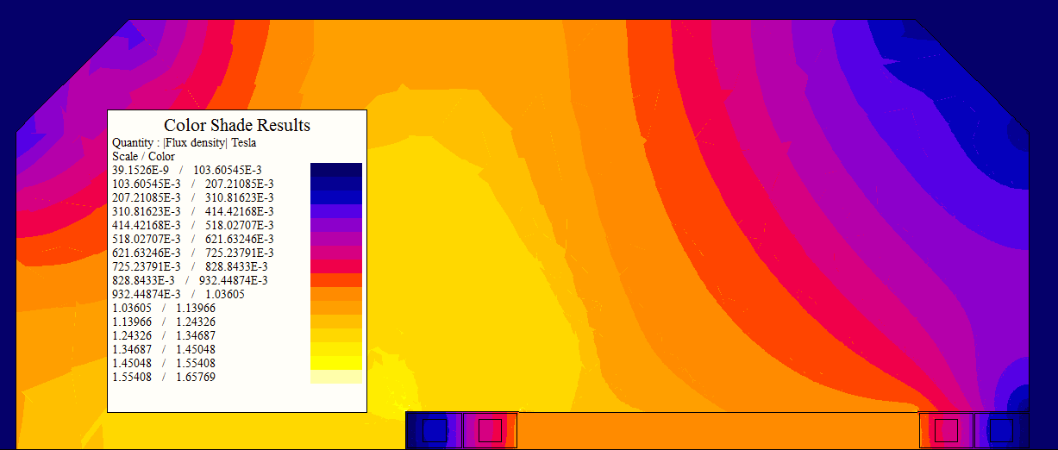
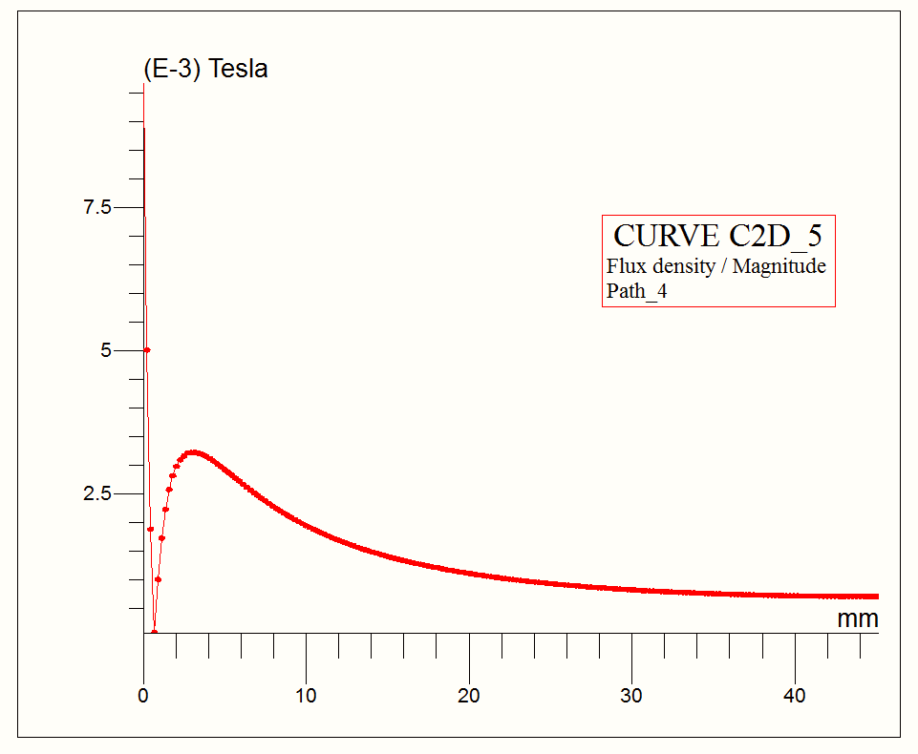
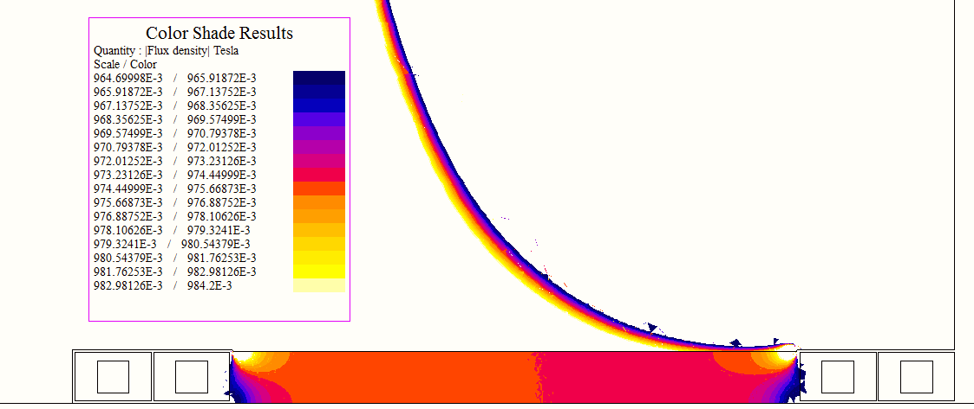
Early modelling of thick septum
Field distribution for thick septum.
Gap field is 0.92T
Magnitude of the stray field on the mid plane from the outer septum edge (0mm) to 45mm.
The peak stray field is 3.25mT which is approximately 0.35% of the gap field.
Field homogeneity for thick septum

Slide 16
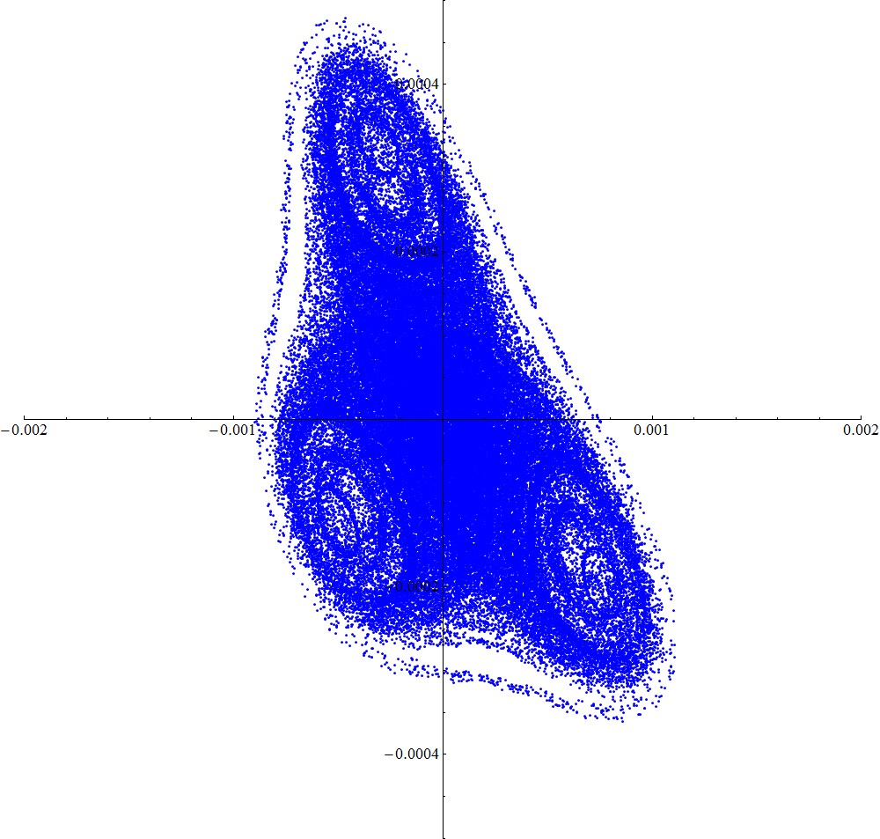
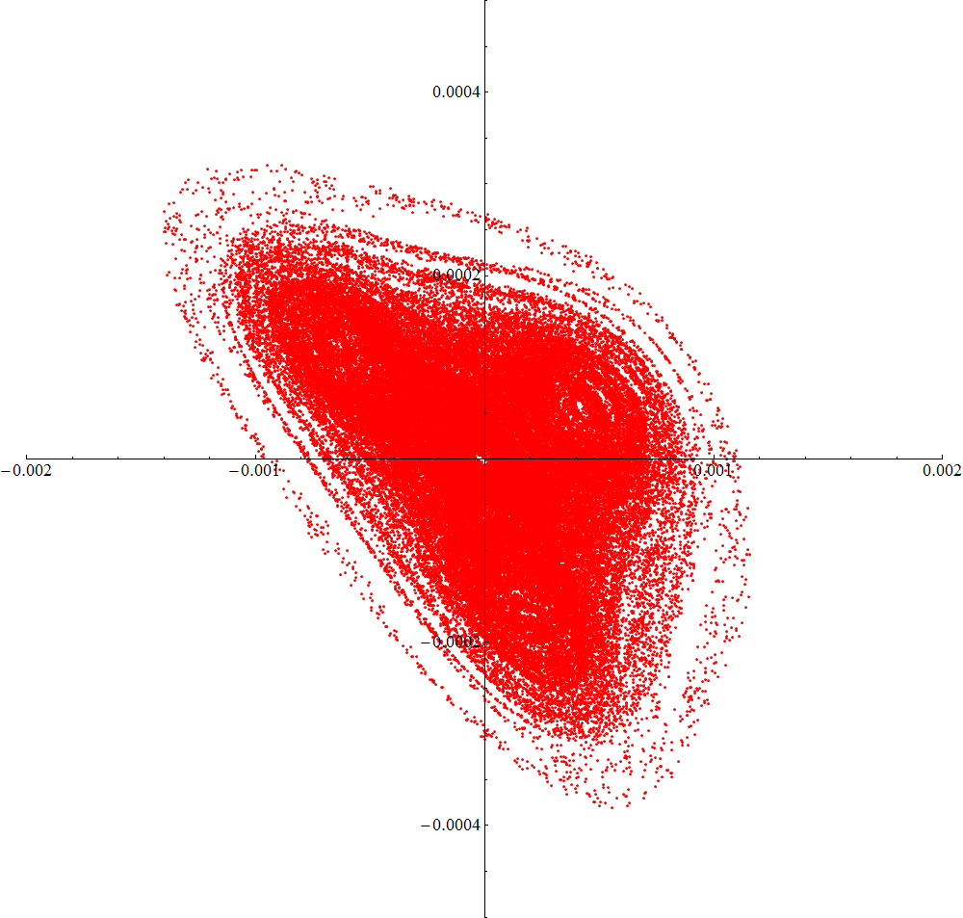
Particle tracking: H-plane
x’
Tracking 100 particles for 1000 turns
x’
x
x
Horizontal phase space plot at the start of the thin extraction septum.
Blue dots represent the phase space without stray fields; red dots represent the phase space with stray fields included.

Slide 17
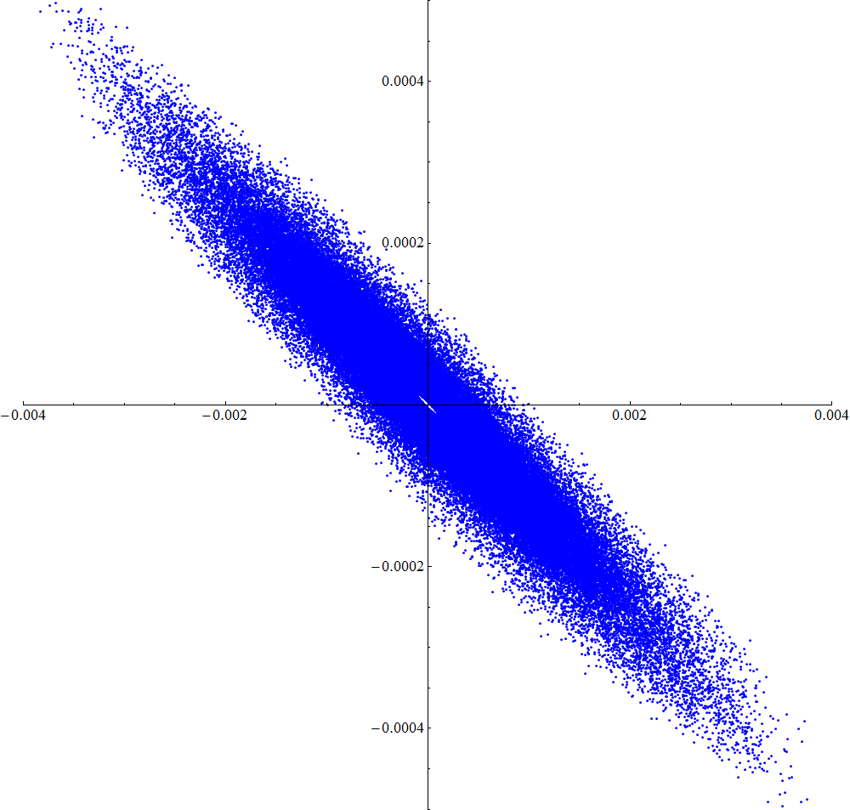
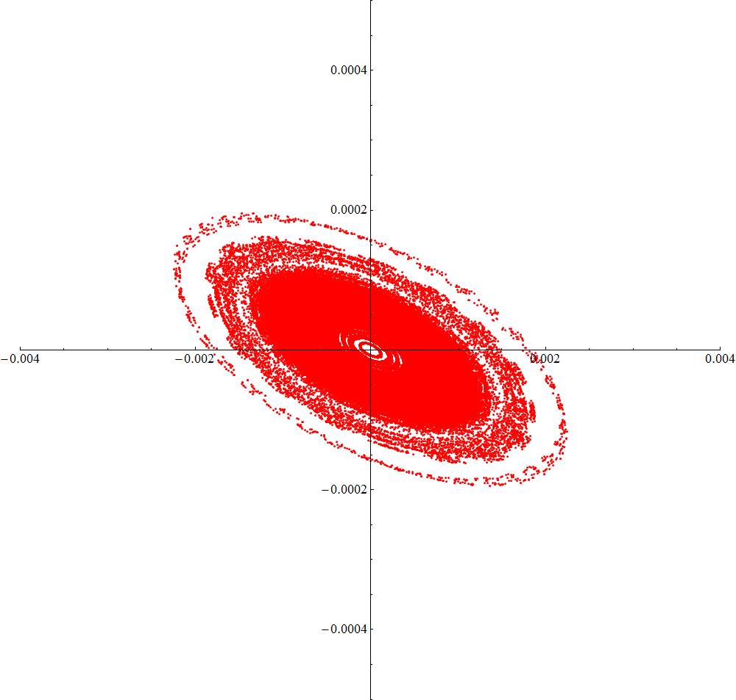
Particle tracking: V-plane
y’
Tracking 100 particles for 1000 turns
y’
y
y
Vertical phase space plot at the start of the thin extraction septum.
Blue dots represent the phase space without stray fields; red dots represent the phase space with stray fields included.

Slide 18
Comparison of stray fields
 |  | Results from 2D modelling
Thin septum | % field | 0.04%
 | Field (T) | 8×10⁻⁵
1st thick septum | % field | 0.2%*
 | Field (T) | 1.8×10⁻³
2nd thick septum | % field | 0.05%
 | Field (T) | 4.6×10⁻⁴
* The stray field from the model actually predicts 0.35%, but this does not produce a stable beam (without altering more optics in the DR). It is believed that with further optimisation of the septum magnet design and magnetic shielding the stray field can easily be reduced to 0.2%

Slide 19
Conclusions
Extraction kicker and septa parameters defined for realistic aperture assumptions
Septa stray field calculations done in 2D
  Tracking results show that resulting beam is stable

Slide 20
Next steps
Design injection system
  Larger aperture required for septum magnets.
  Stronger kicker from injection kicker required due to larger beam size.
3D modelling of septum magnets and particle tracking
  3D modelling will be with Vector Fields (Cobham)
Study of spoiler/absorber to protect septum edge and consideration of failure modes

Slide 21
“back-up” slides

Slide 22
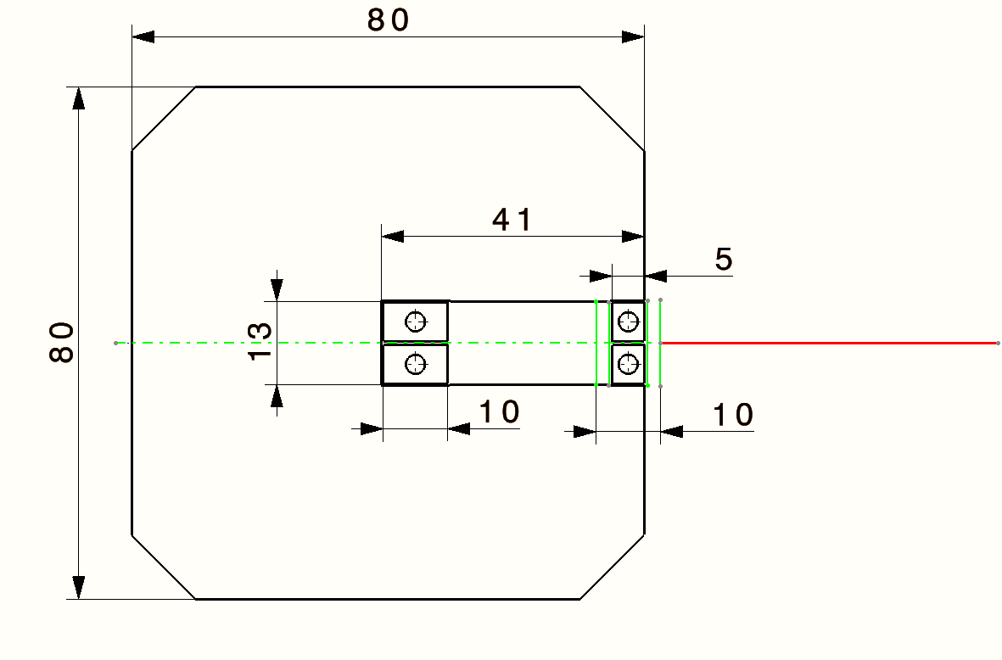
Thin septum design

Slide 23
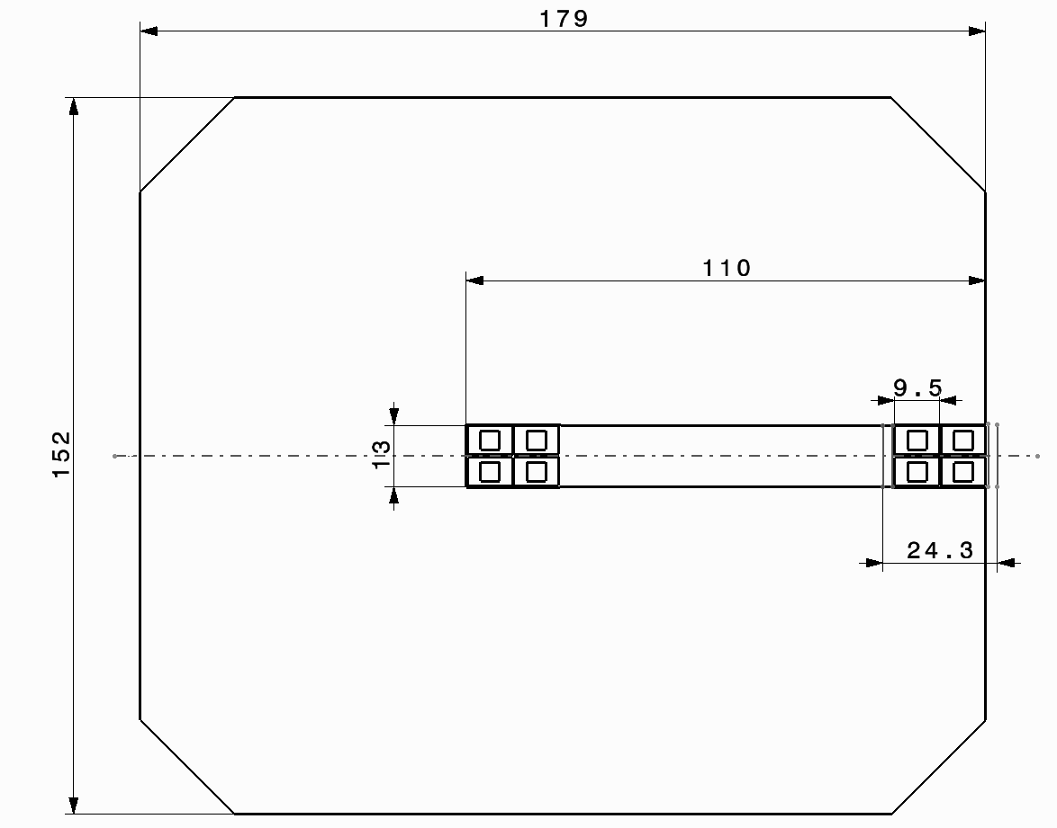
Thick septum design

