Slide 1
STRIPLINE KICKERS DESIGN
DAMPING RING DESIGN PROGRESS
09/05/2012

Slide 2
Introduction
Cross section design of the stripline extraction kicker for the the CLIC DR
Design study of the tapers
Beam coupling impedance
Test campaign
Conclusions

Slide 3
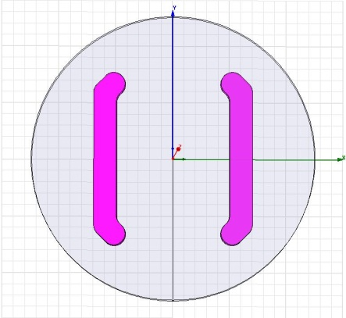
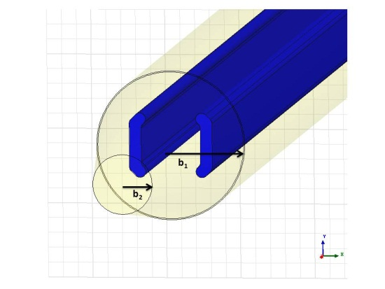
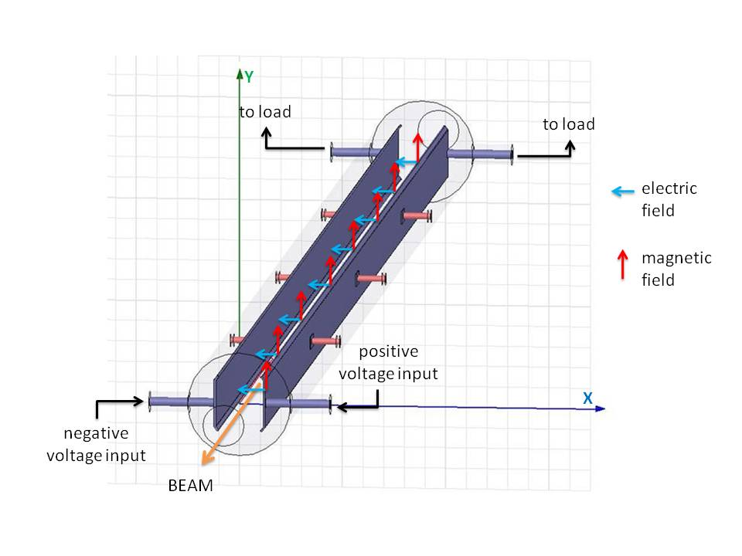
1) INTRODUCTION
The striplines design can be divided into two steps:
  Cross section design. The striplines cross section defines the characteristic impedance and field homogeneity of the striplines.
  Design of the transition between the stripline kicker and the beam pipe. A suitable tapering between the kicker and the beam pipe is needed to reduce the beam coupling impedance.
Once the design has finished, the stripline kicker will be built by Trinos Vacuum-Projects

Slide 4
2) CROSS SECTION DESIGN OF THE STRIPLINE KICKER FOR CLIC DR
The cross section of the striplines must be matched to 50 Ω characteristic impedance
Striplines driven to same magnitude, but opposite polarity, voltage, to extract beam
⇨ ODD mode characteristic impedance.
Total capacitance (C) is given by:
capacitance between a stripline and virtual ground (C₁₁)
capacitance between a stripline and beam-pipe ground (2C₁₂)
Same polarity and magnitude of current / voltage induced on both striplines by beam.
⇨ EVEN mode characteristic impedance
Capacitance (C) is given by:
capacitance between a stripline and beam-pipe ground (C₁₁)
Beam pipe Ground
Beam pipe Ground
+ve
Virtual Ground
+/-ve
Beam
-ve
+/-ve
Goal: achieve 50 Ω characteristic impedance in the even mode, while keeping the odd characteristic impedance as close as possible to 50 Ω. Furthermore, a field homogeneity of ± 0.01% at the center between the striplines is required.

Slide 5
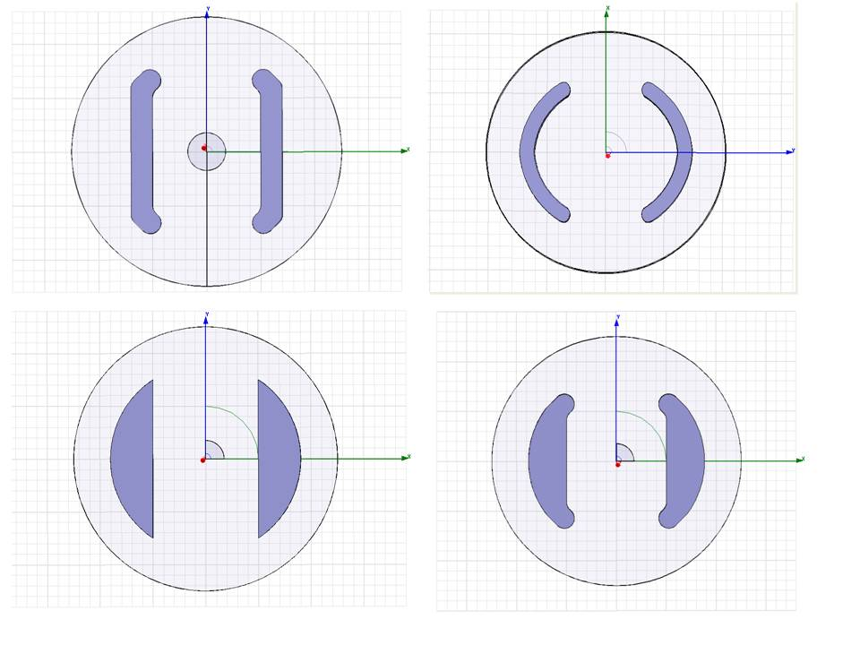
2) CROSS SECTION DESIGN OF THE STRIPLINE KICKER FOR CLIC DR
Four possible cross sections have been considered to start the design of the striplines, all of them using cylindrical beam pipe, since it is the easiest shape for manufacturing from a commercial pipe.
The challenging value required for the field homogeneity at the center of the kicker is achieved with minimum kicker radius in the case of flat shape electrodes
Parameter | Optimum value
Kicker radius | 24.625 mm
Aperture | 20 mm
Electrode height | 24.2 mm
Electrode thickness | 4 mm
Electrode edge length | 4.9 mm
Electrode edge angle | 45°
Odd characteristic impedance = 37.3 Ω
Even characteristic impedance = 50.4 Ω

Slide 6
2) CROSS SECTION DESIGN OF THE STRIPLINE KICKER FOR CLIC DR
Aperture = 20 mm
Electrode thickness = 4mm
Electrode edge length = 5 mm
Electrode edge angle = 45°
R = 20 mm → h/R = 0,68
(Z₀)_{e} = 49,5 Ω
(Z₀)_{o} = 40,7 Ω (FH)_{o} = 0,16%
R = 25 mm → h/R = 1
(Z₀)_{e} = 50,2 Ω
(Z₀)_{o} = 36,8 Ω (FH)_{o} = 0,01%
R = 30 mm → h/R = 1,18
(Z₀)_{e} = 50,9 Ω
(Z₀)_{o} = 33,7 Ω
(FH)_{o} = 0,005%

Slide 7
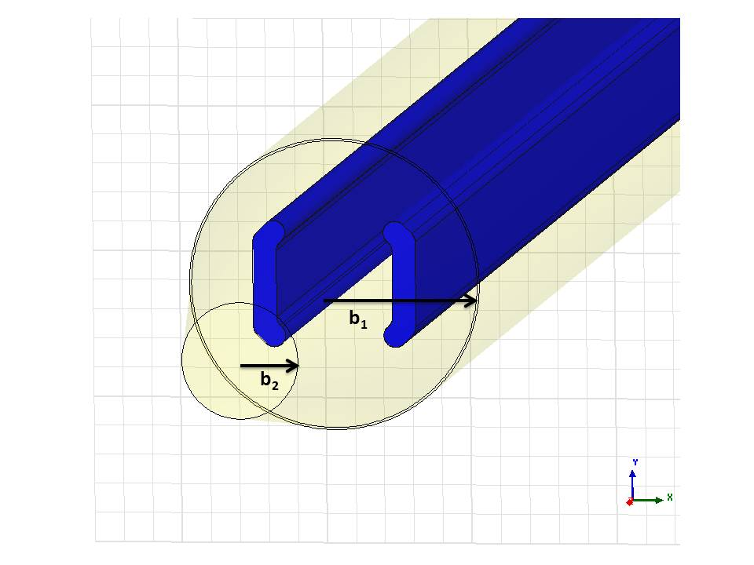

3) DESIGN STUDY OF TAPERS
An abrupt change in the cross section of a beam pipe will produce scattered fields when the beam passes through the kicker.
By using long gradual tapers the total energy loss may be drastically reduced.
Approximate criteria to choose a reasonable taper length, valid for short bunches:
MINIMUM TAPER LENGTH
$$\frac{lσ}{{\left(b_{1}−b_{2}\right)}^{2}}>1$$
l > 12.5 – 14 cm for CLIC DR
l = electrode length
b₁ = stripline kicker tube radius
b₂ = beam pipe radius
σ = bunch length
Connical transitions will be used to connect the 25 mm stripline kicker tube, with the 10 mm beam pipe of CLIC DR.

Slide 8


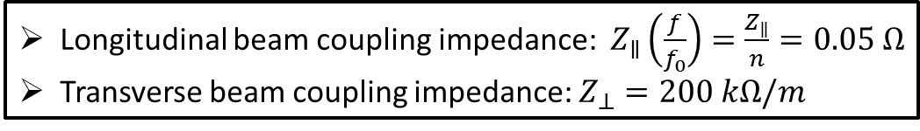
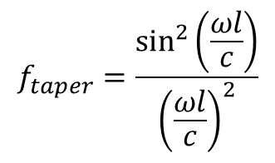
4) BEAM COUPLING IMPEDANCE
PERMISSIBLE BEAM COUPLING IMPEDANCE PER KICKER SYSTEM
Longitudinal beam coupling impedance: $Z_{∥}\left(\frac{f}{f_{0}}\right)=\frac{Z_{∥}}{n}=0.05 Ω$
Transverse beam coupling impedance: $Z_{⊥}=200 kΩ/m$
ANALYTICAL EQUATIONS FOR UNTAPERED STRIPLINES BPMs
LONGITUDINAL BEAM COUPLING IMPEDANCE
TRANSVERSE BEAM COUPLING IMPEDANCE
ANALYTICAL EQUATIONS FOR TAPERED STRIPLINES BPMs
TAPERING FACTOR (S. Smith, SLAC)
Z_{c} is the even characteristic impedance
Φ₀ is the coverage angle
L is the electrode length
c is the speed of light
b is the kicker radius
l is the taper length
$$f_{taper}=\frac{\sin^{2}\left(\frac{ωl}{c}\right)}{{\left(\frac{ωl}{c}\right)}^{2}}$$
$$Z_{∥tapered}=f_{taper} Z_{∥}$$
$$Z_{⊥tapered}=f_{taper} Z_{⊥}$$

Slide 9
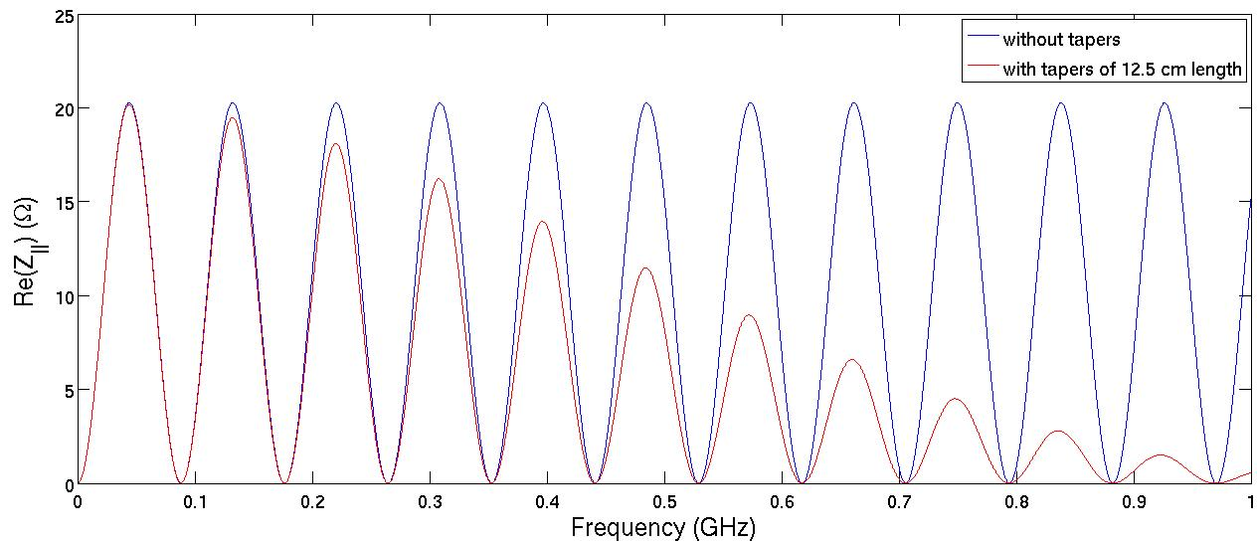
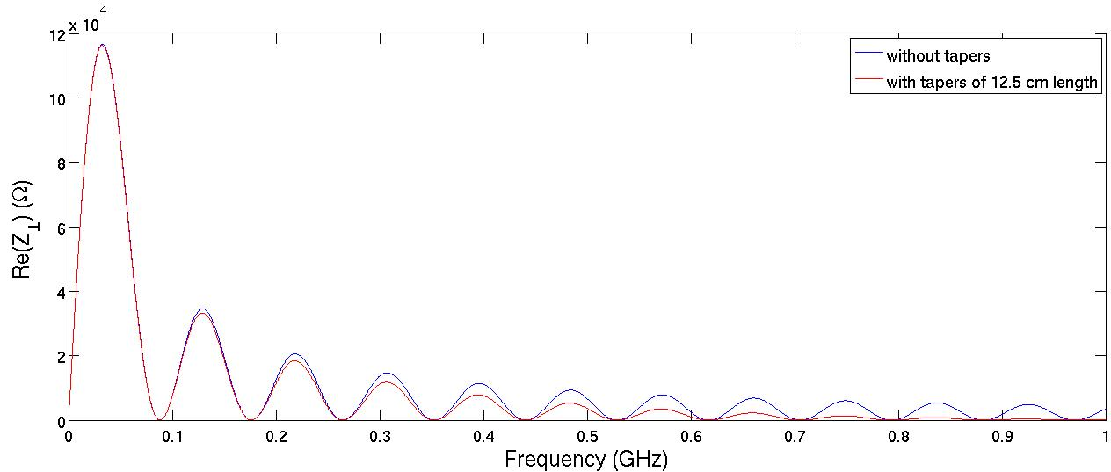
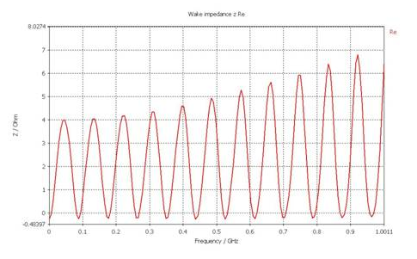
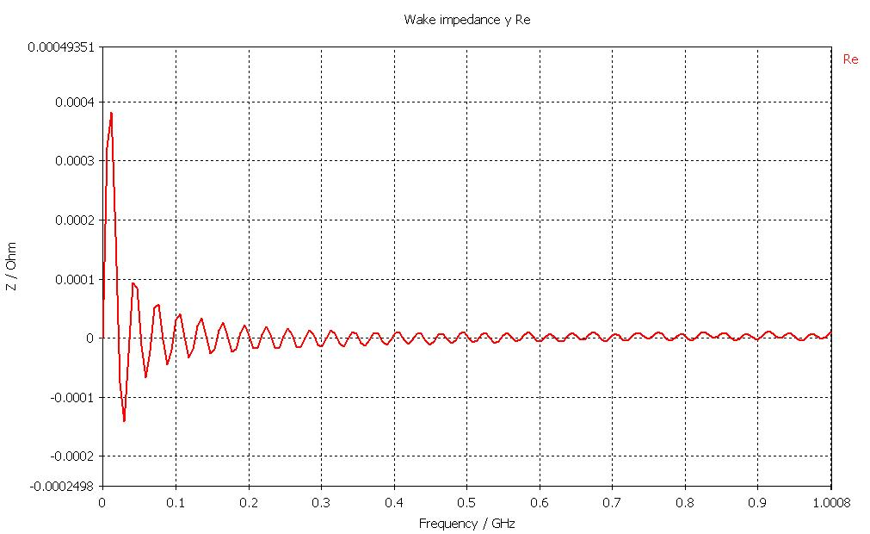
4) BEAM COUPLING IMPEDANCE
PREDICTIONS FROM ANALYTICAL EQUATIONS
SIMULATIONS FOR THE UNTAPERED KICKER

Slide 10
5) TEST CAMPAIGN
Laboratory test at CERN
  Verification of dimensions, including tapering;
  Vacuum compatibility;
  Longitudinal and transverse beam coupling impedance measurements;
  Field homogeneity
  Others…
Test in ALBA, without inductive adder
  Field homogeneity measurements with DC current supplies
  Beam impedance measurements with circulating beam (transverse impedance measurements with DC supplies and a closed bump).
  A proposal is being prepared for ALBA
Test in ATF2, with the inductive adder
  Stripline kicker + inductive adder will be tested from the point of view of stability issues
  The kicker will be installed in a straight section in the ATF2 FFS, which is provided with cavity BPMs.
  Due to the fact that the kicker will not extract the beam in ATF2, we have the possibility to match as much as possible the parameters to the performances of CLIC DR ones.
  A formal proposal will be presented in June 2012 in front of the ATF2 Technical Board.

Slide 11
Parameter | CLIC DR | CLIC PDR | ATF2 (draft)
Beam energy (GeV) | 2.86 | 2.86 | 1.30
Total kick deflection angle (mrad) | 1.5 | 2.0 | 1.5
Deflection | horizontal | horizontal | horizontal
Aperture (mm) | 20 | 40 | 20
Beam pipe range (mm) | 20 - 30 | 40 - 50 | 20 - 30
Effective length (m) | 1.7 | 3.4 | 1.7
Field rise/fall time (ns) | 560/1000 | 428/1000 | 560/1000
Pulse flat top duration (ns) | 900/160 | 900/160 | 900/160
Repetition rate (Hz) | 50 | 50 | 1.56
Vacuum (mbar) | 10⁻¹⁰ | 10⁻¹⁰ | 10⁻¹⁰
Pulse voltage per stripline (kV) | ± 12.5 | ± 17 | ± 5.5
Stripline pulse current [50 Ω load] (A) | ± 250 | ± 335 | ± 115
Longitudinal beam coupling impedance (Ω) | < 0.05 · n | < 0.05 · n | < 0.05 · n
Transverse beam coupling impedance (kΩ/m) | < 200 | < 200 | < 200
Peak beam current (A) | 110/120 | 70/50 | 60/20/30
Minimum bunch spacing (ns) | 1/0.5 | 1/0.5 | 2.8/140
Bunch length (ps) | 6/5.3 | 10/14 | 16.7
Notes:
Pulse voltage per stripline: $V_{k}=E×h$, where E is the electric field along the striplines and h is the half-aperture;
Electric field along the striplines: $E=\frac{V_{⊥}}{2l}$, where $V_{⊥}$ is the energy per unit charge given to the transverse momentum of the particles when passing through the striplines, known as transverse voltage.
Transverse voltage: $V_{⊥}=\frac{E_{b}}{e}\tan{α}$, where $E_{b}$ is the beam energy, and $α$ is the beam deflection angle.
Peak beam current: $I_{pulse}=\frac{eN_{pulse}}{t_{pulse}}$, where $N_{pulse}$is the number of particles/pulse, $e$ the electron charge and $t_{pulse}$ the pulse length.
Pulse length: $t_{pulse}=\frac{N_{pulse}}{N_{bunch}}t_{bunch}$

Slide 12
6) CONCLUSIONS
The design of the stripline kicker for CLIC Damping Ring is almost done: 50 Ω even mode impedance and ± 0.01% field homogeneity over a cercle of 1 mm radius between the striplines have been achieved by using flat electrodes and cylindrical beam pipe. For the optimum geometry, the odd characteristic impedance is 37 Ω, and this will traduce in power reflections.
  Further research is being carried out to diminish the power lost due to the impedance mismatching.
The effect of the tapers is presently being investigated: tapers of at least 12-14 cm are needed between the stripline kicker tube and the beam pipe to damp beam coupling impedance at high frequencies. With this taper length, both longitudinal and transverse coupling impedance are almost zero above 1 GHz of frequency.
Investigations are ongoing to understand differences between predictions and analytical equations.
Tests with/without beam and with/without the inducte adder are being planned for the two next years.

Slide 13
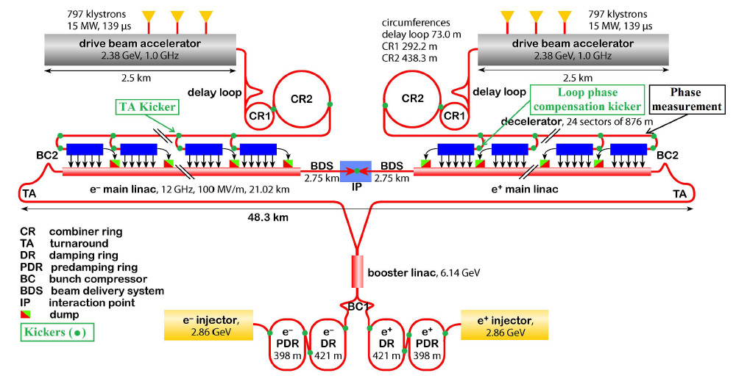
1) INTRODUCTION
E_{b} = 2.86 GeV
The extraction kicker for the Damping Rings will deflect the e⁻/e⁺ beam 1.5 mrad in the horizontal plane.
1 GHz baseline
2 GHz baseline
Beam current = 110 A
Bunch length = 6 ps
Minimum spacing between bunches = 1 ns
Beam current = 120 A
Bunch length = 5.3 ps
Minimum spacing between bunches = 0.5 ns

Slide 14
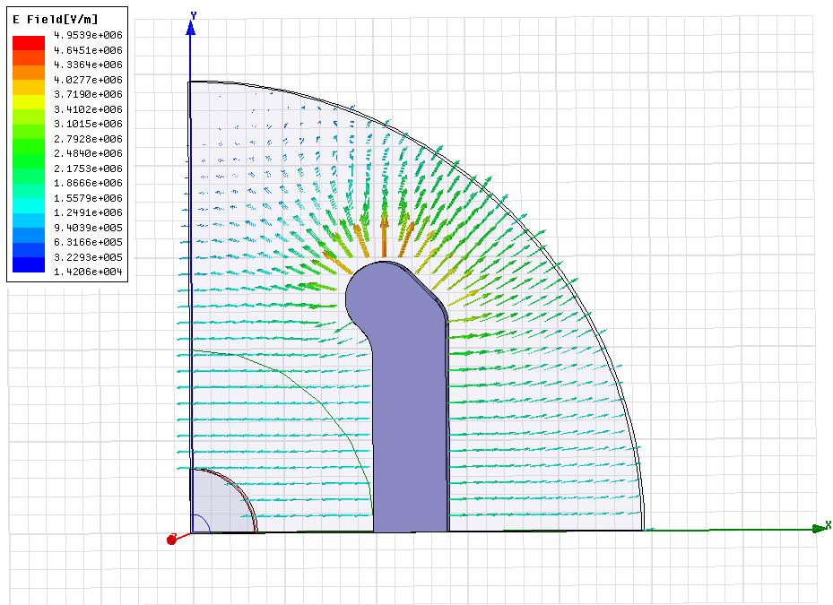
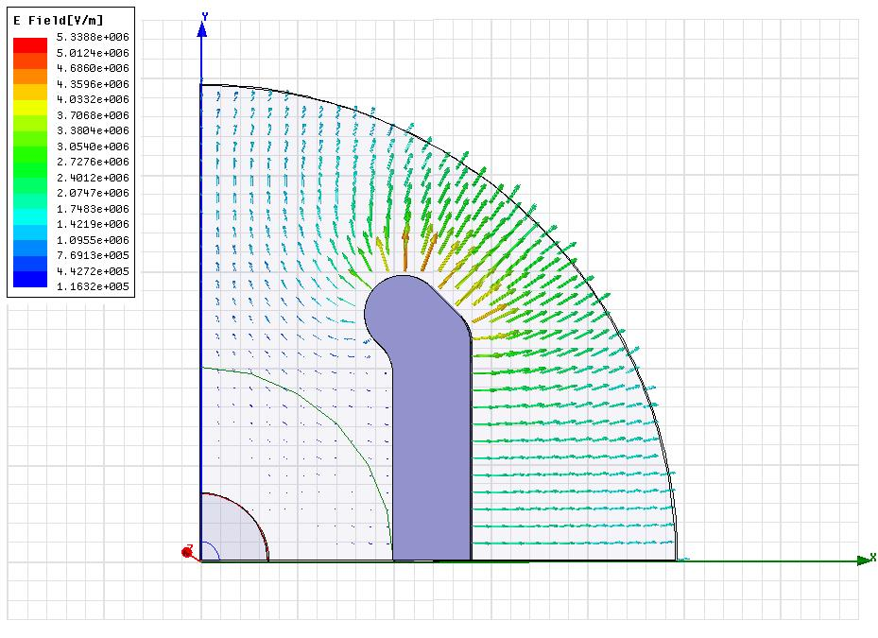
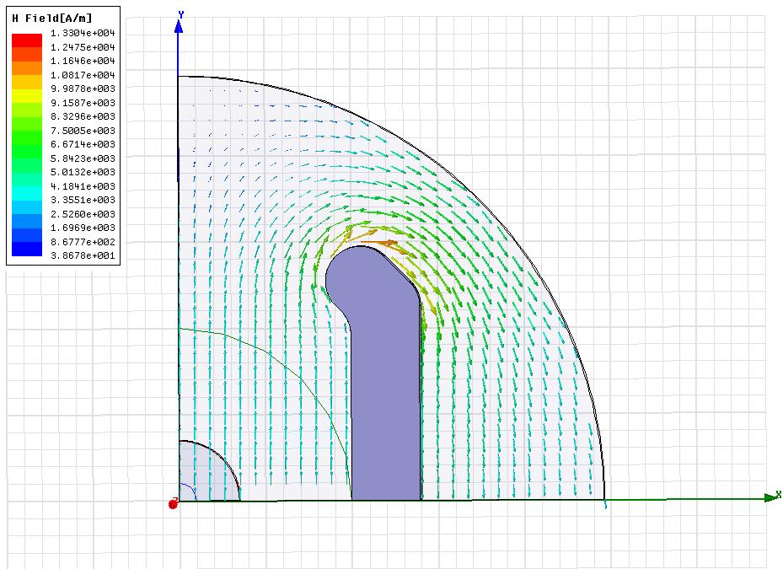
2) CROSS SECTION DESIGN OF THE STRIPLINE KICKER FOR CLIC DR
ELECTRIC FIELD ODD MODE
ELECTRIC FIELD EVEN MODE
MAGNETIC FIELD ODD/EVEN MODE
Plots normalized to a power input of 3.125 MW, which corresponds to a voltage input of 12.5 kV
Maximum electric field expected at the kicker walls: 2 MV/m
Kilpatrick limit: 2.35 MV/m

Slide 15
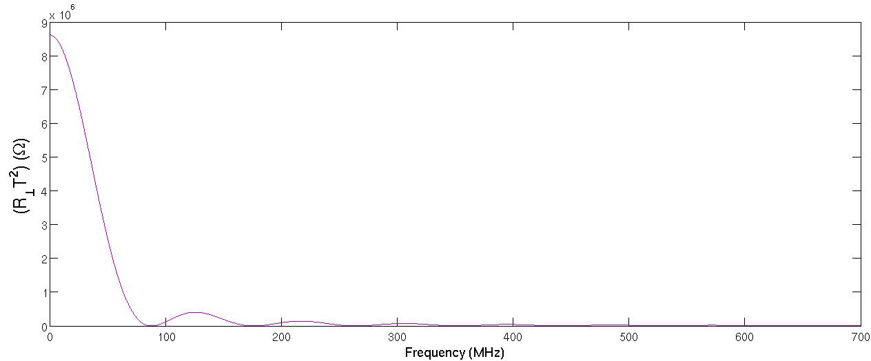
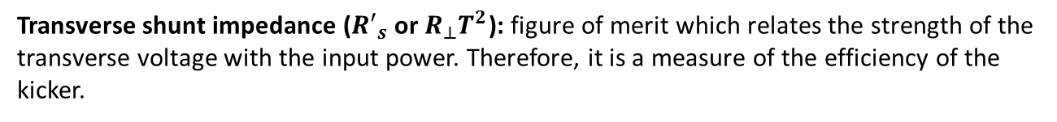
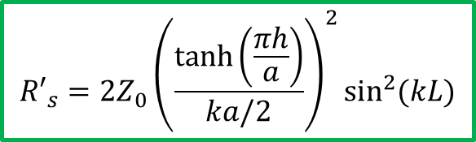
3) STRIPLINE KICKER EFFICIENCY
Transverse shunt impedance (${R′}_{s}$ or $R_{⊥}T^{2}$): figure of merit which relates the strength of the transverse voltage with the input power. Therefore, it is a measure of the efficiency of the kicker.
TRANSVERSE SHUNT IMPEDANCE FOR A STRIPLINE KICKER
k = ω/c is the wave number
h is the electrode height
a is the striplines aperture
Z₀ is the odd characteristic impedance.
$${R′}_{s}=2Z_{0}{\left(\frac{\tanh\left(\frac{πh}{a}\right)}{ka/2}\right)}^{2}\sin^{2}{(kL)}$$
$${R′}_{s}\left(f=685 kHz,f=862 kHz\right)=8.6 MΩ$$

