Slide 1

WLCG Service Report
6 weeks April 24 – June 4
Maarten Litmaath
~~~
WLCG Management Board, 5th June 2012

Slide 2
Executive summary (1/2)
FTS
  GridFTP v2 use reintroduced through patch by IGE, agreed with Globus
  Intermittent expired proxy failures at various T1 for various VOs
    GGUS:81844
May 3: UCSD cooling incident
  2 GlideinWMS CRAB servers unavailable for a few days
  Some unmerged data lost
Ongoing investigation of corrupted LHCb files at IN2P3
  GGUS:82247
  LHCb will implement checksum verification immediately after transfers
May 22: CMS run could not be started for 1.5 hours due to online DB access blocked by concurrent operations
  See SIR
May 8 – now: SARA SRM errors for ATLAS and LHCb due to continuous name space service overload
  No clear single culprit so far, but LHCb have reduced their query rates
  DB moved to faster HW on June 4: looking better, some tuning needed

Slide 3
Executive summary (2/2)
GGUS
  May 22-23: GGUS inaccessible overnight due to DNS issue
  May 24-25: GGUS e-mail engine stuck (alarm mails not affected)
  June 2-3: GGUS very frequently refusing CERN CA certificates, claiming they have expired (ATLAS alarm 82797)
GOCDB
  May 25 evening – May 28 morning: GOCDB not working due to DB problem (GGUS:82543)
May 29 – June 1: INFN-T1 storage controller problem, CMS and ALICE activities drained
  Not caused by earthquake
  No access due to precautionary evacuation
  Fixed Thu afternoon and Fri morning
June 3 evening – June 4 noon: PIC cooling problem due to power glitch, 2500 job slots (~240 WN) switched off
  See SIR
And business as usual…

Slide 4
Service Incident Reports https://twiki.cern.ch/twiki/bin/view/LCG/WLCGServiceIncidents
Apr 2 – CERN – LHCb disk server crash, 3 file systems lost
Apr 10-11 – TRIUMF – two site-wide power failures
Apr 11-12 – ASGC – hardware failure, CASTOR DB crashed
Apr 18-20 – CERN – batch system slow, ATLAS Tier-0 job submission system could not keep up with incoming raw data
Apr 19-20 – CERN – batch system down
May 22 – CERN – CASTOR: ~1k ATLAS files 40 min unavailable after transparent DB intervention
May 22 – CERN – CMS could not start run due to online DB access blockage, 1.5 hours of high luminosity data lost
June 3-4 – PIC – 60% fewer job slots due to cooling problem

Slide 5
GGUS summary (11 weeks) by Maria Dimou
VO | User | Team | Alarm | Total
ALICE | 12 | 0 | 0 | 12
ATLAS | 66 | 378 | 13 | 457
CMS | 26 | 7 | 2 | 35
LHCb | 18 | 118 | 3 | 139
Totals | 122 | 503 | 18 | 643
5

Slide 6
Support-related events since last MB
On slide 1 18 real ALARMs appear. However, there were 17 real ALARM tickets actually since the 2012/03/20 MB (12 weeks). The reason for the mismatch is a misclassification of a ‘test’ ticket by the GGUS developers.
  12 submitted by ATLAS (of which GGUS:81429 turned out to be a false (not test) ALARM, hence not drilled here).
  2 by CMS.
  3 by LHCb.
Ticket closing is now automatic after 10 working days as per EGI reporting requirements. (ticket closing in CERN SNOW is also automatic after only 3 working days).
The GGUS monthly release took place on 2012/03/20 and 2012/04/25 and 2012/05/30. Bugs related to the Remedy upgrade, preventing email notifications and attachments from being delivered, were discovered and fixed thanks to the regular test ALARMs’ suite. Details Savannah:127010
Details follow…

Slide 7
ATLAS ALARM-> INFN-T1 SRM can’t be contacted GGUS:80582
What time UTC | What happened
2012/03/24 14:40 SATURDAY | GGUS TEAM ticket, automatic email notification to t1-admin@lists.cnaf.infn.it Automatic ticket assignment to NGI_IT. Type of Problem = ToP: Other.
2012/03/24 14:55 | TEAM ticket upgraded to ALARM. Email sent to t1-alarms@cnaf.infn.it
2012/03/24 15:17 | Site mgr records that the service seems to be fine but only one of the FE pool servers is used so the DNS balancing seems not to work.
2012/03/24 16:24 | Six comments were recorded in the ticket with additional data from the views of the dashboard service. The problem indeed was due to other FE pool members not accepting connections due to a problem with certificates.
2012/03/26 08:13 | With the above diagnostic the ticket was ‘solved’ and ‘verified’.

Slide 8
ATLAS ALARM-> Taiwan Transfers to CALIBDISK fail GGUS:80586
What time UTC | What happened
2012/03/25 08:18 SUNDAY | GGUS TEAM ticket, automatic email notification to ops@lists.grid.sinica.edu.tw Automatic ticket assignment to ROC_Asia/Pacific. Type of Problem = ToP: File Transfer.
2012/03/25 08:48 SUNDAY | TEAM ticket upgraded to ALARM. Email sent to asgc-t1-op@lists.grid.sinical.edu.tw.
2012/03/25 09:22 | Expert at the site starts investigation.
2012/03/25 14:16 | Expert records in the ticket the problem was traced down to a broken network link between Taipei and Amsterdam. The backup connection didn’t offer enough bandwidth.
2012/03/26 08:10 MONDAY | Ticket set to ‘verified’.

Slide 9
LHCb ALARM->Tape recall rate very low at GridKa GGUS:80589
What time UTC | What happened
2012/03/25 13:20 SUNDAY | GGUS TEAM ticket, automatic email notification to lcg-admin@lists.kit.edu AND automatic assignment to NGI_DE. Type of Problem = ToP: File Access.
2012/03/26 05:51 MONDAY | Site mgr records in the ticket that the tsm and dcache experts’ mailing lists were notified.
2012/03/26 14:49 | Submitter records it the ticket that the backlog of jobs for this site has become huge.
2012/03/26 15:00 | Site mgr comments a tape library broke just before the weekend.
2012/03/29 05:57 | Another shifter upgrades the ticket to ALARM because despite the intermediate (3) comments claiming the tape problem was identified and solved, the users still couldn’t stage and tape. Email sent to de-kit-alarm@scc.kit.edu.
2012/03/29 06:59 | Site mgr explains the reason of the problem is different, eventually the ticket gets ‘solved’ and verified 7 days later without any explanation in the solution field.

Slide 10
ATLAS ALARM-> CERN-IN2P3 transfers not processed by FTS GGUS:80602
What time UTC | What happened
2012/03/26 08:43 | GGUS ALARM ticket, automatic email notification to atlas-operator-alarm@cern.ch Automatic ticket assignment to ROC_CERN. Automatic SNOW ticket creation successful. Type of Problem = ToP: File Transfer.
2012/03/26 09:03 | Operator notifies FTS experts by email.
2012/03/26 09:15 | Expert records in the ticket that investigation started.
2012/03/26 09:30 | Expert records that the problem was gone after FTS agent restart and puts the ticket to status ‘solved’. Another authorised ALARMer requests the installation of the patch announced by the developers. Ticket re-opened (8 comments exchanged).
2012/03/26 16:38 | Ticket set to ‘solved’ when all agents and webservers were upgraded to the unreleased version 2.2.8 on request by the experiment. Ticket was ‘verified’ 4.5 hrs. later (at 20:58).

Slide 11
CMS ALARM-> CERN Storage mgmt system shows issues with file copying GGUS:80905
What time UTC | What happened
2012/04/04 13:01 | GGUS ALARM ticket, automatic email notification to cms-operator-alarm@cern.ch Automatic ticket assignment to ROC_CERN. Automatic SNOW ticket creation successful. Type of Problem = ToP: Storage Systems.
2012/04/04 13:13 | Operator notifies CASTOR piquet. Expert immediately records the start of investigation.
2012/04/04 15:09 | The problem was that 2 files appeared to be copied correctly but they were later found with zero size. After 2 comment exchanges and log checks, the expert sets the ticket to ‘solved’ suggesting the users transfer the file again.
2012/04/05 06:34 | After 4 further comment exchanges with the experiment the ticket is set to ‘solved’ again (without being re-opened) and with no change of the solution description.
2012/04/05 14:51 | Experiment expert summarises actions to be taken in the future, if needed, namely: check the rfcp parent pid value in >1h timeouts & develop a new client using xrdcp.

Slide 12
LHCb ALARM-> FZK fail to download files to WNs GGUS:81028
What time UTC | What happened
2012/04/08 10:14 SUNDAY | GGUS ALARM ticket, automatic email notification to de-kit-alarm@scc.kit.edu Automatic ticket assignment to NGI_DE. Type of Problem = ToP: File Access.
2012/04/08 10:52 | Site administrator notifies dcache-admin@lists.kit.edu
2012/04/08 20:44 | Following the exchange of 8 comments between submitter and site admin. the problem was proved to be load-related. The bulk submission of many jobs during the night, a problem with the gsiftp doors at gridka-dcache server and the use of command lcg-cp which uses only one server instead of taking data from the pool as srmcp does with the ‘passive’ mode option, caused the slow-down of the file download.
2012/04/10 06:13 | Ticket set to ‘solved’ and soon afterwards ‘verified’. The recommendation was to use ‘dcap’ transfers instead of ‘gsiftp’ which is lighter in authorisation controls, hence, faster.

Slide 13
ATLAS ALARM-> IN2P3 transfer errors due to destination SRM Auth GGUS:81286
What time UTC | What happened
2012/04/15 16:03 SUNDAY | GGUS TEAM ticket, automatic email notification to grid.admin@cc.in2p3.fr Automatic ticket assignment to NGI_FRANCE. Type of Problem = ToP: Network.
2012/04/15 16:51 | Another TEAMer decides to upgrade the ticket to ALARM. Notification sent to lhc-alarm@cc.in2p3.fr observing a 98% failure rate T0-to-IN2P3 during 4 hours. Automatic email notification from the IN2P3-CC about ALARM reception recorded.
2012/04/15 17:07 | Site admin. declares a downtime until the next morning due to how load on the dcache server.
2012/04/15 19:23 | Site admin reboots the dcache server, the blockage goes away.
2012/04/16 06:48 | The ALARMer sets the ticket to status ‘solved’.

Slide 14
ATLAS ALARM-> CERN Raw data retrieval problem from Castor GGUS:81352
What time UTC | What happened
2012/04/17 13:02 | GGUS ALARM ticket, automatic email notification to atlas-operator-alarm@cern.ch Automatic ticket assignment to ROC_CERN. SNOW ticket creation successful. Type of Problem = ToP: File Access.
2012/04/17 13:22 | Service expert puts the ticket in status ‘solved’ explaining that the unavailable disk server is undergoing a system intervention.
2012/04/17 13:24 | The operator, not knowing that the expert already saw the ticket due to direct email notification, contacts the Castor piquet.
2012/04/17 18:28 | The submitter sets the ticket to ‘verified’.

Slide 15
ATLAS ALARM-> CERN Slow LSF response GGUS:81401
What time UTC | What happened
2012/04/18 17:06 | GGUS ALARM ticket, automatic email notification to atlas-operator-alarm@cern.ch Automatic ticket assignment to ROC_CERN. SNOW ticket creation successful. Type of Problem = ToP: Local Batch System.
2012/04/18 17:16 | The operator contacts it-pes-ps, an e-group of grid service mgrs.
2012/04/19 07:17 | Grid service mgr records in the ticket that investigation has started.
2012/04/20 15:13 | LSF expert recorded 6 updates in the ticket observing high load from the CREAM CEs and specifically from creamtest001.cern.ch. The problem will be discussed with the company (Platform). The submitter sees better performance. The ticket is still in progress on 2012/04/23 (noon).

Slide 16
ATLAS ALARM-> CERN LSF down
GGUS:81445
What time UTC | What happened
2012/04/19 19:06 | GGUS ALARM ticket, automatic email notification to atlas-operator-alarm@cern.ch Automatic ticket assignment to ROC_CERN. SNOW ticket creation successful. Type of Problem = ToP: Local Batch System.
2012/04/19 19:07 | The operator contacts it-pes-ps, an e-group of grid service mgrs.
2012/04/19 19:45 | Grid service mgr records in the ticket that investigation has started.
2012/04/20 14:47 | LSF expert recorded 5 updates in the ticket seeing a crash of master daemons on restart or a few minutes after that. The submitter updates the ticket every time a degradation is observed. The ticket is still in progress on 2012/04/23 (noon).
2012/04/23 13:26 | The symptom was correlated to high load on LSF, now being followed by LSF vendor, ticket set to ‘solved’ and, ‘verified’ at 20:19hrs.

Slide 17
ATLAS ALARM-> CERN Can’t recall raw data from tape
GGUS:81512
What time UTC | What happened
2012/04/23 14:56 | GGUS ALARM ticket, automatic email notification to atlas-operator-alarm@cern.ch Automatic ticket assignment to ROC_CERN. SNOW ticket creation successful. Type of Problem = ToP: File Access.
2012/04/23 15:02 | The operator contacts castor piquet, while the service experts already saw the email notification and started investigating.
2012/04/23 15:18 | Grid service mgr records in the ticket a misconfiguration of the tape libraries caused 500 requests to pile up. The problem was corrected.
2012/04/23 21:11 | Submitter confirms the problem is gone. Ticket is set to ‘solved’. It was set to ‘verified’ 3 days later.

Slide 18
ATLAS ALARM-> File transfer failures to SARA
GGUS:81786
What time UTC | What happened
2012/05/01 12:27 Public holiday for some. | GGUS TEAM ticket, automatic email notification to eugrid.support@sara.nl Type of Problem = ToP: File Transfer.
2012/05/01 19:03 | Shifter changes, upgrades ticket to ALARM due to no reaction from the site so far. Email sent to nlt1-alarms@biggrid.nl
2012/05/02 07:07 | Site admin records in the ticket that investigation has started.
2012/05/02 16:33 | 10 comments were exchanged, site admins followed-up closely and recorded feedback in the ticket every half-hour on average. Various reasons were supposed but the one who fixed the problem was the killing of cron jobs that loaded the chimera server.
2012/05/03 05:35 | Ticket set to ‘solved’ and soon ‘verified’ by the shifter. Site 100% available.

Slide 19
CMS ALARM-> CERN Problem with authenticated web sites GGUS:82237
What time UTC | What happened
2012/05/15 19:50 | GGUS ALARM ticket, automatic email notification to cms-operator-alarm@cern.ch Automatic ticket assignment to ROC_CERN. Automatic SNOW ticket creation successful. Type of Problem = ToP: Monitoring.
2012/05/15 20:02 | Operator notifies web sites’ authentication expert
2012/05/15 20:05 | Experiment Support expert comments in the ticket that a similar symptom is seen with a WMS node.
2012/05/16 09:27 | The submitter comments in the ticket that none of the relevant supporters seems to be working with this ticket.
2012/05/16 12:02 | Experiment Support expert discovers a problem with CRL publication that caused the side effects with the web and WMS services. No information was ever recorded in this ticket on the lack of reply by the services or for the CRL update problem!

Slide 20
LHCb ALARM-> CERN Files unavailable on the SRM GGUS:82166
What time UTC | What happened
2012/05/13 04:18 SUNDAY | GGUS ALARM ticket, automatic email notification to lhcb-operator-alarm@cern.ch Automatic ticket assignment to ROC_CERN. Automatic SNOW ticket creation successful. Type of Problem = ToP: File Access.
2012/05/13 04:33 | Expert sees the ticket notification and starts investigation.
2012/05/13 04:34 | CC Operator records in the ticket that CASTOR piquet was called.
2012/05/13 05:44 | Ticket set to ‘solved’ after 3 exchanges between the expert and the experiment in order to continue the discussion in TEAM ticket GGUS:82146 opened 2 days earlier. Conclusion was that a file system was broken and vendor intervention was required. 10 days later… “after 2 different interventions, the affected disk server was repaired. We recovered all files present on the file system affected. All files should be now accessible.” (sic) SNOW-GGUS interface didn’t transfer the updates (checking!)

Slide 21
ATLAS ALARM-> File transfer failures to SARA
GGUS:82791
What time UTC | What happened
2012/06/02 07:13 SATURDAY | GGUS ALARM ticket, automatic email notification to nlt1-alarms@biggrid.nl Automatic assignment to NGI_NL. Type of Problem = ToP: File Transfer.
2012/06/02 07:14 | Automatic email reply acknowledging ALARM reception.
2012/06/04 04:24 | Site admin records in the ticket that investigation has started.
2012/06/04 04:27 | Site admin sets the ticket to status “solved” as a duplicate of TEAM ticket GGUS:82490
2012/06/04 08:23 | Ticket set to ‘verified’ by the submitter, although the other ticket is still ‘in progress’.

Slide 22
ATLAS ALARM-> GGUS web unavailable for users with CERN certificates
GGUS:82797
What time UTC | What happened
2012/06/03 09:32 SUNDAY | GGUS ALARM ticket, automatic email notification to de-kit-alarm@scc.kit.edu. Automatic assignment to NGI_DE, later changed to Support Unit: GGUS as appropriate. Type of Problem = ToP: Other. This ALARM was opened on recommendation by the GGUS dev. Team member in CERN/IT/ES due to no on-call service at KIT for GGUS matters.
2012/06/03 09:42 | KIT supporter on call records in the ticket that the GGUS experts have been contacted.
2012/06/03 13:54 | Access to ggus.org or ggus.eu or gus.fzk.de starts working again after 20 comments exchanged between the experiment supporters and GGUS system administrator.
2012/06/03 17:53 | GGUS developer sets the ticket to ‘solved’. As sys. admin. Is now on holidays abroad, the full explanation of this problem will be given by him when he returns.

Slide 23
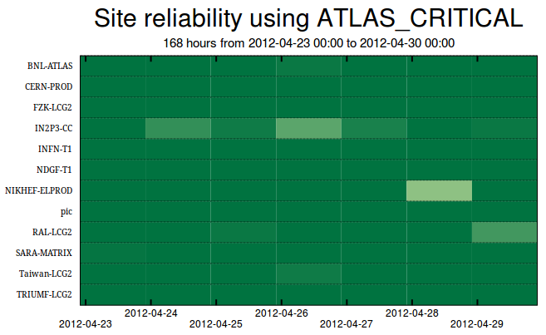
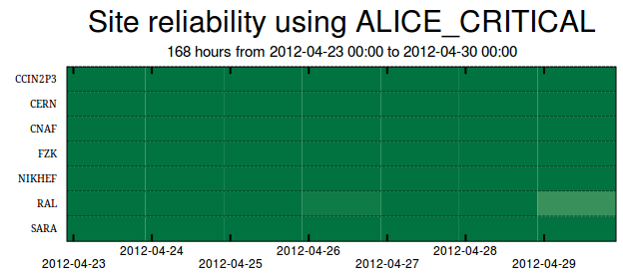
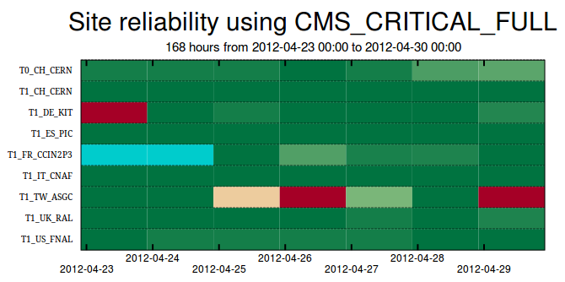
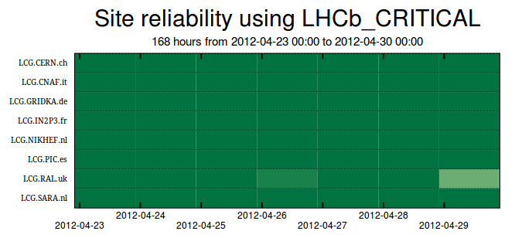
1.1
3.1
3.2
3.2
3.3
3.3
3.3
3.4
4.1

Slide 24
Analysis of the reliability plots: Week of 23/04/2012 – 29/04/2012
                by Jarka Schovancova
Trans-VO events
[None]
ATLAS
1.1 NIKHEF-ELPROD (28/04). CE test results degraded for 7 hrs due to issue with org.sam.CREAMCE-JobSubmit submission (timeout/drop) between 12-19 hrs on 28/04/2012, preceded by no test being submitted between 0:30 and 12:00 on the same day (default test validity is 24 hrs).
ALICE
[Nothing to report]
CMS
Avalanche of missing CE org.cms.WN-mc test results. This can happen when a site is extremely busy, then the test job is in the queue with other jobs which run with a production role, and can time-out/not start within 24 hrs.
3.1 KIT (23/04). Period of unknown reliability due to missing CE tests org.cms.WN-mc between 18/04 and 4am 24/04.
3.2 CCIN2P3 (23-24/04). CE test result unknown on all CREAM-CEs (cccreamceli0[56]) between 1am 22/04 and 5am 25/04, due to missing test org.cms.WN-mc: latest submit 2am 21/04, validity 24 hrs, no test org.cms.WN-mc before 4am 25/04, next test 11pm 25/04.
3.3 ASGC (25-27/04). SRMv2 tests degraded due to issues with CASTOR at ASGC.
3.3 ASGC (29/04). CE tests degraded due to missing test org.cms.WN-mc after ~6am 27/04 (24 hrs test validity, therefore no test results after ~6am 28/04).
LHCb
4.1 RAL (29/04). Degraded CREAM-CE tests due to ca 7 hrs of degraded org.sam.CREAMCE-JobSubmit and warning of org.sam.CREAMCE-DirectJobSubmit.

Slide 25
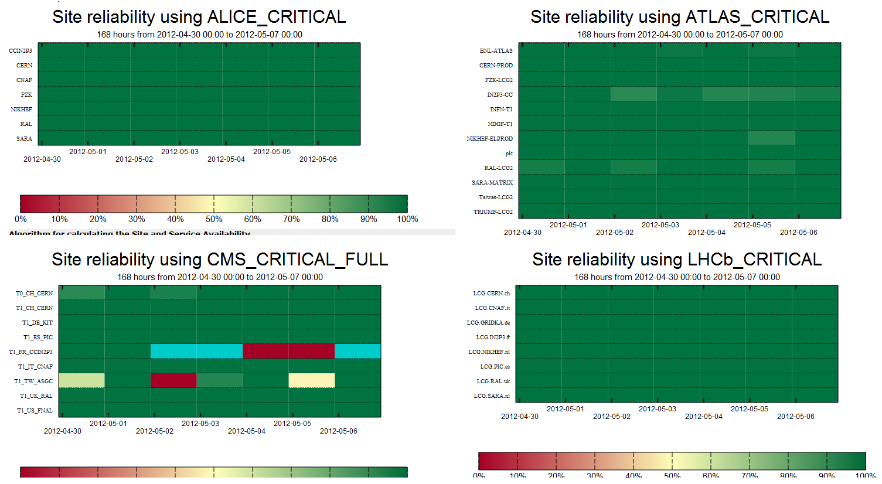
3.1
3.1
3.2
3.2
3.3

Slide 26
Analysis of the availability plots: Week 30/05/2012 by Lukasz Kokoszkiewicz
CMS
  3.1, 3.2 – The availability is zero for some days at ASGC and IN2P3 because the mc test did not run for more than 24 hours (most probably due to the fact that the site was very busy). There is a timeout in Nagios which cancels jobs that haven't completed 23 hours after their submission.

Slide 27
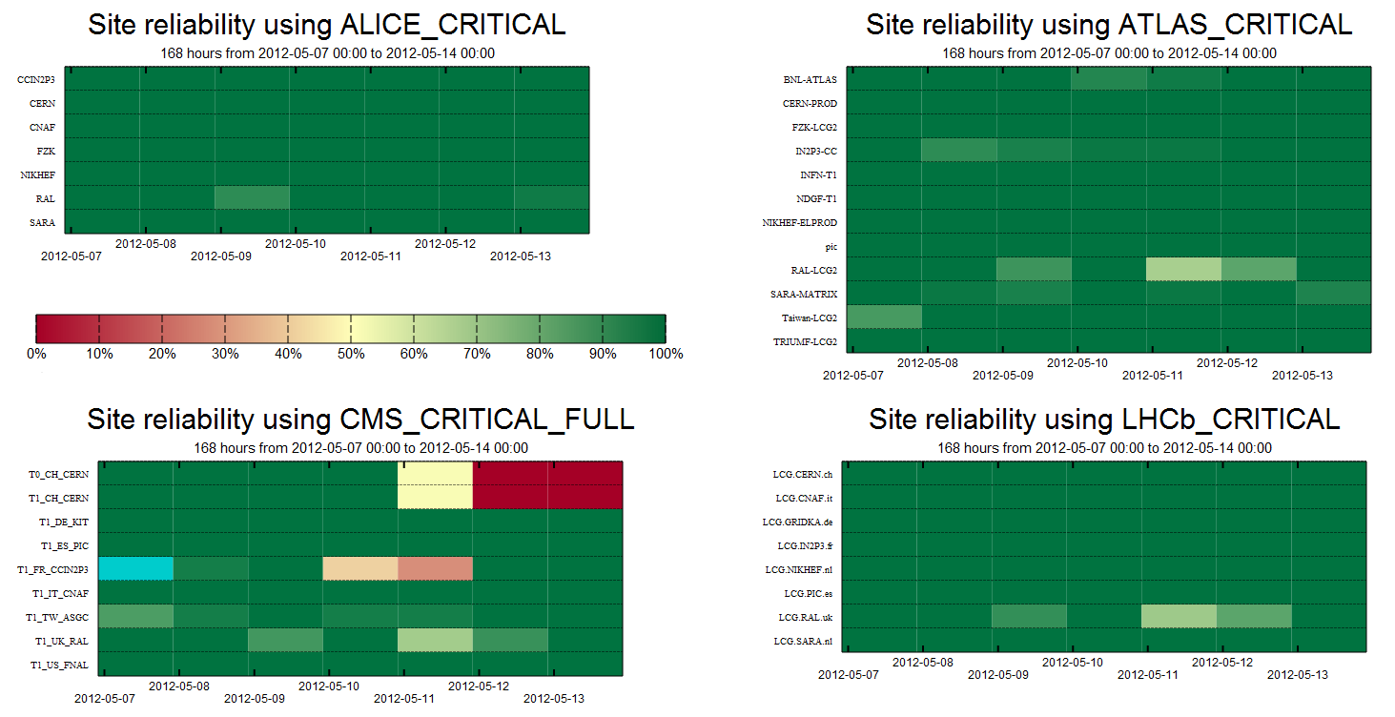
3.1
3.1
3.1
3.2
3.2
3.2
3.3
3.3

Slide 28
Analysis of the availability plots: Week 07/05/2012 by Lukasz Kokoszkiewicz
CMS
  3.1, 3.2 – CERN failing the sync test between the online and CVS versions of TFC
  3.3 – SCHEDULED- Migration to EMI

Slide 29
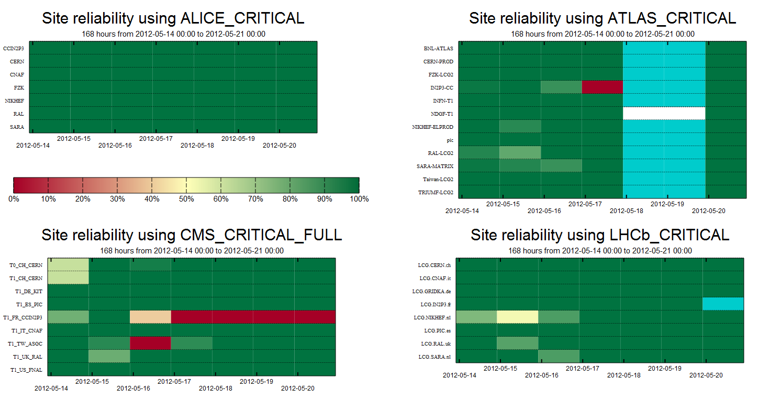
2.1
3.1
3.1
3.1
3.1
3.1
3.2

Slide 30
Analysis of the availability plots: Week 14/05/2012 by Lukasz Kokoszkiewicz
Atlas
  2.1 – Many sites automatically blacklisted by HammerCloud. It was related to upgrade of Panda pilot conflicting with installed 'AtlasSetup'. Pilot update was rolled back this morning and site were automatically unblacklisted after few hours. Problem solved quickly enough to avoid impact on production activity.
  Cyan/white periods: test results unknown/absent due to misconfiguration of the SAM-Nagios machine
CMS
  3.1 – CE-cms-analysis and CE-cms-mc tests were failing
  3.2 – org.cms.WN-swinst test ended with the notice: One or more production releases are not installed

Slide 31
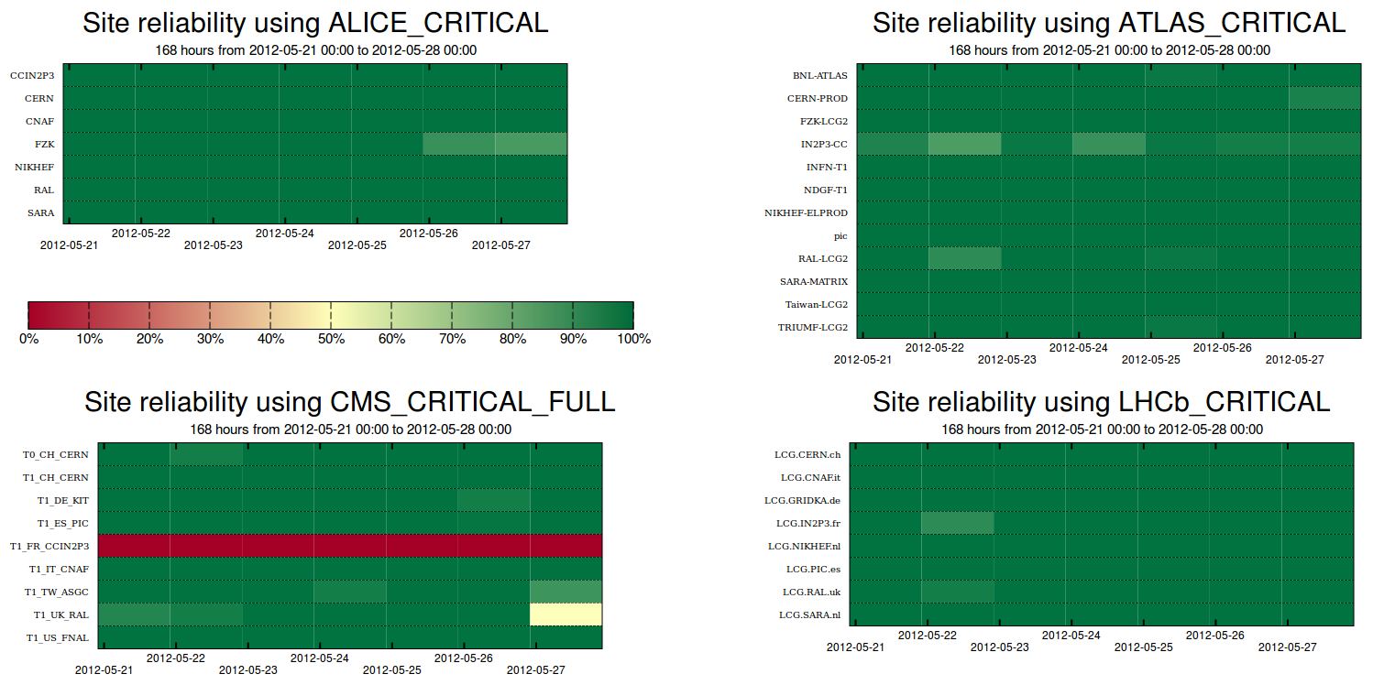
3.1
3.1
3.1
3.1
3.1
3.1
3.1
3.2

Slide 32
Analysis of the reliability plots: Week 21/05/2012 by David Tuckett
CMS
  3.1 – IN2P3 : org.sam.CREAMCE-JobSubmit test failing: “BrokerHelper: no compatible resources”.
  Suspected monitoring issue to be investigated fully after leave 05/06/2012.
  3.2 – RAL : org.cms.WN-basic test failing: “local Trivial Catalog File file differ from CVS”.
  Resolved 28/05/2012.

Slide 33
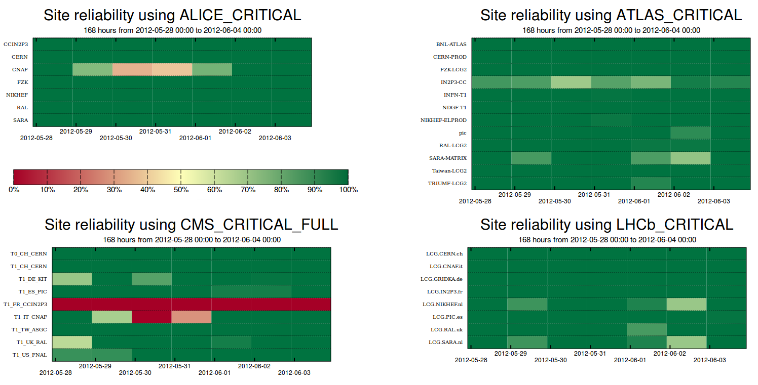
1.1
1.1
3.1
3.1
3.1
3.1
3.1
3.1
3.1
3.2
3.2

Slide 34
Analysis of the reliability plots: Week 28/05/2012 by David Tuckett
ALICE
  1.1 – CNAF : Unscheduled outage of storm-fe-alice. “Due to recent earthquakes which had hit Northern Italy, INFN Tier1 building has been evacuated. We have only closed the CMS and ALICE batch queues because we are experiencing hardware issues on the related storage system, which can't be repaired because nobody can access the building.”
CMS
  3.1 – IN2P3 : CREAMCE-JobSubmit test failing. Suspected monitoring issue to be investigated fully after vacations.
  3.2 – CNAF : Unscheduled outage of storm-fe-cms. See 1.1.

