Slide 1
DBD status and schedule
Y.Sugimoto
2012/4/26
@ILD meeting in KILC12

Slide 2
Today’s meeting
Purpose : Review status of the ILD study toward DBD, and share the information among ILD group
  DBD preparation
  Physics analysis
  MDI/Integration
  Simulation software
  Other discussion
  Short term plan

Slide 3
DBD Status
Section editors decided: early March
SVN repository set up
DBD extended outline has been submitted to RD: early April
IDAG interview on 24th

Slide 4
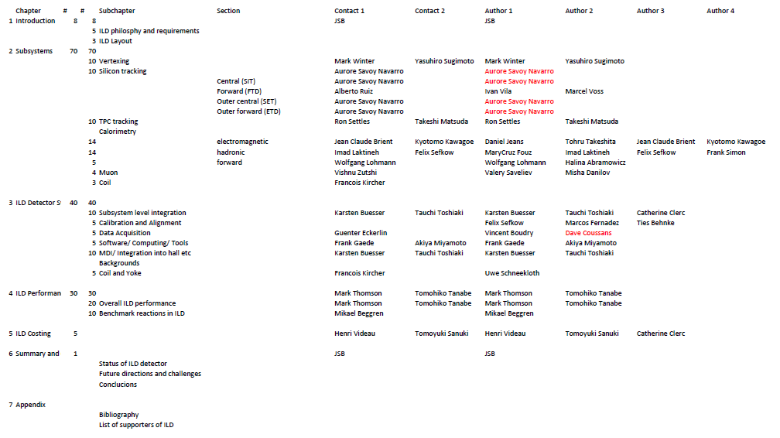
Section editors

Slide 5
Technical aspect
DBD is written in Tex
Common style file as TDR
SVN repository at https://svnsrv.desy.de/baswebsvn/wsvn/General.ilddbd/trunk/ilddbd/
Read only user: ILDReader@desy.de

Slide 6
Schedule
Group of “readers” to be decided
1st internal draft deadline: end of June (before summer vacation)
Complete draft for circulation: end of August
1st official draft: End of September → Submitted to IDAG
LCWS2012: Oct.21~
Freeze the contents: Mid November
Almost final draft sent to PAC: End of Nov.(?)
PAC at KEK: December 15-16
Final draft for circulation: December 15

