Slide 1
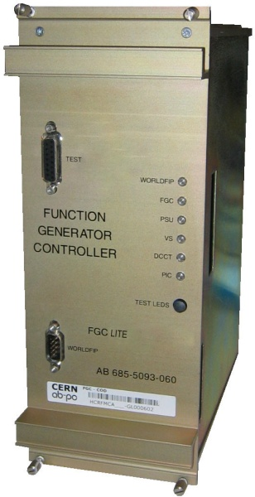
The FGClite Project
Status Update and Requirements
9th R2E Project meeting
TE-EPC-CC R2E Team

Slide 2
Radiation Testing
TRAD – UCL Heavy Ion Tests
  Tests of ADS1271B and 1281 ongoing (this week)
  Slawosz Uznanski visited TRAD twice, presently assisting in tests
  Preliminary results next week…
H4IRRAD – Slot 1
  DAC test: 3 x MAX5541
  ADC test: 3 x ADS1271B (previously exposed in 2011)
  Dallas 1-wire test: 50 x 2401 (ID) + 50 x 18B20 (ID + temperature)
  SRAM tests in preparation for slot 2…
PSI – Protons tests Foreseen
  Voltage Regulator test: 30 x LP3990MF-1.8 (1.8V)
  Voltage Regulator test: 30 x LM340MP-5.0 (5.0V)
  Voltage Regulator test: 30 x LP2980AIM5-3.3 (3.3V)
  Voltage Reference test: MAX6350 (5.0V)

Slide 3
Manpower
Arni Dinius – Project Leader
Benjamin Todd – Hardware Engineer
Gillies Ramseier – Analogue Engineer
Stephen Page – Software Engineer
Slawosz Uznanski – Radiation Expert
R2E Technician – Selection Board May 15th
David Millar – Technical Student – July 1st – 6 months – Dallas 1-wire

Slide 4
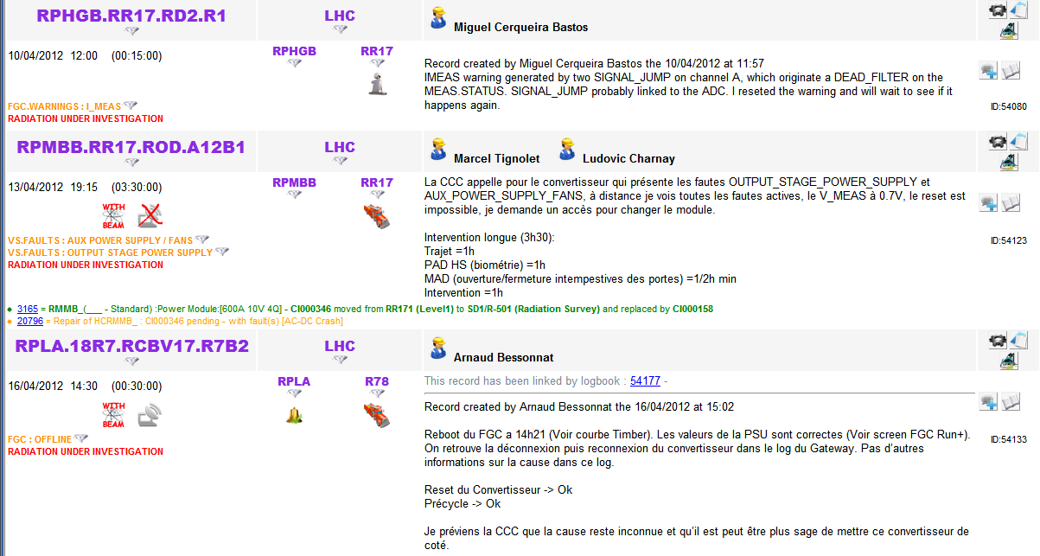
LHC operation
Analysis of FGC failures
  Slawosz will be responsible for trying to understand which events are really due to radiation
  Two cases require analysis. Sometimes no conclusions can be reached:

Slide 5
Development Milestones
1st prototype expected by Autumn
30 prototypes = FGClite segment by the end of the year
Final design = early 2014
Production and testing = 2014
Installation = 2015

Slide 6
Radiation Testing Milestones
H4IRRAD – only available in 2012…
  Two more slots left…
  Cover all aspects as much as we can…
  Type testing & Batch testing
PSI – 2012-13…
  By the end of 2013 = finished procurement and testing
Heavy Ion Tests
  Open question – which components we can afford to test for SEL.

