Slide 1
Federated Identity Management:
Status and perspectives of EGI
Gergely Sipos
EGI.eu, Amsterdam
gergely.sipos@egi.eu

Slide 2
Outline
Introduction to the European Grid Infrastructure
AAI in the middleware-based EGI
Towards FIM adoption
  EGI Federated Cloud
  Federated AAI Pilot for EGA
  NGI survey
Conclusions and next steps

Slide 3
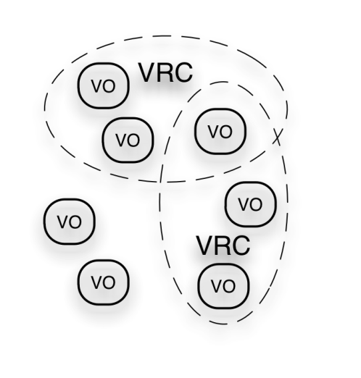
The EGI Ecosystem
User Community
VRC: Virtual Research Community
VO: Virtual Organisation
TRANSfoRm
Policies + Funding
Requirements + Feedback
Services + Support
Resource & service Providers
Requirements + Feedback
Public Funding Bodies
Policies + Funding
Requirements
Technology Providers
European Commission
EGI.eu foundation
National Grid Infrastructures (NGIs) ~45
Grid middleware software
National Research Councils
Strategic Feedback
SW +
Support
Cloud provider software

Slide 4
EGI’s Strategic Focus http://go.egi.eu/EGI2020
Operational Infrastructure
  Operate a European wide infrastructure
  Offer its use to other research infrastructures
  Build a federated cloud environment
Community & Coordination
  Community building through events
  Community networking through the NGIs
Virtual Research Environments (VREs)
  Support the development, integration & operation of
  community/project/domain specific services

Slide 5
AAI in the middleware-based EGI
Grid = federated resources exposed for controlled sharing via middleware services
  X.509 personal certificates
    From IGTF CAs
    From Terena Certificate Service
  Limited certificates
    Restricted in lifetime and/or infrastructure coverage
  Robot certificates
    Belong to applications (portals) instead of users
  Identity federations
    Middleware bridging, science gateways
Nb. of users
Tens of thousands
Thousands
Hundreds
?

Slide 6

Federated Cloud: a new EGI platform
Research Communities
Virtual Research Environment
Collaboration services
‘Cloud’ EGI:
applications in
Virtual Machines
‘Traditional’ EGI: batch processing
job
job
job
Virtual machine
Grid middleware services
Research facilities
(e.g. detectors, sensor networks)
Virtual machine
Virtual machine
VM
DB
SW
EGI Federated Cloud
EGI resources
(clusters, storages,...)
Dedicated or shared resources/platforms
(e.g. Clusters; dekstop grids, commercial cluds, GPUs, etc.)

Slide 7
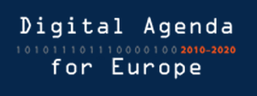
FIM adoption in the EGI cloud
Personalised environments for individual research communities
in the European Research Area
Testbed with ~1.700 CPUs is available for scientific communities!
Project/community specific services
SaaS
Project/community
specific services
Project/community
specific services
Custom
AAI
PaaS
VM Mgmt
Data
Information
VM Mgmt
Data
Information
VM Mgmt
Data
Information
X.509
AAI
Institutional cloud
NGI cloud
Commercial cloud
IaaS
Monitoring
Accounting
Notification
Monitoring
Accounting
Notification
Monitoring
Accounting
Notification
EGI-wide message bus

Slide 8
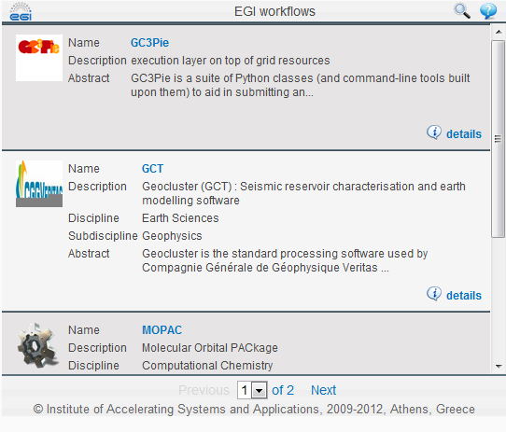
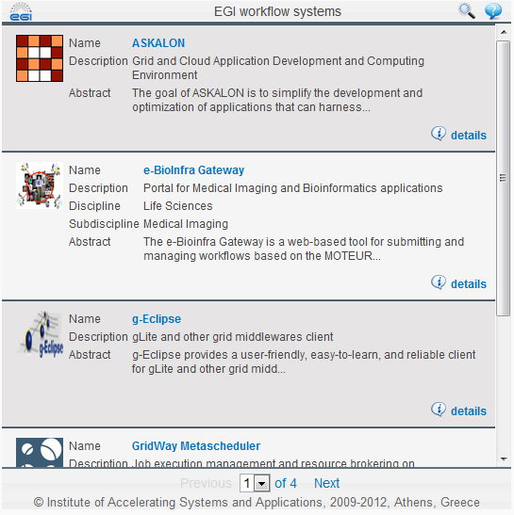
Application/service integration: workflows
Turn applications into repeatable, sharable experiments
Catalogue of existing workflow tools and workflow applications
  http://go.egi.eu/workflows

Slide 9
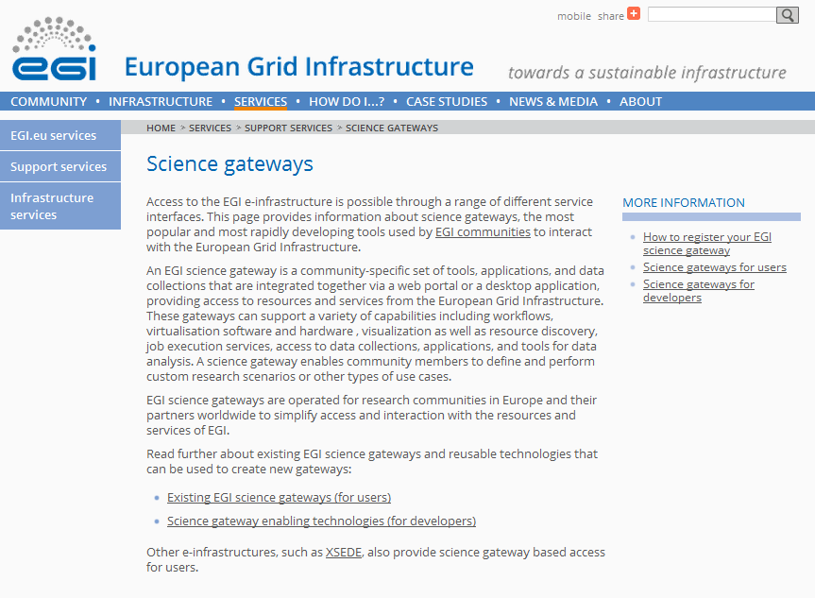
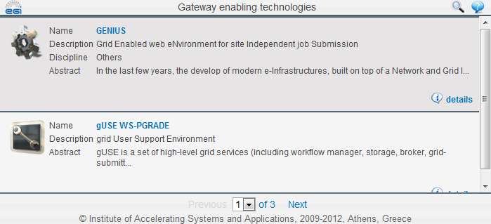
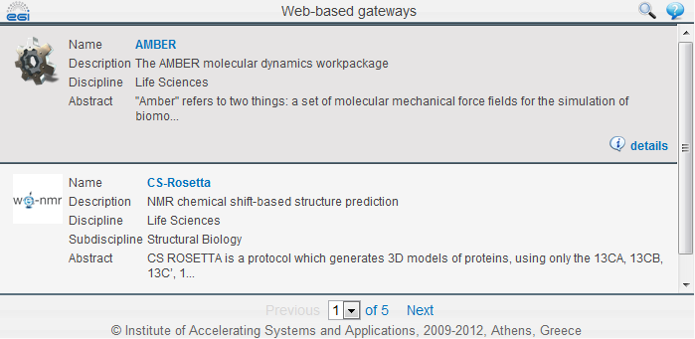
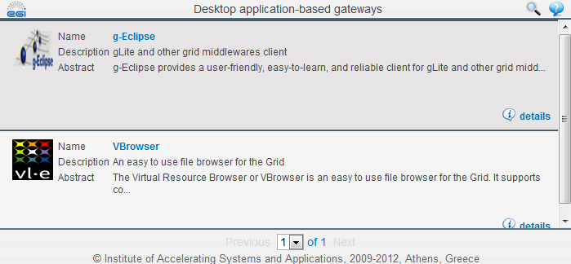
EGI-compatible portals
Access EGI-based applications through the Web
Catalogue of existing portals and enabling technologies
  http://go.egi.eu/sciencegateways
“How-to” documentation for portal developers
  Under development https://wiki.egi.eu/wiki/VT_Science_Gateway_Primer
NEW: Become an associated member of the SCI-BUS project
  Funding for portal development
  http://www.sci-bus.eu

Slide 10
Other FIM adoption activities
European Genome-phenome Archive AAI Pilot
  Interface EGA service with an Identity Federation (HAKA, Finnland)
  Demonstrator supported through EGI-InSPIRE (EBI-EMBL, CSC, EGI.eu)
Virtual Team project
  Assess the readiness of the NGIs in adopting FIM mechanisms: https://wiki.egi.eu/wiki/VT_Federated_Identity_Providers_Assessment
    Terena Certificate Service
      Availability of personal certificates
      Availability for ‘NGI institutions’
      Availability for potential EGI user institutions
    Custom FIM solutions
    Czech, French, Italian, Irish, Swiss NGIs + EGI.eu

Slide 11
Conclusions
Requirements for a generic AAI: Geographical coverage, science discipline coverage, scalability, robustness, simplicity, sustainability, integrate-ability with EGI platforms.
X509 certificates
  Complicated to most users, but no sign of change in middleware (provided by EMI, IGE)
  Expected to stay for platform developers for the IaaS cloud
Terena Certificate Service
  Not much simpler, serious lack of coverage (country, NGI members, community)
FIM solutions
  There is no single provider, standard. Rapid evolution and adoption
  Several initifiaves by EC (EduGAIN, REFEDS, ...) and NGIs (IT, CH, HU, CZ...)
  EGI community-wide collection, evaluation and discussion of these is the next step:
  AAI workshop at the EGI Technical Forum
White paper / Report
  Authentication solutions in the European Grid Infrastructure https://documents.egi.eu/document/1178

Slide 12

Questions?
EGI Technical Forum 2012,
Prague, Czech Republic, 17–21 September
www.egi.eu
AAI Workshop
Send your one paragraph long abstract before July to
gergely.sipos@egi.eu, peter.solagna@egi.eu

Slide 13
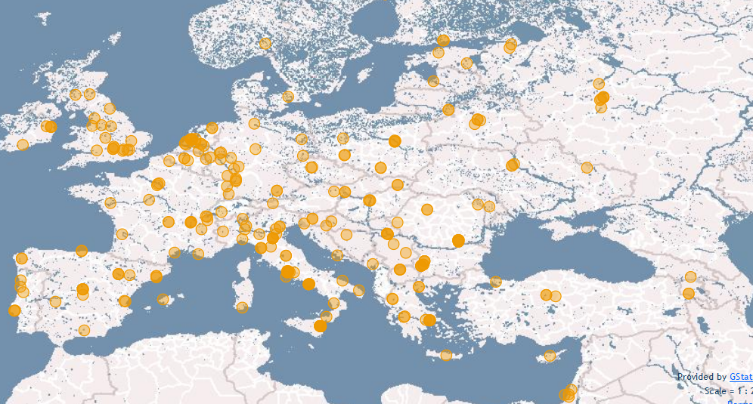
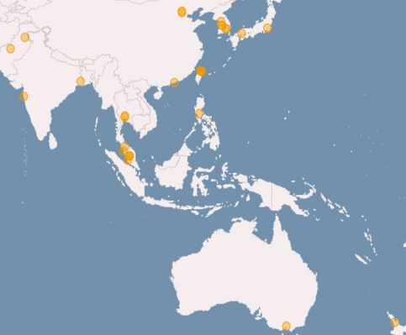
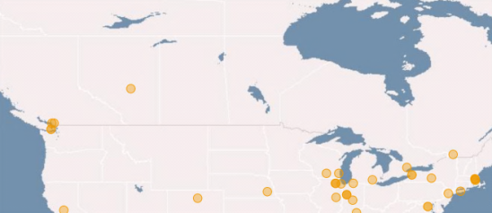
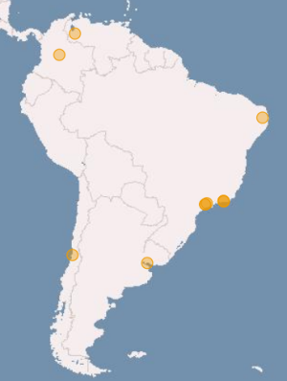
Installed capacity (Apr ‘12)
Metric | Value (yearly increase)
Sites | 326 (+3%)
Nb. of CPU cores | 270,800 (+31%)
Disk (PB) | 139 PB (+31%)
Tape (PB) | 134 PB (+50%)

Slide 14
EGI Cloud based on open standards
Infrastructure Capabilities
  VM Management, Data Management, Information Discovery, Accounting, Monitoring, Notification
Community Capabilities
  Federated authentication & authorisation, VM Image Sharing (Virtual Image repository)
Implementation based on third party, open standards and open source implementations:
  Frond-end interfaces: OCCI, CDMI-OVF, GLUE-LDAP
  Back-end interfaces: UR+-StAR, Nagios, ActiveMQ
  Providers: OpenNebula, OpenStack, Stratuslab

Slide 15
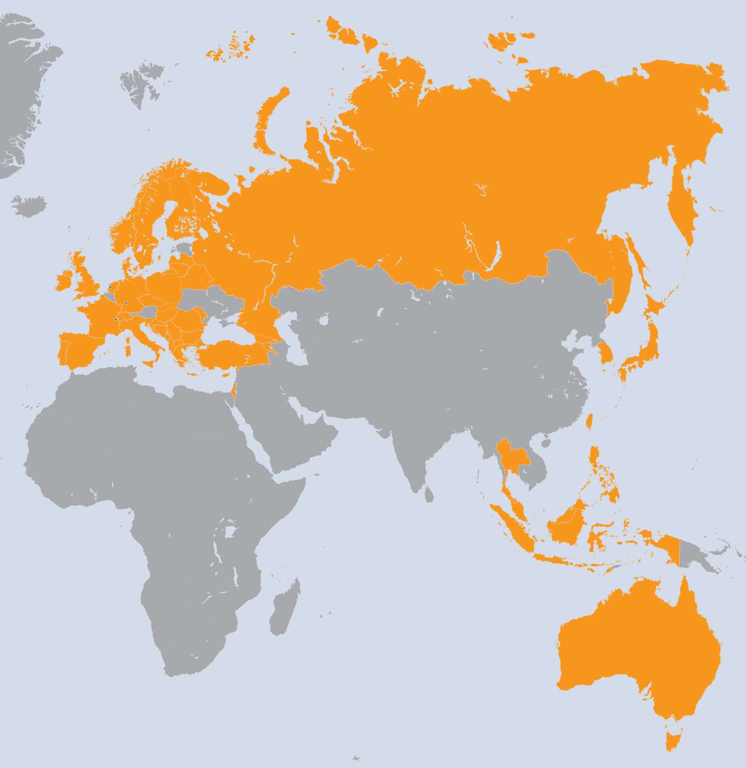
EGI-InSPIRE Project
Integrated Sustainable Pan-European Infrastructure for Researchers in Europe
A 4 year project with €25M EC
contribution
  Project cost €72M
  Total Effort ~€330M
  Effort: 9261PMs
Project Partners (50)
EGI.eu, 38 NGIs, 2 EIROs
Asia Pacific (9 partners)

