Slide 1
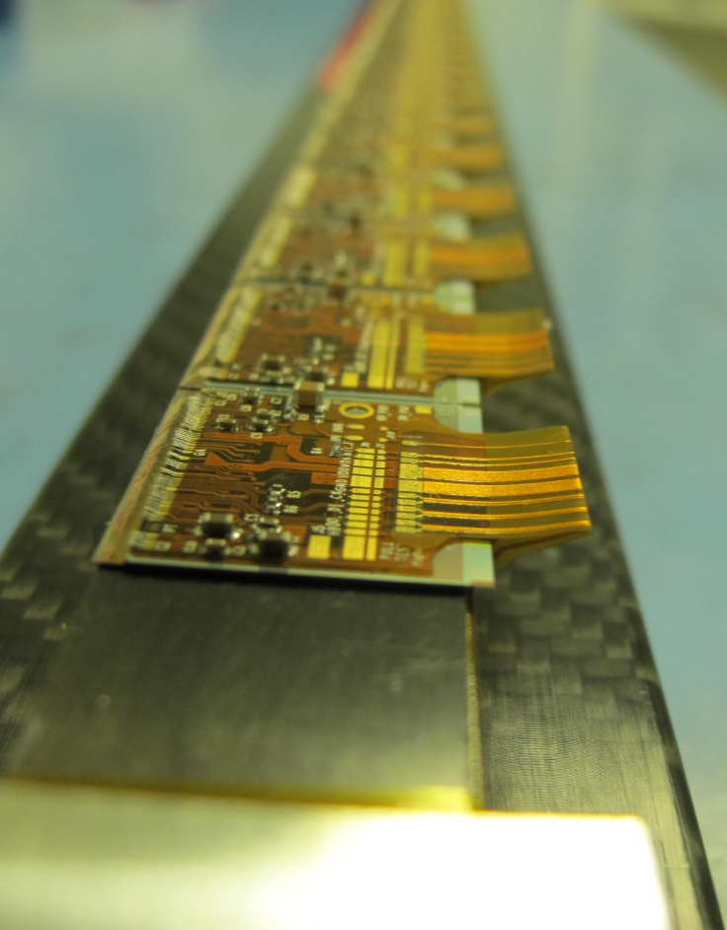
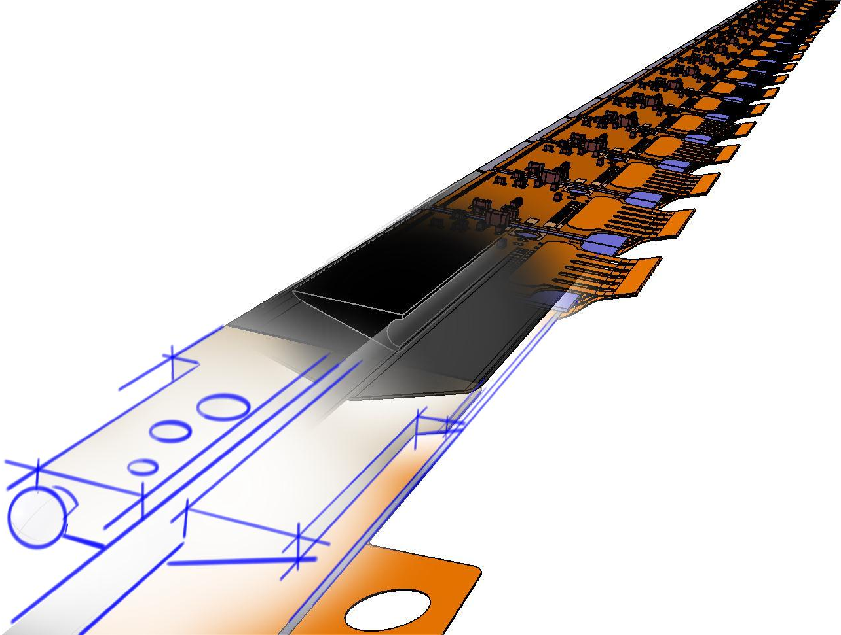
Experience from ATLAS IBL
Eric Vigeolas, July the 3rd 2012

Slide 2
Status
The IBL detector construction already started and the components assembly (flex, modules, stave loagin) will start in Sept, Oct this year
Due to fast track schedule initiated one and half year ago the production and qualification have been pursue in parallel
The first demonstrator stave (“stave 0”) have been assembled and stave commissioning is on going
Stave review (PRR) is scheduled July the 10th

Slide 3
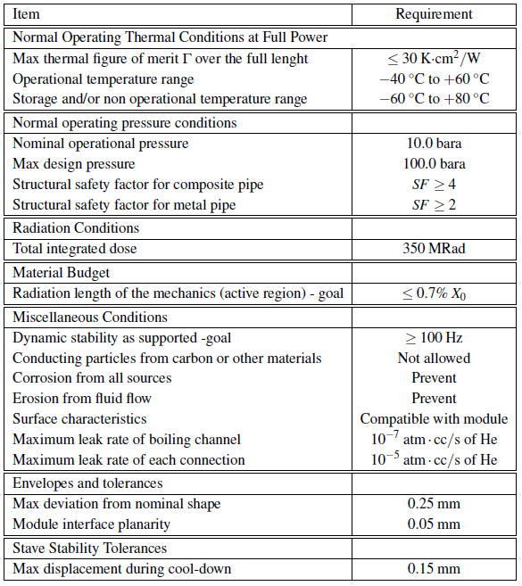
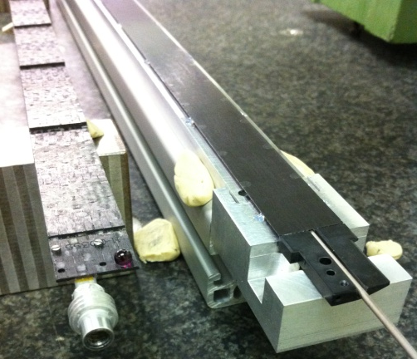
IBL Local supports requirements
The most important requirements which has been set for IBL detector are:
  The material reduction → IBL bare stave weight = 26 grams, Pixel bare stave weight = 45 grams
  The operating module temperature → Pixel module are between 0°C to -7°C, IBL modules will be bellow -15°C
  The radiation conditions are 3 times higher on IBL than Pixel
  Stave deformations (Thermo-mechanical, gravity sag …) have been relaxed to 150 m compare to 30 m for pixel detector
  CO2 cooling have been chosen instead of C3f8 → high pressure resistance cooling lines (150 Bars)
Compare to Pixel detector important progress have been done in most of performances parameters
Pixel Stave
IBL Stave

Slide 4
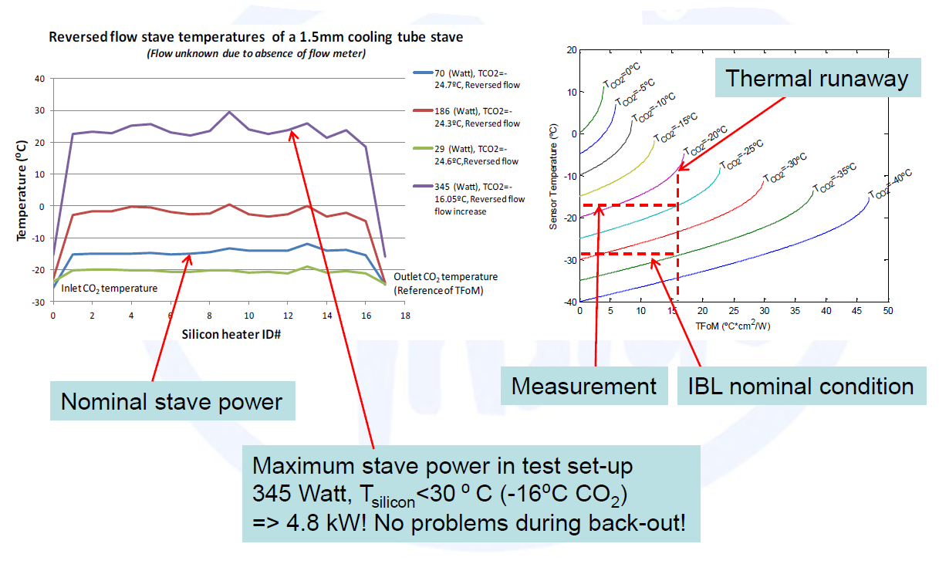
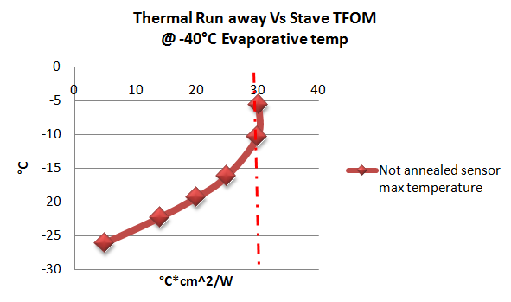
Thermal performances
IBL thermal performances are driven by the impact of radiations on planar sensors (“Thermal run away”)
Performances are evaluated looking to the “Thermal Figure Of Merit” (TFOM) of the local supports
Long term testing was performed (thermo cycling, pressure cycling, combine temperature and pressure cycles) → Stave performances remain unchanged (> 400 cycles done)

Slide 5
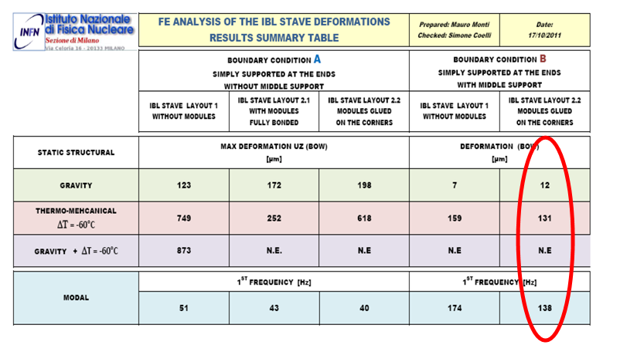
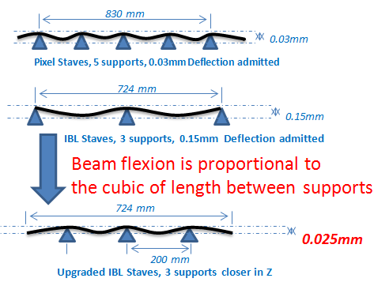
Thermo mechanical performances
The Stave deformation depend on many factors:
  CTE mismatch between parts composing the stave assembly
  Stave material mechanical properties
  The stave assembly scheme (how many fixation points and cinematic..)
IBL stave was designed to minimize the CTE mismatch → Except the type 0 flex circuit which impact the stave deformation and stress → Services integration need to be studied early in the design
The staves fixations points are from the theatrical point of view more important that the material properties → Detector integration with support tubes or global structures needs to be carefully studied

Slide 6
Lessons from IBL construction
The small number of staves inside IBL (14 parts) permit us to produce more than twice the amount without impacting the cost → luxury situation but mandatory when the schedule is tight
Early decision was taken to produce large number of prototypes (11 parts made up to now) in nominal conditions (tools and process) to evaluate the quality and uniformity → This is very important and useful to not restrict prototyping to one or two staves
Stave 0 program was one of the most instructive prototypes while all the assembly steps have been tested. We have in hand a fully functional stave which will suffer stress tests to evaluate the design stiffness

Slide 7
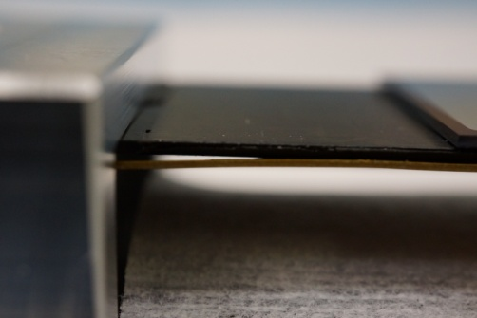
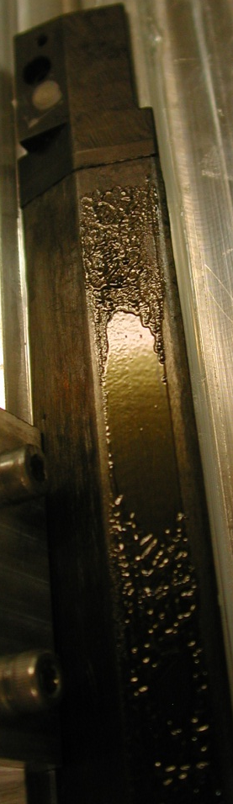
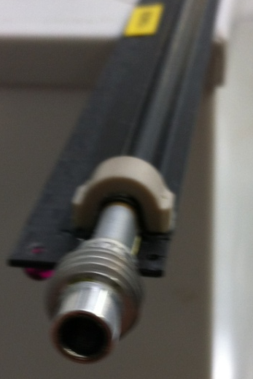
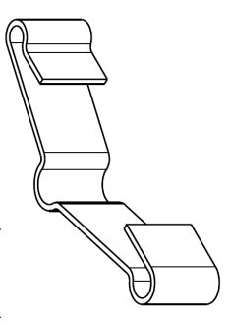
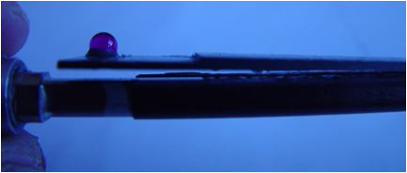
Lessons from IBL construction
Flex delamination @ Ends Of Staves → This is a lesson we should have learnt from Pixel
EOS are areas where stress are concentrate especially handling stress→ Designing glue less structures should consider this point
Flex delamination
IBL Stave
Pixel Omega delamination @ EOS
Peek reinforcement bloc have been added which solved the problem
Carbon Clip will be added at the Stave ends to clamp the flex on the stave. Glue deposition has been improved for better contact surface

Slide 8
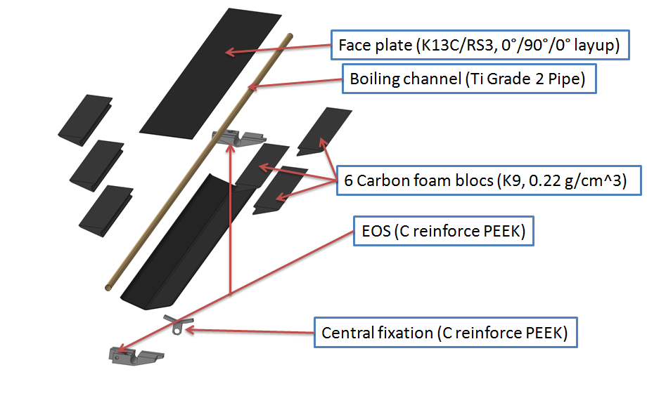
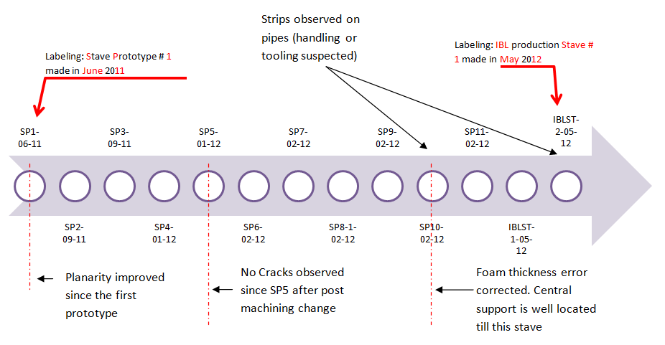
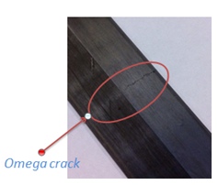
Lessons from IBL construction
11 prototypes manufacturing permit us to identify early some problems in the tasks sequence and improvements were applied
An IBL stave is an assembly of 12 parts in a 13 steps process → We keep improving this process

Slide 9
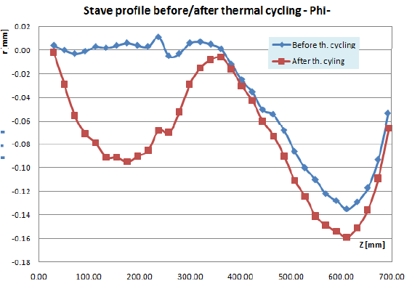
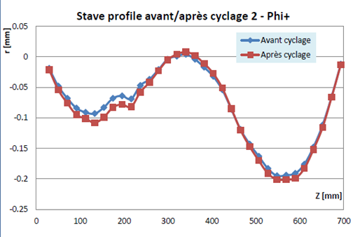
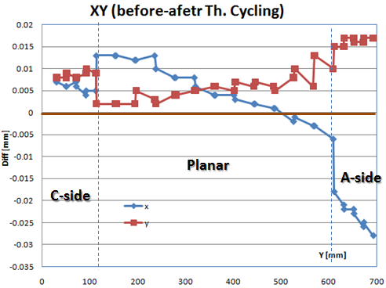
Remaining problems under improvement
Thermal chocks and Cycles was applied on Pixel detector and reveal most of the problems (wire bond potting detachment, omega delamination …)
IBL stave thermal cycles are part of the QA and module metrological survey is done before and after cycles (which was not done on Pixel) → UniGe observed an asymmetric deformation of the stave without modules and with modules
The stave/Jig/Flex CTE mismatch is suspected(even if srews are relaxed during cycles)
The Glue Glass transition temperature is also suspected → A post curing step of the bare stave have been added in the taks sequence → Detail stave relaxing procedure and Metrology process are under improvement

Slide 10
IBL design, any improvements?
One of the major change between Pixel and IBL detector is the use of micro-cable for pixel and Flex circuits for IBL
The flex is glued directly on the stave and impact the flexibility of the assembly → while on Pixel cable were floating along the stave and glued only bellow the connector on the module side
A lot of design changes was driven by our past experience on Pixel and aimed to improve the reliability
IBL will be the good proof of reliability improvement with flex circuits → too early to reply
The global electrical chain will provide important informations on type one services management
Local support should integrate early the services and more embedded design should be preferred

Slide 11
Conclusion
We are a the beginning of the story, a lot will be discovered and corrected
Many tasks remain to be tested :
  PP0 brazing
  Stave integration around the beam pipe
  Stave long term testing and burn in
  Detector insertion inside IST
  …
IBL is a good improvement of the pixel staves

