Slide 1
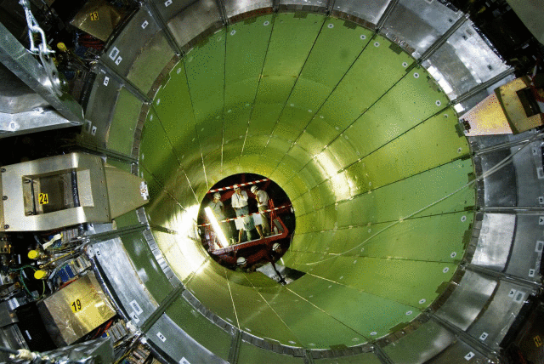
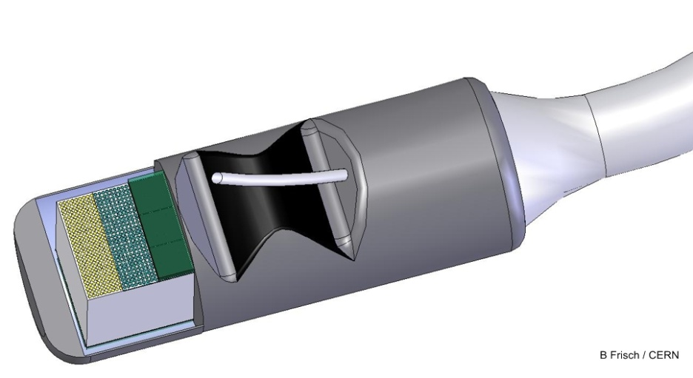


A Multimodal Ultrasonic Probe Featuring Time of Flight PET in Diagnostic and Therapeutic Endoscopy
Endo-TOFPET-US
FP7 Project, Call Health 2010
© 2008 CERN, for the benefit of the CMS Collaboration
“The research leading to these results has received funding from the European Union Seventh Framework Program (FP7/2007-2013) under Grant Agreement No. 256984. This research is also supported by the Marie-Curie Actions ITN:
PicoSEC-MCNeT under Grant Agreement No. 289355.”
NINO
PADJK
APD Array
NINO
NINO
LSO
PADJK
PADJK
APD Array
APD Array
LSO
LSO
Fig. 5: Functional diagram of the photon detection and signal processing layout
Fig. 5: Functional diagram of the photon detection and signal processing layout
Notes:
Introduction:
From physics to health? US stands for ultrasound not united states;
CMS calorimeter a real marvel, fully crystal-built
Endoscopic probe: go from 80 tons to grams and build a miniature calorimeter; as small as my small finger tip;
learn from HEP; use tools and instruments from HEP (NINO from ALICE used in TOF, crystals from CMS, FEDC05 amplifiers from ATLAS, etc); Vast pool of knowledge and competence in scintillating material;
TOF extremely useful, temporal collimation, space points, used in TOTEM, ALICE, comes at no extra charge (except for ALICE)
this research also useful for next generation of accelerators (CLIC);
Endo-TOFPET-US addresses new biomarkers specific for prostatic and pancreatic cancers
Collaboration – called consortium – of academia, medical sector and industry, perhaps a novelty in joint ventures
All partners plus one more (STM) have also engaged in the Marie-Curie Actions Program and actively participate in an Initial training network; education oriented
Our research entirely “sponsored” funded by the European Commission.

Slide 2
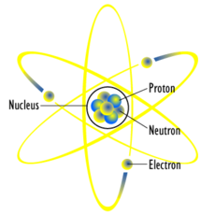












The Consortium
NINO
PADJK
APD Array
NINO
NINO
LSO
PADJK
PADJK
APD Array
APD Array
LSO
LSO
Fig. 5: Functional diagram of the photon detection and signal processing layout
Fig. 5: Functional diagram of the photon detection and signal processing layout
Notes:
Very exciting environment involving research & academia and industry and medical sector

Slide 3
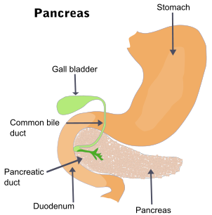
EndoTOFPET-US: The Principle

Slide 4
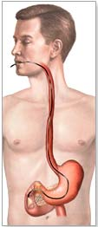
EndoTOFPET-US: The Principle

Slide 5
EndoTOFPET-US: The Principle
External PET Plate
Notes:
Get large field of view;
we in HEP call it: cover as much of the solid angle as possible

Slide 6
EndoTOFPET-US: The Principle
External PET Plate

Slide 7
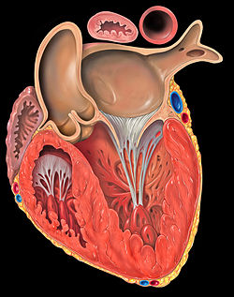
EndoTOFPET-US: The Principle
External PET Plate

Slide 8
EndoTOFPET-US: The Principle
External PET Plate
Conventional Back-Projection

Slide 9
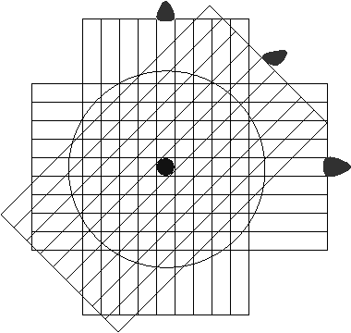
EndoTOFPET-US: Why TOF?
External PET Plate
With TOF Constraint
t₁
Target CTR: 200ps → 30mm FWHM
t₂

Slide 10
Project Objectives
Development of new biomarkers;
First clinical targets: pancreatic & prostatic cancers;
Develop a dual modality PET-US endoscopic probe with...
  Spatial resolution: 1mm;
  Timing resolution: 200ps FWHM coincidence;
  High sensitivity to detect 1mm tumors in a few minutes;
  Energy resolution: sufficient to discriminate against Compton events .

Slide 11
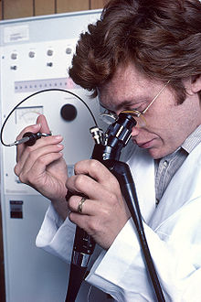
PET Configuration
Asymmetric:
  One PET detector close to ROI
    incomplete (non-2π) projections;
    → Simulation and reconstruction challenge.
Endoscopic:
  One PET head inside the body
    → Extreme miniaturization;
    → Background from close organs (e.g. heart, bladder);
    Varying geometry (body & organ motion)

Slide 12
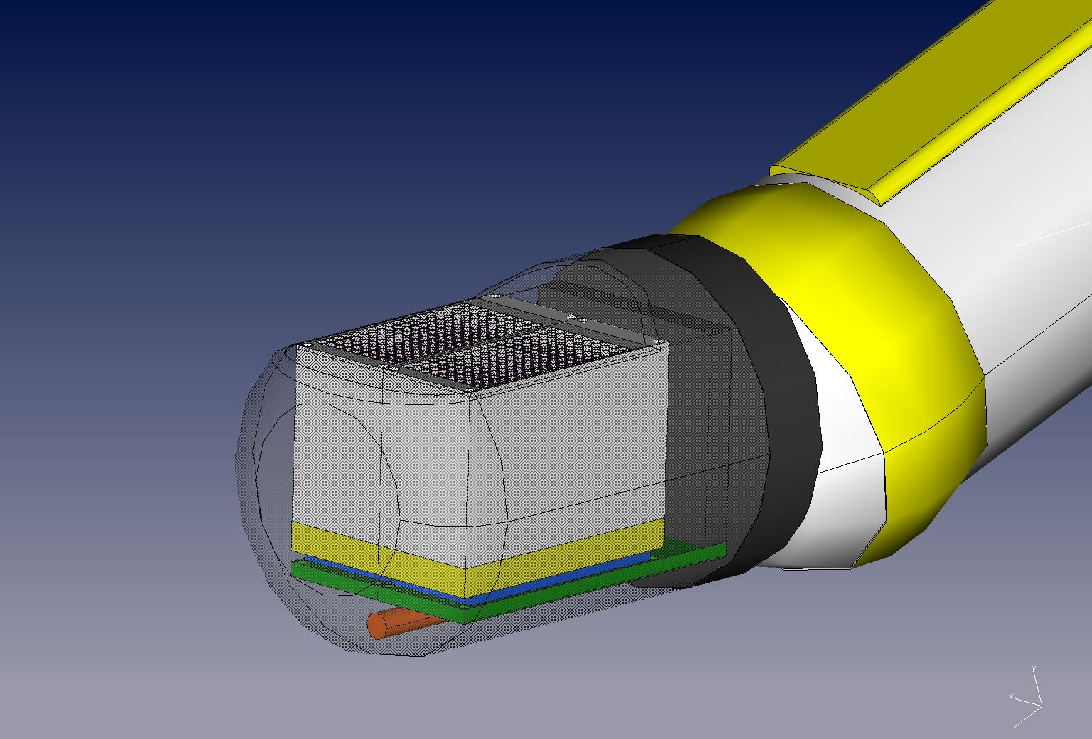
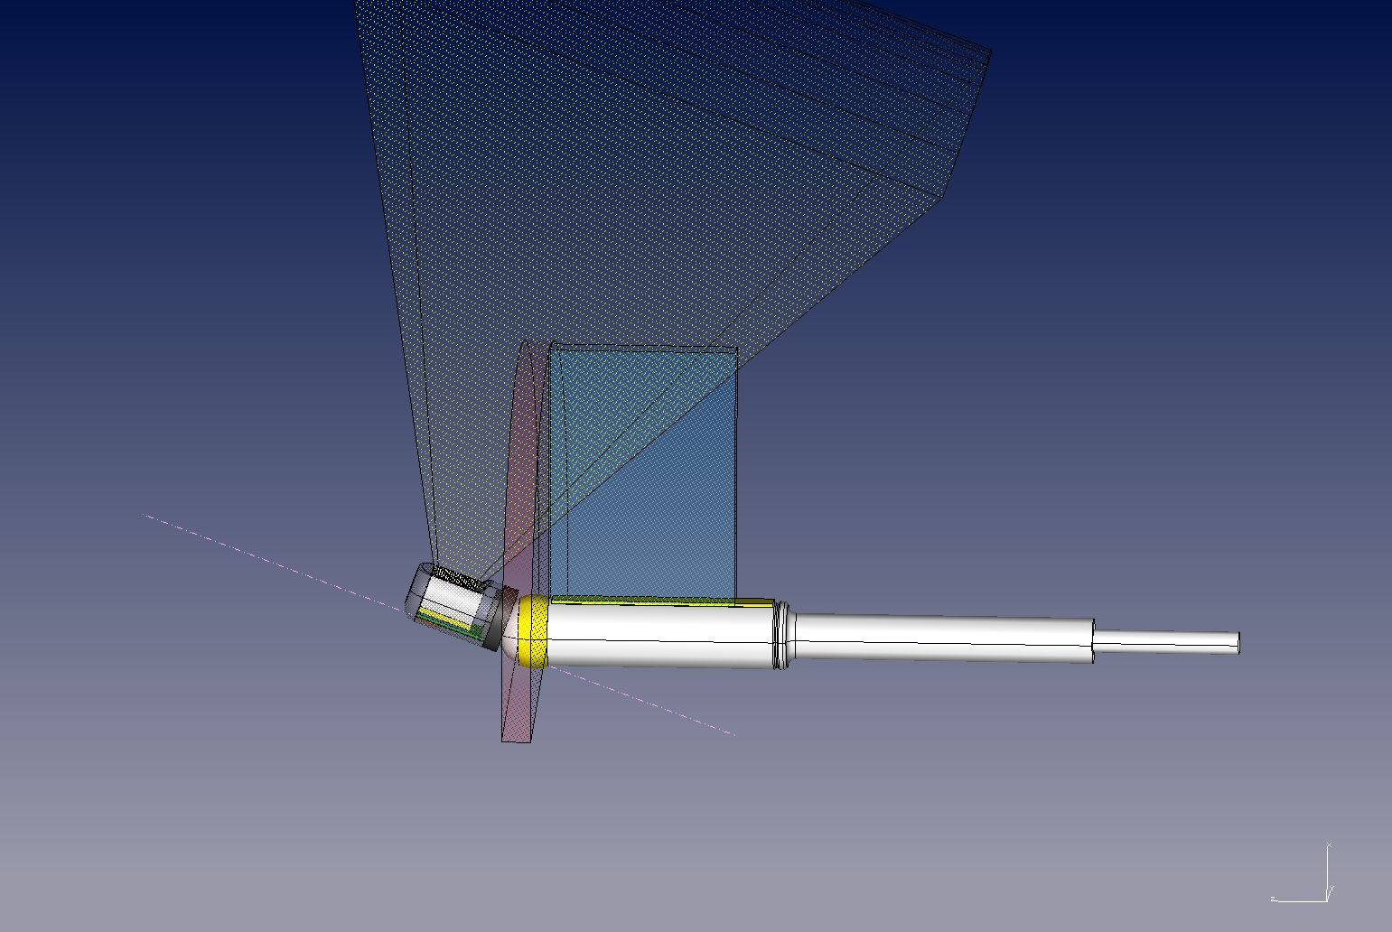
The Endoscopic Probe
PET head
External plate
PET head FOV
Object under study
US FOV
Ultrasonic (US) probe
e.m. tracking sensor

Slide 13
Two Different Probes...
PET head
External plate
PET head FOV
Object under study
US FOV
Ultrasonic (US) probe
e.m. tracking sensor

Slide 14
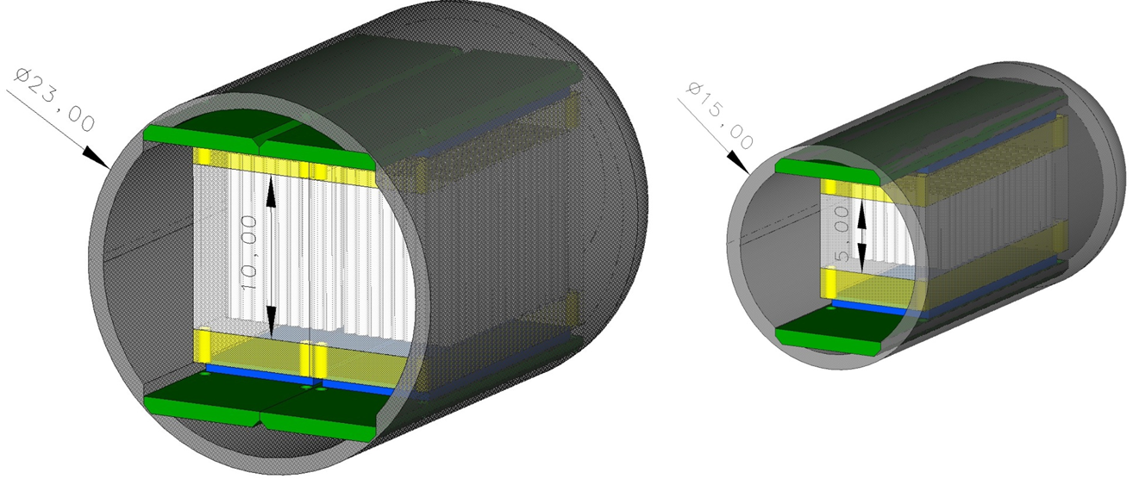

Two Different Probes...
22.00
22.00
Option 1: prostate
 |  | Prostate
Crystal Matrix | [mm²] | 14 x 15
Fiber length | [mm] | 10
Fiber pitch x/y | [µm] | 780/800
# Fibers in x/y |  | 18x18 (324)
Diffractive optics | [mm] | 2
SPAD array thickness | [mm] | 0.75
PCB thickness | [mm] | 1
# Readout layers |  | 1
Total thickness | [mm] | 18
Diameter of detector | [mm] | 23
Length of detector | [mm] | 22
Notes:
What looks big on slide and screen is in fact only as large as a thumb or finger.

Slide 15
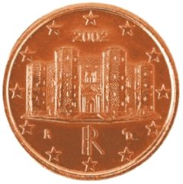
Two Different Probes...
22.00
22.00
22.00
Option 1: prostate
 |  | Prostate | Pancreas
Crystal Matrix | [mm²] | 14 x 15 | 7 x 15
Fiber length | [mm] | 10 | 5 (9)
Fiber pitch x/y | [µm] | 780/800 | 780/800
# Fibers in x/y |  | 18x18 (324) | 9x18 (162)
Diffractive optics | [mm] | 2 | 2
SPAD array thickness | [mm] | 0.75 | 0.75
PCB thickness | [mm] | 1 | 1
# Readout layers |  | 1 | 1
Total thickness | [mm] | 18 | 13
Diameter of detector | [mm] | 23 | 15
Length of detector | [mm] | 22 | 22
Option 2: pancreas

Slide 16
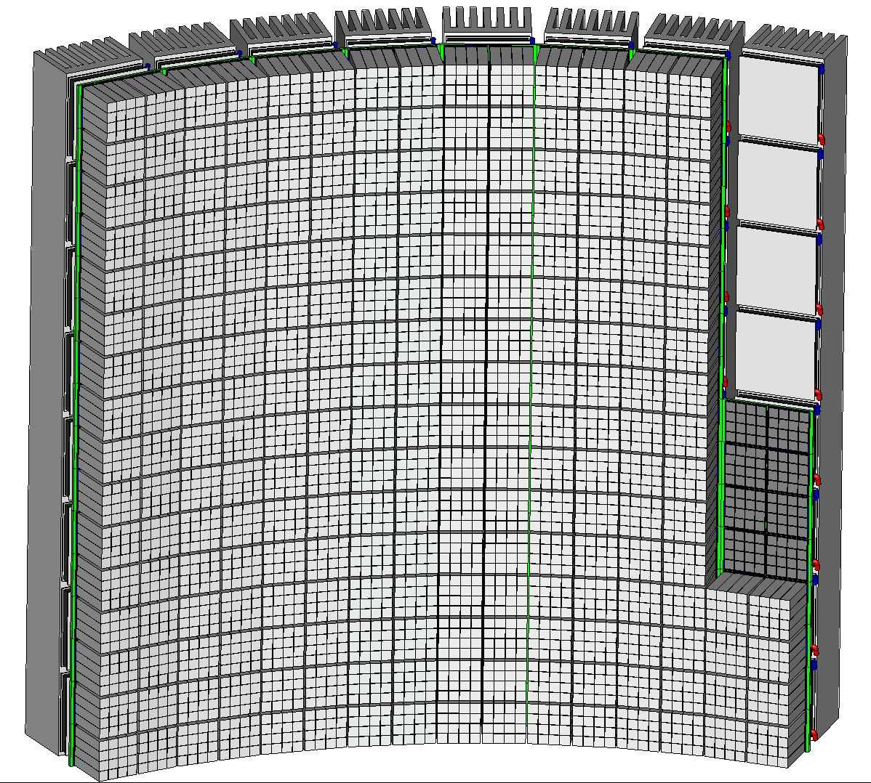
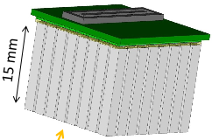
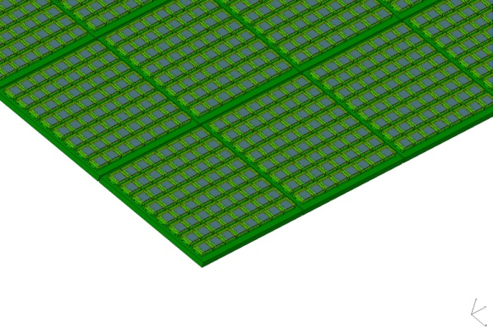
External PET Plate
15 mm
8 x 8 Crystals/”Matrix”
8 x 8 crystals
3 x 3 x 15 mm³
205 mm
64 x 64 Crystals Total
SiPM “8x8-Module”, i.e. four close-butted 4 x 4 MPPC monoliths
205 mm

Slide 17
Technical Challenges
Calls for innovative solutions
  Very thin crystal pixels/fibers for the internal probe;
    for high granularity and sub-millimeter spatial resolution;
  Temporal collimation with TOF: CTR < 200ps FWHM;
    for background rejection outside ROI of 30mm;
  Digital light detection: SiPM with single SPAD readout;
    for single optical photon counting and ultimate timing resolution;
  Diffractive optics - light concentrators ;
    for overcoming loss of sensitive area and optimizing light collection;
  High level of integration for electronics & mechanics;
    For miniaturization (±5μm precision);

Slide 18
Detector R&D
1.) Photodetectors
  The analog SiPM (a-SiPM)
  The digital “Endo-TOFPET” SiPM (d-SiPM)
2.) Diffractive Optics
3.) Scintillators
4.) Integration
5.) Readout and Data Acquisition

Slide 19
Detector R&D
1.) Photodetectors
  The analog SiPM (a-SiPM)
  The digital “Endo-TOFPET” SiPM (d-SiPM)
2.) Diffractive Optics
3.) Scintillators
4.) Integration
5.) Readout and Data Acquisition

Slide 20
Photodetectors: Choices
The a-SiPM:
a-SiPM
low rise time;
high capacitance;
reasonable fill factor (FF);
mature technology;
commercially available
time over threshold discr.
standard (HP)TDC readout.
∑

Slide 21

a-SiPM versus d-SiPM
The a-SiPM:
a-SiPM
low rise time;
high capacitance;
reasonable fill factor (FF);
mature technology;
commercially available
time over threshold discr.
standard (HP)TDC readout.
∑
The d-SiPM:
very low rise time;
individual SPAD readout
  → single photon counting
  → optimum timing
high functionality
ambitious/risky
novel technology
optimized for endoscope
d-SiPM
“endoTOFPET”
TDC
TDC
TDC
TDC
Notes:
d-SiPM:
intelligent detector/chip
functionality: active quenching, control afterpulsing, counters (1,1.5, 2 bits)
very attractive features

Slide 22
Detector R&D
1.) Photodetectors
  The analog SiPM (a-SiPM)
  The digital “Endo-TOFPET” SiPM (d-SiPM)
2.) Diffractive Optics
3.) Scintillators
4.) Integration
5.) Readout and Data Acquisition

Slide 23
a-SiPM: Test Scenario
☛ For an intrinsic SiPM timing evaluation,
see poster by Stefan Gundacker/CERN;
Coincidence time resolution (CTR) measured with scintillating “reference” crystals and the NINO amplifier/discriminator;
Use high-BW scope (LeCroy DDA 735Zi, 40GS/s) or HPTDC.
NINO chip:
Fast discrimin. (3GHz BW)
Signal peaking time: <1ns
Output time jitter: ≤ 25ps
Differential architecture
Sample CTR Spectrum
NINO
SiPM
LSO
(2 x 2 x 10 mm³)
²²Na-Source
SiPM
LSO
CTR measured with two same SiPMs:
Crystals are wrapped and mounted
“small-face-to-SiPM” with grease;
Spectra are refined through photo-peak selection.
NINO

Slide 24
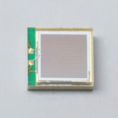
a-SiPM: Evaluation & Selection
Suitable SiPMs are commercial MPPCs by Hamamatsu Photonics;
Evaluation of photodetectors via measurement of the (CTR):
MPPC S10931- | # SPADs | Fill Factor [%] | V_{Manuf.} [V] | V_{optimum} [V] | DCR^{*)} [MHz] | NINO Thr. [mV] | CTR FWHM [ps]
-025P | 14’400 | 30.8 | 71.49 71.44 | 73.0 | 3.2 | 150 | 340±9
-050P | 3’600 | 61.5 | 72.11 72.09 | 72.4 | 1.1 1.0 | 100 | 220±4
-100P | 900 | 78.5 | 70.81 70.87 | 70.3 | 9.0 9.5 | 300 | 280±9
3mm
3mm
Note: Optimization of SiPMs done with non-optimized crystals.
☛
*) DCR = Dark Count Rate
MPPC S10931-050P
DCR [MHz]
CTR FWHM [ps]
CTR FWHM [ps]
Threshold Scan
Bias Scan
S. Gundacker et al., “A Systematic Study to Optimize SiPM Photo-Detectors for Highest Time Resolution in PET” (TNS-00225-2011)

Slide 25
Detector R&D
1.) Photodetectors
  The analog SiPM (a-SiPM)
  The digital “Endo-TOFPET” SiPM (d-SiPM)
2.) Diffractive Optics
3.) Scintillators
4.) Integration
5.) Readout and Data Acquisition

Slide 26
d-SiPM for endo-TOFPET-US
Capability to gather the statistics of the first individual photons that reach a cluster;
  Intrinsically best timing performance → attractive for TOF;
Balance functionality and PDE;
Design must adapt to process-specific effects:
  high DCR from tunneling and trap-assisted noise;
  after-pulsing;
  lower PDP than with conventional a-SiPMs.
Requires multi-parameter optimization/simulation.
*) M. Fishburn & E. Charbon, “System Tradeoffs in Gamma-Ray Detection Utilizing SPAD Arrays and Scintillators”, IEEE-TNS, VOL. 57, NO. 5, OCTOBER 2010.
S. Seifert et al., “The lower bound on the timing resolution of scintillation detectors”, Phys. Med. Biol. 57 (2012) 1797–1814
Notes:
d-SiPM favored for internal probe;
get the statistics of the first 48 individual photons that reach the cluster (assuming one Gamma event per cluster-column or 24 assuming two Gamma events per cluster column;
Modified d-SiPMs (Philips) can give you the first photon or the second or the third or the fourth, so it is far from the 20 photons you need to achieve the CR lowerbound (see Fig. 4 in Seifert et al.);
Improvement of one parameter easily offset by the degradation of an associated parameter;
AMS process
low PDP: Well, PDP is not to be confused with QE. In fact, PDP = QE * Prob(avalanche). The latter is dependent on the impact ionization process. The energy required to ionize a hole is indeed higher that that of the electron. So, you are right about your reasoning, however there is a difficulty in having electrons as minority carriers since it would imply a different design (which we tried) that has some major shortcomings in terms of DCR, cross-talk, and after pulsing.
p-n-junction vs. n-p-junction in CMOS

Slide 27
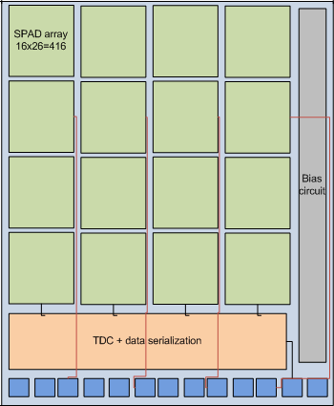
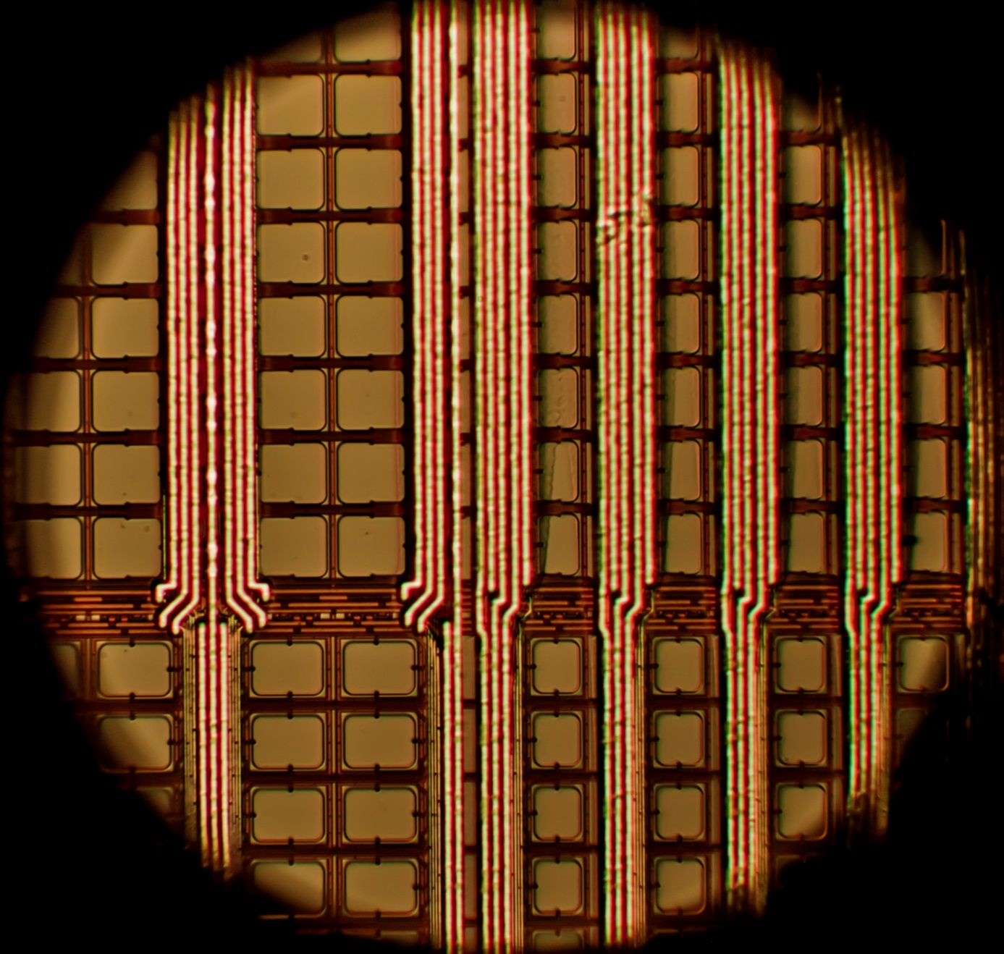
d-SiPM: Sensor Floor Plan
1 Cluster
.8 x .8 mm²
16 x 26 SPADs
1 LSO Fiber
.8 x .8 x 10mm³
14.4mm
“Pancreas” Imager:
9 x 18 clusters
Test Structures
(4 x 4 or 4 x 6)
Inactive Zones
7.2mm
30um
50um
Added functionality results in a maximum fill factor of ~50%.
Sensitive
Strips
TDC Array
pads

Slide 28
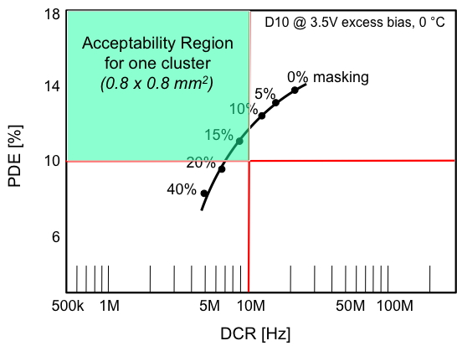
d-SiPM: Characteristics & Results
Characteristic Parameters of d-SiPM- “endo-TOFPET-US” Test Structure |  | Commercial d-SiPM
Cluster Pitch [μm] | 800 | 4000
# SPADs/cluster | 416 | 6400
Maximum Fill Factor [%] | 50 | 77
PDP [%] @ 430nm | 32 | 31
PDE [%] | 15 | 24
# TDCs / Cluster Column | 48 | 1
# Time Of Arrivals (TOA) / cluster | 48 | 1
TDC Resolution or LSB [ps] | 51.8 | -
Clock Frequency [MHz] | 25 | 200
First evaluation results:
DCR (0 °C): 25kHz/SPAD → DCR (40 °C): 80kHz/SPAD
NEED COOLING OF d-SiPM!
Masking of noisy pixels (“screamers”): DCR ↘ but also PDE ↘
Lowering excess bias: DCR ↘ but also PDE ↘
Example of multi-parameter chip optimization:
Boost PDE optically!

Slide 29
Detector R&D
1.) Photodetectors
  The analog SiPM (a-SiPM)
  The digital “Endo-TOFPET” SiPM (d-SiPM)
2.) Diffractive Optics
3.) Scintillators
4.) Integration
5.) Readout and Data Acquisition

Slide 30

Diffractive Optics: Concept
Objective: Recover light lost (50%) in the dead zones of the d-SiPM
d-SiPM (50% FF)
Crystal

Slide 31
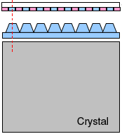
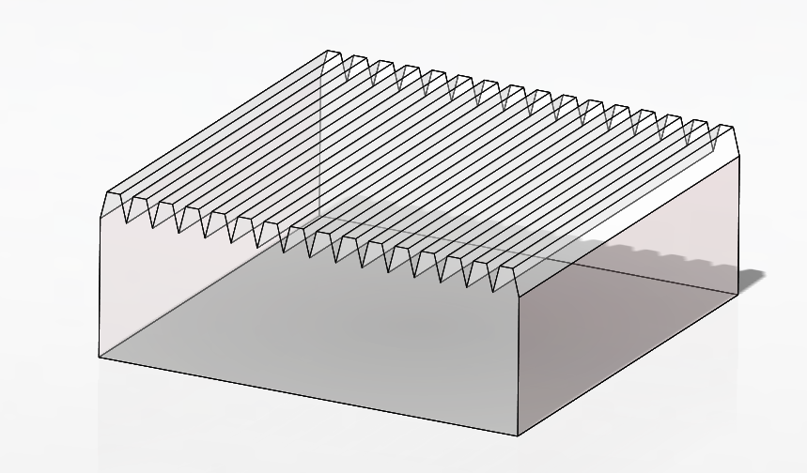
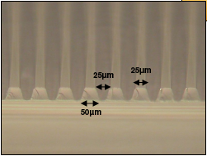
Diffractive Optics: Concept
Objective: Recover light lost (50%) in the dead zones of the d-SiPM
  Glue an optical grating between crystal and photodetector;
  Match pitch of grating with that of d-SiPM (50µm);
d-SiPM
Optical Grating/
Lenticular Lens
d-SiPM (50% FF)
grating
Crystal
500µm
Light
“Concentrator”
Crystal
Notes:
direct laser writing process, micro-structuring

Slide 32
Diffractive Optics: Concept
Objective: Recover light lost (50%) in the dead zones of the d-SiPM
  Glue an optical grating between crystal and photodetector;
  Match pitch of grating with that of d-SiPM (50µm);
  Create ‘differential’ light pattern on the SPAD surface only;
  Expect transmission gain of 1.3 (from simulations).
d-SiPM
Optical Grating/
Lenticular Lens
d-SiPM (50% FF)
grating
Light
Pattern
Crystal
500µm
Light
“Concentrator”
Crystal
Notes:
grating is miniscule, handling with micro-manipulators and microscopes,

Slide 33
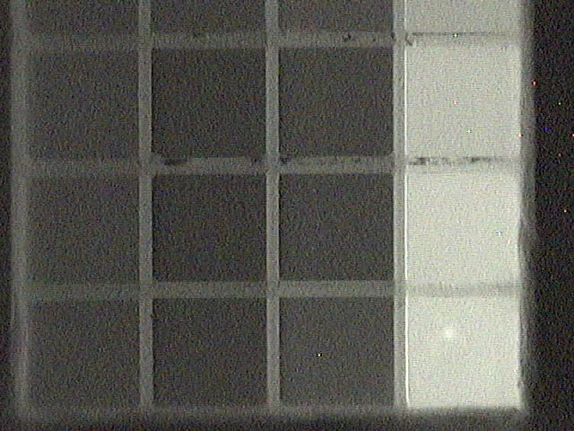

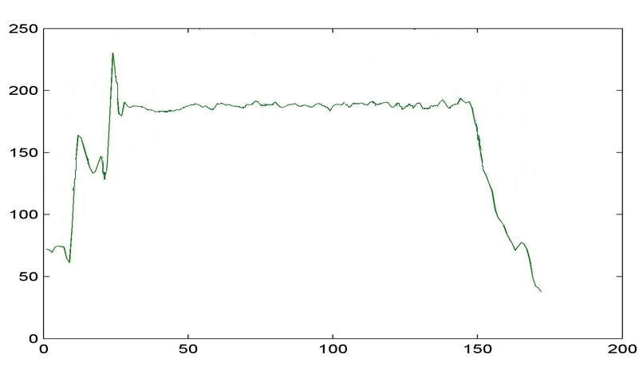
Diffractive Optics: Tests
Crystal Matrix (4x4)
Bare crystal- matrix & glass
X-Ray
Generator
0.71mm
Glass plate
‘Air’ contact
CCD
Sony, Philips, Eureka
Tests with Proteus/AGILE crystal matrix:
interface crystal-grating: air
interface grating-CCD: air
all crystals fully wrapped (3M-ESR Vikuiti)
Notes:
CCDs from Sony, Eureka (D), webcam, Philips

Slide 34

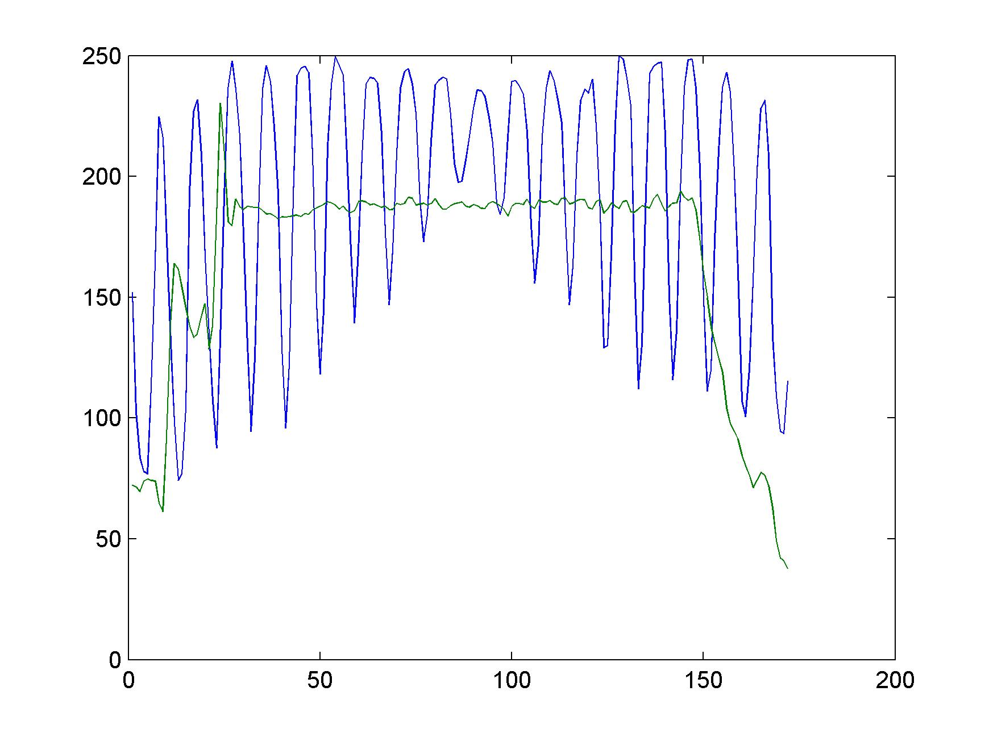
Diffractive Optics: Tests
Crystal Matrix (4x4)
Bare crystal- matrix & glass
X-Ray
Generator
0.71mm
Grating
‘Air’ contact
CCD
Crystal-matrix &
optical grating
Sony, Philips, Eureka
Tests with Proteus/AGILE crystal matrix:
interface crystal-grating: air
interface grating-CCD: air
all crystals fully wrapped (3M-ESR Vikuiti)
25μm
☛ Average gain in peaks = 1.26
w/o grating
with grating

Slide 35
Detector R&D
1.) Photodetectors
  The analog SiPM (a-SiPM)
  The digital “Endo-TOFPET” SiPM (d-SiPM)
2.) Diffractive Optics
3.) Scintillators
4.) Integration
5.) Readout and Data Acquisition

Slide 36
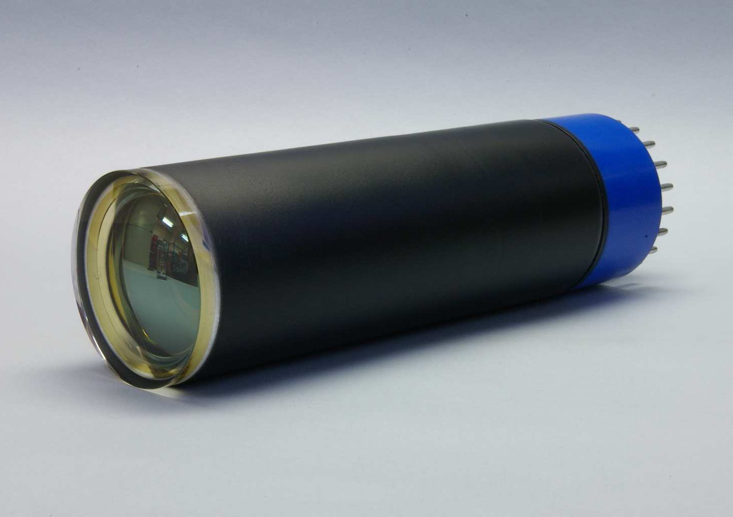
Crystal Performance
Crystal performance is “gauged” by light yield (LY) and
coincidence time resolution (CTR):
Crystal | Size [mm³] | Decay Time [ns] | Light Yield [Ph/MeV] | CTR [ps] FWHM
LuAG:Ce | 2 x 2 x 8 | 60 | 15’000 | 872 ± 50
LuAG:Pr | 2 x 2 x 8 | 20 | 10’400 | 672 ± 30
Light yield measured with PMT (linear!); crystals wrapped and mounted “small-face-to-PMT”
with grease; source: ¹⁶⁷Cs.
Crystal (2x2x10mm³) | Manufacturer | Decay Time [ns] | Light Yield [Ph/MeV] | CTR [ps] FWHM
LGSO:Ce | Hitachi | 42.50 | 19’500 | 176
LYSO:Ce | SIPAT | 42.60 | 19’000 | 206
LYSO:Ce | Proteus | 41.40 | 18’000 | 175
LYSO:Ce | CPI | 45.00 | 17’400 | 184
LSO:Ce | PML | 47.00 | 16’300 | 206
LSO:Ce | CTI | 43.50 | 23’000 | 190
LSO:Ce:Ca | Agile | 32.00 | 15’700 | 170
PMT: Photonis XP 2020 Q
CTR measurements were made with the Hamamatsu MPPC S10931-050P;
all crystals were fully wrapped and coupled with grease to the MPPC.
E. Affray et al., Nuclear Science Symposium and Medical Imaging Conference (NSS/MIC), 2011 IEEE, 10.1109/NSSMIC.2011.6154402

Slide 37
Crystal Performance
Crystal performance is “gauged” by light yield (LY) and
coincidence time resolution (CTR):
Crystal | Size [mm³] | Decay Time [ns] | Light Yield [Ph/MeV] | CTR [ps] FWHM
LuAG:Ce | 2 x 2 x 8 | 60 | 15’000 | 872 ± 50
LuAG:Pr | 2 x 2 x 8 | 20 | 10’400 | 672 ± 30
Light yield measured with PMT (linear!); crystals wrapped and mounted “small-face-to-PMT”
with grease; source: ¹⁶⁷Cs.
slow!
UV!
Crystal (2x2x10mm³) | Manufacturer | Decay Time [ns] | Light Yield [Ph/MeV] | CTR [ps] FWHM
LGSO:Ce | Hitachi | 42.50 | 19’500 | 176
LYSO:Ce | SIPAT | 42.60 | 19’000 | 206
LYSO:Ce | Proteus | 41.40 | 18’000 | 175
LYSO:Ce | CPI | 45.00 | 17’400 | 184
LSO:Ce | PML | 47.00 | 16’300 | 206
LSO:Ce | CTI | 43.50 | 23’000 | 190
LSO:Ce:Ca | Agile | 32.00 | 15’700 | 170
PMT: Photonis XP 2020 Q
CTR measurements were made with the Hamamatsu MPPC S10931-050P;
all crystals were fully wrapped and coupled with grease to the MPPC.
best!
E. Affray et al., Nuclear Science Symposium and Medical Imaging Conference (NSS/MIC), 2011 IEEE, 10.1109/NSSMIC.2011.6154402

Slide 38
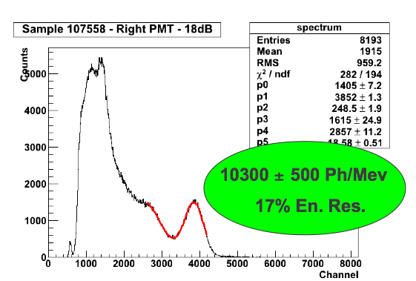
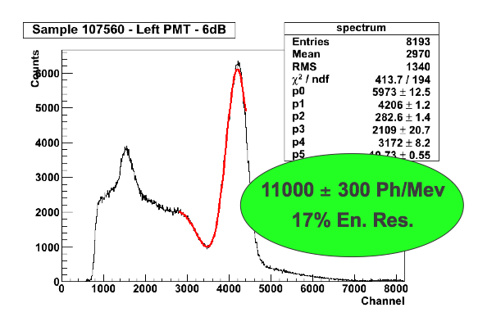
Small & Large Crystals
0.75 x 0.75 x 10mm³
3 x 3 x 15mm³
Light Yield &
E-Resolution
16 LYSO crystals, 4 x 4 matrix; 80µm 3M-ESR Vikuiti wrapping; Uniform irradiation with ¹³⁷Cs; Dry contact with PMT.

Slide 39
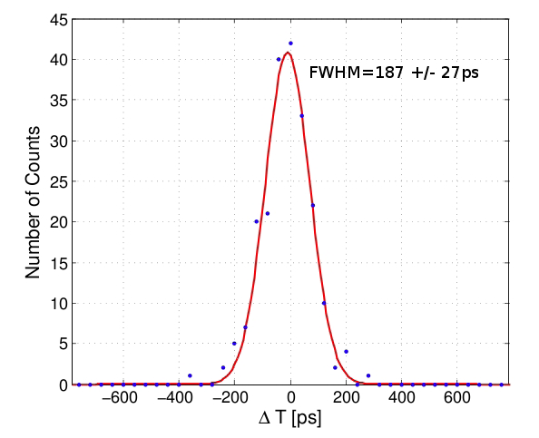
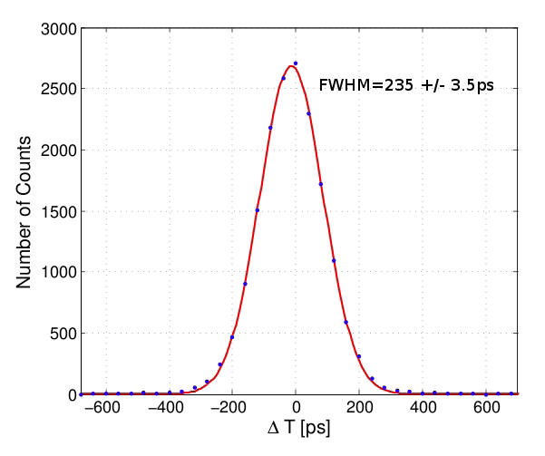
Small & Large Crystals
0.75 x 0.75 x 10mm³
3 x 3 x 15mm³
Light Yield &
E-Resolution
16 LYSO crystals, 4 x 4 matrix; 80µm 3M-ESR Vikuiti wrapping; Uniform irradiation with ¹³⁷Cs; Dry contact with PMT.
Coincidence Time Resolution
187±27ps
FWHM
235±4ps
FWHM

Slide 40
Small & Large Crystals
0.75 x 0.75 x 10mm³
3 x 3 x 15mm³
Light Yield &
Energy-Resolution
16 LYSO crystals, 4 x 4 matrix; 80µm 3M-ESR Vikuiti wrapping; Uniform irradiation with ¹³⁷Cs; Dry contact with PMT.
Coincidence Time Resolution
187±27ps
FWHM
235±4ps
FWHM
De-convolution yields 212ps FWHM small vs. large (target value: 200ps)

Slide 41
Detector R&D
1.) Photodetectors
  The analog SiPM (a-SiPM)
  The digital “Endo-TOFPET” SiPM (d-SiPM)
2.) Diffractive Optics
3.) Scintillators
4.) Integration
5.) Readout and Data Acquisition

Slide 42
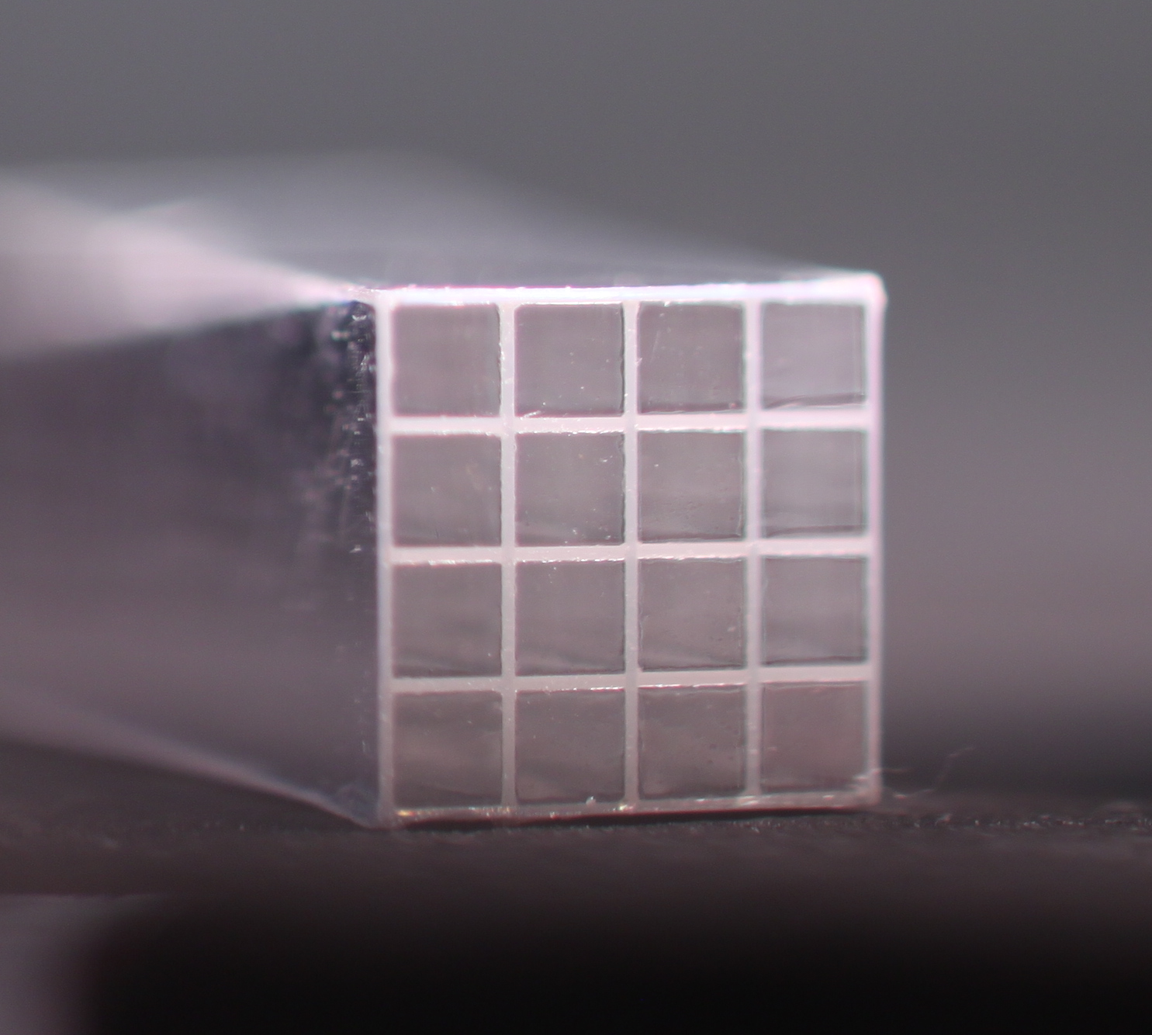

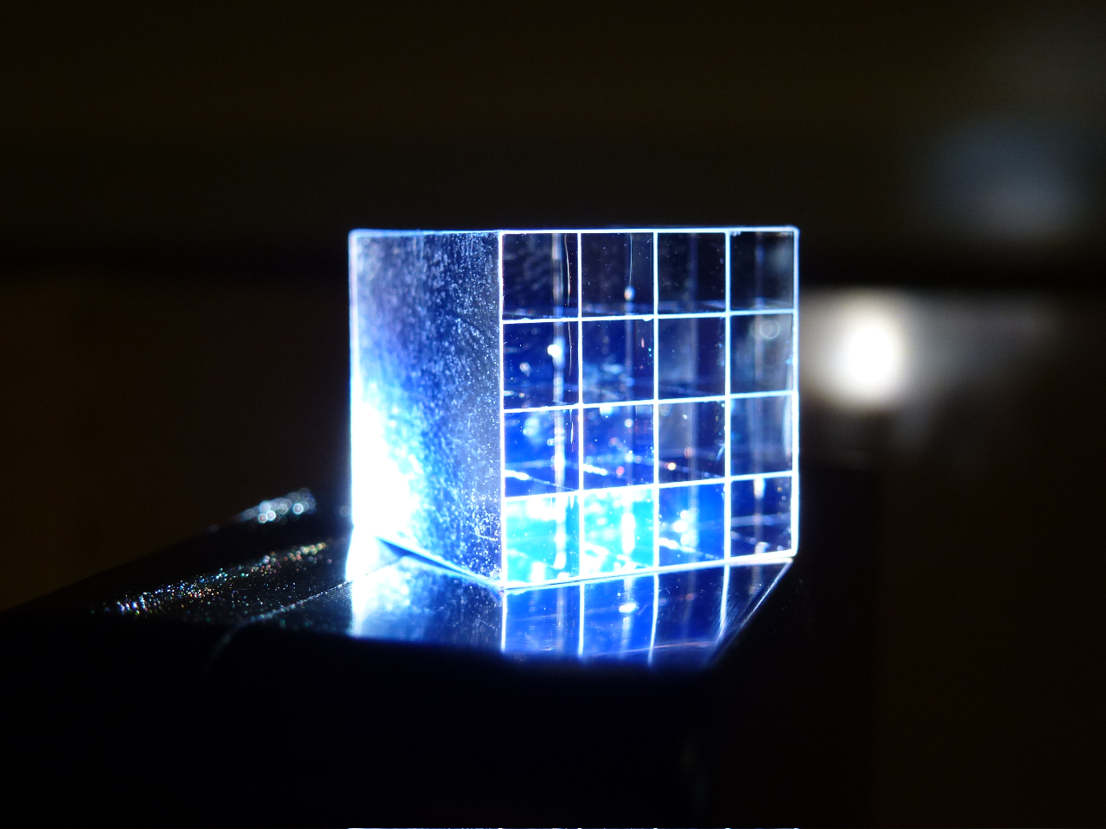
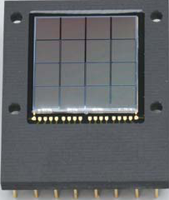
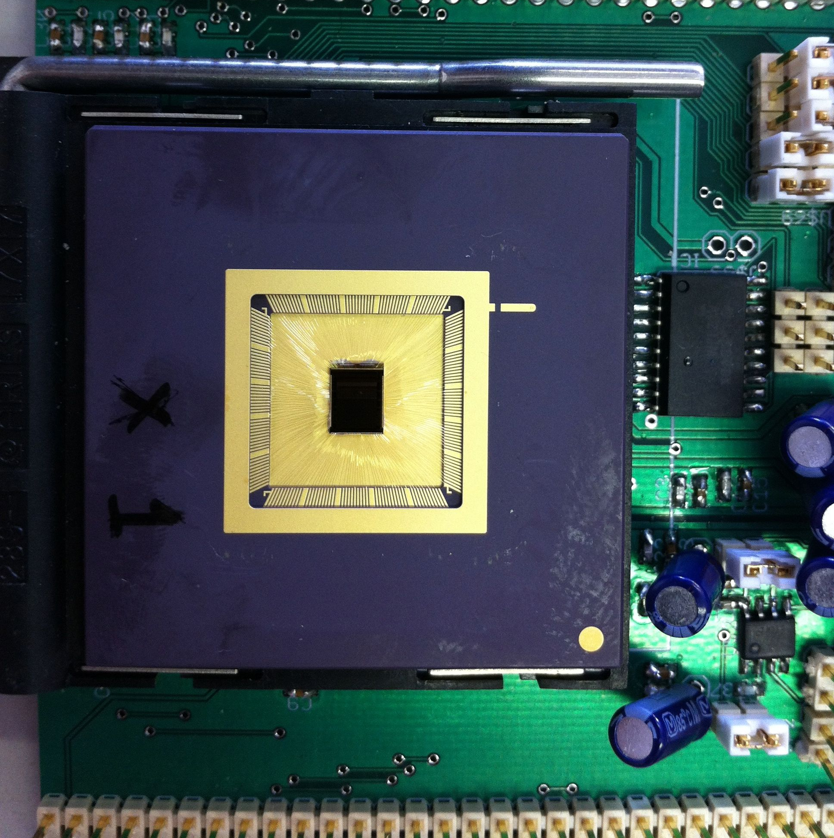
Integration: Crystal Matrices
Endoscope Matrix:
External Plate Matrix:
80µm 3M ESR
Gap
3.4 mm
80µm 3M ESR Gap
12.4 mm
Fibers: .75 x .75 x 10 mm³
Crystals: 3 x 3 x 15 mm³
S11827-3344MG
CMOS (4x4) array:
each with 800 x 800µm² area
SPAD pitch 50µm (x), 30µm (y)
192 TDCs total
Monolithic (4 x 4) MPPC array:
each with 3 x 3mm² area
SPAD pitch: 50µm
Photo of MPPCs courtesy of Hamamatsu Photonics

Slide 43
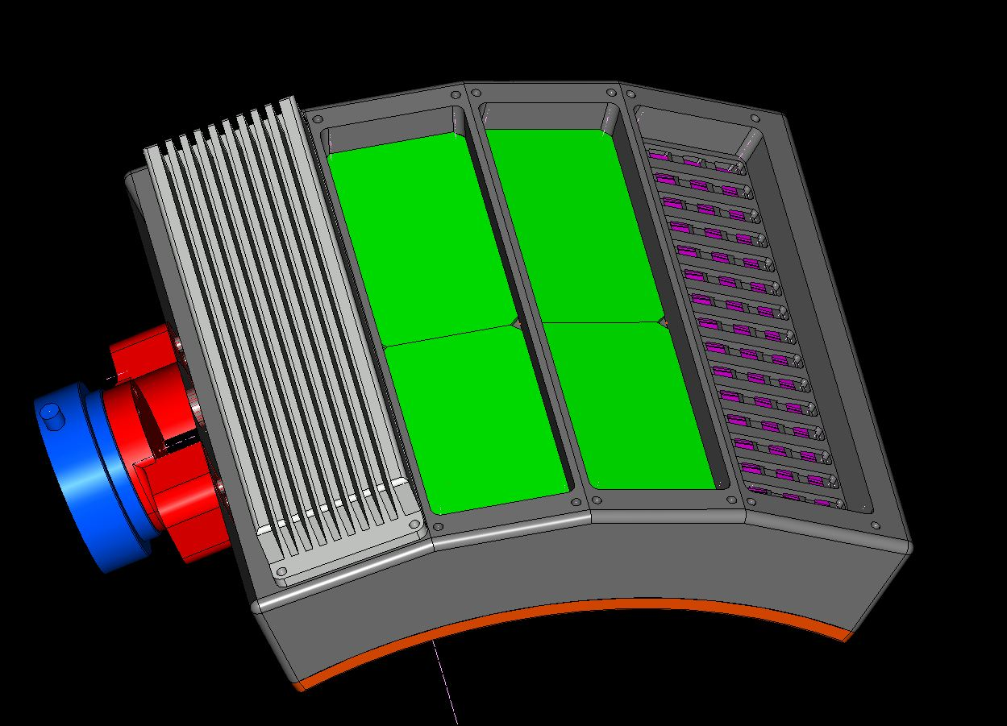
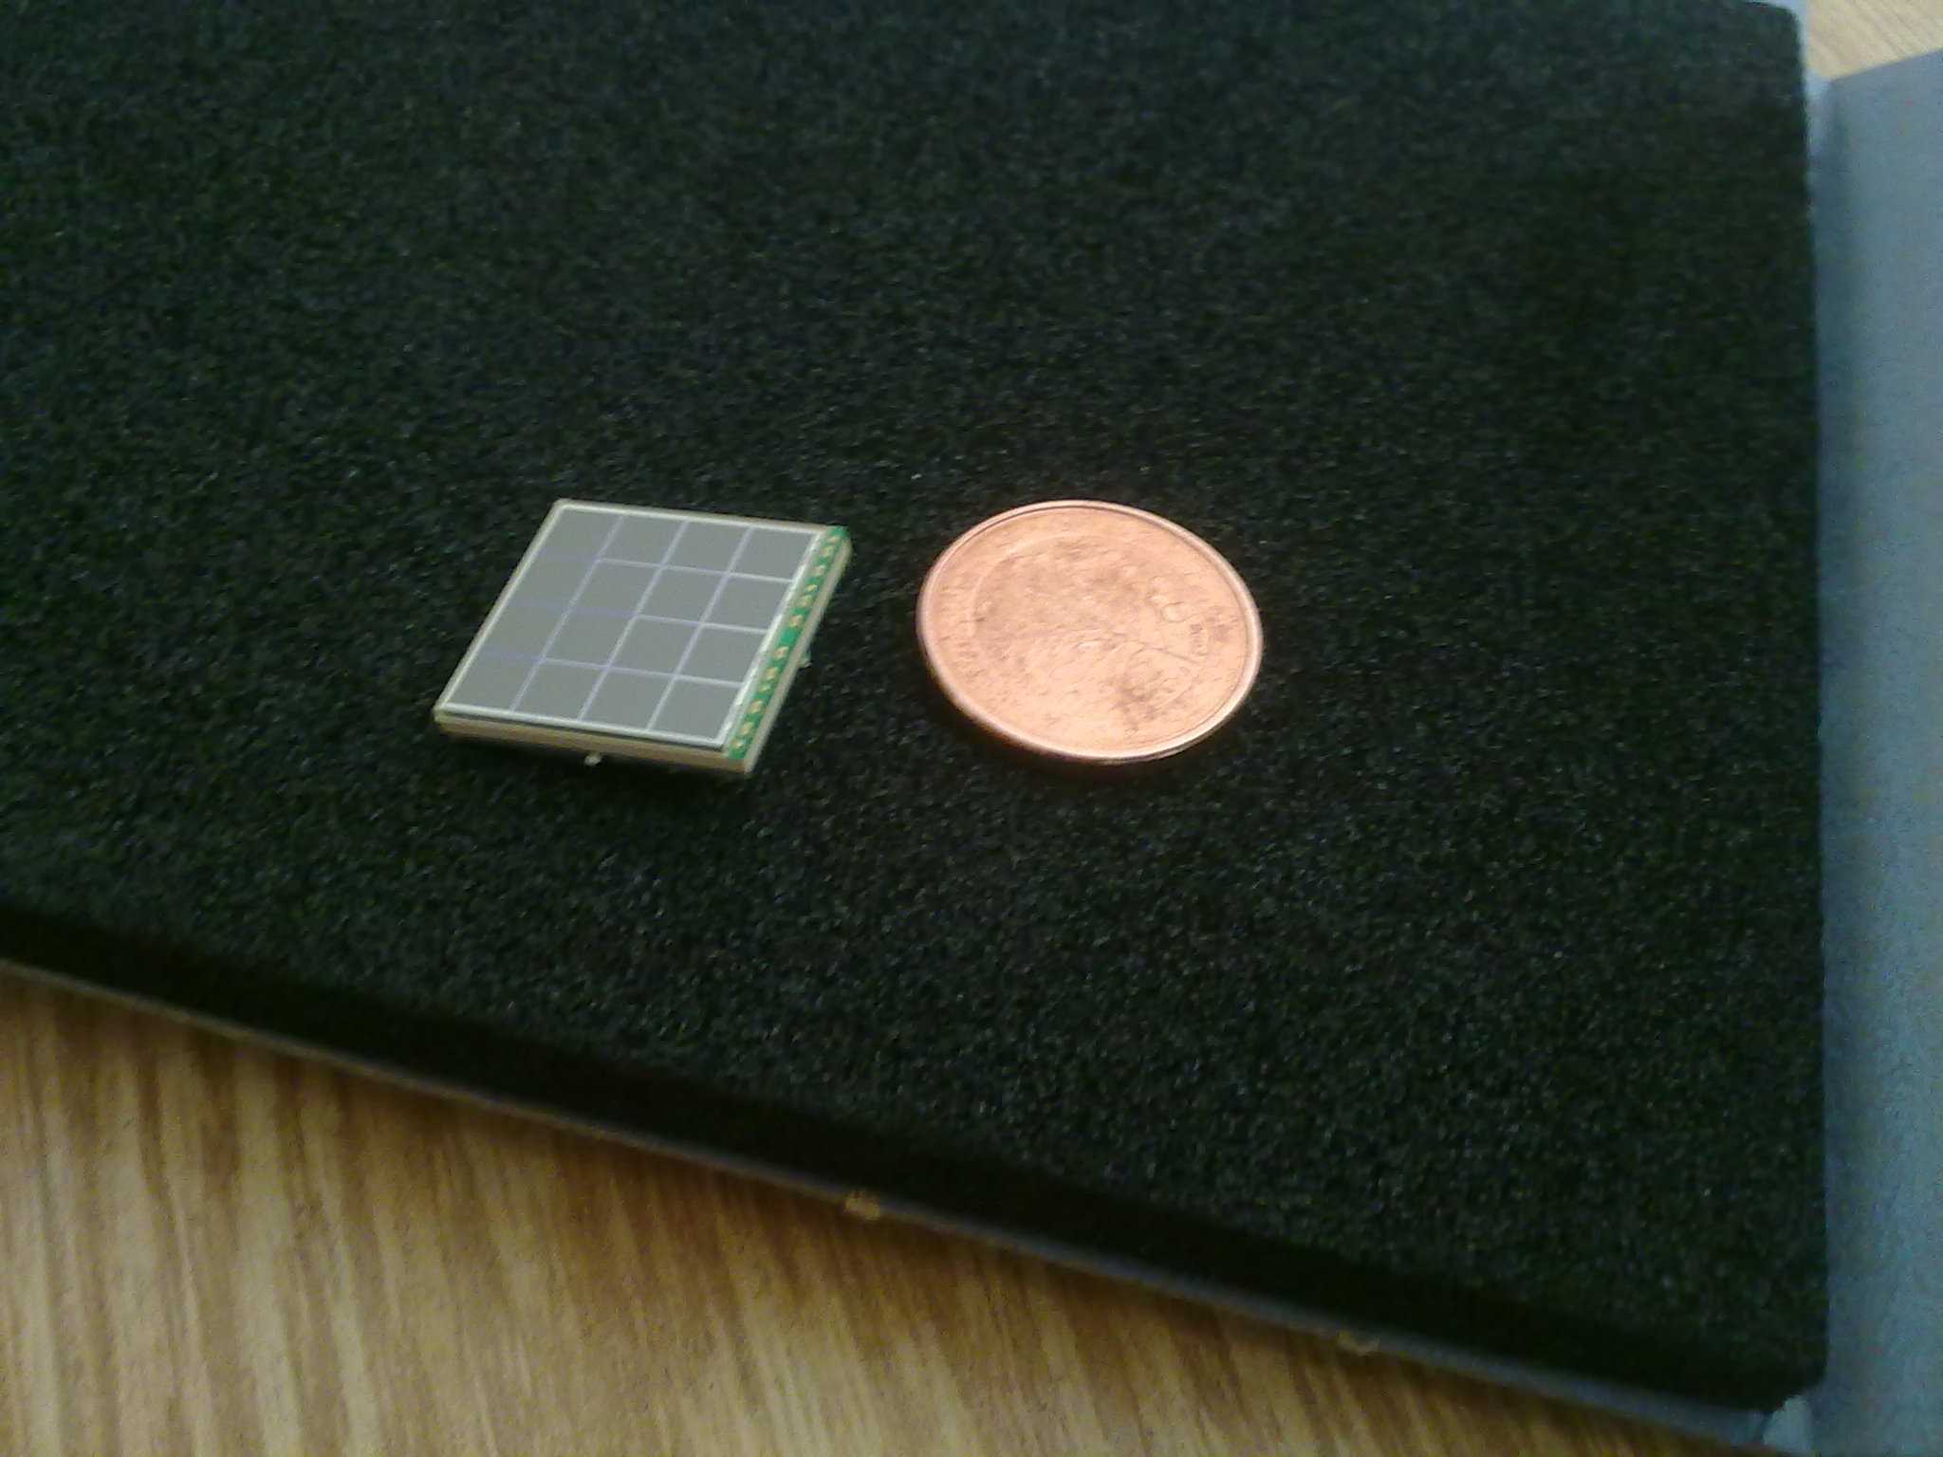
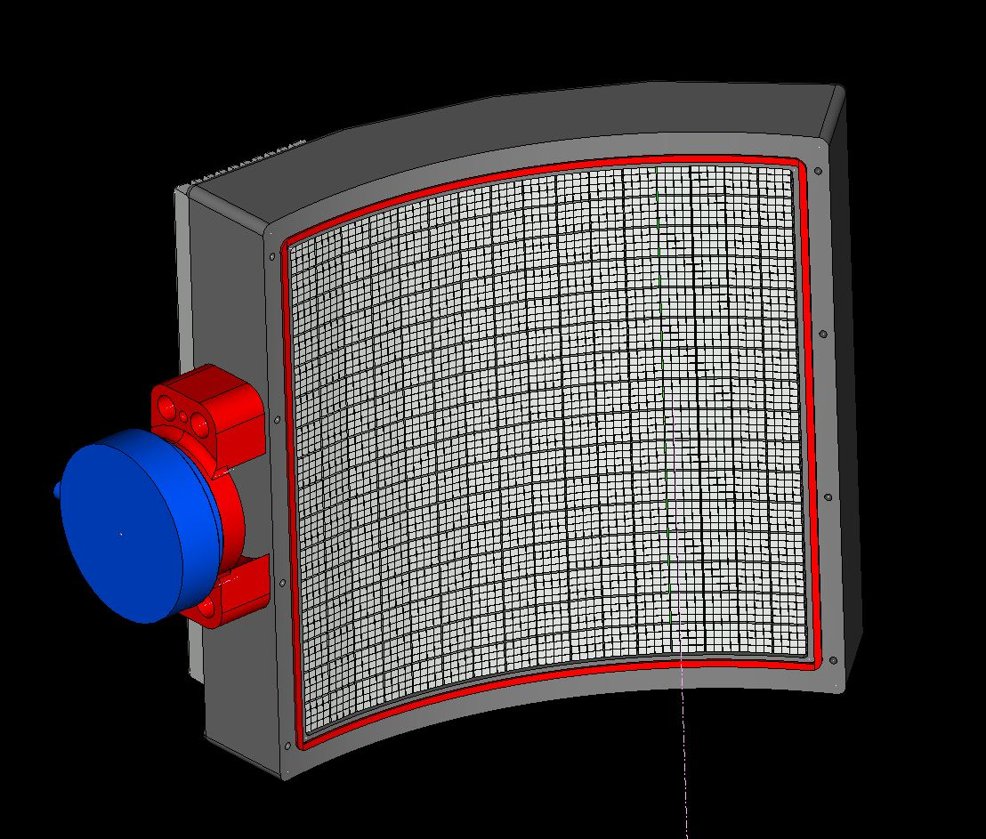
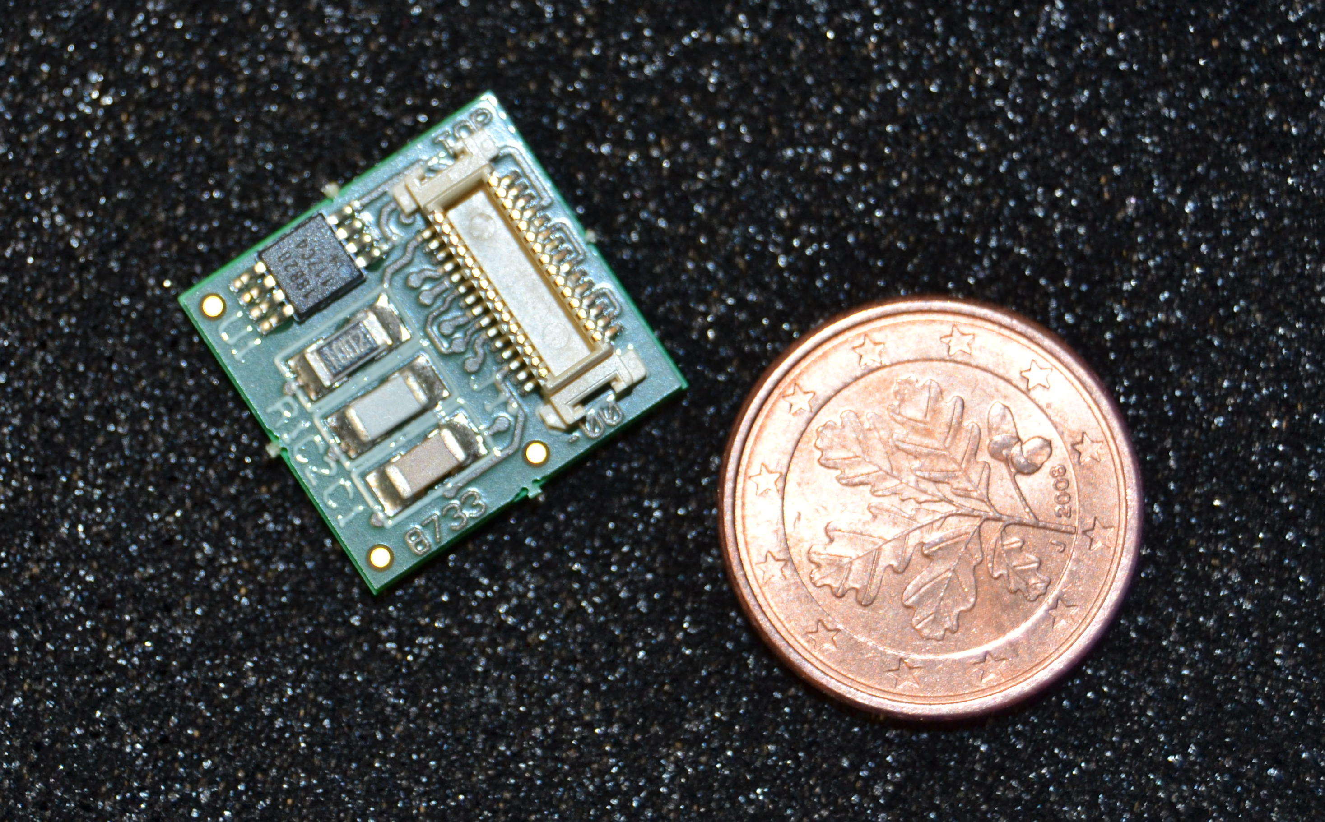
System Integration: External Plate
Electronics PCBs
Cooling
23 cm
4 x 4 - MPPC
monolithic array on
a custom-made PCB
22 cm
T-sensor
HV filter
Sensitive detector: 16 x16 detector units (4096 ch.) with ~100µm gap;
Electronics: dedicated readout chips on PCBs (512 ch./PCB) ;
Cooling: detector stabilized to room temperature via Peltier elements (expected 30mW/ch);
Tracking: detector mounted on a robotic arm for mechanical tracking (6D info, <1mm accuracy);
Curved geometry: facing the organ during diagnose (r = 21cm).
Notes:
The design guidelines chosen in this design are:
Modularity: interchangeable parts to reduce costs and required spares
Flexibility: allow parallel development of novel components minimizing final time for integration
Minimum dead material between crystals

Slide 44
Summary
Frontline research in the domain of:
  digital photodetectors;
  scintillators & optical systems;
  medical instrumentation.
Large knowledge and technology transfer
between HEP, industry and medicine;
  Defines a roadmap for the development of a new generation of multimodal endoscopic probes.
Thanks to the endo-TOFET and PicoSEC-Coll.
We still seek ESR applications for the Marie-Curie ITN
  Please contact us or our Marie-Curie-Homepage:
  http://picosec.web.cern.ch/picosec/home.html
Notes:
The design guidelines chosen in this design are:
Modularity: interchangeable parts to reduce costs and required spares
Flexibility: allow parallel development of novel components minimizing final time for integration
Minimum dead material between crystals

Slide 45
End
Notes:
The design guidelines chosen in this design are:
Modularity: interchangeable parts to reduce costs and required spares
Flexibility: allow parallel development of novel components minimizing final time for integration
Minimum dead material between crystals

Slide 46
Detector R&D
1.) Photodetectors
  The analog SiPM (a-SiPM)
  The digital “Endo-TOFPET” SiPM (d-SiPM)
2.) Diffractive Optics
3.) Scintillators
4.) Integration
5.) Readout and Data Acquisition

Slide 47
Event Rates and DAQ
The hit rate in the external plate is expected to be 10 kHz per crystal.
The total hit rate is 40 MHz.
The event rate in the internal probe is of the order of 1 MHz.
The total average data rate from the PET plate is 2 Gb/s. The available bandwidth is 3.2 Gb/s (4 x LVDS links at 800 Mb/s each)
The total average rate from the internal probe is of the order of 1 Gb/s.
→ Use 2 LVDS links at 800 Mb/s each.
Random coincidence rate is estimated at 250 kHz (assuming 6.25 ns coincidence window). The true coincidence rate is assumed to be of the same order. Therefore we assume that the total trigger rate is 0.5MHz.
For a trigger rate of 0.5MHz the storage rate is relatively modest (about 100 Mbyte/s).
The stored data is reduced by a factor 10 after offline filtering with a coincidence window of 600 ps.
Notes:
The design guidelines chosen in this design are:
Modularity: interchangeable parts to reduce costs and required spares
Flexibility: allow parallel development of novel components minimizing final time for integration
Minimum dead material between crystals

