Slide 1

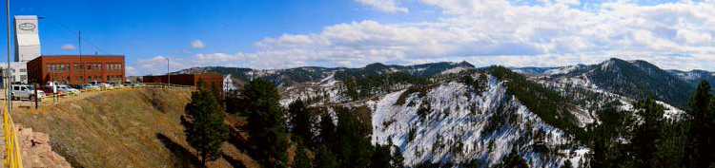

MINING FOR WIMPS:
THE LUX-ZEPLIN (LZ) EXPERIMENT
Henrique Araújo
Imperial College London
On behalf of the LZ Collaboration
TIPP 2014, Amsterdam, The Netherlands, 2-6 June 2014

Slide 2
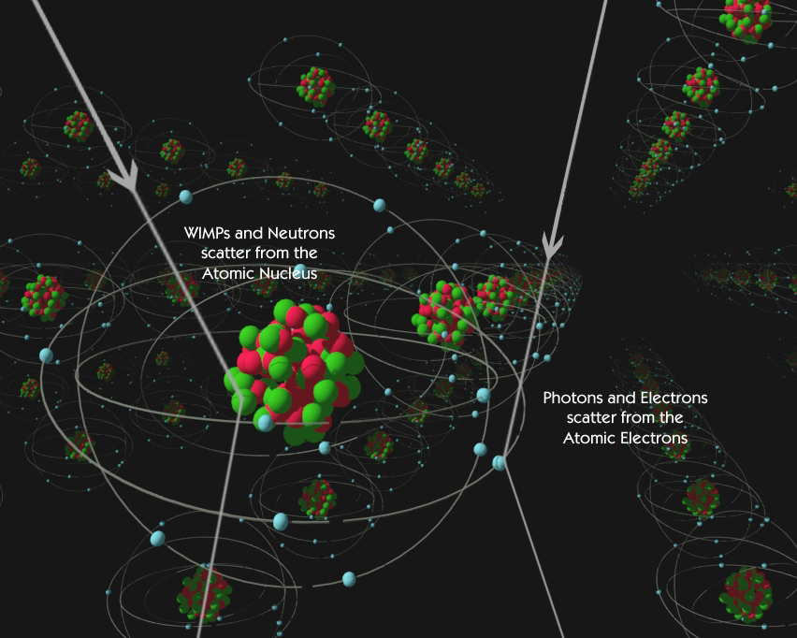
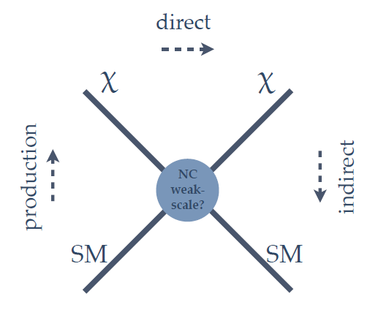
HOW TO CATCH A WIMP
Direct detection (scattering XS)
  Nuclear (atomic) recoils from elastic scattering
  (annual modulation, directionality, A- & J-dependence)
  Galactic DM at the Sun’s position – our DM!
  Mass measurement (if not too heavy)
Indirect detection (decay, annihilation XS)
  High-energy cosmic-rays, γ-rays, neutrinos, etc.
  Over-dense regions, annihilation signal ∝ n²
  Challenging backgrounds
Accelerator searches (production XS)
  Missing transverse energy, monojets, etc.
  Good place to look for particles…
  Mass measurement poor, at least initially
  Can it establish that new particle is the DM?

Slide 3

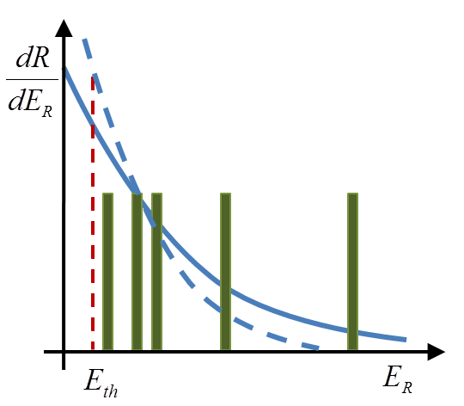
WIMP-NUCLEUS ELASTIC SCATTERING RATES
The ‘spherical cow’ galactic model
DM halo is 3-dimensional, stationary, with no lumps
Isothermal sphere with density profile ρ ∝ r ⁻²
Local density ρ₀ ~ 0.3 GeV/cm³ (~1/pint for 100 GeV WIMPs)
Maxwellian (truncated) velocity distribution, f(v)
  Characteristic velocity v₀=220 km/s
  Escape velocity v_{esc}=544 km/s
  Earth velocity v_{E}=230 km/s
Nuclear recoil spectrum [events/kg/day/keV]
~ few keV

Slide 4
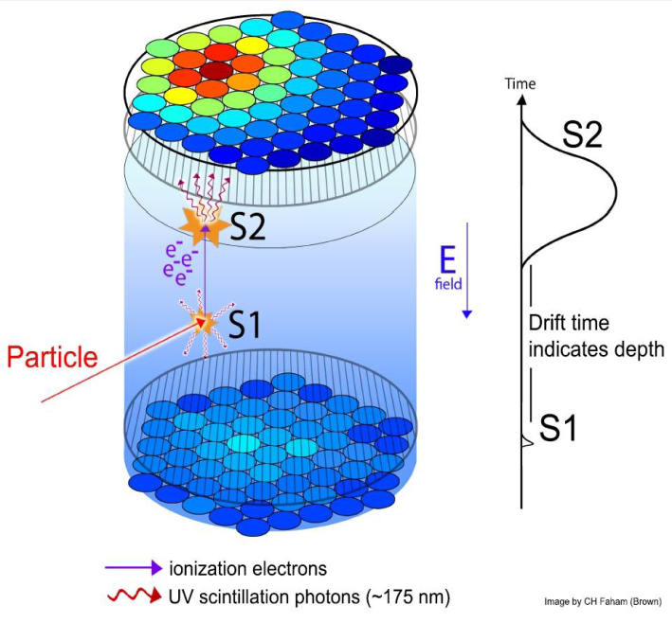
TWO-PHASE XENON TPC
S1: prompt scintillation signal
  Light yield: ∼60 ph/keV (ER, 0 field)
  Scintillation light: 178 nm (VUV)
  Nuclear recoil threshold ∼5 keV
S2: delayed ionisation signal
  Electroluminescence in vapour phase
  Sensitive to single ionisation electrons
  Nuclear recoil threshold ∼1 keV
S1+S2 event by event
  ER/NR discrimination (>99.5% rejection)
  mm vertex resolution + high density: self-shielding of external backgrounds
LXe is the leading WIMP target:
  Scalar WIMP-nucleon scattering rate dR/dE∼A², broad mass coverage (>5 GeV)
  Odd-neutron isotopes (¹²⁹Xe, ¹³¹Xe) enable SD sensitivity; target exchange possible
  No damaging intrinsic nasties (¹²⁷Xe short-lived, ⁸⁵Kr removable, ¹³⁶Xe 2νββ ok)

Slide 5
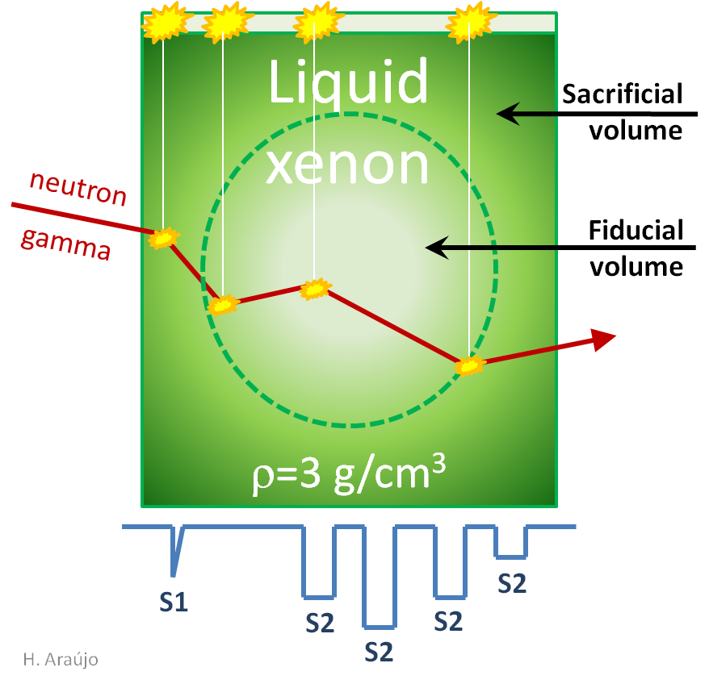
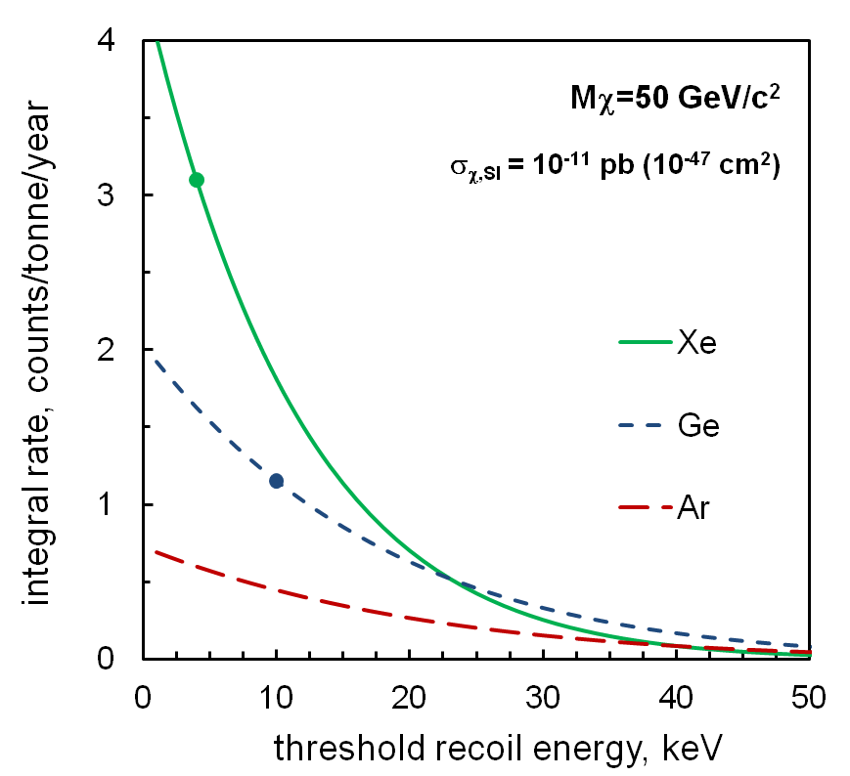
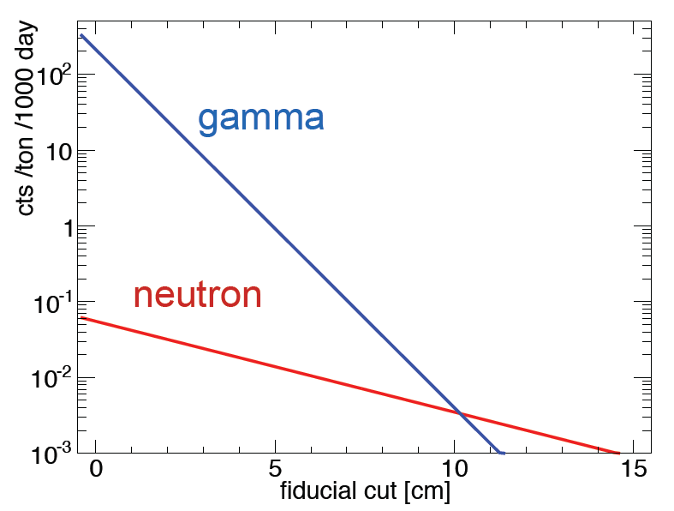
THE NOBLE LIQUID XENON
single scatters
<5 keVee
Searches for RARE and LOW ENERGY events: a very challenging combination

Slide 6
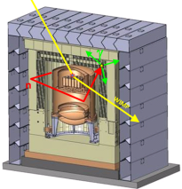
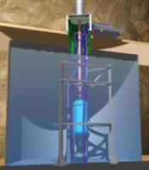
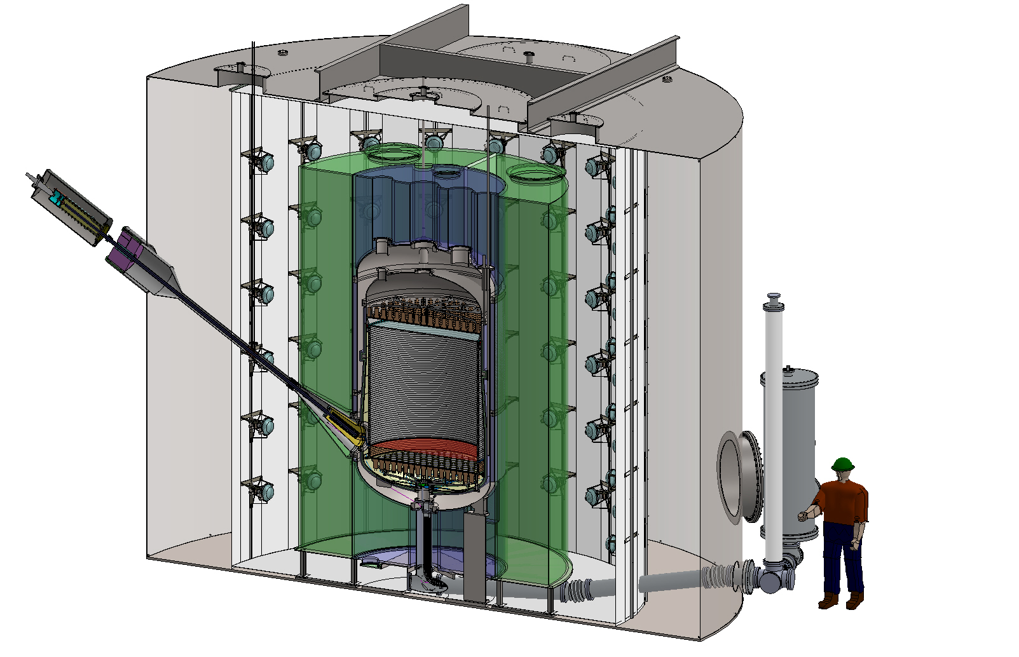
ZEPLIN → LUX → LZ
ZEPLIN-III LUX LZ
Next-generation LXe experiment
building on LUX & ZEPLIN programmes
Route to detection & study: a progressive programme
  ZEPLIN pioneered two-phase Xe for WIMP searches (3.9x10⁻⁸ pb/n)
  LUX is present world leader in sensitivity (7.6x10⁻¹⁰ pb/n, and ongoing)
  LZ expected sensitivity: ∼2x10⁻¹² pb/n with 3-year run
Experimental approach: a low risk but aggressive programme
  Internal bk-free strategy (self-shielding, modest discrimination assumed)
  Two-phase Xe technology: high readiness level
  Some infrastructure inherited from LUX
LZ will provide exciting physics opportunities for light & heavy WIMPs (GeV-TeV): since we do not know what BSM physics looks like!
6 kg LXe fid 100 kg 6,000 kg
6

Slide 7
LZ DETECTOR(S)
Gd-loaded
liquid scintillator
veto detector
LUX
water tank
LXe ‘skin’
detector
LXe HX
HV umbilical
low-bk cryostat
LXe TPC

Slide 8
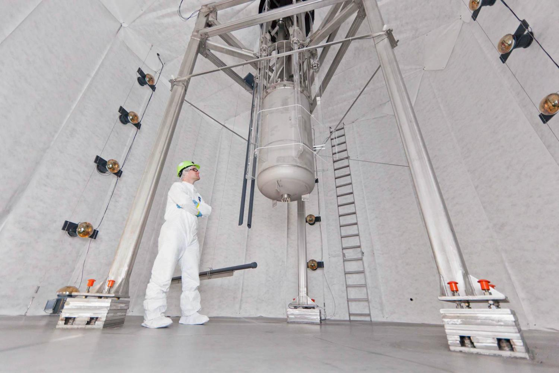

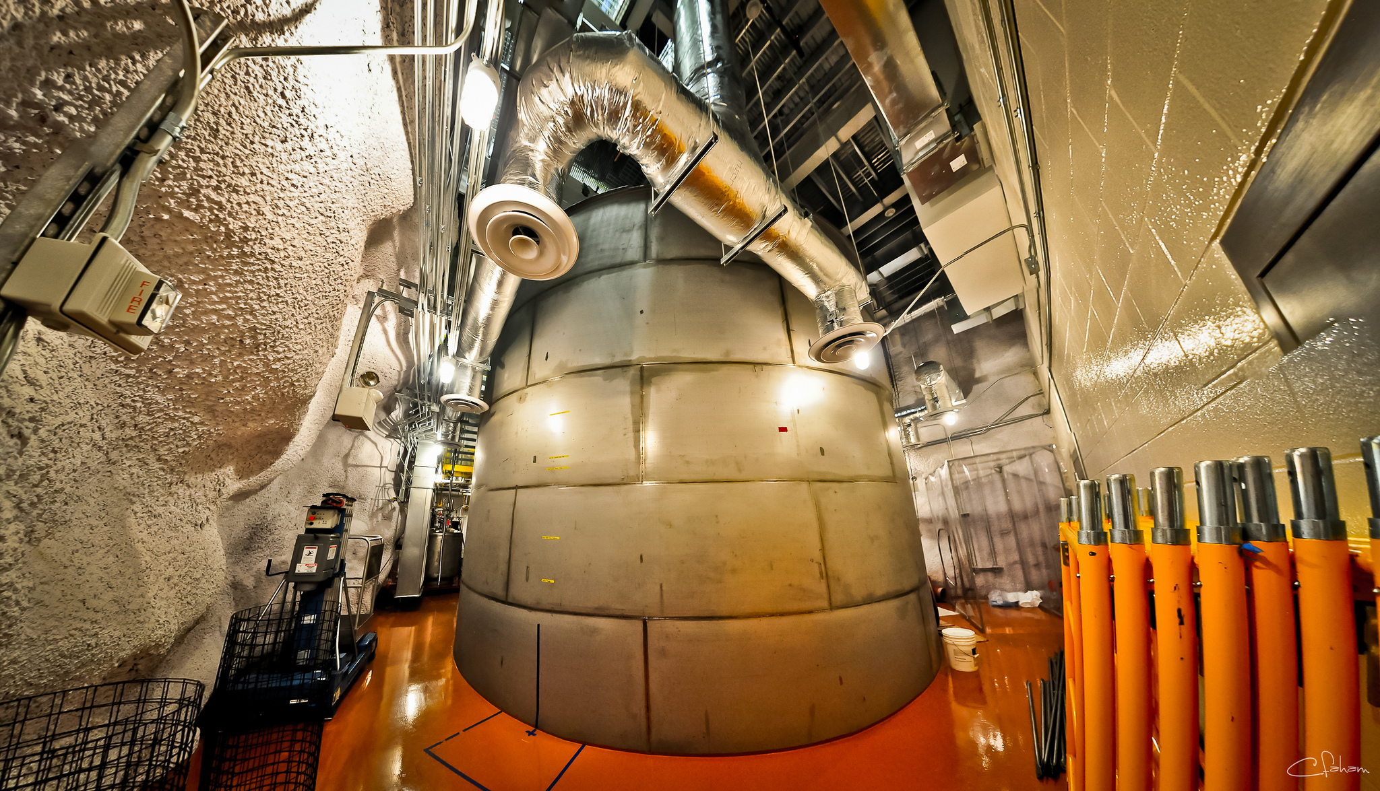
The 8-m diameter LUX water tank (to contain LZ), Davis Campus, 4850-ft u/g level,
Sanford Underground Research Facility

Slide 9
THE LZ TPC
TPC PARAMETERS
  1.5 m diameter/length (3x LUX)
  7 tonne active LXe mass (28x LUX)
  2x 241 3-inch PMTs (4x LUX)
  Highly reflective PTFE field cage
  100 kV cathode HV (10x LUX)
  Electron lifetime 3 ms (3x LUX)
PHYSICS PARAMETERS
5.8 keVr S1 threshold (4.5 keVr LUX)
0.7 kV/cm drift field, 99.5% ER/NR disc.
(already surpassed in LUX at 0.2 kV/cm)
TPC CALIBRATION
ER: Dispersed sources: Kr-83m, CH₃T
NR: AmBe, YBe, D-D generator

Slide 10
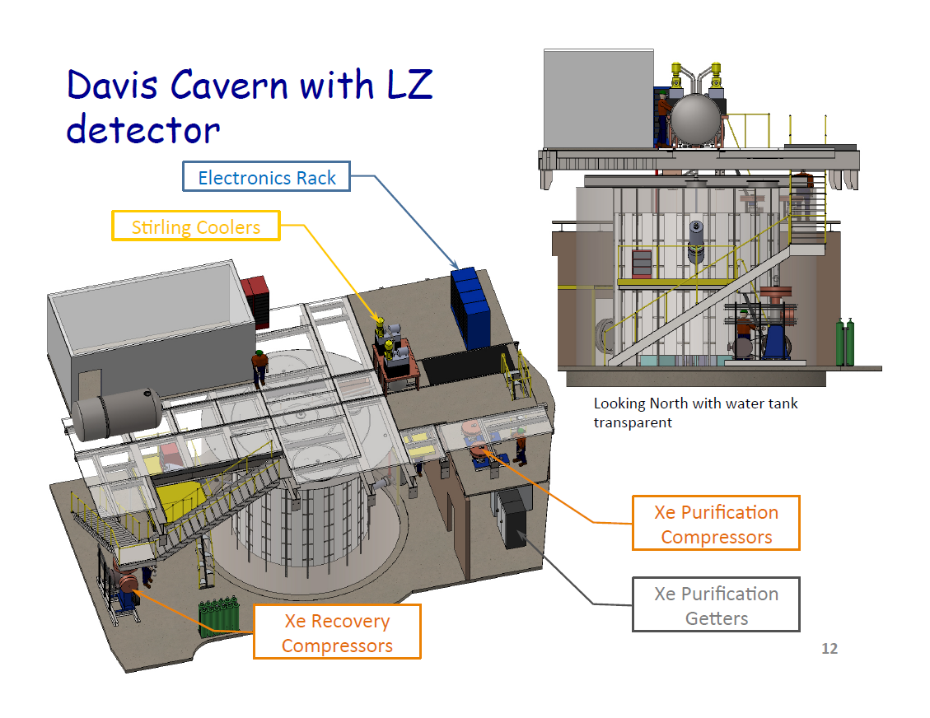
LZ IN DAVIS CAMPUS

Slide 11
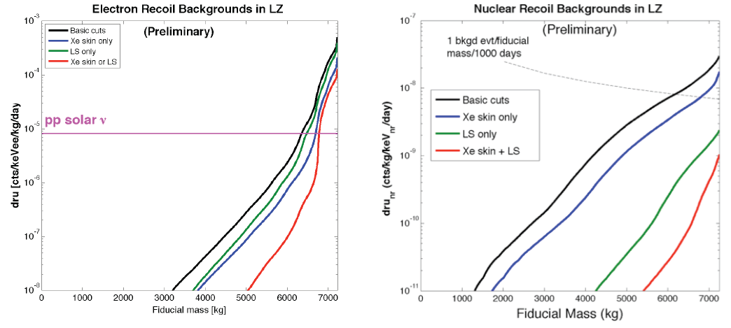
IMPORTANT BACKGROUNDS
PMTs +
Cryostat
PMTs +
Cryostat
Neutrons and gamma-rays from internal radioactivity
  Die out very quickly into xenon target, leaving ∼6-tonne fiducial
  Layered, near-hermetic detector strategy plus self-shielding and accurate 3D position reconstruction are extremely effective

Slide 12
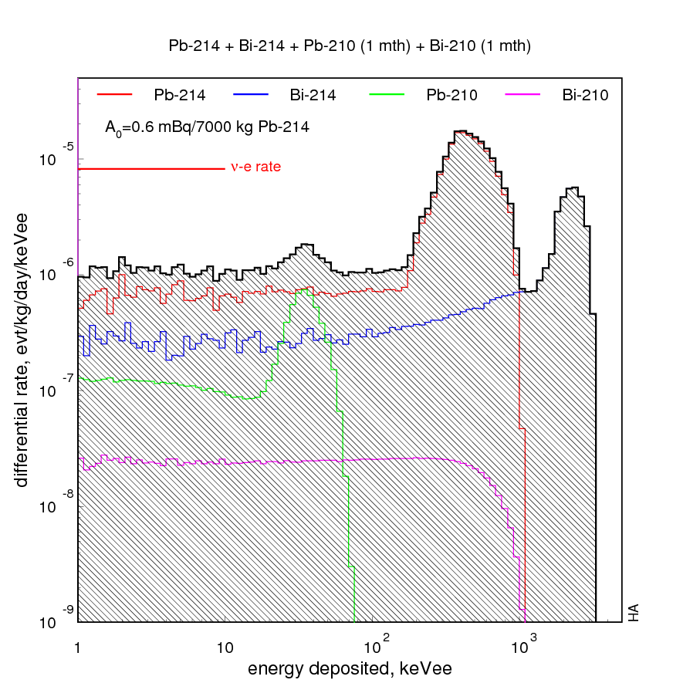
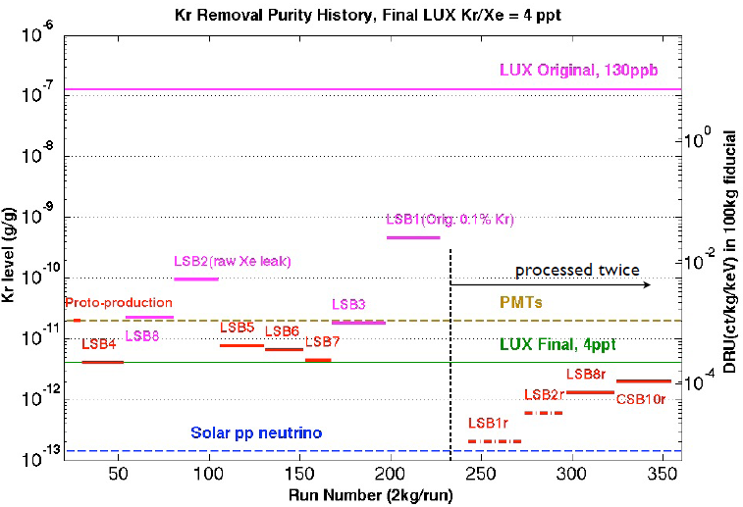
INTRINSIC BACKGROUNDS
Intrinsic electron backgrounds
  Controlled with modest discrimination (99.5%) – already achieved in LUX
    ⁸⁵Kr: require <0.02 ppt Kr (best LUX production batch ∼0.2 ppt)
    ²¹⁴Pb: require <0.6 mBq radon in active volume (cf. ∼μBq in Borexino, SNO)
    2νββ from ¹³⁶Xe dominates only >20 keVee (signal acceptance <6 keVee)

Slide 13
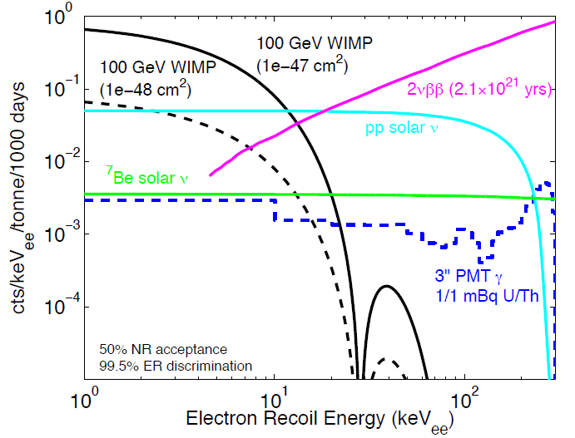
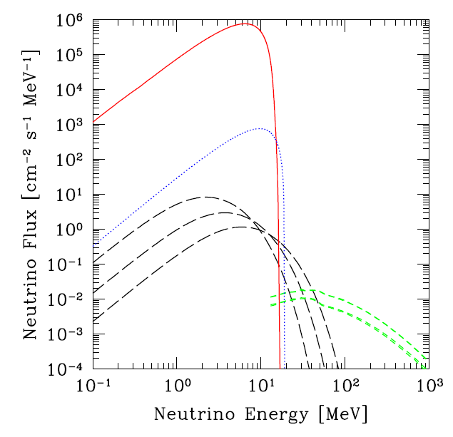
DOMINANT BACKGROUNDS
⁸B
^{hep}
^{DSNB}
^{Atm}
D. Malling, Brown
Strigari 2009
Solar pp ν-e elastic scattering is dominant e-recoil background
  1.5 events in 1,000 live days x 6,000 kg (99.5% discrimination, 50% acceptance)
CNS is dominant nuclear recoil background
  ⁸B solar neutrinos: significant number of events, but ∼0 above 6 keVr threshold
  Small background from atmospheric and diffuse supernova neutrinos
  0.26 events in 1,000 live days x 6,000 kg (50% acceptance)

Slide 14
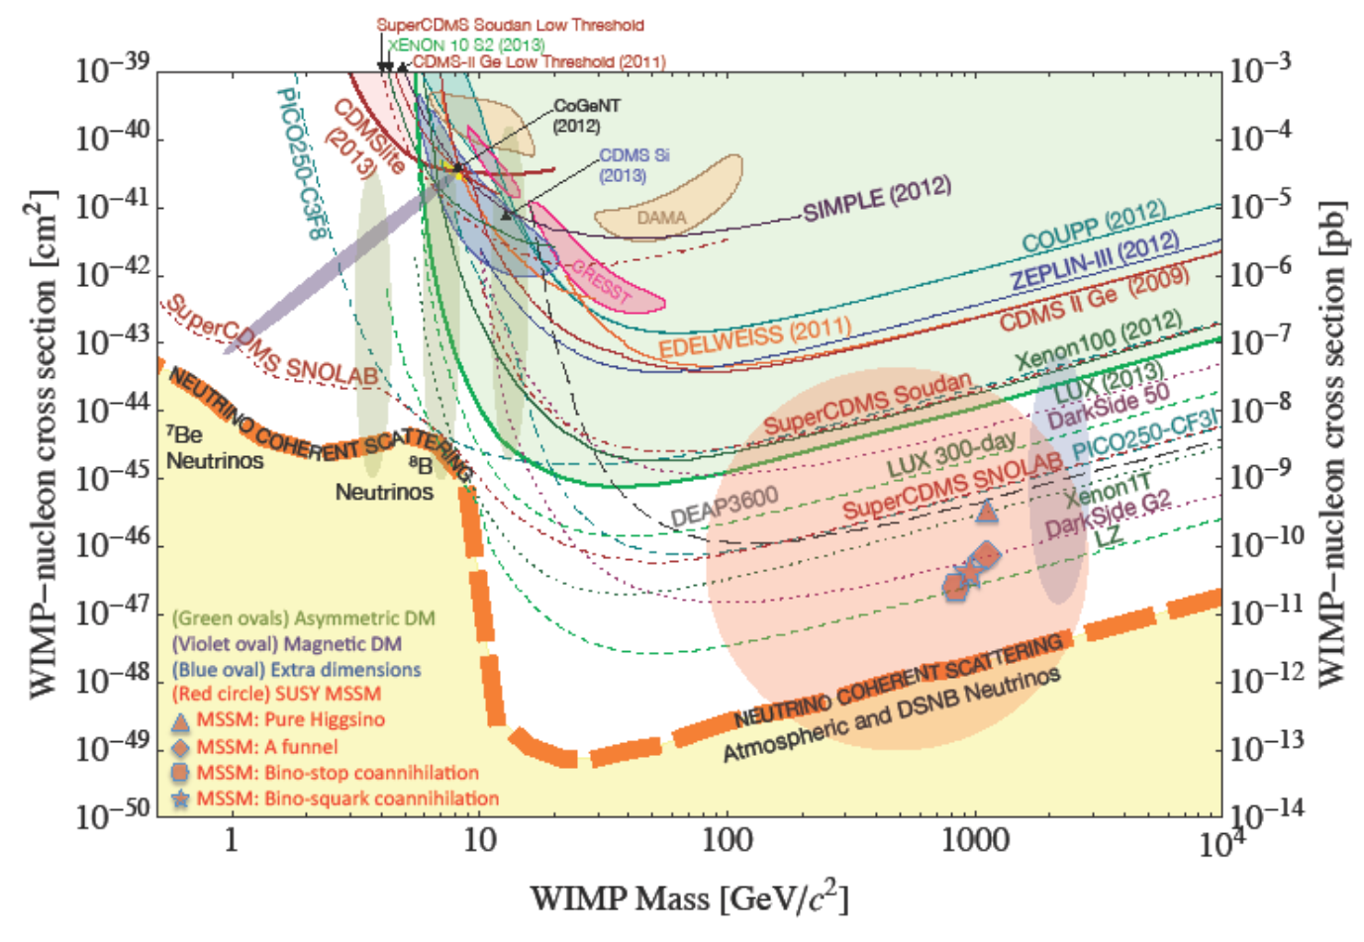
LZ SENSITIVITY
Snowmass Community Summer Study 2013
CF1: WIMP Dark Matter Detection

Slide 15
PROGRAMME STATUS
Conceptual design nearly completed
Construction from 2015/16
Operation from 2018
DOE/NSF experiment down-selection imminent in US
Substantial support from South Dakota Science & Technology Authority
Endorsed by DMUK consortium in the UK

Slide 16
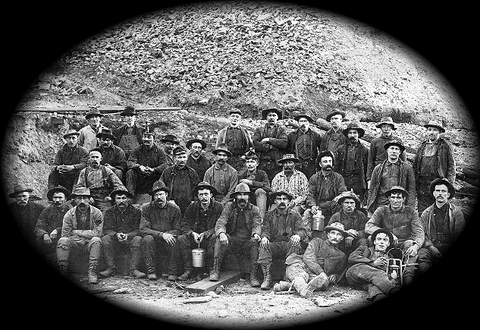
LZ
COLLABORATION
US (17) + UK (7) + PT (1) + RU (1)
University of Alabama
Brown University
University of California, Berkeley
University of California, Davis
University of California, Santa Barbara
Case Western Reserve University
Daresbury Laboratory
Edinburgh University
Imperial College London
MEPHI-Moscow, Russia
Lawrence Berkeley National Laboratory
Lawrence Livermore National Laboratory
LIP-Coimbra, Portugal
University of Maryland
University of Oxford
Rutherford Appleton Laboratory
University of Rochester
Sheffield University
SLAC National Accelerator Laboratory
SD School of Mines & Technology
University of South Dakota
Texas A&M University
University College London
Washington University
University of Wisconsin
Yale University

