Slide 1

First Years of Running for the
LHCb Calorimeter System
2 June 2014
Pascal Perret
LPC Clermont
On behalf LHCb Collaboration

Slide 2
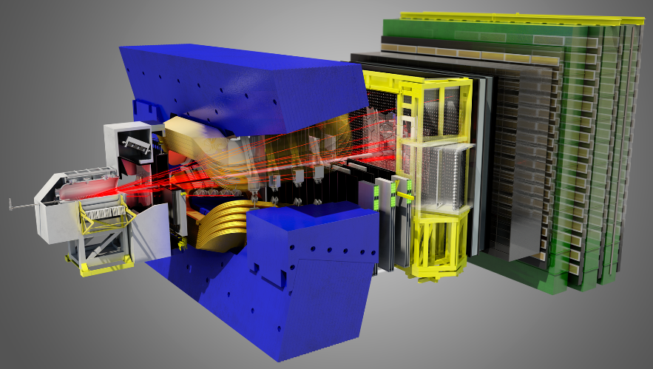
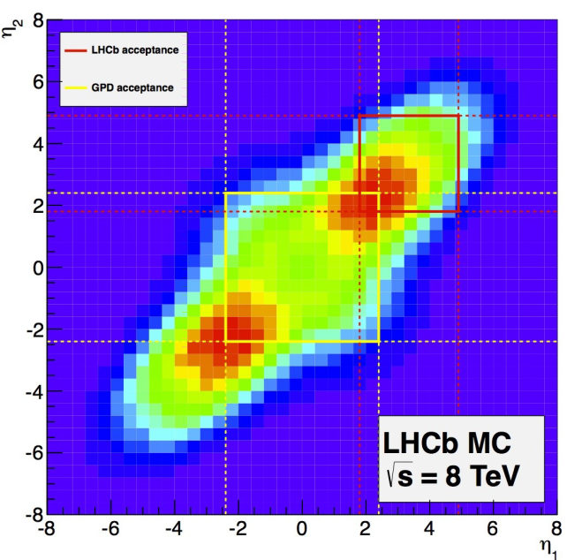
The LHCb detector
A single-arm forward spectrometer:
  Covers ~4% of the solid angle, but captures ~30% of the heavy quark production cross-section
ATLAS & CMS
region |η| < 2.5
~10m
LHCb region
2 < η < 5
10 – 250 mrad
10 – 300 mrad
~20m
  Precision measurements in beauty and charm sectors

Slide 3
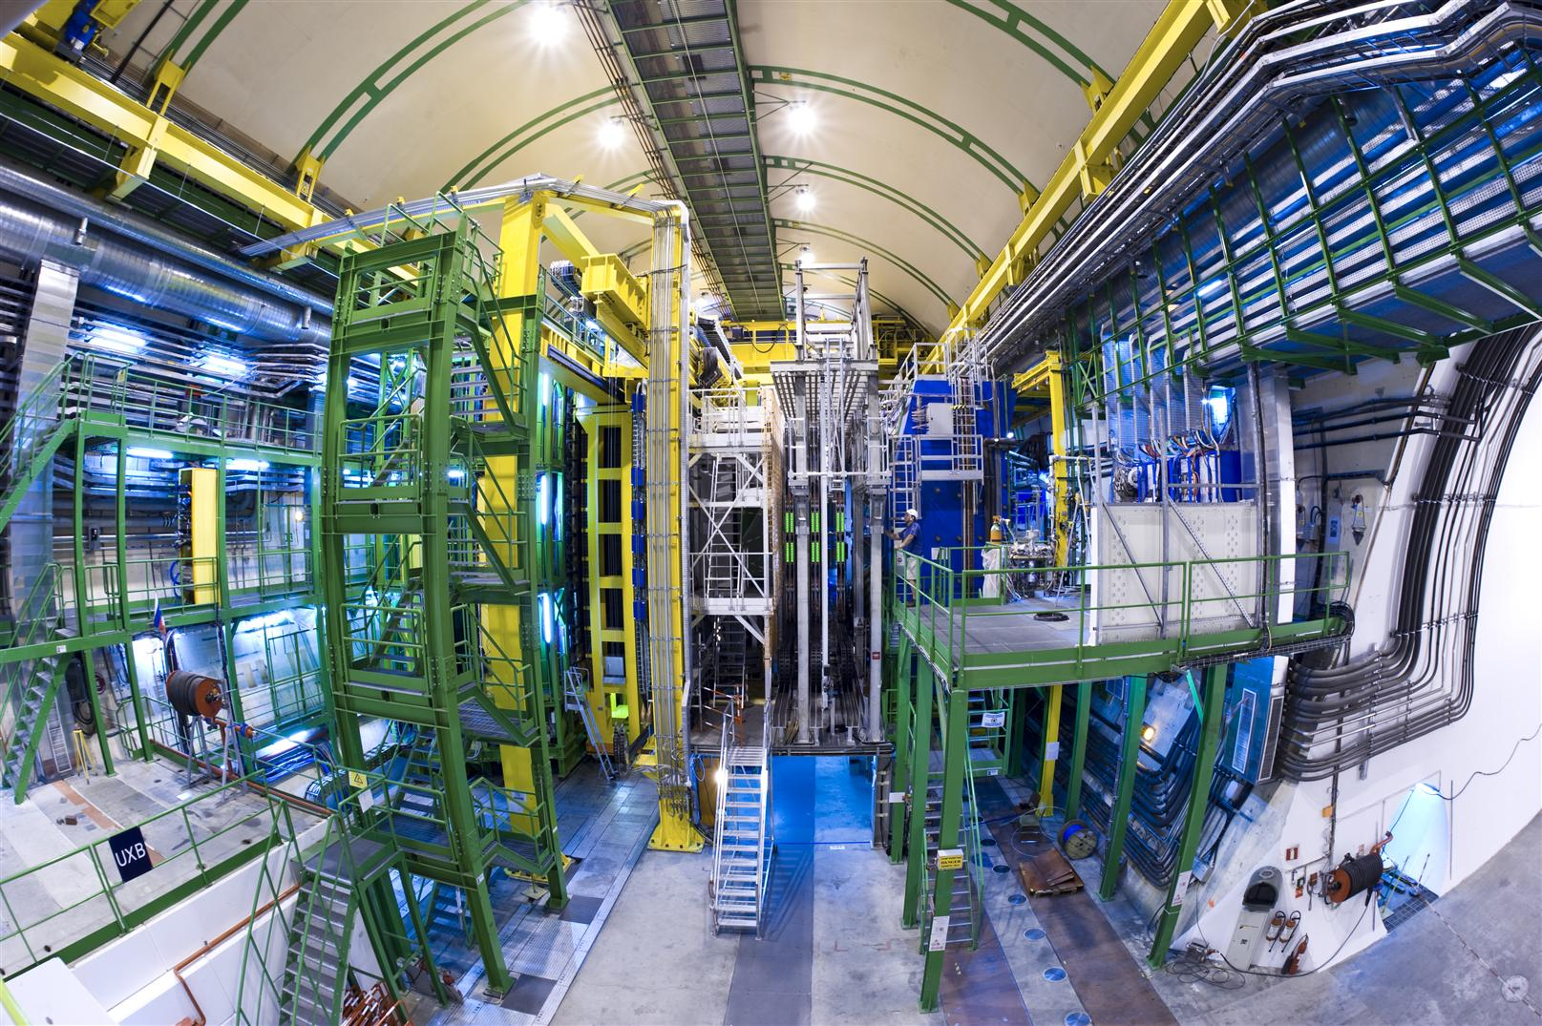
The LHCb detector

Slide 4
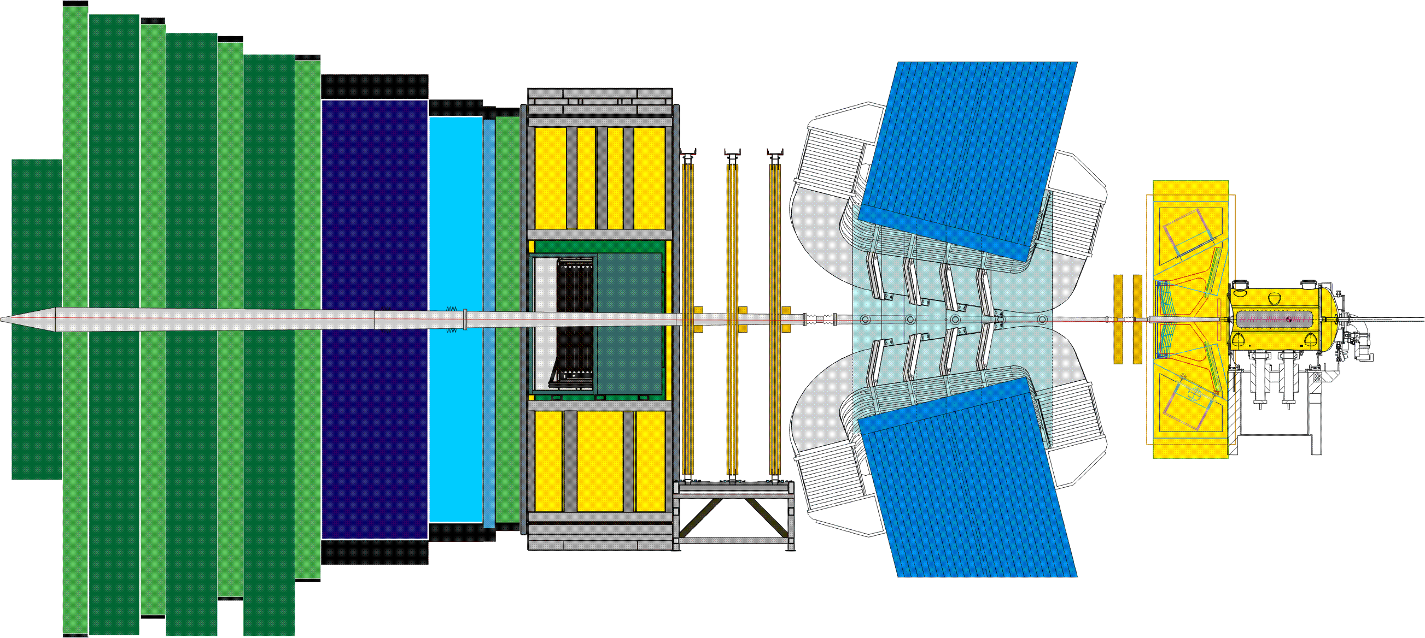
The LHCb detector
RICH2
Outer Tracker straw Tubes
TT
Si
HCAL
ECAL
Magnet
VELO&PU
Si
p
p
Muon
MWPCGEM
Inner Tracker
Si
RICH1
PS+SPD
[The LHCb Detector at the LHC, JINST 3 (2008) S08005]

Slide 5
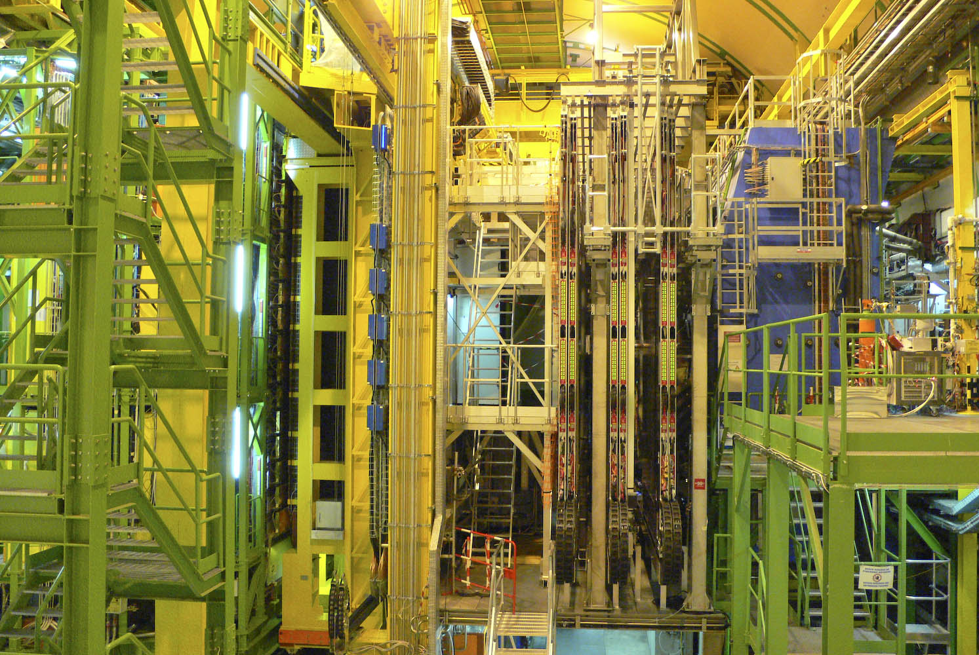
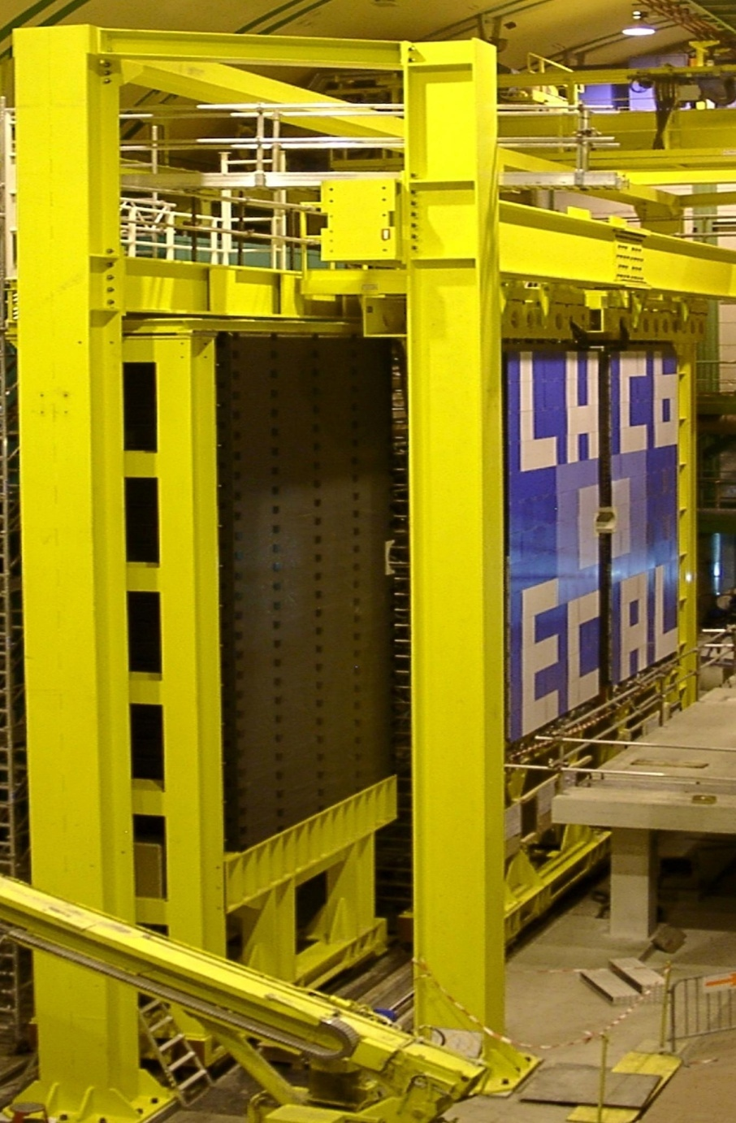
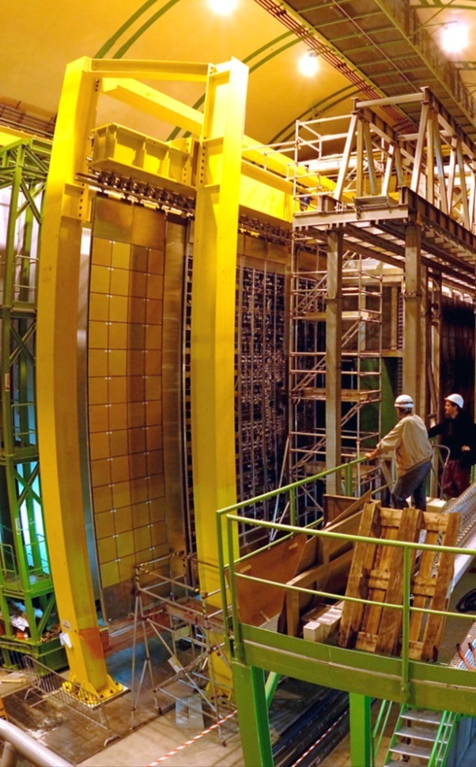
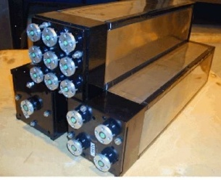
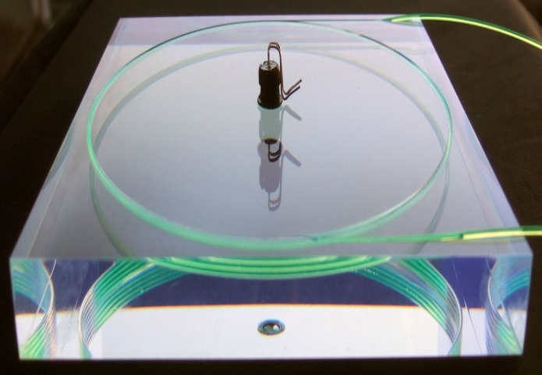
The LHCb calorimeters
HCAL
ECAL
PS
SPD
Inner Outer Middle
region
ECAL (inner modules): σ(E)/E ~ 8.2% /√E + 0.9%
Calorimeter system :
L0 trigger on high E_{T} e / γ / π⁰ and hadron
Precise energy measurement of e and γ
Particle Identification: e / γ / h (contributes to µ PID)
[JINST 3 (2008) S08005,
LHCb calorimeters", TDR, CERN/LHCC/2000-0036 LHCb TDR 2]

Slide 6
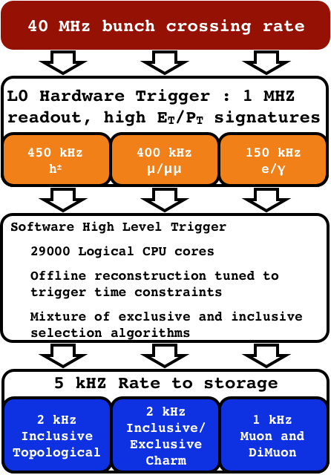
LHCb trigger
  Level-0 trigger: hardware
    4 μs latency @ 40MHz
    “Moderate” E_{T}/p_{T} threshold:
      Typically
        E_{T}(e/γ)>2.7 GeV
        E_{T}(h)>3.6 GeV
        p_{T}(μ)>1.4 GeV/c
  HLT trigger: software
    ~30000 tasks in parallel on ~1500 nodes
  Storage rate: 5 kHz
  Combined efficiency (L0+HLT):
    ~90 % for di-muon channels
    ~30 % for multi-body hadronic final states

Slide 7
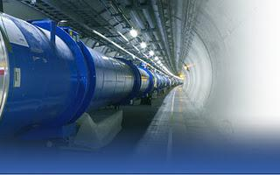
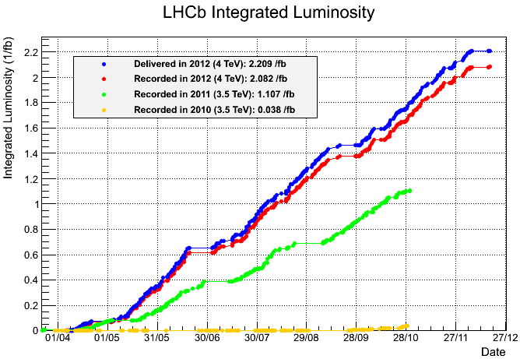
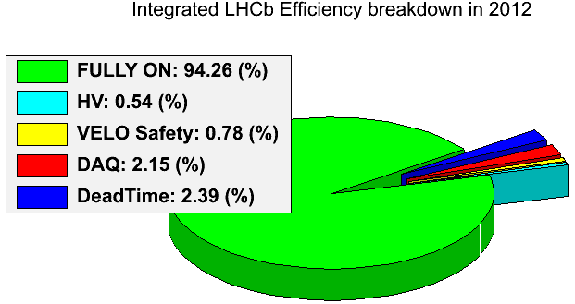
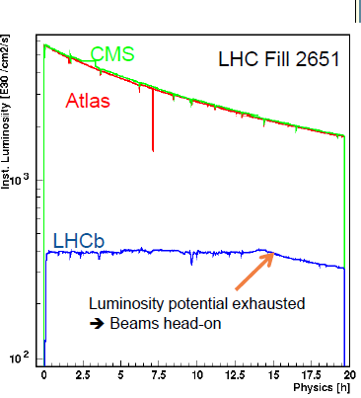
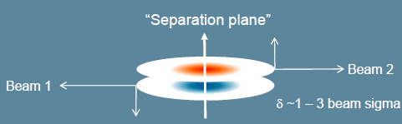
LHCb operation
LHC
2012 | 8 TeV | 2.1 fb⁻¹
2011 | 7 TeV | 1.1 fb⁻¹
2010 | 7 TeV | 0.038 fb⁻¹
High Efficiency!
ε(operation)>94%
~98% are good data!
2012
2011
Detectors all with >~99% active channels
2010
Semi-continuous (automatic) adjustment of offset of colliding beams allows luminosity to be levelled
15 h!
4x10³²cm⁻²s⁻¹
Design:
2x10³²cm⁻²s⁻¹
    4 times more collisions per crossing than in the design!!!

Slide 8
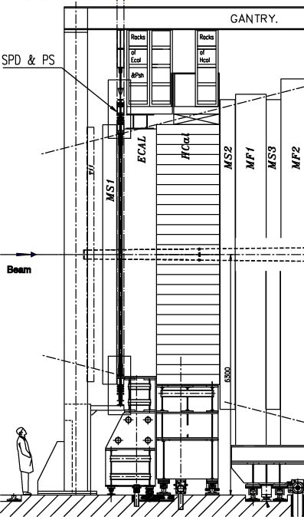
LHCb Calorimeter System
  40 MHz trigger on energetic e, π⁰, γ, h
  Distance to i.p. ~13 m
  Solid angle coverage 300x250 mrad
  Four sub-detectors: SPD,PS,ECAL,HCAL
    Independently retractable halves
  Granularity:
    SPD, PS, ECAL:
      6016 cells: 3 zones 4x4; 6x6 and 12x12 cm²
    HCAL: 1488 cells: 13x13 and 26x26 cm²
Y~7m
X~8.5m
PS/SPD
HCAL
ECAL
120 mm
60 mm
40
Z~2.7m

Slide 9
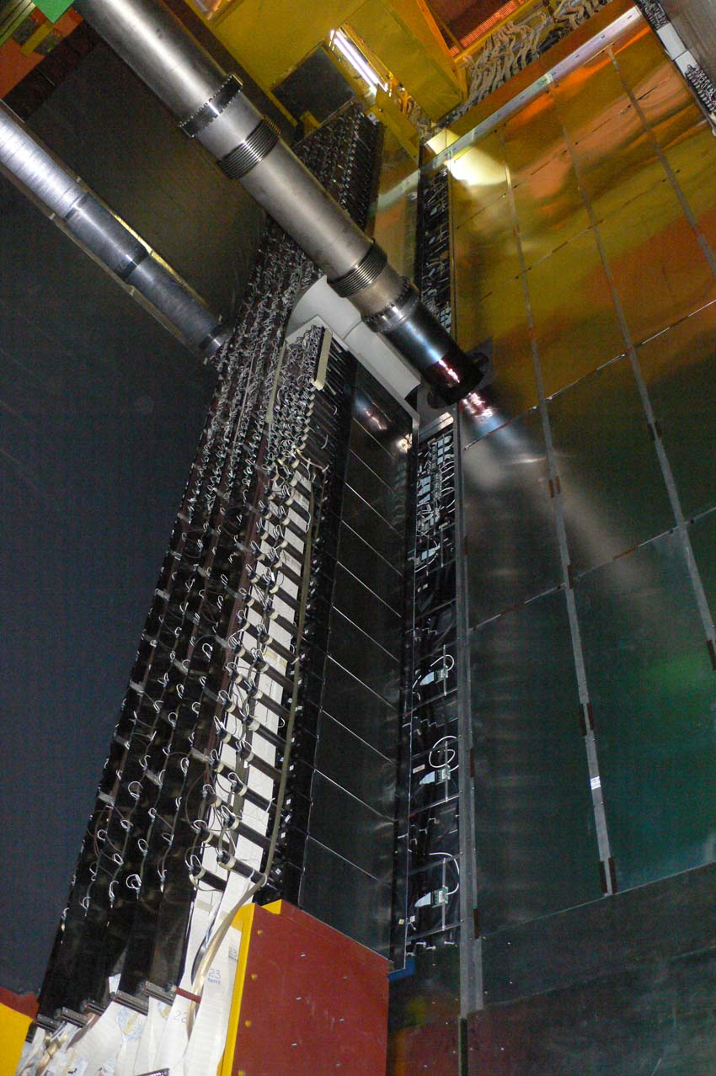
LHCb Calorimeter System
  40 MHz trigger on energetic e, π⁰, γ, h
  Distance to i.p. ~13 m
  Solid angle coverage 300x250 mrad
  Four sub-detectors: SPD,PS,ECAL,HCAL
    Independently retractable halves
  Granularity:
    SPD, PS, ECAL:
      6016 cells: 3 zones 4x4; 6x6 and 12x12 cm²
    HCAL: 1488 cells: 13x13 and 26x26 cm²
HCAL
Y~7m
X~8.5m
PS/SPD
HCAL
ECAL
PS/SPD
ECAL
120 mm
60 mm
40
Z~2.7m

Slide 10
LHCb Calorimeter System
  40 MHz trigger on energetic e, π⁰, γ, h
  Distance to i.p. ~13 m
  Solid angle coverage 300x250 mrad
  Four sub-detectors: SPD,PS,ECAL,HCAL
    Independently retractable halves
  Granularity:
    SPD, PS, ECAL:
      6016 cells: 3 zones 4x4; 6x6 and 12x12 cm²
    HCAL: 1488 cells: 13x13 and 26x26 cm²
  Detection
    Sandwich of scintillator/lead (iron for HCAL)
    WLS fibres are used to collect the light read out thanks to photomultipliers (PMT)
      Multianode PMT (64) for SPD & PS
    Cost effective
HCAL
PS/SPD
ECAL

Slide 11
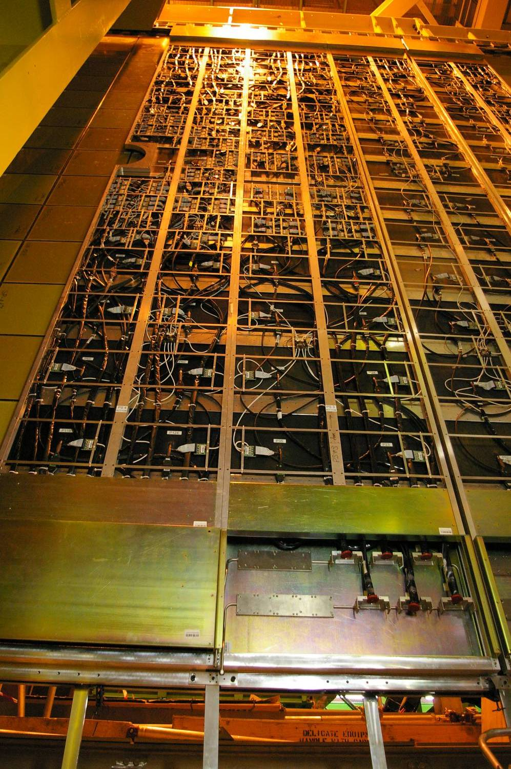
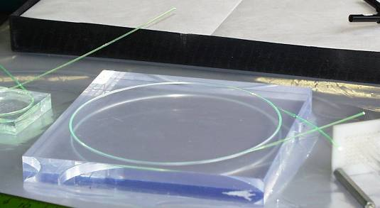
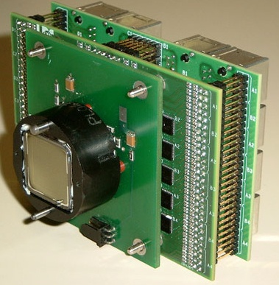
SPD (Scintillator Pad Detector) and PS (Preshower)
    Scintillator Pad – 2.5X₀ lead – Scintillator Pad
      15/15/15 mm thick;
      WLS fibres are used to collect the light
      Signal read by 64-channel MAPMT
      Average light yield: ~20 p.e/MIP
      PS: 10 bits – dynamic range: 0.1-100 MIPs
      SPD: 1 bit
4 m
8 m

Slide 12
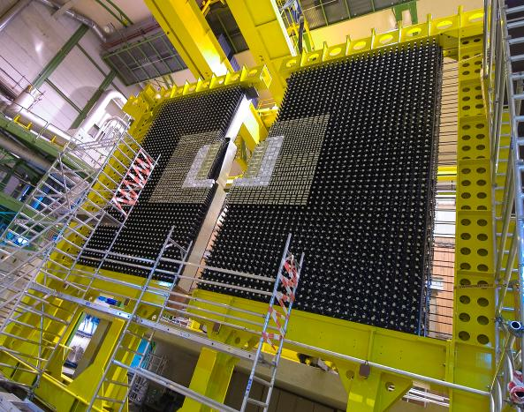
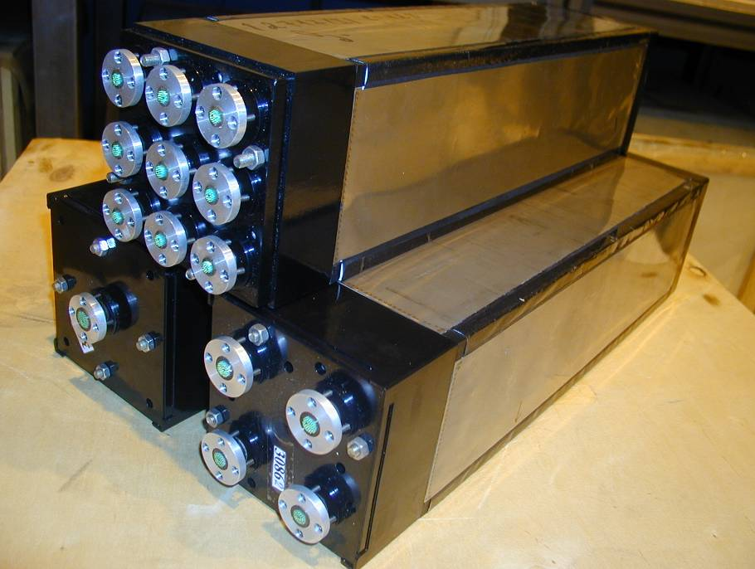
ECAL
  Electromagnetic Calorimeter (ECAL):
    66 layers of 2mm Pb/ 4mm scintillator
    Light collected through WLS fibres bunch
      Moliere radius: 3.5 cm
      Longitudinal size: 25X₀, 1.1 λ_{I},
      Average light yield: ~3000 p.e/GeV
      Dynamic range: 10 ÷ 12 GeV of transverse energy (E(max, GeV)=7 + 10 /sin(θ))
      Energy resolution (beam tests)
      σ(E)/E = (8 ÷ 10)% /√E ⊕ 0.9%
Inner
Module 9 cells: 4x4 cm²
Middle
Module 4 cells: 6x6 cm²
Outer
Module 1 cell: 12x12 cm²
3312 shashlik modules with 25 X₀ Pb

Slide 13
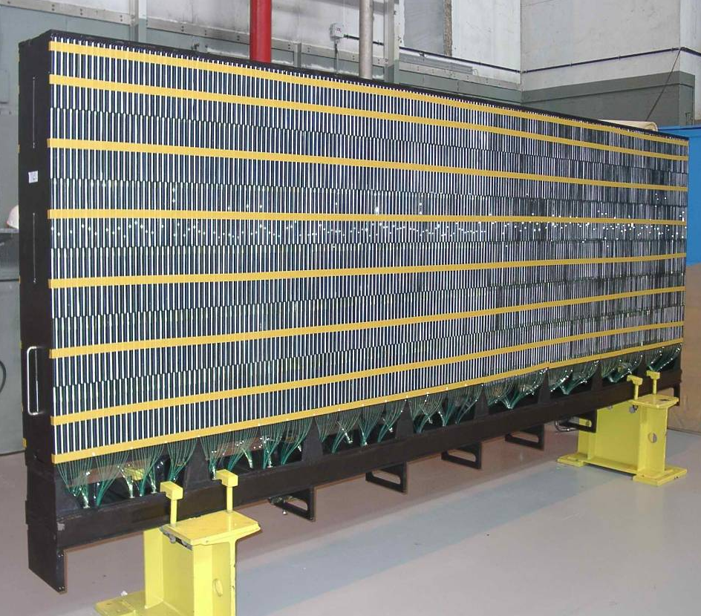
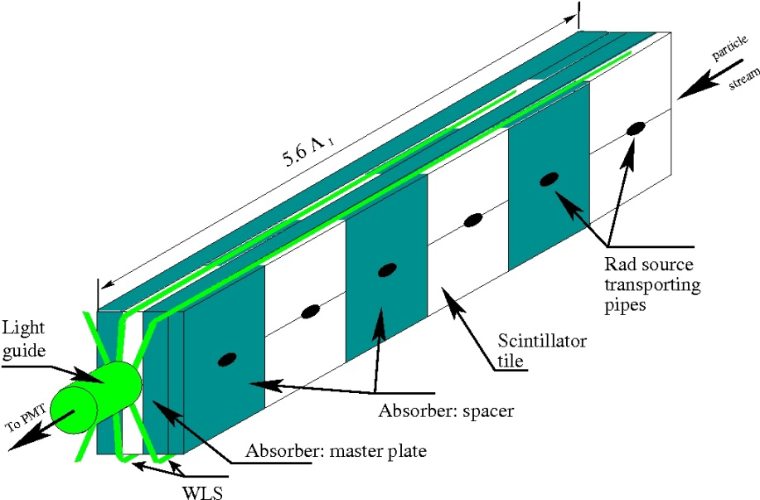
HCAL
52 modules with longitudinal tiles
  Hadronic Calorimeter (HCAL):
    26x2 horizontal modules
      The same design as in ATLAS TileCal
      interleaving Sc tiles and iron plates parallel to the beam axis. Volume ratio Fe:Sc = 5.58:1
      Longitudinal size: 5.6 λ_{I}
        Mostly used as a trigger device!
      Average light yield: ~105 p.e/GeV
      Dynamic range: 15 GeV of E_{T} (now 30 GeV)
      Energy resolution (beam tests)
      σ(E)/E = (69 ± 5)% /√E ⊕ (9 ± 2)%
      moderate resolution is sufficient
6mm master, 4mm spacer / 3mm scintillator

Slide 14
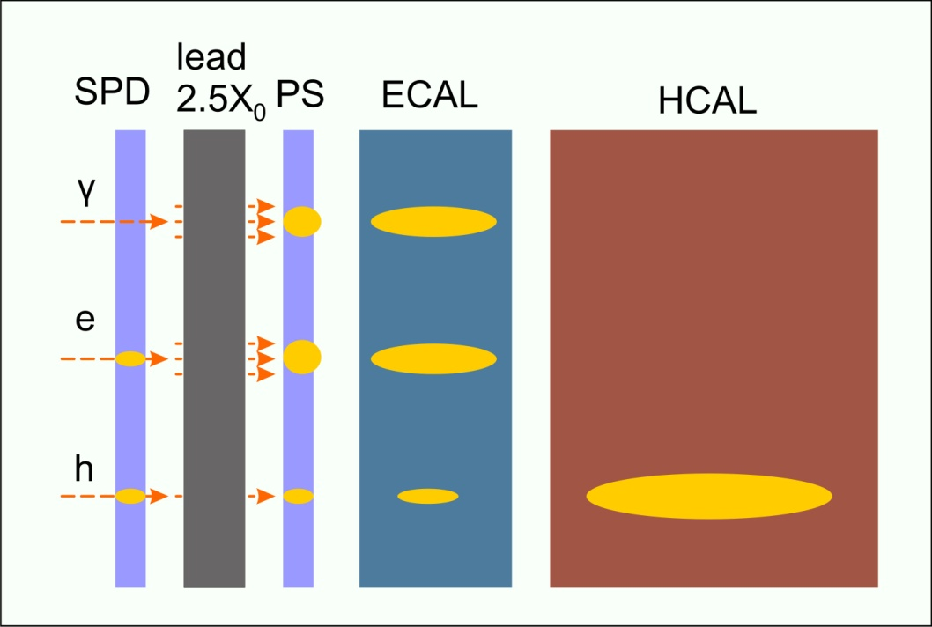
Calorimeter functionalities
    PS/SPD: PID for L0 electron and photon trigger
      electron, photon/pion separation by PS
      photon/MIP separation by SPD
      Charged multiplicity by SPD
SPD/PS/ECAL/HCAL in coincidence
SPD | PS | ECAL | HCAL
1 | 1 | 1 | 0 | e
0 | 1 | 1 | 0 | γ
1 | 0 | 0 | 1 | h
1 | 0 | 0 | 0 | µ
    ECAL
      E_{T} of electrons, photons and π⁰ for L0 trigger (B_{d} → K* ee, B⁰ → K* γ, )
      Reconstruction of π⁰ and prompt γ offline (+ PS)
      Particle ID (+ PS)
    HCAL: E_{T} of hadrons, ΣE_{T} for L0 trigger
      ~ 500 kHz (out of ~1 MHz)

Slide 15
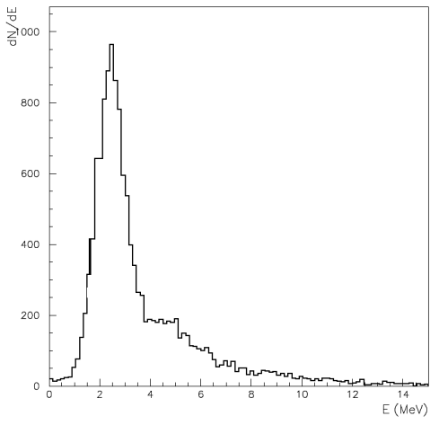
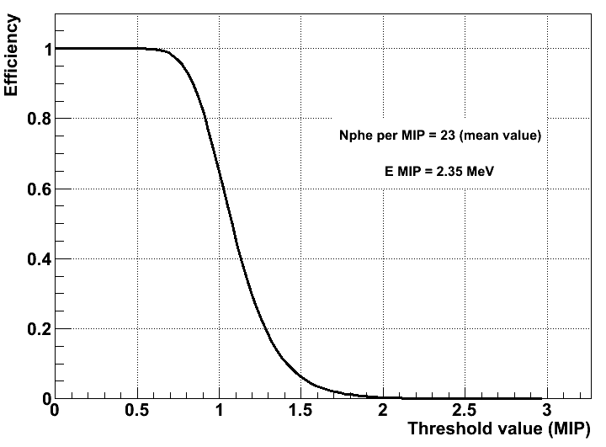

Calibration
  SPD: [LHCb-PUB-2011-024]
  Threshold set at ~0.5 MIP
  Binary detector: no straight MIP calibration
    Tracks pointing to given cell are extrapolated
~95% efficient for MIPs
    Collect data at different thresholds and get efficiency to MIP by comparing with theoretical value
Theoretical efficiency
ε = Landau x Poisson
SPD efficiency as a function of threshold
Fluctuations of nphe at photocathode.
Energy loss
    Provide a resolution in the MIP position smaller than 5%

Slide 16
Calibration
PS
  MIP signal set at ~10 ADC count (10 bits – dynamic range: 0.1-100 MIPs)
    Use any reconstructed track which extrapolation hits the Preshower
    MIP signal is fitted (Landau⊗Gauss to account for photostatistics resolution) and fixed to a given number of ADC counts
      ~5% precision level
2011 data Preliminary
µ: 10.87 ± 0.03
σ: 0.83 ± 0.02
µ: 10.41 ± 0.03
σ: 0.90 ± 0.02
µ: 10.58 ± 0.03
σ: 0.93 ± 0.02
INNER
MIDDLE
OUTER

Slide 17
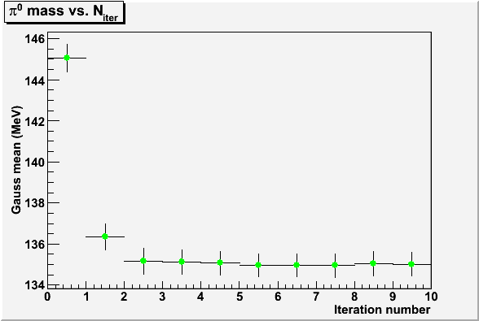
Calibration
ECAL: fine absolute calibration using reconstructed π⁰ peak
  Iterative procedure by π⁰ mass peak fitting
    Find the coefficient which would move the measured mass closer to the π⁰ nominal one: λ = M_{nom}/M_{meas} = 135 MeV / M_{meas}
    Repeat for each cell (6096)
    Iterate until stable: 5-6 iterations
  ~1-2% precision
    ~100M events needed
      ~200 pb⁻¹ (~1month)
2011 data (June)
Preliminary
π⁰ selection cuts:
No SPD hit
p_{T}(γ)>300 MeV
E_{PS}<10 MeV
(only ECAL calibration)
p_{T} (π⁰)>800 MeV
Initial calibration value
Absolute
calibration iterations
Final calibration value

Slide 18
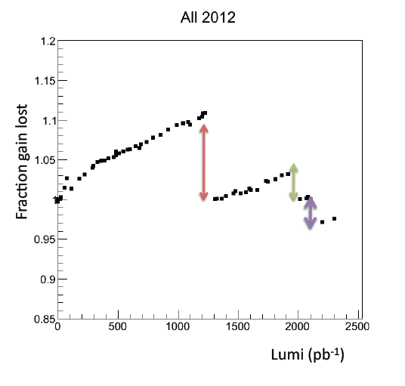
Calibration
ECAL calibration with electrons
  Comparison of the electron momentum measured in the tracking system with its energy measured by the ECAL and PS
      Electrons from conversion selected with RichDllE and loose electron id.
    Used to monitor ageing with applying ageing trend corrections every 40 pb⁻¹ (not enough statistics to apply π⁰ method).
E/p for electrons in ECAL
E/p for hadrons in ECAL
2011 data
HV corrections
Annealing
after one month
E/p

Slide 19
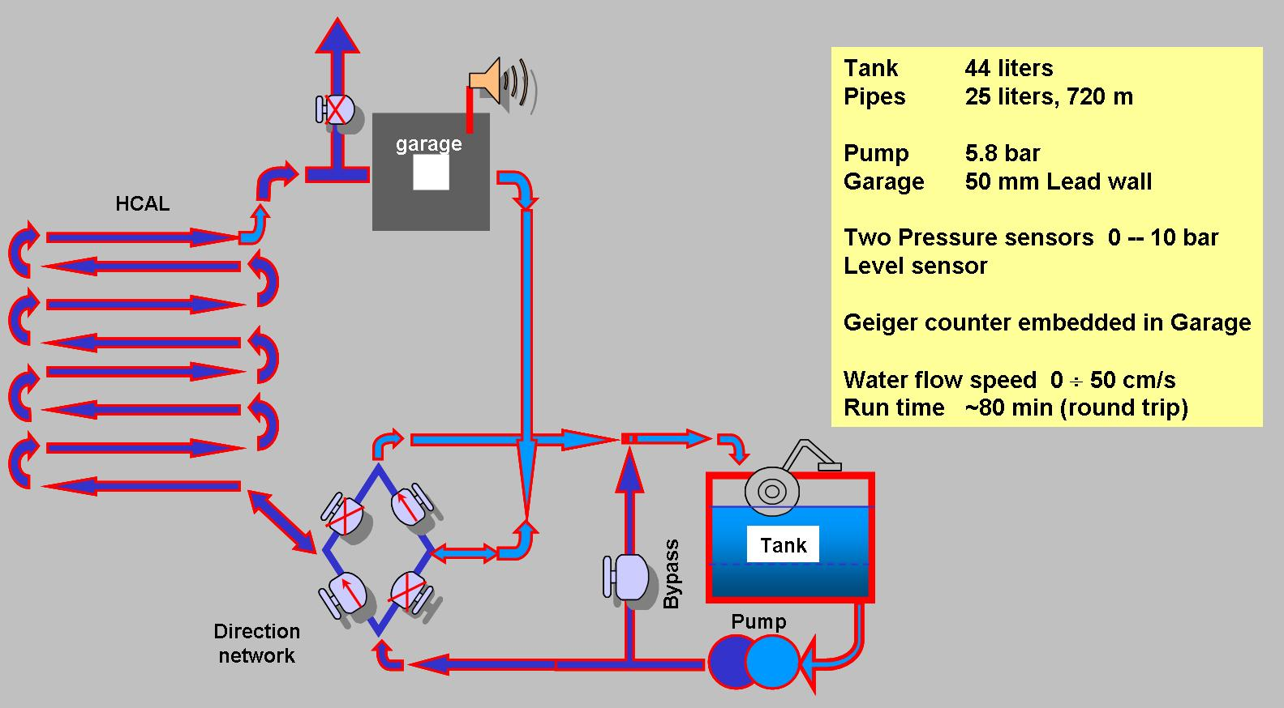
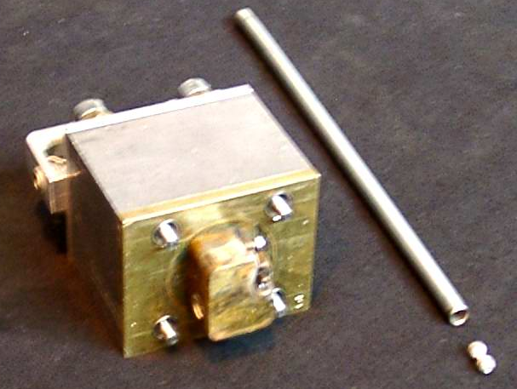
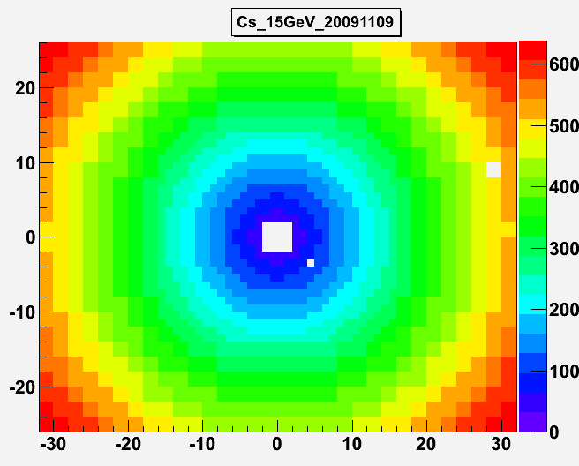
Calibration
HCAL calibration done with ¹³⁷Cs source:
  Two ~ 10 mCi ¹³⁷Cs source used:
    1 per each detector half
      Driven by hydraulic system
      Similar to the ATLAS TileCal one
  Each source propagates consecutively through 26 HCAL modules
    average velocity of about 20–40 cm/s.
    System of dedicated integrators measures PM anode currents every 5 ms
    Absolute normalization ~10%, dominated by the uncertainty in the source activity
    Cell to cell intercalibration better than 4%
    Calibration done regularly during Technical Stops
    LED monitoring system is used to control HCAL response during data taking.
Radioactive source
2 dead cells

Slide 20
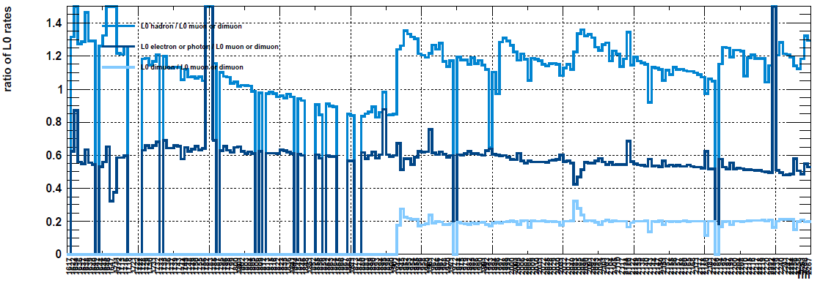
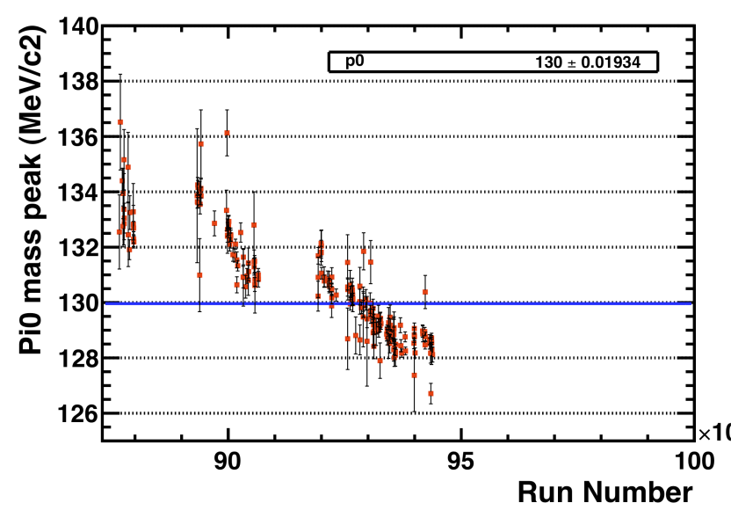
Detector ageing
  Combination of several effects:
    Scintillator ageing due to radiations (~0.25 Mrad /year);
      Plastic tiles become less and less transparent
      Proportional to particule flux (neutral + charged)
    PMT ageing as a function of the integrated current (PMT dynode)
      Depends upon cell size and location (up to 100C)
  These are well known unavoidable effects …
    On the trigger rate, on detector performances, etc
L0Hadron/L0muon-dimuon trigger rate
π⁰ mass as a function of time (recorded luminosity)
Regular calibration!
L0electron/photon / L0muon-dimuon trigger rate

Slide 21
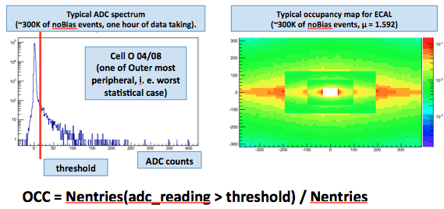
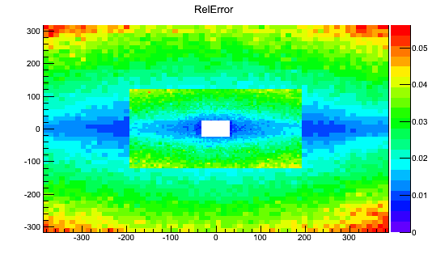
Calibration
Towards an automatic (online) calibration for RUN 2
  Based on LED and raw ocupancy
Precision reached with 1 hour data taking
  The method is very promising: ~1% could be achieved
      A first look was done at 2012 collection for ECAL, HCAL and PS
    Adjust PMT HV on a fill basis
    Obtain a stable trigger

Slide 22
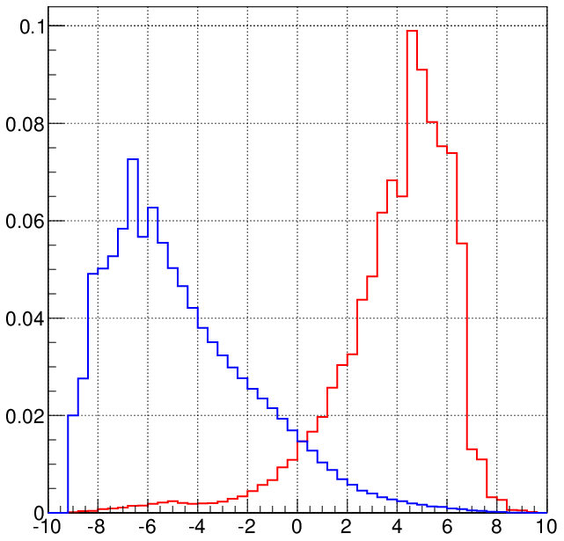
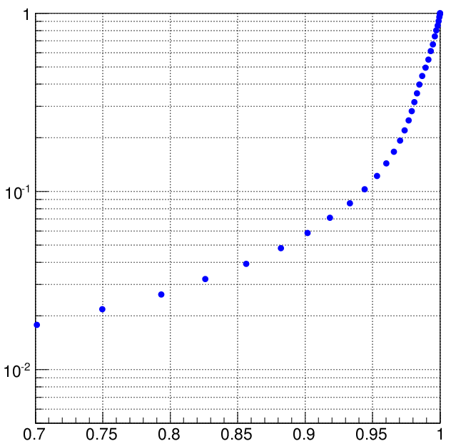
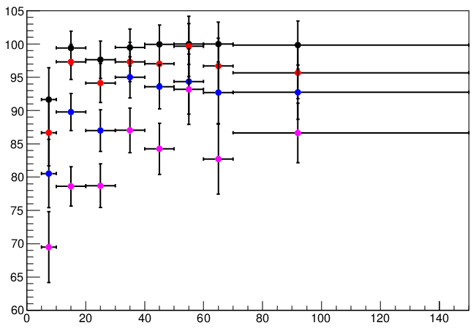
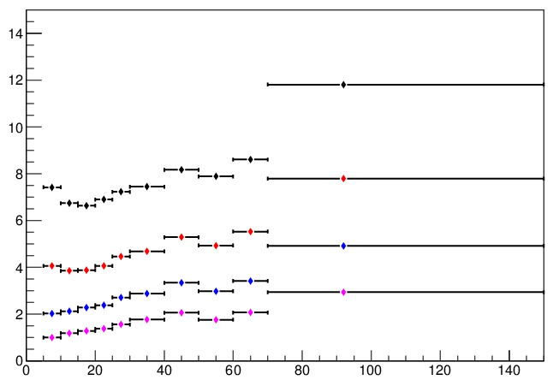
Performances: Electron PID
  Based on difference between likehood of the (electron) signal and background
    Fully based on data distributions
      Signal : electrons/positrons from γ conversions
      Background : hadrons from D⁰ → Kπ
__ e from γ → e⁺e⁻
__ hadrons from D⁰
misID rate (%)
Combined Calo Delta Log –Likelihood
Electron efficiency
+ RICH information:
Mis_ID rate <2%
for electron eff >97%
__ Δ log > 0
Electron efficiency(%)
misID rate (%)
__ Δ log > 1
__ Δ log > 2
Mis_ID rate ~5%
for electron eff 90%
From B⁺→ J/ψ K
__ Δ log > 3
Momentum (GeV/c)
Momentum (GeV/c)

Slide 23
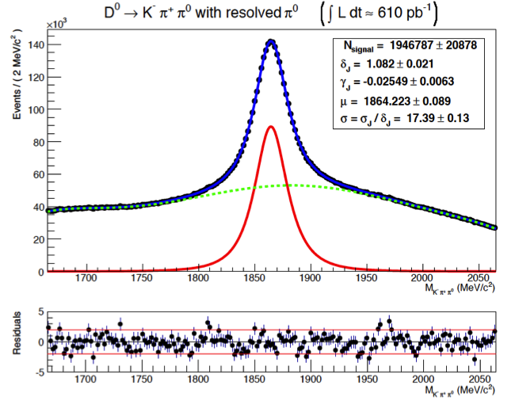
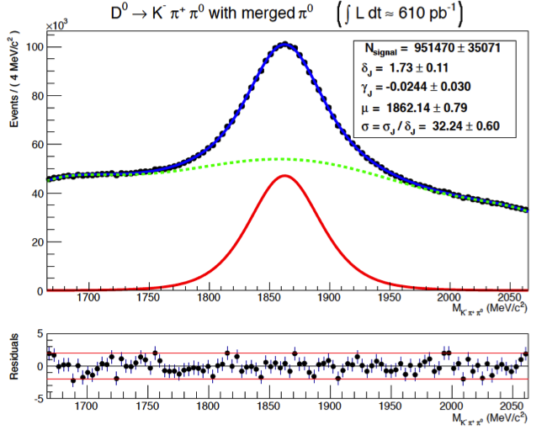
Performances: π⁰ reconstruction
  Low energy π⁰ : resolved pair of γ: σ ~ 8 MeV/c²
  High energy π⁰ (p_{T} > 2 GeV/c):
D⁰→K⁺π⁻π⁰ (resolved π⁰)
D⁰→K⁺π⁻π⁰ (merged π⁰)
σ=17.4 MeV/c²
σ=32.2 MeV/c²
Resolved pair of well separated photons
      Photons that cannot be resolved as a pair of clusters within ECAL granularity

Slide 24
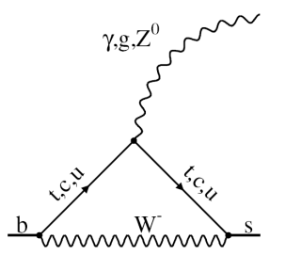
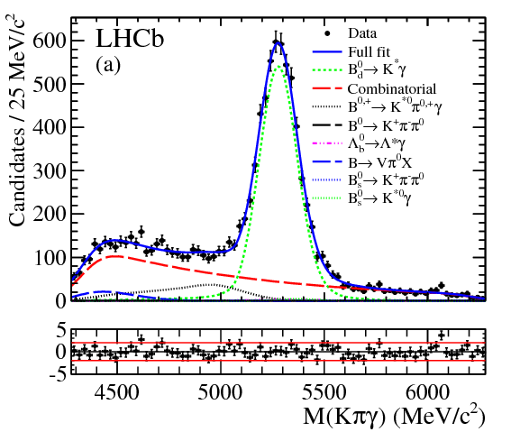
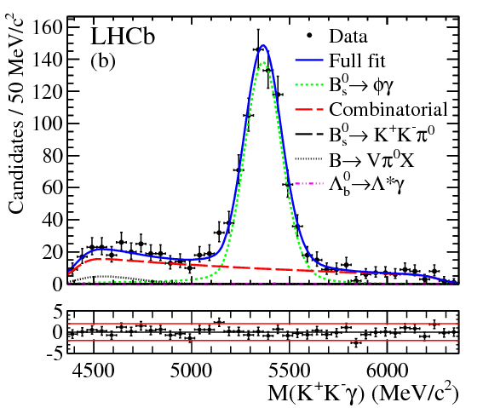
Performances: Radiative decays
  Theory
      Predictions for BR suffer from large uncertainties from hadronic form factors
        B⁰ → K* γ = (4.3±1.4)x10⁻⁵ ; B_{s} → ϕ γ = (4.3±1.4)x10⁻⁵
      Ratio of BR and direct CP asymmetries are better known
  LHCb measurements (1 fb⁻¹) [NP B 867 (2012) 1]
N _{B0 → K* γ} = 5279 ± 93
N _{Bs → ϕ γ} = 691 ± 36
B⁰ → K* γ
B_{s} → φ γ
  R_{BR} = 1.23 ± 0.06 ± 0.04 ± 0.10(f_{s}/f_{d})
    Th: 1.0 ± 0.2
  A_{CP}(B⁰ → K* γ) =
  (0.8 ± 1.7 ± 0.9)%
    Th: (-0.61 ± 0.43)%
  WB measurements
Invariant mass resolution: ~92 MeV/c²
BR(B_{s} → φ γ) = (3.5 ± 0.4)x10⁻⁵
    No sizeable deviation from SM

Slide 25

LHCb calorimeter upgrade
Running at ~2x10³³cm⁻²s⁻¹ (instead of 4x10³²cm⁻²s⁻¹) @ √s =14 TeV
  After LS2: ~2019
Full software trigger
  DAQ @ 40MHz
    Change in the readout electronics
  Lower PMT gain
    Higher luminosity
    Ageing
  New electronics under development : 5 times more gain
    See poster session
  PS and SPD shall be removed (mainly contribute to L0 trigger)
LHCb upgrade PID TDR: CERN/LHCC 2013-022
    LHCb Upgrade LoI: CERN-LHCC-2011-001
    LHCb Upgrade Framework TDR: CERN-LHCC-2012-007

Slide 26
Summary & Conclusion
  The calorimeters are running smoothly!
    O(10⁻³) dead channels
  and performing well:
    Trigger capabilities: hadron, electron, photon
      Key role in the trigger system
    Energy resolution
      Important measurements achieved:
        b → s γ (B⁰ → K* γ, B_{s} → φ γ), etc.
  Significant ageing (PMT, scintillators) … as expected
    Under control thanks to “frequent calibrations”
    New calibration procedure for RUN 2
      Automation of HV PMT adjustment procedures after each fill
  Calorimeter (LHCb) upgrade to run at L ~2x10³³cm⁻²s⁻¹ > 2020
  Many other LHCb talks & posters @ TIPP
    Trigger, VELO, RICH, SciFi, etc.

Slide 27
Thank you!

Slide 28
The LHCb detector
σ(E)/E ~ 70%/√E ⊕ 10%
σ(E)/E ~ 10%/√E ⊕ 1% σ_{m}~90 MeV for B⁰→K*γ
σ_{m}~8 MeV for B⁺→J/ψK⁺, 25 MeV for B →µ⁺µ-
~20 µm IP resolution at P_{T} > 2 GeV
p
p
Excellent muon identication ε = 97%, misid 2%
ε(k → k) 90% for ε(k → π) <10%
Great Vertex Resolution! Primary/secondary separation, proper time resolution.
Excellent momentum and mass resolution.
Outstanding PID (K-π) and μ reconstruction.
Dedicated Trigger system for B and C!

Slide 29
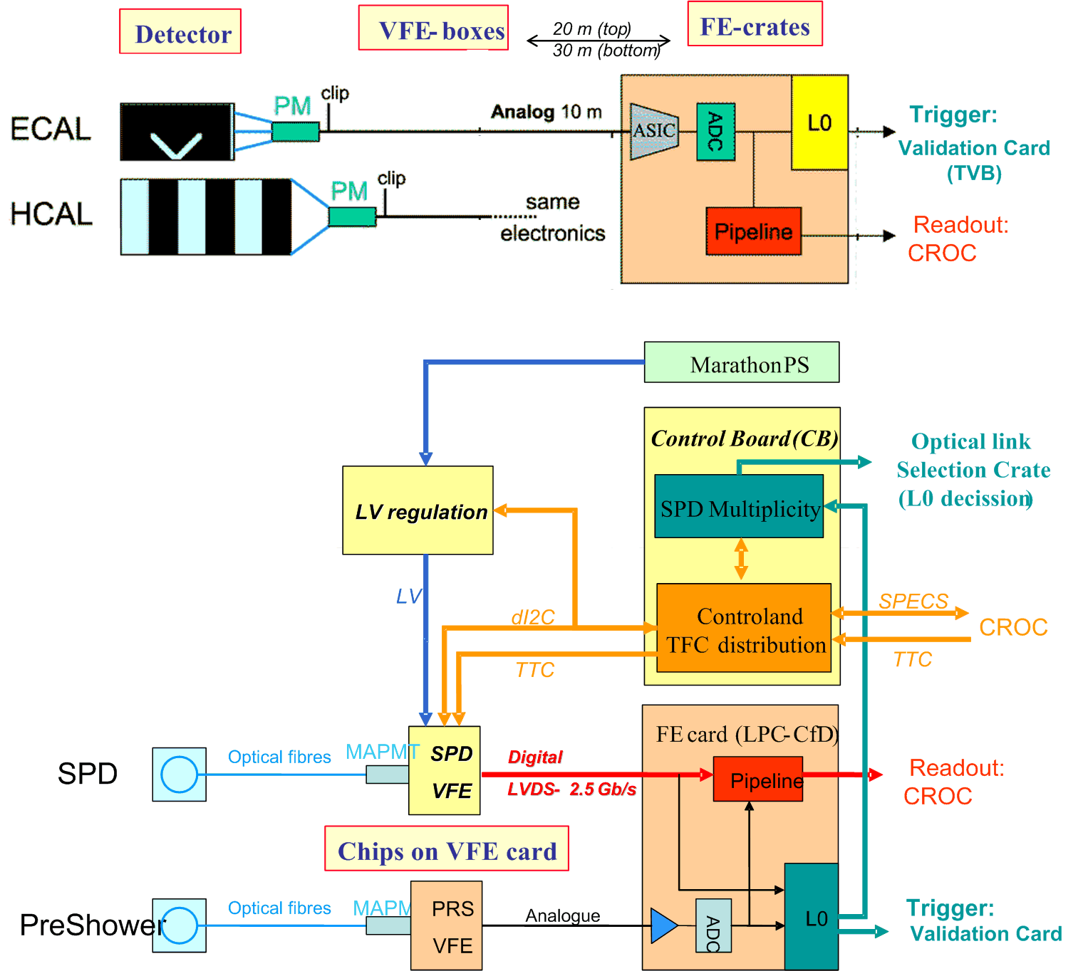
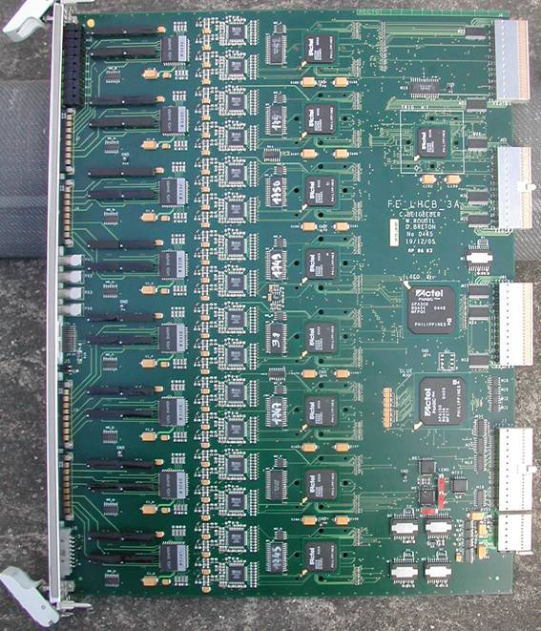
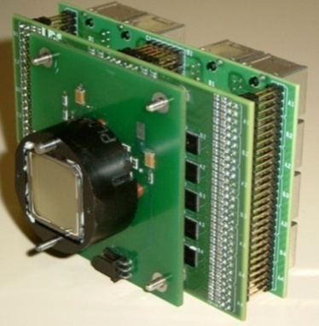
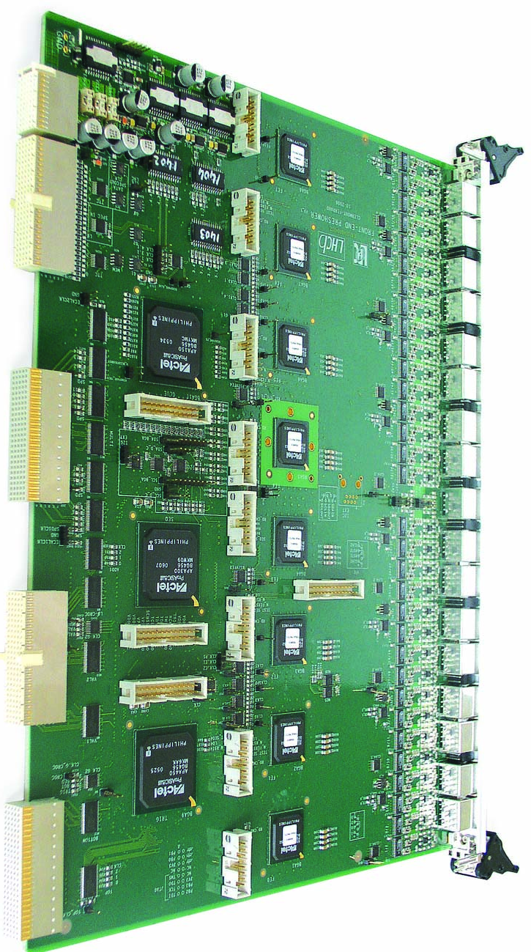
The readout system
192 ECAL FEB
54 HCAL FEB
12-bit ADC
40 MHz
32 channels
1 MHz
100 PS/SPD FEB
10-bit ADC
40 MHz
1 MHz
64 channels
40 MHz
40 MHz

Slide 30
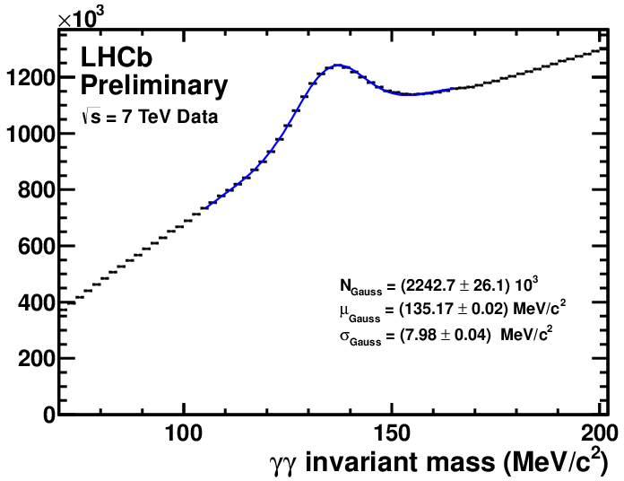
ECAL ageing
After calibration (preliminary, 2011 data):
April May June July August
10³
2012

Slide 31


HCAL ageing
  ¹³⁷Cs source
    Allow to separate the light yield degradation from the PMT gain loss
    Radiation damage of tiles and fibers
Longitudinal dose in HCAL,
cell closest to the beam
0 1 2 3 4 5
HCAL tile row
The hadronic shower maximum lays ~ within the tile row 0; the dose in the row 5 is much less. Radiation damage of scintillator tiles and fibers can therefore manifest itself as a decrease of relative response of upstream rows (0, 1) with respect to row 5.

Slide 32






HCAL ageing
    Radiation damage of tiles and fibers
      30-Aug vs 29-Mar (758 pb⁻¹)
Row0/R5
Row1/R5
Row2/R5
Row3/R5
Row4/R5
Further decrease in the centre
At low doses, it develops ~linearly in time

Slide 33




HCAL ageing
    PMT ageing
      The anode currents of the HCAL PMTs are continuously monitored with integrators of the source calibration system
      In 2011, at L=3.5∙10³²/cm²/s, PMT anode current was significant, up to 35μA in the HCAL centre. The integrated anode currents are up to 100C
      x5 times more current than for ECAL
      In 2012, the PMT gain has been reduced by a factor 2 to reduce the ageing rate

Slide 34

HCAL ageing
  HCAL HV corrections
    Results of Cs calibrations at TS is used as a starting point, then LED-based corrections
sum/sum_{ref}, 56 central cells
LED-based HV corrections (17)
Cs calibrations (3)
shutdown
¹³⁷Cs calibration
TS1, ¹³⁷Cs calibration
TS2, ¹³⁷Cs calibration
TS3, ¹³⁷Cs calibration
      Precision of corrections is limited by:
        annealing during TS (and faster ageing afterwards)
        A model to account for plastic ageing has been used >August 2012
          uncertainty in the “plastic ageing” prediction – non linearity, annealing

Slide 35
Neutral clusters
Energy deposits in ECAL cells are clusterized applying a 3x3 cell pattern around local maxima
  Photon PID based on probability density functions
    Track – ECAL cluster anti-coincidence
    ECAL shower shape
    PS energy
  Neutral pions
    Mostly reconstructed as a resolved pair of well separated photons
      Mass resolution of ~8 MeV/c² (low transverse energy π⁰ )
    For high energy π⁰ (p_{T} > 2 GeV/c):
      A large fraction of the pairs of photons cannot be resolved as a pair of clusters within ECAL granularity: merged π⁰
        Specific procedure: consists in spliting each single Ecal clusters into two interleaved 3x3 subclusters built around the two highest deposits of the original cluster. Iterative procedure for the sharing of the energy of the common cells based on the expected transversal shape of photon showers.
      Mass resolution of ~20 MeV/c²

Slide 36

LHCb upgrade
    2013: R&D, technology choices, preparation of sub-system TDRs
    2014: funding, procurements
    2015-2019: construction and installation

Slide 37

Performance under irradiation
TDR
Assuming L=2x10³²cm⁻²s⁻¹, 10⁷s/year
ECAL
  0.25 Mrad/year close to the beam pipe
    Fast variation with distance from beam pipe
      Middle & outer section: 0.02 Mrad/year
    The radiation affects a small part of ECAL
  Modules irradiated at LIL with ~10 rad/s for a total dose of 5 Mrad
    Scintillator and WLS fiber degradation (and annealing) effects studied
    Simulation used to estimate the degradation on resolution:
    Constant term degrades from 0.8% to 1.5% with 2.2 Mrad

Slide 38

Performance under irradiation
TDR
Assuming L=2x10³²cm⁻²s⁻¹, 10⁷s/year
HCAL
  50 krad/year close to the beam pipe
    Fast variation with distance from beam pipe
      Down by a factor 2 for cells second closest The radiation affects a small part of HCAL
  Modules irradiated at Serpukhov with ~70 krad/day for 25 days (80 to 1500 krad)
    Scintillator and WLS fiber degradation (and annealing) effects studied
      Simulation used to estimate the degradation on resolution
    Constant term degrades from 10% to ~12% with 0.5 Mrad in the inner most modules (negligible for next to central modules)
2011 measurements (1fb⁻¹)
HCAL front: ~30 krad
HCAL back:~3krad

Slide 39


HCAL ageing
TDR
Light yield degradation map (front tile)
HCAL front dose ~100 krad
Degradation ~20-25% at the center
From TDR (100 krad ):
Tile light yield degradation ~ 5-10%
Fibre attenuation increases by ~10-20%
__ Non irradiated fibre
--- 50 krad/year (10y)
…. 100 krad/year (10y

