Slide 1
CMOS based terahertz instrumentation for imaging and spectroscopy
TIPP, 2nd of June 2014
Dr. Marion Matters-Kammerer
Electrical Engineering
Center of Wireless Technology Eindhoven

Slide 2
Overview
Introduction
Terahertz unique properties
Technology evolution
Terahertz roadmap initiative
Miniaturized terahertz systems for imaging and spectroscopy
Nonlinear mixing in CMOS technology
Terahertz imaging camera
Spectroscopy system
3D microsystem integration
Free space network analyzer for application testing
Conclusions

Slide 3
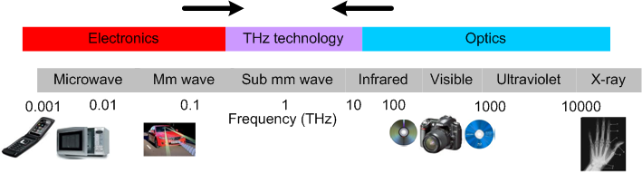
THz radiation: Unique properties
1 THz = 1000 GHz
THz radiation can penetrate through non-polar materials (e.g. plastics, wood, clothing)
THz imaging has sub-mm resolution
THz spectroscopy identifies specific materials (e.g. explosives)
THz radiation is non-ionizing (and therefore safer than X-ray)
THz radiation is strongly absorbed polar materials (e.g water)
Enabler for extreme high data rate communication
Applications in the THz range continue to increase rapidly

Slide 4
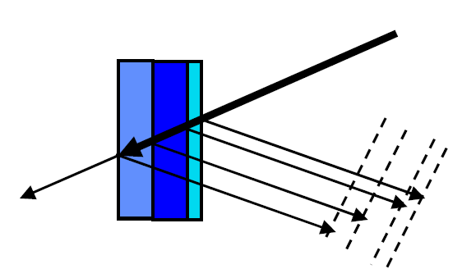
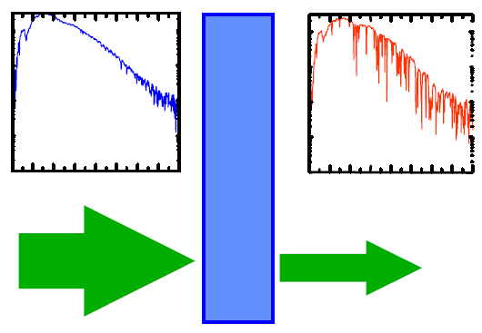

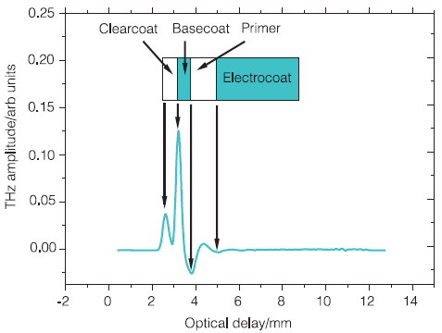
Terahertz characterization techniques
Terahertz imaging
Terahertz tomography
Terahertz spectroscopy
CW or pulsed systems
Pulsed systems
CW or pulsed systems
Intensity
only
Intensity
and
phase
Intensity
only
Intensity
and
phase
Amplitude and phase
imaging
Broadband detection
Transmission or reflection measurements are both valuable

Slide 5
Professional and consumer applications
Market size
Consumer
application
research
Professional
application
research
Consumer
Applications
> 10 Million
devices/year
Medical
Industrial
Security
Space
1st technology switch:
Specialized equipment
Medium quantities
High margins
2nd technology switch:
Standard technologies
High quantities
Lower margins
1990-?
2013
Future
Market
introduction

Slide 6
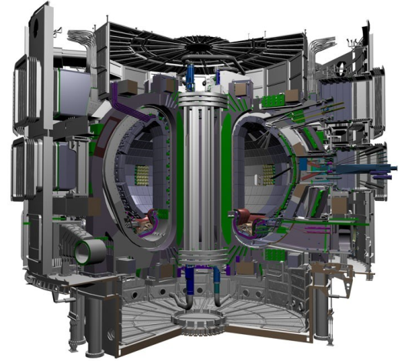
Terahertz for large science
SRON: Dutch space research organization:
Terahertz research group in Groningen
Miniaturized terahertz sensors for space applications
Plasma physics research at TU/e:
Experiments at ITER
Nuclear fusion experiments
Terahertz sensors for fusion control
Terahertz for particle physics:
Let’s exchange ideas on this
Non-destructive testing of thin layers?
Radiation sensors in the terahertz domain?
Tokamak reactor
HTSM roadmap “Advanced Instrumentation” mentions Terahertz as one of the
key new technologies, potential for funding of research projects.

Slide 7
CWT/e: Short range terahertz observation program
Center of Wireless technology Eindhoven (CWT/e) is an interface between:
Users of Terahertz technology
Terahertz research within TU/e
New research results and industrial partners
Research focus:
CMOS integrated transmitter-receiver systems at mm-wave and terahertz
Beam steering systems (2D and 3D imaging)
Lab-building for mm-wave and terahertz measurements
Terahertz Applications:
Industrial process control (non-destructive testing, inline process monitoring)
Large volume consumer applications (e.g. mobile phone/tablet, 3D scanners)
Medical applications (spectroscopy and imaging, minimal invasive surgery)
Growing interest form large science applications (ITER, SRON)

Slide 8
Dutch terahertz roadmap initiative
Goal: Form strong networks on terahertz applications and technologies
with research institutes and international companies
TU/e CWT/e is leading the initiative
Involved research organizations (growing):
TU Eindhoven
Dutch Space Research Organization (SRON)
TU Delft
In discussion with many companies (growing):
ABB
Philips
NXP
Canon-Océ
Kippen&Zonen
Food&Agriculture industry
Packaging industry

Slide 9
Overview
Introduction
Terahertz unique properties
Technology evolution
Terahertz roadmap initiative
Miniaturized terahertz systems for imaging and spectroscopy
Nonlinear mixing in CMOS technology
Spectroscopic imaging camera
Spectroscopy system
3D microsystem integration
Free space network analyzer for application testing
Conclusions

Slide 10
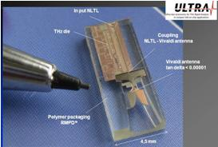
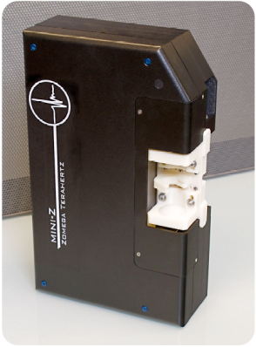
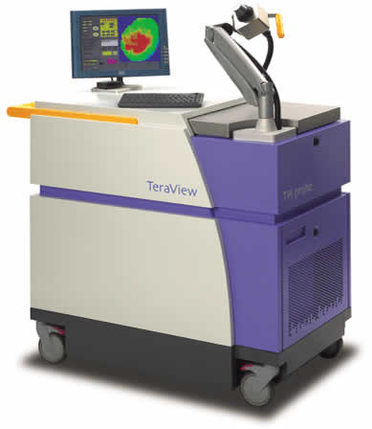
Research on miniaturized THz systems
New THz applications
All-electronic approach:
CMOS based generation and detection of the THz signals
Optical setups
based on
femtosecond
lasers
Miniaturized
and
integrated
THz systems
Hybrid approach:
miniaturized/integrated opto-electronics sources and receivers

Slide 11
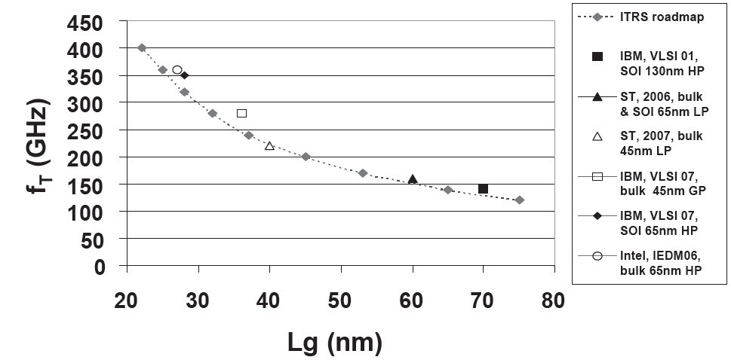
Frequency limits of CMOS transistors
timeline

Slide 12
Terahertz generation and detection
Sources
Oscillator based
fundamental oscillators: limited by f_{T} and f_{max}
harmonic oscillators: filter out the base frequency and use the harmonics
Multiplier based
Generate harmonics in a nonlinear device
Require a strong input signal
Receivers
“Traditional non-mixing” techniques
limited by f_{T} and f_{max}
Mixing in Schottky diode based detectors
can work beyond the transistor frequency limits
Mixing in FET detectors
broadband direct conversion demonstrated
passive imaging detectors not sensitive enough
Bolometers integrated into CMOS technology
Require special postprocessing (etching of the Silicon)

Slide 13
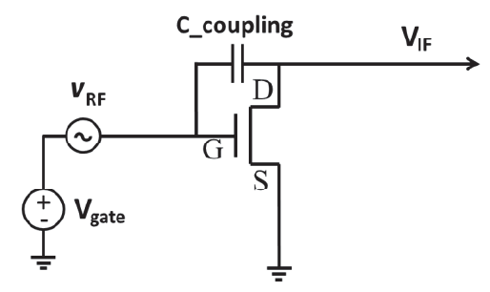
Self-mixing in CMOS transistors
Linear term!
Quadratic term!
I_{ds} contains signals at 0, f_{in} and 2 f_{in} .

Slide 14
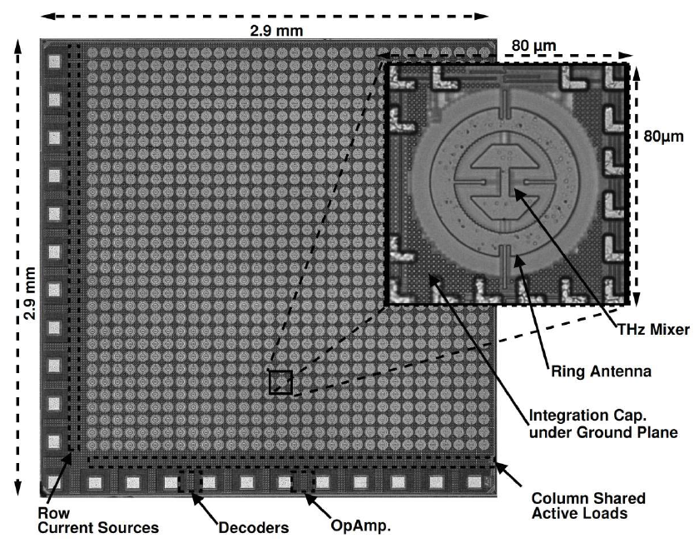
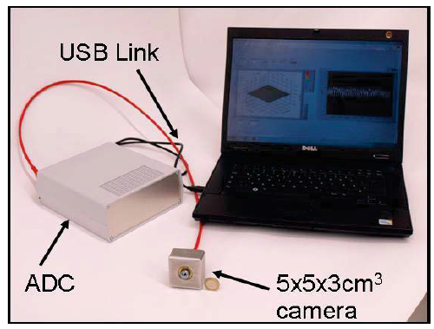
2012: World’s first CMOS terahertz camera
H. M. Sherry, U. R. Pfeiffer, et al., University of Wuppertal
32 by 32 pixels, differential source coupled FET direct conversion

Slide 15
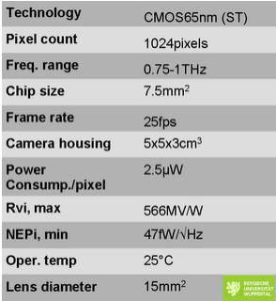
Key specs of the CMOS terahertz camera
H.M. Sherry, U. R. Pfeiffer, University of Wuppertal, Germany

Slide 16
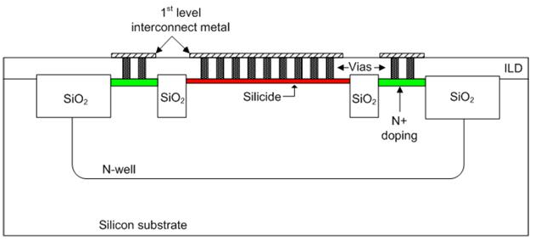
Schottky diodes in CMOS: cross section
- Nonlinearity originates from the I(V) curve of the diode
- Speed of the diode originates from the parasitics and diode size

Slide 17
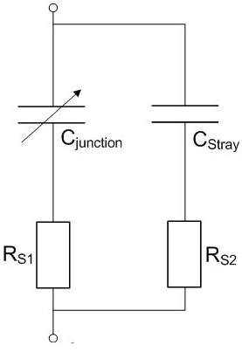
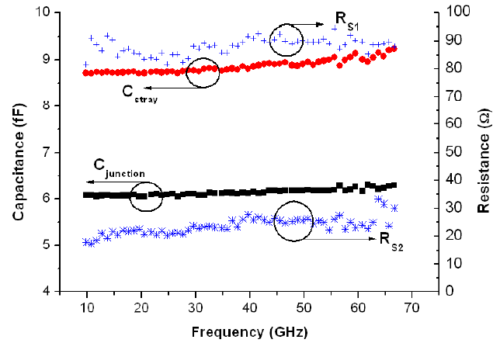
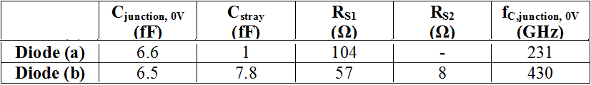
Schottky diodes in CMOS:
Reverse bias diode model

Slide 18
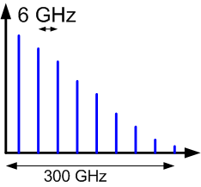
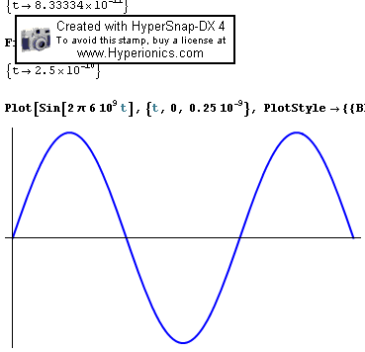
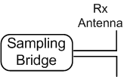
EU-project ULTRA
System overview
f=6 GHz
f=6 GHz
f=6 GHz
t
t
t
Tx
antenna
f
f=6 GHz
TX
t
RX
t
t
f=6.001 GHz
f=6.001 GHz
f=6.001 GHz
t

Slide 19
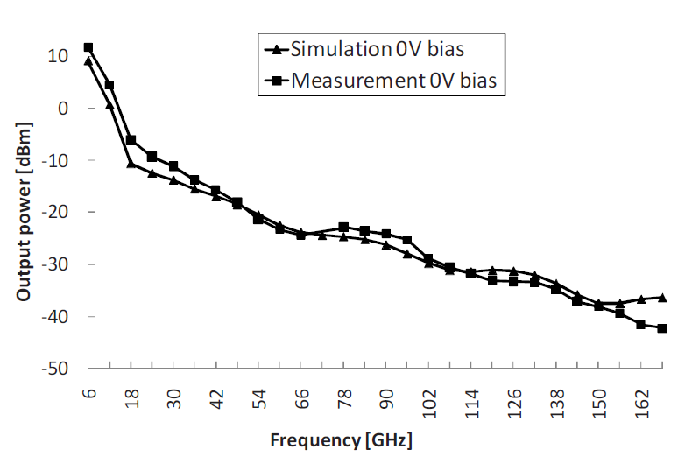
NLTL: Measurement Results
EU-project ULTRA
Input: Sinusoid
P_{in}=18 dBm
6 GHz
L. Tripodi, X. Hu, R. Goetzen,
M.K. Matters-Kammerer et al.,
Broadband CMOS Millimeter-Wave
Frequency Multiplier with
Vivaldi Antenna in 3-D Chip-Scale
Packaging,
Trans. on MTT, Vol. 60, no. 12,
part 1, pp. 3761-3768, 2012

Slide 20
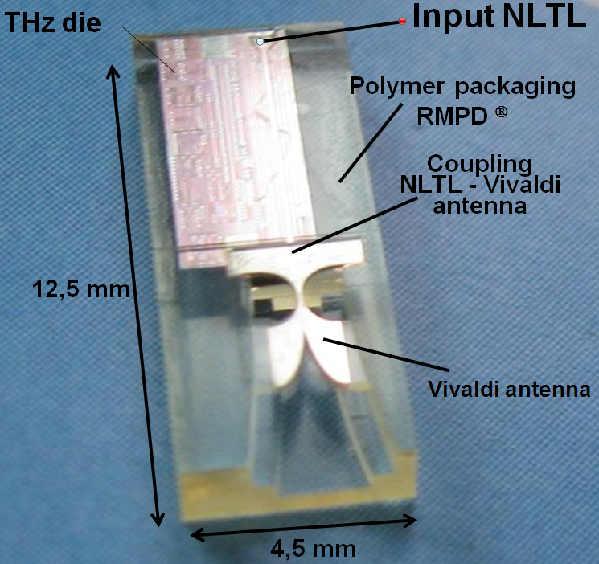
Nonlinear transmission line transmitter
EU-project ULTRA
THz CMOS integrated circuit
Micro-machined external Vivaldi antenna
Highly integrated transmitter
3D CSP-based THz packaging
Bandwidth 6 GHz – 300 GHz
Transmission and Reflection mode solutions
X. Hu, L. Tripodi, M.K. Matters-Kammerer et al.,
65-nm CMOS Monolithically Integrated Subterahertz Transmitter,
Electron Device Letters, pp. 1182-1184, Vol. 32, issue 9, 2011.

Slide 21
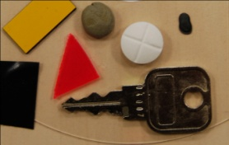


Terahertz imaging with NLTL source
EU-project ULTRA
Visible
200 GHz image
Prof. P. Haring-Bolivar

Slide 22
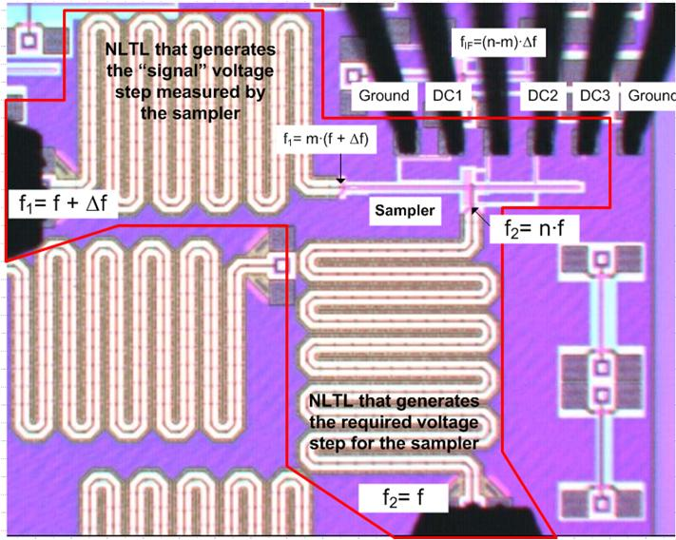
On-chip sub-THz generator and sampler

Slide 23
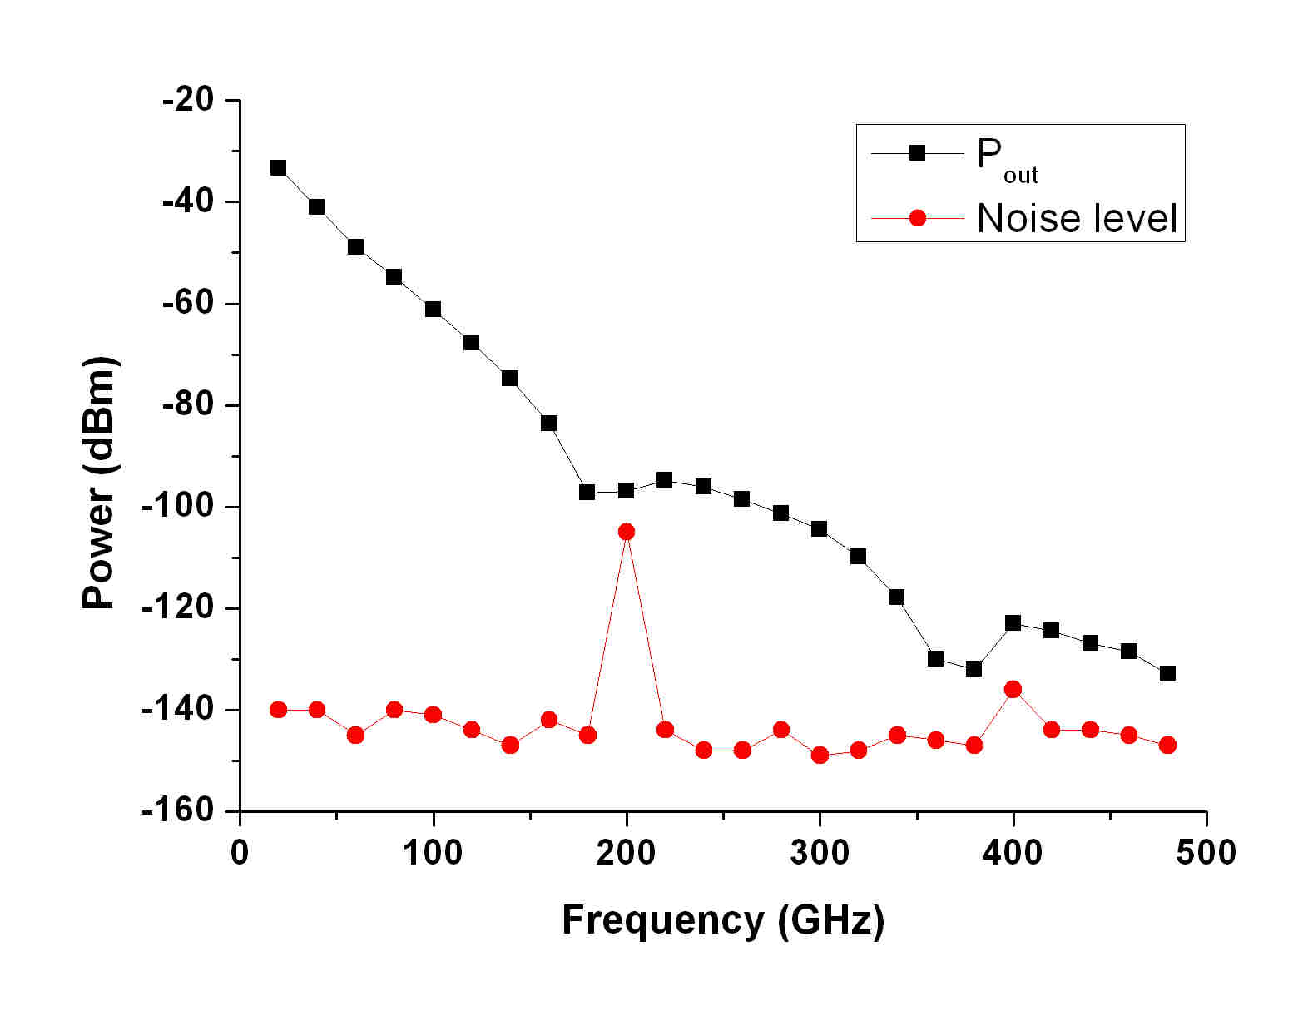
Output spectrum of nonlinear transmission line
Input signal: f=20 GHz, 18 dBm

Slide 24
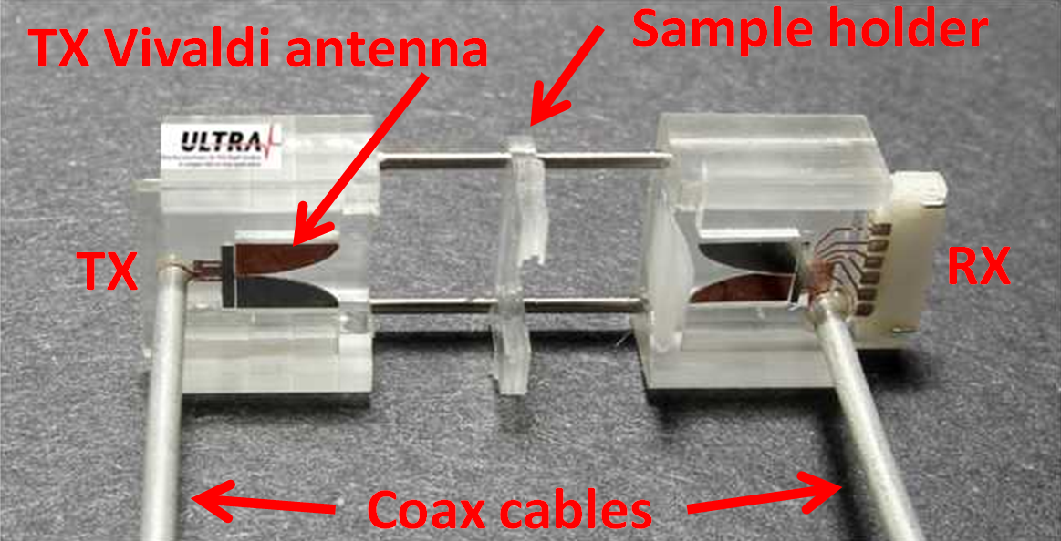
Hybrid integration concept
L. Tripodi , M. Matters-Kammerer, et al. Eurosensor 2012

Slide 25
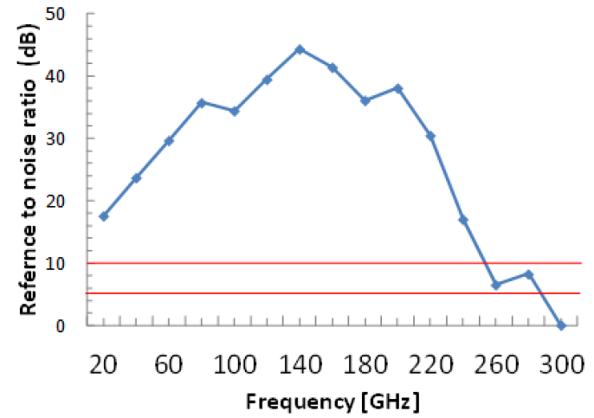
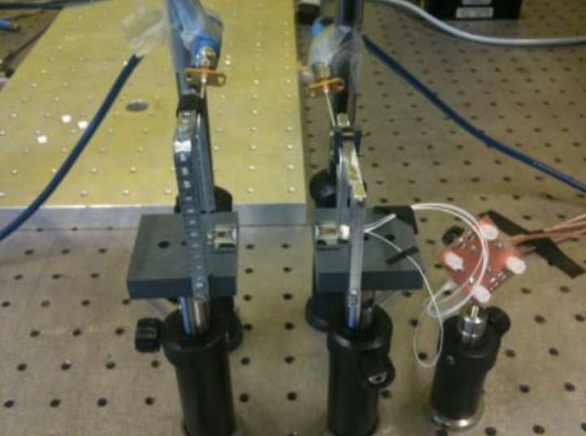
Terahertz microsystem: Dynamic range

Slide 26
Overview
Introduction
Terahertz unique properties
Technology evolution
Terahertz roadmap initiative
Miniaturized terahertz systems for imaging and spectroscopy
Nonlinear mixing in CMOS technology
Spectroscopic imaging camera
Spectroscopy system
3D microsystem integration
Free space network analyzer for application testing
Conclusions

Slide 27
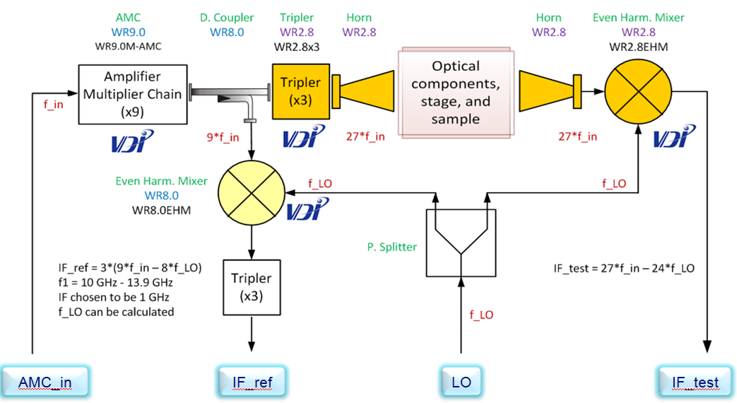
270 GHz to 370 GHz free space network analyzer

Slide 28
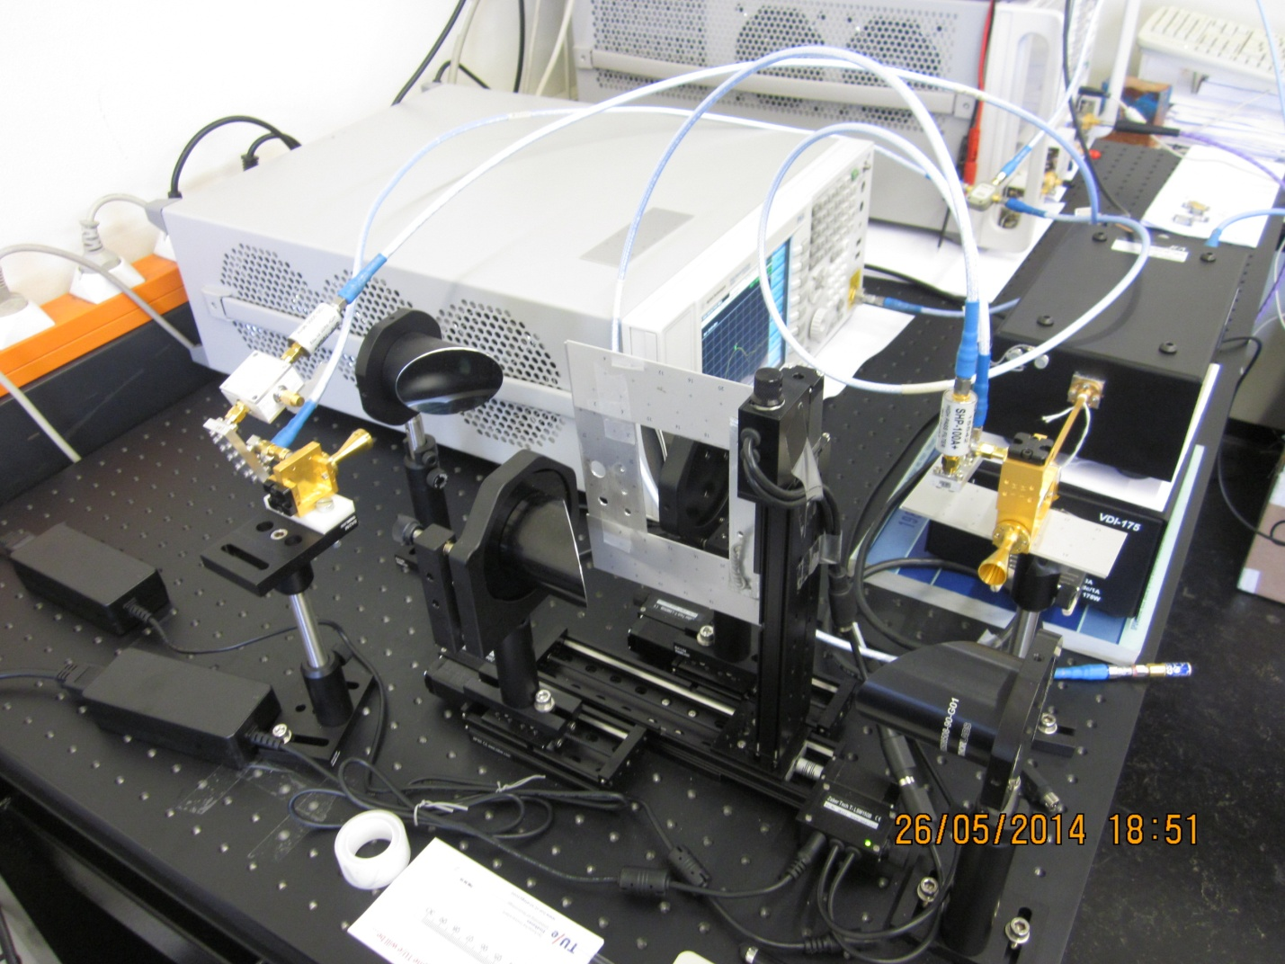
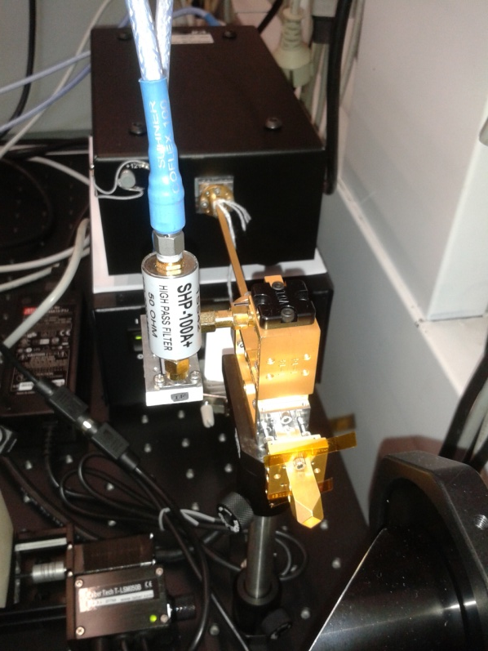
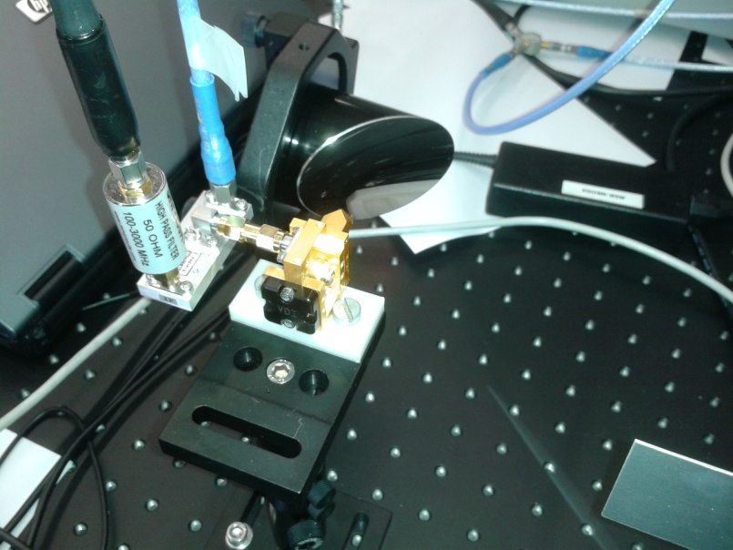
Free space Network analyzer
90 GHz to 120 GHz setup
Up:Tripler+antenna
Down: downconcersion
for operation in WR 2.8

Slide 29
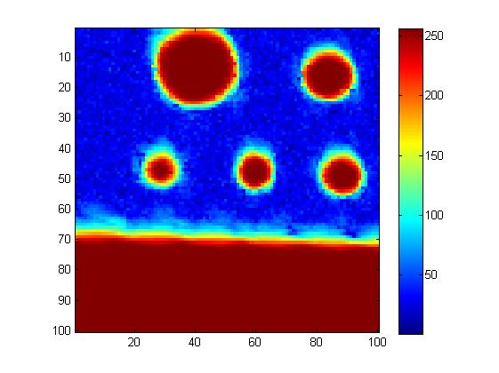
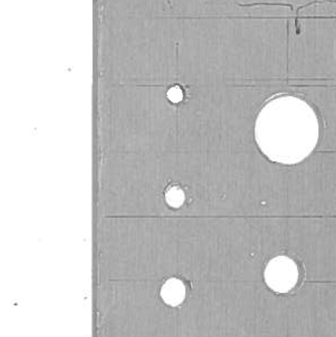
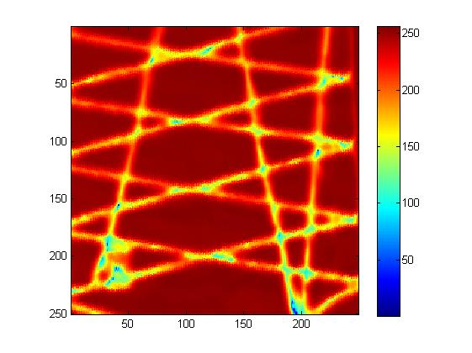
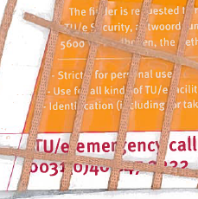
Amplitude images at 345 GHz
D=10,05mm
Metal plate
with
holes
D=6mm
D=2,7mm
D=4,5mm
D=3,5mm
Plastic card
with
metal
ribbon

Slide 30
Conclusions
Focus on CMOS integration of terahertz circuits
Excellent contacts to companies in the Brainport area and abroad
Leading the Dutch terahertz roadmap initiative
Long term view on terahertz integration in CMOS technology
Cooperation opportunities
Joint lab building and demonstrations
Joint research project proposals (Dutch and European)
PhD and master projects/exchanges
Joint professional educational program

Slide 31
Publications
M. K. Matters-Kammerer et al., RF Characterization of Schottky Diodes in 65-nm CMOS, IEEE TRANSACTIONS ON ELECTRON DEVICES, Volume: 57 Issue: 5 Pages: 1063-1068 , May 2010.
X. Hu, L. Tripodi, M.K. Matters-Kammerer, et al., 65-nm CMOS Monolithically Integrated Subterahertz Transmitter , IEEE ELECTRON DEVICE LETTERS Volume: 32 Issue: 9 Pages: 1182-1184 , Published: SEP 2011.
L. Tripodi, X. Hu, R. Goetzen, et al., Broadband CMOS Millimeter-Wave Frequency Multiplier with Vivaldi Antenna in 3-D Chip-Scale Packaging, Trans. MTT, Vol. 60, no. 12, part 1, pp. 3761-3768, 2012.
L. Tripodi, M.K. Matters-Kammerer, 26th European Conference on Solid-State Transducers (Eurosensors), Broadband terahertz and sub-terahertz CMOS modules for imaging and spectroscopy applications, Volume: 47 Pages: 1491-1497, Sep. 2012.
L. Tripodi, M.K. Matters-Kammerer, et al., Extremely wideband CMOS circuits for future THz applications, Analog Circuit Design, ISBN 978-94-007-1926-2, Springer, 2012.

Slide 32
Extra Slides

Slide 33
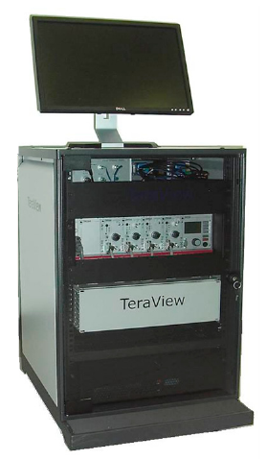
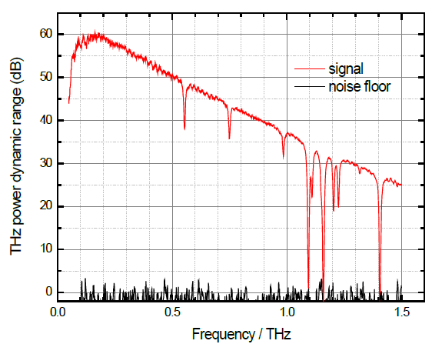
Teraview: CW Spectra 400
Frequency range: up to 1.5 THz, cw tunable
Scanning spead: typically 8 minutes
Robust system
53cm x 80cm x 76cm
100 kg

Slide 34
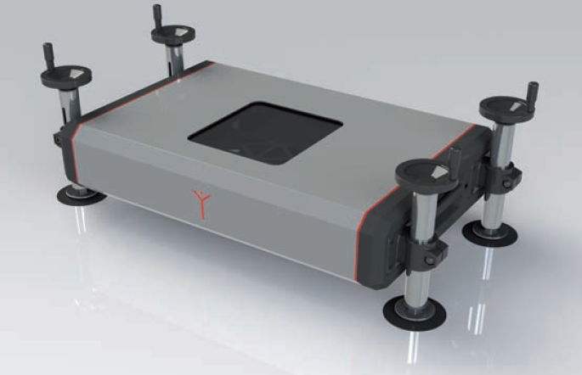
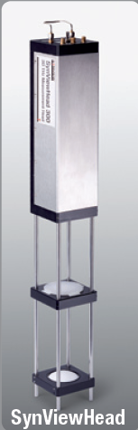
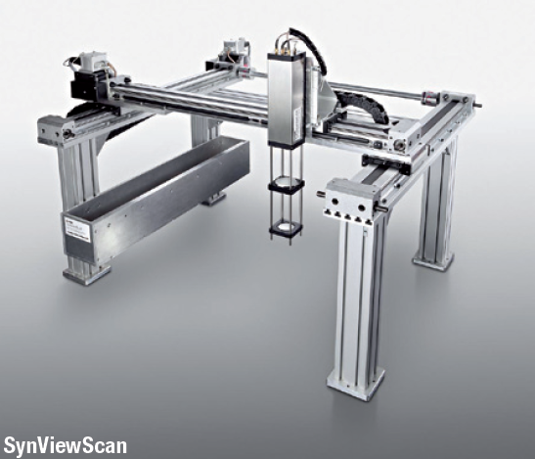
Synview: Electronic single pixel terahertz systems
90cm x 48cm x 15cm
Frequency ranges:
0.07 THz – 0.11 THz
0.23 THz – 0.32 THz
0.84 THz – 0.87 THz
Speed:
15 minutes for full image
Signal to noise ratio:
typically 40 dB

Slide 35
Non-destructive testing techniques (NDT)
Visual inspection
X-ray
Conventional
NDT techniques
Infrared
thermography
Non
Destructive
Testing
methods
Ultrasound
Terahertz spectroscopy
Terahertz imaging
Terahertz tomography
Terahertz based
NDT techniques

Slide 36
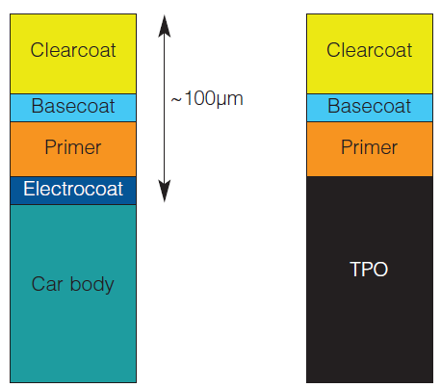
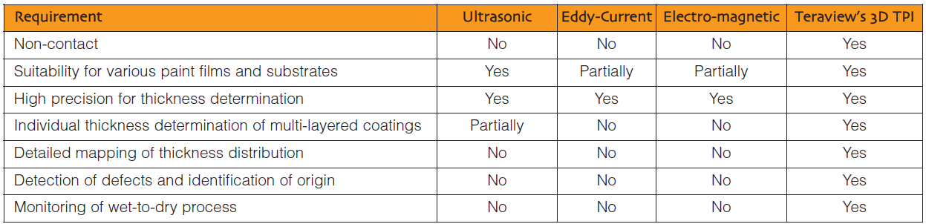
Automotive paint: www.teraview.com

Slide 37
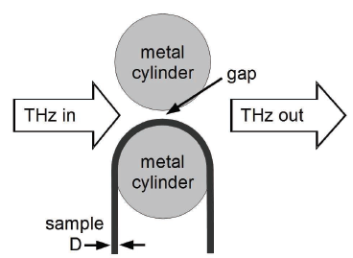
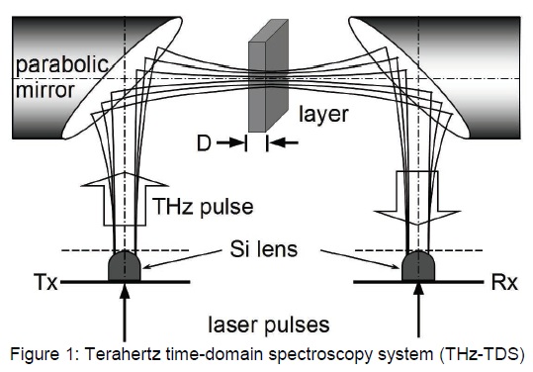
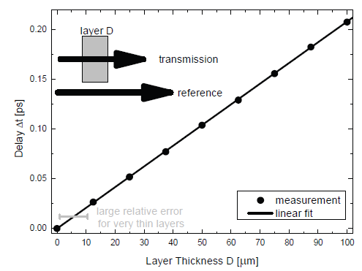
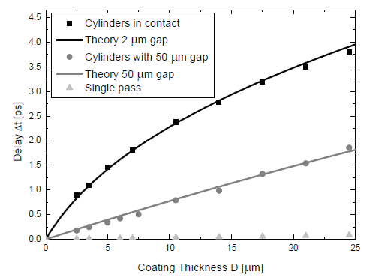
Layer thickness: Fraunhofer Institute, 2011

Slide 38
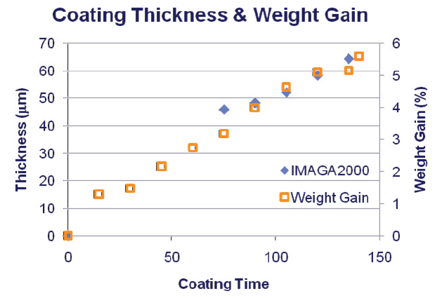
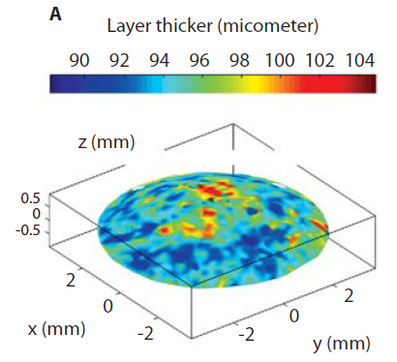
Medical drug release, coating control, Teraview
Coating in tables are used to regulate the drug release over time
→ coating thickness needs to be carefully monitored for quality control

Slide 39
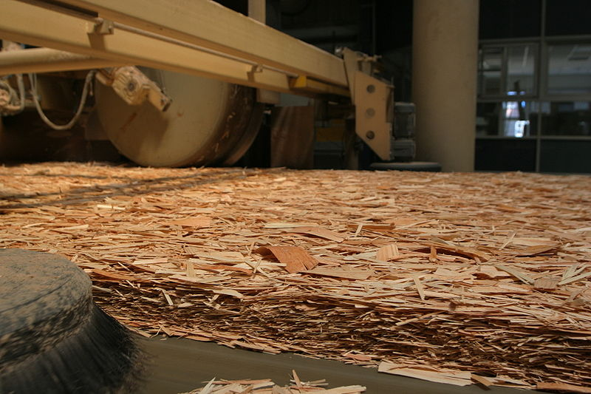

Wood industry: Oriented strand board
OSB replaces other board types that require more wood
Terahertz radiation is used to
analyze link between the fiber structure and the physical strength of the board
The intention is to optimize the production process for quality and costs
New applications are continuously emerging for terahertz frequencies.

Slide 40


Spectroscopy example: DNA analysis
Femtsecond laser based setup
Laser pulse incident onto substrate
generates currents with terahertz frequency components
P. Haring-Bolivar
et al.
Goal of our research:
Fully on-chip CMOS based
terahertz system
Frequency range: 300 GHz to 1.5 THz
Broadband or multi-frequency required
Phase and amplitude information typically required

Slide 41


THz market
2007
TAM: 33.5 Million $
CAGR: 28%
2017
TAM: 398 Million $
Other
4 %
Biomedical 5%
Environment 2%
Communication 13 %
Astronomy
12%
Agriculture
& Food 2%
Security
& Surveillance
40%
Security
& Surveillance
39 %
Other
Manufacturing
& Quality control
& NDT
45 %
Astronomy 2%
Manufacturing
& Quality control
& NDT
34 %
Source: The THz technologies, Fuji-Kezai USA, 2007

Slide 42
Current single pixel THz systems
Cooperation with
Teraview:
TPS Spectra 3000
CW Spectra 400
Advanced Photonix Inc. (Picometrix):
T-Ray 2000
T-Ray 4000, includes handheld scanner
Toptica:
Terabeam
Newport Corporation:
THz pulse generation kit
Microtech instruments
TPO 1500
Michigan
university
Heinrich Hertz
Institute Berlin
Oregon state
university

Slide 43
Current single pixel THz systems
Cooperation with
Zomega
mini-Z
micro-Z (handheld)
Bridge 12 Technologies:
Bridge 12 Gyrotron
NIST and JILA
THz system for trace gas detection
Thru Vision Systems
T-scan 2003 A: handheld system for security
Smiths detection
handheld passenger security system
ST Microelectronics
video-rate 1024 pixel THz camera
Renselaer
Polytechnique Institute
Teraview
IEMN,
University of Wuppertal

Slide 44


CMOS terahertz: multipixel arrays
Ulrich Pfeiffer, Wuppertal (ISSCC 2010+2011)
http://spectrum.ieee.org/semiconductors/optoelectronics/a-cheap-terahertz-camera
32 by 32 pixel camera
Real-time imaging
Frequency range : 0.7 THz to 1.1 THz
Pfeiffer et al., JSSCC, n.12, 2012

Slide 45

CMOS Schottky diodes: electrode layout
Option A: one “large” electrode
Option B: tiny electrode array
M. Matters et al., IEEE Trans. Electron Dev. 57 (5), pp. 1063-1068, 2010

Slide 46

Cut-off frequency of diodes in 65 nm CMOS
M. Matters-Kammerer et al., RF Characterization of Schottky Diodes in 65-nm CMOS IEEE TRANSACTIONS ON ELECTRON DEVICES
Volume: 57 Issue: 5 Pages: 1063-1068 , May 2010

Slide 47
Effect of the stray capacitance
Input signal splits!
Schottky contact:
Nonlinear
→ can generate
higher harmonics!
Stray capacitor:
Linear
→ Does not generate
higher harmonics!
Only part of the input signal is used
for higher harmonics generation!

Slide 48
Broadband THz spectrometer in CMOS electronics
THz source: transmitter
TX
Sample
RX
THz detector: receiver

Slide 49

Broadband signal generation with NLTLs
time
time
freq
freq

Slide 50


Nonlinear transmission line in CMOS

Slide 51
CMOS NLTL fabrication
Commercial 65-nm CMOS technology
EU-project ULTRA
5-7 mm

Slide 52
Schematic of the Sample-and-hold-circuit
Differentiator
Sampling bridge
Signal input
IF and DC circuitry

Slide 53
Broadband THz spectrometer in CMOS electronics
THz source: transmitter
TX
Sample
RX
THz detector: receiver

Slide 54
Differentiator and Sampling bridge
Bridge voltage
Reflected signal,
inverted in phase
Primary signal
Strobe signal generated by NLTL
R. A. Marsland et al., Appl. Phys. Lett. 55 (6), 7 August 1989, pp. 592-594

Slide 55

CMOS Sampling bridge design & layout

Slide 56

Details of the developed sampler layout
Combined 100 Ω slotline
and 50 Ω coplanar waveguide
Miniaturized
diode bridge

Slide 57



Time-domain measurements of the sampler
Measured V(t) curve
Fall-time as a function of bias

Slide 58

Hybrid integration concept
EU-project ULTRA
Dr. R. Goetzen, microTEC GmbH, Duisburg, Germany

Slide 59


Sub-THz CMOS integrated spectrometer
Scientific result:
Realization of a 20 GHz to 500 GHz broadband
spectrometer, fully integrated into 65nm CMOS
technology. Within the spectrometer a nonlinear transmission line generates a 3ps wide pulse which is used in a sub-harmonic sampler to
switch newly developed fast Schottky diodes
and samples an up to 500 GHz broadband signal.
CMOS IC with spectrometer
Relevance:
The sub-THz and THz frequency band enables a wealth of new applications, in the area of security, industrial inspection, bio-medicine,
environmental monitoring and communication. The integration of devices into CMOS is a key enabler for the growth and economic viability of these applications.
Output spectrum

Slide 60


Next steps in sub-THz CMOS
Extension of frequency and power range:
Higher frequency range directly translates into larger variety of applications. Higher power directly translates into larger dynamic range and measurement distances (e.g. tissue penetration). Basic research on highly efficient nonlinear components for sources and receivers in CMOS/BiCMOS is at the basis of this development.
Optimized layout of a Schottky
diode in CMOS
Modular integration and miniaturization:
Exploring the application domain of sub-THz electronics, goes hand in hand with developing
THz adapted packages and further miniaturization of all components. Cooperation
with potential users form the industrial, bio-medical and consumer domain will elucidate the requirements.
Packaged sub-THz transmitter

Slide 61




Toptica and Heinrich Hertz institute Berlin
Photo mixers
Laser source
Range: up to 1.8 THz
Scan Speed: 100 GHz/s

