Slide 1
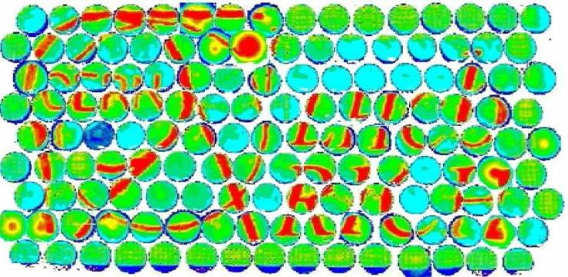
The RICH detectors of LHCb and the proposed upgrade
Antonis Papanestis
On behalf of the LHCb RICH collaboration

Slide 2
Outline
The LHCb experiment
The LHCb RICH detectors
  Description
  Operation
  Alignment and Calibration
  Performance
  Physics examples
LHCb Upgrade
Conclusions

Slide 3
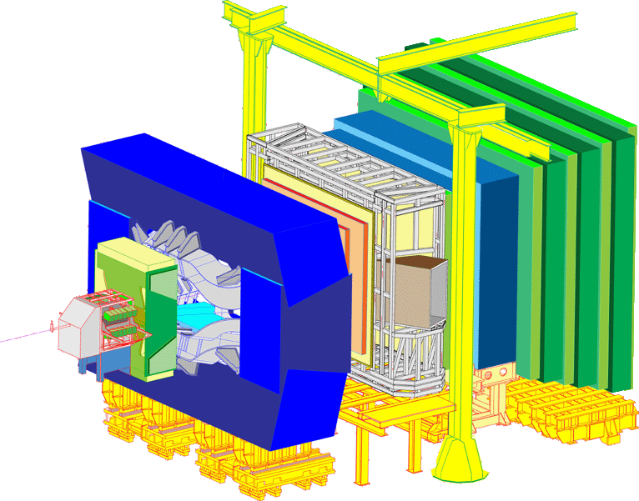
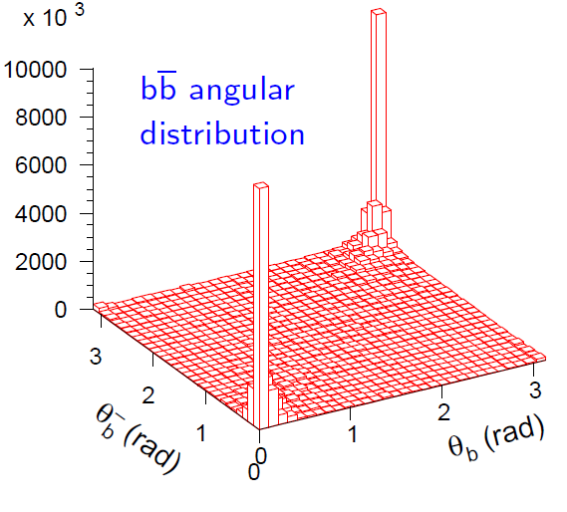
The LHCb experiment
Probing New Physics in CP violation and rare decays of b and c quarks
Single arm spectrometer with:
Excellent vertexing
Excellent PID
Efficient trigger and tracking
RICH 2
RICH 1

Slide 4
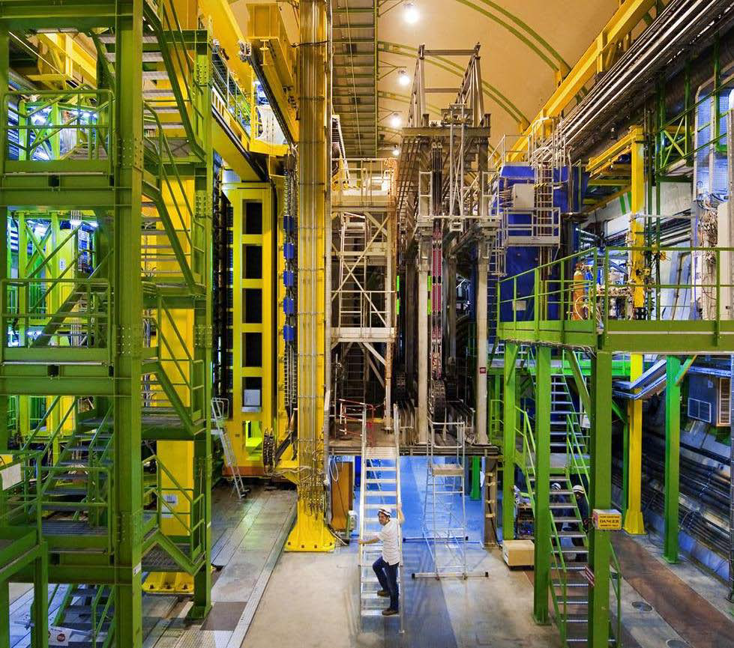
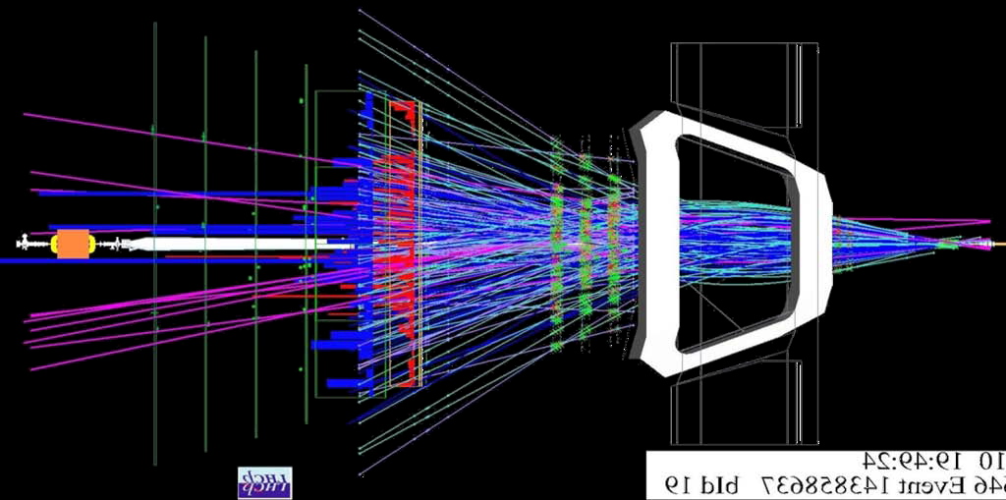
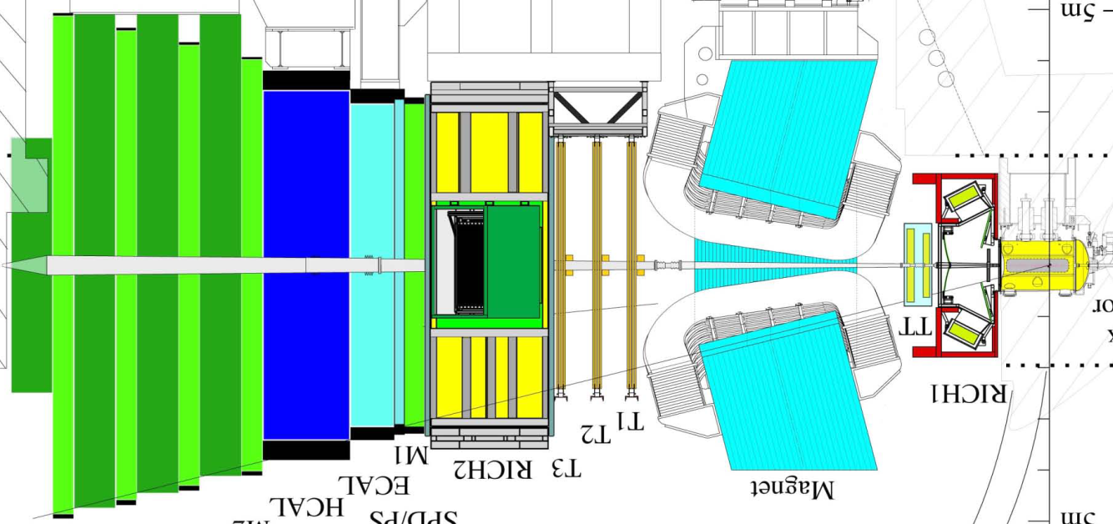
LHCb event
23 sep 2010 19:49:24
Run 79646 Event 143858637

Slide 5
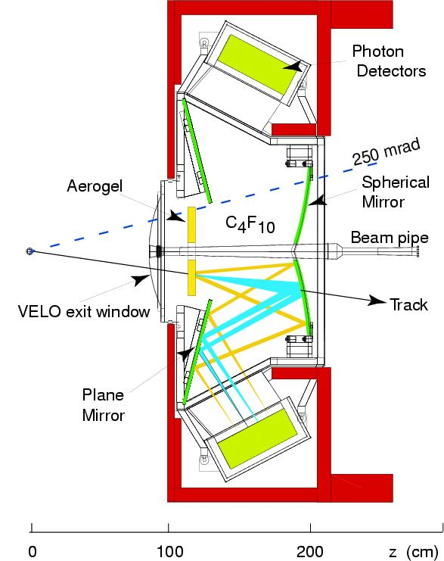
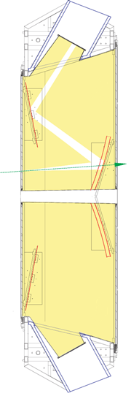
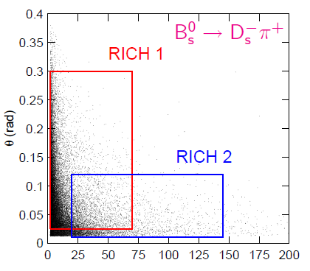
The LHCb RICH detectors
RICH 1
RICH 2
2 Detectors
3 Radiators
Acceptance 25-300 mrad
Acceptance 15-120 mrad
Side view
Top view
Note Scale Difference
300 mrad
~7 m
120 mrad
Spherical mirrors
Flat mirrors
CF₄ gas

Slide 6
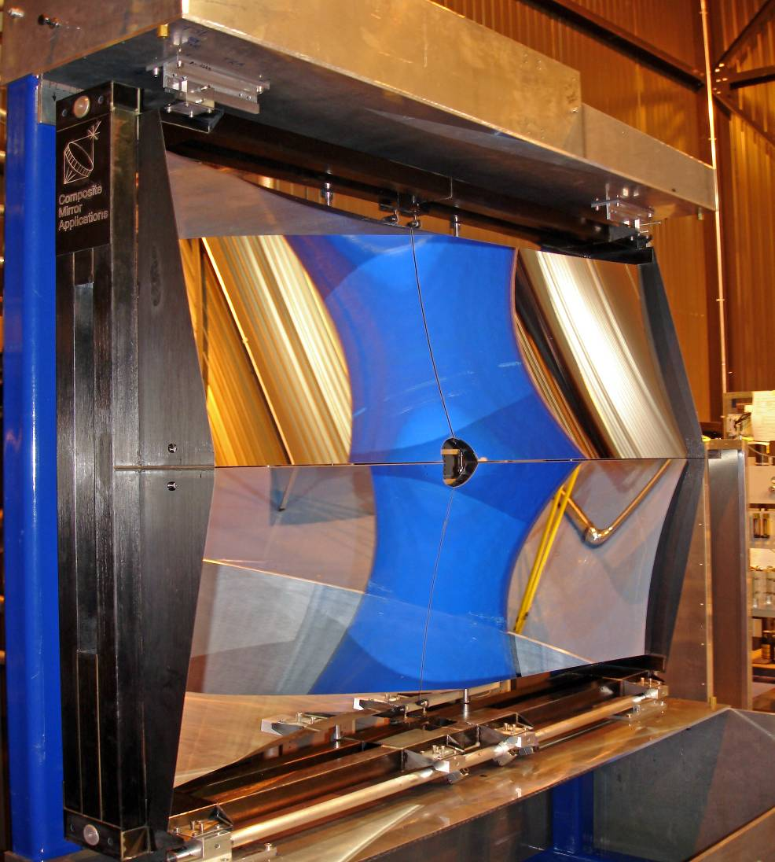
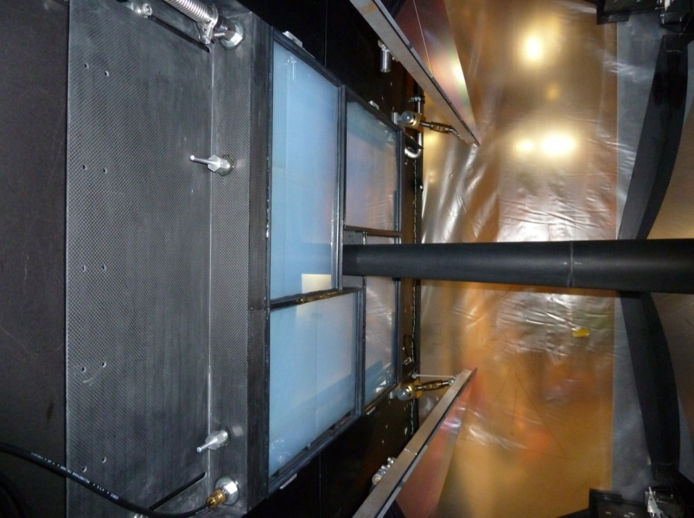
RICH1 Mirrors and Aerogel
Aerogel is inside a gas tight box flushed with CO₂ to avoid performance degradation from exposure to C₄F₁₀
~0.5 m
Carbon fibre mirrors for low material budget

Slide 7
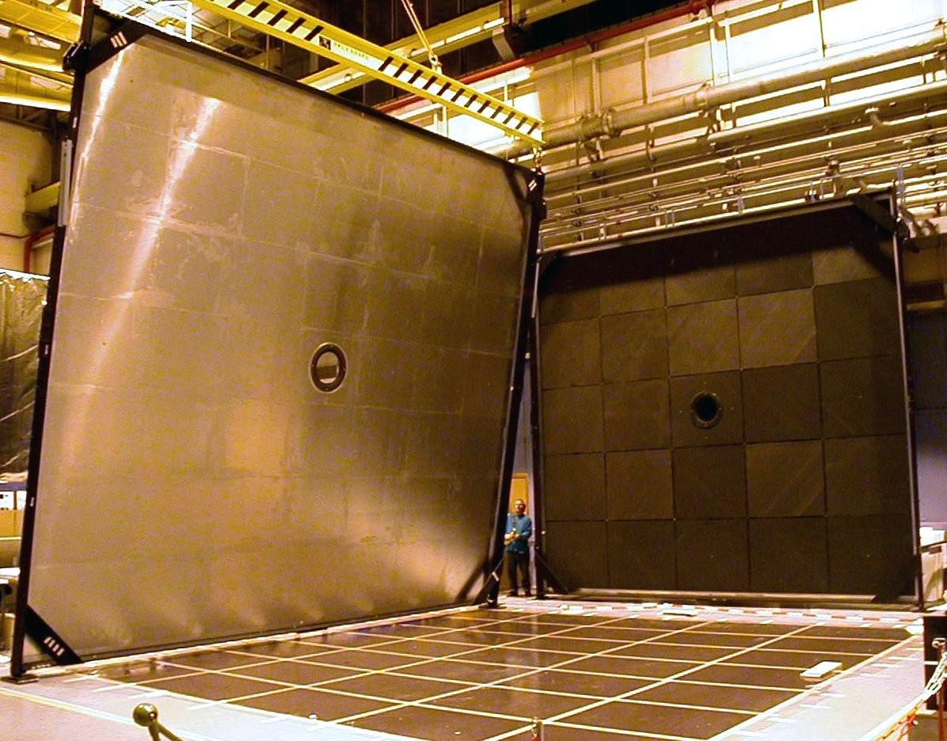
RICH 2 entry and exit windows

Slide 8
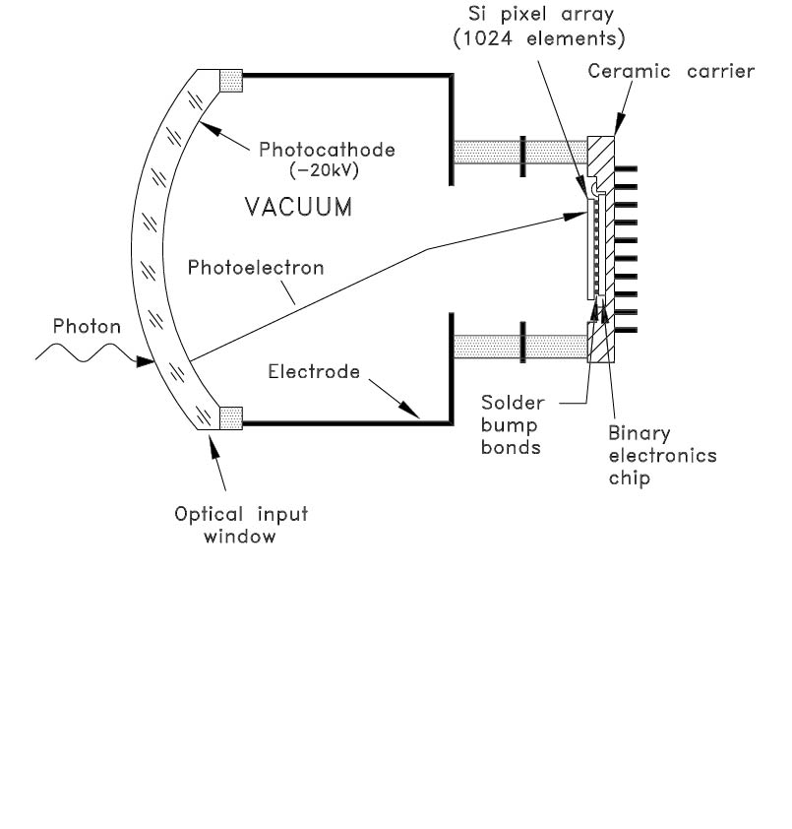
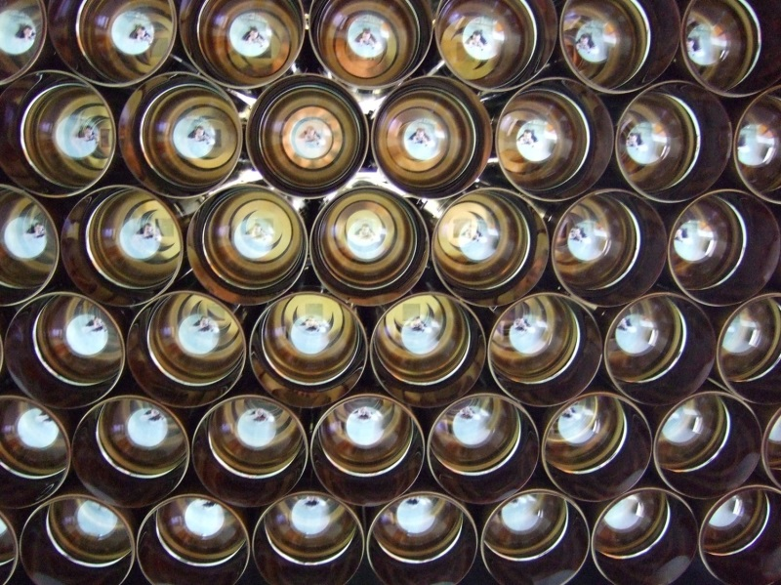
Photon Detectors
Main features of Pixel-HPD:
Quartz window with thin S20 pK
Cross-focussing optics (tetrode structure):
  De-magnification by ~5
  Active diameter 75mm
  ⇒ 484 tubes for overall RICH system
  Up to 20 kV operating voltage (~5000 e– [eq. Si])
  Low noise (~140 e⁻ RMS)
32×32 pixel sensor array (0.5mm×0.5mm each)
Encapsulated binary electronics readout chip
Schematic
view

Slide 9
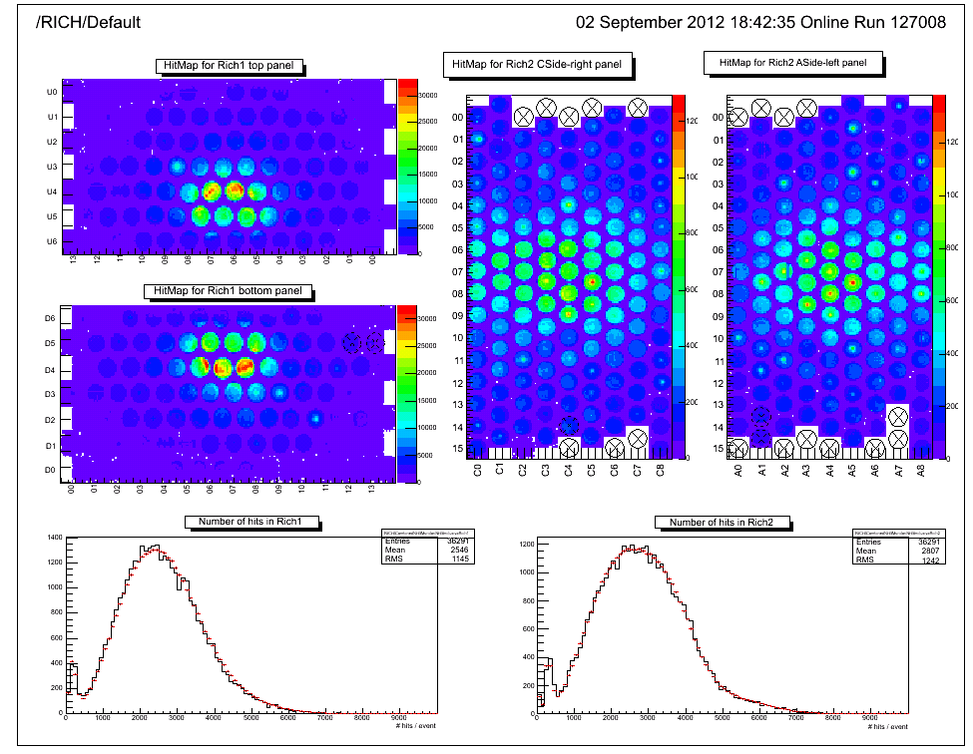
RICH 1 & 2 Hitmap
From Online Monitor.
RED histograms for reference

Slide 10
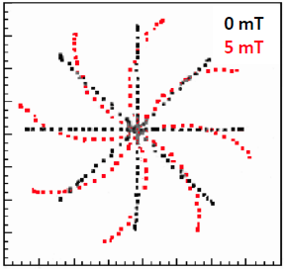
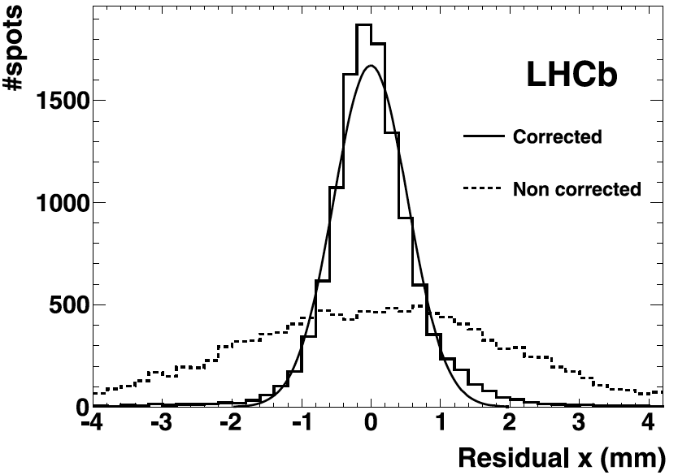
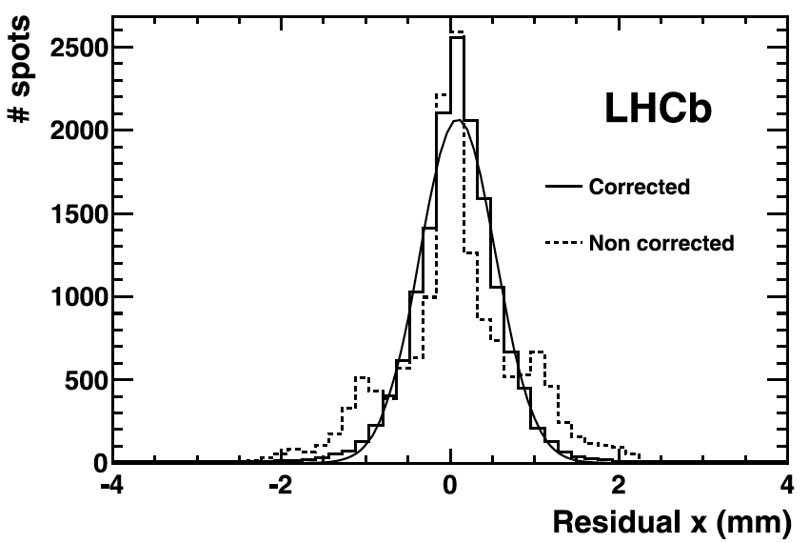
Magnetic field corrections
HPD image distortion due to magnetic field
Projection of test pattern with and without magnetic field to extract correction parameters
RICH-1
σ=0.5mm
RICH-2
σ=0.47mm

Slide 11
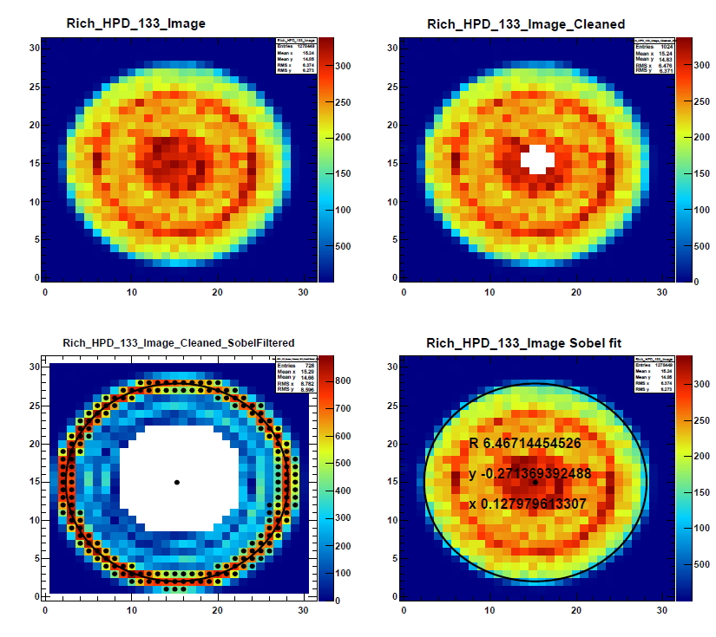
Anode image fitting
Position of the photocathode image on the anode can change due to charging effects.
Anode images are cleaned and a Sobel filter is used to detect the edge.
Automated procedure, updates the position of the photo-cathode centre in Conditions Database

Slide 12
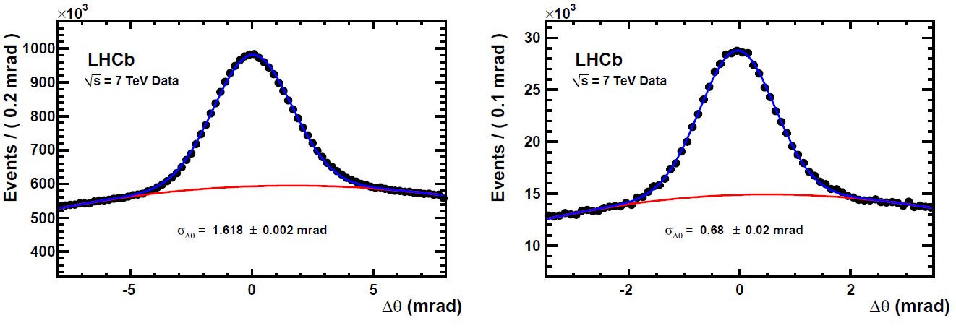
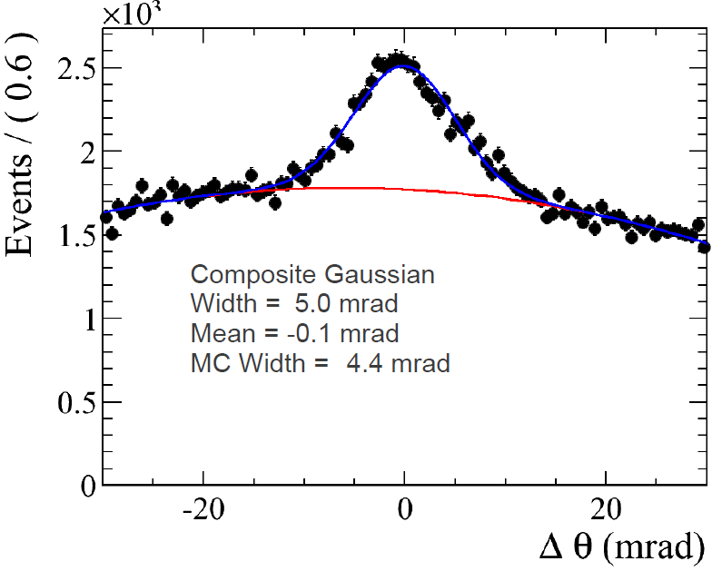
Cherenkov angle resolution
 | Data | MC | Unit
Aerogel | 5.0 | 4.4 | mrad
C₄F₁₀ | 1.62 | 1.53 | mrad
CF₄ | 0.68 | 0.68 | mrad

Slide 13
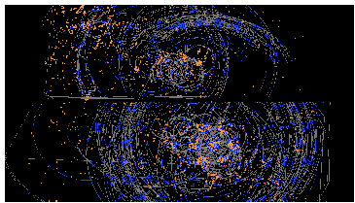
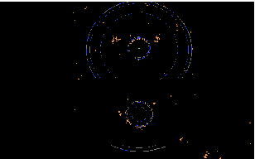
Number of detected photons
Two event types
Physics event: D⁰→K⁻π⁺
“Light” Event: pp→ppµ⁺µ⁻
Radiator | N_{pe} from data |  | N_{pe} Simulation
 | D⁰→K⁻π⁺ | pp→ppµ⁺µ⁻
Aerogel | 5.0±3.0 | 4.3±0.9 | 6.8±0.3
C₄F₁₀ | 20.4±0.1 | 24.5±0.3 | 29.5±0.5
CF₄ | 15.8±0.1 | 17.6±0.2 | 23.3±0.5

Slide 14
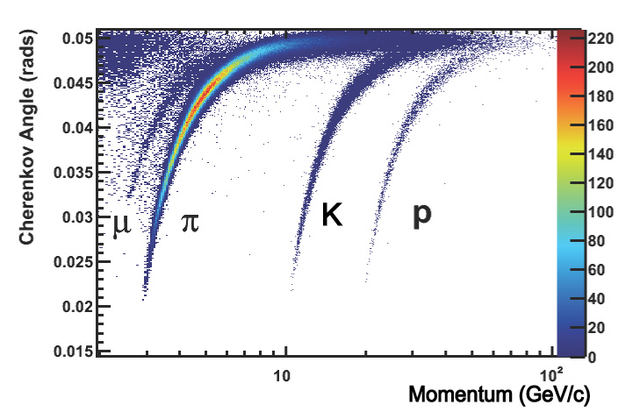
Using isolated rings
Cherenkov angle vs momentum in RICH1

Slide 15
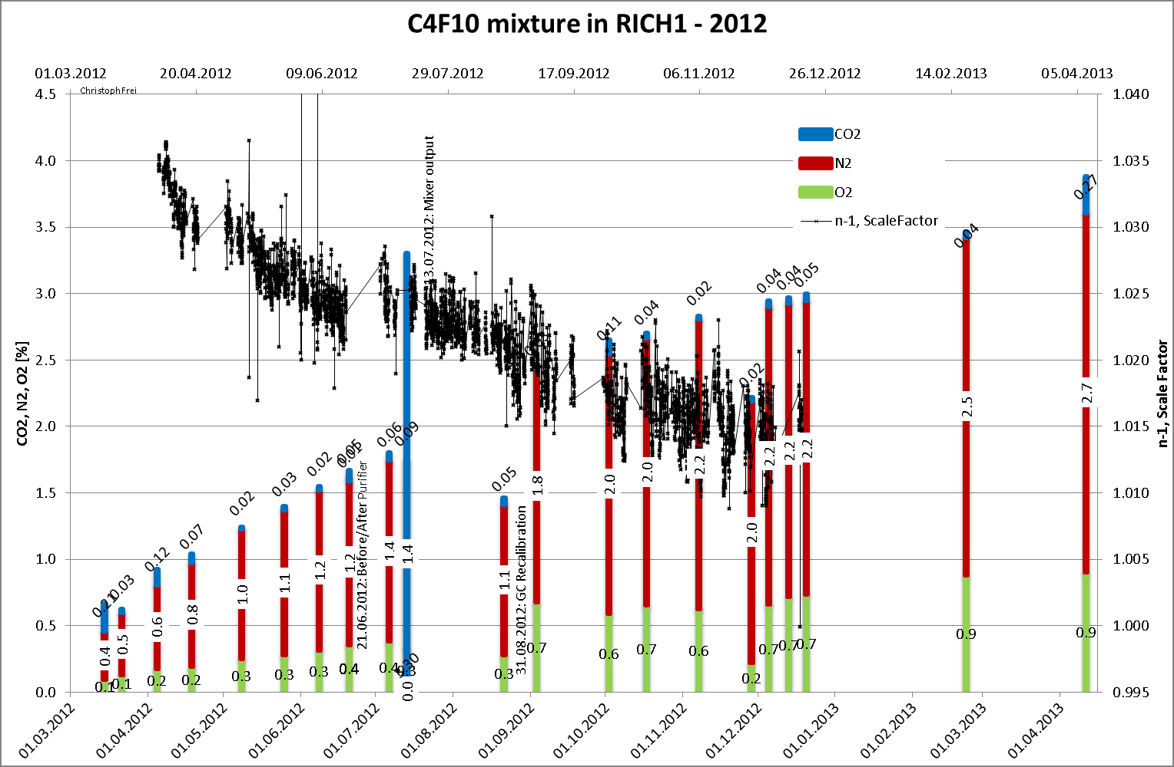
C₄F₁₀ Gas Composition

Slide 16
PID algorithm
Consider all photons and all tracks and all radiators at once and maximise likelihood function:
Take all PIDs to be pions
  Estimate background parameter b_{pixel} per HPD
Calculate likelihood of given pixel distribution.
Iterate
  Change PID hypothesis one track at a time
  Recalculate likelihood
  Choose change that had biggest impact
  Assign new PID to that track
Until no significant improvement is found
As signal photons are now identified better, update background estimate and start a 2nd (and usually final) iteration.

Slide 17
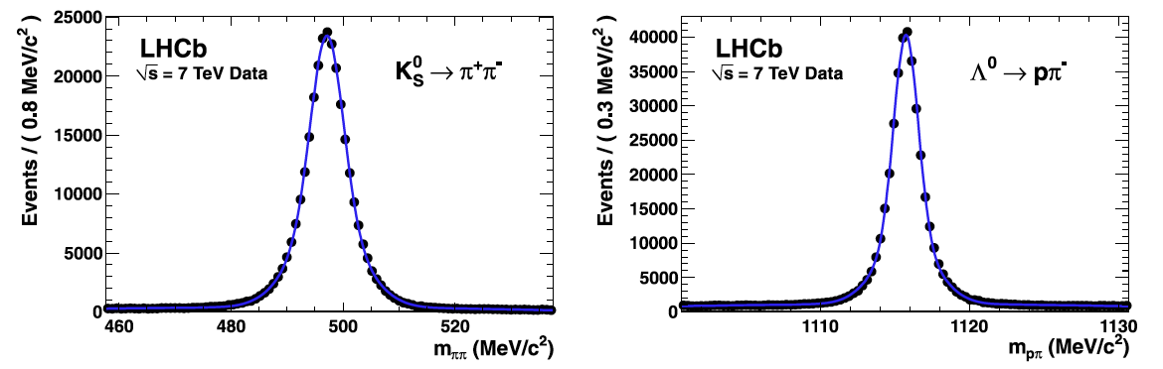
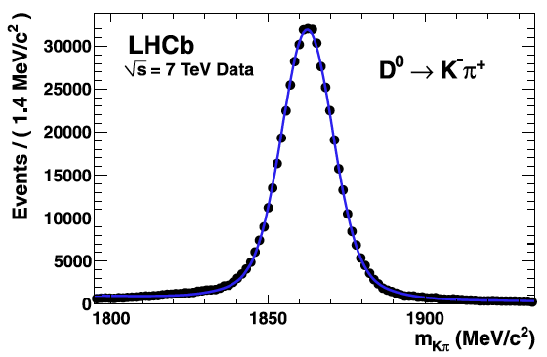
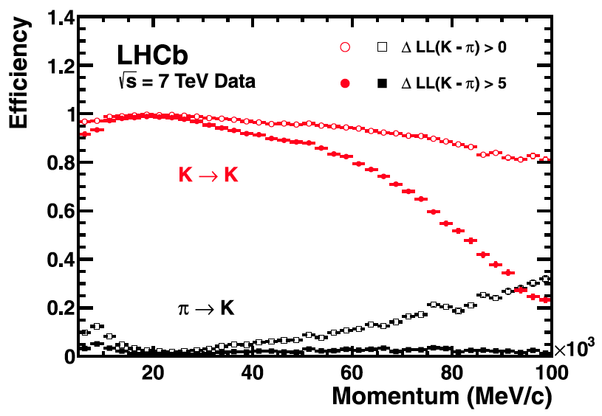
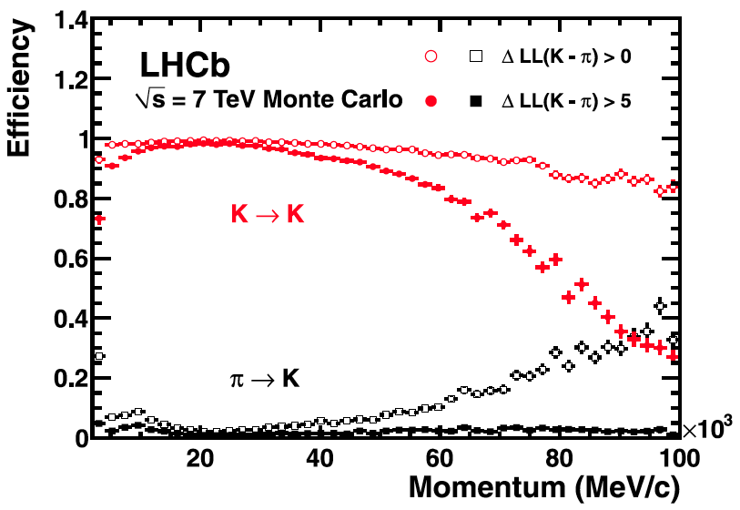
PID Performance
PID performance evaluated from data
  Genuine π/K/p samples identified from kinematics only
Data
Monte-Carlo

Slide 18
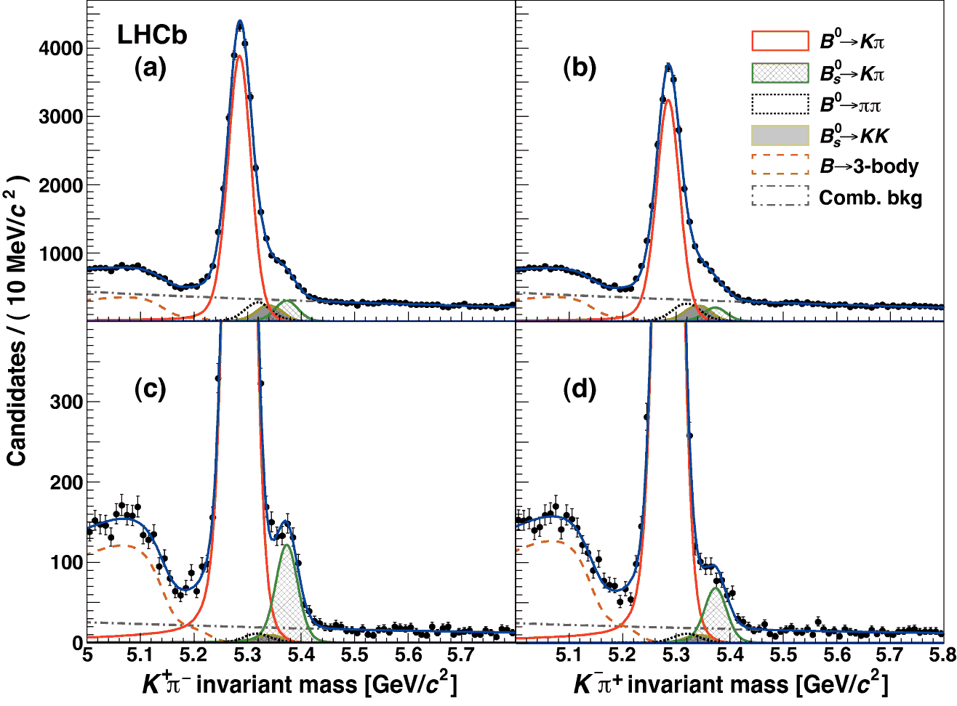
CP violation in B⁰_{(s)}
First observation of CP violation in the decays of B_{s} mesons
(arXIV 1304.6173; Phys.Rev.Lett 110 ,221601(2013))

Slide 19
CP violation in B⁰_{(s)}
Where
and
41420±300 events
1065±55 events
Correction for production and detection asymmetries
10.5 σ
World’s best
6.5 σ
First observation

Slide 20
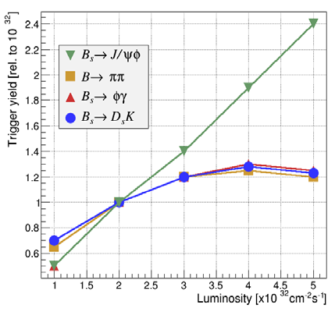
LHCb Upgrade
Goal: collect 50 fb⁻¹
Consequence: run at L_{inst} up to 2×10³³cm⁻²s⁻¹
Approach: remove trigger limitations and readout detector @ 40 MHz
  Current max trigger rate of 1.1 MHz limits the efficiency of hadronic channels
40 MHz readout rate
@
  up to 2×10³³cm⁻²s⁻¹
Change opto-electronic chain:
Photon detectors
Front-end electronics
DAQ
RICH optics and mechanics:
Modify RICH1 optics
Optimise for available space.
Remove aerogel radiator

Slide 21
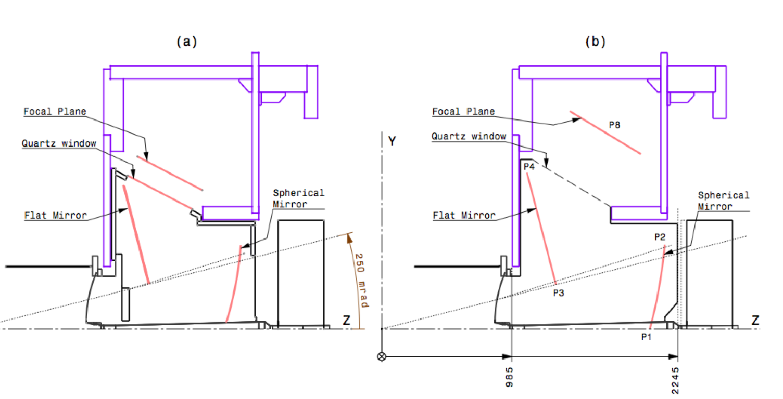
New RICH 1 layout
Hit distribution on photon detectors.
Reduced peak occupancy for upgrade geometry
Present
Upgraded

Slide 22
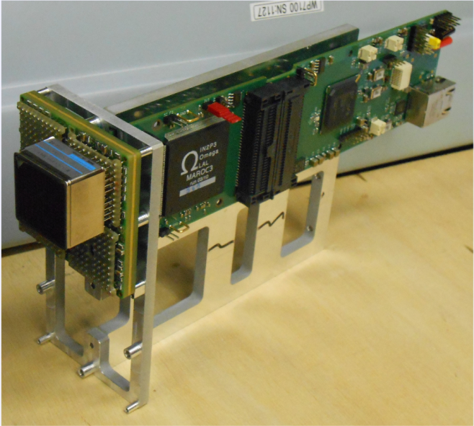
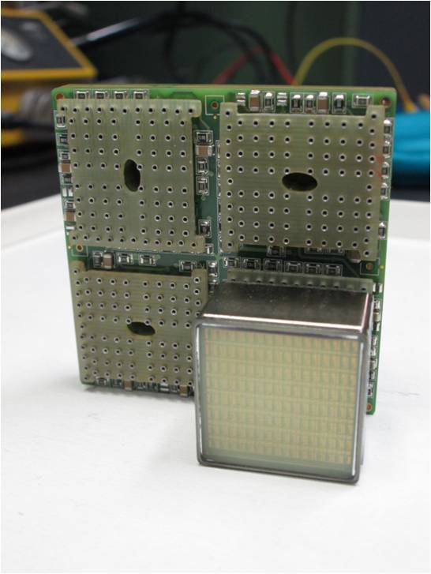
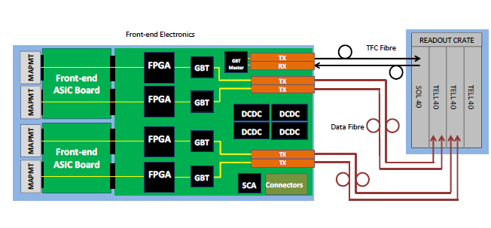
New photo-electronic chain
Baseline option: 64 pixels MaPMT
+ custom FE chip (CLARO8)
+ digital board + GBTs
TORCH - a Cherenkov based Time-of-Flight Detector by Euan Cowie (Thu 17:10)

Slide 23
Conclusions
LHCb has recorded 3 fb⁻¹ in 2010-2012, running in conditions well above the original specifications, at 90% efficiency, producing a number of world first and world best measurements.
The LHCb RICH detectors have been operating in a difficult environment of high track multiplicity and form an essential part of the experiment. There are advanced plans to use the RICH detector in the LHCb trigger for the LHC Run2.
After careful alignment and calibration, the performance of the RICH detectors has reached the levels expected from MC simulations. This is due to:
  Excellent photo-detectors.
  Very stable optical system.
  Well controlled gas radiators.
The LHCb RICH upgrade is progressing well and is on schedule for installation in 2018.
Performance of the LHCb RICH detector at LHCb;
Eur. Phys. J. C (2013) 73:2431

Slide 24
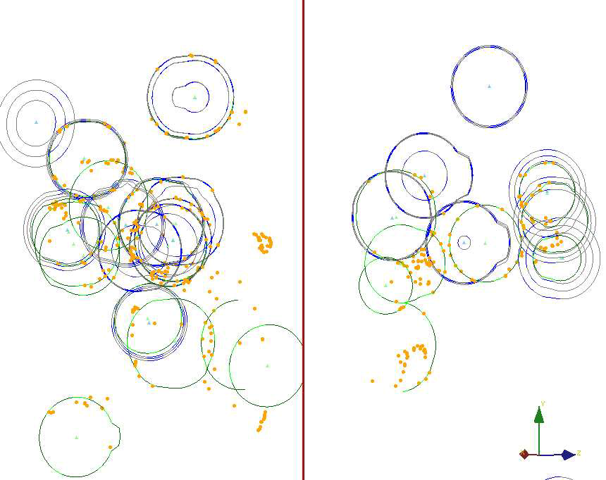
The END

Slide 25
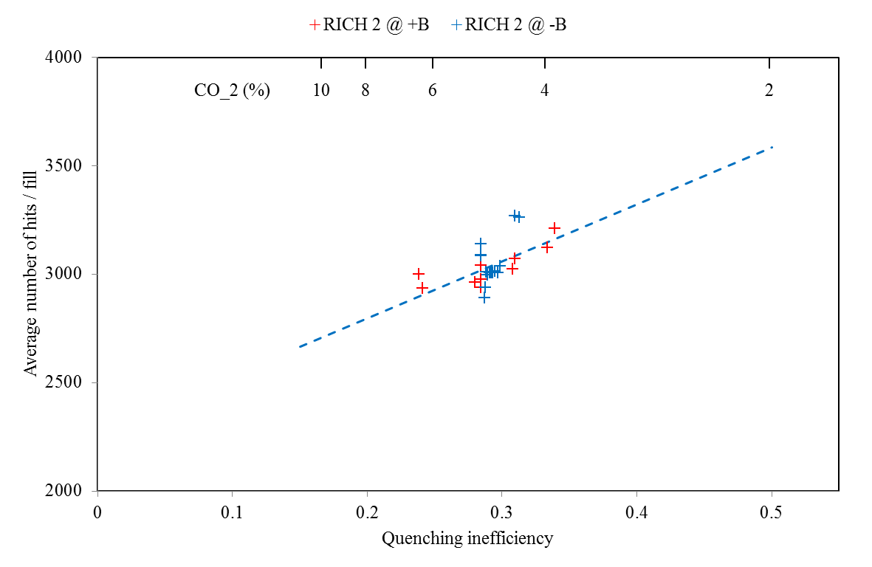
CF₄ Scintillation
Quenched using CO₂
“Extra” photons from scintillation were saturating data bandwidth
Inefficiency is calculated from lab measurements

Slide 26
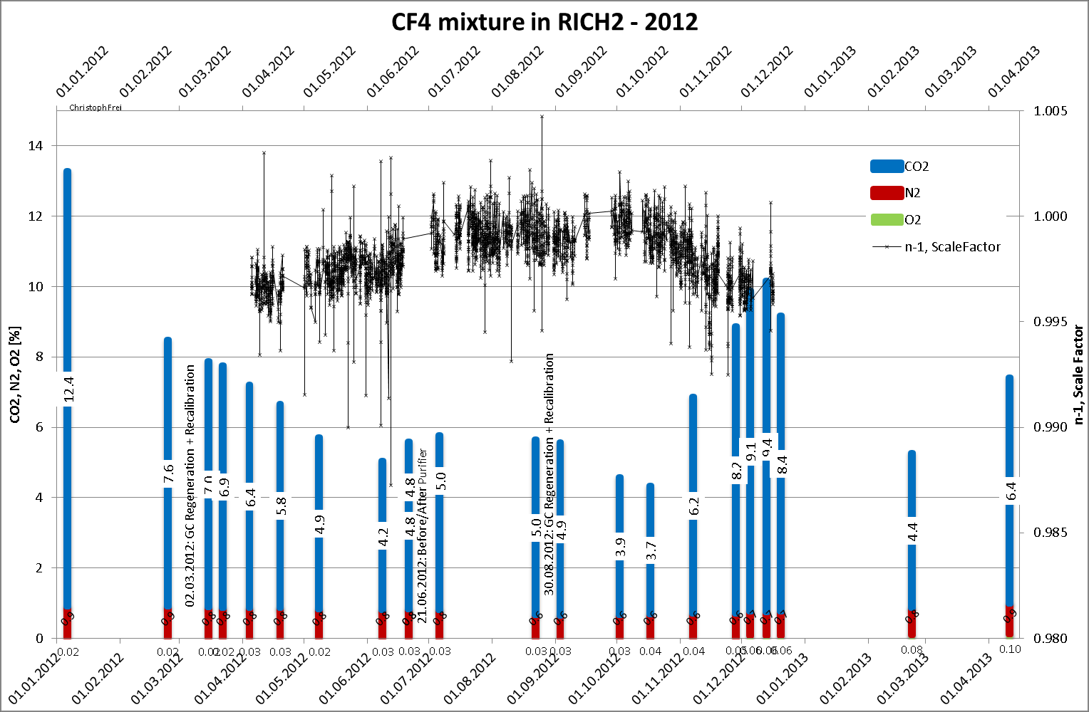
CF₄ Ref Index calibration

Slide 27
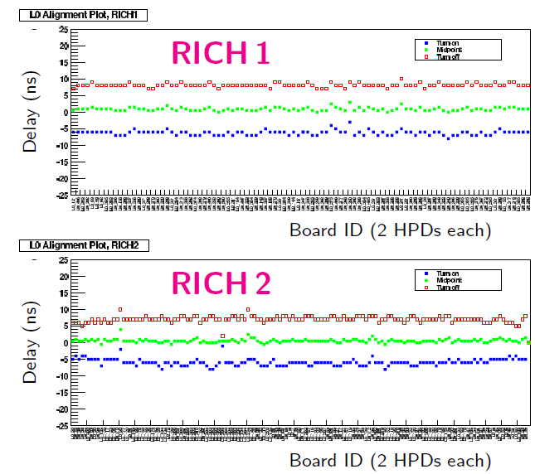
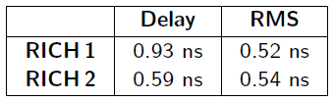
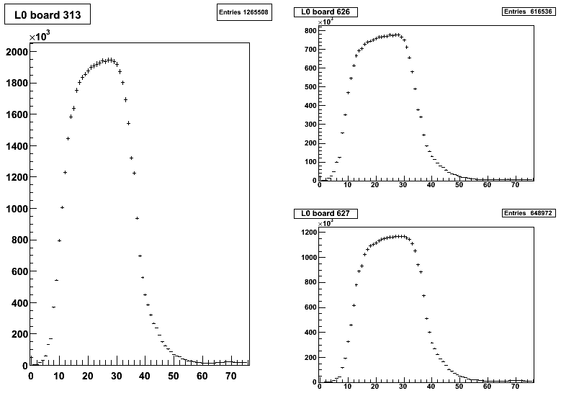
Time alignment
Both RICH detectors are time aligned to less than 1 ns

Slide 28
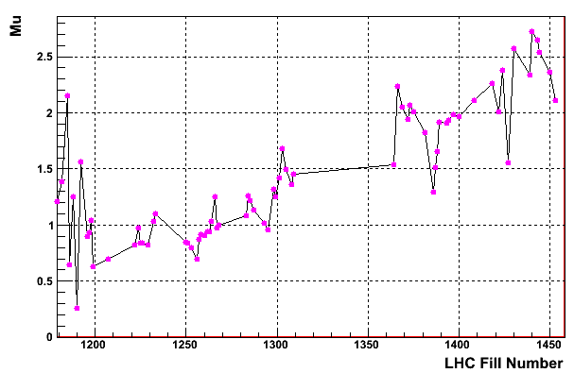
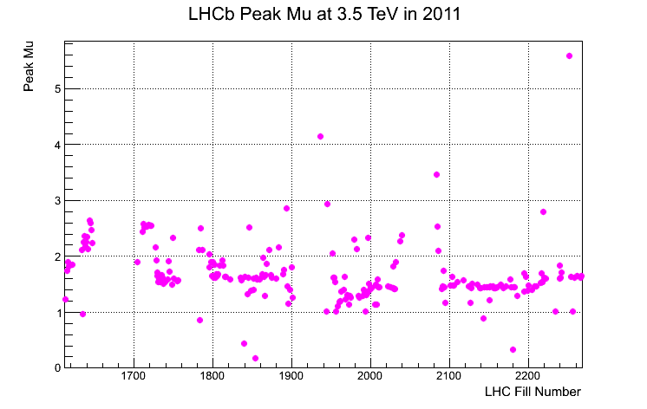
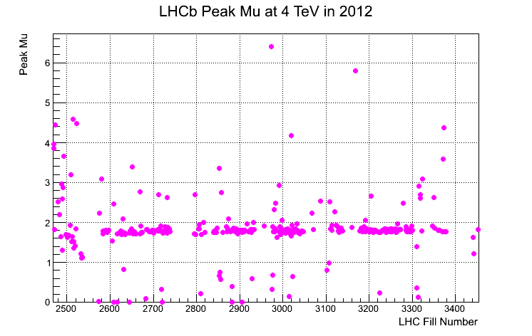
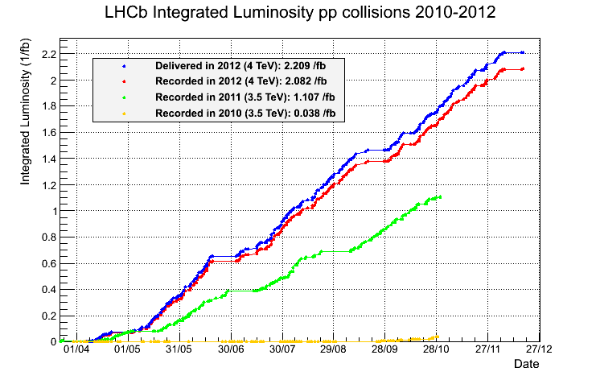
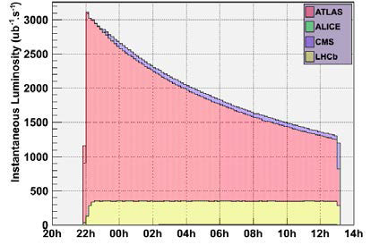
LHCb luminosity
LHCb was designed to run at μ~0.5 and n_{b}~2600 ⇒ L_{inst}~2×10³²cm⁻²s⁻¹
In 2012 LHCb runs with μ~1.7 and n_{b}~1300 ⇒ L_{inst}~4×10³²cm⁻²s⁻¹
2010 data
2011 data
2012 data
μ=2.7
μ=0.4
design
Automatic luminosity levelling
2 fb⁻¹
1 fb⁻¹

Slide 29
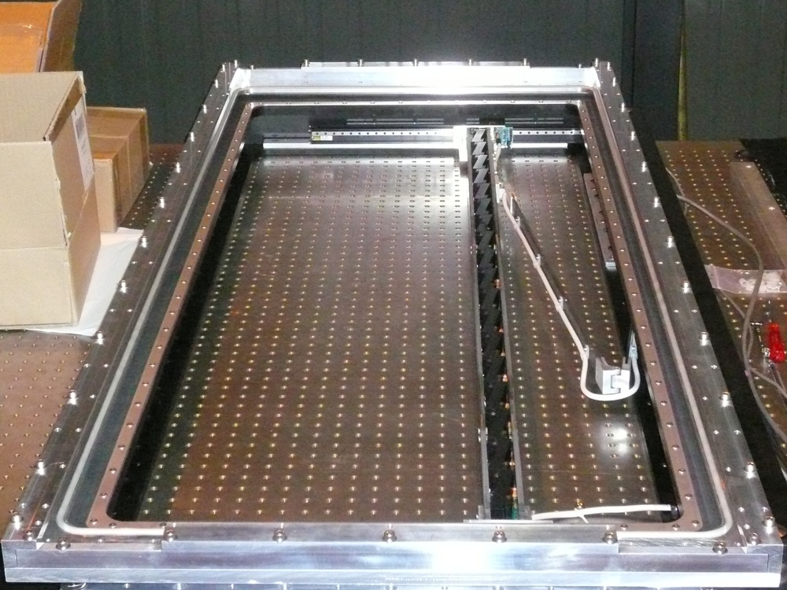
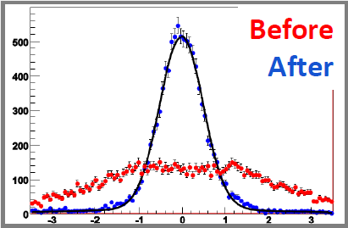
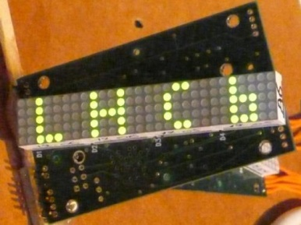
RICH 1 MDCS
Correcting for the magnetic distortions
RICH1
Pixels (0.5 mm)

Slide 30
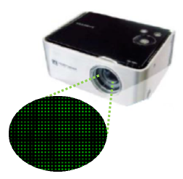

RICH 2 MDCS
A temporary setup, using commercial projector was used in 2008 to project a static, reproducible grid of light spots onto the photon detector plane,
The raw spot images were analysed to calculate the centre of gravity for precision comparison between measurements:

Slide 31

RICH 1
Tight space, low mass
Photon detector plane 14 by 7 Hybrid Photon Detectors (HPDs)
4m
Spherical Mirrors Lightweight carbon fibre mirrors 1.5% radiation length
VELO Exit Window 2mm aluminium.. Sealed to gas enclosure. No RICH entrance window.
RICH1 Exit Window Carbon fibre & PMMI foam
Sealed direct to the beampipe.

Slide 32



HPDs in magnetic field
Magnetic distortions
Test pattern measurements with locally shielded HPD
0 G
B║ 30 G
B┴ 50 G

Slide 33

Event snapshot 1

Slide 34

Event snapshot 2

Slide 35

RICH 2
Huge volume, very precise
8m
Flat Mirrors each made from 20 square glass segments
Spherical Mirrors each made from 21 glass hexagonal segments
Magnetic Shields protect the HPD planes
HPD planes of 9 by 16 HPDs
RICH2 entrance / exit windows carbon fibre and foam sandwich
Gas Enclosure Contains CF₄ gas radiator and the optical system

Slide 36


The readout chain
All HPDs arranged in columns with ancillary front-end electronics
LV & HV boards power the HPDs
“Level-0” board passes triggered data to the “Level-1” off-detector board via an ~100m optical link
Level-1 board receives and zero-suppresses the data and passes to the DAQ
HPD column assembly

